Slide 1
ᎣᏏᏲ
ᏍᎯᏁ ᏣᎳᎩ ᎠᏕᎶᏆᏍᏗ

Slide 2
ᏍᎯᏁ ᏣᎳᎩ ᎠᏕᎶᏆᏍᏗ
ᏏᏊ ᏥᏂᎪᎵᏯ
Jundeloquasdi wakte Meli.
Nvnohi degandisge.
Jolani widukanane.
Ije uniltanvdodi wugohe.
Gigage ulsuwid gesv uniltanvdodi.
Uniltanvdodi udulisge.
Tla yudulisge uweti (worn out) uniltanvdodi junav (flexible thing that she had).
ᎭᏢ ᏩᎧᏖ ᎺᎵ?
ᏧᎾᏕᎶᏆᏍᏗ ᏩᎧᏖ ᎺᎵ.
ᎦᏙ ᎤᏍᏗ ᏕᎦᎾᏗᏍᎨ?
ᏅᏃᎯ ᏕᎦᎾᏗᏍᎨ.
ᏦᎳᏂᏍ ᎦᎶᎯᏍᏗᎨ ᏫᏚᎧᎾᏁ ᎺᎵ?
ᏦᎳᏂ ᏫᏚᎧᎾᏁ ᎺᎵ.
ᎦᏙ ᎤᏍᏗ ᏭᎪᎮ?
ᎢᏤ ᎤᏂᎵᏔᏅᏙᏗ ᏭᎪᎮ.
ᎦᏙ ᎤᏍᏗ ᎤᎵᏑᏫᏗ ᎨᏒ?
ᎩᎦᎨ ᎤᎵᏑᏫᏗ ᎨᏒ.
ᎦᏙ ᎤᏍᏗ ᎤᏚᎵᏍᎨ?
ᎤᏂᎵᏔᏅᏙᏗ ᎤᏚᎵᏍᎨ.

Slide 3
ᏍᎯᏁ ᏣᎳᎩ ᎠᏕᎶᏆᏍᏗ
ᎢᏓᎴᎾ
ᏣᎳᎩ ᎢᏗᏬᏂ!

Slide 4
ᏍᎯᏁ ᏣᎳᎩ ᎠᏕᎶᏆᏍᏗ
ᎦᏙ ᎤᏍᏗ ᏚᏙᎠ?
Garfield ᏚᏙᎠ.
ᏪᏌᏍ ᎩᏟᎨ Garfield?
Garfield ᏪᏌ.
ᎤᎴᏐᏓᏍ Garfield?
Ꮭ. Ꮭ ᎤᎴᏐᏓᏍ ᏱᎩ. ᎦᎵᏦᎯᏓ.
ᎬᎿᎦᎵᏍᏗᏍ ᎦᎾᎵᎨ Garfield?
ᏙᏳ ᎦᎾᎵ Garfield.
ᎦᎪ ᎤᎸᏈᏗ ᎤᏢᏗ?
Garfield ᎤᎸᏈᏗ ᎤᏢᏗ.
PizzaᎢᏍ lasagnaᎨ ᎤᎸᏈᏗ?
Lasagna ᎤᎸᏈᏗ.
ᎠᎩᎸᏈᏗᏍ lasagna?
ᎥᎥ. Lasagna ᎠᎩᎸᏈᏗ.
Hiyoligis Garfield?
Garfield galjohid wesa.
Garfield doyu ganali’
Garfield ulvqd utlvdi.
Ulvqd lasagna.
Ayadvsquu, lasagna agilvqd!
Jalvqdis lasagna?

Slide 5
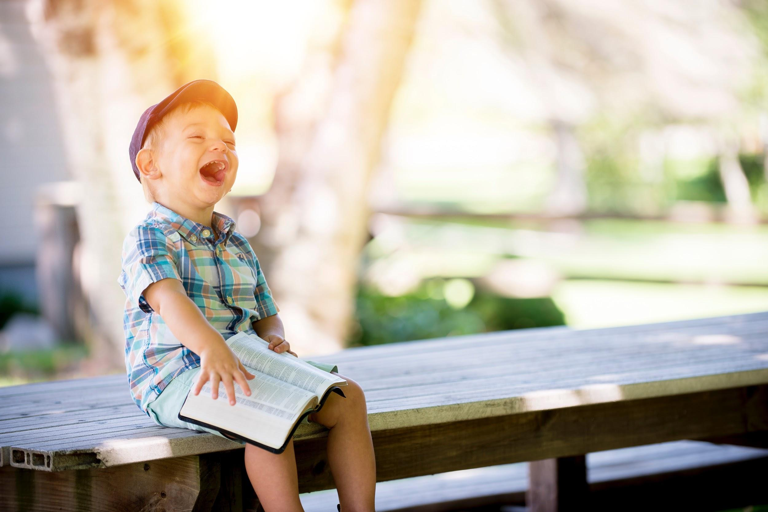
ᏍᎯᏁ ᏣᎳᎩ ᎠᏕᎶᏆᏍᏗ
Ahani achuja.
Ayonega.
Na achuj owotla.
Digoweli agoliye na achuj.
Ulvqd ugoliyedi na achuj.
Uyetsga.

Slide 6
ᏍᎯᏁ ᏣᎳᎩ ᎠᏕᎶᏆᏍᏗ
ᎠᏧᏣᏍ ᎠᎨᏳᏣᎨ?
ᎠᏧᏣ.
ᎠᏣᎳᎩᏍ?
Ꮭ. Ꮭ ᎠᏣᎳᎩ ᏱᎩ. ᎠᏲᏁᎦ.
ᎤᏬᏝᏍ ᎦᏙᎦᎨ Ꮎ ᎠᏧᏣ?
ᎤᏬᏝ.
ᎦᏙ ᎤᏍᏗ ᎠᎪᎵᏰ Ꮎ ᎠᏧᏣ?
ᏗᎪᏪᎵ ᎠᎪᎵᏰ Ꮎ ᎠᏧᏣ.
ᎤᏰᏘᏍᎦᏍ?
ᎥᎥ. ᎤᏰᏘᏍᎦᏛ Ꮎ ᎠᏧᏣ.
Ahani achuja.
Ayonega.
Na achuj owotla.
Digowel agoliye na achuj.
Ulvqd ugoliyedi na achuj.
Uyetsga.

Slide 7
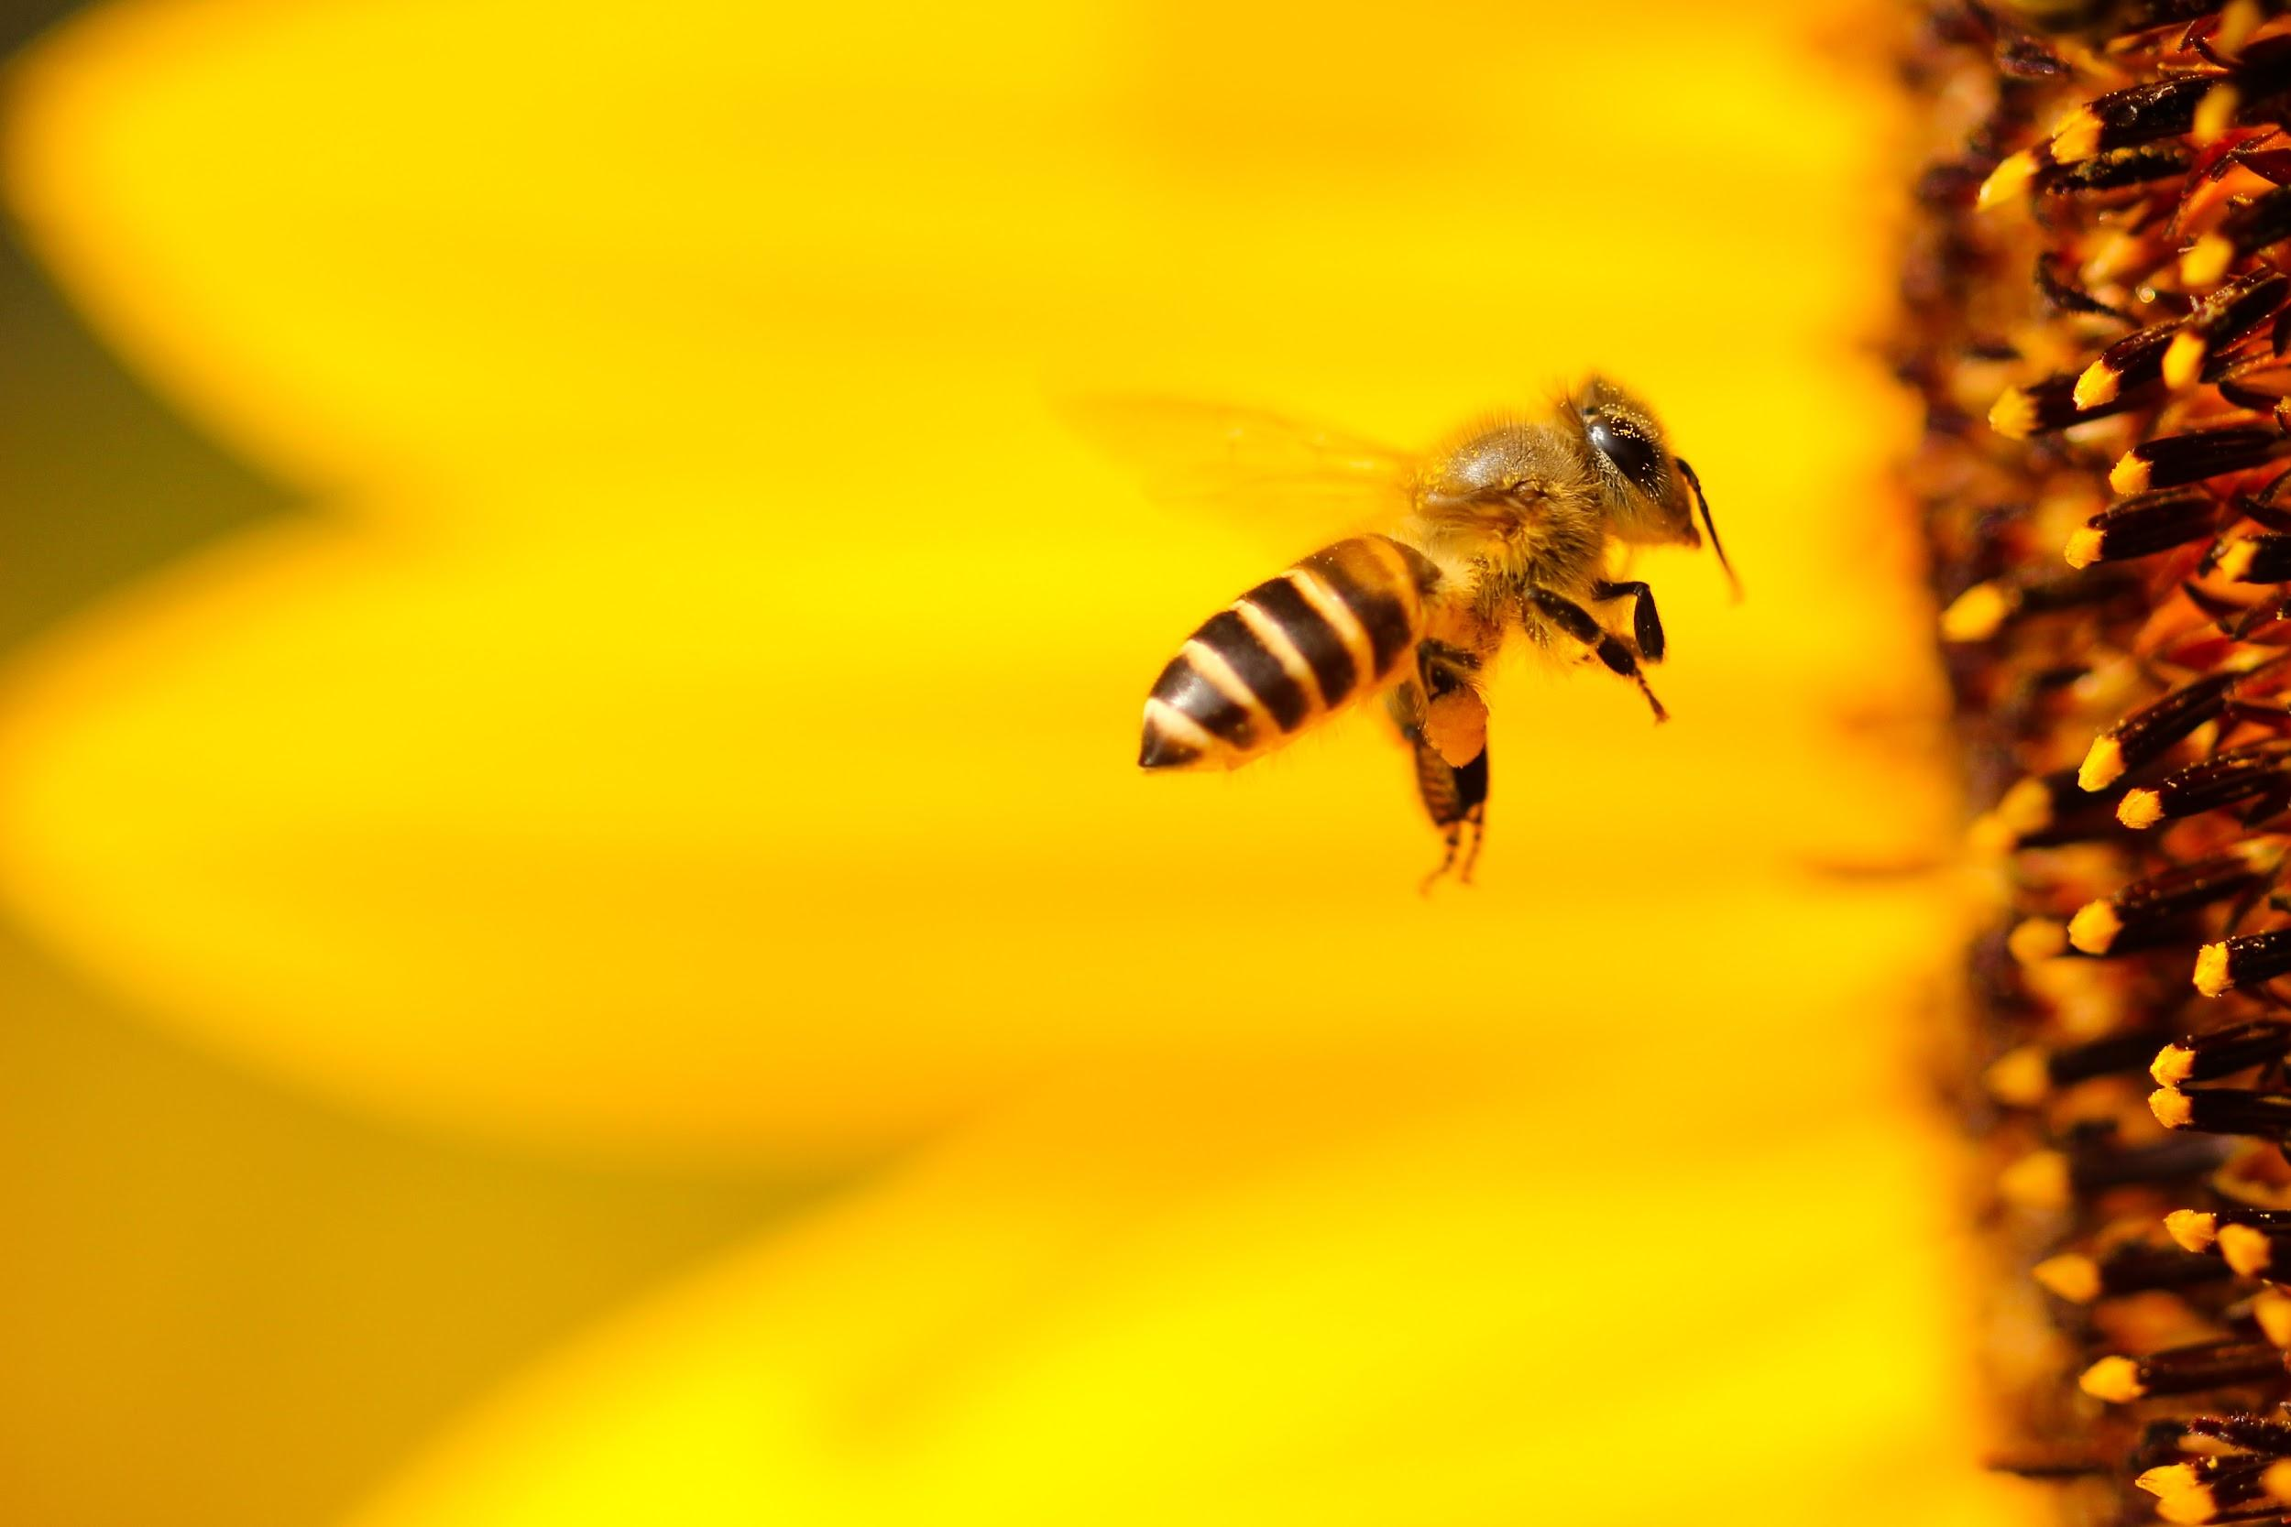
ᏍᎯᏁ ᏣᎳᎩ ᎠᏕᎶᏆᏍᏗ
ᎧᏃᎩᏍᏗ
Ahan wadulisi uninsav
Hatlvno nigada wadulisi?
Wanatlvwida uninsav.
Saquu, tal, jo, nvg, hisg.
(tal yuwakt tinogi)
Galvladi aninohil
Eladi aninohil
Gajanul aninohil
Usganol aninohil
Agsgandidl aninohil
Aktisididl aninohil
Dodaquad aninohildo
nowle unitlanvg.
(siquu tinogi agvyi udatlgv)
Wadulisi ganohilido

Slide 8
ᏍᎯᏁ ᏣᎳᎩ ᎠᏕᎶᏆᏍᏗ
Hiyegi- wake up
Hadida- get up (from lying down)
Talehvga- stand up
jotlesd- sit down (in a specific spot)
Talasutlvga- tie your shoes

Slide 9
ᏍᎯᏁ ᏣᎳᎩ ᎠᏕᎶᏆᏍᏗ
“ Hiyegi Sara” udvne elis. “Alsquali adidi.”
“Tla Sara yidagwado,” udvne agehyuja
“Ohhhh….. Dogi usd dejado?” utvdvne elisi.
“Alice Wells dawado. Agvyi agehya didaniyisgi Amayetli,” udvne agehyuja.
“Hawa Alice,” udvne elis. “Hadida. Tvnawoja ale dehalsdanuga”
“Siyo Alice,” udvne Elis. “Alsdaidi. Ahan jotlesd.

Slide 10
ᏍᎯᏁ ᏣᎳᎩ ᎠᏕᎶᏆᏍᏗ
ᎦᎪ ᎤᏛᏁ, “ᎯᏰᎩ ᏌᎳ.”
ᎡᎵᏏ ᎤᏛᏁ “ᎯᏰᎩ ᏌᎳ.”
ᎠᎨᏳᏣᏍ ᎠᏧᏣᎨ ᏌᎳ?
ᎠᎨᏳᏣ.
ᎦᏙ ᎤᏍᏗ ᏚᏙᎠ ᎠᎬᏱ ᎠᎨᏯ ᏗᏓᏂᏱᏍᎩ ᎠᎹᏰᏟ.
Alice Wells ᏚᏙᎠ.
“ᏔᎳᏑᏢᎦᏍ” ᎤᏛᏁ ᎡᎵᏏ?
Ꮭ. Ꮭ ᏳᏛᏁ “ᏔᎳᏑᏢᎦ”. “ᏛᎾᏬᏣ” ᎤᏛᏁ.
“ Hiyegi Sara” udvne elis. “Alsquali adidi.”
“Tla Sara yidagwado,” udvne agehyuja
“Ohhhh….. Dogi usd dejado?” utvdvne elisi.
“Alice Wells dawado. Agvyi agehya didaniyisgi Amayetli,” udvne agehyuja.
“Hawa Alice,” udvne elis. “Hadida. Tvnawoja ale dehalsdanuga”
“Siyo Alice,” udvne Elis. “Alsdaidi. Ahan jotlesd.

Slide 11
ᏍᎯᏁ ᏣᎳᎩ ᎠᏕᎶᏆᏍᏗ
“ Hiyegi Sara” udvne elis. “Alsquali adidi.”
“Tla Sara yidagwado,” udvne agehyuja
“Ohhhh….. Dogi usd dejado?” utvdvne elisi.
“Alice Wells dawado. Agvyi agehya didaniyisgi Amayetli,” udvne agehyuja.
“Hawa Alice,” udvne elis. “Hadida. Tvnawoja ale dehalsdanuga”
“Siyo Alice,” udvne Elis. “Alsdaidi. Ahan jotlesd.

Slide 12
ᏍᎯᏁ ᏣᎳᎩ ᎠᏕᎶᏆᏍᏗ
ᎤᏪᏘ- worn out
ᎦᎾᎵ- lazy
ᎤᎸᏈᏗ- he/she likes it
ᎠᎩᎸᏈᏗ- I like it
ᏣᎸᏈᏗ- you like it
ᎤᏢᏗ- to sleep
ᎠᏯᏛsᏊ- me too
ᎤᎴᏐᏓ- thin, skinny
ᎬᎿᎦᎵᏍᏗ- active
ᏩᏚᎵᏏ- Bee, Honey
ᎤᏂᎾᏌᎥ- Where they save it
ᏂᎦᏓ- all
ᏩᎾtᎸᏫᏓ- they are flying out
ᎦᎸᎳᏗ- high
ᎡᎳᏗ- low
ᎦᏣᏄᎳ- fast
ᎤᏍᎦᏃᎵ- slow
ᎠᎦᏍᎦᏂ- left
ᎠᎩᏘᏏ- right
ᏙᏓᏆᏗ- all day
ᏃᏊᎴ- and then

Slide 13
ᏍᎯᏁ ᏣᎳᎩ ᎠᏕᎶᏆᏍᏗ
ᎤᏂᏝᏅᎩ- they go to sleep
ᎯᏰᎩ- wake up
ᎭᏗᏓ- get up
ᏔᎴᎲᎦ- stand up
ᏦᏞᏍᏗ- sit down
ᏔᎳᏑᏢᎦ- Tie your shoes
ᎠᎪᎵᏰᎠ- he/she is reading
ᎤᎪᎵᏰᏗ- to read
ᎤᏰᏘᏍᎦ- he/she is laughing
ᎠᎵᏍᏆᎵ- It’s time
ᎠᏗᏗ- to get up
ᏗᏓᏂᏱᏍᎩ- police officer
ᎠᎹᏰᏟ- America
ᎭᏩ- OK
ᏛᎾᏬᏨ- Get dressed
ᏕᎭᎵᏍᏓᏄᎦ- Come eat
ᎠᎵᏍᏓᏗ- time to eat
ᎡᎵᏏ- Grandma

