Slide 1
ᎣᏏᏲ
ᏌᏚᏏᏁ ᏣᎳᎩ ᎠᏕᎶᏆᏍᏗ

Slide 2
ᏌᏚᏏᏁ ᏣᎳᎩ ᎠᏕᎶᏆᏍᏗ
ᎢᏓᎴᎾ
ᏣᎳᎩ ᎢᏗᏬᏂ!

Slide 3
ᏌᏚᏏᏁ ᏣᎳᎩ ᎠᏕᎶᏆᏍᏗ
“ Hiyegi Sara” udvne elis. “Alsquali adidi.”
“Tla Sara yidagwado,” udvne agehyuja
“Ohhhh….. Dogi usd dejado?” utvdvne elisi.
“Alice Wells dawado. Agvyi agehya didaniyisgi Amayetli,” udvne agehyuja.
“Hawa Alice,” udvne elis. “Hadida. Tvnawoja ale dehalsdanuga”
“Siyo Alice,” udvne Elis. “Alsdaidi. Ahan jotlesd.

Slide 4
ᏌᏚᏏᏁ ᏣᎳᎩ ᎠᏕᎶᏆᏍᏗ
ᎦᎪ ᎤᏛᏁ, “ᎯᏰᎩ ᏌᎳ,”?
ᎡᎵᏏ ᎤᏛᏁ “ᎯᏰᎩ ᏌᎳ.”
ᎠᎨᏳᏣᏍ ᎠᏧᏣᎨ ᏌᎳ?
ᎠᎨᏳᏣ.
ᎦᏙ ᎤᏍᏗ ᏚᏙᎠ ᎠᎬᏱ ᎠᎨᏯ ᏗᏓᏂᏱᏍᎩ ᎠᎹᏰᏟ?
Alice Wells ᏚᏙᎠ.
“ᏔᎳᏑᏢᎦᏍ” ᎤᏛᏁ ᎡᎵᏏ?
Ꮭ. Ꮭ ᏳᏛᏁ “ᏔᎳᏑᏢᎦ”. “ᏛᎾᏬᏣ” ᎤᏛᏁ.
“ Hiyegi Sara” udvne elis. “Alsquali adidi.”
“Tla Sara yidagwado,” udvne agehyuja
“Ohhhh….. Dogi usd dejado?” utvdvne elisi.
“Alice Wells dawado. Agvyi agehya didaniyisgi Amayetli,” udvne agehyuja.
“Hawa Alice,” udvne elis. “Hadida. Tvnawoja ale dehalsdanuga”
“Siyo Alice,” udvne Elis. “Alsdaidi. Ahan jotlesd.

Slide 5
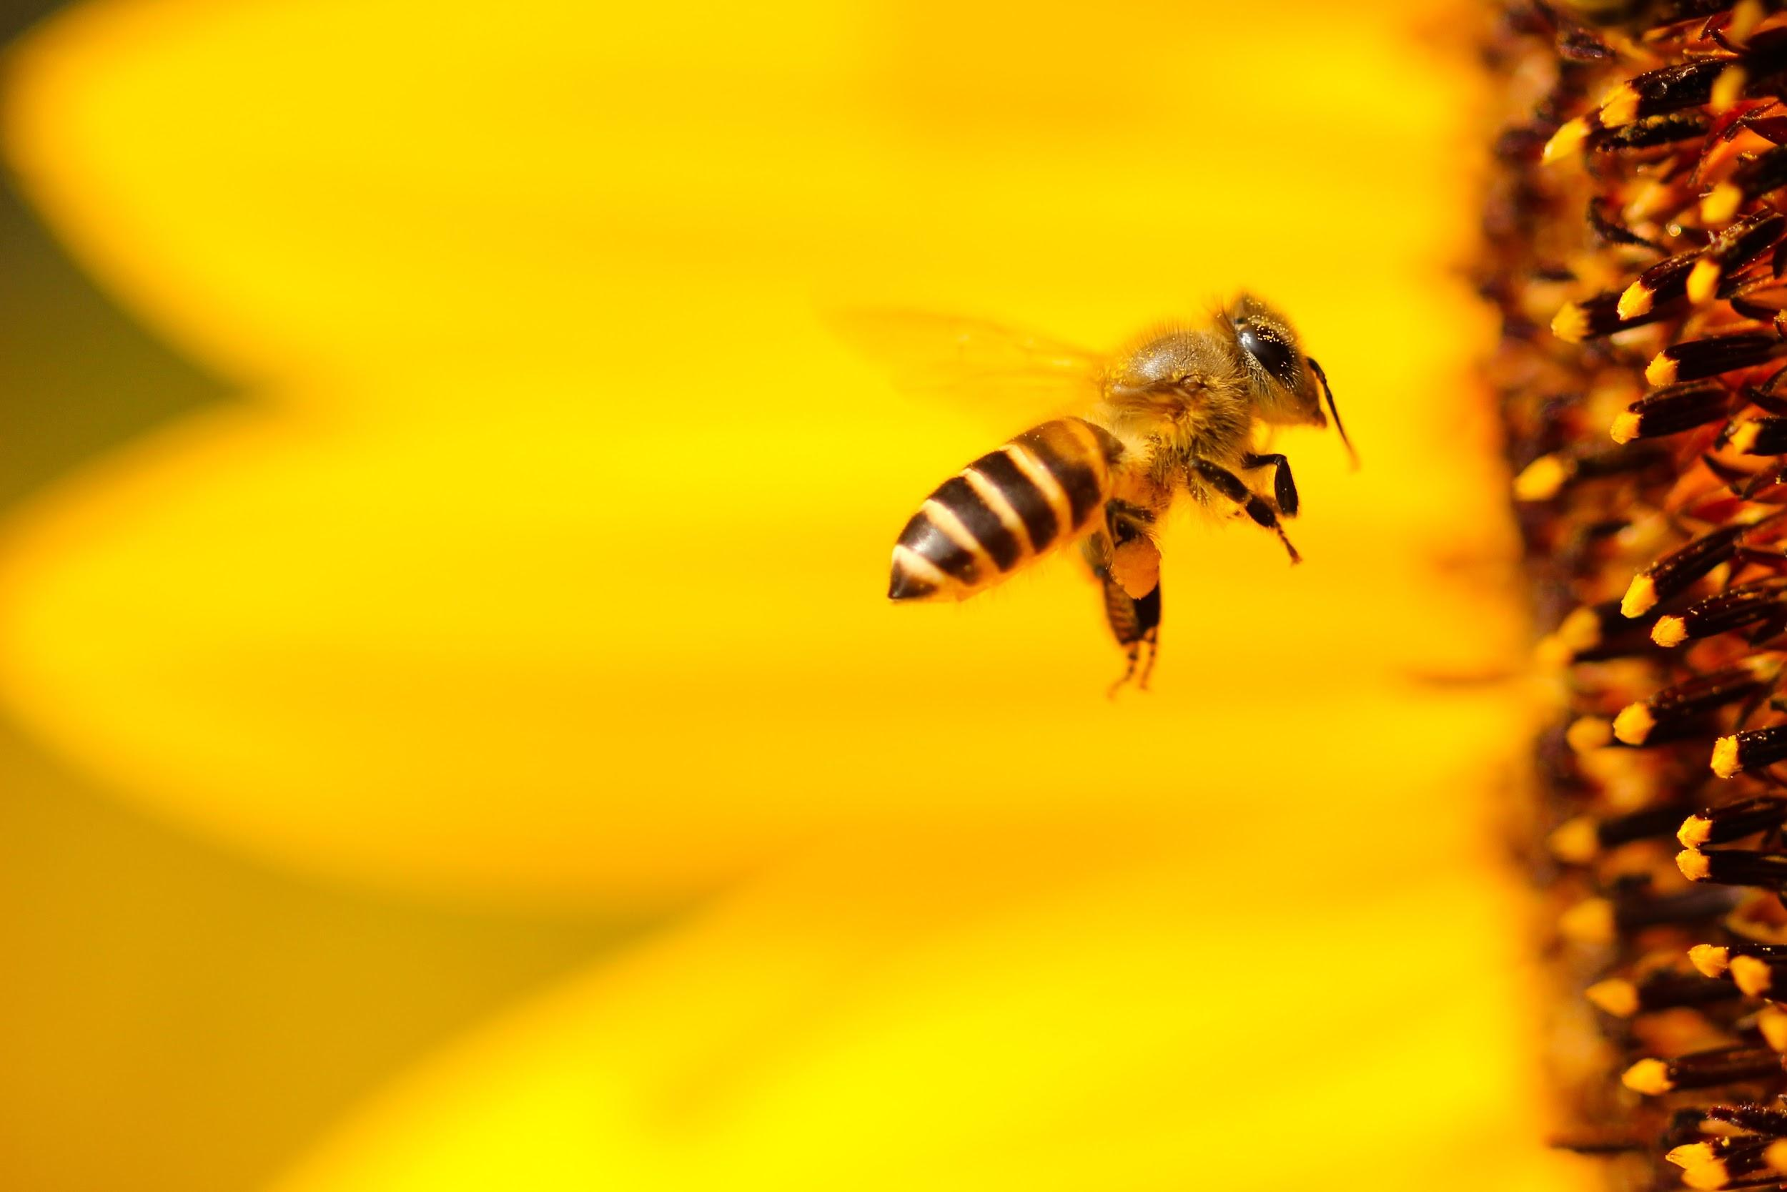
ᏌᏚᏏᏁ ᏣᎳᎩ ᎠᏕᎶᏆᏍᏗ
ᎧᏃᎩᏍᏗ
Ahan wadulisi uninsav
Hatlvno nigada wadulisi?
Wanatlvwida uninsav.
Saquu, tal, jo, nvg, hisg.
(tal yuwakt tinogi)
Galvladi aninohil
Eladi aninohil
Gajanul aninohil
Usganol aninohil
Agsgandidl aninohil
Aktisididl aninohil
Dodaquad aninohildo
nowle unitlanvg.
(siquu tinogi agvyi udatlgv)
Wadulisi ganohilido

Slide 6
ᏌᏚᏏᏁ ᏣᎳᎩ ᎠᏕᎶᏆᏍᏗ
“Tla Alice yidawado” udvne agehyuja.
“Tlagi?” udvne elis, “Gagke dodvg hawiya ale juwej jidegvnisda?”
Elizabeth Blackwell dagwado, agvyi agehya aganagti amayetli,” udvne agehyuj.
“Jayosinase, Elizabeth. Na juwej ale hawiya tiga si uhyvdli nulsdanvnv.”
“Hawa, Elizabeth. Alsqualiha dijadelquavsdi. Gasalen hanawojv,” udvne Elis.

Slide 7
ᏌᏚᏏᏁ ᏣᎳᎩ ᎠᏕᎶᏆᏍᏗ
Juwej
Hawiya
Gasalen
Aganagti
Elis
Agvyi
Dijadelquavsdi
Uhyvdli
“Tla Alice yidawado” udvne agehyuja.
“Tlagi?” udvne _____, “Gagke dodvgi hawiya ale ______ jidegvnisda?”
Elizabeth Blackwell dagwado, ______ agehya _________ amayetli,” udvne agehyuj.
“Jayosinase, Elizabeth. Na juwej ale ______ tiga si _________ nulsdanvnv.”
“Hawa, Elizabeth. Alsqualiha ____________. ________ hanawojv,” udvne Elis.

Slide 8
ᏌᏚᏏᏁ ᏣᎳᎩ ᎠᏕᎶᏆᏍᏗ
ᏝᎩ- You say No?
ᏙᏛᎩ- he/she will eat
ᏕᎬᏂᏍᏓ- I cooked them for you
ᎠᎦᎾᎦᏘ- doctor
ᏣᏲᏏᎾᏎ- You must be hungry
ᏘᎦ- You eat them
Ꮟ- before
ᎤᏴᏟ- Cold
ᏄᎵᏍᏓᏅᏅ-it happens/occurs
ᏕᏣᏕᎶᏆᎥᏍᏗ- you go to school
ᎦᏌᎴᏂ- Coat
ᎭᎾᏬᏨ- Put it on.

Slide 9
ᏌᏚᏏᏁ ᏣᎳᎩ ᎠᏕᎶᏆᏍᏗ
ᎤᏂᏝᏅᎩ- they go to sleep
ᎯᏰᎩ- wake up
ᎭᏗᏓ- get up
ᏔᎴᎲᎦ- stand up
ᏦᏞᏍᏗ- sit down
ᏔᎳᏑᏢᎦ- Tie your shoes
ᎠᎪᎵᏰᎠ- he/she is reading
ᎤᎪᎵᏰᏗ- to read
ᎤᏰᏘᏍᎦ- he/she is laughing
ᎠᎵᏍᏆᎵ- It’s time
ᎠᏗᏗ- to get up
ᏗᏓᏂᏱᏍᎩ- police officer
ᎠᎹᏰᏟ- America
ᎭᏩ- OK
ᏛᎾᏬᏨ- Get dressed
ᏕᎭᎵᏍᏓᏄᎦ- Come eat
ᎠᎵᏍᏓᏗ- time to eat
ᎡᎵᏏ- Grandma

