Slide 1
ᎣᏏᏲ
ᏂᎦᏚᏏᏁ ᏣᎳᎩ ᎠᏕᎶᏆᏍᏗ

Slide 2
ᏂᎦᏚᏏᏁ ᏣᎳᎩ ᎠᏕᎶᏆᏍᏗ
ᎢᏓᎴᎾ
ᏣᎳᎩ ᎢᏗᏬᏂ!

Slide 3
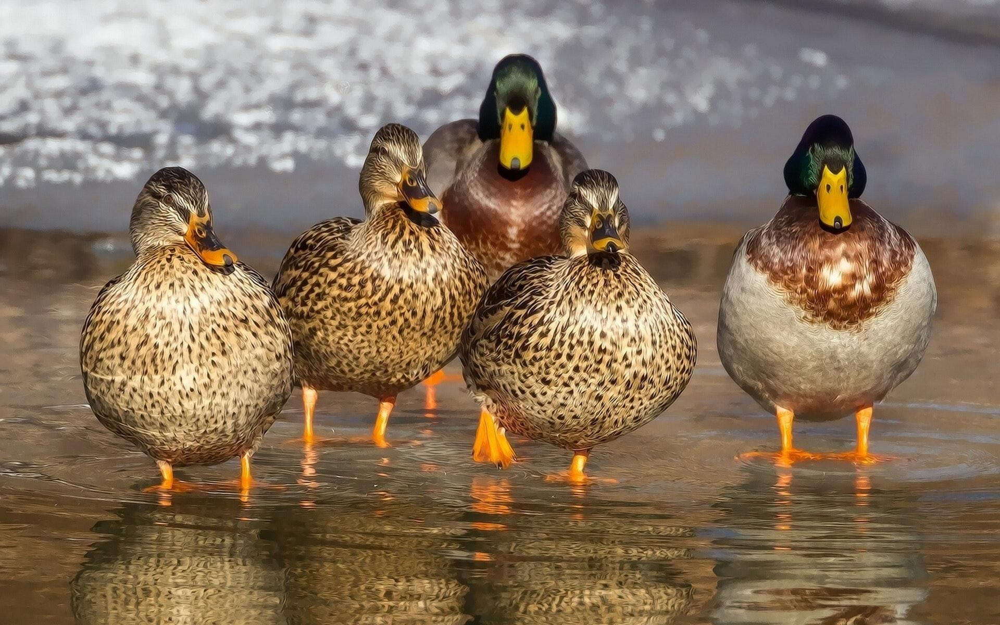
ᏂᎦᏚᏏᏁ ᏣᎳᎩ ᎠᏕᎶᏆᏍᏗ
ᎧᏃᎩᏍᏗ
Hisgi kawon anid andawohv
Ujatindidl wunilosv
Uniji nigawesgv “quack! quack! Quack!”
Nvgiwu kawon anid unilujv.

Slide 4
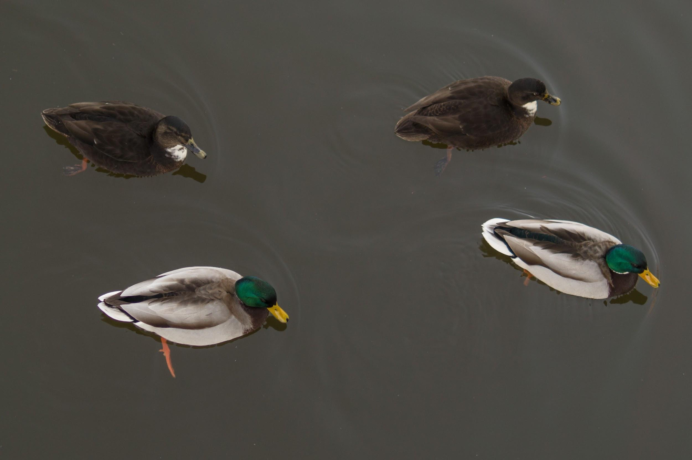
ᏂᎦᏚᏏᏁ ᏣᎳᎩ ᎠᏕᎶᏆᏍᏗ
ᎧᏃᎩᏍᏗ
Didseka kawonu
Sawu, tal, jo, nvg
nvgi kawon anid andawohv
Ujatindidl wunilosv
Uniji nigawesgv “quack! quack! Quack!”
joiwu kawon anid unilujv.

Slide 5
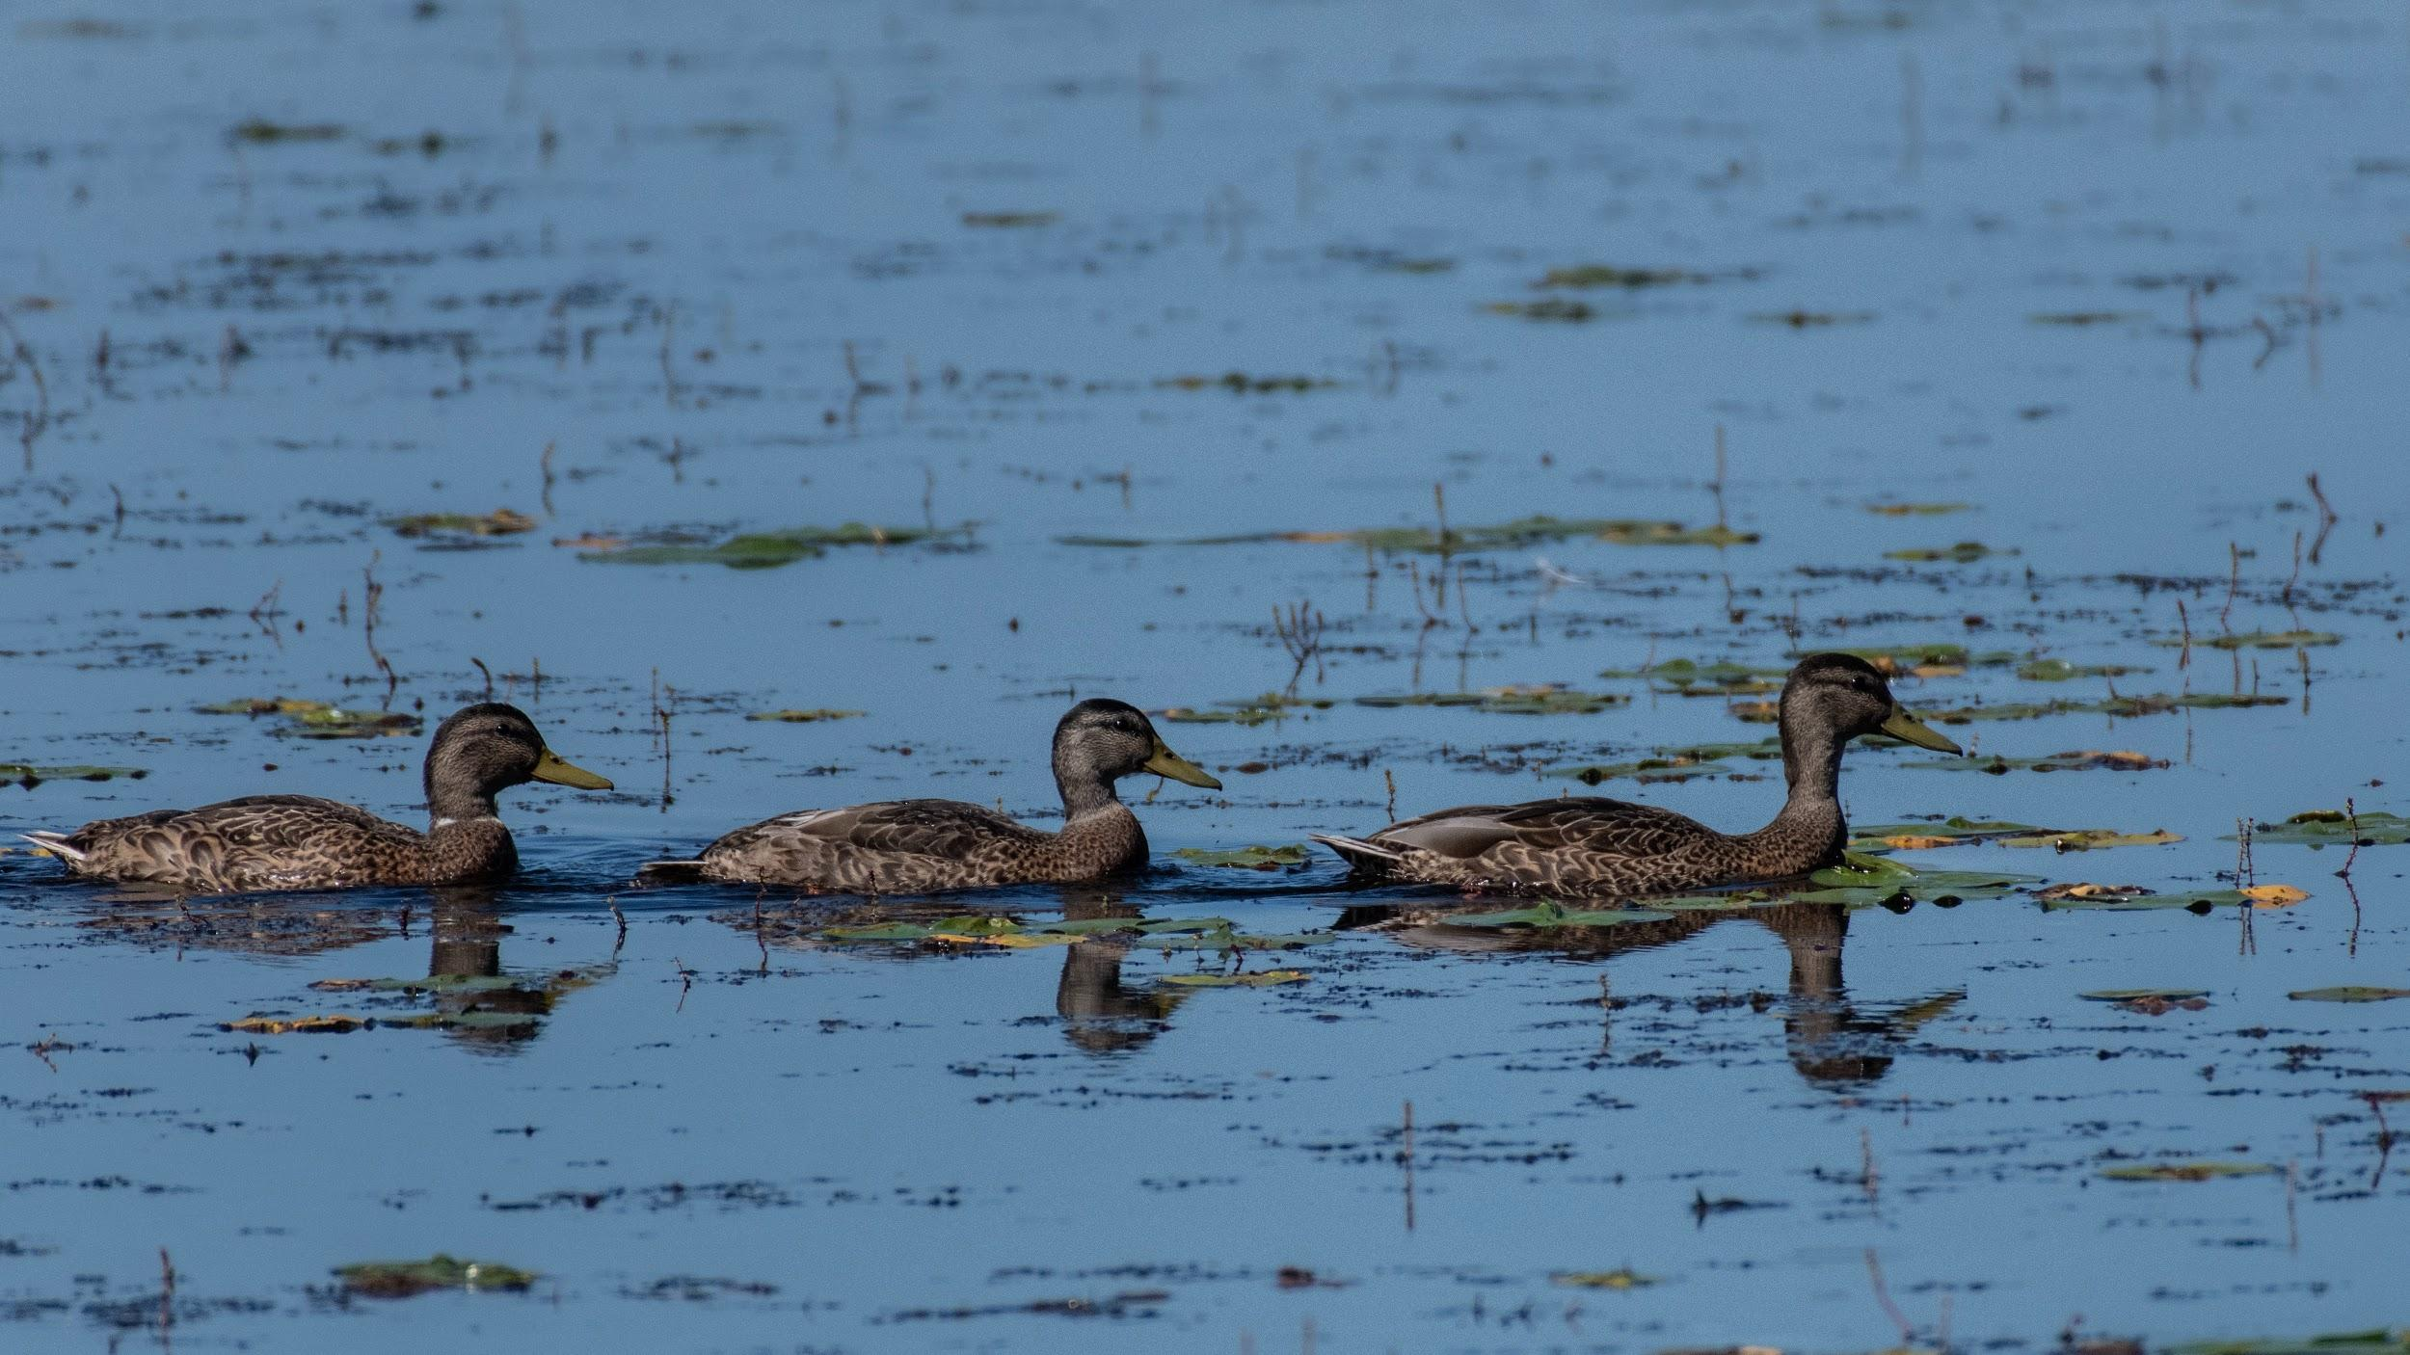
ᏂᎦᏚᏏᏁ ᏣᎳᎩ ᎠᏕᎶᏆᏍᏗ
ᎧᏃᎩᏍᏗ
Didseka kawonu
Sawu, tal, jo,
Joi kawon anid andawohv
Ujatindidl wunilosv
Uniji nigawesgv “quack! quack! Quack!”
taliwu kawon anid unilujv.

Slide 6
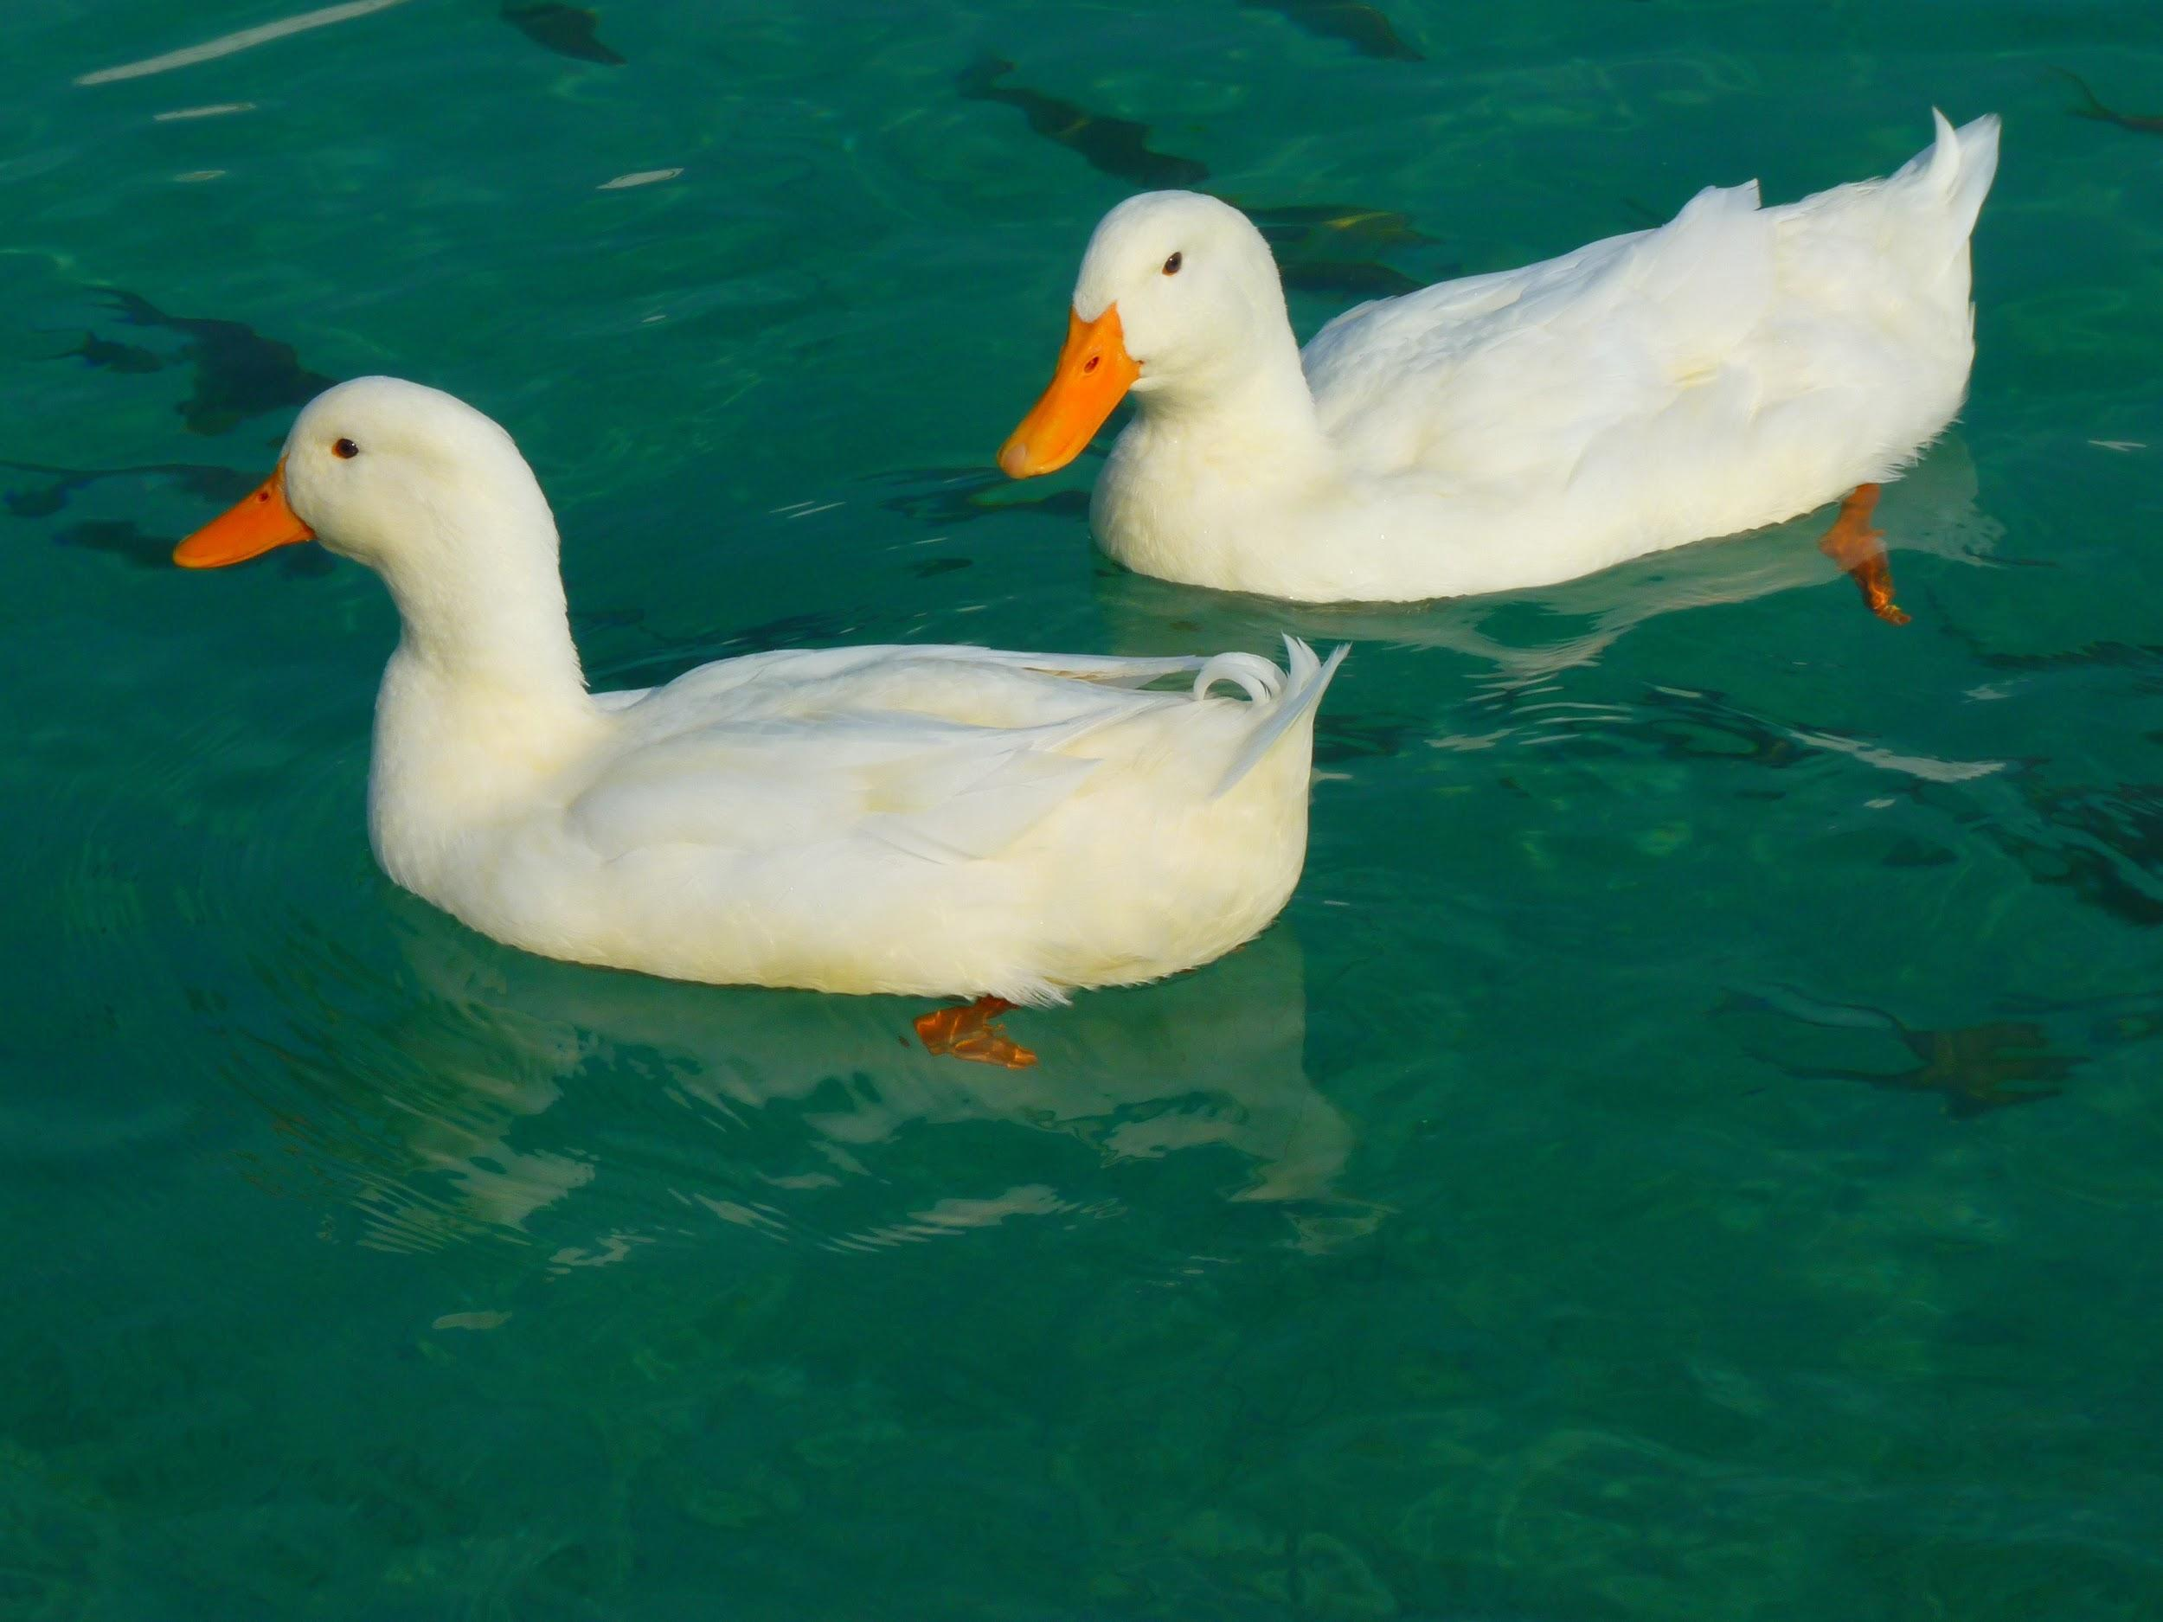
ᏂᎦᏚᏏᏁ ᏣᎳᎩ ᎠᏕᎶᏆᏍᏗ
ᎧᏃᎩᏍᏗ
Didseka kawonu
Sawu, tal,
Tali kawon anid andawohv
Ujatindidl wunilosv
Uniji nigawesgv “quack! quack! Quack!”
sawu kawonu at ulujv.

Slide 7
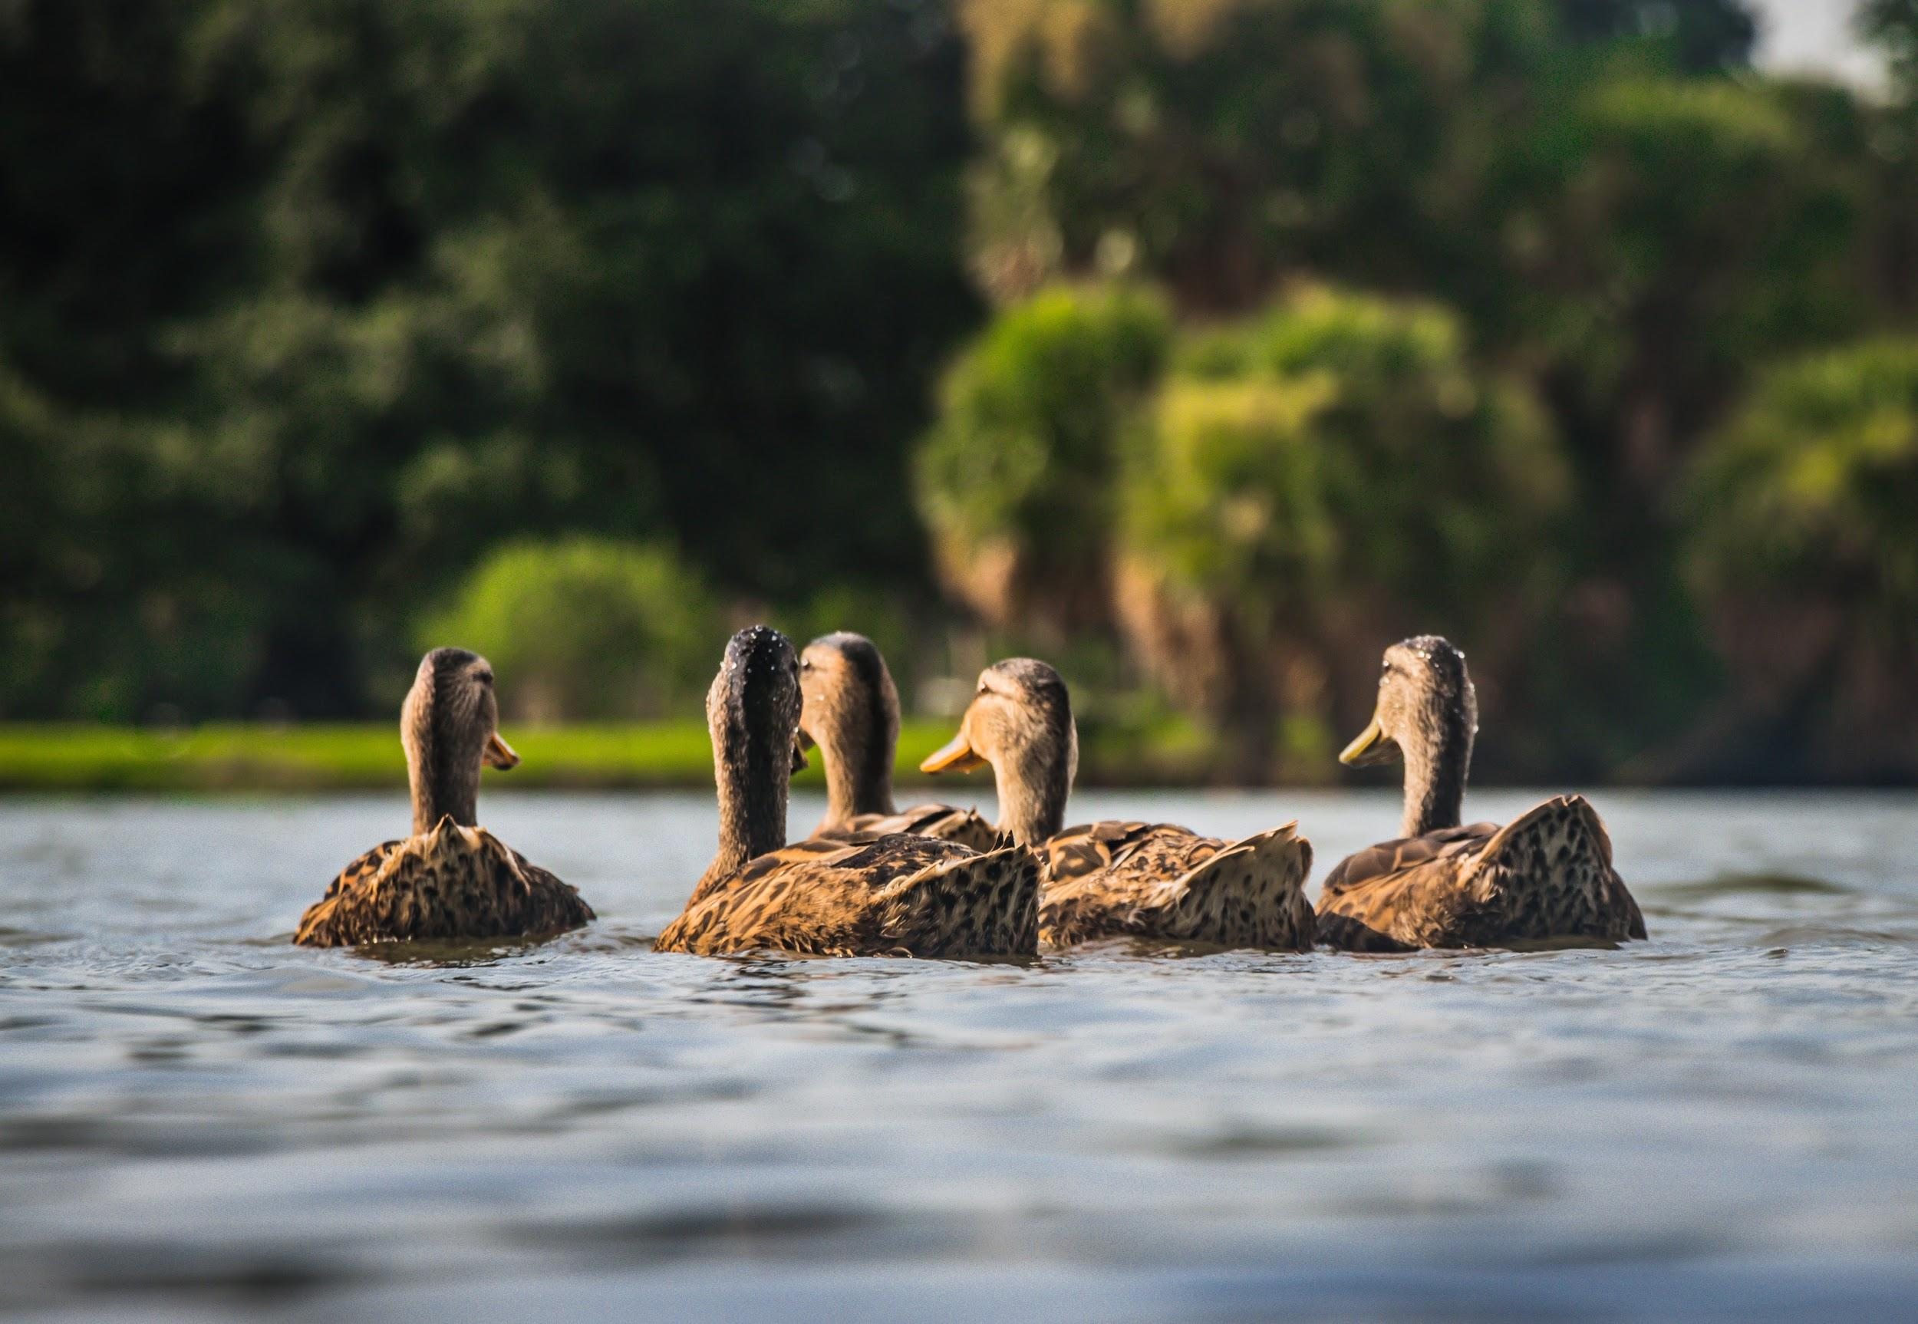
ᏂᎦᏚᏏᏁ ᏣᎳᎩ ᎠᏕᎶᏆᏍᏗ
ᎧᏃᎩᏍᏗ
Didseka kawonu
Sawu
sawu kawonu at adawohv
Ujatindidl wulosv
Uji nigawesgv “quack! quack! Quack!”
nigadawu kawonu anid unilujv.

Slide 8
ᏂᎦᏚᏏᏁ ᏣᎳᎩ ᎠᏕᎶᏆᏍᏗ
Aksti tsigesv, edud eladi osdanigisgo amayididla.
Uhna edud agwehyonv awadawosdi amayi uweyv danelv nav.
Uhyvdla gesv amayi, hawin ama ganvgogv.
Uhnasdedlv nusdv gadetanidohv uksatv nav amayi.
Gogi walsquadisgv gadawosgv Inada ale dlanusi doginaksasdo.
Yudahv tsisdvn dosdiniyisgv.

Slide 9
ᏂᎦᏚᏏᏁ ᏣᎳᎩ ᎠᏕᎶᏆᏍᏗ
Aksti tsigesv- when I was small
Edud- grandpa
Eladi- down
Osdanigisgv- we would walk to the creek
Amayididla- toward the water
Uhna- there
Agwehyonv- he taught me
Awadawosdi- I to swim
Uweyv- the creek

Slide 10
ᏂᎦᏚᏏᏁ ᏣᎳᎩ ᎠᏕᎶᏆᏍᏗ
Danelv- the house
Nav- nearby
Ganvgogv- it comes out
Uhnasdedlv- root
Nusdv- where there is
Gadetanidohv- I would dive
Uksatv- it sticks out
Nav- near
Gogi- summer

Slide 11
ᏂᎦᏚᏏᏁ ᏣᎳᎩ ᎠᏕᎶᏆᏍᏗ
Walsquadisgv- until it finished
Gadawosgv- I swam
Inada- snake
Dlanusi- leech
Doginaksasdo- we would watch for them
Yudahv- sometimes, from time to time
Tsisdvn- crawdad
Dosdiniyisgv- we would catch them

Slide 12
ᏂᎦᏚᏏᏁ ᏣᎳᎩ ᎠᏕᎶᏆᏍᏗ
Aksti tsigesv, edud eladi osdanigisgo amayididla.
Uhna edud agwehyonv awadawosdi amayi uweyv danelv nav.
Uhyvdla gesv amayi, hawin ama ganvgogv.
Uhnasdedlv nusdv gadetanidohv uksatv nav amayi.
Gogi walsquadisgv gadawosgv Inada ale dlanusi doginaksasdo.
Yudahv tsisdvn dosdiniyisgv.

