Slide 1
ᎣᏏᏲ
ᏍᎩᎦᏚᏏᏁ ᏣᎳᎩ ᎠᏕᎶᏆᏍᏗ

Slide 2
ᏍᎩᎦᏚᏏᏁ ᏣᎳᎩ ᎠᏕᎶᏆᏍᏗ
ᎢᏓᎴᎾ
ᏣᎳᎩ ᎢᏗᏬᏂ!

Slide 3
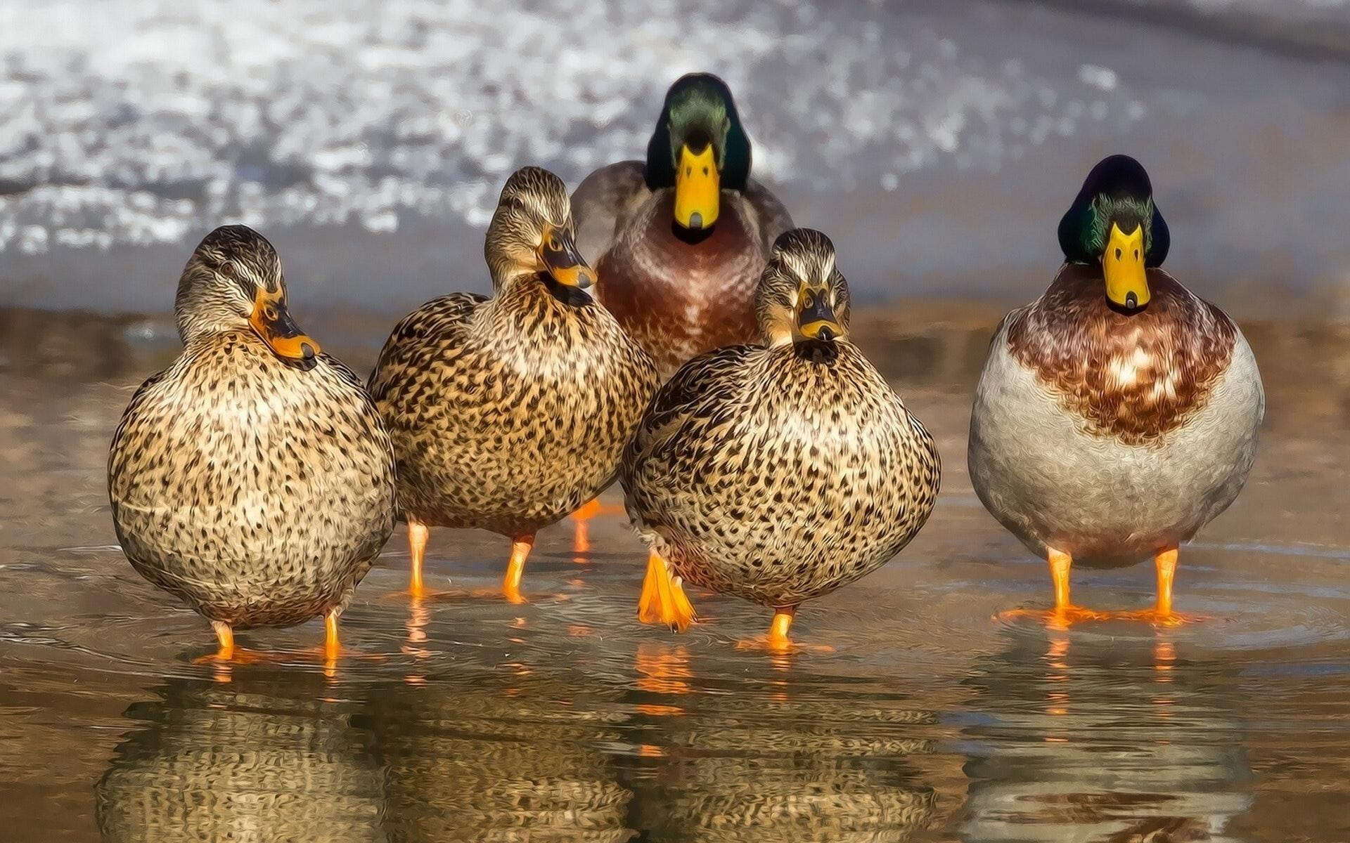
ᏍᎩᎦᏚᏏᏁ ᏣᎳᎩ ᎠᏕᎶᏆᏍᏗ
ᎧᏃᎩᏍᏗ
Hisgi kawon anid andawohv
Ujatindidl wunilosv
Uniji nigawesgv “quack! quack! Quack!”
Nvgiwu kawon anid unilujv.

Slide 4
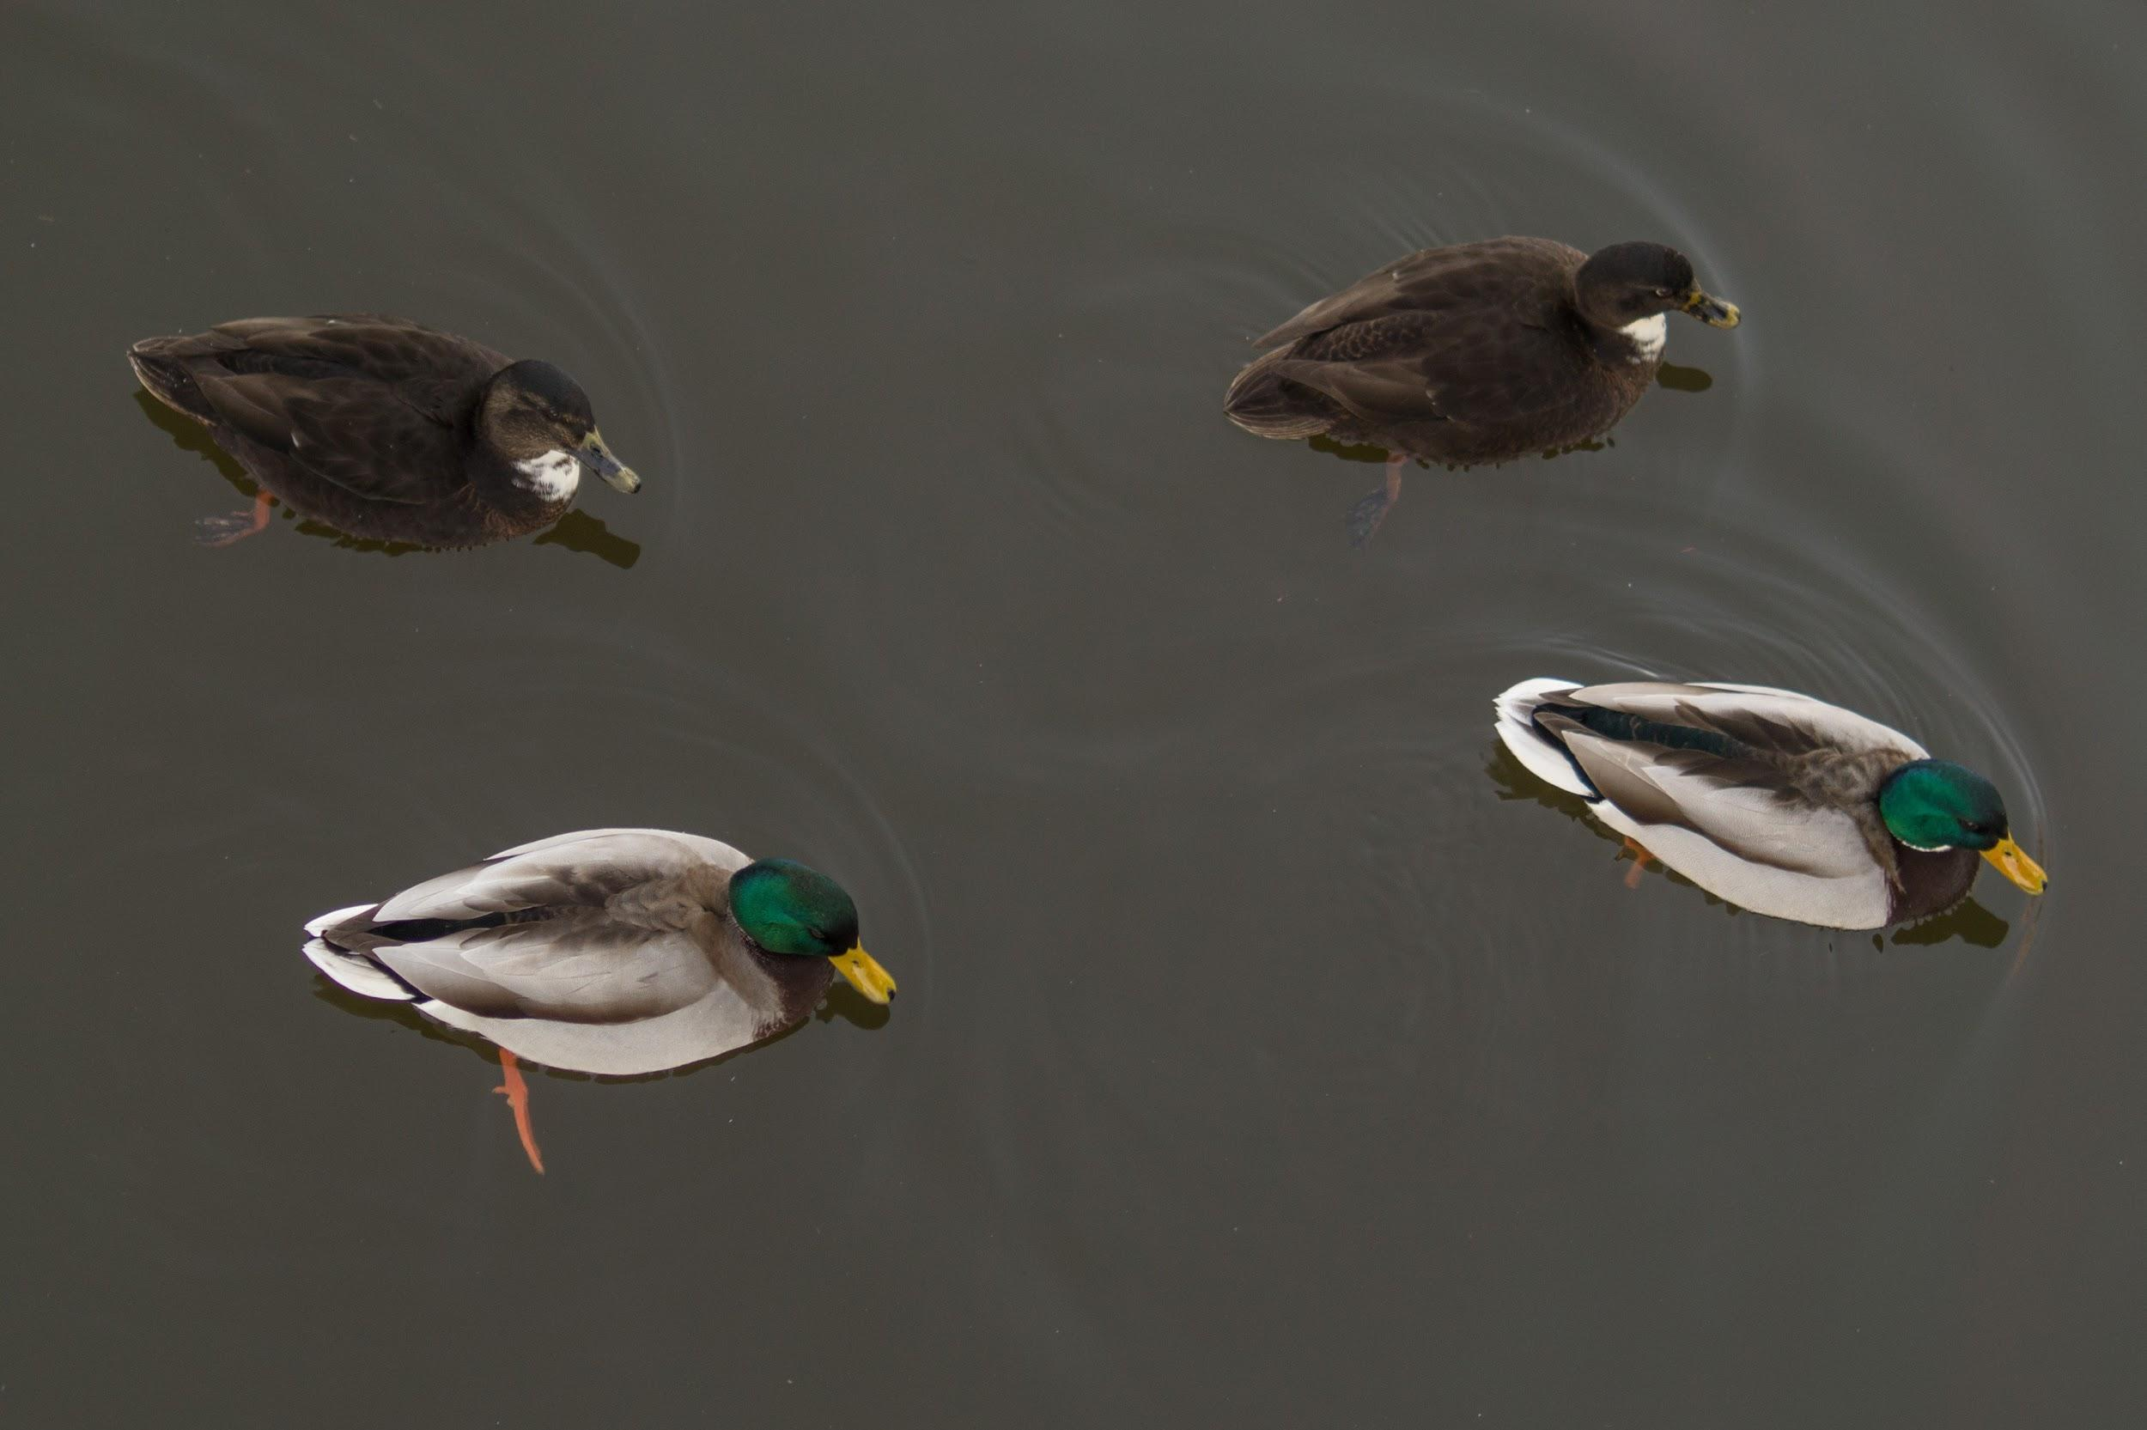
ᏍᎩᎦᏚᏏᏁ ᏣᎳᎩ ᎠᏕᎶᏆᏍᏗ
ᎧᏃᎩᏍᏗ
Didseka kawonu
Sawu, tal, jo, nvg
nvgi kawon anid andawohv
Ujatindidl wunilosv
Uniji nigawesgv “quack! quack! Quack!”
joiwu kawon anid unilujv.

Slide 5
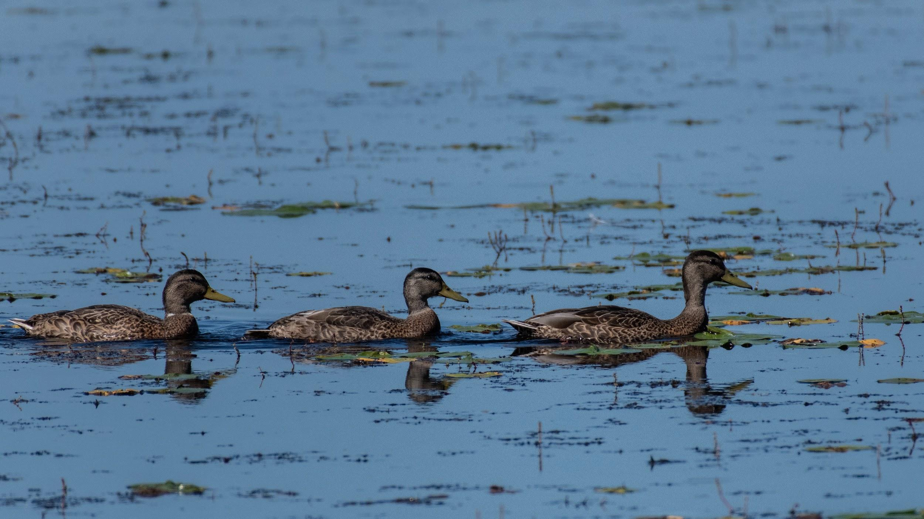
ᏍᎩᎦᏚᏏᏁ ᏣᎳᎩ ᎠᏕᎶᏆᏍᏗ
ᎧᏃᎩᏍᏗ
Didseka kawonu
Sawu, tal, jo,
Joi kawon anid andawohv
Ujatindidl wunilosv
Uniji nigawesgv “quack! quack! Quack!”
taliwu kawon anid unilujv.

Slide 6
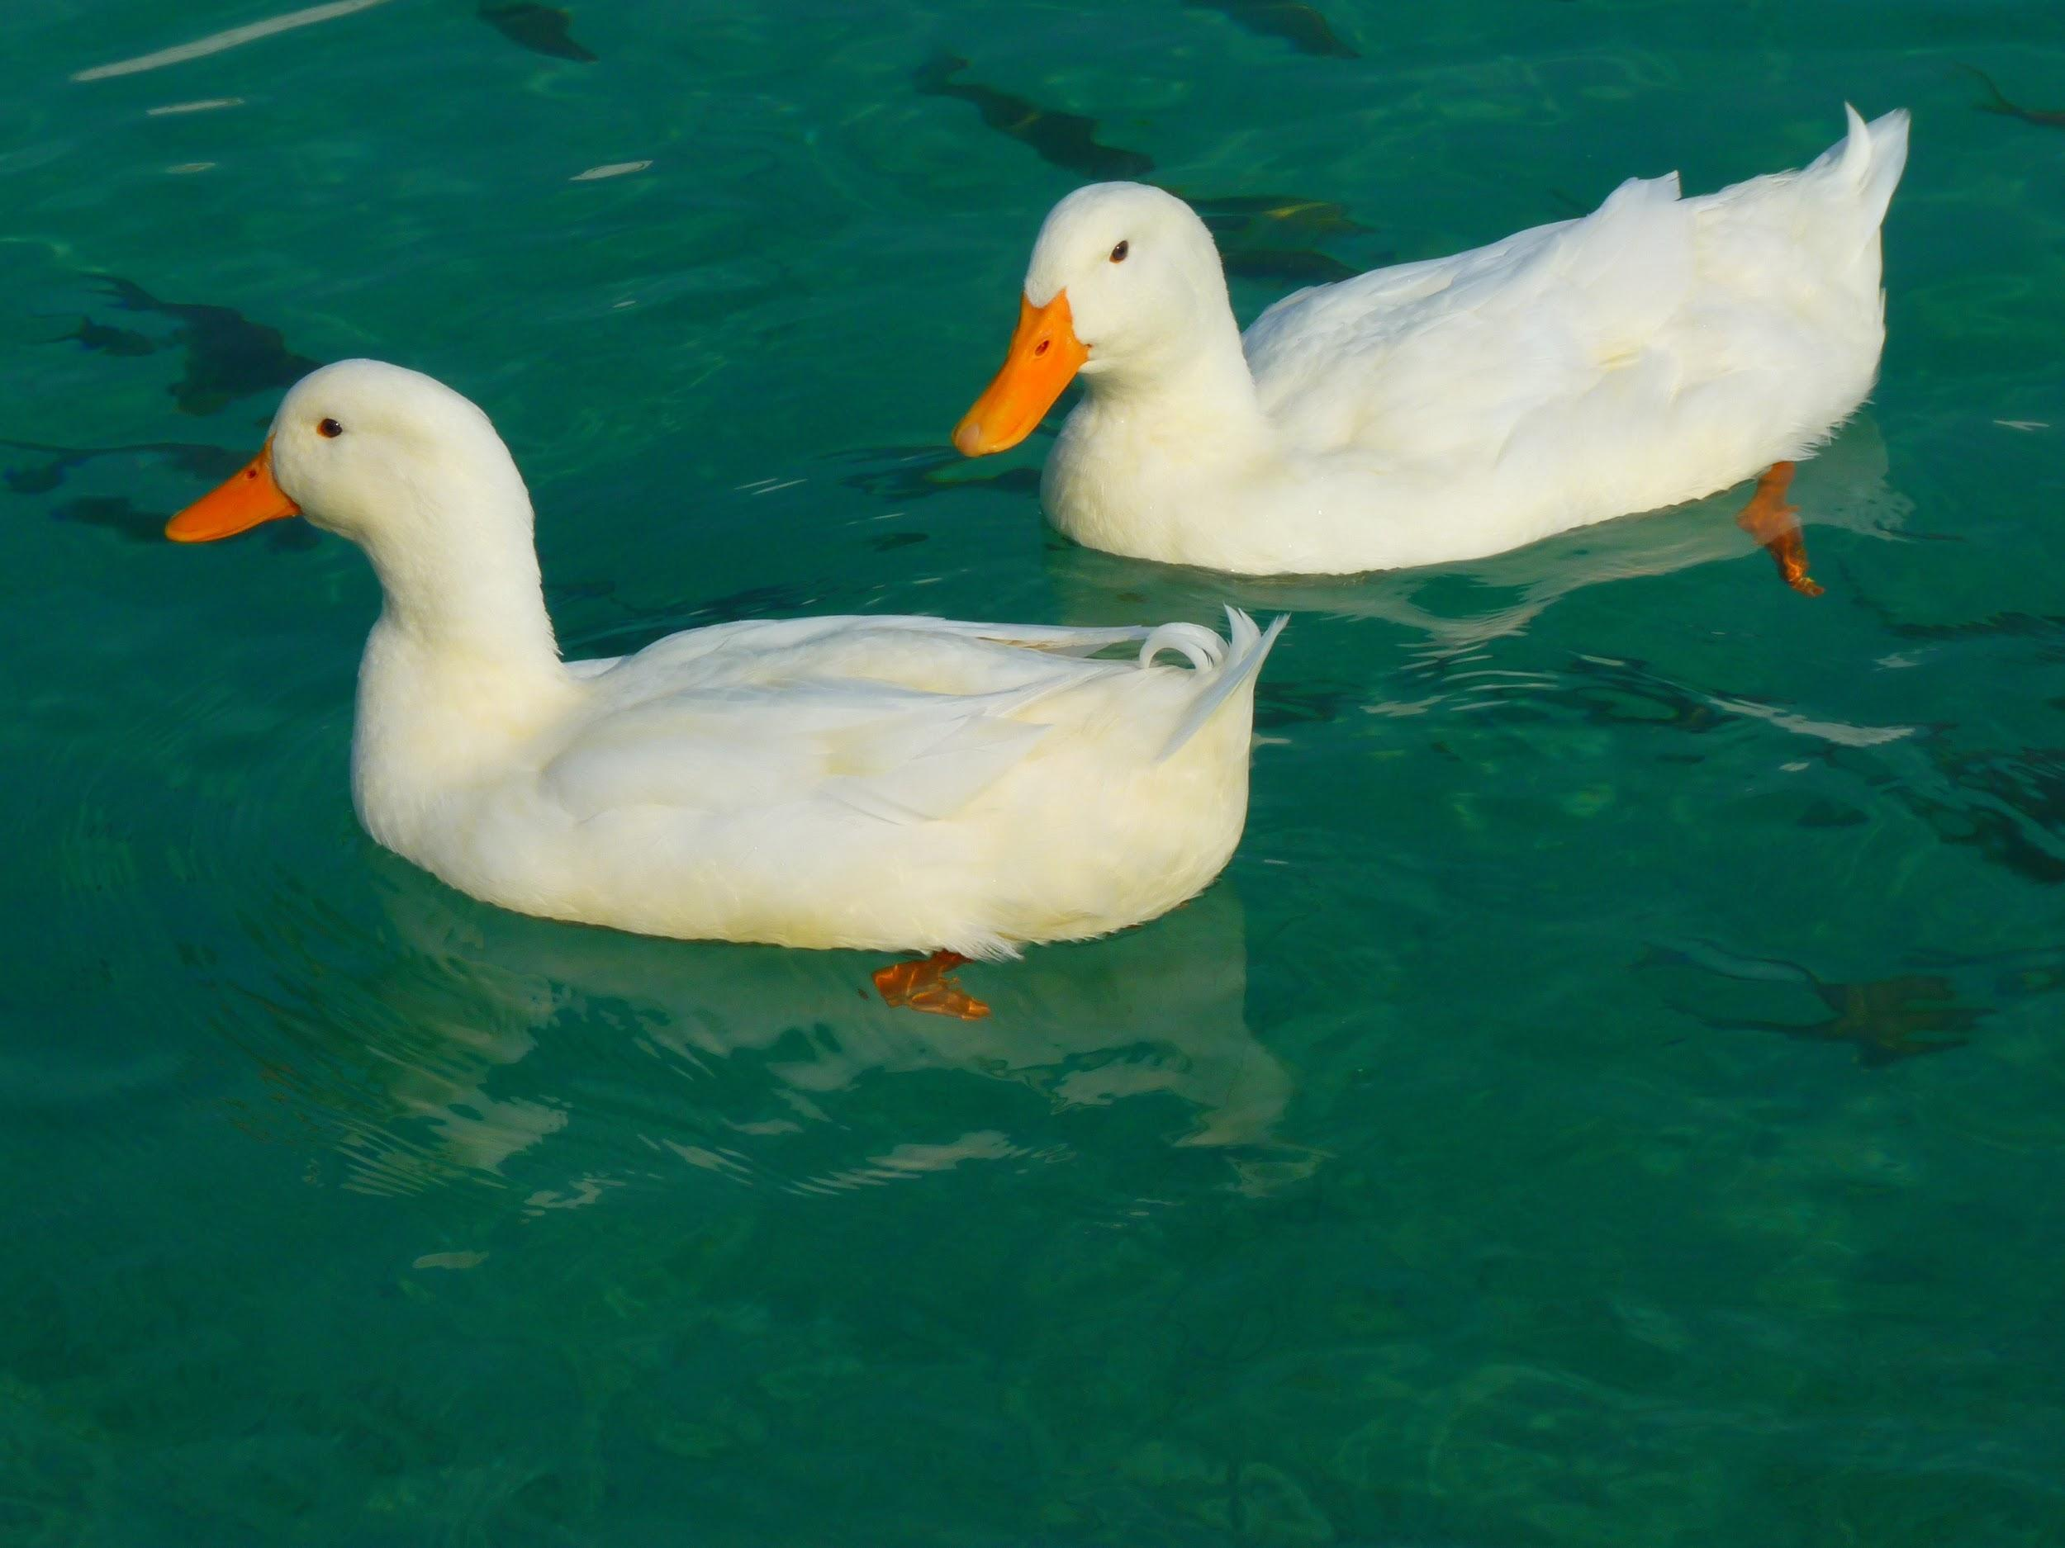
ᏍᎩᎦᏚᏏᏁ ᏣᎳᎩ ᎠᏕᎶᏆᏍᏗ
ᎧᏃᎩᏍᏗ
Didseka kawonu
Sawu, tal,
Tali kawon anid andawohv
Ujatindidl wunilosv
Uniji nigawesgv “quack! quack! Quack!”
sawu kawonu at ulujv.

Slide 7
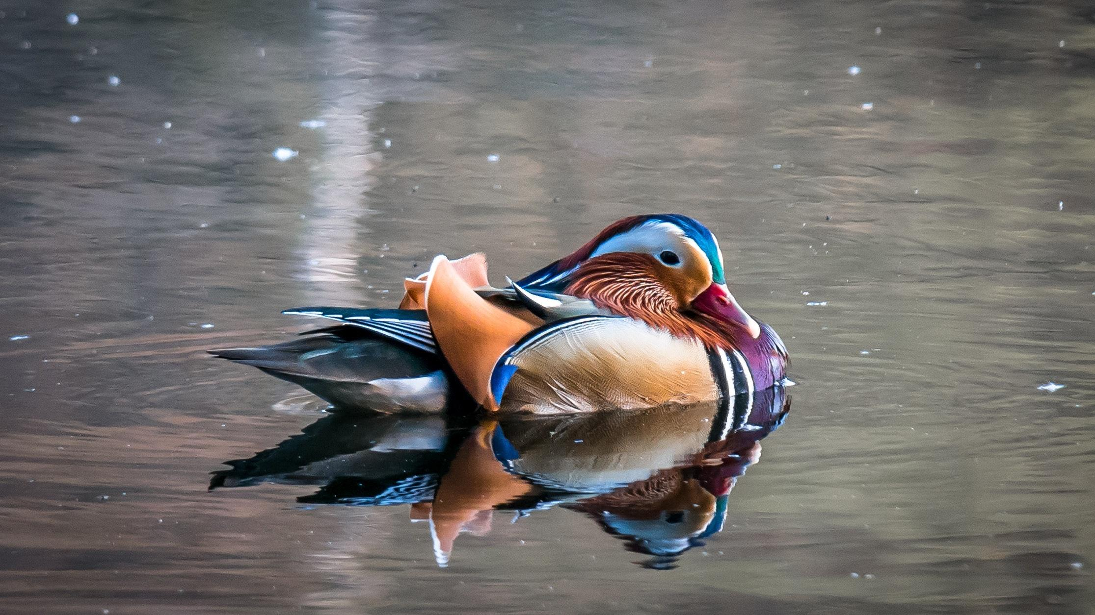
ᏍᎩᎦᏚᏏᏁ ᏣᎳᎩ ᎠᏕᎶᏆᏍᏗ
ᎧᏃᎩᏍᏗ
Didseka kawonu
Sawu
sawu kawonu at adawohv
Ujatindidl wulosv
Uji nigawesgv “quack! quack! Quack!”
nigadawu kawonu anid unilujv.

Slide 8
ᏍᎩᎦᏚᏏᏁ ᏣᎳᎩ ᎠᏕᎶᏆᏍᏗ
Aksti tsigesv, edud eladi osdanigisgo amayididla.
Uhna edud agwehyonv awadawosdi amayi uweyv danelv nav.
Uhyvdla gesv amayi, hawin ama ganvgogv.
Uhnasdedlv nusdv gadetanidohv uksatv nav amayi.
Gogi walsquadisgv gadawosgv.
Inada ale dlanusi doginaksasdo.
Yudahv tsisdvn dosdiniyisgv.

Slide 9
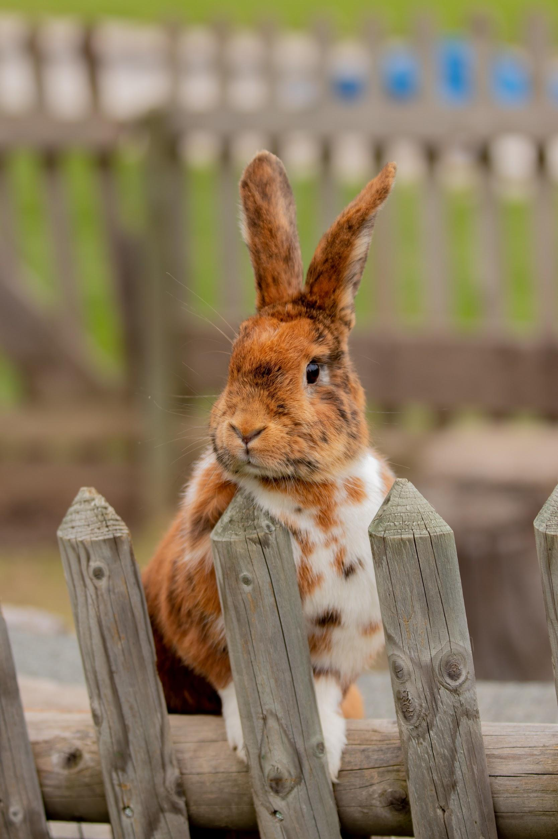
ᏍᎩᎦᏚᏏᏁ ᏣᎳᎩ ᎠᏕᎶᏆᏍᏗ
Jisdu uyosisge
Ilvhiyu jigesv jisdu at ehe.
Uwodige ale unega ulsiwid gesv.
Jisdu at uyosisge.
Ahwisvsdididl wulose.
Adalonige anildisg duhyohv.
Tuya dahwisv hawindidl wuktane.
Tla yiduwatvhe adalonige anildisg.
Jugahnten gadudidl dahwisv wuktane.
Tla yiduwatvhe dalonige anildisg.

Slide 10
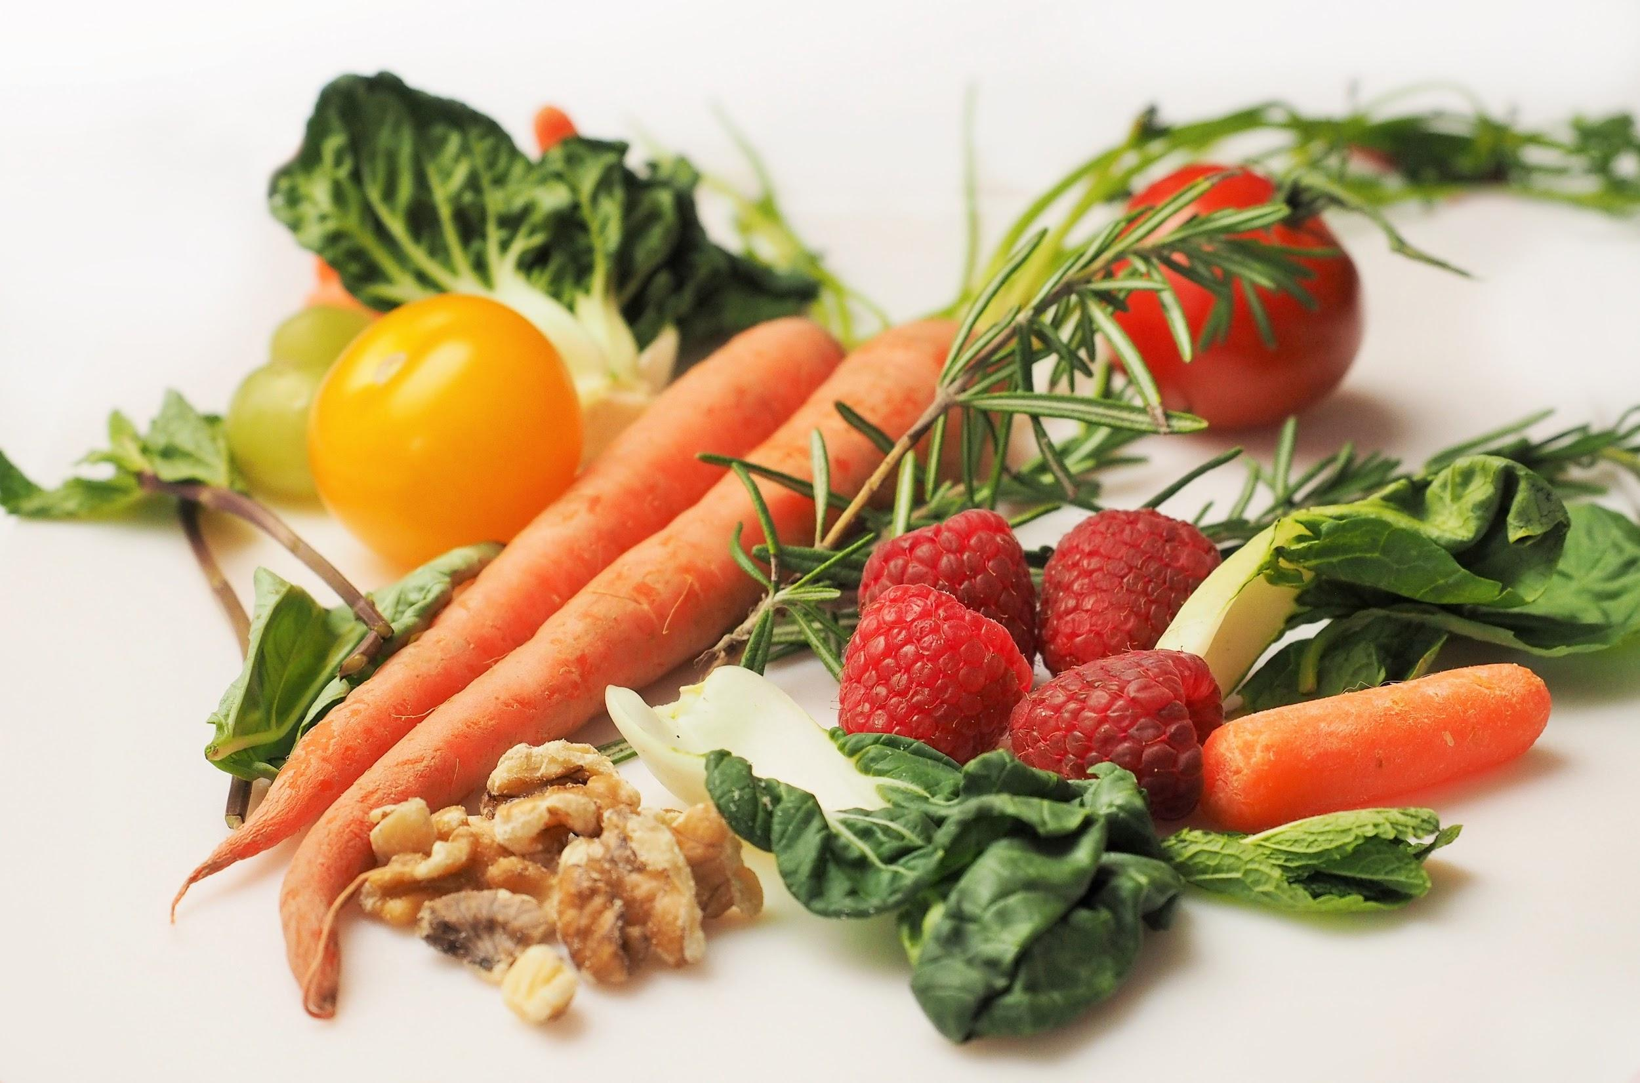
ᏍᎩᎦᏚᏏᏁ ᏣᎳᎩ ᎠᏕᎶᏆᏍᏗ
Ohndidl dahwisv ani wuktane.
Tla yiduwatvhe adalonige anildisg.
Damatli dahwisvdidl wuktane.
Tla yiduwatvhe adalonige anildisg.
Uwodige kanesa ugohe.
Uwodige kanesai wuktane.
Widugohe juwodu squisd adalonige anildisg.
Kanesai wujane.
Nigad juwodu dalonige anildisg dustige.
Nowu, tla yuyosisge.

