Slide 1
ᎣᏏᏲ
ᏁᎳᏚᏏᏁ ᏣᎳᎩ ᎠᏕᎶᏆᏍᏗ

Slide 2
ᏁᎳᏚᏏᏁ ᏣᎳᎩ ᎠᏕᎶᏆᏍᏗ
ᎢᏓᎴᎾ
ᏣᎳᎩ ᎢᏗᏬᏂ!

Slide 3
ᏁᎳᏚᏏᏁ ᏣᎳᎩ ᎠᏕᎶᏆᏍᏗ
Description: Describing setting in the present tense.
Gado yusdi?- What is it like?

Slide 4
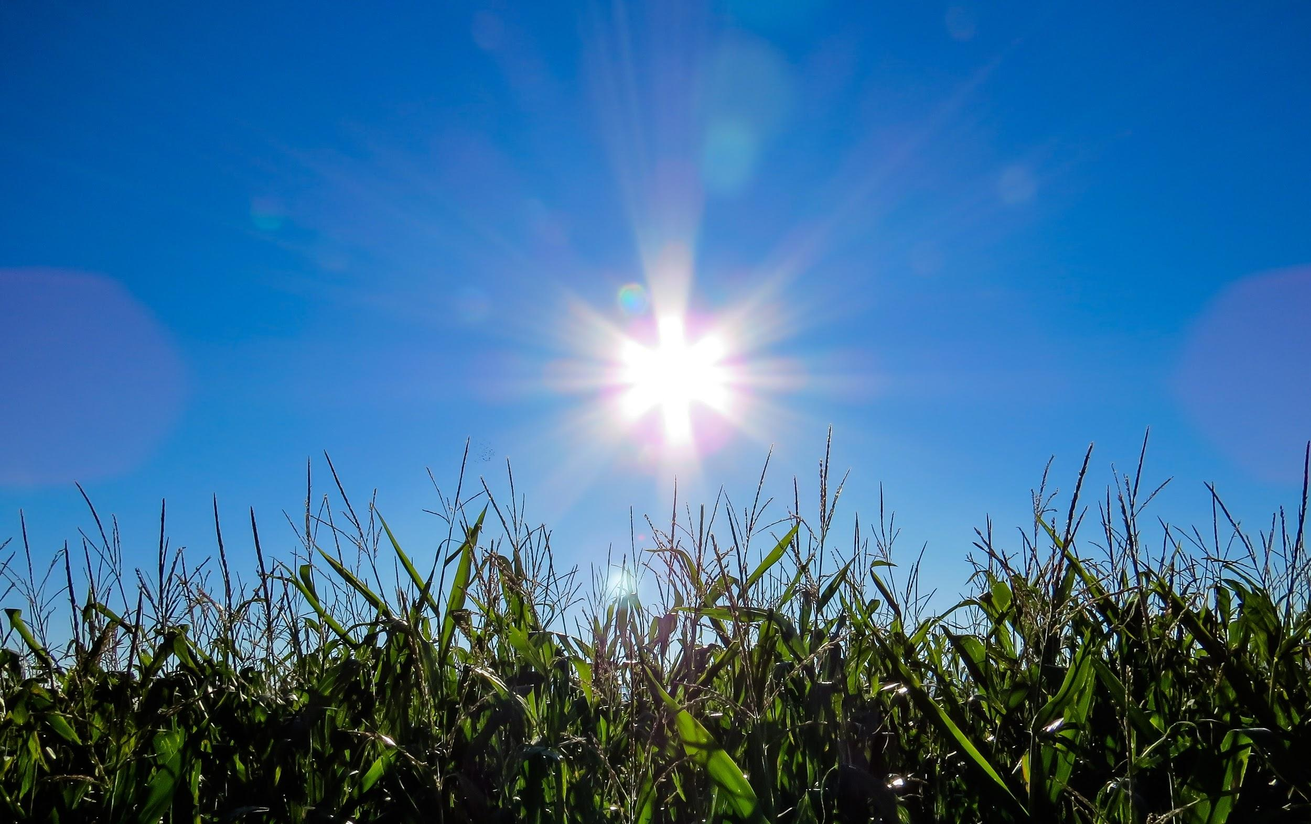
ᏁᎳᏚᏏᏁ ᏣᎳᎩ ᎠᏕᎶᏆᏍᏗ
Doyadidl nigalsdanvsgv- Weather (What’s happening outside)
ᏙᏯᏗᏟ ᏂᎦᎵᏍᏓᏅᏍᎬ
Nvda
Nvda iga ehi
Nvda iga ehi agali.
Agali.

Slide 5
ᏁᎳᏚᏏᏁ ᏣᎳᎩ ᎠᏕᎶᏆᏍᏗ
Doyadidl nigalsdanvsgv- Weather (What’s happening outside)
ᏙᏯᏗᏟ ᏂᎦᎵᏍᏓᏅᏍᎬ
ᏅᏓ
ᏅᏓ ᎢᎦ ᎡᎯ.
ᏅᏓ ᎢᎦ ᎡᎯ ᎠᎦᎵ.
ᎠᎦᎵ.

Slide 6
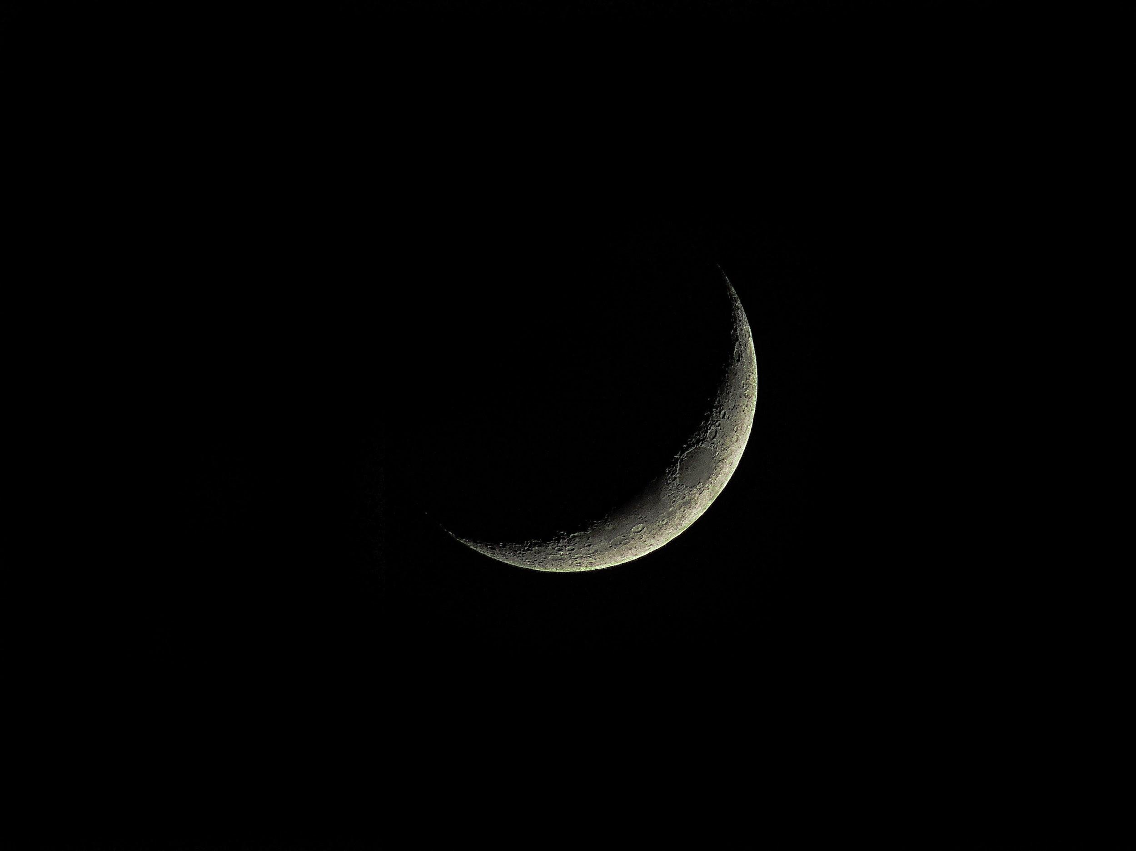
ᏁᎳᏚᏏᏁ ᏣᎳᎩ ᎠᏕᎶᏆᏍᏗ
Doyadidl nigalsdanvsgv- Weather (What’s happening outside)
ᏙᏯᏗᏟ ᏂᎦᎵᏍᏓᏅᏍᎬ
Nvda
Nvda svnoyi ehi
Nvda svnoyi ehi agali.
Svnoyi agali.

Slide 7
ᏁᎳᏚᏏᏁ ᏣᎳᎩ ᎠᏕᎶᏆᏍᏗ
Doyadidl nigalsdanvsgv- Weather (What’s happening outside)
ᏙᏯᏗᏟ ᏂᎦᎵᏍᏓᏅᏍᎬ
ᏅᏓ
ᏅᏓ ᏒᏃᏱ ᎡᎯ
ᏅᏓ ᏒᏃᏱ ᎡᎯ ᎠᎦᎵ.
ᏒᏃᏱ ᎠᎦᎵ.

Slide 8
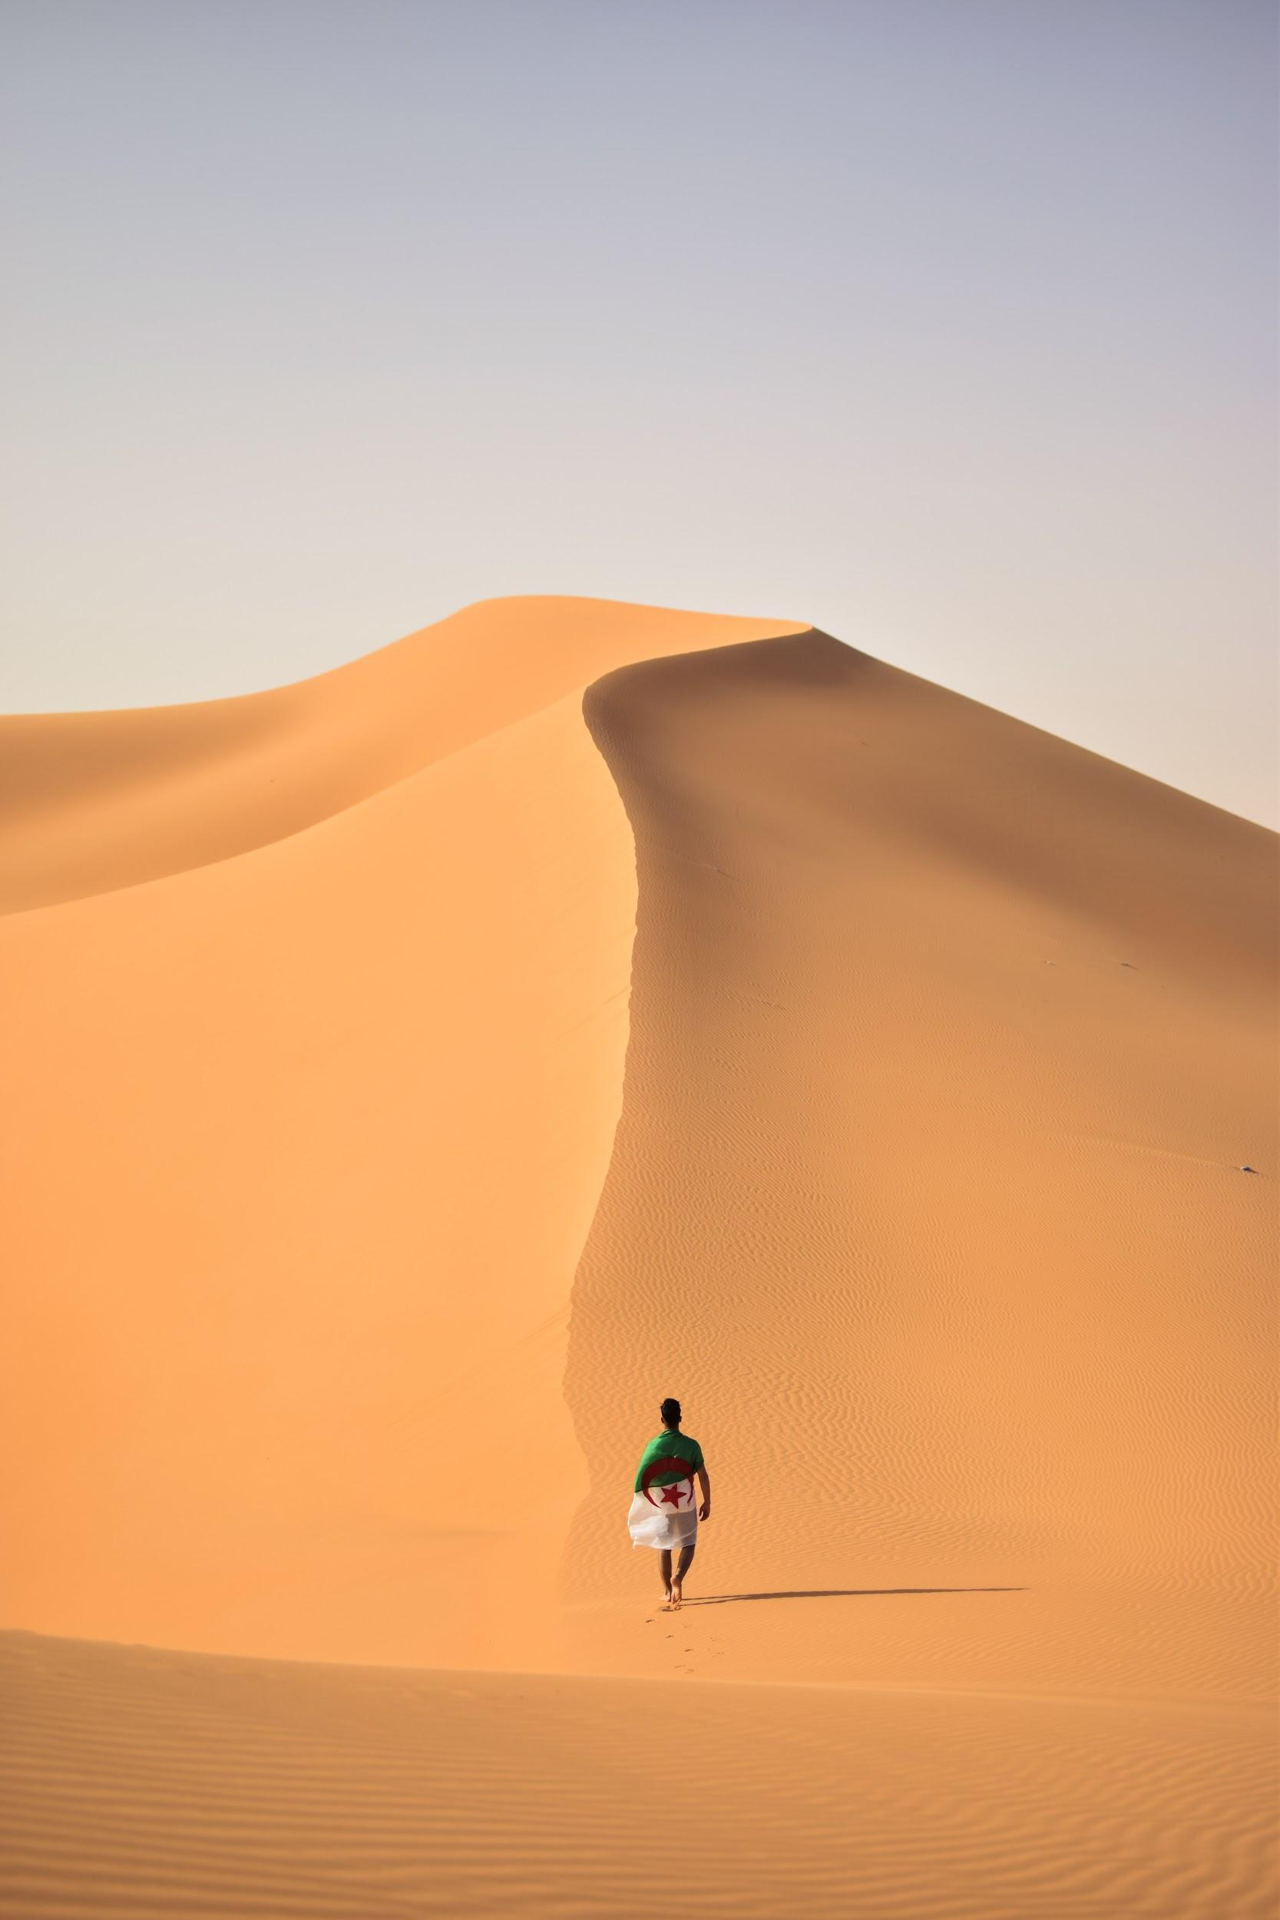
ᏁᎳᏚᏏᏁ ᏣᎳᎩ ᎠᏕᎶᏆᏍᏗ
Gado usdi higoti?
Igas, svnoyike?
Iga.
Kilos higoti?
Ayvwi.
Hatlv edo ayvwi?
Noyi inage edo ayvwi.
Asgayas agehyake?
Asgaya.
Gado advne asgaya?
Asgaya ai.
Ais, waike na asgaya?
Asgaya wai.

Slide 9
ᏁᎳᏚᏏᏁ ᏣᎳᎩ ᎠᏕᎶᏆᏍᏗ
Hila yani asgaya wai?
Sawu asgaya ai.
Na asgaya uwasv wai.
Hatlv wai asgaya?
Noyi inage wai na asgaya.
Hatlvdidl wai asgaya?
Gadusididl wai asgaya.
Gado nigalsdi doyadidl?
Agali.
Gado heli? Yuditlegas, yuhvydlike noyi inage?
Uditlega noyi inage.

Slide 10
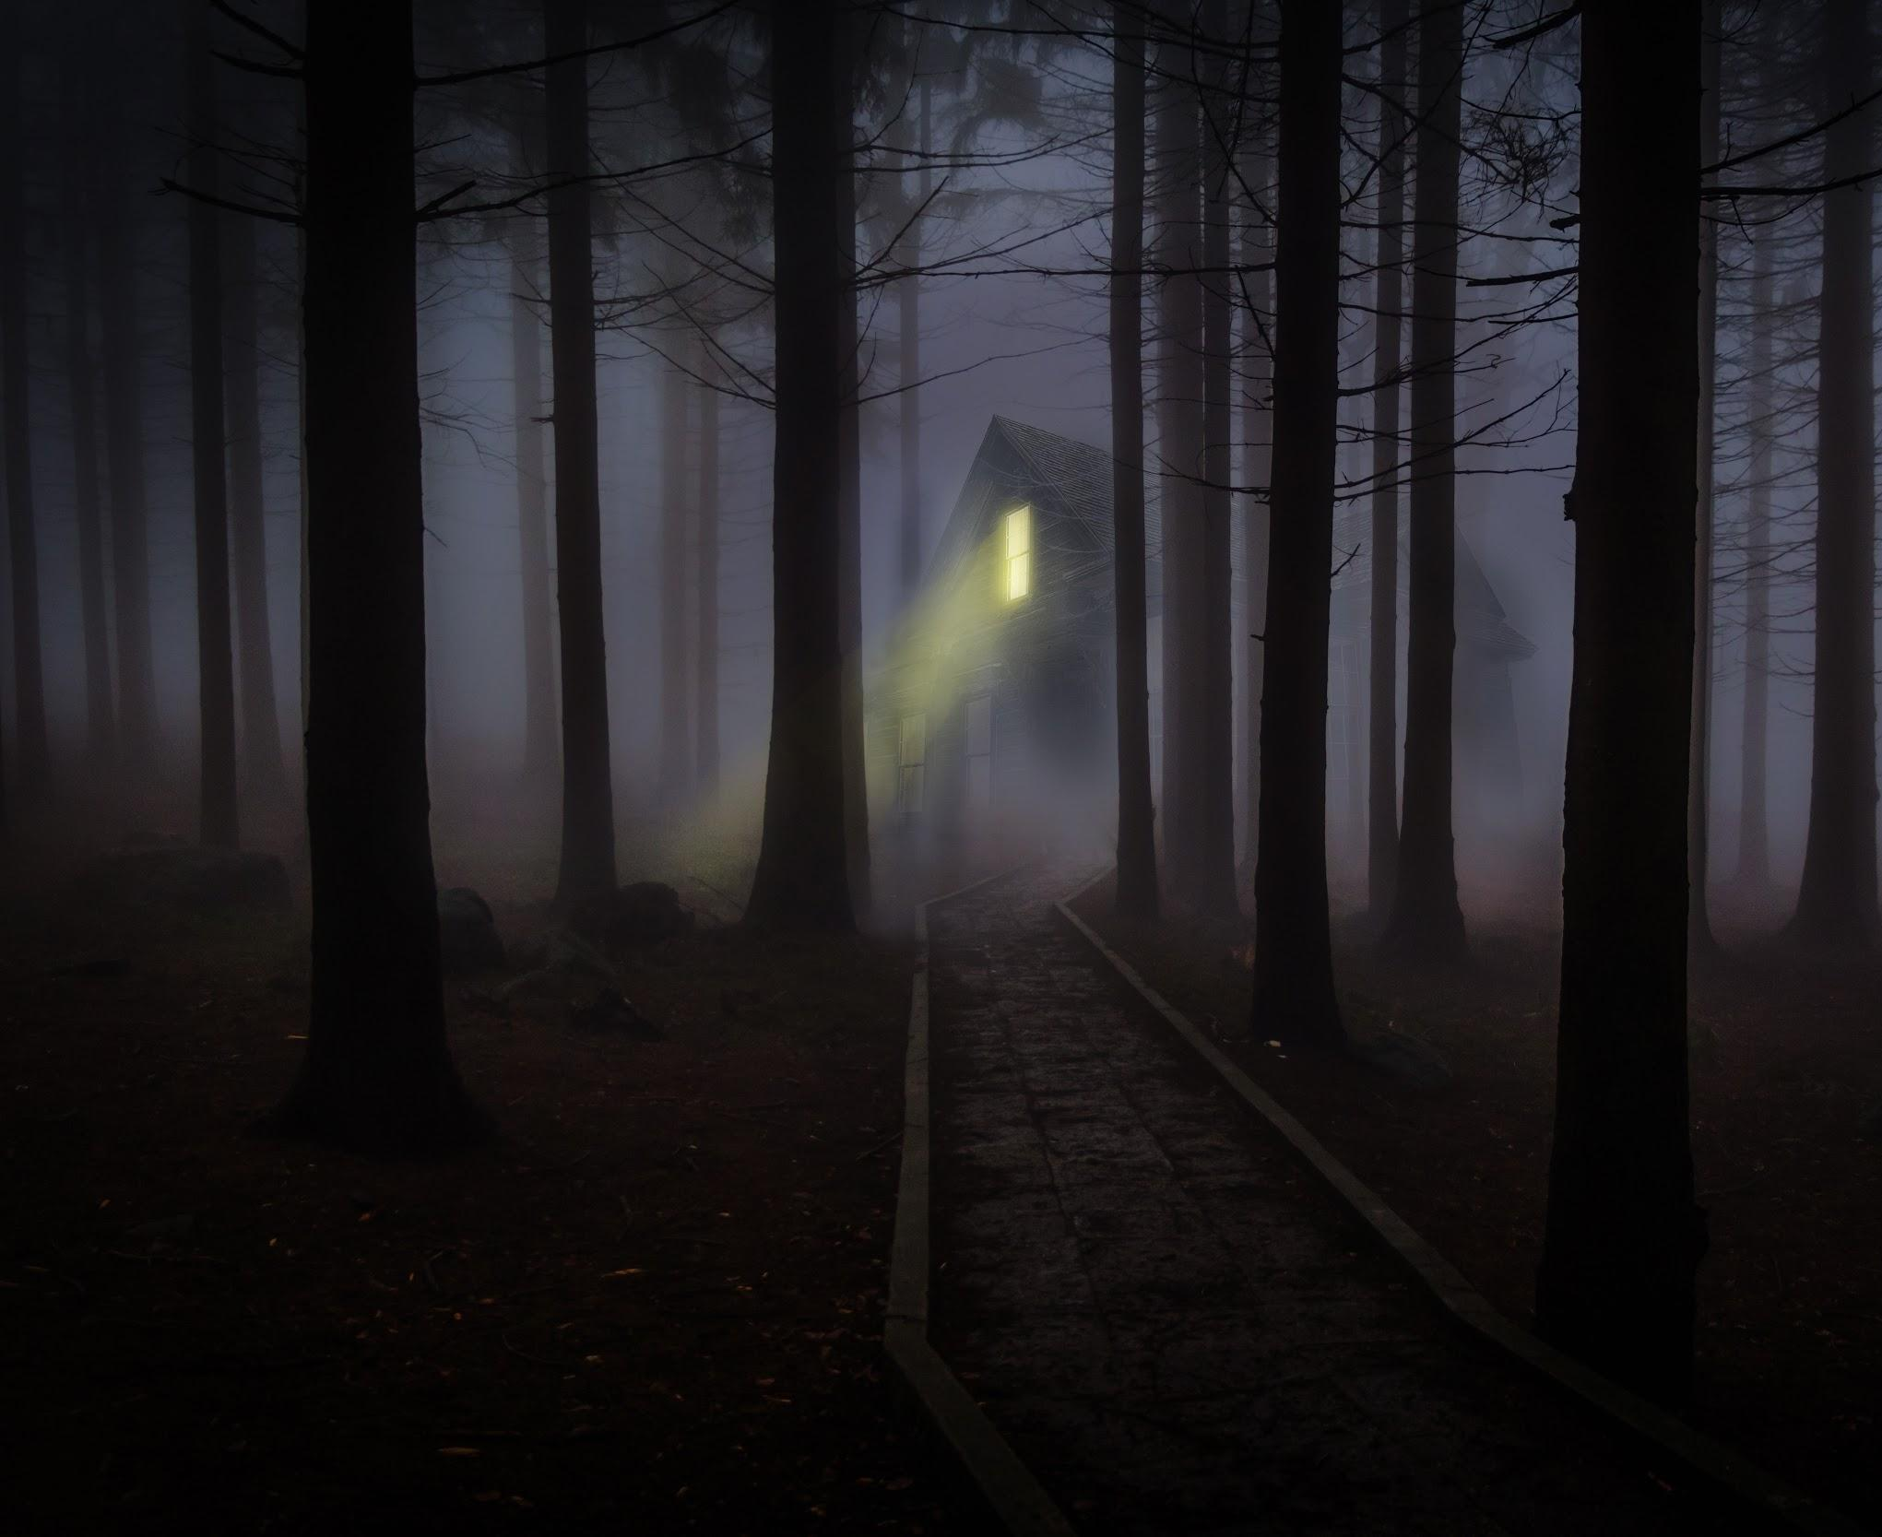
ᏁᎳᏚᏏᏁ ᏣᎳᎩ ᎠᏕᎶᏆᏍᏗ
Igas? Svnoyike?
Svnoyi.
Higotis asgaya?
Tla.
Gado usdi higoti?
Galjode.
Hatlv galjod galjode?
Adohi inage galjode galjod.
Hila yiga galjode?
Sawu galjode.
Hila yiga jolani?
Sawu jolani.

Slide 11
ᏁᎳᏚᏏᏁ ᏣᎳᎩ ᎠᏕᎶᏆᏍᏗ
Svnoyi agalis?
Tla yagali. Ukvhatv.
Ganyeg stigid anelisgv!

Slide 12
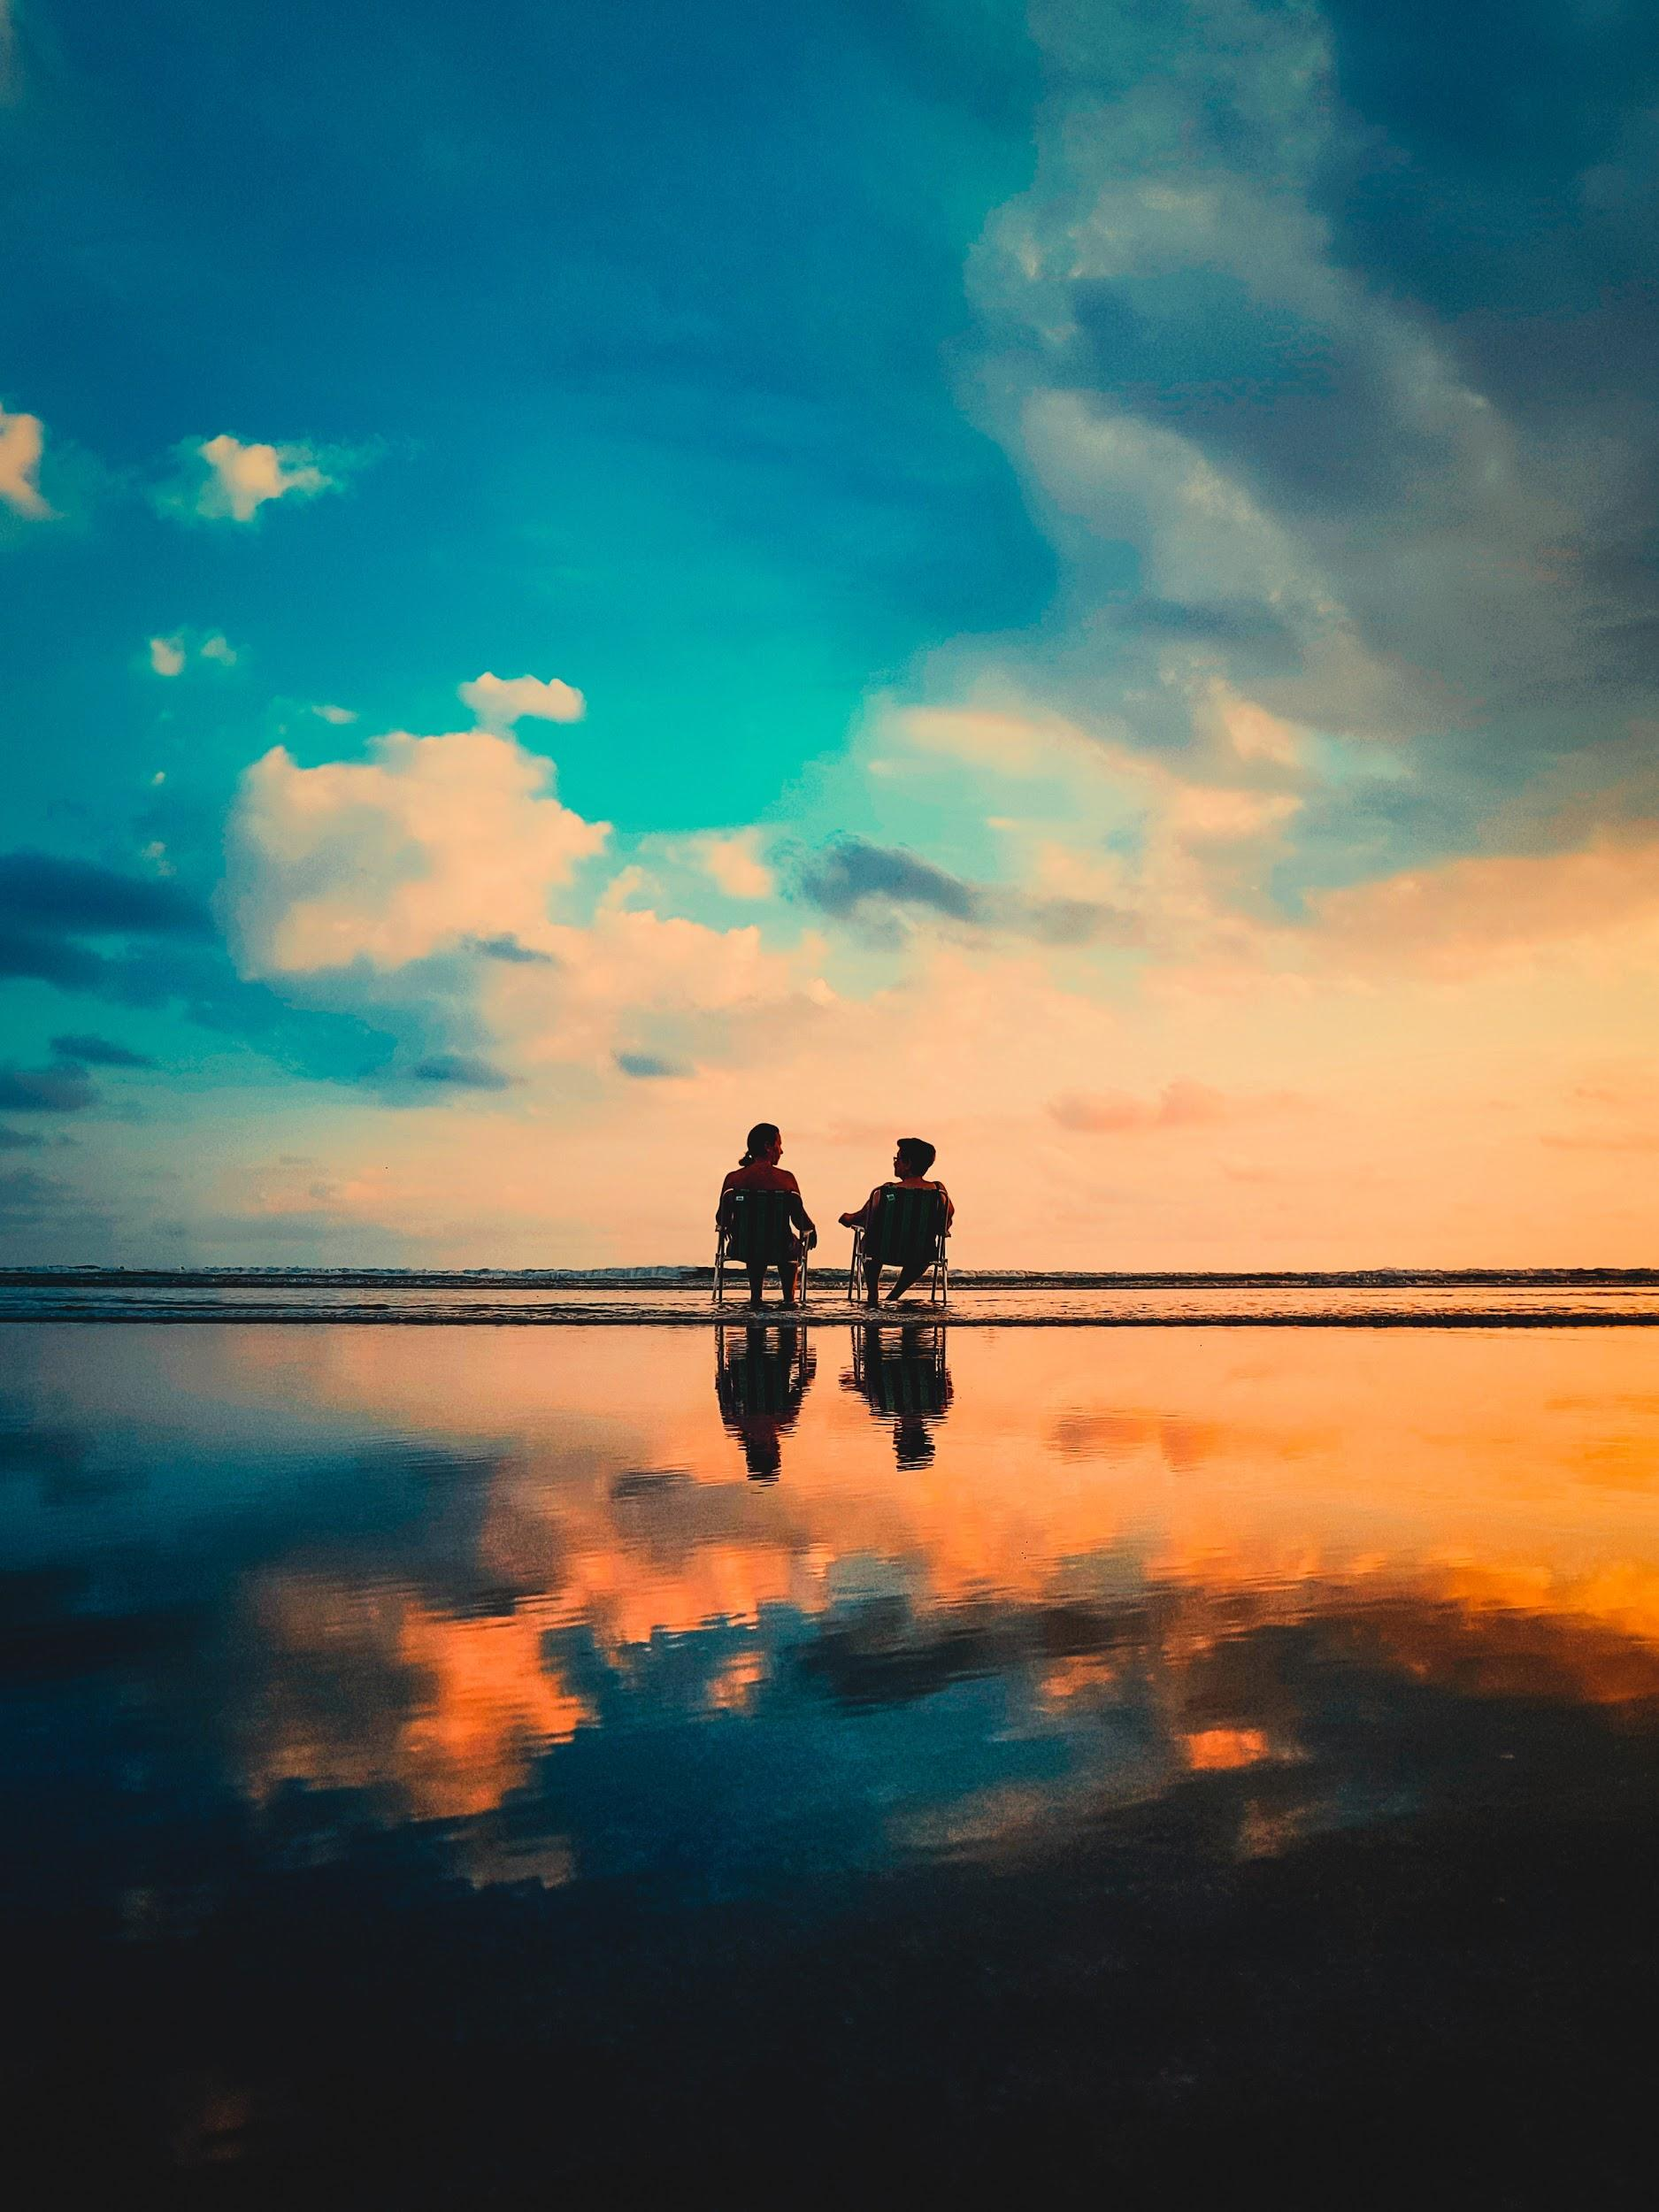
ᏁᎳᏚᏏᏁ ᏣᎳᎩ ᎠᏕᎶᏆᏍᏗ
Igas? Svnoyis?
Tla iga yigi ale tla svnoyi yigi.
Svhiyeyi.
Gado nigalsdi doyadidl?
Agalis?
Tla yagali.
Ukvhatvs?
Tla yukvhatv. Ulogilv.
Kilos higoti?

Slide 13
ᏁᎳᏚᏏᏁ ᏣᎳᎩ ᎠᏕᎶᏆᏍᏗ
Vv. tal aniyvwi anedo.
Asgayas, agehyake anedo?
Sawu agehya, sawu asgaya anedo.
Gado andvne aniyvwi?
Tla yiwidanidog, tla yiwanai. Widunotla.
Noyi inageis widunotla?
Tla yiwidunotla noyi inage.
Adohi inageis widunotla?

Slide 14
ᏁᎳᏚᏏᏁ ᏣᎳᎩ ᎠᏕᎶᏆᏍᏗ
Tla yiwidunotla adohi inage.
Hatlv widunotla aniyvwi?
Amayuldi widunotla.

Slide 15
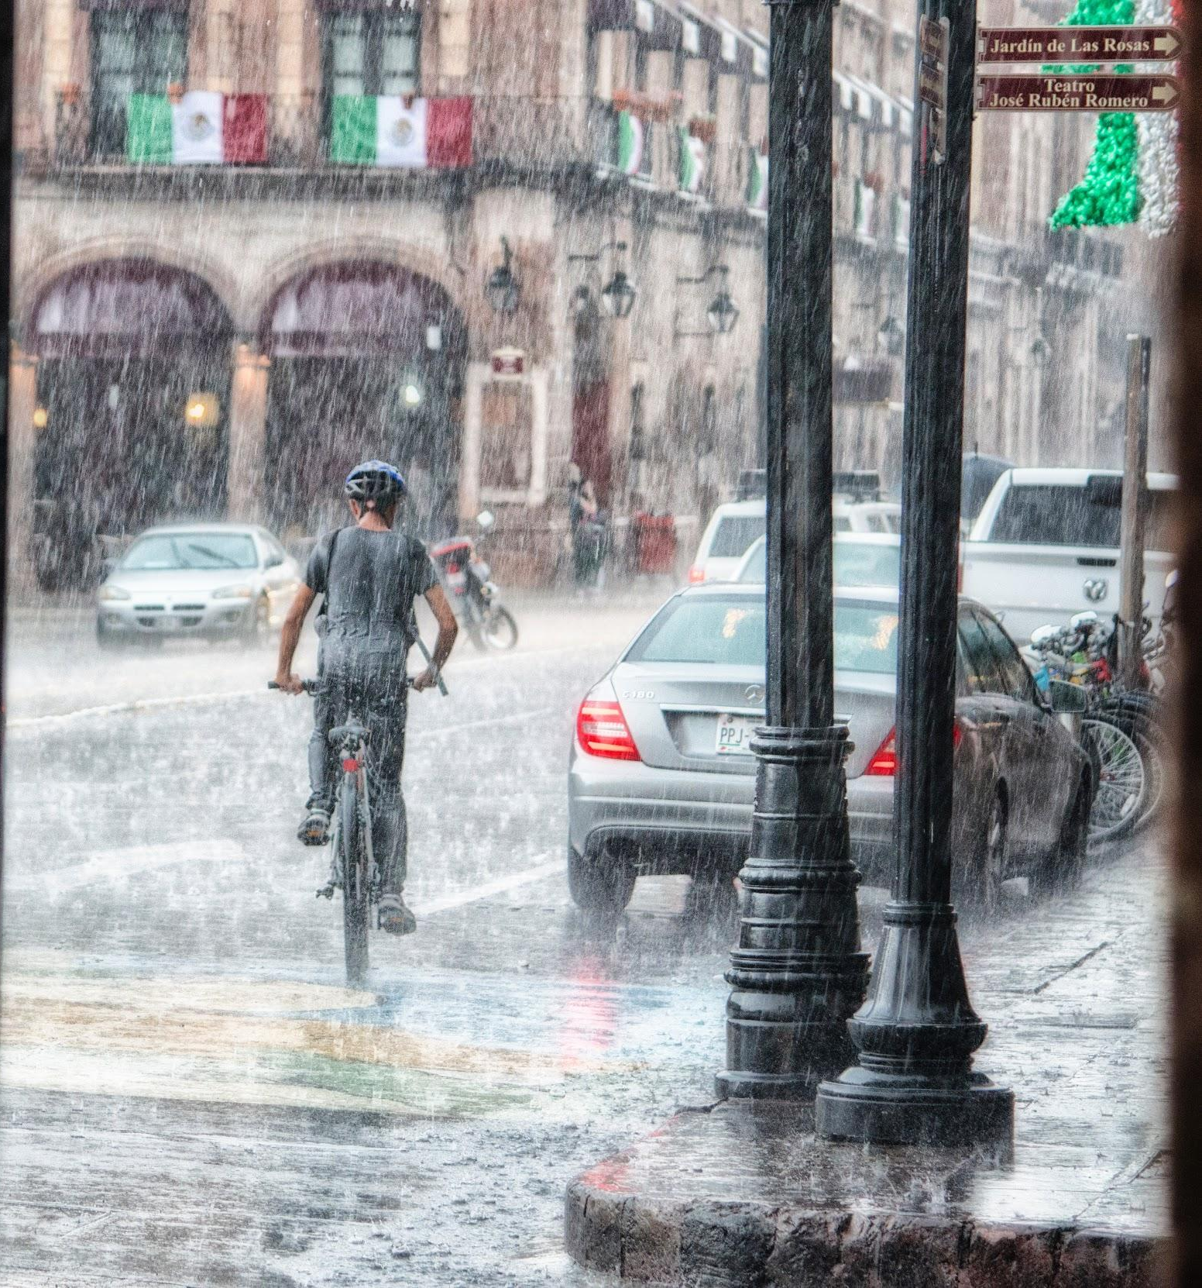
ᏁᎳᏚᏏᏁ ᏣᎳᎩ ᎠᏕᎶᏆᏍᏗ
Igas, svnoyike?
Iga.
Gado nigalsdi doyididl?
Agalis?
Tla yagali.
Uhvkatvs?
Tla yuhvkatv. Agasga.
Kilos higoti?
Vv. sawu yvwi edo.
Asgayas agehyake?

Slide 16
ᏁᎳᏚᏏᏁ ᏣᎳᎩ ᎠᏕᎶᏆᏍᏗ
Asgaya. Udulida na asgaya!
Gado advne gadulida asgaya?
Tal digagwat wukilvd na asgaya.
Noyi inageis wukilvd?
Tla. tla yiwukilvd noyi inage.
Amayuldis wukilvd?
Tla. Tla yiwukilvd amayuldi.
Hatlv wukilvd?
Utan digaduhv nvnohi wukildvd.

Slide 17
ᏁᎳᏚᏏᏁ ᏣᎳᎩ ᎠᏕᎶᏆᏍᏗ
ᏅᏓ ᎢᎦ ᎡᎯ- sun
ᏅᏓ ᏒᏃᏱ ᎡᎯ- moon
ᎠᎦᎵ- It is shining
ᎯᎪᏘ- You see it
ᎩᎶ- Someone
ᎡᏙ- he/she is located/ present
ᏃᏱ ᎢᎾᎨ- desert. (sand wilds)
ᎠᏛᏁ- he/she is doing it
ᎤᏩᏒ- by himself/herself
ᎦᏚᏏ- hill
ᎦᏙ ᏂᎦᎵᏍᏗ- What’s happening
ᎮᎵᎠ- You think
ᎤᏗᏞᎦ- It’s hot
ᎤᏴᏟ- It’s cold
ᎠᏙᎯ ᎢᎾᎨ- Forest (wood wilds)
ᎤᎬᎭᏛ- it’s foggy
ᎦᏂᏰᎩ- It’s scary
ᏍᏗᎩᏛ- little bit
ᎠᏁᎵᏍᎬ- It seems
ᏒᎯᏰᎯ- evening

Slide 18
ᏁᎳᏚᏏᏁ ᏣᎳᎩ ᎠᏕᎶᏆᏍᏗ
ᎤᎶᎩᎸ- It’s cloudy
ᏫᏚᏃᏝ- They are sitting (away)
ᎠᎦᏍᎦ- It’s raining
ᎤᏚᎵᏓ- He’s wet
ᏔᎵ ᏗᎦᏆᏘ- Bicycle
ᎤᎩᎸᏓ- He’s riding (straddling)

