Slide 1
ᎣᏏᏲ
ᏓᎳᏚᏏᏁ ᏣᎳᎩ ᎠᏕᎶᏆᏍᏗ

Slide 2
ᏐᏁᎳᏚᏏᏁ ᏣᎳᎩ ᎠᏕᎶᏆᏍᏗ
ᎢᏓᎴᎾ
ᏣᎳᎩ ᎢᏗᏬᏂ!

Slide 3
ᏐᏁᎳᏚᏏᏁ ᏣᎳᎩ ᎠᏕᎶᏆᏍᏗ
Description: Describing setting in the present tense.

Slide 4
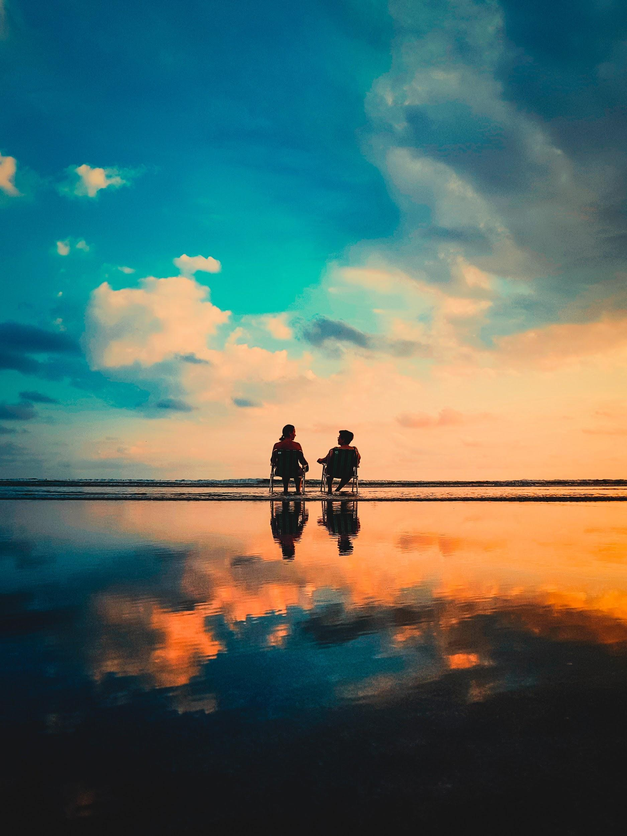
ᏁᎳᏚᏏᏁ ᏣᎳᎩ ᎠᏕᎶᏆᏍᏗ
Tla yiwidunotla adohi inage.
Hatlv widunotla aniyvwi?
Amayuldi widunotla.

Slide 5
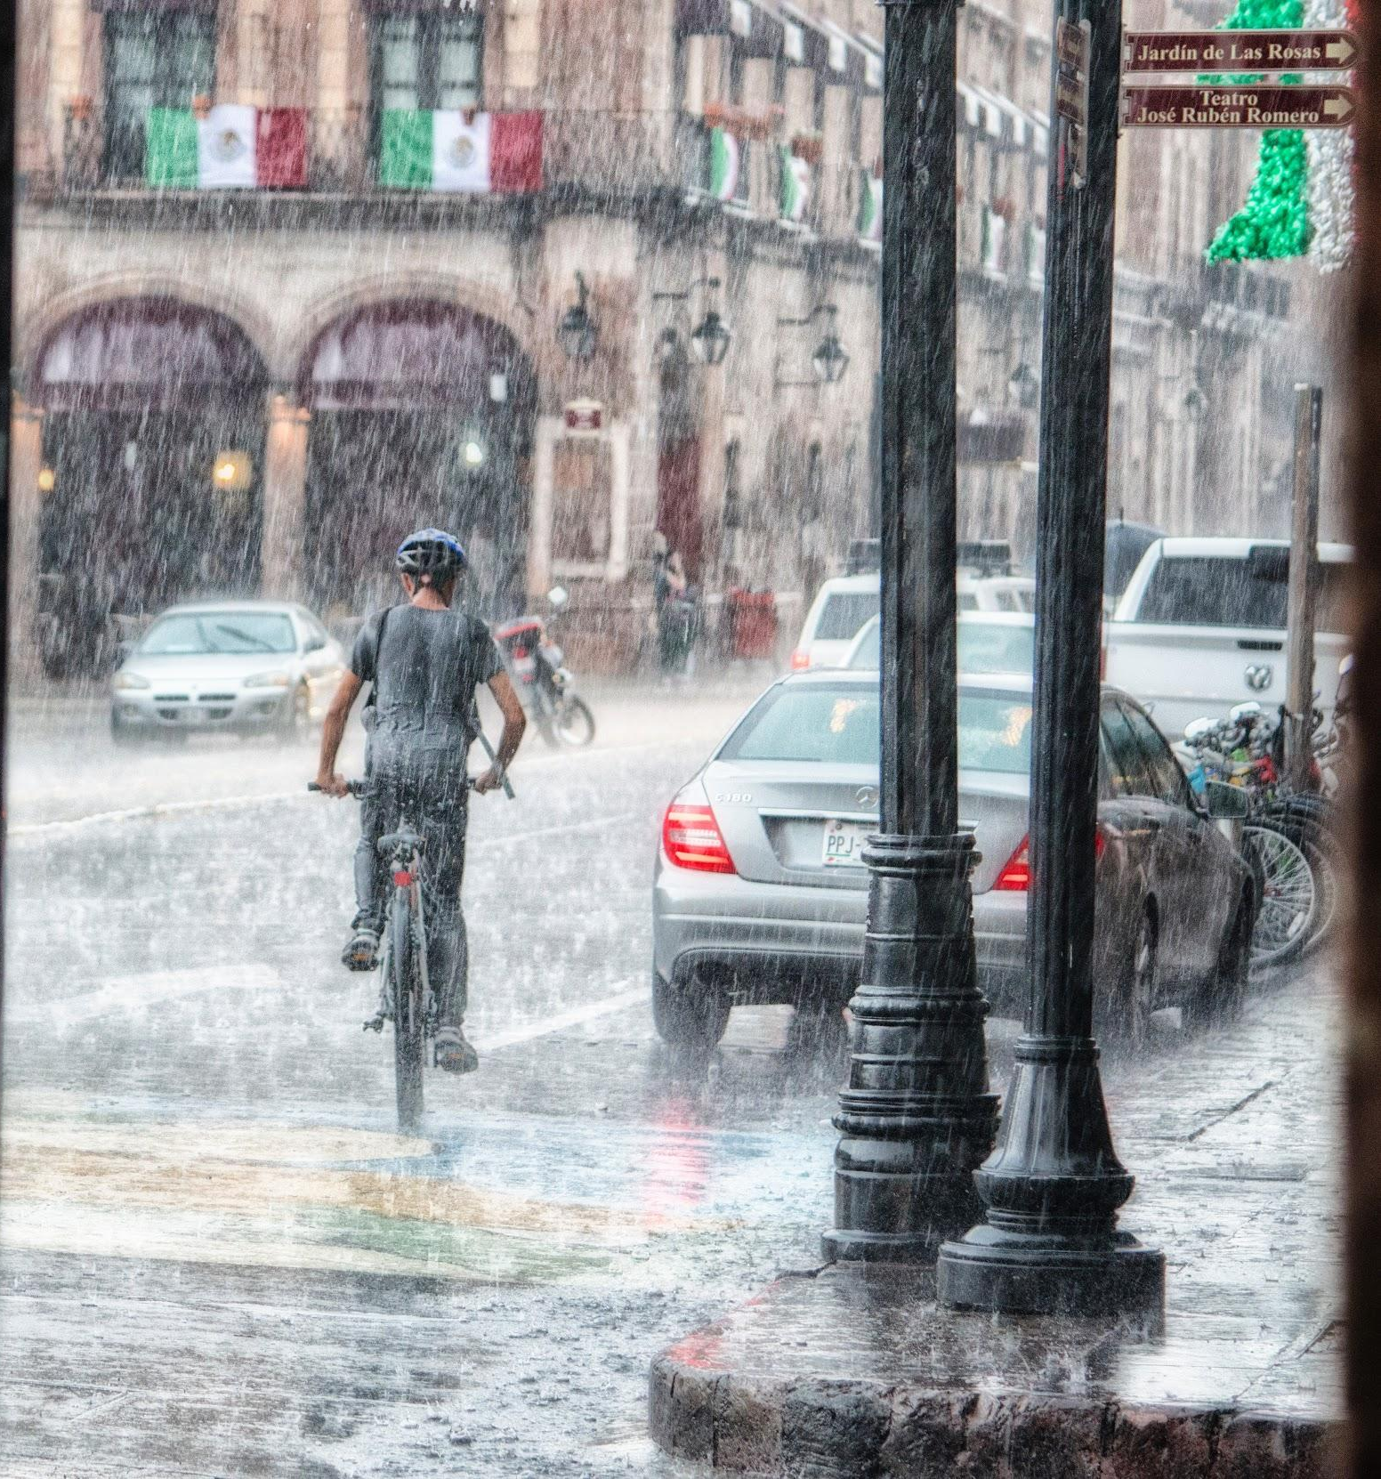
ᏁᎳᏚᏏᏁ ᏣᎳᎩ ᎠᏕᎶᏆᏍᏗ
Igas, svnoyike?
Iga.
Gado nigalsdi doyididl?
Agalis?
Tla yagali.
Ukvhatvs?
Tla yukvhatv. Agasga.
Kilos higoti?
Vv. sawu yvwi edo.
Asgayas agehyake?

Slide 6
ᏁᎳᏚᏏᏁ ᏣᎳᎩ ᎠᏕᎶᏆᏍᏗ
Asgaya. Udulida (gadane) na asgaya!
Gado advne gadulida asgaya?
Tal digagwat wukilvd na asgaya.
Noyi inageis wukilvd?
Tla. tla yiwukilvd noyi inage.
Amayuldis wukilvd?
Tla. Tla yiwukilvd amayuldi.
Hatlv wukilvd?
Utan digaduhv nvnohi wukildvd.

Slide 7
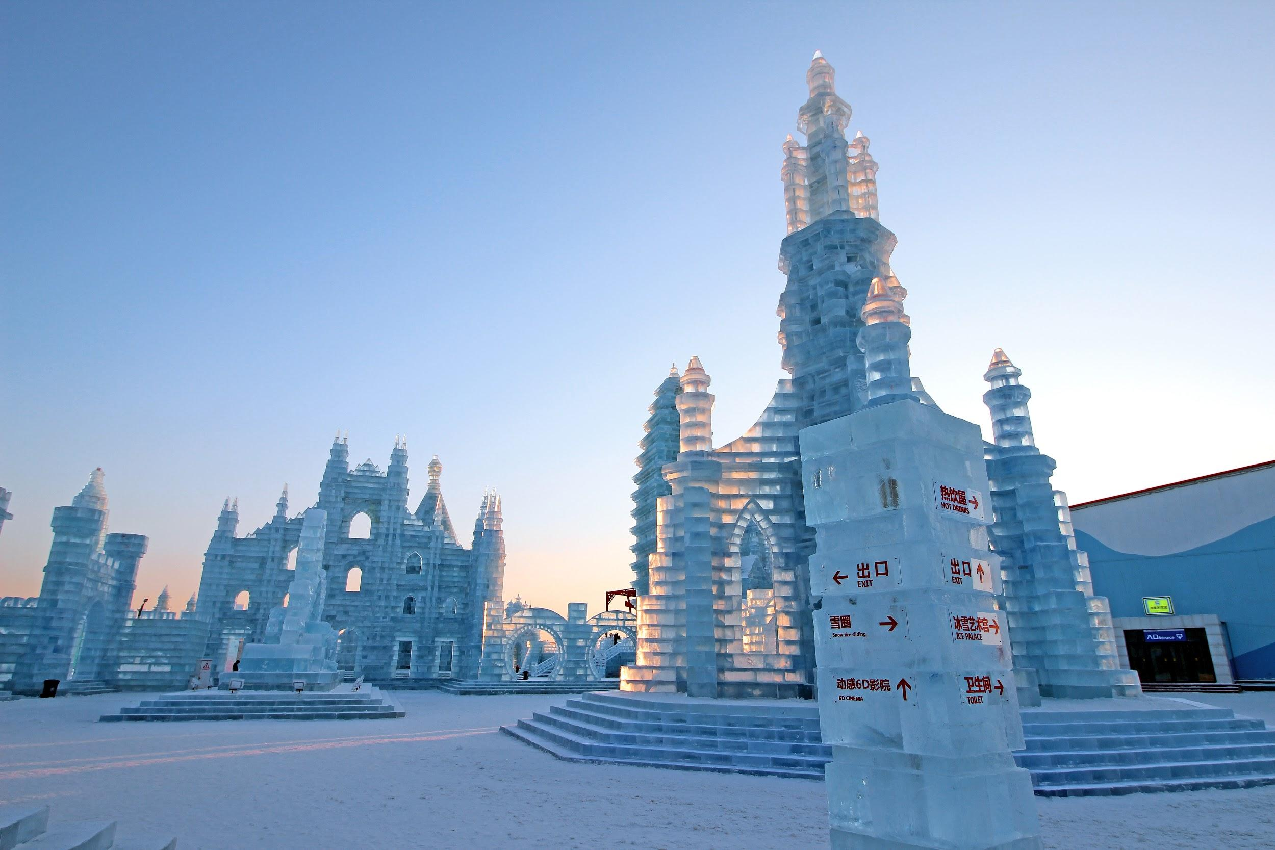
ᏐᏁᎳᏚᏏᏁ ᏣᎳᎩ ᎠᏕᎶᏆᏍᏗ
Gado yusdi?
Uditlegas, uhyvdlike?
Gado nigalsdi?
Agali.
Hatlvi heli?
Amayetlis?
Tla amayetli yigi.
Anisegi na dadanelv.
Gado usdi heli digotlvtanv dadanelv?
Unesdal digotlvtanv dadanelv!

Slide 8
ᏐᏁᎳᏚᏏᏁ ᏣᎳᎩ ᎠᏕᎶᏆᏍᏗ
Gado yusdi?
ᎤᏗᏞᎦᏍ, ᎤᏴᏟᎨ?
ᎦᏙ ᏂᎦᎵᏍᏗ?
ᎠᎦᎵ.
ᎭᏢᎢ ᎮᎵ?
ᎠᎹᏰᏟᏍ?
Ꮭ ᎠᎹᏰᏟ ᏱᎩ.
ᎠᏂᏎᎩ Ꮎ ᏓᏓᏁᎸ.
ᎦᏙ ᎤᏍᏗ ᎮᎵ ᏗᎪᏢᏔᏅ ᏓᏓᏁᎸ?
ᎤᏁᏍᏓᎳ ᏗᎪᏢᏔᏅ ᏓᏓᏁᎸ!

Slide 9
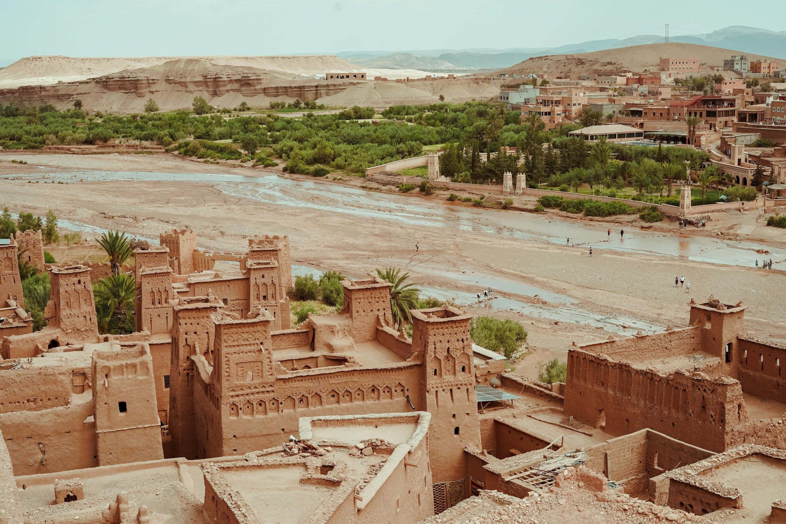
ᏐᏁᎳᏚᏏᏁ ᏣᎳᎩ ᎠᏕᎶᏆᏍᏗ
Hiina? Jutloyis uhna igvnaden?
Uhyvdlas?
Tla yuhyvdla. Uditlega.
Gado nigalsdi?
Agali.
Hatlvi heli?
Amayetlis?
Tla amayetli yigi.
Anisegi na dadanelv.
Gado usdi heli digotlvtanv dadanelv?
Gadaqual digotlvtanv dadanelv!
Gado yusdi?

Slide 10
ᏐᏁᎳᏚᏏᏁ ᏣᎳᎩ ᎠᏕᎶᏆᏍᏗ
Gado yusdi?
ᎯᎢᎾ? ᏧᏠᏱᏍ ᎤᎾ ᎢᎬᏯᏕᎾ?
ᎤᏴᏝᏍ?
Ꮭ ᏳᏢᏝ. ᎤᏗᏞᎦ.
ᎦᏙ ᏂᎦᎵᏍᏗ?
ᎠᎦᎵ.
ᎭᏢ ᎮᎵ?
ᎠᎹᏰᏟᏍ?
Ꮭ ᎠᎹᏰᏟ ᏱᎩ.
ᎠᏂᏎᎩ Ꮎ ᏓᏓᏁᎸ.
ᎦᏙ ᎤᏍᏗ ᎮᎵ ᏗᎪᏢᏔᏅ ᏓᏓᏁᎸ?
ᎦᏓᏆᎵ ᏗᎪᏢᏔᏅ ᏓᏓᏁᎸ!

Slide 11
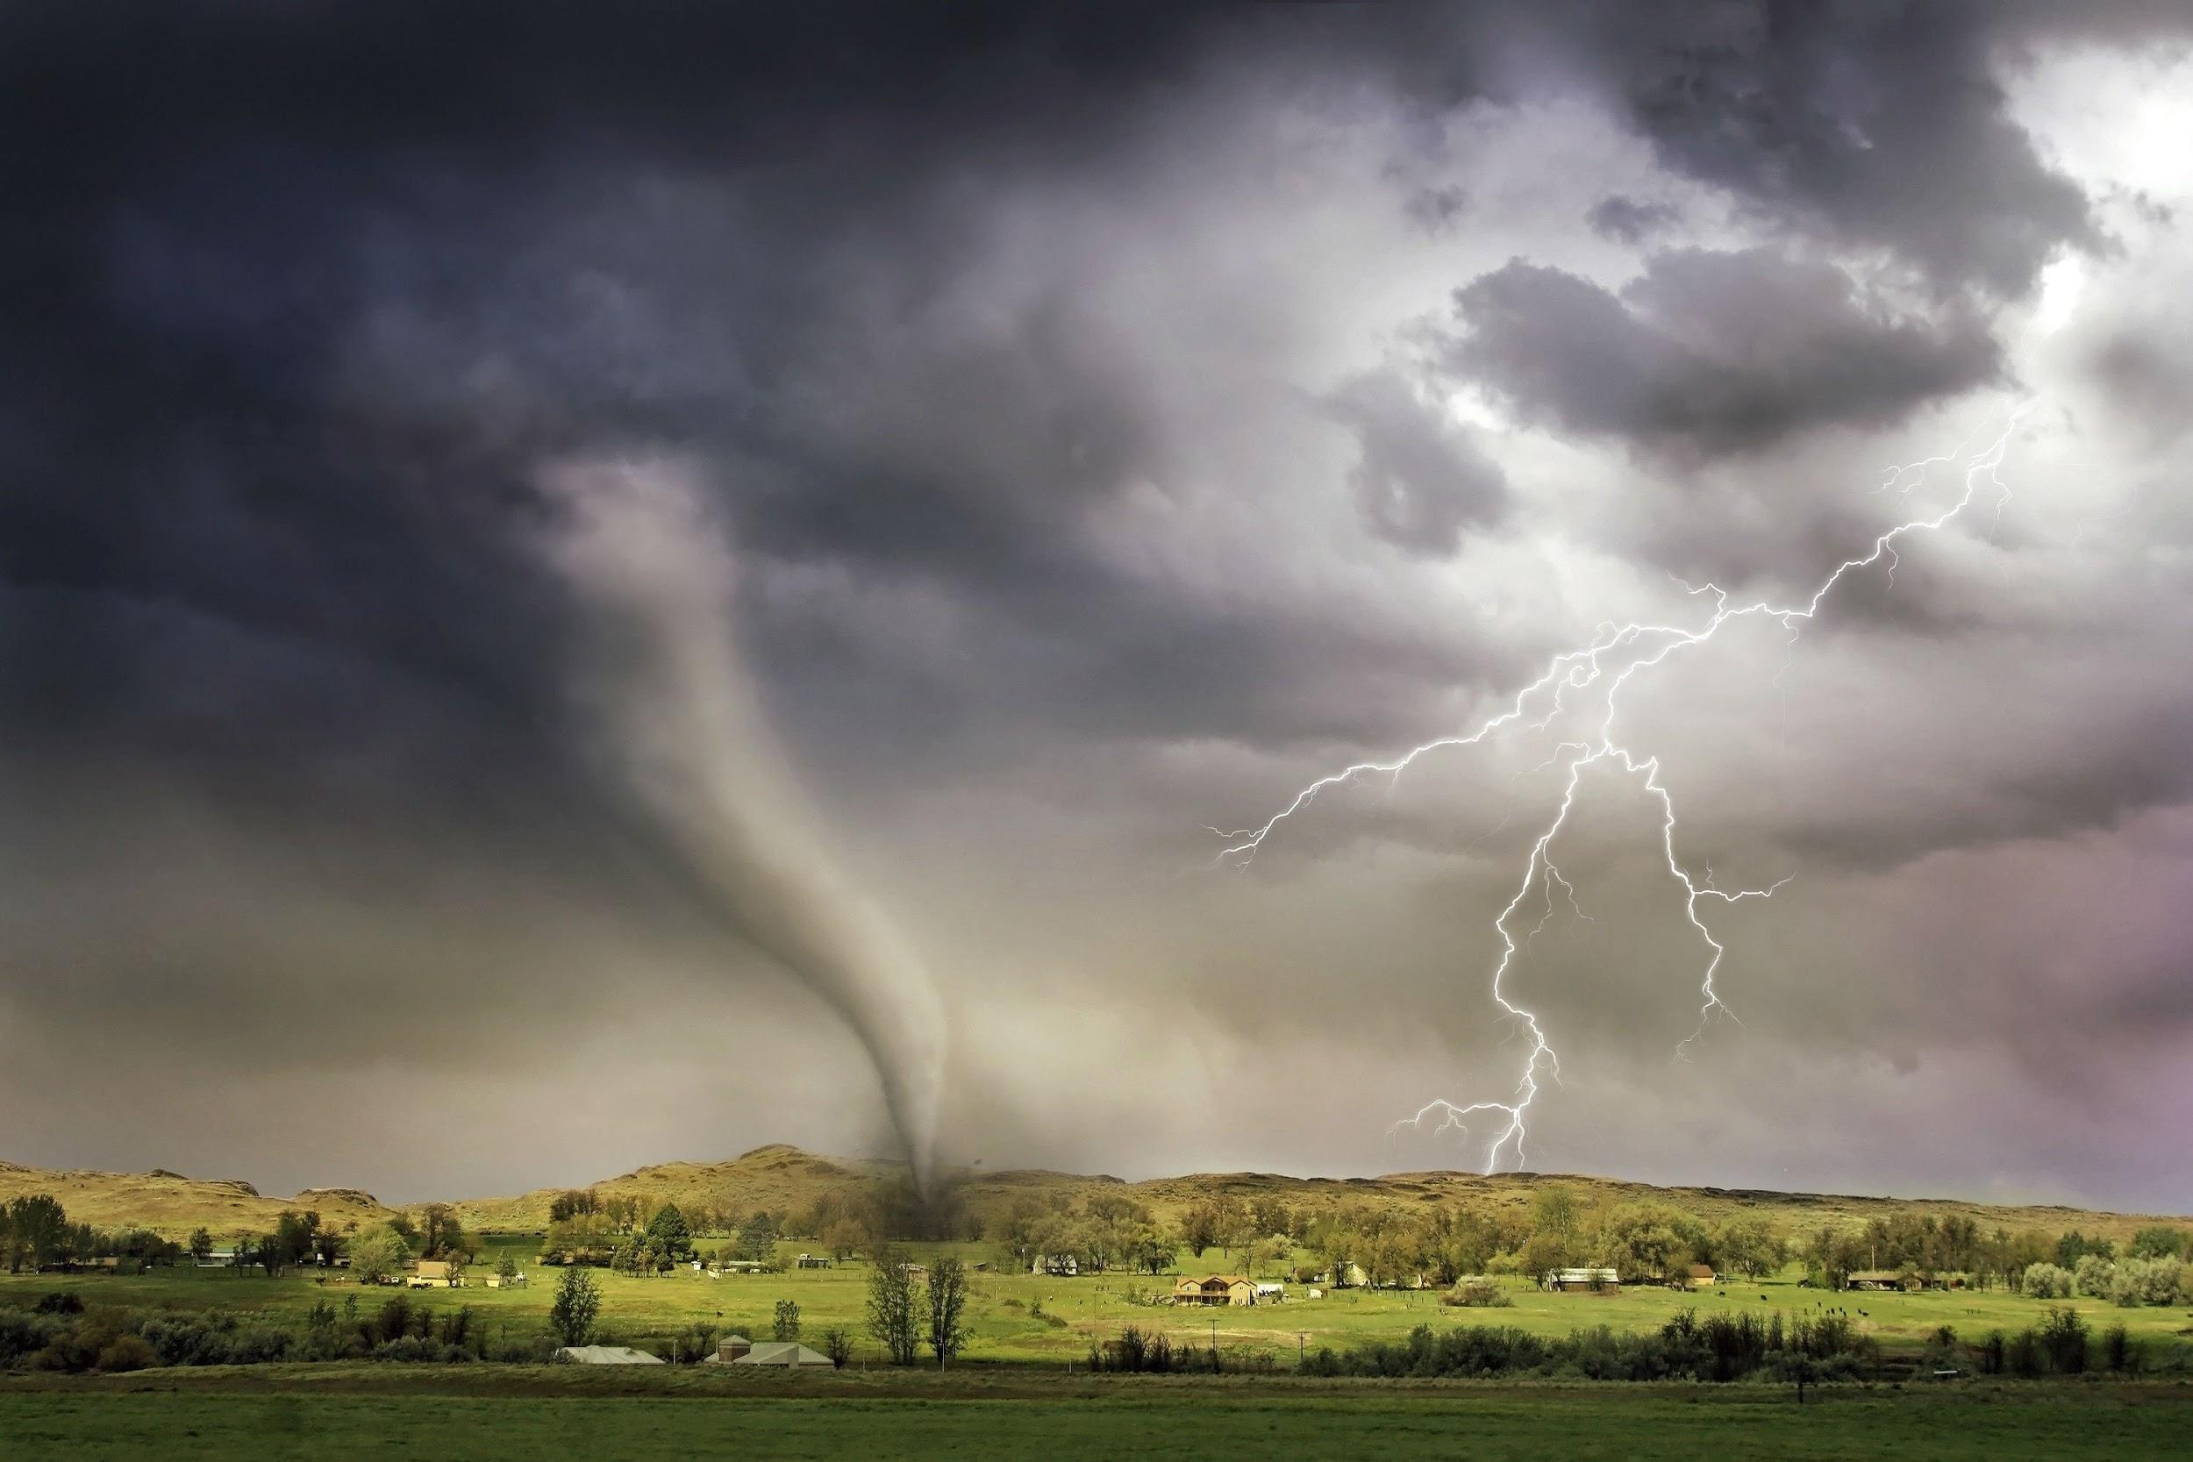
ᏐᏁᎳᏚᏏᏁ ᏣᎳᎩ ᎠᏕᎶᏆᏍᏗ
Gado yusdi?
Hiina? Hatlvi heli? Digaduhvs?
Tla digaduhv yigi. Gado usdi higoti? Degalogesv. Gayotli dadanelv. Digaljode, soquil juniyvsdi.
Gado nigalsdi?
Anagaliha. Unole. Ulogila.
Ganolvsg.

Slide 12
ᏐᏁᎳᏚᏏᏁ ᏣᎳᎩ ᎠᏕᎶᏆᏍᏗ
Gado yusdi?
ᎯᎢᎾ? ᎭᏢ ᎮᎵ? ᏗᎦᏚᎲᏍ?
Ꮭ ᏗᎦᏚᎲ ᏱᎩ. ᎦᏙ ᎤᏍᏗ ᎯᎪᏘ?
ᏕᎦᎶᎨᏒ. ᎦᏲᏟ ᏓᏓᏁᎸ.
ᏗᎦᎵᏦᏕ, ᏐᏈᎵ ᏧᏂᏴᏍᏗ.
ᎦᏙ ᏂᎦᎵᏍᏗ?
ᎠᎾᎦᎵᎭ. ᎤᏃᎴ. ᎤᎶᎩᎳ.
ᎦᏃᎸᏍᎦ.

Slide 13
ᏐᏁᎳᏚᏏᏁ ᏣᎳᎩ ᎠᏕᎶᏆᏍᏗ
1
2
3
Uhyvdla.
Uditlega.
Gadaqual digotlvtanv dadanelv.
Ganolvsg.
Unole.
Unesdal digotlvtanv dadanelv.
Anagaliha.
Agali.

Slide 14
ᏐᏁᎳᏚᏏᏁ ᏣᎳᎩ ᎠᏕᎶᏆᏍᏗ
What words here describe the setting?
Jegskin, Meli ale unej achuja Jani agvyi yuwakt utan digaduhv unenvse. Nvnohuldi wanaise jolani digaduhv widunkanane. Gohusdi usquanikd wunigohe! talugisgi galohisdi agvyadidl wigadoge galjohid agayvlige. Unisduise galohisd, wutsane agayvlige. Unisdune galohisdi. Kohiyv, unisduise galohisdi, uwodu agehya unvgojv.
“Edoda, gado usdi? Utvdvne Jani.
“Hadiyawant,” udvne Jegskin,, “Nula, jajidv wiyasadohya!”

Slide 15
ᏐᏁᎳᏚᏏᏁ ᏣᎳᎩ ᎠᏕᎶᏆᏍᏗ
What words here describe the setting?
Jegskin, Meli ale unej achuja Jani agvyi yuwakt utan digaduhv unenvse. Nvnohuldi wanaise jolani digaduhv widunkanane. Gohusdi usquanikd wunigohe! talugisgi galohisdi agvyadidl wigadoge galjohid agayvlige. Unisduise galohisd, wutsane agayvlige. Unisdune galohisdi. Kohiyv, unisduise galohisdi, uwodu agehya unvgojv.
“Edoda, gado usdi? Utvdvne Jani.
“Hadiyawant,” udvne Jegskin,, “Nula, jajidv wiyasadohya!”

Slide 16
ᏁᎳᏚᏏᏁ ᏣᎳᎩ ᎠᏕᎶᏆᏍᏗ
ᏅᏓ ᎢᎦ ᎡᎯ- sun
ᏅᏓ ᏒᏃᏱ ᎡᎯ- moon
ᎠᎦᎵ- It is shining
ᎯᎪᏘ- You see it
ᎩᎶ- Someone
ᎡᏙ- he/she is located/ present
ᏃᏱ ᎢᎾᎨ- desert. (sand wilds)
ᎠᏛᏁ- he/she is doing it
ᎤᏩᏒ- by himself/herself
ᎦᏚᏏ- hill
ᎦᏙ ᏂᎦᎵᏍᏗ- What’s happening
ᎮᎵᎠ- You think
ᎤᏗᏞᎦ- It’s hot
ᎤᏴᏟ- It’s cold
ᎠᏙᎯ ᎢᎾᎨ- Forest (wood wilds)
ᎤᎬᎭᏛ- it’s foggy
ᎦᏂᏰᎩ- It’s scary
ᏍᏗᎩᏛ- little bit
ᎠᏁᎵᏍᎬ- It seems
ᏒᎯᏰᎯ- evening

Slide 17
ᏁᎳᏚᏏᏁ ᏣᎳᎩ ᎠᏕᎶᏆᏍᏗ
ᎤᎶᎩᎸ- It’s cloudy
ᏫᏚᏃᏝ- They are sitting (away)
ᎠᎦᏍᎦ- It’s raining
ᎤᏚᎵᏓ- He’s wet
ᏔᎵ ᏗᎦᏆᏘ- Bicycle
ᎤᎩᎸᏓ- He’s riding (straddling)

Slide 18
ᏐᏁᎳᏚᏏᏁ ᏣᎳᎩ ᎠᏕᎶᏆᏍᏗ
ᎠᎹᏰᏟ- United States
ᎠᏂᏎᎩ- they are unusual
ᏓᏓᏁᎸ- buildings
ᏗᎪᏢᏔᏅ- they are made
ᎤᏁᏍᏓᎳ- Ice
ᏧᏠᏱ- they are the same
ᎤᎾ ᎢᎬᎾᏕᎾ- location
ᏕᎦᎶᎨᏒ- farms
ᎦᏲᏟ- a few
ᏗᎦᎵᏦᏕ- houses
ᏐᏈᎵ ᏧᏂᏴᏍᏗ- barns
ᎠᎾᎦᎵᎭ- it’s lightning
ᎤᏃᎴ- It’s windy/ tornado
ᎤᎶᎩᎳ- It’s cloudy
ᎦᏃᎸᏍᎦ- Storm

