Slide 1
ᎣᏏᏲ
ᏔᎵᏁ ᏣᎳᎩ ᎠᏕᎶᏆᏍᏗ

Slide 2
ᏔᎵᏁ ᏣᎳᎩ ᎠᏕᎶᏆᏍᏗ
ᏏᏊ ᏥᏂᎪᎵᏯ
ᎦᏙ ᎤᏍᏗ ᏓᏩᏙ ᏲᏁᎩ ᎬᏗ?
Wade ᏓᏩᏙ ᏲᏁᎩ ᎬᏗ
ᎦᏙ ᎤᏍᏗ ᏓᏩᏙ ᏣᎳᎩ ᎬᏗ?
ᎤᏃᎴ ᏓᏩᏙ ᏣᎳᎩ ᎬᏗ
ᎦᏙ ᎤᏍᏗ ᏚᏙᎠ Ꮎ ᎠᎬᏱ ᎠᏍᎦᏯ ᏅᏙ ᏥᏭᏪᏙᎴᎢ?
Neil Armstrong ᏚᏙᎠ Ꮎ ᎠᎬᏱ ᎠᏍᎦᏯ ᏅᏙ ᏥᏭᏪᏙᎴᎢ.

Slide 3
ᏔᎵᏁ ᏣᎳᎩ ᎠᏕᎶᏆᏍᏗ
ᎢᏓᎴᎾ!
ᏣᎳᎩ ᎢᏗᏬᏂ!

Slide 4
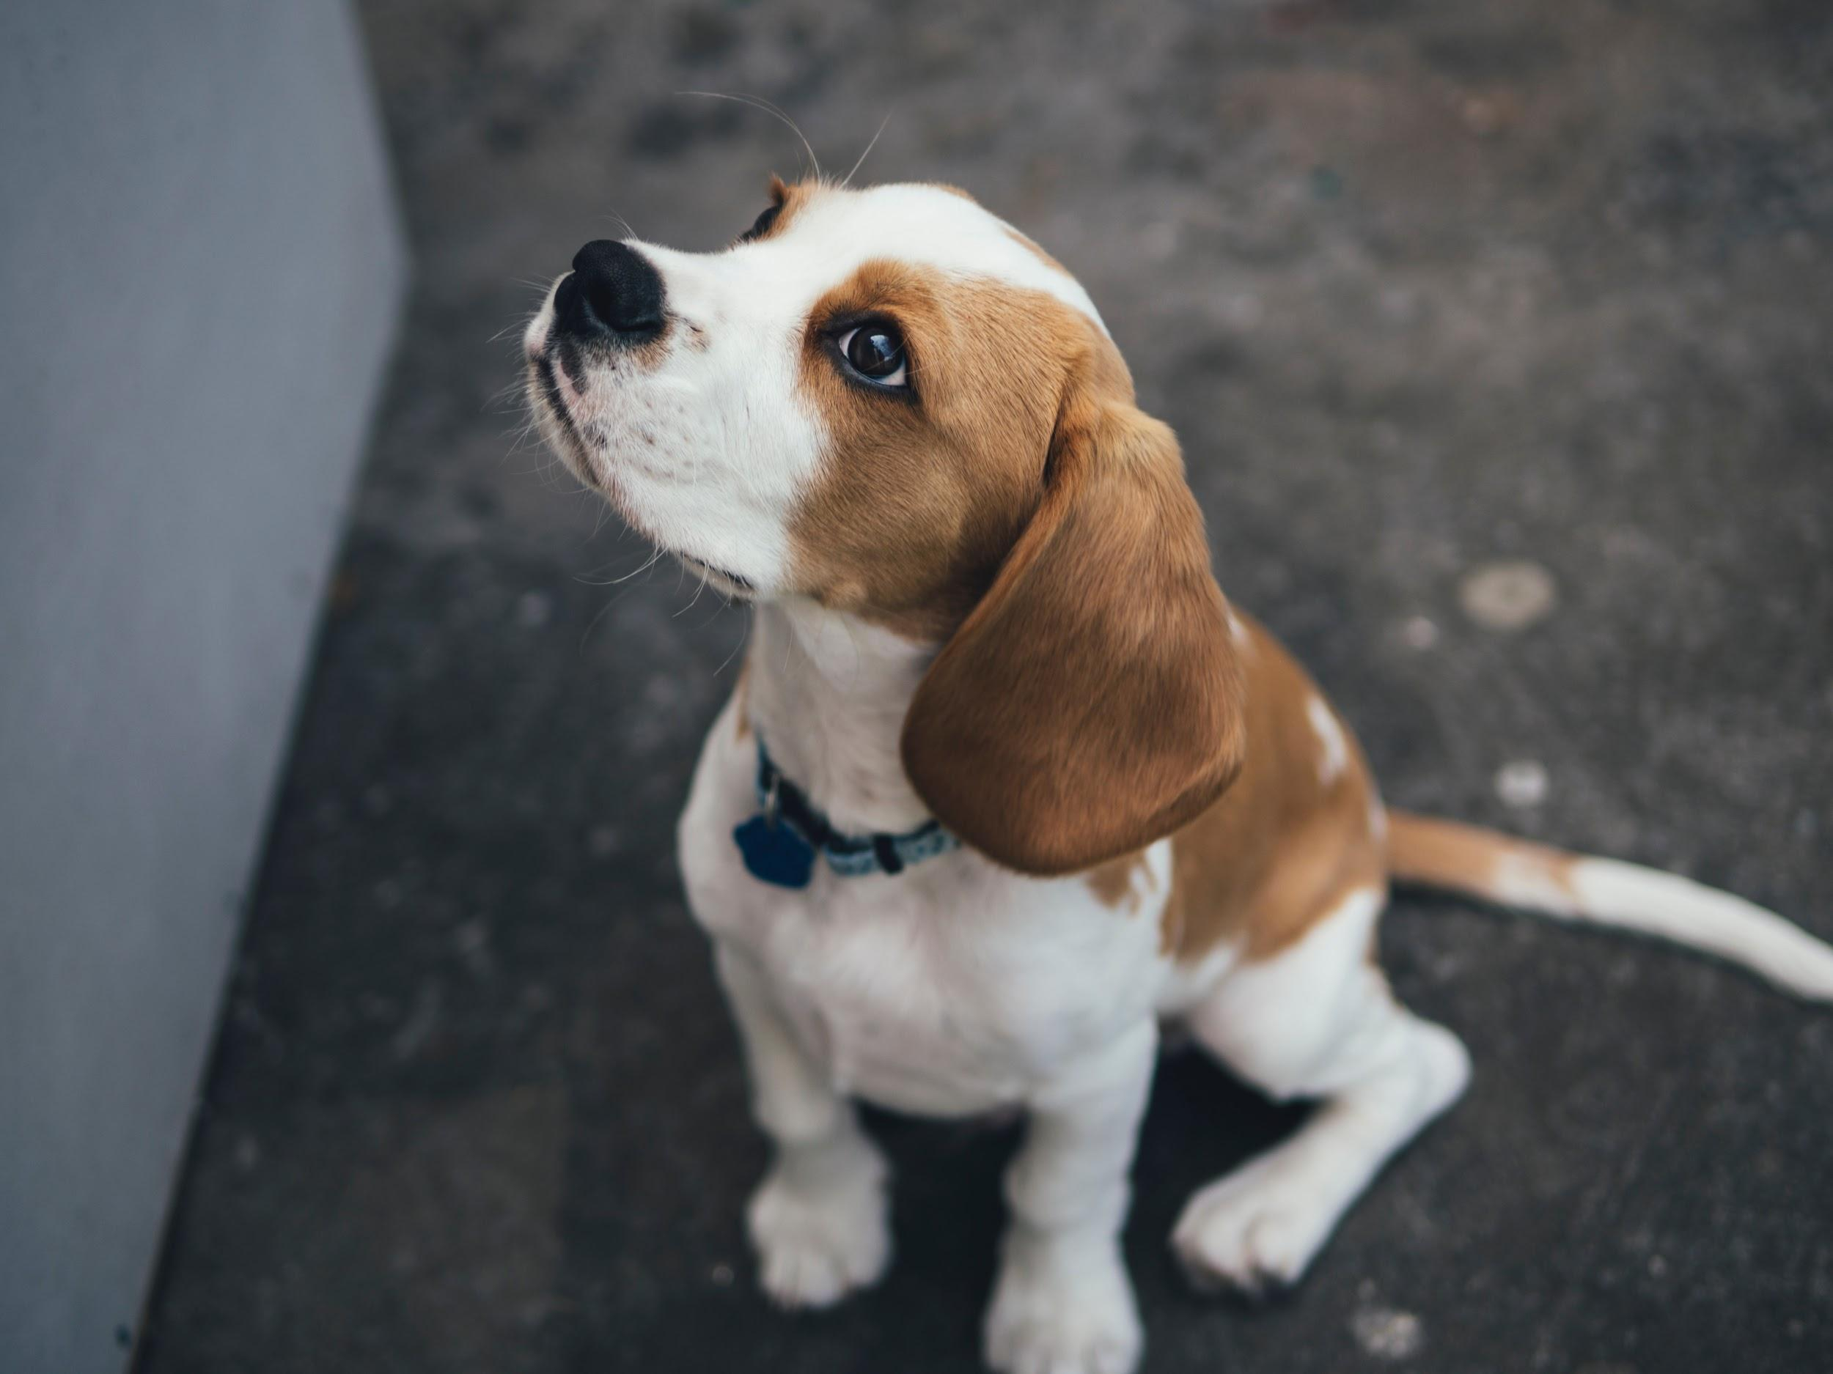
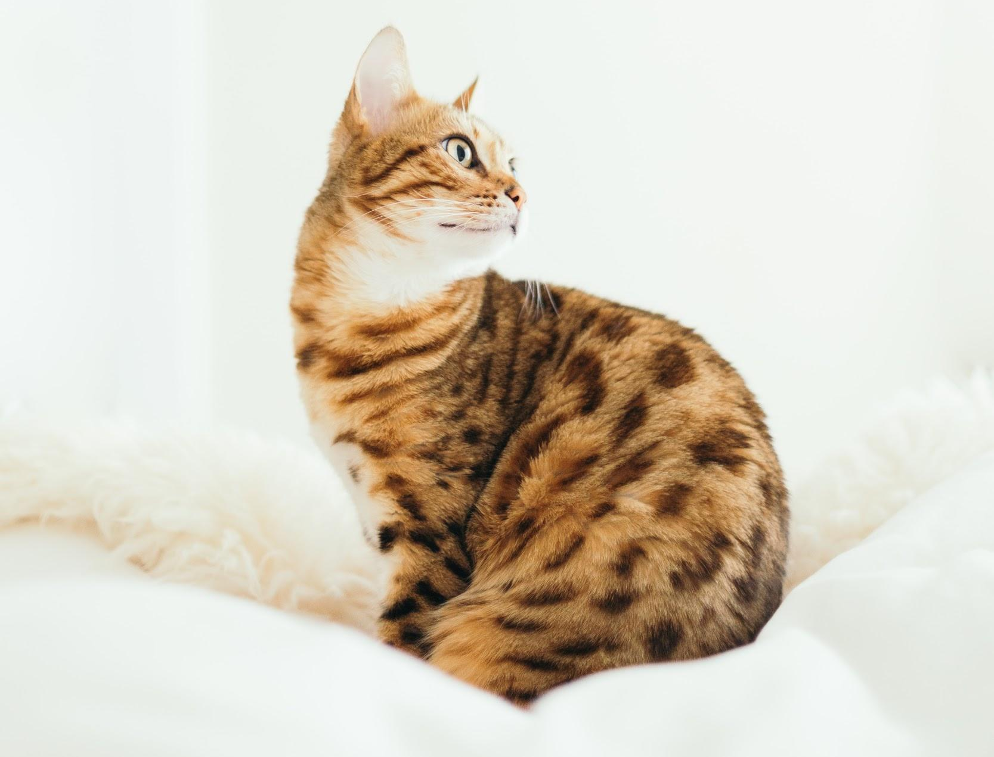
ᏔᎵᏁ ᏣᎳᎩ ᎠᏕᎶᏆᏍᏗ
gitli
wesa

Slide 5
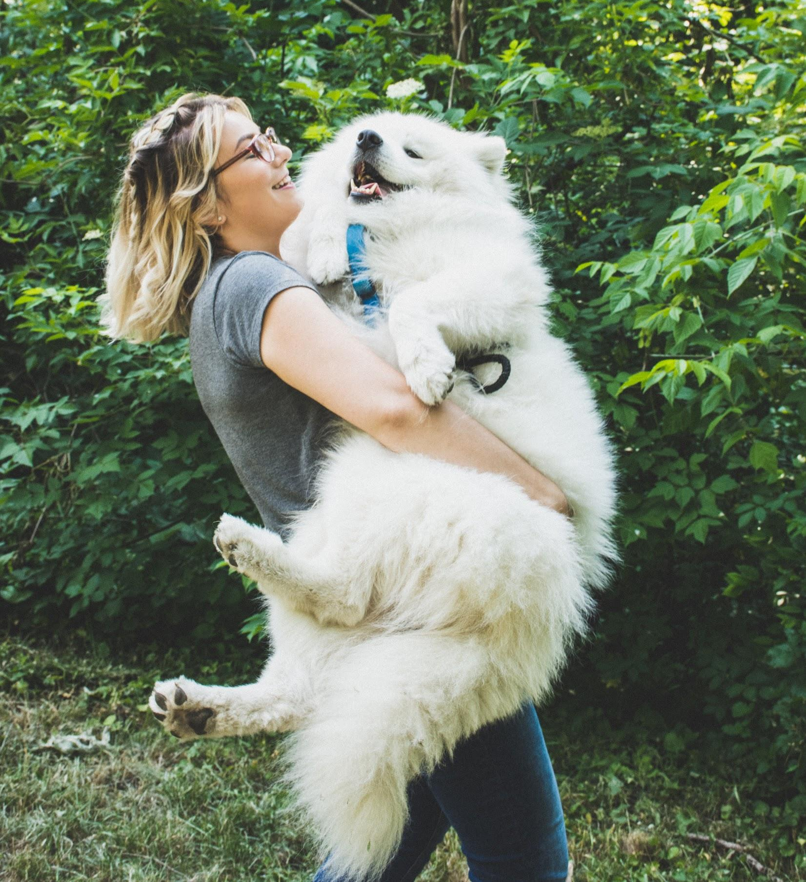
ᏔᎵᏁ ᏣᎳᎩ ᎠᏕᎶᏆᏍᏗ
ᎦᏙ ᎤᏍᏗ ᎤᏪᎧ Ꮎ ᎠᎨᏯ?
ᎩᏟ ᎤᏪᎧ Ꮎ ᎠᎨᏯ
ᏌᏊᏍ ᏯᏂ ᎩᏟ ᎤᏪᎧ Ꮎ ᎠᎨᏯ?
ᎥᎥ, ᏌᏊᏛ ᏯᏂ ᎩᏟ ᎤᏪᎧ Ꮎ ᎠᎨᏯ.
ᏪᏌᏍ ᎤᏪᎧ ᎠᎨᏯ?
Ꮭ. Ꮭ ᏪᏌ ᏳᏪᎧ Ꮎ ᎠᎨᏯ. ᎩᏟ ᎤᏪᎧ Ꮎ ᎠᎨᏯ.
ᎯᎳ ᏯᏂ ᎩᏟ ᎤᏪᎧ Ꮎ ᎠᎨᏯ?
ᏌᏊ ᏯᏂ ᎩᏟ ᎤᏪᎧ Ꮎ ᎠᎨᏯ.
ᎠᏍᎦᏯᏍ ᎠᎨᏯᎨ ᎩᏟ ᎤᏪᎧ?
ᎠᎨᏯ ᎩᏟ ᎤᏪᎧ.
ᎤᏔᎾᏍ ᎤᏍᏗᎨ ᎩᏟ ᎤᏪᎧ Ꮎ ᎠᎨᏯ?
ᎤᏔᎾ ᎩᏟ ᎤᏪᎧ Ꮎ ᎠᎨᏯ.
ᎦᎪ ᎩᏟ ᎤᏪᎧ?
ᎠᎨᏯ ᎩᏟ ᎤᏪᎧ.
Gitli uweka agehya

Slide 6
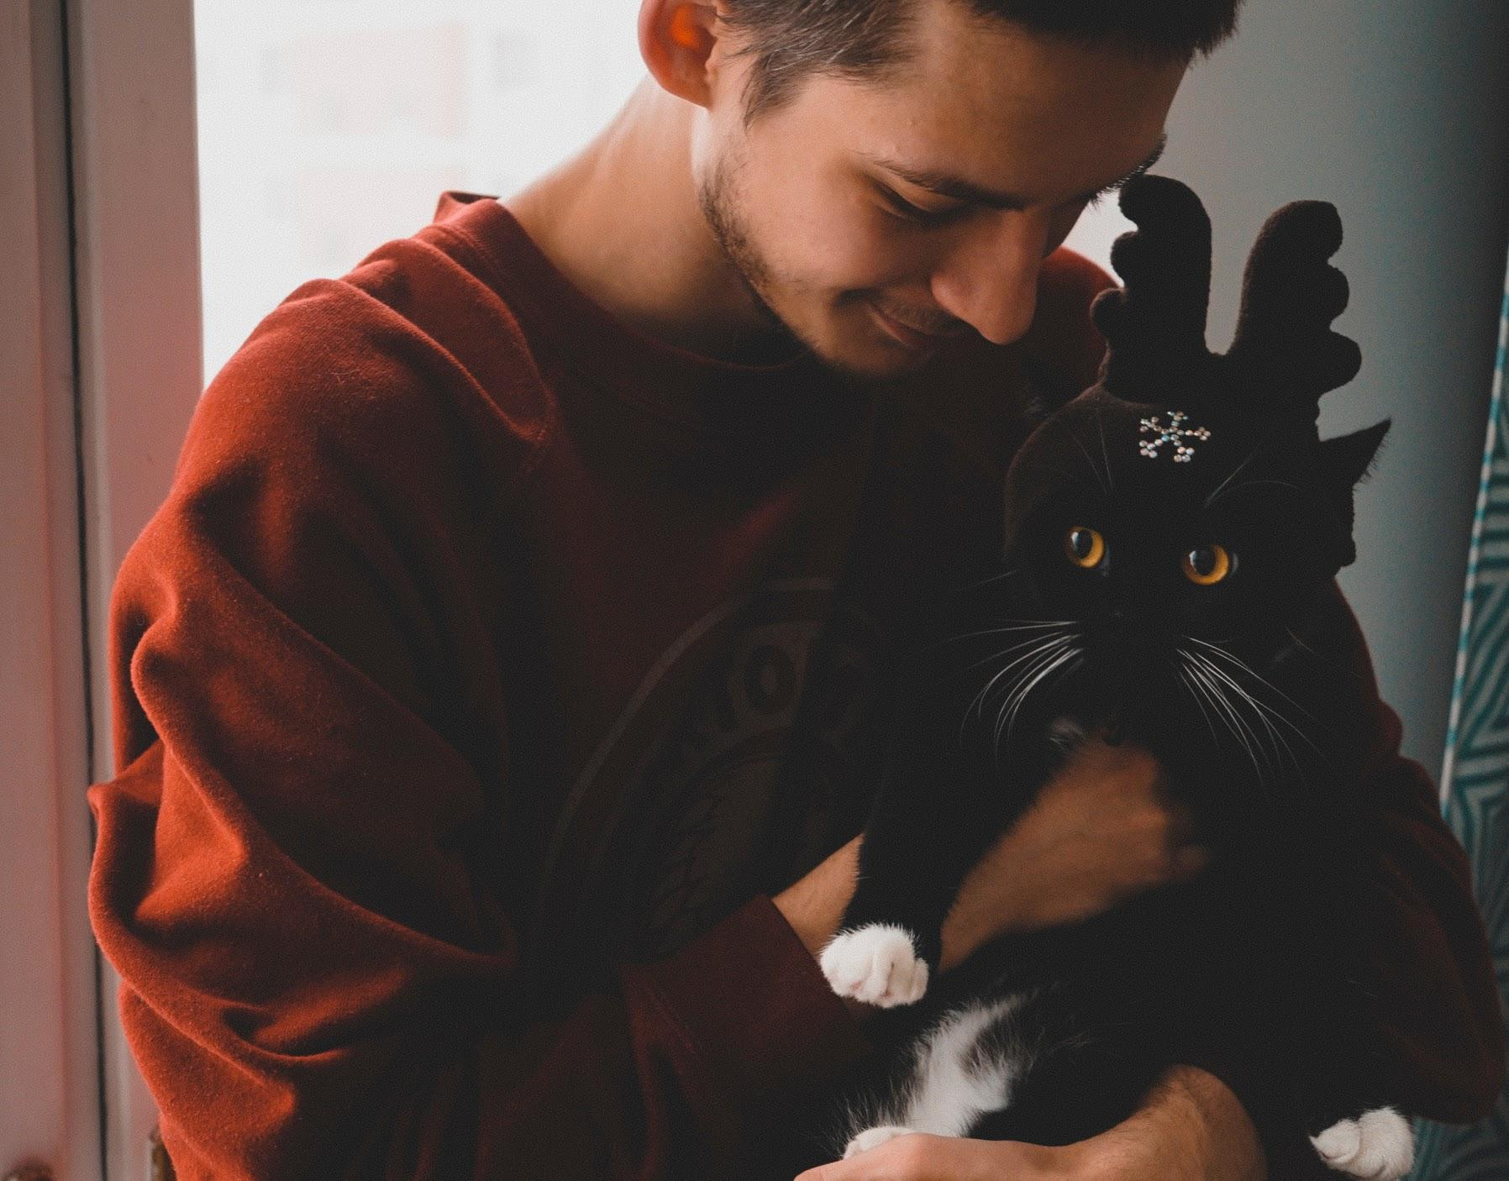
ᏔᎵᏁ ᏣᎳᎩ ᎠᏕᎶᏆᏍᏗ
ᎩᏟ ᎤᏪᎧ ᎠᎨᏯ
ᏪᏌ ᎤᏪᎧ ᎠᏍᎦᏯ

Slide 7
ᏔᎵᏁ ᏣᎳᎩ ᎠᏕᎶᏆᏍᏗ
ᎦᏙ ᎤᏍᏗ ᎤᏪᎧ Ꮎ ᎠᏍᎦᏯ?
ᏪᏌ ᎤᏪᎧ Ꮎ ᎠᏍᎦᏯ.
ᎦᎪ ᎩᏟ ᎤᏪᎧ?
ᎠᎨᏳᏣ ᎩᏟ ᎤᏪᎧ.
ᎤᏔᎾᏍ ᎤᏍᏗᎨ ᎩᏟ ᎤᏪᎧ Ꮎ ᎠᎨᏯ?
ᎤᏔᎾ ᎩᏟ ᎤᏪᎧ Ꮎ ᎠᎨᏯ.
Gado usdi-- What
gago- Who
Hila yani- How Many

Slide 8
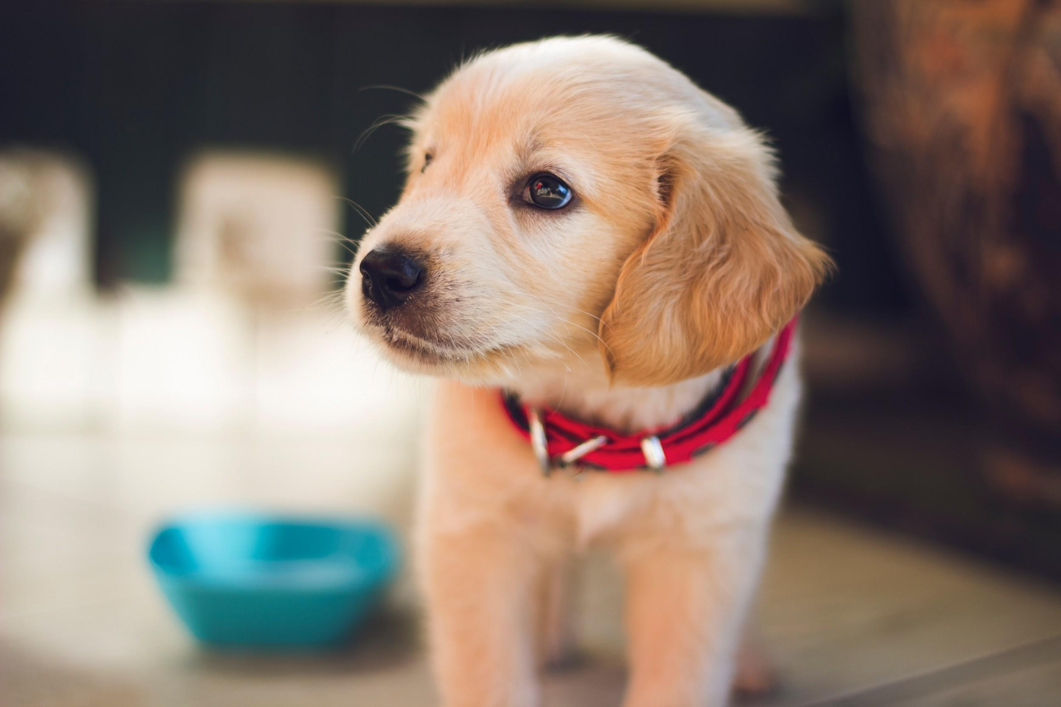
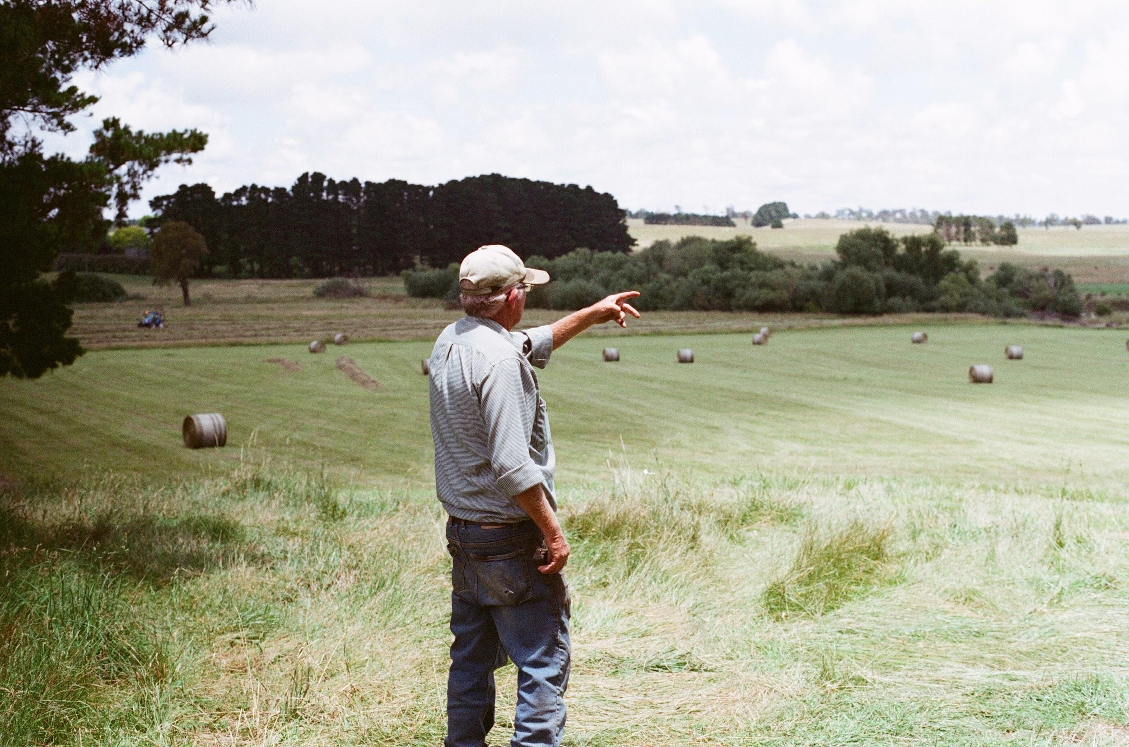
ᏔᎵᏁ ᏣᎳᎩ ᎠᏕᎶᏆᏍᏗ
ᏣᎳᎩ ᎧᏃᎩᏍᎩ
ᎩᏟ ᎤᏪᎧ ᏗᎦᎶᎩᏍᎩ
BINGO ᏚᏙᎠ
B-I-N-G-O ᏚᏙᎠ. (ᏦᎢ ᏳᏩᎧᏘ)
ᎩᏟ
digalogisgi

Slide 9
ᏔᎵᏁ ᏣᎳᎩ ᎠᏕᎶᏆᏍᏗ
ᏣᎳᎩ ᎧᏃᎩᏍᎩ
ᎦᏙ ᎤᏍᏗ ᎤᏪᎧ ᏗᎦᎶᎩᏍᎩ?
ᎩᏟ ᎤᏪᎧ ᏗᎦᎶᎩᏍᎩ.
ᎦᏙ ᎤᏍᏗ ᏚᏙᎠ Ꮎ ᎩᏟ ᏧᏪᎧ ᏗᎦᎶᎩᏍᎩ?
BINGO ᏚᏙᎠ Ꮎ ᎩᏟ ᏧᏪᎧ ᏗᎦᎶᎩᏍᎩ.
ᎦᎪ ᎩᏟ ᎤᏪᎧ?
ᏗᎦᎶᎩᏍᎩ ᎩᏟ ᎤᏪᎧ.

Slide 10
ᏔᎵᏁ ᏣᎳᎩ ᎠᏕᎶᏆᏍᏗ
ᏣᎳᎩ ᎧᏃᎩᏍᎩ ᏗᏗᏃᎩ
ᎩᏟ ᎤᏪᎧ ᏗᎦᎶᎩᏍᎩ
BINGO ᏚᏙᎠ
B-I-N-G-O ᏚᏙᎠ. (ᏦᎢ ᏳᏩᎧᏘ)
nowu- now
tohi- soft/peaceful/calm
yuwakt- times
didasitvniga- let’s clap
sdayi- loud/hard
gajanul- fast
usganoli- slow

Slide 11
ᏔᎵᏁ ᏣᎳᎩ ᎠᏕᎶᏆᏍᏗ
ᎣᏏᏲ. Wade ᏓᏩᏙ. ᏣᎳᎩ ᎬᏗᏃ, ᎤᏃᎴ ᏓᏩᏙ. ᏥᏍᎦᏯ. ᏌᏊ ᏪᏌ, ᏌᏊ ᎩᏟ ᎠᏗ ᏓᎩᎧ. Miss Cleo ᏚᏙᎠ Ꮎ ᏪᏌ ᏣᎩᎧ. Ꮎ ᏪᏌ ᎤᏬᏗᎨ ᏧᎶᎵᏗ ᎤᎵᏑᏫᏗ. Pretty Buddy Puddles ᏚᏙᎠ Ꮎ ᎩᏟ ᎠᏗ ᏣᎩᎧ. ᏓᎶᏂᎨ ᎤᎵᏑᏫᏗ “Buddy”. ᎢᏧᎳ ᏙᏳ ᎤᏂᎬᎯᏍᏗ.

Slide 12
ᏔᎵᏁ ᏣᎳᎩ ᎠᏕᎶᏆᏍᏗ
ᎣᏏᏲ. Hello
Wade ᏓᏩᏙ. Wade is my name.
ᏣᎳᎩ ᎬᏗᏃ, ᎤᏃᎴ ᏓᏩᏙ. In Cherokee, Unole is my name.
ᏥᏍᎦᏯ. I am a man.
ᏌᏊ ᏪᏌ, ᏌᏊ ᎩᏟ ᎠᏗ ᏓᎩᎧ. I have one puppy and one cat.
Miss Cleo ᏚᏙᎠ Ꮎ ᏪᏌ ᏣᎩᎧ. Miss Cleo is the name of the cat that I have.
Ꮎ ᏪᏌ ᎤᏬᏗᎨ ᏧᎶᎵᏗ ᎤᎵᏑᏫᏗ. The Cat has brown stripes.
Pretty Buddy Puddles ᏚᏙᎠ Ꮎ ᎩᏟ ᎠᏗ ᏣᎩᎧ. Pretty Buddy Puddles is the name of the puppy that I have.
ᏓᎶᏂᎨ ᎤᎵᏑᏫᏗ “Buddy”. Buddy is Yellow colored.
ᎢᏧᎳ ᏙᏳ ᎤᏂᎬᎯᏍᏗ. They are both really cute.

Slide 13
ᏔᎵᏁ ᏣᎳᎩ ᎠᏕᎶᏆᏍᏗ
ᎦᏙ ᎤᏍᏗ ᏚᏙ Ꮎ ᎩᏟ ᎠᏗ ᏣᎩᎧ?
Pretty Buddy Puddles ᏚᏙ Ꮎ ᎩᏟ ᏣᎩᎧ.
ᎯᎳ ᏯᏂ ᏪᏌ ᎠᎩᎧ?
ᏌᏊ ᏪᏌ ᎠᎩᎧ.
ᏥᏍᎦᏯᏍ ᏥᎨᏯᎨ?
ᏥᏍᎦᏯ.
ᎦᏙ ᎤᏍᏗ ᏓᏩᏙᎠ?
Wade ᏓᏩᏙᎠ.
ᎦᏙ ᎤᏍᏗ ᎤᎵᏑᏫᏗ Ꮎ ᎩᏟ ᎠᏗ?
ᎩᏟ ᎠᏗ ᏓᎶᏂᎨ ᎤᎵᏑᏫᏗ.

Slide 14
ᏔᎵᏁ ᏣᎳᎩ ᎠᏕᎶᏆᏍᏗ
Notes on “uweka”
In some communities, uweka is only used when it’s physically in your possession.
Instead of “uweka”, many communities prefer to use “unatla”.
However, in other communities, “unatla” is reserved for animals that do work, and “uweka” is used for pets.
“Uweka” can also be used for children
“Unatla” cannot be used in that sense, because it indicates ownership.

Slide 15
ᏔᎵᏁ ᏣᎳᎩ ᎠᏕᎶᏆᏍᏗ
ᏪᏌ- Cat
ᎩᏟ- Dog
ᎠᏗ- Young animal (not hoofed)
ᎠᎩᎧ- I have something alive
ᏣᎧ- You have something alive
ᎤᏪᎧ- He/she has something alive
ᏗᎦᎶᎩᏍᎩ- Farmer
ᎠᎨᏯ- Woman
ᎠᏍᎦᏯ- Man
ᎤᏔᎾ- Big
ᎤᏍᏗ- Little
ᏃᏭ- Now
ᏙᎯ- Soft/peaceful/calm
ᏳᏩᎧᏘ- Times
ᏗᏓᏏᏛᏂᎦ- Let’s clap
ᏍᏓᏱ- Loud/hard
ᎦᏣᏄᎳ- Fast
ᎤᏍᎦᏃᎵ- Slow
ᏥᏍᎦᏯ- I am a man
ᏥᎨᏯ- I am a woman
ᎤᏬᏗᎨ- Brown
ᏓᎶᏂᎨ- Yellow
ᏧᎶᎵᏗ- Striped
ᎢᏧᎳ- Both
ᏙᏳ- Really
ᎤᎬᎯᏍᏗ- It’s cute

