Slide 1
ᎣᏏᏲ
ᏔᎵᏍᎪᎯᏁ ᏣᎳᎩ ᎠᏕᎶᏆᏍᏗ

Slide 2
ᏔᎵᏍᎪᎯᏁ ᏣᎳᎩ ᎠᏕᎶᏆᏍᏗ
ᎢᏓᎴᎾ
ᏣᎳᎩ ᎢᏗᏬᏂ!

Slide 3
ᏔᎵᏍᎪᎯᏁ ᏣᎳᎩ ᎠᏕᎶᏆᏍᏗ
Description: Describing our preferences

Slide 4
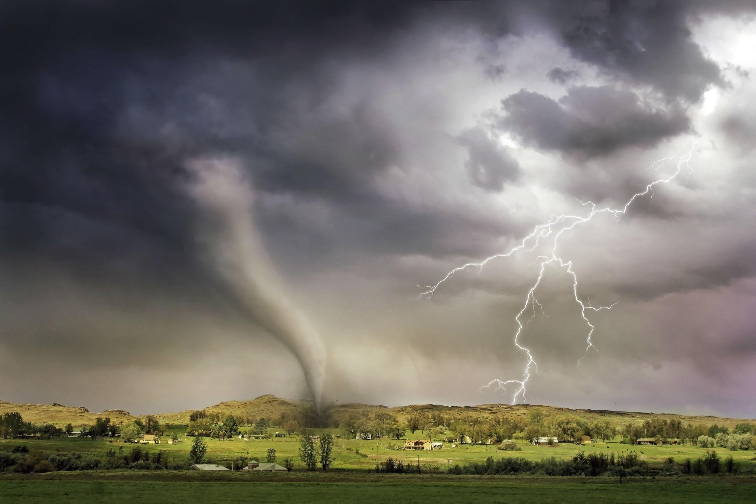
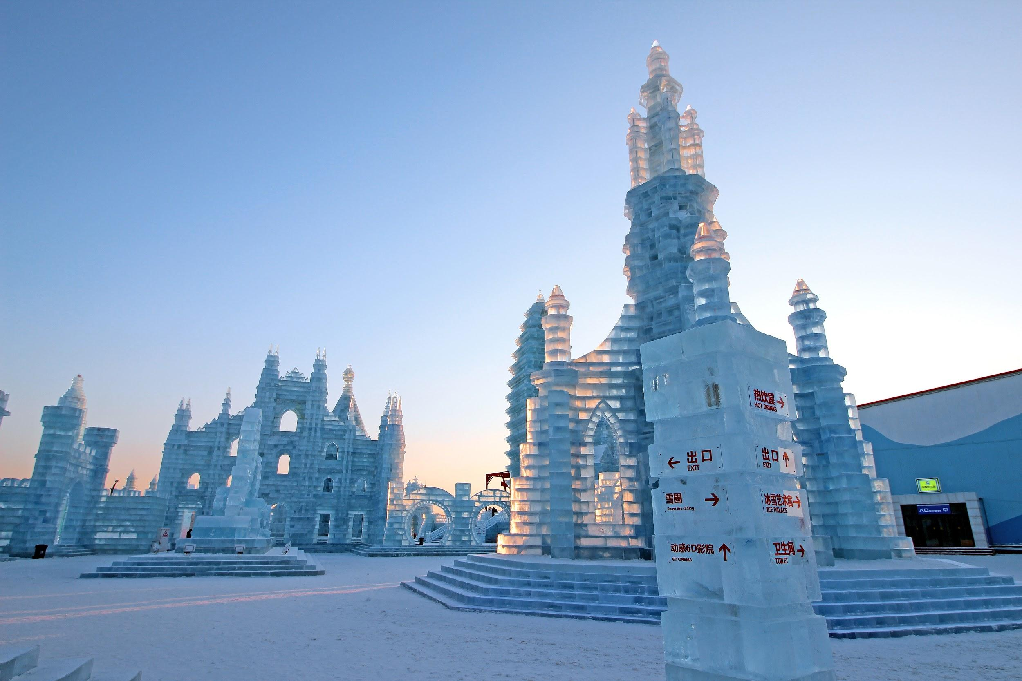
ᏔᎵᏍᎪᎯᏁ ᏣᎳᎩ ᎠᏕᎶᏆᏍᏗ
1
2
3
Uhyvdla.
Uditlega.
Gadaqual digotlvtanv dadanelv.
Ganolvsg.
Unole.
Unesdal digotlvtanv dadanelv.
Anagaliha.
Agali.

Slide 5
ᏔᎵᏍᎪᎯᏁ ᏣᎳᎩ ᎠᏕᎶᏆᏍᏗ
What words here describe the setting?
Jegskin, Meli ale unej achuja Jani agvyi yuwakt utan digaduhv unenvse. Nvnohuldi wanaise jolani digaduhv widunkanane. Gohusdi usquanikd wunigohe! talugisgi galohisdi agvyadidl wigadoge galjohid agayvlige. Unisduise galohisd, wutsane agayvlige. Unisdune galohisdi. Kohiyv, unisduise galohisdi, uwodu agehya unvgojv.
“Edoda, gado usdi? Utvdvne Jani.
“Hadiyawant,” udvne Jegskin,, “Nula, jajidv wiyasadohya!”

Slide 6
ᏔᎵᏍᎪᎯᏁ ᏣᎳᎩ ᎠᏕᎶᏆᏍᏗ
What words here describe the setting?
Jegskin, Meli ale unej achuja Jani agvyi yuwakt utan digaduhv unenvse. Nvnohuldi wanaise jolani digaduhv widunkanane. Gohusdi usquanikd wunigohe! talugisgi galohisdi agvyadidl wigadoge galjohid agayvlige. Unisduise galohisd, wutsane agayvlige. Unisdune galohisdi. Kohiyv, unisduise galohisdi, uwodu agehya unvgojv.
“Edoda, gado usdi? Utvdvne Jani.
“Hadiyawant,” udvne Jegskin,, “Nula, jajidv wiyasadohya!”

Slide 7
ᏔᎵᏍᎪᎯᏁ ᏣᎳᎩ ᎠᏕᎶᏆᏍᏗ
yuditlegas, yuhyvdlike jalvqd?
Aya, uditlega agilvqd.
Gado usdi heli ulvqd kemili? yuditlegas yuhyvdlike?
Kemili yuditlega ulvqd, geli. Tla yulvqd yuhyvdli.
Yon unegina? Yuditlegas yuhyvdlike ulvqd?
Uhyvdlidv ulvqd yon uneg. Tla yulvqd yuditlega.
Ganolvsgas jalvqd? Yiganolvsga agilvqd yagwotla digwenvsa.

Slide 8
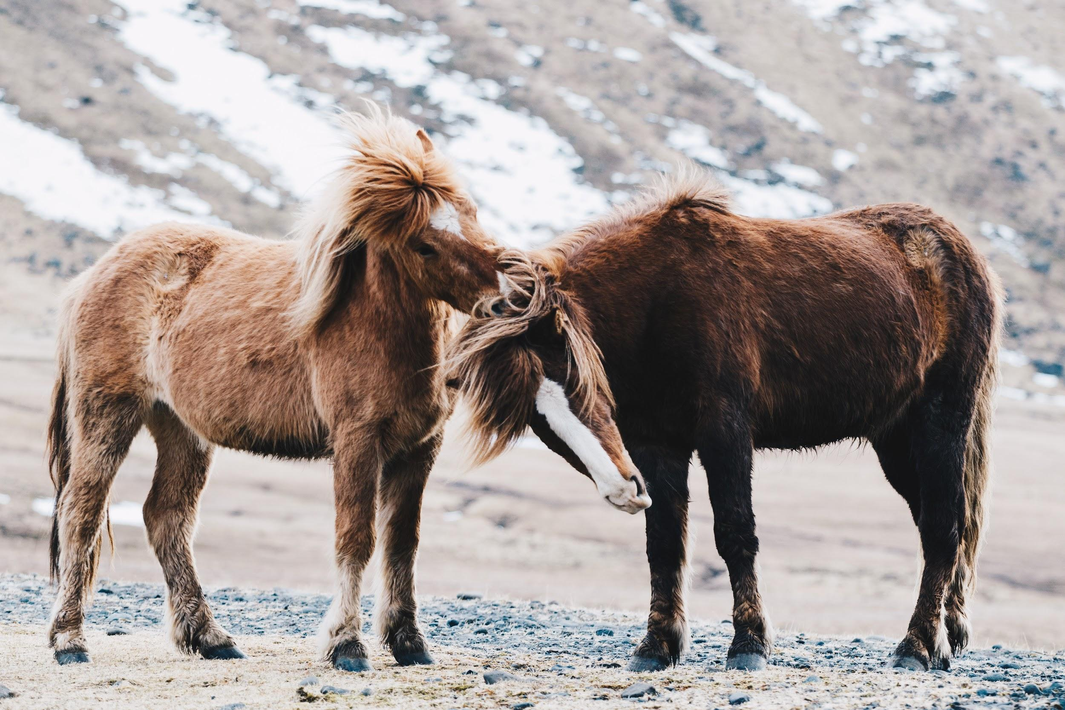
ᏔᎵᏍᎪᎯᏁ ᏣᎳᎩ ᎠᏕᎶᏆᏍᏗ
Gado yusdi?
Gado yusdi? Igas, svnoyike?
Iga. hatlv anedo? Amayuldis?
Tla amayuldi yanedo. Digaduhvs, odalvke?
Odalv anedo.
Gado usdi?
Soquil odalv anedo.
Na soquil gohusdi ulvqd.
Gado usdi ulvqdi na soquil?
Na soquil nudale soquil ulvqd!
Soquil dunilvqd igvsa!
Unikvhisd!

Slide 9
ᏔᎵᏍᎪᎯᏁ ᏣᎳᎩ ᎠᏕᎶᏆᏍᏗ
Gado yusdi?
ᎦᏙ ᏳᏍᏗ? ᎢᎦᏍ, ᏒᏃᏱᎨ?
ᎢᎦ. ᎭᏢ ᎠᏁᏙ? ᎠᎹᏳᎵᏗᏍ?
Ꮭ ᎠᎹᏳᎵᏗ ᏯᏁᏙ. ᏗᎦᏚᎲᏍ, ᎣᏓᎸᎨ?
ᎣᏓᎸᎢ ᎠᏁᏙ.
ᎦᏙ ᎤᏍᏗ?
ᏐᏈᎵ ᎣᏓᎸᎢ ᎠᏁᏙ.
Ꮎ ᏐᏈᎵ ᎪᎱᏍᏗ ᎤᎸᏈᏗ.
ᎦᏙ ᎤᏍᏗ ᎤᎸᏈᏗ Ꮎ ᏐᏈᎵ?
Ꮎ ᏐᏈᎵ ᏄᏓᎴ ᏐᏈᎵ ᎤᎸᏈᏗ!
ᏐᏈᎵ ᏚᏂᎸᏈᏗ ᎢᎬᏌ!
ᎤᏂᎬᎯᏍᏗ!

Slide 10
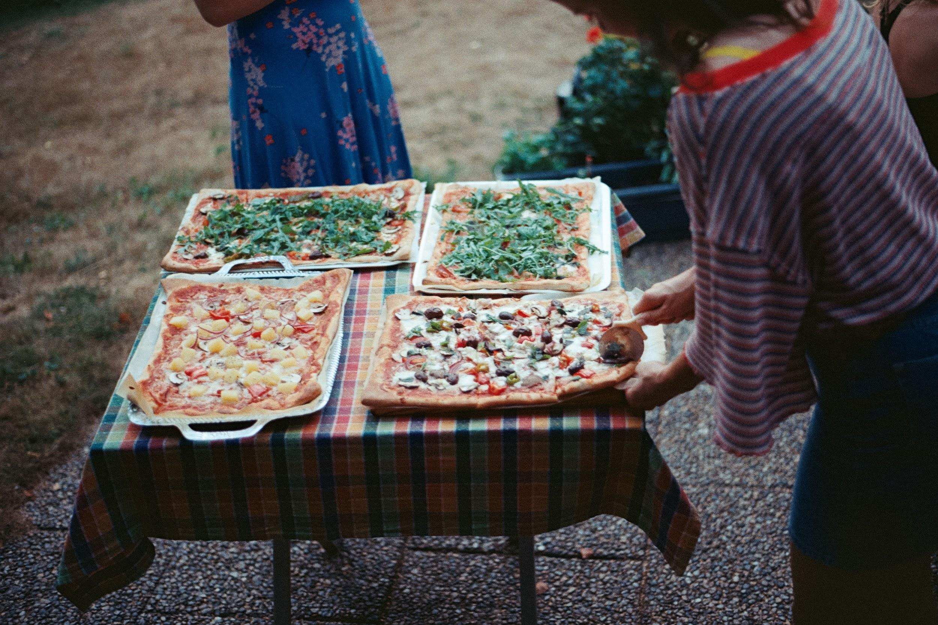
ᏔᎵᏍᎪᎯᏁ ᏣᎳᎩ ᎠᏕᎶᏆᏍᏗ
Gado usdi ulvqd?
Gado usdi?
Pizza!
Jalvqdis pizza?
Pizza agilvqd.
Gado usdi pizza wijalvqd?
Meat Lovers Pizza wagilvqd.

Slide 11
ᏔᎵᏍᎪᎯᏁ ᏣᎳᎩ ᎠᏕᎶᏆᏍᏗ
Gado usdi ulvqd?
ᎦᏙ ᎤᏍᏗ?
Pizza!
ᏣᎸᏈᏗᏍ pizza?
Pizza ᎠᎩᎸᏈᏗ.
ᎦᏙ ᎤᏍᏗ pizza ᏫᏣᎸᏈᏗ?
Meat Lovers Pizza ᏩᎩᎸᏈᏗ.

Slide 12
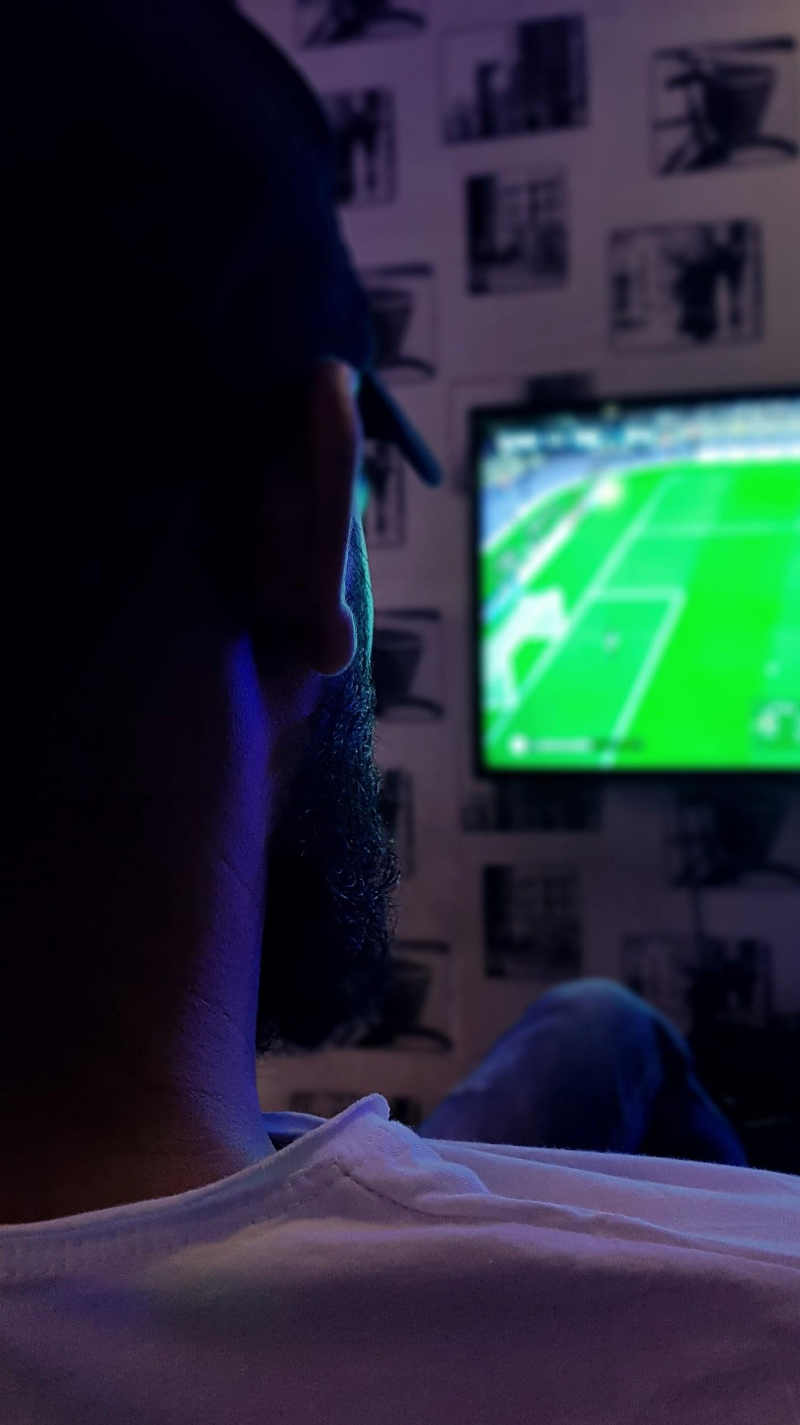
ᏔᎵᏍᎪᎯᏁ ᏣᎳᎩ ᎠᏕᎶᏆᏍᏗ
Gado usdi ulvqd?
Gado usdi?
Udayvlatvsgi.
Kilo udayvlatvsgi aktosd.
Gago udayvlatvsgi aktosd?
Asgaya udayvlatvsgi aktosd.
Ulvqdis udayvlatvsgi aktosdodi na asgaya?
Vv. na asgaya udayvlatvsgi ulvqd aktosdodi.
Gado usdi ulvqd aktosdodi?
Dinehldiyi ulvqd aktosdodi.
Nihina? Gado usdi jalvqd haktosdodi? Dinehldiyis? Gohusdis ganyeg? Gohusdike uwohldi?

Slide 13
ᏔᎵᏍᎪᎯᏁ ᏣᎳᎩ ᎠᏕᎶᏆᏍᏗ
Gado usdi ulvqd?
ᎦᏙ ᎤᏍᏗ?
ᎤᏓᏴᎳttᏍᎩ.
ᎩᎶ ᎤᏓᏴᎳᏛᏍᎩ ᎠᎩᏙᏍᏗ.
ᎦᎪ ᎤᏓᏴᎳᏛᏍᎩ ᎠᎩᏙᏍᏗ?
ᎠᏍᎦᏯ ᎤᏓᏴᎳᏛᏍᎩ ᎠᎩᏙᏍᏗ.
ᎤᎸᏈᏍᏗᏍ ᎤᏓᏴᎳᏛᏍᎩ ᎠᎩᏙᏍᏙᏗ Ꮎ ᎠᏍᎦᏯ?
ᎥᎥ. Ꮎ ᎠᏍᎦᏯ ᎤᏓᏴᎳᏛᏍᎩ ᎤᎸᏈᏗ ᎠᎩᏙᏍᏙᏗ.
ᎦᏙ ᎤᏍᏗ ᎤᎸᏈᏗ ᎠᎩᏙᏍᏙᏗ?
ᏗᏁᎵᏗᏱ ᎤᎸᏈᏗ ᎠᎩᏙᏍᏙᏗ.
ᏂᎯᎾ? ᎦᏙ ᎤᏍᏗ ᏣᎸᏈᏗ ᎭᎧᏙᏍᏙᏗ? ᏗᏁᎵᏗᏱᏍ? ᎪᎱᏍᏗᏍ ᎦᏂᏰᎦ? ᎪᎱᏍᏗᎨ ᎤᏬᎵᏗ?

Slide 14
ᏁᎳᏚᏏᏁ ᏣᎳᎩ ᎠᏕᎶᏆᏍᏗ
ᏅᏓ ᎢᎦ ᎡᎯ- sun
ᏅᏓ ᏒᏃᏱ ᎡᎯ- moon
ᎠᎦᎵ- It is shining
ᎯᎪᏘ- You see it
ᎩᎶ- Someone
ᎡᏙ- he/she is located/ present
ᏃᏱ ᎢᎾᎨ- desert. (sand wilds)
ᎠᏛᏁ- he/she is doing it
ᎤᏩᏒ- by himself/herself
ᎦᏚᏏ- hill
ᎦᏙ ᏂᎦᎵᏍᏗ- What’s happening
ᎮᎵᎠ- You think
ᎤᏗᏞᎦ- It’s hot
ᎤᏴᏟ- It’s cold
ᎠᏙᎯ ᎢᎾᎨ- Forest (wood wilds)
ᎤᎬᎭᏛ- it’s foggy
ᎦᏂᏰᎩ- It’s scary
ᏍᏗᎩᏛ- little bit
ᎠᏁᎵᏍᎬ- It seems
ᏒᎯᏰᎯ- evening

Slide 15
ᏁᎳᏚᏏᏁ ᏣᎳᎩ ᎠᏕᎶᏆᏍᏗ
ᎤᎶᎩᎸ- It’s cloudy
ᏫᏚᏃᏝ- They are sitting (away)
ᎠᎦᏍᎦ- It’s raining
ᎤᏚᎵᏓ- He’s wet
ᏔᎵ ᏗᎦᏆᏘ- Bicycle
ᎤᎩᎸᏓ- He’s riding (straddling)

Slide 16
ᏔᎵᏍᎪᎯᏁ ᏣᎳᎩ ᎠᏕᎶᏆᏍᏗ
ᎠᎹᏰᏟ- United States
ᎠᏂᏎᎩ- they are unusual
ᏓᏓᏁᎸ- buildings
ᏗᎪᏢᏔᏅ- they are made
ᎤᏁᏍᏓᎳ- Ice
ᏧᏠᏱ- they are the same
ᎤᎾ ᎢᎬᎾᏕᎾ- location
ᏕᎦᎶᎨᏒ- farms
ᎦᏲᏟ- a few
ᏗᎦᎵᏦᏕ- houses
ᏐᏈᎵ ᏧᏂᏴᏍᏗ- barns
ᎠᎾᎦᎵᎭ- it’s lightning
ᎤᏃᎴ- It’s windy/ tornado
ᎤᎶᎩᎳ- It’s cloudy
ᎦᏃᎸᏍᎦ- Storm

Slide 17
ᏔᎵᏍᎪᎯᏁ ᏣᎳᎩ ᎠᏕᎶᏆᏍᏗ
ᏣᎸᏈᏗ- you like it
ᎠᎩᎸᏈᏗ- I like it
ᎤᎸᏈᏗ- he/she likes it
ᎨᎻᎵ- Camel
ᏲᎾ ᎤᏁᎦ- Polar bear
ᎠᏉᏝ- I’m sitting, I’m at home
ᏗᏇᏅᏒ- my home
ᏐᏈᎵ- horse
ᏄᏓᎴ- a different/ another one
ᎢᎬᏌ- each other
ᏚᏂᎸᏈᏗ- they like them
ᎤᏂᎬᎯᏍᏗ- they are cute
ᏫᏣᎸᏈᏗ- it’s your favorite
ᏩᎩᎸᏈᏗ- It’s my favorite
ᎤᏓᏴᎳᏛᏍᎩ- TV
ᎠᎩᏙᏍᏗ- he’s watching it
ᏗᏁᎵᏗᏱ- Sports
ᎪᎯᏍᏗ ᎦᏂᏰᎩ- something scary
ᎤᏬᎵᏗ- Funny

