Slide 1
ᎣᏏᏲ
ᏔᎵᏍᎪ ᏅᎩᏁ ᏣᎳᎩ ᎠᏕᎶᏆᏍᏗ

Slide 2
ᏔᎵᏍᎪ ᏅᎩᏁ ᏣᎳᎩ ᎠᏕᎶᏆᏍᏗ
ᎢᏓᎴᎾ
ᏣᎳᎩ ᎢᏗᏬᏂ!

Slide 3
ᏔᎵᏍᎪ ᏅᎩᏁ ᏣᎳᎩ ᎠᏕᎶᏆᏍᏗ
Description: Narrating personal stories in the past with dialogue both internal and external.

Slide 4
ᏔᎵᏍᎪ ᏅᎩᏁ ᏣᎳᎩ ᎠᏕᎶᏆᏍᏗ
Na gitli uyosisge- As retold by Peggy Girty-Flute
Ilvhiyu jigesv, awalesod jigesv. Sawu iga, utana waga hawiya agiwatvhv. Awalihelijv. “Doyu agiyosi,” agwelisv. “Waga hawiya agilvqd.” Hawiya agwutesv. Nole, utlisd diwenvsv widawuktanv. Agosd hawiya awahnvsgatlv. Adaha asvtlv jinandisv. Toi amayi widawakananv, soi gitli wijigov agwelisv, nudale hawiya uhnvsgatlv gitli. “Siquu soi hawiya awaduli,” agwelisv. Widawsuwisv, Hawiya agwohoselv, utlisd hawin amo wudelitse. Usganoli digwewenvsvdidla wagilosv, agiyosisgo.

Slide 5
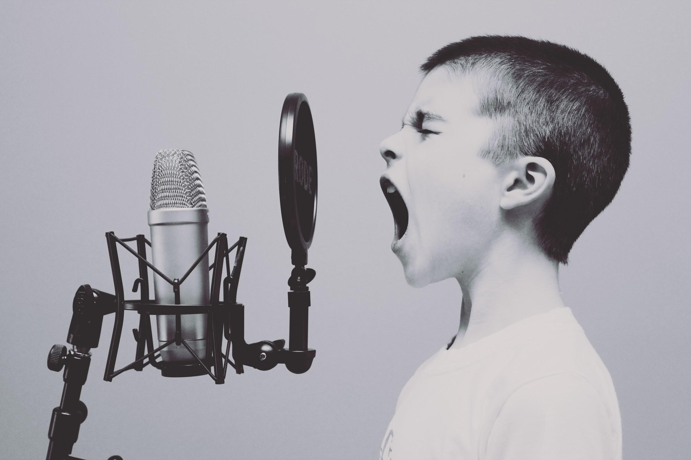
ᏔᎵᏍᎪ ᏅᎩᏁ ᏣᎳᎩ ᎠᏕᎶᏆᏍᏗ
Hisgi yawadetiyvda jigesv, elis, edud ayano widogilawitsidolv, igahnvdadisgo. Edud altsadohvsgi gesv. Jisa dulehisanv gesv. Elisi, ayano agvyididl widoginotlv. Edudu utvdvnv, “kilole yuduli juhnogisdi?” Wawaselitanv. “Edudu, dikanogidv dijinogisdi awaduli!” jiyoselv. Nole, agvyididl junilawsdi wagiwedolv. “Gado usdi dikanogidv dijanogisdi jaduli?” utvdvnv edudu. “Itse dikanogidv,” wijinohetlv. “Jisa agigeyuhina?” utvdvnv. “Tla. Na itse dikanogidv dakinogisdi awaduli. Tla yijahntadv,” edudu tsiyoselv. “Hawawu,” udvnv edudu.

Slide 6
ᏔᎵᏍᎪ ᏅᎩᏁ ᏣᎳᎩ ᎠᏕᎶᏆᏍᏗ
Nole, agvyididl wawalehnv ale hia dikanogidv widaginogisv, “O Bunnies have pink shiny noses, and this is the reason my friends, o bunnies have pink shiny noses and a powder puff on the wrong end” noleno, wawaktahvsv ale detsiquali detsitelvnv agvyidil nigad junilawsdi! Agidud doyu uyetsv. Yudaha, hia kanohetlvsgi uhnohetlvsgo, agitantanv nigalstanv!
Now, let’s look at the story and identify the words we need to use dialogue.

Slide 7
ᏔᎵᏍᎪ ᏅᎩᏁ ᏣᎳᎩ ᎠᏕᎶᏆᏍᏗ
Hisgi yawadetiyvda jigesv, elis, edud ayano widogilawitsidolv, igahnvdadisgo. Edud altsadohvsgi gesv. Jisa dulehisanv gesv. Elisi, ayano agvyididl widoginotlv. Edudu utvdvnv, “kilole yuduli juhnogisdi?” Wawaselitanv. “Edudu, dikanogidv dijinogisdi awaduli!” jiyoselv. Nole, agvyididl junilawsdi wagiwedolv. “Gado usdi dikanogidv dijanogisdi jaduli?” utvdvnv edudu. “Itse dikanogidv,” wijinohetlv. “Jisa agigeyuhina?” utvdvnv. “Tla. Na itse dikanogidv dakinogisdi awaduli. Tla yijahntadv,” edudu tsiyoselv. “Hawawu,” udvnv edudu.

Slide 8
ᏔᎵᏍᎪ ᏅᎩᏁ ᏣᎳᎩ ᎠᏕᎶᏆᏍᏗ
Nole, agvyididl wawalehnv ale hia dikanogidv widaginogisv: “O Bunnies have pink shiny noses, and this is the reason my friends, o bunnies have pink shiny noses and a powder puff on the wrong end” noleno, wawaktahvsv ale detsiquali detsitelvnv agvyidil nigad junilawsdi! Agidud doyu uyetsv. Yudaha, hia kanohetlvsgi uhnohetlvsgo, agitantanv nigalstanv!

Slide 9
ᏔᎵᏍᎪ ᏅᎩᏁ ᏣᎳᎩ ᎠᏕᎶᏆᏍᏗ
Jegsin uwej achuj, Tami danelv uluje. Udod utvdvne, “Edod, wijuntan diwalasden nigad joine ayodanv’. Igvnisisgis jijalagi?
“Tladv,” udvne Jegskin, “Igvnisisgi soneladu dejadatinvd!

Slide 10
ᏔᎵᏍᎪ ᏅᎩᏁ ᏣᎳᎩ ᎠᏕᎶᏆᏍᏗ
ᎠᏩᏕᏘᏴᏓ- the years I have
ᏫᏙᎩᎳᏫᏥᏙᎸ- we went to church
ᎢᎦᏅᏓᏗᏍᎪ- I remember
ᎠᎵᏣᏙᎲᏍᎩ- preacher
ᏥᏌ ᏚᎴᎯᏌᏅ - Easter (when jesus arose)
ᏫᏙᎩᏃᏢ- we sat
ᏧᏃᎩᏍᏗ- he/she to sing
ᏩᏩᏎᎵᏔᏅ- I raised my hand
ᏗᎧᏃᎩᏛ- song

Slide 11
ᏔᎵᏍᎪ ᏅᎩᏁ ᏣᎳᎩ ᎠᏕᎶᏆᏍᏗ
ᏗᏥᏃᎩᏍᏗ- I to sing
ᏥᏲᏎᎸ- I told him
ᏧᏂᎳᏫᏍᏗ- church
ᏩᎩᏪᏙᎸ- I went
ᏫᏥᏃᎮᏢ - I said
ᎠᎩᎨᏳᎯ- he/she loves me
ᏓᎩᏃᎩᏍᏗ- I to sing
ᏣᎾᏔ- You know
ᏩᏩᎴᏅ- I went and stood
ᏫᏓᎩᏃᎩᏒ- I sang

Slide 12
ᏔᎵᏍᎪ ᏅᎩᏁ ᏣᎳᎩ ᎠᏕᎶᏆᏍᏗ
ᏩᏩᎧᏔᎲᏒ- I turned around
ᏕᏥᏆᎵ- my butt
ᏕᏥᏖᎸᏅ- I shook them
ᎤᏰᏨ- he laughed
ᏳᏓᎭ - from time to time
ᎧᏃᎮᏢᏍᎩ- story, something that’s told
ᎤᏃᎮᏢᏍᎪ- he would tell it
ᎠᎩᏔᎾᏔᏅ- I became an adult
ᏂᎦᎵᏍᏔᏅ- it happened

