Slide 1
ᎣᏏᏲ
ᏔᎵᏍᎪ ᎯᏍᎩᏁ ᏣᎳᎩ ᎠᏕᎶᏆᏍᏗ

Slide 2
ᏔᎵᏍᎪ ᎯᏍᎩᏁ ᏣᎳᎩ ᎠᏕᎶᏆᏍᏗ
ᎢᏓᎴᎾ
ᏣᎳᎩ ᎢᏗᏬᏂ!

Slide 3
ᏔᎵᏍᎪ ᎯᏍᎩᏁ ᏣᎳᎩ ᎠᏕᎶᏆᏍᏗ
Description: Narrating fictional and cultural stories in the past with inner thinking and dialogue and setting and character description.

Slide 4
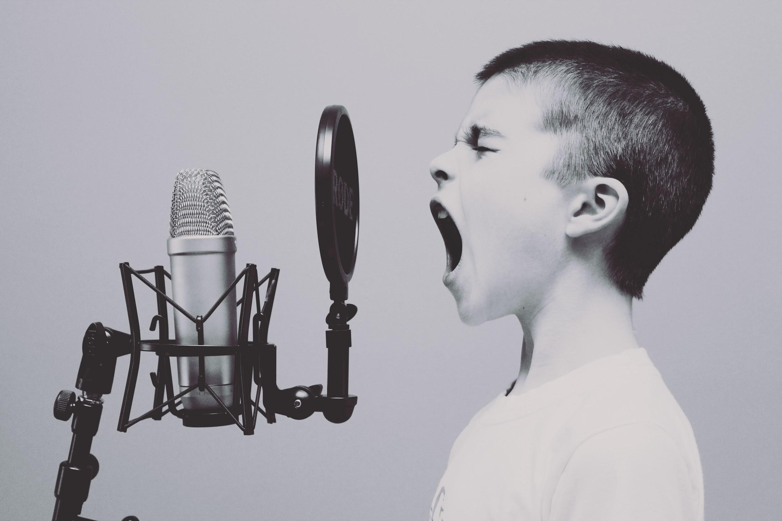
ᏔᎵᏍᎪ ᏅᎩᏁ ᏣᎳᎩ ᎠᏕᎶᏆᏍᏗ
Hisgi yawadetiyvda jigesv, elis, edud ayano widogilawitsidolv, igahnvdadisgo. Edud altsadohvsgi gesv. Jisa dulehisanv gesv. Elisi, ayano agvyididl widoginotlv. Edudu utvdvnv, “kilole yuduli juhnogisdi?” Wawaselitanv. “Edudu, dikanogidv dijinogisdi awaduli!” jiyoselv. Nole, agvyididl junilawsdi wagiwedolv. “Gado usdi dikanogidv dijanogisdi jaduli?” utvdvnv edudu. “Itse dikanogidv,” wijinohetlv. “Jisa agigeyuhina?” utvdvnv. “Tla. Na itse dikanogidv dakinogisdi awaduli. Tla yijahntadv,” edudu tsiyoselv. “Hawawu,” udvnv edudu.

Slide 5
ᏔᎵᏍᎪ ᏅᎩᏁ ᏣᎳᎩ ᎠᏕᎶᏆᏍᏗ
Nole, agvyididl wawalehnv ale hia dikanogidv widaginogisv, “O Bunnies have pink shiny noses, and this is the reason my friends, o bunnies have pink shiny noses and a powder puff on the wrong end” noleno, wawaktahvsv ale detsiquali detsitelvnv agvyidil nigad junilawsdi! Agidud doyu uyetsv. Yudaha, hia kanohetlvsgi uhnohetlvsgo, agitantanv nigalstanv!

Slide 6
ᏓᎳᏚᏏᏁ ᏣᎳᎩ ᎠᏕᎶᏆᏍᏗ
Na jisdu ale ujetsdi junisdahvsg dundulihe.
Na jisdu ulvqwd junehldi.
Na jisdu ale ujetsdi junisdahvsg dundulihe.
Sesgihno tla kilo yidunilvqde jisdu ale ujetsd.
Jisdu unosele ujetsdi ksdawaduga so digaduhv
Na jisdu wuluje soh digaduhv widuhnosele
“Aya gajiwonihise dinilawigi.
Nigadahen dijaneladisdi unaduli nowu”
nigad inge aneha dunanelide

Slide 7
ᏓᎳᏚᏏᏁ ᏣᎳᎩ ᎠᏕᎶᏆᏍᏗ
jisdu usdayvhsg uhwatvhe.
Usganolv nulsdane, ujetsdi ugoniyojv wuluje. tla yiwatvhe usdayvhvsg.
“Hesdi uyo yijadahntesdi.” udvne jisdu.
Soh digaduhhdidl wulose jisdu.
Ujetsdihno nav wudasdawadvsdane.
wuluje so dagaduhv jisdu dunosele,
“Aya gajiwonihise dinilawig.
Ijadanul ale ijiwangala andi dinilawigi.
Ijalendi dajatlihv nowu. ”

Slide 8
ᏓᎳᏚᏏᏁ ᏣᎳᎩ ᎠᏕᎶᏆᏍᏗ
nowu unalenvhe dantlihv inage anehi.
Sesgino nvgi yigvnvhid widultadese jisdu. Wultise jisdu.
ujetsdi nuhntvn nuwesv jisdu. Wuluji, nigada inage anehi gadugi unantegwalohne anilvhnihv.
ujetsdi wusagwalele ulihwojv udayelvhne.
Tohi nulsdan, nowu widulene wutise.
tla lehiyu yuwatvhe usdahvsg,
Kohi iga jigi si yusgasdaneli, si yiwasogwalela uliwhojv yadayelv.

Slide 9
ᏓᎳᏚᏏᏁ ᏣᎳᎩ ᎠᏕᎶᏆᏍᏗ
Let’s look at what words indicate dialogue or inner thinking and highlight them in yellow

Slide 10
ᏓᎳᏚᏏᏁ ᏣᎳᎩ ᎠᏕᎶᏆᏍᏗ
Na jisdu ale ujetsdi junisdahvsg dundulihe.
Na jisdu ulvqwd junehldi.
Na jisdu ale ujetsdi junisdahvsg dundulihe.
Sesgihno tla kilo yidunilvqde jisdu ale ujetsd.
Jisdu unosele ujetsdi ksdawaduga so digaduhv
Na jisdu wuluje soh digaduhv widuhnosele
“Aya gajiwonihise dinilawigi.
Nigadahen dijaneladisdi unaduli nowu”
nigad inge aneha dunanelide

Slide 11
ᏓᎳᏚᏏᏁ ᏣᎳᎩ ᎠᏕᎶᏆᏍᏗ
jisdu usdayvhsg uhwatvhe.
Usganolv nulsdane, ujetsdi ugoniyojv wuluje. tla yiwatvhe usdayvhvsg.
“Hesdi uyo yijadahntesdi.” udvne jisdu.
Soh digaduhhdidl wulose jisdu.
Ujetsdihno nav wudasdawadvsdane.
wuluje so dagaduhv jisdu dunosele,
“Aya gajiwonihise dinilawig.
Ijadanul ale ijiwangala andi dinilawigi.
Ijalendi dajatlihv nowu. ”

Slide 12
ᏓᎳᏚᏏᏁ ᏣᎳᎩ ᎠᏕᎶᏆᏍᏗ
nowu unalenvhe dantlihv inage anehi.
Sesgino nvgi yigvnvhid widultadese jisdu. Wultise jisdu.
ujetsdi nuhntvn nuwesv jisdu. Wuluji, nigada inage anehi gadugi unantegwalohne anilvhnihv.
ujetsdi wusagwalele ulihwojv udayelvhne.
Tohi nulsdan, nowu widulene wutise.
tla lehiyu yuwatvhe usdahvsg,
Kohi iga jigi si yusgasdaneli, si yiwasogwalela uliwhojv yadayelv.

Slide 13
ᏓᎳᏚᏏᏁ ᏣᎳᎩ ᎠᏕᎶᏆᏍᏗ
Let’s look at what words indicate setting and highlight them in blue

Slide 14
ᏓᎳᏚᏏᏁ ᏣᎳᎩ ᎠᏕᎶᏆᏍᏗ
Na jisdu ale ujetsdi junisdahvsg dundulihe.
Na jisdu ulvqwd junehldi.
Na jisdu ale ujetsdi junisdahvsg dundulihe.
Sesgihno tla kilo yidunilvqde jisdu ale ujetsd.
Jisdu unosele ujetsdi ksdawaduga so digaduhv
Na jisdu wuluje soh digaduhv widuhnosele
“Aya gajiwonihise dinilawigi.
Nigadahen dijaneladisdi unaduli nowu”
nigad inge aneha dunanelide

Slide 15
ᏓᎳᏚᏏᏁ ᏣᎳᎩ ᎠᏕᎶᏆᏍᏗ
jisdu usdayvhsg uhwatvhe.
Usganolv nulsdane, ujetsdi ugoniyojv wuluje. tla yiwatvhe usdayvhvsg.
“Hesdi uyo yijadahntesdi.” udvne jisdu.
Soh digaduhhdidl wulose jisdu.
Ujetsdihno nav wudasdawadvsdane.
wuluje so dagaduhv jisdu dunosele,
“Aya gajiwonihise dinilawig.
Ijadanul ale ijiwangala andi dinilawigi.
Ijalendi dajatlihv nowu. ”

Slide 16
ᏓᎳᏚᏏᏁ ᏣᎳᎩ ᎠᏕᎶᏆᏍᏗ
nowu unalenvhe dantlihv inage anehi.
Sesgino nvgi yigvnvhid widultadese jisdu. Wultise jisdu.
ujetsdi nuhntvn nuwesv jisdu. Wuluji, nigada inage anehi gadugi unantegwalohne anilvhnihv.
ujetsdi wusagwalele ulihwojv udayelvhne.
Tohi nulsdan, nowu widulene wutise.
tla lehiyu yuwatvhe usdahvsg,
Kohi iga jigi si yusgasdaneli, si yiwasogwalela uliwhojv yadayelv.

Slide 17
ᏓᎳᏚᏏᏁ ᏣᎳᎩ ᎠᏕᎶᏆᏍᏗ
Let’s look at what words indicate character description and highlight them in green.

Slide 18
ᏓᎳᏚᏏᏁ ᏣᎳᎩ ᎠᏕᎶᏆᏍᏗ
Na jisdu ale ujetsdi junisdahvsg dundulihe.
Na jisdu ulvqwd junehldi.
Na jisdu ale ujetsdi junisdahvsg dundulihe.
Sesgihno tla kilo yidunilvqde jisdu ale ujetsd.
Jisdu unosele ujetsdi ksdawaduga so digaduhv
Na jisdu wuluje soh digaduhv widuhnosele
“Aya gajiwonihise dinilawigi.
Nigadahen dijaneladisdi unaduli nowu”
nigad inage aneha dunanelide

Slide 19
ᏓᎳᏚᏏᏁ ᏣᎳᎩ ᎠᏕᎶᏆᏍᏗ
jisdu usdayvhsg uhwatvhe.
Usganolv nulsdane, ujetsdi ugoniyojv wuluje. tla yiwatvhe usdayvhvsg.
“Hesdi uyo yijadahntesdi.” udvne jisdu.
Soh digaduhhdidl wulose jisdu.
Ujetsdihno nav wudasdawadvsdane.
wuluje so dagaduhv jisdu dunosele,
“Aya gajiwonihise dinilawig.
Ijadanul ale ijiwangala andi dinilawigi.
Ijalendi dajatlihv nowu. ”

Slide 20
ᏓᎳᏚᏏᏁ ᏣᎳᎩ ᎠᏕᎶᏆᏍᏗ
nowu unalenvhe dantlihv inage anehi.
Sesgino nvgi yigvnvhid widultadese jisdu. Wultise jisdu.
ujetsdi nuhntvn nuwesv jisdu. Wuluji, nigada inage anehi gadugi unantegwalohne anilvhnihv.
ujetsdi wusagwalele ulihwojv udayelvhne.
Tohi nulsdan, nowu widulene wutise.
tla lehiyu yuwatvhe usdahvsg,
Kohi iga jigi si yusgasdaneli, si yiwasogwalela uliwhojv yadayelv.

Slide 21
ᏓᎳᏚᏏᏁ ᏣᎳᎩ ᎠᏕᎶᏆᏍᏗ
As we can see, there are areas that can be improved in the story. We could add more to describe the setting, maybe a little more dialogue.

Slide 22
ᏓᎳᏚᏏᏁ ᏣᎳᎩ ᎠᏕᎶᏆᏍᏗ
Na jisdu ale ujetsdi junisdahvsg dundulihe.
Ilvhiyu jigesv ehnai degaduhv daninele aniyvwi yusdi.
Na jisdu ale ujetsdi unalii gese. Na jisdu gajanul ale uwoljadi gese. Ulvqwd junehldino na jisdu. Ujetsdi usganol ale sdigid nigolgvna. Dodalv anehe.
Na jisdu ale ujetsdi junisdahvsg dundulihe. Sesgihno tla kilo yidunilvqde jisdu ale ujetsd. “Usdayvhvsg awaduli,” udvne ujetsdi. “Ayadvsquu,” udvne jisdu. “Gohusd yidadvg geli. Degisdayvhvsgi yidediwat. Ksdawaduga so digaduhv.”

Slide 23
ᏓᎳᏚᏏᏁ ᏣᎳᎩ ᎠᏕᎶᏆᏍᏗ
Na jisdu wuluje soh digaduhv nutlisdv widuhnosele “Aya gajiwonihise dinilawigi. Nigadahen dijaneladisdi unaduli nowjig” Nole nigad inage aneha dunanelide. uhwatvhehno usdayvhvsg na jisdu.
Usganolv nulsdane, ujetsdi ugoniyojv wuluje. tla yuwatvhe usdayvhvsg. “Hesdi uyo yijadahntesdi.” udvne jisdu. “Siwu idaneltanv.”
Soh digaduhhdidl wulose jisdu. Ujetsdihno nav wudasdawadvsdane. Wuluje so dagaduhv jisdu dunosele,
“Aya gajiwonihise dinilawig. Ijadanul ale ijiwangala andi dinilawigi. Ijalendi dajatlihv nowu. ”

Slide 24
ᏓᎳᏚᏏᏁ ᏣᎳᎩ ᎠᏕᎶᏆᏍᏗ
Nole unalenvhe dantlihv inage anehi. Sesgino nvgi yigvnvhid widultadese jisdu. Wultise jisdu.
Ujetsdi nuhntvn nuwesv jisdu. Wuluji, nigada inage anehi gadugi unantegwalohne anilvhnihv. Ujetsdi wusagwalele ulihwojv udayelvhne. Tohi nulsdan, nowu widulene wultise. Tla lehiyu yuwatvhe usdayvhvsg ujetsdi.
Kohi iga jigi si yusgasdaneli, si yiwasogwalela uliwhojv yadayelv. Sidv jugalvdino na jisdu.

