Slide 1
ᎣᏏᏲ
ᏔᎵᏍᎪ ᎦᎵᏉᎩᏁ ᏣᎳᎩ ᎠᏕᎶᏆᏍᏗ

Slide 2
ᏔᎵᏍᎪ ᎦᎵᏉᎩᏁ ᏣᎳᎩ ᎠᏕᎶᏆᏍᏗ
ᎢᏓᎴᎾ
ᏣᎳᎩ ᎢᏗᏬᏂ!

Slide 3
ᏓᎳᏚᏏᏁ ᏣᎳᎩ ᎠᏕᎶᏆᏍᏗ
ᏓᎩᏏ ᎤᏚᎵᏍᎨ ᎺᎵ
ᎢᎸᎯᏳ ᏥᎨᏒ, ᎠᎨᎱᏣ ᎨᎮ. ᎺᎵ ᏚᏙᎡ. ᏓᎩᏏ ᎤᏚᎵᎮ.
ᎺᎵ ᏂᎬ ᎠᏥᏯᎸ.
ᎺᎵ ᏅᏃᎱᎵᏗ ᏭᎦᏔᏁ.
Ꮭ ᏱᏩᏥᏩᏛᎮ ᏓᎩᏏ ᏅᏃᎱᎵᏗ.
ᎥᏓᎵ ᏭᎦᏔᏁ ᎺᎵ.
Ꮭ ᏱᏩᏥᏩᏛᎮ ᏓᎩᏏ ᎥᏓᎵ.
ᎺᎵ ᎤᏥ ᏭᏃᏎᎴ, “ᏓᎩᏏ ᎠᏩᏚᎵ, ᎠᏎᏃ Ꮭ ᏱᎢᏩᏘ.”
“ᏫᎩᏂᏩᎯ,” ᎤᏛᏁ ᎤᏥ.

Slide 4
ᏓᎳᏚᏏᏁ ᏣᎳᎩ ᎠᏕᎶᏆᏍᏗ
ᏓᏆᎴᎵ ᏭᎾᏣᏁ.
ᏗᏓᎾᏅ ᎤᏁᏅᏒ.
ᏓᎩᏏ ᎤᏂᏩᏒ. ᎤᏬᏗᎨ ᎤᎵᏑᏫᏗ. Pokey ᏚᏬᏁ.
ᎺᎵ ᎤᎵᎮᎵᏨ ᏓᎩᏏ ᏧᏩᏛᎲ.
Let’s see if you can answer these questions…..

Slide 5
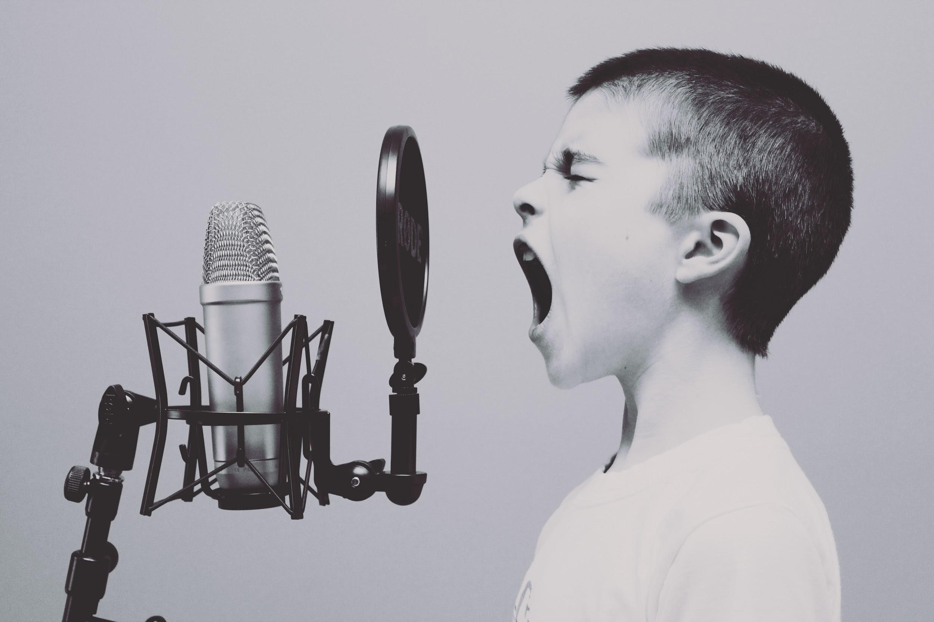
ᏔᎵᏍᎪ ᎦᎵᏉᎩᏁ ᏣᎳᎩ ᎠᏕᎶᏆᏍᏗ
Hisgi yawadetiyvda jigesv, elis, edud ayano widogilawitsidolv, igahnvdadisgo. Edud altsadohvsgi gesv. Jisa dulehisanv gesv. Elisi, ayano agvyididl widoginotlv. Edudu utvdvnv, “kilole yuduli juhnogisdi?” Wawaselitanv. “Edudu, dikanogidv dijinogisdi awaduli!” jiyoselv. Nole, agvyididl junilawsdi wagiwedolv. “Gado usdi dikanogidv dijanogisdi jaduli?” utvdvnv edudu. “Itse dikanogidv,” wijinohetlv. “Jisa agigeyuhina?” utvdvnv. “Tla. Na itse dikanogidv dakinogisdi awaduli. Tla yijahntadv,” edudu tsiyoselv. “Hawawu,” udvnv edudu.

Slide 6
ᏔᎵᏍᎪ ᎦᎵᏉᎩᏁ ᏣᎳᎩ ᎠᏕᎶᏆᏍᏗ
Nole, agvyididl wawalehnv ale hia dikanogidv widaginogisv: “O Bunnies have pink shiny noses, and this is the reason my friends, o bunnies have pink shiny noses and a powder puff on the wrong end” noleno, wawaktahvsv ale detsiquali detsitelvnv agvyidil nigad junilawsdi! Agidud doyu uyetsv. Yudaha, hia kanohetlvsgi uhnohetlvsgo, agitantanv nigalstanv!

Slide 7
ᏓᎳᏚᏏᏁ ᏣᎳᎩ ᎠᏕᎶᏆᏍᏗ
Wesa at uyohusele.
Susani agehyuja.
Susani wesa at uweka.
Na wesa at gvhnage ulsuwid.
Ani dudo wesa at.
Susani gvhnage wesa at uyohuselv.
Susani nikv ajiyalv.
Susani hawindidl ganitli wuktane.
Tla yuwatvhe ani hawindidli ganitli.

Slide 8
ᏓᎳᏚᏏᏁ ᏣᎳᎩ ᎠᏕᎶᏆᏍᏗ
Susani gadudidl gasgilv wuktane. Tla yukile ani gasgilv.
Susani wuktane yuja kanesai. Kanesai tla yujae ani.
Susani wahyanihe, “Ani! Ani! Dehena!” Tla yuluje na gvhnage wesa at.
Susani sdudi ohndidl gohusdi wugohe.
Uhna, wajiwatvhe gvhnage wesa at juwekahv.
Ani gatlihe.

Slide 9
ᏓᎳᏚᏏᏁ ᏣᎳᎩ ᎠᏕᎶᏆᏍᏗ
ᏪᏌ ᎠᏔ ᎤᏲᎱᏎᎴ
ᏑᏌᏂ ᎠᎨᎱᏣ.
ᏑᏌᏂ ᏪᏌ ᎠᏔ ᎤᏪᎧ.
Ꮎ ᏪᏌ ᎠᏔ ᎬᎿᎨ ᎤᎵᏑᏫᏗ.
ᎠᏂ ᏚᏙᎠ ᏪᏌ ᎠᏔ.
ᏑᏌᏂ ᎬᎿᎨ ᏪᏌ ᎠᏔ ᎤᏲᎱᏎᎸ.
ᏑᏌᏂ ᏂᎬ ᎠᏥᏯᎸ.
ᏑᏌᏂ ᎭᏫᎾᏗᏟ ᎦᏂᏟ ᏭᎦᏔᏁ.
Ꮭ ᏳᏩttᎮ ᎠᏂ ᎭᏫᎾᏗᏟ ᎦᏂᏟ.

Slide 10
ᏓᎳᏚᏏᏁ ᏣᎳᎩ ᎠᏕᎶᏆᏍᏗ
ᏑᏌᏂ ᎦᏚᏗᏟ ᎦᏍᎩᎸ ᏭᎦᏔᏁ. Ꮭ ᏳᎩᎴ ᎠᏂ ᎦᏍᎩᎸ.
ᏑᏌᏂ ᏭᎦᏔᏁ ᏳᏣ ᎧᏁᏌᎢ. ᎧᏁᏌᎢ Ꮭ ᏳᏣᎡ ᎠᏂ.
ᏑᏌᏂ ᏩᎯᏯᏂᎮ, “ᎠᏂ! ᎠᏂ! ᏕᎮᎾ!” Ꮭ ᏳᎷᏤ Ꮎ ᎬᎿᎨ ᏪᏌ ᎠᏔ.
ᏑᏌᏂ ᏍᏚᏗ ᎣᏂᏗᏟ ᎪᎱᏍᏗ ᏭᎪᎮ.
ᎤᎾ, ᏩᏥᏩᏛᎮ ᎬᎿᎨ ᏪᏌ ᎠᏔ ᏧᏪᎧᎲ.
ᎠᏂ ᎦᏟᎮ.

