Slide 1
ᎣᏏᏲ
ᏦᎢᏁ ᏣᎳᎩ ᎠᏕᎶᏆᏍᏗ

Slide 2
ᏦᎢᏁ ᏣᎳᎩ ᎠᏕᎶᏆᏍᏗ
ᏏᏊ ᏥᏂᎪᎵᏯ
ᎦᏙ ᎤᏍᏗ ᏚᏙᎠ Ꮎ ᎩᏟ ᏧᏪᎧ ᏗᎦᎶᎩᏍᎩ?
BINGO ᏚᏙᎠ Ꮎ ᎩᏟ ᏧᏪᎧ ᏗᎦᎶᎩᏍᎩ.
ᎦᎪ ᎩᏟ ᎤᏪᎧ?
ᏗᎦᎶᎩᏍᎩ ᎩᏟ ᎤᏪᎧ
ᎩᏟ ᎤᏪᎧᏍ ᎤᏚᎵᎨ Ꮎ ᏗᎦᎶᎩᏍᎩ?
ᎩᏟ ᎤᏪᎧ Ꮎ ᏗᎦᎶᎩᏍᎩ

Slide 3
ᏦᎢᏁ ᏣᎳᎩ ᎠᏕᎶᏆᏍᏗ
ᎢᏓᎴᎾ
ᏣᎳᎩ ᎢᏗᏬᏂ!

Slide 4
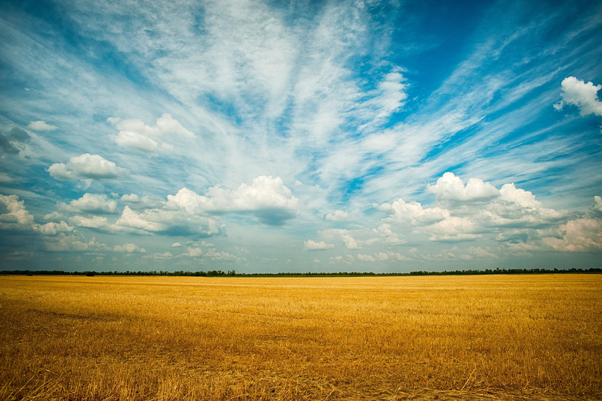
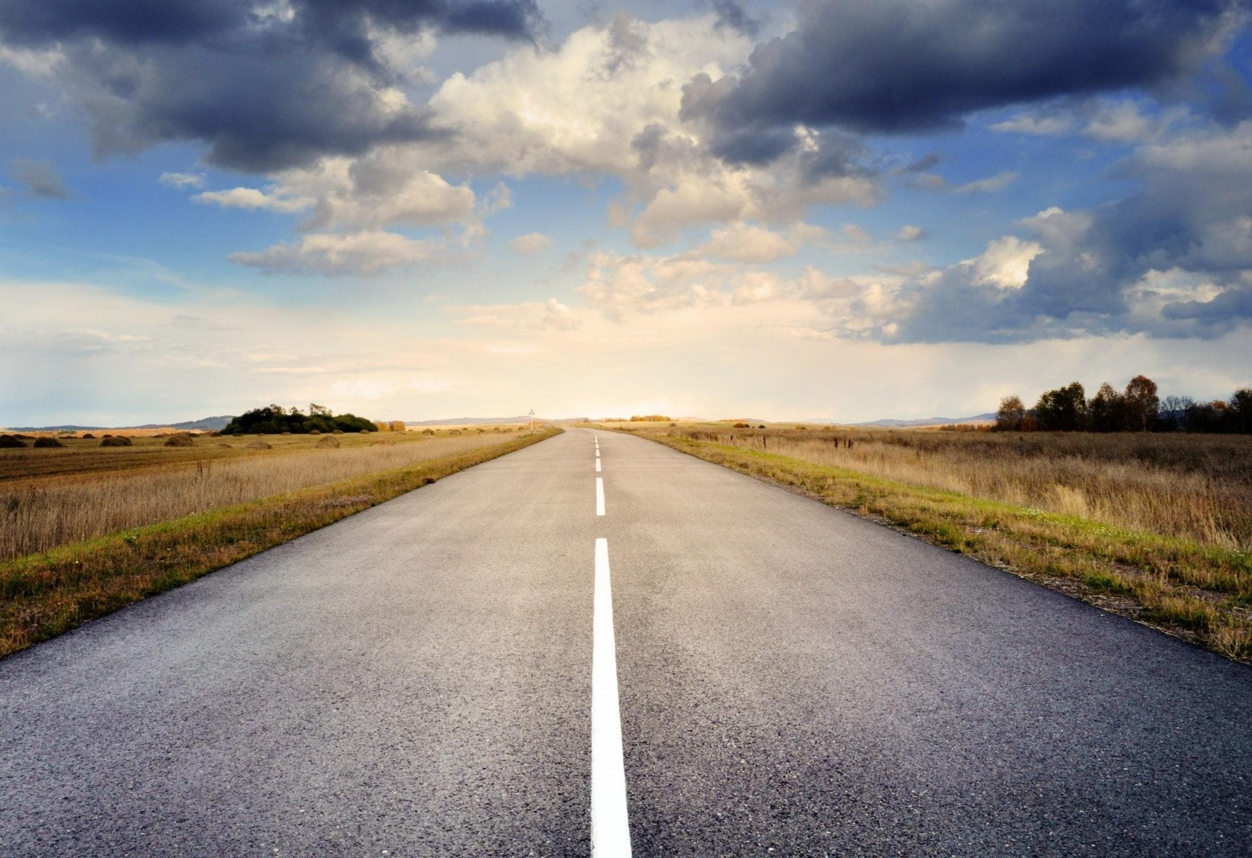
ᏦᎢᏁ ᏣᎳᎩ ᎠᏕᎶᏆᏍᏗ
tloges
nvnohi

Slide 5
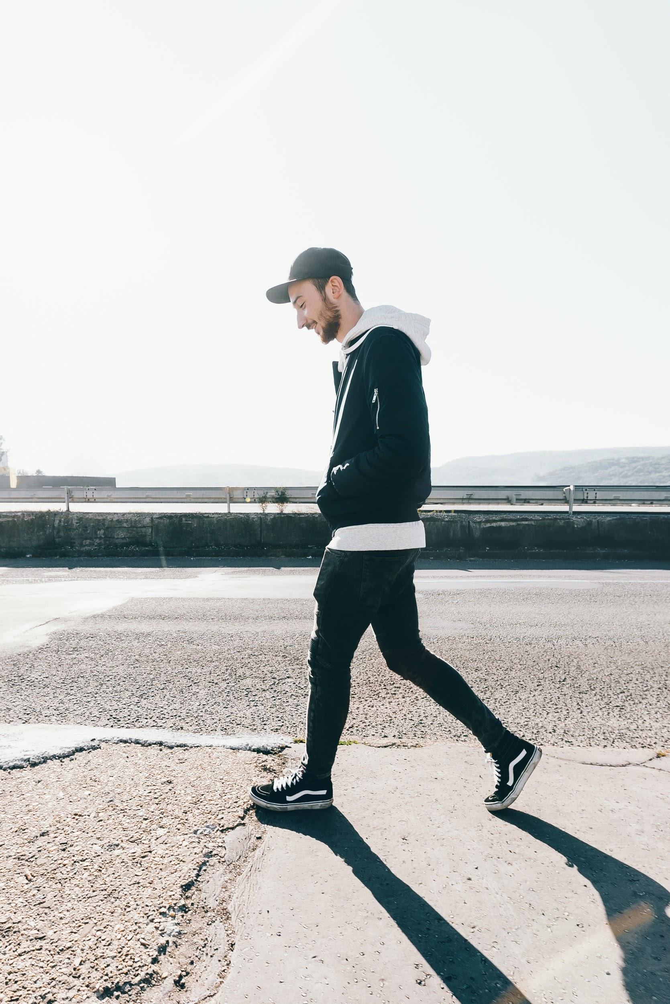
ᏦᎢᏁ ᏣᎳᎩ ᎠᏕᎶᏆᏍᏗ
Ꮎ ᎠᏍᎦᏯ ᏅᏃᎯ ᎠᎢ.
Na asgaya nvnohi ai.
ᎠᏍᎦᏯ

Slide 6
ᏦᎢᏁ ᏣᎳᎩ ᎠᏕᎶᏆᏍᏗ
ᎠᎨᏯᏍ ᎠᎢ?
Ꮭ. Ꮭ ᎠᎨᏯ ᏱᎩ ᏣᎢ. ᎠᏍᎦᏯ ᎠᎢ.
ᎦᎪ ᎠᎢ?
ᎠᏍᎦᏯ ᎠᎢ.
ᎦᏙ ᎠᏛᏁ Ꮎ ᎠᏍᎦᏯ?
Ꮎ ᎠᏍᎦᏯ ᏅᏃᎯ ᎠᎢ.
ᎭᏢ ᎠᎢ ᎠᏍᎦᏯ?
ᏅᏃᎯ ᎠᎢ Ꮎ ᎠᏍᎦᏯ.
Na asgaya nvnohi ai.

Slide 7
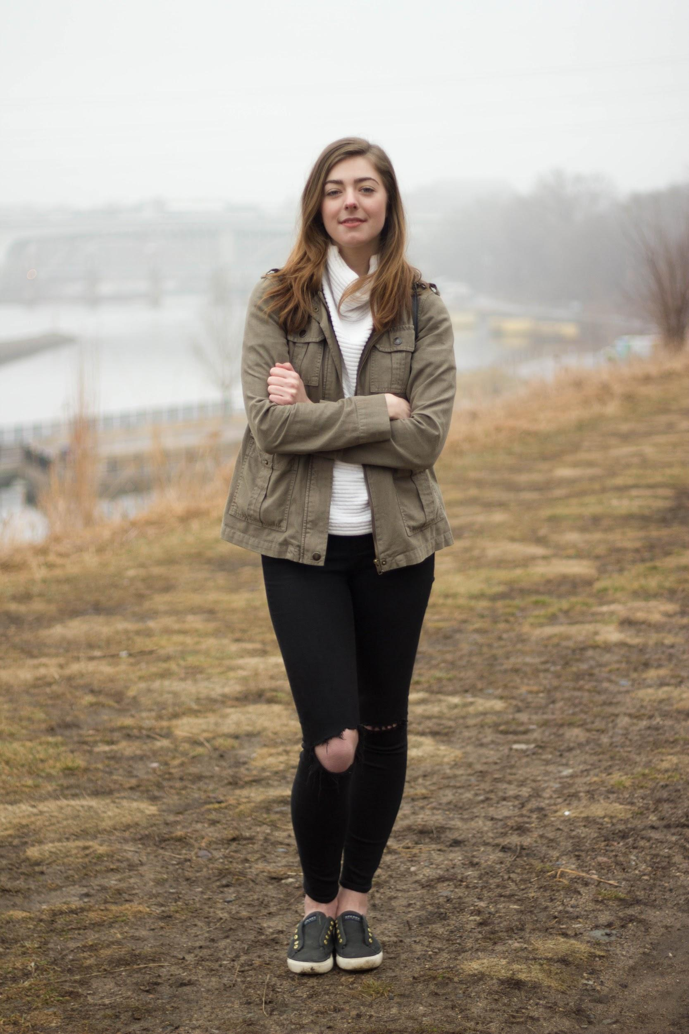
ᏦᎢᏁ ᏣᎳᎩ ᎠᏕᎶᏆᏍᏗ
Ꮎ ᎠᎨᏯ ᏠᎨᏏ ᎦᏙᎦ.
Na ageya tloges gadog.
ᎠᎨᏯ

Slide 8
ᏦᎢᏁ ᏣᎳᎩ ᎠᏕᎶᏆᏍᏗ
ᎠᏍᎦᏯᏍ ᎦᏙᎦ?
Ꮭ. Ꮭ ᎠᏍᎦᏯ ᏱᎩ ᏥᎦᏙᎦ. ᎠᎨᏯ ᎦᏙᎦ.
ᎠᎢᏍ ᎦᏙᎦᎨ Ꮎ ᎠᎨᏯ?
ᎦᏙᎦ Ꮎ ᎠᎨᏯ.
ᎭᏢ ᎦᏙᎦ Ꮎ ᎠᎨᏯ?
ᏠᎨᏏ ᎦᏙᎦ Ꮎ ᎠᎨᏯ.
ᎦᎪ ᏠᎨᏏ ᎦᏙᎦ?
ᎠᎨᏯ ᏠᎨᏏ ᎦᏙᎦ.
Na agehya tloges gadog.

Slide 9
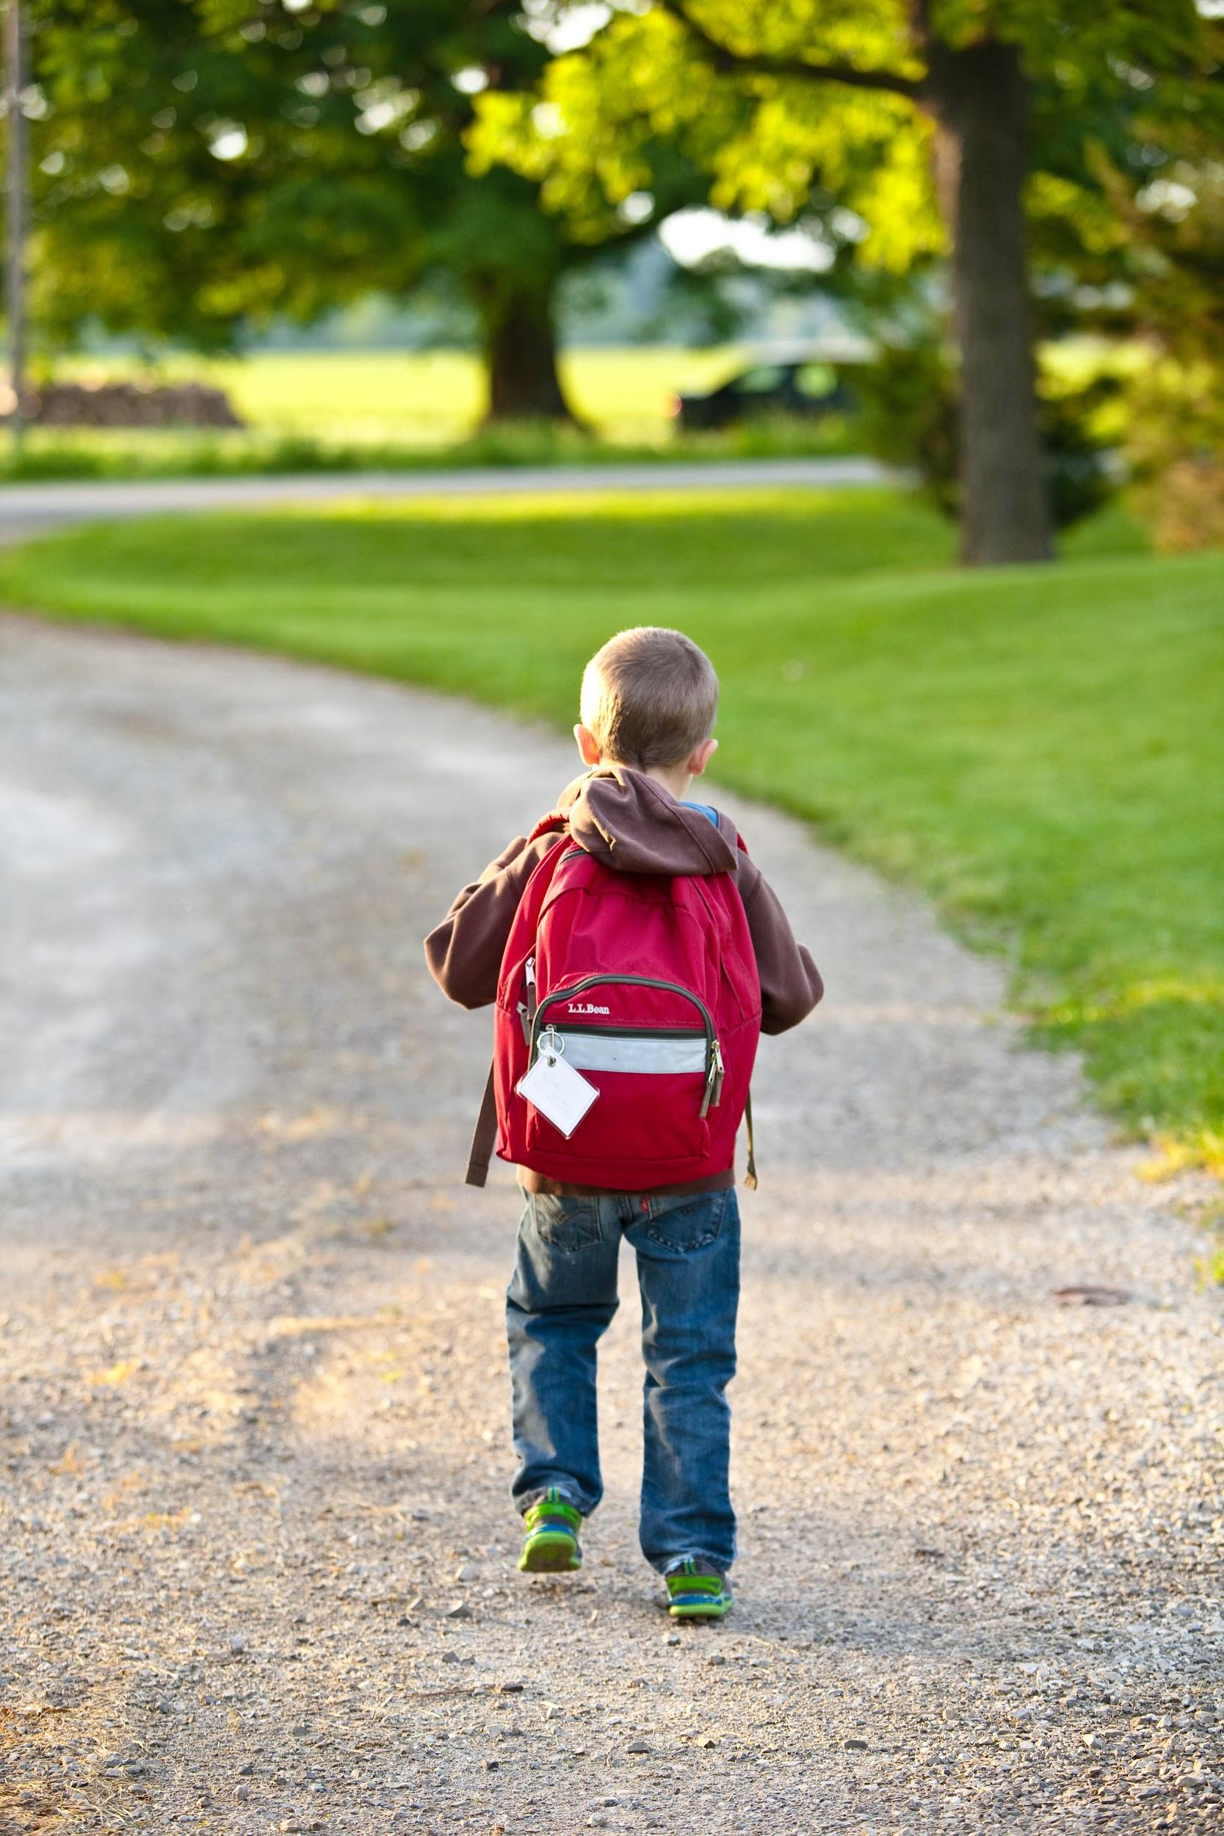
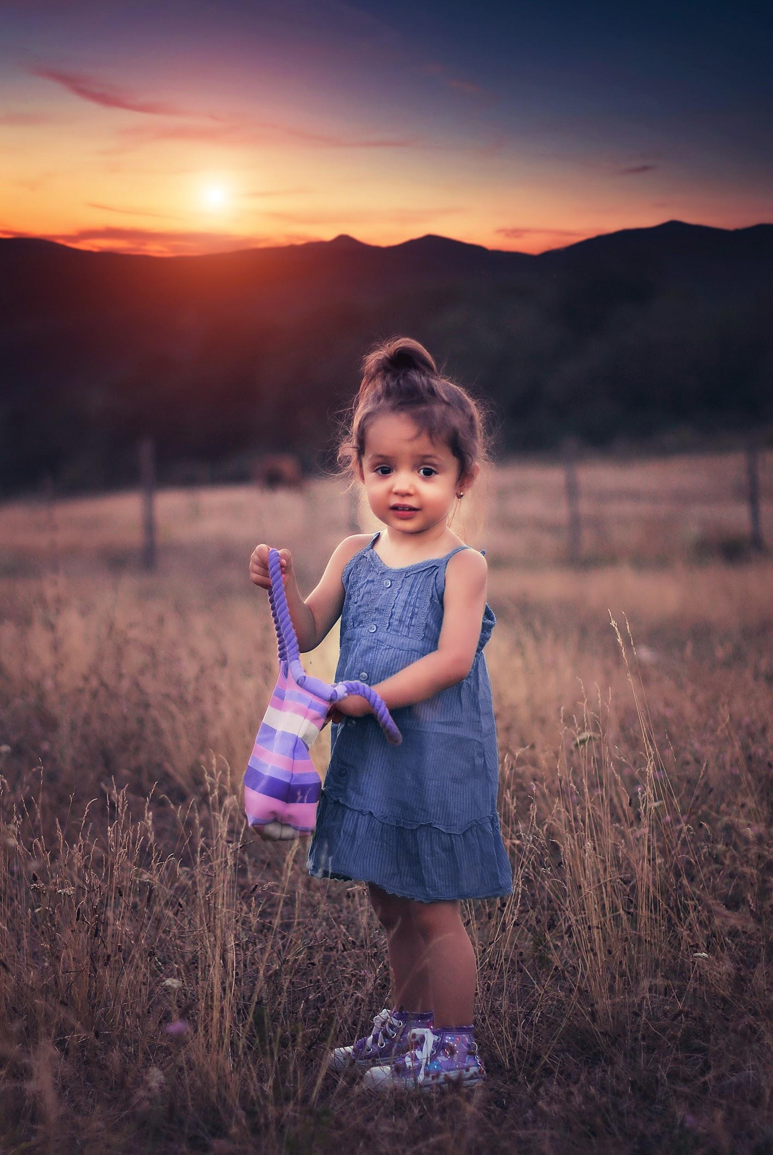
ᏦᎢᏁ ᏣᎳᎩ ᎠᏕᎶᏆᏍᏗ
Achuja
ᎠᏧᏣ
Agehyuja
ᎠᎨᏳᏣ

Slide 10
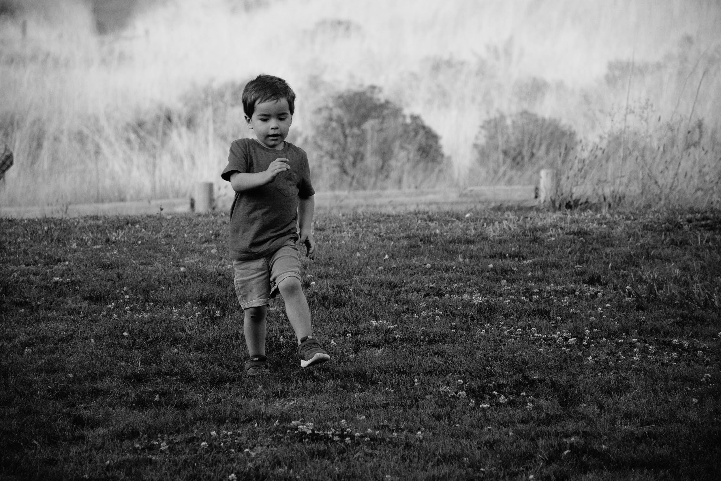
ᏦᎢᏁ ᏣᎳᎩ ᎠᏕᎶᏆᏍᏗ
ᎦᎪ ᏠᎨᏏ ᎠᎢ?
ᎠᏧᏣ ᏠᎨᏏ ᎠᎢ.
ᎭᏢ ᎠᎢ Ꮎ ᎠᏧᏣ?
ᏠᎨᏏ ᎠᎢ Ꮎ ᎠᏧᏣ.
ᎠᎢᏍ ᎦᏙᎦᎨ Ꮎ ᎠᏧᏣ?
ᎠᎢ Ꮎ ᎠᏧᏣ.
ᎦᏙ ᎠᏛᏁ Ꮎ ᎠᏧᏣ?
Ꮎ ᎠᏧᏣ ᏠᎨᏏ ᎠᎢ.
ᎠᏧᏣ
Na achuj tloges ai.

Slide 11
ᏦᎢᏁ ᏣᎳᎩ ᎠᏕᎶᏆᏍᏗ
ᎦᎪ ᏅᏃᎯ ᏩᎢ?
ᎠᏧᏣ ᏅᏃᎯ ᏩᎢ.
ᎭᏢ ᏩᎢ Ꮎ ᎠᏧᏣ?
ᏅᏃᎯ ᏩᎢ Ꮎ ᎠᏧᏣ.
ᎠᎨᏳᏣᏍ ᎠᏧᏣᎨ ᏅᏃᎯ ᏩᎢ?
ᎠᏧᏣ ᏅᏃᎯ ᏩᎢ.
ᎦᏙ ᎠᏛᏁ Ꮎ ᎠᏧᏣ?
ᏅᏃᎯ ᏩᎢ Ꮎ ᎠᏧᏣ.
ᎠᏧᏣ
Na achuj nvnohi wai.

Slide 12
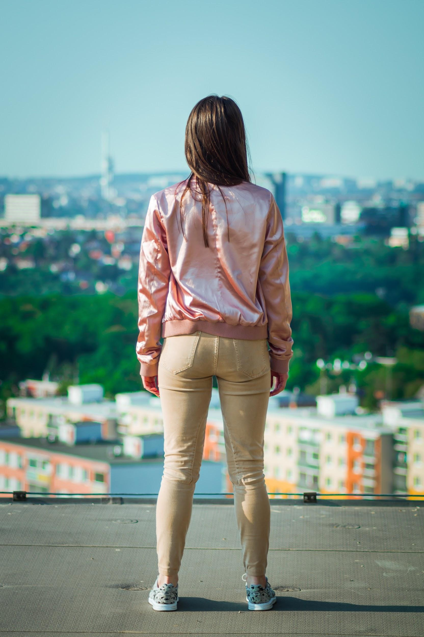
ᏦᎢᏁ ᏣᎳᎩ ᎠᏕᎶᏆᏍᏗ
Na ageya gadog.
Na ageya wigadog.

Slide 13
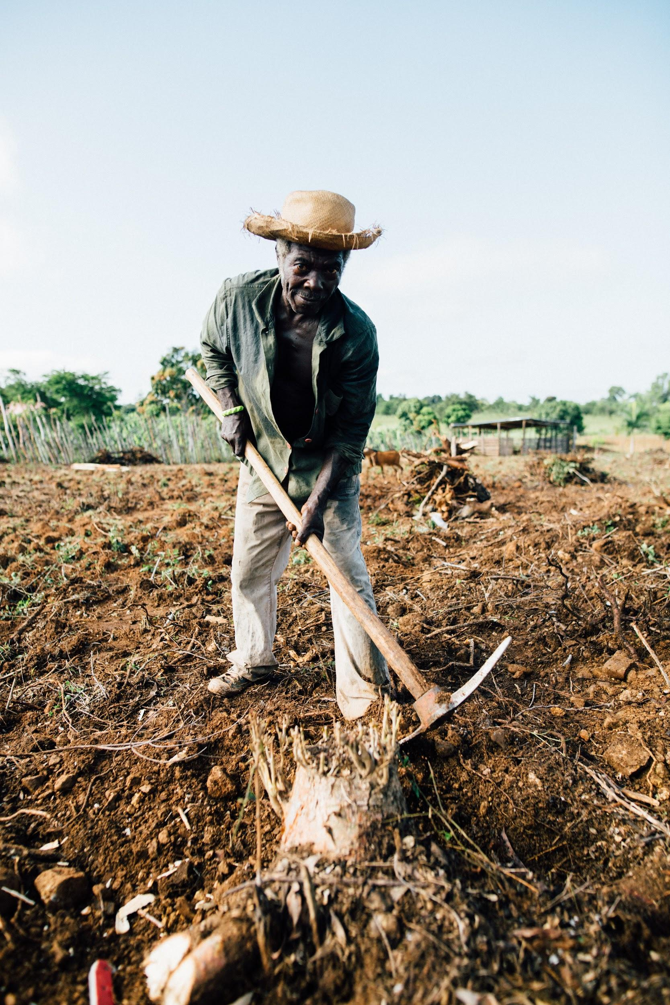
ᏦᎢᏁ ᏣᎳᎩ ᎠᏕᎶᏆᏍᏗ
Digalogisgi tloges dulvwsdane.
ᏗᎦᎶᎩᏍᎩᏍ ᏠᎨᏏ ᏚᎸᏍᏓᏁ?
ᎥᎥ. ᏗᎦᎶᎩᏍᎩ ᏠᎨᏏ ᏚᎸᏍᏓᏁ.
ᏅᏃᎯᏍ ᏠᎨᏏᎨ ᏚᎸᏍᏓᏁ ᏗᎦᎶᎩᏍᎩ?
ᏠᎨᏏ ᏚᎸᏍᏓᏁ ᏗᎦᎶᎩᏍᎩ.
ᎦᎪ ᏠᎨᏏ ᏚᎸᏍᏓᏁ?
ᏗᎦᎶᎩᏍᎩ ᏠᎨᏏ ᏚᎸᏍᏓᏁ.
ᎭᏢ ᏚᎸᏍᏓᏁ ᏗᎦᎶᎩᏍᎩ?
ᏠᎨᏏ ᏚᎸᏍᏓᏁ ᏗᎦᎶᎩᏍᎩ.
ᏗᎦᎶᎩᏍᎩ

Slide 14
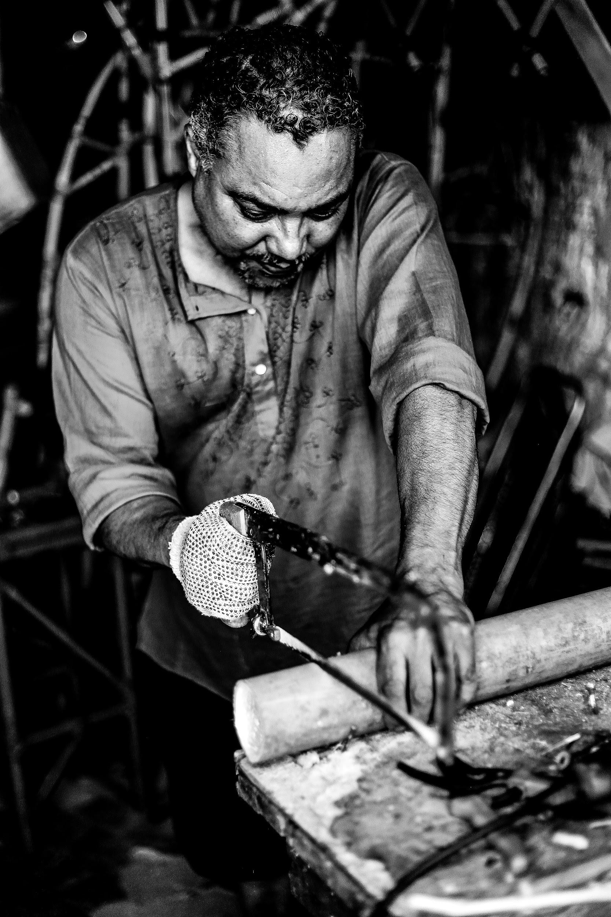
ᏦᎢᏁ ᏣᎳᎩ ᎠᏕᎶᏆᏍᏗ
ᏗᎦᎶᎩᏍᎩᏍ?
Ꮭ. Ꮭ ᏗᎦᎶᎩᏍᎩ ᏱᎩ. ᏗᏁᏍᎨᏍᎩ.
ᎠᏍᎦᏯᏍ ᎠᎨᏯᎨ ᏗᏁᏍᎨᏍᎩ?
ᎠᏍᎦᏯ ᏗᏁᏍᎨᏍᎩ.
Dihnesgesgi

Slide 15
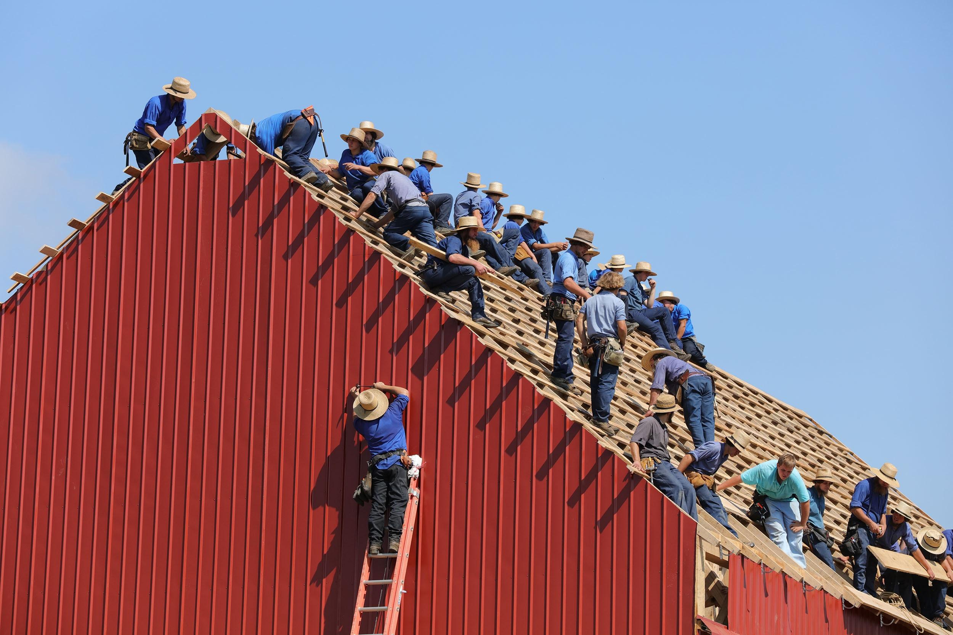
ᏦᎢᏁ ᏣᎳᎩ ᎠᏕᎶᏆᏍᏗ
Didahnesgesgi dunilvwsdane.
Anahnesge galjode.
ᎠᏂᏍᎦᏯᏍ ᎠᏂᎨyᎨ ᏗᏓᏁᏍᎨᏍᎩ?
ᎠᏂᏍᎦᏯ ᏗᏓᏁᏍᎨᏍᎩ.
ᎦᏙ ᎠᎾᏛᏁ ᏗᏓᏁᏍᎨᏍᎩ?
ᏗᏓᏁᏍᎨᏍᎩ ᏚᏂᎸᏍᏓᏁ.
ᎦᏙ ᎤᏍᏗ ᎠᎾᏁᏍᎨ ᏗᏓᏁᏍᎨᏍᎩ?
ᎦᎵᏦᏕ ᎠᎾᏁᏍᎨ.
Didahnesgesgi

Slide 16
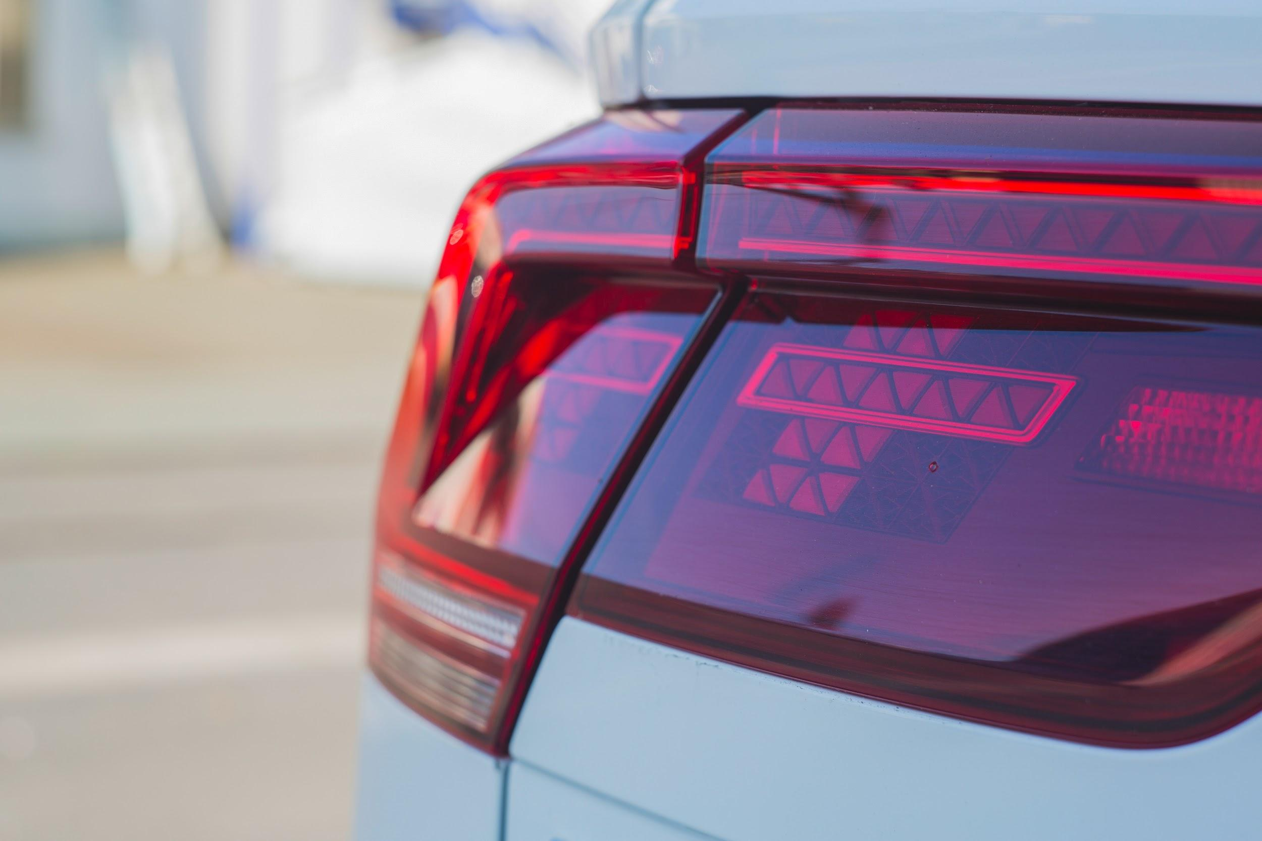
ᏦᎢᏁ ᏣᎳᎩ ᎠᏕᎶᏆᏍᏗ
ᎤᏬᏢᏗ
John, Jegskin unosele, "Jegskin, ohndidl dagwalel hidogesdi. Na dijvsd dejaksasdesdi. Sginoselvhno osd yidulvwsdane."
Ohndidl dagwalel wulehne. "Dulvwsdanes?" wutvdvne Jani.
"vv, tla, vv, tla, vv, tla" udvne Jegskin.

Slide 17
ᏦᎢᏁ ᏣᎳᎩ ᎠᏕᎶᏆᏍᏗ
ᏠᎨᏏ- Field
ᏅᏃᎯ- Road
ᎠᎢ- he/she is walking
ᎦᏙᎦ- he/she is standing
ᎠᏧᏣ- Boy
ᎠᎨᏳᏣ- Girl
ᏚᎸᏫᏍᏓᏁ- he/she is working
ᏗᏁᏍᎨᏍᎩ- Carpenter
ᏚᏂᎸᏫᏍᏓᏁ- They are working
ᎦᎵᏦᏕ- House
ᎠᎾᏁᏍᎨ- They are building it
ᏓᏆᎴᎵ- Car
ᎣᏂᏗᏝ- Behind
ᎯᏙᎨᏍᏗ- Stand there
ᏗᏨᏍᏗ- Lights
ᏕᏣᎧᏌᏍᏕᏍᏗ- you look at them

Slide 18
ᏦᎢᏁ ᏣᎳᎩ ᎠᏕᎶᏆᏍᏗ
ᏍᎩᏃᏎᎸ- You tell me
ᎣᏍᏓ- Good
ᏭᎴᏁ- He went and stood
ᎤᏛᏁ- he/she said
ᎤᏛᏛᏁ- he/she asked

