Slide 1
ᎣᏏᏲ
ᏦᏍᎪᎯ ᏣᎳᎩ ᎠᏕᎶᏆᏍᏗ

Slide 2
ᏦᏍᎪᎯ ᏣᎳᎩ ᎠᏕᎶᏆᏍᏗ
ᎢᏓᎴᎾ
ᏣᎳᎩ ᎢᏗᏬᏂ!

Slide 3
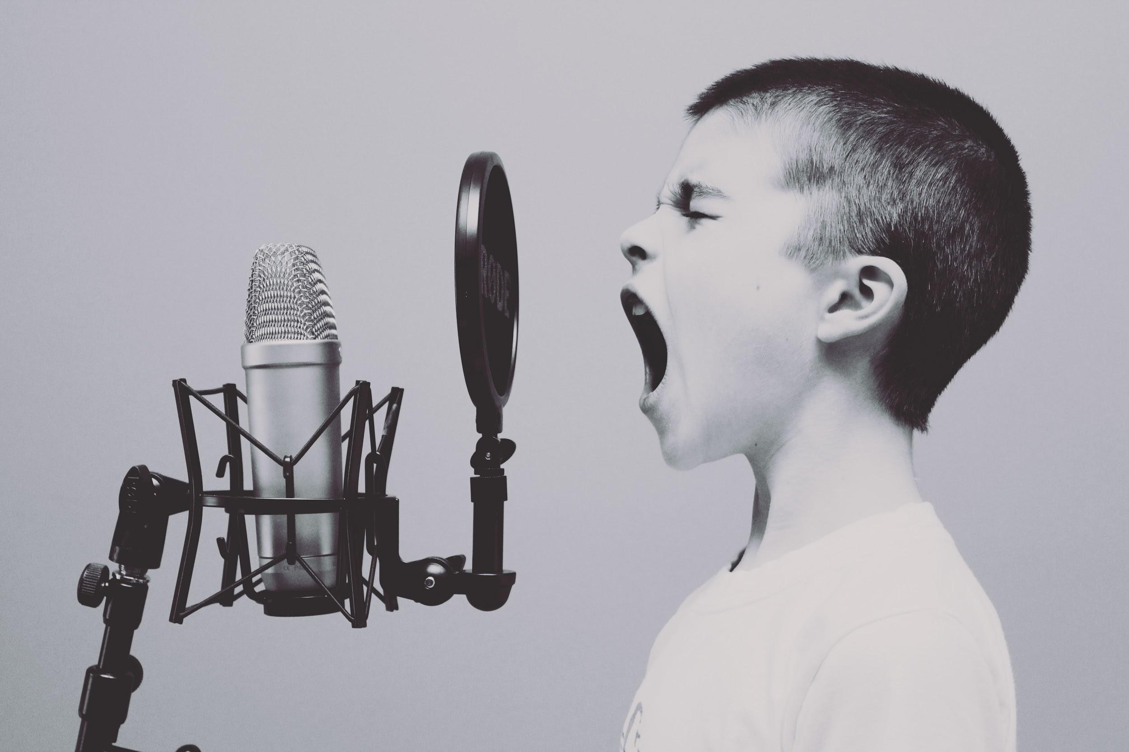
ᏔᎵᏍᎪ ᏅᎩᏁ ᏣᎳᎩ ᎠᏕᎶᏆᏍᏗ
Hisgi yawadetiyvda jigesv, elis, edud ayano widogilawitsidolv, igahnvdadisgo. Edud altsadohvsgi gesv. Jisa dulehisanv gesv. Elisi, ayano agvyididl widoginotlv. Edudu utvdvnv, “kilole yuduli juhnogisdi?” Wawaselitanv. “Edudu, dikanogidv dijinogisdi awaduli!” jiyoselv. Nole, agvyididl junilawsdi wagiwedolv. “Gado usdi dikanogidv dijanogisdi jaduli?” utvdvnv edudu. “Itse dikanogidv,” wijinohetlv. “Jisa agigeyuhina?” utvdvnv. “Tla. Na itse dikanogidv dakinogisdi awaduli. Tla yijahntadv,” edudu tsiyoselv. “Hawawu,” udvnv edudu.

Slide 4
ᏔᎵᏍᎪ ᏅᎩᏁ ᏣᎳᎩ ᎠᏕᎶᏆᏍᏗ
Nole, agvyididl wawalehnv ale hia dikanogidv widaginogisv, “O Bunnies have pink shiny noses, and this is the reason my friends, o bunnies have pink shiny noses and a powder puff on the wrong end” noleno, wawaktahvsv ale detsiquali detsitelvnv agvyidil nigad junilawsdi! Agidud doyu uyetsv. Yudaha, hia kanohetlvsgi uhnohetlvsgo, agitantanv nigalstanv!
Now, let’s look at the story and identify the words we need to use dialogue.

Slide 5
ᏓᎳᏚᏏᏁ ᏣᎳᎩ ᎠᏕᎶᏆᏍᏗ
Let’s read it in syllabary
ᏓᎩᏏ ᎤᏚᎵᏍᎨ ᎺᎵ
ᎢᎸᎯᏳ ᏥᎨᏒ, ᎠᎨᎱᏣ ᎨᎮ. ᎺᎵ ᏚᏙᎡ. ᎺᎵ ᏍᎪᎯ ᎢᏳᏕᏘᏴᏓ ᏥᎨᏒ.ᏂᎦᏓ ᎠᎾᏓᏂᏏᏂᏙᎯ ᏭᎸᏈᏕ. ᏓᎩᏏ ᏙᏳ ᎤᏚᎵᎮ ᎺᎵ. ᎤᏥ ᎤttᏛᏁ ᎺᎵ, “ᏓᎩᏏ ᎠᏩᏚᎵ. ᎭᏢ ᏱᏥᏩᏘ?”
“ᎭᎵᏭ ᏱᏩᎯᏩᏘ ᏙᏱᏗᏟ,” ᎤᏛᏁ ᎤᏥ.
ᎺᎵ ᏂᎬ ᎠᏥᏯᎸ ᏓᎩᏏ. ᎺᎵ ᏅᏃᎱᎵᏗ ᏭᎦᏔᏁ. Ꮭ ᏱᏩᏥᏩᏛᎮ ᏓᎩᏏ ᏅᏃᎱᎵᏗ.
ᎥᏓᎵ ᎾᎥ ᏓᏁᎸ ᏭᎦᏔᏁ ᎺᎵ. Ꮭ ᏱᏩᏥᏩᏛᎮ ᏓᎩᏏ ᎥᏓᎵ.
ᎺᎵ ᎤᏥ ᏭᏃᏎᎴ, “ᏓᎩᏏ ᎠᏩᏚᎵ, ᎠᏎᏃ Ꮭ ᏱᏥᏩᏘ.”
“ᏫᎩᏂᏩᎯ,” ᎤᏛᏁ ᎤᏥ

Slide 6
ᏓᎳᏚᏏᏁ ᏣᎳᎩ ᎠᏕᎶᏆᏍᏗ
ᏓᏆᎴᎵ ᏭᎾᏣᏁ. “ᎭᏢ ᏫᎩᏂᏩᎯ, ᎡᏥ?” ᎤᏛᏛᏁ ᎺᎵ.
“ᏗᎦᏚᎲ ᎢᏁᎾ,” ᎤᏛᏁ ᎺᎵ ᎤᏥ.
ᏗᏓᎾᏅ ᎤᏁᏅᏎ. ᎤᎾ, ᎤᏂᏍᏈᏍᏗ ᏧᏓᎴᏅᏓ ᎠᎾᏓᏂᏏᏂᏙ ᎠᎴ ᎢᏧᎳ ᎦᏙ ᎠᎹ ᏱᏃ ᎡᎯ ᎠᏁᎮ. ᎢᎾᏓ, ᏘᏲᎭᏟ, ᏚᏪᎦ, ᏧᏫ, ᏩᎶᏏ, ᎠᎴ ᏓᎩᏏ ᏚᏂᎧᎮ.
ᎤᏍᏗ ᏓᎩᏏ ᎤᏂᏩᏎ. ᎤᏬᏗᎨ ᎤᎵᏑᏫᏗ ᎨᏎ. Pokey ᏚᏬᏁ. ᏧᏁᏅᏒ ᎤᏂᏫᏕ.
ᎺᎵ ᎤᎵᎮᎵᏤ ᏓᎩᏏ ᏧᏩᏛᎮ.

Slide 7
ᏓᎳᏚᏏᏁ ᏣᎳᎩ ᎠᏕᎶᏆᏍᏗ
Let’s read it in syllabary
Jegskin ale Meli New York unenvse. Junalsdaiydi unalsdaiyvhvsge. Unalenvhe antlanohedihv asgaya nagoligvn nav juwotle.
“Osiju?” udvne jegskin. “Osiqudv,” udvne nagoligvn. “Jalagis sdiwoni?”
“Vv. osdijalagi. Nihina?” udvne Jegskin
“Jijalagisquu! Hatlv disdegvi?” utvdvne nagoligvn.
“Tlaigo osdegv.” udvne Jegskin
“Oh! Tlaigo wawedolv! Wunegihlda agehya nikv eloh dogindlosv Tlaigoi!”
“Gado udvne?” utvdvne Meli.
“O, aginohetlv nihidv jotlig” udvne Jegskin.

