Slide 1
ᎣᏏᏲ
ᏦᏍᎪ ᏐᏁᎵᏁ ᏣᎳᎩ ᎠᏕᎶᏆᏍᏗ

Slide 2
ᏦᏍᎪ ᏐᏁᎵᏁ ᏣᎳᎩ ᎠᏕᎶᏆᏍᏗ
ᎢᏓᎴᎾ
ᏣᎳᎩ ᎢᏗᏬᏂ!

Slide 3
ᏦᏍᎪᎯ ᏌᏊᎯᏁ ᏣᎳᎩ ᎠᏕᎶᏆᏍᏗ
Ilvhiyu jigesv uwosulojv ehe. Sudetiyvd gvwayohuse gese aninel. Sawu uwej agehya uwekahe. Doyu uwodu gese uwej agehya. “Osd ganohalidohi hiwatahvi,” unosele agayvlige. “Jituisd osd ganohalido oginaneldisdi,” udvne uwej agehya. Sawu iga, ulilohi asgaya junenvsv wuluje. “Jagwej agehya oginaneldisdi awaduli” udvne asgaya. “Osda ganohalidohi unaneldisdi,” udvne uji. Uwosulojv unosele “Ayadv wosda jinohalidohi.” udvne asgaya. “Widajilinohedtanv,” udvne agayvlige. Svhiyeno, uwej ageya unosele, “asgaya wulujv. Udulisgv sdaneldisdi. Osd ganohalidohi gesv udvne. Alisdi yisdanelvdi.” udvne uwosulojv. “Hawa. yosdanelvda,” udvne agehya. Na agehya asgayahno unanelde. Asgaya widunele agehyuja ujihno.
Soi sunale winulstan asgaya wuyeje “dajinohildo kohig,” udvne. Dodaquad uhnelde. Svhiyegi wulujehno, tal yiga junsdi jisdej duhnotle. “Agiquolvsv kohig.”
Taline sunale winulstan, wuyeje udvnvistaneho, “yidagasunes, geli.” udvne. Dodaquad uhnelade. Svhiyegi wulujehno, jo yani junsdi ajad duhnotlv.

Slide 4
ᏦᏍᎪᎯ ᏌᏊᎯᏁ ᏣᎳᎩ ᎠᏕᎶᏆᏍᏗ
Joine sunale winulstan, wuyeje duhnawoahno unohalesdi. Dodaquad uhnelade. Dunenvsv wulujehno, digvhalvda hawiya duyhotle junihiyv nudale aninohalidohi.
Nole agayvlige udlasitihe. “Hisdawaduga sunale,” agehya unosele. Soi sunale winulstan, wuyeje asgaya wunoselehno jusihnena. “Dvjisdawades anagisv,” elisge agehya. Juhnigise, asgaya wusdawadvse na agehya. Usdawadvse kila uweyv wuluje aninel.
Uhna, uguk nulsdane udanedliyvse aninel. “Ugukuu! Ugukuu!” nigawesge. Doyu uhnalvje agehya. “Asgaya oginaneldv gelisgv, aseno uguku ugvwiyusv oginaneldv." Agasesde uguku. Gohida amayi uksesde uguku. Nutlisdawu, wutlawidvhe amayuldi. Noyi duwutese degasugatlv. Usdi jisdvna usuyesv.
Duwasosv amayuldi, udanedliyvse asgaya nulstane. Juwenvsadidl wulose. Agehya uwanvje igvyihno wuluje junenvsv. Wuluje asgaya, usdi jisdvn wugotvtane uniyvd. Usdayvhvsg utvdvne “gado usdi nidulstane nigad ajad jidehiniyvhe?” “Uguku dusgasdanele nigad ajad,” udvne asgaya. “halsgosg” agosele na asgaya “nihidv uguku geli,” udvne ageya. Agadaniyvstane. Inage wulose. Uhisodanele ulesod nulsdane nasgi uskol uwasa.

Slide 5
ᏦᏍᎪᎯ ᏌᏊᎯᏁ ᏣᎳᎩ ᎠᏕᎶᏆᏍᏗ

Slide 6
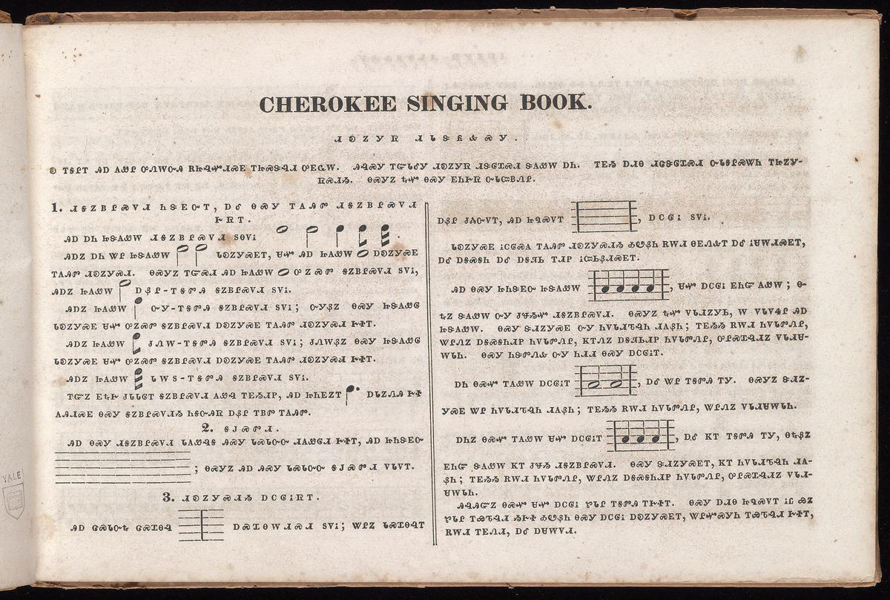
ᏦᏍᎪᎯ ᏌᏊᎯᏁ ᏣᎳᎩ ᎠᏕᎶᏆᏍᏗ

Slide 7
ᏦᏍᎪᎯ ᏌᏊᎯᏁ ᏣᎳᎩ ᎠᏕᎶᏆᏍᏗ
ᏗᎧᏃᎩᏒ ᏗᏓᏕᏲᎲᏍᎩ
Ꭷ ᎢᎦᎵᎢ ᎯᎠ ᏗᎪᏪᎵ ᎤᏁᎳᏅᎯ ᎡᏥᎸᏉᏗᏍᎬ ᎢᏥᏍᏕᎸᏗ ᎤᎬᏩᎳ. ᎯᎸᏍᎩ ᎢᏳᏓᎴᎩ ᏗᎧᏃᎩᏒ ᏗᏕᎶᏆᏍᏗ ᏕᎪᏪᎸ ᎠᏂ. ᎢᎬᏱ ᎠᏗᎾ ᏗᏥᏌᏕᎶᏆᏍᏗ ᏅᏓᎦᎵᏍᏔᏂ ᎢᏥᏃᎩ ᏒᏍᏗᏱ. ᎾᏍᎩᏃ ᎿᏉ ᎾᏍᎩ ᎬᏂᎨᏒ ᏅᏓᏨᏴᏁᎵ.
Dikanogisv didadeyohvsgi
Ka igalii hia digoweli unelanvhi etsilvquodisgv itsisdelvdi ugvwala.
Hilvsgi iyudalegi dikanogisv dideloquasdi degowelv ani. igvyi adina ditsadeloquasdi nvdagalistani itsinogi svsdiyi. nasgino hnaquo nasgi gvnigesv nvdatsvyvneli

Slide 8
ᏦᏍᎪᎯ ᏌᏊᎯᏁ ᏣᎳᎩ ᎠᏕᎶᏆᏍᏗ
ᏗᎦᏃᏴᎵᏍᏙᏗ ᏂᏕᎬᏅᎢ, ᎠᎴ ᎾᏍᎩ ᎢᎪᎯᏛ ᏗᎦᏃᏴᎵᏍᏙᏗ ᎨᏒᎢ.
ᎯᎠ ᎠᏂ ᏥᏕᎪᏪᎳ ᏗᎦᏃᏴᎵᏍᏙᏗ ᏚᎾᏙᎥ
ᎯᎠᏃ ᎠᏂ ᏔᎵ ᏥᏕᎪᏪᎳ ᏓᎧᏃᎩᏍᎬᎢ, ᏌᏉ ᎯᎠ ᎠᎧᏃᎩᏍᎬ ᎢᎪᎯᏛ ᏗᎧᏃᎩᏍᏗ.
diganoyvlisdodi nidegvnvi, ale nasgi igohidv diganoyvlisdodi gesvi
hia ani tsidegowela diganoyvlisdodi dunadov
hiano ani tali tsidegowela dakanogisgvi, saquo akanogisgv igohidv dikanogisdi.

Slide 9
ᏦᏍᎪᎯ ᏌᏊᎯᏁ ᏣᎳᎩ ᎠᏕᎶᏆᏍᏗ
ᎾᏍᎩᏃ ᎢᏳᏍᏗ ᏥᎪᏪᎳ ᎤᏃᏍᏓ ᎦᏃᏴᎵᏍᏙᏗ ᏚᏙᎥ,
ᎯᎠᏃ ᏥᎪᏪᎳ ᎠᏰᎵ ᎢᎦᏛᎯ ᎦᏃᏴᎵᏍᏙᏗ ᏚᏙᎥ.
ᎯᎠᏃ ᏥᎪᏪᎳ ᏅᎩ ᎢᎦᏛᎯ ᎦᏃᏴᎵᏍᏙᏗ ᏚᏙᎥ; ᏅᎩᏰᏃ ᎾᏍᎩ ᏥᏕᎪᏪᎶ ᏓᎧᏃᎩᏍᎬ ᏌᏉ ᎤᏃᏍᏛ ᎦᏃᏴᎵᏍᏙᏗ ᎠᎧᏃᎩᏍᎬ ᎢᎪᎯᏛ ᏗᎧᏃᎩᏍᏗ ᎨᏐᎢ.
ᎯᎠᏃ ᏥᎪᏪᎳ ᏧᏁᎳ ᎢᎦᏛᎯ ᎦᏃᏴᎵᏍᏙᏗ ᏚᏙᎥ; ᏧᏁᎳᏰᏃ ᎾᏍᎩ ᏥᏕᎪᏪᎶ ᏓᎧᏃᎩᏍᎬ ᏌᏉ ᎤᏃᏍᏛ ᎦᏃᏴᎵᏍᏙᏗ ᎠᎧᏃᎩᏍᎬ ᎢᎪᎯᏛ ᏗᎧᏃᎩᏍᏗ ᎨᏐᎢ.
ᎯᎠᏃ ᏥᎪᏪᎳ ᏓᎳᏚ ᎢᎦᏛᎯ ᎦᏃᏴᎵᏍᏙᏗ ᏚᏙᎥ.
ᎢᏳᏃ ᎬᎿᎨ ᏧᏓᏓᎶᎢ ᎦᏃᏴᎵᏍᏙᏗ ᎪᏪᎸ ᎢᎬᏱᏗᏢ, ᎯᎠ ᏥᏂᎬᏃᎢ ᎠᏓᏃᏁᎯ ᎨᏐ ᎪᎯᏗᏍᎬ ᎾᏍᎩ ᎦᏃᏴᎵᏍᏙᏗ ᏂᎦᏅᎯᏒ ᎠᏰᎵ ᎢᏴᏛ ᎢᎪᎯᏛ.

Slide 10
ᏦᏍᎪᎯ ᏌᏊᎯᏁ ᏣᎳᎩ ᎠᏕᎶᏆᏍᏗ
Nasgino iyusdi hia tsigowela unosda ganoyvlisdodi dudov,
Hiano tsigowela ayeli igadvhi ganoyvlisdodi dudov.
Hiano tsigowela nvgi igadvhi ganoyvlisdodi dudov; nvgiyeno nasgi tsidegowelo dakanogisgv saquo unosdv ganoyvlisdodi akanogisgv igohidv dikanogisdi gesoi.
Hiano tsigowela tsunela igadvhi ganoyvlisdodi dudov; tsunelayeno nasgi tsidegowelo dakanogisgv saquo unosdv ganoyvlisdodi akanogisgv igohidv dikanogisdi gesoi.
Hiano tsigowela daladu igadvhi ganoyvlisdodi dudov.
Iyuno gvhnage tsudadaloi ganoyvlisdodi gowelv igvyiditlv, hia tsinigvnoi adanonehi geso gohidisgv nasgi ganoyvlisdodiyi niganvhisv ayeli iyvdv igohidv.

Slide 11
ᏦᏍᎪᎯ ᏌᏊᎯᏁ ᏣᎳᎩ ᎠᏕᎶᏆᏍᏗ
2. ᎦᎫᏍᏛᏗ
ᎯᎠ ᎾᏍᎩ ᏗᎦᏃᏴᎵᏍᏙᏗ ᏓᎪᏪᎸᎦ ᎯᏍᎩ ᏓᏍᏓᏅᏅ ᏗᎪᏪᎶᏗ ᎨᏐᎢ, ᎯᎠ
ᏥᏂᏕᎬᏅ ᎠᏰᎵ ᏧᏜ ᏅᏙᎢ, ᎯᎠ ᏥᏄᏍᏙᎢ , ᎠᏟᎶᎥ ᏚᏙᎥ.
ᏓᎧᏃᎩᏍᎬ ᎥᏟᎶᏍᎪ ᎢᎪᎯᏛ ᏗᎧᏃᎩᏍᏗᏱ ᎣᏬᏰᏂ ᎡᎳᏗ ᎾᎬᏁᎲᎢ ᎠᎴ ᎥᏌᎳᏗᏍᎬᎢ, ᎠᎴ ᎠᎦᏍᎦᏂ ᎠᎴ ᎠᎦᏘᏏ ᎢᏗᏢ ᎥᏨᏏᏰᏗᏍᎬᎢ.
ᎯᎠ ᎾᏍᎩ ᏥᏂᏕᎬᏅ ᏥᏕᎪᏪᎳ , ᏌᏉ ᎠᏟᎶᎥ ᎬᏂᏳ ᎪᏪᎸ; ᎾᎿᏃ ᏕᎪᏪᎳ ᏅᎩ ᏧᏠᏱᏉ ᏗᎦᏃᏴᎵᏍᏙᏗ. ᎾᏍᎩᏃ ᎿᏉ ᏙᏓᏗᏃᎩᏏ, Ꮃ ᏙᏓᏙᏎᎵ ᎯᎠ ᏥᏕᎪᏪᎳ. ᎾᏍᎩ ᏕᏗᏃᎩᏍᎬ ᏅᎩ ᏂᏙᏓᏗᏖᎸᏂ ᏗᎪᏰᏂ; ᎢᎬᏱᏱ ᎡᎳᏗ ᏂᏙᏓᏛᏁᎵ, ᏔᎵᏁᏃ ᎠᎦᏍᎦᏂᏗᏢ ᏂᏙᏓᏛᏁᎵ, ᏦᎢᏁᏃ ᎠᎦᏘᏏᏗᏢ ᏂᏙᏓᏛᏁᎵ, ᎤᎵᏍᏆᎸᏗᏃ ᏙᏓᏗᏌᎳᏓᏂ. ᎾᏍᎩ ᏂᏕᏛᏁᎲ ᏅᎩ ᏂᏗᏗ ᎾᏍᎩ ᎠᏟᎶᎥᎢ.

Slide 12
ᏦᏍᎪᎯ ᏌᏊᎯᏁ ᏣᎳᎩ ᎠᏕᎶᏆᏍᏗ
2. Gadasdvdi
Hia nasgi diganoyvlisdodi dagowelvga hisgi dasdanvnv digowelodi gesoi, hia tsinidegvnv ayeli tsudlanvdoi, hia tsinusdoi , atlilov dudov.
Dakanogisgv vtlilosgo igohidv dikanogisdiyi owoyeni eladi nagvnehvi ale vsaladisgvi, ale agasgani ale agatisi iditlv itsvsiyedisgvi.
hia nasgi tsinidegvnv tsidegowela , saquo atlilov gvniyu gowelv; nahnano degowela nvgi tsutloyiquo diganoyvlisdodi. Nasgino hnaquo dodadinogisi, la dodadoseli hia tsidegowela. Nasgi dedinogisgv nvgi nidodaditelvni digoyeni; igvyiyi eladi nidodadvneli, talineno agasganiditlv nidodadvneli, tsoineno agatisiditlv nidodadvneli, ulisqualvdino dodadisaladani. Nasgi nidedvnehv nvgi nididi nasgi atlilovi.

Slide 13
ᏦᏍᎪᎯ ᏌᏊᎯᏁ ᏣᎳᎩ ᎠᏕᎶᏆᏍᏗ
ᎠᏂ ᎾᏍᏉ ᎢᎪᏪᎳ ᎠᏟᎶᎥᎢ , ᎠᎴ ᏔᎵ ᎢᎦᏛᎯ ᎢᎩ. ᎾᏍᎩᏃ ᏕᏗᏃᎩᏍᎬ ᏔᎵ ᏂᏙᏓᏗᏖᎸᏂ ᏗᎪᏰᏂ; ᎢᎬᏱᏱ ᎡᎳᏗ ᏂᏙᏓᏛᏁᎵ, ᏔᎵᏁᏃ ᏙᏓᏗᏌᎳᏓᏂ.
ᎠᏂᏃ ᎾᏍᏉ ᎢᎪᏪᎳ ᏌᏉ ᎠᏟᎶᎥᎢ , ᎠᎴ ᏦᎢ ᎢᎦᏛᎯ ᎢᎩ, ᎾᎿᏰᏃ ᎬᏂᏳ ᏕᎪᏪᎳ ᏦᎢ ᏧᏠᏱ ᏗᎦᏃᏴᎵᏍᏙᏗ. ᎾᏍᎩ ᏕᏗᏃᎩᏍᎬᎢ, ᏦᎢ ᏂᏙᏓᏗᏖᎸᏂ ᏗᎪᏰᏂ; ᎢᎬᏱᏱ ᎡᎳᏗ ᏂᏙᏓᏛᏁᎵ, ᏔᎵᏁᏃ ᎠᎦᏍᎦᏂᏗᏢ ᏂᏙᏓᏛᏁᎵ, ᎤᎵᏍᏆᎸᏗᏃ ᏙᏓᏗᏌᎳᏓᏂ.
ᎯᎸᎯᏳᏃ ᎾᏍᏉ ᏌᏉ ᎠᏟᎶᎥ ᏑᏓᎵ ᎢᎦᏛᎯ ᎢᎨᏐᎢ. ᎾᏍᎩ ᎠᏗᎾ ᏥᏄᏍᏙᎢ ᎥᏝ ᏯᏃ ᏑᏓᎵ ᎢᏯᏖᎸᏗ ᏱᎨᏐ ᎣᏬᏰᏂ ᎾᏍᎩ ᎠᏟᎶᎥ ᎠᎧᏃᎩᏍᎬᎢ, ᏔᎵᏉᏍᎩᏂ ᎢᏯᏖᎸᏗ ᎨᏐᎢ,

Slide 14
ᏦᏍᎪᎯ ᏌᏊᎯᏁ ᏣᎳᎩ ᎠᏕᎶᏆᏍᏗ
ani nasquo igowela atlilovi , ale tali igadvhi igi. Nasgino dedinogisgv tali nidodaditelvni digoyeni; igvyiyi eladi nidodadvneli, talineno dodadisala dani.
Anino igowela saquo atlilovi , ale tsoi igadvhi igi, nahnayeno gvniyu degowela tsoi tsutloyi diganoyvlisdodi. Nasgi dedinogisgvi, tsoi nidodaditelvni digoyeni; igvyiyi eladi nidodadvneli, talineno agasganiditlv nidodadvneli, ulisqualvdino dodadisaladani.
Hilvhiyuno nasquo saquo atlilov sudali igadvhi igesoi. Nasgi adina tsinusdoi vtla yano sudali iyatelvdi yigeso owoyeni nasgi nasgi atlilov akanogisgvi, taliquosgini iyatelvdi gesoi,

