Slide 1
ᎣᏏᏲ
ᏅᎩᏁ ᏣᎳᎩ ᎠᏕᎶᏆᏍᏗ

Slide 2
ᏅᎩᏁ ᏣᎳᎩ ᎠᏕᎶᏆᏍᏗ
ᎢᏓᎴᎾ
ᏣᎳᎩ ᎢᏗᏬᏂ!

Slide 3
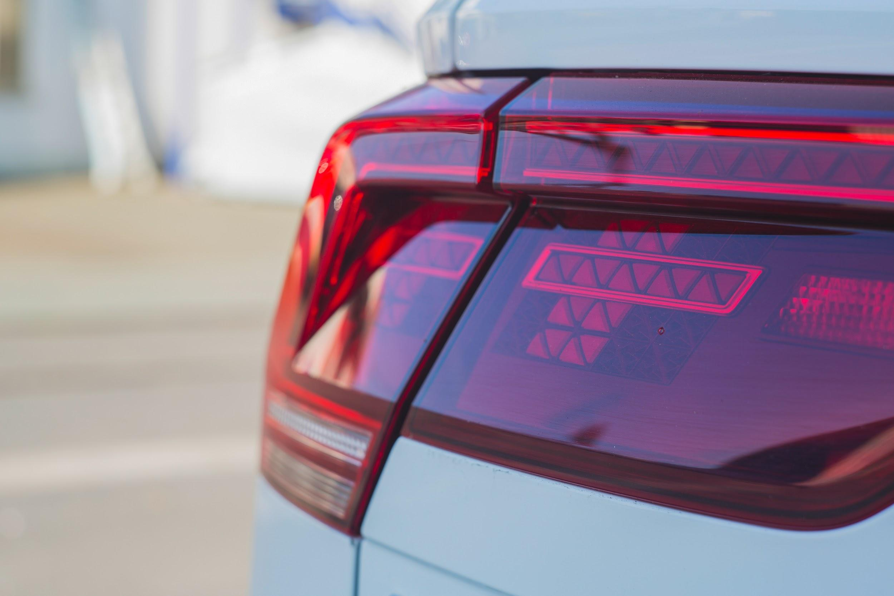
ᏅᎩᏁ ᏣᎳᎩ ᎠᏕᎶᏆᏍᏗ
John, Jegskin unosele, "Jegskin, ohndidl dagwalel hidogesdi. Na dijvsd dejaksasdesdi. Sginoselvhno osd yidulvwsdane."
Ohndidl dagwalel wulehne. "Dulvwsdanes?" wutvdvne Jani.
"vv, tla, vv, tla, vv, tla" udvne Jegskin.

Slide 4
ᏅᎩᏁ ᏣᎳᎩ ᎠᏕᎶᏆᏍᏗ
ᏏᏊ ᏥᏂᎪᎵᏯ
John, Jegskin unosele, "Jegskin, ohndidl dagwalel hidogesdi. Na dijvsd dejaksasdesdi. Sginoselvhno osd yidulvwsdane."
Ohndidl dagwalel wulehne. "Dulvwsdanes?" wutvdvne Jani.
"vv, tla, vv, tla, vv, tla" udvne Jegskin.
ᎦᎪ ᎣᏂᏗᏜ ᏓᏆᎴᎵ ᏭᎴᏁ?
ᏤᎩᏍᎨᏂ ᎣᏂᏗᏜ ᏓᏆᎴᎵ ᏭᎴᏁ.
ᎦᏙ ᎤᏍᏗ ᏭᎧᏌᏍᏓᏁ ᏤᎩᏍᎨᏂ?
ᎠᏨᏍᏗ ᏭᎧᏌᏍᏓᏁ ᏤᎩᏍᎨᏂ.
ᎣᏂᏗᏜᏍ ᎠᎬᏱᏗᏝᎨ ᏭᎴᏁ ᏤᎩᏍᎨᏂ?
ᎣᏂᏗᏜ ᏭᎴᏁ ᏤᎩᏍᎨᏂ.

Slide 5
ᏅᎩᏁ ᏣᎳᎩ ᎠᏕᎶᏆᏍᏗ
ᏠᎨᏏ- Field
ᏅᏃᎯ- Road
ᎠᎢ- he/she is walking
ᎦᏙᎦ- he/she is standing
ᎠᏧᏣ- Boy
ᎠᎨᏳᏣ- Girl
ᏚᎸᏫᏍᏓᏁ- he/she is working
ᏗᏁᏍᎨᏍᎩ- Carpenter
ᏚᏂᎸᏫᏍᏓᏁ- They are working
ᎦᎵᏦᏕ- House
ᎠᎾᏁᏍᎨ- They are building it
ᏓᏆᎴᎵ- Car
ᎣᏂᏗᏝ- Behind
ᎯᏙᎨᏍᏗ- Stand there
ᏗᏨᏍᏗ- Lights
ᏕᏣᎧᏌᏍᏕᏍᏗ- you look at them

Slide 6
ᏅᎩᏁ ᏣᎳᎩ ᎠᏕᎶᏆᏍᏗ
ᏍᎩᏃᏎᎸ- You tell me
ᎣᏍᏓ- Good
ᏭᎴᏁ- He went and stood
ᎤᏛᏁ- he/she said
ᎤᏛᏛᏁ- he/she asked

Slide 7
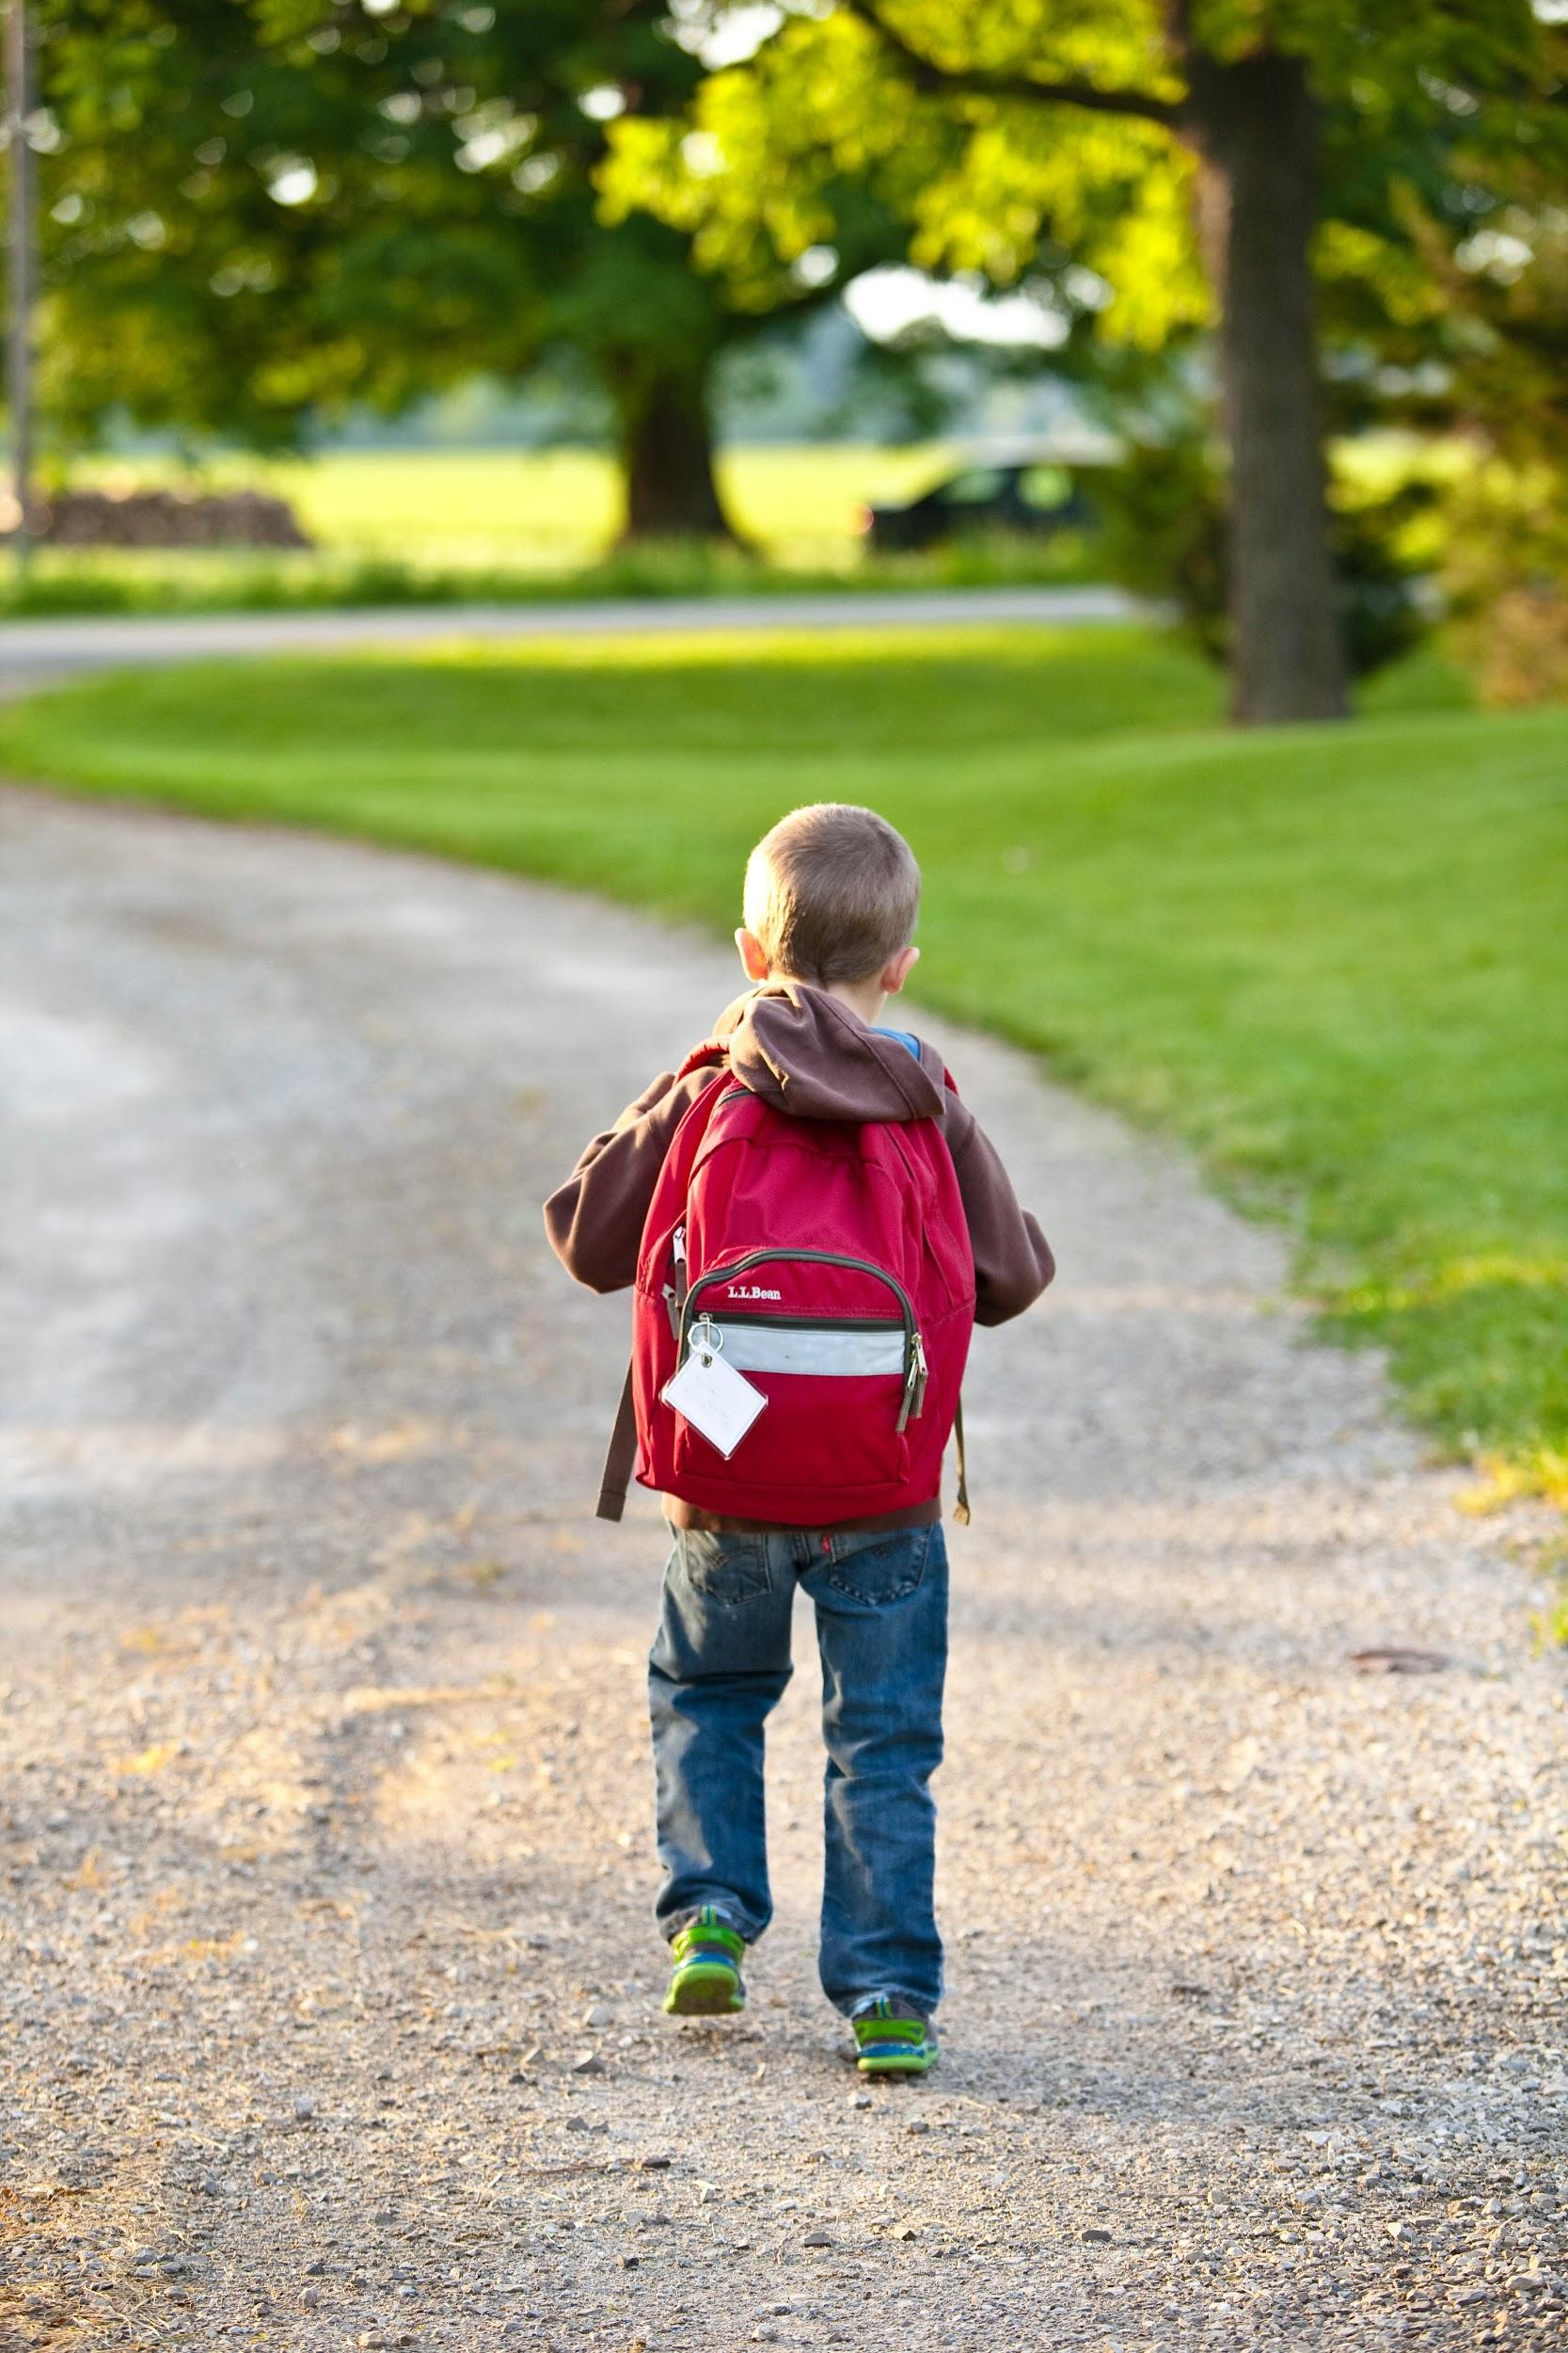
ᏅᎩᏁ ᏣᎳᎩ ᎠᏕᎶᏆᏍᏗ
Hia achuj.
Uniltanvdodi una na achuj.
Gigage ulsuwid na uniltanvdodi juna achuj.
Na achuj nvnohi wai.
Jundelquasdi ega na achuj.
ᎠᏧᏣ
uniltanvdodi

Slide 8
ᏅᎩᏁ ᏣᎳᎩ ᎠᏕᎶᏆᏍᏗ
ᎠᏧᏣᏍ ᎠᎨᏳᏣᎨ ᎤᏂᎵᏔᏅᏙᏗ ᎤᎾ?
ᎠᏧᏣ ᎤᏂᎵᏔᏅᏙᏗ ᎤᎾ.
ᎦᏙ ᎤᏍᏗ ᎤᎾ Ꮎ ᎠᏧᏣ?
ᎤᏂᎵᏔᏅᏙᏗ ᎤᎾ Ꮎ ᎠᏧᏣ.
ᎩᎦᎨᏍ ᏌᎪᏂᎨᎨ ᎤᎵᏑᏫᏗ Ꮎ ᎤᏂᎵᏔᏅᏙᏗ ᏧᎾ Ꮎ ᎠᏧᏣ?
ᎩᎦᎨ ᎤᎵᏑᏫᏗ Ꮎ ᎤᏂᎵᏔᏅᏙᏗ ᏧᎾ Ꮎ ᎠᏧᏣ.
ᎭᏢ ᎡᎦ Ꮎ ᎠᏧᏣ?
ᏧᎾᏕᎶᏆᏍᏗ ᎡᎦ Ꮎ ᎠᏧᏣ.
ᎠᏧᏣ

Slide 9
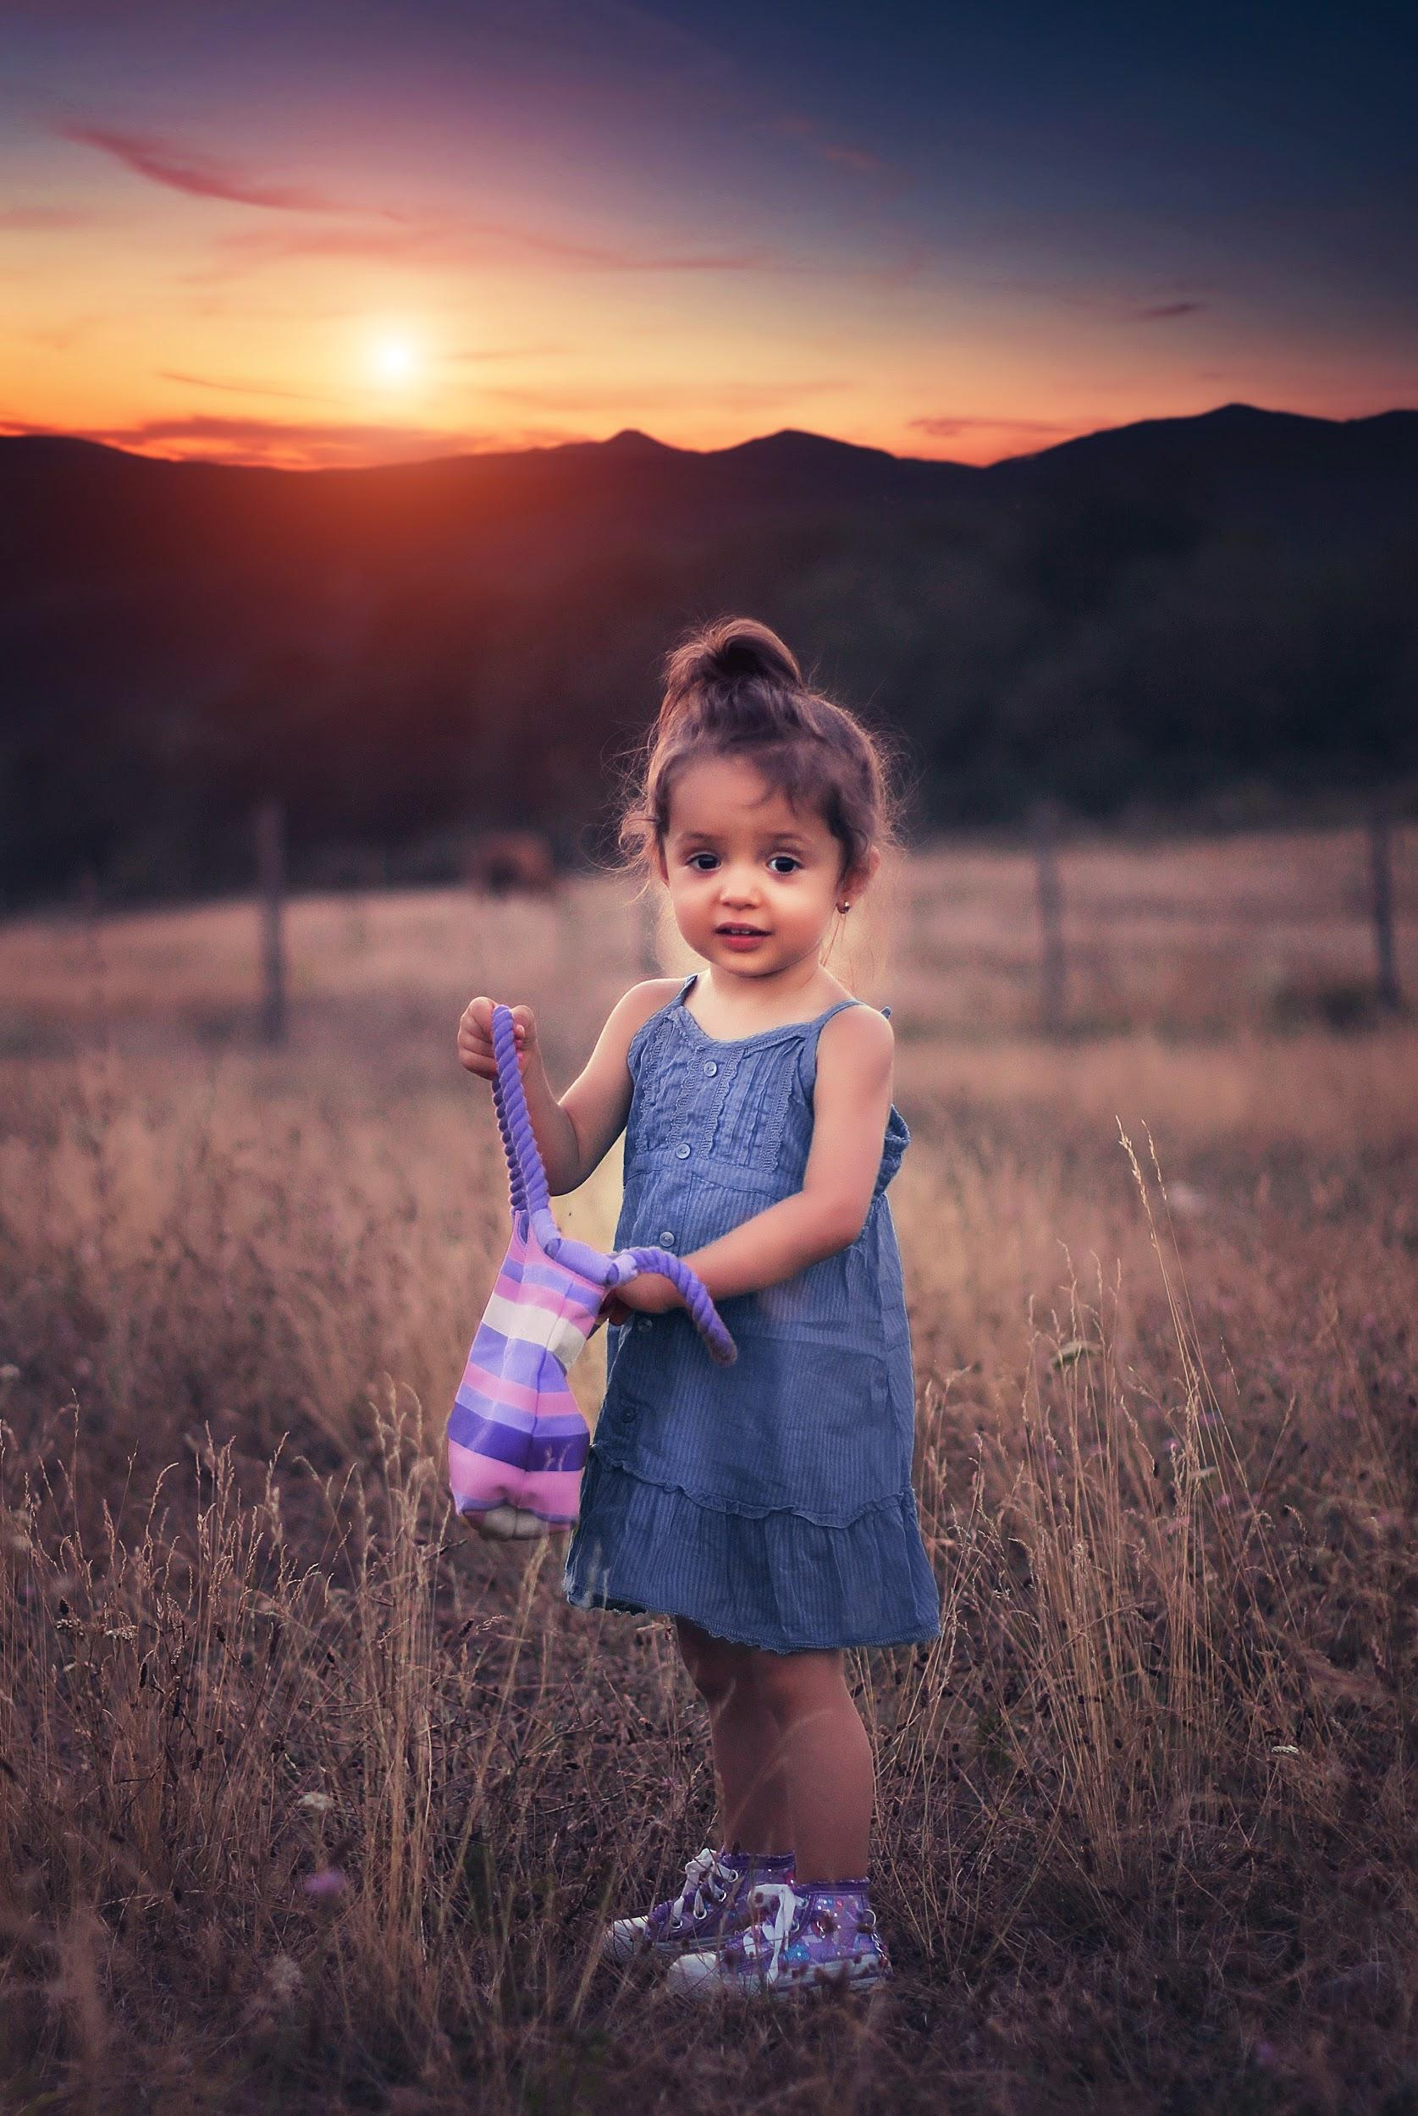
ᏅᎩᏁ ᏣᎳᎩ ᎠᏕᎶᏆᏍᏗ
Hia aguhyuja.
Adeldigahldodi una na agehyuj.
Julohldi ulsuwid na adeldigahldod juna agehyuj.
Tloges gadog na agehyuj.
ᎠᎨᏳᏣ
adeldigahldod

Slide 10
ᏅᎩᏁ ᏣᎳᎩ ᎠᏕᎶᏆᏍᏗ
ᎠᏕᎳᏗᎦᎵᏙᏗᏍ ᎤᏂᎵᏔᏅᏙᏗᎨ ᎤᎾ Ꮎ ᎠᎨᏳᏣ?
ᎠᏕᎳᏗᎦᎵᏙᏗ ᎤᎾ Ꮎ ᎠᎨᏳᏣ.
ᎠᏧᏣᏍ ᎠᏕᎳᏗᎦᎵᏙᏗ ᎤᎾ?
Ꮭ. Ꮭ ᎠᏧᏣ ᏱᎩ ᏧᎾ ᎠᏕᎳᏗᎦᎵᏙᏗ. ᎠᎨᏳᏣ ᎠᏕᎳᏗᎦᎵᏙᏗ ᎤᎾ.
ᎦᏙ ᎤᏍᏗ ᎤᎵᏑᏫᏗ Ꮎ ᎠᏕᎳᏗᎦᎵᏙᏗ ᏧᎾ Ꮎ ᎠᎨᏳᏣ?
ᏧᎶᎵᏗ ᎤᎵᏑᏫᏗ ᎠᏕᎳᏗᎦᎵᏙᏗ.
ᎠᎨᏳᏣ

Slide 11
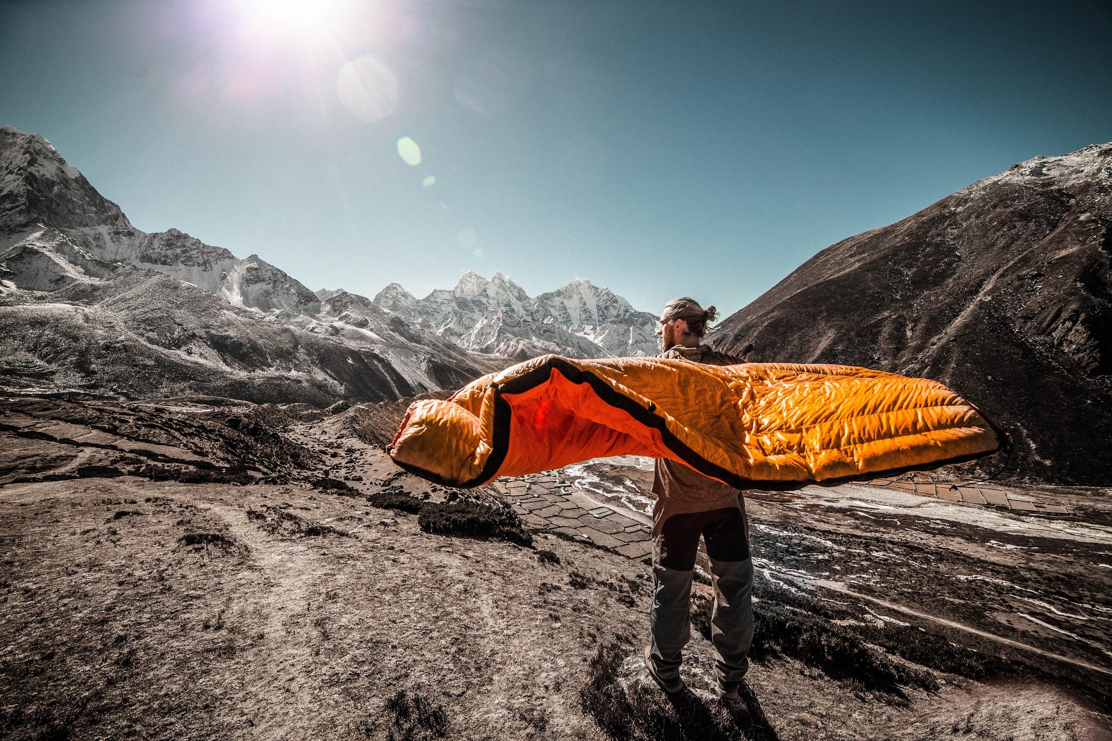
ᏅᎩᏁ ᏣᎳᎩ ᎠᏕᎶᏆᏍᏗ
Ahani asgaya wigadog.
Odalv wigadog na asgaya.
Unegvha una na asgaya.
Anji ulsuwid na unegvha juna na asgaya.
Anji unegvha una na asgaya odalv wijigadog.

Slide 12
ᏅᎩᏁ ᏣᎳᎩ ᎠᏕᎶᏆᏍᏗ
ᎠᎨᏯᏍ ᏫᎦᏙᎦ?
Ꮭ. Ꮭ ᎠᎨᏯ ᏱᎩ ᏫᏥᎦᏙᎦ. ᎠᏍᎦᏯ ᏫᎦᏙᎦ.
ᏠᎨᏏᏍ ᎣᏓᎸᎨ ᏫᎦᏙᎦ Ꮎ ᎠᏍᎦᏯ?
ᎣᏓᎸ ᏫᎦᏙᎦ ᎠᏍᎦᏯ.
ᎤᏂᎵᏔᏅᏙᏗᏍ ᎤᏁᎬᎭᎨ ᎤᎾ Ꮎ ᎠᏍᎦᏯ?
ᎤᏁᎬᎭ ᎤᎾ Ꮎ ᎠᏍᎦᏯ.
ᎦᏙ ᎤᏍᏗ ᎤᎵᏑᏫᏗ Ꮎ ᎤᏁᎬᎭ ᏧᎾ Ꮎ ᎠᏍᎦᏯ?
ᎠᏂᏥ ᎤᎵᏑᏫᏗ Ꮎ ᎤᏁᎬᎭ.

Slide 13
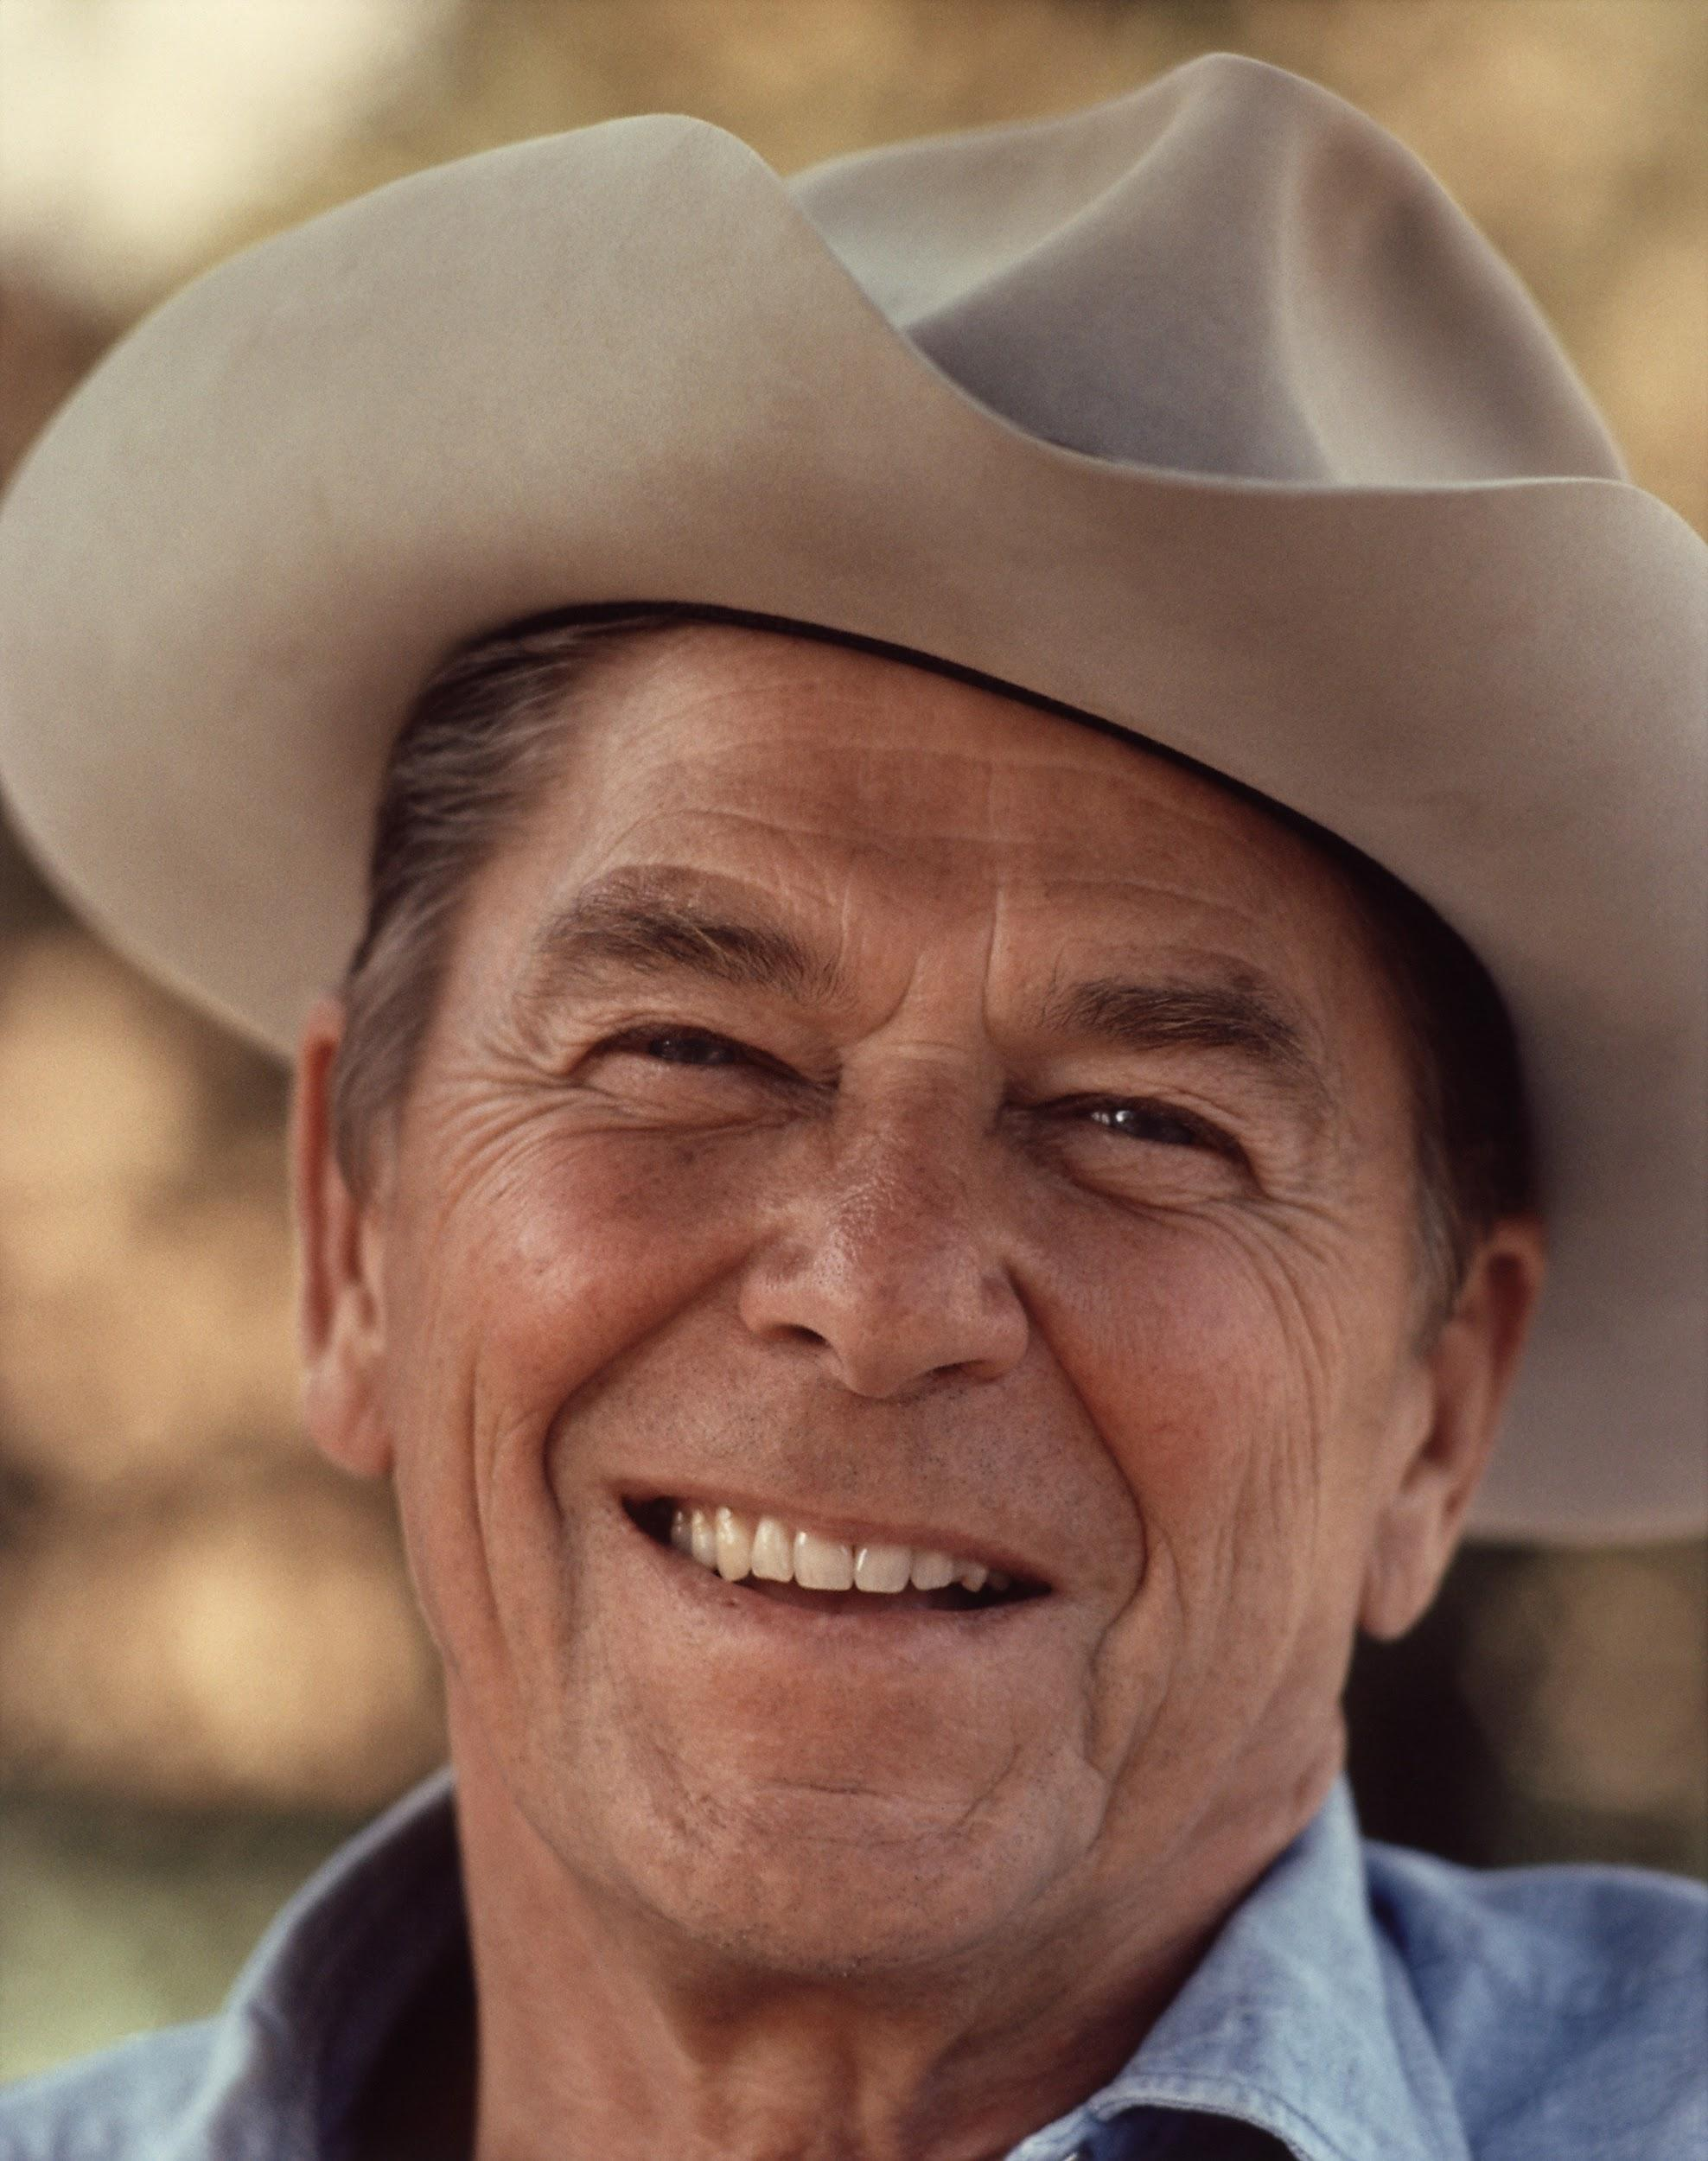
ᏅᎩᏁ ᏣᎳᎩ ᎠᏕᎶᏆᏍᏗ
Hia utvsonv.
Ronald Reagan dudoa.
Ugvwiyuhi gese.
ᎤᏛᏐᏅᏍ ᎠᏧᏣᎨ?
ᎤᏛᏐᏅ.
ᎦᏙ ᎤᏍᏗ ᏚᏙᎠ?
Ronald Reagan ᏚᏙᎠ.
ᏃᏭᏍ ᎤᎬᏫᏳᎯ?
Ꮭ. Ꮭ ᏃᏭ ᏱᎦ. ᎤᎬᏫᏳᎯ ᎨᏎ.

Slide 14
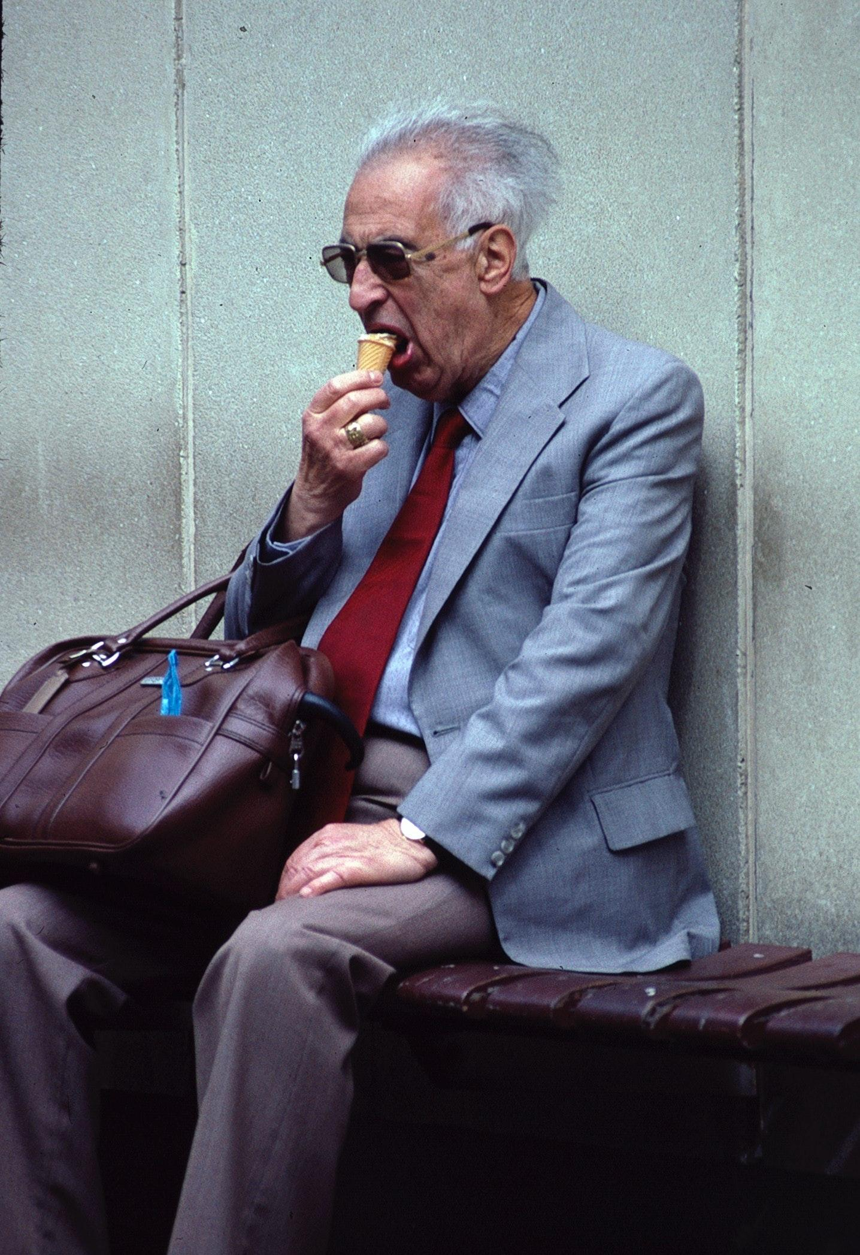
ᏅᎩᏁ ᏣᎳᎩ ᎠᏕᎶᏆᏍᏗ
Hia utvsonv.
Ganoji gotlvnv degald.
Ganoji degald una na utvsonv.
Utvsonv uwotla.
Unvdi ganesdaldistanv agia na utvsonv.
ᎠᏧᏣᏍ?
Ꮭ ᎠᏧᏣ ᏱᎩ. ᎤᏛᏐᏅ.
ᎦᏃᏥᏍ ᎠᏓᎭᎨ ᎪᏢᏅ ᏧᎾ Ꮎ ᎤᏛᏐᏅ?
ᎦᏃᏥ ᎪᏢᏅ ᎤᎾ Ꮎ ᎤᏛᏐᏅ.
ᎦᏙᎦᏍ ᎤᏛᏐᏅ?
Ꮭ. Ꮭ ᏱᎦᏙᎦ ᎤᏛᏐᏅ. ᎤᏬᏢ.

Slide 15
ᏅᎩᏁ ᏣᎳᎩ ᎠᏕᎶᏆᏍᏗ
Hia utvsonv.
Ganoji gotlvnv degald.
Ganoji degald una na utvsonv.
Utvsonv uwotla.
Unvdi ganesdaldistanv agia na utvsonv.
ᎦᏙ ᎠᏛᏁ Ꮎ ᎤᏛᏐᏅ?
ᎤᏛᏐᏅ ᎤᏬᏢ.
ᎦᏙ ᎤᏍᏗ ᎠᎩᎠ ᎤᏛᏐᏅ?
ᎤᏅᏗ ᎦᏁᏍᏓᎵᏗᏍᏔᏅ ᎠᎩᎠ Ꮎ ᎤᏛᏐᏅ.
ᏕᎦᎵᏗᏍ ᎤᏁᎬᎭᎨ ᎤᎾ Ꮎ ᎤᏛᏐᏅ?
ᏕᎦᎵᏗ ᎤᎾ Ꮎ ᎤᏛᏐᏅ.

Slide 16
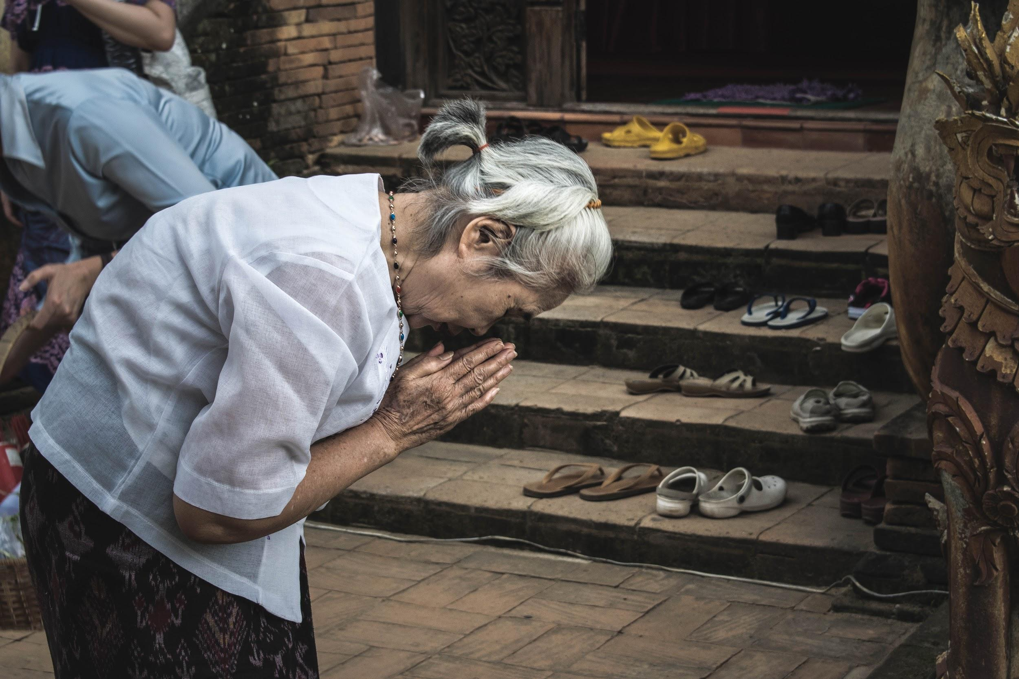
ᏅᎩᏁ ᏣᎳᎩ ᎠᏕᎶᏆᏍᏗ
Ahani, tla utvsonv yigi. Agayvlige.
Agayvlige gadoga.
Adadolisdi na agayvlige.
ᎤᏛᏐᏅᏍ ᎠᎦᏴᎵᎨᎨ?
ᎠᎦᏴᎵᎨ.
ᎤᏬᏝᏍ ᎦᏙᎦᎨ Ꮎ ᎠᎦᏴᎵᎨ?
ᎦᏙᎦ Ꮎ ᎠᎦᏴᎵᎨ.
ᎦᎪ ᎠᏓᏙᎵᏍᏗ?
ᎠᎦᏴᎵᎨ ᎠᏓᏙᎵᏍᏗ.

Slide 17
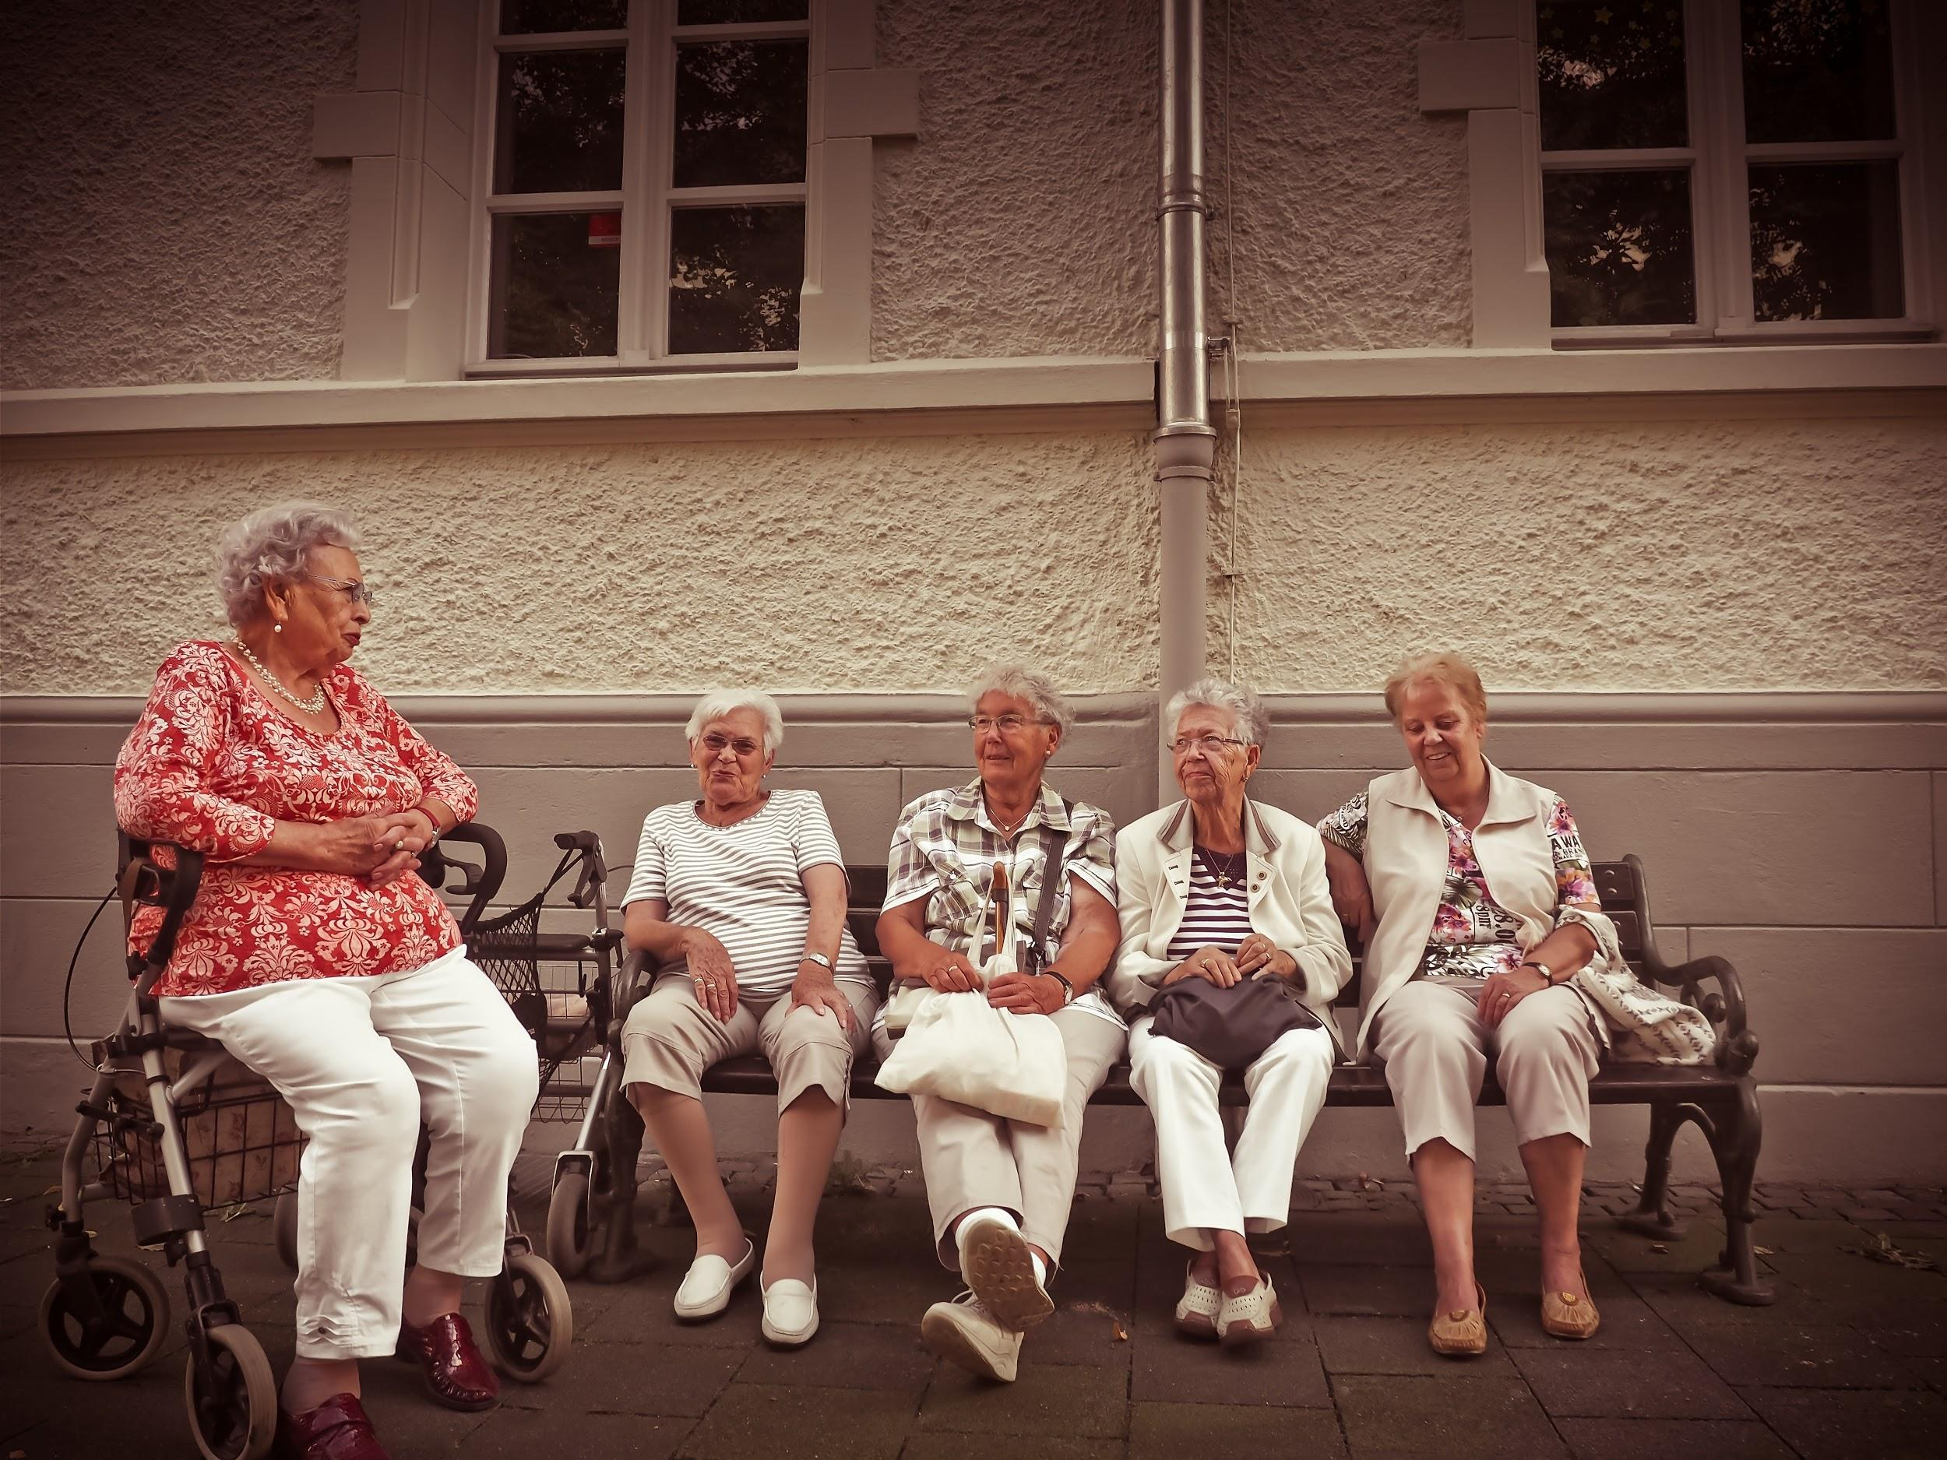
ᏅᎩᏁ ᏣᎳᎩ ᎠᏕᎶᏆᏍᏗ
Ahani hisgi yani anigayvlige.
Hisgi anigayvlige dunotla.
Tal yani anigayvlige adeldigaldod dunina.
Sawu unega ulsuwid na adeldigaldodi.
Soi, uwodige ulsuwid.

Slide 18
ᏅᎩᏁ ᏣᎳᎩ ᎠᏕᎶᏆᏍᏗ
ᏅᎩᏍ ᏯᏂ ᎠᏂᎦᏴᎵᎨ ᏚᏃᏝ?
Ꮭ. Ꮭ ᏅᎩ ᏱᎩ ᏥᏚᏃᏔ. ᎯᏍᎩ ᎠᏂᎦᏴᎵᎨ ᏚᏃᏝ.
ᎯᎳ ᏯᏂ ᎠᏂᎦᏴᎵᎨ ᎠᏕᎳᏗᎦᎵᏙᏗ ᏚᏂᎾ?
ᏔᎵ ᏯᏂ ᎠᏂᎦᏴᎵᎨ ᎠᏕᎳᏕᎦᎵᏙᏗ ᏚᏂᎾ.

Slide 19
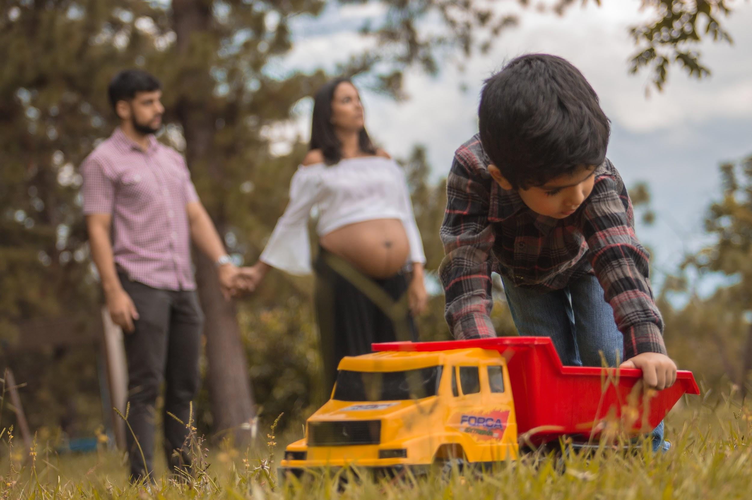
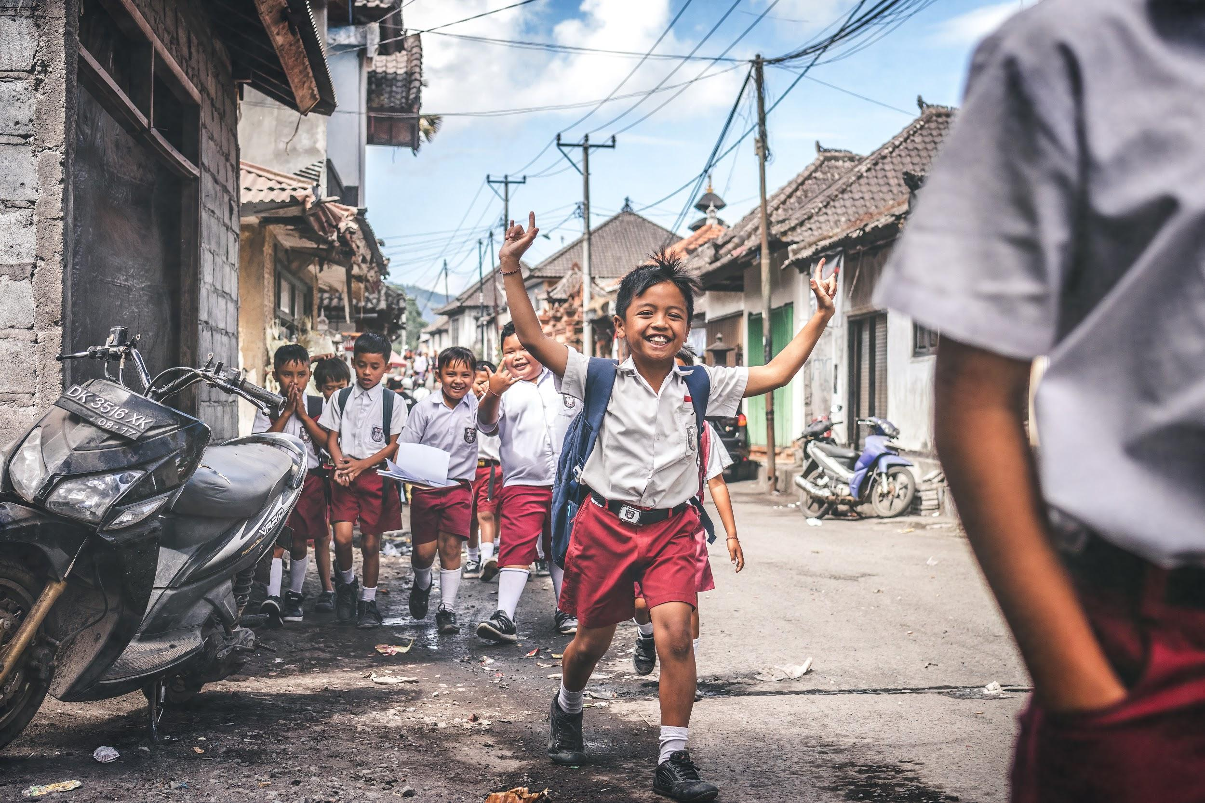
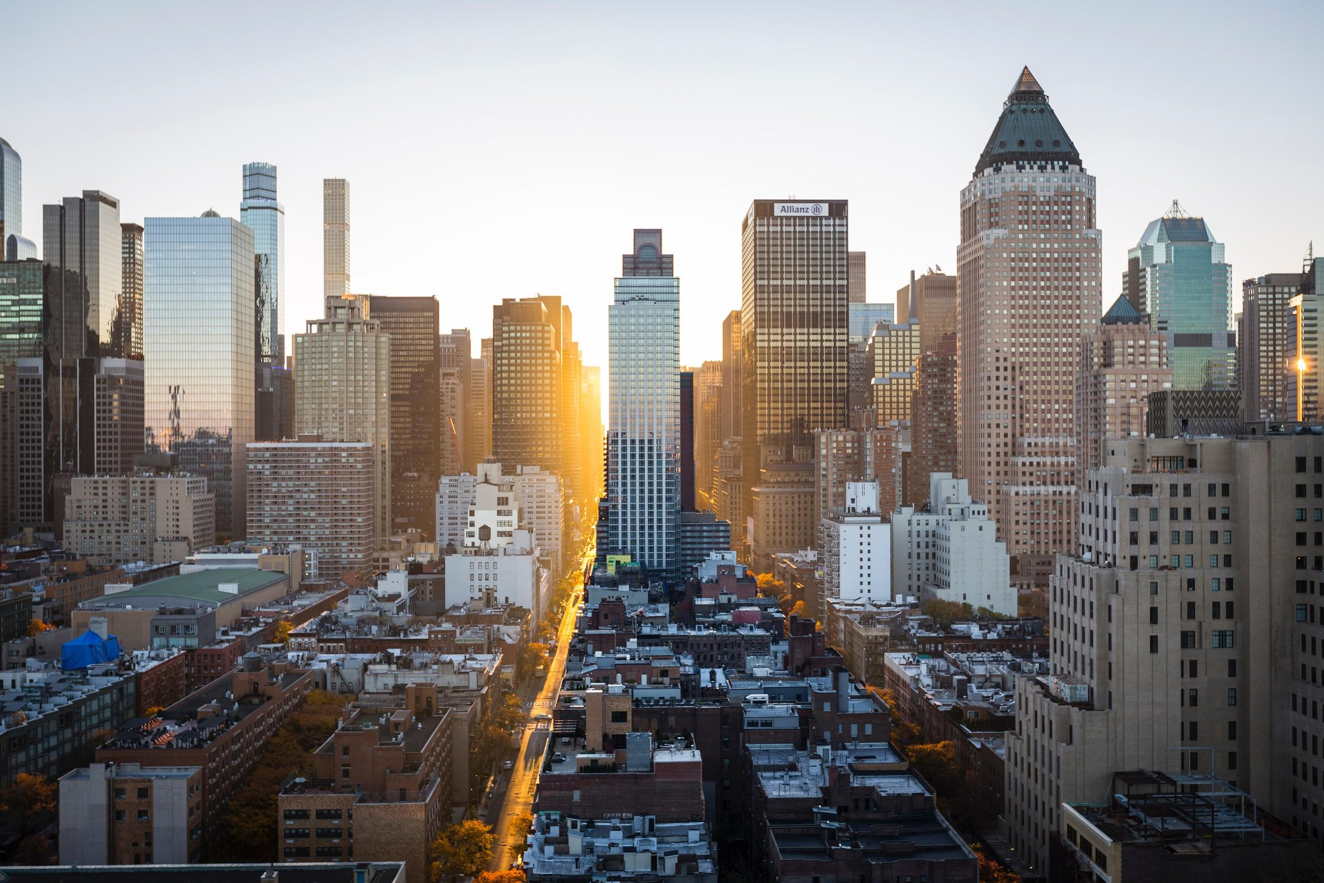
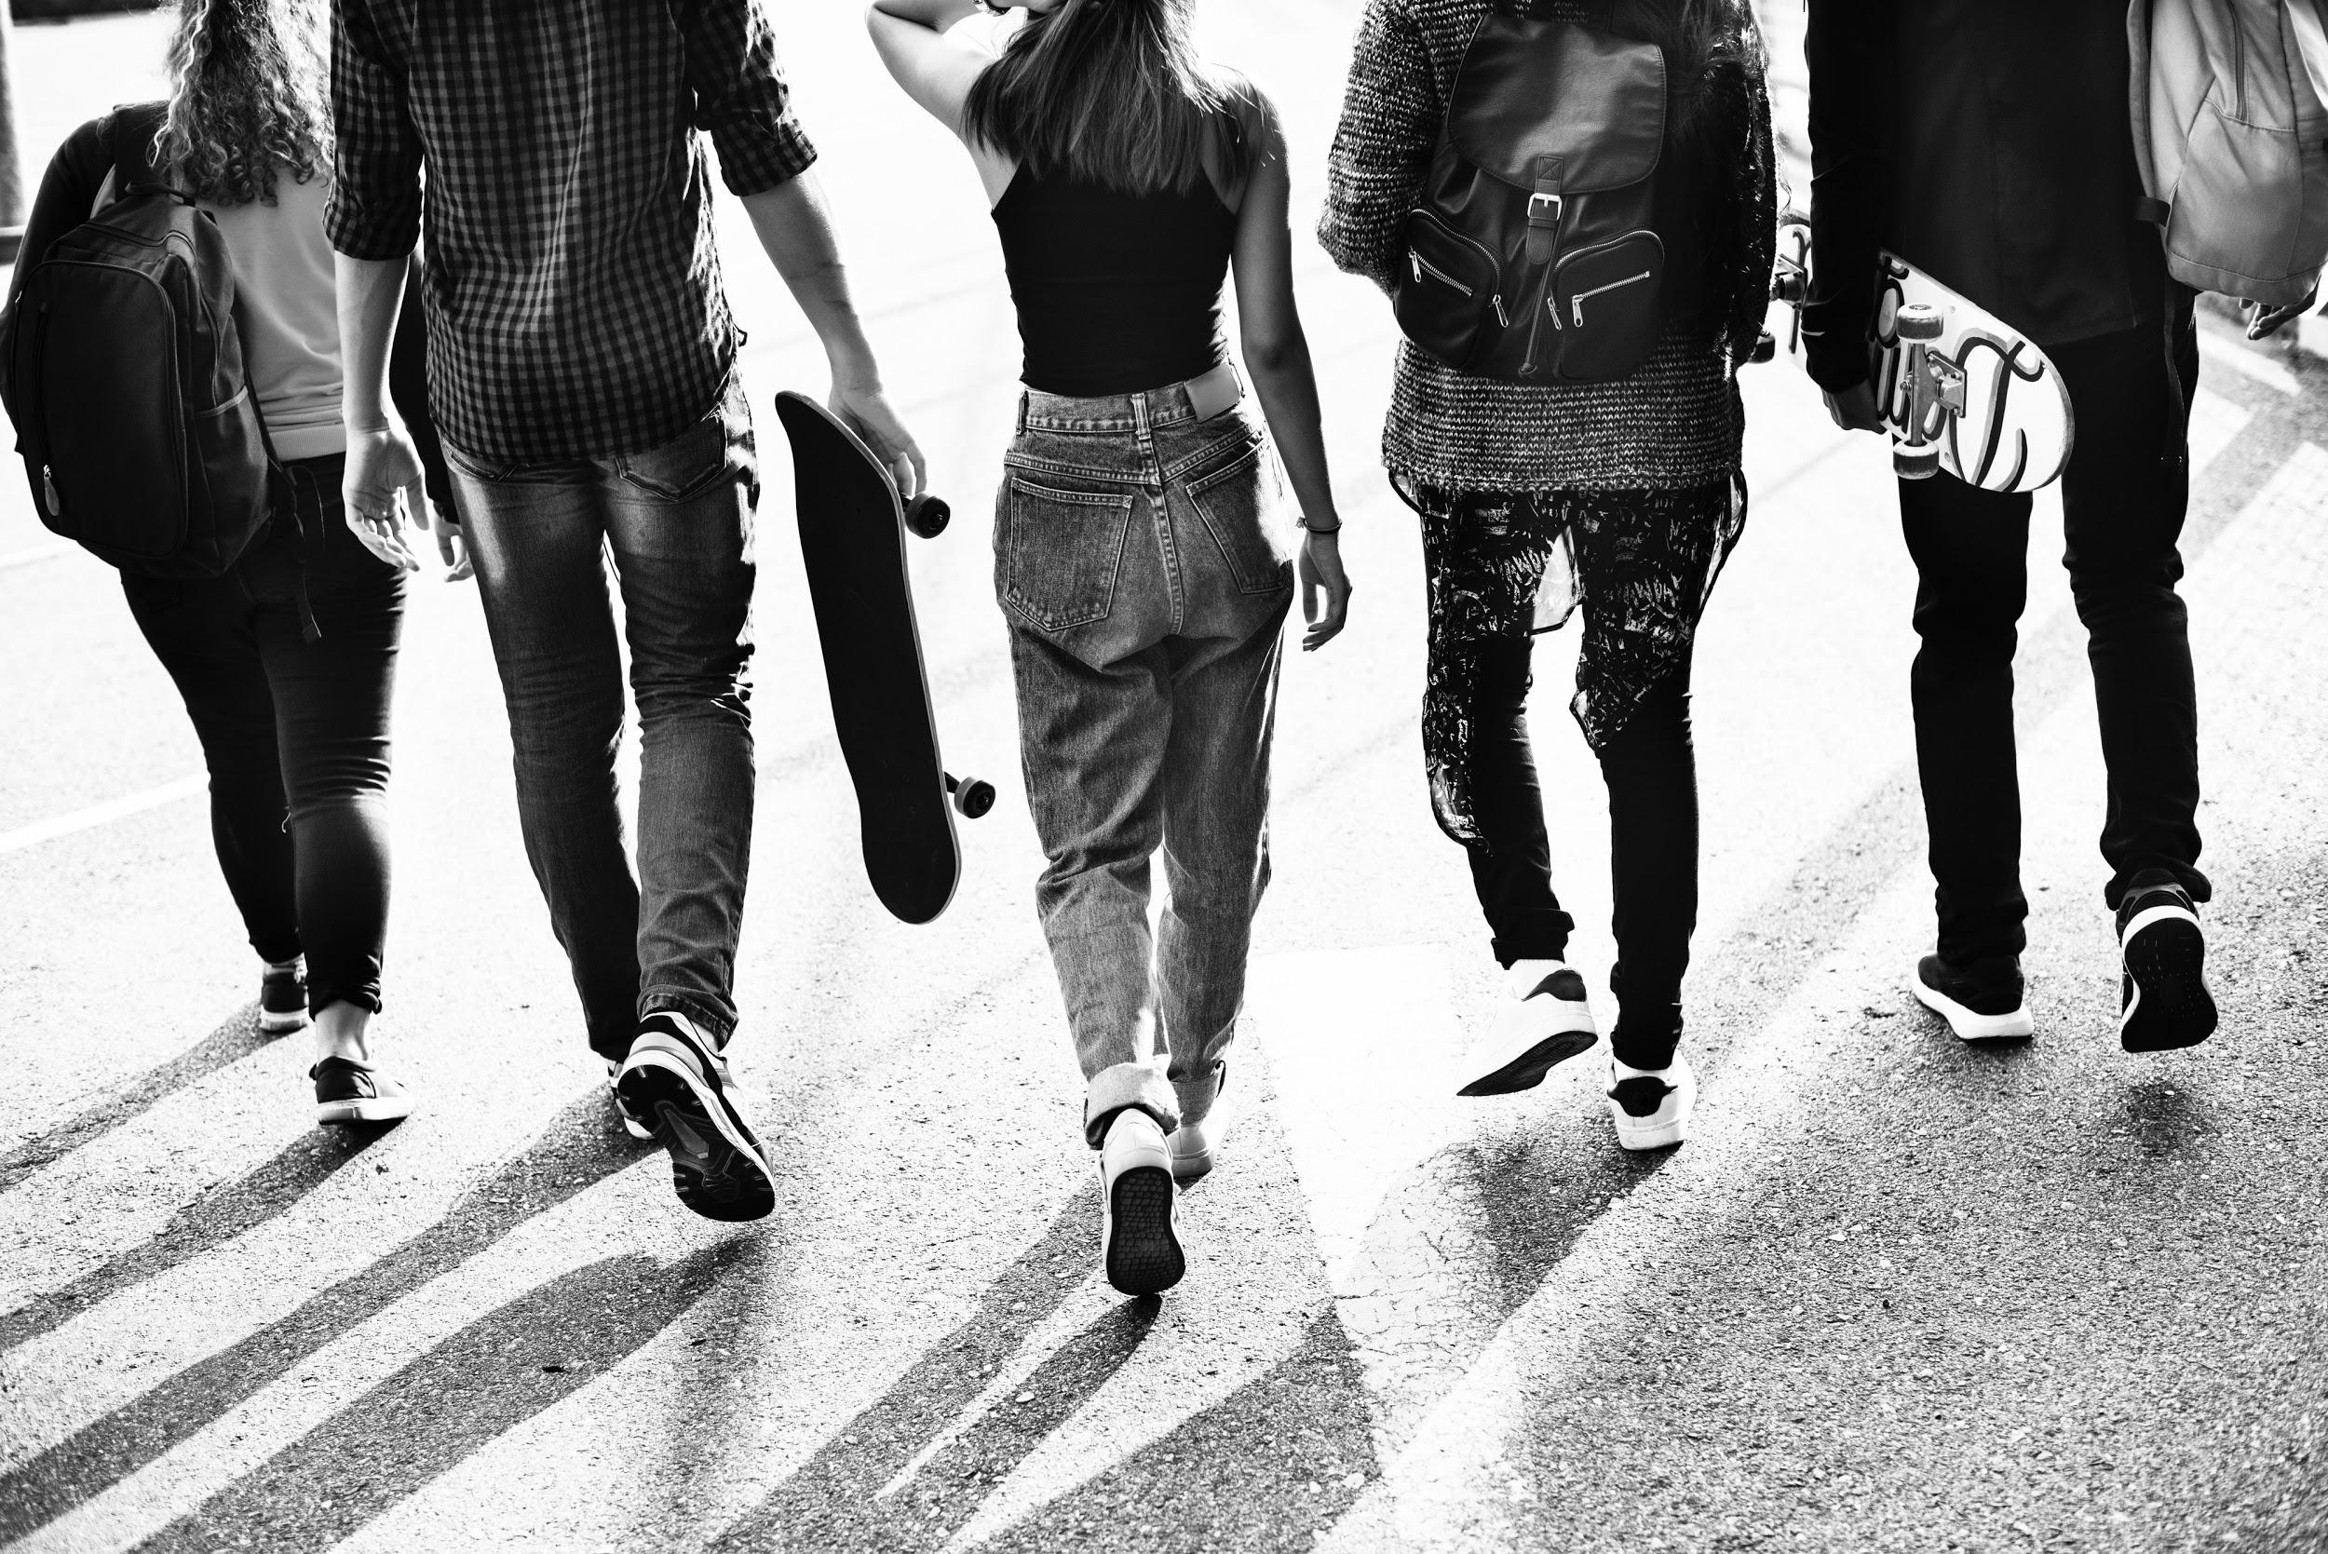
ᏅᎩᏁ ᏣᎳᎩ ᎠᏕᎶᏆᏍᏗ
ᎤᏬᏢᏗ
unej achuja
Nvnohuldi wanaise
Utan digaduhv
unenvse

Slide 20
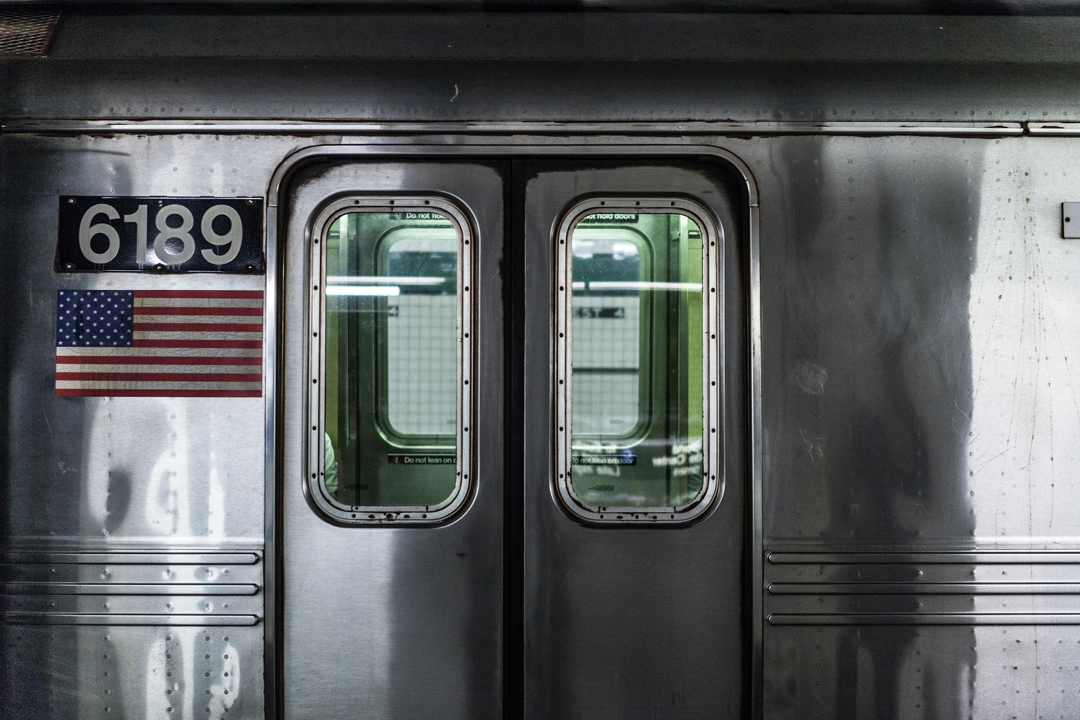
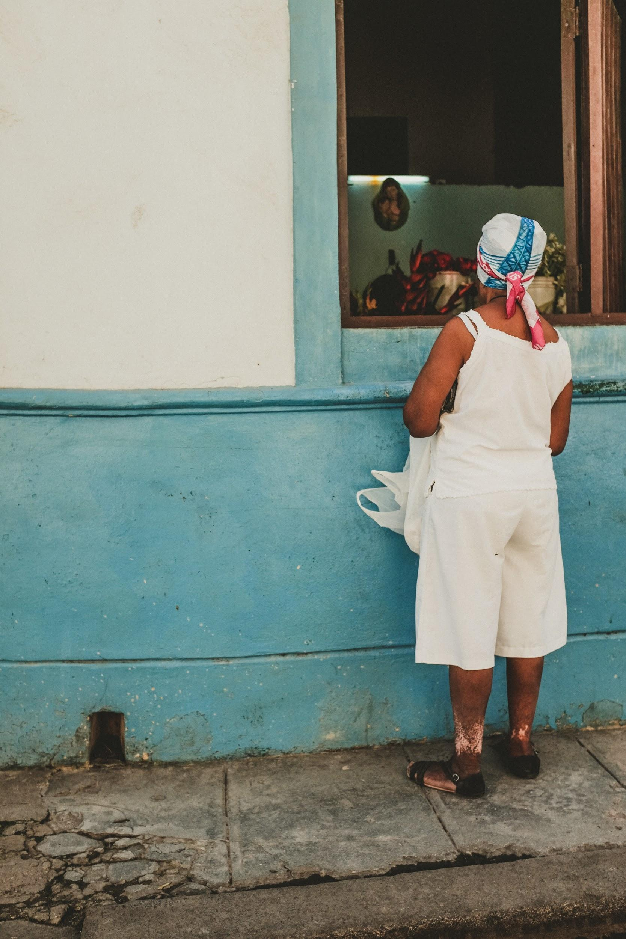
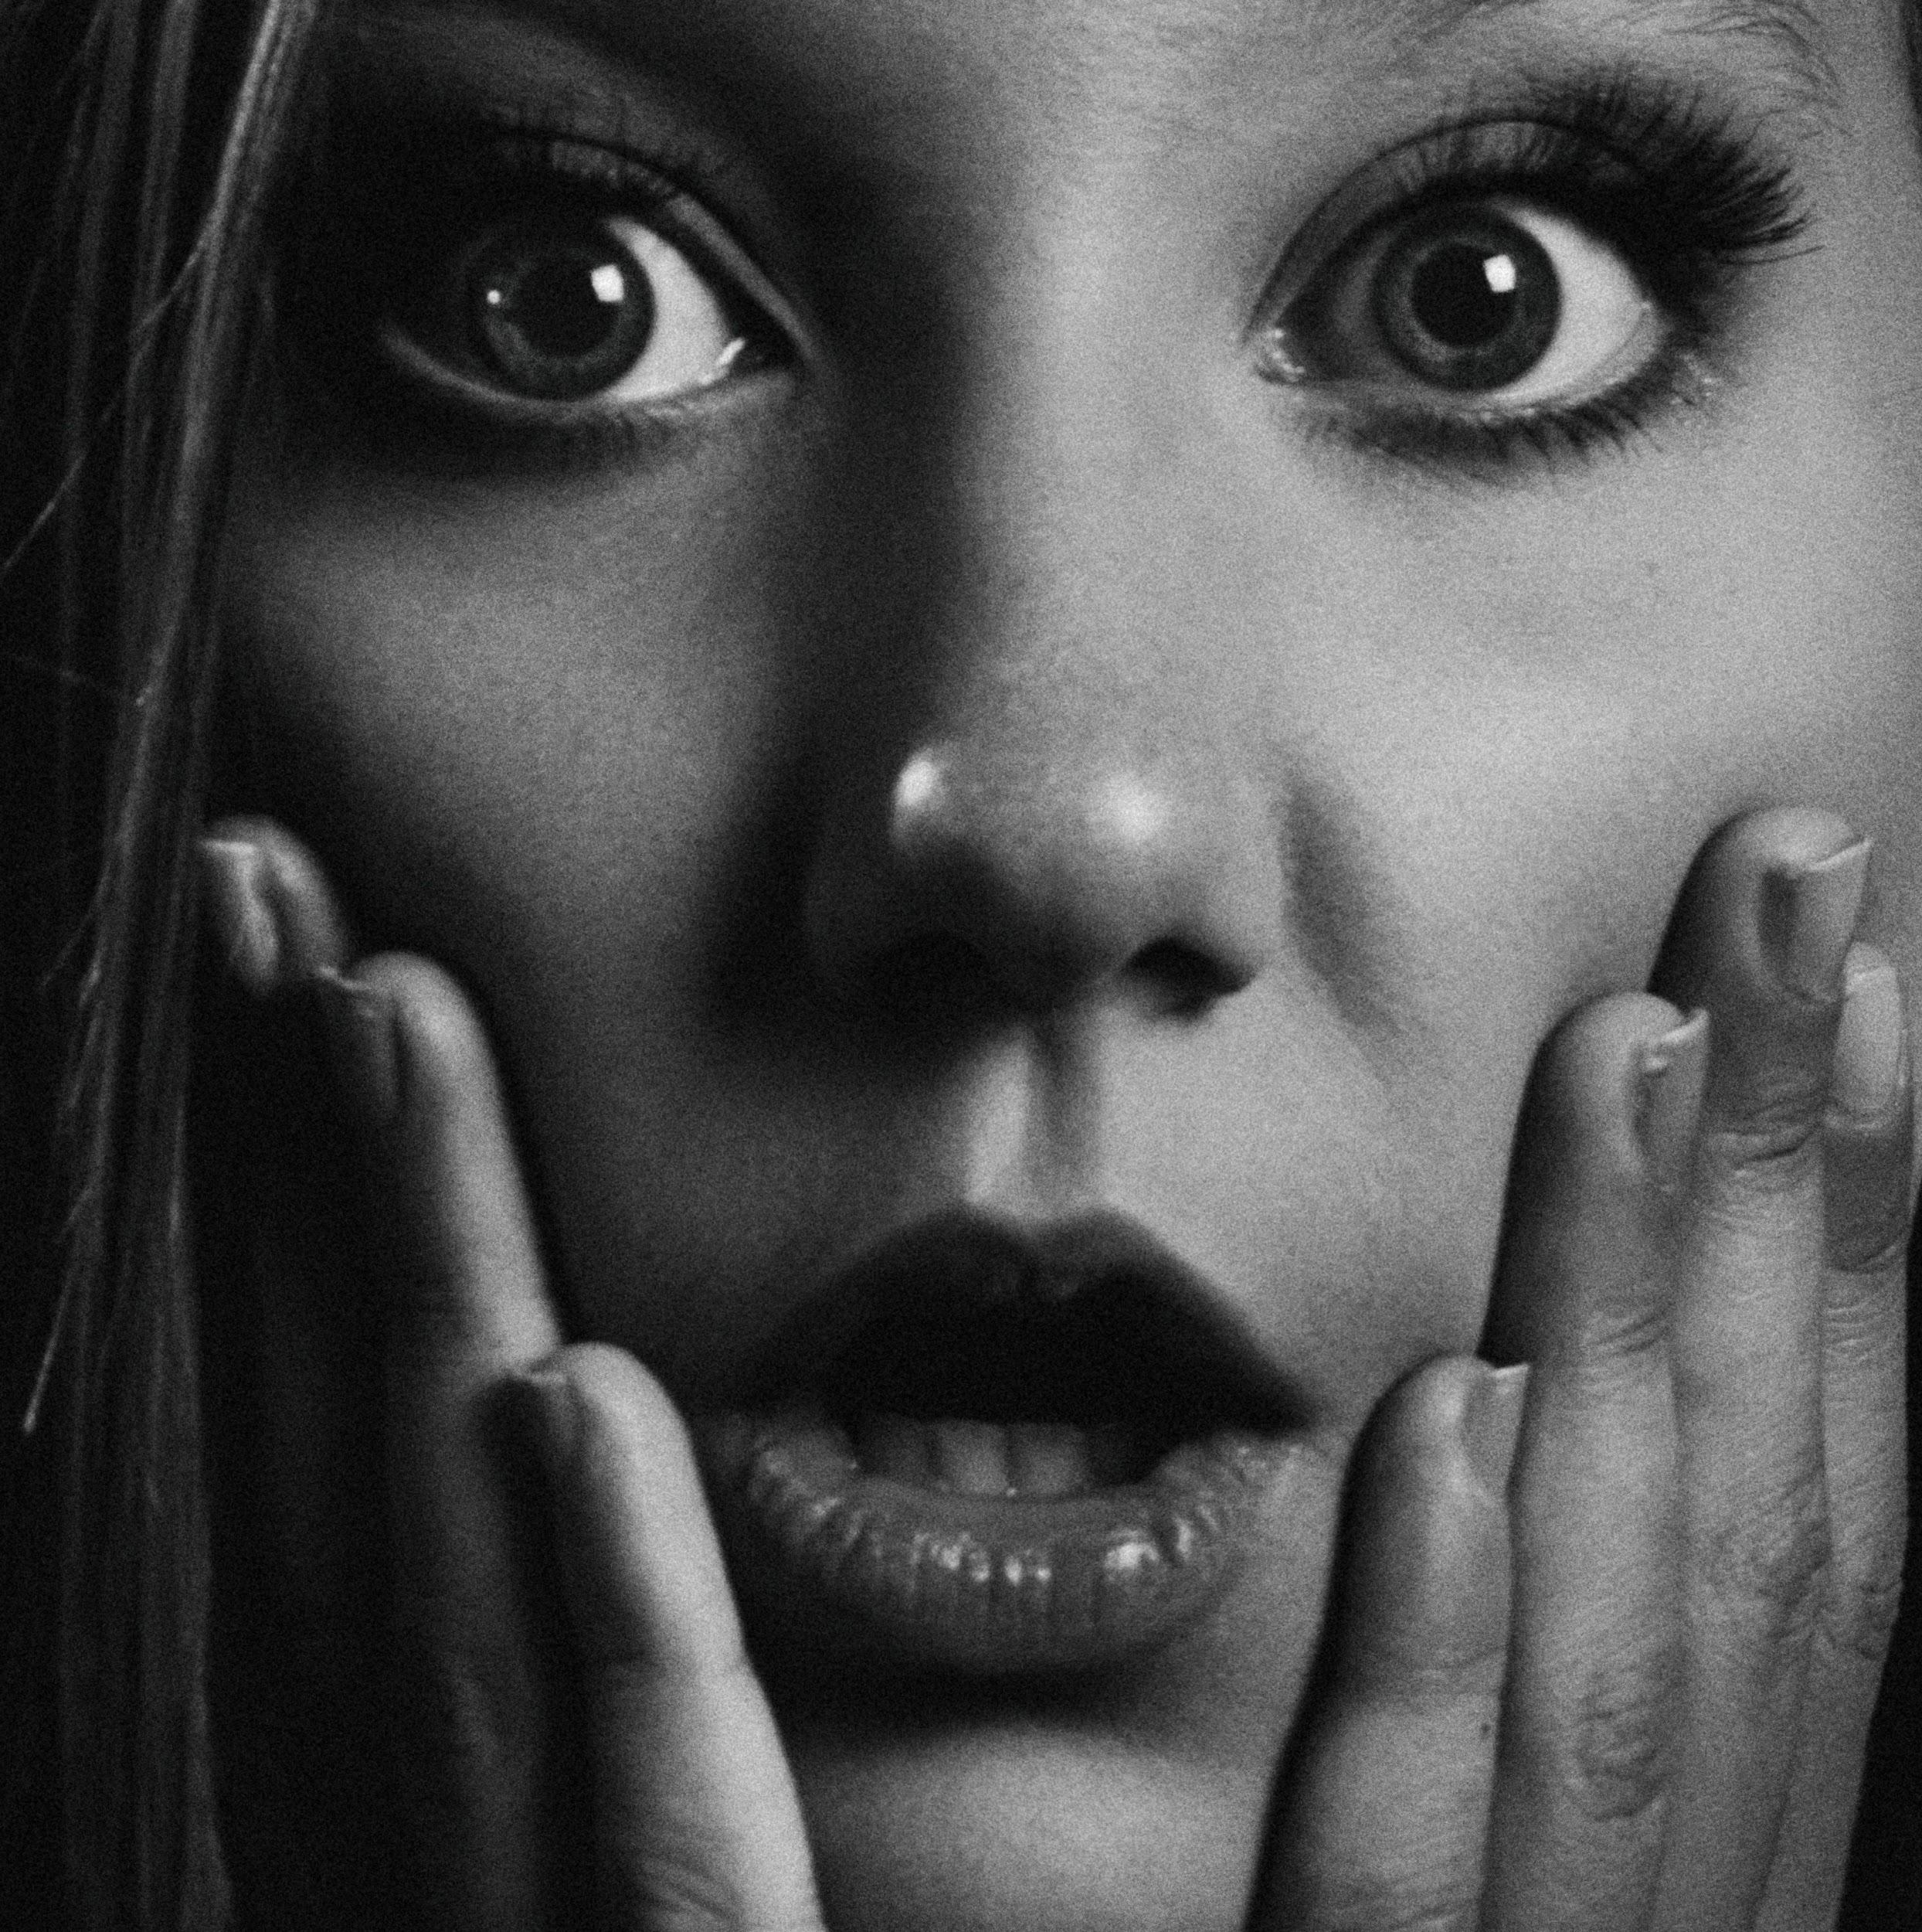
ᏅᎩᏁ ᏣᎳᎩ ᎠᏕᎶᏆᏍᏗ
ᎤᏬᏢᏗ
Jolani widukanane
Talugisgi galohisdi
usquanikd
Siqua galjohid

Slide 21
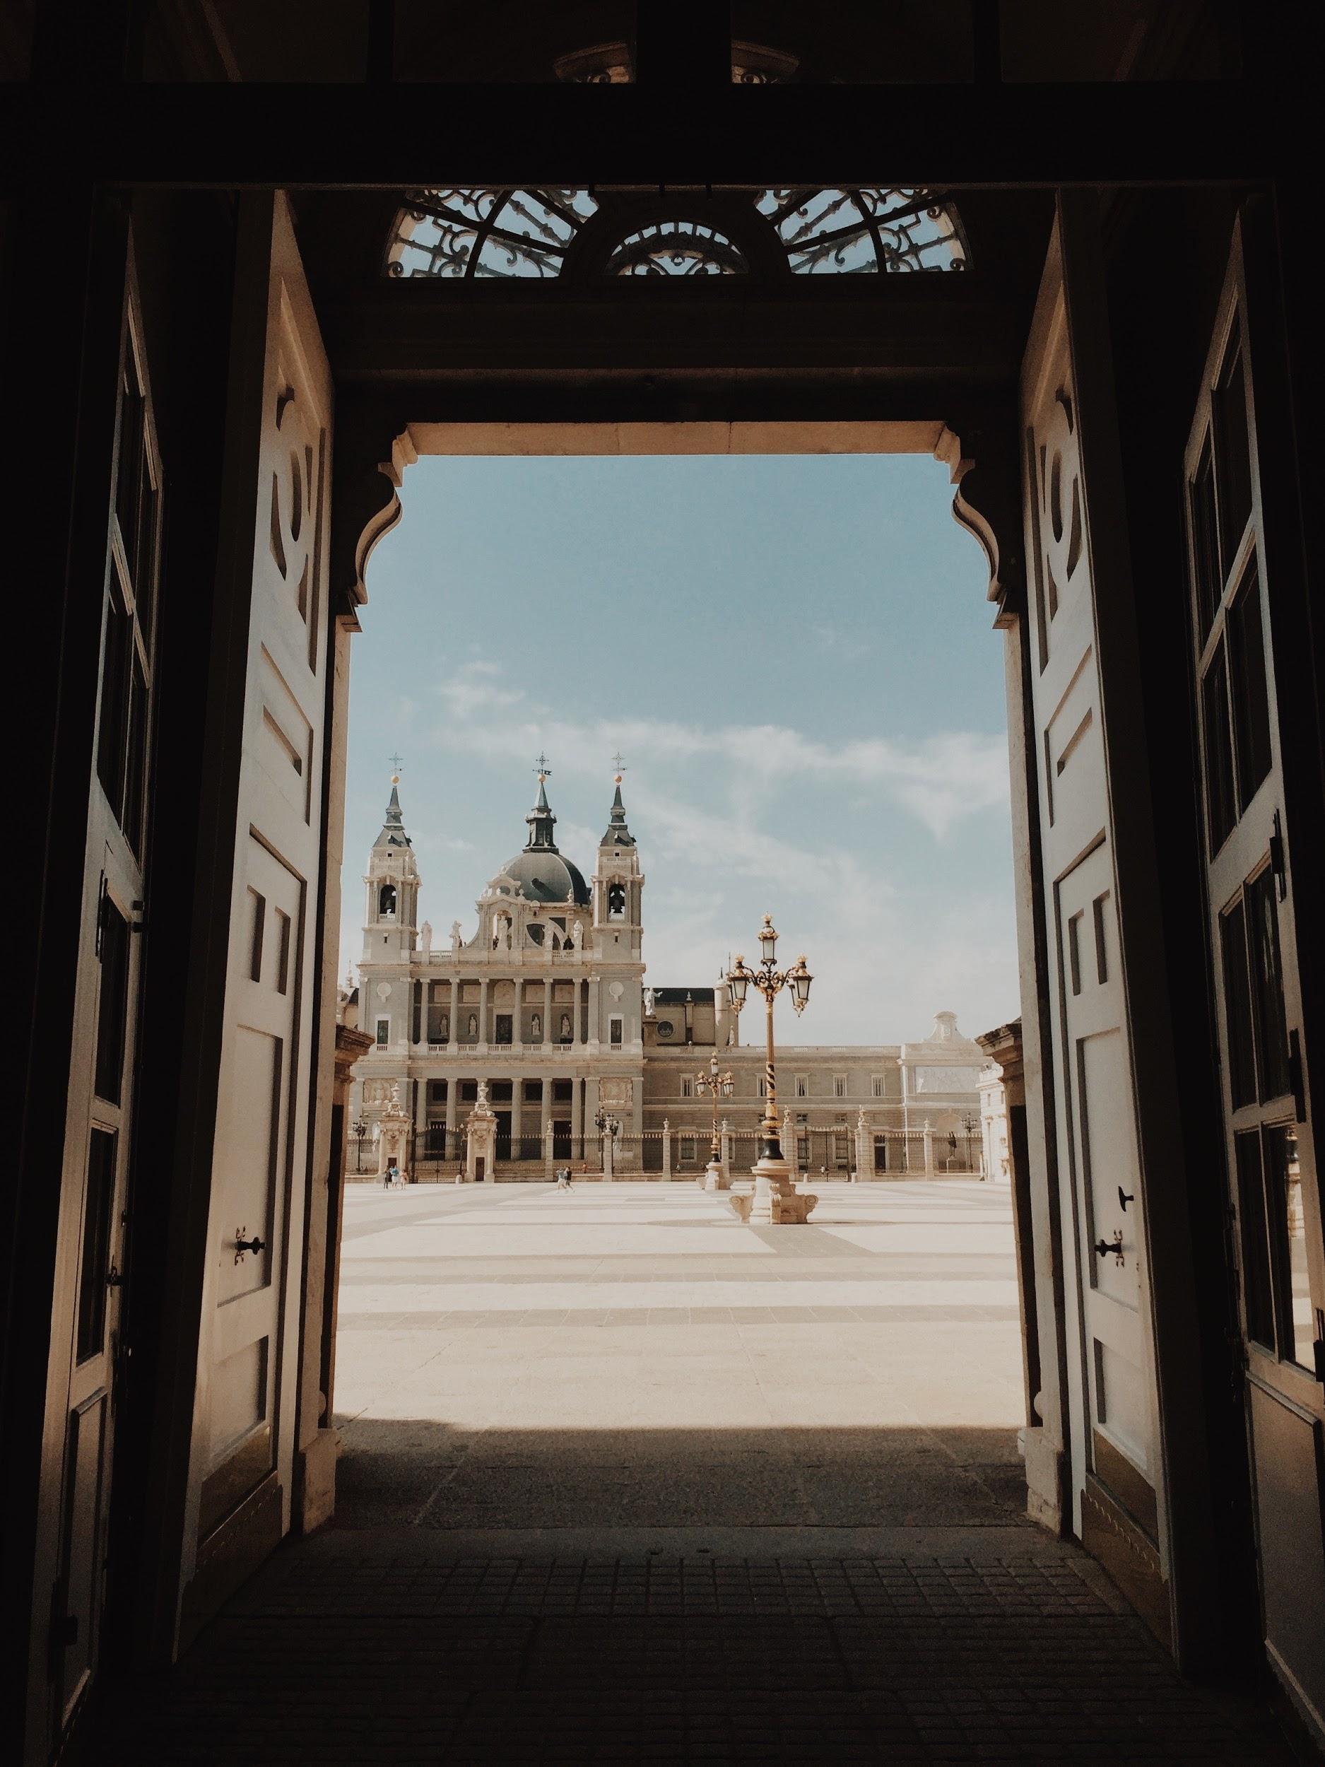
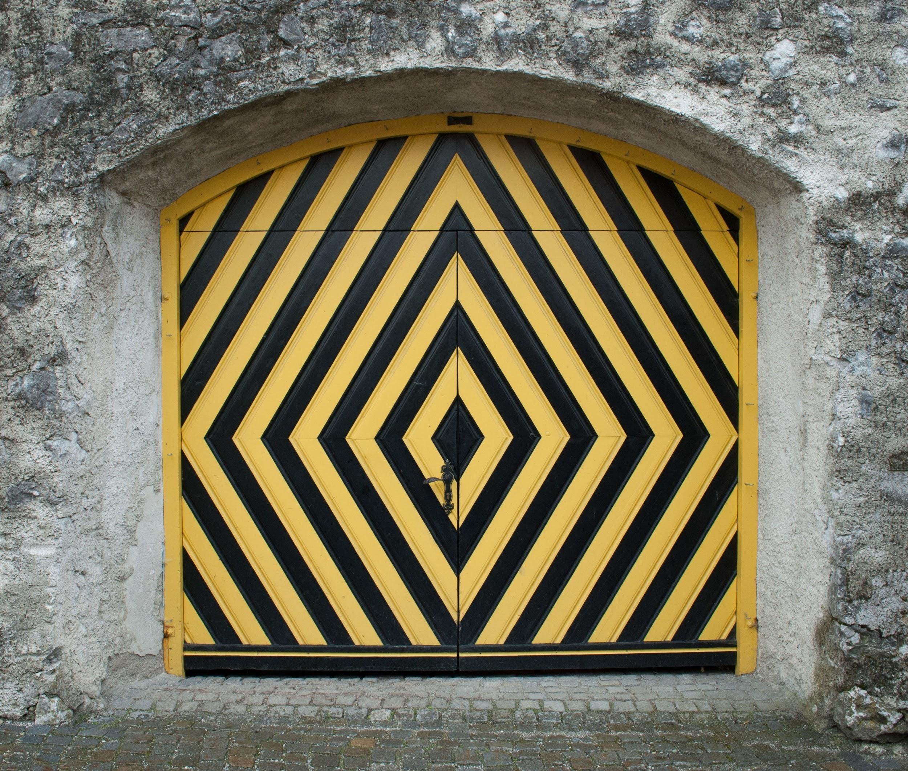
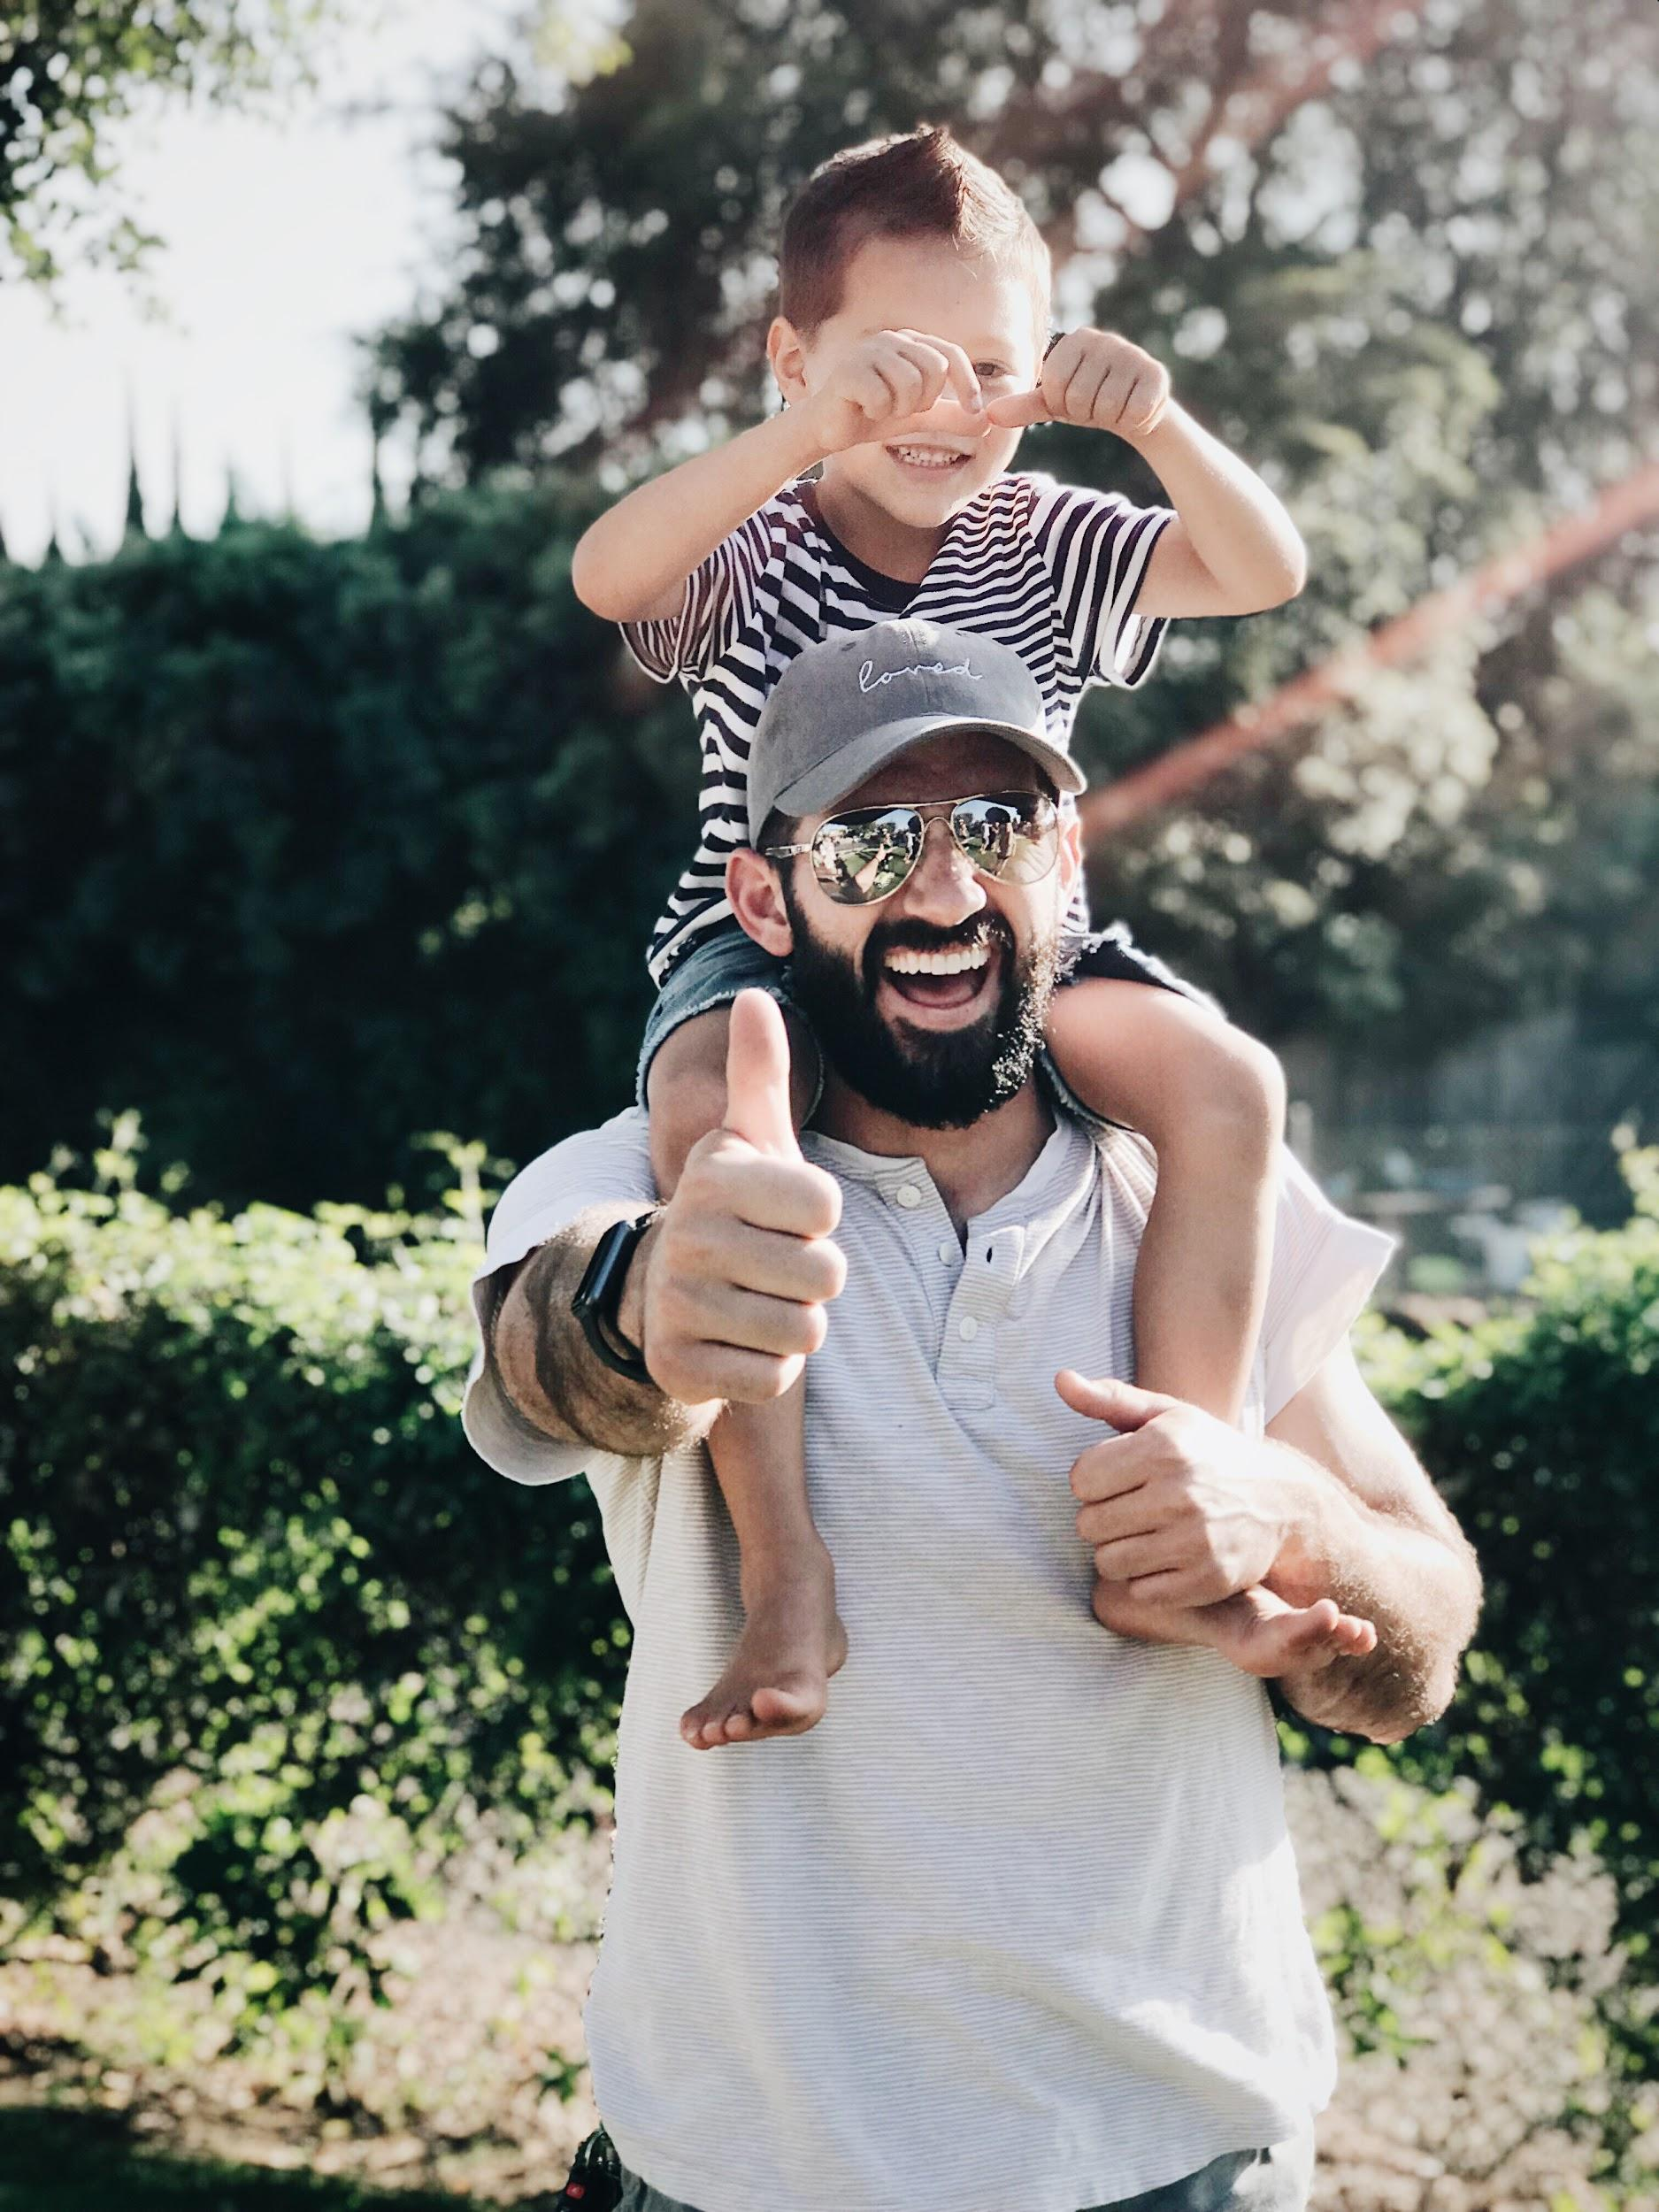
ᏅᎩᏁ ᏣᎳᎩ ᎠᏕᎶᏆᏍᏗ
ᎤᏬᏢᏗ
unisduise
unisdune
wujane
edoda

Slide 22
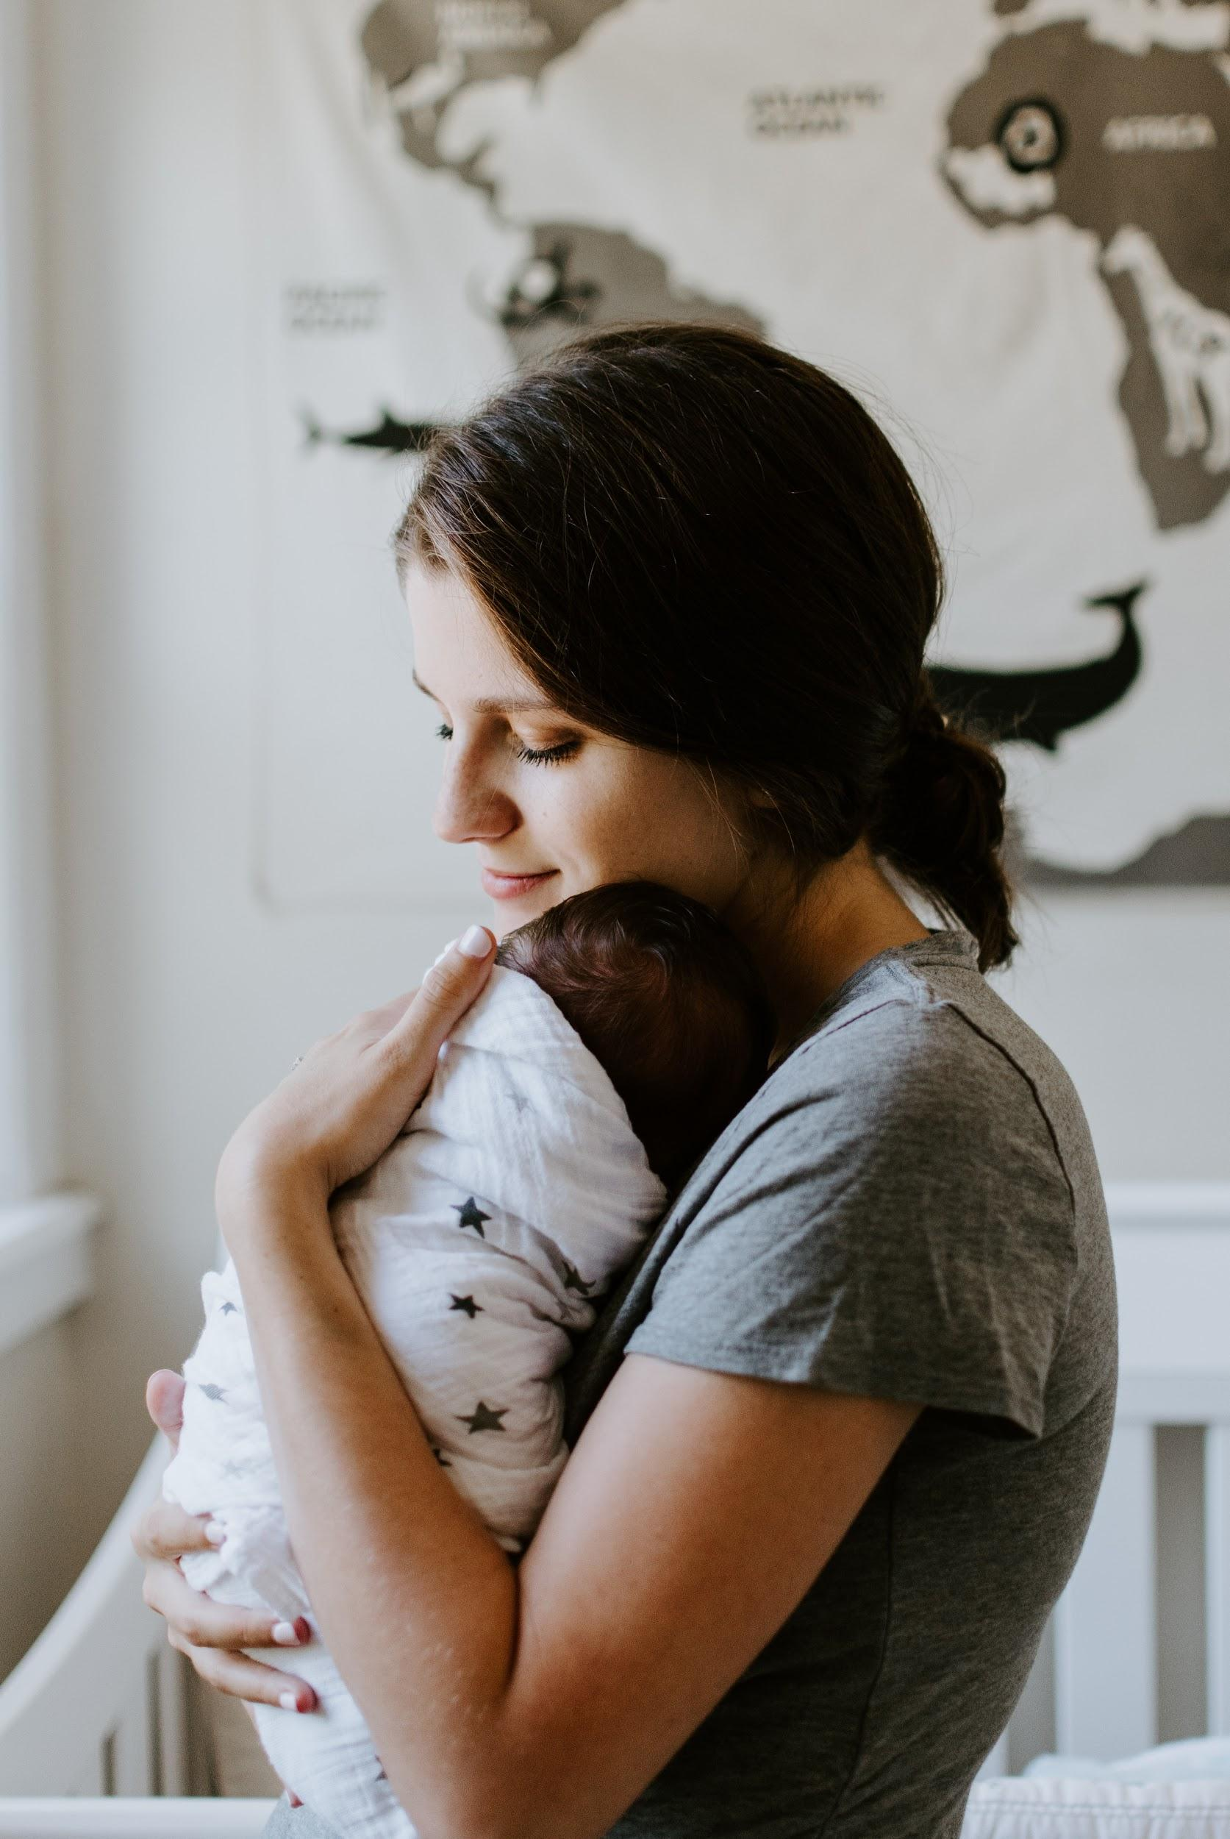
ᏅᎩᏁ ᏣᎳᎩ ᎠᏕᎶᏆᏍᏗ
ᎤᏬᏢᏗ
hadiyaquanta
eji
edoda

Slide 23
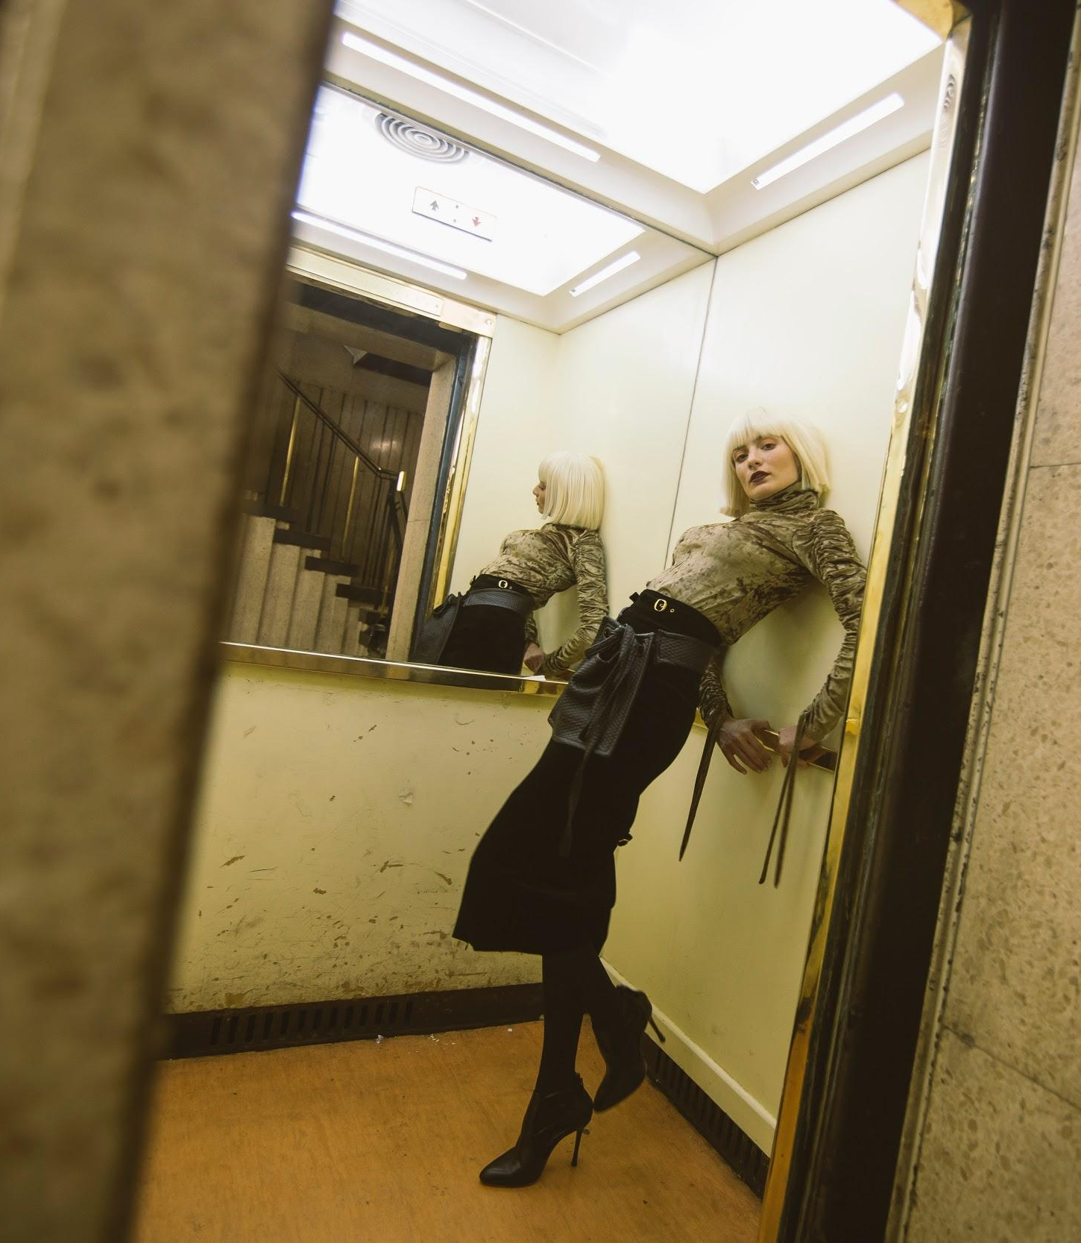
ᏅᎩᏁ ᏣᎳᎩ ᎠᏕᎶᏆᏍᏗ
ᎤᏬᏢᏗ
Jegskin, Meli ale unej achuja Jani agvyi yuwakt utan digaduhv unenvse. Nvnohuldi wanaise jolani digaduhv widunkanane. Gohusdi usquanikd wunigohe! talugisgi galohisdi agvyadidl wigadoge galjohid agayvlige. Unisduise galohisd, wutsane agayvlige. Unisdune galohisdi. Kohiyv, unisduise galohisdi, uwodu agehya unvgojv.
“Edoda, gado usdi? Utvdvne Jani.
“Hadiyawant,” udvne Jegskin, “Nula, jajidv wiyasadohya!”

Slide 24
ᏅᎩᏁ ᏣᎳᎩ ᎠᏕᎶᏆᏍᏗ
ᎤᏬᏢᏗ
ᎦᏙ ᎤᏍᏗ ᏚᏙᎠ Ꮎ ᎤᏪᏥ ᎠᏧᏣ?
ᏣᏂ ᏚᏙᎠ Ꮎ ᎤᏪᏥ ᎠᏧᏣ.
ᎭᏢ ᎤᏁᏅᏎ ᏤᎦᏍᎨᏂ, ᎺᎵ ᎠᎴ ᏣᏂ?
ᎤᏔᎾ ᏗᎦᏚᎲ ᎤᏁᏅᏎ.
ᎭᏢ ᏩᎾᎢᏎ?
ᏅᏃᎱᎵᏗ ᏩᎾᎢᏎ.
ᎦᎪ ᎠᎬᏱᏗtᏜ ᎦᎶᎯᏍᏗ ᏫᎦᏙᎨ?
ᎦᎵᏦᎯᏓ ᎠᎦᏴᎵᎨ ᎠᎬᏱᏗᏜ ᎦᎶᎯᏍᏗ ᏫᎦᏙᎨ.
ᎦᎪ ᎤᏅᎪᏨ?
ᎤᏬᏚ ᎠᎨᏯ ᎤᏅᎪᏨ.
ᎦᏙ ᎤᏛᏁ ᏤᎦᏍᎨᏂ?
“ᏫᏯᏌᏙᎯᏯ,” ᎤᏛᏁ ᏤᎦᏍᎨᏂ.

Slide 25
ᏅᎩᏁ ᏣᎳᎩ ᎠᏕᎶᏆᏍᏗ
ᎤᏂᎳᏔᏅᏙᏗ- Backpack
ᎩᎦᎨ- Red
ᏧᎾᏕᎶᏆᏍᏗ- School
ᎡᎦ- he/she is going
ᎠᏕᎳᏗᎦᎵᏙᏗ- Purse
ᎣᏓᎸ- Mountains
ᎤᏁᎬᎭ- Blanket
ᎠᏂᏥ- Orange
ᎤᏛᏐᏅ- elderly man
ᎨᏎ- It was
ᎦᏃᏥ- Leather
ᎪᏢᏅ- It is made
ᏕᎦᎵᏗ- Bag
ᎤᏬᏢ- he/she is sitting
ᎤᏅᏗ ᎦᏁᏍᏓᎵᏗᏍᏔᏅ- Ice cream
ᎠᎩᎠ- he/she is eating it
ᎠᏓᏙᎵᏍᏗ- he/she is praying
ᏅᎩ- 4
ᎯᏍᎩ- 5
ᎠᎦᏴᎵᎨ- elderly woman

Slide 26
ᏅᎩᏁ ᏣᎳᎩ ᎠᏕᎶᏆᏍᏗ
ᎠᏂᎦᏴᎵᎨ- elderly women
ᏚᏃᏝ- they are sitting
ᏚᏂᎾ- they have something flexible
ᎤᏁᎦ- white
ᎤᏬᏗᎨ- brown
ᏐᎢ- next, other
ᎤᏁᏣ ᎠᏧᏣ- their son
ᎤᏔᎾ ᏗᎦᏚᎲ- city
ᏅᏃᎱᎵᏗ- by the road
ᏩᎾᎢᏎ- they walked away
ᎤᏁᏅᏎ- they went
ᏦᎳᏂ ᏫᏚᎧᎾᏁ- he/she looked in the window
ᎤᏍᏆᏂᎩᏗ- amazing
ᏔᎷᎩᏍᎩ- metal
ᎦᎶᎯᏍᏗ- door
ᎦᎵᏦᎯᏗ- fat
ᏏᏆ- pig
ᎤᏂᏍᏚᎢᏎ- they opened

Slide 27
ᏅᎩᏁ ᏣᎳᎩ ᎠᏕᎶᏆᏍᏗ
ᏭᏣᏁ- he/she got in
ᎤᏂᏍᏚᏁ- they closed
ᎡᏙᏓ- dad
ᏣᏥ- your mom
ᎭᏗᏯᏆᏂᏔ- I don’t know
ᏄᎳ- hurry
ᎤᎾ- he/she has something flexible
ᎤᏂᎾ- they have something flexible

