Slide 1
ᎣᏏᏲ
ᏅᎩᏍᎪ ᏔᎵᏁ ᏣᎳᎩ ᎠᏕᎶᏆᏍᏗ

Slide 2
ᏅᎩᏍᎪ ᏔᎵᏁ ᏣᎳᎩ ᎠᏕᎶᏆᏍᏗ
ᎢᏓᎴᎾ
ᏣᎳᎩ ᎢᏗᏬᏂ!

Slide 3
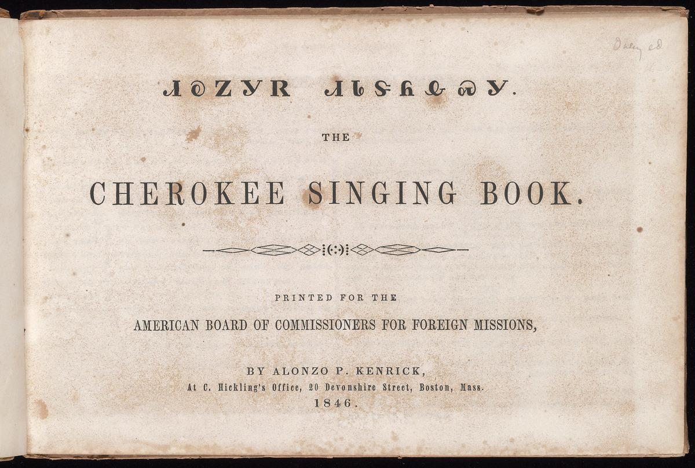
ᏅᎩᏍᎪᎯ ᏔᎵᏁ ᏣᎳᎩ ᎠᏕᎶᏆᏍᏗ

Slide 4
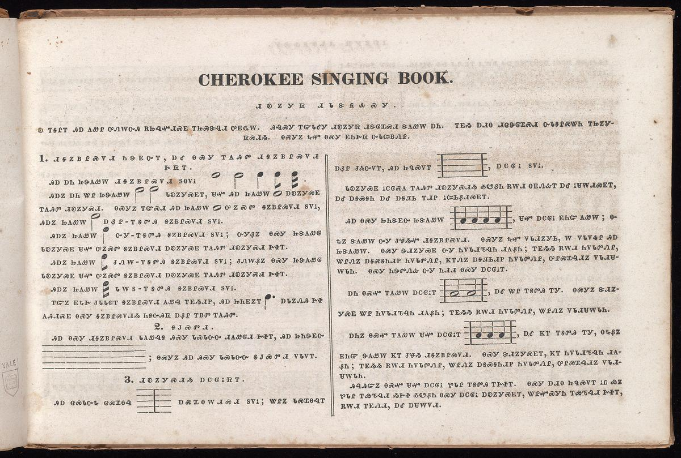
ᏅᎩᏍᎪᎯ ᏔᎵᏁ ᏣᎳᎩ ᎠᏕᎶᏆᏍᏗ

Slide 5
ᏅᎩᏍᎪᎯ ᏔᎵᏁ ᏣᎳᎩ ᎠᏕᎶᏆᏍᏗ
ᏗᎧᏃᎩᏒ ᏗᏓᏕᏲᎲᏍᎩ
Ꭷ ᎢᎦᎵᎢ ᎯᎠ ᏗᎪᏪᎵ ᎤᏁᎳᏅᎯ ᎡᏥᎸᏉᏗᏍᎬ ᎢᏥᏍᏕᎸᏗ ᎤᎬᏩᎳ. ᎯᎸᏍᎩ ᎢᏳᏓᎴᎩ ᏗᎧᏃᎩᏒ ᏗᏕᎶᏆᏍᏗ ᏕᎪᏪᎸ ᎠᏂ. ᎢᎬᏱ ᎠᏗᎾ ᏗᏥᏌᏕᎶᏆᏍᏗ ᏅᏓᎦᎵᏍᏔᏂ ᎢᏥᏃᎩᏒᏍᏗᏱ. ᎾᏍᎩᏃ ᎿᏉ ᎾᏍᎩ ᎬᏂᎨᏒ ᏅᏓᏨᏴᏁᎵ.
Dikanogisv didadeyohvsgi
Ka igalii hia digoweli unelanvhi etsilvquodisgv itsisdelvdi ugvwala.
Hilvsgi iyudalegi dikanogisv dideloquasdi degowelv ani. igvyi adina ditsadeloquasdi nvdagalistani itsinogisvsdiyi. nasgino hnaquo nasgi gvnigesv nvdatsvyvneli

Slide 6


ᏅᎩᏍᎪᎯ ᏔᎵᏁ ᏣᎳᎩ ᎠᏕᎶᏆᏍᏗ
ᏗᎦᏃᏴᎵᏍᏙᏗ ᏂᏕᎬᏅᎢ, ᎠᎴ ᎾᏍᎩ ᎢᎪᎯᏛ ᏗᎦᏃᏴᎵᏍᏙᏗ ᎨᏒᎢ.
ᎯᎠ ᎠᏂ ᏥᏕᎪᏪᎳ ᏗᎦᏃᏴᎵᏍᏙᏗ ᏚᎾᏙᎥ
ᎯᎠᏃ ᎠᏂ ᏔᎵ ᏥᏕᎪᏪᎳ ᏓᎧᏃᎩᏍᎬᎢ, ᏌᏉ ᎯᎠ ᎠᎧᏃᎩᏍᎬ ᎢᎪᎯᏛ ᏗᎧᏃᎩᏍᏗ.
diganoyvlisdodi nidegvnvi, ale nasgi igohidv diganoyvlisdodi gesvi
hia ani tsidegowela diganoyvlisdodi dunadov
hiano ani tali tsidegowela dakanogisgvi, saquo akanogisgv igohidv dikanogisdi.

Slide 7
ᏅᎩᏍᎪᎯ ᏔᎵᏁ ᏣᎳᎩ ᎠᏕᎶᏆᏍᏗ
ᎾᏍᎩᏃ ᎢᏳᏍᏗ ᏥᎪᏪᎳ ᎤᏃᏍᏓ ᎦᏃᏴᎵᏍᏙᏗ ᏚᏙᎥ,
ᎯᎠᏃ ᏥᎪᏪᎳ ᎠᏰᎵ ᎢᎦᏛᎯ ᎦᏃᏴᎵᏍᏙᏗ ᏚᏙᎥ.
ᎯᎠᏃ ᏥᎪᏪᎳ ᏅᎩ ᎢᎦᏛᎯ ᎦᏃᏴᎵᏍᏙᏗ ᏚᏙᎥ; ᏅᎩᏰᏃ ᎾᏍᎩ ᏥᏕᎪᏪᎶ ᏓᎧᏃᎩᏍᎬ ᏌᏉ ᎤᏃᏍᏛ ᎦᏃᏴᎵᏍᏙᏗ ᎠᎧᏃᎩᏍᎬ ᎢᎪᎯᏛ ᏗᎧᏃᎩᏍᏗ ᎨᏐᎢ.
ᎯᎠᏃ ᏥᎪᏪᎳ ᏧᏁᎳ ᎢᎦᏛᎯ ᎦᏃᏴᎵᏍᏙᏗ ᏚᏙᎥ; ᏧᏁᎳᏰᏃ ᎾᏍᎩ ᏥᏕᎪᏪᎶ ᏓᎧᏃᎩᏍᎬ ᏌᏉ ᎤᏃᏍᏛ ᎦᏃᏴᎵᏍᏙᏗ ᎠᎧᏃᎩᏍᎬ ᎢᎪᎯᏛ ᏗᎧᏃᎩᏍᏗ ᎨᏐᎢ.
ᎯᎠᏃ ᏥᎪᏪᎳ ᏓᎳᏚ ᎢᎦᏛᎯ ᎦᏃᏴᎵᏍᏙᏗ ᏚᏙᎥ.
ᎢᏳᏃ ᎬᎿᎨ ᏧᏓᏓᎶᎢ ᎦᏃᏴᎵᏍᏙᏗ ᎪᏪᎸ ᎢᎬᏱᏗᏢ, ᎯᎠ ᏥᏂᎬᏃᎢ ᎠᏓᏃᏁᎯ ᎨᏐ ᎪᎯᏗᏍᎬ ᎾᏍᎩ ᎦᏃᏴᎵᏍᏙᏗ ᏂᎦᏅᎯᏒ ᎠᏰᎵ ᎢᏴᏛ ᎢᎪᎯᏛ.

Slide 8
ᏅᎩᏍᎪᎯ ᏔᎵᏁ ᏣᎳᎩ ᎠᏕᎶᏆᏍᏗ
Nasgino iyusdi hia tsigowela unosda ganoyvlisdodi dudov,
Hiano tsigowela ayeli igadvhi ganoyvlisdodi dudov.
Hiano tsigowela nvgi igadvhi ganoyvlisdodi dudov; nvgiyeno nasgi tsidegowelo dakanogisgv saquo unosdv ganoyvlisdodi akanogisgv igohidv dikanogisdi gesoi.
Hiano tsigowela tsunela igadvhi ganoyvlisdodi dudov; tsunelayeno nasgi tsidegowelo dakanogisgv saquo unosdv ganoyvlisdodi akanogisgv igohidv dikanogisdi gesoi.
Hiano tsigowela daladu igadvhi ganoyvlisdodi dudov.
Iyuno gvhnage tsudadaloi ganoyvlisdodi gowelv igvyiditlv, hia tsinigvnoi adanonehi geso gohidisgv nasgi ganoyvlisdodiyi niganvhisv ayeli iyvdv igohidv.

Slide 9


ᏅᎩᏍᎪᎯ ᏔᎵᏁ ᏣᎳᎩ ᎠᏕᎶᏆᏍᏗ
2. ᎦᎫᏍᏛᏗ
ᎯᎠ ᎾᏍᎩ ᏗᎦᏃᏴᎵᏍᏙᏗ ᏓᎪᏪᎸᎦ ᎯᏍᎩ ᏓᏍᏓᏅᏅ ᏗᎪᏪᎶᏗ ᎨᏐᎢ, ᎯᎠ
ᏥᏂᏕᎬᏅ ᎠᏰᎵ ᏧᏜ ᏅᏙᎢ, ᎯᎠ ᏥᏄᏍᏙᎢ , ᎠᏟᎶᎥ ᏚᏙᎥ.
ᏓᎧᏃᎩᏍᎬ ᎥᏟᎶᏍᎪ ᎢᎪᎯᏛ ᏗᎧᏃᎩᏍᏗᏱ ᎣᏬᏰᏂ ᎡᎳᏗ ᎾᎬᏁᎲᎢ ᎠᎴ ᎥᏌᎳᏗᏍᎬᎢ, ᎠᎴ ᎠᎦᏍᎦᏂ ᎠᎴ ᎠᎦᏘᏏ ᎢᏗᏢ ᎥᏨᏏᏰᏗᏍᎬᎢ.
ᎯᎠ ᎾᏍᎩ ᏥᏂᏕᎬᏅ ᏥᏕᎪᏪᎳ , ᏌᏉ ᎠᏟᎶᎥ ᎬᏂᏳ ᎪᏪᎸ; ᎾᎿᏃ ᏕᎪᏪᎳ ᏅᎩ ᏧᏠᏱᏉ ᏗᎦᏃᏴᎵᏍᏙᏗ. ᎾᏍᎩᏃ ᎿᏉ ᏙᏓᏗᏃᎩᏏ, Ꮃ ᏙᏓᏙᏎᎵ ᎯᎠ ᏥᏕᎪᏪᎳ. ᎾᏍᎩ ᏕᏗᏃᎩᏍᎬ ᏅᎩ ᏂᏙᏓᏗᏖᎸᏂ ᏗᎪᏰᏂ; ᎢᎬᏱᏱ ᎡᎳᏗ ᏂᏙᏓᏛᏁᎵ, ᏔᎵᏁᏃ ᎠᎦᏍᎦᏂᏗᏢ ᏂᏙᏓᏛᏁᎵ, ᏦᎢᏁᏃ ᎠᎦᏘᏏᏗᏢ ᏂᏙᏓᏛᏁᎵ, ᎤᎵᏍᏆᎸᏗᏃ ᏙᏓᏗᏌᎳᏓᏂ. ᎾᏍᎩ ᏂᏕᏛᏁᎲ ᏅᎩ ᏂᏗᏗ ᎾᏍᎩ ᎠᏟᎶᎥᎢ.

Slide 10
ᏅᎩᏍᎪᎯ ᏔᎵᏁ ᏣᎳᎩ ᎠᏕᎶᏆᏍᏗ
2. Gadasdvdi
Hia nasgi diganoyvlisdodi dagowelvga hisgi dasdanvnv digowelodi gesoi, hia tsinidegvnv ayeli tsudlanvdoi, hia tsinusdoi , atlilov dudov.
Dakanogisgv vtlilosgo igohidv dikanogisdiyi owoyeni eladi nagvnehvi ale vsaladisgvi, ale agasgani ale agatisi iditlv itsvsiyedisgvi.
hia nasgi tsinidegvnv tsidegowela , saquo atlilov gvniyu gowelv; nahnano degowela nvgi tsutloyiquo diganoyvlisdodi. Nasgino hnaquo dodadinogisi, la dodadoseli hia tsidegowela. Nasgi dedinogisgv nvgi nidodaditelvni digoyeni; igvyiyi eladi nidodadvneli, talineno agasganiditlv nidodadvneli, tsoineno agatisiditlv nidodadvneli, ulisqualvdino dodadisaladani. Nasgi nidedvnehv nvgi nididi nasgi atlilovi.

Slide 11


ᏅᎩᏍᎪᎯ ᏔᎵᏁ ᏣᎳᎩ ᎠᏕᎶᏆᏍᏗ
ᎠᏂ ᎾᏍᏉ ᎢᎪᏪᎳ ᎠᏟᎶᎥᎢ , ᎠᎴ ᏔᎵ ᎢᎦᏛᎯ ᎢᎩ. ᎾᏍᎩᏃ ᏕᏗᏃᎩᏍᎬ ᏔᎵ ᏂᏙᏓᏗᏖᎸᏂ ᏗᎪᏰᏂ; ᎢᎬᏱᏱ ᎡᎳᏗ ᏂᏙᏓᏛᏁᎵ, ᏔᎵᏁᏃ ᏙᏓᏗᏌᎳᏓᏂ.
ᎠᏂᏃ ᎾᏍᏉ ᎢᎪᏪᎳ ᏌᏉ ᎠᏟᎶᎥᎢ , ᎠᎴ ᏦᎢ ᎢᎦᏛᎯ ᎢᎩ, ᎾᎿᏰᏃ ᎬᏂᏳ ᏕᎪᏪᎳ ᏦᎢ ᏧᏠᏱ ᏗᎦᏃᏴᎵᏍᏙᏗ. ᎾᏍᎩ ᏕᏗᏃᎩᏍᎬᎢ, ᏦᎢ ᏂᏙᏓᏗᏖᎸᏂ ᏗᎪᏰᏂ; ᎢᎬᏱᏱ ᎡᎳᏗ ᏂᏙᏓᏛᏁᎵ, ᏔᎵᏁᏃ ᎠᎦᏍᎦᏂᏗᏢ ᏂᏙᏓᏛᏁᎵ, ᎤᎵᏍᏆᎸᏗᏃ ᏙᏓᏗᏌᎳᏓᏂ.
ᎯᎸᎯᏳᏃ ᎾᏍᏉ ᏌᏉ ᎠᏟᎶᎥ ᏑᏓᎵ ᎢᎦᏛᎯ ᎢᎨᏐᎢ. ᎾᏍᎩ ᎠᏗᎾ ᏥᏄᏍᏙᎢ ᎥᏝ ᏯᏃ ᏑᏓᎵ ᎢᏯᏖᎸᏗ ᏱᎨᏐ ᎣᏬᏰᏂ ᎾᏍᎩ ᎠᏟᎶᎥ ᎠᎧᏃᎩᏍᎬᎢ, ᏔᎵᏉᏍᎩᏂ ᎢᏯᏖᎸᏗ ᎨᏐᎢ,

Slide 12
ᏅᎩᏍᎪᎯ ᏔᎵᏁ ᏣᎳᎩ ᎠᏕᎶᏆᏍᏗ
ani nasquo igowela atlilovi , ale tali igadvhi igi. Nasgino dedinogisgv tali nidodaditelvni digoyeni; igvyiyi eladi nidodadvneli, talineno dodadisala dani.
Anino igowela saquo atlilovi , ale tsoi igadvhi igi, nahnayeno gvniyu degowela tsoi tsutloyi diganoyvlisdodi. Nasgi dedinogisgvi, tsoi nidodaditelvni digoyeni; igvyiyi eladi nidodadvneli, talineno agasganiditlv nidodadvneli, ulisqualvdino dodadisaladani.
Hilvhiyuno nasquo saquo atlilov sudali igadvhi igesoi. Nasgi adina tsinusdoi vtla yano sudali iyatelvdi yigeso owoyeni nasgi nasgi atlilov akanogisgvi, taliquosgini iyatelvdi gesoi,

