Slide 1
ᎣᏏᏲ
ᏅᎩᏍᎪ ᏦᎢᏁ ᏣᎳᎩ ᎠᏕᎶᏆᏍᏗ

Slide 2
ᏅᎩᏍᎪ ᏦᎢᏁ ᏣᎳᎩ ᎠᏕᎶᏆᏍᏗ
ᎢᏓᎴᎾ
ᏣᎳᎩ ᎢᏗᏬᏂ!

Slide 3
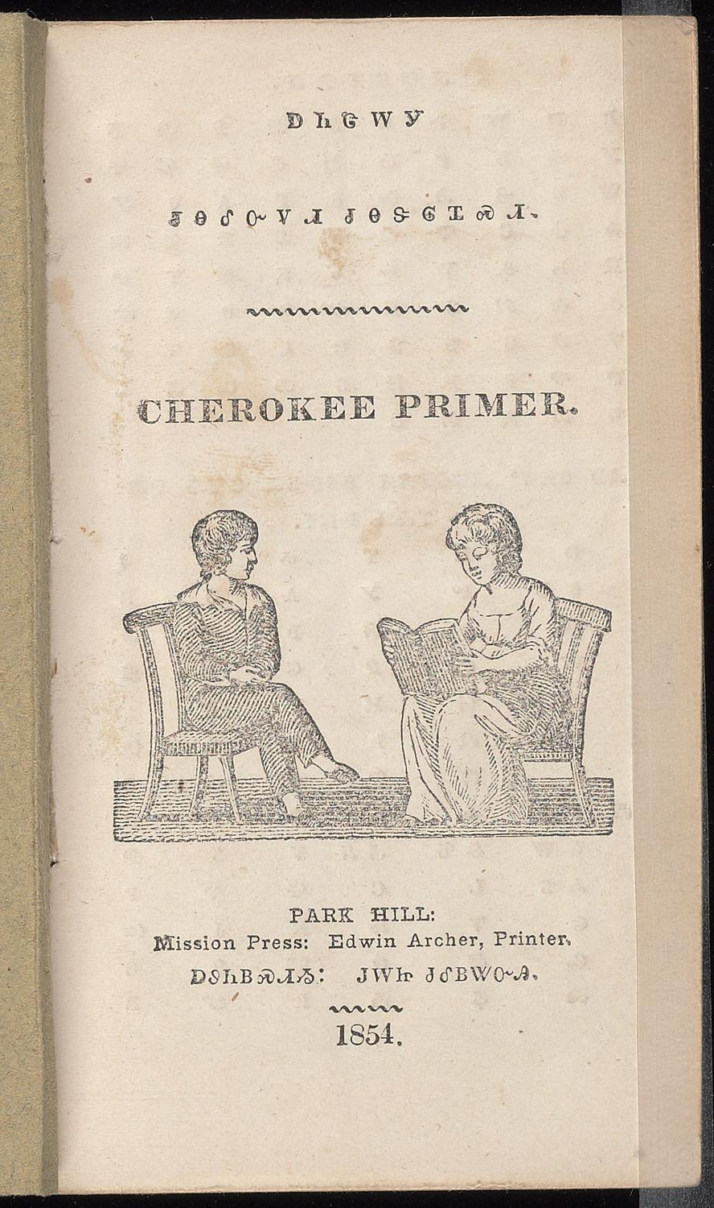
ᏅᎩᏍᎪᎯ ᏦᎢᏁ ᏣᎳᎩ ᎠᏕᎶᏆᏍᏗ

Slide 4
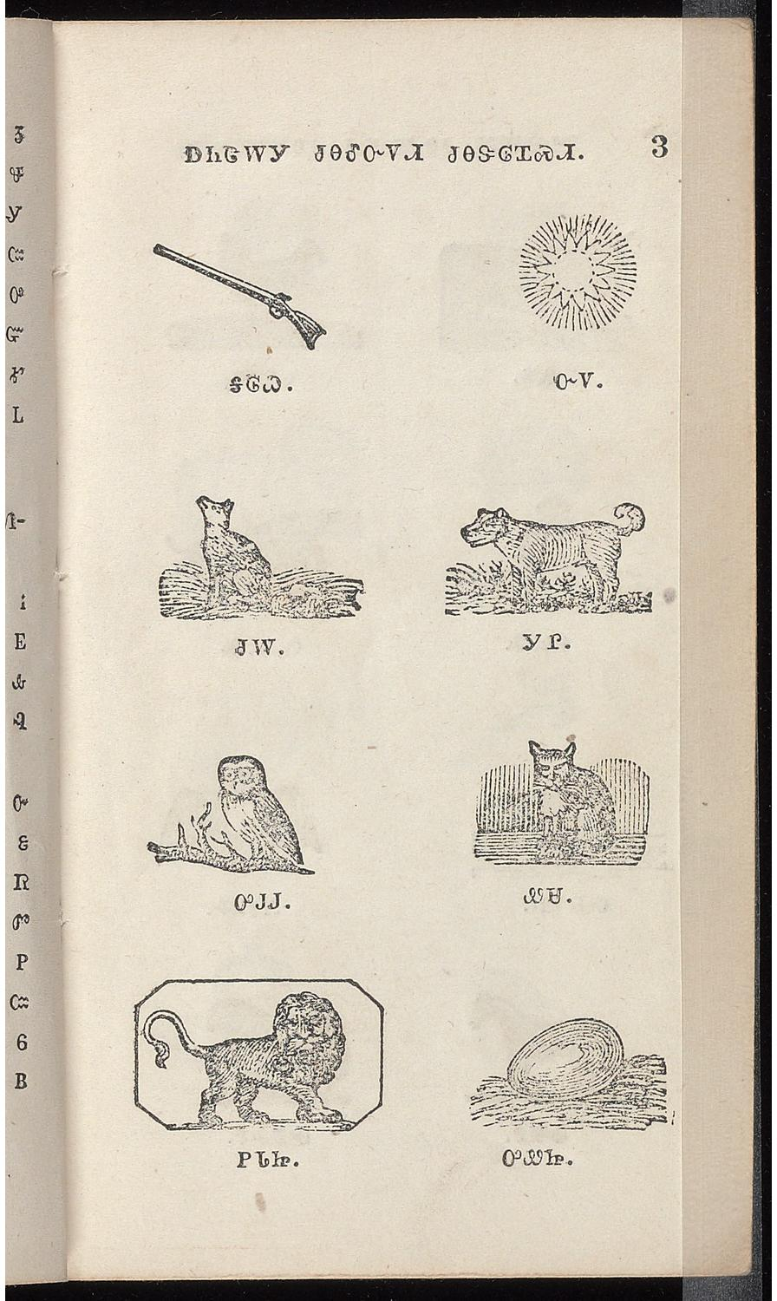
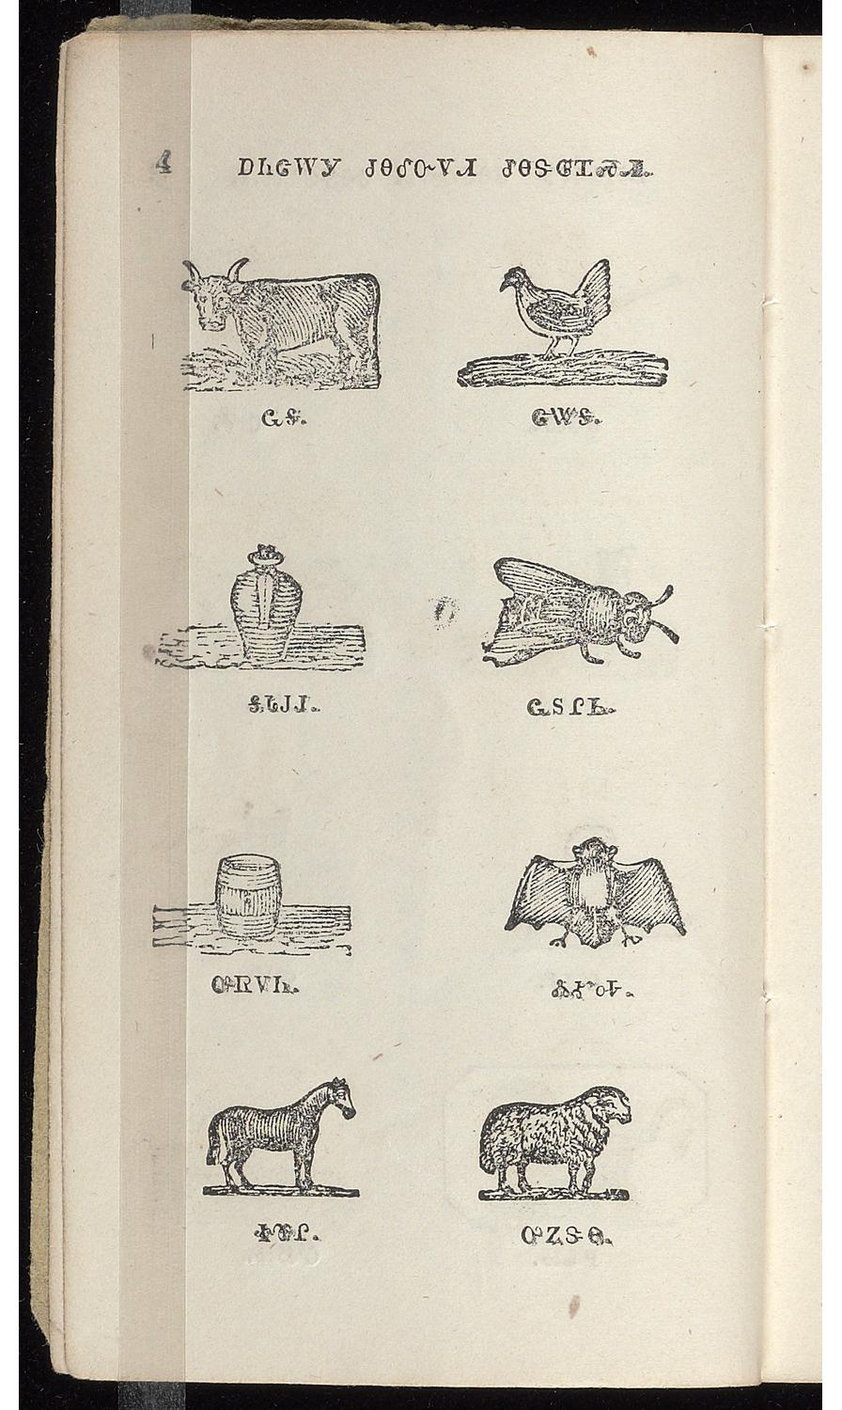
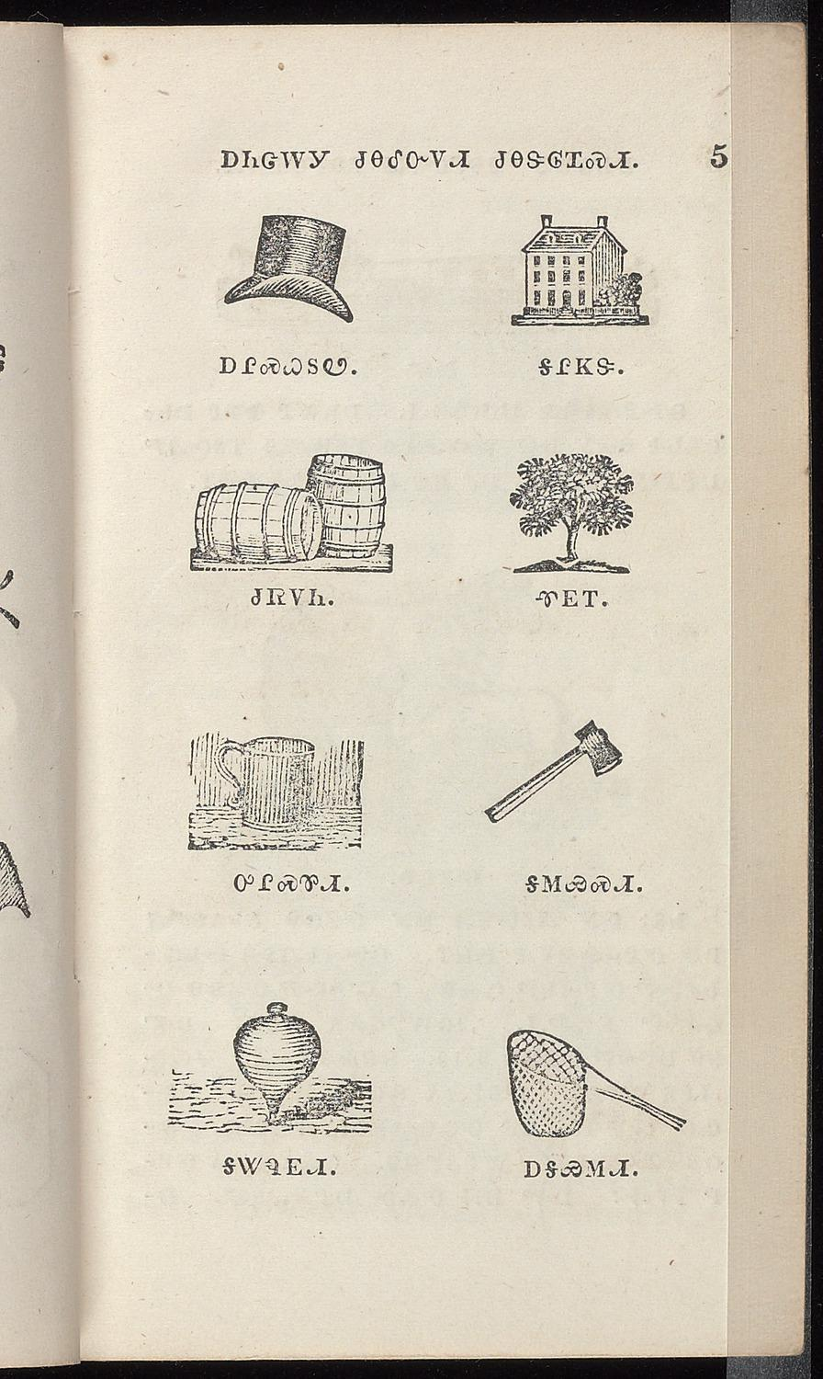
ᏅᎩᏍᎪᎯ ᏦᎢᏁ ᏣᎳᎩ ᎠᏕᎶᏆᏍᏗ

Slide 5
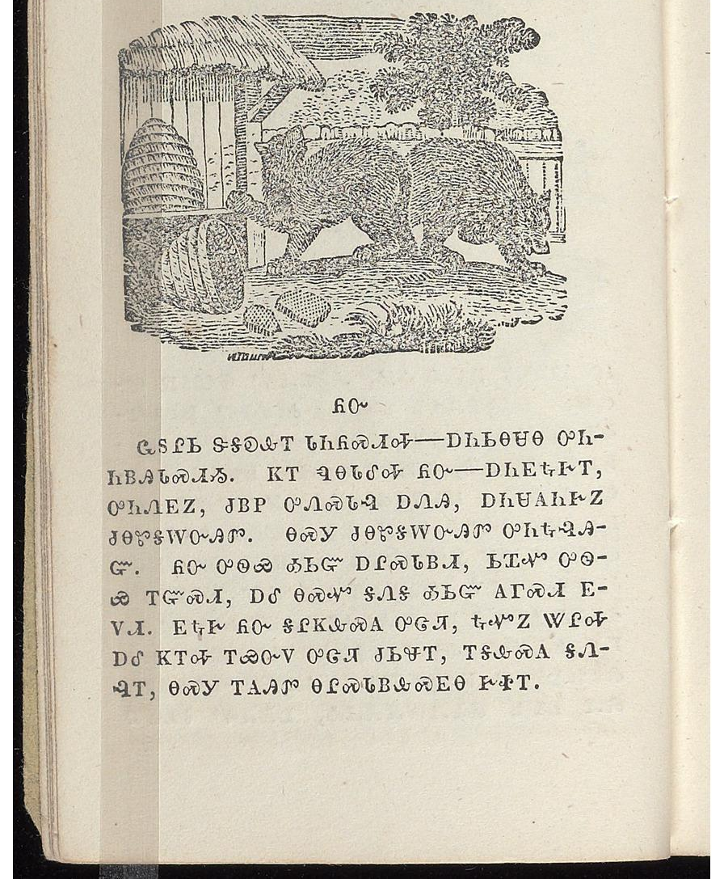
ᏅᎩᏍᎪᎯ ᏦᎢᏁ ᏣᎳᎩ ᎠᏕᎶᏆᏍᏗ
ᏲᏅ
ᏩᏚᎵᏏ ᏕᎦᎧᎲᎢ ᏓᏂᏲᏍᏗᎭ----- ᎠᏂᏏᎾᏌᎾ ᎤᏂᏂᏴᎯᏓᏍᏗᏱ. ᏦᎢ ᏄᎾᏓᎴᎭ ᏲᏅ-----ᎠᏂᎬᎿᎨᎢ, ᎤᏂᏁᎬᏃ, ᏧᏴᏢ ᎤᏁᏍᏓᎸ ᎠᏁᎯ, ᎠᏂᏌᎪᏂᎨᏃ ᏧᎾᏑᎦᎳᏅᎯᏛ. ᎾᏍᎩ ᏧᎾᏑᎦᎳᏅᎯᏛ ᎤᏂᎿᎸᎯᏳ. ᏲᏅ ᎤᏫᏯ ᎣᏏᏳ ᎠᎵᏍᏓᏴᏗ, ᏏᏆᏉ ᎤᏫᏯ ᎢᏳᏍᏗ, ᎠᎴ ᎾᏍᏉ ᎦᏁᎦ ᎣᏏᏳ ᎪᎱᏍᏗ ᎬᏙᏗ. ᎬᎿᎨ ᏲᏅ ᎦᎵᏦᎲᏍᎪ ᎤᏣᏘ, ᎿᏉᏃ ᏔᎵᎭ ᎠᎴ ᏦᎢᎭ ᎢᏯᏅᏙ ᎤᏣᏘ ᏧᏏᏠᎢ, ᎢᎦᎲᏍᎪ ᎦᏁᎸᎢ, ᎾᏍᎩ ᎢᎪᎯᏛ ᎾᎵᏍᏓᏴᎲᏍᎬᎾ ᎨᏐᎢ.
Yonv
Wadulisi degakahvi daniyosdiha------ anisinsana uniniyvhidasdiyi. Joi nunadaleha yonv------ anigvhnagei, uninegvno, juhyvtlv unesdalv anehi, anisakonigehno zunasugalanvhidv. Nasgi junasugalanvhidv unihnalvhiyu. Yonv uwiya osiyu alsdayvdi, siquaquo uwiya iyusdi, ale nasquo ganega osiyu gohusdi gvdodi. Gvhnage yonv galijohvsgo ujati, hnaquono taliha ale joiha iyunvdo ujati jusitloi, igahvsgo ganelvi, nasgi igohidv nalsdayvhvsgvna gesoi.

Slide 6
ᏅᎩᏍᎪᎯ ᏦᎢᏁ ᏣᎳᎩ ᎠᏕᎶᏆᏍᏗ
Adalenisgv atlilov akanogisgv ase eladi igvnedi geso yiwoyeni. Nasgi ijanvtesdi. Dikanogisv dideloquasdi jagowelisgoi, datlilov idiganvhidvha idigvnedi geso dakanogisgvi. Iyuyeno saquo uhnnosdv ganoyvlisdodi yigowela saquo atlilovi, ale tali ayetli-idigadvhi diganoyvlisdodi nasquo saquo atlilov yidigowela, hia yinidigvnv ___________, nasgi ayetli- idigadvhi diganoyvlisdodi tali dakanogisgvi nasgi saquo uhnosdv ganoyvlisdodi akanogisgv igohidv dikanogisdi gesoi. Hiano eladitlv jidegowela datlilov nigadv idiganvhidvha idigvnedi dikanogisgvi.

Slide 7
ᏅᎩᏍᎪᎯ ᏦᎢᏁ ᏣᎳᎩ ᎠᏕᎶᏆᏍᏗ

