Slide 1
ᎣᏏᏲ
ᏅᎩᏁ ᏣᎳᎩ ᎠᏕᎶᏆᏍᏗ

Slide 2
ᏅᎩᏁ ᏣᎳᎩ ᎠᏕᎶᏆᏍᏗ
ᎢᏓᎴᎾ
ᏣᎳᎩ ᎢᏗᏬᏂ!

Slide 3
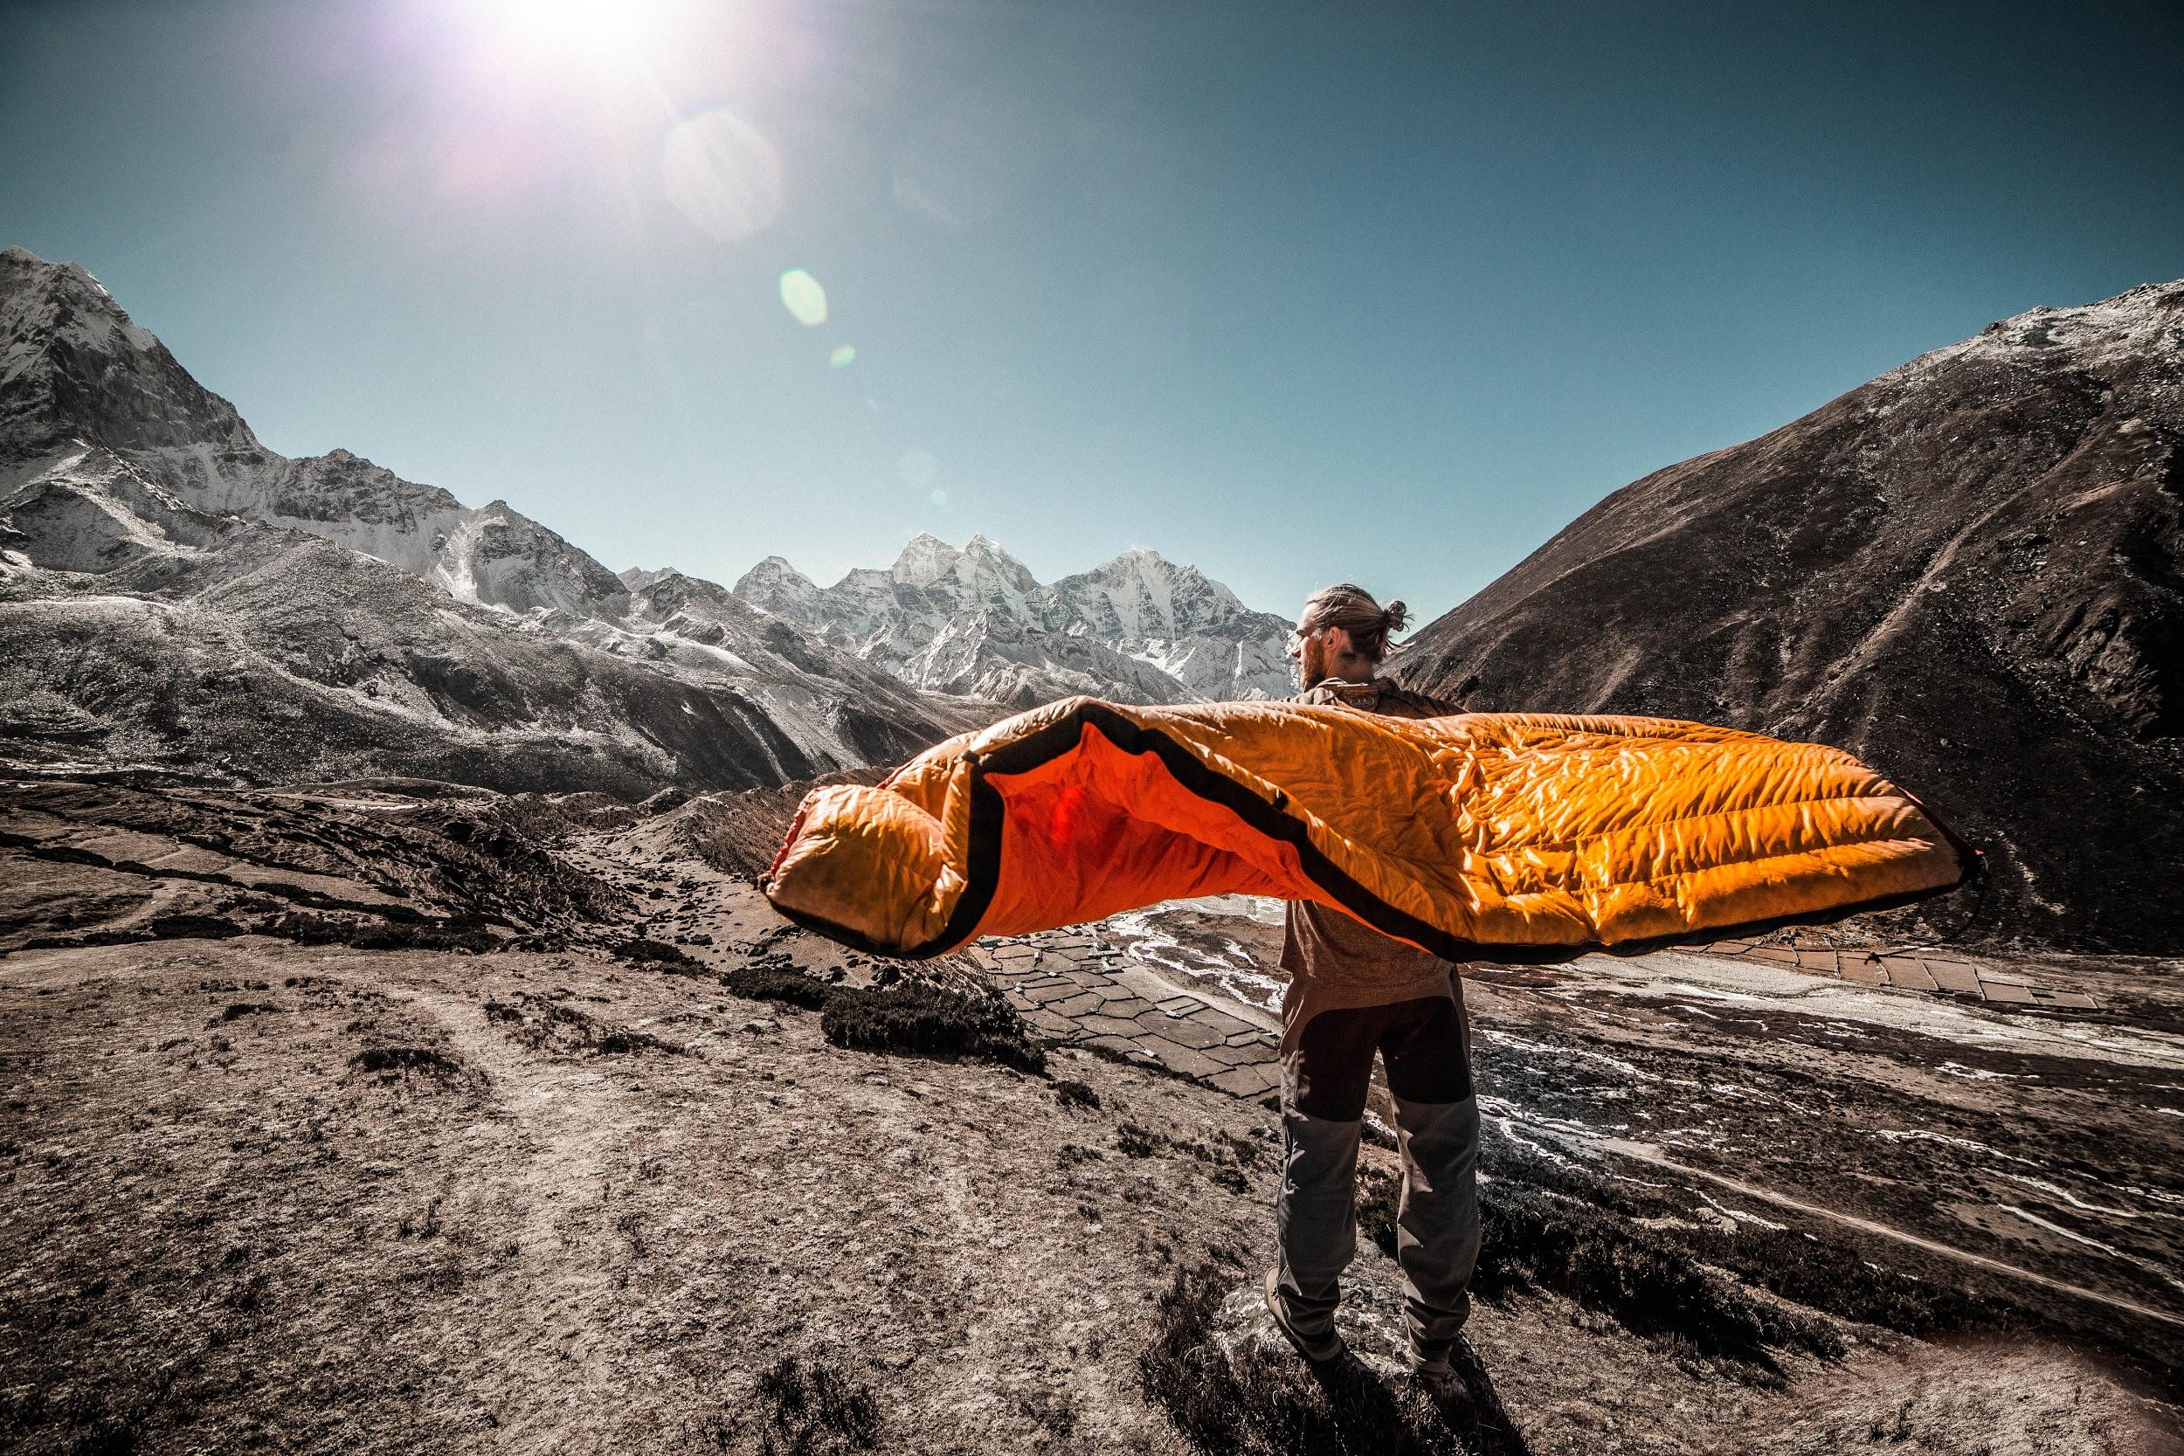
ᏅᎩᏁ ᏣᎳᎩ ᎠᏕᎶᏆᏍᏗ
Ahani asgaya wigadog.
Odalv wigadog na asgaya.
Unegvha una na asgaya.
Anji ulsuwid na unegvha juna na asgaya.
Anji unegvha una na asgaya odalv jiwigadog.

Slide 4
ᏅᎩᏁ ᏣᎳᎩ ᎠᏕᎶᏆᏍᏗ
ᎠᎨᏯᏍ ᏫᎦᏙᎦ?
Ꮭ. Ꮭ ᎠᎨᏯ ᏱᎩ ᏫᏥᎦᏙᎦ. ᎠᏍᎦᏯ ᏫᎦᏙᎦ.
ᏠᎨᏏᏍ ᎣᏓᎸᎨ ᏫᎦᏙᎦ Ꮎ ᎠᏍᎦᏯ?
ᎣᏓᎸ ᏫᎦᏙᎦ ᎠᏍᎦᏯ.
ᎤᏂᎵᏔᏅᏙᏗᏍ ᎤᏁᎬᎭᎨ ᎤᎾ Ꮎ ᎠᏍᎦᏯ?
ᎤᏁᎬᎭ ᎤᎾ Ꮎ ᎠᏍᎦᏯ.
ᎦᏙ ᎤᏍᏗ ᎤᎵᏑᏫᏗ Ꮎ ᎤᏁᎬᎭ ᏧᎾ Ꮎ ᎠᏍᎦᏯ?
ᎠᏂᏥ ᎤᎵᏑᏫᏗ Ꮎ ᎤᏁᎬᎭ.

Slide 5
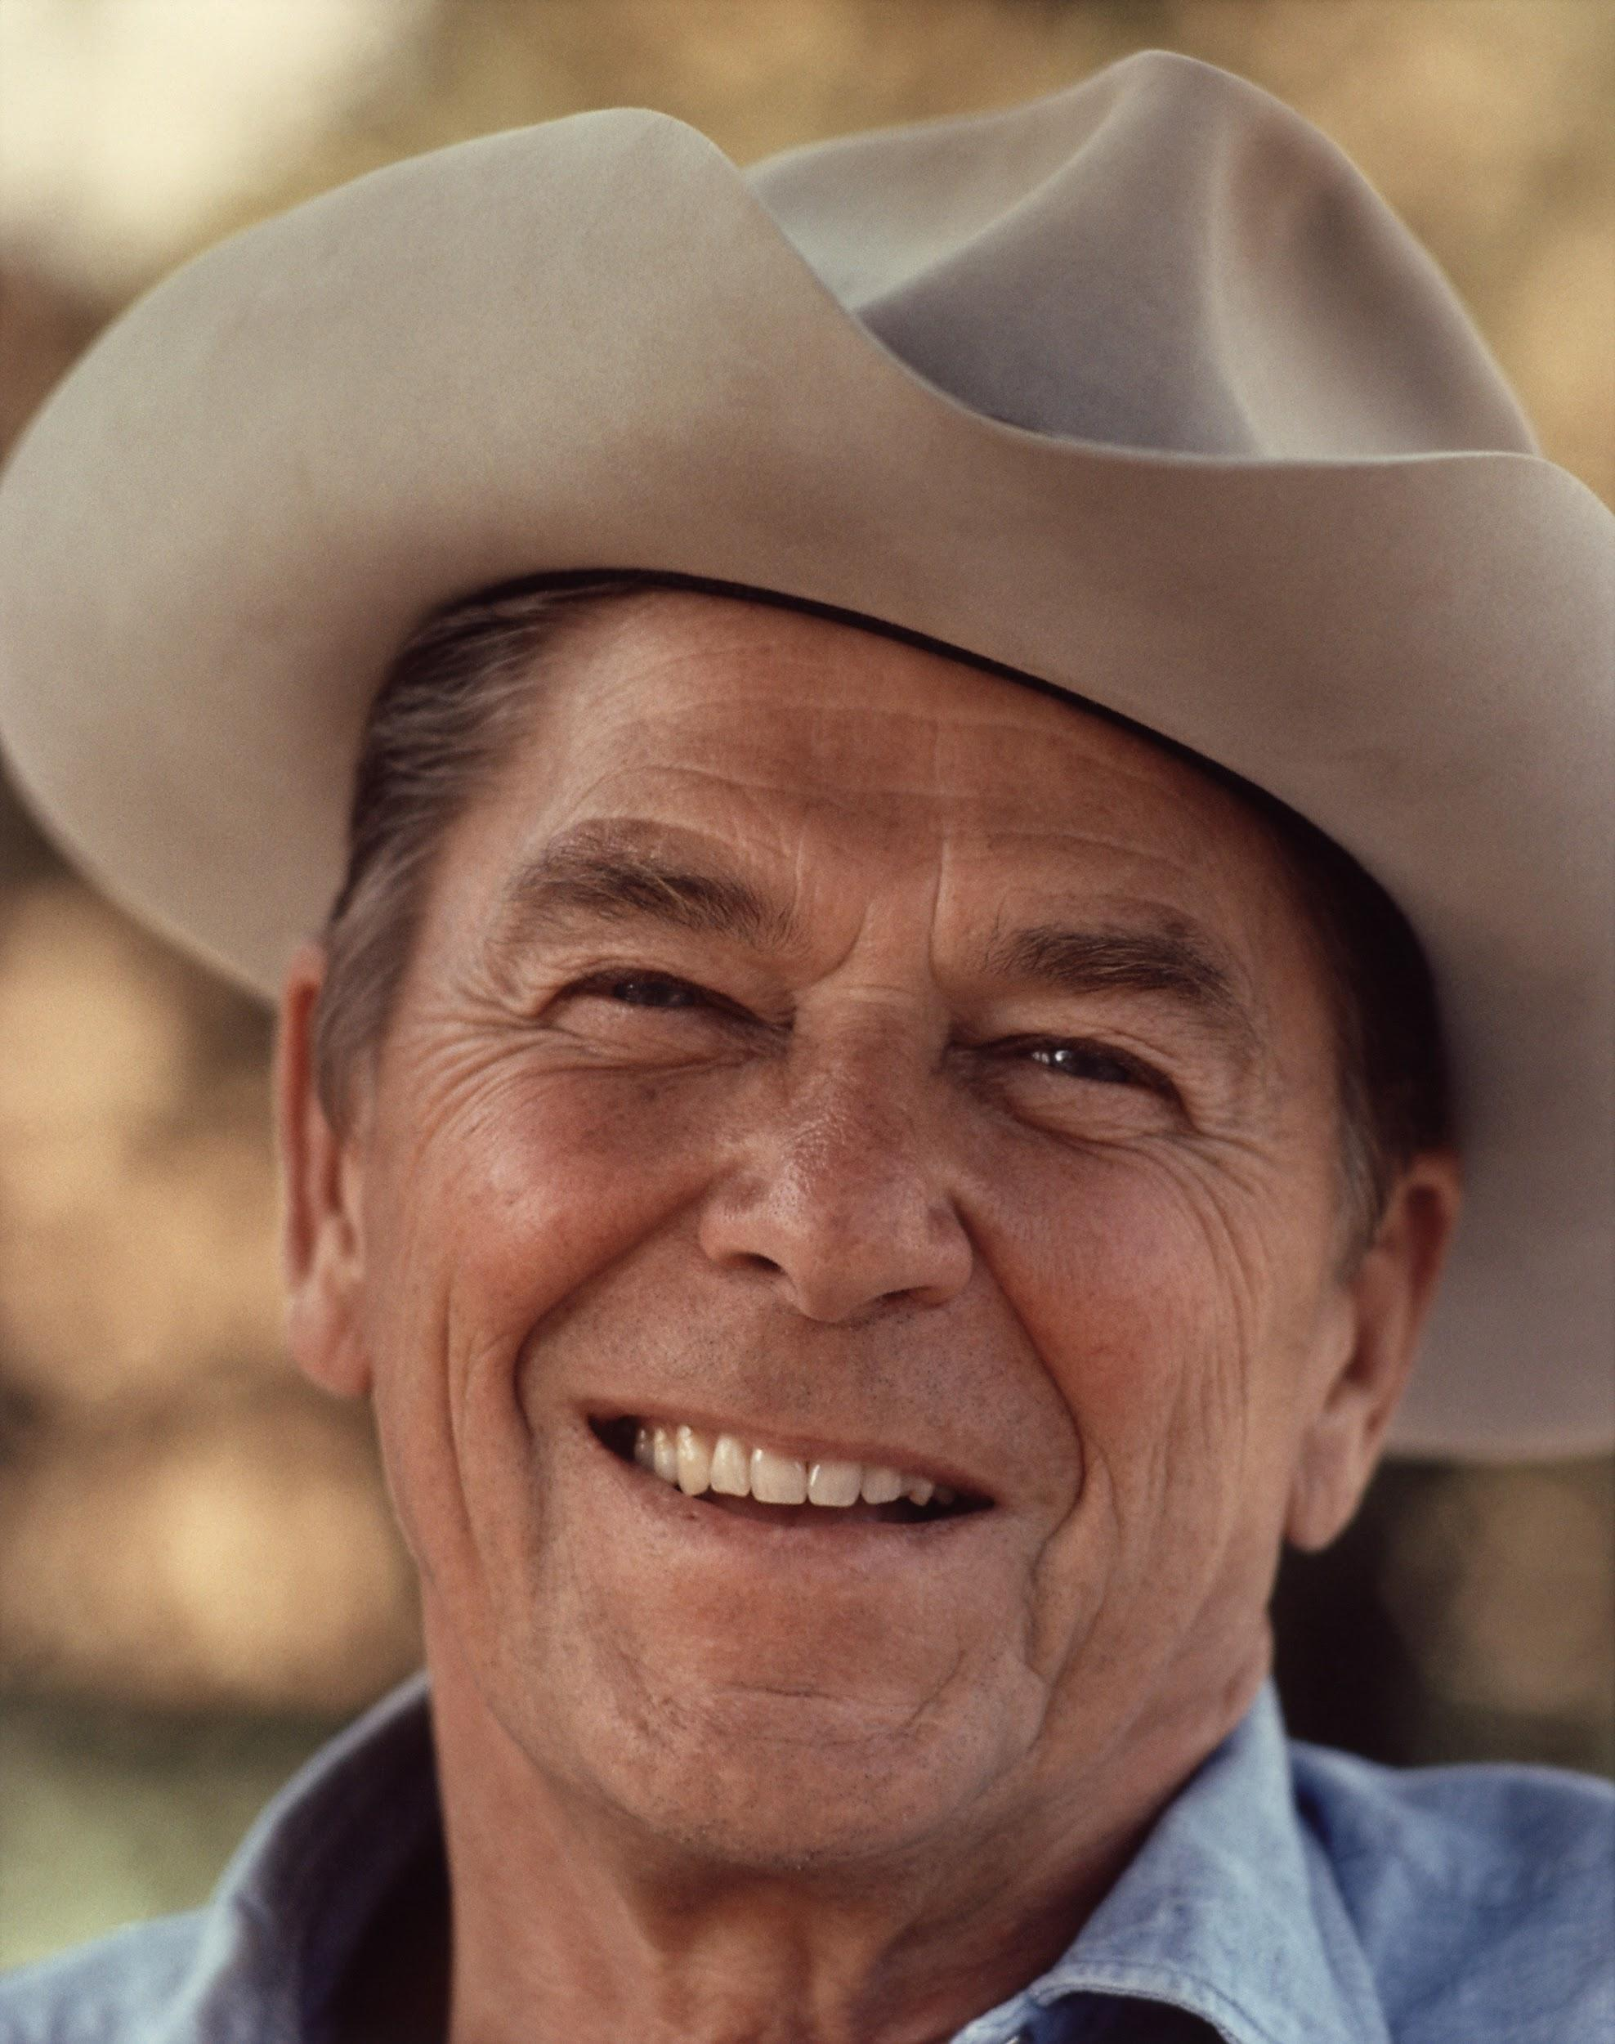
ᏅᎩᏁ ᏣᎳᎩ ᎠᏕᎶᏆᏍᏗ
Hia utvsonv.
Ronald Reagan dudoa.
Ugvwiyuhi gese.
ᎤᏛᏐᏅᏍ ᎠᏧᏣᎨ?
ᎤᏛᏐᏅ.
ᎦᏙ ᎤᏍᏗ ᏚᏙᎠ?
Ronald Reagan ᏚᏙᎠ.
ᏃᏭᏍ ᎤᎬᏫᏳᎯ?
Ꮭ. Ꮭ ᏃᏭ ᏱᎦ. ᎤᎬᏫᏳᎯ ᎨᏎ.

Slide 6
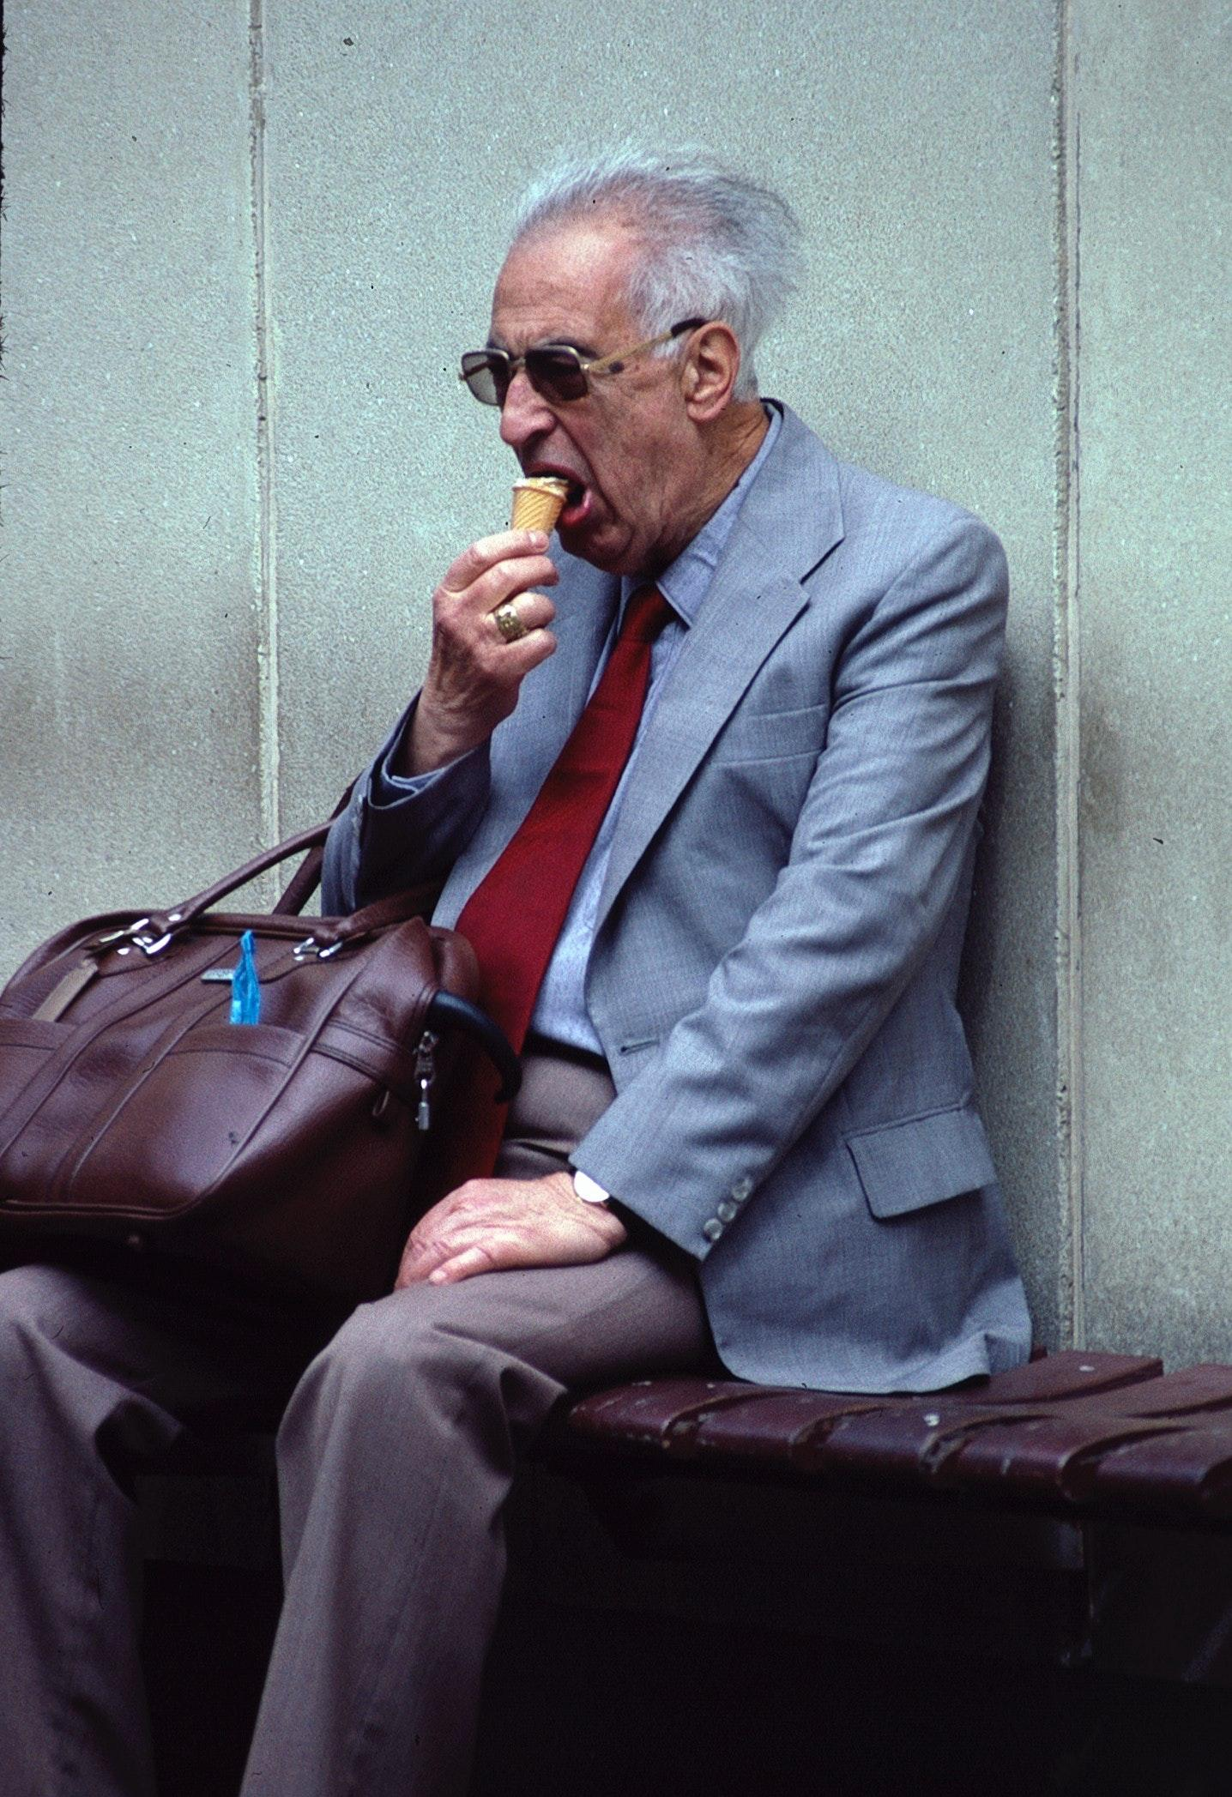
ᏅᎩᏁ ᏣᎳᎩ ᎠᏕᎶᏆᏍᏗ
Hia utvsonv.
Ganoji gotlvnv degald.
Ganoji degald una na utvsonv.
Utvsonv uwotla.
Unvdi ganesdaldistanv agia na utvsonv.
ᎠᏧᏣᏍ?
Ꮭ ᎠᏧᏣ ᏱᎩ. ᎤᏛᏐᏅ.
ᎦᏃᏥᏍ ᎠᏓᎭᎨ ᎪᏢᏅ ᏧᎾ Ꮎ ᎤᏛᏐᏅ?
ᎦᏃᏥ ᎪᏢᏅ ᎤᎾ Ꮎ ᎤᏛᏐᏅ.
ᎦᏙᎦᏍ ᎤᏛᏐᏅ?
Ꮭ. Ꮭ ᏱᎦᏙᎦ ᎤᏛᏐᏅ. ᎤᏬᏢ.

Slide 7
ᏅᎩᏁ ᏣᎳᎩ ᎠᏕᎶᏆᏍᏗ
Hia utvsonv.
Ganoji gotlvnv degald.
Ganoji degald una na utvsonv.
Utvsonv uwotla.
Unvdi ganesdaldistanv agia na utvsonv.
ᎦᏙ ᎠᏛᏁ Ꮎ ᎤᏛᏐᏅ?
ᎤᏛᏐᏅ ᎤᏬᏢ.
ᎦᏙ ᎤᏍᏗ ᎠᎩᎠ ᎤᏛᏐᏅ?
ᎤᏅᏗ ᎦᏁᏍᏓᎵᏗᏍᏔᏅ ᎠᎩᎠ Ꮎ ᎤᏛᏐᏅ.
ᏕᎦᎵᏗᏍ ᎤᏁᎬᎭᎨ ᎤᎾ Ꮎ ᎤᏛᏐᏅ?
ᏕᎦᎵᏗ ᎤᎾ Ꮎ ᎤᏛᏐᏅ.

Slide 8
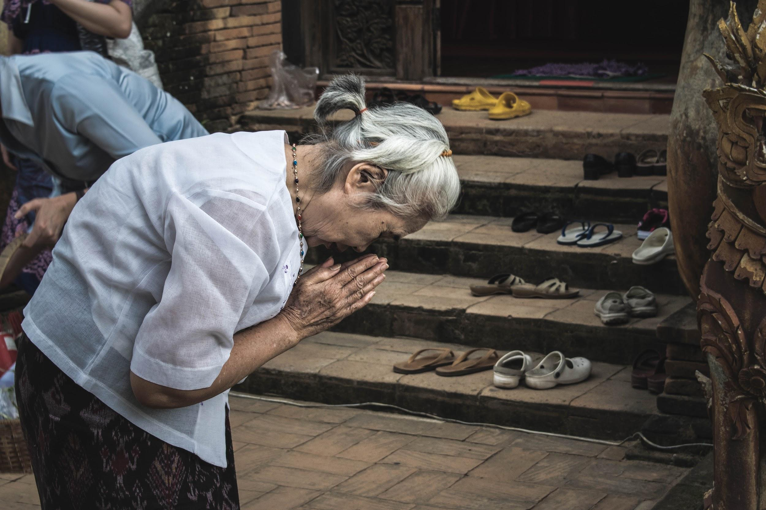
ᏅᎩᏁ ᏣᎳᎩ ᎠᏕᎶᏆᏍᏗ
Ahani, tla utvsonv yigi. Agayvlige.
Agayvlige gadoga.
Adadolisdi na agayvlige.
ᎤᏛᏐᏅᏍ ᎠᎦᏴᎵᎨᎨ?
ᎠᎦᏴᎵᎨ.
ᎤᏬᏝᏍ ᎦᏙᎦᎨ Ꮎ ᎠᎦᏴᎵᎨ?
ᎦᏙᎦ Ꮎ ᎠᎦᏴᎵᎨ.
ᎦᎪ ᎠᏓᏙᎵᏍᏗ?
ᎠᎦᏴᎵᎨ ᎠᏓᏙᎵᏍᏗ.

Slide 9
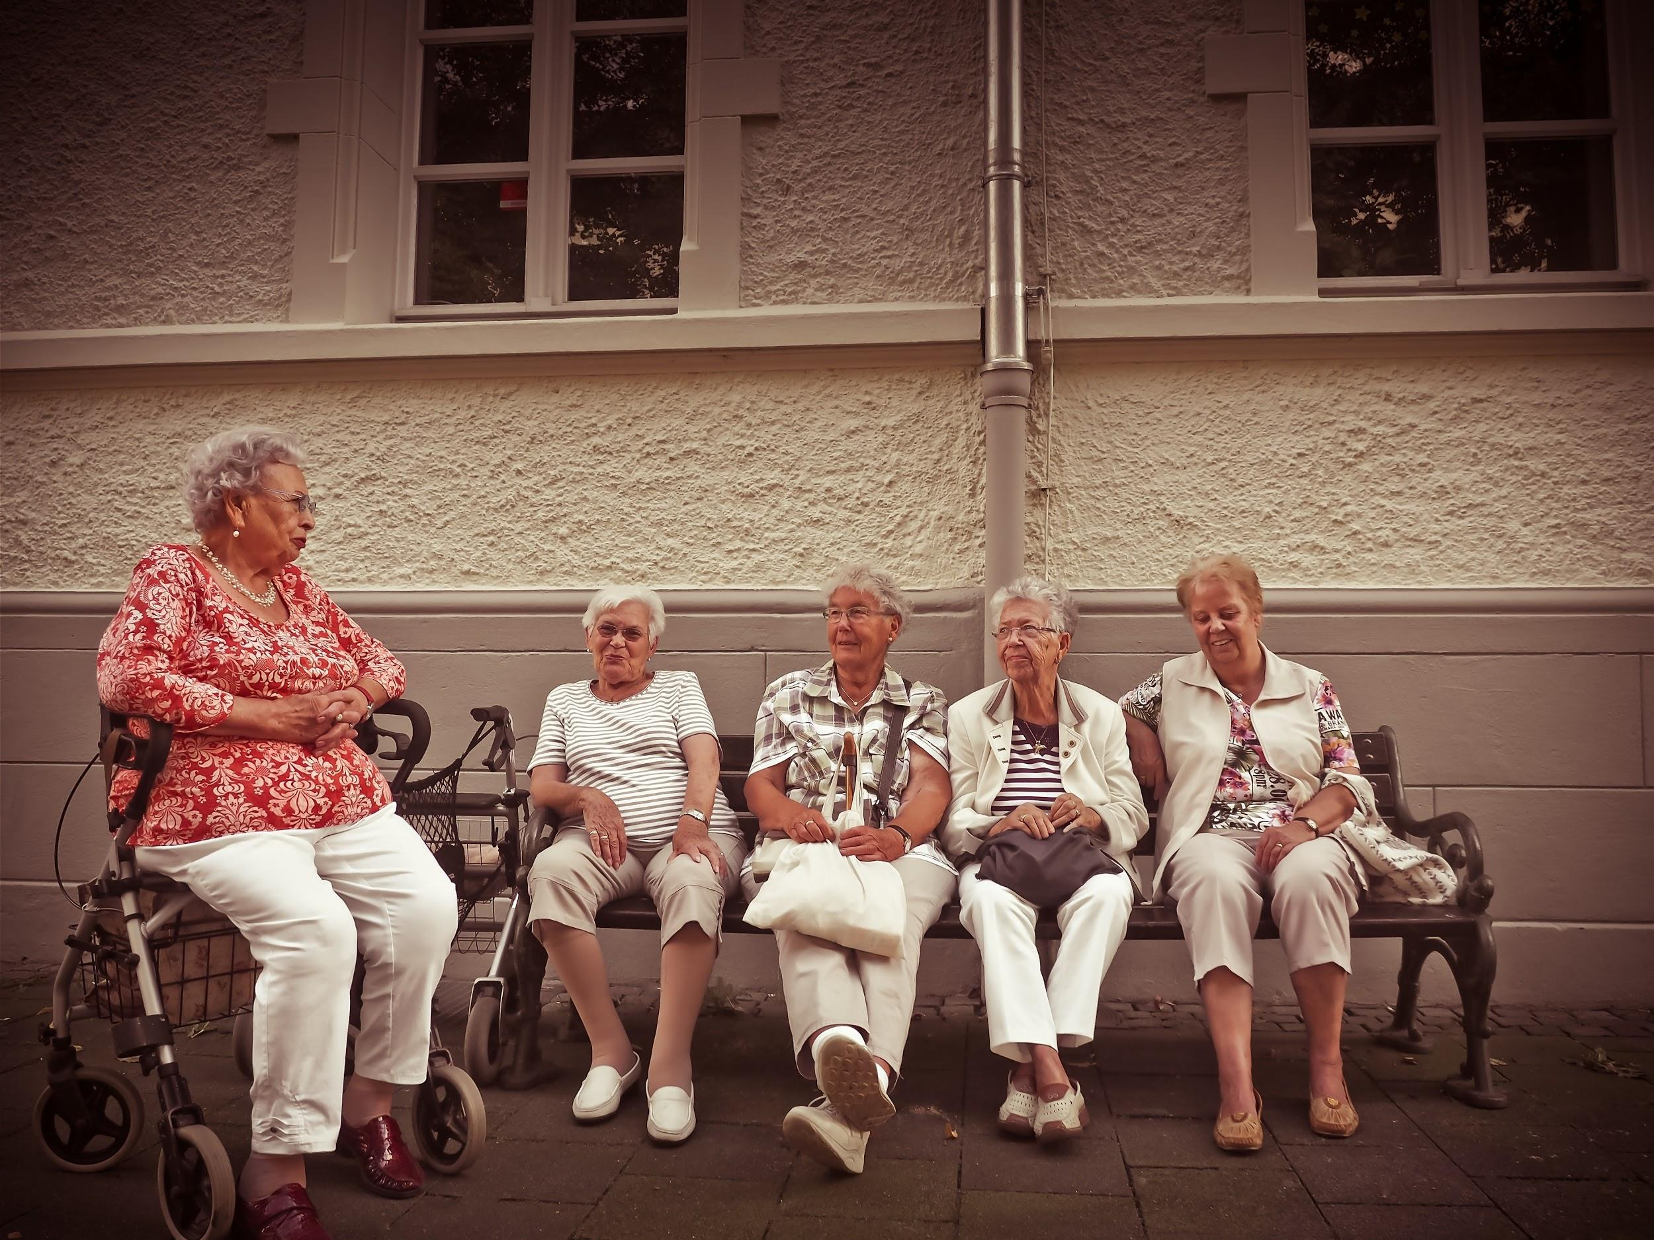
ᏅᎩᏁ ᏣᎳᎩ ᎠᏕᎶᏆᏍᏗ
Ahani hisgi yani anigayvlige.
Hisgi anigayvlige dunotla.
Tal yani anigayvlige adeldigaldod dunina.
Sawu unega ulsuwid na adeldigaldodi.
Soi, uwodige ulsuwid.

Slide 10
ᏅᎩᏁ ᏣᎳᎩ ᎠᏕᎶᏆᏍᏗ
ᏅᎩᏍ ᏯᏂ ᎠᏂᎦᏴᎵᎨ ᏚᏃᏝ?
Ꮭ. Ꮭ ᏅᎩ ᏱᎩ ᏥᏚᏃᏔ. ᎯᏍᎩ ᎠᏂᎦᏴᎵᎨ ᏚᏃᏝ.
ᎯᎳ ᏯᏂ ᎠᏂᎦᏴᎵᎨ ᎠᏕᎳᏗᎦᎵᏙᏗ ᏚᏂᎾ?
ᏔᎵ ᏯᏂ ᎠᏂᎦᏴᎵᎨ ᎠᏕᎳᏕᎦᎵᏙᏗ ᏚᏂᎾ.

Slide 11
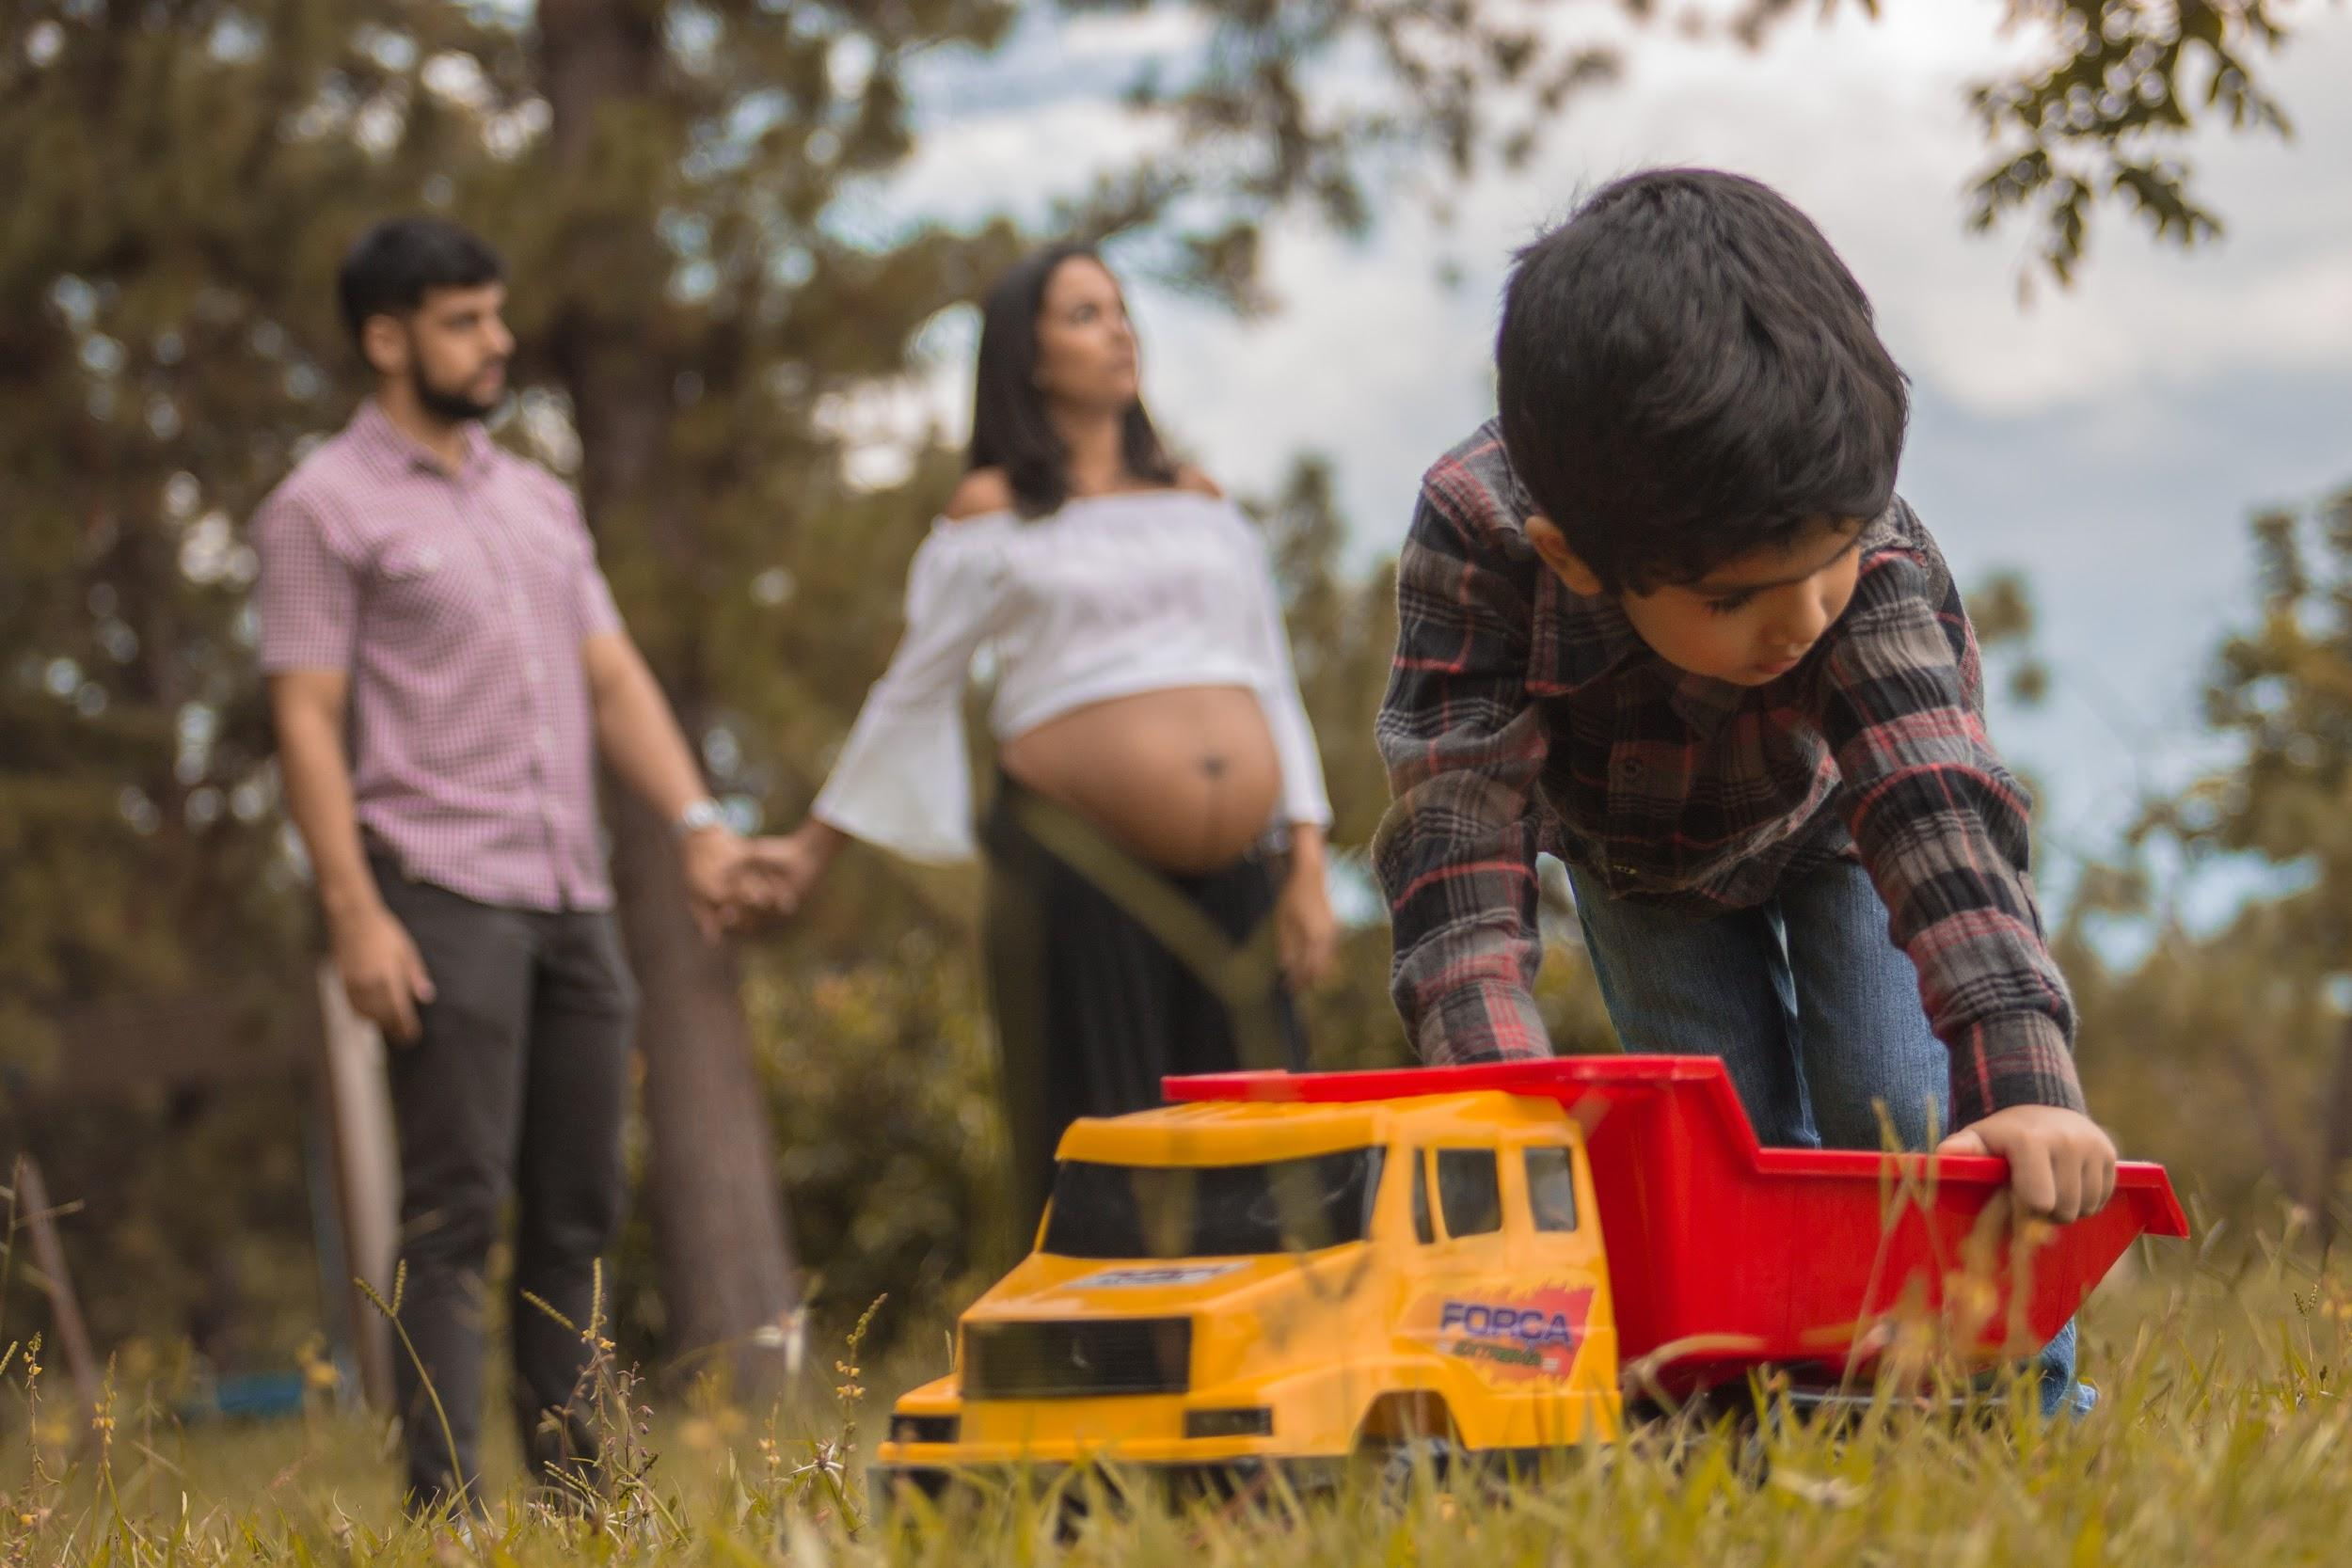
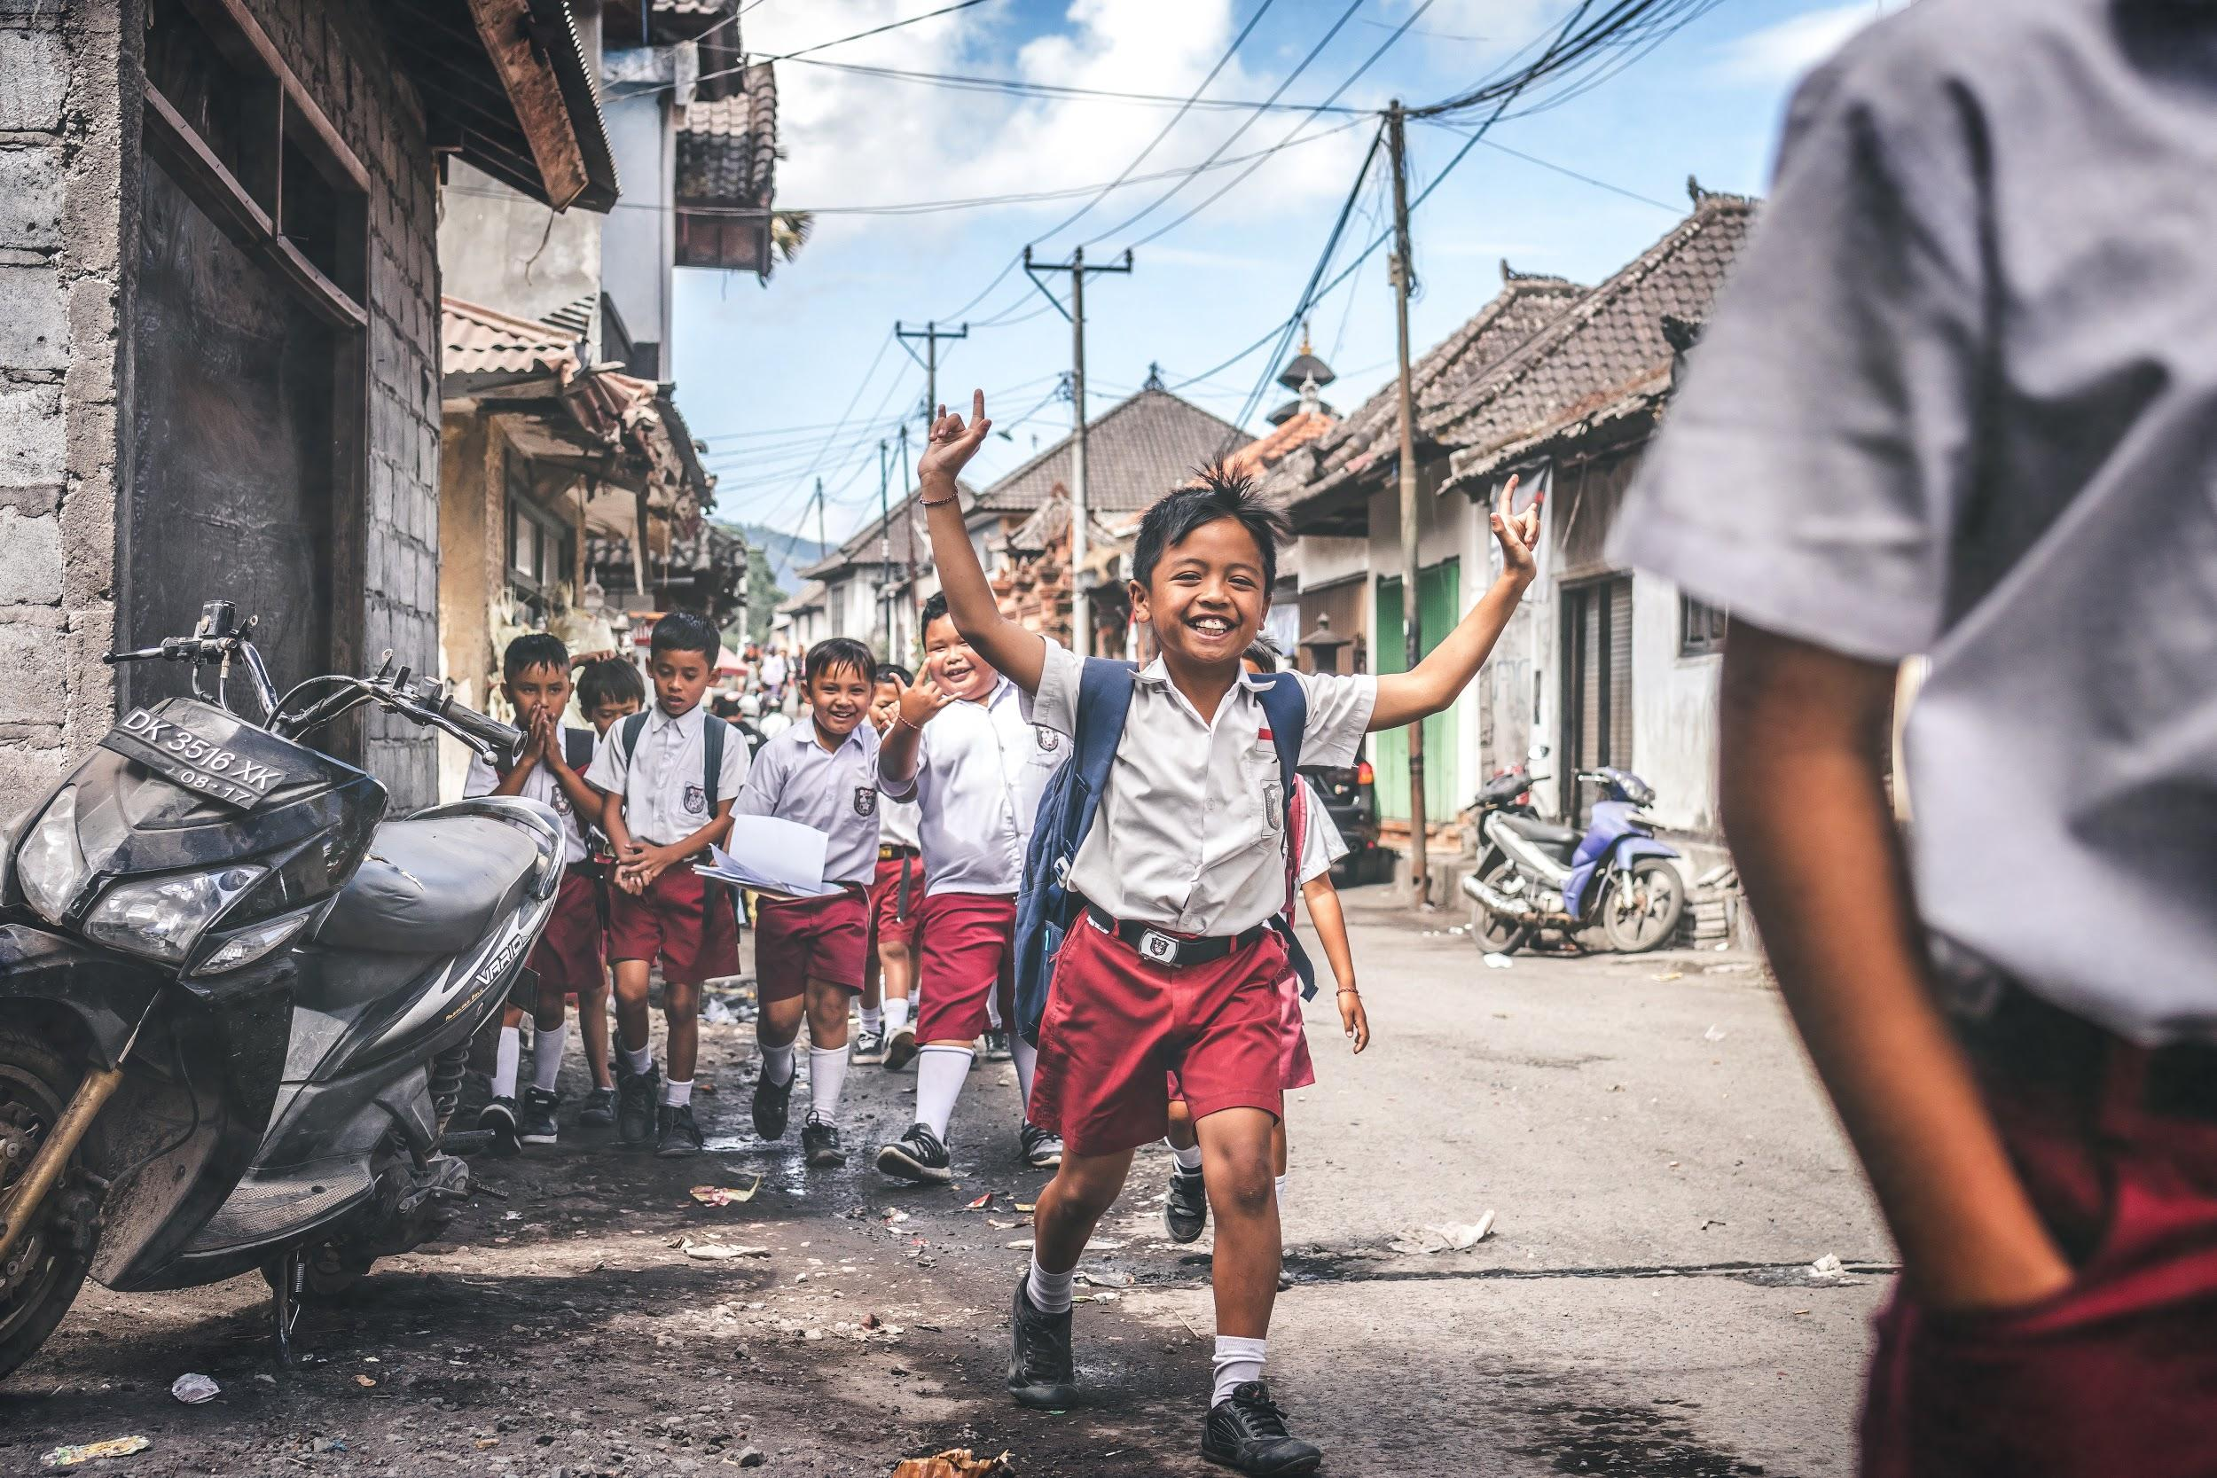
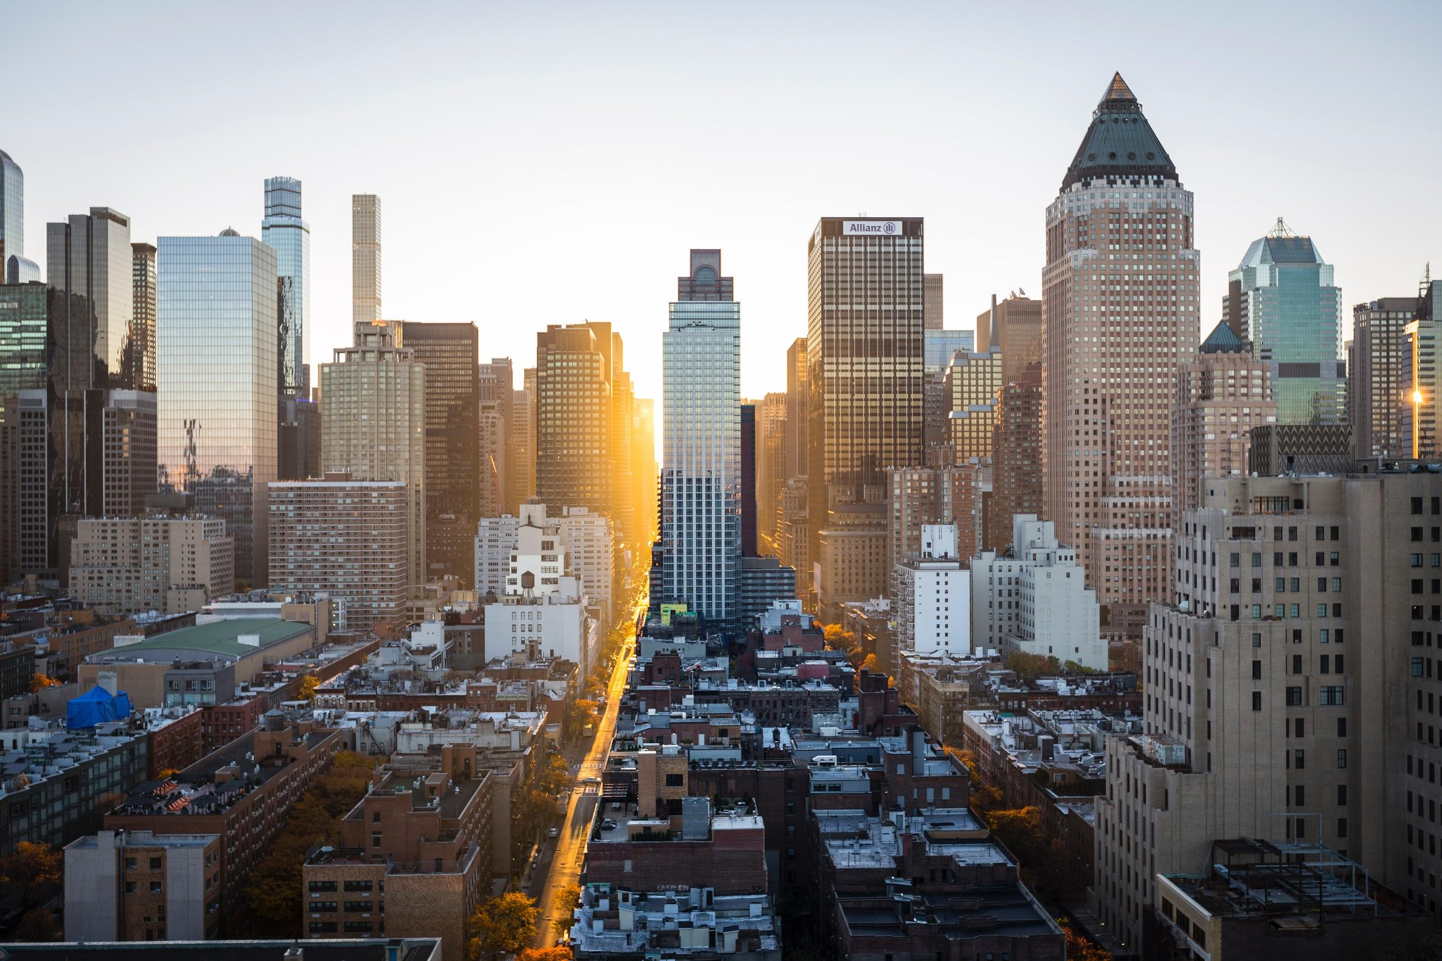
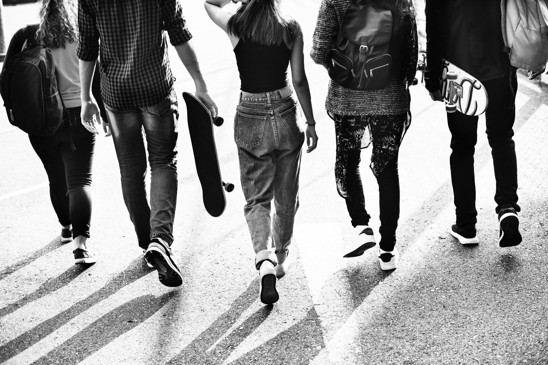
ᏅᎩᏁ ᏣᎳᎩ ᎠᏕᎶᏆᏍᏗ
ᎤᏬᏢᏗ
unej achuja
Nvnohuldi wanaise
Utan digaduhv
unenvse

Slide 12
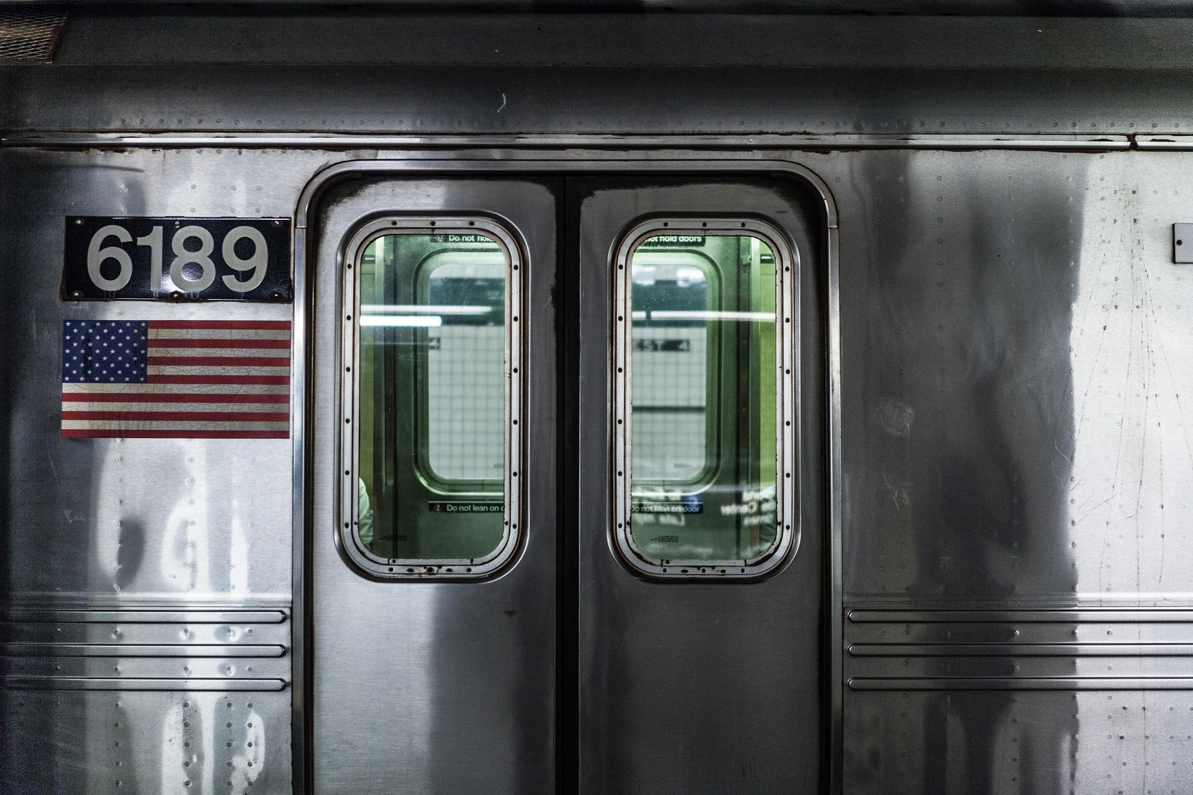
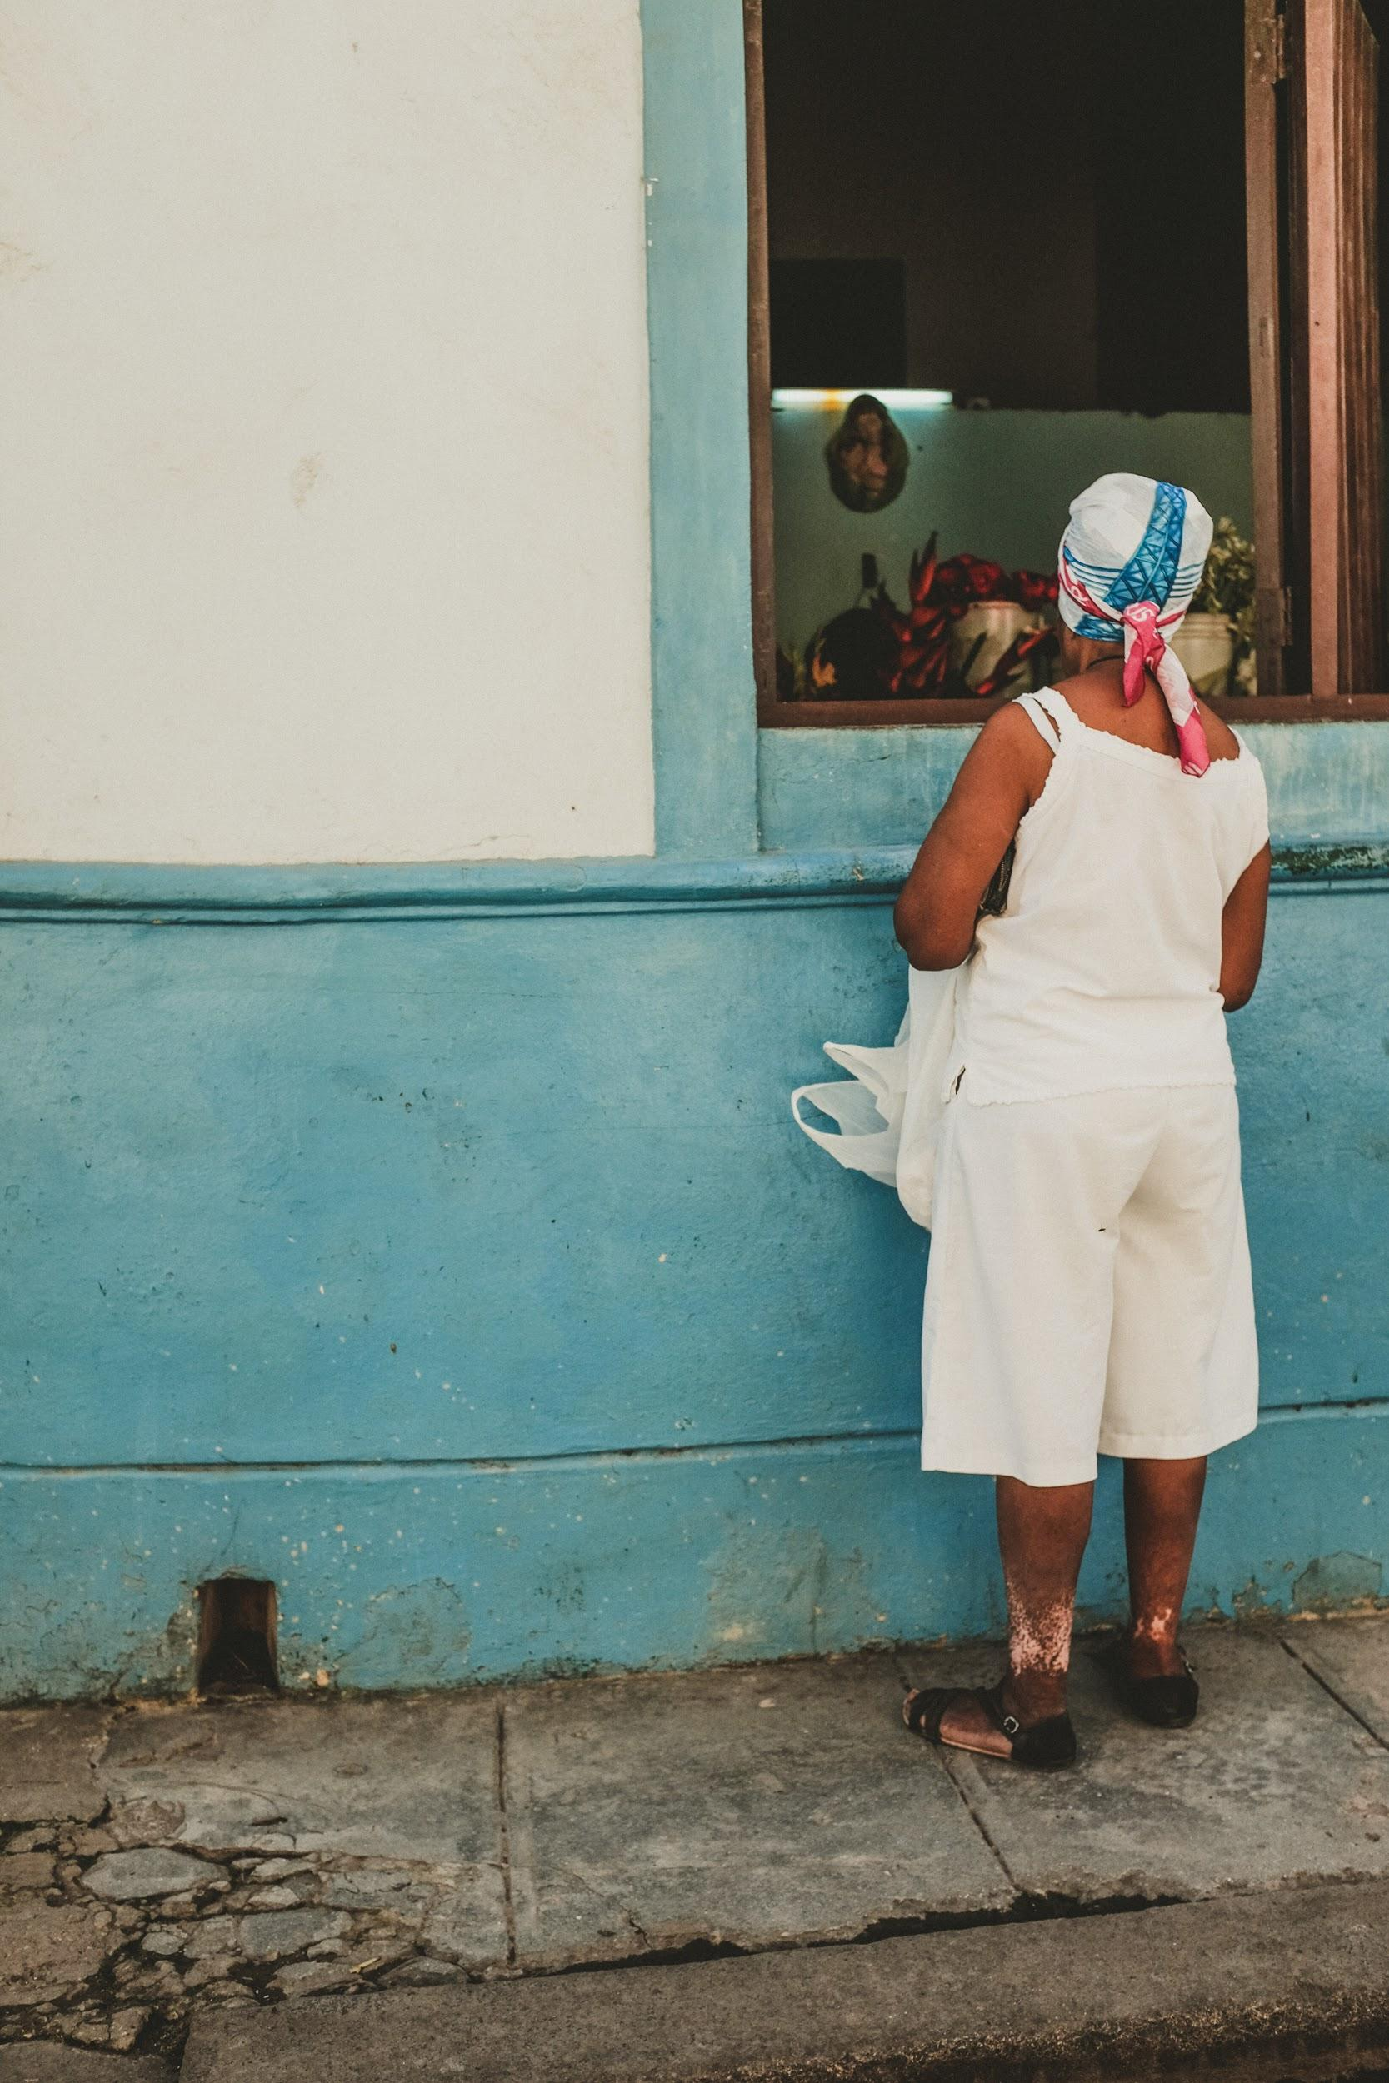
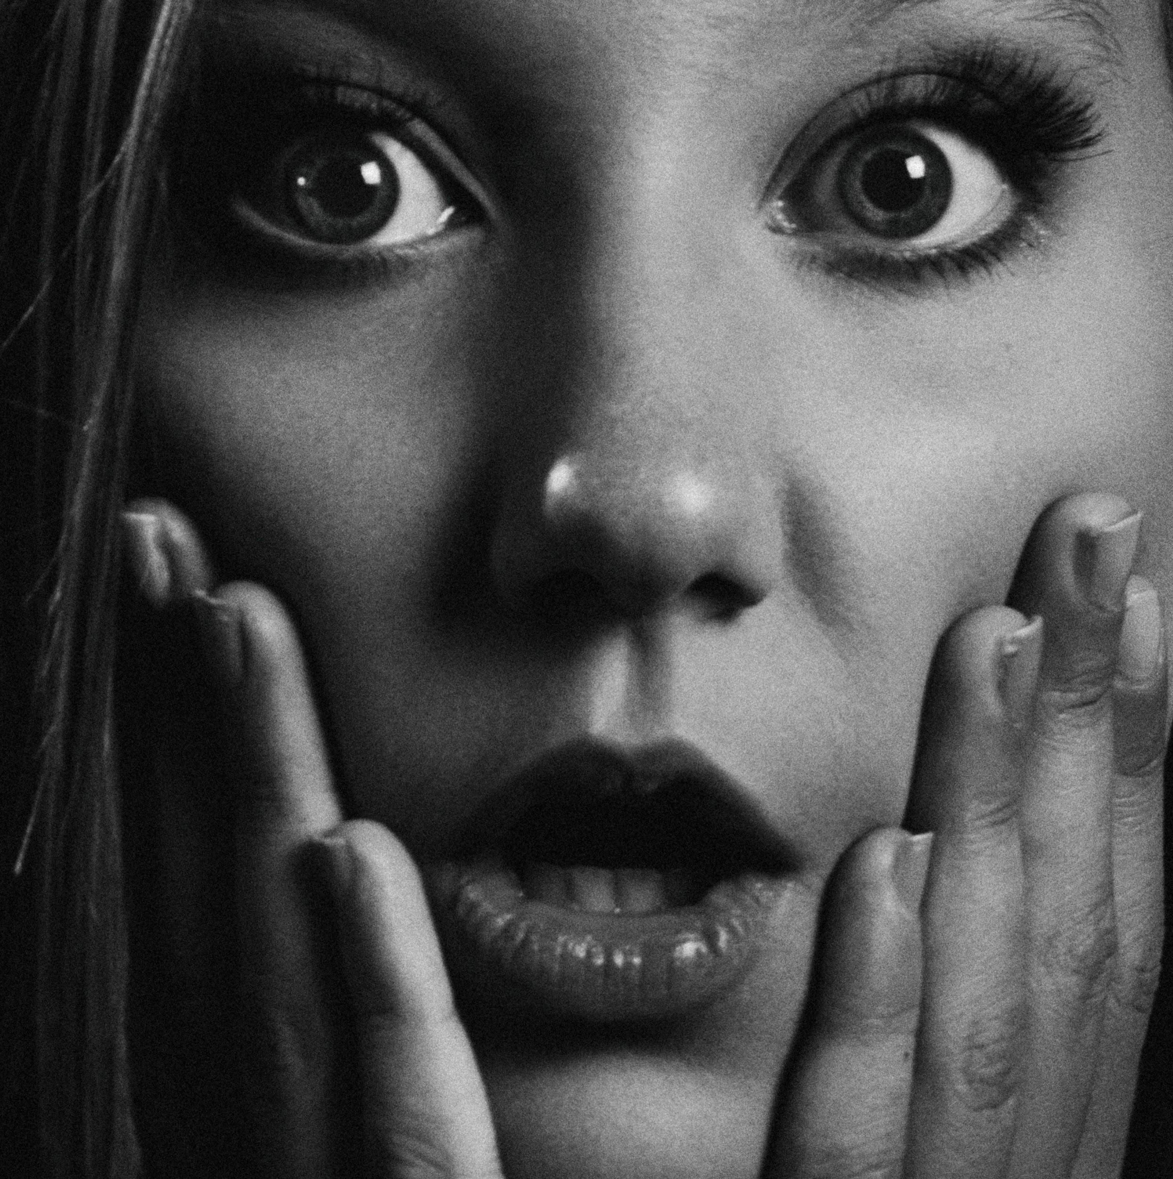
ᏅᎩᏁ ᏣᎳᎩ ᎠᏕᎶᏆᏍᏗ
ᎤᏬᏢᏗ
Jolani widukanane
Talugisgi galohisdi
usquanikd
Siqua galjohid

Slide 13
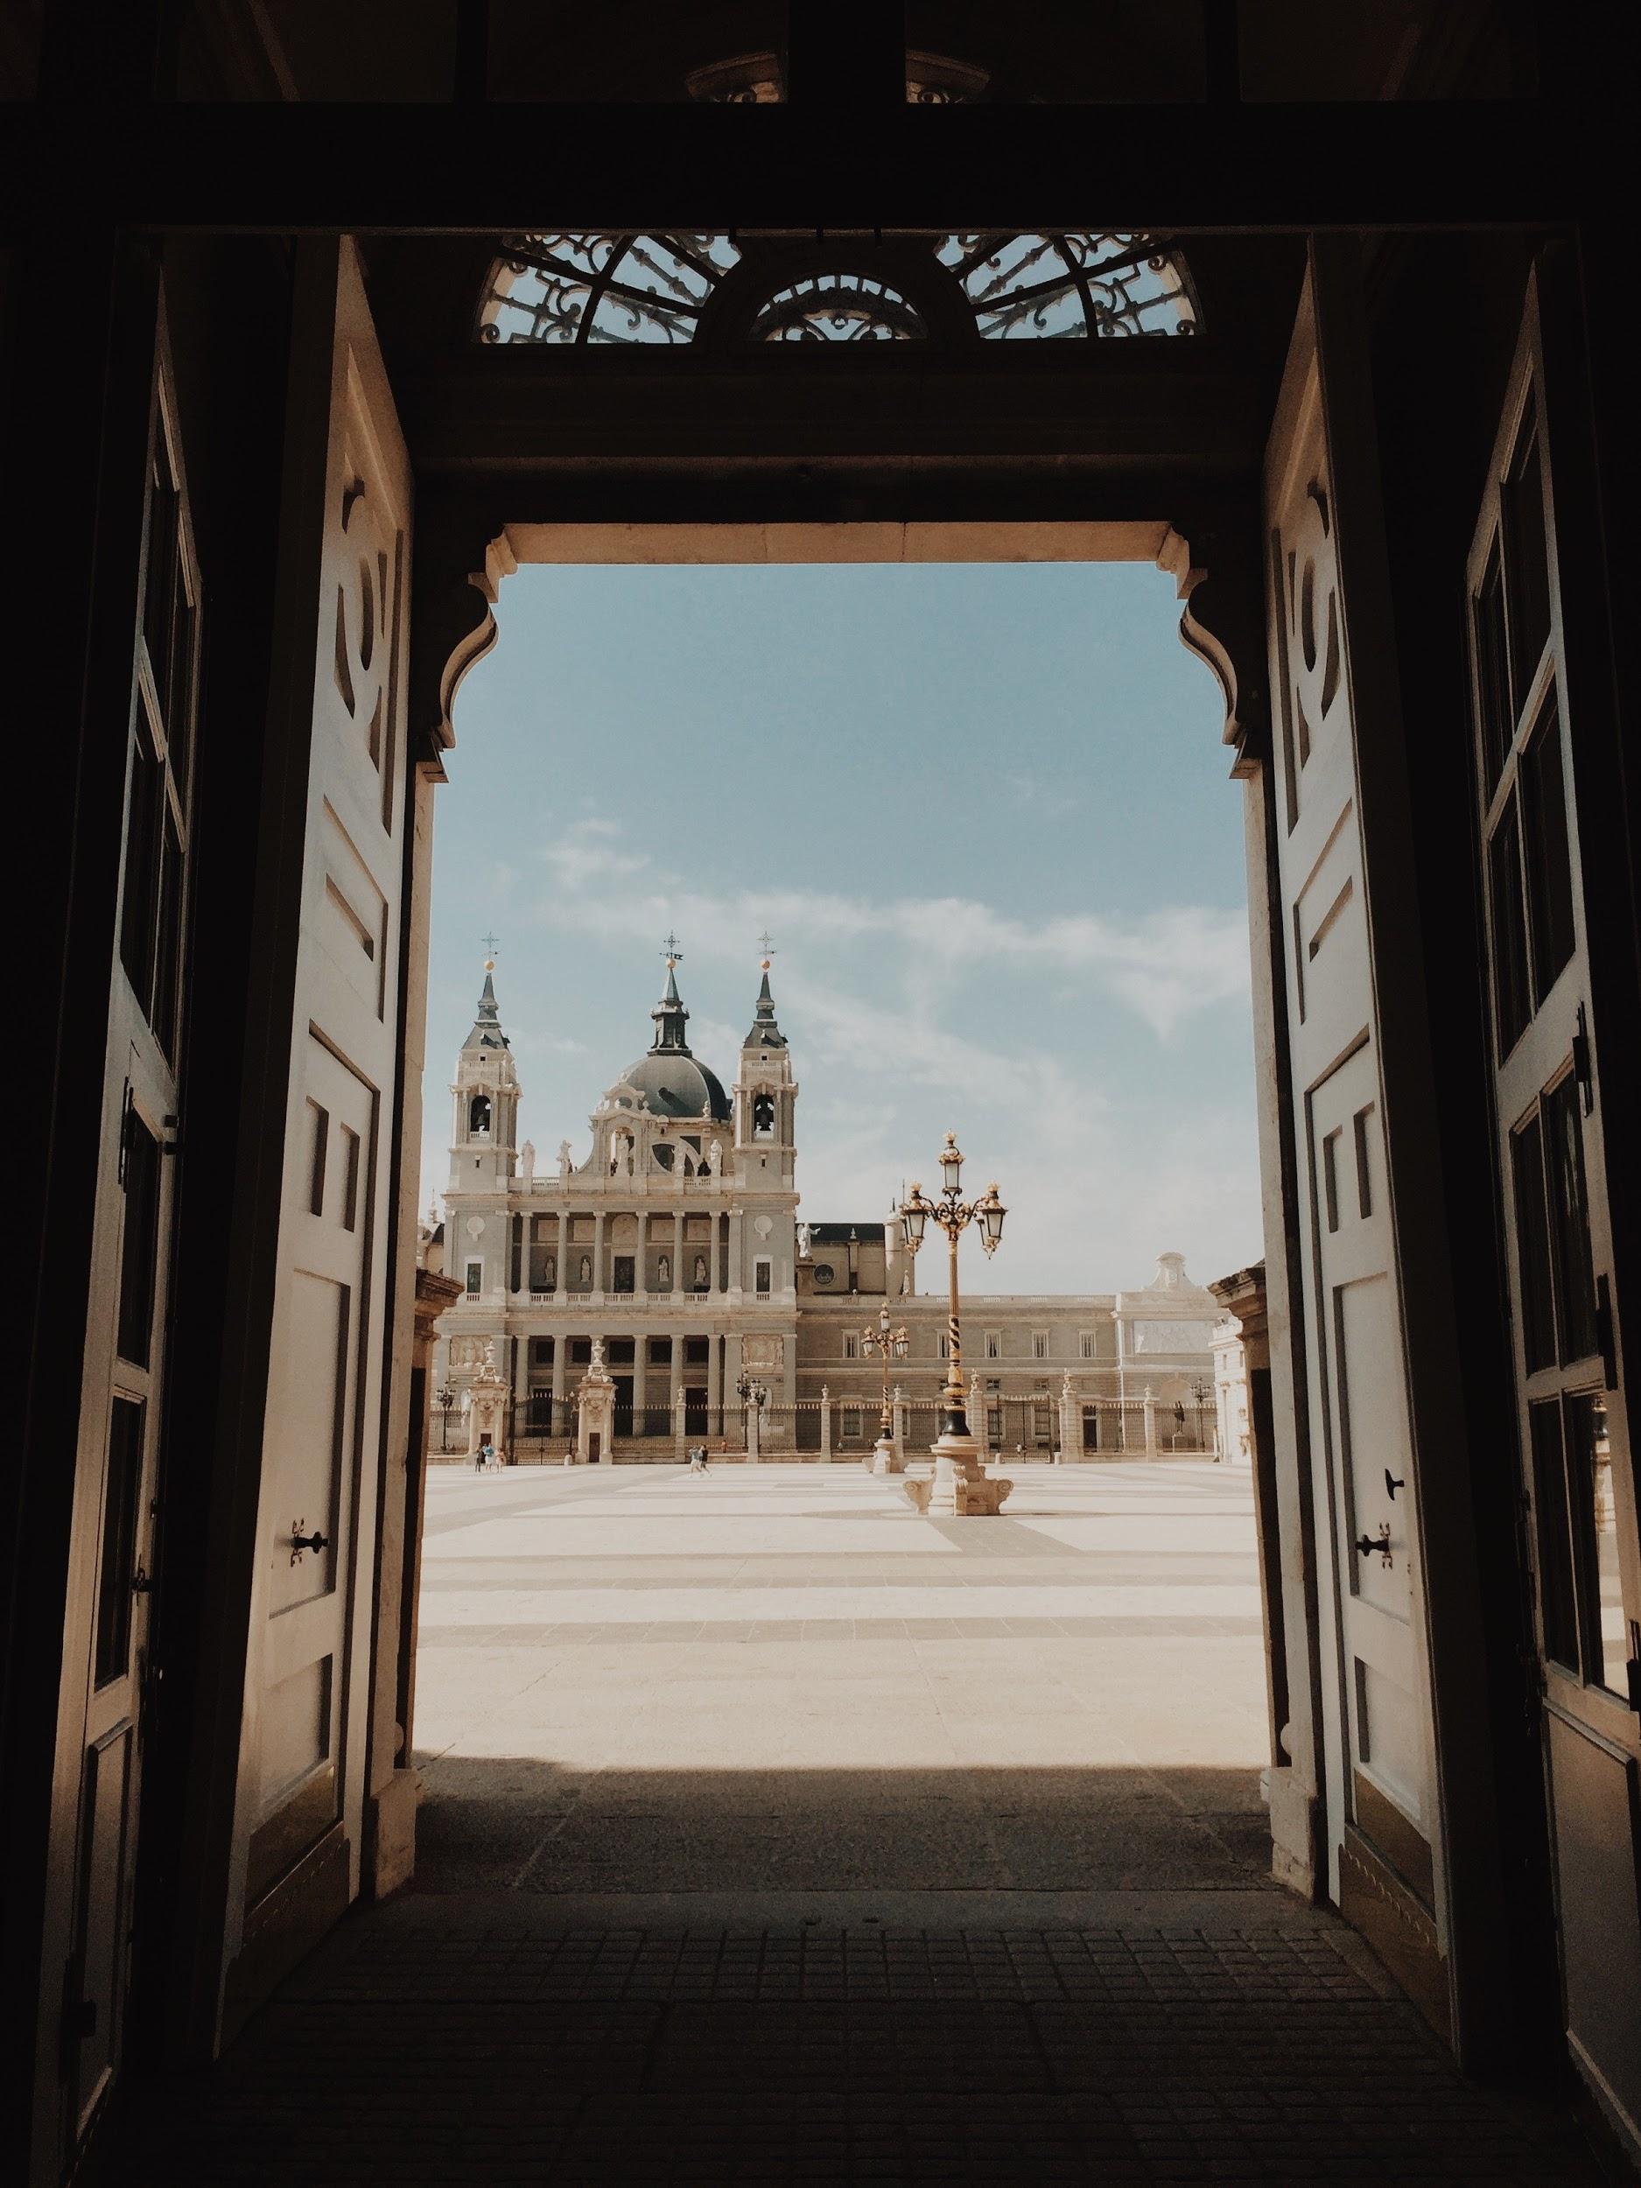
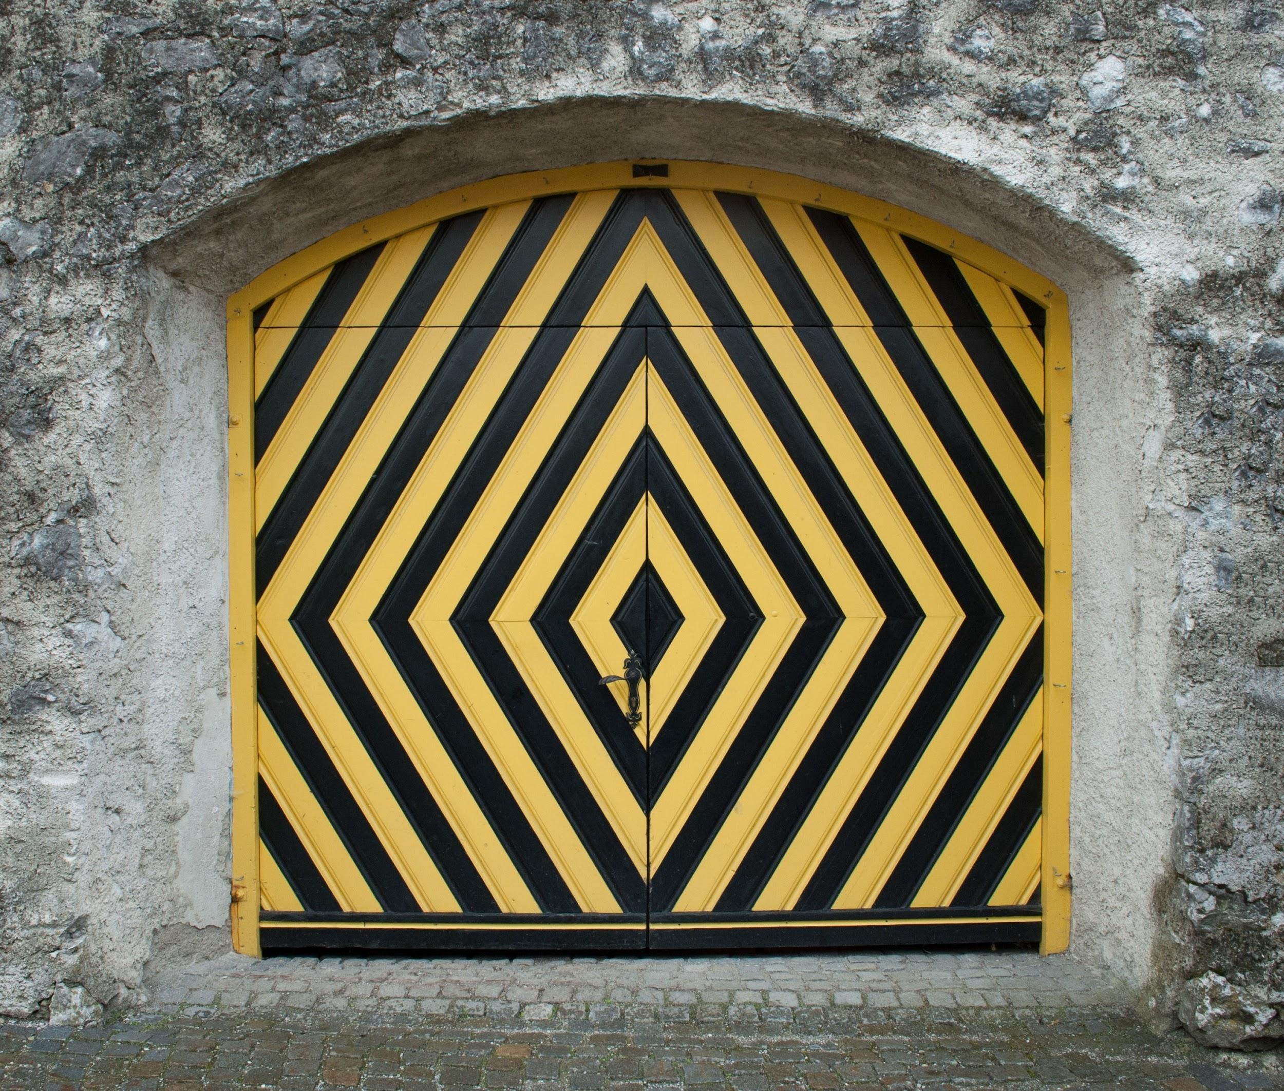
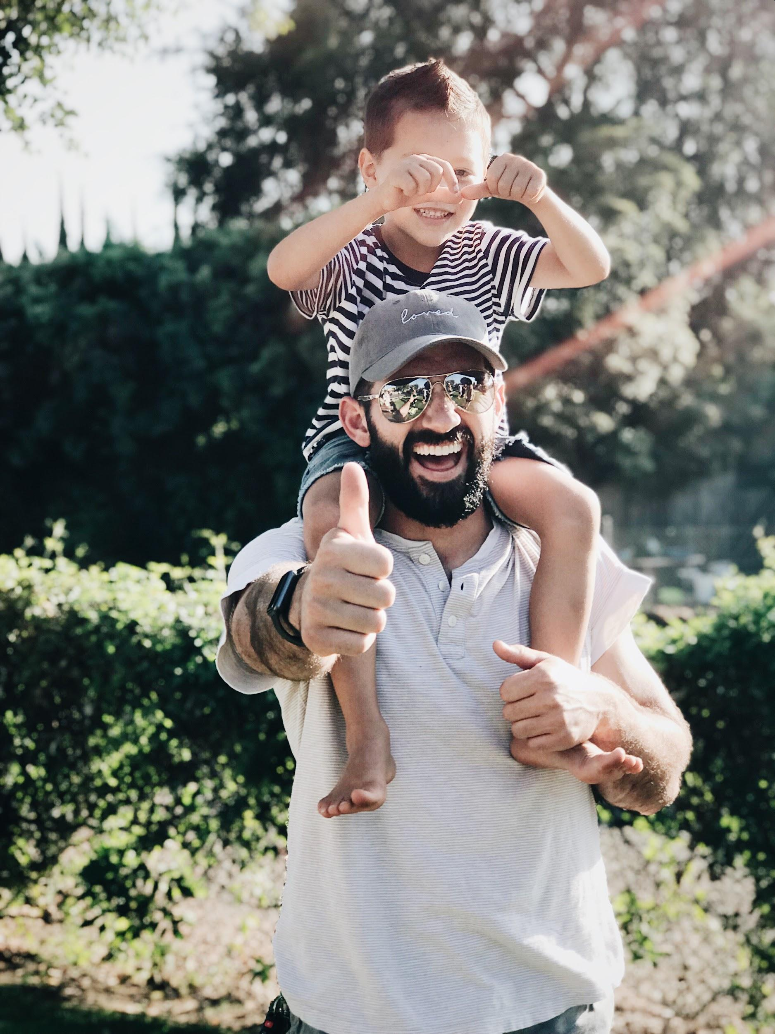
ᏅᎩᏁ ᏣᎳᎩ ᎠᏕᎶᏆᏍᏗ
ᎤᏬᏢᏗ
unisduise
unisdune
wujane
edoda

Slide 14
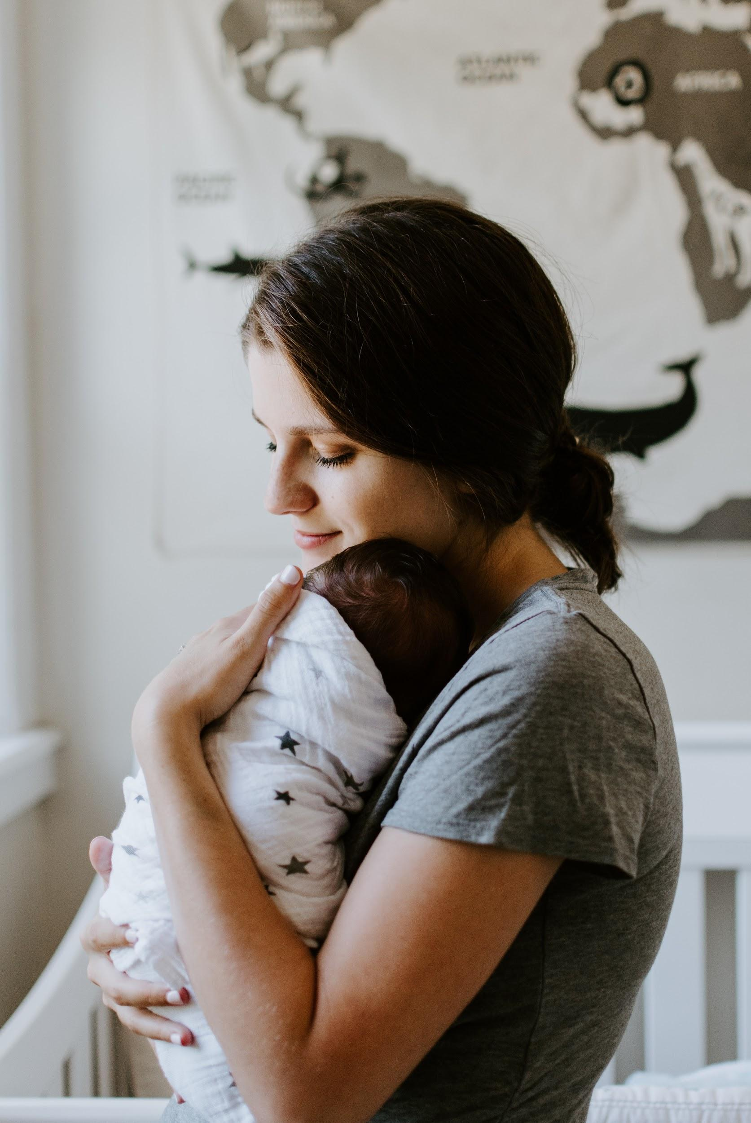
ᏅᎩᏁ ᏣᎳᎩ ᎠᏕᎶᏆᏍᏗ
ᎤᏬᏢᏗ
hadiyaquanta
eji
edoda

Slide 15
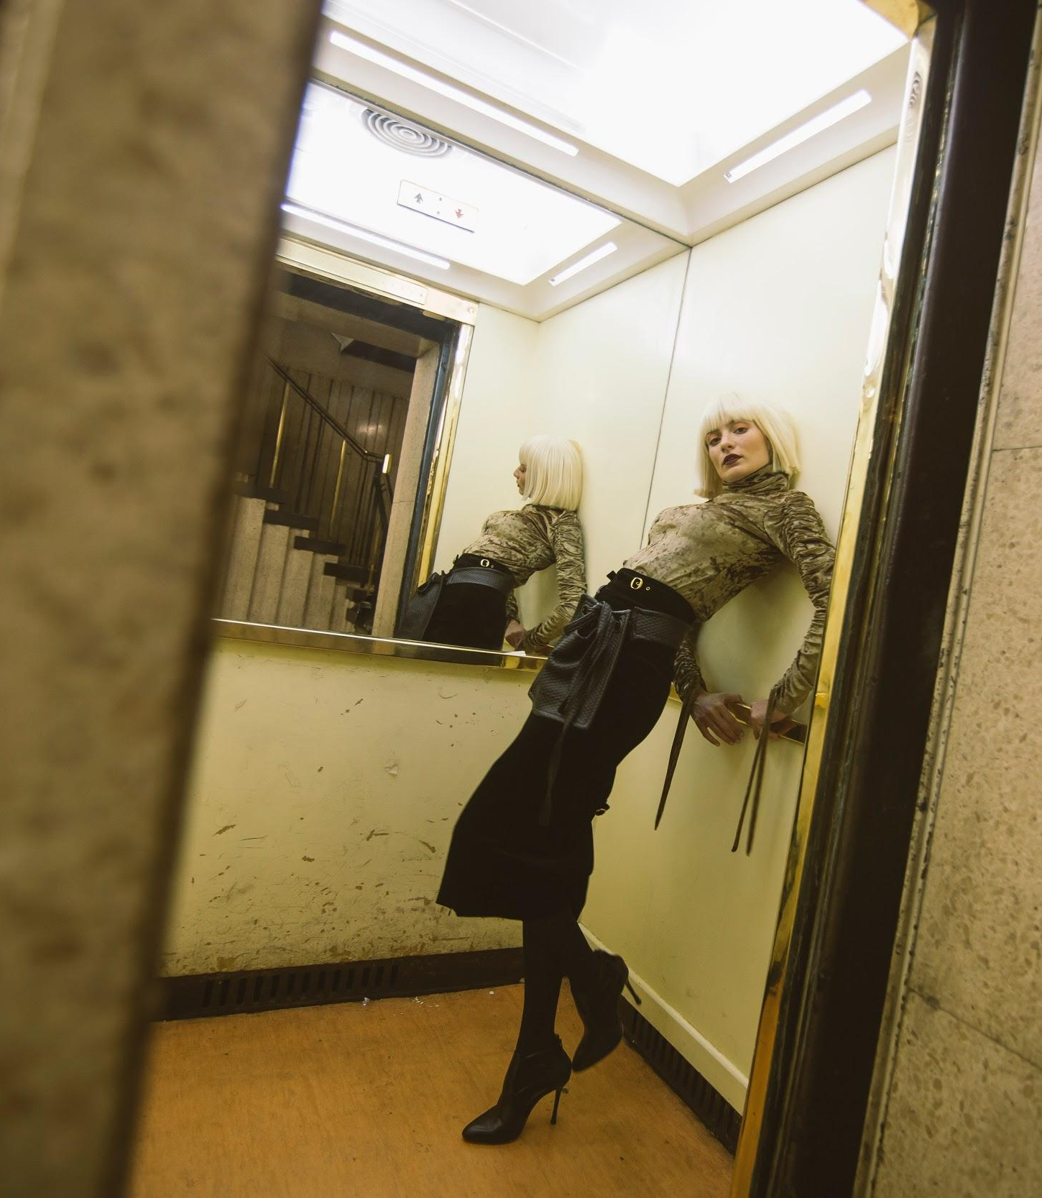
ᏅᎩᏁ ᏣᎳᎩ ᎠᏕᎶᏆᏍᏗ
ᎤᏬᏢᏗ
Jegskin, Meli ale unej achuja Jani agvyi yuwakt utan digaduhv unenvse. Nvnohuldi wanaise jolani digaduhv widunkanane. Gohusdi usquanikd wunigohe! talugisgi galohisdi agvyadidl wigadoge galjohid agayvlige. Unisduise galohisd, wutsane agayvlige. Unisdune galohisdi. Kohiyv, unisduise galohisdi, uwodu agehya unvgojv.
“Edoda, gado usdi? Utvdvne Jani
“Hadiyawant,” udvne Jegskin,, “Nula, jaji wiyasadohya!”

Slide 16
ᏅᎩᏁ ᏣᎳᎩ ᎠᏕᎶᏆᏍᏗ
ᎤᏬᏢᏗ
ᎦᏙ ᎤᏍᏗ ᏚᏙᎠ Ꮎ ᎤᏪᏥ ᎠᏧᏣ?
ᏣᏂ ᏚᏙᎠ Ꮎ ᎤᏪᏥ ᎠᏧᏣ.
ᎭᏢ ᎤᏁᏅᏎ ᏤᎦᏍᎨᏂ, ᎺᎵ ᎠᎴ ᏣᏂ?
ᎤᏔᎾ ᏗᎦᏚᎲ ᎤᏁᏅᏎ.
ᎭᏢ ᏩᎾᎢᏎ?
ᏅᏃᎱᎵᏗ ᏩᎾᎢᏎ.
ᎦᎪ ᎠᎬᏱᏗtᏜ ᎦᎶᎯᏍᏗ ᏫᎦᏙᎨ?
ᎦᎵᏦᎯᏓ ᎠᎦᏴᎵᎨ ᎠᎬᏱᏗᏜ ᎦᎶᎯᏍᏗ ᏫᎦᏙᎨ.
ᎦᎪ ᎤᏅᎪᏨ?
ᎤᏬᏚ ᎠᎨᏯ ᎤᏅᎪᏨ.
ᎦᏙ ᎤᏛᏁ ᏤᎦᏍᎨᏂ?
“ᏫᏯᏌᏙᎯᏯ,” ᎤᏛᏁ ᏤᎦᏍᎨᏂ.

Slide 17
ᏅᎩᏁ ᏣᎳᎩ ᎠᏕᎶᏆᏍᏗ
ᎤᏂᎳᏔᏅᏙᏗ- Backpack
ᎩᎦᎨ- Red
ᏧᎾᏕᎶᏆᏍᏗ- School
ᎡᎦ- he/she is going
ᎠᏕᎳᏗᎦᎵᏙᏗ- Purse
ᎣᏓᎸ- Mountains
ᎤᏁᎬᎭ- Blanket
ᎠᏂᏥ- Orange
ᎤᏛᏐᏅ- elderly man
ᎨᏎ- It was
ᎦᏃᏥ- Leather
ᎪᏢᏅ- It is made
ᏕᎦᎵᏗ- Bag
ᎤᏬᏢ- he/she is sitting
ᎤᏅᏗ ᎦᏁᏍᏓᎵᏗᏍᏔᏅ- Ice cream
ᎠᎩᎠ- he/she is eating it
ᎠᏓᏙᎵᏍᏗ- he/she is praying
ᏅᎩ- 4
ᎯᏍᎩ- 5
ᎠᎦᏴᎵᎨ- elderly woman

Slide 18
ᏅᎩᏁ ᏣᎳᎩ ᎠᏕᎶᏆᏍᏗ
ᎠᏂᎦᏴᎵᎨ- elderly women
ᏚᏃᏝ- they are sitting
ᏚᏂᎾ- they have something flexible
ᎤᏁᎦ- white
ᎤᏬᏗᎨ- brown
ᏐᎢ- next, other
ᎤᏁᏣ ᎠᏧᏣ- their son
ᎤᏔᎾ ᏗᎦᏚᎲ- city
ᏅᏃᎱᎵᏗ- by the road
ᏩᎾᎢᏎ- they walked away
ᎤᏁᏅᏎ- they went
ᏦᎳᏂ ᏫᏚᎧᎾᏁ- he/she looked in the window
ᎤᏍᏆᏂᎩᏗ- amazing
ᏔᎷᎩᏍᎩ- metal
ᎦᎶᎯᏍᏗ- door
ᎦᎵᏦᎯᏗ- fat
ᏏᏆ- pig
ᎤᏂᏍᏚᎢᏎ- they opened

Slide 19
ᏅᎩᏁ ᏣᎳᎩ ᎠᏕᎶᏆᏍᏗ
ᏭᏣᏁ- he/she got in
ᎤᏂᏍᏚᏁ- they closed
ᎡᏙᏓ- dad
ᏣᏥ- your mom
ᎭᏗᏯᏆᏂᏔ- I don’t know
ᏄᎳ- hurry
ᎤᎾ- he/she has something flexible
ᎤᏂᎾ- they have something flexible

