Slide 1
ᎣᏏᏲ
ᎯᏍᎩᏁ ᏣᎳᎩ ᎠᏕᎶᏆᏍᏗ

Slide 2
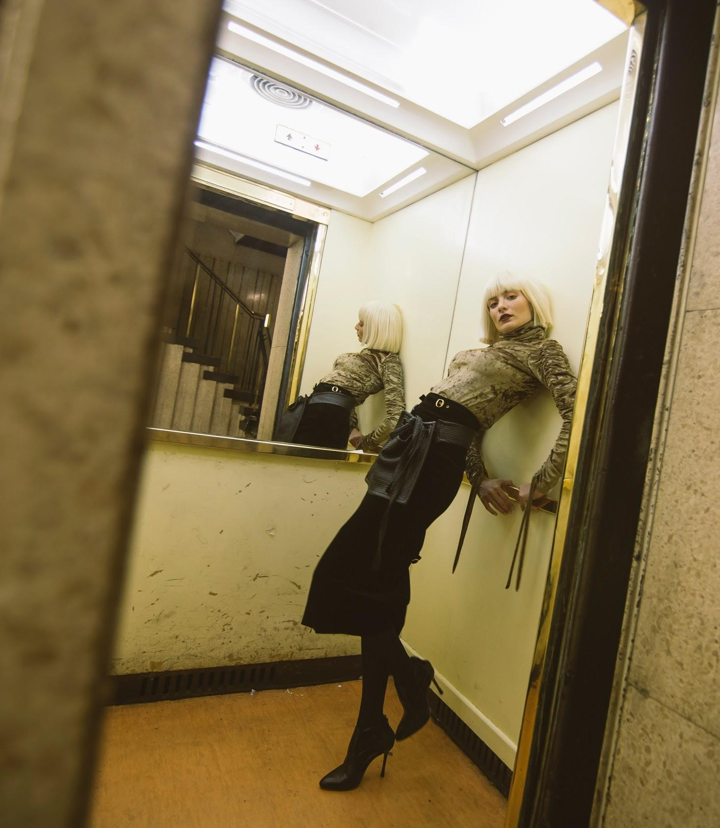
ᎯᏍᎩᏁ ᏣᎳᎩ ᎠᏕᎶᏆᏍᏗ
Jegskin, Meli ale unej achuja Jani agvyi yuwakt utan digaduhv unenvse. Nvnohuldi wanaise jolani digaduhv widunkanane. Gohusdi usquanikd wunigohe! talugisgi galohisdi agvyadidl wigadoge galjohid agayvlige. Unisduise galohisd, wutsane agayvlige. Unisdune galohisdi. Kohiyv, unisduise galohisdi, uwodu agehya unvgojv.
“Edoda, gado usdi? Utvdvne Jani
“Hadiyawant,” udvne Jegskin,, “Nula, jaji wiyasadohya!”

Slide 3
ᎯᏍᎩᏁ ᏣᎳᎩ ᎠᏕᎶᏆᏍᏗ
ᎦᏙ ᎤᏍᏗ ᏚᏙᎠ Ꮎ ᎤᏪᏥ ᎠᏧᏣ?
ᏣᏂ ᏚᏙᎠ Ꮎ ᎤᏪᏥ ᎠᏧᏣ.
ᎭᏢ ᎤᏁᏅᏎ ᏤᎦᏍᎨᏂ, ᎺᎵ ᎠᎴ ᏣᏂ?
ᎤᏔᎾ ᏗᎦᏚᎲ ᎤᏁᏅᏎ.
ᎭᏢ ᏩᎾᎢᏎ?
ᏅᏃᎱᎵᏗ ᏩᎾᎢᏎ.
ᎦᎪ ᎠᎬᏱᏗtᏜ ᎦᎶᎯᏍᏗ ᏫᎦᏙᎨ?
ᎦᎵᏦᎯᏓ ᎠᎦᏴᎵᎨ ᎠᎬᏱᏗᏜ ᎦᎶᎯᏍᏗ ᏫᎦᏙᎨ.
ᎦᎪ ᎤᏅᎪᏨ?
ᎤᏬᏚ ᎠᎨᏯ ᎤᏅᎪᏨ.
ᎦᏙ ᎤᏛᏁ ᏤᎦᏍᎨᏂ?
“ᏫᏯᏌᏙᎯᏯ,” ᎤᏛᏁ ᏤᎦᏍᎨᏂ.

Slide 4
ᎯᏍᎩᏁ ᏣᎳᎩ ᎠᏕᎶᏆᏍᏗ
ᎤᏂᎳᏔᏅᏙᏗ- Backpack
ᎩᎦᎨ- Red
ᏧᎾᏕᎶᏆᏍᏗ- School
ᎡᎦ- he/she is going
ᎠᏕᎳᏗᎦᎵᏙᏗ- Purse
ᎣᏓᎸ- Mountains
ᎤᏁᎬᎭ- Blanket
ᎠᏂᏥ- Orange
ᎤᏛᏐᏅ- elderly man
ᎨᏎ- It was
ᎦᏃᏥ- Leather
ᎪᏢᏅ- It is made
ᏕᎦᎵᏗ- Bag
ᎤᏬᏢ- he/she is sitting
ᎤᏅᏗ ᎦᏁᏍᏓᎵᏗᏍᏔᏅ- Ice cream
ᎠᎩᎠ- he/she is eating it
ᎠᏓᏙᎵᏍᏗ- he/she is praying
ᏅᎩ- 4
ᎯᏍᎩ- 5
ᎠᎦᏴᎵᎨ- elderly woman

Slide 5
ᎯᏍᎩᏁ ᏣᎳᎩ ᎠᏕᎶᏆᏍᏗ
ᎠᏂᎦᏴᎵᎨ- elderly women
ᏚᏃᏝ- they are sitting
ᏚᏂᎾ- they have something flexible
ᎤᏁᎦ- white
ᎤᏬᏗᎨ- brown
ᏐᎢ- next, other
ᎤᏁᏣ ᎠᏧᏣ- their son
ᎤᏔᎾ ᏗᎦᏚᎲ- city
ᏅᏃᎱᎵᏗ- by the road
ᏩᎾᎢᏎ- they walked away
ᎤᏁᏅᏎ- they went
ᏦᎳᏂ ᏫᏚᎧᎾᏁ- he/she looked in the window
ᎤᏍᏆᏂᎩᏗ- amazing
ᏔᎷᎩᏍᎩ- metal
ᎦᎶᎯᏍᏗ- door
ᎦᎵᏦᎯᏗ- fat
ᏏᏆ- pig
ᎤᏂᏍᏚᎢᏎ- they opened

Slide 6
ᎯᏍᎩᏁ ᏣᎳᎩ ᎠᏕᎶᏆᏍᏗ
ᏭᏣᏁ- he/she got in
ᎤᏂᏍᏚᏁ- they closed
ᎡᏙᏓ- dad
ᏣᏥ- your mom
ᎭᏗᏯᏆᏂᏔ- I don’t know
ᏄᎳ- hurry
ᎤᎾ- he/she has something flexible
ᎤᏂᎾ- they have something flexible

Slide 7
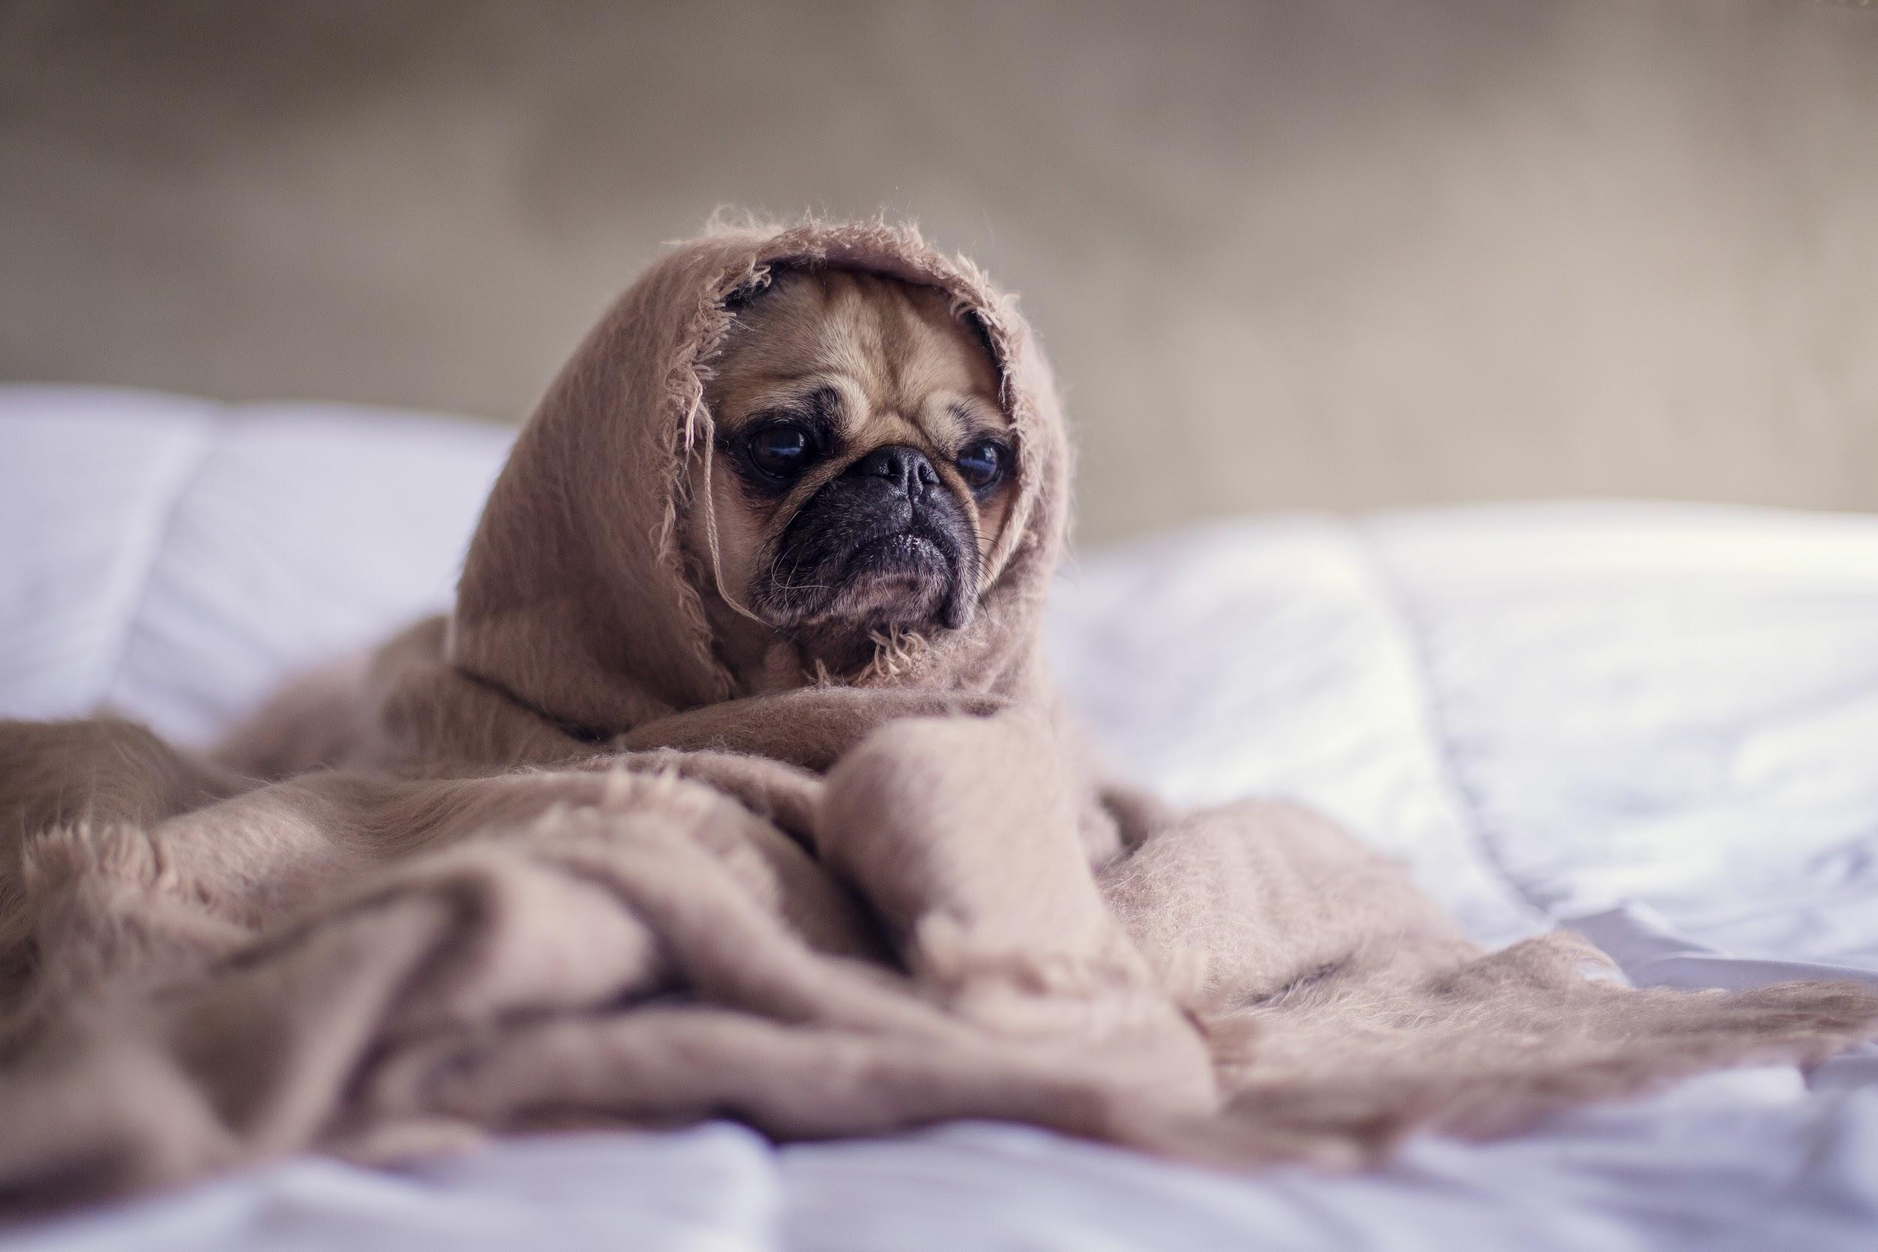
ᎯᏍᎩᏁ ᏣᎳᎩ ᎠᏕᎶᏆᏍᏗ
ᏏᏊ ᏥᏂᎪᎵᏯ
Ahani usdi gitli.
Na gitli unegvha una.
Uwodige ulsuwid na gitli unegvha juna.
ᎦᏙ ᎤᏍᏗ ᎤᎾ Ꮎ ᎩᏟ?
ᎤᏁᎬᎭ ᎤᎾ Ꮎ ᎩᏟ.
ᎤᏔᎾᏍ ᎤᏍᏗᎨ Ꮎ ᎩᏟ?
ᎤᏍᏗ.
ᎦᏙ ᎤᏍᏗ ᎤᎵᏑᏫᏗ Ꮎ ᎩᏟ?
ᎤᏬᏗᎨ ᎤᎵᏑᏫᏗ Ꮎ ᎩᏟ.

Slide 8
ᎯᏍᎩᏁ ᏣᎳᎩ ᎠᏕᎶᏆᏍᏗ
ᎢᏓᎴᎾ
ᏣᎳᎩ ᎢᏗᏬᏂ!

Slide 9
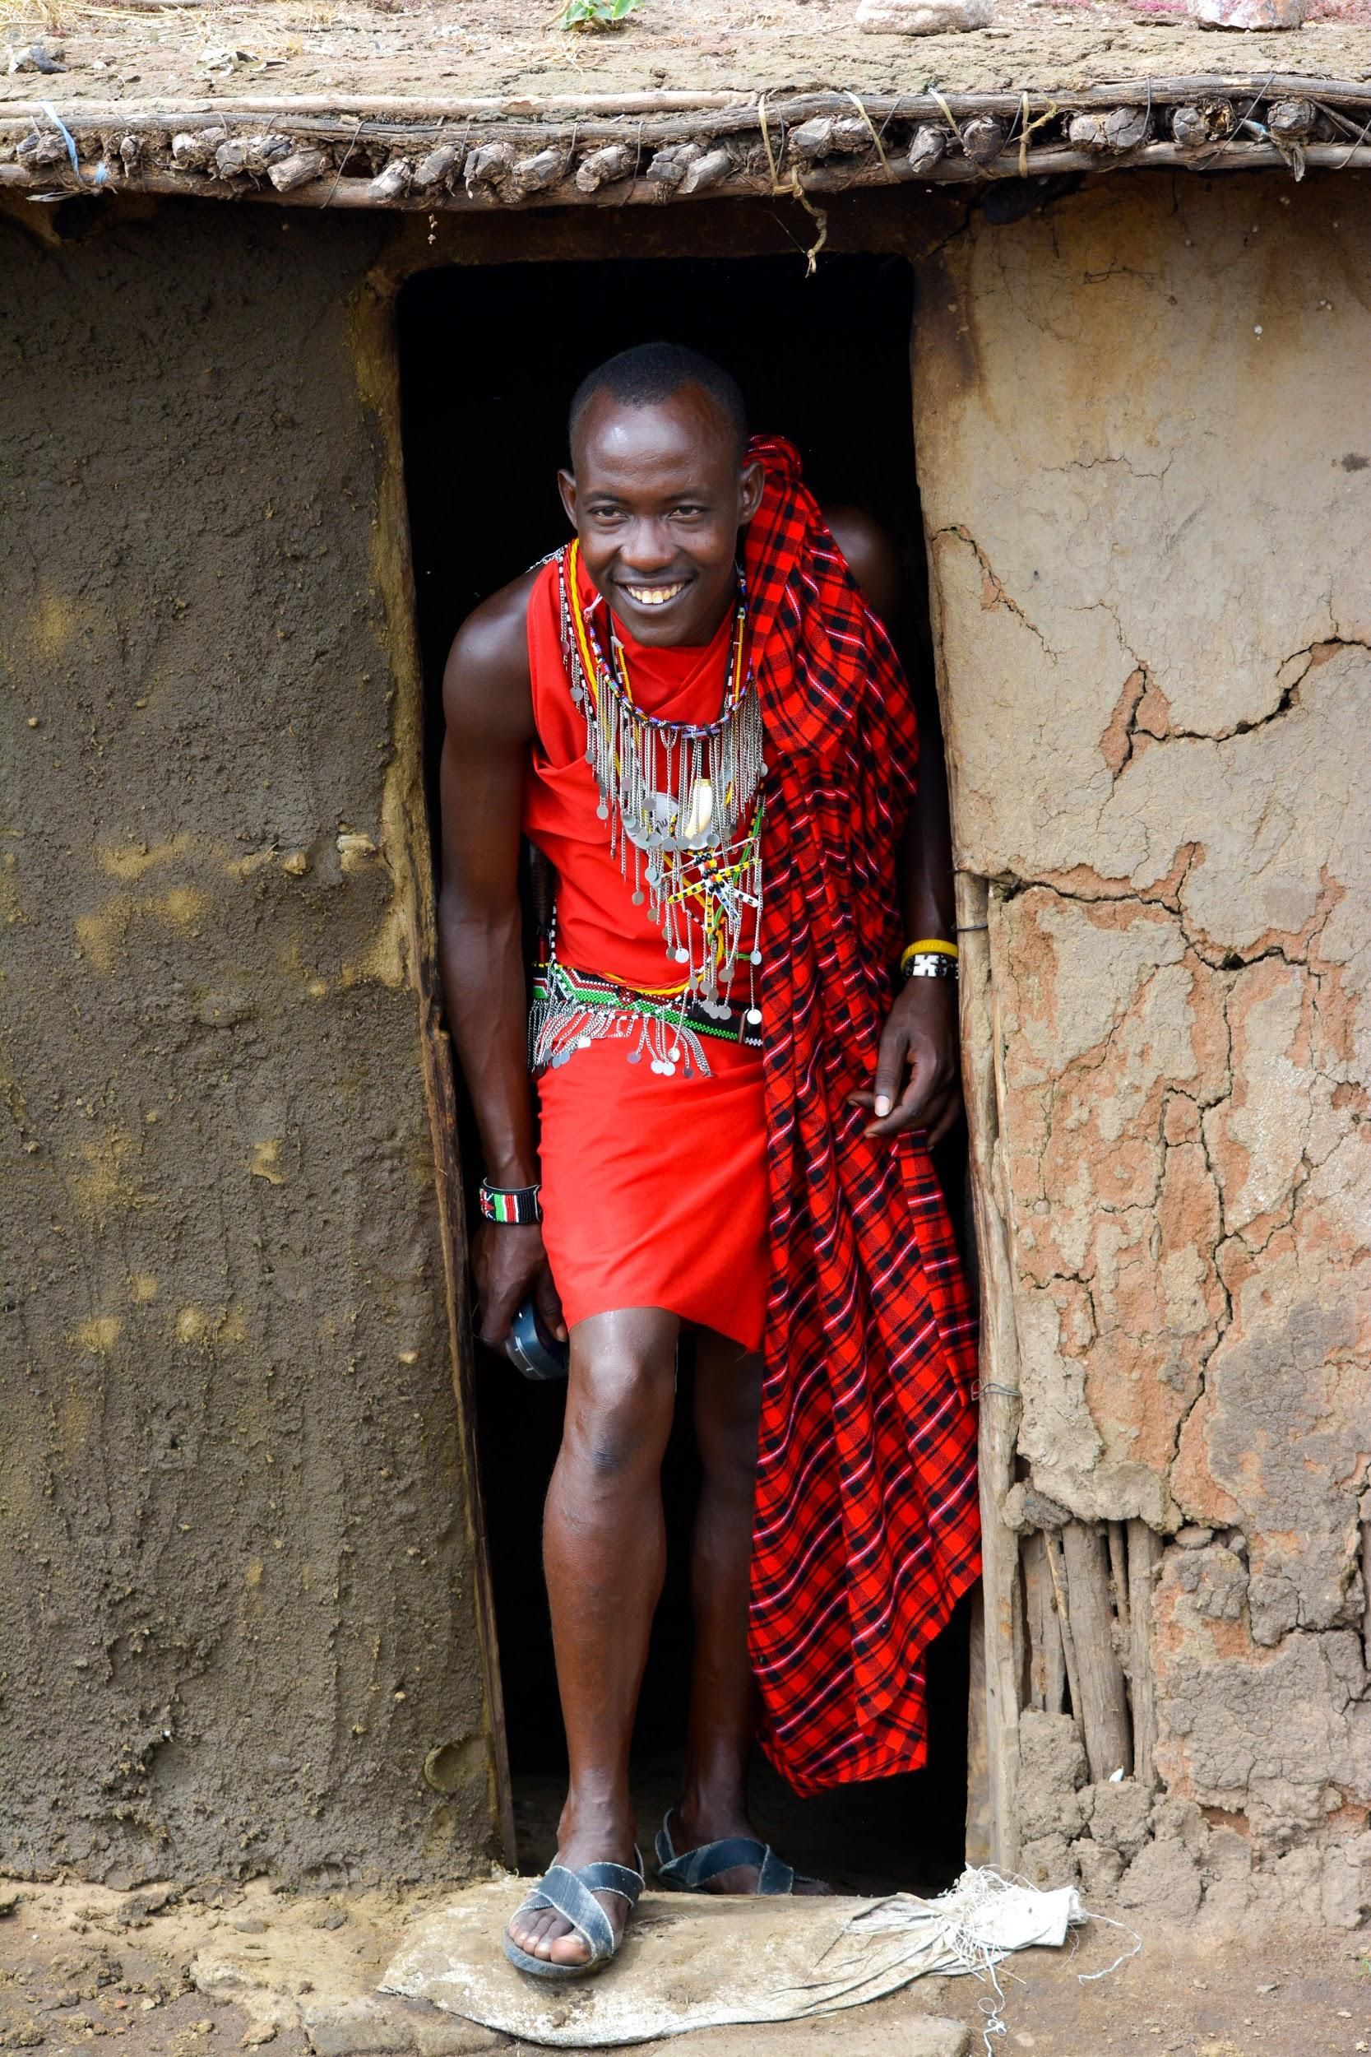
ᎯᏍᎩᏁ ᏣᎳᎩ ᎠᏕᎶᏆᏍᏗ
Ahani asgaya.
Na asgaya tla ajalgi yigi.
Na asgaya agvhnage.
Galjode ganel asgaya.
Gadaqual gotlvnv galjode.
Gadaqual gotlvnv galjode ganel na agvhnage asgaya.
Africa jegvi na asgaya.

Slide 10
ᎯᏍᎩᏁ ᏣᎳᎩ ᎠᏕᎶᏆᏍᏗ
ᎠᎨᏯᏍ ᎠᏍᎦᏯᎨ?
ᎠᏍᎦᏯ.
ᎠᏣᎳᎩᏍ Ꮎ ᎠᏍᎦᏯ?
Ꮭ. Ꮭ ᎠᏣᎳᎩ ᏱᎩ. ᎠᎬᎿᎨ.
ᎦᏙ ᎤᏍᏗ ᎪᏢᏅ ᎦᎵᏦᏕ?
ᎦᏓᏆᎵ ᎪᏢᏅ ᎦᎵᏦᏕ.
ᎭᏢ ᎦᏁᎳ Ꮎ ᎠᎬᎿᎨ?
ᎦᏓᏆᎵ ᎦᎵᏦᏕ ᎦᏁᎳ ᎠᎬᎿᎨ.
ᎭᏢ ᏤᎬᎢ ᎠᏍᎦᏯ?
Africa ᏤᎬᎢ ᎠᏍᎦᏯ.
Ahani asgaya.
Na asgaya tla ajalgi yigi.
Na asgaya agvhnage.
Galjode ganel asgaya.
Gadaqual gotlvnv galjode.
Gadaqual gotlvnv galjode ganel na agvhnage asgaya.
Africa jegvi na asgaya.

Slide 11
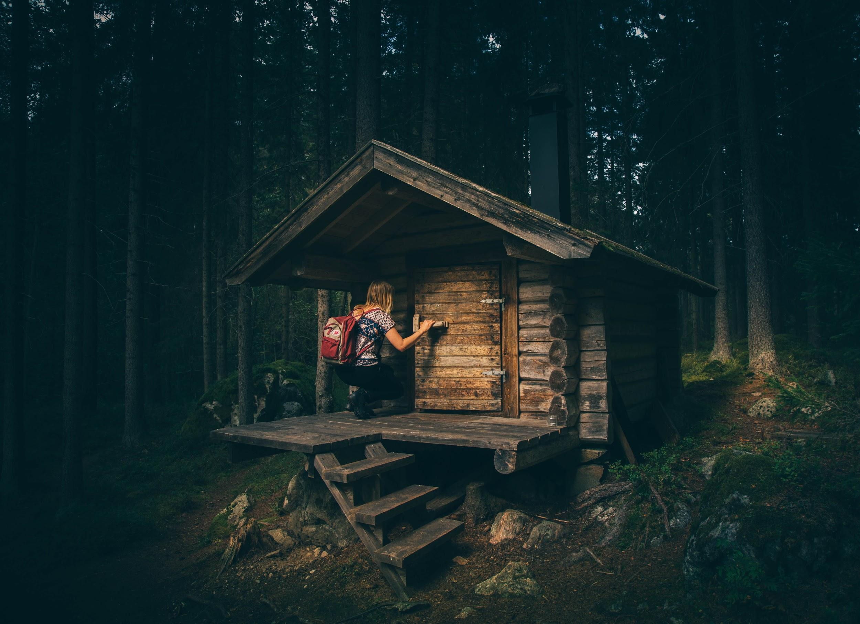
ᎯᏍᎩᏁ ᏣᎳᎩ ᎠᏕᎶᏆᏍᏗ
Ahani agehya.
Na agehya tla ajalagi yigi.
Na agehya tla agvhnage yigi.
Ayoneg na agehya.
Usdi galjode ganel na agehya.
Gadaqual tla yigotlvnv galjode.
Ada gotlvnv galjode ganel agehya.
Tla yijegvi Africa.
Sweden jegvi.

Slide 12
ᎯᏍᎩᏁ ᏣᎳᎩ ᎠᏕᎶᏆᏍᏗ
ᎠᏍᎦᏯᏍ ᎠᎨᏯᎨ?
ᎠᎨᏯ.
ᎠᏣᎳᎩᏍ ᎠᏲᏁᎦᎨ Ꮎ ᎠᎨᏯ?
ᎠᏲᏁᎦ.
ᎤᏔᎾᏍ ᎦᎵᏦᏕ ᎦᏁᎳ ᎠᏲᏁᎦ?
Ꮭ. Ꮭ ᎤᏔᎾ ᏱᎩ Ꮎ ᎦᎵᏦᏕ ᎢᎦᏁᎳ ᎠᏲᏁᎦ. ᎤᏍᏗ.
ᎦᏙ ᎤᏍᏗ ᎪᏢᏅ ᎦᎵᏦᏕ?
ᎠᏓ ᎪᏢᏅ ᎦᎵᏦᏕ.
AfricaiᏍ swedenᎨ ᏤᎬᎢ?
Sweden ᏤᎬᎢ Ꮎ ᎠᏲᏁᎦ.
Ahani agehya.
Na agehya tla ajalagi yigi.
Na agehya tla agvhnage yigi.
Ayoneg na agehya.
Usdi galjode ganel na agehya.
Gadaqual tla yigotlvnv galjode.
Ada gotlvnv galjode ganel agehya.
Tla yijegvi Africa.
Sweden jegvi.

Slide 13
ᎯᏍᎩᏁ ᏣᎳᎩ ᎠᏕᎶᏆᏍᏗ
ᎦᏙ ᎤᏍᏗ ᏓᏩᏙ ᏲᏁᎩ ᎬᏗ?
Wade ᏓᏩᏙ ᏲᏁᎩ ᎬᏗ.
ᏣᎳᎩ ᎬᏗᎾ?
ᎤᏃᎴ ᏓᏩᏙᎠ.
ᏥᏍᎦᏯᏍ ᏥᎨᏯᎨ?
ᏥᏍᎦᏯ.
ᏥᏣᎳᎩᏍ?
ᎥᎥ. ᏥᏣᎳᎩ ᎠᎴ ᏥᏲᏁᎦ.
ᎦᏙ ᎤᏍᏗ ᏚᏙᎠ Ꮎ ᏍᎦᏚᎩ ᏥᏗᎨᎬ?
Butler ᏚᏙᎠ ᏍᎦᏚᎩ.
ᎣᏏᏲ.
Wade Blevins ᏓᏩᏙᎠ. ᏣᎳᎩ ᎬᏗᏃ, ᎤᏃᎴ ᏓᏩᏙ.
ᏥᏍᎦᏯ.
ᎢᏧᎳ ᏥᏣᎳᎩ ᎠᎴ ᏥᏲᏁᎦ.
ᏣᎳᎩ ᎠᏰᏟ ᏓᎩᎸᏫᏍᏓᏁᎰ.
ᏧᏴᏜᏗᏜ ᏝᎪ ᏗᎨᎬ.
Butler ᏚᏙᎠ Ꮎ ᏍᎦᏚᎩ ᏥᏗᎨᎬ.
ᏏᏛ ᏥᏁᎳ Butler.
ᏗᏛᏓᏅᎯ ᎪᏢᏅ ᎦᎵᏦᏕ ᏥᏁᎳ.

Slide 14
ᎯᏍᎩᏁ ᏣᎳᎩ ᎠᏕᎶᏆᏍᏗ
ᎦᏙ ᎤᏍᏗ ᏚᏙᎠ ᎠᎩᏥ?
Peggy ᏚᏙᎠ ᎠᎩᏥ.
ᎭᏢ ᏤᎬᎢ Peggy?
Butler ᏤᎬᎢ Peggy.
ᎠᎩᏙᏓᎾ? ᎦᏙ ᎤᏍᏗ ᏚᏙᎠ?
Dennis Fields ᏥᎨᏒ ᏚᏙᎠ.
1994ᎢᏍ ᏧᏲᎱᏒ Dennis?
Ꮭ. Ꮭ 1994 ᏱᎩ ᏧᏲᎱᏒ Dennis. 1995 ᎤᏲᎱᏒ Dennis.
ᏈᏓ ᎠᎪᏓᏍ ᏛᎵᏏᎨ ᏤᎬᎢ Dennis?
ᏈᏓ ᎠᎪᏓ ᏤᎬᎢ.
Peggy Blevins ᏚᏙᎠ ᎠᎩᏥ.
Butler ᏍᎦᏚᎩ ᏤᎬᎢ Peggy.
ᏏᏛ Butler ᎦᏁᎳ Peggy.
ᎠᎩᏙᏓ, Dennis Fields ᏥᎨᏒ ᏚᏙᎠ.
1995 ᏥᎨᏒ ᎤᏲᎱᏒ Dennis.
ᏈᏓ ᎠᎪᏓ ᏤᎬᎢ Dennis, ᎠᏎᏃ ᏛᎵᏏ ᏥᎬᏁᎸ.

Slide 15
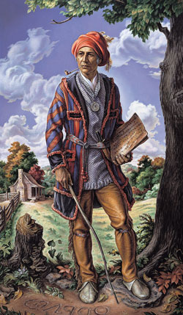
ᎯᏍᎩᏁ ᏣᎳᎩ ᎠᏕᎶᏆᏍᏗ
Asgaya.
Ijula ajalagi ale ayonegsquu gehe.
Siquoya dudoe.
Turkeytown, Alabama udehne Siquoya.
George Guess dudoe yonegi gvdi.
Siquoya udoda, ayoneg gehe.
Nathaniel Guess dudoe Siquoya udod.
Siquoya uji, ajalagi gehe.
Wute dudoe Siquoya uji.
Anijisqua juyvwi gehe Wute.

Slide 16
ᎯᏍᎩᏁ ᏣᎳᎩ ᎠᏕᎶᏆᏍᏗ
ᎦᏙ ᎤᏍᏗ ᏚᏙᎡ ᎠᏍᎦᏯ?
ᏏᏉᏯ ᏚᏙᎡ.
ᎭᏢ ᎤᏕᏁ ᏏᏉᏯ?
Turkeytown, Alabama ᎤᏕᏁ ᏏᏉᏯ.
ᎠᏲᏁᎦᏍ ᎠᏣᎳᎩᎨ ᎨᎮ ᎤᏙᏓ?
ᎤᏙᏓ ᎠᏲᏁᎦ ᎨᎮ.
ᏏᏉᏯ ᎤᏙᏓ, ᎦᏙ ᎤᏍᏗ ᏚᏙᎡ?
Nathaniel Guess ᏚᏙᎡ ᏏᏉᏯ ᎤᏙᏓ.
ᎦᏙ ᎤᏍᏗ ᏚᏙᎡ ᏏᏉᏯ ᎤᏥ?
ᏭᏖ ᏚᏙᎡ ᏏᏉᏯ ᎤᏥ.
ᎦᏙ ᎤᏍᏗ ᏧᏴᏫ ᎨᎮ ᏭᏖ?
ᎠᏂᏥᏍᏆ ᏧᏴᏫ ᎨᎮ ᏭᏖ.

Slide 17
ᎯᏍᎩᏁ ᏣᎳᎩ ᎠᏕᎶᏆᏍᏗ
Jo(i) jusdayvhvsgi duwekahe Siquoya.
Agvyi usdayvhvsgi, Sarah Benge dudoe.
Siquoya ale Sarah sawu ayotli unikahe.
Rachel Guess dudoe.
Rachel uwej agehya gehe.
Taline usdayvhvsgi, Utiyu Langley dudoe.
Nvgi diniyotli dunikahe Siquoya ale Utiyu.

Slide 18
ᎯᏍᎩᏁ ᏣᎳᎩ ᎠᏕᎶᏆᏍᏗ
ᎯᎳ ᏯᏂ ᏧᏍᏓᏴᎲᏍᎩ ᏚᏪᎧᎮ ᏏᏉᏯ?
ᏦᎢ ᏯᏂ ᏧᏍᏓᏴᎲᏍᎩ ᏚᏪᎧᎮ ᏏᏉᏯ.
ᎦᏙ ᎤᏍᏗ ᏚᏙᎡ ᎠᎬᏱ ᎤᏍᏓᏴᎲᏍᎩ?
Sarah Benge ᏚᏙᎡ ᎠᎬᏱ ᎤᏍᏓᏴᎲᏍᎩ.
ᎯᎳ ᏯᏂ ᏗᏂᏲᏟ ᏚᏂᎧᎮ ᏏᏉᏯ ᎠᎴ Sarah?
ᏌᏊ ᏯᏂ ᎠᏲᏟ ᎤᏂᎧᎮ ᏏᏉᏯ ᎠᎴ Sarah.
ᎠᎨᏯᏍ ᎠᏍᎦᏯᎨ Ꮎ ᎤᏪᏥ ᏧᏂᎧᎮ ᏏᏉᏯ ᎠᎴ Sarah?
ᎤᏪᏥ ᎠᎨᏯ ᎤᏂᎧᎮ ᏏᏉᏯ ᎠᎴ Sarah.
ᏔᎵᏁ ᎤᏍᏓᏴᎲᏍᎩ, ᎦᏙ ᎤᏍᏗ ᏚᏙᎡ?
ᎤᏘᏳ Langley ᏚᏙᎡ ᏔᎵᏁ ᎤᏍᏓᏴᎲᏍᎩ.
ᎯᎳ ᏯᏂ ᏗᏂᏲᏟ ᏚᏂᎧᎮ ᏏᏉᏯ ᎠᎴ ᎤᏘᏳ?
ᏅᎩ ᏯᏂ ᏚᏂᎧᎮ ᏏᏉᏯ ᎠᎴ ᎤᏘᏳ.

Slide 19
ᎯᏍᎩᏁ ᏣᎳᎩ ᎠᏕᎶᏆᏍᏗ
Joine usdayvhvsgi, Sallie Waters dudoe.
Nvgi diniyotli dunikahe Siquoya ale Sallie.
Eyagu, Guuneki, Uluja ale Tisi dundoe na diniyotli jidunikahe Siquoya ale Sallie.

Slide 20
ᎯᏍᎩᏁ ᏣᎳᎩ ᎠᏕᎶᏆᏍᏗ
ᎦᏙ ᎤᏍᏗ ᏚᏙᎡ ᏦᎢᏁ ᎤᏍᏓᏴᎲᏍᎩ?
Sallie Waters ᏚᏙᎡ ᏦᎢᏁ ᎤᏍᏓᏴᎲᏍᎩ.
ᎯᎳ ᏯᏂ ᏗᏂᏲᏟ ᏚᏂᎧᎮ ᏏᏉᏯ ᎠᎴ Sallie?
ᏅᎩ ᏗᏂᏲᏟ ᏚᏂᎧᎮ ᏏᏉᏯ ᎠᎴ Sallie.

Slide 21
ᎯᏍᎩᏁ ᏣᎳᎩ ᎠᏕᎶᏆᏍᏗ
ᎠᏣᎳᎩ- He/she is Cherokee
ᎠᏲᏁᎦ- he/she is white
ᎠᎬᎿᎨ- he/she is black
ᏥᏁᎳ- I live
ᎯᎾᎴ- you live
ᎦᏁᎳ- he/she lives
ᎦᏓᏆᎵ- clay
ᏗᎨᎬᎢ- I am from
ᏖᎬᎢ- you are from
ᏤᎬᎢ- he/she is from
ᏥᏍᎦᏯ- I am a man
ᎢᏧᎳ- both
ᏥᏣᎳᎩ- I am Cherokee
ᏥᏲᏁᎦ- I am white
ᏓᎩᎸᏫᏍᏓᏁᎰ- I work at
ᏧᏴᏜᏗᏜ- North
ᏝᎪ- Jay
ᏍᎦᏚᎩ- community
ᏗᏛᏓᏅᎯ- brick

Slide 22
ᎯᏍᎩᏁ ᏣᎳᎩ ᎠᏕᎶᏆᏍᏗ
ᎠᎩᏥ- my mother
ᎠᎩᏙᏓ- my father
ᏥᎨᏒ- that used to be
ᎤᏲᎱᏒ- he/she died
ᎨᎮ- he/she was
ᎤᏕᏁ- he/she was born
ᎤᏙᏓ- his/her father
ᎤᏥ- his/her mother
ᏧᏍᏓᏴᎲᏍᎩ- wives
ᎤᏍᏓᏴᎲᏍᎩ- wife
ᏚᏪᎧᎮ- he/she had living things
ᎠᎬᏱ- first
ᏔᎵᏁ- second
ᏦᎢᏁ- third
ᎤᏂᎧᎮ- they had a living thing
ᏚᏂᎧᎮ- they had living things
ᏚᎾᏙᎡ- were their names
ᎠᏲᏟ- child
ᏗᏂᏲᏟ- children

