Slide 1
ᎣᏏᏲ
ᏣᏁᎵᏁ ᏣᎳᎩ ᎠᏕᎶᏆᏍᏗ

Slide 2
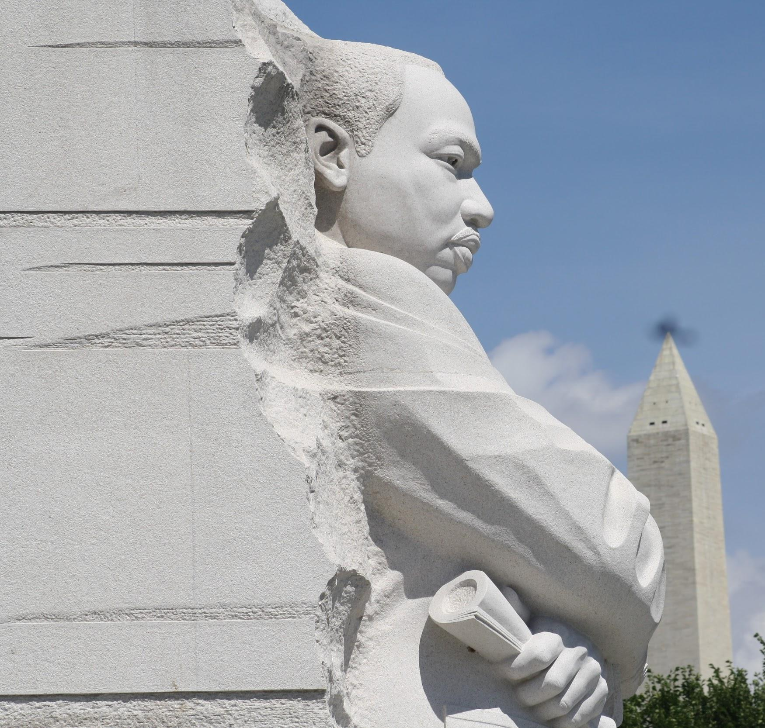
ᏣᏁᎵᏁ ᏣᎳᎩ ᎠᏕᎶᏆᏍᏗ
ᏏᏊ ᏥᏂᎪᎵᏯ
Ahani ditlilosdanv nvyaha.
Hiyoligis hia asgaya?
Martin Luther King, Jr dudoe.
Agvhnage gese.
Atlanta, Georgia jegvi MLK
Martin Luther King Sr dudoe udoda.
Alberta Williams King dudoe uji.
Coretta Scott dudoe usdayvhvsga.
Aljadohvsgi ale osd gawonisgi gese MLK.
Memphis, Tennessee uyohusv.

Slide 3
ᏣᏁᎵᏁ ᏣᎳᎩ ᎠᏕᎶᏆᏍᏗ
ᎠᎬᎿᎨᏍ ᎠᏲᏁᎦᎨ MLK?
ᎠᎬᎿᎨ.
ᎦᏙ ᎤᏍᏗ ᏚᏙᎡ ᎤᏙᏓ?
Martin Luther King Sr ᏚᏙᎡ ᎤᏙᏓ.
ᎦᏙ ᎤᏍᏗ ᏚᏙᎡ ᎤᏥ?
Alberta Williams King ᏚᏙᎡ ᎤᏥ.
ᎦᏙ ᎤᏍᏗ ᏚᏙᎡ ᎤᏍᏓᏴᎲᏍᎦ?
Correta Scott King ᏚᏙᎡ ᎤᏍᏓᏴᎲᏍᎦ.
ᏗᎦᎶᎩᏍᎩᏍ ᎠᎵᏣᏙᎲᏍᎩᎨ ᎨᏎ MLK?
ᎠᎵᏣᏙᎲᏍᎩ ᎨᏎ.
ᎭᏢ ᎤᏲᎱᏒ MLK?
Memphis Tenessee ᎤᏲᎱᏒ.
Ahani ditlilosdanv nvyaha.
Hiyoligis hia asgaya?
Martin Luther King, Jr dudoe.
Agvhnage gese.
Atlanta, Georgia jegvi MLK
Martin Luther King Sr dudoe udoda.
Alberta Williams King dudoe uji.
Coretta Scott dudoe usdayvhvsga.
Aljadohvsgi ale osd gawonisgi gese MLK.
Memphis, Tennessee uyohusv.

Slide 4
ᏣᏁᎵᏁ ᏣᎳᎩ ᎠᏕᎶᏆᏍᏗ
ᎢᏓᎴᎾ
ᏣᎳᎩ ᎢᏗᏬᏂ!

Slide 5
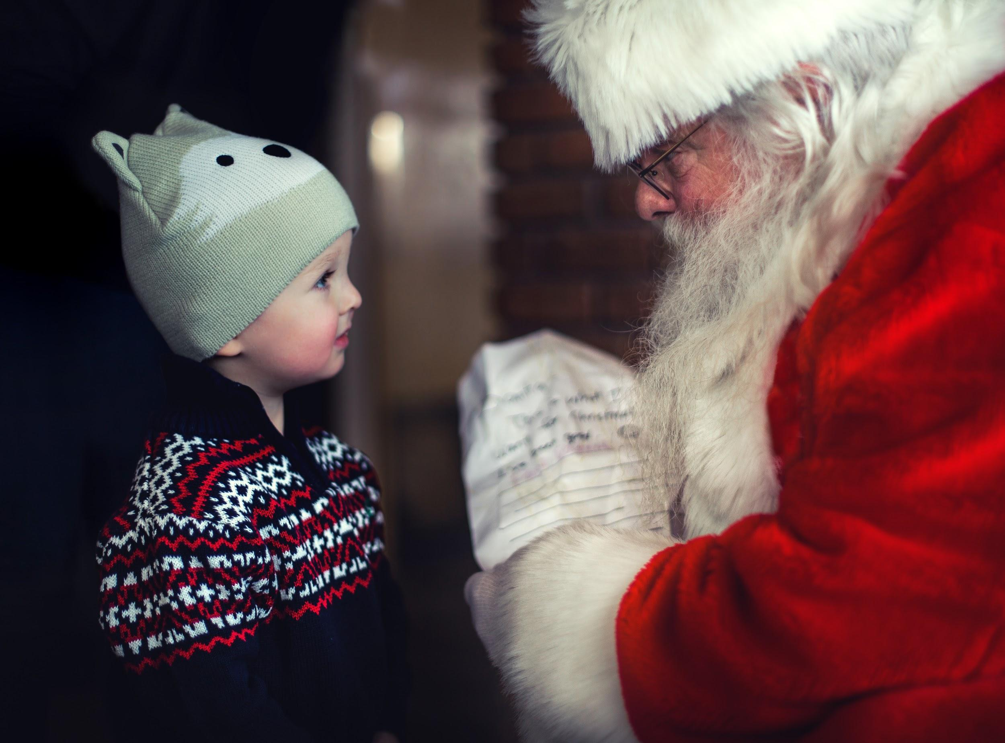
ᏣᏁᎵᏁ ᏣᎳᎩ ᎠᏕᎶᏆᏍᏗ
Utvsonv.
Judlogaled dudo.
“Gado usdi jaduli?” judlogaled unosele achuja.
“Dinehldodi dawaduli.” udvne achuja.
“Gado usdi dinehldodi dejaduli?” utvdvne judlogaled.
“Ije gansanesdodi ale talugisgi yvwi dawaduli.” udvne achuj.

Slide 6
ᏣᏁᎵᏁ ᏣᎳᎩ ᎠᏕᎶᏆᏍᏗ
ᎤᏛᏐᏅᏍ ᎠᎦᏴᎵᎨᎨ ᏧᏠᎦᎴᏗ?
ᎤᏛᏐᏅ ᏧᏠᎦᎴᏗ.
ᎠᎨᏳᏣᏍ ᎠᏧᏣᎨ ᏗᏁᎵᏙᏗ ᏚᏚᎵ?
ᎠᏧᏣ ᏗᏁᎵᏙᏗ ᏚᏚᎵ.
ᎦᏙ ᎤᏍᏗ ᏚᏚᎵ ᎠᏧᏣ?
ᎢᏤ ᎦᎾᏌᏁᏍᏙᏗ ᎠᎴ ᏔᎷᎩᏍᎩ ᏚᏚᎵ ᎠᏧᏣ.
Utvsonv.
Judlogaled dudo.
“Gado usdi jaduli?” judlogaled unosele achuja.
“Dinehldodi dawaduli.” udvne achuja.
“Gado usdi dinehldodi dejaduli?” utvdvne judlogaled.
“Ije gansanesdodi ale talugisgi dawaduli.” udvne achuj.

Slide 7
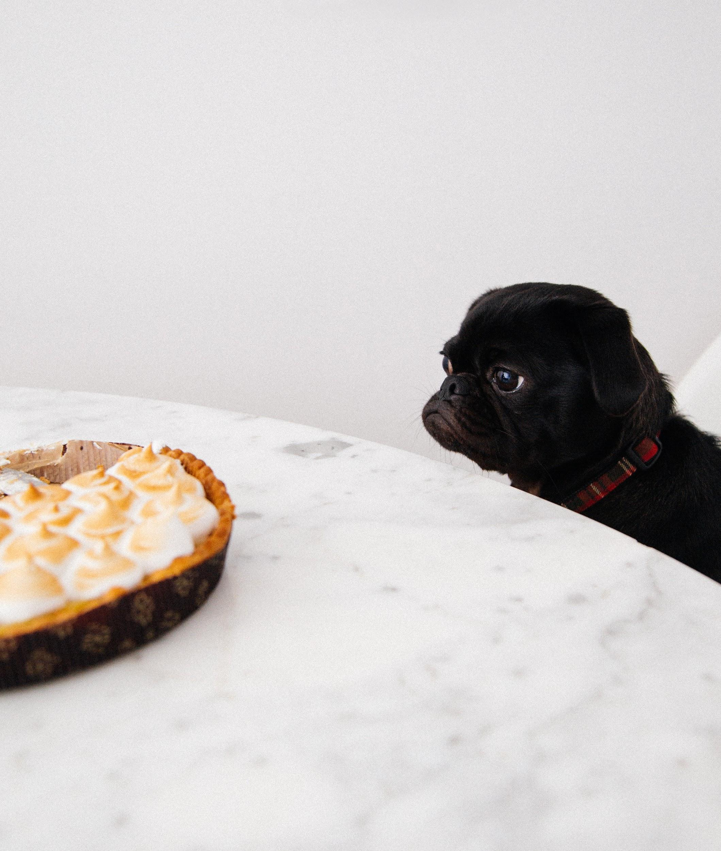
ᏣᏁᎵᏁ ᏣᎳᎩ ᎠᏕᎶᏆᏍᏗ
Ahani usdi gitli
Gvhnage ulsuwid na gitli.
Gigage uhyatla.
Gohusdi uduli na gitli.
Gelisgi uduli gitli.
Uyotli gitli!

Slide 8
ᏣᏁᎵᏁ ᏣᎳᎩ ᎠᏕᎶᏆᏍᏗ
ᎤᏔᎾᏍ ᎩᏟ?
Ꮭ. Ꮭ ᎤᏔᎾ ᏱᎩ ᎩᏟ. ᎤᏍᏗ.
ᎤᏁᎦᏍ ᎬᎿᎨᎨ ᎤᎵᏑᏫᏗ Ꮎ ᎩᏟ?
ᎬᎿᎨ ᎤᎵᏑᏫᏗ Ꮎ ᎩᏟ.
ᎦᏙ ᎤᏍᏗ ᎤᎵᏑᏫᏗ ᎤᏯᏝ Ꮎ ᎩᏟ?
ᎩᎦᎨ ᎤᎵᏑᏫᏗ ᎤᏯᏝ.
ᎦᏙ ᎤᏍᏗ ᎤᏚᎵ Ꮎ ᎩᏟ?
ᎨᎵᏍᎩ ᎤᏚᎵ Ꮎ ᎩᏟ.
Ahani usdi gitli
Gvhnage ulsuwid na gitli.
Gigage uhyatla.
Gohusdi uduli na gitli.
Gelisgi uduli gitli.
Uyotli gitli!

Slide 9
ᏣᏁᎵᏁ ᏣᎳᎩ ᎠᏕᎶᏆᏍᏗ
Gado usdi jaduli
Gado usdi jaduli ijadvndi?

Slide 10
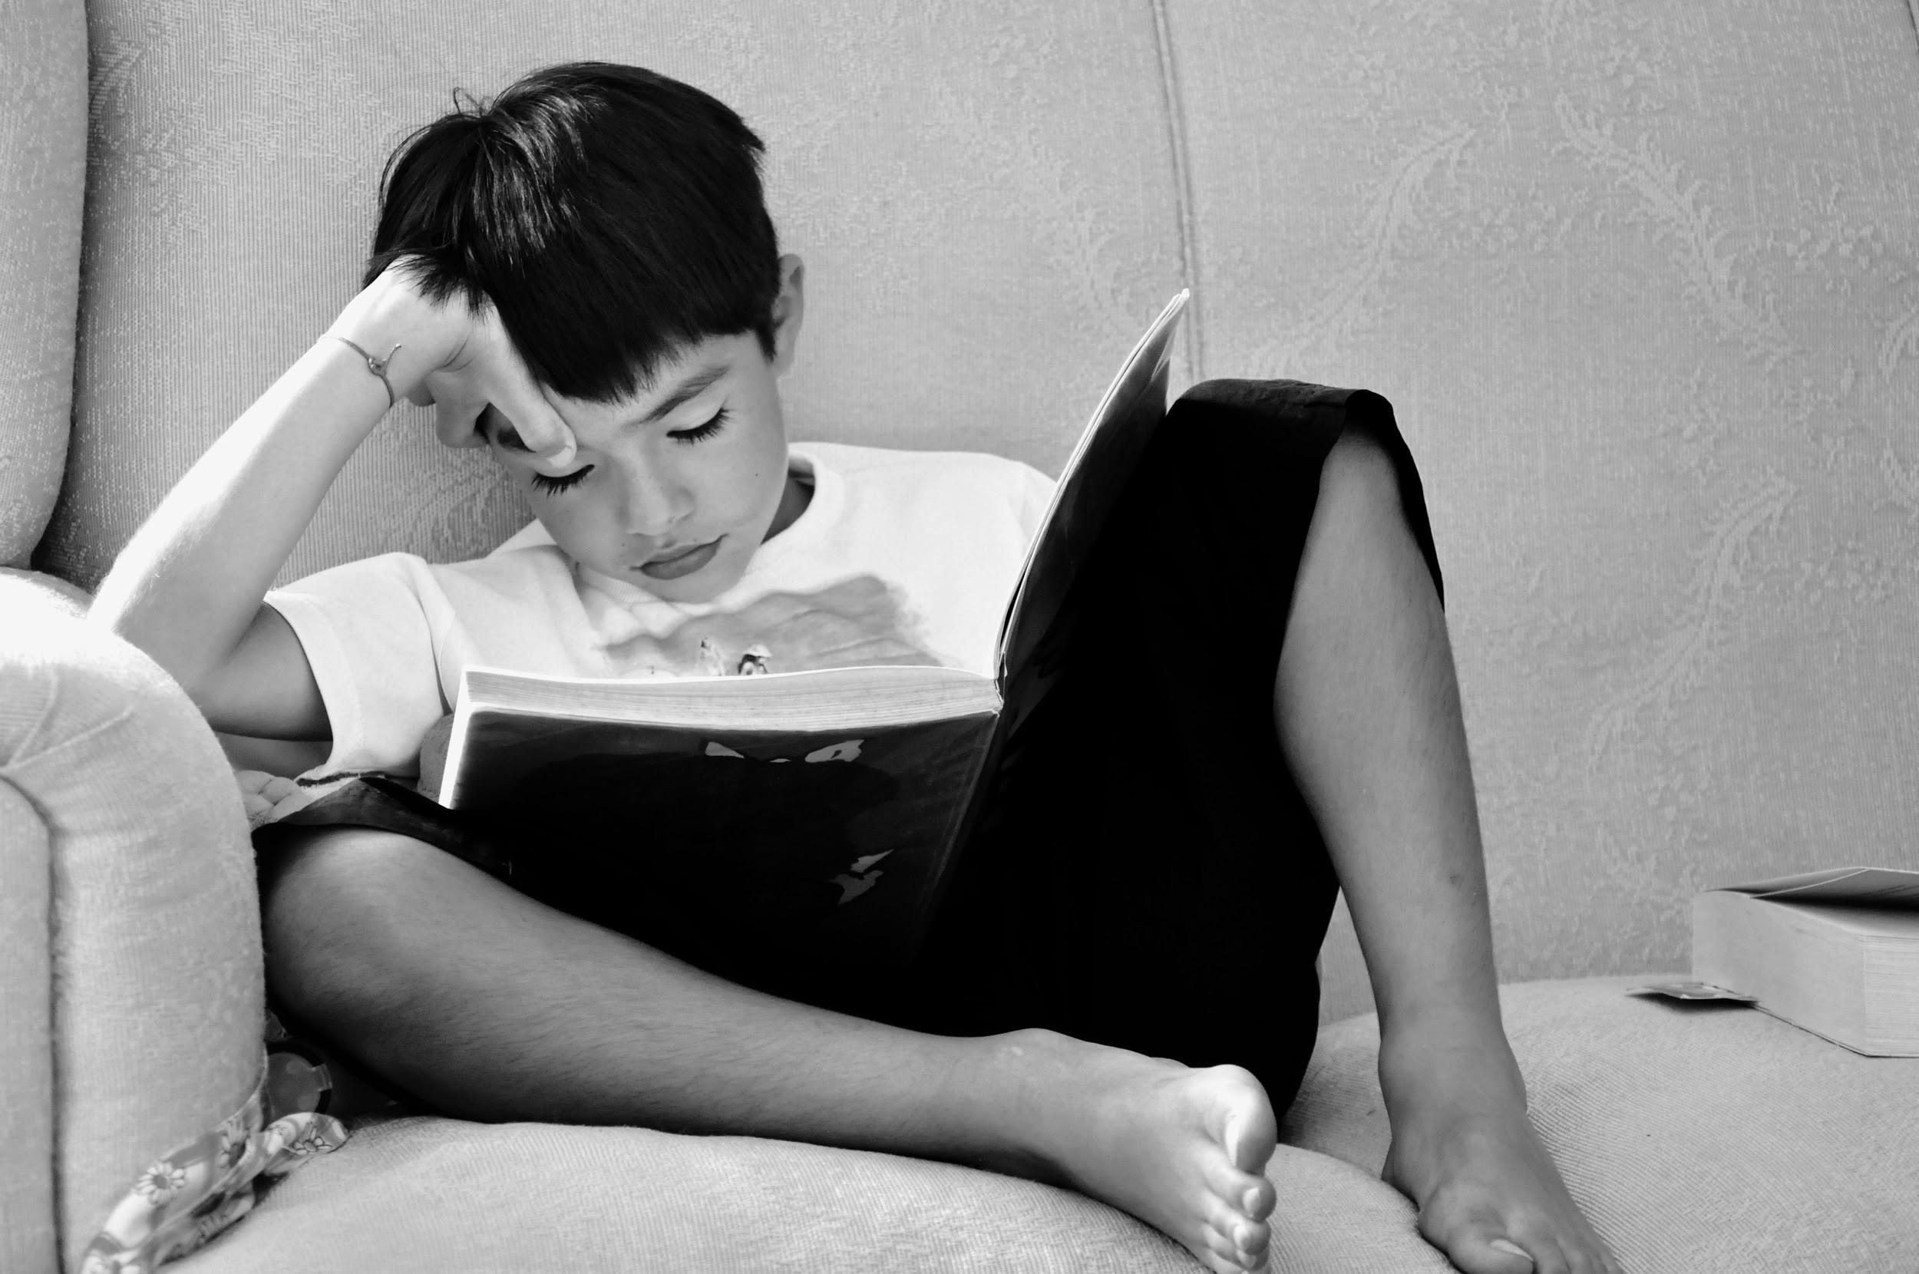
ᏣᏁᎵᏁ ᏣᎳᎩ ᎠᏕᎶᏆᏍᏗ
Dijagoliyedis jaduli?
Tla yawaduli digigoliyedi

Slide 11
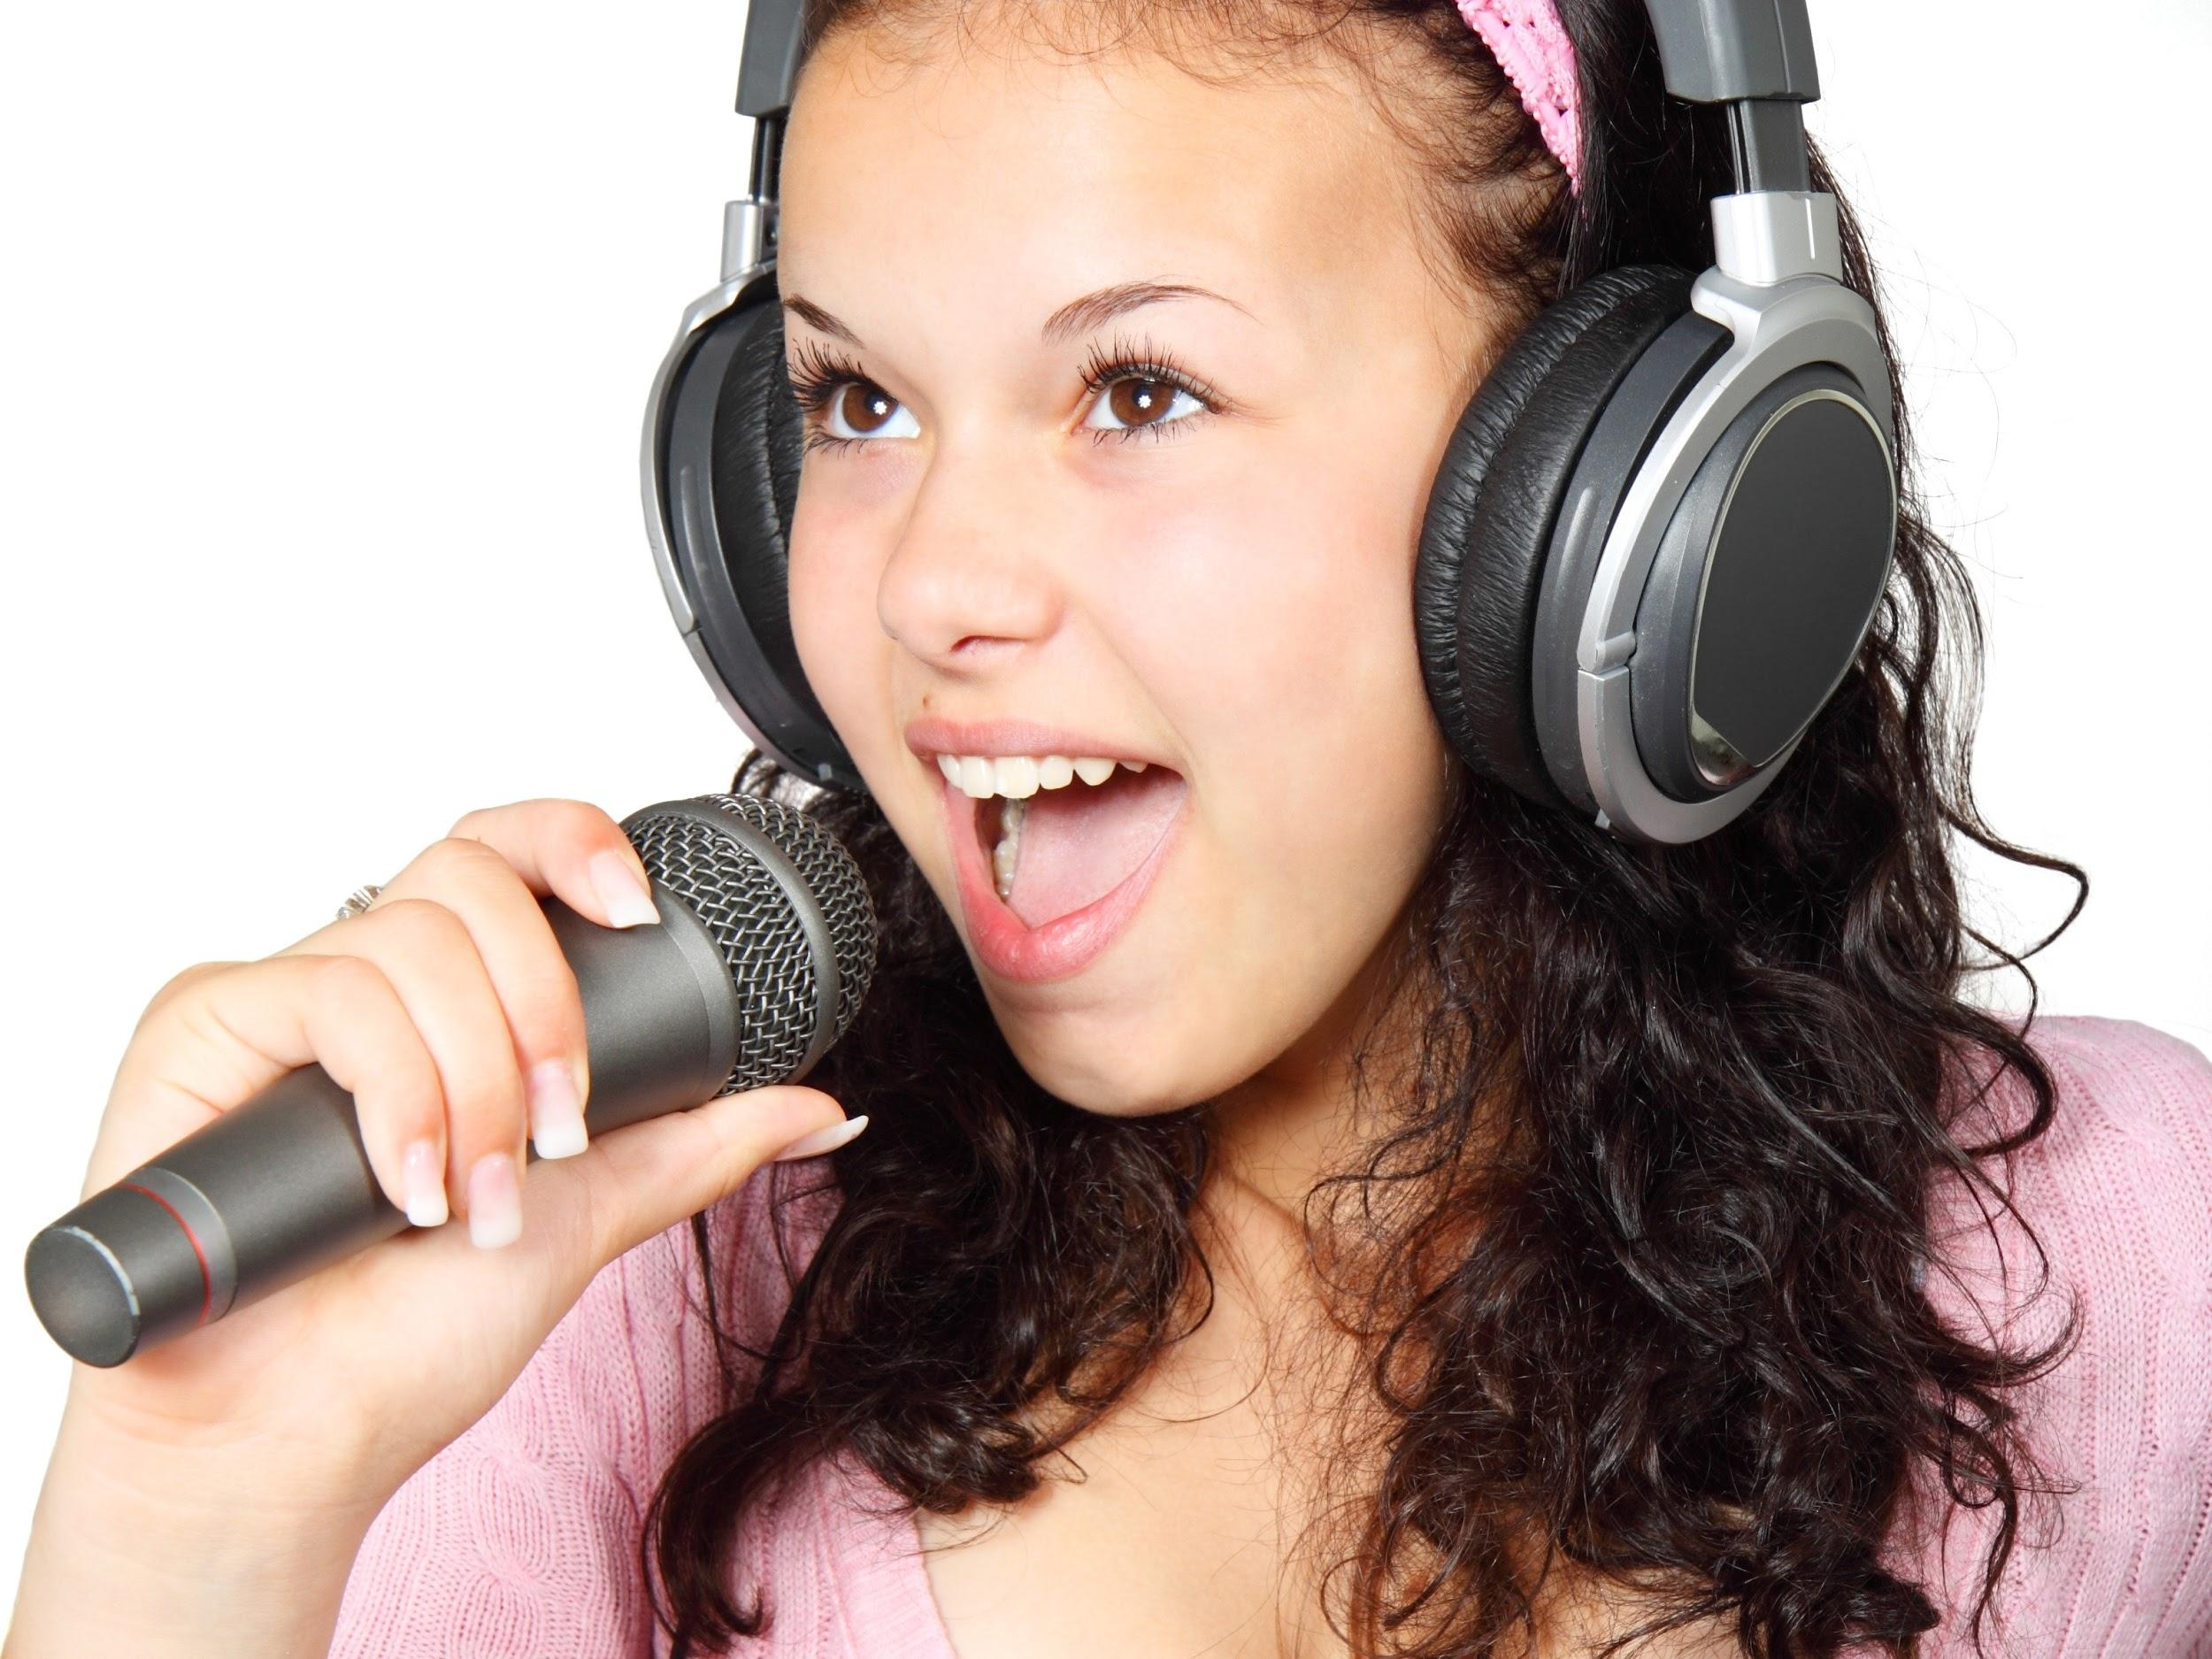
ᏣᏁᎵᏁ ᏣᎳᎩ ᎠᏕᎶᏆᏍᏗ
dijanogisdis jaduli?
Tla yawaduli dikinogisdi

Slide 12
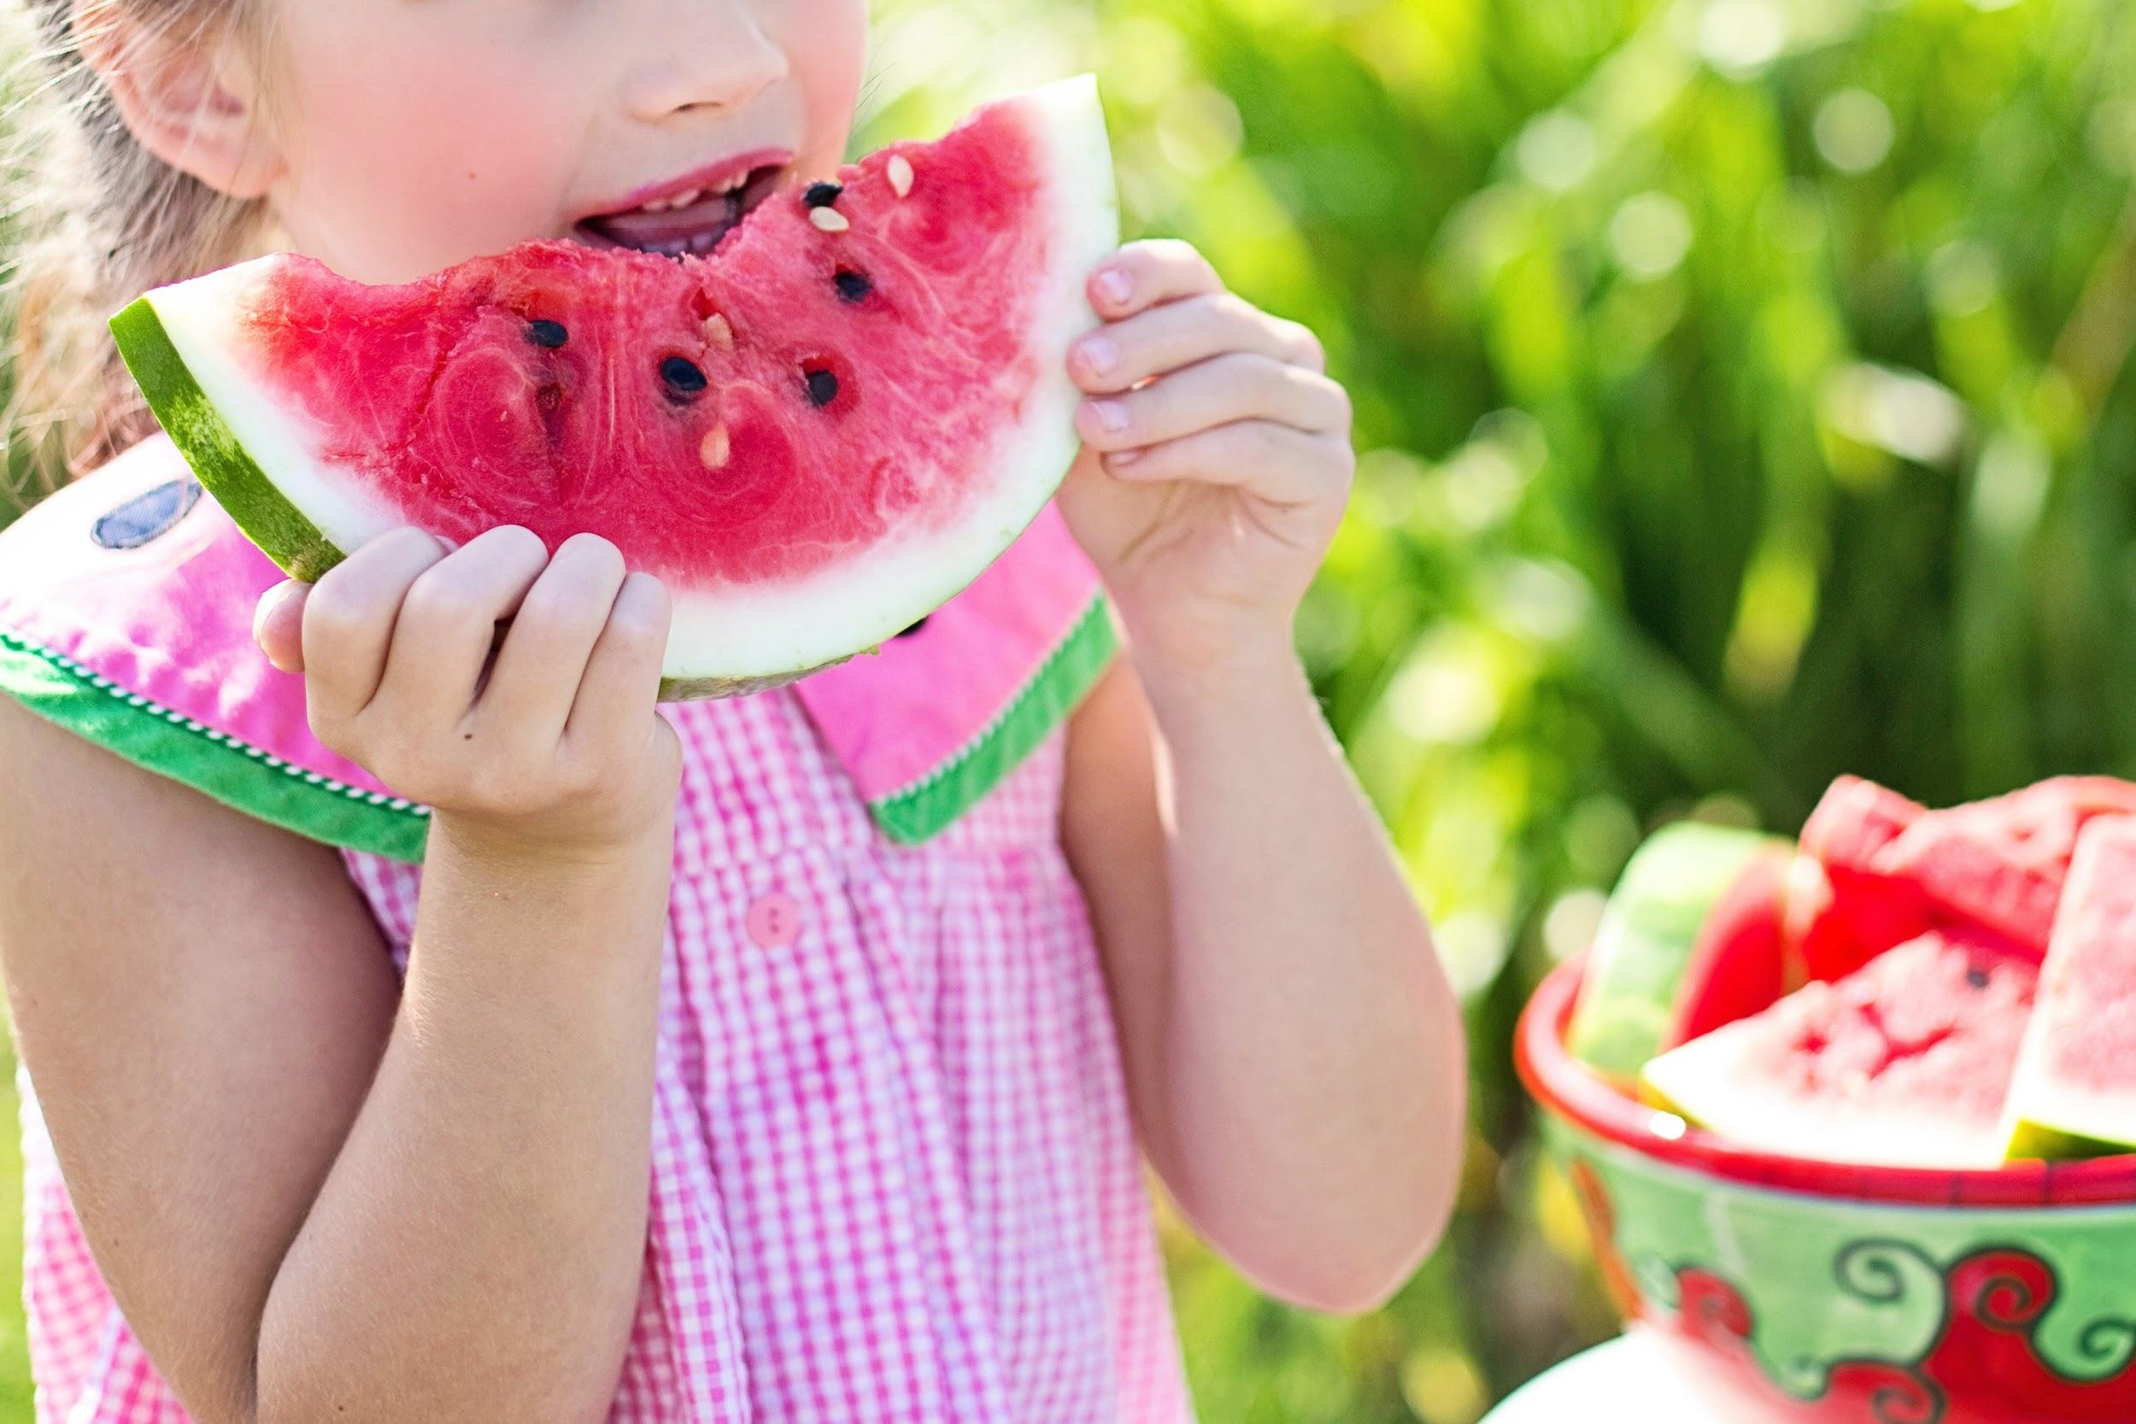
ᏣᏁᎵᏁ ᏣᎳᎩ ᎠᏕᎶᏆᏍᏗ
jalsdaiyudis jaduli?
Tla yawaduli awalsdaidi

Slide 13
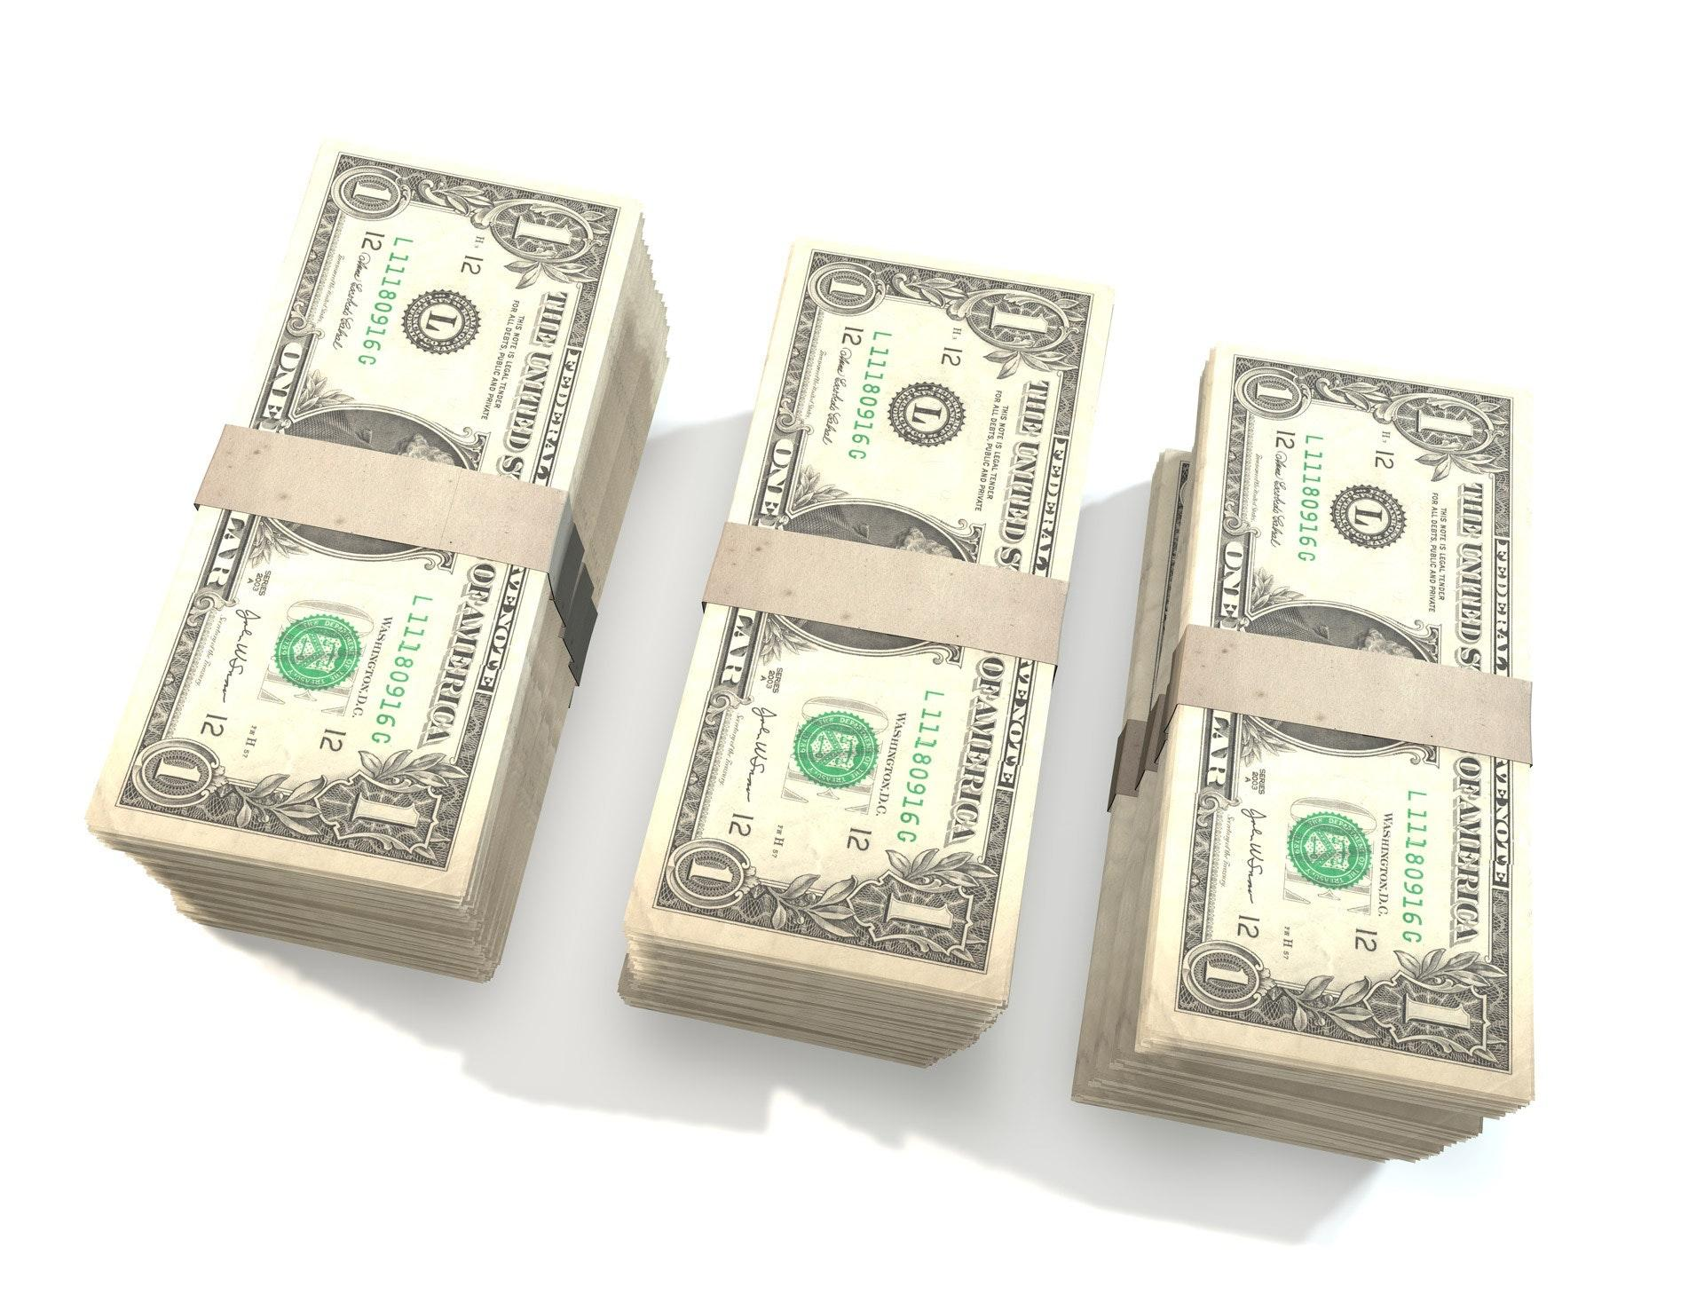
ᏣᏁᎵᏁ ᏣᎳᎩ ᎠᏕᎶᏆᏍᏗ
jahwahisdis jaduli?
Tla yawaduli agihwahisdi

Slide 14
ᏣᏁᎵᏁ ᏣᎳᎩ ᎠᏕᎶᏆᏍᏗ

Slide 15
ᏣᏁᎵᏁ ᏣᎳᎩ ᎠᏕᎶᏆᏍᏗ
ᎠᎵᏣᏙᎲᏍᎩ- Preacher
ᎦᏬᏂᏍᎩ- Speaker
ᏧᏠᎦᎴᏗ- Santa Clause
ᎠᏩᏚᎵ- I want it
ᏣᏚᎵ- You want it
ᎤᏚᎵ- he/she wants it
ᏗᏁᎵᏙᏗ- toy
ᏓᏩᏚᎵ- I want them
ᏕᏣᏚᎵ- You want them
ᎢᏤ- new
ᎦᎾᏌᏁᏍᏙᏗ- Truck
ᏔᎷᎩᏍᎩ ᏴᏫ- Robot
ᎩᎦᎨ- Red
ᎤᎯᏯᏝ- He’s wearing a collar
ᎪᎱᏍᏗ- Something
ᎨᎵᏍᎩ- Pie

