Slide 1
ᎣᏏᏲ
ᏐᏁᎵᏁ ᏣᎳᎩ ᎠᏕᎶᏆᏍᏗ

Slide 2
ᏐᏁᎵᏁ ᏣᎳᎩ ᎠᏕᎶᏆᏍᏗ
ᎢᏓᎴᎾ
ᏣᎳᎩ ᎢᏗᏬᏂ!

Slide 3
ᏐᏁᎵᏁ ᏣᎳᎩ ᎠᏕᎶᏆᏍᏗ
Na gitli uyosisge
As retold by Peggy Girty-Flute
Juwenvse wakte gitli. Hawiya uhnvsgatle. Asvtlv degandisge. Amayi widukanane, soi gitli wagotihe, elisge, Hawiya uhnvsgatlv. Siquu soi hawiya udulisge, Widusiwise, Hawiya uwohosele, hawin amo wudelitse. Juwenvsvdidla wulose, uyosisge.

Slide 4
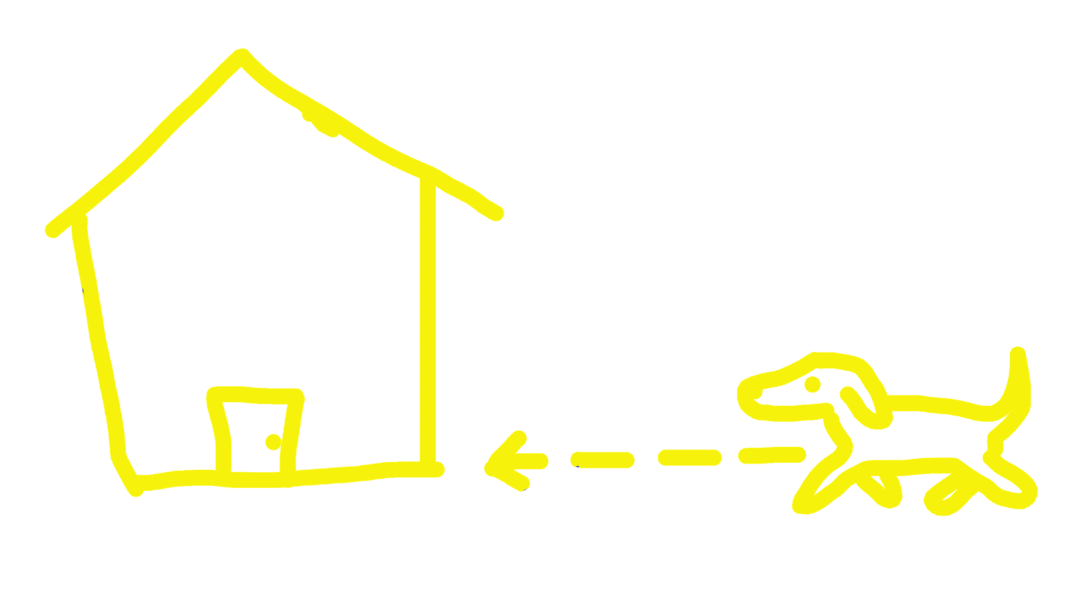
ᏐᏁᎵᏁ ᏣᎳᎩ ᎠᏕᎶᏆᏍᏗ
Juwenvse wakte gitli.
juwenvsv
gitli
wakte

Slide 5
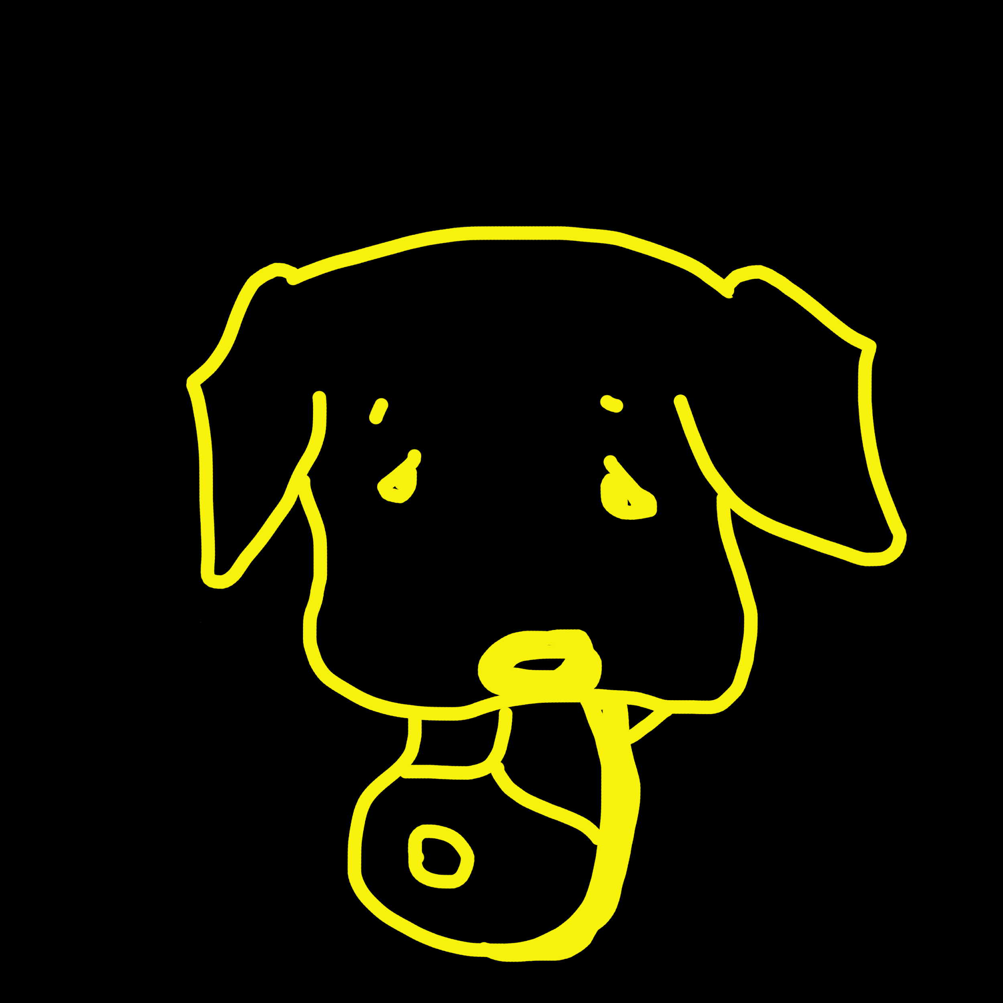
ᏐᏁᎵᏁ ᏣᎳᎩ ᎠᏕᎶᏆᏍᏗ
Hawiya uhnvsgatle.
uhnvsgatle
hawiya

Slide 6
ᏐᏁᎵᏁ ᏣᎳᎩ ᎠᏕᎶᏆᏍᏗ
Asvtlv degandisge.
degandisge
asvtlv

Slide 7
ᏐᏁᎵᏁ ᏣᎳᎩ ᎠᏕᎶᏆᏍᏗ
Amayi widukanane,
widukanane
amayi

Slide 8
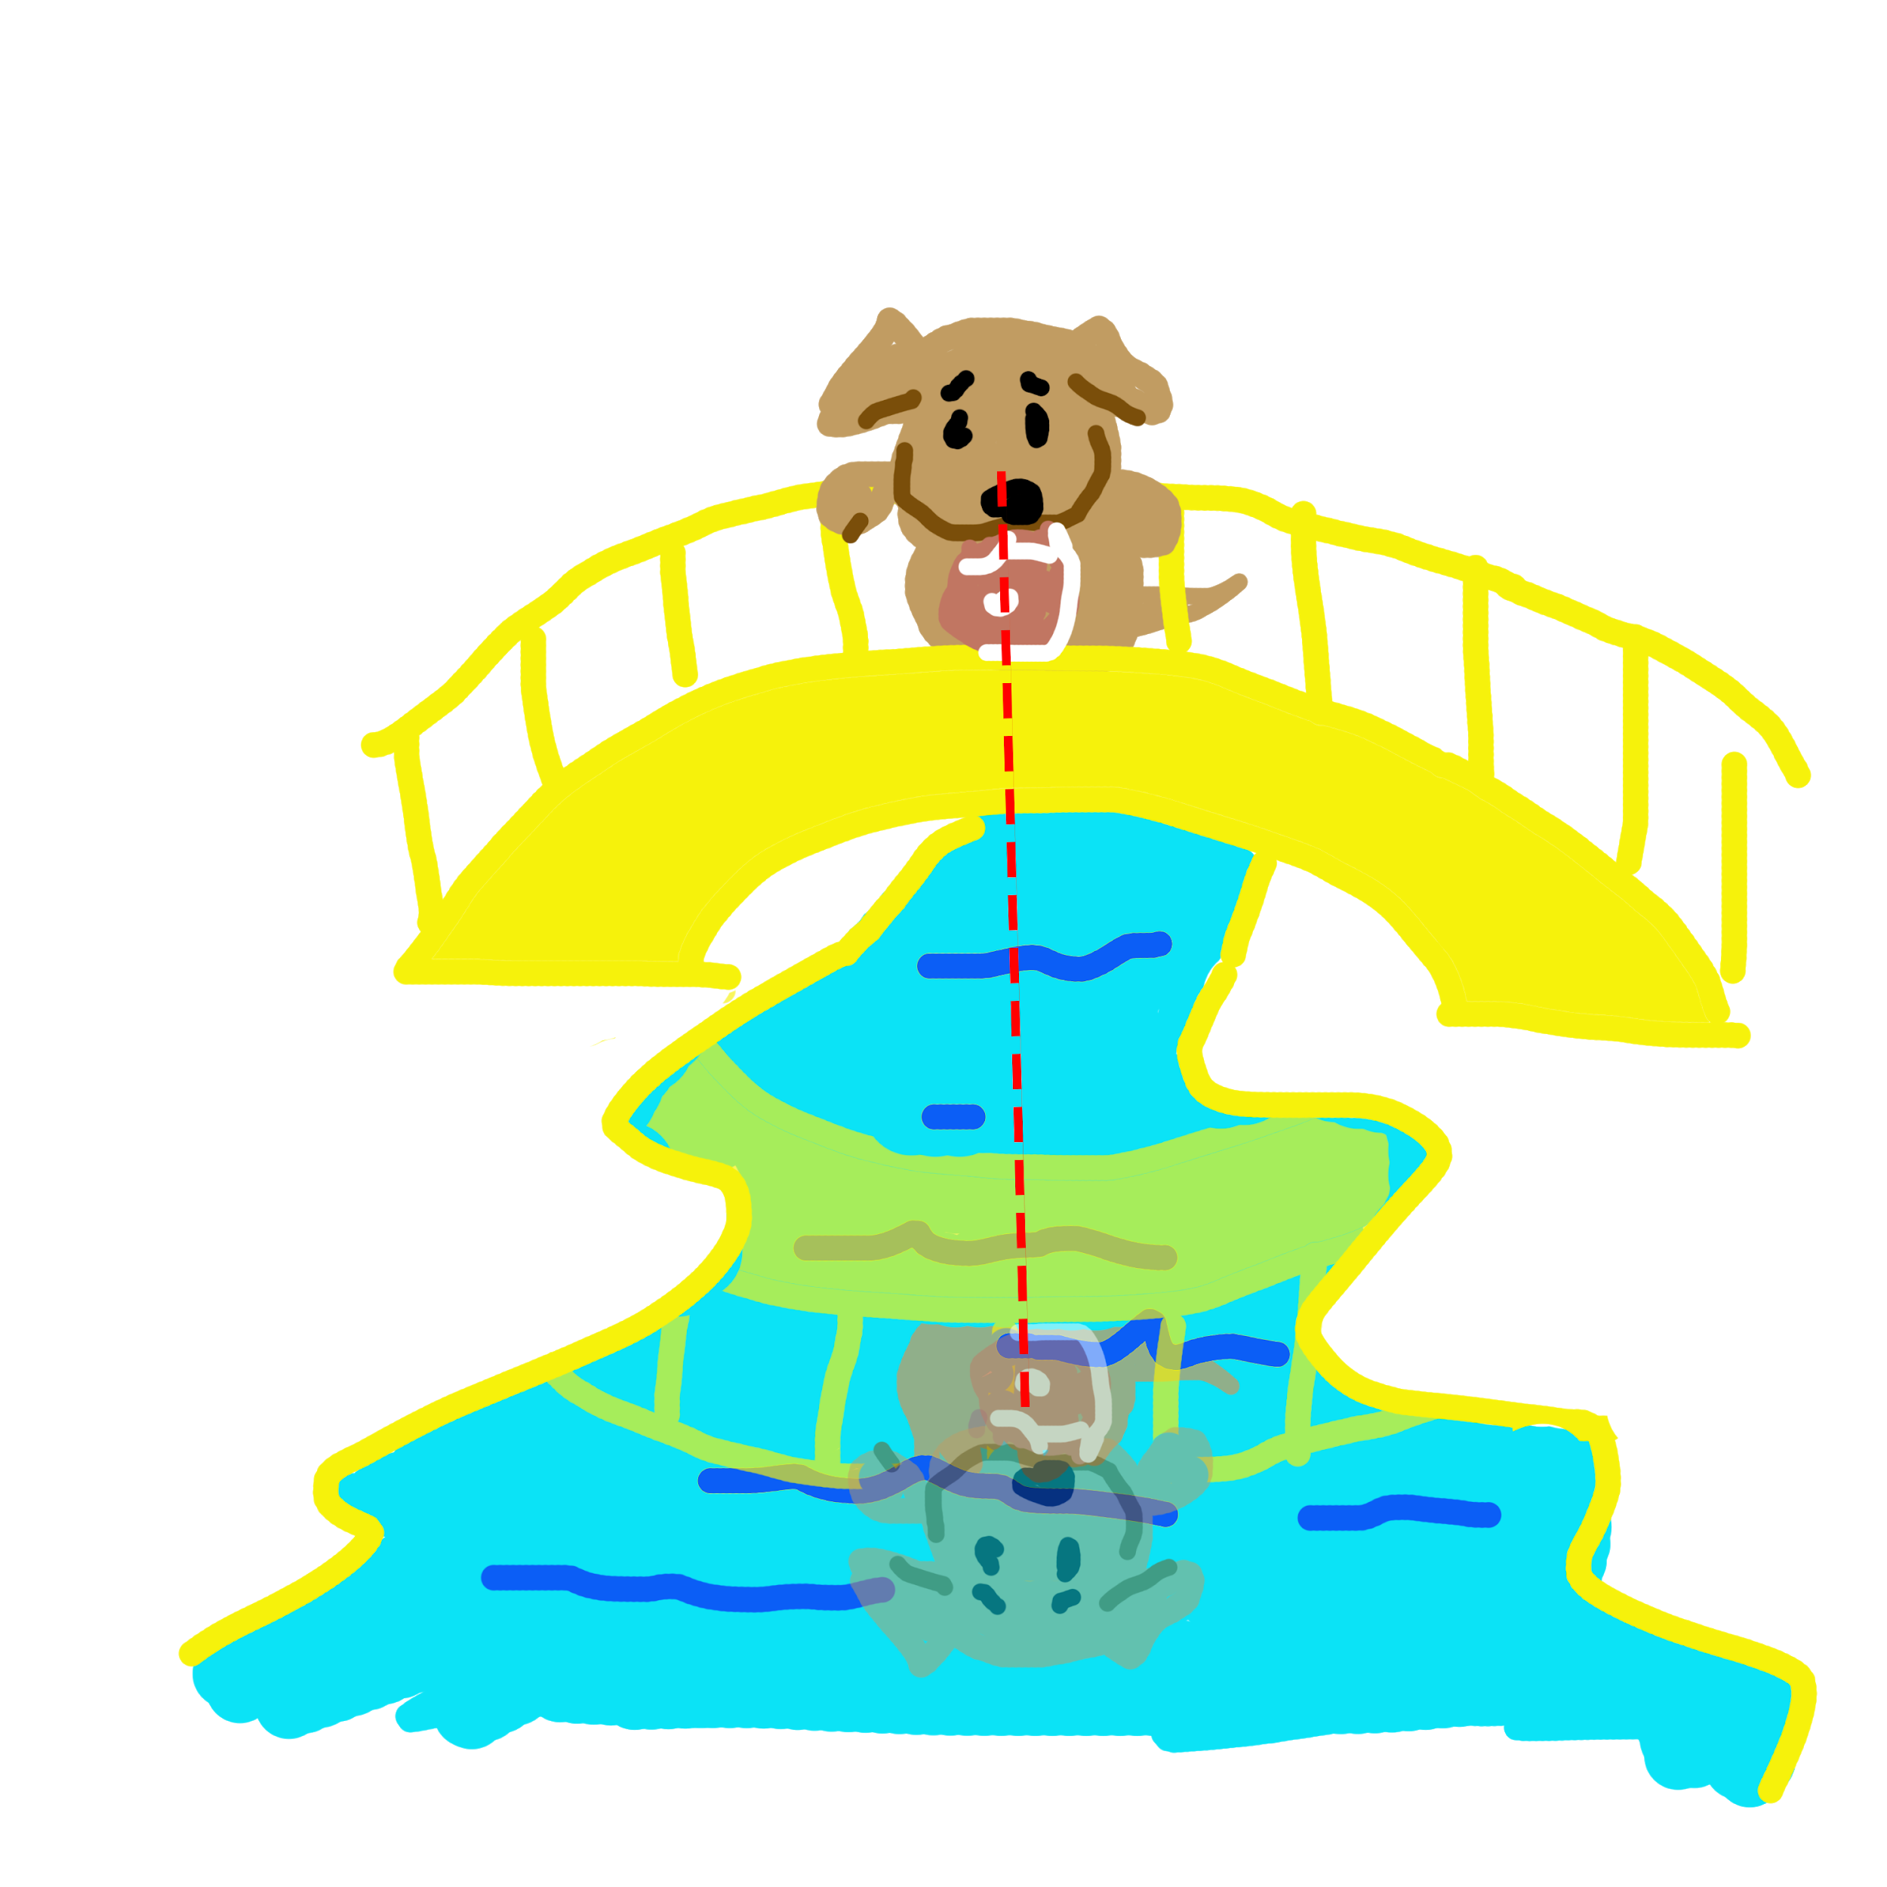
ᏐᏁᎵᏁ ᏣᎳᎩ ᎠᏕᎶᏆᏍᏗ
elisge
soi gitli wagotihe, elisge,
wagigoe
Soi gitli

Slide 9
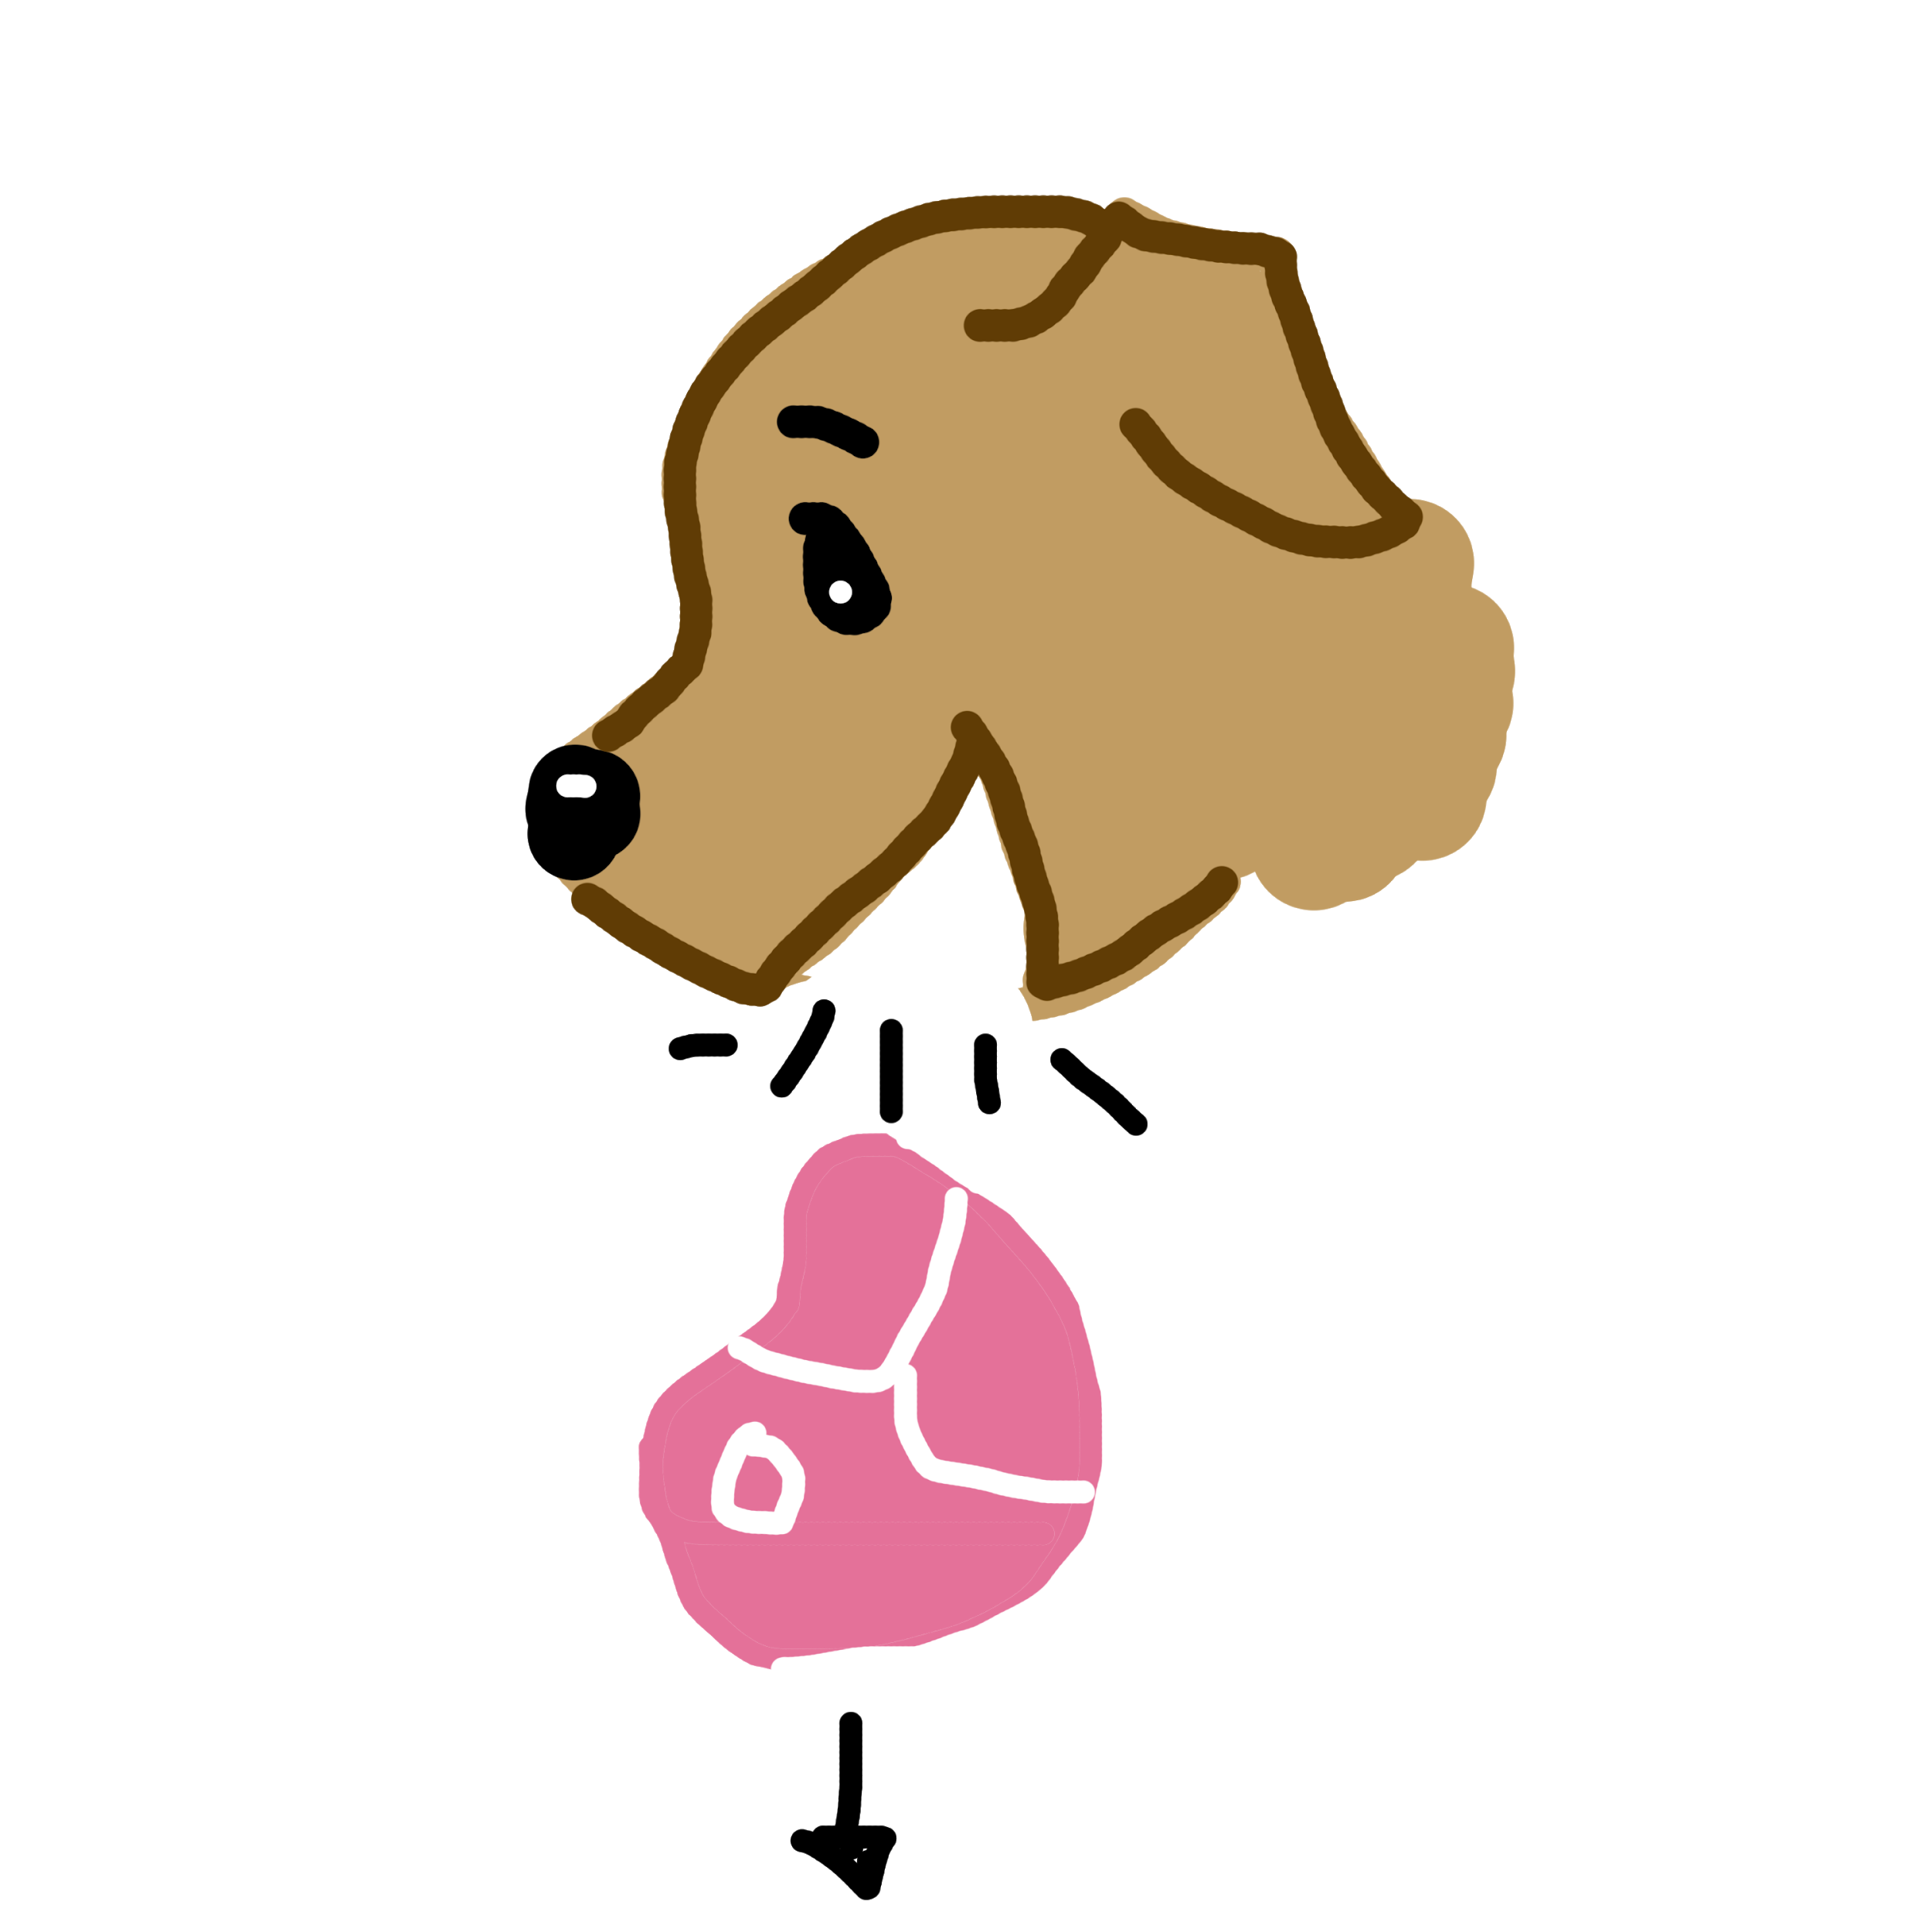
ᏐᏁᎵᏁ ᏣᎳᎩ ᎠᏕᎶᏆᏍᏗ
Widusiwise, Hawiya uwohosele,
widusiwise
Hawiya uwohosele

Slide 10
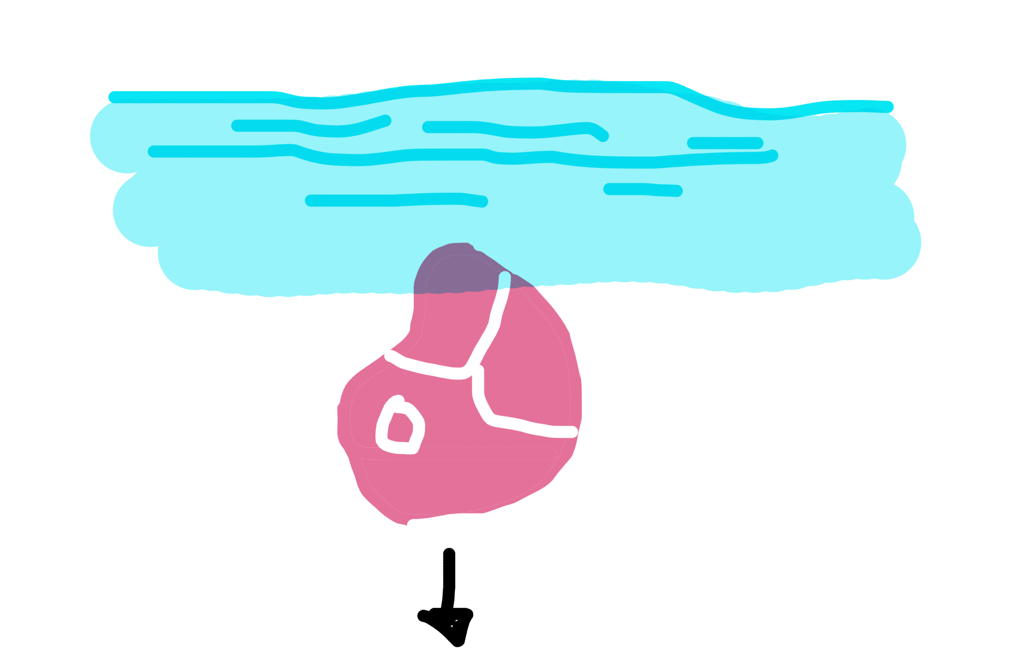
ᏐᏁᎵᏁ ᏣᎳᎩ ᎠᏕᎶᏆᏍᏗ
hawin amo wudelitse.
amo
hawin
wudelije

Slide 11
ᏐᏁᎵᏁ ᏣᎳᎩ ᎠᏕᎶᏆᏍᏗ
Juwenvsvdidla wulose,
juwenvsvdidl
wulose

Slide 12
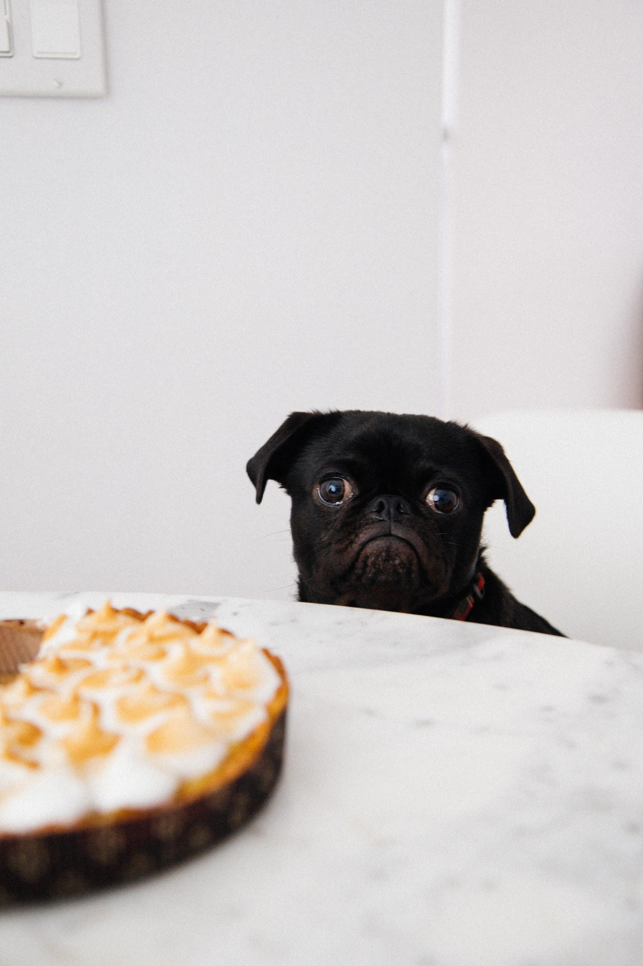
ᏐᏁᎵᏁ ᏣᎳᎩ ᎠᏕᎶᏆᏍᏗ
uyosisge.
uyosisge

Slide 13
ᏐᏁᎵᏁ ᏣᎳᎩ ᎠᏕᎶᏆᏍᏗ
Na gitli uyosisge
As retold by Peggy Girty-Flute
Juwenvse wakte gitli. Hawiya uhnvsgatle. Asvtlv degandisge. Amayi widukanane, soi gitli wagotihe, elisge, Hawiya uhnvsgatlv. Siquu soi hawiya udulisge, Widusiwise, Hawiya uwohosele, hawin amo wudelitse. Juwenvsvdidla wulose, uyosisge.

Slide 14
ᏐᏁᎵᏁ ᏣᎳᎩ ᎠᏕᎶᏆᏍᏗ
ᏧᏪᏅᏒᏍ ᎤᎾᏕᎶᏆᏍᏗᎨ ᏩᎧᏖ ᎩᏟ?
ᏧᏪᏅᏒ ᏩᎧᏖ ᎩᏟ.
ᎭᏫᏯᏍ ᎤᏅᏍᎦᏞ ᎩᏟ?
ᎥᎥ. ᎭᏫᏯ ᎤᏅᏍᎦᏞ.
ᏅᏃᎯᏍ ᎠᏒᏢᎨ ᏕᎦᎾᏗᏍᎨ?
ᎠᏒᏢ ᏕᎦᎾᏗᏍᎨ.
ᎠᎹᏱ ᏫᏚᎧᎾᏁ, ᎦᏙ ᎤᏍᏗ ᏩᎪᏘᎮ ᎩᏟ?
ᏐᎢ ᎩᏟ ᏩᎪᏘᎮ Ꮎ ᎩᏟ.
ᎦᏙᎲ ᎭᏫᏯ ᏧᏬᎰᏎᎴ?
ᏫᏚᏏᏫᏎ.

Slide 15
ᏐᏁᎵᏁ ᏣᎳᎩ ᎠᏕᎶᏆᏍᏗ
ᎭᏫᏯ- meat
ᎤᏅᏍᎦᏞ- was in his mouth
ᎠᏒᏢ- Bridge
ᏕᎦᎾᏗᏍᎨ- he/she crossed
ᎠᎹᏱ- the water
ᏫᏚᎧᎾᏁ- he/she looked at
ᏐᎢ- another
ᏩᎪᏘᎮ- he/she saw it
ᎡᎵᏍᎨ- he/she thought
ᏏᏊ- more, again
ᎤᏚᎵᏍᎨ- he/she wanted it
ᏫᏚᏏᏫᏎ- He barked
ᎤᏬᎰᏎᎴ- he/she dropped it
ᎭᏫᏂ- under, beneath
ᎠᎼ- in the water
ᏭᏕᎵᏤ- it went down
ᏭᎶᏎ- he she went
ᎤᏲᏏᏍᎨ- he/she was hungry

