Slide 1
ᎣᏏᏲ! ᎦᎵᎡᎢᎦ ᏂᎦᏓ ᏥᏤᏙ ᎪᎯ ᎤᏒᎢ.

Slide 2
Who is this guy???
How to watch these classes
Concentrate on meaning, rather than memorizing individual words.
Have fun!

Slide 3
ᎠᎬᏱ ᏣᎳᎩ ᎠᏕᎶᏆᏍᏗ
What to expect from this course:
Be able to introduce yourself in Cherokee
Learn some common phrases to use at home.
Be exposed to more Cherokee through stories and songs.

Slide 4
ᎠᎬᏱ ᏣᎳᎩ ᎠᏕᎶᏆᏍᏗ
ᎢᏓᎴᎾ- Let’s begin
ᏣᎳᎩ ᎢᏗᏬᏂ- Let’s talk Cherokee

Slide 5
ᎠᎬᏱ ᏣᎳᎩ ᎠᏕᎶᏆᏍᏗ
Hello everyone
My name is ______ I am ______ years old.
I am Cherokee. (mixed. Full blood. half) I am not Cherokee.
I am from _______ and I live in
I work at _________
My moms name is_______ and my dads name is ______
I am married

Slide 6
ᎠᎬᏱ ᏣᎳᎩ ᎠᏕᎶᏆᏍᏗ
dawado/daquado- Is my name
dejado- Is your name
dudo- Is his/her name

Slide 7
ᎠᎬᏱ ᏣᎳᎩ ᎠᏕᎶᏆᏍᏗ
ᏓᏩᏙᎠ/ᏓᏆᏙᎠ- Is my name
ᏩᏙ. ᎠᏓ ᏓᏩᏙᎠ. Thank you. Wood is my name.

Slide 8
ᎠᎬᏱ ᏣᎳᎩ ᎠᏕᎶᏆᏍᏗ
ᏗᏗᏃᎩ- Let’s sing
ᏏᏲ, ᏏᏲ, ᎦᏙ ᎤᏍᏗ ᏕᏣᏙ? X2
______ ᏓᏩᏙ, ______ᏓᏩᏙ
______ ᏗᎨᎬ.

Slide 9
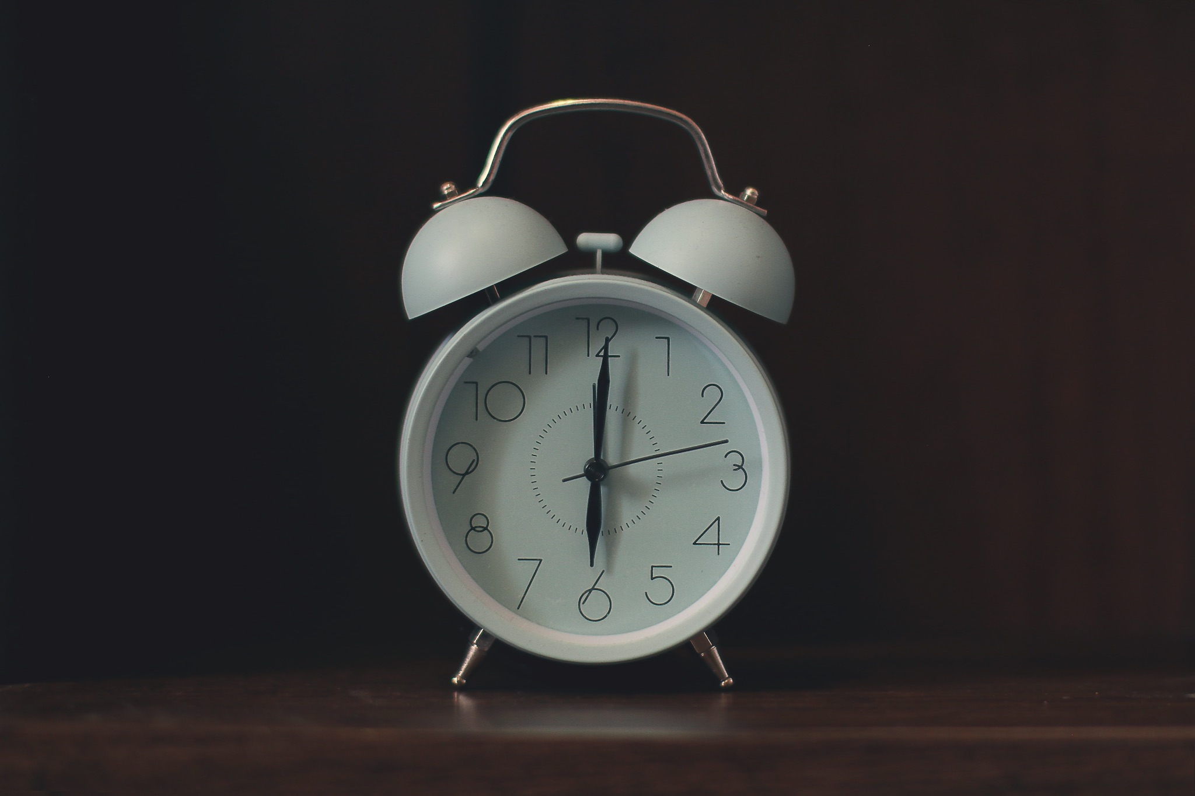
ᎠᎬᏱ ᏣᎳᎩ ᎠᏕᎶᏆᏍᏗ
ᎯᏰᎩ- Wake up!
Extra
ᏣᏁᎳ ᎠᎩᏰᏨ ᏒᎯ ᏥᎨᏒ. I woke up at 8 yesterday.
ᏣᏂ ᎦᎵᏉᎩ ᏛᏰᏨ ᏒᎾᎴᎢ. John will wake up at 7 tomorrow.

Slide 10
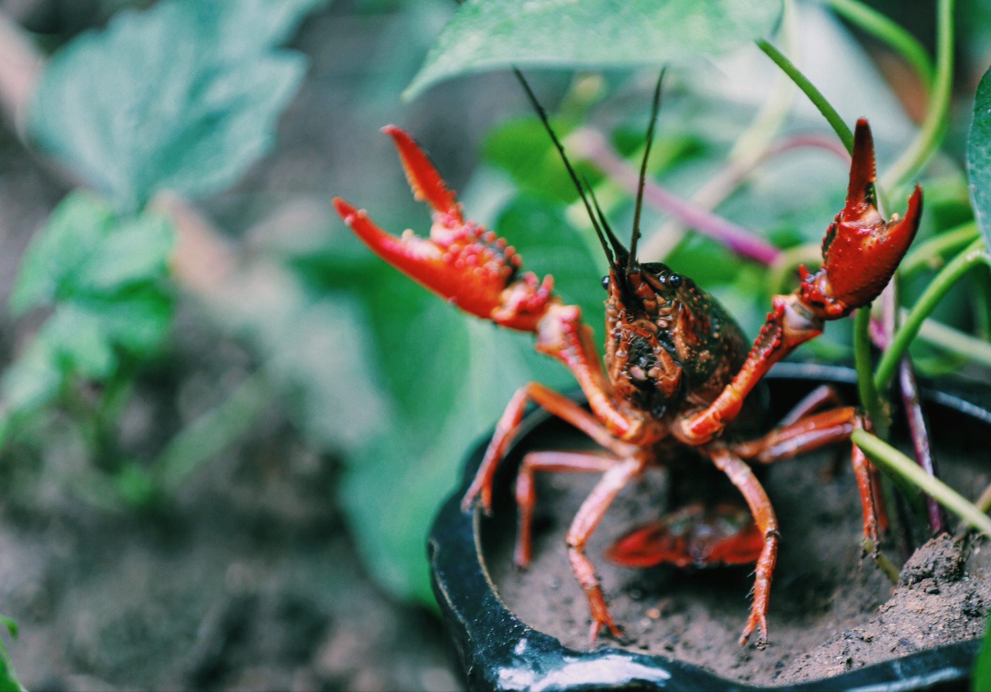
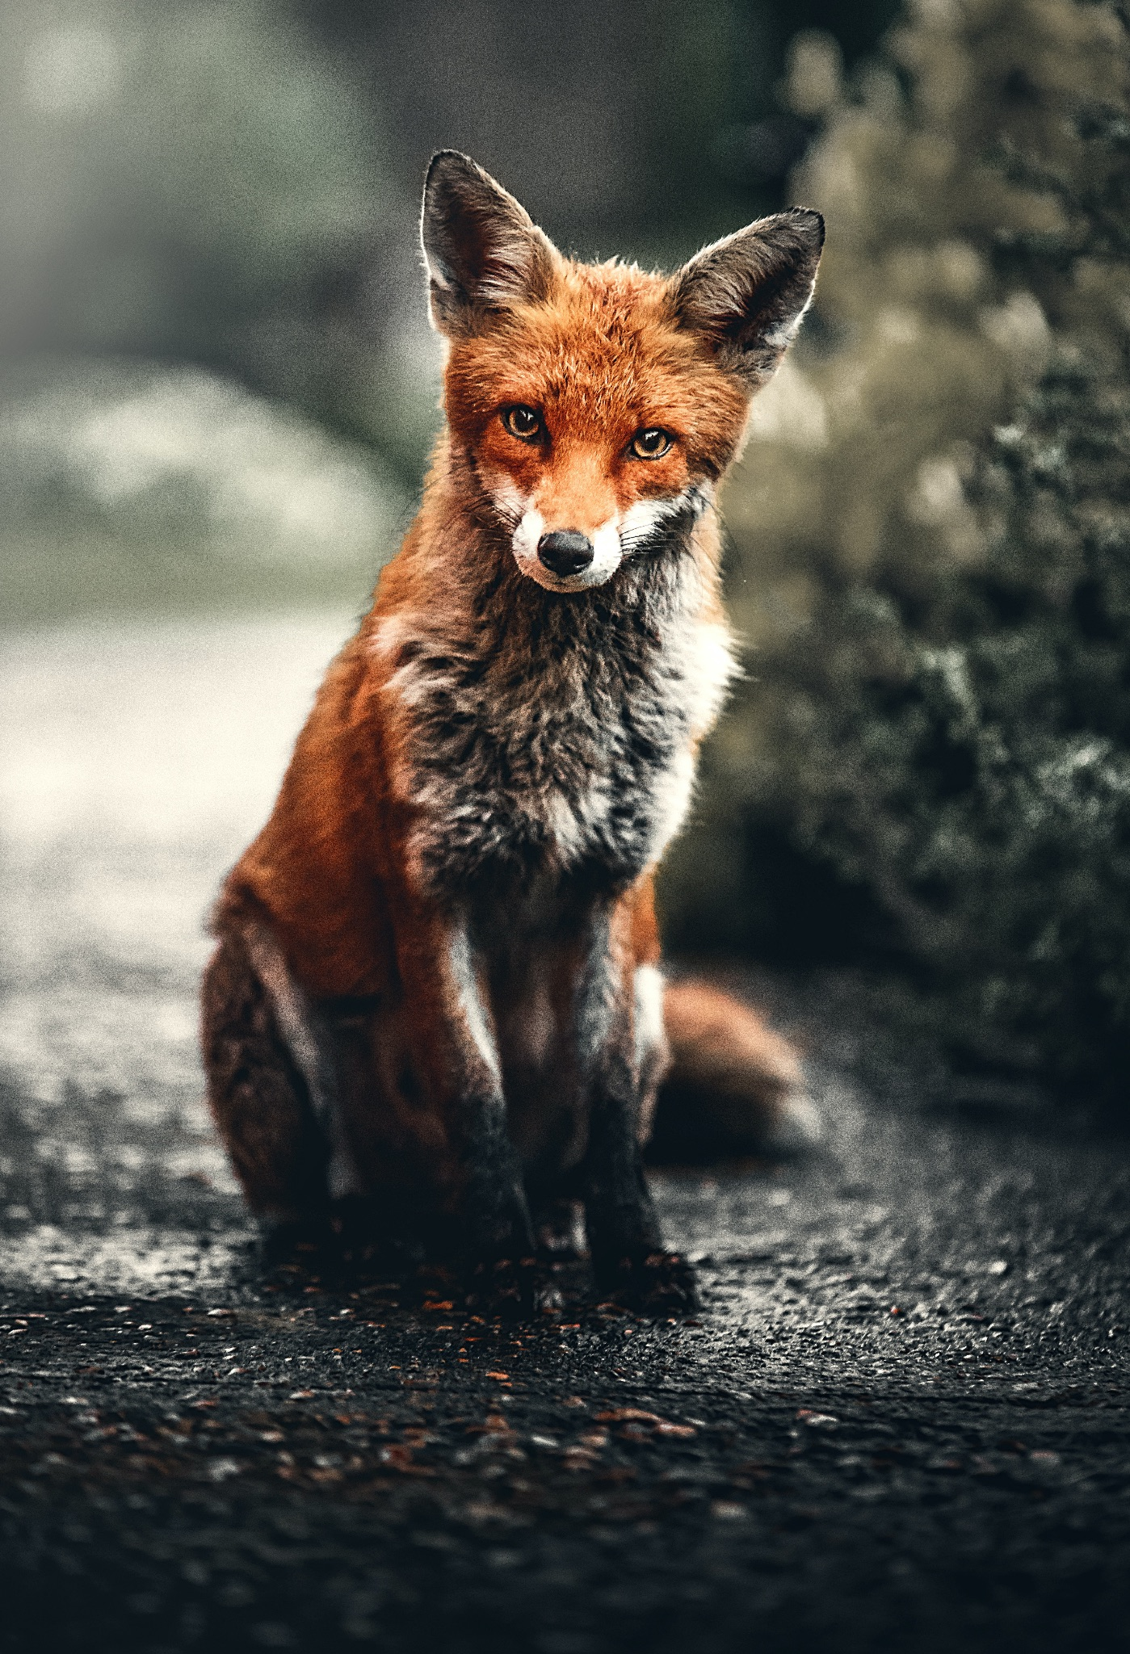
ᎠᎬᏱ ᏣᎳᎩ ᎠᏕᎶᏆᏍᏗ
Ilvhiyu jigesv, jutli ale jisdvn anehe.
ᏥᏍᏛᎾ
ᏧᏟ

Slide 11
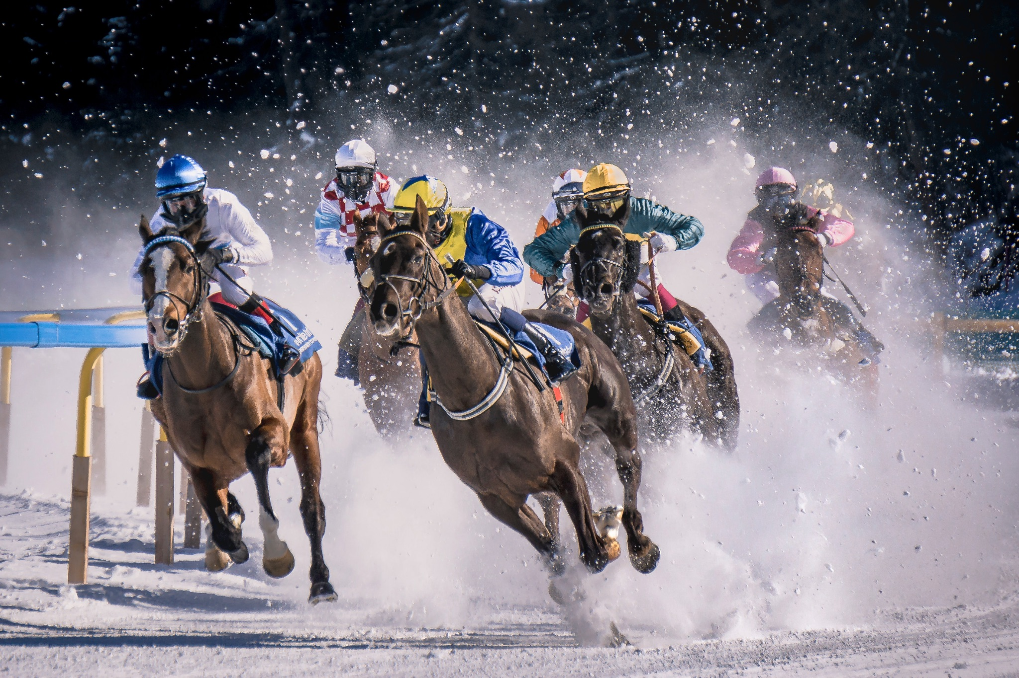
ᎠᎬᏱ ᏣᎳᎩ ᎠᏕᎶᏆᏍᏗ
Jutli ale jisdvn untohgiyastanv.
ᎤᎾᏙᎩᏯᏍᏔᏅ

Slide 12
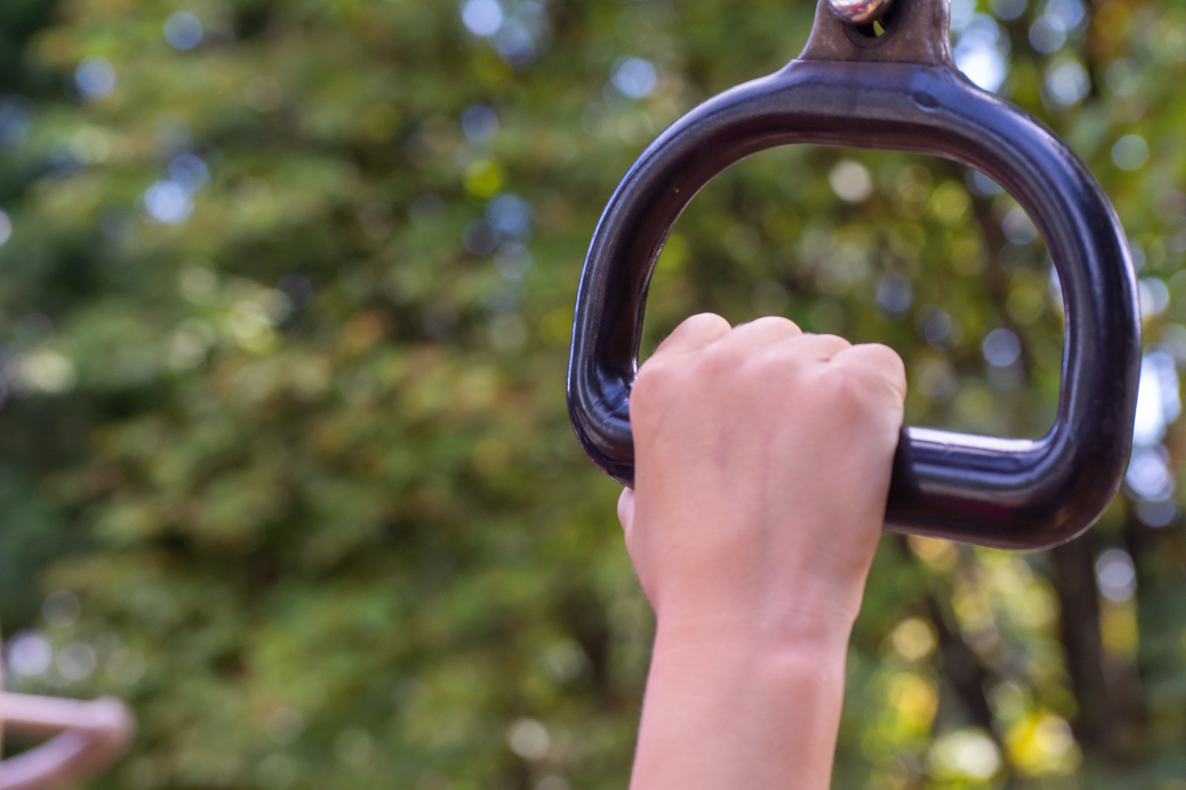
ᎠᎬᏱ ᏣᎳᎩ ᎠᏕᎶᏆᏍᏗ
Unlenvhe, jisdvn wajiniyvselv jutli ganidadv.
ᏩᏥᏂᏴᏎᎸ

Slide 13
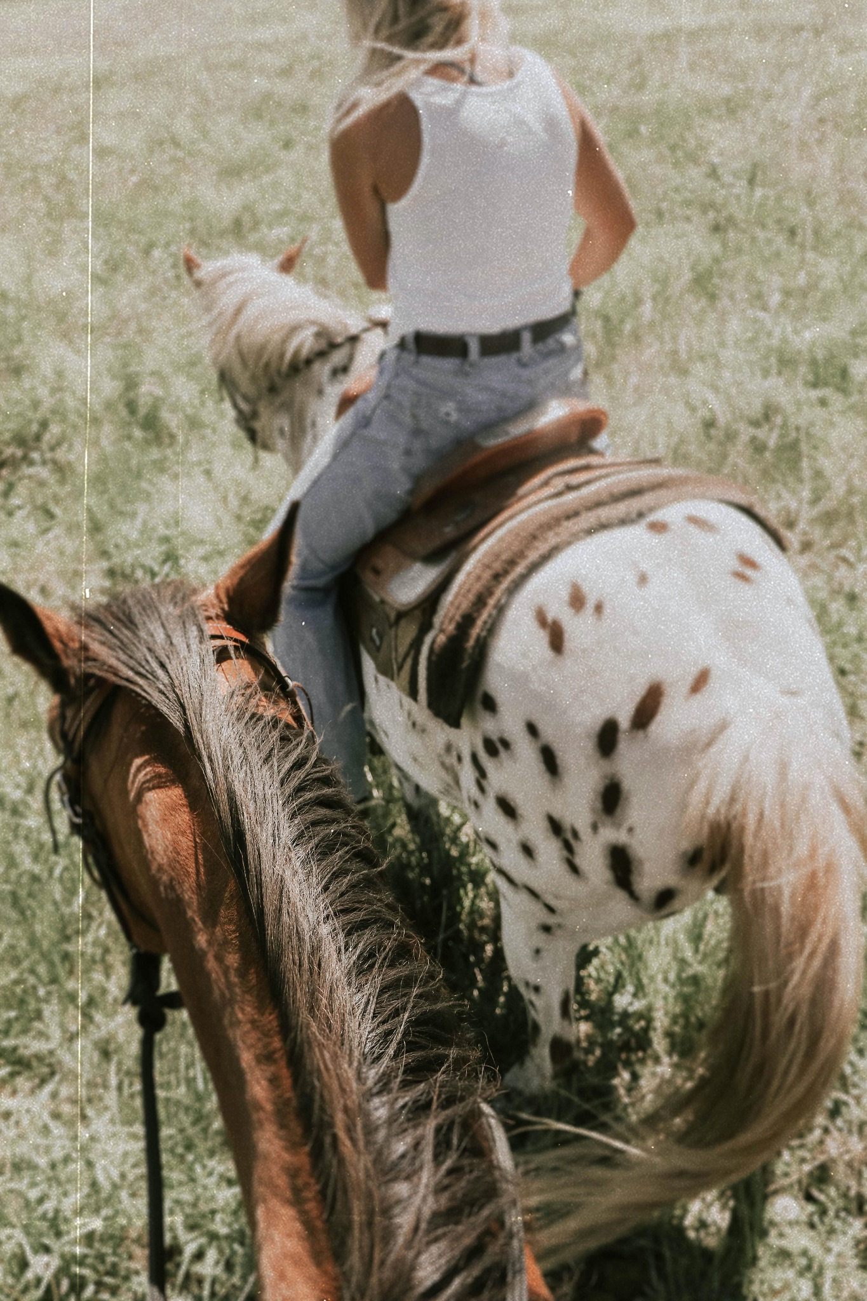
ᎠᎬᏱ ᏣᎳᎩ ᎠᏕᎶᏆᏍᏗ
Jisdvn wukilv jutli ganidadv.
ᏭᎩᎸ

Slide 14
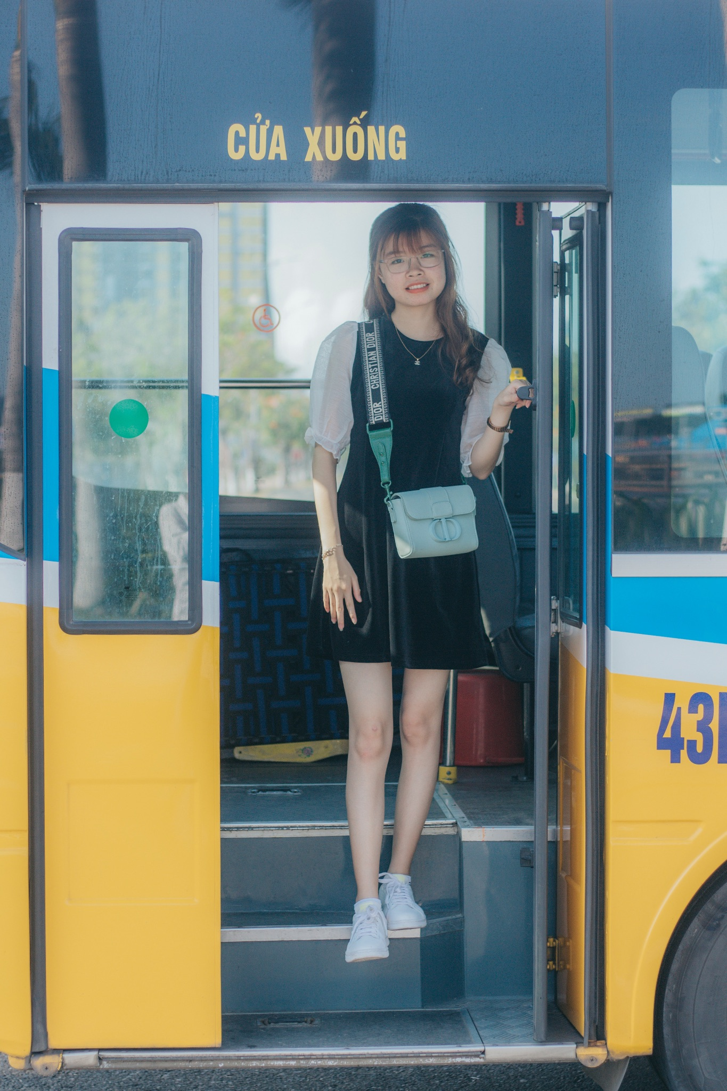
ᎠᎬᏱ ᏣᎳᎩ ᎠᏕᎶᏆᏍᏗ
ᏭᏠᏒ
Wunisquad antohgiyasgv, jisdvn wudlosv jutli ganidadv.

Slide 15
ᎠᎬᏱ ᏣᎳᎩ ᎠᏕᎶᏆᏍᏗ
ᎤᏓᏠᏎ
Jisdvn udatlose, elisge na jutli.

Slide 16
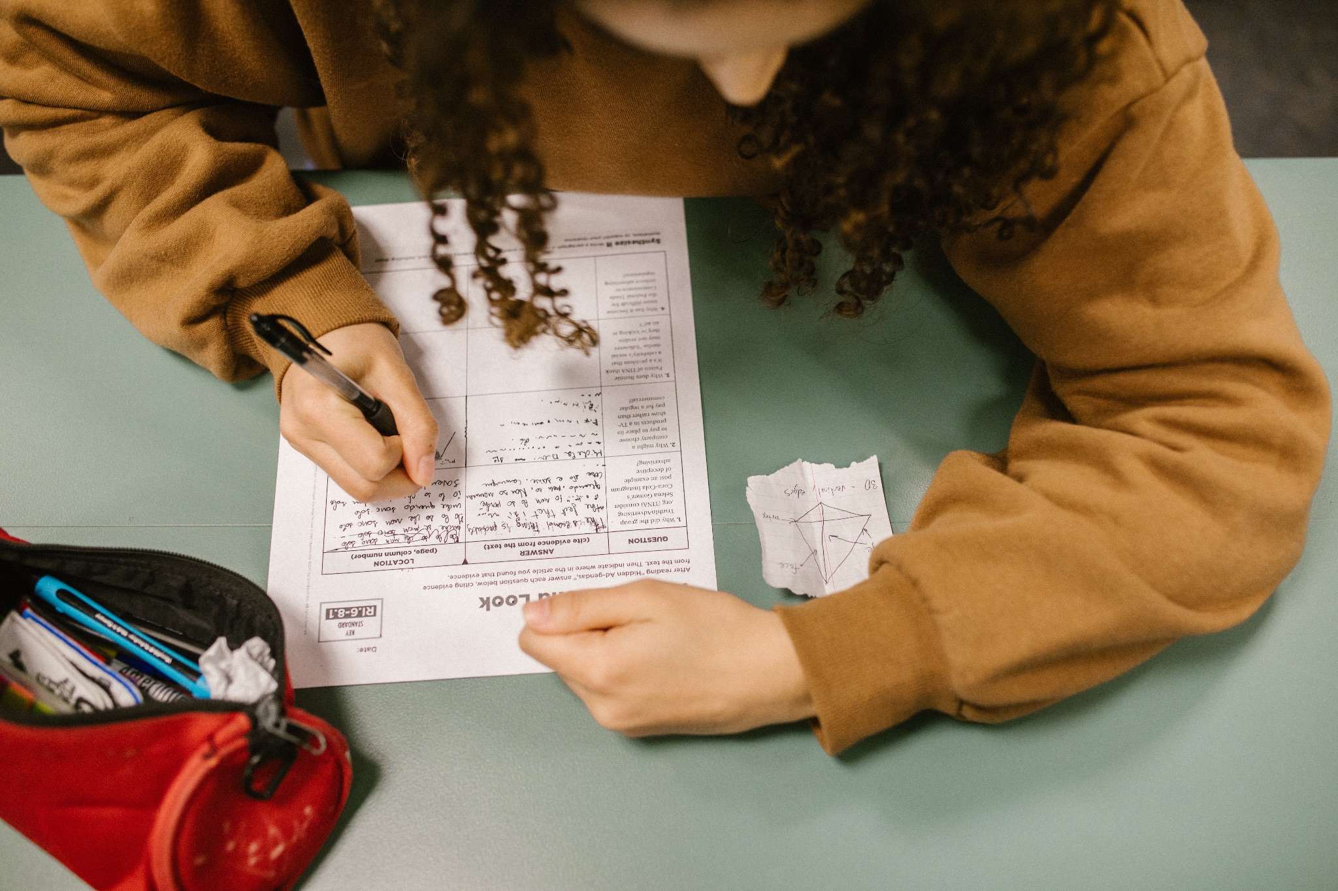
ᎠᎬᏱ ᏣᎳᎩ ᎠᏕᎶᏆᏍᏗ
ᎤᎶᏄᎮᏞ
Aseno, jisdvn ulonuhetle.

Slide 17
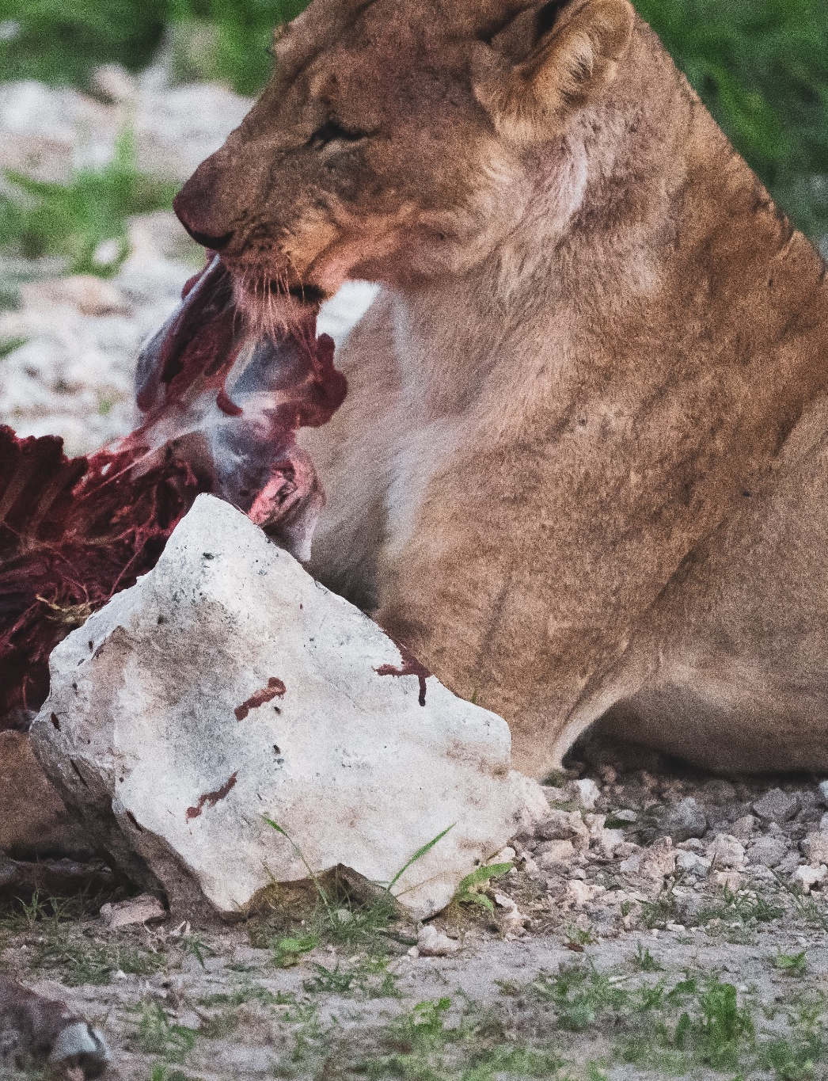
ᎠᎬᏱ ᏣᎳᎩ ᎠᏕᎶᏆᏍᏗ
ᏩᏥᏯᎥ
Jutli wajiyav jisdvn. (uge)

Slide 18
ᎠᎬᏱ ᏣᎳᎩ ᎠᏕᎶᏆᏍᏗ
Ilvhiyu jigesv, jutli ale jisdvn anehe. Jutli ale jisdvn untohgiyastanv. Unlenvhe, jisdvn wajiniyvselv jutli ganidadv. Jisdvn wukilv jutli ganidadv. Wunisquad antohgiyasgv, jisdvn wudlosv jutli ganidadv. Jisdvn udatlose, elisge na jutli. Asehno, jisdvn ulonuhetle. Jutli wajiyav na jisdvn!

Slide 19
ᎠᎬᏱ ᏣᎳᎩ ᎠᏕᎶᏆᏍᏗ
ᎢᎸᎯᏳ ᏥᎨᏒ, ᏧᏟ ᎠᎴ ᏥᏍᏛᎾ ᎠᏁᎮ. ᏧᏟ ᎠᎴ ᏥᏍᏛᎾ ᎤᎾᏙᎩᏯᏍᏔᏅ. ᎤᎾᎴᏅᎮ, ᏥᏍᏛᎾ ᏩᏥᏂᏴᏎᎸ ᏧᏟ ᎦᏂᏓᏛ. ᏥᏍᏛᎾ ᏭᎩᎸ ᏧᏟ ᎦᏂᏓᏛ. ᏭᏂᏍᏆᏛ ᎠᎾᏙᎩᏯᏍᎬ, ᏥᏍᏛᎾ ᏭᏠᏒ ᏧᏟ ᎦᏂᏓᏛ. ᏥᏍᏛᎾ ᎤᏓᏠᏎ, ᎡᎵᏍᎨ Ꮎ ᏧᏟ. ᎠᏎᏃ, ᏥᏍᏛᎾ ᎤᎶᏄᎮᏞ. ᏧᏟ ᏩᏥᏯᎥ Ꮎ ᏥᏍᏛᎾ!

Slide 20
ᎠᎬᏱ ᏣᎳᎩ ᎠᏕᎶᏆᏍᏗ
ᏧᏟ- fox
ᏥᏍᏛᎾ- crawdad
ᎤᎾttᎩᏯᏍᏔᏅ- they raced
ᎤᎾᎴᏅᎮ- they started
ᎦᏂᏓᏛ- tail
ᏩᏥᏂᏴᏎᎸ- he grabbed it
ᏭᎩᎸ- he rode it
ᏭᏂᏍᏆᏛ- they finished it
ᏭᏠᏒ- he got off of it
ᎤᏓᏠᏎ- he won it
ᎡᎵᏍᎨ- he thought
ᎤᎶᏄᎮᏞ- he cheated
ᏩᏥᏯᎥ- he ate it (alive)

