Slide 1
ᎣᏏᏲ
ᏍᎪᎯᏁ ᏣᎳᎩ ᎠᏕᎶᏆᏍᏗ

Slide 2
ᏍᎪᎯᏁ ᏣᎳᎩ ᎠᏕᎶᏆᏍᏗ
ᎢᏓᎴᎾ- Let’s begin
ᏣᎳᎩ ᎢᏗᏬᏂ- Let’s talk Cherokee

Slide 3
ᏍᎪᎯᏁ ᏣᎳᎩ ᎠᏕᎶᏆᏍᏗ
Hello everyone
My name is ______ I am ______ years old.
I am Cherokee. (mixed. Full blood. half) I am not Cherokee.
I am from _______ and I live in
I work at _________
My moms name is_______ and my dads name is ______
I am married

Slide 4
ᏍᎪᎯᏁ ᏣᎳᎩ ᎠᏕᎶᏆᏍᏗ
ᎠᏂᏩᏯ- wolf
ᎠᏂᏥᏍᏆ- bird
ᎠᏂᎠᏫ- deer
ᎠᏂᏬᏗ- paint
ᎠᏂᎩᎶᎯ- long hair
ᎠᏂᏌᎰᏂ- blue
ᎠᏂᎪᏕᎨᏫ- wild potato
ᏗᎩᏴᏫ
Is my clan

Slide 5
ᏍᎪᎯᏁ ᏣᎳᎩ ᎠᏕᎶᏆᏍᏗ
ᎯᏩᏛᎦ
Go hang it up (something flexible)

Slide 6
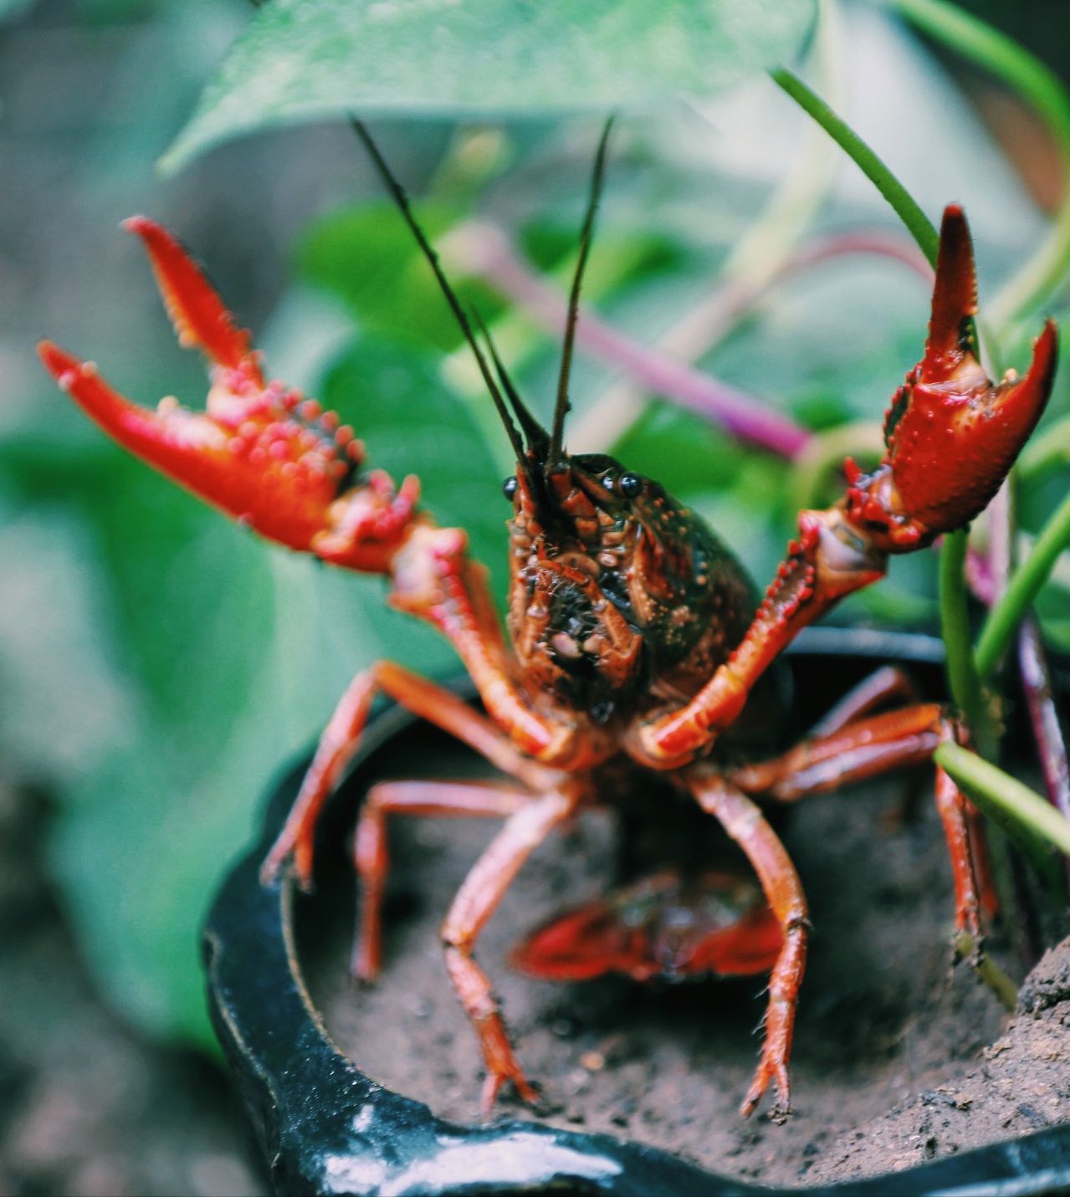
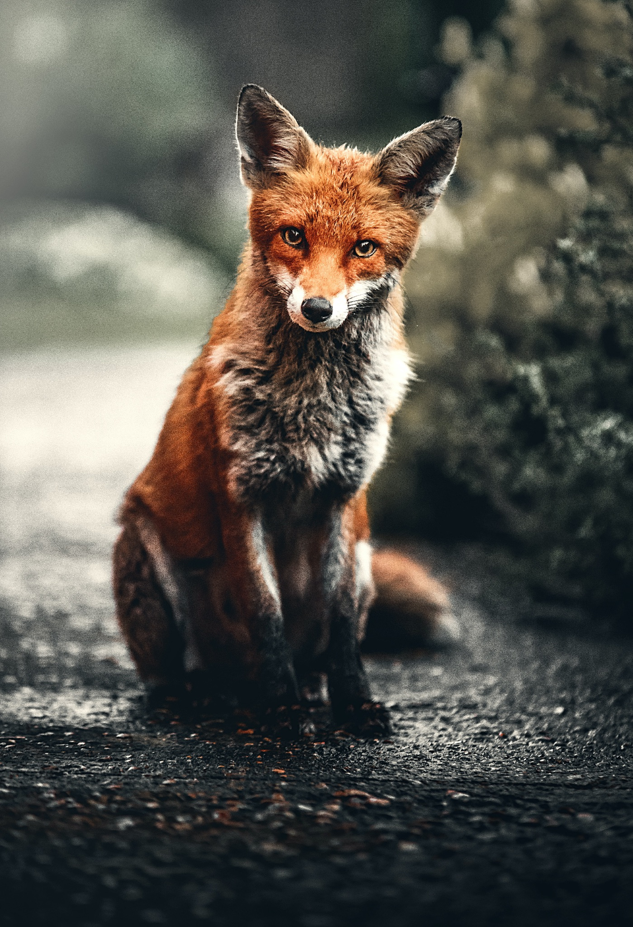
ᏍᎪᎯᏁ ᏣᎳᎩ ᎠᏕᎶᏆᏍᏗ
ᎢᎸᎯᏳ ᏥᎨᏒ, ᏂᎦᏓ ᎢᎾᎨ ᎠᏁᎮ ᏓᎾᏝᏃᎮᏍᎨ. ᏥᏍᏛᎾ ᎤᎵᏎᎩ ᎨᏎ. ᎦᏙ ᎠᎴ ᎠᎼ ᎢᏧᎳ ᎦᏁᎶ. ᏌᏊ ᎢᎦ, ᏥᏍᏛᎾ ᏝᏬᏚ ᎠᎹᏳᎵᏗ ᎾᎥ ᎠᏓᎾᎢᏃᏙᎲ. ᎾᎥ, ᏧᏟ ᎤᏬᏞ. ᎤᎾᎴᏅᎮ ᏓᎾᏝᏃᎮᏍᎬ. ᏧᏟ ᎤᏛᏛᏁ, “ᏙᏳ ᎯᏌᏄᎵ ᎠᎼ. ᎦᏙᎯᎾ? ᎤᏠᏯᏍ ᎯᏌᏄᎵ?”
“ᏙᏛ ᏥᏌᏄᎵ,” ᎤᏛᏁ ᏥᏍᏛᎾ. “ᏱᎩᏂᏙᎩ ᎠᎯᏗ ᏱᎬᎶᎯᏍ, ᎨᎵᎠ.”
“Ꮭ ᏱᎬᎪᏘᏍᎪ ᎦᏙ ᎭᏟᏙᎲ. ᏝᏬᏚᎯᏭ ᎬᎪᏘᎰ ᎭᏓᎾᏏᏂᏙᎲ.” ᎤᏛᏁ ᏧᏟ.
“Ꮭ Ꮩ ᎯᏰᎵ, ᏂᎦᎵᏍᏗᏭ ᏱᏂᏙᎩ.” ᎤᏛᏁ ᏥᏍᏛᎾ.
“ᎭᏩ,” ᎤᏛᏁ ᏧᏟ. “ᏃᏭᏛ ᏱᏂᏙᎩ.”

Slide 7
ᏍᎪᎯᏁ ᏣᎳᎩ ᎠᏕᎶᏆᏍᏗ
“ᎭᏩ,” ᎤᏛᏁ ᏥᏍᏛᎾ. ᎦᎵᏉᎩ ᎦᏚᏏ ᏚᏄᎪᏔᏁ ᏭᎾᏢᏍᏗ. ᎠᎬᏱ ᏫᎦᎷᏨ ᎦᎵᏉᎩᏁ ᎦᏚᏏ, ᏫᏓᎨᏡᎲᏍᎨᏍᏗ. ᎤᏓᏠᏒ ᎨᏎᏍᏗ. ᎦᏚ ᎦᎸᎳᏗ ᎣᏓᎸ ᏭᏂᎶᏒ. ᎤᎾᏃ, ᎦᎵᏉᎩ ᎦᏚᏏ ᏚᏂᏑᏰᏒ ᏭᎾᏢᏍᏗ. ᎡᎳᏗ, ᎦᎸᎳᏗ, ᎦᎵᏉᎩ ᏳᏩᎧᏘ ᏚᎾᏂᎩ. ᎤᎾᎴᏅᎮ, ᏭᎾᏪᏡᏁ ᏭᎾᏓᏫᏍᏔᏅ. ᎤᏍᎦᏃᎵᏃ ᎨᏎ ᏥᏍᏛᎾ. ᏧᏟ ᎤᎶᎯᏎᎴ ᏥᏍᏛᎾ. ᏥᏍᏛᎾ ᏩᏥᏂᏴᏎᎴ ᏧᏟ ᎦᏂᏓᏛ. ᏃᎴ ᏭᎩᎸᏁ ᏧᏟ ᎦᏂᏓᏛ. ᎤᏟᏍᏗ ᏧᏟ ᏭᏢᏍᏔᏅ. ᎦᏂᏓᏛ ᏭᎩᎶ ᏥᏍᏛᎾ. ᏭᏂᎷᏨ ᎦᎵᏉᎩᏁ ᎦᏚᏏ, ᏧᏟ ᎤᏪᏡᏁ. ᎤᎾᏃ, ᎾᎥ ᏧᏟ, ᏥᏍᏛᎾ ᎤᏪᏡᏁᏍᏊ.

Slide 8
ᏍᎪᎯᏁ ᏣᎳᎩ ᎠᏕᎶᏆᏍᏗ
ᎤᏍᏆᏂᎩᏗ ᎤᏰᎸᏎ ᏧᏟ Ꮎ ᏥᏍᏛᎾ ᏭᎷᏨᏍᏊ. “ᏙᏳ ᎯᏌᏄᎵ,” ᎤᏛᏁ ᏧᏟ. “ᏍᎩᏛ ᏥᎬᏃᏎᎸ,” ᎤᏛᏁ ᏥᏍᏛᎾ. “ᏥᏌᏄᎵ. ᏂᎪᎸ ᎦᏙᎩᏯ.” “ᏏᏊ ᎢᎾᏙᎩᏯ,” ᎤᏛᏁ ᏧᏟ. “ᏏᏊ ᎦᏚᏏ ᏫᎾᏢᏍᏗ, ᎣᏓᎸᎾ ᏗᏜ.” ᎤᎾᎧᏔᎲᏎ, ᎤᎾᏙᎩᏯᏍᏔᏅ ᎣᏓᎸ ᏧᎾᎴᏅᎮ. ᎠᏰᏟ Ꮲ ᎠᎾᏙᎩᏯᏍᎬ, ᏧᏟ ᎤᏟᏍᏗ ᎤᎧᏔᎲᏎ. Ꮎ ᏥᏍᏛᎾ ᎭᎴ ᏭᎶᏎ. ᏃᏭ ᏍᏓᏲᏒ ᏩᏥᏂᏴᏎᎸ ᏧᏟ ᎦᏂᏓᏛ. ᏧᏟ ᏭᎷᏤ ᎣᏓᎸ. ᏃᎴ ᏭᏪᏡᏁ. ᎾᎯᏳ ᏥᏍᏛᎾ ᏭᏪᏡᏁᏍᏊ. “ᎯᎶᏄᎮ!” ᎤᏪᏡᏁ ᏧᏟ. “Ꮭ ᏱᏥᎶᏄᎮ.” ᎤᏛᏁ ᏥᏍᏛᎾ. “ᎤᏍᏊ ᏥᏌᏄᎵ.”
ᏧᏟ ᎤᏃᏎᎴ ᏥᏍᏛᎾ, “ᎠᏆᏂᏔ ᏍᎩᏂᏴᏎᎸ ᏥᏂᏓᏛ.” ᏧᏟ ᎠᏥᎨᎯᏙᎸ ᏥᏍᏛᎾ. ᏝᏍᎩᏂ ᎡᎵ ᏭᎵᏘᏎ. ᏧᏟ ᏩᏥᏯᎥ ᏥᏍᏛᎾ. ᎢᏗᏍᏆᏓ.

Slide 9
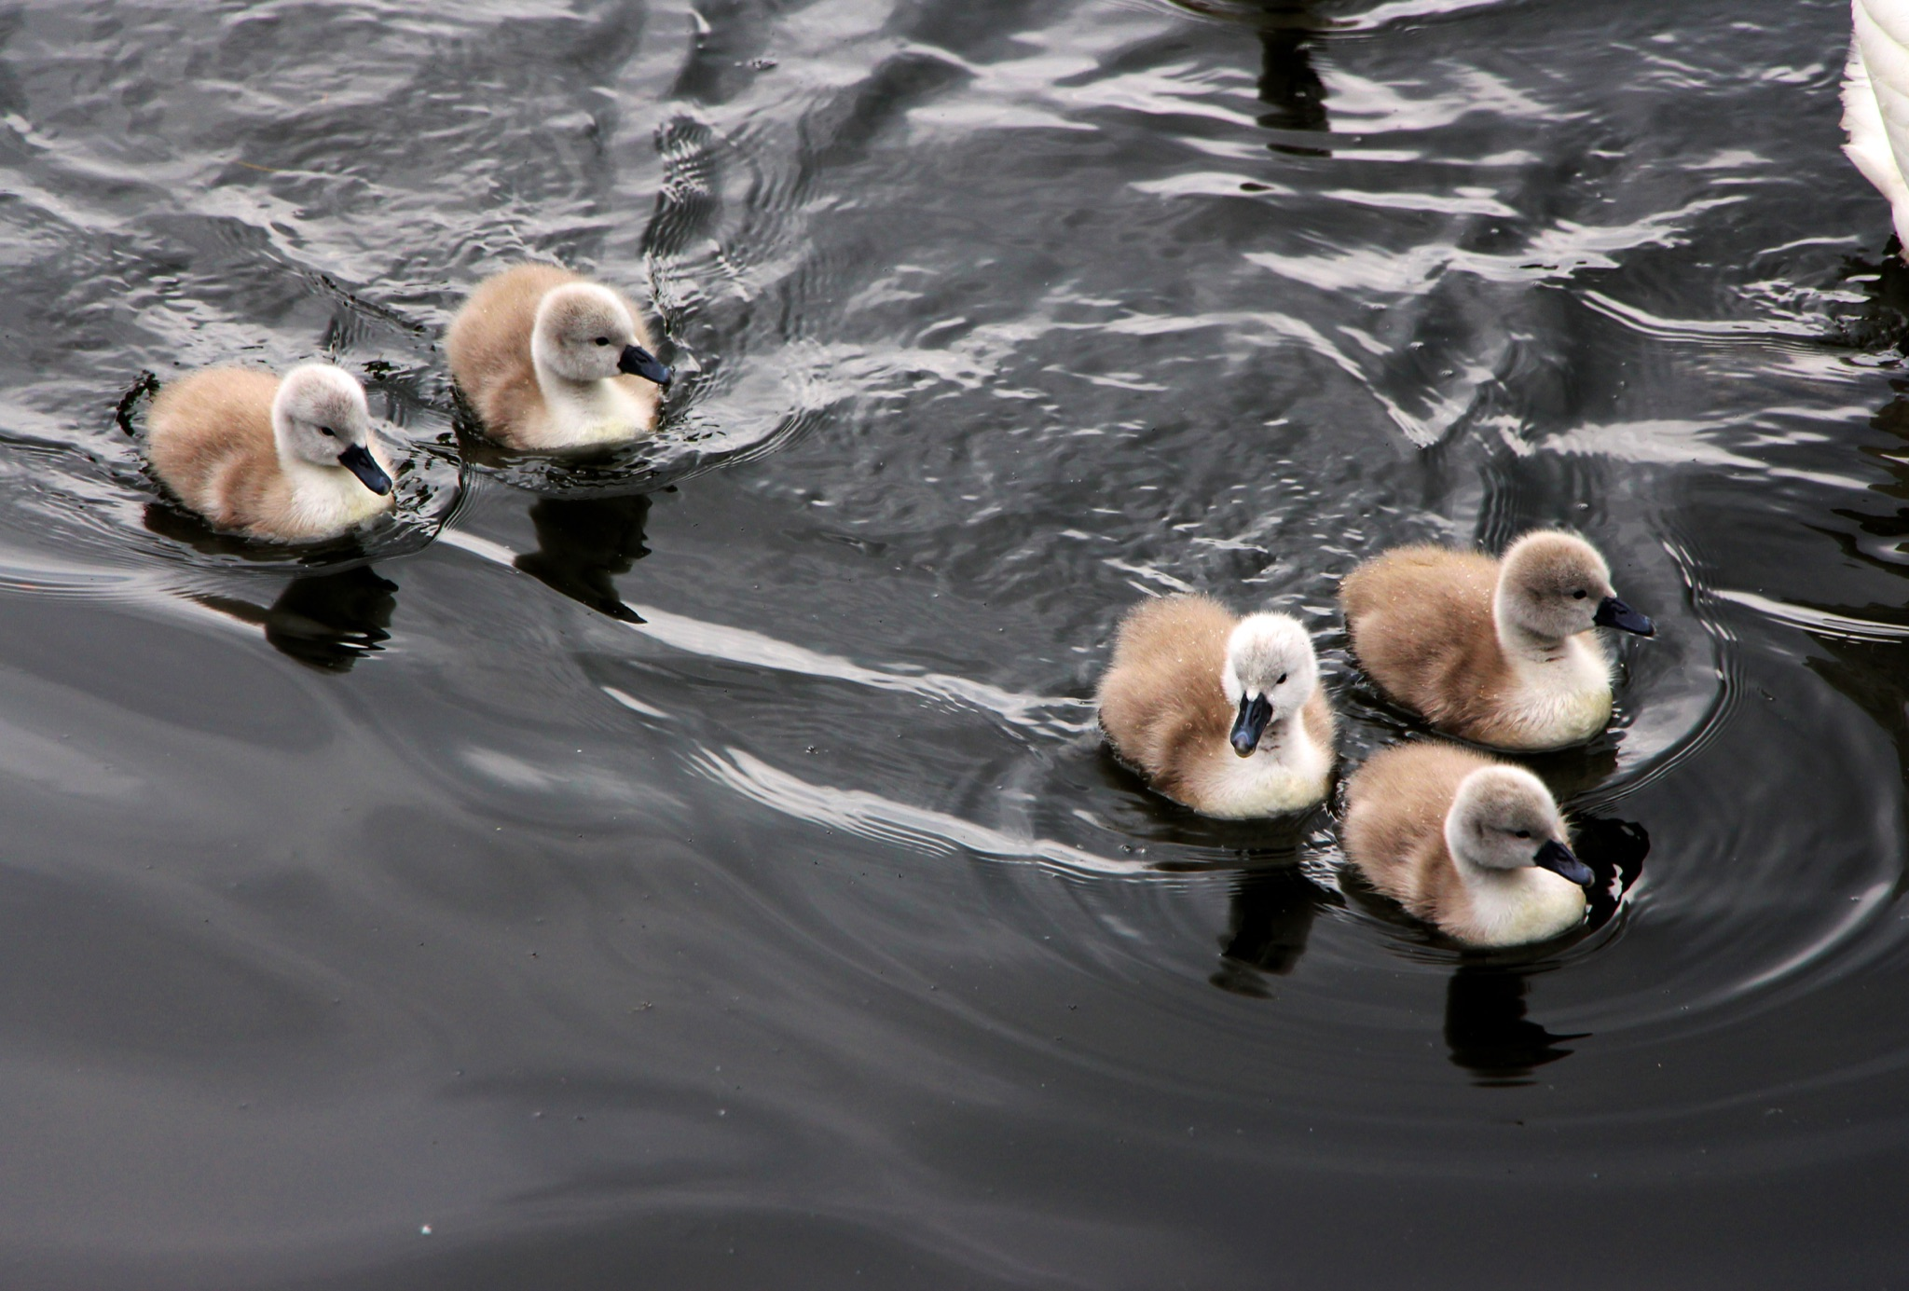
ᏍᎪᎯᏁ ᏣᎳᎩ ᎠᏕᎶᏆᏍᏗ
ᎯᏍᎩ ᎧᏬᏄ ᎠᏂᏓ ᎠᎾᏓᏬᎲ.
ᎤᏣᏘᎾ ᏗᏜ ᏭᏂᎶᏒ.
ᎤᏂᏥ ᏂᎦᏪᏍᎬ
“Quack! Quack! Quack!”
ᏅᎩᏭ ᎧᏬᏄ ᎠᏂᏓ ᎤᏂᎷᏨ.

Slide 10
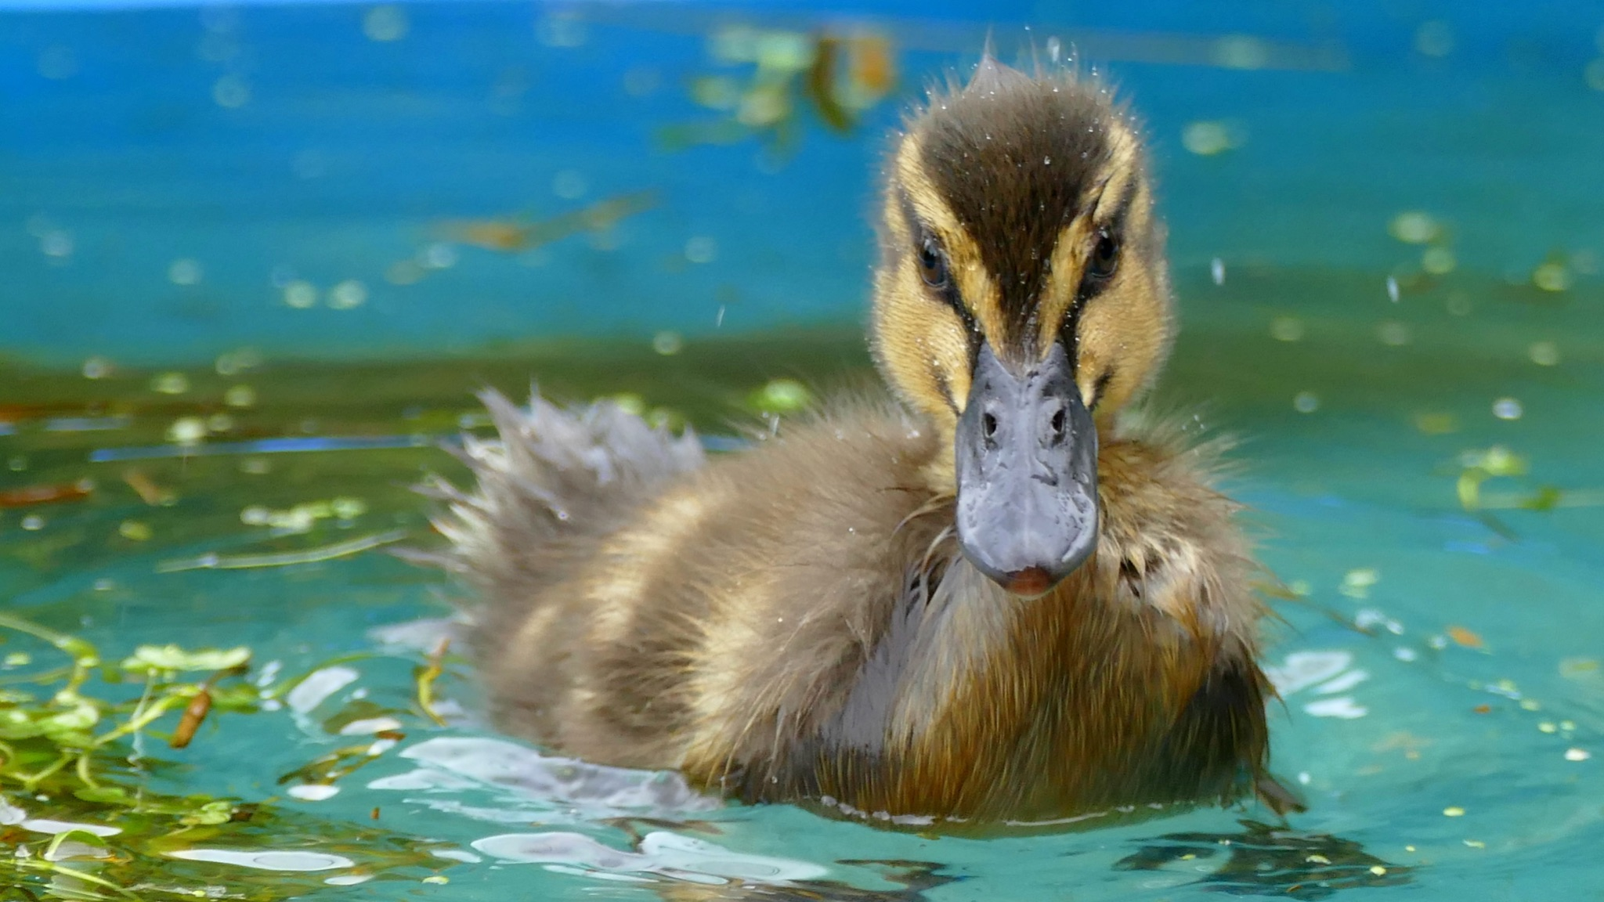
ᏍᎪᎯᏁ ᏣᎳᎩ ᎠᏕᎶᏆᏍᏗ
ᏌᏊ ᎧᏬᏄ ᎠᏗ ᎠᏓᏬᎲ.
ᎤᏣᏘᎾ ᏗᏜ ᏭᎶᏒ.
ᎤᏥ ᏂᎦᏪᏍᎬ
“Quack! Quack! Quack!”
ᏂᎦᏓᏭ ᎧᏬᏄ ᎠᏂᏓ ᎤᏂᎷᏨ.

Slide 11
ᏍᎪᎯᏁ ᏣᎳᎩ ᎠᏕᎶᏆᏍᏗ
Atsalag utvsonv tsisdvn uweyv deganiyisgv.
ᏕᎦᏂᏱᏍᎬ- he was catching them

Slide 12
ᏍᎪᎯᏁ ᏣᎳᎩ ᎠᏕᎶᏆᏍᏗ
Didaniyisg agalewisdodane duhyohv.
ᎠᎦᎴᏫᏍᏙᏓᏁ- he stopped him.

Slide 13
ᏍᎪᎯᏁ ᏣᎳᎩ ᎠᏕᎶᏆᏍᏗ
“Tsantas esga gesv tsisdvn diganiyti ahan uweyv,” udvne didaniyisgi.
ᎡᏍᎦ ᎨᏒ- it was wrong
ᏗᎦᏂᏱᏘ- to catch

Slide 14
ᏍᎪᎯᏁ ᏣᎳᎩ ᎠᏕᎶᏆᏍᏗ
“Tla yidijiniyi jisdvn, didaniyisgi,” udvne utvsonv.
Ꮭ ᏱᏗᏥᏂᏱ- I’m not catching them.

Slide 15
ᏍᎪᎯᏁ ᏣᎳᎩ ᎠᏕᎶᏆᏍᏗ
ᎭᏓᏍᎪᏍᎬ- you’re lying
“Agwant hadsgosgv. Detsigoti tsisdvn ultsadi dehiyav.” udvne didaniyisgi.

Slide 16
ᏍᎪᎯᏁ ᏣᎳᎩ ᎠᏕᎶᏆᏍᏗ
“Hi ina jisdvn,” udvne utvsonv.
Ꭿ ᎢᎾ- these ones

Slide 17
ᏍᎪᎯᏁ ᏣᎳᎩ ᎠᏕᎶᏆᏍᏗ
“Danelvdv tsunahnigid, detsinatlaidv, iga yinulsdan degatsiyatinohiho ahan uweyv unadawosdidv degadeyohvsg
ᏓᏁᎸᏛ- from the house
ᏧᎾᏂᎩᏓ- that they came from
ᏕᎦᏥᏯᏘᏃᎯᎰ- I bring them
ᏕᎦᏕᏲᎲᏍᎦ- I teach them

Slide 18
ᏍᎪᎯᏁ ᏣᎳᎩ ᎠᏕᎶᏆᏍᏗ
Atsalag utvsonv tsisdvn uweyv deganiyisgv.
Didaniyisg agalewisdodane duhyohv.
“Tsantas esga gesv tsisdvn diganiyti ahan uweyv,” udvne didaniyisgi.
“Tla yidijiniyi jisdvn, didaniyisgi,” udvne utvsonv.
“Agwant hadsgosgv. Detsigoti tsisdvn ultsadi dehiyav.” udvne utvsonv.
“Hi ina jisdvn,” udvne utvsonv.
“Danelvdv tsunahnigid, detsinatlaidv, iga yinulsdan degatsiyatinohiho ahan uweyv unadawosdidv degadeyohvsg

Slide 19
ᏍᎪᎯᏁ ᏣᎳᎩ ᎠᏕᎶᏆᏍᏗ
ᎠᏣᎳᎩ ᎤᏛᏐᏅ ᏥᏍᏛᎾ ᎤᏪᏴ ᏕᎦᏂᏱᏍᎬ.
ᏗᏓᏂᏱᏍᎩ ᎠᎦᎴᏫᏍᏙᏓᏁ ᏚᎯᏲᎲ.
“ᏣᏂᏔᏍ ᎡᏍᎦ ᎨᏒ ᏥᏍᏛᎾ ᏗᎦᏂᏱᏘ ᎠᎭᏂ ᎤᏪᏴ,” ᎤᏛᏁ ᏗᏓᏂᏱᏍᎩ.
“Ꮭ ᏱᏗᏥᏂᏱ ᏥᏍᏛᎾ, ᏗᏓᏂᏱᏍᎩ,” ᎤᏛᏁ ᎤᏛᏐᏅ.
“ᎠᏆᏂᏔ ᎭᏓᏍᎪᏍᎬ. ᏕᏥᎪᏘ ᏥᏍᏛᎾ ᎤᎵᏣᏗ ᏕᎯᏯᎥ.” ᎤᏛᏁ ᏗᏓᏂᏱᏍᎩ.
“Ꭿ ᎢᎾ ᏥᏍᏛᎾ?” ᎤᏛᏁ ᎤᏛᏐᏅ.
“ᏓᏁᎸᏛ ᏧᎾᏂᎩᏗ, ᏕᏥᎾᏝᎢᏛ, ᎢᎦ ᏱᏄᎵᏍᏓᏅ ᏕᎦᏥᏯᏘᏃᎯᎰ ᎠᎭᏂ ᎤᏪᏴ ᎤᎾᏓᏬᏍᏗᏛ ᏕᎦᏕᏲᎲᏍᎦ.”

Slide 20
ᏍᎪᎯᏁ ᏣᎳᎩ ᎠᏕᎶᏆᏍᏗ
ᏕᎦᏂᏱᏍᎬ- he was catching them
ᎠᎦᎴᏫᏍᏙᏓᏁ- he stopped him.
ᎡᏍᎦ ᎨᏒ- it was wrong
ᏗᎦᏂᏱᏘ- to catch
Ꮭ ᏱᏗᏥᏂᏱ- I’m not catching them.
ᎭᏓᏍᎪᏍᎬ- you’re lying
ᏓᏁᎸᏛ- from the house
ᏧᎾᏂᎩᏓ- that they came from
ᏕᎦᏥᏯᏘᏃᎯᎰ- I bring them
ᏕᎦᏕᏲᎲᏍᎦ- I teach them

