Slide 1
ᎣᏏᏲ
ᏌᏚᏏᏁ ᏣᎳᎩ ᎠᏕᎶᏆᏍᏗ

Slide 2
ᏌᏚᏏᏁ ᏣᎳᎩ ᎠᏕᎶᏆᏍᏗ
ᎢᏓᎴᎾ- Let’s begin
ᏣᎳᎩ ᎢᏗᏬᏂ- Let’s talk Cherokee

Slide 3
ᏌᏚᏏᏁ ᏣᎳᎩ ᎠᏕᎶᏆᏍᏗ
Hello everyone
My name is ______ I am ______ years old.
I am Cherokee. (mixed. Full blood. half) I am not Cherokee.
I am from _______ and I live in
I work at _________
My moms name is_______ and my dads name is ______
I am married

Slide 4
ᏌᏚᏏᏁ ᏣᎳᎩ ᎠᏕᎶᏆᏍᏗ
ᎦᎵᎡᎵᎦ ᏥᎨᏙ- I’m glad/thankful that I’m here
ᎦᎵᎡᎵᎦ ᏥᏤᏙ- I’m glad/thankful that you are all here

Slide 5
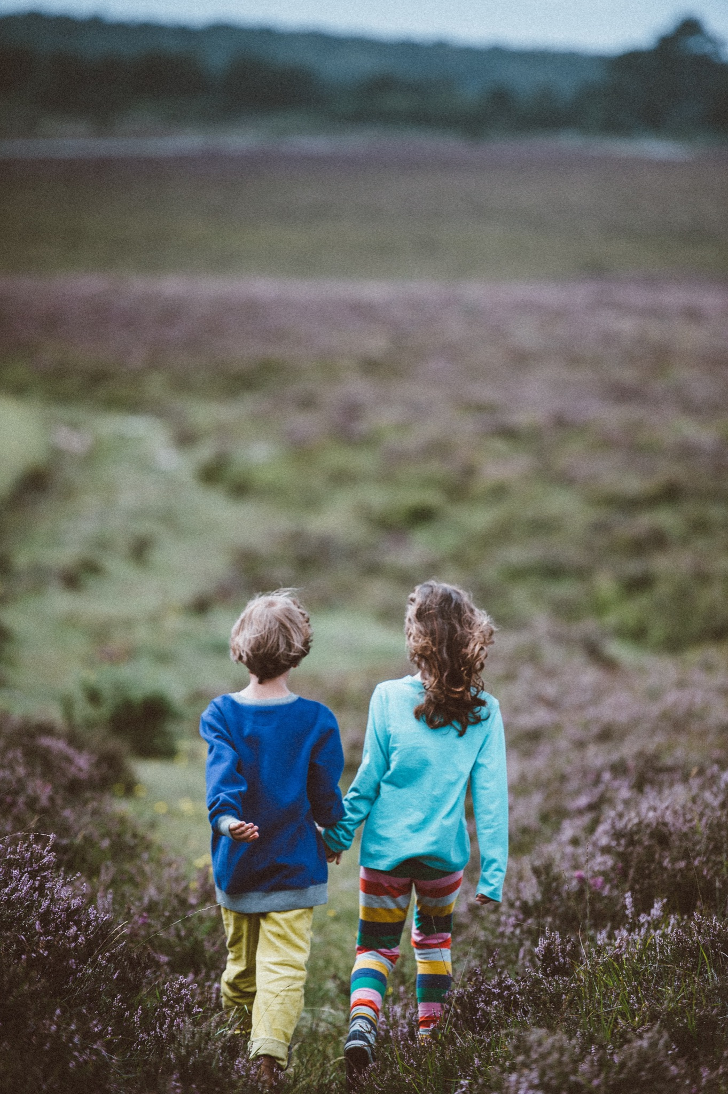
ᏌᏚᏏᏁ ᏣᎳᎩ ᎠᏕᎶᏆᏍᏗ
ᏫᏕᎾ
Let’s go
ᏫᏓᏂᎩ
Let’s go (let’s move)

Slide 6
ᏌᏚᏏᏁ ᏣᎳᎩ ᎠᏕᎶᏆᏍᏗ
Atsalag utvsonv tsisdvn uweyv deganiyisgv.
Didaniyisg agalewisdodane duhyohv.
“Tsantas esga gesv tsisdvn diganiyti ahan uweyv,” udvne didaniyisgi.
“Tla yidijiniyi jisdvn, didaniyisgi,” udvne utvsonv.
“Agwant hadsgosgv. Detsigoti tsisdvn ultsadi dehiyav.” udvne didaniyisgi.
“Hi ina jisdvn,” udvne utvsonv.
“Danelvdv tsunahnigid, detsinatlaidv, iga yinulsdan degatsiyatinohiho ahan uweyv unadawosdidv degadeyohvsg

Slide 7
ᏌᏚᏏᏁ ᏣᎳᎩ ᎠᏕᎶᏆᏍᏗ
ᎠᏣᎳᎩ ᎤᏛᏐᏅ ᏥᏍᏛᎾ ᎤᏪᏴ ᏕᎦᏂᏱᏍᎬ.
ᏗᏓᏂᏱᏍᎩ ᎠᎦᎴᏫᏍᏙᏓᏁ ᏚᏲᎲ.
“ᏣᏅᏔᏍ ᎡᏍᎦ ᎨᏒ ᏥᏍᏛᎾ ᏗᎦᏂᏱᏘ ᎠᎭᏂ ᎤᏪᏴ,” ᎤᏛᏁ ᏗᏓᏂᏱᏍᎩ.
“Ꮭ ᏱᏗᏥᏂᏱ ᏥᏍᏛᎾ, ᏗᏓᏂᏱᏍᎩ,” ᎤᏛᏁ ᎤᏛᏐᏅ.
“ᎠᏆᏅᏔ ᎭᏥᏍᎪᏍᎬ. ᏕᏥᎪᏘ ᏥᏍᏛᎾ ᎤᎵᏣᏗ ᏕᎯᏯᎥ.” ᎤᏛᏁ ᏗᏓᏂᏱᏍᎩ.
“Ꭿ ᎢᎾ ᏥᏍᏛᎾ?” ᎤᏛᏁ ᎤᏛᏐᏅ.
“ᏓᏁᎸᏛ ᏧᎾᏂᎩᏓ, ᏕᏥᎾᏝᎢᏛ, ᎢᎦ ᏱᏄᎵᏍᏔᏂ ᏕᎦᏥᏯᏘᏃᎯᎰ ᎠᎭᏂ ᎤᏪᏴ ᎤᎾᏓᏬᏍᏗᏛ ᏕᎦᏕᏲᎲᏍᎦ.”

Slide 8
ᏌᏚᏏᏁ ᏣᎳᎩ ᎠᏕᎶᏆᏍᏗ
“Tla yawohiyu do gesv,” udvne didaniyisgi,
Ꮭ ᏯᏬᎯᏳ- i don’t believe it

Slide 9
ᏌᏚᏏᏁ ᏣᎳᎩ ᎠᏕᎶᏆᏍᏗ
Unlenvhe dasehihv tsisdvn ultsadi aniyav.
ᏓᏎᎯᎲ- he counted them

Slide 10
ᏌᏚᏏᏁ ᏣᎳᎩ ᎠᏕᎶᏆᏍᏗ
“Ahan tsaksasdedi,” udvne utvsonv.
ᎠᎭᏂ ᏣᎧᏌᏍᏕᏗ- watch here

Slide 11
ᏌᏚᏏᏁ ᏣᎳᎩ ᎠᏕᎶᏆᏍᏗ
“Uweyv widegatsiyosgo, hisg yitawosdanv anadawosgo, nowu anilugo, detsiniyisgo.”
ᏫᏕᎦᏥᏲᏍᎪ- I go put them
ᏱᏔᏬᏍᏓᏅ- minutes
ᎠᏂᎷᎪ- they come back

Slide 12
ᏌᏚᏏᏁ ᏣᎳᎩ ᎠᏕᎶᏆᏍᏗ
“Hawa winandvga,” udvne didaniyisgi
ᏫᎾᏛᎦ- let them go do it

Slide 13
ᏌᏚᏏᏁ ᏣᎳᎩ ᎠᏕᎶᏆᏍᏗ
Ultsadi tsisdvn kali dutinvsv uweyvditla, utvsonv, widutsewv nigad tsisdvn uweyv
ᏚᏘᏅᏒ- he carried them
ᏫᏚᏤᏮ- he poured them

Slide 14
ᏌᏚᏏᏁ ᏣᎳᎩ ᎠᏕᎶᏆᏍᏗ
Hisg yitawosdanv ulos, didaniyisg utvdvne, “Hawa, hadlv tsisdvna?”
ᎤᎶᏒ- passed by

Slide 15
ᏌᏚᏏᏁ ᏣᎳᎩ ᎠᏕᎶᏆᏍᏗ
“Tsisdvnigi?”udvne utvsonv.

Slide 16
ᏌᏚᏏᏁ ᏣᎳᎩ ᎠᏕᎶᏆᏍᏗ
“Tla yawohiyu do gesv,” udvne didaniyisgi,
Unlenvhe dasehihv tsisdvn ultsadi aniyav.
“Ahan tsaksasdedi,” udvne utvsonv.
“Uweyv widegatsiyosgo, hisg yitawosdanv anadawosgo, nowu anilugo, detsiniyisgo.”
“Hawa winandvga,” udvne didaniyisgi
Ultsadi tsisdvn kali dutinvsv uweyvditla, utvsonv, widutsewv nigad tsisdvn uweyv.
Hisg yitawosdanv ulos, didaniyisg utvdvne, “Hawa, hadlv tsisdvna?”
“Tsisdvnigi?”udvne utvsonv

Slide 17
ᏌᏚᏏᏁ ᏣᎳᎩ ᎠᏕᎶᏆᏍᏗ
ᎠᏣᎳᎩ ᎤᏛᏐᏅ ᏥᏍᏛᎾ ᎤᏪᏴ ᏕᎦᏂᏱᏍᎬ.
ᏗᏓᏂᏱᏍᎩ ᎠᎦᎴᏫᏍᏙᏓᏁ ᏚᏲᎲ.
“ᏣᏅᏔᏍ ᎡᏍᎦ ᎨᏒ ᏥᏍᏛᎾ ᏗᎦᏂᏱᏘ ᎠᎭᏂ ᎤᏪᏴ,” ᎤᏛᏁ ᏗᏓᏂᏱᏍᎩ.
“Ꮭ ᏱᏗᏥᏂᏱ ᏥᏍᏛᎾ, ᏗᏓᏂᏱᏍᎩ,” ᎤᏛᏁ ᎤᏛᏐᏅ.
“ᎠᏆᏅᏔ ᎭᏥᏍᎪᏍᎬ. ᏕᏥᎪᏘ ᏥᏍᏛᎾ ᎤᎵᏣᏗ ᏕᎯᏯᎥ.” ᎤᏛᏁ ᏗᏓᏂᏱᏍᎩ.
“Ꭿ ᎢᎾ ᏥᏍᏛᎾ?” ᎤᏛᏁ ᎤᏛᏐᏅ.
“ᏓᏁᎸᏛ ᏧᎾᏂᎩᏓ, ᏕᏥᎾᏝᎢᏛ, ᎢᎦ ᏱᏄᎵᏍᏔᏂ ᏕᎦᏥᏯᏘᏃᎯᎰ ᎠᎭᏂ ᎤᏪᏴ ᎤᎾᏓᏬᏍᏗᏛ ᏕᎦᏕᏲᎲᏍᎦ.”

Slide 18
ᏌᏚᏏᏁ ᏣᎳᎩ ᎠᏕᎶᏆᏍᏗ
“Ꮭ ᏯᏬᎯᏳ Ꮩ ᎨᏒ,” ᎤᏛᏁ ᏗᏓᏂᏱᏍᎩ,
ᎤᎾᎴᏅᎮ ᏓᏎᎯᎲ ᏥᏍᏛᎾ ᎤᎵᏣᏗ ᎠᏂᏯᎥ.
“ᎠᎭᏂ ᏣᎧᏌᏍᏕᏗ,” ᎤᏛᏁ ᎤᏛᏐᏅ.
“ᎤᏪᏴ ᏫᏕᎦᏥᏲᏍᎪ, ᎯᏍᎩ ᏱᏔᏬᏍᏔᏅ ᎠᎾᏓᏬᏍᎪ, ᏃᏭ ᎠᏂᎷᎪ, ᏕᏥᏂᏱᏍᎪ.”
“ᎭᏩ ᏫᎾᎾᏛᎦ,” ᎤᏛᏁ ᏗᏓᏂᏱᏍᎩ.
ᎤᎵᏣᏗ ᏥᏍᏛᎾ ᎧᎵ ᏚᏘᏅᏒ ᎤᏪᏴᏗᏜ, ᎤᏛᏐᏅ, ᏫᏚᏤᏮ ᏂᎦᏓ ᏥᏍᏛᎾ ᎤᏪᏴ.
ᎯᏍᎩ ᏱᏔᏬᏍᏔᏅ ᎤᎶᏒ, ᏗᏓᏂᏱᏍᎩ ᎤᏛᏛᏁ, “ᎭᏩ, ᎭᏢ ᏥᏍᏛᎾ?”
“ᏥᏍᏛᏂᎩ?”ᎤᏛᏁ ᎤᏛᏐᏅ.

Slide 19
ᏌᏚᏏᏁ ᏣᎳᎩ ᎠᏕᎶᏆᏍᏗ
Ꮭ ᏯᏬᎯᏳ- i don’t believe it
ᏓᏎᎯᎲ- he counted them
ᎠᎭᏂ ᏣᎧᏌᏍᏕᏗ- watch here
ᏫᏕᎦᏥᏲᏍᎪ- I go put them
ᏱᏔᏬᏍᏓᏅ- minutes
ᎠᏂᎷᎪ- they come back
ᏫᎾᏛᎦ- let them go do it
ᏚᏘᏅᏒ- he carried them
ᏫᏚᏤᏮ- he poured them
ᎤᎶᏒ- passed by

