Slide 1
ᎣᏏᏲ
ᏔᎵᏚᏏᏁ ᏣᎳᎩ ᎠᏕᎶᏆᏍᏗ

Slide 2
ᏔᎵᏚᏏᏁ ᏣᎳᎩ ᎠᏕᎶᏆᏍᏗ
ᎢᏓᎴᎾ- Let’s begin
ᏣᎳᎩ ᎢᏗᏬᏂ- Let’s talk Cherokee

Slide 3
ᏔᎵᏚᏏᏁ ᏣᎳᎩ ᎠᏕᎶᏆᏍᏗ
Hello everyone
My name is ______ I am ______ years old.
I am Cherokee. (mixed. Full blood. half) I am not Cherokee.
I am from _______ and I live in
I work at _________
My moms name is_______ and my dads name is ______
I am married

Slide 4
ᏔᎵᏚᏏᏁ ᏣᎳᎩ ᎠᏕᎶᏆᏍᏗ
ᎯᎠ ᎠᎩᏍᏓᏴᎲᏍᎦ- this is my wife.
ᎯᎠ ᎣᏍᏗᏁᎳ- This is my husband.
Notes:
aksdayvhvsg

Slide 5
ᏔᎵᏚᏏᏁ ᏣᎳᎩ ᎠᏕᎶᏆᏍᏗ
ᎦᏌᎴᏂ- coat
ᎠᎿᏬ- shirt
ᎤᏅᏗ- milk
ᎠᏗᏔᏍᏗ- drink
ᎪᏪᎵ- paper
ᎠᎹ (short)- water
ᎯᏫᏁᎩ
Go get it (something flexible)
ᎯᏫᏁᎩ
Go get it (something liquid)

Slide 6
ᏔᎵᏚᏏᏁ ᏣᎳᎩ ᎠᏕᎶᏆᏍᏗ
Atsalag utvsonv tsisdvn uweyv deganiyisgv.
Didaniyisg agalewisdodane duhyohv.
“Tsantas esga gesv tsisdvn diganiyti ahan uweyv,” udvne didaniyisgi.
“Tla yidijiniyi jisdvn, didaniyisgi,” udvne utvsonv.
“Agwant hadsgosgv. Detsigoti tsisdvn ultsadi dehiyav.” udvne didaniyisgi.
“Hi ina jisdvn,” udvne utvsonv.
“Danelvdv tsunahnigid, detsinatlaidv, iga yinulsdan degatsiyatinohiho ahan uweyv unadawosdidv degadeyohvsg

Slide 7
ᏔᎵᏚᏏᏁ ᏣᎳᎩ ᎠᏕᎶᏆᏍᏗ
“Tla yawohiyu do gesv,” udvne didaniyisgi,
Unlenvhe dasehihv tsisdvn ultsadi aniyav.
“Ahan tsaksasdedi,” udvne utvsonv.
“Uweyv widegatsiyosgo, hisg yitawosdanv anadawosgo, nowu anilugo, detsiniyisgo.”
“Hawa winandvga,” udvne didaniyisgi
Ultsadi tsisdvn kali dutinvsv uweyvditla, utvsonv, widutsewv nigad tsisdvn uweyv.
Hisg yitawosdanv ulos, didaniyisg utvdvne, “Hawa, hadlv tsisdvna?”
“Tsisdvnigi?”udvne utvsonv

Slide 8
ᏔᎵᏚᏏᏁ ᏣᎳᎩ ᎠᏕᎶᏆᏍᏗ
ᎠᏣᎳᎩ ᎤᏛᏐᏅ ᏥᏍᏛᎾ ᎤᏪᏴ ᏕᎦᏂᏱᏍᎬ.
ᏗᏓᏂᏱᏍᎩ ᎠᎦᎴᏫᏍᏙᏓᏁ ᏚᏲᎲ.
“ᏣᏅᏔᏍ ᎡᏍᎦ ᎨᏒ ᏥᏍᏛᎾ ᏗᎦᏂᏱᏘ ᎠᎭᏂ ᎤᏪᏴ,” ᎤᏛᏁ ᏗᏓᏂᏱᏍᎩ.
“Ꮭ ᏱᏗᏥᏂᏱ ᏥᏍᏛᎾ, ᏗᏓᏂᏱᏍᎩ,” ᎤᏛᏁ ᎤᏛᏐᏅ.
“ᎠᏆᏅᏔ ᎭᏥᏍᎪᏍᎬ. ᏕᏥᎪᏘ ᏥᏍᏛᎾ ᎤᎵᏣᏗ ᏕᎯᏯᎥ.” ᎤᏛᏁ ᏗᏓᏂᏱᏍᎩ.
“Ꭿ ᎢᎾ ᏥᏍᏛᎾ?” ᎤᏛᏁ ᎤᏛᏐᏅ.
“ᏓᏁᎸᏛ ᏧᎾᏂᎩᏓ, ᏕᏥᎾᏝᎢᏛ, ᎢᎦ ᏱᏄᎵᏍᏔᏂ ᏕᎦᏥᏯᏘᏃᎯᎰ ᎠᎭᏂ ᎤᏪᏴ ᎤᎾᏓᏬᏍᏗᏛ ᏕᎦᏕᏲᎲᏍᎦ.”

Slide 9
ᏔᎵᏚᏏᏁ ᏣᎳᎩ ᎠᏕᎶᏆᏍᏗ
“Ꮭ ᏯᏬᎯᏳ Ꮩ ᎨᏒ,” ᎤᏛᏁ ᏗᏓᏂᏱᏍᎩ,
ᎤᎾᎴᏅᎮ ᏓᏎᎯᎲ ᏥᏍᏛᎾ ᎤᎵᏣᏗ ᎠᏂᏯᎥ.
“ᎠᎭᏂ ᏣᎧᏌᏍᏕᏗ,” ᎤᏛᏁ ᎤᏛᏐᏅ.
“ᎤᏪᏴ ᏫᏕᎦᏥᏲᏍᎪ, ᎯᏍᎩ ᏱᏔᏬᏍᏔᏅ ᎠᎾᏓᏬᏍᎪ, ᏃᏭ ᎠᏂᎷᎪ, ᏕᏥᏂᏱᏍᎪ.”
“ᎭᏩ ᏫᎾᎾᏛᎦ,” ᎤᏛᏁ ᏗᏓᏂᏱᏍᎩ.
ᎤᎵᏣᏗ ᏥᏍᏛᎾ ᎧᎵ ᏚᏘᏅᏒ ᎤᏪᏴᏗᏜ, ᎤᏛᏐᏅ, ᏫᏚᏤᏮ ᏂᎦᏓ ᏥᏍᏛᎾ ᎤᏪᏴ.
ᎯᏍᎩ ᏱᏔᏬᏍᏔᏅ ᎤᎶᏒ, ᏗᏓᏂᏱᏍᎩ ᎤᏛᏛᏁ, “ᎭᏩ, ᎭᏢ ᏥᏍᏛᎾ?”
“ᏥᏍᏛᏂᎩ?”ᎤᏛᏁ ᎤᏛᏐᏅ.

Slide 10
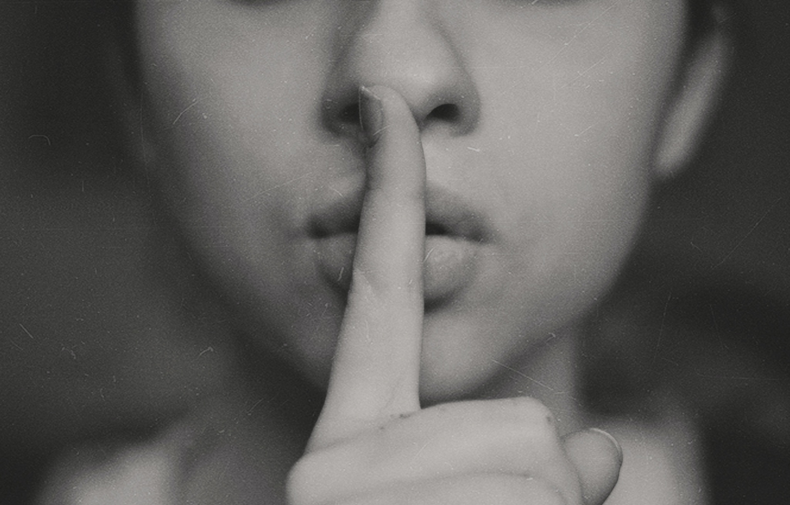
ᏔᎵᏚᏏᏁ ᏣᎳᎩ ᎠᏕᎶᏆᏍᏗ
Tohi gehesdi- be quiet

Slide 11
ᏔᎵᏚᏏᏁ ᏣᎳᎩ ᎠᏕᎶᏆᏍᏗ
Yvwi junsdi- Little People

Slide 12
ᏔᎵᏚᏏᏁ ᏣᎳᎩ ᎠᏕᎶᏆᏍᏗ
wijena- you all go

Slide 13
ᏔᎵᏚᏏᏁ ᏣᎳᎩ ᎠᏕᎶᏆᏍᏗ
agwenvsv- my home

Slide 14
ᏔᎵᏚᏏᏁ ᏣᎳᎩ ᎠᏕᎶᏆᏍᏗ
galvladidl- upward

Slide 15
ᏔᎵᏚᏏᏁ ᏣᎳᎩ ᎠᏕᎶᏆᏍᏗ
dayulosv- come from

Slide 16
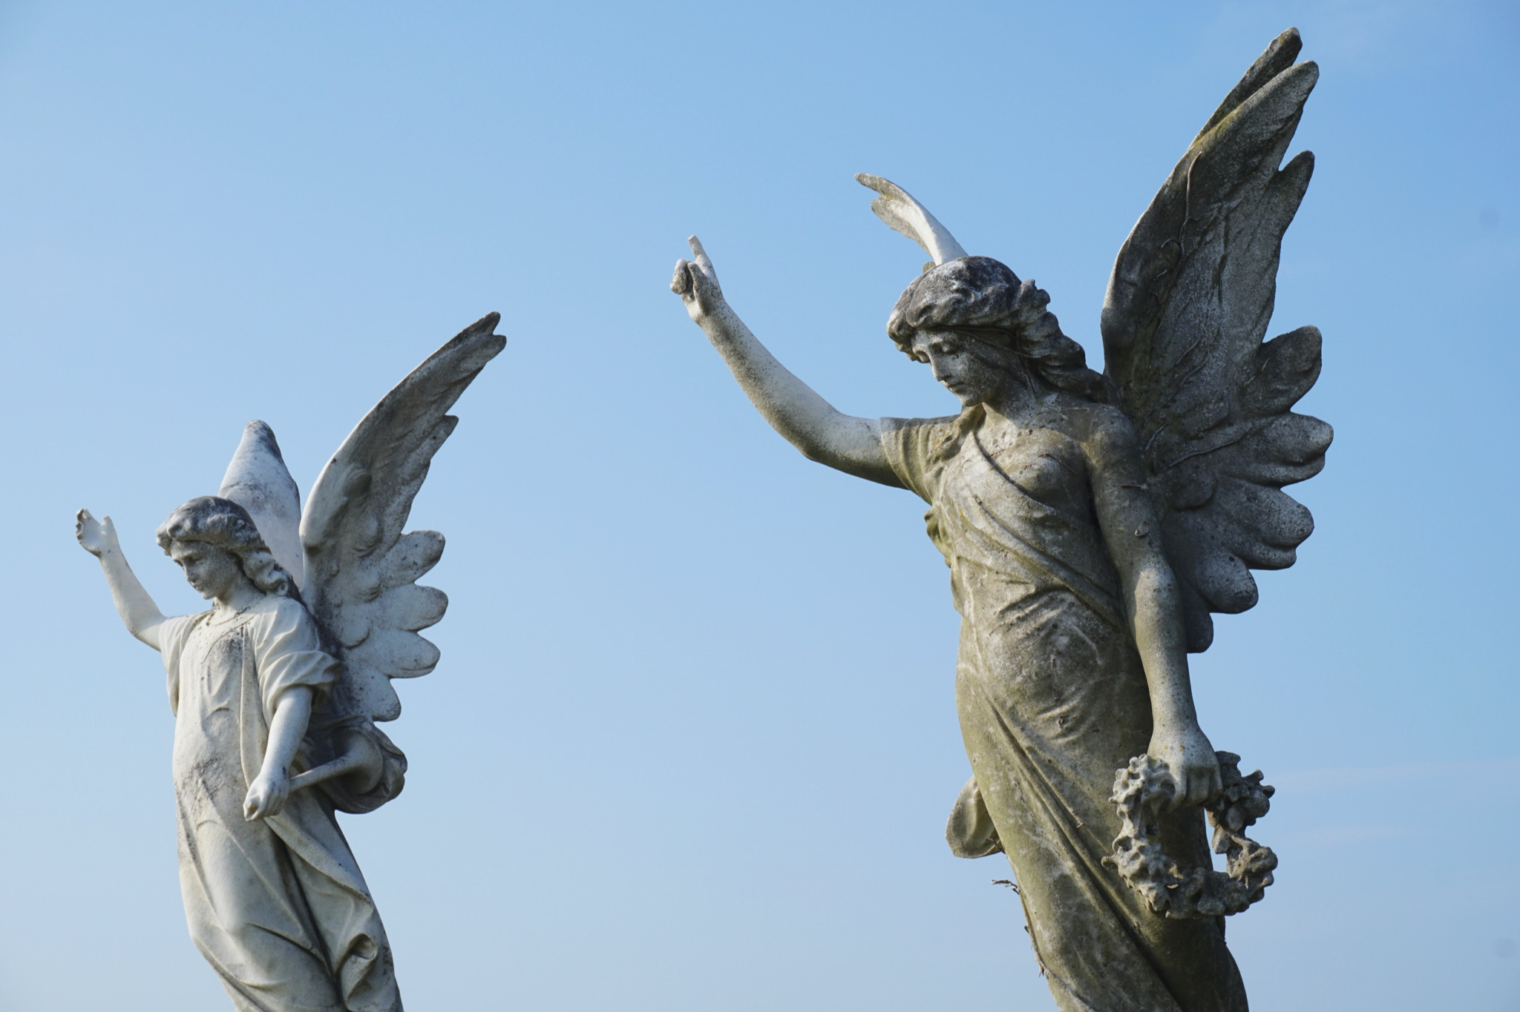
ᏔᎵᏚᏏᏁ ᏣᎳᎩ ᎠᏕᎶᏆᏍᏗ
anidawehi- wise ones/ angels
Dinikanowdido- the ones that watch over you

Slide 17
ᏔᎵᏚᏏᏁ ᏣᎳᎩ ᎠᏕᎶᏆᏍᏗ
hitlvna- you sleep

Slide 18
ᏔᎵᏚᏏᏁ ᏣᎳᎩ ᎠᏕᎶᏆᏍᏗ
Baloo Baleerie- a scottish lullaby
ᏙᎯ ᎨᎮᏍᏗ, ᏙᎯ ᎨᎮᏍᏗ, ᏙᎯ ᎨᎮᏍᏗ
ᏙᎯ, ᏙᎯ

Slide 19
ᏔᎵᏚᏏᏁ ᏣᎳᎩ ᎠᏕᎶᏆᏍᏗ
ᏴᏫ ᏧᏂᏍᏗ ᏫᏤᎾ, ᏴᏫ ᏧᏂᏍᏗ ᏫᏤᎾ
ᏴᏫ ᏧᏂᏍᏗ ᏫᏤᎾ,
ᎠᏇᏅᏒᎢ.

Slide 20
ᏔᎵᏚᏏᏁ ᏣᎳᎩ ᎠᏕᎶᏆᏍᏗ
ᏙᎯ ᎨᎮᏍᏗ, ᏙᎯ ᎨᎮᏍᏗ, ᏙᎯ ᎨᎮᏍᏗ
ᏙᎯ, ᏙᎯ

Slide 21
ᏔᎵᏚᏏᏁ ᏣᎳᎩ ᎠᏕᎶᏆᏍᏗ
ᎦᎸᎳᏗᏜ ᏓᏳᎶᏒ, ᎦᎸᎳᏗᏜ ᏓᏳᎶᏒ
ᎦᎸᎳᏗᏜ ᏓᏳᎶᏒ
ᎠᏂᏓᏪᎯ

Slide 22
ᏔᎵᏚᏏᏁ ᏣᎳᎩ ᎠᏕᎶᏆᏍᏗ
ᏙᎯ ᎨᎮᏍᏗ, ᏙᎯ ᎨᎮᏍᏗ, ᏙᎯ ᎨᎮᏍᏗ
ᏙᎯ, ᏙᎯ

Slide 23
ᏔᎵᏚᏏᏁ ᏣᎳᎩ ᎠᏕᎶᏆᏍᏗ
ᏙᎯ ᎯᏢᎾ, ᏙᎯ ᎯᏢᎾ, ᏙᎯ ᎯᏢᎾ
ᎠᏇᏅᏒᎢ

Slide 24
ᏔᎵᏚᏏᏁ ᏣᎳᎩ ᎠᏕᎶᏆᏍᏗ
ᏙᎯ ᎨᎮᏍᏗ, ᏙᎯ ᎨᎮᏍᏗ, ᏙᎯ ᎨᎮᏍᏗ
ᏙᎯ, ᏙᎯ

Slide 25
ᏔᎵᏚᏏᏁ ᏣᎳᎩ ᎠᏕᎶᏆᏍᏗ
ᏙᎯ ᎨᎮᏍᏗ- be quiet
ᏴᏫ ᏧᏂᏍᏗ- Little People
ᏫᏤᎾ- you all go
ᎠᏇᏅᏒ- my home
ᎦᎸᎳᏗᏜ- upward
ᏓᏳᎶᏒ- come from
ᎠᏓᏪᎯ- wise one, angel
ᎯᏢᎾ- you sleep

