Slide 1
ᎣᏏᏲ
ᏅᎩᏁ ᏣᎳᎩ ᎠᏕᎶᏆᏍᏗ

Slide 2
ᏅᎩᏁ ᏣᎳᎩ ᎠᏕᎶᏆᏍᏗ
ᎢᏓᎴᎾ- Let’s begin
ᏣᎳᎩ ᎢᏗᏬᏂ- Let’s talk Cherokee

Slide 3
ᏅᎩᏁ ᏣᎳᎩ ᎠᏕᎶᏆᏍᏗ
Hello everyone
My name is ______ I am ______ years old.
I am Cherokee. (mixed. Full blood. half) I am not Cherokee.
I am from _______ and I live in
I work at _________
My moms name is_______ and my dads name is ______
I am married

Slide 4
ᏅᎩᏁ ᏣᎳᎩ ᎠᏕᎶᏆᏍᏗ
ᏥᏣᎳᎩ- I am Cherokee
ᏥᎩᏚᏩᎩ- I am Keetoowah
Ꮭ (Ꮵ)ᏣᎳᎩ ᏱᎩ- I’m not Cherokee

Slide 5
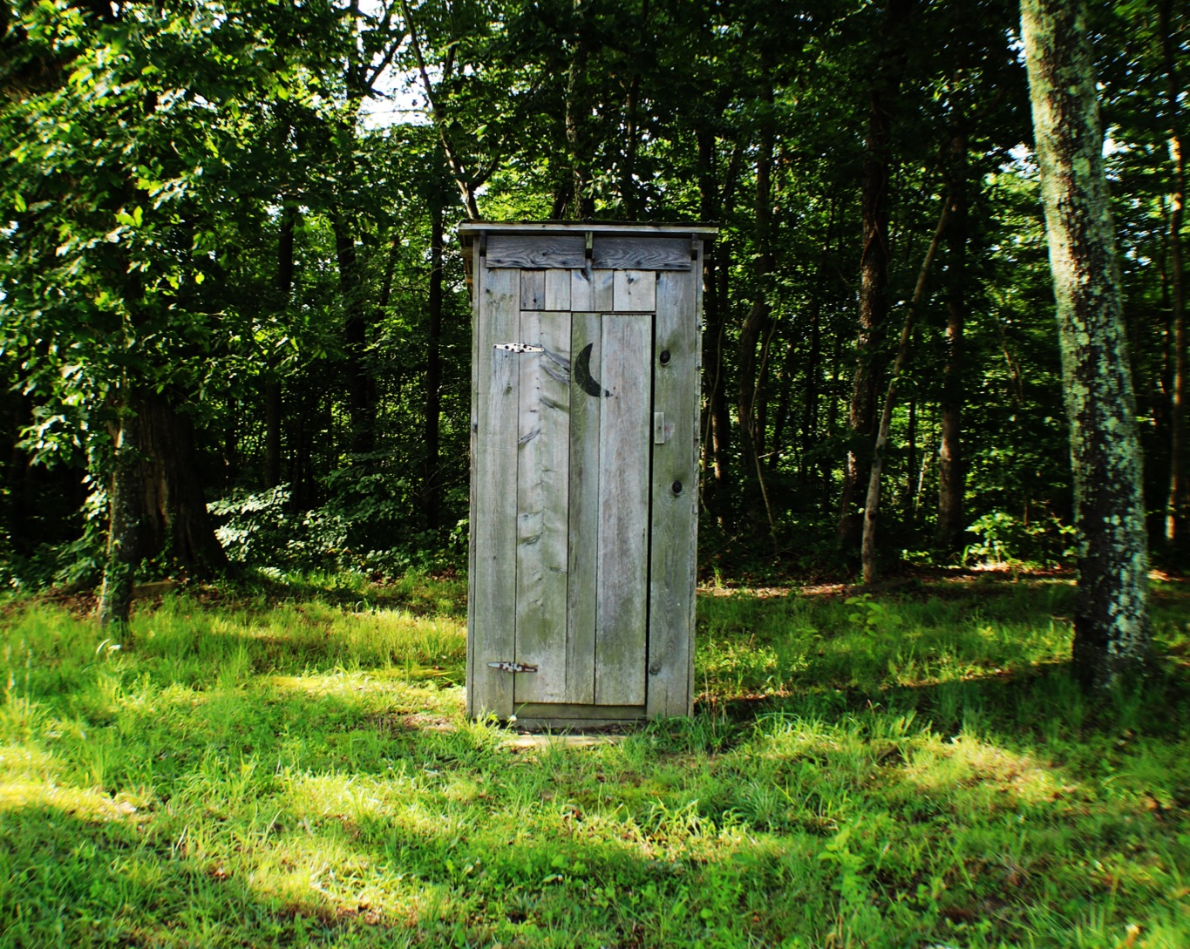
ᏅᎩᏁ ᏣᎳᎩ ᎠᏕᎶᏆᏍᏗ
ᏣᏨᏏᏗᏍ?- do you need to go to the restroom?
Extra
ᎠᏩᏨᏏᏗ- I have to go to the bathroom.
ᎠᏨᎠ- he/she is going to the bathroom

Slide 6
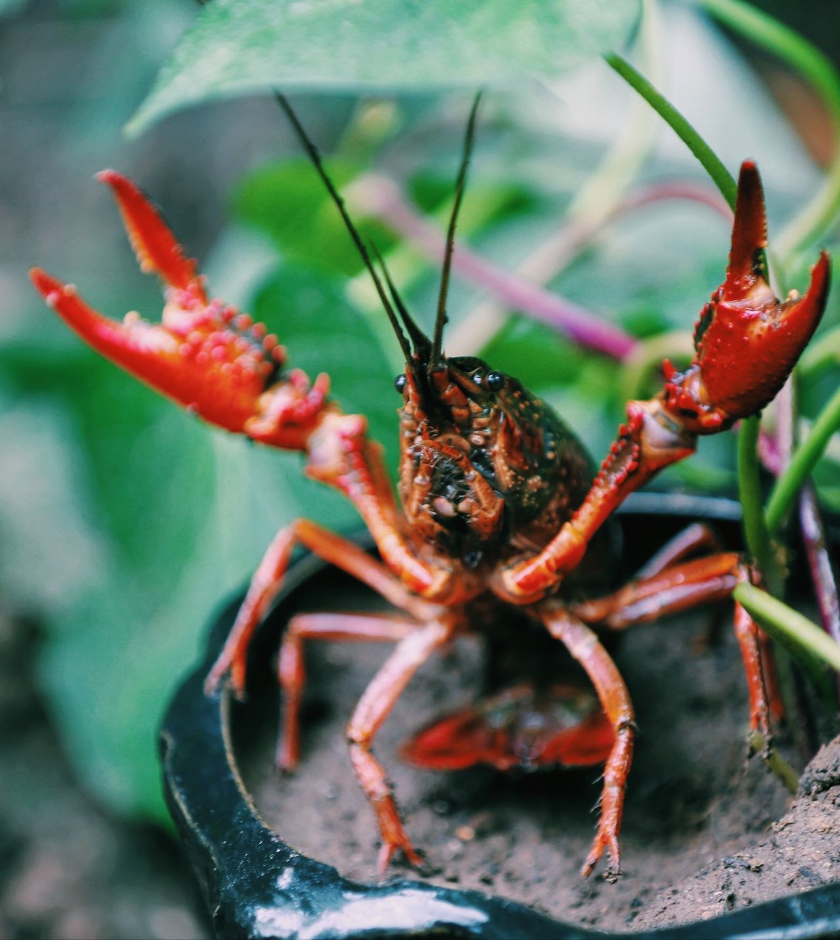
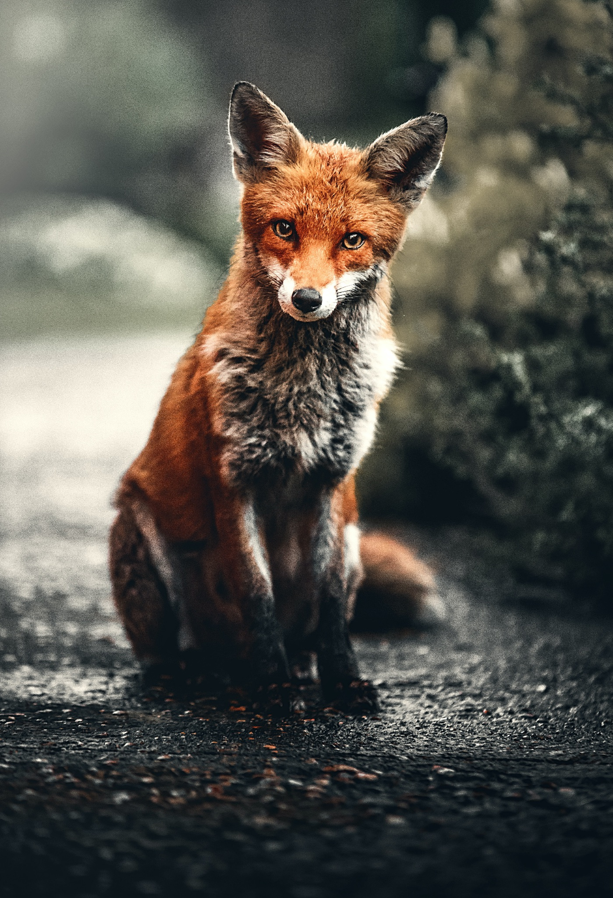
ᏅᎩᏁ ᏣᎳᎩ ᎠᏕᎶᏆᏍᏗ
ᎢᎸᎯᏳ ᏥᎨᏒ, ᏂᎦᏓ ᎢᎾᎨ ᎠᏁᎯ ᎡᎵ ᏓᎾᏝᏃᎮᏍᎬ. ᏌᏊ ᎢᎦ, ᏝᏬᏚᎯ ᎾᎥ ᎠᎹᏳᎵᏗ ᎠᏓᎾᏏᏂᏙᎲ ᏥᏍᏛᎾ. ᎾᎥ, ᏧᏟ ᏭᏬᏢ. ᎤᎾᎴᏅᎮ ᏓᎾᏝᏃᎲᏍᎬ. ᏧᏟ ᏥᏍᏛᎾ ᎤᏛᏛᏁ, “ᏙᏳᏍ ᎯᏌᏄᎵ ᎦᏙ ᎠᎴ ᎠᎹᏱᎨ ᎯᏌᏄᎵ.”
“ᎥᎥ,” ᎤᏛᏁ ᏥᏍᏛᎾ. “ᎤᏠᏱ ᏥᏌᏄᎵ ᎦᏙ ᎠᎴ ᎠᎹᏱ.”
ᏧᏟ Ꮭ ᏳᏬᎯᏳᏁ. ᎤᏂᏙᎩᏯᏍᏗ ᏚᏄᎪᏔᏁ ᏧᏟ ᎠᎴ ᏥᏍᏛᎾ.

Slide 7
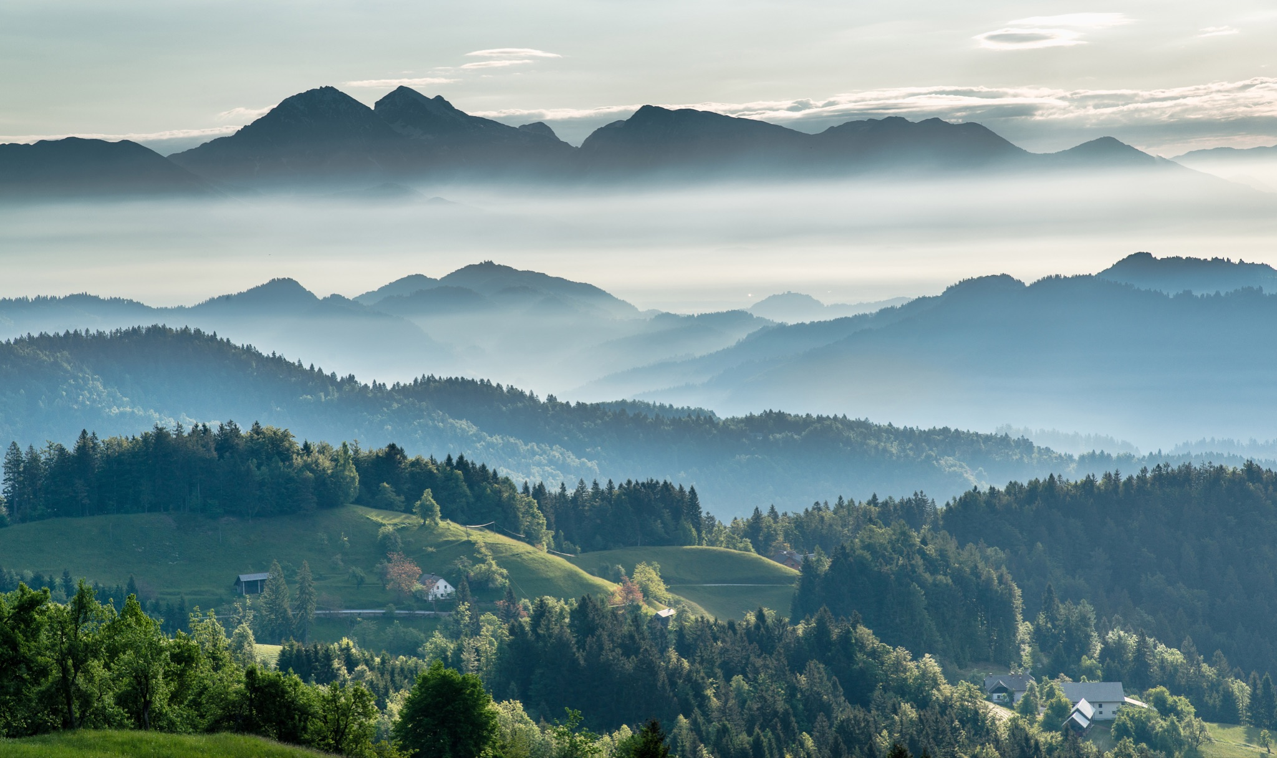
ᏅᎩᏁ ᏣᎳᎩ ᎠᏕᎶᏆᏍᏗ
ᎦᎵᏉᎩ ᎦᏚᏏ ᏚᏄᎧᏔᏁ ᏭᎾᏢᏍᏗ. ᎠᎬᏱ ᏫᎦᎷᏨ ᎦᎵᏉᎩᏁ ᎦᏚᏏ, ᏫᏗᎨᏡᎲᏍᎨᏍᏗ. ᎤᏓᏠᏒ ᎨᏎᏍᏗ. ᎦᏚ ᎦᎸᎳᏗ ᎣᏓᎸ ᏭᏂᎶᏒ. ᎦᎵᏉᎩ ᎦᏚᏏ ᏚᏂᏑᏰᏒ ᏭᎾᏢᏍᏗ.

Slide 8
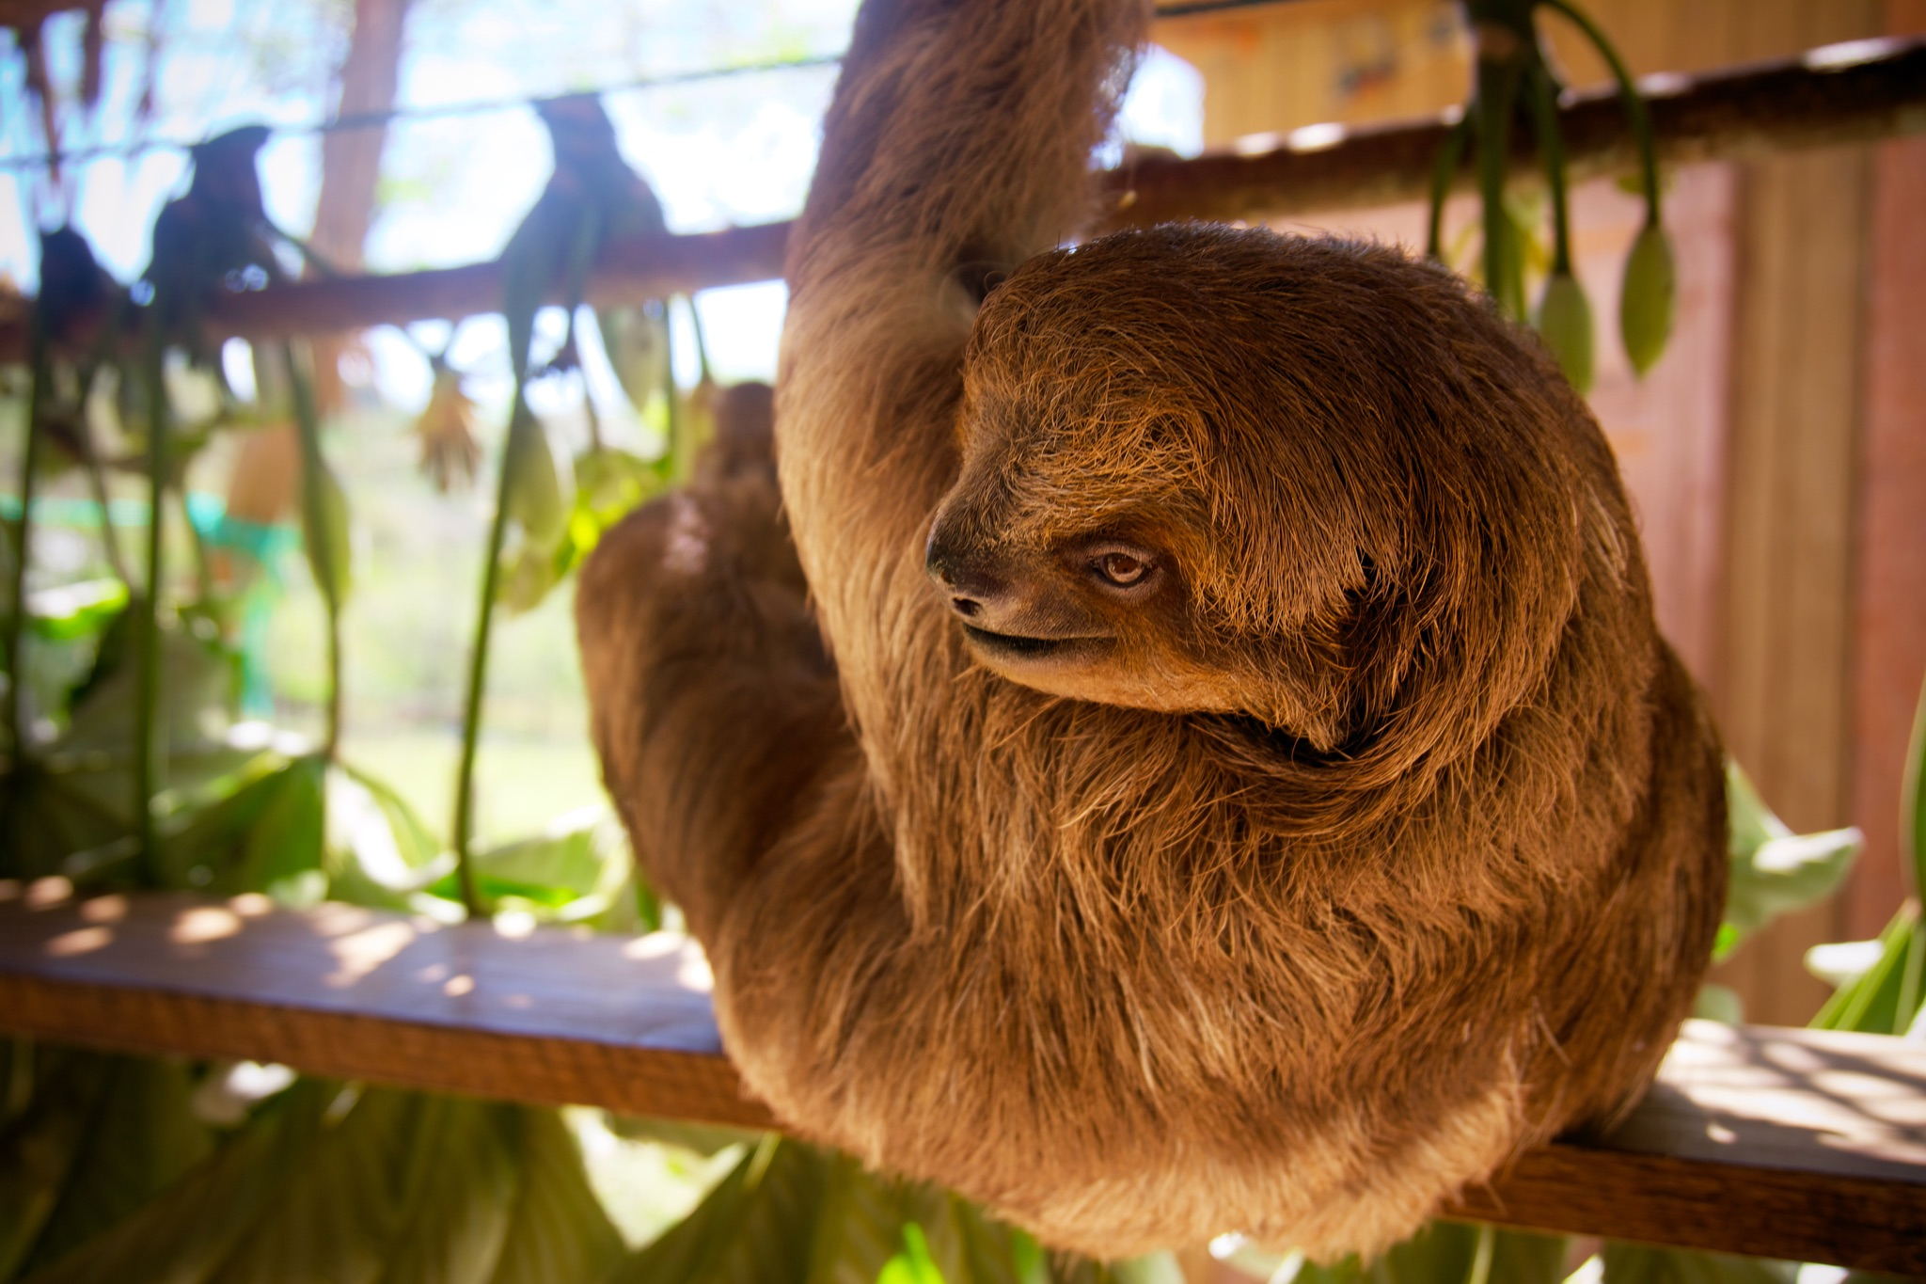
ᏅᎩᏁ ᏣᎳᎩ ᎠᏕᎶᏆᏍᏗ
Unlenvhe, usganoli gese jisdvn.

Slide 9
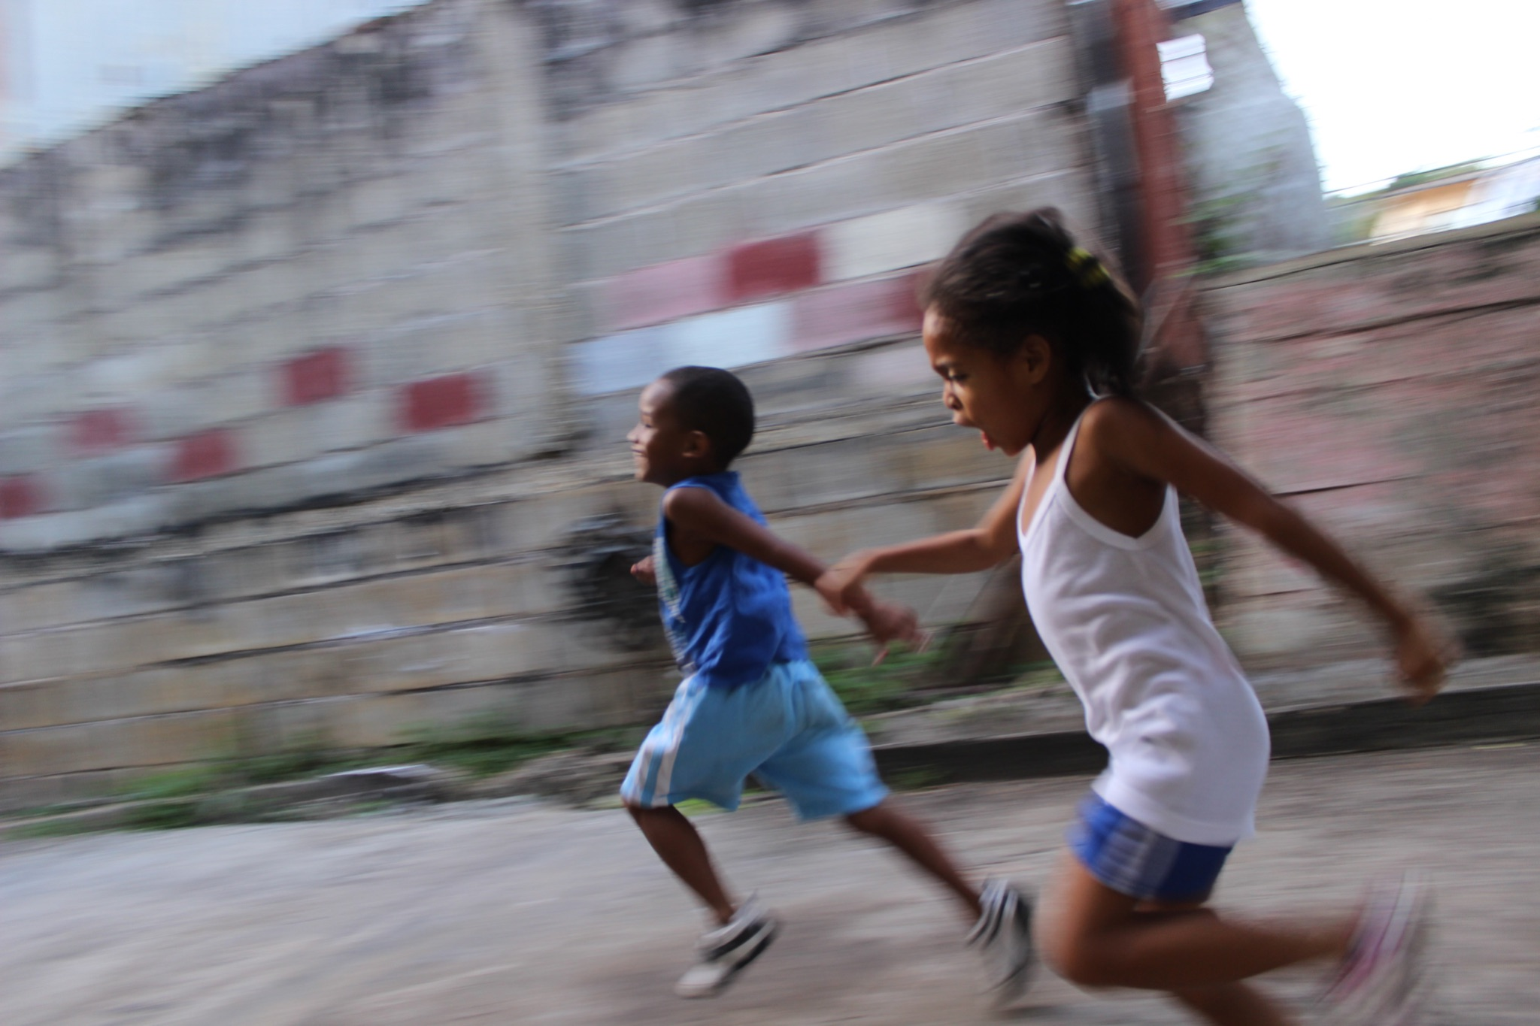
ᏅᎩᏁ ᏣᎳᎩ ᎠᏕᎶᏆᏍᏗ
Jutli ulohisele jisdvn.

Slide 10
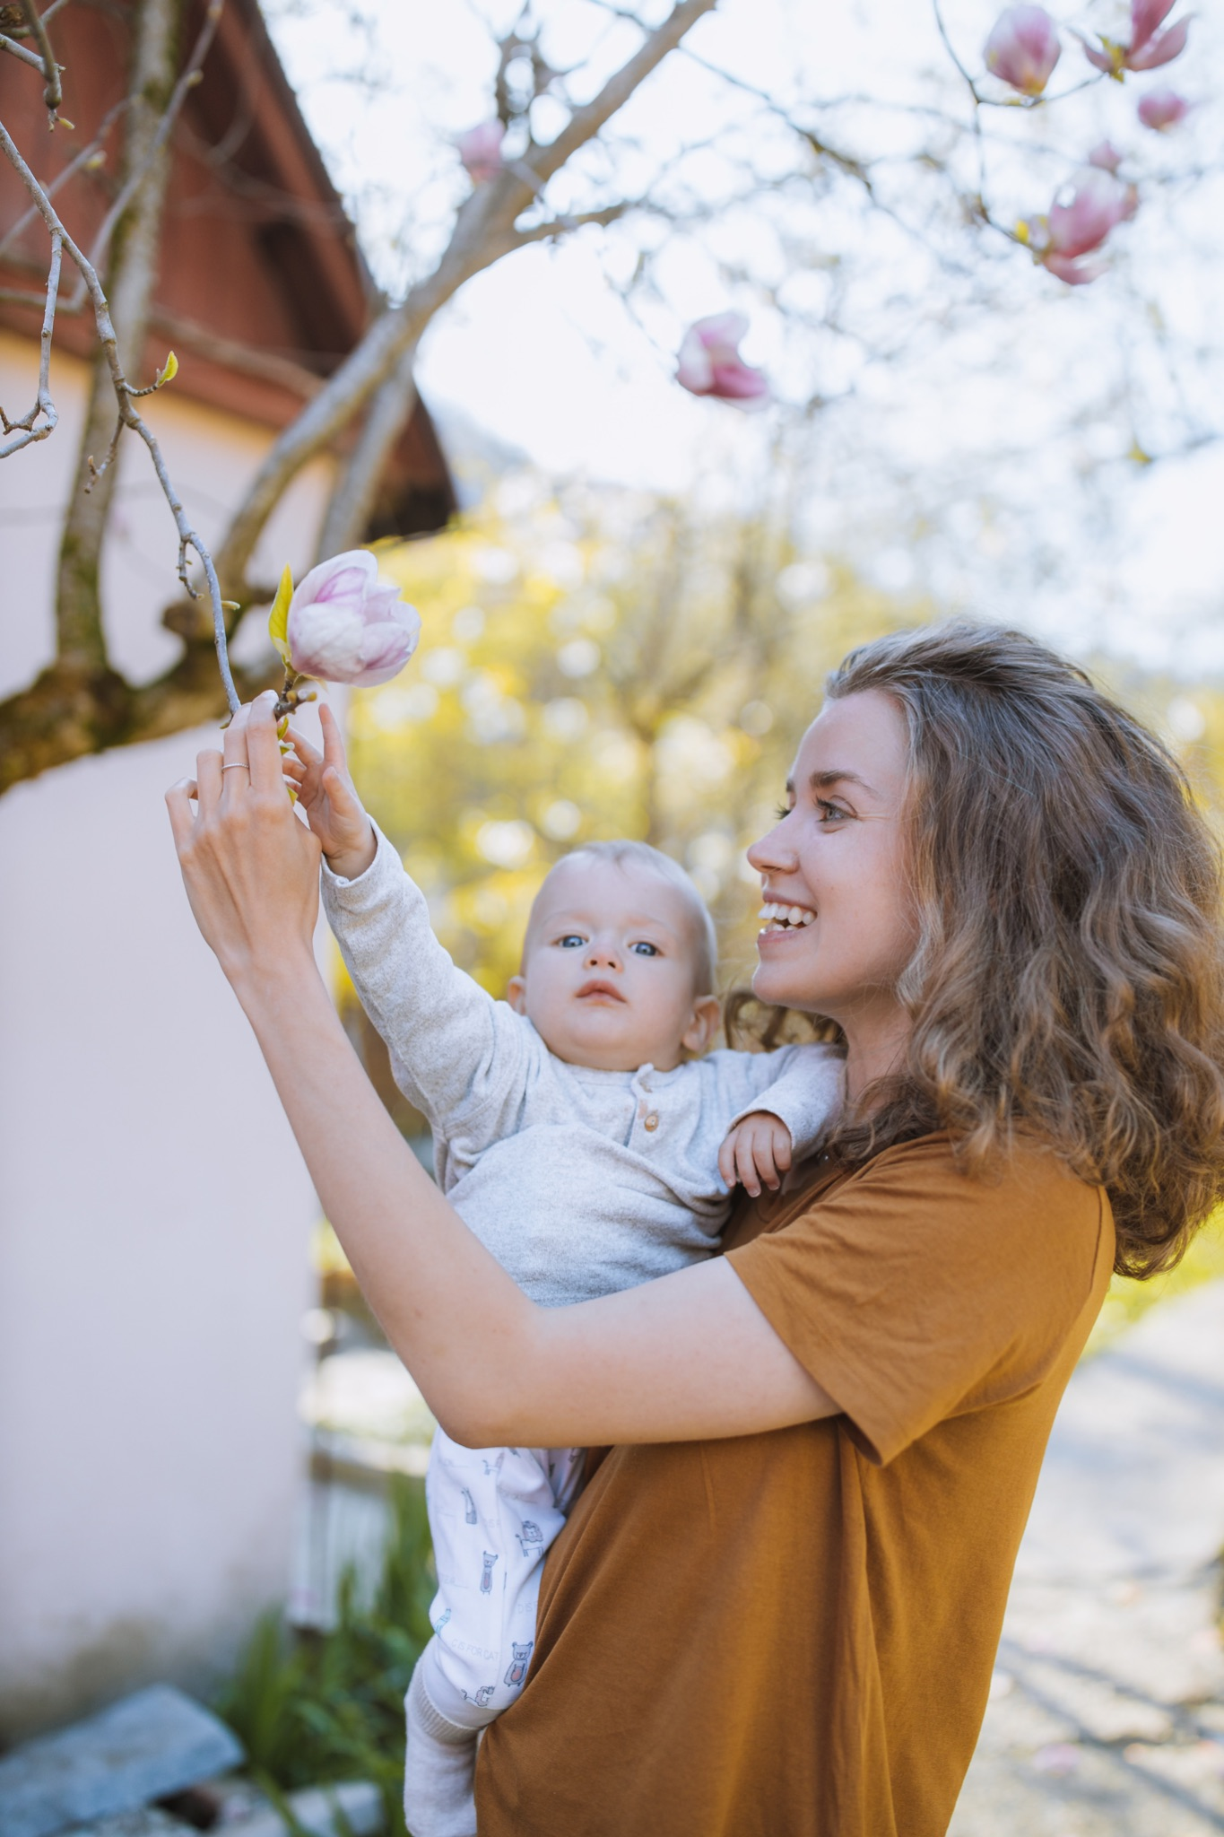
ᏅᎩᏁ ᏣᎳᎩ ᎠᏕᎶᏆᏍᏗ
Jisdvn wajiniyvselv jutli ganidadv, nav ulose.

Slide 11
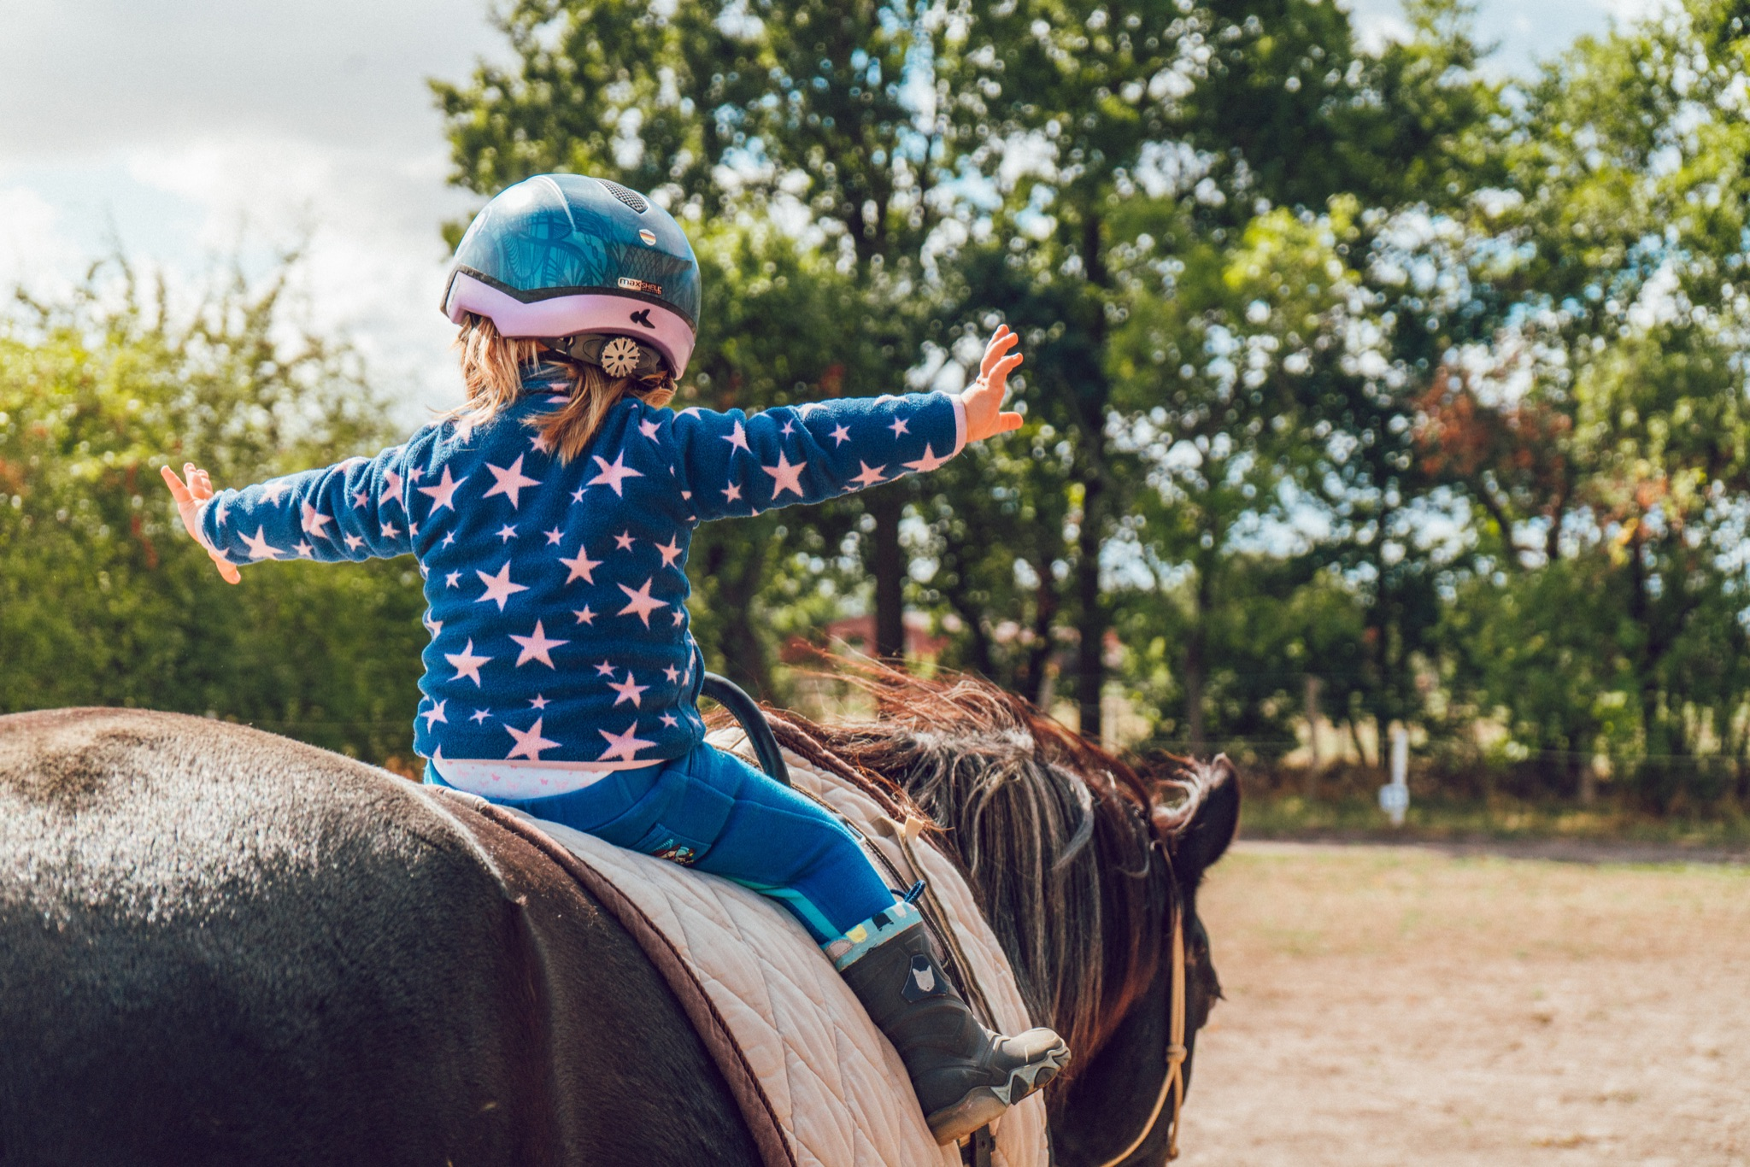
ᏅᎩᏁ ᏣᎳᎩ ᎠᏕᎶᏆᏍᏗ
Ganidadv wukilvhe jisdvn.

Slide 12
ᏅᎩᏁ ᏣᎳᎩ ᎠᏕᎶᏆᏍᏗ
Utlisd jutli wutlvstanv.

Slide 13
ᏅᎩᏁ ᏣᎳᎩ ᎠᏕᎶᏆᏍᏗ
Jutli ganidadv ukilo jisdvn.

Slide 14
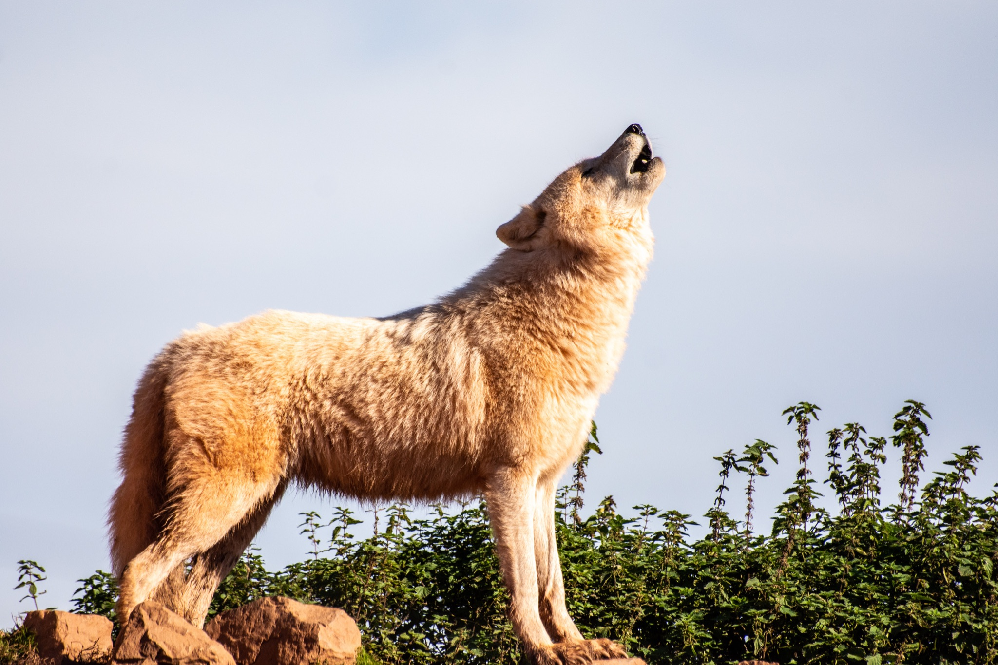
ᏅᎩᏁ ᏣᎳᎩ ᎠᏕᎶᏆᏍᏗ
Wuniluj galquogine gadus, jutli uwetlune.

Slide 15
ᏅᎩᏁ ᏣᎳᎩ ᎠᏕᎶᏆᏍᏗ
Jisdvn nav uwetlunesquu.

Slide 16
ᏅᎩᏁ ᏣᎳᎩ ᎠᏕᎶᏆᏍᏗ
Unlenvhe, usganoli gese jisdvn.
Jutli ulohisele jisdvn.
Jisdvn wajiniyvselv jutli ganidadv, nav ulose.
Ganidadv wukilvhe jisdvn.
Utlisd jutli wutlvstanv.
Jutli ganidadv ukilo jisdvn.
Wuniluj galquogine gadus, jutli uwetlune.
Jisdvn nav uwetlunesquu.

Slide 17
ᏅᎩᏁ ᏣᎳᎩ ᎠᏕᎶᏆᏍᏗ
ᎤᎾᎴᏅᎮ, ᎤᏍᎦᏃᎵ ᎨᏎ ᏥᏍᏛᎾ.ᏧᏟ ᎤᎶᎯᏎᎴ ᏥᏍᏛᎾ.
ᏥᏍᏛᎾ ᏩᏥᏂᏴᏎᎸ ᏧᏟ ᎦᏂᏓᏛ, ᎾᎥ ᎤᎶᏎ. ᎦᏂᏓᏛ ᏭᎩᎸᎮ ᏥᏍᏛᎾ. ᎤᏟᏍᏗ ᏧᏟ ᏭᏢᏍᏔᏅ. ᏧᏟ ᎦᏂᏓᏛ ᎤᎩᎶ ᏥᏍᏛᎾ. ᏭᏂᎷᏨ ᎦᎵᏉᎩᏁ ᎦᏚᏏ ᏧᏟ ᎤᏪᏡᏁ. ᏥᏍᏛᎾ ᎾᎥ ᎤᏪᏡᏁᏍᏊ.

Slide 18
ᏅᎩᏁ ᏣᎳᎩ ᎠᏕᎶᏆᏍᏗ
ᎢᎸᎯᏳ ᏥᎨᏒ, ᏂᎦᏓ ᎢᎾᎨ ᎠᏁᎯ ᎡᎵ ᏓᎾᏝᏃᎮᏍᎬ. ᏌᏊ ᎢᎦ, ᏝᏬᏚᎯ ᎾᎥ ᎠᎹᏳᎵᏗ ᎠᏓᎾᏏᏂᏙᎲ ᏥᏍᏛᎾ. ᎾᎥ, ᏧᏟ ᏭᏬᏢ. ᎤᎾᎴᏅᎮ ᏓᎾᏝᏃᎲᏍᎬ. ᏧᏟ ᏥᏍᏛᎾ ᎤᏛᏛᏁ, “ᏙᏳᏍ ᎯᏌᏄᎵ ᎦᏙ ᎠᎴ ᎠᎹᏱᎨ ᎯᏌᏄᎵ.”
“ᎥᎥ,” ᎤᏛᏁ ᏥᏍᏛᎾ. “ᎤᏠᏱ ᏥᏌᏄᎵ ᎦᏙ ᎠᎴ ᎠᎹᏱ.”
ᏧᏟ Ꮭ ᏳᏬᎯᏳᏁ. ᎤᏂᏙᎩᏯᏍᏗ ᏚᏄᎪᏔᏁ ᏧᏟ ᎠᎴ ᏥᏍᏛᎾ.

Slide 19
ᏅᎩᏁ ᏣᎳᎩ ᎠᏕᎶᏆᏍᏗ
ᎤᎾᎴᏅᎮ, ᎤᏍᎦᏃᎵ ᎨᏎ ᏥᏍᏛᎾ.ᏧᏟ ᎤᎶᎯᏎᎴ ᏥᏍᏛᎾ.
ᏥᏍᏛᎾ ᏩᏥᏂᏴᏎᎸ ᏧᏟ ᎦᏂᏓᏛ, ᎾᎥ ᎤᎶᏎ. ᎦᏂᏓᏛ ᏭᎩᎸᎮ ᏥᏍᏛᎾ. ᎤᏟᏍᏗ ᏧᏟ ᏭᏢᏍᏔᏅ. ᏧᏟ ᎦᏂᏓᏛ ᎤᎩᎶ ᏥᏍᏛᎾ. ᏭᏂᎷᏨ ᎦᎵᏉᎩᏁ ᎦᏚᏏ ᏧᏟ ᎤᏪᏡᏁ. ᏥᏍᏛᎾ ᎾᎥ ᎤᏪᏡᏁᏍᏊ.

Slide 20
ᏅᎩᏁ ᏣᎳᎩ ᎠᏕᎶᏆᏍᏗ
ᎦᏣᏄᎵ/ᎠᏯᏄᎳ/ ᎤᏟᏍᏗ
Generally,
Gajanul is used to describe things.
Ayanul is saying “he/she is fast”
Utlisd is used to describe actions.

Slide 21
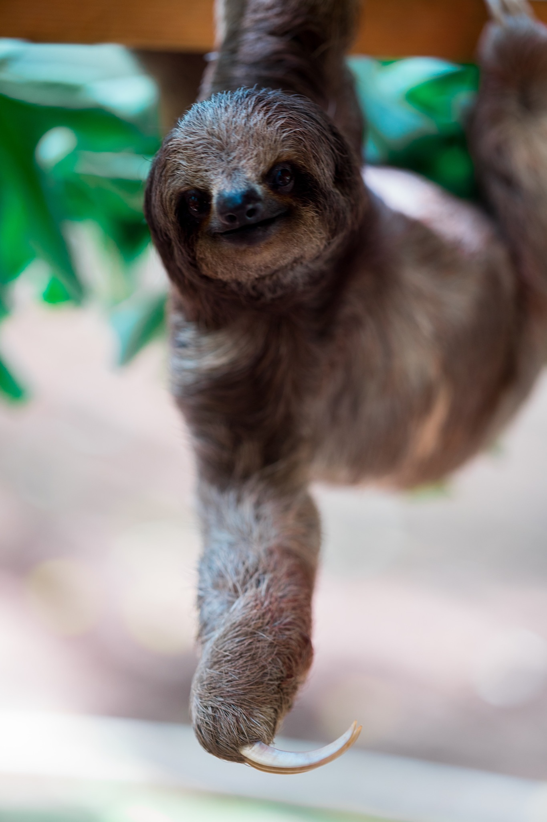
ᏅᎩᏁ ᏣᎳᎩ ᎠᏕᎶᏆᏍᏗ
ᎦᏣᏄᎵᏍ? ᎤᏍᎦᏃᎵᎨ?
ᎤᏒᎦᏃᎵ ᏲᎾ ᎢᏳᏍᏗ

Slide 22
ᏅᎩᏁ ᏣᎳᎩ ᎠᏕᎶᏆᏍᏗ
ᎦᏣᏄᎵᏍ? ᎤᏍᎦᏃᎵᎨ?
ᎠᏫ

Slide 23
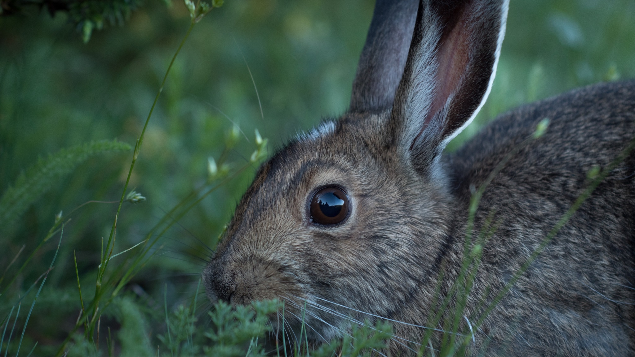
ᏅᎩᏁ ᏣᎳᎩ ᎠᏕᎶᏆᏍᏗ
ᎦᏣᏄᎵᏍ? ᎤᏍᎦᏃᎵᎨ?
ᏥᏍᏚ

Slide 24
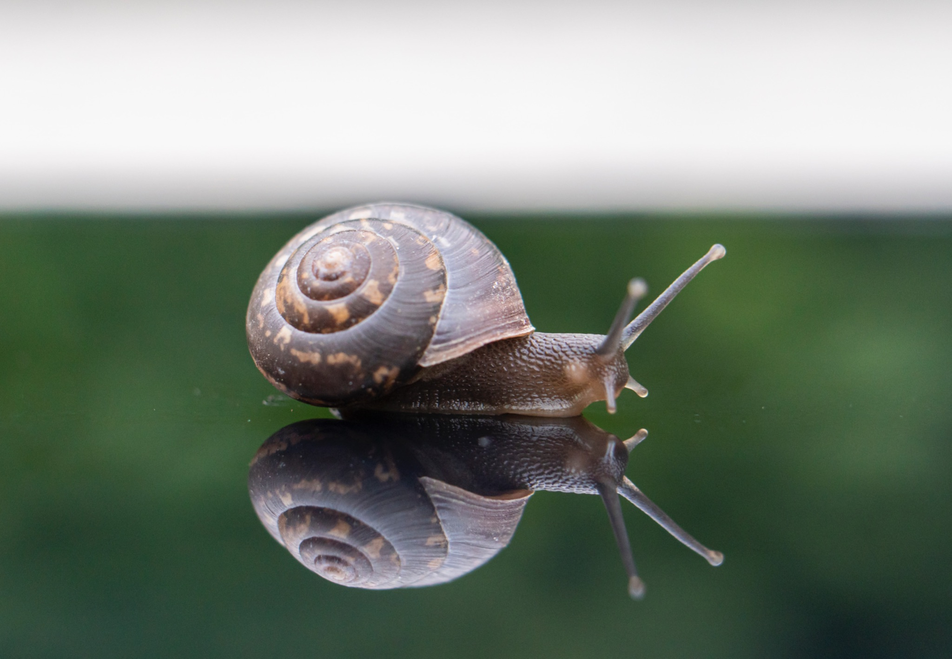
ᏅᎩᏁ ᏣᎳᎩ ᎠᏕᎶᏆᏍᏗ
ᎦᏣᏄᎵᏍ? ᎤᏍᎦᏃᎵᎨ?
ᎡᎳᏈ

Slide 25
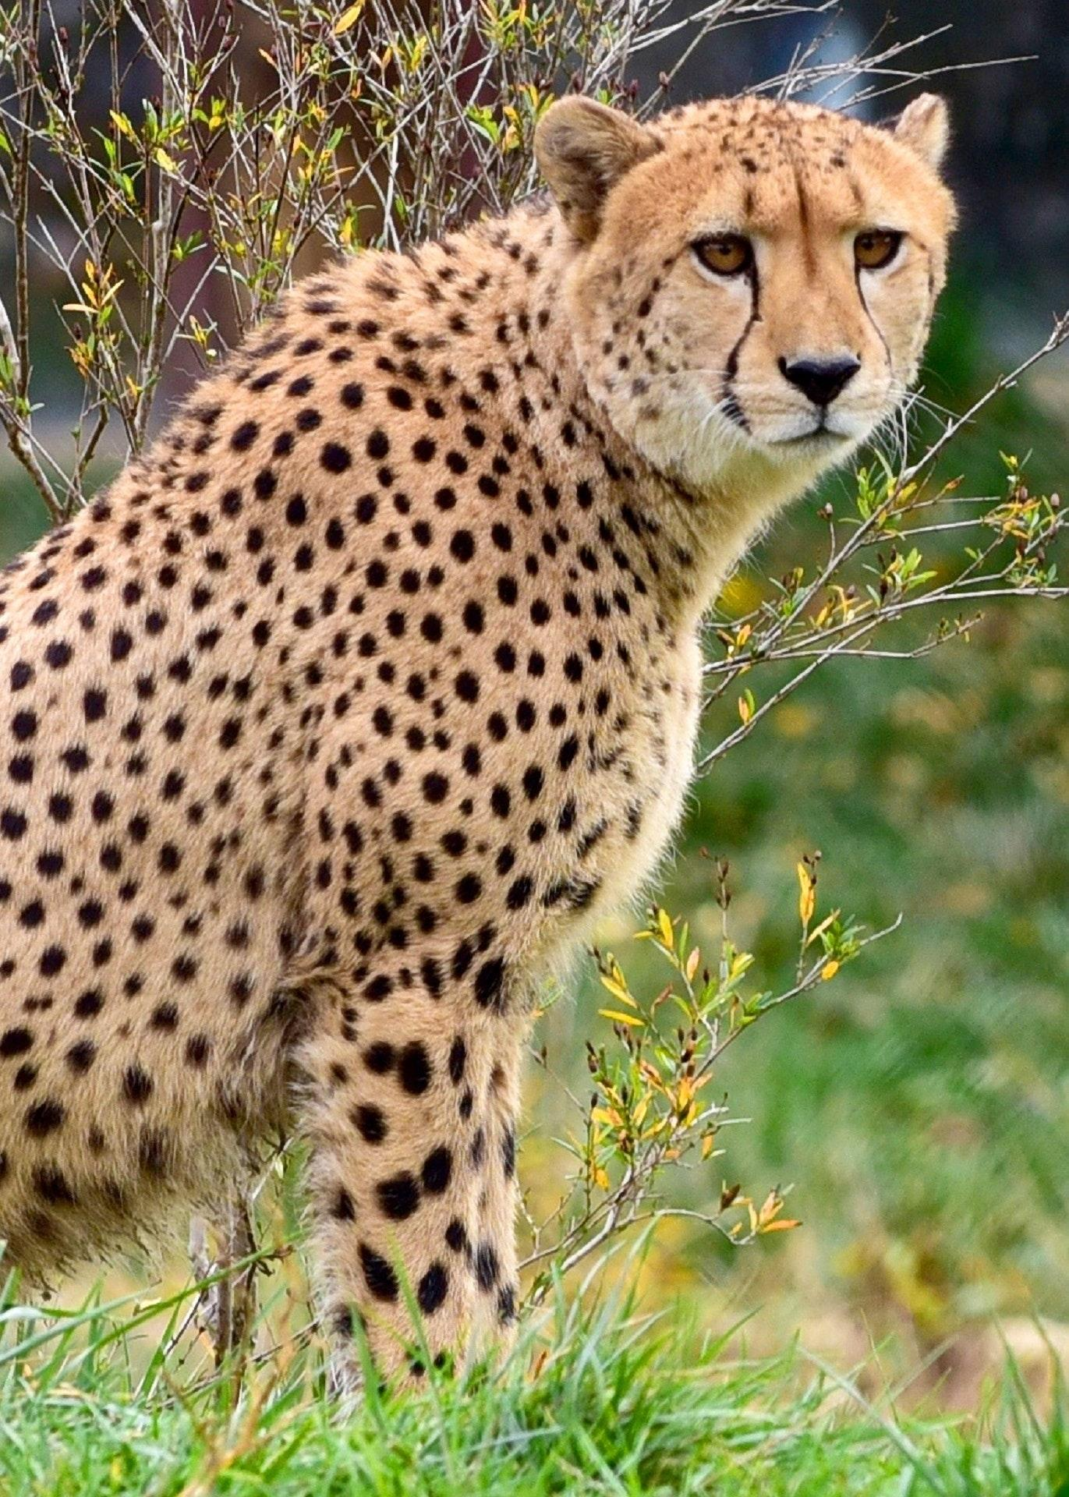
ᏅᎩᏁ ᏣᎳᎩ ᎠᏕᎶᏆᏍᏗ
ᎦᏣᏄᎵᏍ? ᎤᏍᎦᏃᎵᎨ?
ᏩᏯᏄᎳ ᏪᏌ

Slide 26
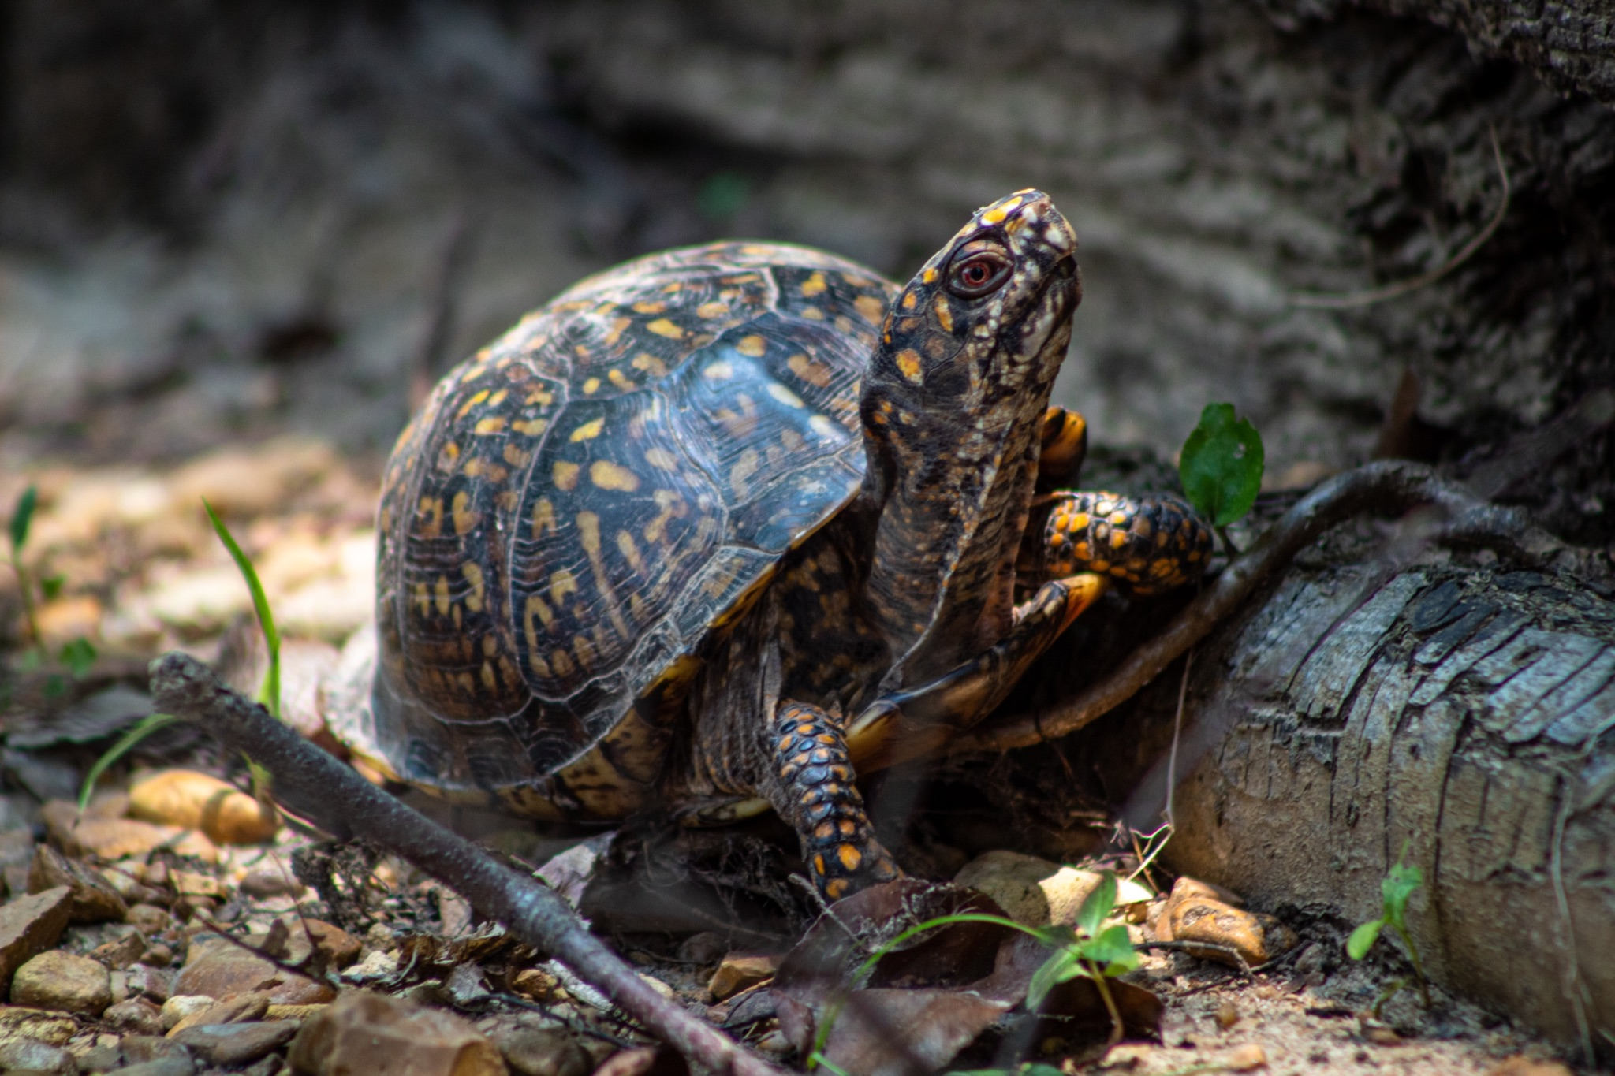
ᏅᎩᏁ ᏣᎳᎩ ᎠᏕᎶᏆᏍᏗ
ᎦᏣᏄᎵᏍ? ᎤᏍᎦᏃᎵᎨ?
ᏓᎦᏏ

Slide 27
ᏅᎩᏁ ᏣᎳᎩ ᎠᏕᎶᏆᏍᏗ
ᎤᎾᎴᏅᎮ- they started
ᎤᎶᎯᏎᎴ- he/she passed by him/her
ᏩᏥᏂᏴᏎᎸ- he/she grabbed it
ᏭᎩᎸᏁ- he/she rode it/ straddled it
ᎤᎩᎶ- he/she rode around
ᎤᏪᏡᏁ- he/she yelled out

