Slide 1
ᎣᏏᏲ
ᎯᏍᎩᏁ ᏣᎳᎩ ᎠᏕᎶᏆᏍᏗ

Slide 2
ᎯᏍᎩᏁ ᏣᎳᎩ ᎠᏕᎶᏆᏍᏗ
ᎢᏓᎴᎾ- Let’s begin
ᏣᎳᎩ ᎢᏗᏬᏂ- Let’s talk Cherokee

Slide 3
ᎯᏍᎩᏁ ᏣᎳᎩ ᎠᏕᎶᏆᏍᏗ
Hello everyone
My name is ______ I am ______ years old.
I am Cherokee. (mixed. Full blood. half) I am not Cherokee.
I am from _______ and I live in
I work at _________
My moms name is_______ and my dads name is ______
I am married

Slide 4
ᎯᏍᎩᏁ ᏣᎳᎩ ᎠᏕᎶᏆᏍᏗ
ᏥᏁᎳ- I live at

Slide 5
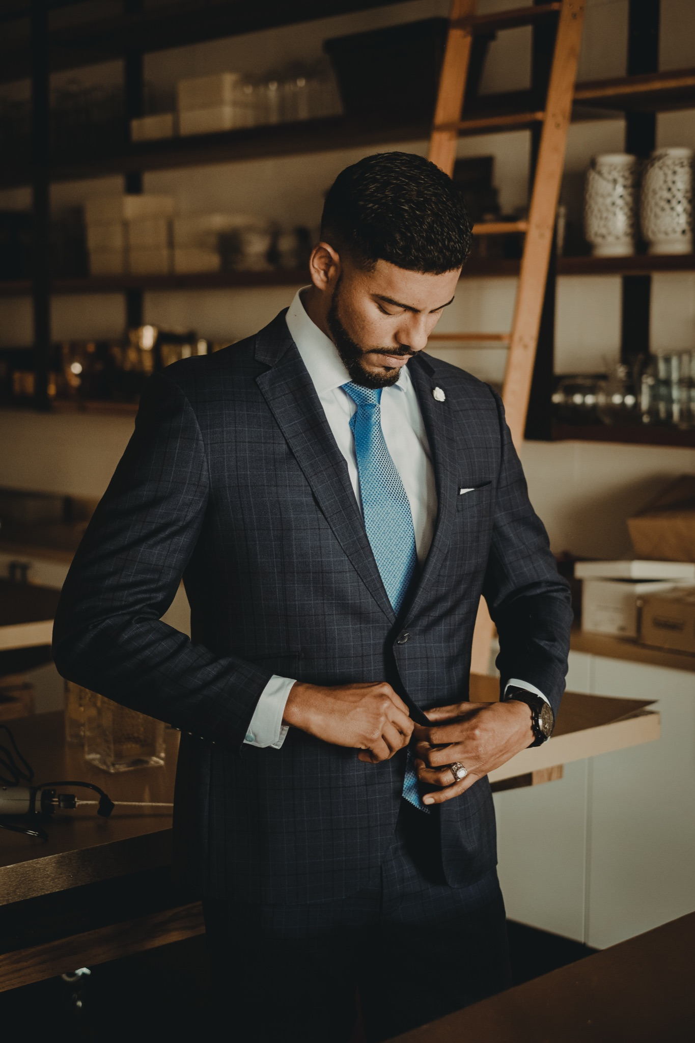
ᎯᏍᎩᏁ ᏣᎳᎩ ᎠᏕᎶᏆᏍᏗ
ᏔᎾᏬᏨ/ ᏫᏔᎾᏬᏨ-
go get dressed
Extra
ᏗᏤ ᏕᎦᎿᏬᎠ- I’m putting on new clothes.
ᏓᎿᏩᎢᏴ- he/she is changing clothes.

Slide 6
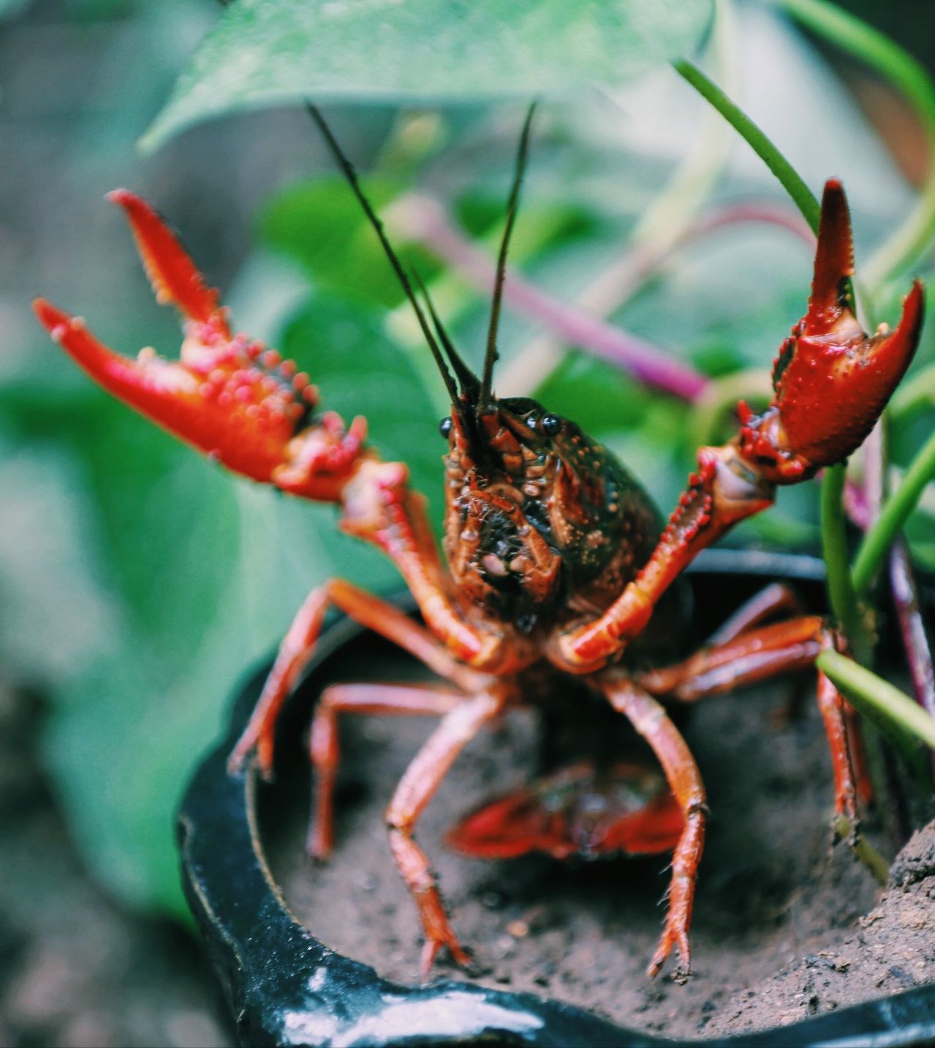
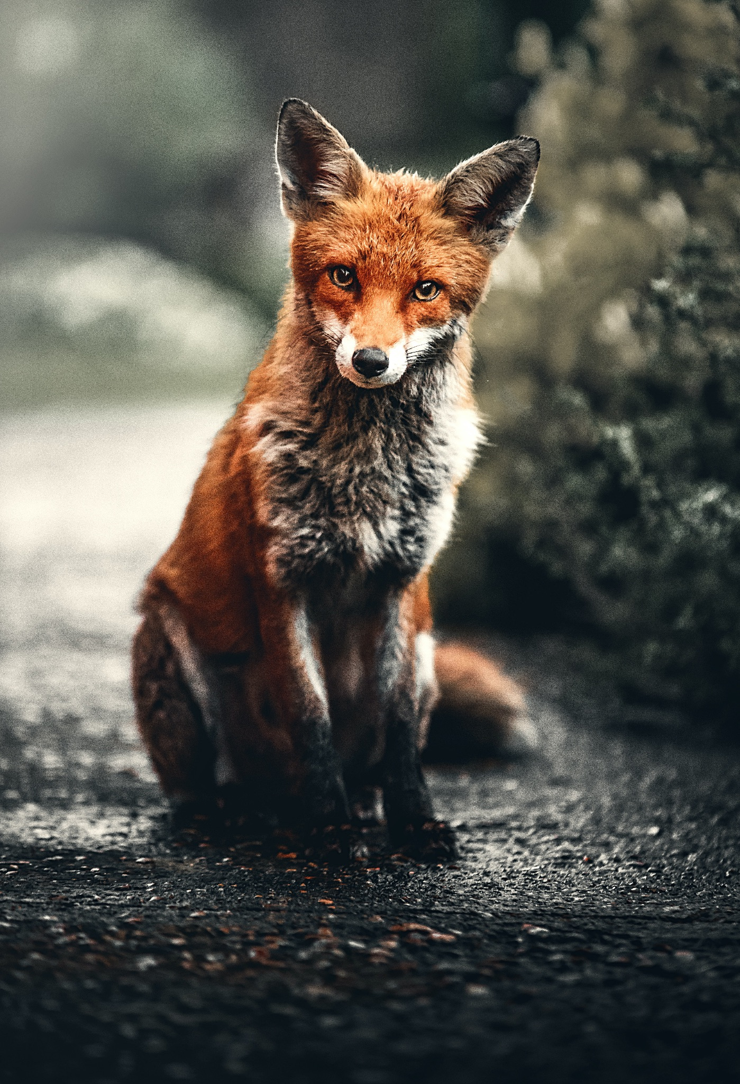
ᎯᏍᎩᏁ ᏣᎳᎩ ᎠᏕᎶᏆᏍᏗ
ᎢᎸᎯᏳ ᏥᎨᏒ, ᏂᎦᏓ ᎢᎾᎨ ᎠᏁᎯ ᎡᎵ ᏓᎾᏝᏃᎮᏍᎬ. ᏌᏊ ᎢᎦ, ᏝᏬᏚᎯ ᎾᎥ ᎠᎹᏳᎵᏗ ᎠᏓᎾᏏᏂᏙᎲ ᏥᏍᏛᎾ. ᎾᎥ, ᏧᏟ ᏭᏬᏢ. ᎤᎾᎴᏅᎮ ᏓᎾᏝᏃᎲᏍᎬ. ᏧᏟ ᏥᏍᏛᎾ ᎤᏛᏛᏁ, “ᏙᏳᏍ ᎯᏌᏄᎵ ᎦᏙ ᎠᎴ ᎠᎹᏱᎨ ᎯᏌᏄᎵ.”
“ᎥᎥ,” ᎤᏛᏁ ᏥᏍᏛᎾ. “ᎤᏠᏱ ᏥᏌᏄᎵ ᎦᏙ ᎠᎴ ᎠᎹᏱ.”
ᏧᏟ Ꮭ ᏳᏬᎯᏳᏁ. ᎤᏂᏙᎩᏯᏍᏗ ᏚᏄᎪᏔᏁ ᏧᏟ ᎠᎴ ᏥᏍᏛᎾ.

Slide 7
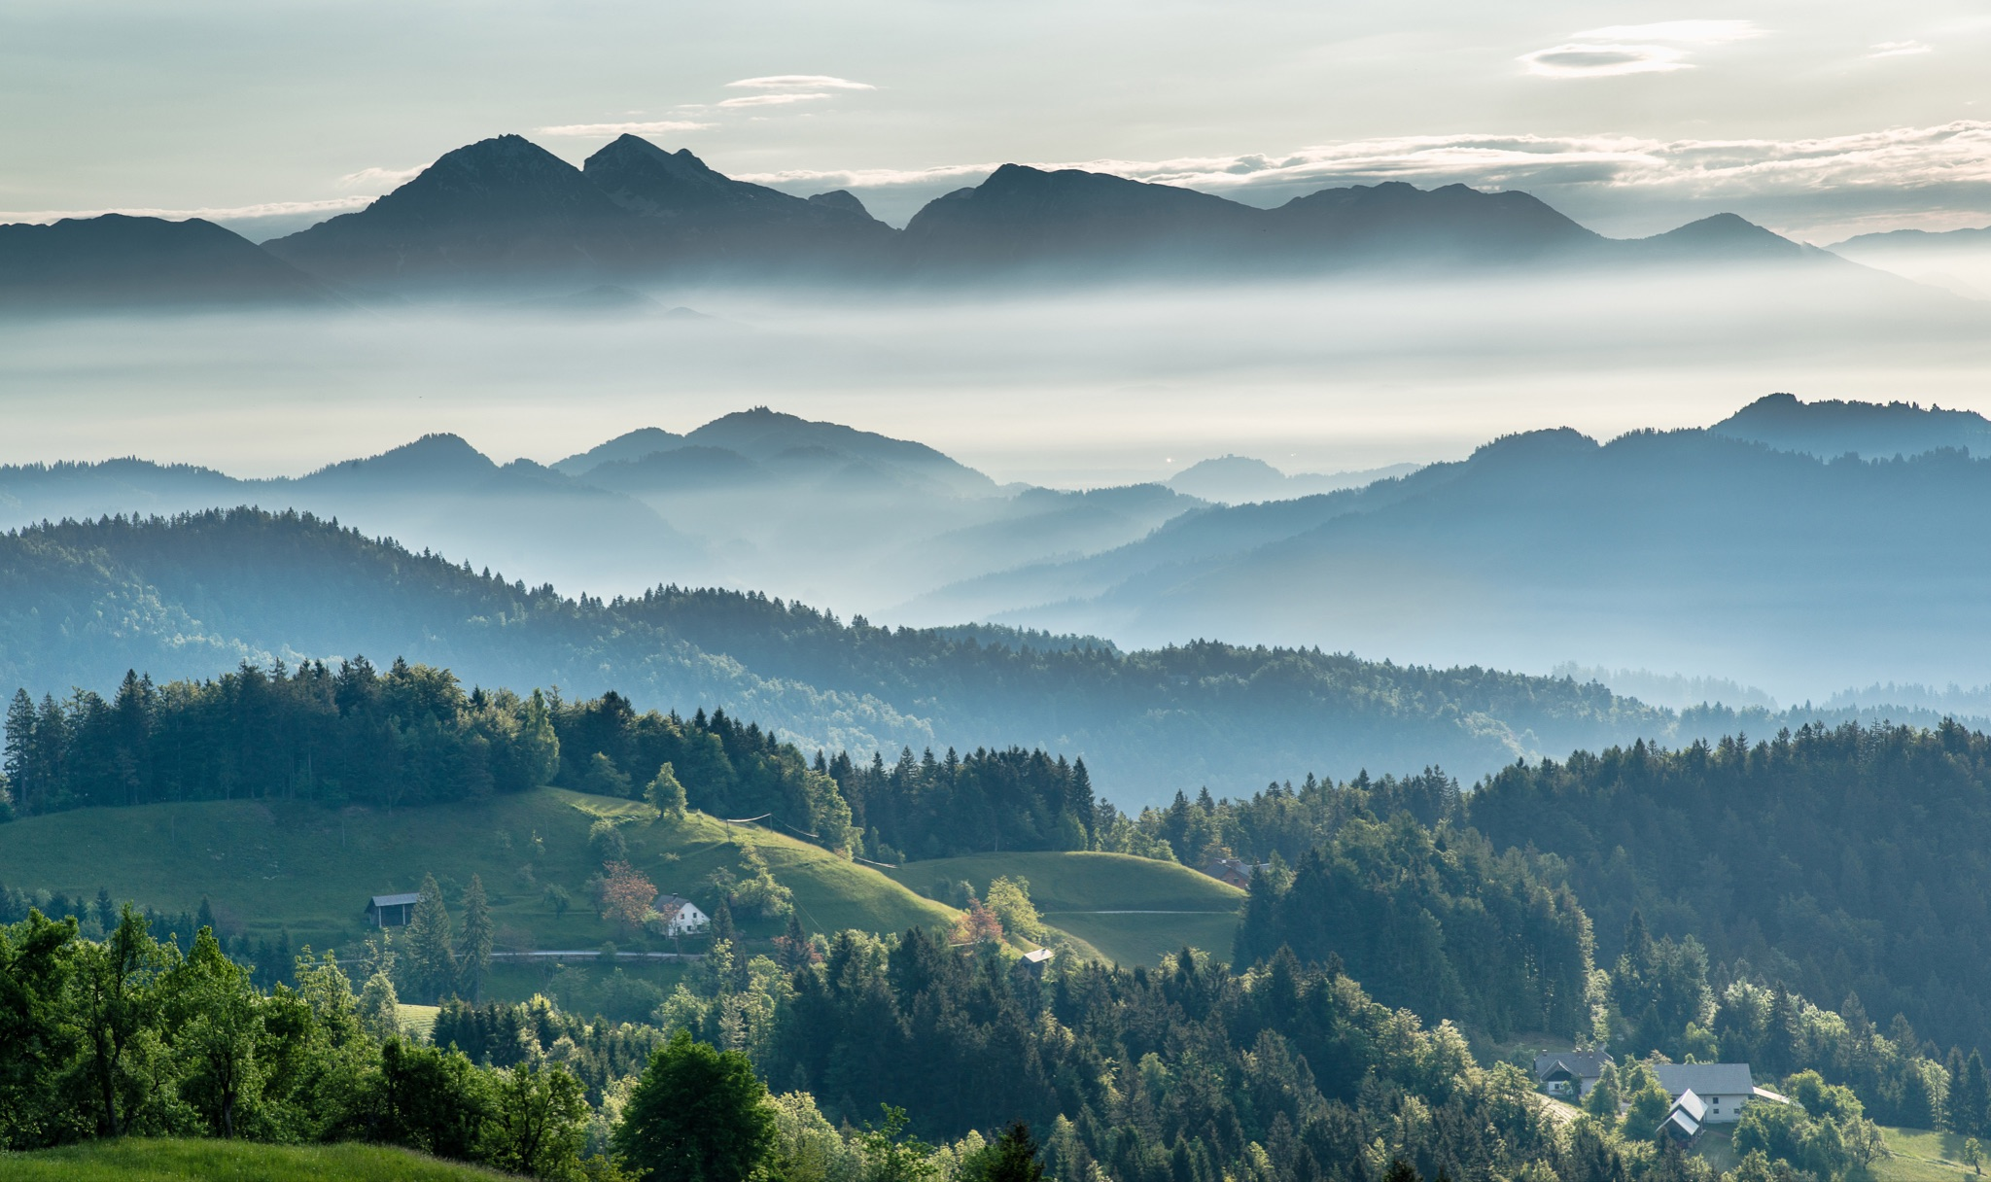
ᎯᏍᎩᏁ ᏣᎳᎩ ᎠᏕᎶᏆᏍᏗ
ᎦᎵᏉᎩ ᎦᏚᏏ ᏚᏄᎧᏔᏁ ᏭᎾᏢᏍᏗ. ᎠᎬᏱ ᏫᎦᎷᏨ ᎦᎵᏉᎩᏁ ᎦᏚᏏ, ᏫᏗᎨᏡᎲᏍᎨᏍᏗ. ᎤᏓᏠᏒ ᎨᏎᏍᏗ. ᎦᏚ ᎦᎸᎳᏗ ᎣᏓᎸ ᏭᏂᎶᏒ. ᎦᎵᏉᎩ ᎦᏚᏏ ᏚᏂᏑᏰᏒ ᏭᎾᏢᏍᏗ.

Slide 8
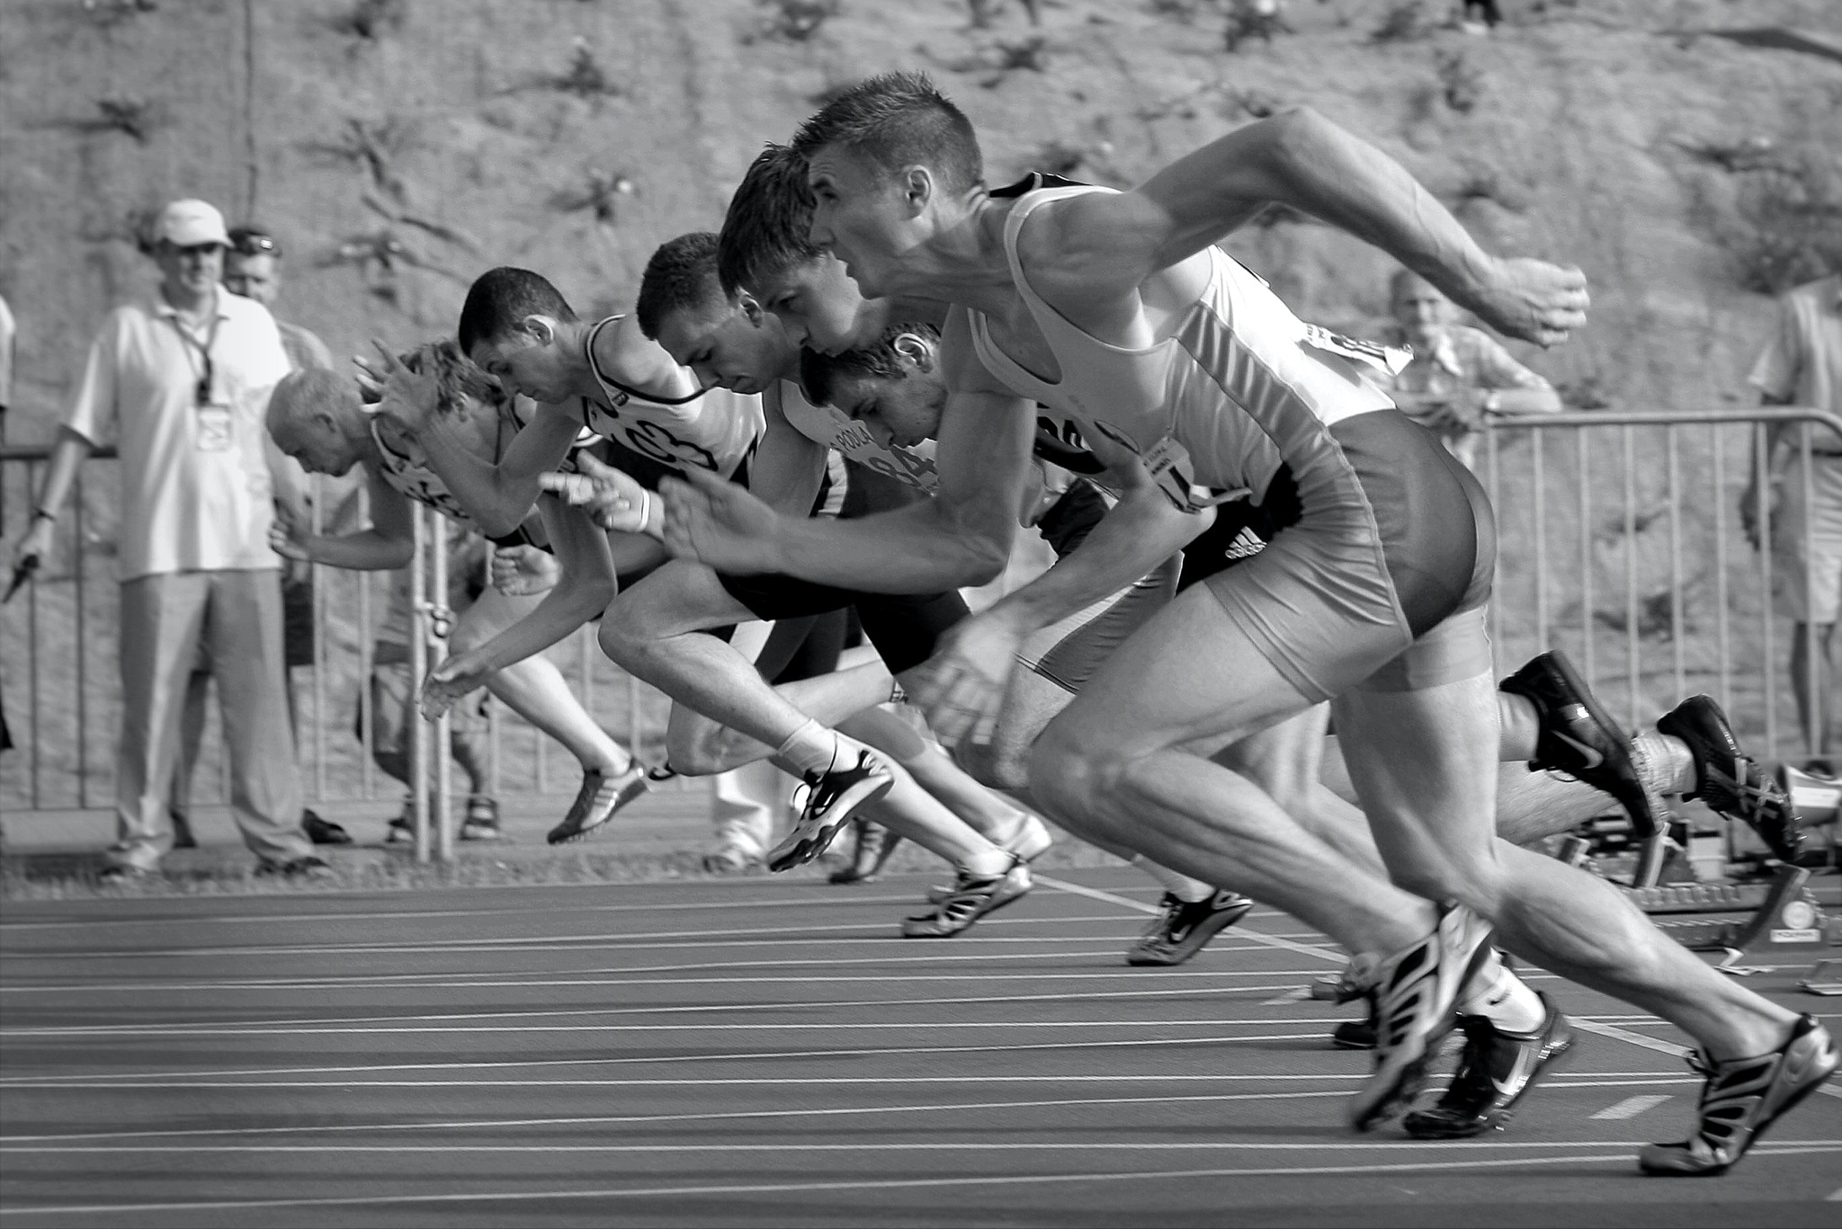
ᎯᏍᎩᏁ ᏣᎳᎩ ᎠᏕᎶᏆᏍᏗ
ᎤᎾᎴᏅᎮ, ᎤᏍᎦᏃᎵ ᎨᏎ ᏥᏍᏛᎾ.ᏧᏟ ᎤᎶᎯᏎᎴ ᏥᏍᏛᎾ.
ᏥᏍᏛᎾ ᏩᏥᏂᏴᏎᎸ ᏧᏟ ᎦᏂᏓᏛ, ᎾᎥ ᎤᎶᏎ. ᎦᏂᏓᏛ ᏭᎩᎸᎮ ᏥᏍᏛᎾ. ᎤᏟᏍᏗ ᏧᏟ ᏭᏢᏍᏔᏅ. ᏧᏟ ᎦᏂᏓᏛ ᎤᎩᎶ ᏥᏍᏛᎾ. ᏭᏂᎷᏨ ᎦᎵᏉᎩᏁ ᎦᏚᏏ ᏧᏟ ᎤᏪᏡᏁ. ᏥᏍᏛᎾ ᎾᎥ ᎤᏪᏡᏁᏍᏊ.

Slide 9
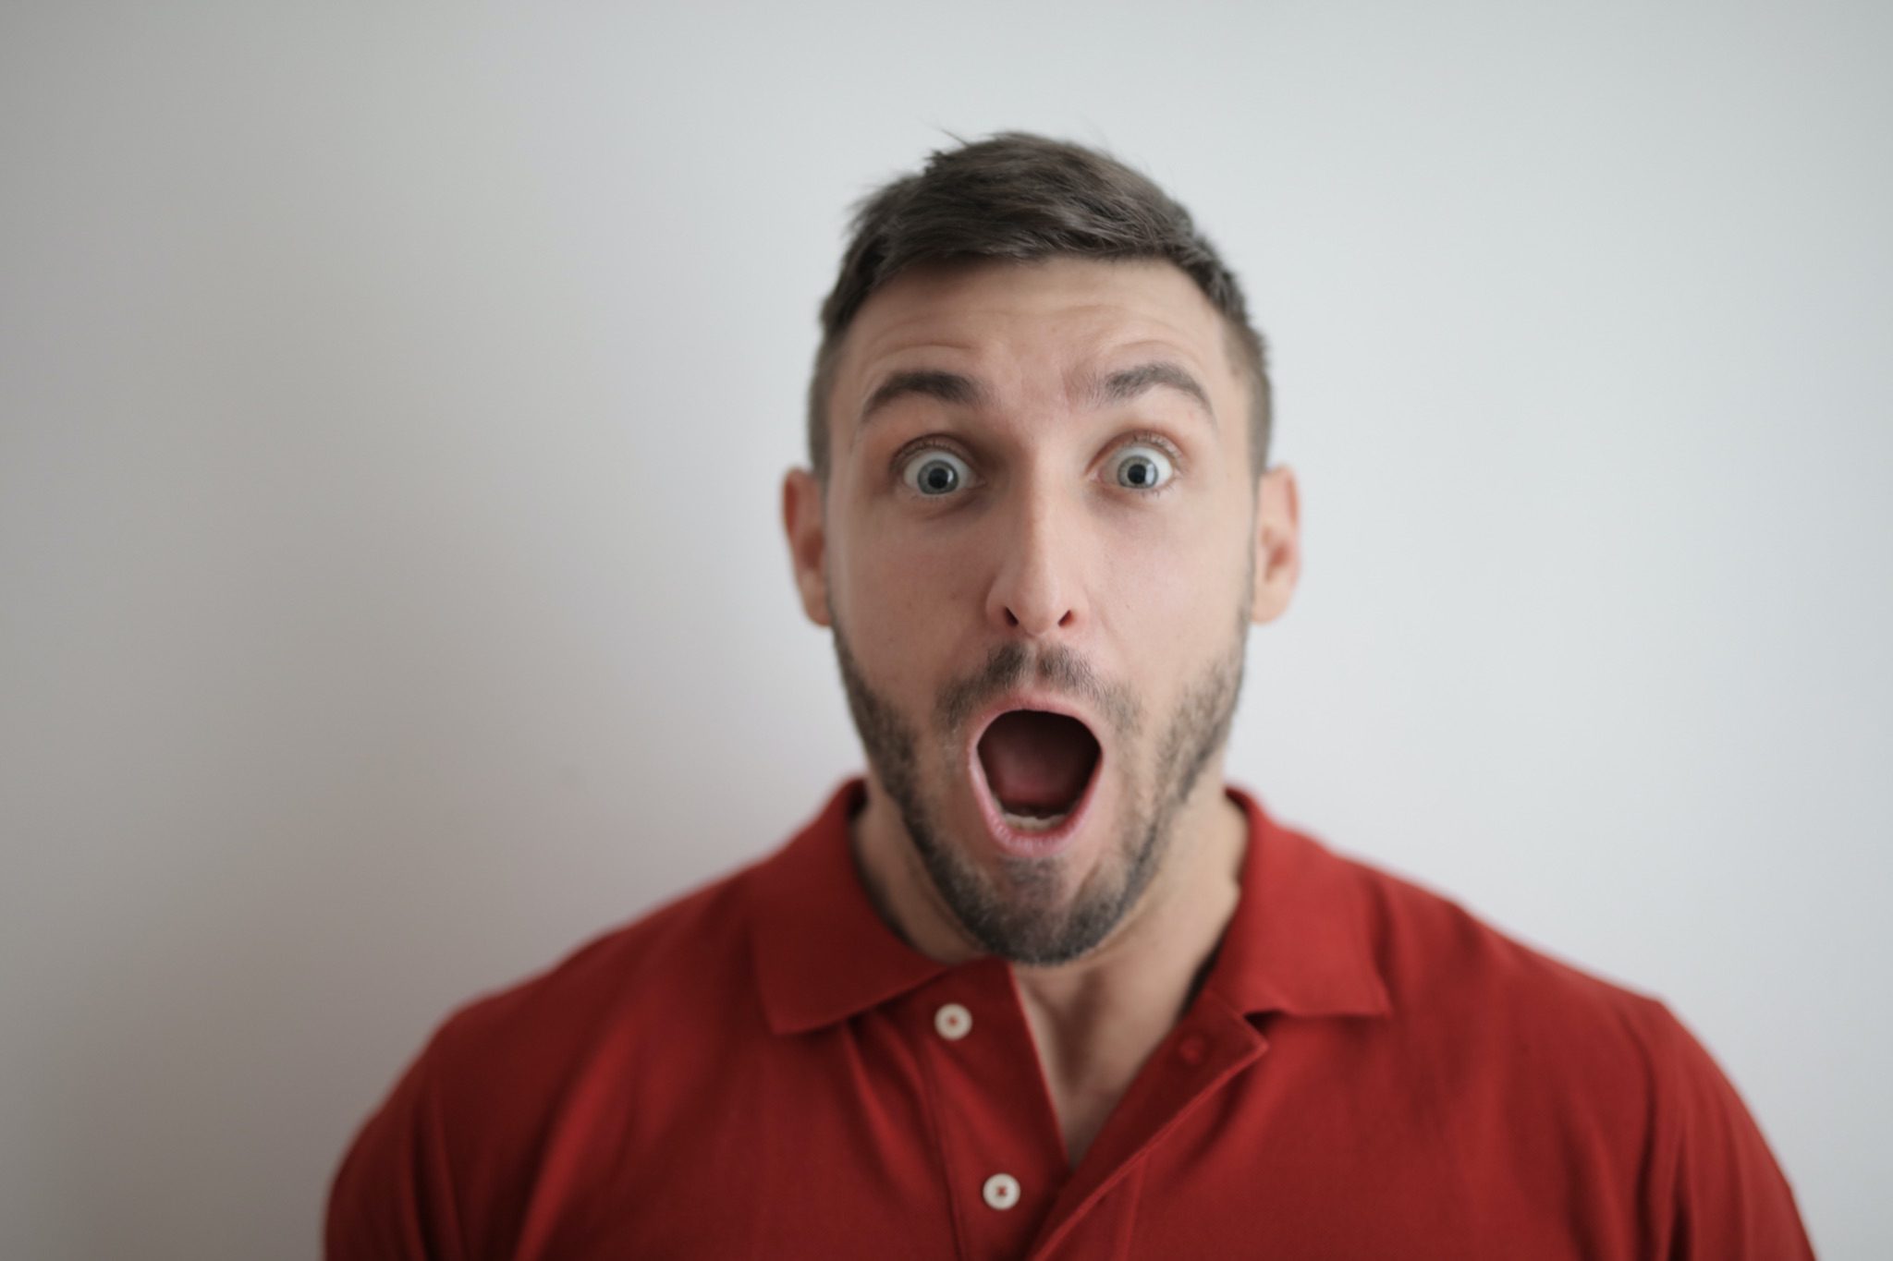
ᎯᏍᎩᏁ ᏣᎳᎩ ᎠᏕᎶᏆᏍᏗ
Usquanikd uyelvse jutli na jisdvn wulujvsquu.

Slide 10
ᎯᏍᎩᏁ ᏣᎳᎩ ᎠᏕᎶᏆᏍᏗ
Jutli utvdvne na jisdvn “siquu inatohgiya.”

Slide 11
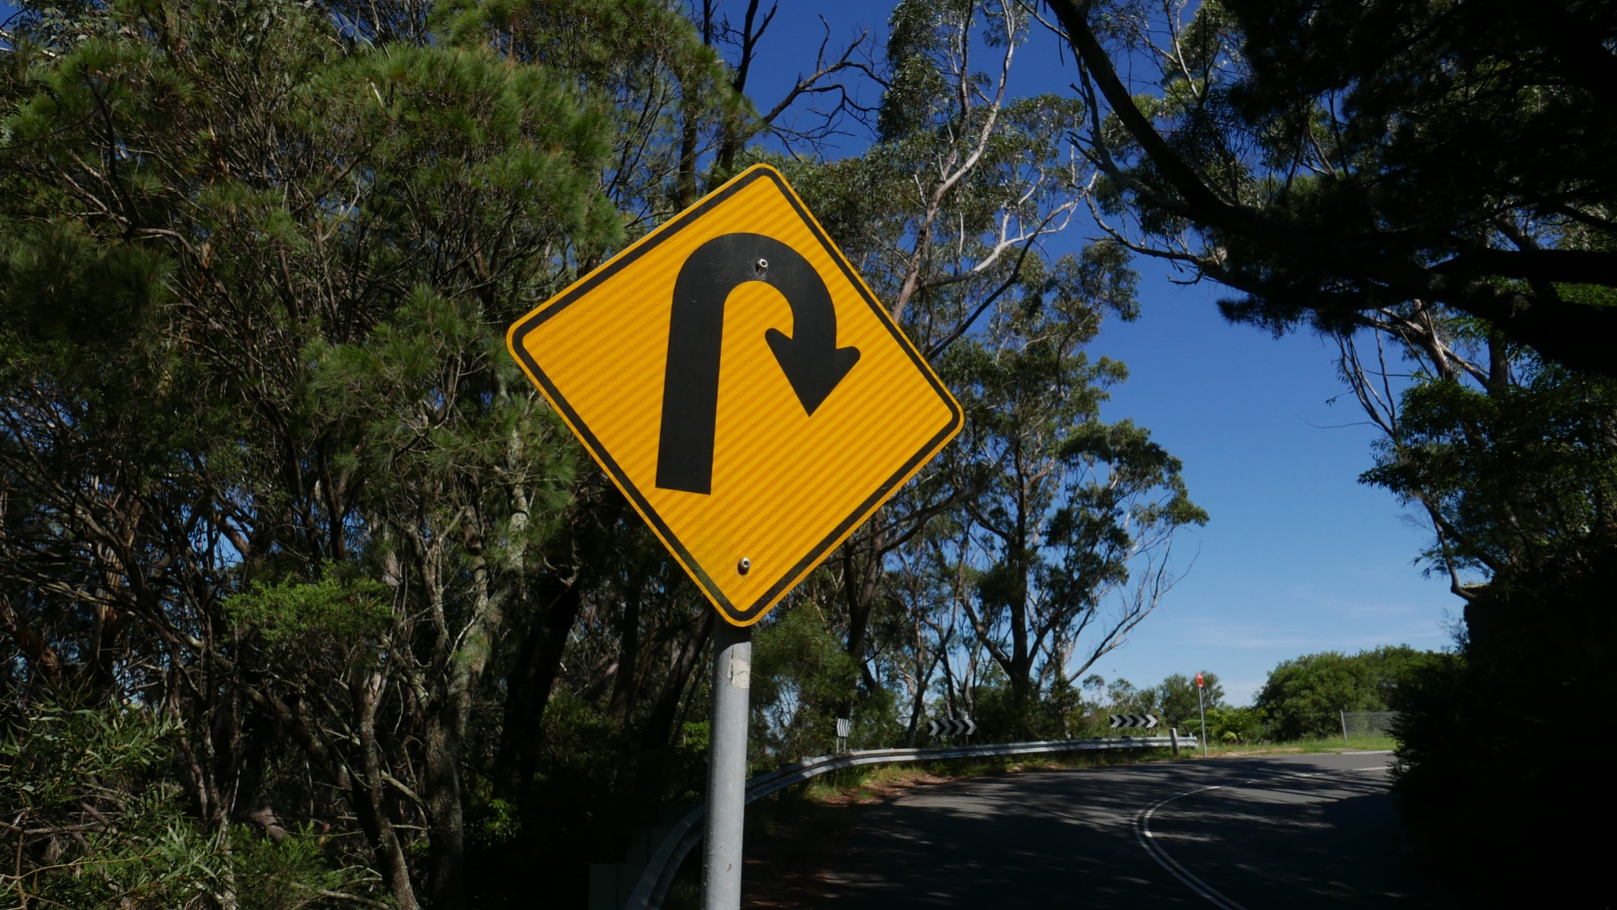
ᎯᏍᎩᏁ ᏣᎳᎩ ᎠᏕᎶᏆᏍᏗ
Unaktahvse, wuntohgiyastanv odalv junlenvhe.

Slide 12
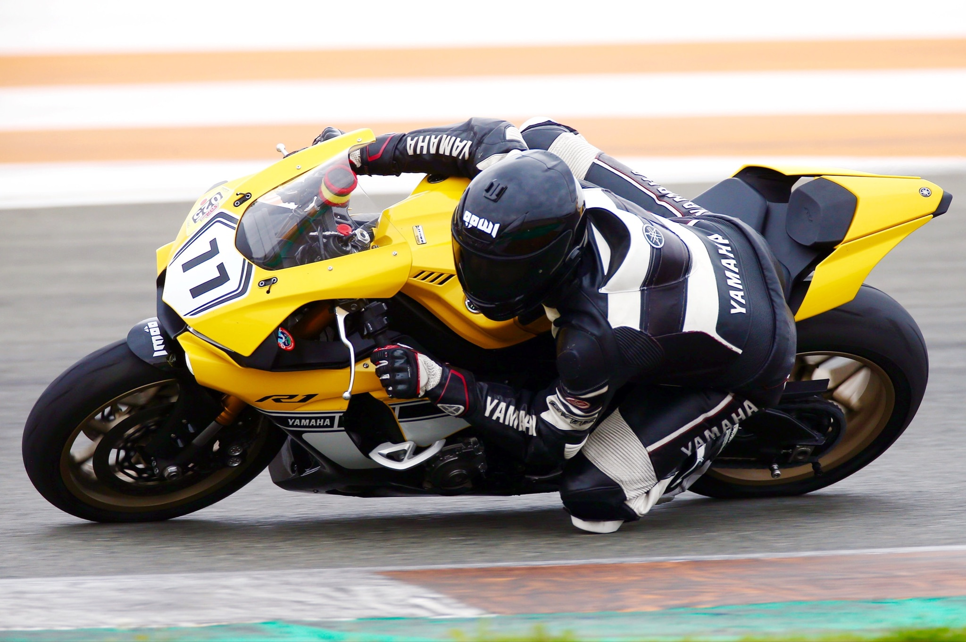
ᎯᏍᎩᏁ ᏣᎳᎩ ᎠᏕᎶᏆᏍᏗ
Ayetli tlv antohgiyasgv jutli utlisd uktahvse.

Slide 13
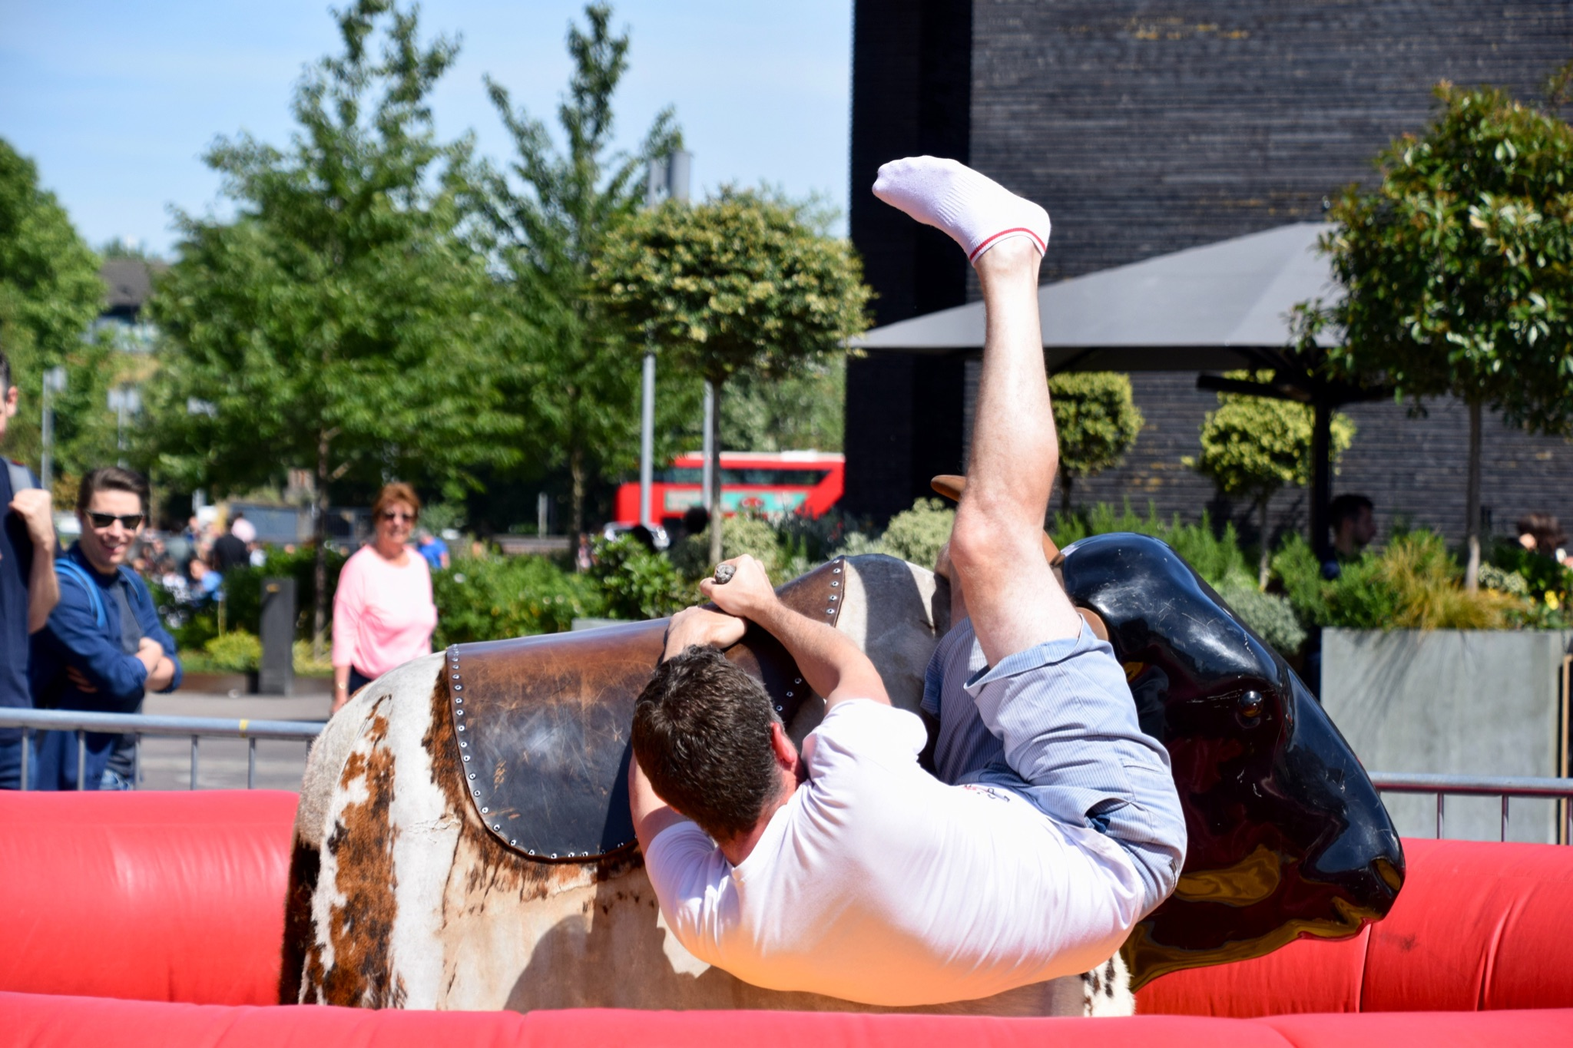
ᎯᏍᎩᏁ ᏣᎳᎩ ᎠᏕᎶᏆᏍᏗ
Na jisdvn hale wulo?se nowu sdayosv wajiniyvsele jutli ganidadv.

Slide 14
ᎯᏍᎩᏁ ᏣᎳᎩ ᎠᏕᎶᏆᏍᏗ
Usquanikd uyelvse jutli na jisdvn wulujvsquu.
Jutli utvdvne na jisdvn “siquu inatogiya.”
Unaktahvse, wuntohgiyastanv odalv junlenvhe.
Ayetli tlv antohgiyasgv jutli utlisd uktahvse.
Na jisdvn hale wulo?se nowu sdayosv wajiniyvsele jutli ganidadv.

Slide 15
ᎯᏍᎩᏁ ᏣᎳᎩ ᎠᏕᎶᏆᏍᏗ
ᎤᏍᏆᏂᎪᏓ ᎤᏰᎸᏎ ᏧᏟ Ꮎ ᏥᏍᏛᎾ ᏭᎷᏨᏍᏊ.ᏧᏟ ᎤᏛᏛᏁ Ꮎ ᏥᏍᏛᎾ “ᏏᏊ ᎢᎾᏙᎩᏯ.”ᎤᎾᎧᏔᎲᏎ, ᏭᎾᏙᎩᏯᏍᏔᏅ ᎣᏓᎸ ᏧᎾᎴᏅᎮ.ᎠᏰᏟ Ꮲ ᎠᎾᏙᎩᏯᏍᎬ ᏧᏟ ᎤᏟᏍᏗ ᎤᎧᏔᎲᏎ.
Ꮎ ᏥᏍᏛᎾ ᎭᎴ ᏭᎶᏎ ᏃᏭ ᏍᏓᏲᏒ ᏩᏥᏂᏴᏎᎴ ᏧᏟ ᎦᏂᏓᏛ.

Slide 16
ᎯᏍᎩᏁ ᏣᎳᎩ ᎠᏕᎶᏆᏍᏗ
ᎢᎸᎯᏳ ᏥᎨᏒ, ᏂᎦᏓ ᎢᎾᎨ ᎠᏁᎯ ᎡᎵ ᏓᎾᏝᏃᎮᏍᎬ. ᏌᏊ ᎢᎦ, ᏝᏬᏚᎯ ᎾᎥ ᎠᎹᏳᎵᏗ ᎠᏓᎾᏏᏂᏙᎲ ᏥᏍᏛᎾ. ᎾᎥ, ᏧᏟ ᏭᏬᏢ. ᎤᎾᎴᏅᎮ ᏓᎾᏝᏃᎲᏍᎬ. ᏧᏟ ᏥᏍᏛᎾ ᎤᏛᏛᏁ, “ᏙᏳᏍ ᎯᏌᏄᎵ ᎦᏙ ᎠᎴ ᎠᎹᏱᎨ ᎯᏌᏄᎵ.”
“ᎥᎥ,” ᎤᏛᏁ ᏥᏍᏛᎾ. “ᎤᏠᏱ ᏥᏌᏄᎵ ᎦᏙ ᎠᎴ ᎠᎹᏱ.”
ᏧᏟ Ꮭ ᏳᏬᎯᏳᏁ. ᎤᏂᏙᎩᏯᏍᏗ ᏚᏄᎪᏔᏁ ᏧᏟ ᎠᎴ ᏥᏍᏛᎾ.

Slide 17
ᎯᏍᎩᏁ ᏣᎳᎩ ᎠᏕᎶᏆᏍᏗ
ᎦᎵᏉᎩ ᎦᏚᏏ ᏚᏄᎧᏔᏁ ᏭᎾᏢᏍᏗ. ᎠᎬᏱ ᏫᎦᎷᏨ ᎦᎵᏉᎩᏁ ᎦᏚᏏ, ᏫᏗᎨᏡᎲᏍᎨᏍᏗ. ᎤᏓᏠᏒ ᎨᏎᏍᏗ. ᎦᏚ ᎦᎸᎳᏗ ᎣᏓᎸ ᏭᏂᎶᏒ. ᎦᎵᏉᎩ ᎦᏚᏏ ᏚᏂᏑᏰᏒ ᏭᎾᏢᏍᏗ.

Slide 18
ᎯᏍᎩᏁ ᏣᎳᎩ ᎠᏕᎶᏆᏍᏗ
ᎤᎾᎴᏅᎮ, ᎤᏍᎦᏃᎵ ᎨᏎ ᏥᏍᏛᎾ.ᏧᏟ ᎤᎶᎯᏎᎴ ᏥᏍᏛᎾ.
ᏥᏍᏛᎾ ᏩᏥᏂᏴᏎᎸ ᏧᏟ ᎦᏂᏓᏛ, ᎾᎥ ᎤᎶᏎ. ᎦᏂᏓᏛ ᏭᎩᎸᎮ ᏥᏍᏛᎾ. ᎤᏟᏍᏗ ᏧᏟ ᏭᏢᏍᏔᏅ. ᏧᏟ ᎦᏂᏓᏛ ᎤᎩᎶ ᏥᏍᏛᎾ. ᏭᏂᎷᏨ ᎦᎵᏉᎩᏁ ᎦᏚᏏ ᏧᏟ ᎤᏪᏡᏁ. ᏥᏍᏛᎾ ᎾᎥ ᎤᏪᏡᏁᏍᏊ.

Slide 19
ᎯᏍᎩᏁ ᏣᎳᎩ ᎠᏕᎶᏆᏍᏗ
ᎤᏍᏆᏂᎪᏓ ᎤᏰᎸᏎ ᏧᏟ Ꮎ ᏥᏍᏛᎾ ᏭᎷᏨᏍᏊ.ᏧᏟ ᎤᏛᏛᏁ Ꮎ ᏥᏍᏛᎾ “ᏏᏊ ᎢᎾᏙᎩᏯ.”ᎤᎾᎧᏔᎲᏎ, ᏭᎾᏙᎩᏯᏍᏔᏅ ᎣᏓᎸ ᏧᎾᎴᏅᎮ.ᎠᏰᏟ Ꮲ ᎠᎾᏙᎩᏯᏍᎬ ᏧᏟ ᎤᏟᏍᏗ ᎤᎧᏔᎲᏎ.
Ꮎ ᏥᏍᏛᎾ ᎭᎴ ᏭᎶᏎ ᏃᏭ ᏍᏓᏲᏒ ᏩᏥᏂᏴᏎᎴ ᏧᏟ ᎦᏂᏓᏛ.

Slide 20
ᎯᏍᎩᏁ ᏣᎳᎩ ᎠᏕᎶᏆᏍᏗ
ᎤᏍᏆᏂᎪᏗ- surprised/ amazed/ wonderful/ interesting
ᎢᎾᏙᎩᏯ- let’s race
ᎤᎾᎧᏔᎲᏎ- they turned around
ᏧᎾᎴᏅᎮ- where they started
Ꮲ- somewhere
ᎭᎴ- almost
ᏭᎶᏎ- he/she fell
ᏍᏓᏲᏒ- firm, tenacious, solid

