Slide 1
ᎣᏏᏲ
ᏑᏓᎵᏁ ᏣᎳᎩ ᎠᏕᎶᏆᏍᏗ

Slide 2
ᏑᏓᎵᏁ ᏣᎳᎩ ᎠᏕᎶᏆᏍᏗ
ᎢᏓᎴᎾ- Let’s begin
ᏣᎳᎩ ᎢᏗᏬᏂ- Let’s talk Cherokee

Slide 3
ᏑᏓᎵᏁ ᏣᎳᎩ ᎠᏕᎶᏆᏍᏗ
Hello everyone
My name is ______ I am ______ years old.
I am Cherokee. (mixed. Full blood. half) I am not Cherokee.
I am from _______ and I live in
I work at _________
My moms name is_______ and my dads name is ______
I am married

Slide 4
ᏑᏓᎵᏁ ᏣᎳᎩ ᎠᏕᎶᏆᏍᏗ
(ᎢᏯ)ᎠᏩᏕᏘᏴᏓ- I am_______ years old

Slide 5
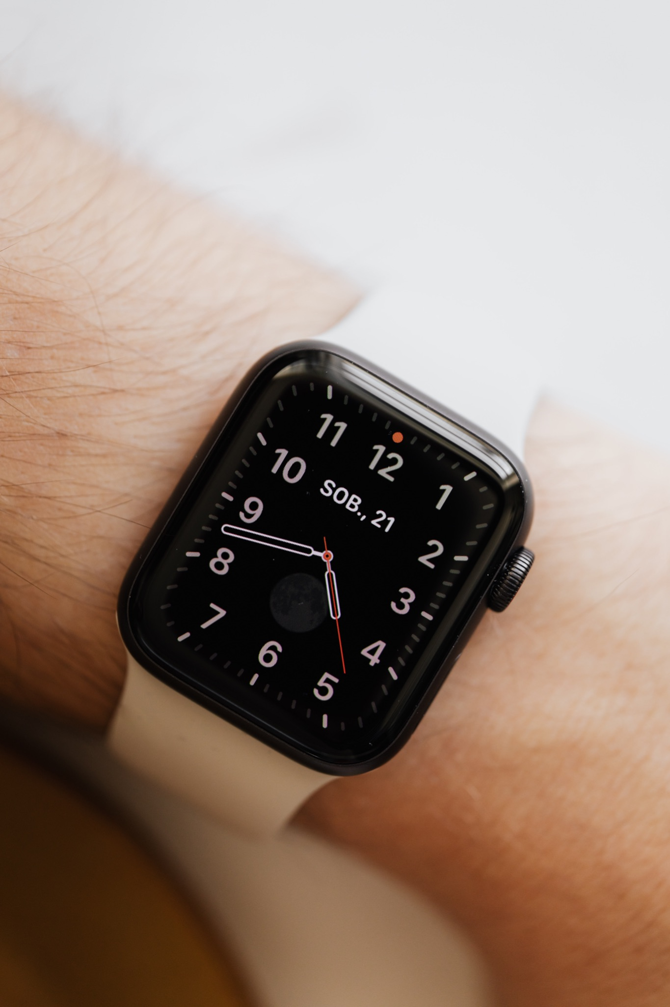
ᏑᏓᎵᏁ ᏣᎳᎩ ᎠᏕᎶᏆᏍᏗ
ᏄᎳ-
hurry/ come here (slang)

Slide 6
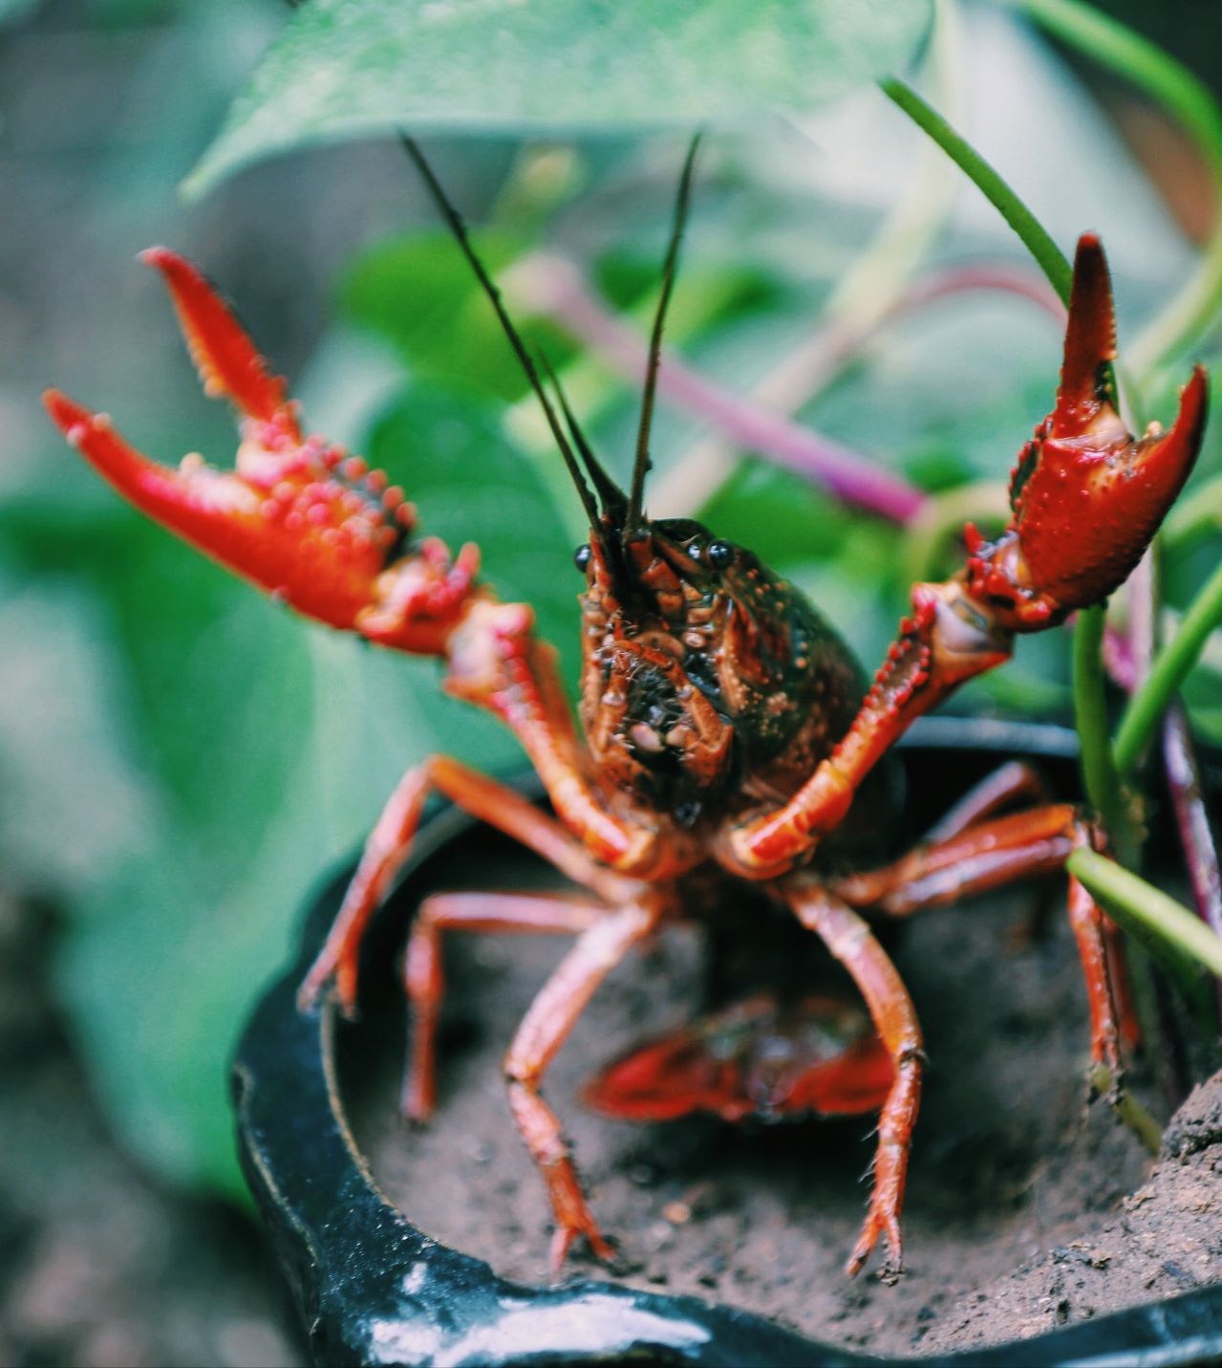
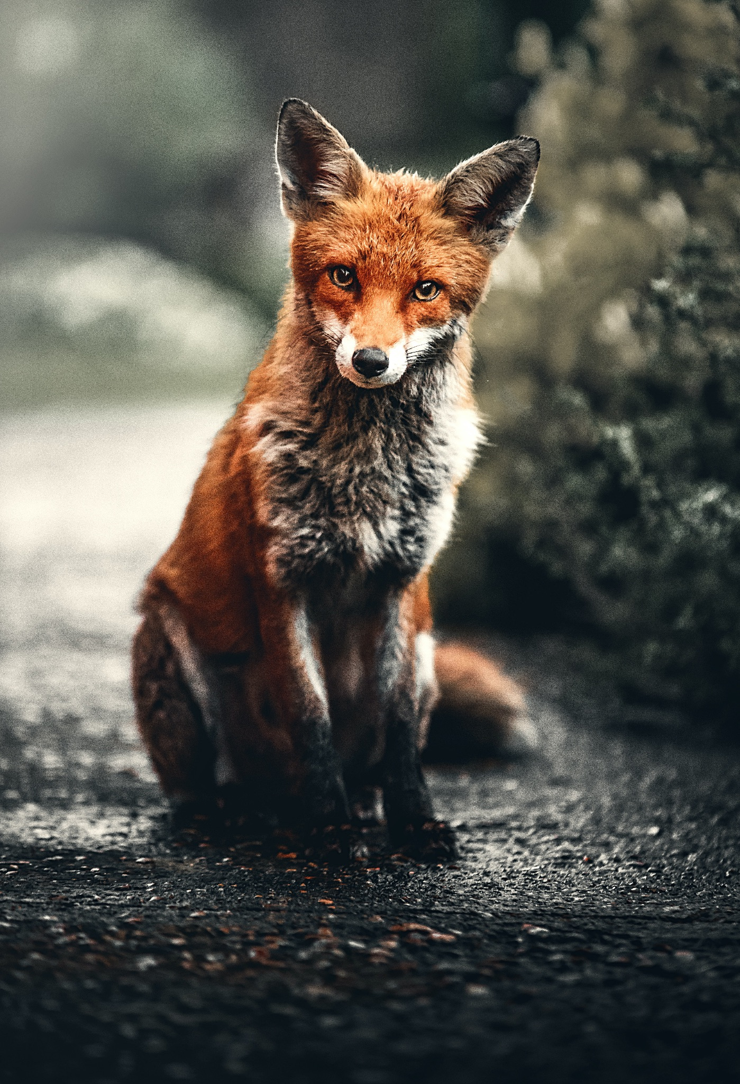
ᏑᏓᎵᏁ ᏣᎳᎩ ᎠᏕᎶᏆᏍᏗ
ᎢᎸᎯᏳ ᏥᎨᏒ, ᏂᎦᏓ ᎢᎾᎨ ᎠᏁᎯ ᎡᎵ ᏓᎾᏝᏃᎮᏍᎬ. ᏌᏊ ᎢᎦ, ᏝᏬᏚᎯ ᎾᎥ ᎠᎹᏳᎵᏗ ᎠᏓᎾᏏᏂᏙᎲ ᏥᏍᏛᎾ. ᎾᎥ, ᏧᏟ ᏭᏬᏢ. ᎤᎾᎴᏅᎮ ᏓᎾᏝᏃᎲᏍᎬ. ᏧᏟ ᏥᏍᏛᎾ ᎤᏛᏛᏁ, “ᏙᏳᏍ ᎯᏌᏄᎵ ᎦᏙ ᎠᎴ ᎠᎹᏱᎨ ᎯᏌᏄᎵ.”
“ᎥᎥ,” ᎤᏛᏁ ᏥᏍᏛᎾ. “ᎤᏠᏱ ᏥᏌᏄᎵ ᎦᏙ ᎠᎴ ᎠᎹᏱ.”
ᏧᏟ Ꮭ ᏳᏬᎯᏳᏁ. ᎤᏂᏙᎩᏯᏍᏗ ᏚᏄᎪᏔᏁ ᏧᏟ ᎠᎴ ᏥᏍᏛᎾ.

Slide 7
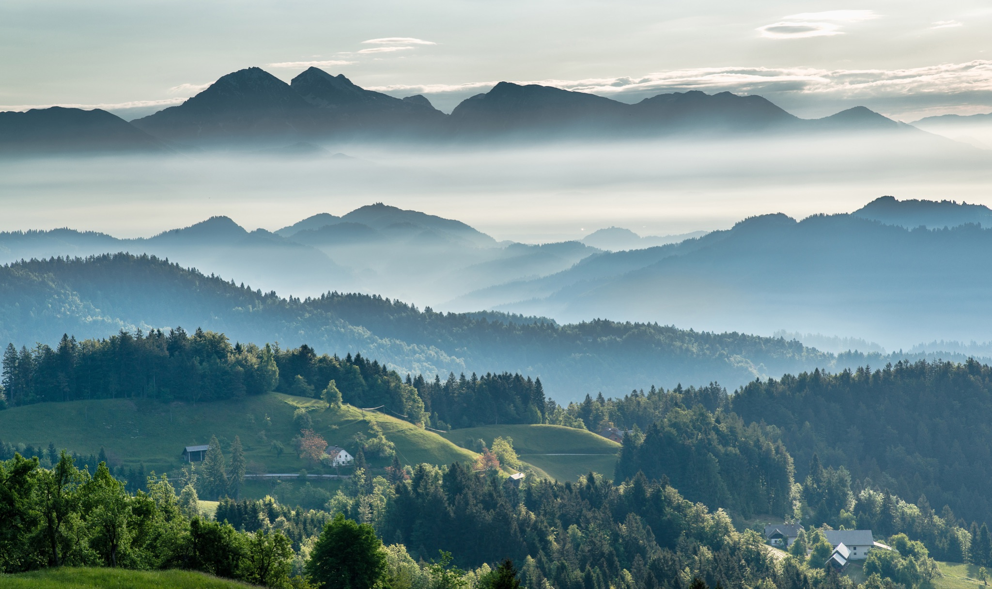
ᏑᏓᎵᏁ ᏣᎳᎩ ᎠᏕᎶᏆᏍᏗ
ᎦᎵᏉᎩ ᎦᏚᏏ ᏚᏄᎧᏔᏁ ᏭᎾᏢᏍᏗ. ᎠᎬᏱ ᏫᎦᎷᏨ ᎦᎵᏉᎩᏁ ᎦᏚᏏ, ᏫᏗᎨᏡᎲᏍᎨᏍᏗ. ᎤᏓᏠᏒ ᎨᏎᏍᏗ. ᎦᏚ ᎦᎸᎳᏗ ᎣᏓᎸ ᏭᏂᎶᏒ. ᎦᎵᏉᎩ ᎦᏚᏏ ᏚᏂᏑᏰᏒ ᏭᎾᏢᏍᏗ.

Slide 8
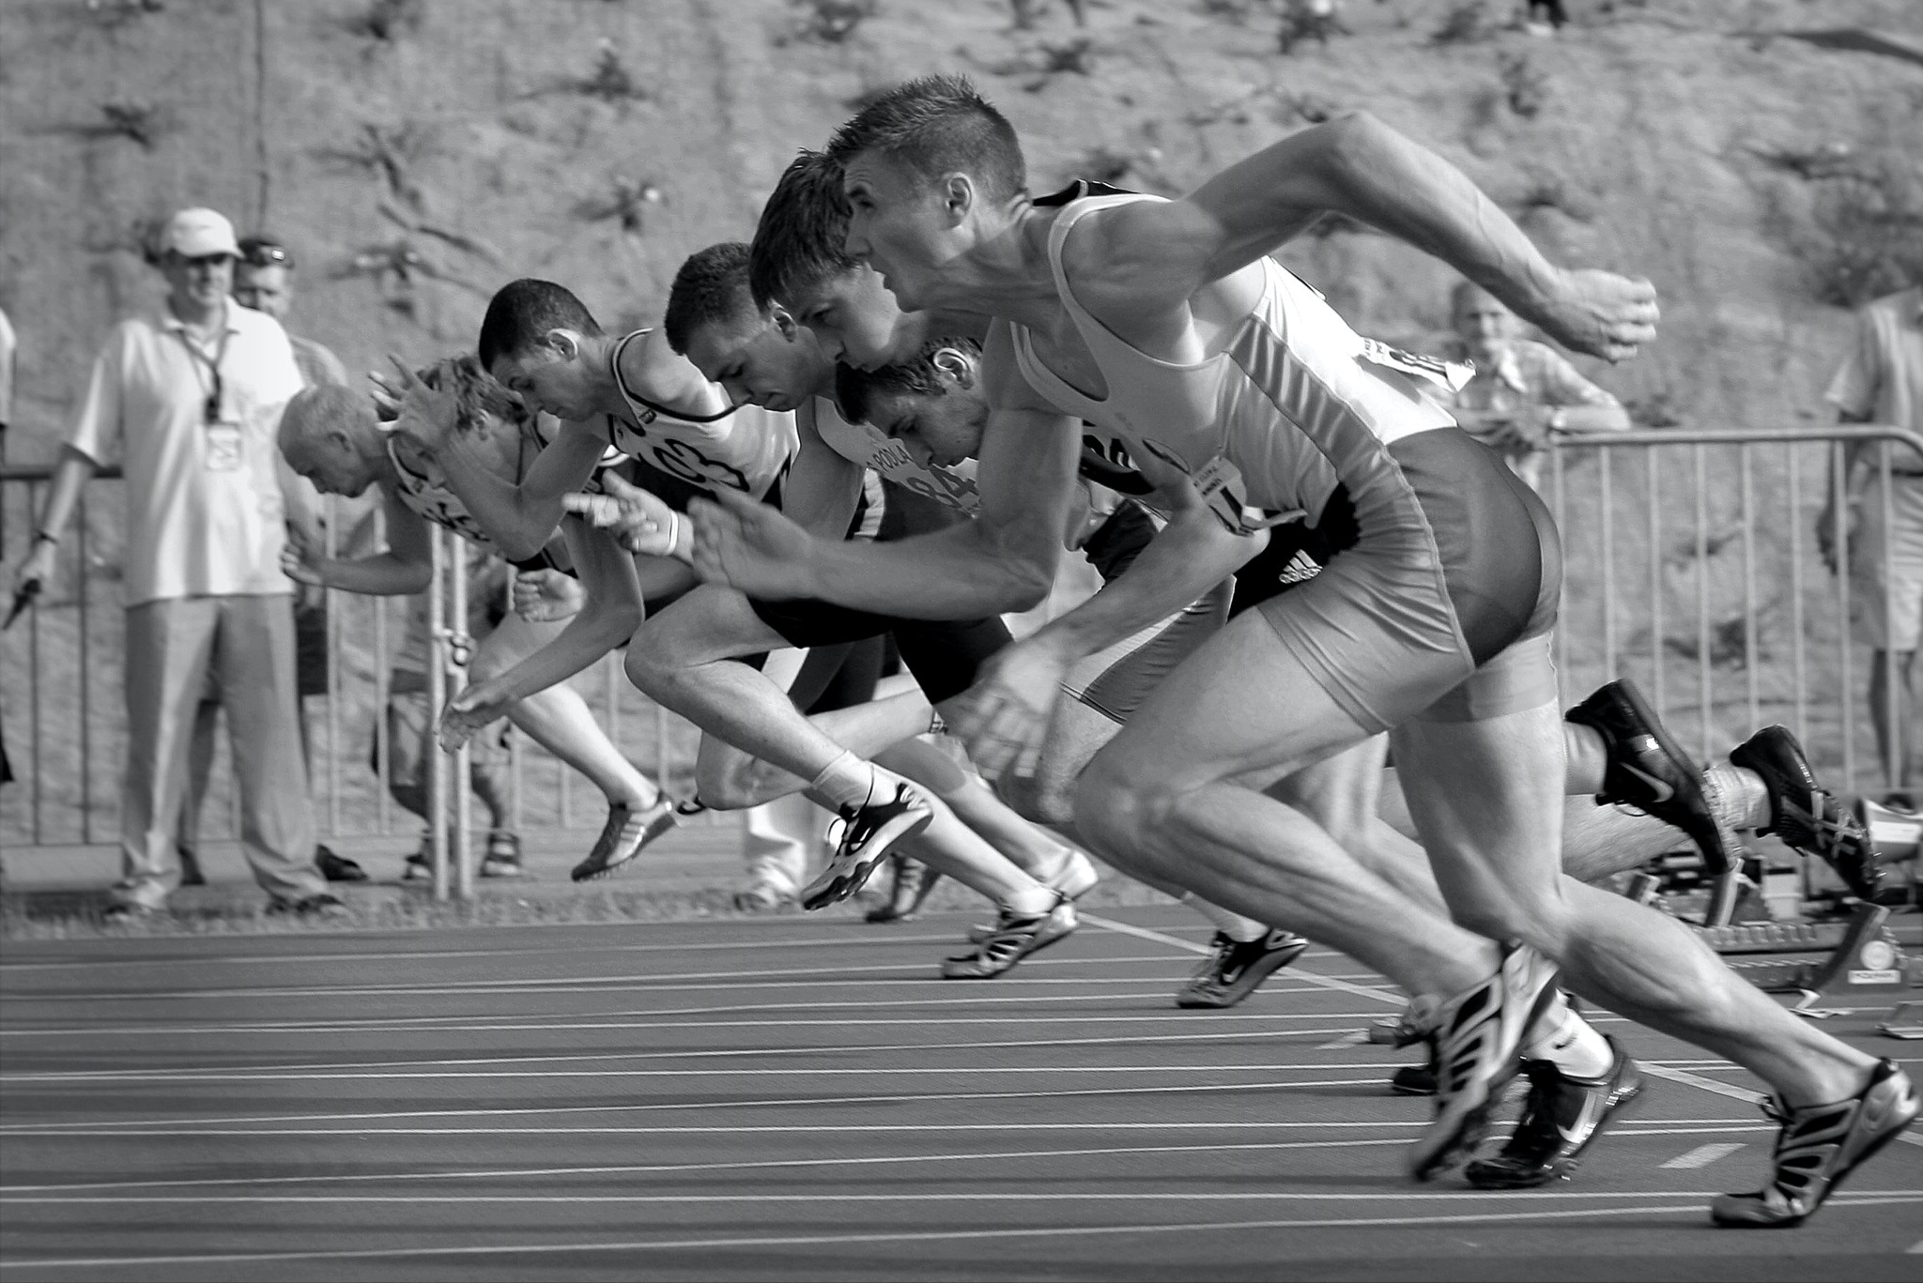
ᏑᏓᎵᏁ ᏣᎳᎩ ᎠᏕᎶᏆᏍᏗ
ᎤᎾᎴᏅᎮ, ᎤᏍᎦᏃᎵ ᎨᏎ ᏥᏍᏛᎾ.ᏧᏟ ᎤᎶᎯᏎᎴ ᏥᏍᏛᎾ.
ᏥᏍᏛᎾ ᏩᏥᏂᏴᏎᎸ ᏧᏟ ᎦᏂᏓᏛ, ᎾᎥ ᎤᎶᏎ. ᎦᏂᏓᏛ ᏭᎩᎸᎮ ᏥᏍᏛᎾ. ᎤᏟᏍᏗ ᏧᏟ ᏭᏢᏍᏔᏅ. ᏧᏟ ᎦᏂᏓᏛ ᎤᎩᎶ ᏥᏍᏛᎾ. ᏭᏂᎷᏨ ᎦᎵᏉᎩᏁ ᎦᏚᏏ ᏧᏟ ᎤᏪᏡᏁ. ᏥᏍᏛᎾ ᎾᎥ ᎤᏪᏡᏁᏍᏊ.

Slide 9
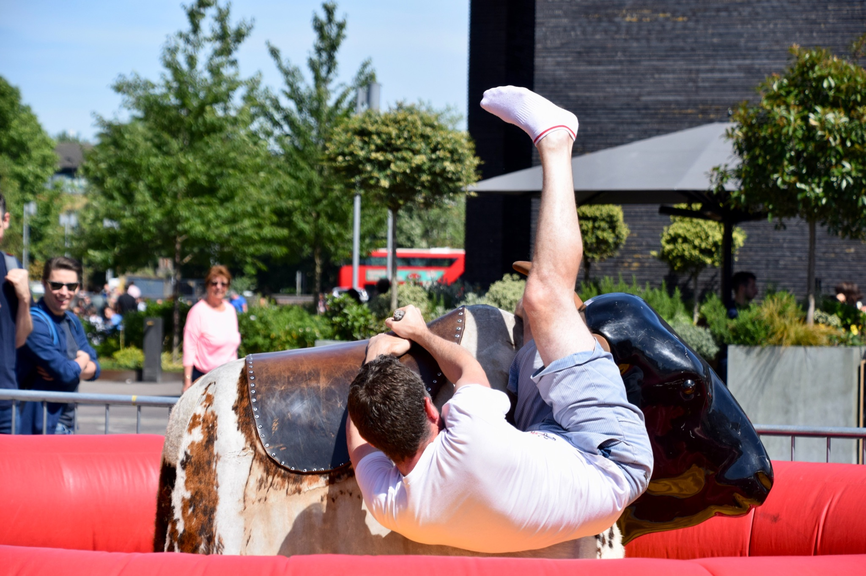
ᏑᏓᎵᏁ ᏣᎳᎩ ᎠᏕᎶᏆᏍᏗ
ᎤᏍᏆᏂᎪᏓ ᎤᏰᎸᏎ ᏧᏟ Ꮎ ᏥᏍᏛᎾ ᏭᎷᏨᏍᏊ.ᏧᏟ ᎤᏛᏛᏁ Ꮎ ᏥᏍᏛᎾ “ᏏᏊ ᎢᎾᏙᎩᏯ.”ᎤᎾᎧᏔᎲᏎ, ᏭᎾᏙᎩᏯᏍᏔᏅ ᎣᏓᎸ ᏧᎾᎴᏅᎮ.ᎠᏰᏟ Ꮲ ᎠᎾᏙᎩᏯᏍᎬ ᏧᏟ ᎤᏟᏍᏗ ᎤᎧᏔᎲᏎ.
Ꮎ ᏥᏍᏛᎾ ᎭᎴ ᏭᎶᏎ ᏃᏭ ᏍᏓᏲᏒ ᏩᏥᏂᏴᏎᎴ ᏧᏟ ᎦᏂᏓᏛ.

Slide 10
ᏑᏓᎵᏁ ᏣᎳᎩ ᎠᏕᎶᏆᏍᏗ
Vsgini nudvnel, kolvha wajiniyvselv ganidadv.

Slide 11
ᏑᏓᎵᏁ ᏣᎳᎩ ᎠᏕᎶᏆᏍᏗ
Jutli wuluje odalv wuwetlune, ale jisdvn wuwetlunesquu.

Slide 12
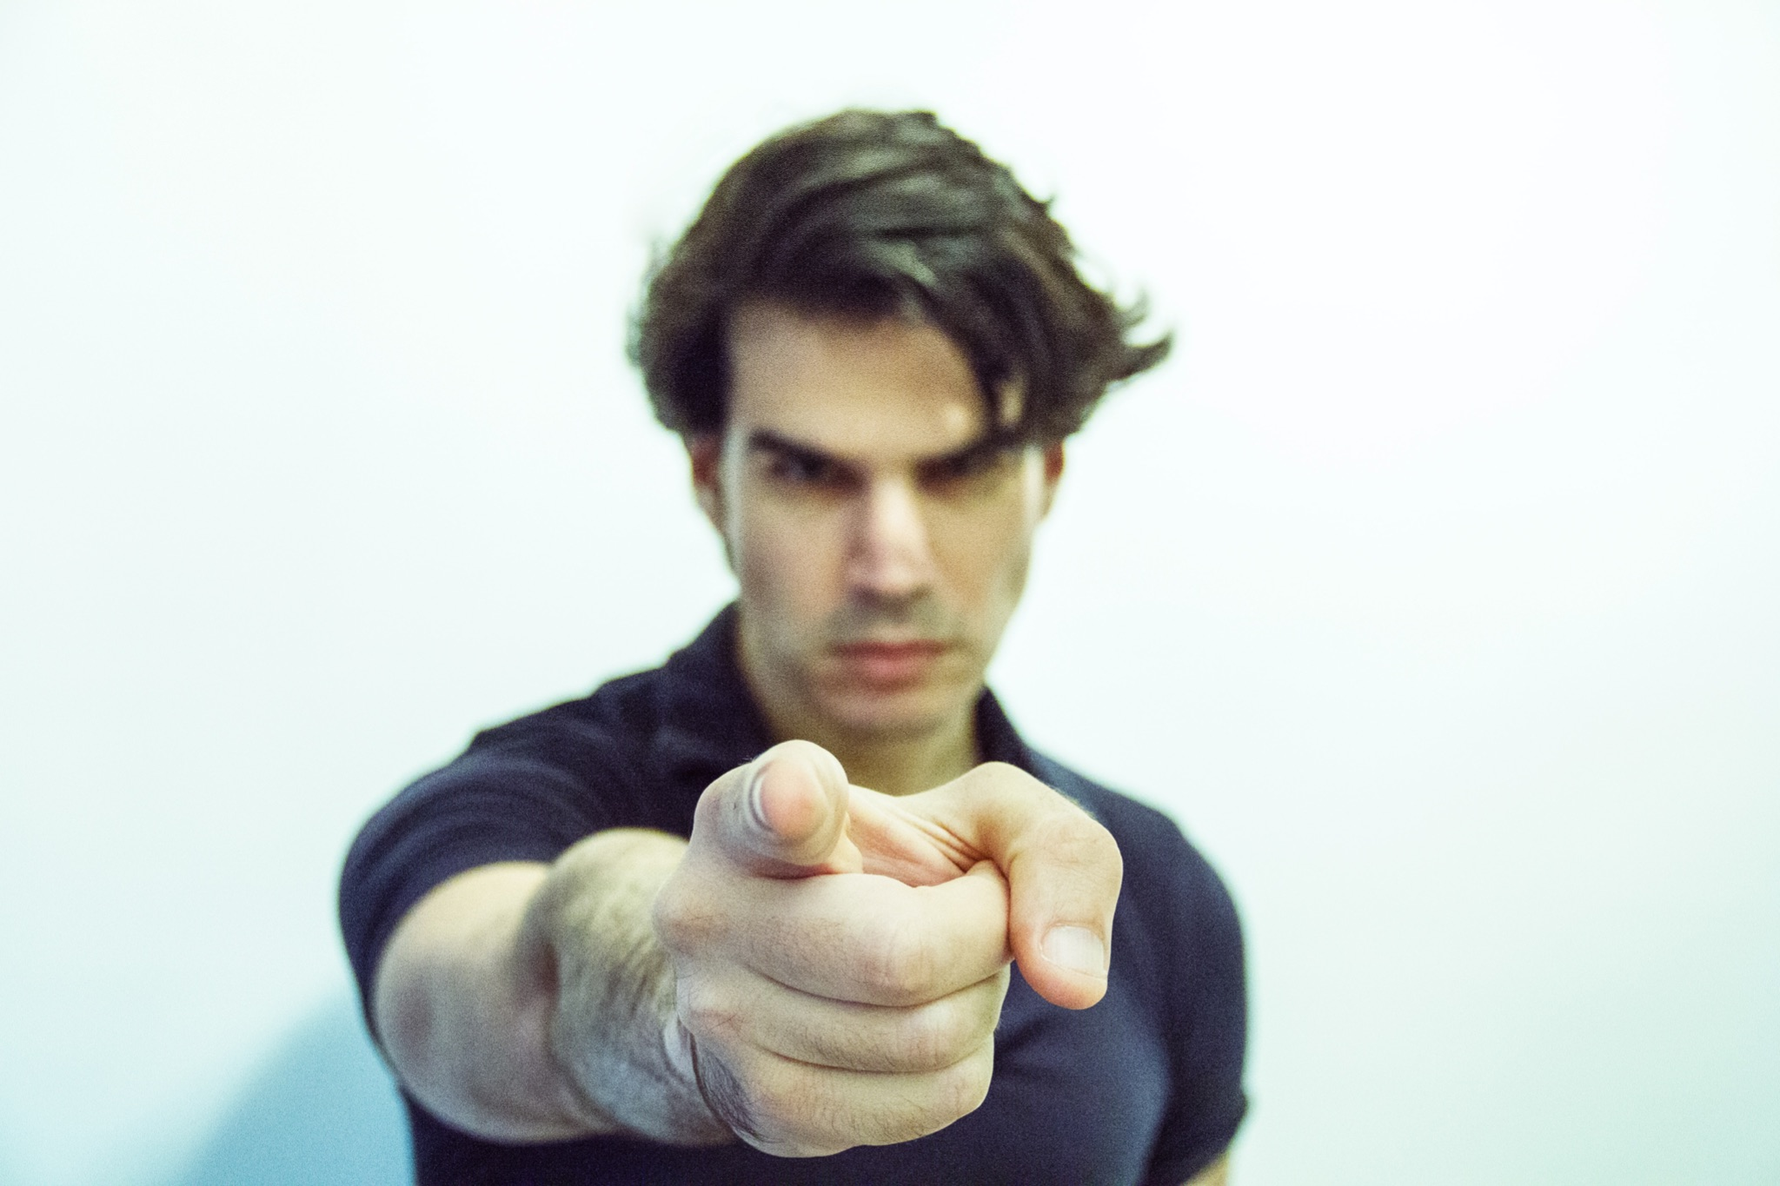
ᏑᏓᎵᏁ ᏣᎳᎩ ᎠᏕᎶᏆᏍᏗ
Jutli aguhistanv jisdvn galonuhesgv.

Slide 13
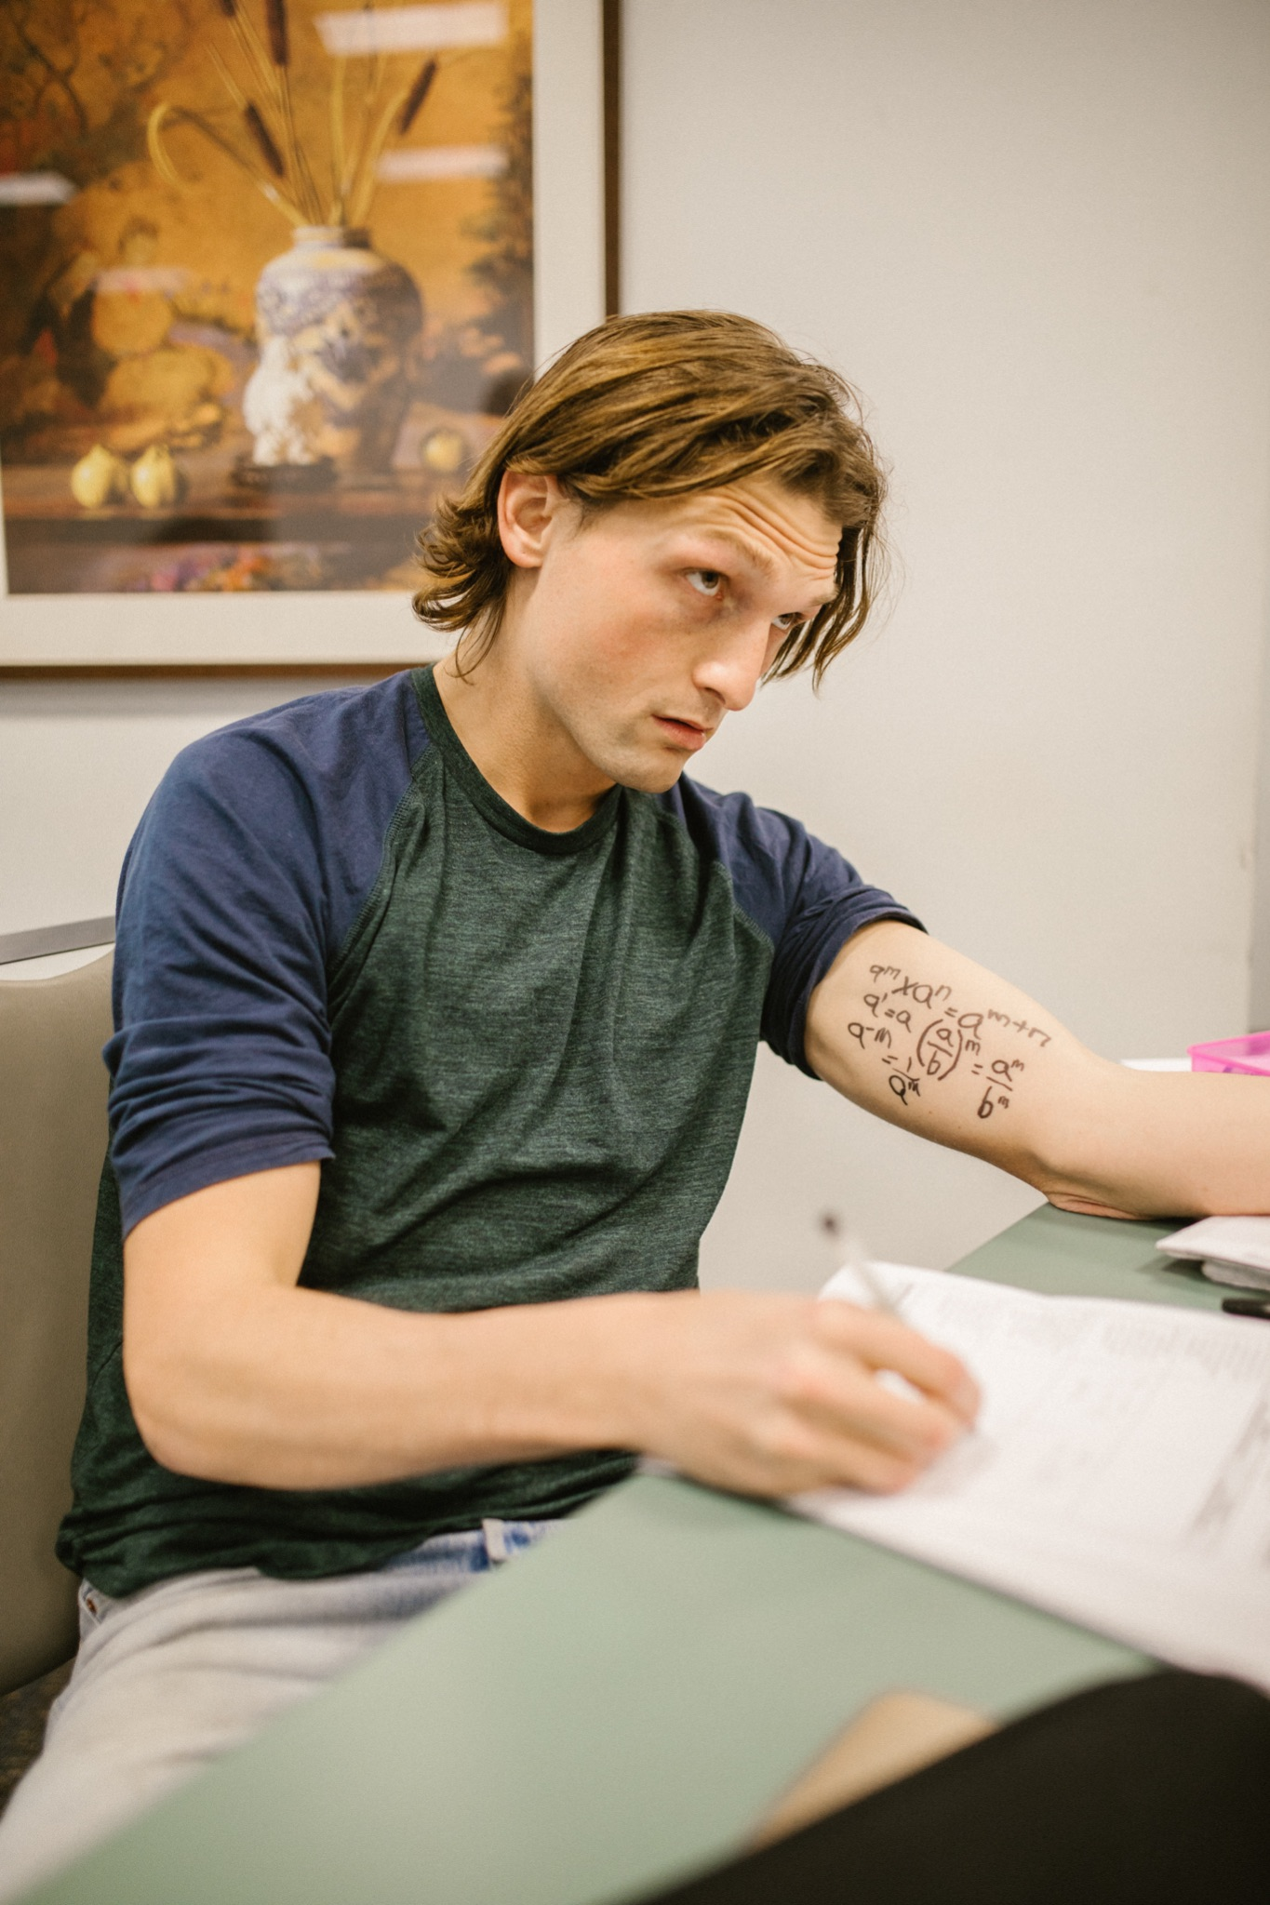
ᏑᏓᎵᏁ ᏣᎳᎩ ᎠᏕᎶᏆᏍᏗ
Jisdvn udahyilv ulonuhetlv.

Slide 14
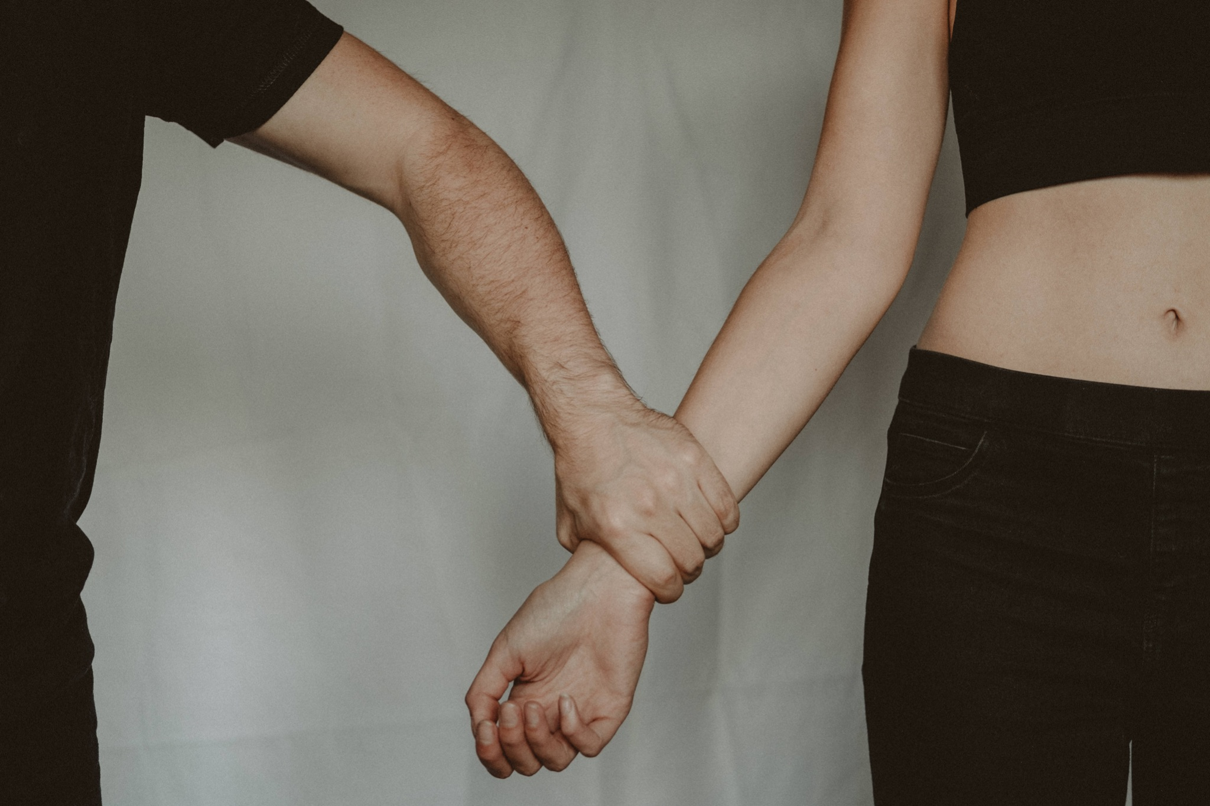
ᏑᏓᎵᏁ ᏣᎳᎩ ᎠᏕᎶᏆᏍᏗ
Jutli unosele jisdvn
“Agwant sginiyvselv jinidadv.”

Slide 15
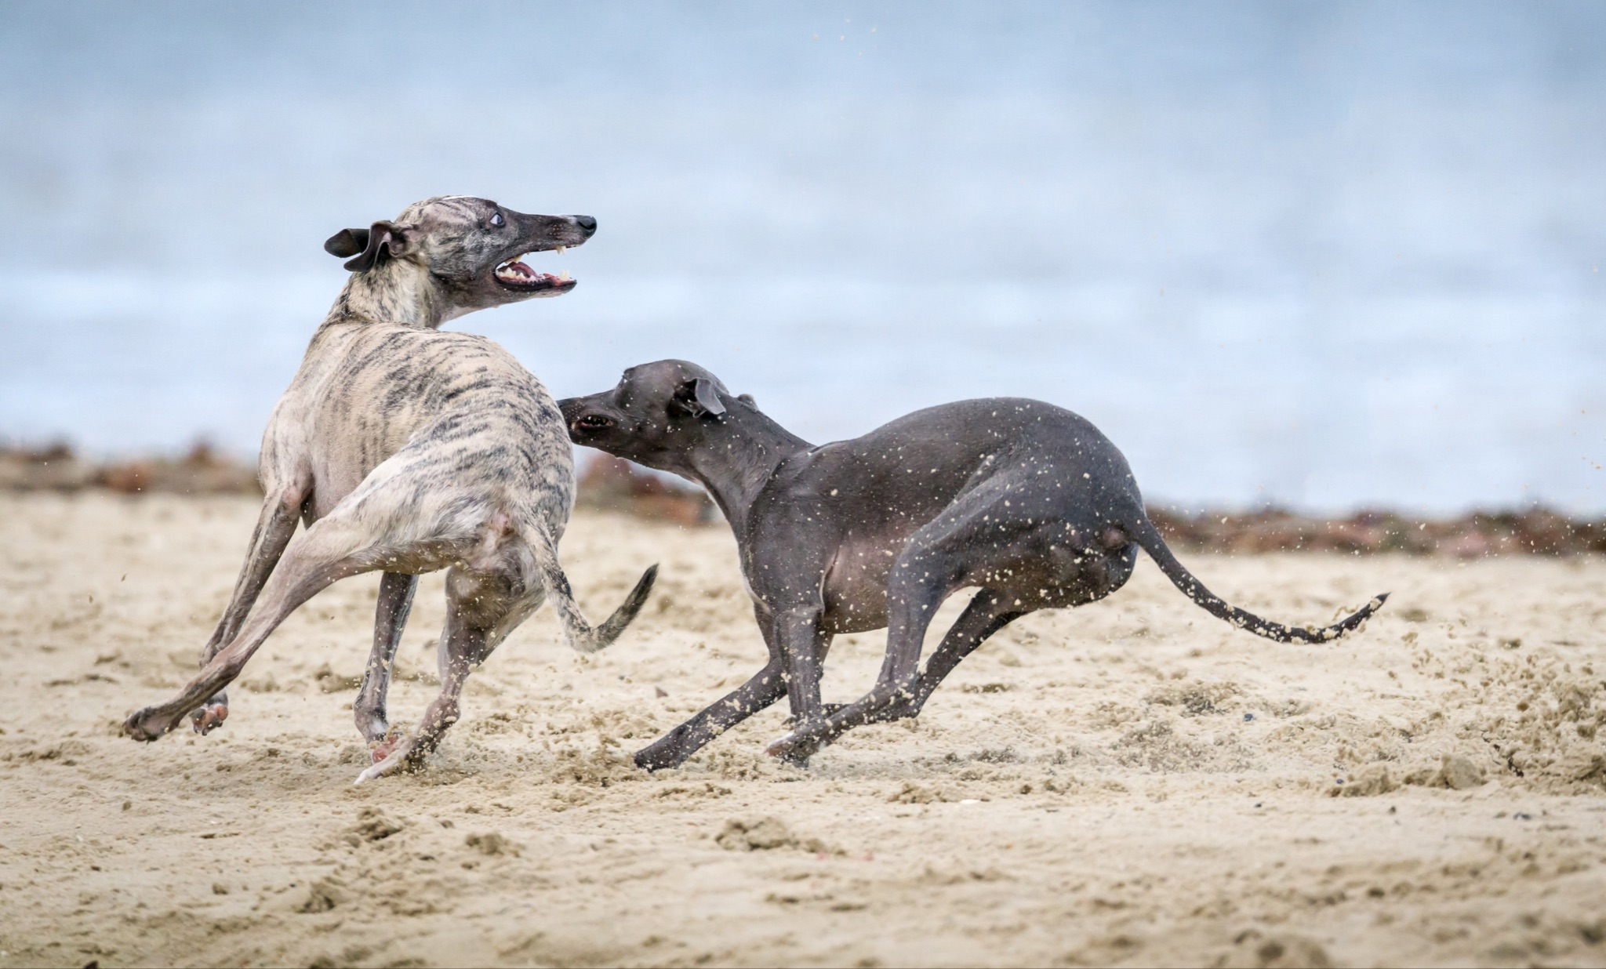
ᏑᏓᎵᏁ ᏣᎳᎩ ᎠᏕᎶᏆᏍᏗ
Jutli ajikehidolv jisdvn. Tlaskin eli yultise.

Slide 16
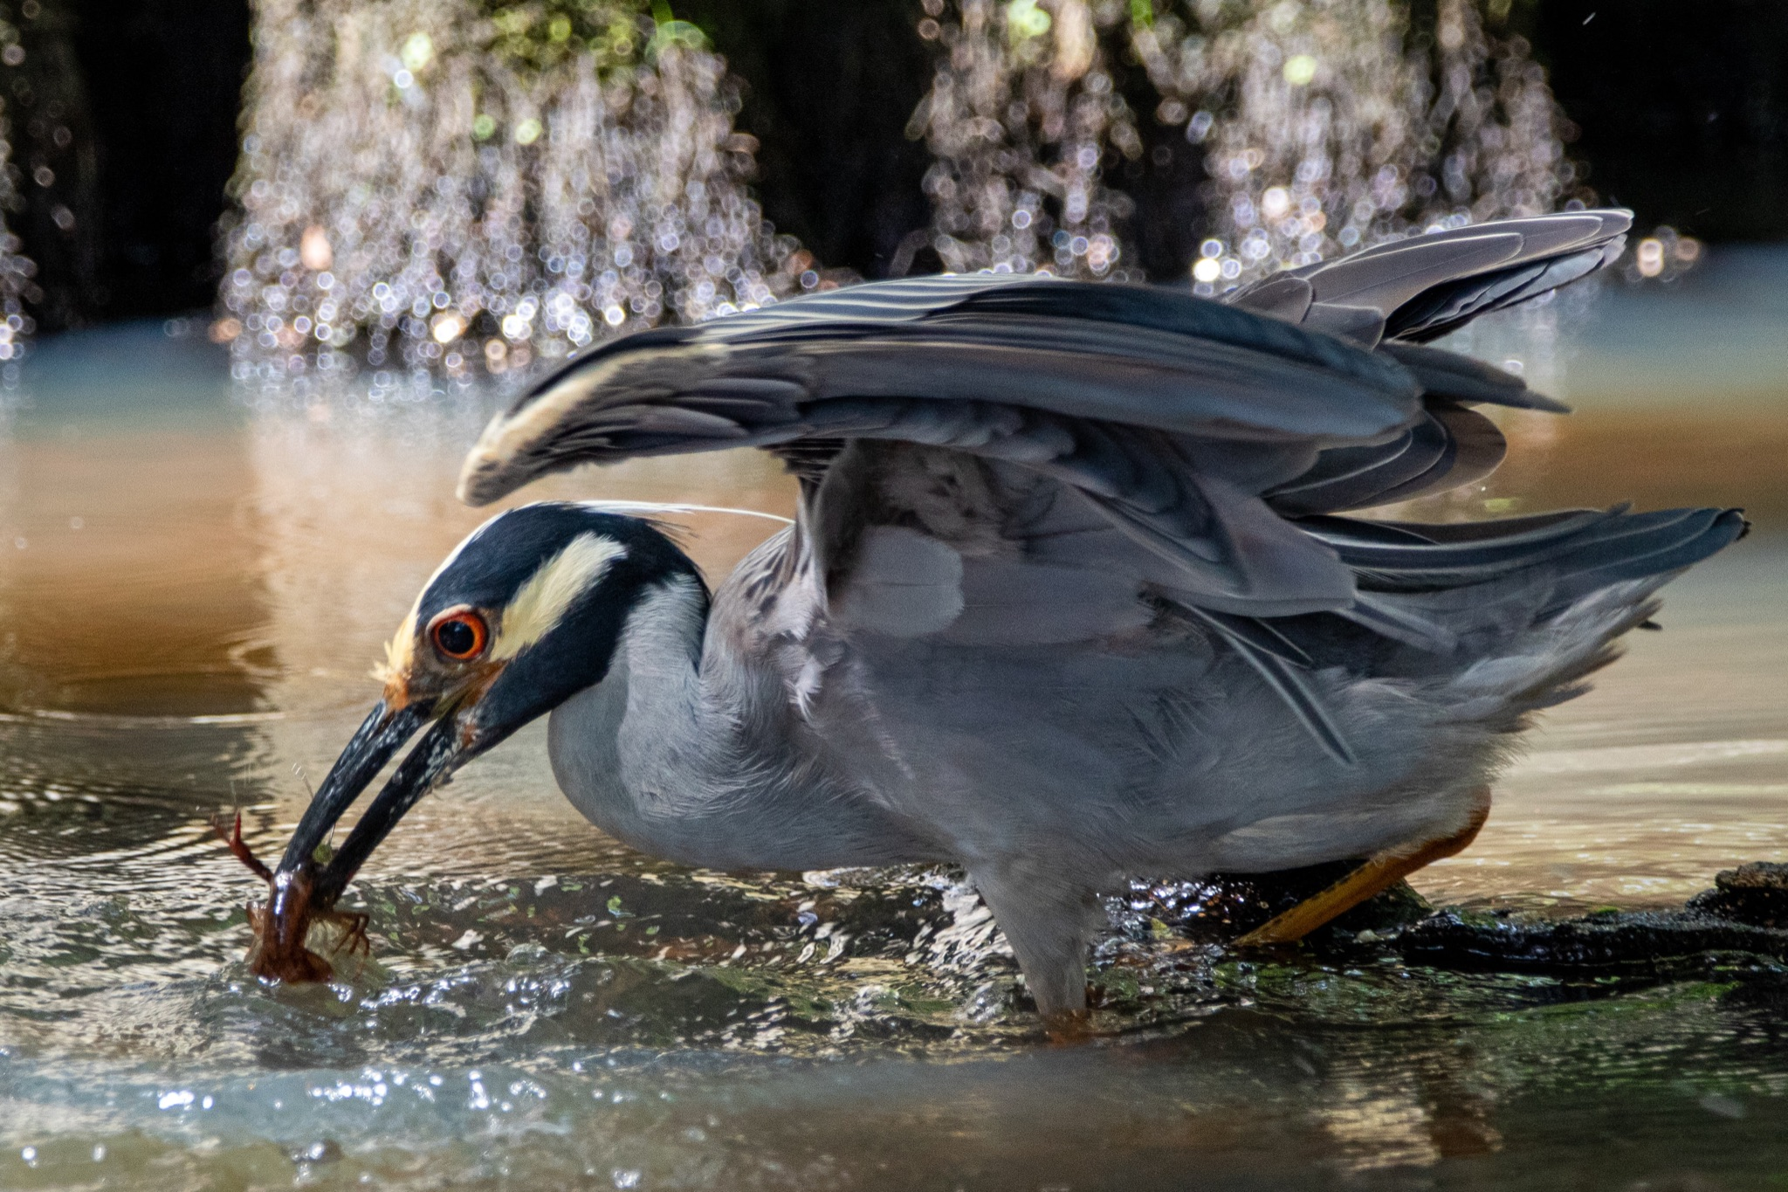
ᏑᏓᎵᏁ ᏣᎳᎩ ᎠᏕᎶᏆᏍᏗ
Jutli wajiyav jisdvn.

Slide 17
ᏑᏓᎵᏁ ᏣᎳᎩ ᎠᏕᎶᏆᏍᏗ
Vsgini nudvnel, kolvha wajiniyvselv ganidadv.
Jutli wuluje odalv wuwetlune, ale jisdvn wuwetlunesquu.
Jutli aguhistanv jisdvn galonuhesgv.
Jisdvn adahyilv ulonuhetlv.
Jutli unosele jisdvn “Agwant sginiyvselv jinidadv.”
Jutli ajikehidolv jisdvn. Tlaskin eli yultise.
Jutli wajiyav jisdvn.

Slide 18
ᏑᏓᎵᏁ ᏣᎳᎩ ᎠᏕᎶᏆᏍᏗ
ᎥᏍᎩᏂ ᏄᏛᏁᎴ, ᎪᎸᎭ ᏩᏥᏂᏴᏎᎸ ᎦᏂᏓᏛ. ᏧᏟ ᏭᎷᏤ ᎣᏓᎸ ᏭᏪᏡᏁ, ᎠᎴ ᏥᏍᏛᎾ ᏭᏪᏡᏁᏍᏊ. ᏧᏟ ᎠᎫᎯᏍᏔᏅ ᏥᏍᏛᎾ ᎦᎶᏄᎮᏍᎬ. ᏥᏍᏛᎾ ᎤᏓᎯᏱᎸ ᎤᎶᏄᎮᏢ. ᏧᏟ ᎤᏃᏎᎴ ᏥᏍᏛᎾ, “ᎠᏆᎾᏔ ᏍᎩᏂᏴᏎᎸ ᏥᏂᏓᏛ.”ᏧᏟ ᎠᏥᎨᎯᏙᎸ ᏥᏍᏛᎾ. ᏝᏍᎩᏂ ᎡᎵ ᏳᎵᏘᏎ. ᏧᏟ ᏩᏥᏯᎥ ᏥᏍᏛᎾ.

Slide 19
ᏑᏓᎵᏁ ᏣᎳᎩ ᎠᏕᎶᏆᏍᏗ
ᎢᎸᎯᏳ ᏥᎨᏒ, ᏂᎦᏓ ᎢᎾᎨ ᎠᏁᎯ ᎡᎵ ᏓᎾᏝᏃᎮᏍᎬ. ᏌᏊ ᎢᎦ, ᏝᏬᏚᎯ ᎾᎥ ᎠᎹᏳᎵᏗ ᎠᏓᎾᏏᏂᏙᎲ ᏥᏍᏛᎾ. ᎾᎥ, ᏧᏟ ᏭᏬᏢ. ᎤᎾᎴᏅᎮ ᏓᎾᏝᏃᎲᏍᎬ. ᏧᏟ ᏥᏍᏛᎾ ᎤᏛᏛᏁ, “ᏙᏳᏍ ᎯᏌᏄᎵ ᎦᏙ ᎠᎴ ᎠᎹᏱᎨ ᎯᏌᏄᎵ.”
“ᎥᎥ,” ᎤᏛᏁ ᏥᏍᏛᎾ. “ᎤᏠᏱ ᏥᏌᏄᎵ ᎦᏙ ᎠᎴ ᎠᎹᏱ.”
ᏧᏟ Ꮭ ᏳᏬᎯᏳᏁ. ᎤᏂᏙᎩᏯᏍᏗ ᏚᏄᎪᏔᏁ ᏧᏟ ᎠᎴ ᏥᏍᏛᎾ.

Slide 20
ᏑᏓᎵᏁ ᏣᎳᎩ ᎠᏕᎶᏆᏍᏗ
ᎦᎵᏉᎩ ᎦᏚᏏ ᏚᏄᎧᏔᏁ ᏭᎾᏢᏍᏗ. ᎠᎬᏱ ᏫᎦᎷᏨ ᎦᎵᏉᎩᏁ ᎦᏚᏏ, ᏫᏗᎨᏡᎲᏍᎨᏍᏗ. ᎤᏓᏠᏒ ᎨᏎᏍᏗ. ᎦᏚ ᎦᎸᎳᏗ ᎣᏓᎸ ᏭᏂᎶᏒ. ᎦᎵᏉᎩ ᎦᏚᏏ ᏚᏂᏑᏰᏒ ᏭᎾᏢᏍᏗ.

Slide 21
ᏑᏓᎵᏁ ᏣᎳᎩ ᎠᏕᎶᏆᏍᏗ
ᎤᎾᎴᏅᎮ, ᎤᏍᎦᏃᎵ ᎨᏎ ᏥᏍᏛᎾ.ᏧᏟ ᎤᎶᎯᏎᎴ ᏥᏍᏛᎾ.
ᏥᏍᏛᎾ ᏩᏥᏂᏴᏎᎸ ᏧᏟ ᎦᏂᏓᏛ, ᎾᎥ ᎤᎶᏎ. ᎦᏂᏓᏛ ᏭᎩᎸᎮ ᏥᏍᏛᎾ. ᎤᏟᏍᏗ ᏧᏟ ᏭᏢᏍᏔᏅ. ᏧᏟ ᎦᏂᏓᏛ ᎤᎩᎶ ᏥᏍᏛᎾ. ᏭᏂᎷᏨ ᎦᎵᏉᎩᏁ ᎦᏚᏏ ᏧᏟ ᎤᏪᏡᏁ. ᏥᏍᏛᎾ ᎾᎥ ᎤᏪᏡᏁᏍᏊ.

Slide 22
ᏑᏓᎵᏁ ᏣᎳᎩ ᎠᏕᎶᏆᏍᏗ
ᎤᏍᏆᏂᎪᏓ ᎤᏰᎸᏎ ᏧᏟ Ꮎ ᏥᏍᏛᎾ ᏭᎷᏨᏍᏊ.ᏧᏟ ᎤᏛᏛᏁ Ꮎ ᏥᏍᏛᎾ “ᏏᏊ ᎢᎾᏙᎩᏯ.”ᎤᎾᎧᏔᎲᏎ, ᏭᎾᏙᎩᏯᏍᏔᏅ ᎣᏓᎸ ᏧᎾᎴᏅᎮ.ᎠᏰᏟ Ꮲ ᎠᎾᏙᎩᏯᏍᎬ ᏧᏟ ᎤᏟᏍᏗ ᎤᎧᏔᎲᏎ.
Ꮎ ᏥᏍᏛᎾ ᎭᎴ ᏭᎶᏎ ᏃᏭ ᏍᏓᏲᏒ ᏩᏥᏂᏴᏎᎴ ᏧᏟ ᎦᏂᏓᏛ.

Slide 23
ᏑᏓᎵᏁ ᏣᎳᎩ ᎠᏕᎶᏆᏍᏗ
ᎥᏍᎩᏂ ᏄᏛᏁᎴ, ᎪᎸᎭ ᏩᏥᏂᏴᏎᎸ ᎦᏂᏓᏛ. ᏧᏟ ᏭᎷᏤ ᎣᏓᎸ ᏭᏪᏡᏁ, ᎠᎴ ᏥᏍᏛᎾ ᏭᏪᏡᏁᏍᏊ. ᏧᏟ ᎠᎫᎯᏍᏔᏅ ᏥᏍᏛᎾ ᎦᎶᏄᎮᏍᎬ. ᏥᏍᏛᎾ ᎤᏓᎯᏱᎸ ᎤᎶᏄᎮᏢ. ᏧᏟ ᎤᏃᏎᎴ ᏥᏍᏛᎾ, “ᎠᏆᎾᏔ ᏍᎩᏂᏴᏎᎸ ᏥᏂᏓᏛ.”ᏧᏟ ᎠᏥᎨᎯᏙᎸ ᏥᏍᏛᎾ. ᏝᏍᎩᏂ ᎡᎵ ᏳᎵᏘᏎ. ᏧᏟ ᏩᏥᏯᎥ ᏥᏍᏛᎾ.

Slide 24
ᏑᏓᎵᏁ ᏣᎳᎩ ᎠᏕᎶᏆᏍᏗ
ᏄᏛᏁᎴ- he/she did it
ᎠᎫᎯᏍᏔᏅ- he made an accusation
ᎤᏓᎯᏱᎸ- he/she denied it
ᎠᏆᎾᏔ- I know it
ᎠᏥᎨᎯᏙᎸ- he/she chased him around
Ꮭ ᏳᎵᏘᏎ- he didn’t escape/ run away

