Slide 1
ᎣᏏᏲ
ᎦᎵᏉᎩᏁ ᏣᎳᎩ ᎠᏕᎶᏆᏍᏗ

Slide 2
ᎦᎵᏉᎩᏁ ᏣᎳᎩ ᎠᏕᎶᏆᏍᏗ
ᎢᏓᎴᎾ- Let’s begin
ᏣᎳᎩ ᎢᏗᏬᏂ- Let’s talk Cherokee

Slide 3
ᎦᎵᏉᎩᏁ ᏣᎳᎩ ᎠᏕᎶᏆᏍᏗ
Hello everyone
My name is ______ I am ______ years old.
I am Cherokee. (mixed. Full blood. half) I am not Cherokee.
I am from _______ and I live in
I work at _________
My moms name is_______ and my dads name is ______
I am married

Slide 4
ᎦᎵᏉᎩᏁ ᏣᎳᎩ ᎠᏕᎶᏆᏍᏗ
ᏓᎩᎸᏫᏍᏓᏁᎰ- I work at

Slide 5
ᎦᎵᏉᎩᏁ ᏣᎳᎩ ᎠᏕᎶᏆᏍᏗ
ᏔᎳᏑᏢᎦ-
Put your shoes on
ᏔᎳᏑᎳᎩ-
Take your shoes off

Slide 6
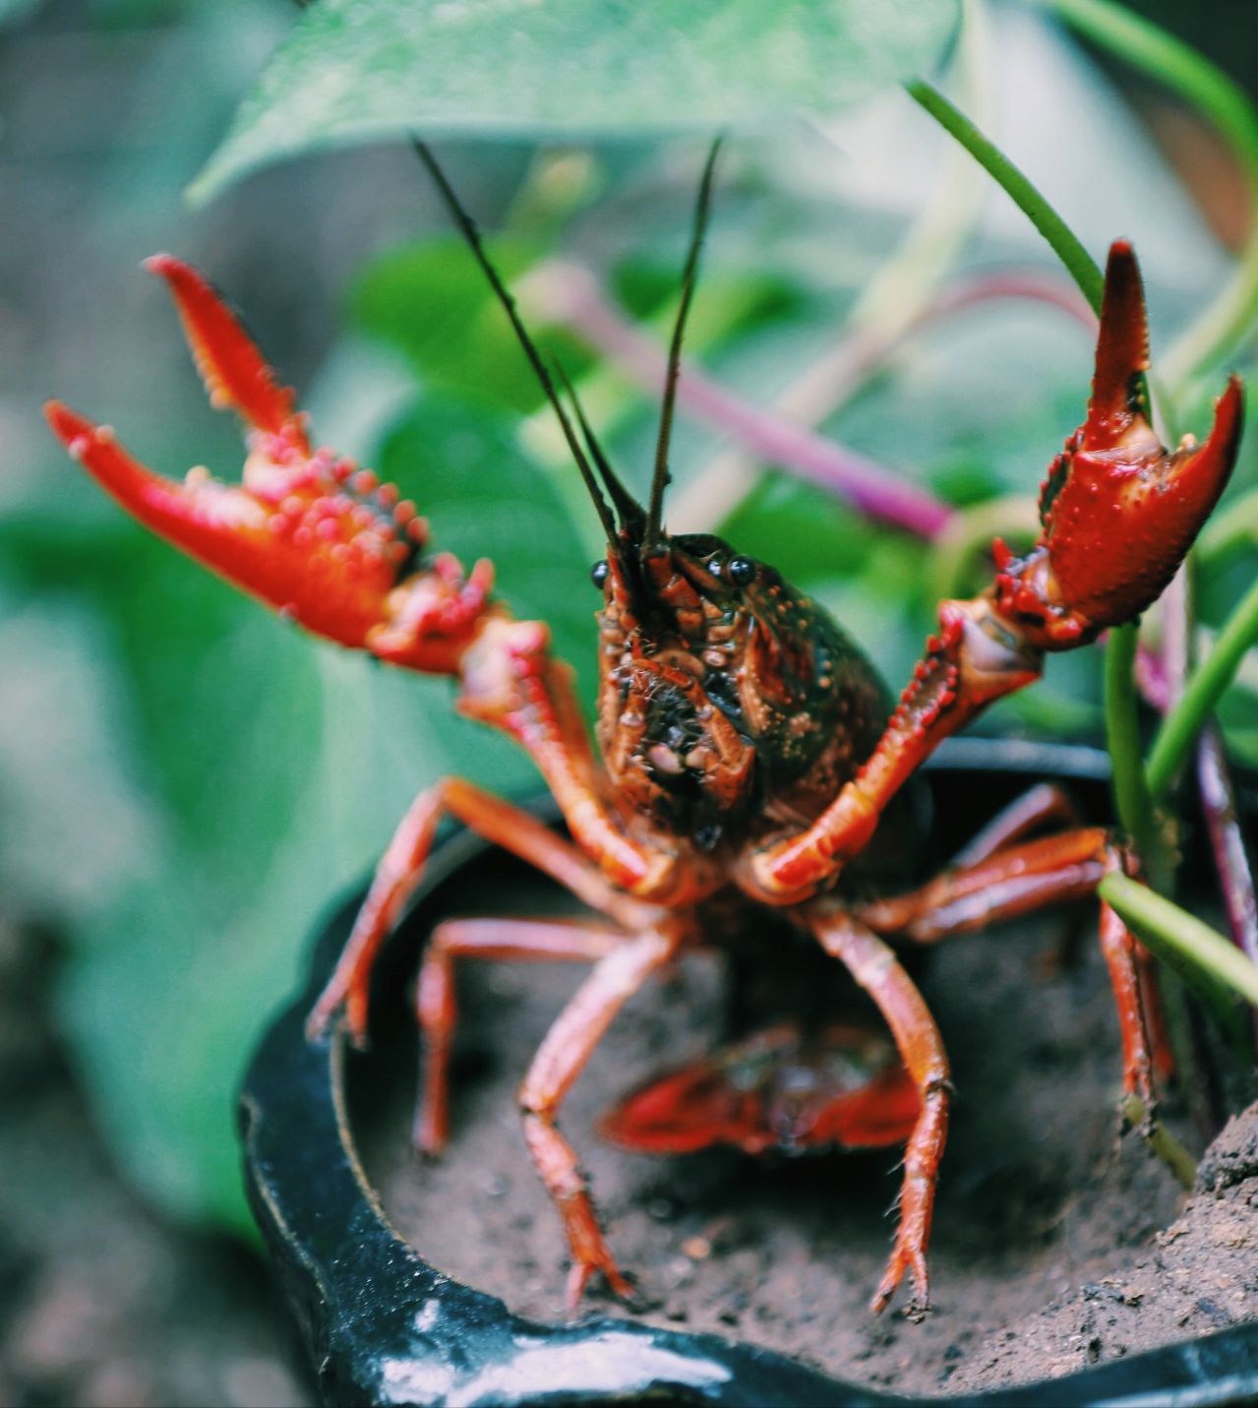
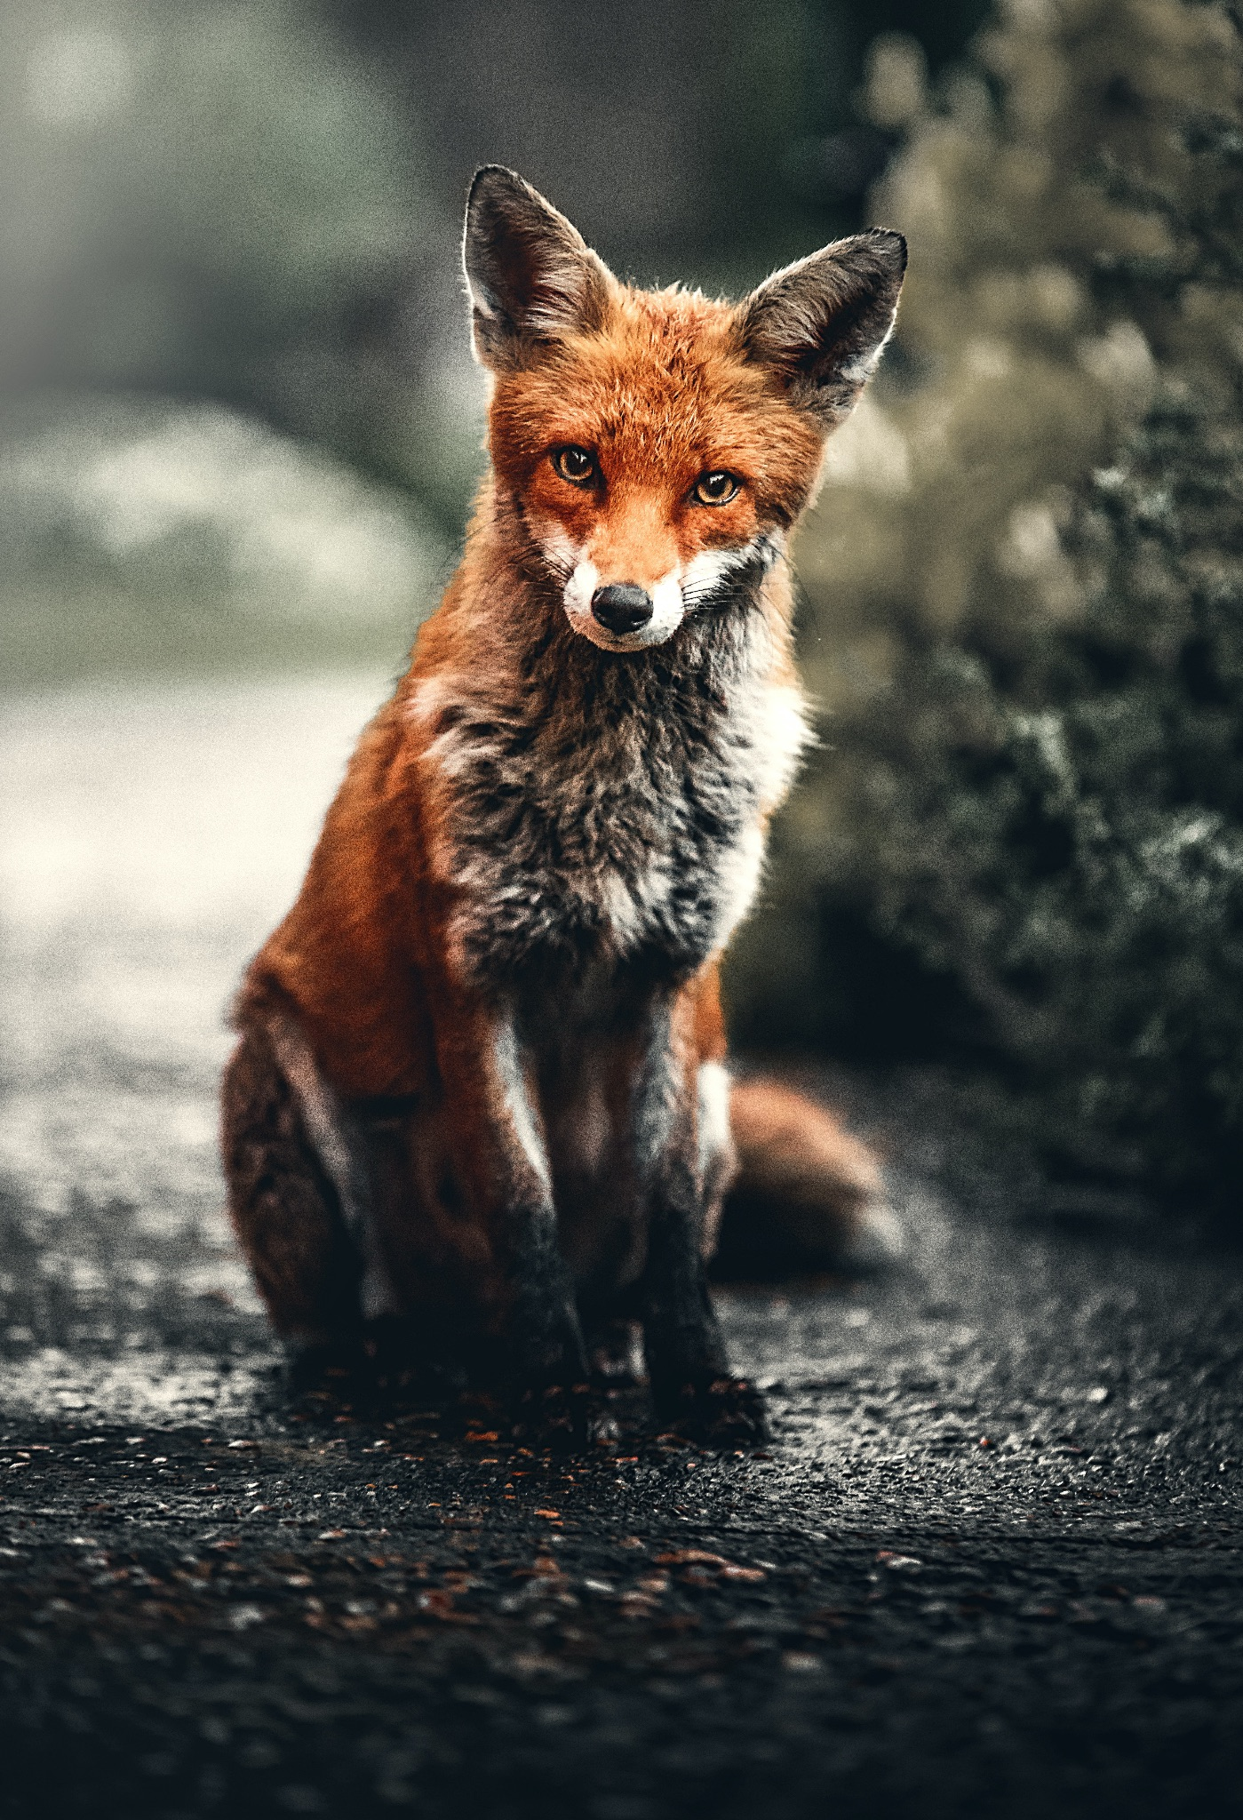
ᎦᎵᏉᎩᏁ ᏣᎳᎩ ᎠᏕᎶᏆᏍᏗ
ᎢᎸᎯᏳ ᏥᎨᏒ, ᏂᎦᏓ ᎢᎾᎨ ᎠᏁᎯ ᎡᎵ ᏓᎾᏝᏃᎮᏍᎬ. ᏌᏊ ᎢᎦ, ᏝᏬᏚᎯ ᎾᎥ ᎠᎹᏳᎵᏗ ᎠᏓᎾᏏᏂᏙᎲ ᏥᏍᏛᎾ. ᎾᎥ, ᏧᏟ ᏭᏬᏢ. ᎤᎾᎴᏅᎮ ᏓᎾᏝᏃᎲᏍᎬ. ᏧᏟ ᏥᏍᏛᎾ ᎤᏛᏛᏁ, “ᏙᏳᏍ ᎯᏌᏄᎵ ᎦᏙ ᎠᎴ ᎠᎹᏱᎨ ᎯᏌᏄᎵ.”
“ᎥᎥ,” ᎤᏛᏁ ᏥᏍᏛᎾ. “ᎤᏠᏱ ᏥᏌᏄᎵ ᎦᏙ ᎠᎴ ᎠᎹᏱ.”
ᏧᏟ Ꮭ ᏳᏬᎯᏳᏁ. ᎤᏂᏙᎩᏯᏍᏗ ᏚᏄᎪᏔᏁ ᏧᏟ ᎠᎴ ᏥᏍᏛᎾ.

Slide 7
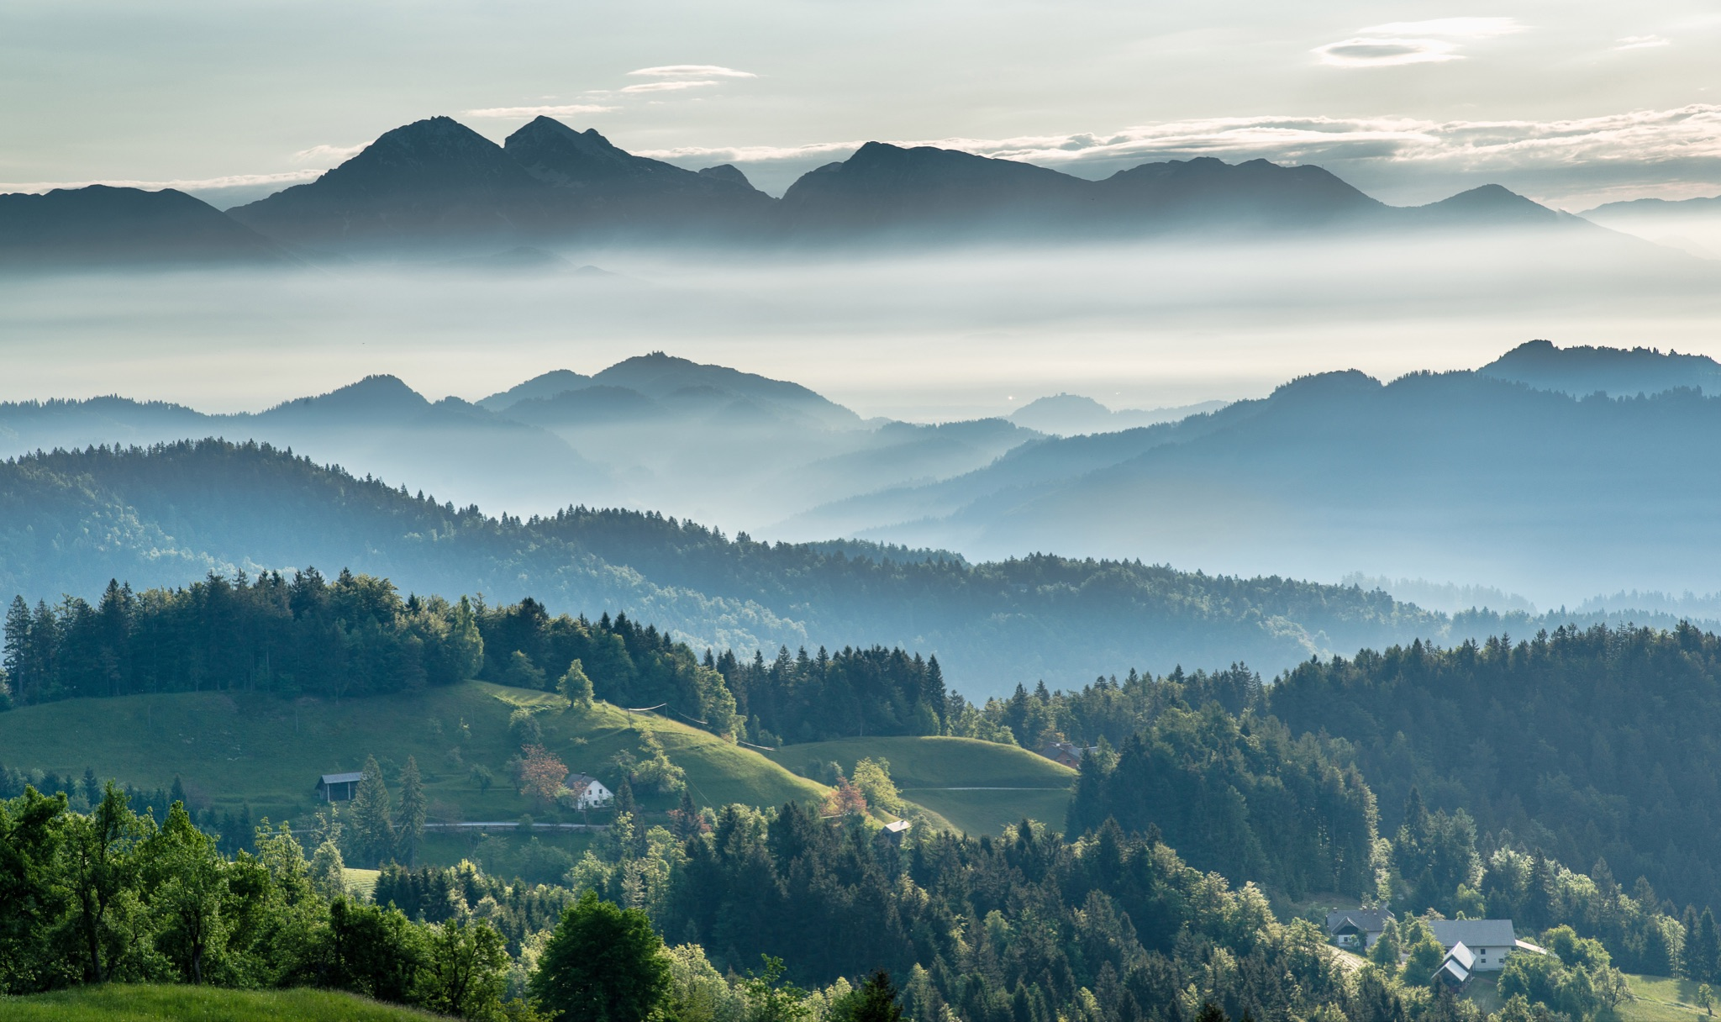
ᎦᎵᏉᎩᏁ ᏣᎳᎩ ᎠᏕᎶᏆᏍᏗ
ᎦᎵᏉᎩ ᎦᏚᏏ ᏚᏄᎧᏔᏁ ᏭᎾᏢᏍᏗ. ᎠᎬᏱ ᏫᎦᎷᏨ ᎦᎵᏉᎩᏁ ᎦᏚᏏ, ᏫᏗᎨᏡᎲᏍᎨᏍᏗ. ᎤᏓᏠᏒ ᎨᏎᏍᏗ. ᎦᏚ ᎦᎸᎳᏗ ᎣᏓᎸ ᏭᏂᎶᏒ. ᎦᎵᏉᎩ ᎦᏚᏏ ᏚᏂᏑᏰᏒ ᏭᎾᏢᏍᏗ.

Slide 8
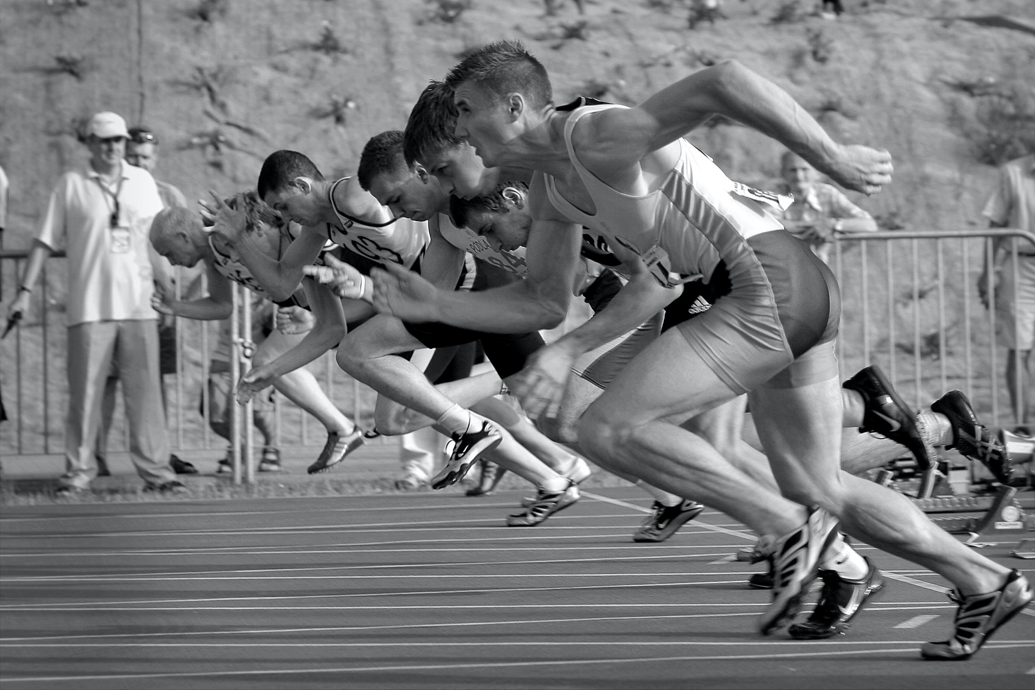
ᎦᎵᏉᎩᏁ ᏣᎳᎩ ᎠᏕᎶᏆᏍᏗ
ᎤᎾᎴᏅᎮ, ᎤᏍᎦᏃᎵ ᎨᏎ ᏥᏍᏛᎾ.ᏧᏟ ᎤᎶᎯᏎᎴ ᏥᏍᏛᎾ.
ᏥᏍᏛᎾ ᏩᏥᏂᏴᏎᎸ ᏧᏟ ᎦᏂᏓᏛ, ᎾᎥ ᎤᎶᏎ. ᎦᏂᏓᏛ ᏭᎩᎸᎮ ᏥᏍᏛᎾ. ᎤᏟᏍᏗ ᏧᏟ ᏭᏢᏍᏔᏅ. ᏧᏟ ᎦᏂᏓᏛ ᎤᎩᎶ ᏥᏍᏛᎾ. ᏭᏂᎷᏨ ᎦᎵᏉᎩᏁ ᎦᏚᏏ ᏧᏟ ᎤᏪᏡᏁ. ᏥᏍᏛᎾ ᎾᎥ ᎤᏪᏡᏁᏍᏊ.

Slide 9
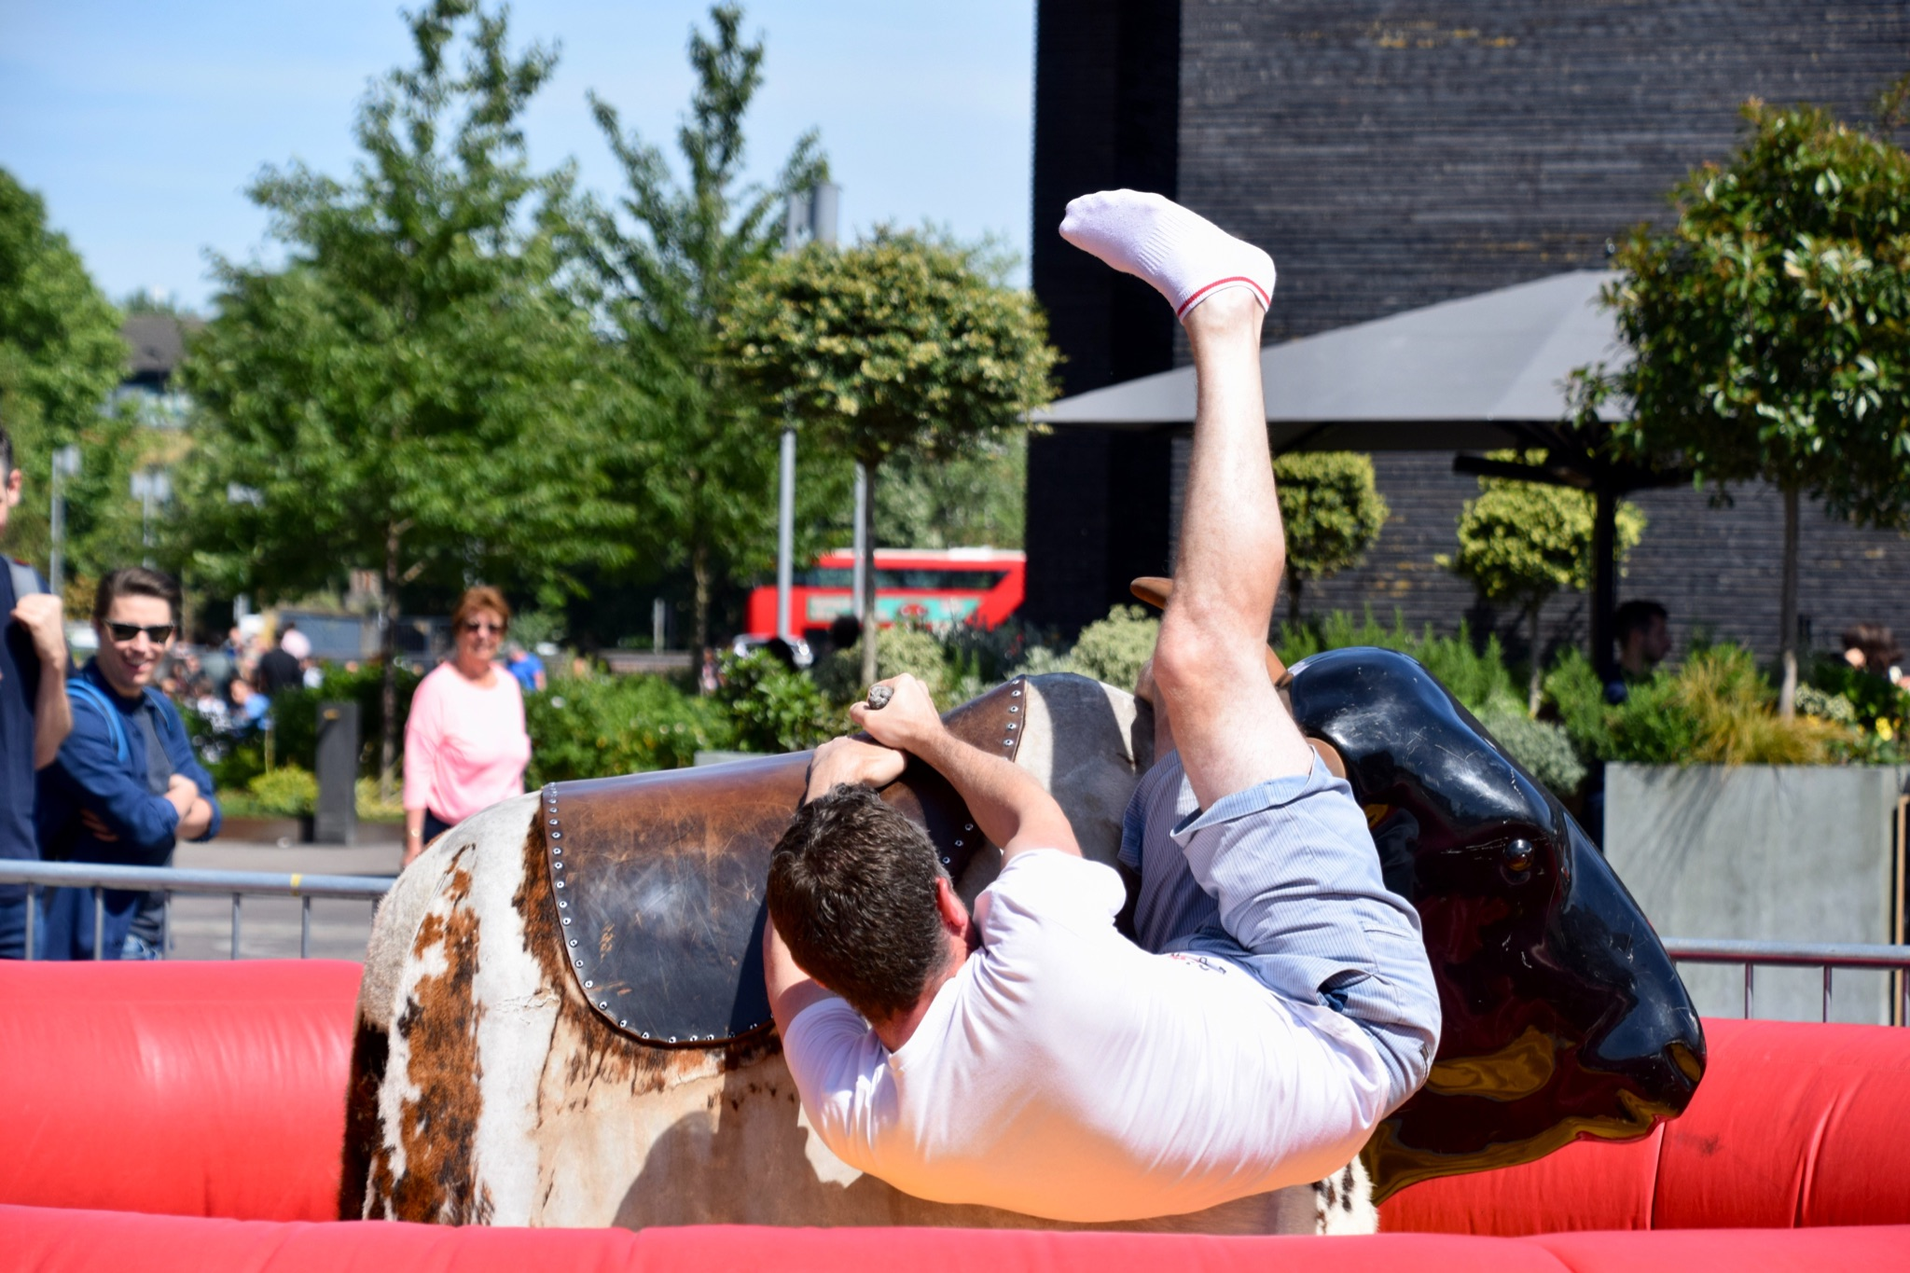
ᎦᎵᏉᎩᏁ ᏣᎳᎩ ᎠᏕᎶᏆᏍᏗ
ᎤᏍᏆᏂᎪᏓ ᎤᏰᎸᏎ ᏧᏟ Ꮎ ᏥᏍᏛᎾ ᏭᎷᏨᏍᏊ.ᏧᏟ ᎤᏛᏛᏁ Ꮎ ᏥᏍᏛᎾ “ᏏᏊ ᎢᎾᏙᎩᏯ.”ᎤᎾᎧᏔᎲᏎ, ᏭᎾᏙᎩᏯᏍᏔᏅ ᎣᏓᎸ ᏧᎾᎴᏅᎮ.ᎠᏰᏟ Ꮲ ᎠᎾᏙᎩᏯᏍᎬ ᏧᏟ ᎤᏟᏍᏗ ᎤᎧᏔᎲᏎ.
Ꮎ ᏥᏍᏛᎾ ᎭᎴ ᏭᎶᏎ ᏃᏭ ᏍᏓᏲᏒ ᏩᏥᏂᏴᏎᎴ ᏧᏟ ᎦᏂᏓᏛ.

Slide 10
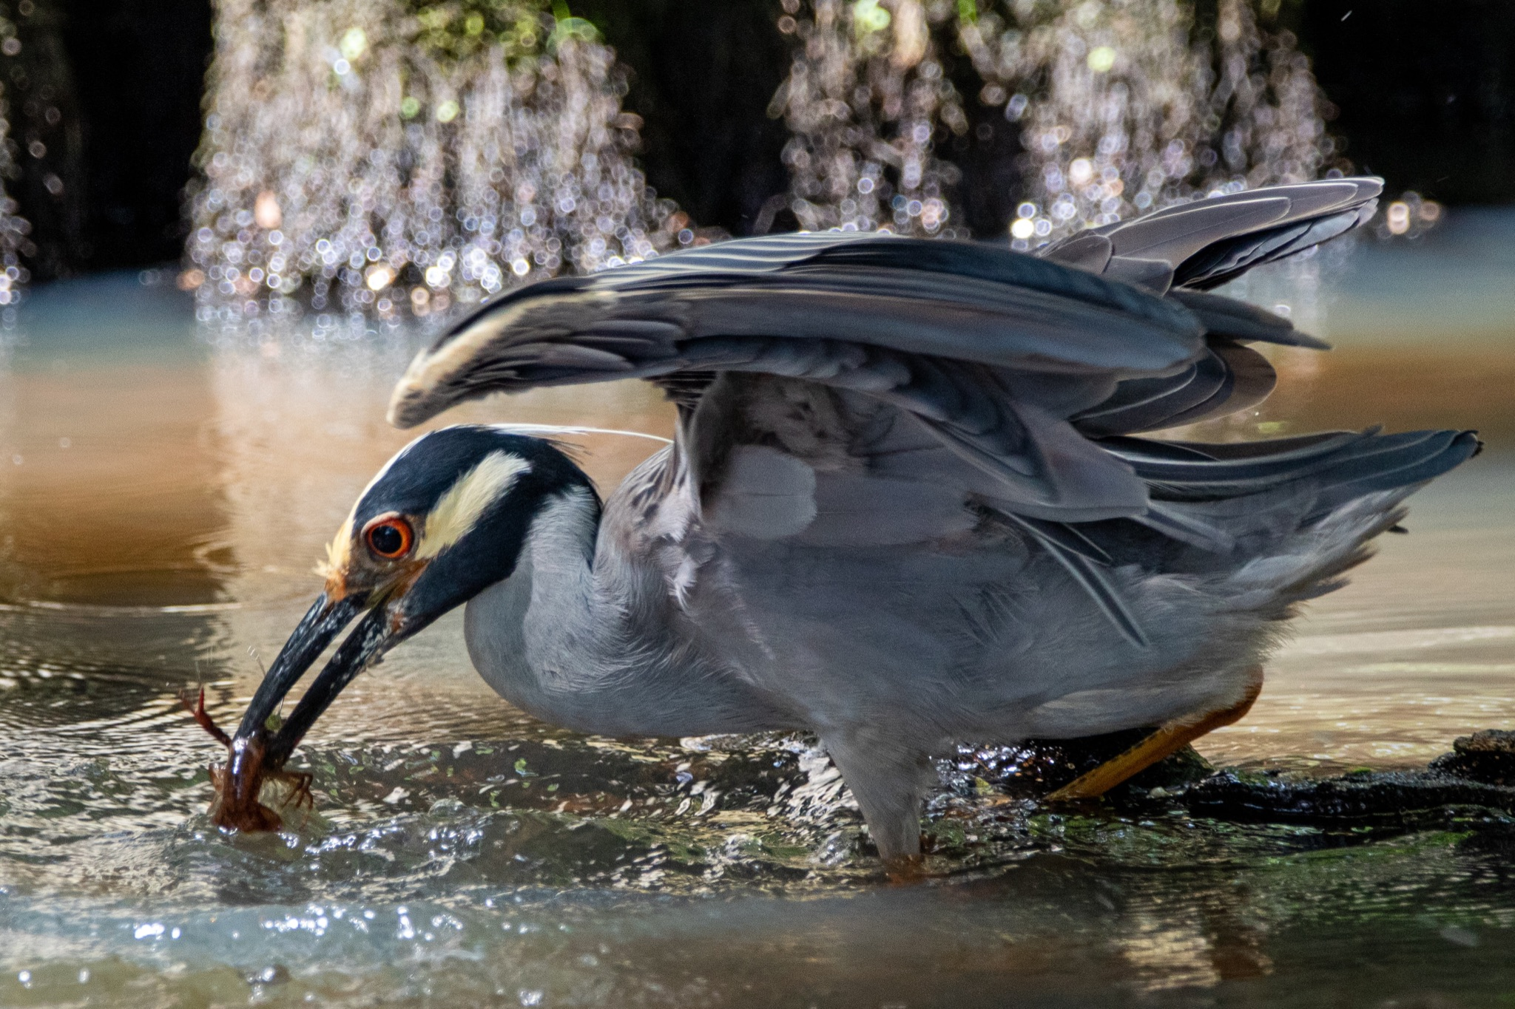
ᎦᎵᏉᎩᏁ ᏣᎳᎩ ᎠᏕᎶᏆᏍᏗ
ᎥᏍᎩᏂ ᏄᏛᏁᎴ, ᎪᎸᎭ ᏩᏥᏂᏴᏎᎸ ᎦᏂᏓᏛ. ᏧᏟ ᏭᎷᏤ ᎣᏓᎸ ᏭᏪᏡᏁ, ᎠᎴ ᏥᏍᏛᎾ ᏭᏪᏡᏁᏍᏊ. ᏧᏟ ᎠᎫᎯᏍᏔᏅ ᏥᏍᏛᎾ ᎦᎶᏄᎮᏍᎬ. ᏥᏍᏛᎾ ᎤᏓᎯᏱᎸ ᎤᎶᏄᎮᏢ. ᏧᏟ ᎤᏃᏎᎴ ᏥᏍᏛᎾ, “ᎠᏆᎾᏔ ᏍᎩᏂᏴᏎᎸ ᏥᏂᏓᏛ.”ᏧᏟ ᎠᏥᎨᎯᏙᎸ ᏥᏍᏛᎾ. ᏝᏍᎩᏂ ᎡᎵ ᏳᎵᏘᏎ. ᏧᏟ ᏩᏥᏯᎥ ᏥᏍᏛᎾ.

Slide 11
ᎦᎵᏉᎩᏁ ᏣᎳᎩ ᎠᏕᎶᏆᏍᏗ
Let’s do one more version of this story, this time, adding some dialogue.

Slide 12
ᎦᎵᏉᎩᏁ ᏣᎳᎩ ᎠᏕᎶᏆᏍᏗ
Ilvhiyu jigesv, nigada inage anehi dantlanohesge

Slide 13
ᎦᎵᏉᎩᏁ ᏣᎳᎩ ᎠᏕᎶᏆᏍᏗ
Jisdvn ulseg gese. Gado ale amo ijula ganelo.

Slide 14
ᎦᎵᏉᎩᏁ ᏣᎳᎩ ᎠᏕᎶᏆᏍᏗ
Sawu iga, jisdvna tlawotu amayuldi nav adansinidohv.

Slide 15
ᎦᎵᏉᎩᏁ ᏣᎳᎩ ᎠᏕᎶᏆᏍᏗ
Nav, jutli uwotle.

Slide 16
ᎦᎵᏉᎩᏁ ᏣᎳᎩ ᎠᏕᎶᏆᏍᏗ
Unlenvhe dantlanohasgv.

Slide 17
ᎦᎵᏉᎩᏁ ᏣᎳᎩ ᎠᏕᎶᏆᏍᏗ
Jutli utvdvne, “doyu hisanul amo, gadohina? utloyas hisanul?”

Slide 18
ᎦᎵᏉᎩᏁ ᏣᎳᎩ ᎠᏕᎶᏆᏍᏗ
“Dodv jisanuli,” udvne jisdvn “yigintohgi ahid yigvlohis, geli.”

Slide 19
ᎦᎵᏉᎩᏁ ᏣᎳᎩ ᎠᏕᎶᏆᏍᏗ
“Tla yigvgotisgo gado hatlidohv, tlawotuhiwu gvgotiho hadansinidohv.”

Slide 20
ᎦᎵᏉᎩᏁ ᏣᎳᎩ ᎠᏕᎶᏆᏍᏗ
Tla do hyeli, nigalsdiwu yintohgi.

Slide 21
ᎦᎵᏉᎩᏁ ᏣᎳᎩ ᎠᏕᎶᏆᏍᏗ
“Hawa,” udvne jutli “nowdv yintohgi.”

Slide 22
ᎦᎵᏉᎩᏁ ᏣᎳᎩ ᎠᏕᎶᏆᏍᏗ
ᎢᎸᎯᏳ ᏥᎨᏒ, ᏂᎦᏓ ᎢᎾᎨ ᎠᏁᎮ ᏓᎾᏝᏃᎮᏍᎨ. ᏥᏍᏛᎾ ᎤᎵᏎᎩ ᎨᏎ. ᎦᏙ ᎠᎴ ᎠᎼ ᎢᏧᎳ ᎦᏁᎶ. ᏌᏊ ᎢᎦ, ᏥᏍᏛᎾ ᏝᏬᏚ ᎠᎹᏳᎵᏗ ᎾᎥ ᎠᏓᎾᏏᏂᏙᎲ. ᎾᎥ, ᏧᏟ ᎤᏬᏞ. ᎤᎾᎴᏅᎮ ᏓᎾᏝᏃᎮᏍᎬ. ᏧᏟ ᎤᏛᏛᏁ, “ᏙᏳ ᎯᏌᏄᎵ ᎠᎼ. ᎦᏙᎯᎾ? ᎤᏠᏯᏍ ᎯᏌᏄᎵ?”
“ᏙᏛ ᏥᏌᏄᎵ,” ᎤᏛᏁ ᏥᏍᏛᎾ. “ᏱᎩᏂᏙᎩ ᎠᎯᏗ ᏱᎬᎶᎯᏍ, ᎨᎵᎠ.”
Ꮭ ᏱᎬᎪᏘᏍᎪ ᎦᏙ ᎭᏟᏙᎲ. ᏝᏬᏚᎯᏭ ᎬᎪᏘᎰ ᎭᏓᎾᏏᏂᏙᎲ.”
“Ꮭ Ꮩ ᎯᏰᎵ, ᏂᎦᎵᏍᏗᏭ ᏱᏂᏙᎩ.”
“ᎭᏩ,” ᎤᏛᏁ ᏧᏟ. “ᏃᏭᏛ ᏱᏂᏙᎩ.”

Slide 23
ᎦᎵᏉᎩᏁ ᏣᎳᎩ ᎠᏕᎶᏆᏍᏗ
ᎤᎵᏎᎩ- unique, different
ᎦᏁᎶ- he lived around
ᎠᏓᎾᎢᎾᏙᎲ- he was walking around
ᏱᎩᏂᏙᎩ- if we raced
ᎠᎯᏗ- easily
ᎬᎶᎯᏍ- I would beat you
ᎬᎪᏘᏍᎪ- I see you
ᎬᎪᏘᎰ- I see you (habitually)
ᎭᏓᎾᏏᏂᏙᎲ- You crawl around
ᏱᎾᏙᎩ- let’s race

