Slide 1
ᎣᏏᏲ
ᏣᏁᎵᏁ ᏣᎳᎩ ᎠᏕᎶᏆᏍᏗ

Slide 2
ᏣᏁᎵᏁ ᏣᎳᎩ ᎠᏕᎶᏆᏍᏗ
ᎢᏓᎴᎾ- Let’s begin
ᏣᎳᎩ ᎢᏗᏬᏂ- Let’s talk Cherokee

Slide 3
ᏣᏁᎵᏁ ᏣᎳᎩ ᎠᏕᎶᏆᏍᏗ
Hello everyone
My name is ______ I am ______ years old.
I am Cherokee. (mixed. Full blood. half) I am not Cherokee.
I am from _______ and I live in
I work at _________
My moms name is_______ and my dads name is ______
I am married

Slide 4
ᏣᏁᎵᏁ ᏣᎳᎩ ᎠᏕᎶᏆᏍᏗ
ᎠᎩᏥ, ______ᏚᏙᎠ. ᎠᎩᏙᏓᏃ, ______ᏚᏙᎠ.
My mom’s name is ____ and my dad’s name is ______.

Slide 5
ᏣᏁᎵᏁ ᏣᎳᎩ ᎠᏕᎶᏆᏍᏗ
ᏙᏯᏗᏟ ᎢᏕᎾ-
Let’s go outside.
ᏙᏯᏗᏟ ᎯᏪᎾ-
You go outside.

Slide 6
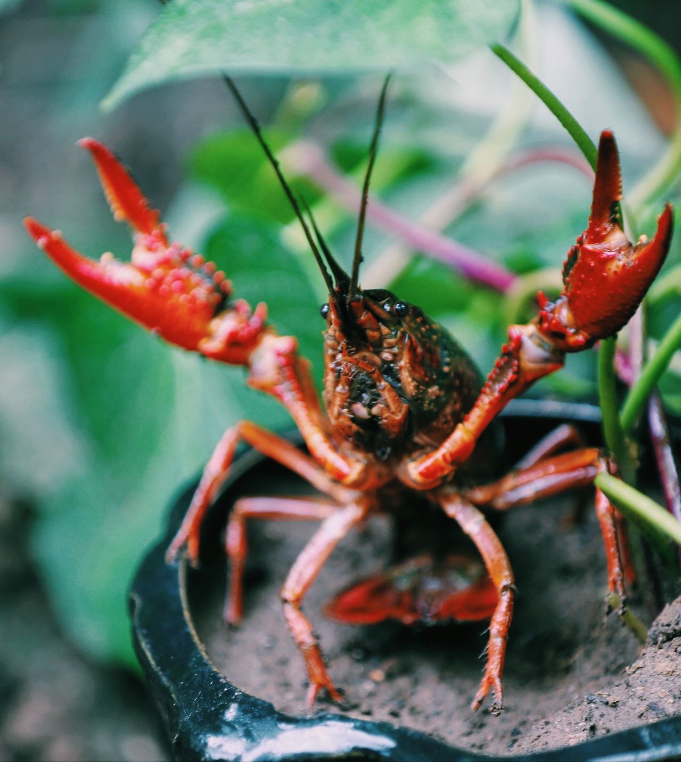
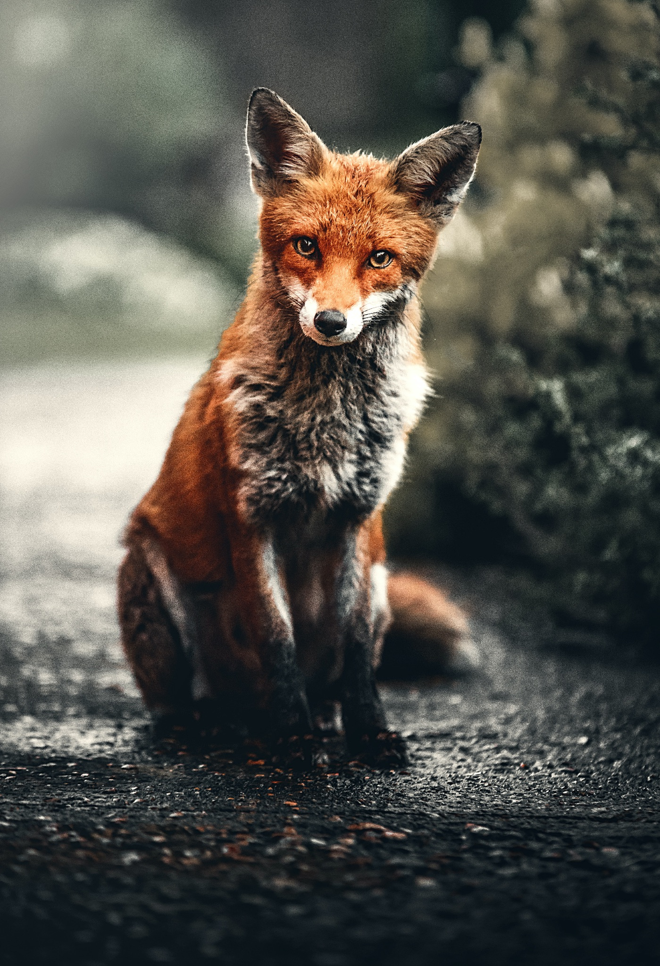
ᏣᏁᎵᏁ ᏣᎳᎩ ᎠᏕᎶᏆᏍᏗ
ᎢᎸᎯᏳ ᏥᎨᏒ, ᏂᎦᏓ ᎢᎾᎨ ᎠᏁᎮ ᏓᎾᏝᏃᎮᏍᎨ. ᏥᏍᏛᎾ ᎤᎵᏎᎩ ᎨᏎ. ᎦᏙ ᎠᎴ ᎠᎼ ᎢᏧᎳ ᎦᏁᎶ. ᏌᏊ ᎢᎦ, ᏥᏍᏛᎾ ᏝᏬᏚ ᎠᎹᏳᎵᏗ ᎾᎥ ᎠᏓᎾᏏᏂᏙᎲ. ᎾᎥ, ᏧᏟ ᎤᏬᏞ. ᎤᎾᎴᏅᎮ ᏓᎾᏝᏃᎮᏍᎬ. ᏧᏟ ᎤᏛᏛᏁ, “ᏙᏳ ᎯᏌᏄᎵ ᎠᎼ. ᎦᏙᎯᎾ? ᎤᏠᏯᏍ ᎯᏌᏄᎵ?”
“ᏙᏛ ᏥᏌᏄᎵ,” ᎤᏛᏁ ᏥᏍᏛᎾ. “ᏱᎩᏂᏙᎩ ᎠᎯᏗ ᏱᎬᎶᎯᏍ, ᎨᎵᎠ.”
Ꮭ ᏱᎬᎪᏘᏍᎪ ᎦᏙ ᎭᏟᏙᎲ. ᏝᏬᏚᎯᏭ ᎬᎪᏘᎰ ᎭᏓᎾᏏᏂᏙᎲ.” ᎤᏛᏁ ᏧᏟ.
“Ꮭ Ꮩ ᎯᏰᎵ, ᏂᎦᎵᏍᏗᏭ ᏱᏂᏙᎩ.” ᎤᏛᏁ ᏥᏍᏛᎾ.
“ᎭᏩ,” ᎤᏛᏁ ᏧᏟ. “ᏃᏭᏛ ᏱᏂᏙᎩ.”

Slide 7
ᏣᏁᎵᏁ ᏣᎳᎩ ᎠᏕᎶᏆᏍᏗ
“Hawa,” udvne jisdvn. Gahlquog gadusi dunuktane wunatlvsdi.

Slide 8
ᏣᏁᎵᏁ ᏣᎳᎩ ᎠᏕᎶᏆᏍᏗ
Agvyi wigalujv galquogine gadusi, widigetluhvsgesdi. Udatlosv gesesdi.

Slide 9
ᏣᏁᎵᏁ ᏣᎳᎩ ᎠᏕᎶᏆᏍᏗ
“Hawa,” udvne jutli.
Gadu galvladi odalv wunilosv.

Slide 10
ᏣᏁᎵᏁ ᏣᎳᎩ ᎠᏕᎶᏆᏍᏗ
Uhnano, gahlquogi gadusi dunisuyesv wunatlvsdi.

Slide 11
ᏣᏁᎵᏁ ᏣᎳᎩ ᎠᏕᎶᏆᏍᏗ
Elad, galvlad, gahlquog yuwakt dunanigi.

Slide 12
ᏣᏁᎵᏁ ᏣᎳᎩ ᎠᏕᎶᏆᏍᏗ
Unlenv, wunwetlune, wundanawstanv.

Slide 13
ᏣᏁᎵᏁ ᏣᎳᎩ ᎠᏕᎶᏆᏍᏗ
Usganolino gese jisdvn.

Slide 14
ᏣᏁᎵᏁ ᏣᎳᎩ ᎠᏕᎶᏆᏍᏗ
Jutli ulohisele jisdvn. Jisdvn wajiniyvsele jutli ganidadv.

Slide 15
ᏣᏁᎵᏁ ᏣᎳᎩ ᎠᏕᎶᏆᏍᏗ
Nole wukilvne jutli ganidadv. Utlisd jutli wutlvstanv.

Slide 16
ᏣᏁᎵᏁ ᏣᎳᎩ ᎠᏕᎶᏆᏍᏗ
Ganidadv wukilo jisdvn.

Slide 17
ᏣᏁᎵᏁ ᏣᎳᎩ ᎠᏕᎶᏆᏍᏗ
Wunilujv gahlquogine gadusi, jutli uwetlune.

Slide 18
ᏣᏁᎵᏁ ᏣᎳᎩ ᎠᏕᎶᏆᏍᏗ
Uhnano, jutli nav, jisdvna uwetlunesquu.

Slide 19
ᏣᏁᎵᏁ ᏣᎳᎩ ᎠᏕᎶᏆᏍᏗ
ᎢᎸᎯᏳ ᏥᎨᏒ, ᏂᎦᏓ ᎢᎾᎨ ᎠᏁᎮ ᏓᎾᏝᏃᎮᏍᎨ. ᏥᏍᏛᎾ ᎤᎵᏎᎩ ᎨᏎ. ᎦᏙ ᎠᎴ ᎠᎼ ᎢᏧᎳ ᎦᏁᎶ. ᏌᏊ ᎢᎦ, ᏥᏍᏛᎾ ᏝᏬᏚ ᎠᎹᏳᎵᏗ ᎾᎥ ᎠᏓᎾᎢᏃᏙᎲ. ᎾᎥ, ᏧᏟ ᎤᏬᏞ. ᎤᎾᎴᏅᎮ ᏓᎾᏝᏃᎮᏍᎬ. ᏧᏟ ᎤᏛᏛᏁ, “ᏙᏳ ᎯᏌᏄᎵ ᎠᎼ. ᎦᏙᎯᎾ? ᎤᏠᏯᏍ ᎯᏌᏄᎵ?”
“ᏙᏛ ᏥᏌᏄᎵ,” ᎤᏛᏁ ᏥᏍᏛᎾ. “ᏱᎩᏂᏙᎩ ᎠᎯᏗ ᏱᎬᎶᎯᏍ, ᎨᎵᎠ.”
Ꮭ ᏱᎬᎪᎵᏍᎪ ᎦᏙ ᎭᏟᏙᎲ. ᏝᏬᏚᎯᏭ ᎬᎪᏘᎰ ᎭᏓᎾᏏᏂᏙᎲ.”
“Ꮭ Ꮩ ᎯᏰᎵ, ᏂᎦᎵᏍᏗᏭ ᏱᏂᏙᎩ.”
“ᎭᏩ,” ᎤᏛᏁ ᏧᏟ. “ᏃᏭᏛ ᏱᏂᏙᎩ.”

Slide 20
ᏣᏁᎵᏁ ᏣᎳᎩ ᎠᏕᎶᏆᏍᏗ
“ᎭᏩ,” ᎤᏛᏁ ᏥᏍᏛᎾ. ᎦᎵᏉᎩ ᎦᏚᏏ ᏚᏄᎪᏔᏁ ᏭᎾᏢᏍᏗ. ᎠᎬᏱ ᏫᎦᎷᏨ ᎦᎵᏉᎩᏁ ᎦᏚᏏ, ᏫᏓᎨᏡᎲᏍᎨᏍᏗ. ᎤᏓᏠᏒ ᎨᏎᏍᏗ. “ᎭᏩ,” ᎤᏛᏁ ᏧᏟ. ᎦᏚ ᎦᎸᎳᏗ ᎣᏓᎸ ᏭᏂᎶᏒ. ᎤᎾᏃ, ᎦᎵᏉᎩ ᎦᏚᏏ ᏚᏂᏑᏰᏒ ᏭᎾᏢᏍᏗ. ᎡᎳᏗ, ᎦᎸᎳᏗ, ᎦᎵᏉᎩ ᏳᏩᎧᏘ ᏚᎾᏂᎩ. ᎤᎾᎴᏅᎮ, ᏭᎾᏪᏡᏁ ᏭᎾᏓᏫᏍᏔᏅ. ᎤᏍᎦᏃᎵᏃ ᎨᏎ ᏥᏍᏛᎾ. ᏧᏟ ᎤᎶᎯᏎᎴ ᏥᏍᏛᎾ. ᏥᏍᏛᎾ ᏩᏥᏂᏴᏎᎴ ᏧᏟ ᎦᏂᏓᏛ. ᏃᎴ ᏭᎩᎸᏁ ᏧᏟ ᎦᏂᏓᏛ. ᎤᏟᏍᏗ ᏧᏟ ᏭᏢᏍᏔᏅ. ᎦᏂᏓᏛ ᏭᎩᎶ ᏥᏍᏛᎾ. ᏭᏂᎷᏨ ᎦᎵᏉᎩᏁ ᎦᏚᏏ, ᏧᏟ ᎤᏪᏡᏁ. ᎤᎾᏃ, ᎾᎥ ᏧᏟ, ᏥᏍᏛᎾ ᎤᏪᏡᏁᏍᏊ.

Slide 21
ᏣᏁᎵᏁ ᏣᎳᎩ ᎠᏕᎶᏆᏍᏗ
ᎤᎾ- and there
ᎡᎳᏗ- down
ᎦᎸᎳᏗ- up
ᏳᏩᎧᏘ- times
ᏚᎾᏂᎩ- they go
ᏭᏂᏓᎾᏫᏍᏔᏅ- they took off running
ᏃᎴ- and then

