Slide 1
ᎣᏏᏲ
ᎠᎬᏱ ᏣᎳᎩ ᎠᏕᎶᏆᏍᏗ

Slide 2
ᎠᎬᏱ ᏣᎳᎩ ᎠᏕᎶᏆᏍᏗ
ᎢᏓᎴᎾ- Let’s begin
ᏣᎳᎩ ᎢᏗᏬᏂ- Let’s talk Cherokee

Slide 3
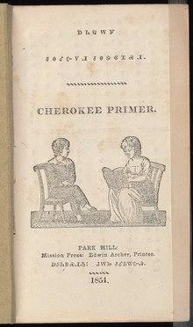
ᎠᎬᏱ ᏣᎳᎩ ᎠᏕᎶᏆᏍᏗ
ᎠᏂᏣᎳᎩ
ᏧᎾᎴᏅᏙᏗ ᏧᎾᏕᎶᏆᏍᏗ
ᎠᏭᏂᏴᏍᏗᏱ: ᎫᎳᏥ ᏧᎴᏴᏔᏅᏗ
Notes:
aksdayvhvsg

Slide 4
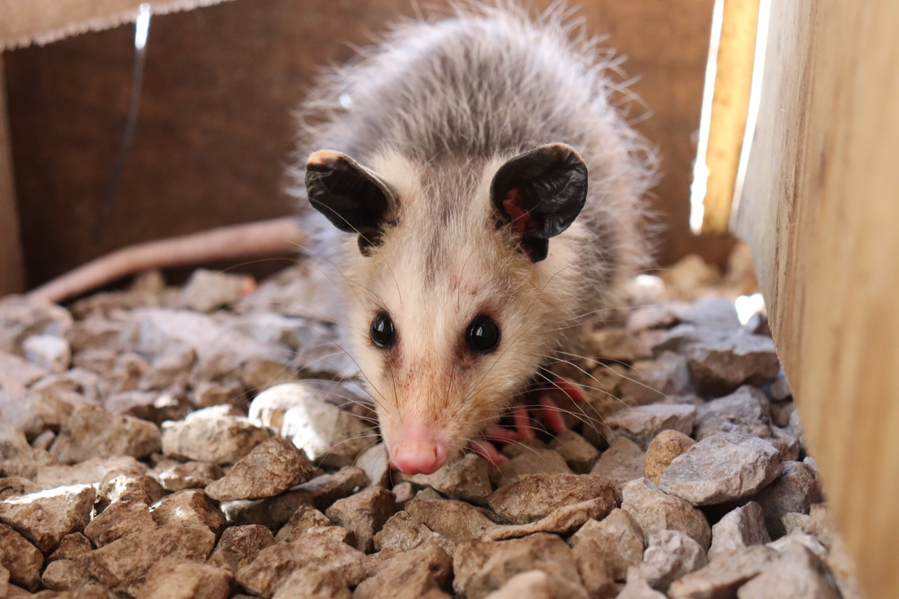
ᎠᎬᏱ ᏣᎳᎩ ᎠᏕᎶᏆᏍᏗ-
ᏏᏆ ᎤᏤᏥᏍᏗ

Slide 5
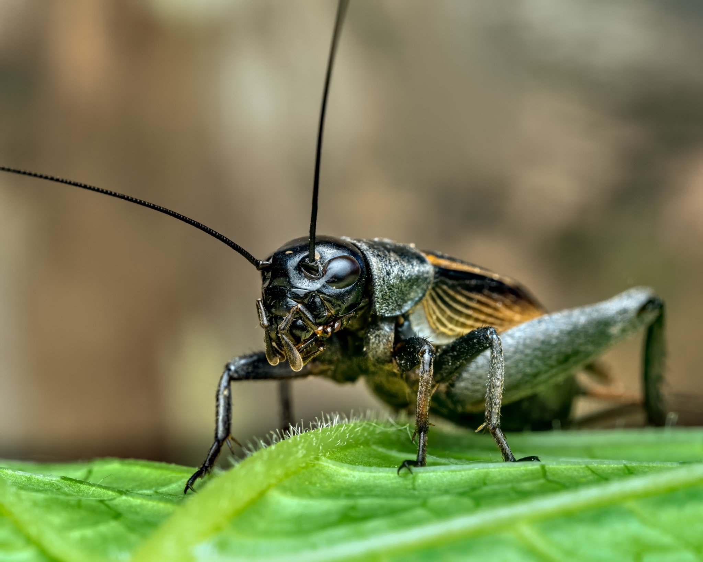
ᎠᎬᏱ ᏣᎳᎩ ᎠᏕᎶᏆᏍᏗ-
ᏔᎳᏚ

Slide 6
ᎠᎬᏱ ᏣᎳᎩ ᎠᏕᎶᏆᏍᏗ
Ilvhiyu jigesv siqua ujetsd ehe.
A long time ago there was a possum.
ᎢᎸᎯᏳ ᏥᎨᏒ ᏏᏆ ᎤᏤᏥᏍᏗ ᎡᎮ.

Slide 7
ᎠᎬᏱ ᏣᎳᎩ ᎠᏕᎶᏆᏍᏗ
Doyu uwodu gese ganidadv.
His tail was really beautiful.
ᏙᏳ ᎤᏬᏚ ᎨᏎ ᎦᏂᏓᏛ.

Slide 8
ᎠᎬᏱ ᏣᎳᎩ ᎠᏕᎶᏆᏍᏗ
Ganidadv nigolv atlvquisde siqua ujetsd.
He was always bragging about his tail.
ᎦᏂᏓᏛ ᏂᎪᎸ ᎠᏢᏈᏍᏕ ᏏᏆ ᎤᏤᏥᏍᏗ.

Slide 9
ᎠᎬᏱ ᏣᎳᎩ ᎠᏕᎶᏆᏍᏗ
Yulsinvsv ganidadv altawosge.
Nightly he would comb his tail.
ᎤᎵᏏᏅᏒ ᎦᏂᏓᏛ ᎠᎵᏔᏬᏍᎨ.

Slide 10
ᎠᎬᏱ ᏣᎳᎩ ᎠᏕᎶᏆᏍᏗ
Ale gigage asti galvwestisgo ganidadv.
And he would wrap it up in a red string.

Slide 11
ᎠᎬᏱ ᏣᎳᎩ ᎠᏕᎶᏆᏍᏗ
Ugitsisgv ayege alsgisidohe ganidadv alihelige dekanogisgv.
At dawn, he would wake up then he would dance and sing about his tail.
ᎤᎩᏥᏍᎬ ᎠᏰᎨ ᎠᎵᏍᎩᏏᏙᎮ ᎦᏂᏓᏛ ᎠᎵᎮᎵᎨ ᏕᎧᏃᎩᏍᎬ.

Slide 12
ᎠᎬᏱ ᏣᎳᎩ ᎠᏕᎶᏆᏍᏗ
Nigad tla yidunilvqde atlvquisgv
Everyone didn’t like his bragging.
ᏂᎦᏓ Ꮭ ᏱᏚᏂᎸᏈᏕ ᎠᏢᏈᏍᎬ.

Slide 13
ᎠᎬᏱ ᏣᎳᎩ ᎠᏕᎶᏆᏍᏗ
Adeloquasdidv duniwuktane unadehyodi
They decided to teach him a lesson
ᎠᏕᎶᏆᏍᏗᏛ ᏚᏂᏭᎧᏔᏁ ᎤᎾᏕᏲᏗ

Slide 14
ᎠᎬᏱ ᏣᎳᎩ ᎠᏕᎶᏆᏍᏗ
Taladu wunitahyotle gohusdi udvhndi
They asked cricket to do something.
ᏔᎳᏚ ᏭᏂᏔᏲᏞ ᎪᎱᏍᏗ ᎤᏛᏅᏗ.

Slide 15
ᎠᎬᏱ ᏣᎳᎩ ᎠᏕᎶᏆᏍᏗ
Usv nulsdan, taladu wuluji ujetsdi juwenvse.
That night, the cricket went to the possum’s place.
ᎤᏒ ᏄᎵᏍᏔᏅ, ᏔᎳᏚ ᏭᎷᏥ ᎤᏤᏥᏍᏗ ᏧᏪᏅᏎ.

