Slide 1
ᎣᏏᏲ
ᏌᏚᏏᏁ ᏣᎳᎩ ᎠᏕᎶᏆᏍᏗ

Slide 2
ᏌᏚᏏᏁ ᏣᎳᎩ ᎠᏕᎶᏆᏍᏗ
ᎢᏓᎴᎾ- Let’s begin
ᏣᎳᎩ ᎢᏗᏬᏂ- Let’s talk Cherokee

Slide 3
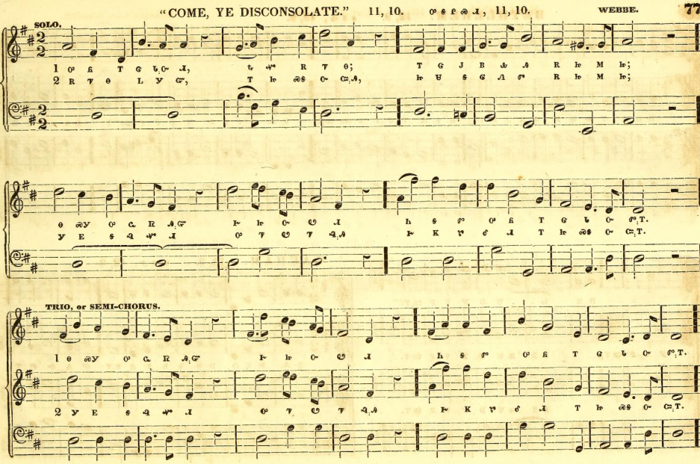
ᏌᏚᏏᏁ ᏣᎳᎩ ᎠᏕᎶᏆᏍᏗ
ᎤᏲ ᎢᏣᏓᏅᏗ, ᎿᏉ ᎡᏤᎾ;
ᎢᏣᎫᏴᎲᎯ ᎡᏥᎷᏥ;
ᎾᏍᎩ ᎤᏩᏒᎯᏳ ᎨᏥᏅᏬᏗ.
ᏂᎦᏛ ᎤᏲ ᎢᏣᏓᏅᏛᎢ.
Those of you who feel bad, now go;
He paid for you. Come to him. That you may come to him alone; That you may be healed by him alone. All of you who feel bad.
Notes:
aksdayvhvsg

Slide 4
ᏌᏚᏏᏁ ᏣᎳᎩ ᎠᏕᎶᏆᏍᏗ
ᎡᏤᎾ ᏞᎩᏳ, ᎢᏥᏍᎦᏅᏨᎯ, ᏥᏌ ᎦᎶᏁᏛ ᎡᏥᎷᏥ;
ᎩᎬ ᎦᎸᏉᏗ ᎤᏤᏬᏤᎸᎯ
ᎨᏦᏑᎴᏗ ᎢᏥᏍᎦᏅᏨᎢ.
Come soon, all you sinners,
Come to Lord Jesus;
He spilled sacred blood on the ground
He has cleaned you sinners.
Notes:
aksdayvhvsg

Slide 5
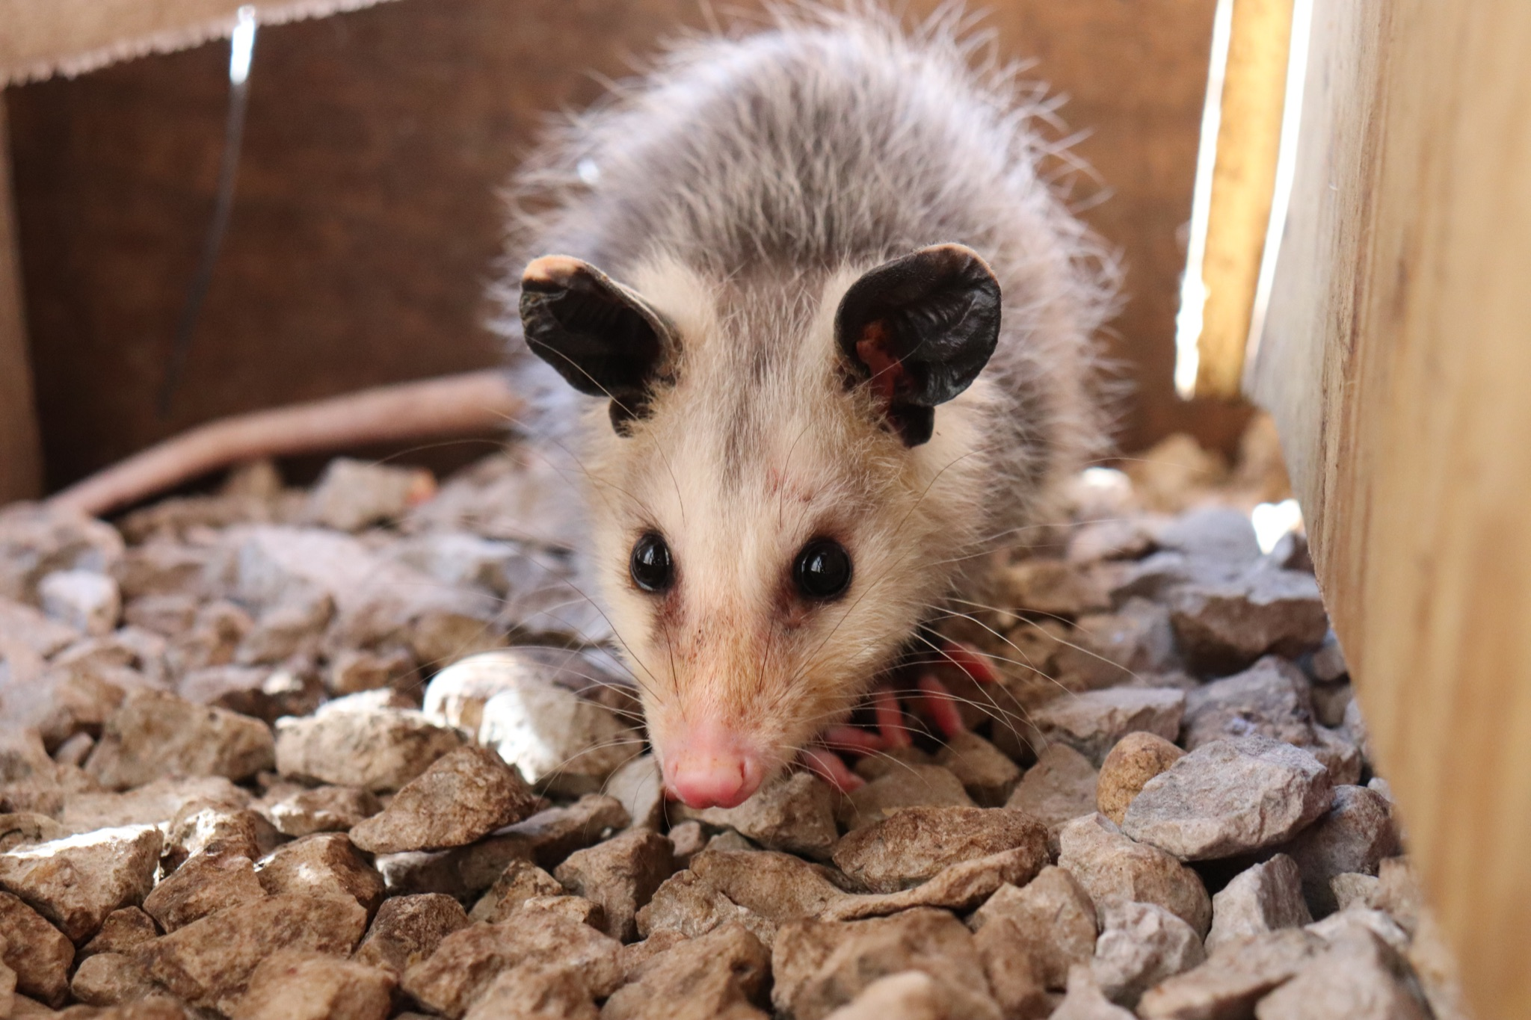
ᏌᏚᏏᏁ ᏣᎳᎩ ᎠᏕᎶᏆᏍᏗ
ᎤᏤᏥᏍᏗ ᎧᏴᏐᎵ ᎠᏓᎴᏂᏍᎬ ᎦᏂᏓᏛᎢ ᎢᎦᏅᎯᏓ ᏦᎦᏚ ᏦᏍᎪᎯ ᎦᎵᏉᎩ ᎢᏏᏔᏗᏍᏗ.
From nose to the base of the tail, the possum is 13 to 37 inches long.

Slide 6
ᏌᏚᏏᏁ ᏣᎳᎩ ᎠᏕᎶᏆᏍᏗ
ᎦᏂᏓᏛ ᎤᏰᎸᎭ ᎠᎴ ᎦᏅᎯᏒ ᏐᏁᎵ ᎠᎴ ᏐᏁᎳᏚ ᎢᏏᏔᏗᏍᏗ.
The tail is naked and between 9 and 19 inches long.

Slide 7
ᏌᏚᏏᏁ ᏣᎳᎩ ᎠᏕᎶᏆᏍᏗ
ᏚᏩᏂᎦᏢ ᎠᎴ ᏧᏓᎴᏅᏓ ᎪᎱᏍᏗ ᏱᎦᏇᏅᎾ ᎦᏂᏓᏛ.
Branches and various things it wraps around the tail.

Slide 8
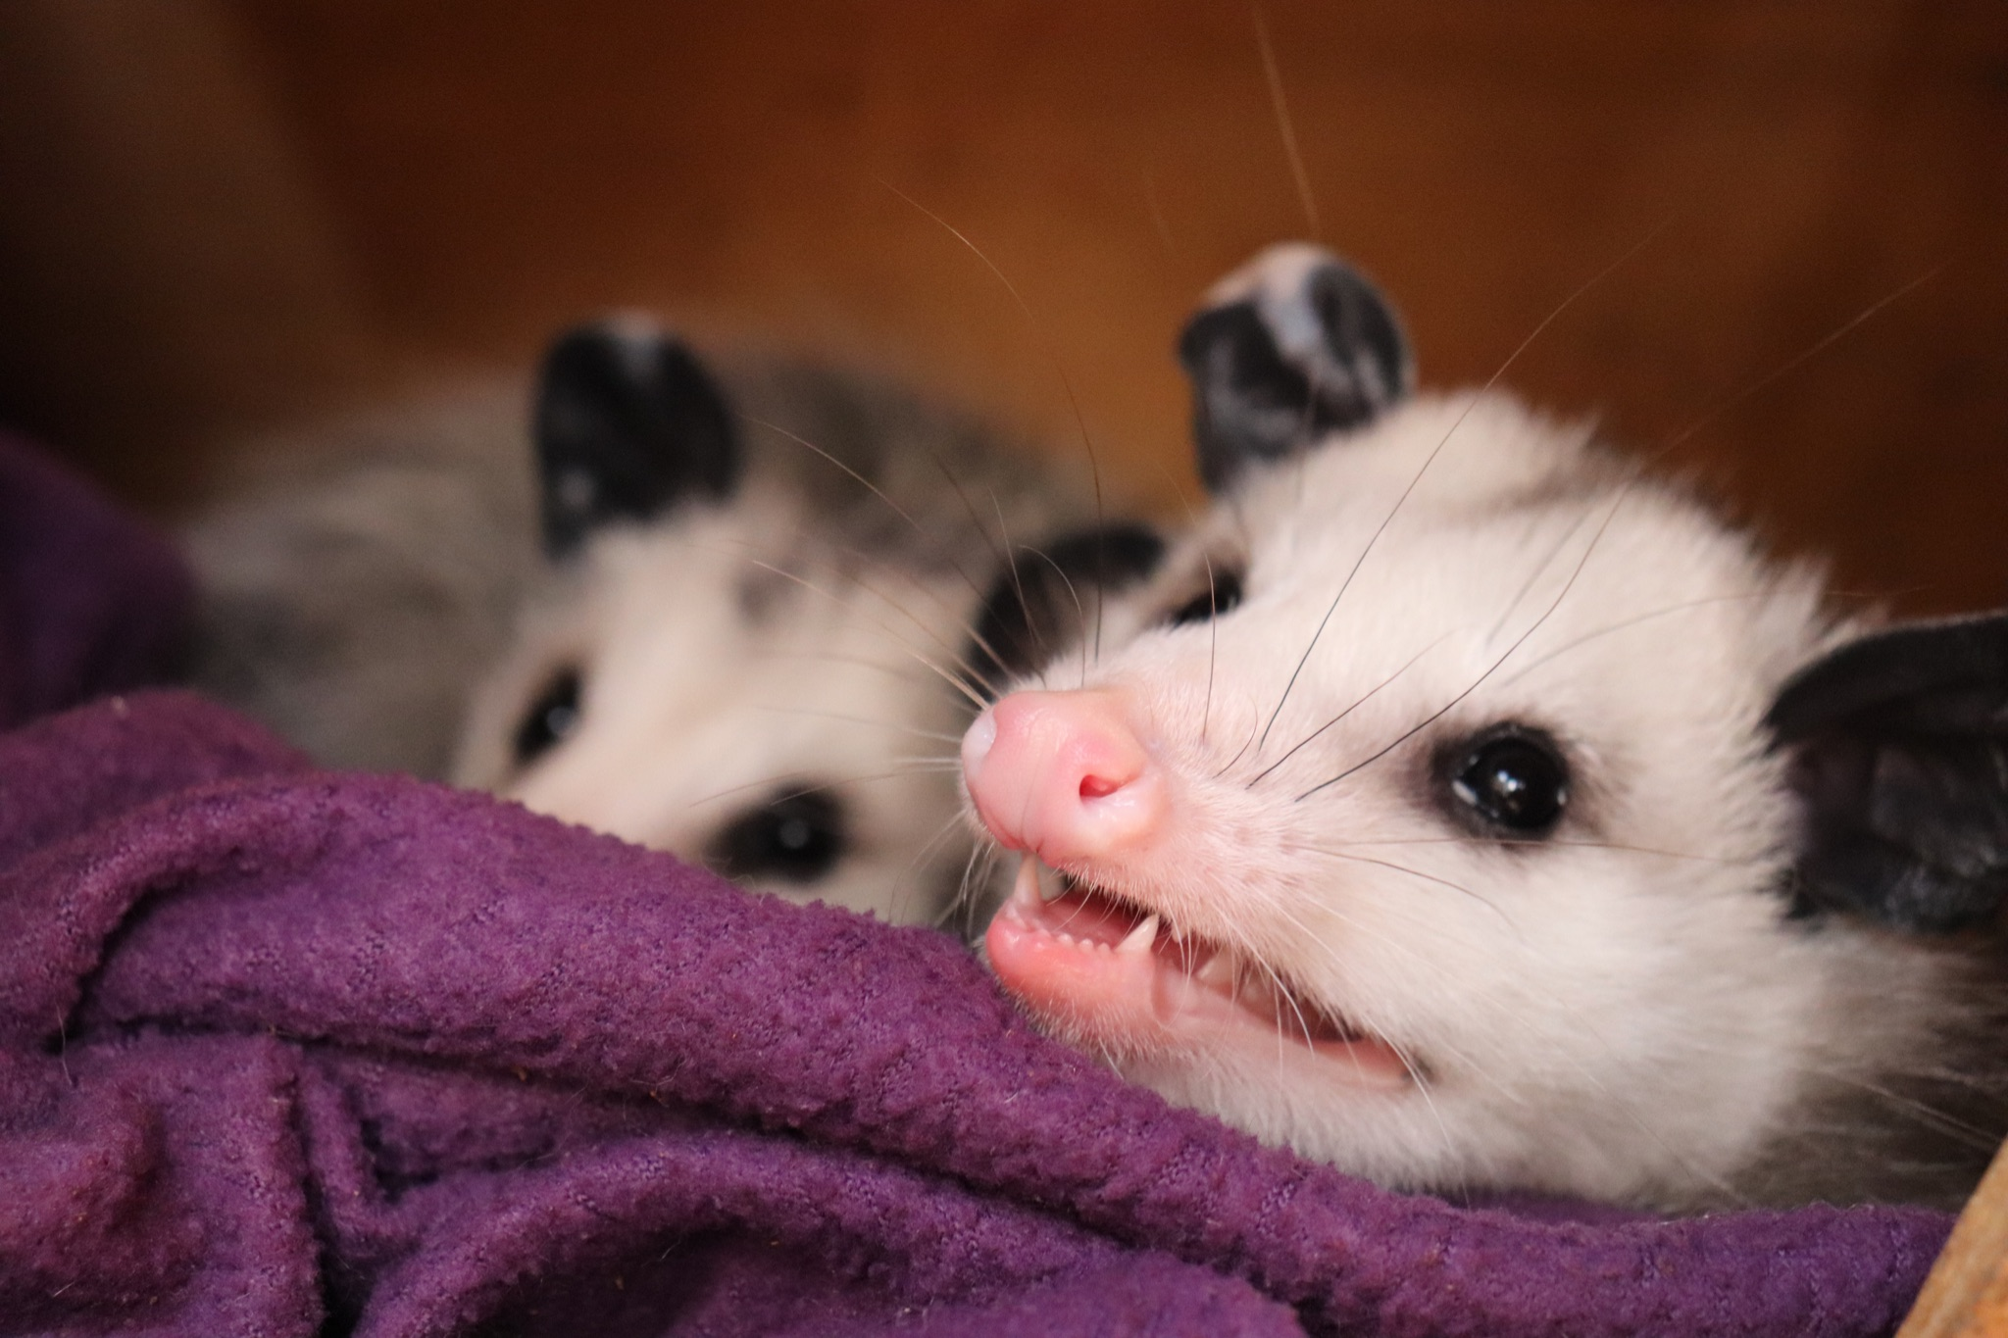
ᏌᏚᏏᏁ ᏣᎳᎩ ᎠᏕᎶᏆᏍᏗ
ᎬᎿᎨ ᎤᏍᎪᎸ ᏧᎾᎵᏑᏫᏓ ᎠᎴ ᎤᏍᏗ ᏓᏂᎵᎵᎪ.
It’s gray colored and has small ears.

Slide 9
ᏌᏚᏏᏁ ᏣᎳᎩ ᎠᏕᎶᏆᏍᏗ
ᎯᏍᎪᎯ ᎢᎦ ᏓᏂᎾᏙᎪ ᎠᎴ ᎬᎿᎨ ᏗᏂᎦᏙᎵ.
They have fifty teeth and black eyes.

Slide 10
ᏌᏚᏏᏁ ᏣᎳᎩ ᎠᏕᎶᏆᏍᏗ
ᏏᏆ ᎤᏤᏥᏍᏗ “marsupials” ᏓᏃᏎᎰ, ᎠᏂᏓ ᎦᏃᏛᎢ ᏓᏂᏃᏙᎰ.
Possums are called “marsupials”, they carry around their young in a pouch.

Slide 11
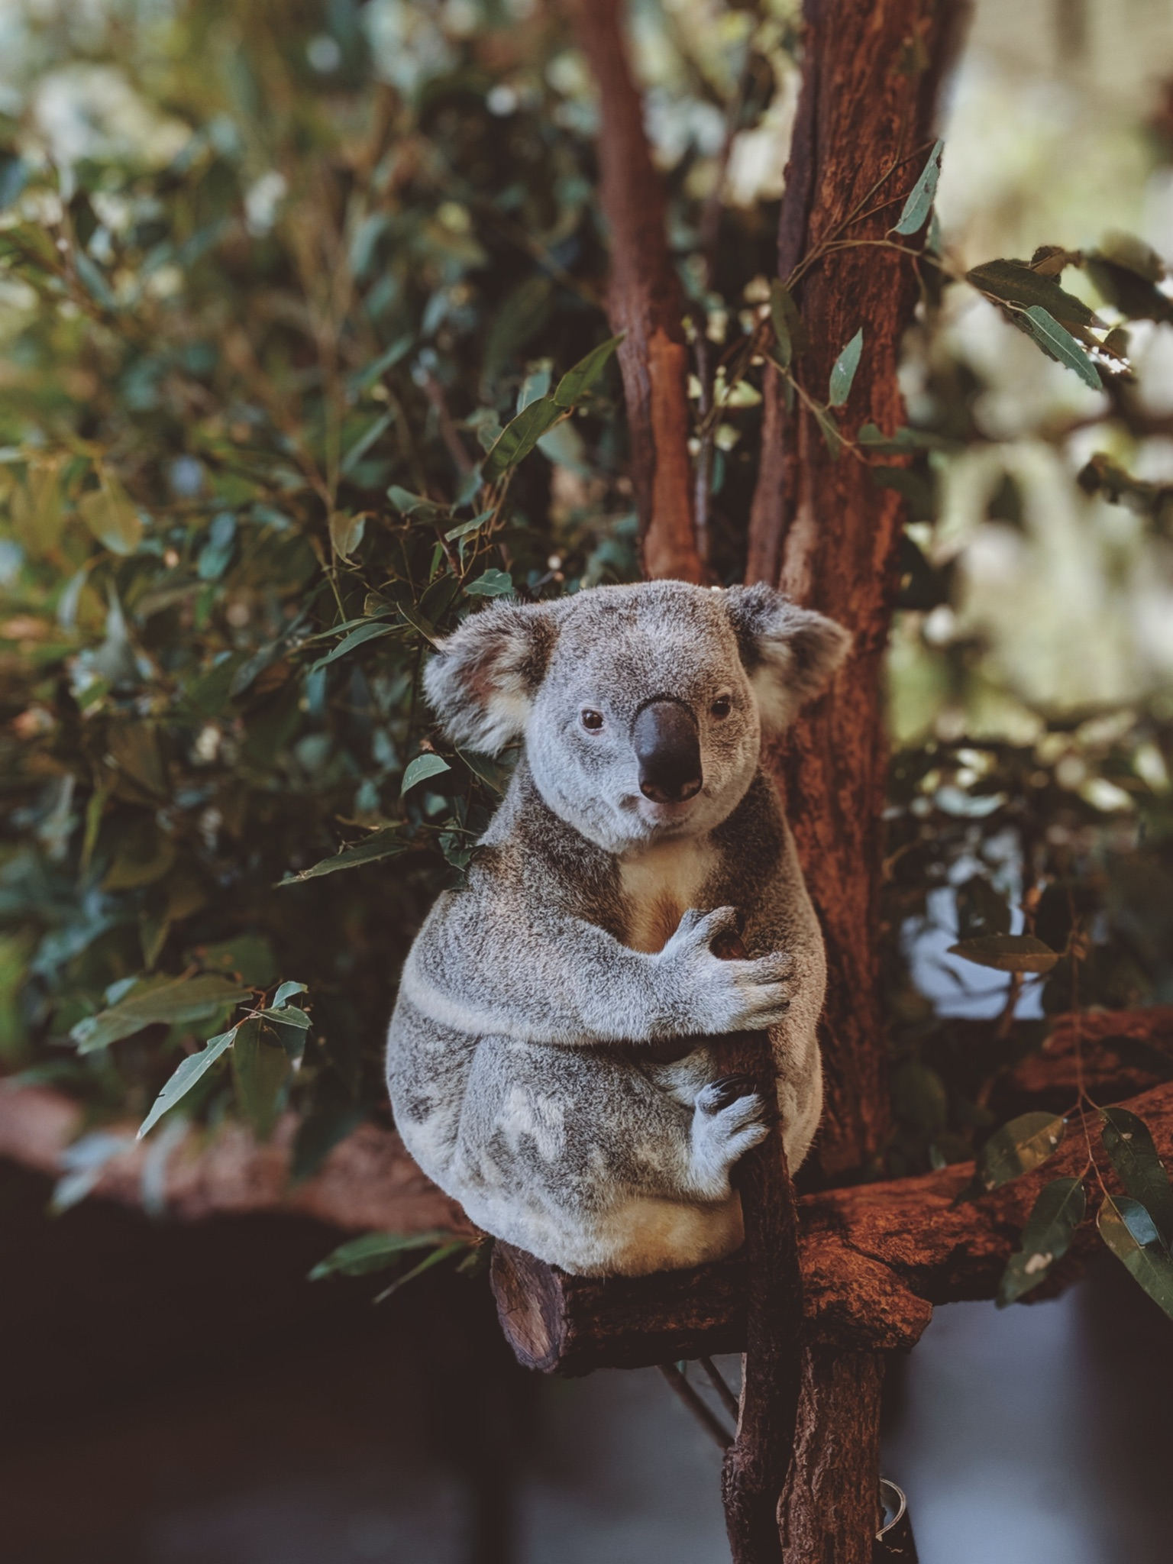
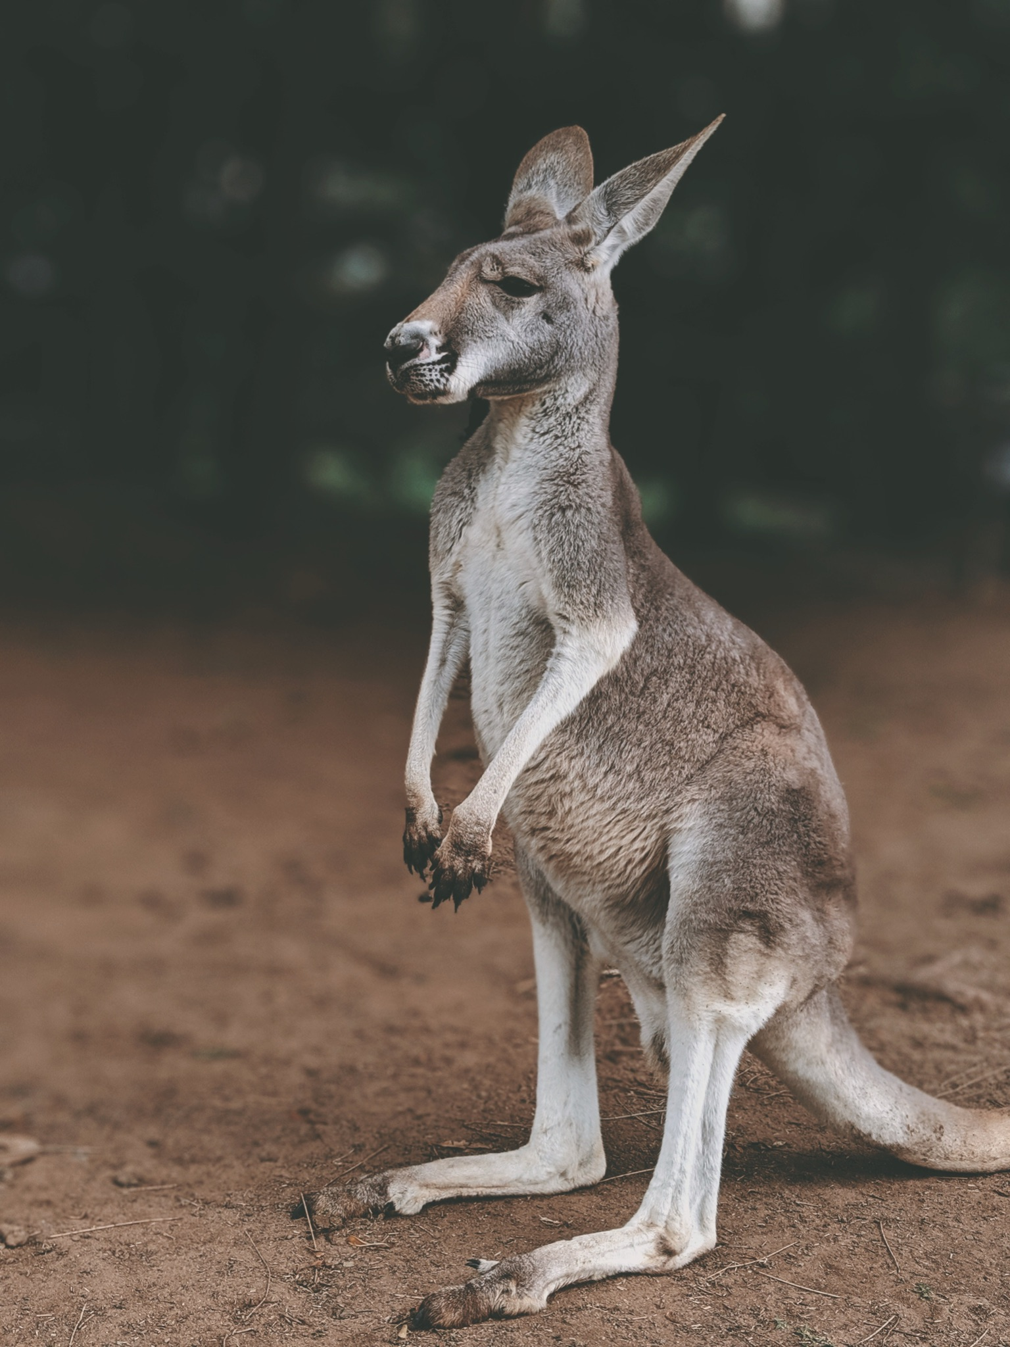
ᏌᏚᏏᏁ ᏣᎳᎩ ᎠᏕᎶᏆᏍᏗ
ᏧᎾᏠᏱ ᎪᎠᎳ ᏲᎾ ᎠᎴ ᎤᏜᏩᏓ ᎤᏤᏥᏍᏗ.
Possums are similar to koalas and kangaroos.

Slide 12
ᏌᏚᏏᏁ ᏣᎳᎩ ᎠᏕᎶᏆᏍᏗ
ᎤᏤᏥᏍᏗ ᎤᏅᏒ “marsupials” ᎠᏁ ᎠᎹᏰᏟ ᏧᏴᏢ.
Possums are the only marsupials in North America.

Slide 13
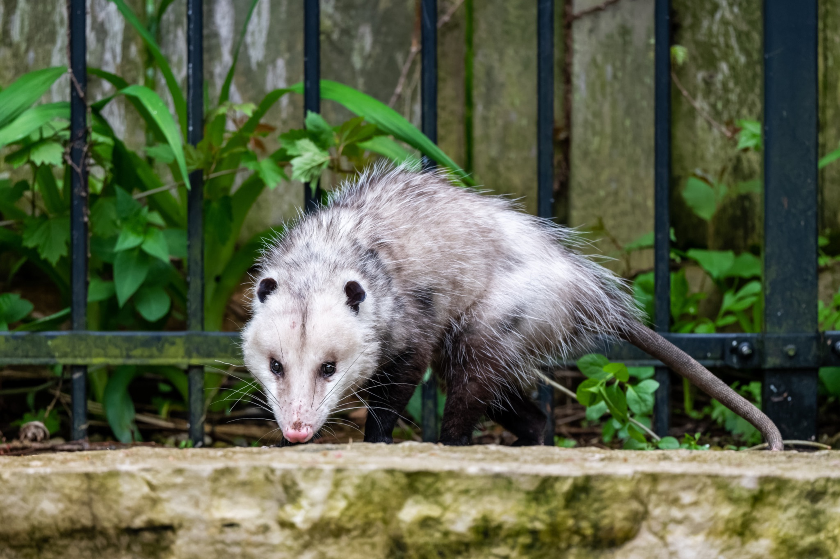
ᏌᏚᏏᏁ ᏣᎳᎩ ᎠᏕᎶᏆᏍᏗ
ᎤᏤᏥᏍᏗ ᎢᎾᎨᎢ ᎠᏁᎰ ᎠᎴ ᏒᏃᏱ ᎠᎢᏄᎪᎪ.
Possums live in the woods and come out at night.

Slide 14
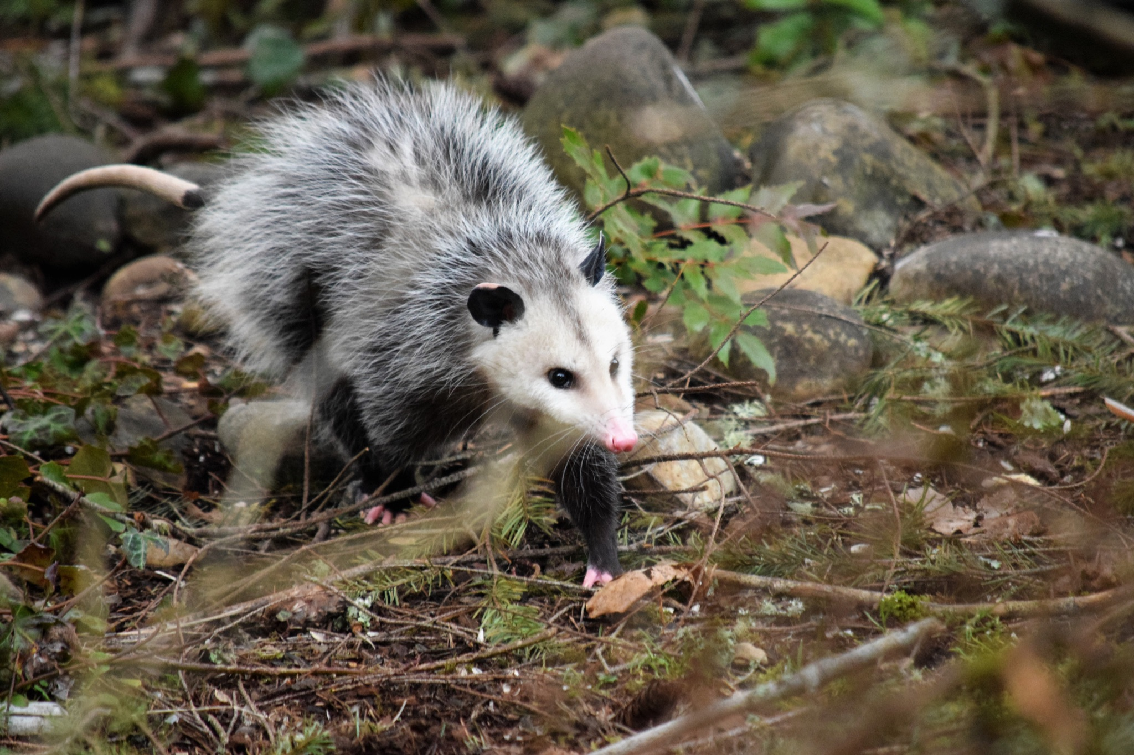
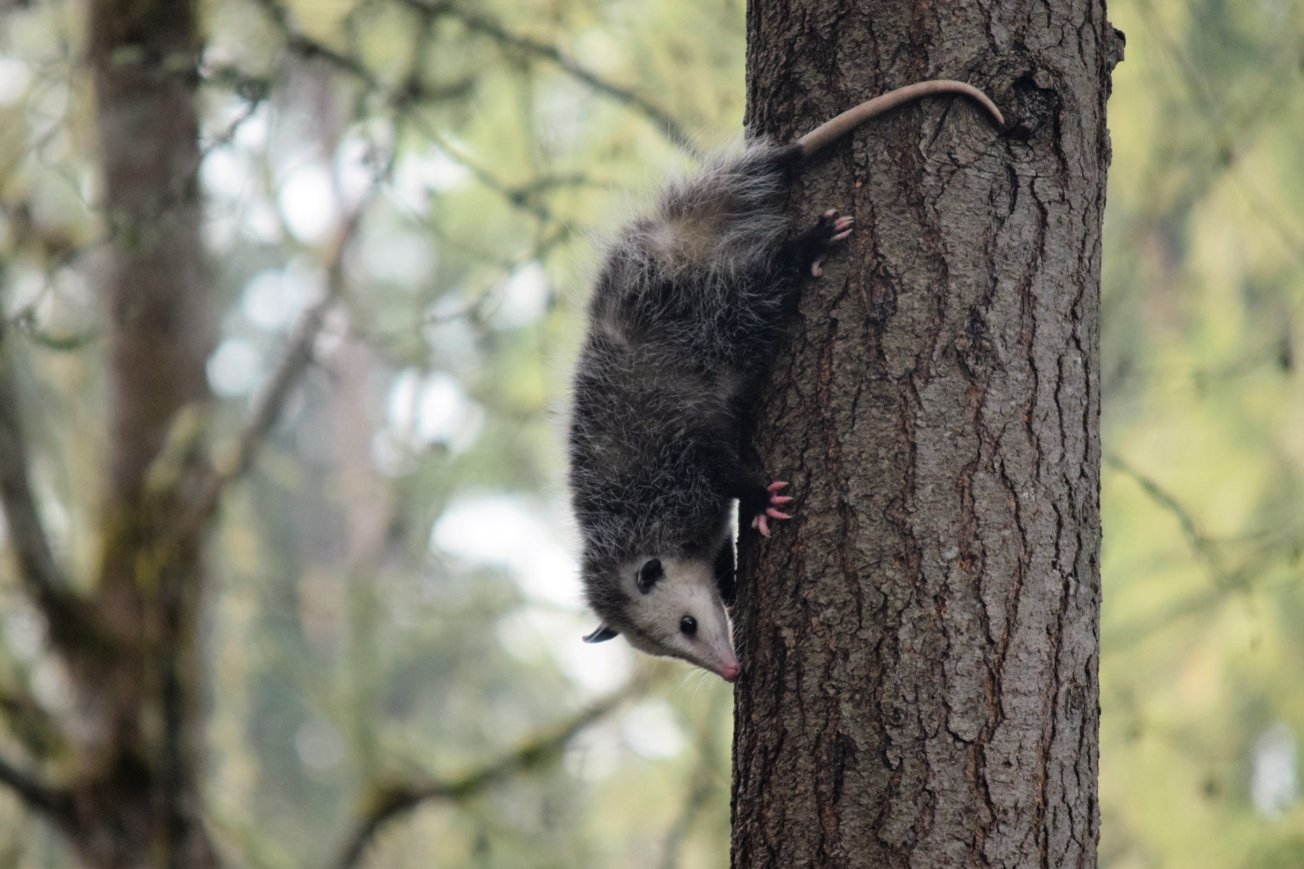
ᏌᏚᏏᏁ ᏣᎳᎩ ᎠᏕᎶᏆᏍᏗ
ᏕᎵᎬᎢ ᏓᏂᎵᏙᎰ ᎠᎴᏎᏍᎩᏃ ᎦᏙ ᎥᏍᏊ ᎤᏂᎸᏈᏗ ᎤᏁᏓᏍᏗ.
The climb trees and are also comfortable on the ground.

Slide 15
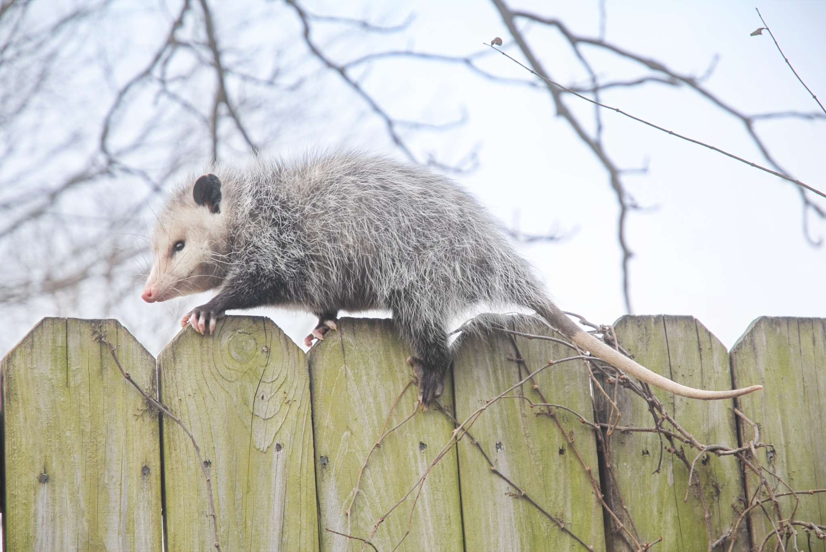
ᏌᏚᏏᏁ ᏣᎳᎩ ᎠᏕᎶᏆᏍᏗ
ᎤᏍᎦᏃᎵ ᎨᏐ.
They are slow.

Slide 16
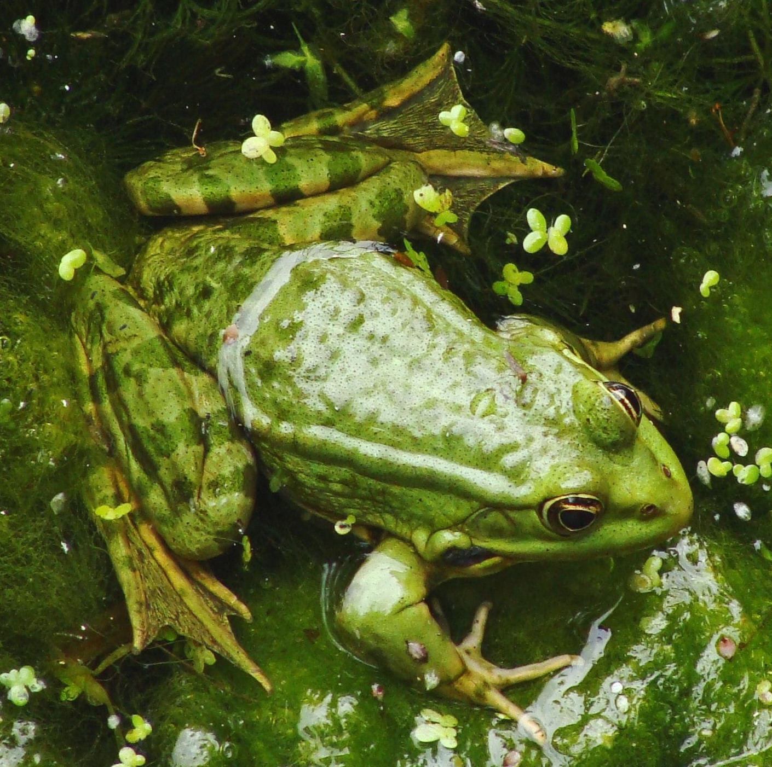
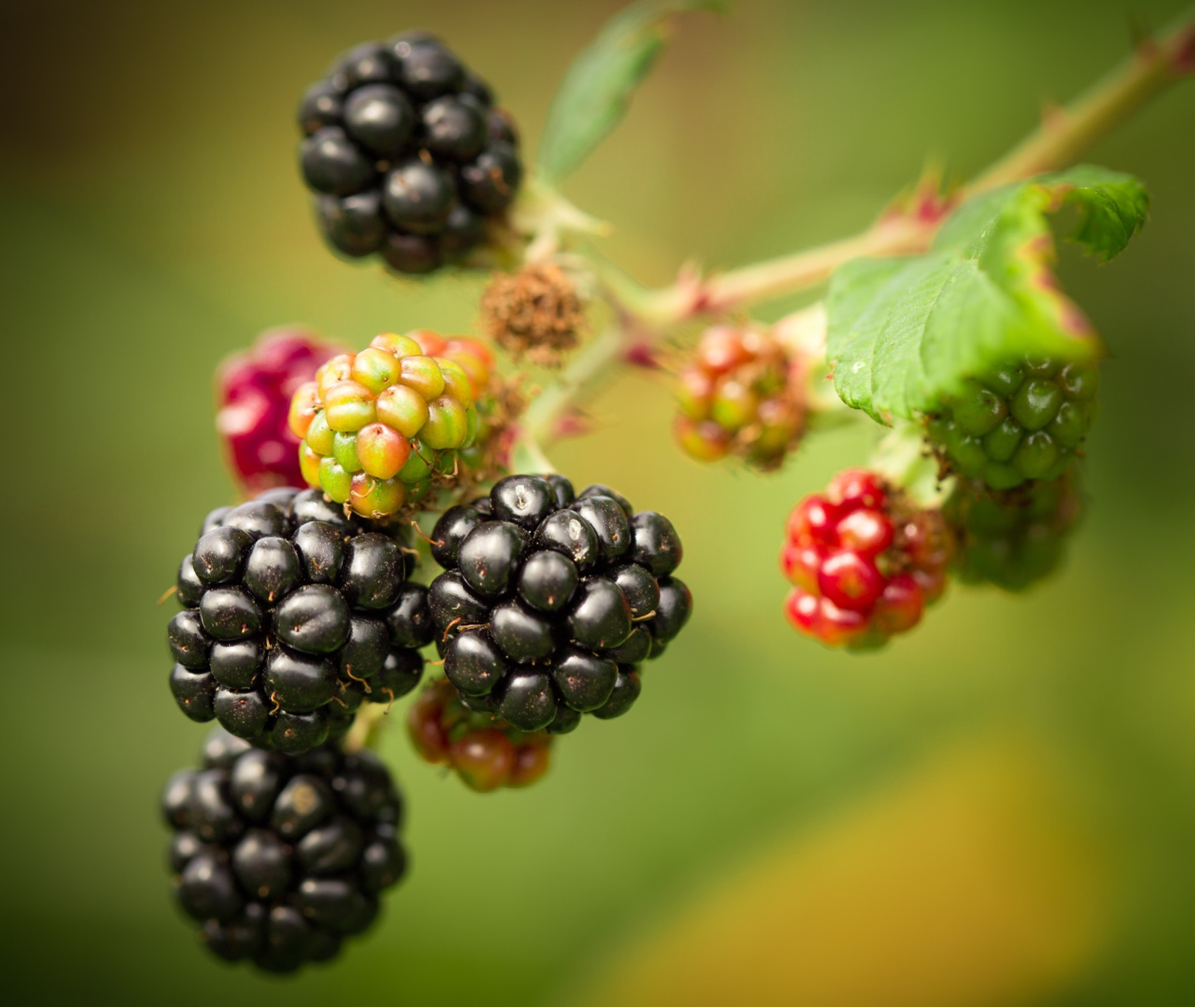
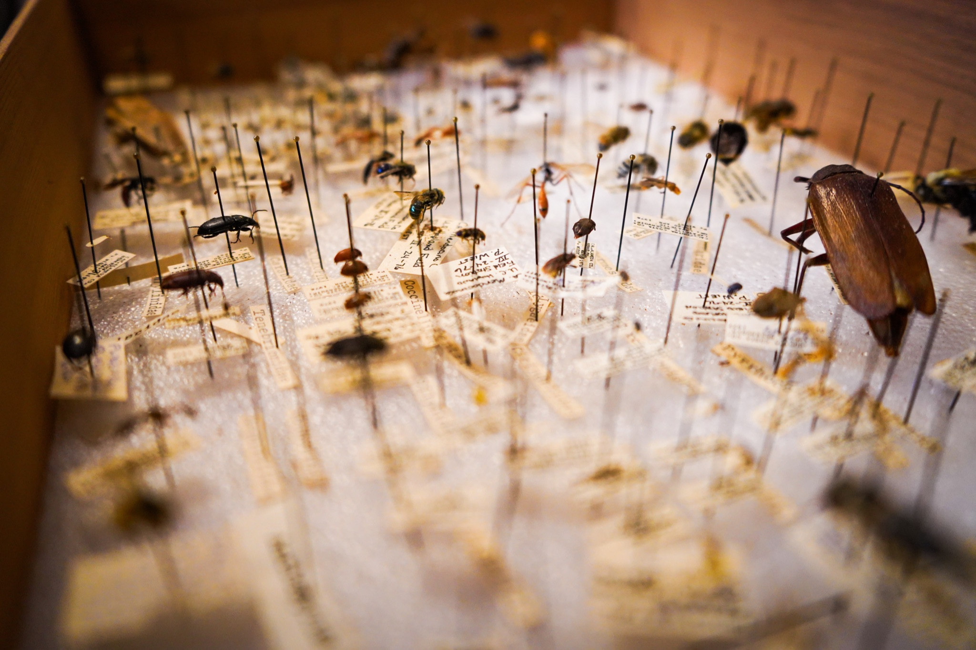
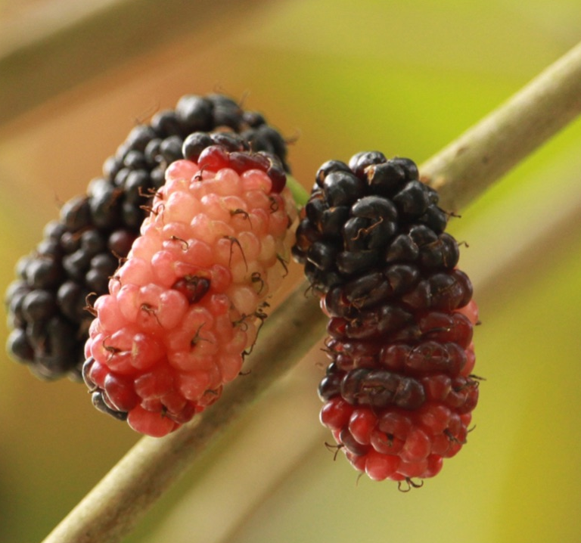
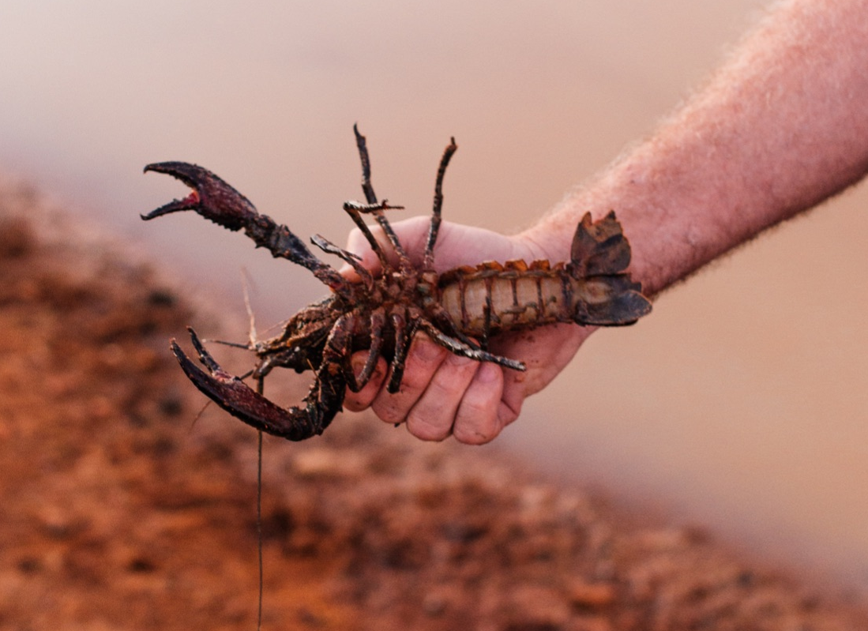
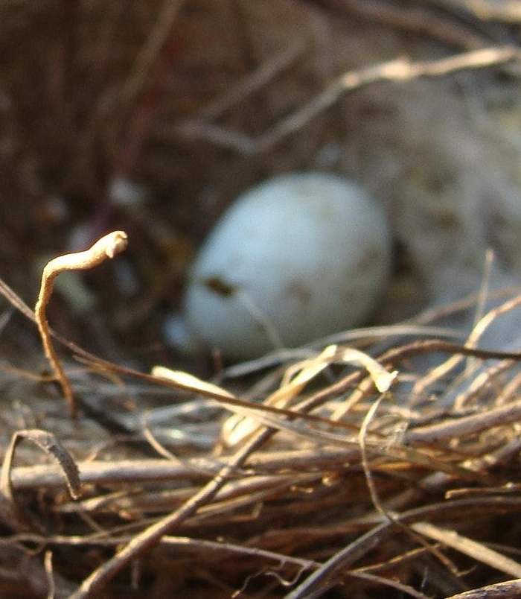
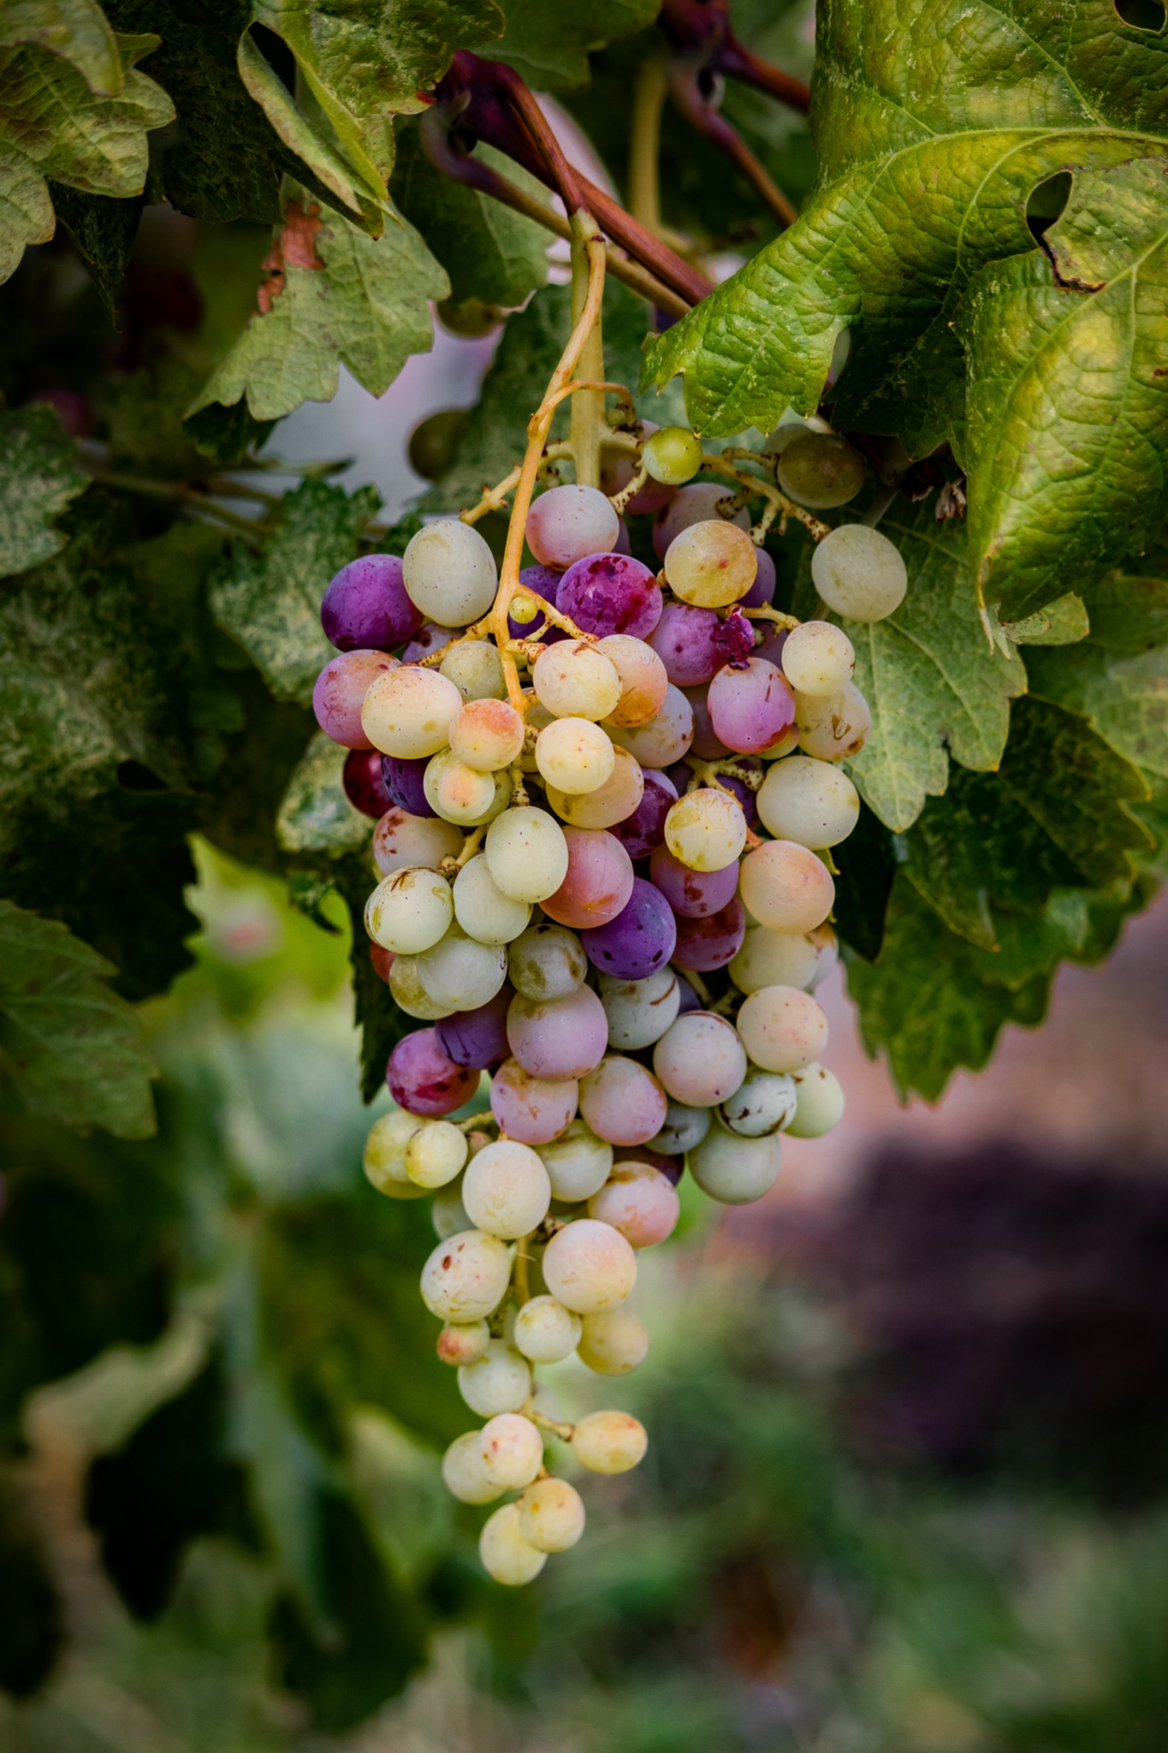
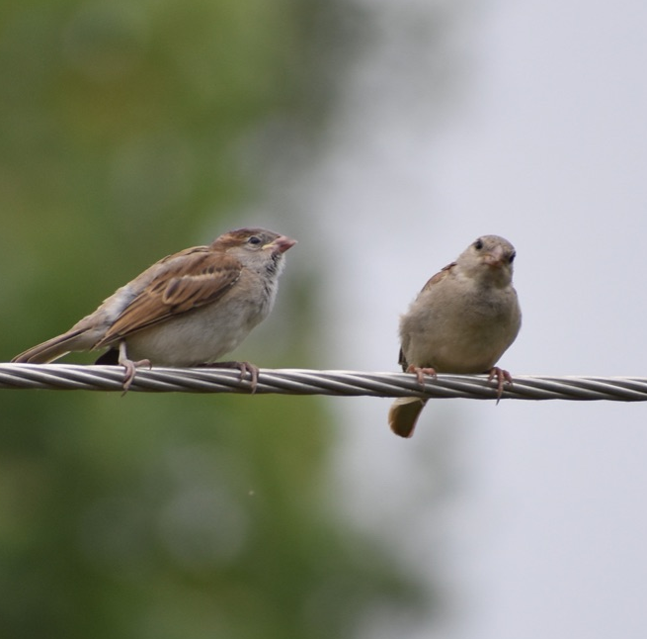
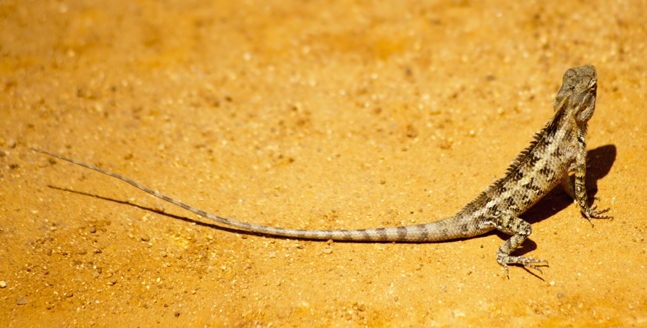
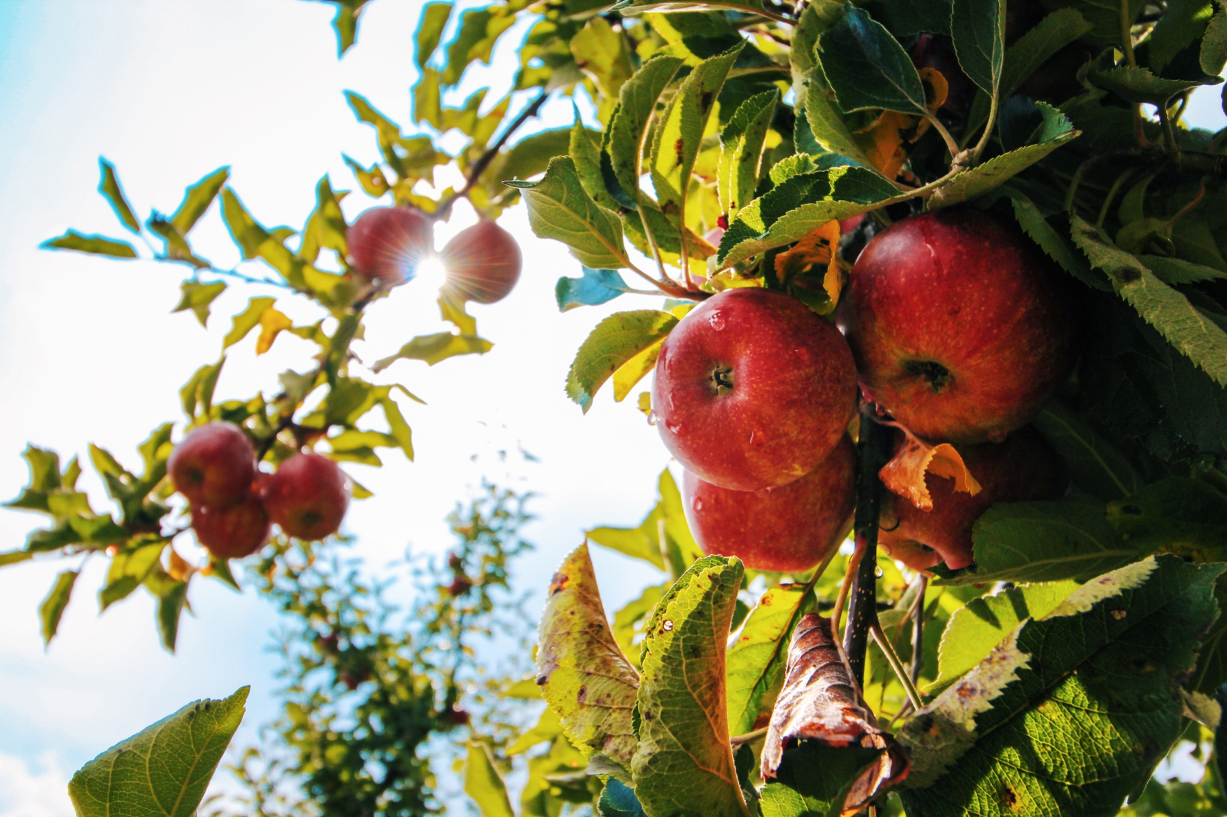
ᏌᏚᏏᏁ ᏣᎳᎩ ᎠᏕᎶᏆᏍᏗ
ᎤᏂᎸᏈᏗ ᎤᏂᎩᏍᏗ ᎧᏄᎦᏟ, ᎫᏩ, ᎤᎿᏒᎩ, ᏒᎦᏔ, ᏥᏍᎪᏯ ᏧᏓᎴᎾ, ᏧᏂᏍᏗ ᏥᏍᏆ, ᏧᏪᏥ, ᏩᎶᏏ, ᏘᏲᎭᏟ ᎠᎴ ᏥᏍᏛᎾ.
They eat things like blackberries, mulberries,wild grapes, apples, bugs, small birds, eggs, frogs, lizards and crawdads.

Slide 17
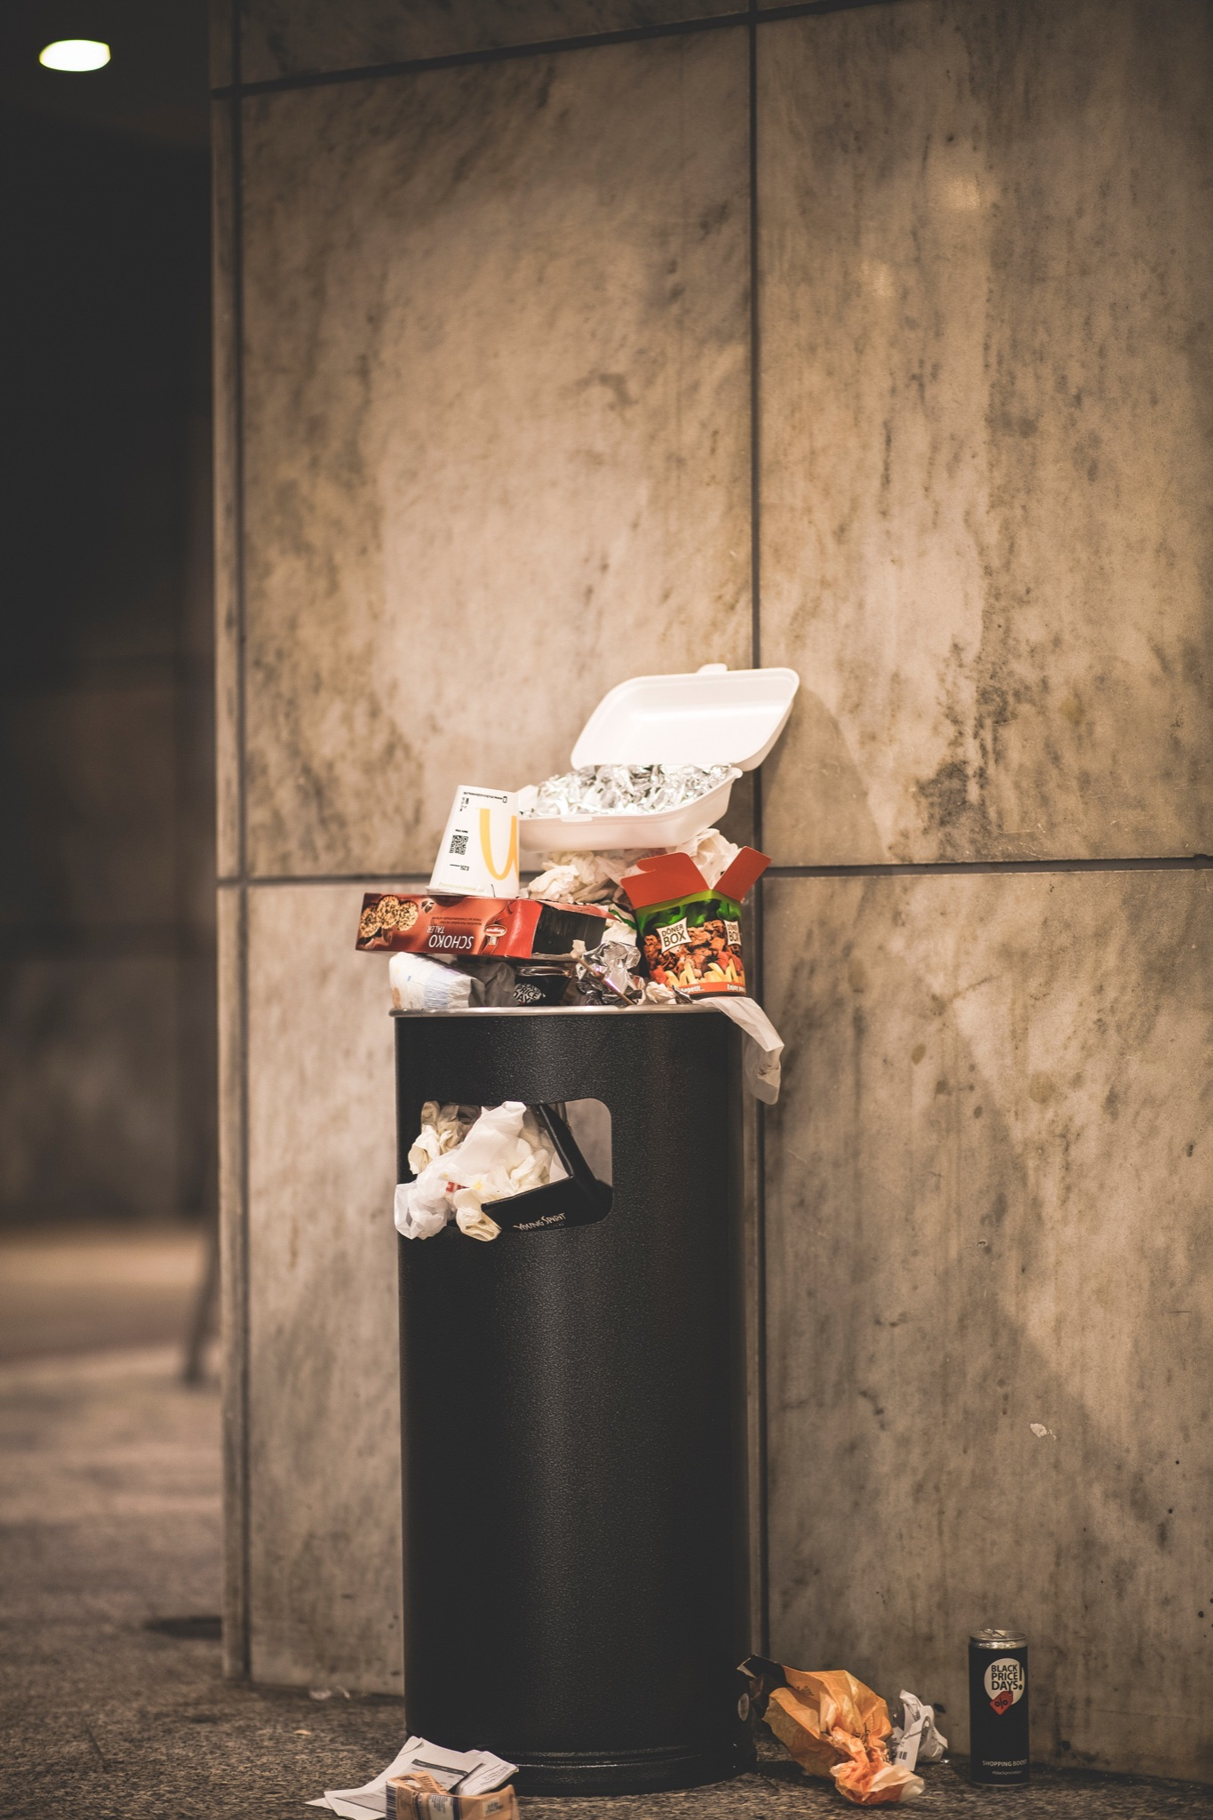
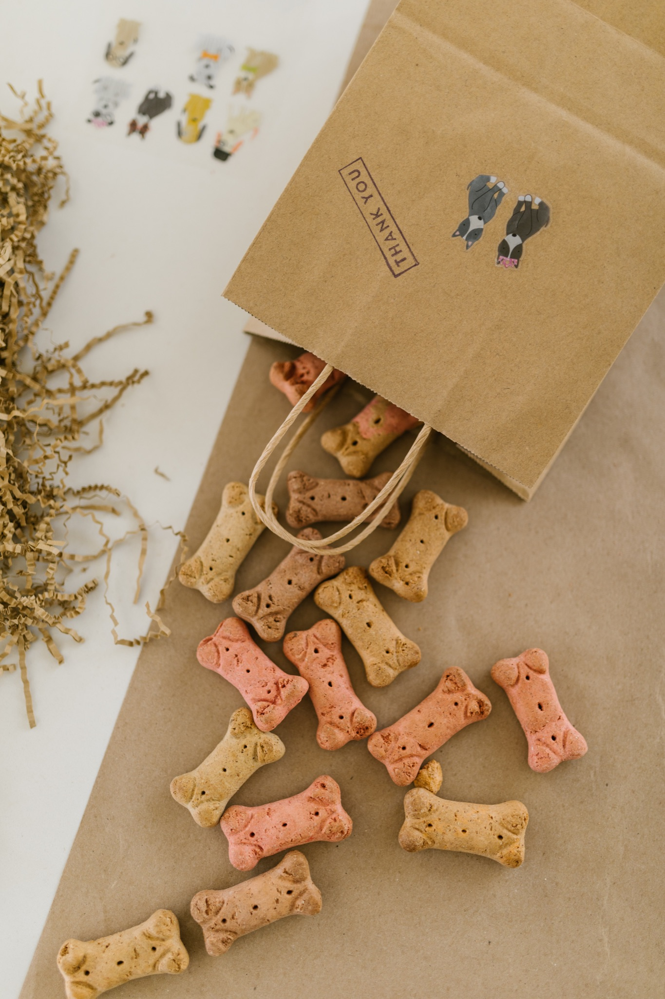
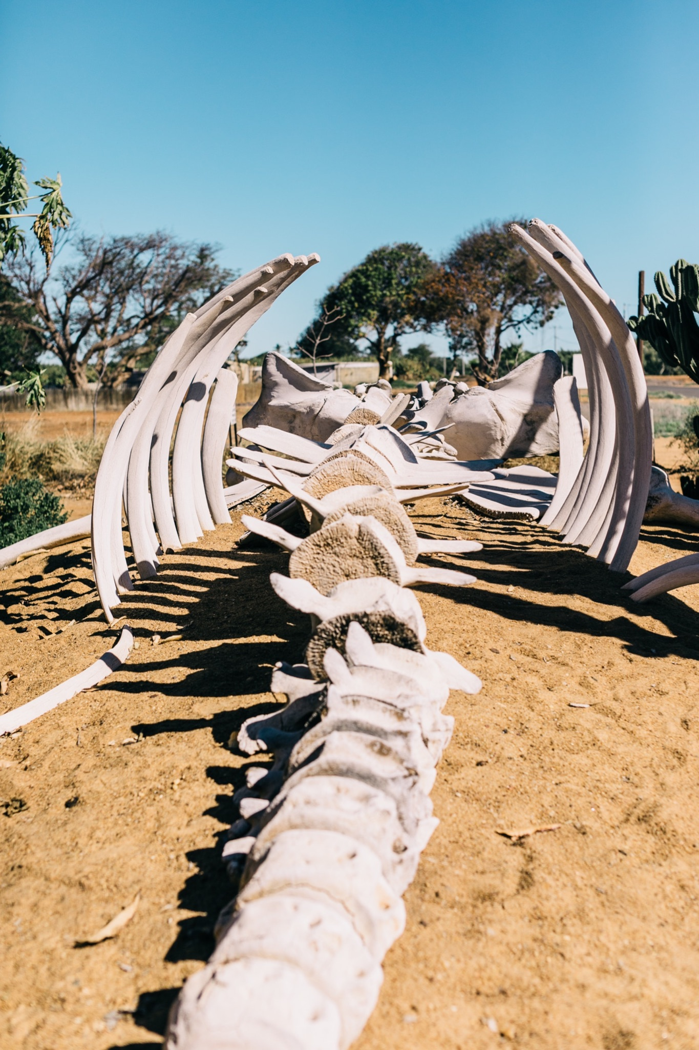
ᏌᏚᏏᏁ ᏣᎳᎩ ᎠᏕᎶᏆᏍᏗ
ᎤᏤᏥᏍᏗ ᎤᏂᎸᏈᏗ ᎤᏲᏨᎯ, ᎩᏥ ᎤᏂᎩᏍᏗ ᎠᎴ ᎤᎵᏬᏨᎦᎾᏝᎥ (ᎡᎿᎢ) ᏧᎪᎳ ᏓᏂᎩᏍᎪ.
Possums also eat trash, dog food and also the bones of dead animals.

Slide 18
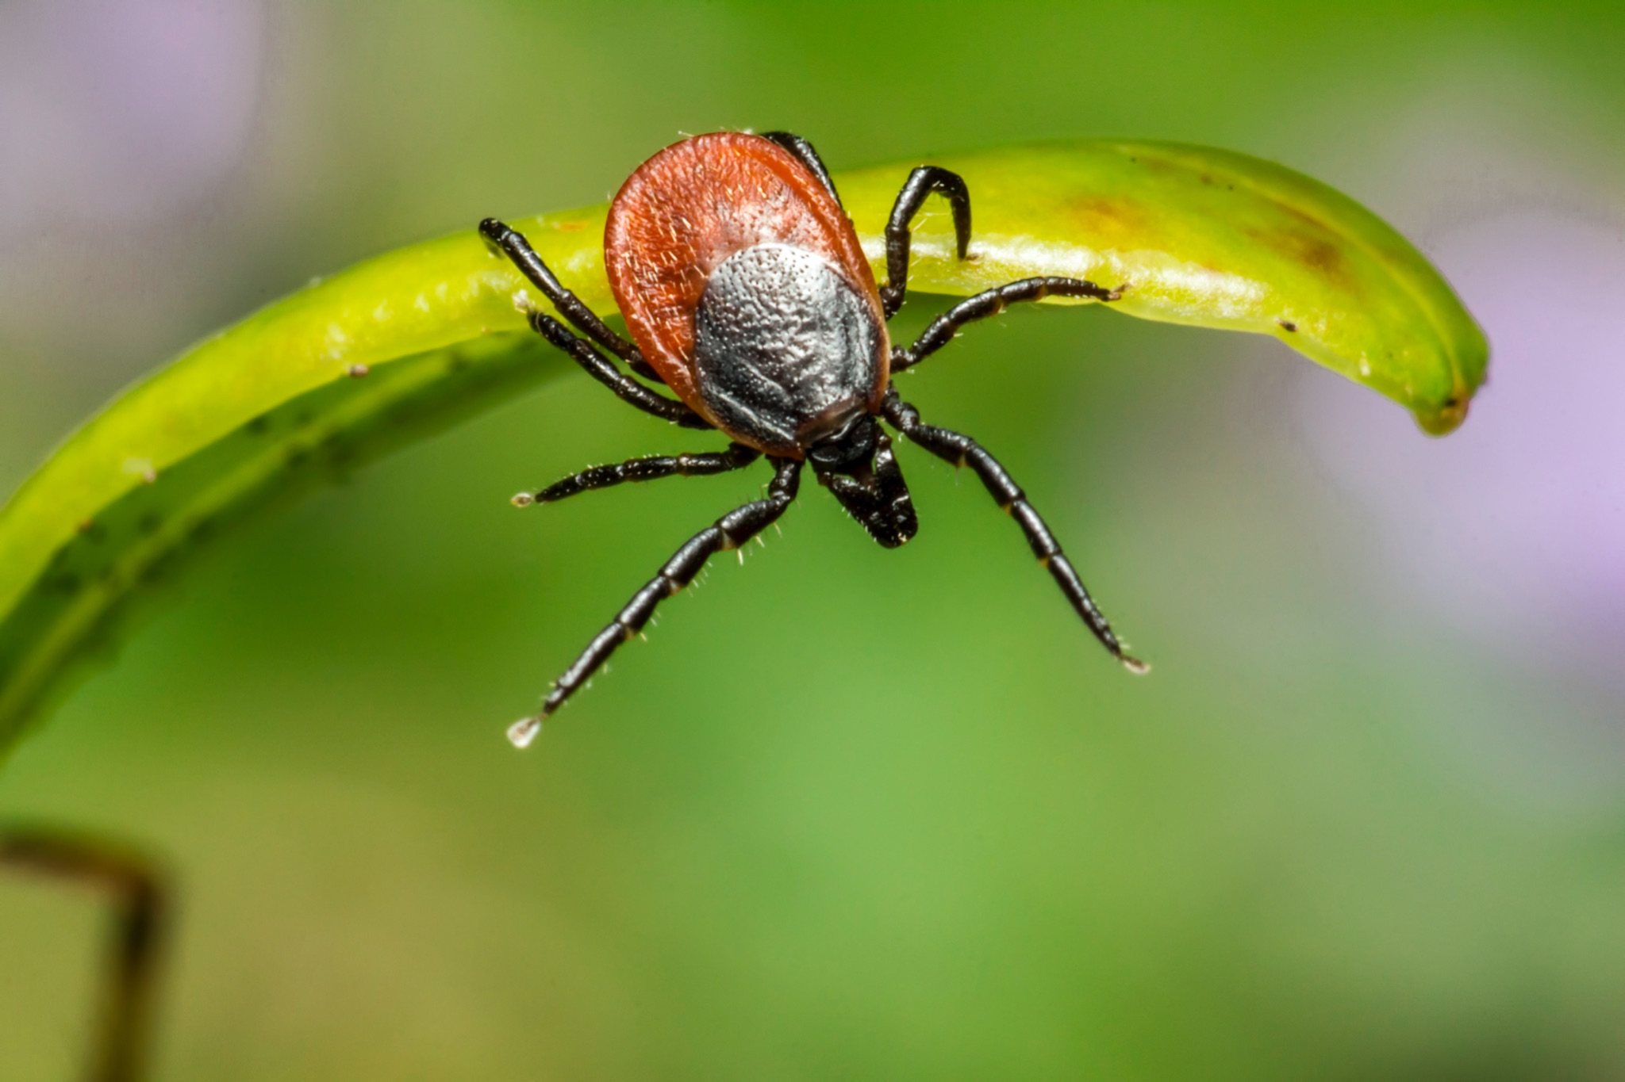
ᏌᏚᏏᏁ ᏣᎳᎩ ᎠᏕᎶᏆᏍᏗ
ᏚᏂᏣᎵᏗ ᎫᎩ ᏓᏂᎩᏍᎬ.
They are well known for eating ticks

Slide 19

ᏌᏚᏏᏁ ᏣᎳᎩ ᎠᏕᎶᏆᏍᏗ
ᏏᏆ ᎤᏤᏥᏍᏗ ᏔᎵ ᎠᎴ ᏅᎩ ᎢᏧᏕᏘᏴᏓ ᎠᏁᎰ.
Possums only live two to four years.

Slide 20
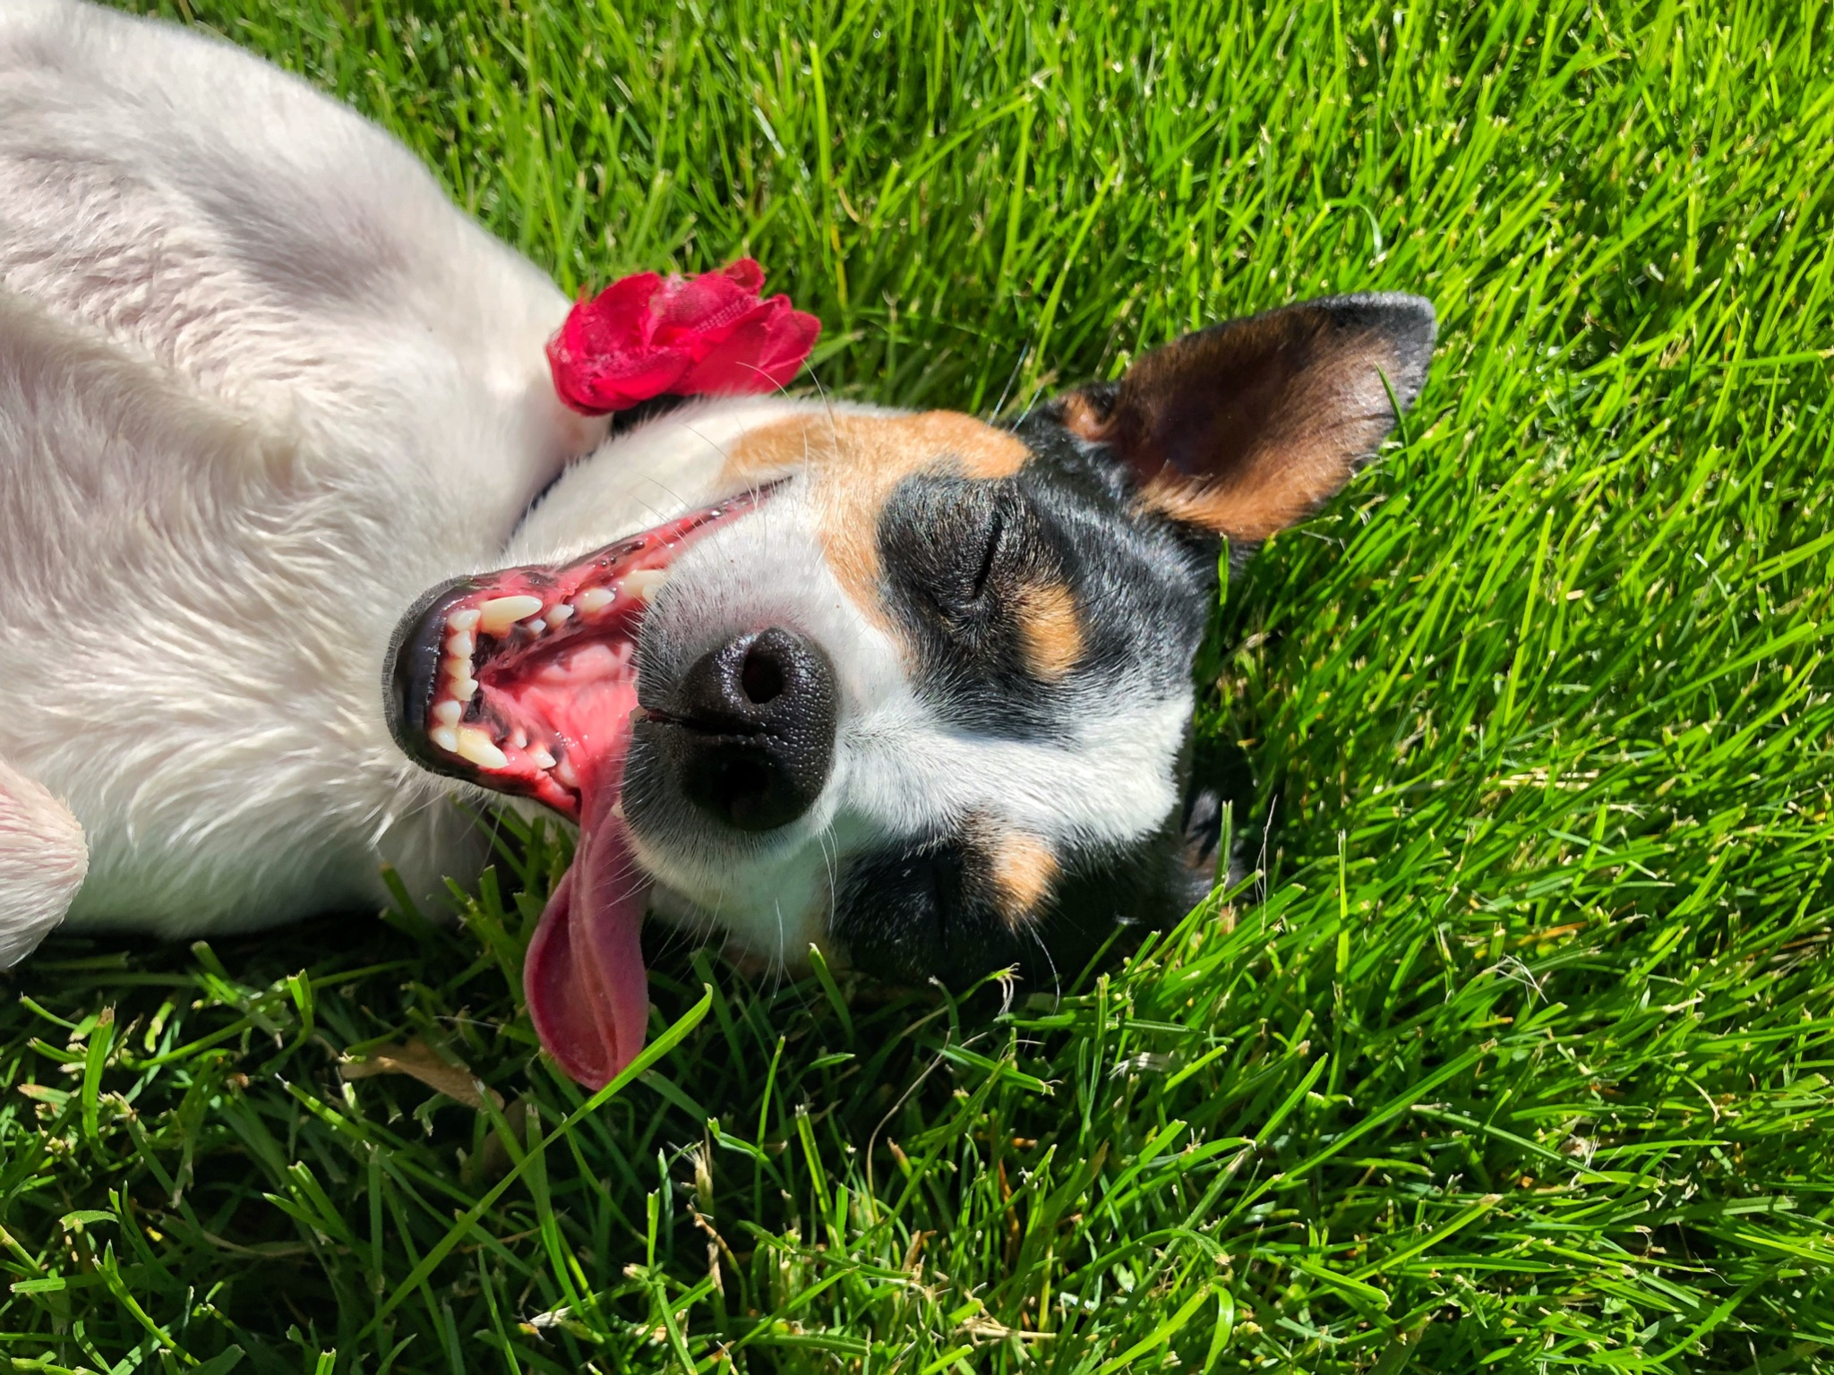
ᏌᏚᏏᏁ ᏣᎳᎩ ᎠᏕᎶᏆᏍᏗ
ᎢᏳᏓᎵᎭ, ᎪᎱᏍᏗ ᏳᏍᎦᏍᏓᏁᎵ, ᎤᎵᏬᏨ ᎠᏤᎸᏍᎪ, ᏯᎾᏑᎦ, ᏳᏔᏠᎦ, ᎠᎴ ᏗᎩᏙᎵ ᏧᏍᏚᎢᏗ ᎨᏐᎢ.
Many times when the possum feels threatened, they will pretend to be dead, laying down, their mouth hanging open and their eyes open.

Slide 21
ᏌᏚᏏᏁ ᏣᎳᎩ ᎠᏕᎶᏆᏍᏗ
ᎥᏍᏊ, ᎤᏂᎵᏬᏨ ᏳᎾᏤᎸᎾ, ᎤᏲ ᎠᏒᏥᎯᏍᎪ.
Also, when they play dead, they smell bad.

Slide 22
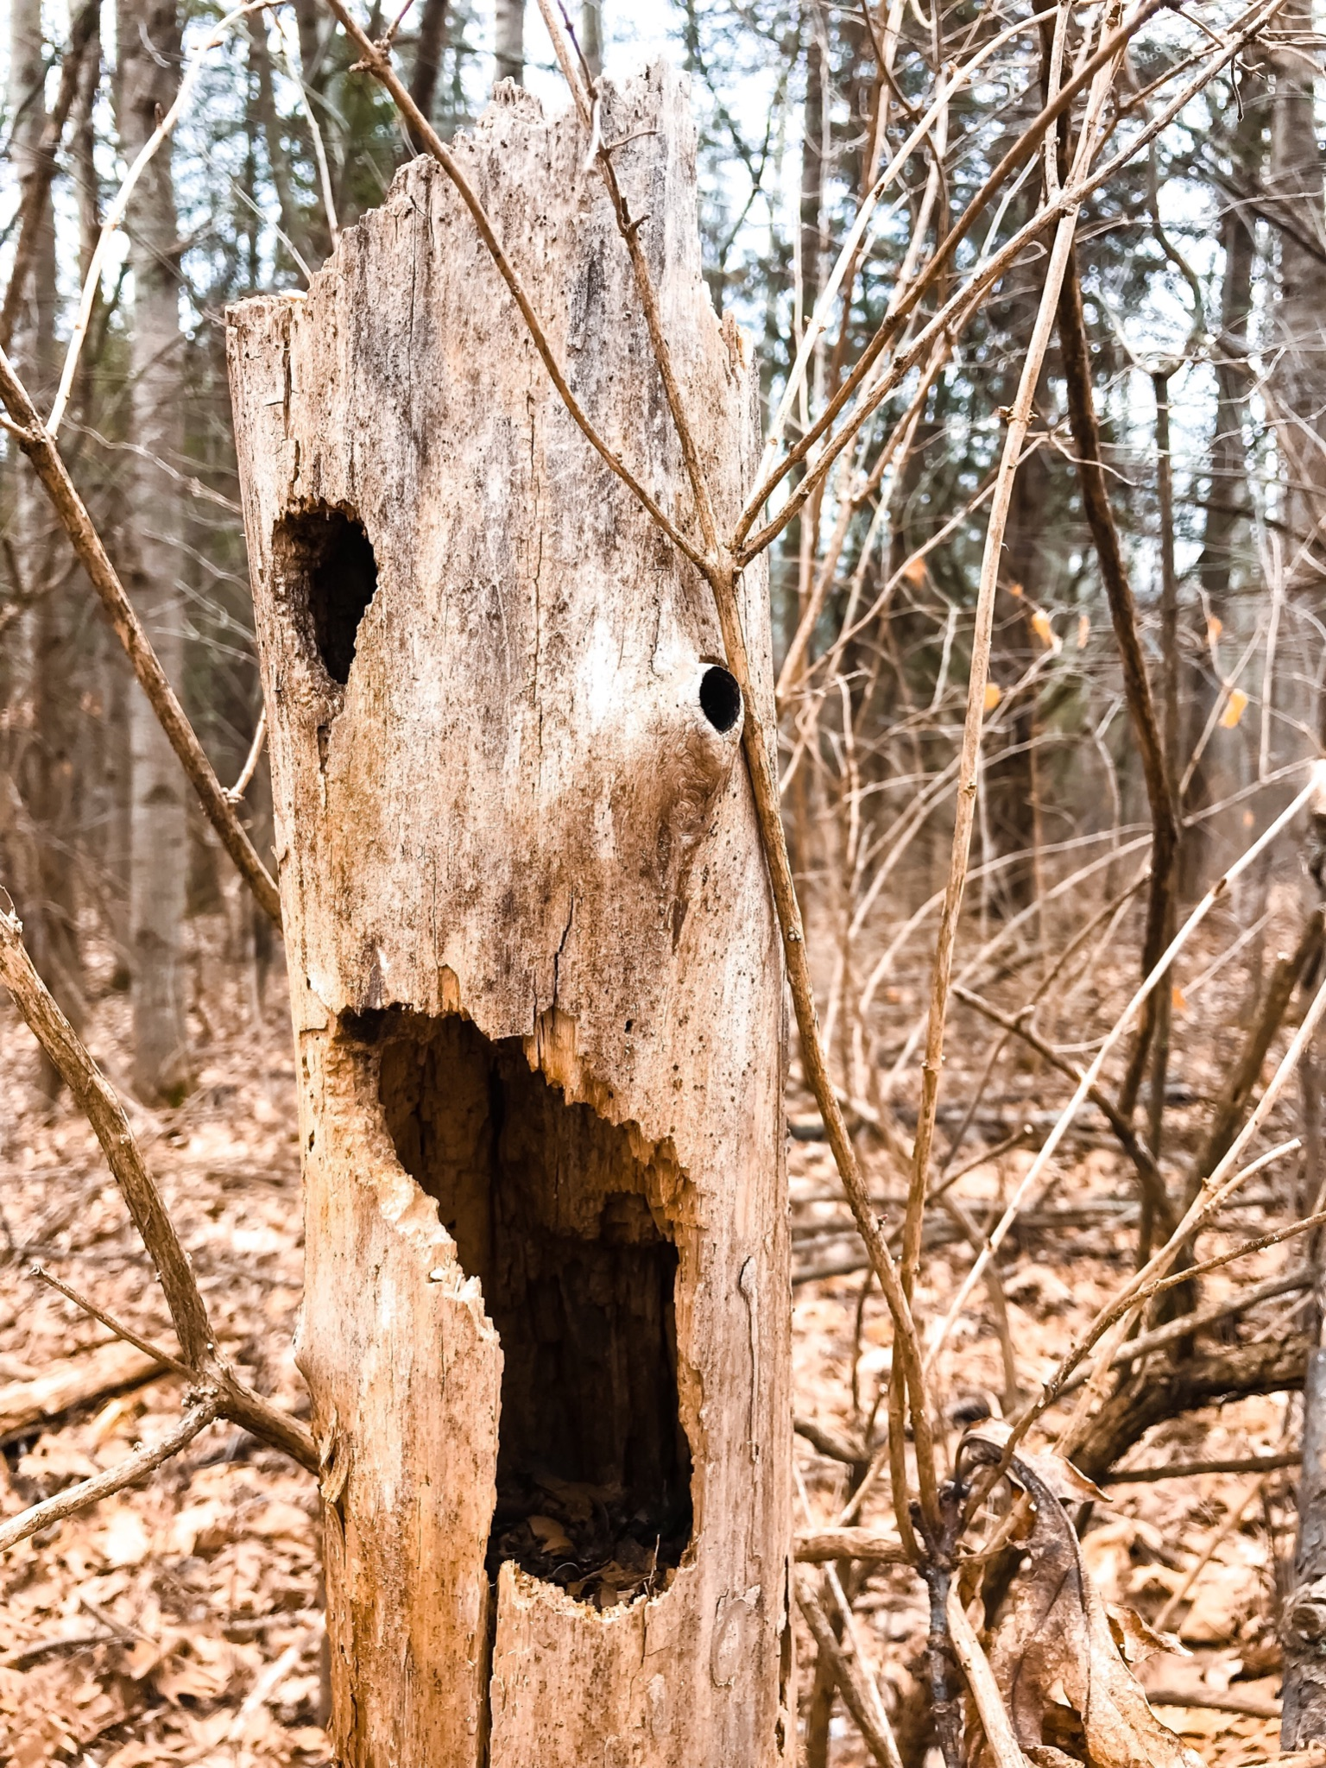
ᏌᏚᏏᏁ ᏣᎳᎩ ᎠᏕᎶᏆᏍᏗ
ᏧᏌᏙᏂ ᏕᏢᎬ ᎤᎾᏣᎣ ᎠᎴ ᎭᏫᏂᏗᏢ ᏚᏂᎵᎬ ᎠᎴ ᏧᎾᏍᏕᏢ ᎠᏂᏁᎶ.
They live in hollow trees or under stumps or roots.

Slide 23
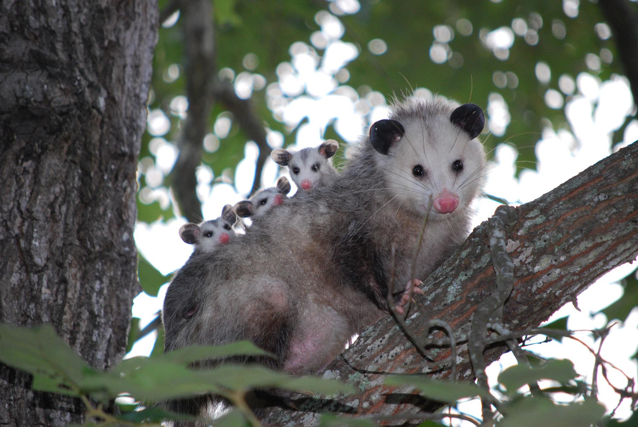
ᏌᏚᏏᏁ ᏣᎳᎩ ᎠᏕᎶᏆᏍᏗ
ᏔᎵᏍᎪ ᎯᏍᎩ ᏯᏂ ᏧᏂᏍᏗ ᏯᎾᏕᎲᎦ, ᎠᏎᏃ Ꮭ ᏂᎦᏓ ᏱᏓᎾᏛᏍᎪ.
Possums can give birth to as many as 25 babies, but most do not survive to adulthood.

Slide 24
ᏌᏚᏏᏁ ᏣᎳᎩ ᎠᏕᎶᏆᏍᏗ
ᏧᏂᏍᏗ ᎯᏍᎩ ᏳᎾᏙᏓᏆᏍᎩ ᎤᎾᏣᎣ ᎦᏃᏛᎢ.
The babies live about 5 weeks in the pouch.

Slide 25
ᏌᏚᏏᏁ ᏣᎳᎩ ᎠᏕᎶᏆᏍᏗ
ᏔᎵ ᏯᏅᏗᏃ ᎦᏐᎯ ᎤᏂᏥ ᎤᏂᎩᎸᏗᏕᎪ.
then 2 months they ride around on their mother’s back.

Slide 26
ᏌᏚᏏᏁ ᏣᎳᎩ ᎠᏕᎶᏆᏍᏗ
ᎤᏤᏥᏍᏗ ᎤᏅᏒ ᎠᏁᏙ.
Possums are solitary animals.

Slide 27
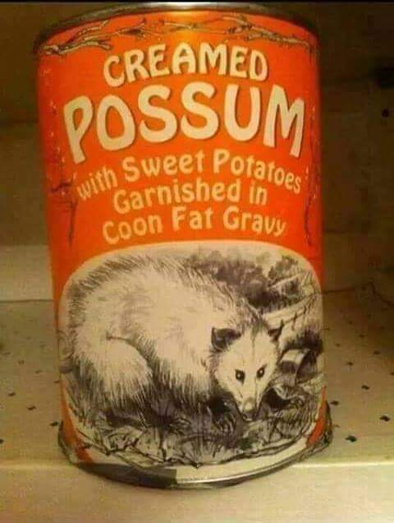
ᏌᏚᏏᏁ ᏣᎳᎩ ᎠᏕᎶᏆᏍᏗ
ᎠᏂᏣᎳᎩ ᏳᏓᎭ ᎤᏤᏥᏍᏗ ᏓᏂᎩᏍᎪ, ᎠᏎᏃ ᎪᎢᎭ ᎭᏫᏯ ᎨᏐᎢ.
Cherokees would sometimes eat possum, but the meat is greasy.

Slide 28
ᏌᏚᏏᏁ ᏣᎳᎩ ᎠᏕᎶᏆᏍᏗ
ᎥᏍᎩ ᏳᏍᏗ ᏄᎾ ᎠᏂᏅᎯᏓ ᎠᎴ ᎤᏤᏥᏍᏗ ᎭᏫᏯ ᎢᏧᎳ ᏓᏂᎩᏍᎪ.
It is often eaten with sweet potatoes.

