Slide 1
ᎣᏏᏲ
ᏦᎦᏚᏏᏁ ᏣᎳᎩ ᎠᏕᎶᏆᏍᏗ

Slide 2
ᏦᎦᏚᏏᏁ ᏣᎳᎩ ᎠᏕᎶᏆᏍᏗ
ᎢᏓᎴᎾ- Let’s begin
ᏣᎳᎩ ᎢᏗᏬᏂ- Let’s talk Cherokee

Slide 3
ᏔᎳᏚᏏᏁ ᏣᎳᎩ ᎠᏕᎶᏆᏍᏗ
ᎯᎦᏔᎮᏍᏗ ᎠᏂ
ᎦᏍᎩᎸ, ᏣᎬᏫᏳᎯ,
ᎠᎴ ᏂᎬᏅᏛᏉ
ᎡᏣᎸᏉᏗᏍᎬᎢ.
Know this place here
At your table, you King,
And everywhere
You will be praised.
Notes:
aksdayvhvsg

Slide 4
ᏦᎦᏚᏏᏁ ᏣᎳᎩ ᎠᏕᎶᏆᏍᏗ
2.ᏂᎯᏉ ᏗᏓᎴᏂ
ᏦᏣᎵᏍᏓᏴᏗᎭ;
ᎠᎴ ᎤᏣᏘ ᎠᏴ
ᎢᏨᏯᎵᎡᎵᏤᎭ.
It begins with only you
That we can eat this meal;
And very much
We are grateful.
Notes:
aksdayvhvsg

Slide 5
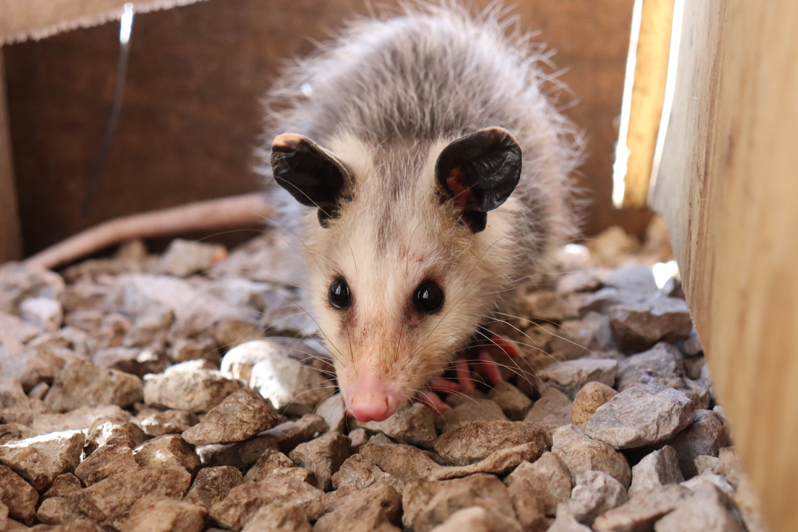
ᏦᎦᏚᏏᏁ ᏣᎳᎩ ᎠᏕᎶᏆᏍᏗ
ᎤᏤᏥᏍᏗ ᎧᏴᏐᎵ ᎠᏓᎴᏂᏍᎬ ᎦᏂᏓᏛᎢ ᎢᎦᏅᎯᏓ ᏦᎦᏚ ᎠᎴ ᏦᏍᎪᎯ ᎦᎵᏉᎩ ᎢᏏᏔᏗᏍᏗ.
From nose to the base of the tail, the possum is 13 to 37 inches long.

Slide 6
ᏦᎦᏚᏏᏁ ᏣᎳᎩ ᎠᏕᎶᏆᏍᏗ
ᎦᏂᏓᏛ ᎤᏰᎸᎭ ᎠᎴ ᎦᏅᎯᏒ ᏐᏁᎵ ᎠᎴ ᏐᏁᎳᏚ ᎢᏏᏔᏗᏍᏗ.
The tail is naked and between 9 and 19 inches long.

Slide 7
ᏦᎦᏚᏏᏁ ᏣᎳᎩ ᎠᏕᎶᏆᏍᏗ
ᏚᏩᏂᎦᏢ ᎠᎴ ᏧᏓᎴᏅᏓ ᎪᎱᏍᏗ ᏱᎦᏇᏅᎾ ᎦᏂᏓᏛ.
Branches and various things it wraps around the tail.

Slide 8
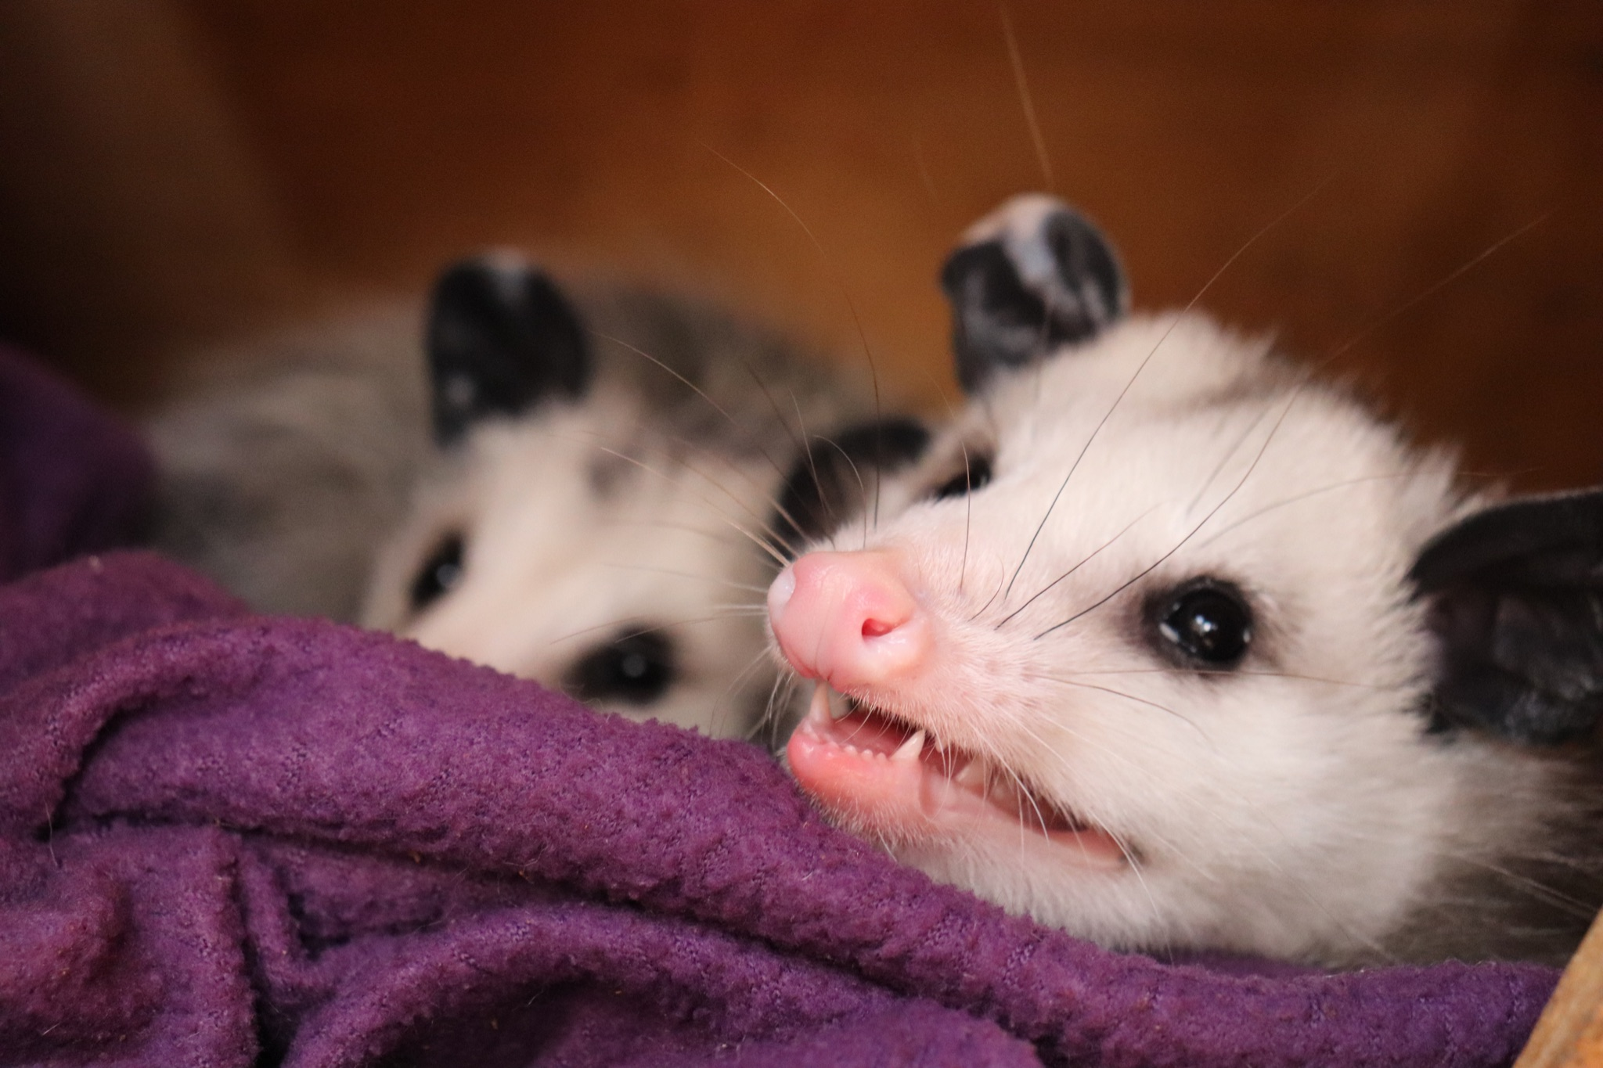
ᏦᎦᏚᏏᏁ ᏣᎳᎩ ᎠᏕᎶᏆᏍᏗ
ᎬᎿᎨ ᎤᏍᎪᎸ ᏧᎾᎵᏑᏫᏓ ᎠᎴ ᎤᏍᏗ ᏓᏂᎵᎵᎪ.
It’s gray colored and has small ears.

Slide 9
ᏦᎦᏚᏏᏁ ᏣᎳᎩ ᎠᏕᎶᏆᏍᏗ
ᎯᏍᎪᎯ ᎢᎦ ᏓᏂᎾᏙᎪ ᎠᎴ ᎬᎿᎨ ᏗᏂᎦᏙᎵ.
They have fifty teeth and black eyes.

Slide 10
ᏦᎦᏚᏏᏁ ᏣᎳᎩ ᎠᏕᎶᏆᏍᏗ
ᏏᏆ ᎤᏤᏥᏍᏗ “marsupials” ᏓᏃᏎᎰ, ᎠᏂᏓ ᎦᏃᏛᎢ ᏓᏂᏃᏙᎰ.
Possums are called “marsupials”, they carry around their young in a pouch.

Slide 11
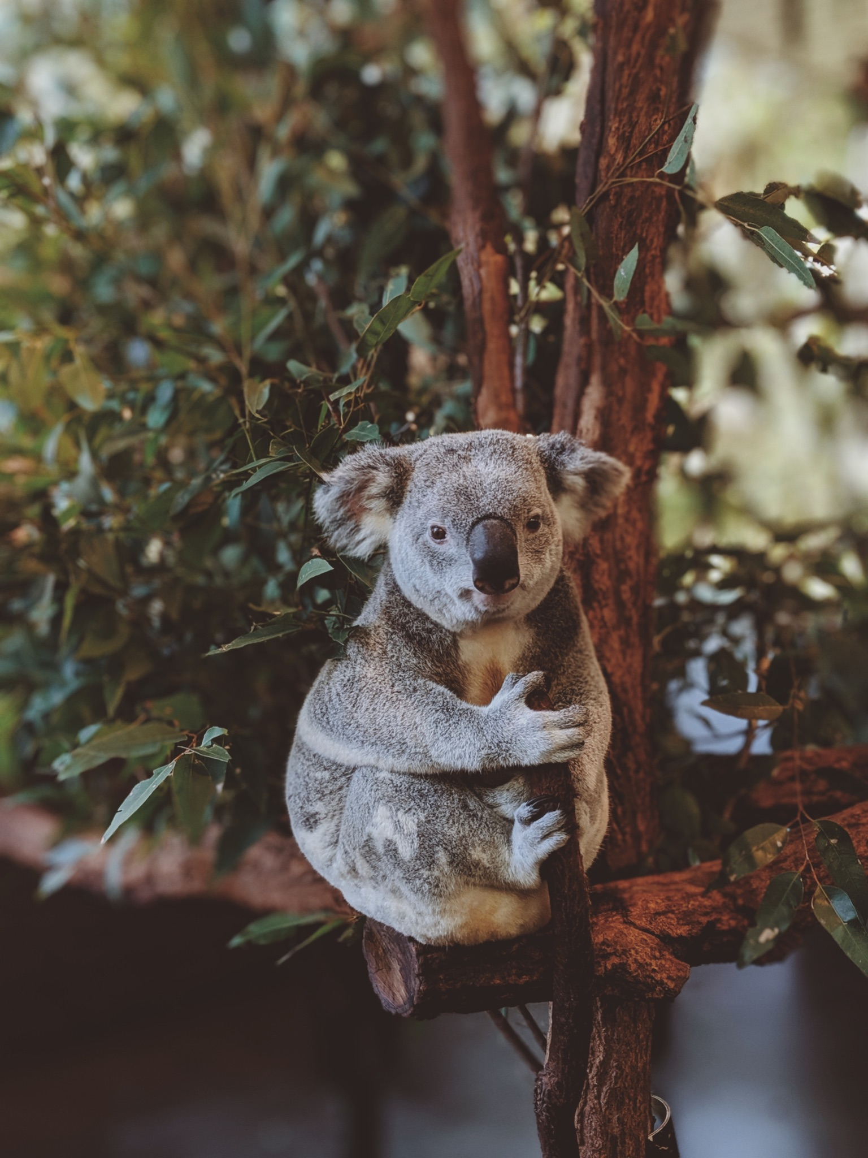
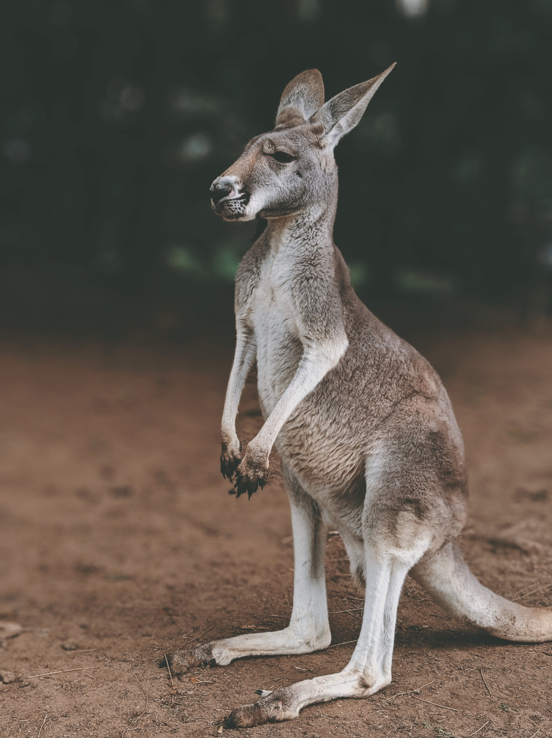
ᏦᎦᏚᏏᏁ ᏣᎳᎩ ᎠᏕᎶᏆᏍᏗ
ᏧᎾᏠᏱ ᎪᎠᎳ ᏲᎾ ᎠᎴ ᎤᏜᏩᏓ ᎤᏤᏥᏍᏗ.
Possums are similar to koalas and kangaroos.

Slide 12
ᏦᎦᏚᏏᏁ ᏣᎳᎩ ᎠᏕᎶᏆᏍᏗ
ᎤᏤᏥᏍᏗ ᎤᏅᏒ “marsupials” ᎠᏁ ᎠᎹᏰᏟ ᏧᏴᏢ.
Possums are the only marsupials in North America.

Slide 13
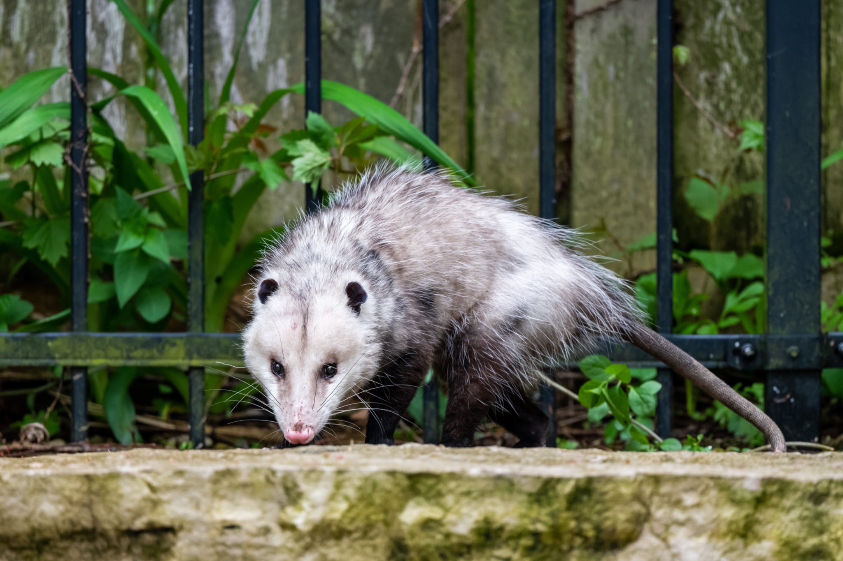
ᏦᎦᏚᏏᏁ ᏣᎳᎩ ᎠᏕᎶᏆᏍᏗ
ᎤᏤᏥᏍᏗ ᎢᎾᎨᎢ ᎠᏁᎰ ᎠᎴ ᏒᏃᏱ ᎠᎢᏄᎪᎪ.
Possums live in the woods and come out at night.

Slide 14
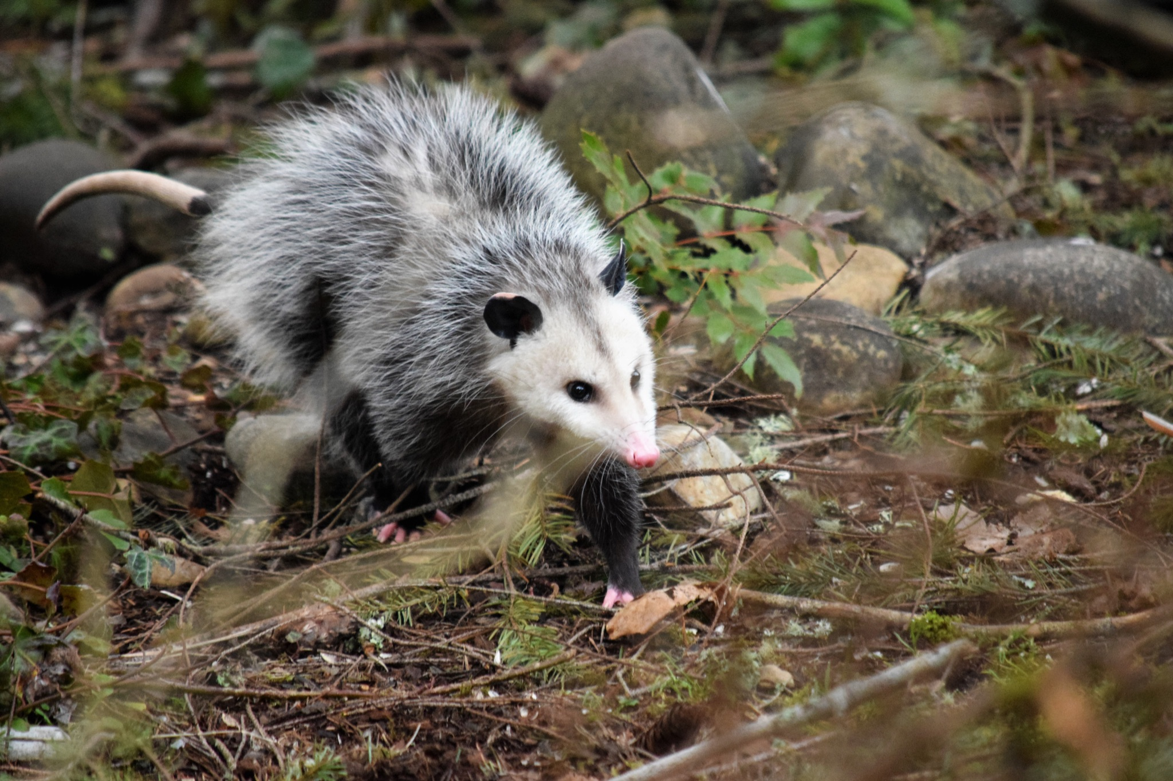
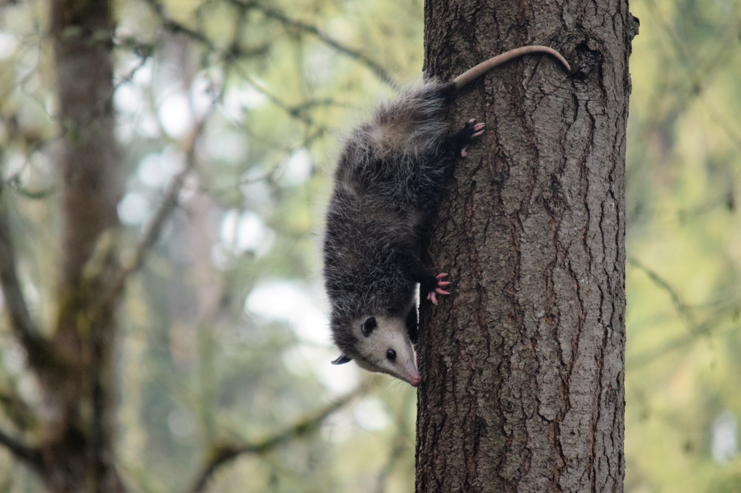
ᏦᎦᏚᏏᏁ ᏣᎳᎩ ᎠᏕᎶᏆᏍᏗ
ᏕᎵᎬᎢ ᏓᏂᎵᏙᎰ ᎠᎴᏎᏍᎩᏃ ᎦᏙ ᎥᏍᏊ ᎤᏂᎸᏈᏗ ᎤᏁᏓᏍᏗ.
The climb trees and are also comfortable on the ground.

Slide 15
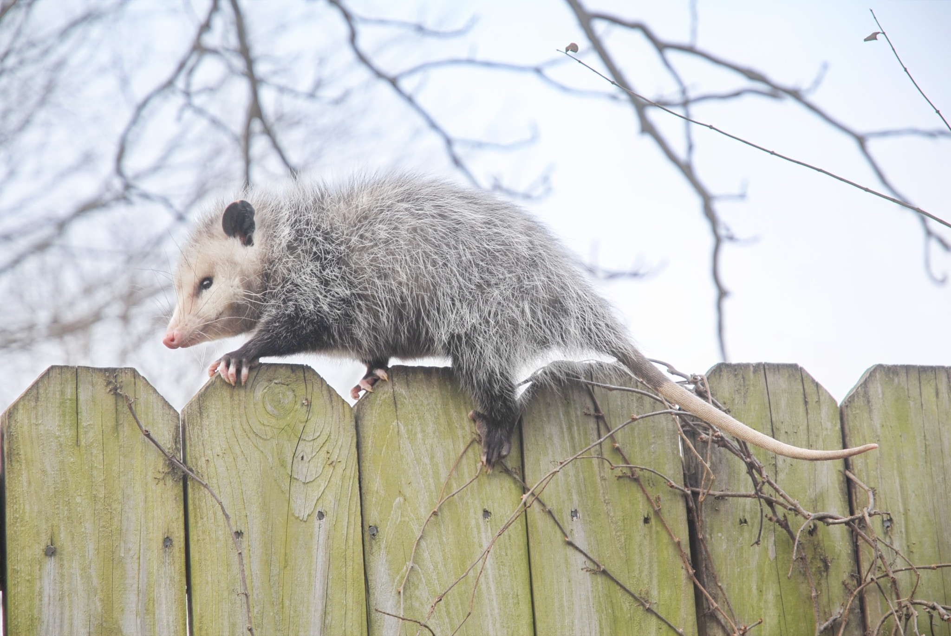
ᏦᎦᏚᏏᏁ ᏣᎳᎩ ᎠᏕᎶᏆᏍᏗ
ᎤᏍᎦᏃᎵ ᎨᏐ.
They are slow.

Slide 16
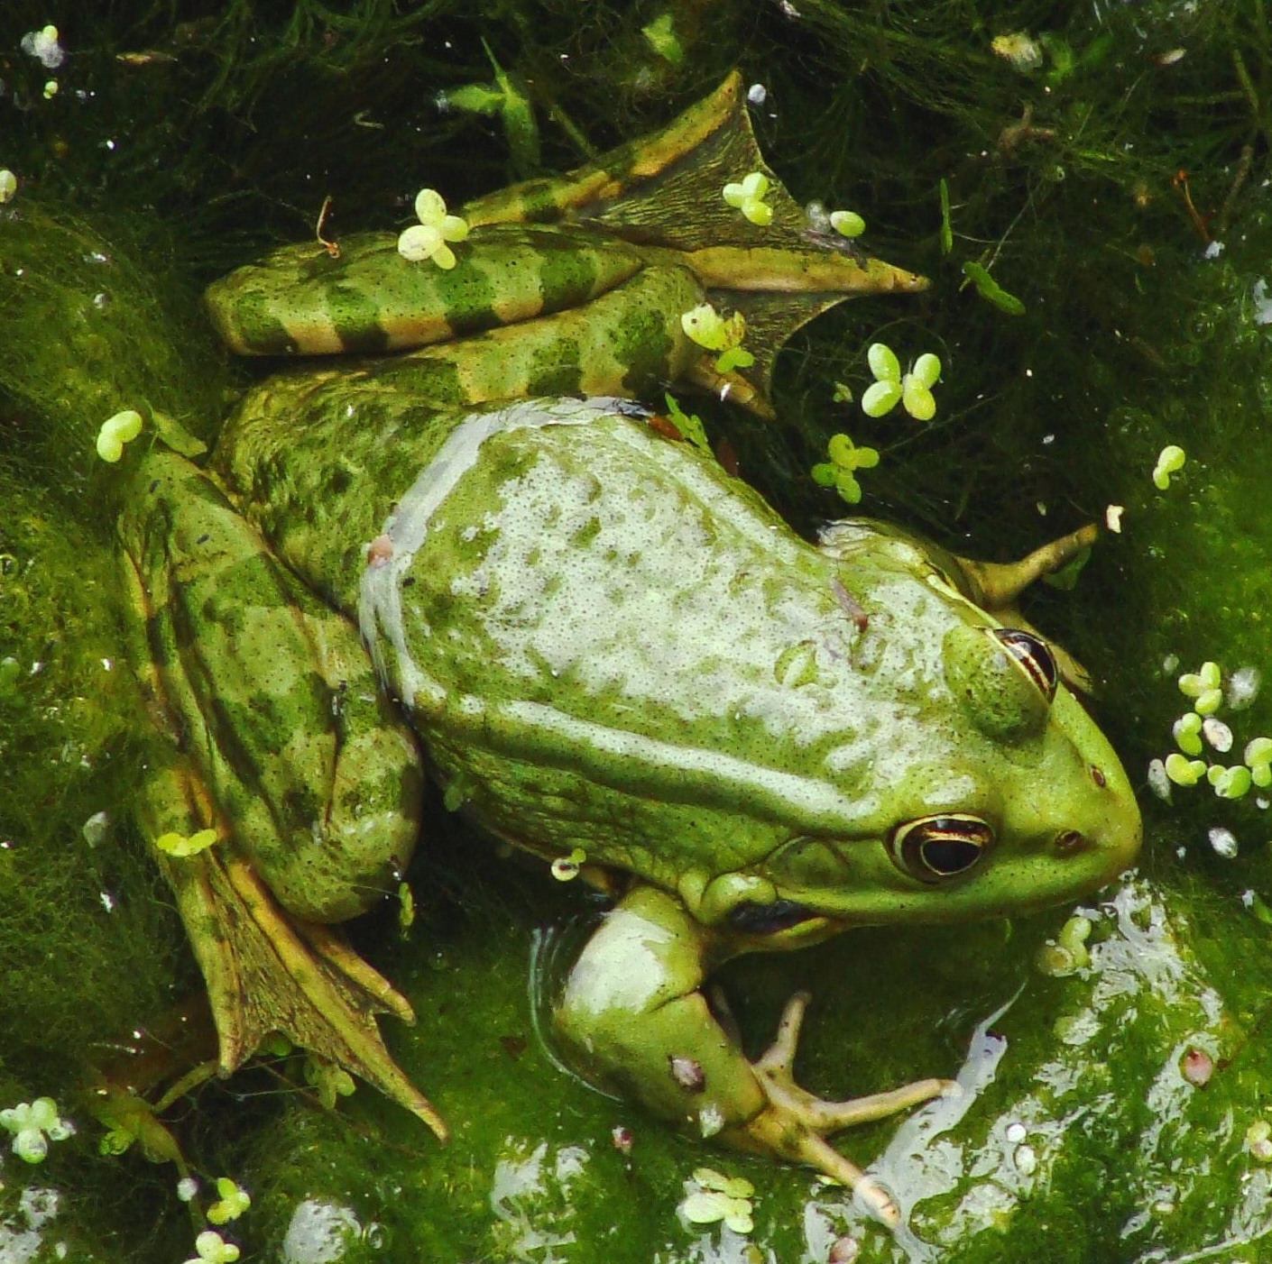
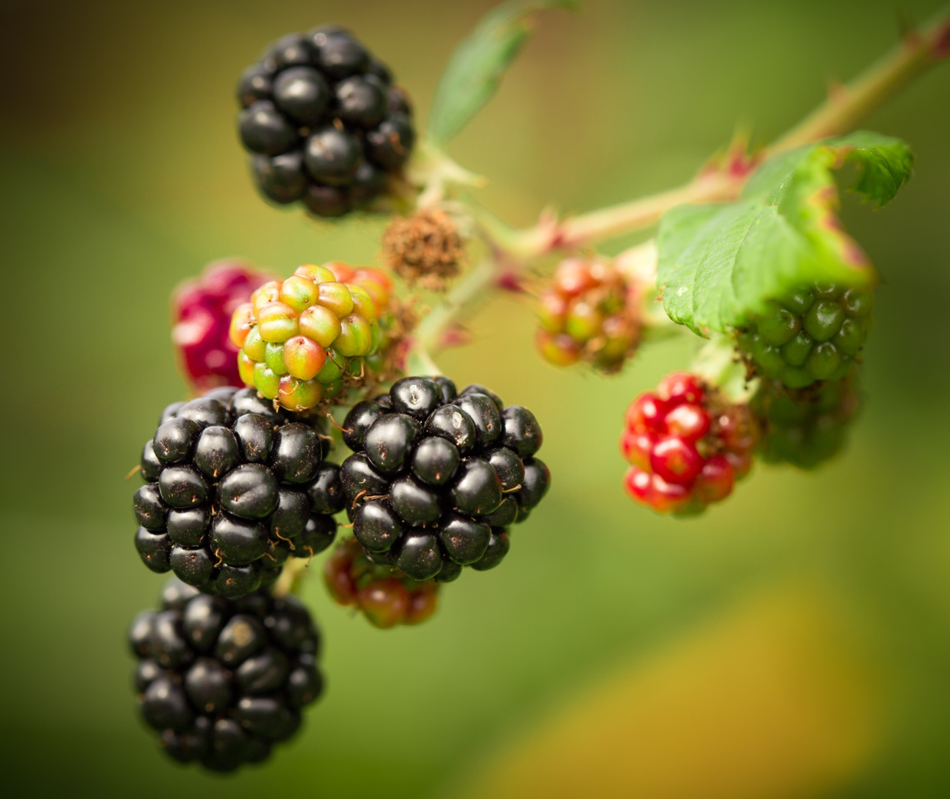
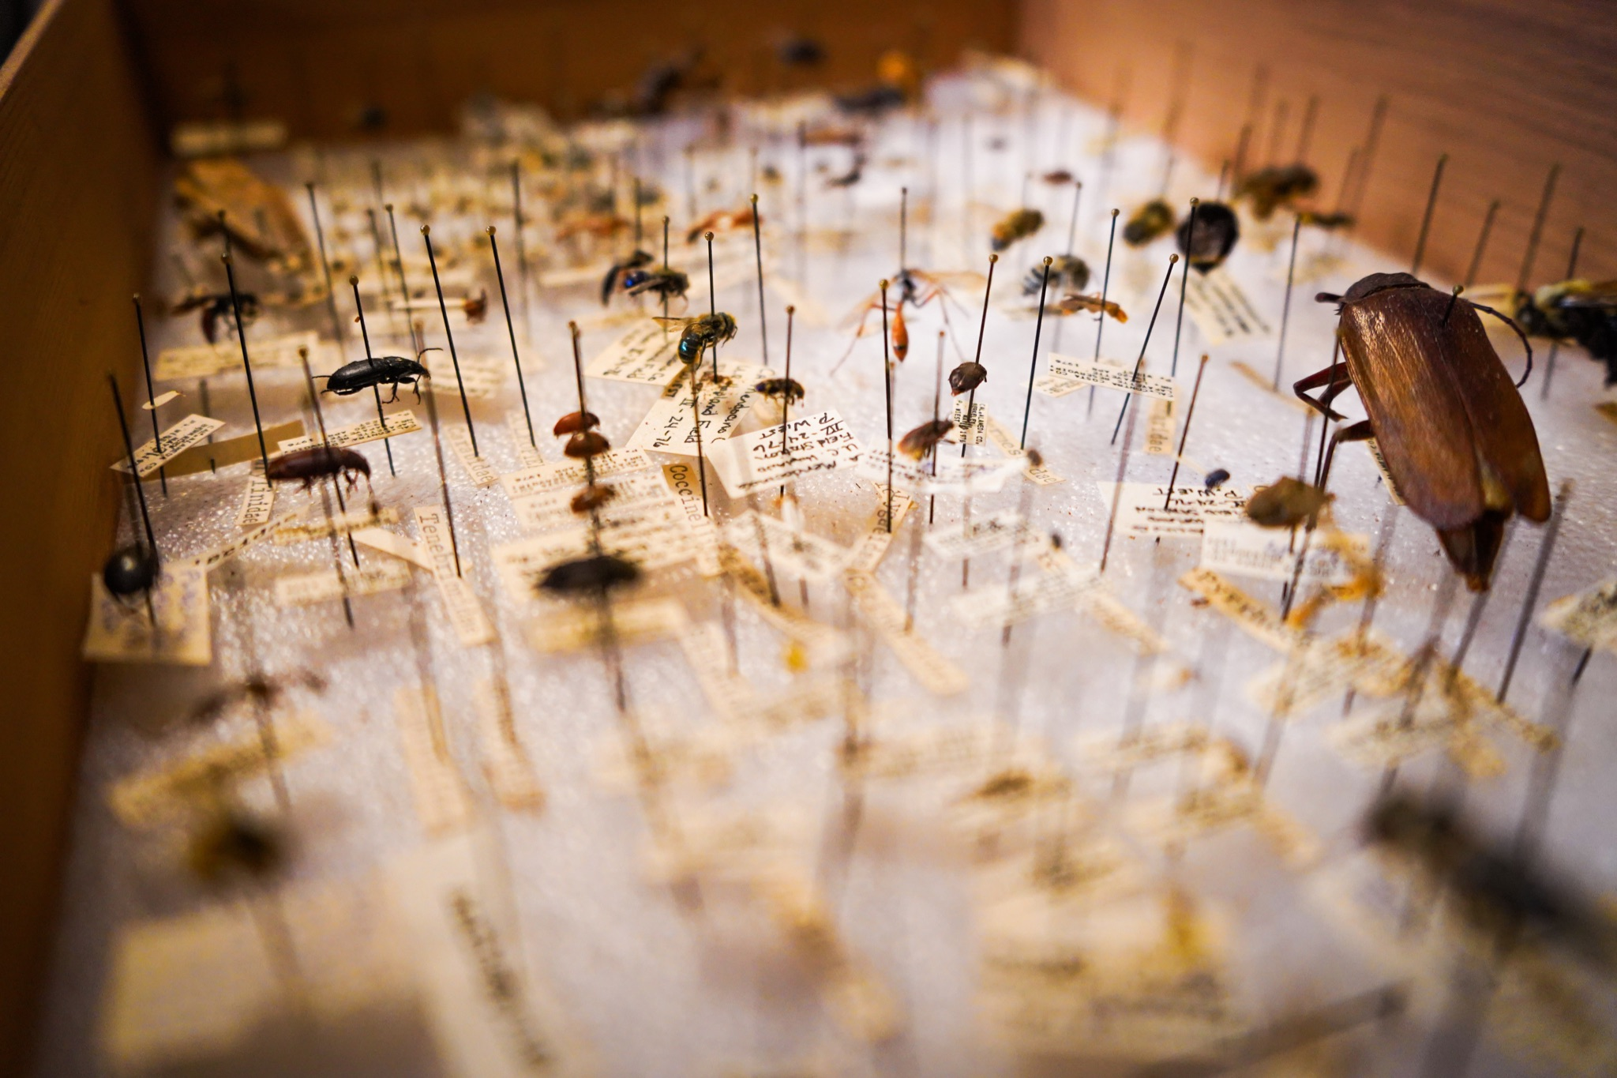
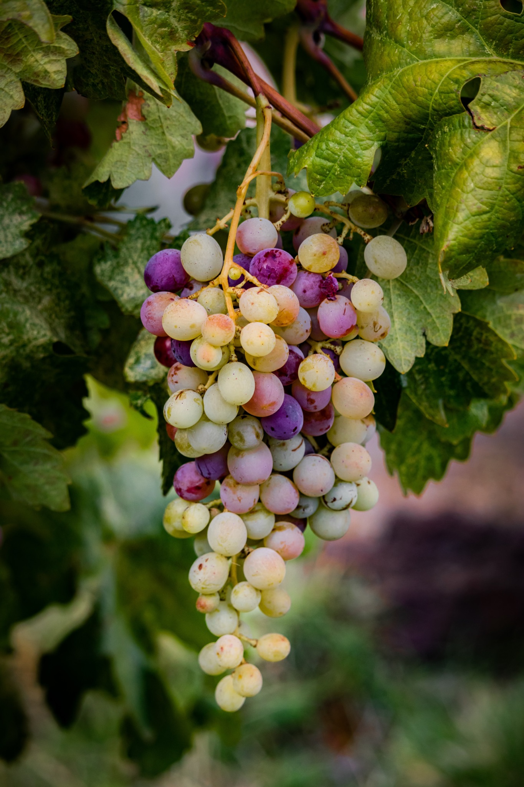
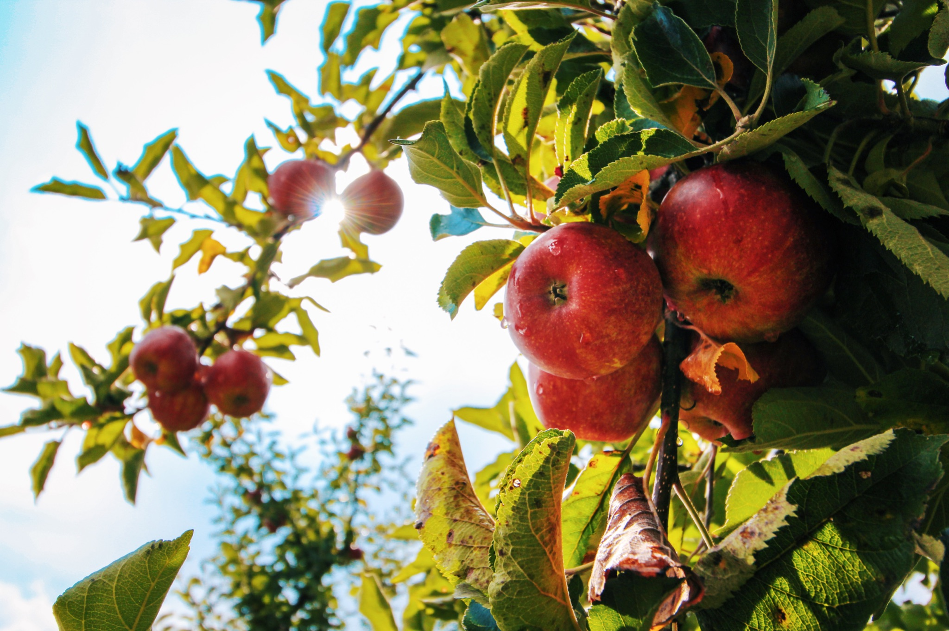
ᏦᎦᏚᏏᏁ ᏣᎳᎩ ᎠᏕᎶᏆᏍᏗ
ᎤᏂᎸᏈᏗ ᎤᏂᎩᏍᏗ ᎧᏄᎦᏟ, ᎫᏩ, ᎤᎿᏒᎩ, ᏒᎦᏔ, ᏥᏍᎪᏯ ᏧᏓᎴᎾ, ᏧᏂᏍᏗ ᏥᏍᏆ, ᏧᏪᏥ, ᏩᎶᏏ, ᏘᏲᎭᏟ ᎠᎴ ᏥᏍᏛᎾ.
They eat things like blackberries, mulberries,wild grapes, apples, bugs, small birds, eggs, frogs, lizards and crawdads.

Slide 17
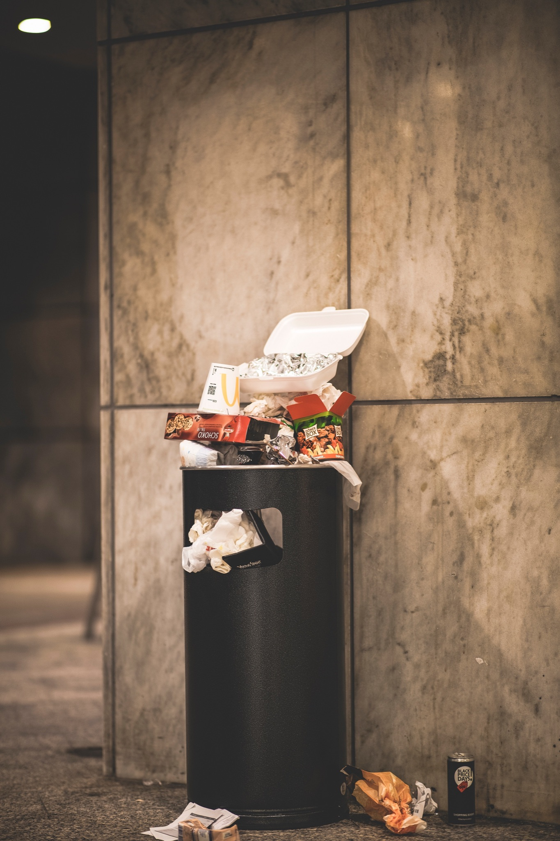
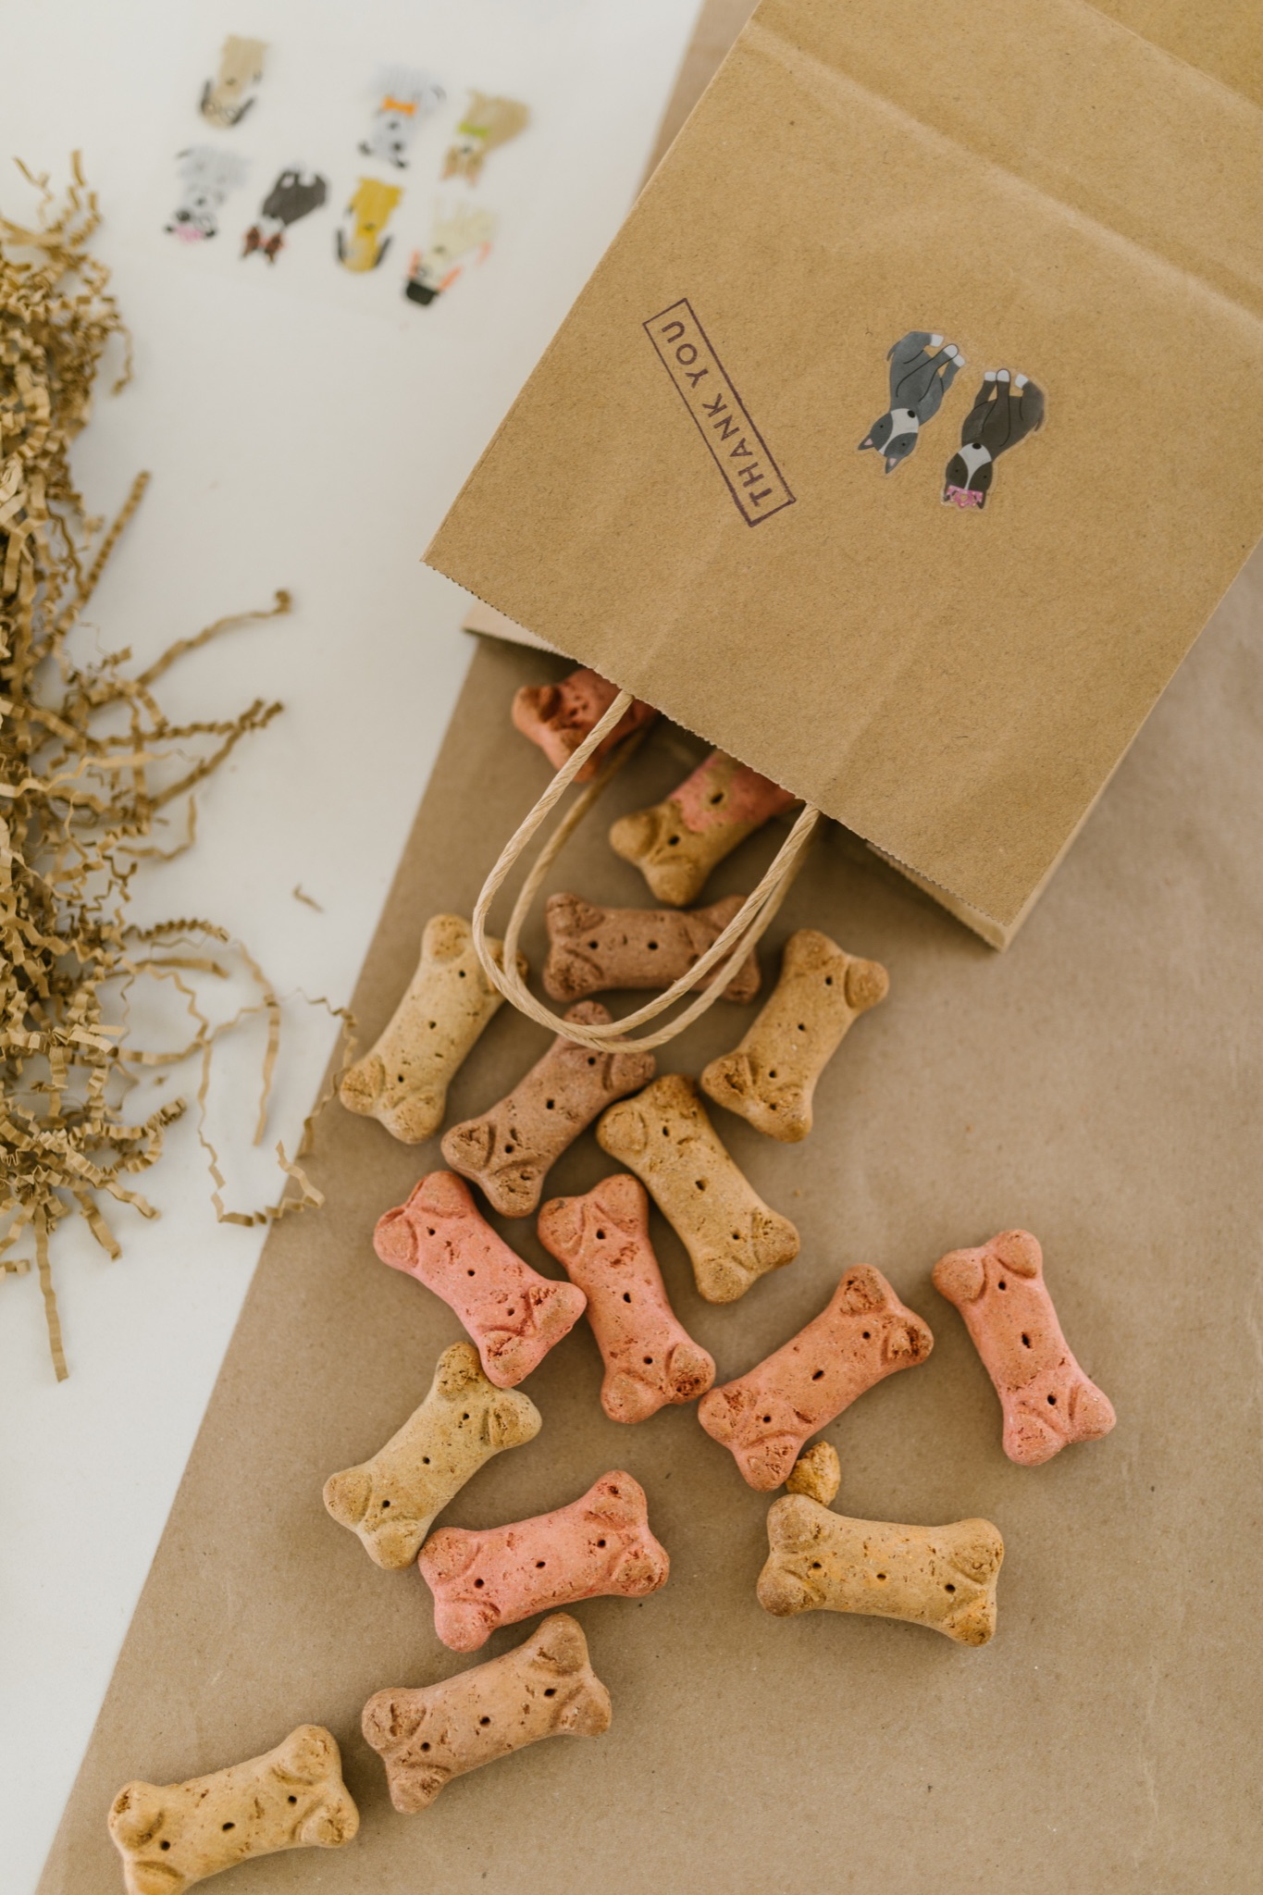
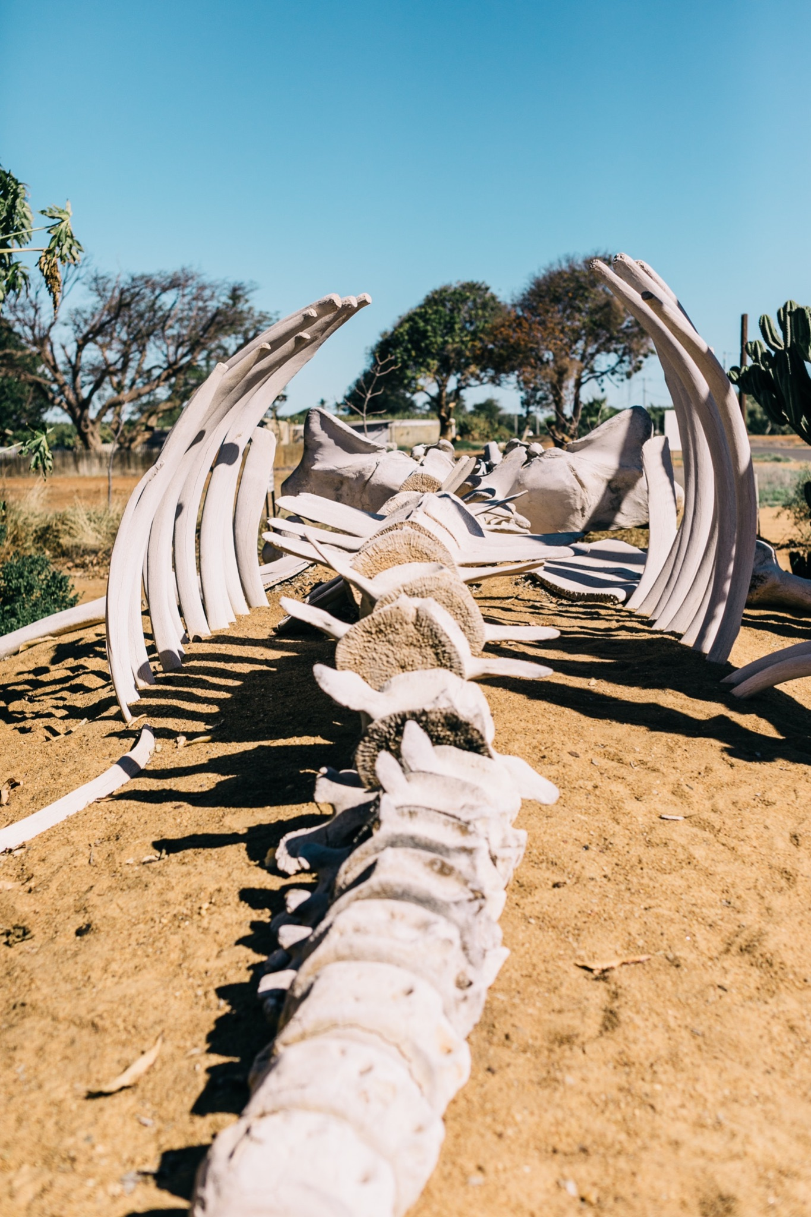
ᏦᎦᏚᏏᏁ ᏣᎳᎩ ᎠᏕᎶᏆᏍᏗ
ᎤᏤᏥᏍᏗ ᎤᏂᎸᏈᏗ ᎤᏲᏨᎯ, ᎩᏥ ᎤᏂᎩᏍᏗ ᎠᎴ ᎤᎵᏬᏨᎦᎾᏝᎥ (ᎡᎿᎢ) ᏧᎪᎳ ᏓᏂᎩᏍᎪ.
Possums also eat trash, dog food and also the bones of dead animals.

Slide 18
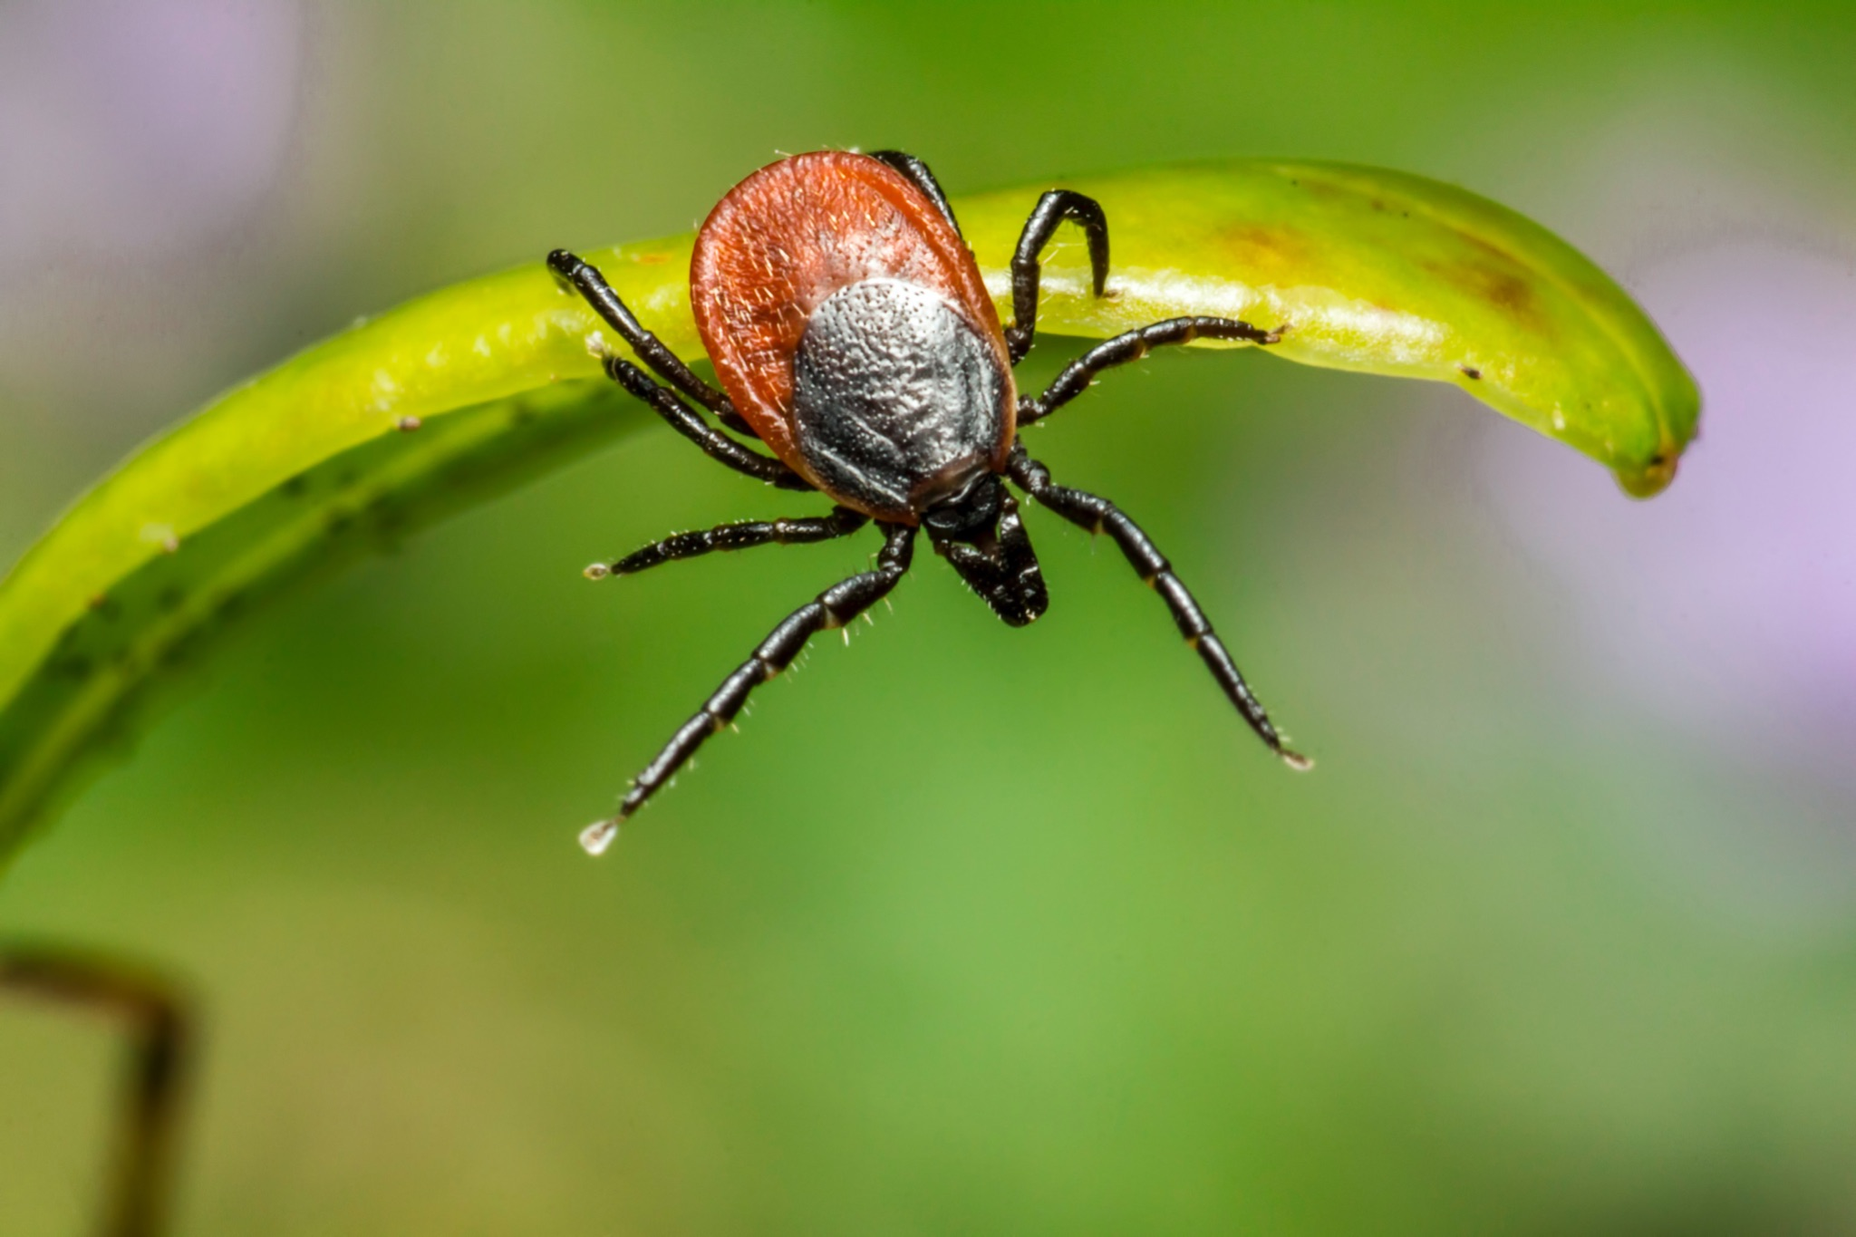
ᏦᎦᏚᏏᏁ ᏣᎳᎩ ᎠᏕᎶᏆᏍᏗ
ᏚᏂᏣᎵᏗ ᎫᎩ ᏓᏂᎩᏍᎬ.
They are well known for eating ticks

Slide 19
ᏦᎦᏚᏏᏁ ᏣᎳᎩ ᎠᏕᎶᏆᏍᏗ
ᏏᏆ ᎤᏤᏥᏍᏗ ᏔᎵ ᎠᎴ ᏅᎩ ᎢᏧᏕᏘᏴᏓ ᎠᏁᎰ.
Possums only live two to four years.

Slide 20
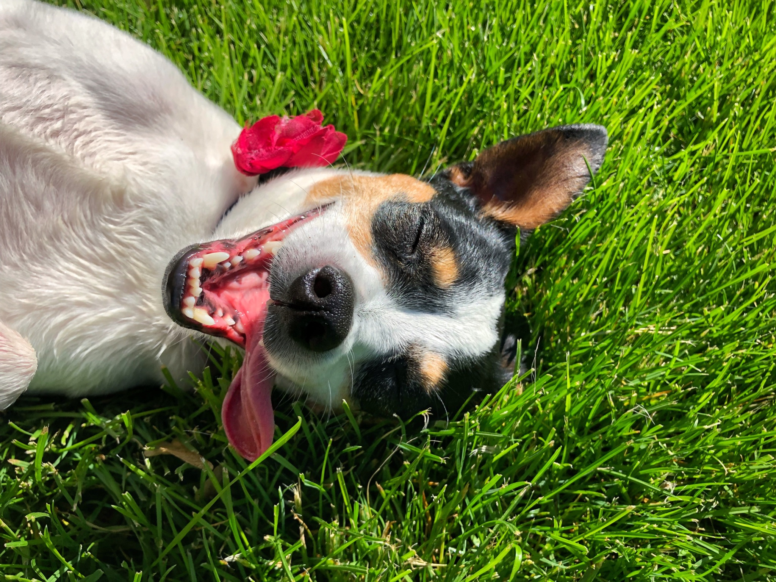
ᏦᎦᏚᏏᏁ ᏣᎳᎩ ᎠᏕᎶᏆᏍᏗ
ᎢᏳᏓᎵᎭ, ᎪᎱᏍᏗ ᏳᏍᎦᏍᏓᏁᎵ, ᎤᎵᏬᏨ ᎠᏤᎸᏍᎪ, ᏯᎾᏑᎦ, ᏳᏔᏠᎦ, ᎠᎴ ᏗᎩᏙᎵ ᏧᏍᏚᎢᏗ ᎨᏐᎢ.
Many times when the possum feels threatened, they will pretend to be dead, laying down, their mouth hanging open and their eyes open.

Slide 21
ᏦᎦᏚᏏᏁ ᏣᎳᎩ ᎠᏕᎶᏆᏍᏗ
ᎥᏍᏊ, ᎤᏂᎵᏬᏨ ᏳᎾᏤᎸᎾ, ᎤᏲ ᎠᏒᏥᎯᏍᎪ.
Also, when they play dead, they smell bad.

Slide 22
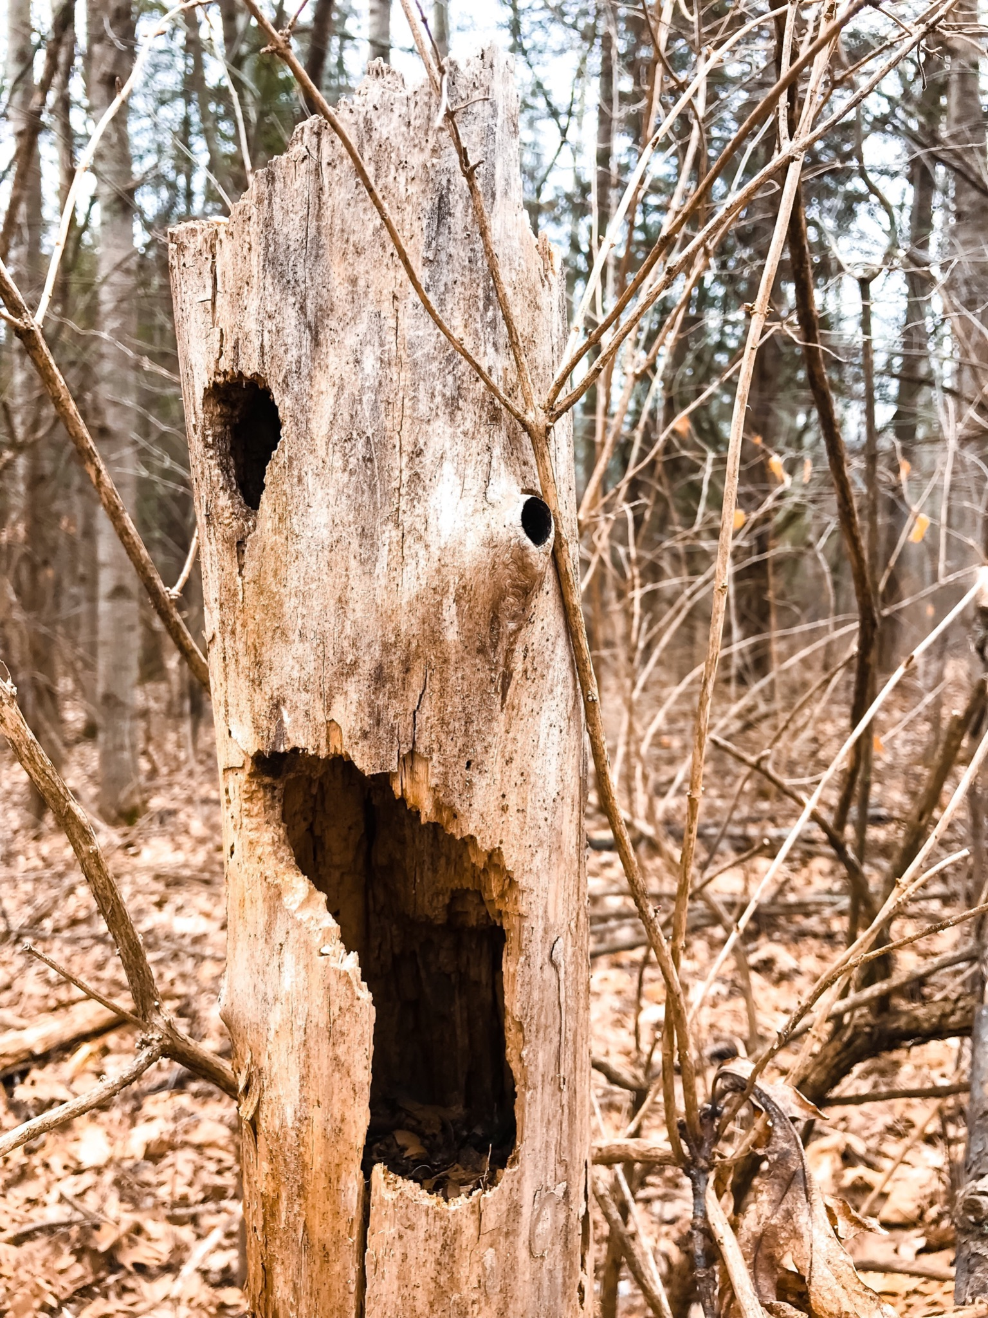
ᏦᎦᏚᏏᏁ ᏣᎳᎩ ᎠᏕᎶᏆᏍᏗ
ᏧᏌᏙᏂ ᏕᏢᎬ ᎤᎾᏣᎣ ᎠᎴ ᎭᏫᏂᏗᏢ ᏚᏂᎵᎬ ᎠᎴ ᏧᎾᏍᏕᏢ ᎠᏂᏁᎶ.
They live in hollow trees or under stumps or roots.

Slide 23
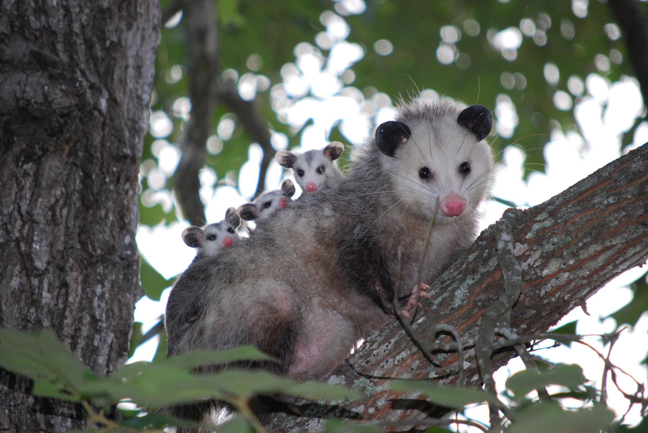
ᏦᎦᏚᏏᏁ ᏣᎳᎩ ᎠᏕᎶᏆᏍᏗ
ᏔᎵᏍᎪ ᎯᏍᎩ ᏯᏂ ᏧᏂᏍᏗ ᏯᎾᏕᎲᎦ, ᎠᏎᏃ Ꮭ ᏂᎦᏓ ᏱᏓᎾᏛᏍᎪ.
Possums can give birth to as many as 25 babies, but most do not survive to adulthood.

Slide 24
ᏦᎦᏚᏏᏁ ᏣᎳᎩ ᎠᏕᎶᏆᏍᏗ
ᏧᏂᏍᏗ ᎯᏍᎩ ᏳᎾᏙᏓᏆᏍᎩ ᎤᎾᏣᎣ ᎦᏃᏛᎢ.
The babies live about 5 weeks in the pouch.

Slide 25
ᏦᎦᏚᏏᏁ ᏣᎳᎩ ᎠᏕᎶᏆᏍᏗ
ᏔᎵ ᏯᏅᏗᏃ ᎦᏐᎯ ᎤᏂᏥ ᎤᏂᎩᎸᏗᏕᎪ.
then 2 months they ride around on their mother’s back.

Slide 26
ᏦᎦᏚᏏᏁ ᏣᎳᎩ ᎠᏕᎶᏆᏍᏗ
ᎤᏤᏥᏍᏗ ᎤᏅᏒ ᎠᏁᏙ.
Possums are solitary animals.

Slide 27
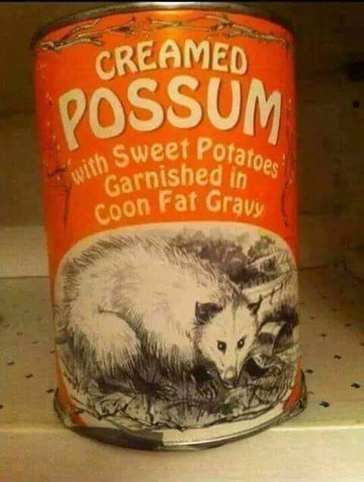
ᏦᎦᏚᏏᏁ ᏣᎳᎩ ᎠᏕᎶᏆᏍᏗ
ᎠᏂᏣᎳᎩ ᏳᏓᎭ ᎤᏤᏥᏍᏗ ᏓᏂᎩᏍᎪ, ᎠᏎᏃ ᎪᎢᎭ ᎭᏫᏯ ᎨᏐᎢ.
Cherokees would sometimes eat possum, but the meat is greasy.

Slide 28
ᏦᎦᏚᏏᏁ ᏣᎳᎩ ᎠᏕᎶᏆᏍᏗ
ᎥᏍᎩ ᏳᏍᏗ ᏄᎾ ᎠᏂᏅᎯᏓ ᎠᎴ ᎤᏤᏥᏍᏗ ᎭᏫᏯ ᎢᏧᎳ ᏓᏂᎩᏍᎪ.
It is often eaten with sweet potatoes.

