Slide 1
ᎣᏏᏲ
ᏂᎦᏚᏏᏁ ᏣᎳᎩ ᎠᏕᎶᏆᏍᏗ

Slide 2
ᏂᎦᏚᏏᏁ ᏣᎳᎩ ᎠᏕᎶᏆᏍᏗ
ᎢᏓᎴᎾ- Let’s begin
ᏣᎳᎩ ᎢᏗᏬᏂ- Let’s talk Cherokee

Slide 3
ᏔᎳᏚᏏᏁ ᏣᎳᎩ ᎠᏕᎶᏆᏍᏗ
ᎯᎦᏔᎮᏍᏗ ᎠᏂ
ᎦᏍᎩᎸ, ᏣᎬᏫᏳᎯ,
ᎠᎴ ᏂᎬᏅᏛᏉ
ᎡᏣᎸᏉᏗᏍᎬᎢ.
Know this place here
At your table, you King,
And everywhere
You will be praised.
Notes:
aksdayvhvsg

Slide 4
ᏦᎦᏚᏏᏁ ᏣᎳᎩ ᎠᏕᎶᏆᏍᏗ
2.ᏂᎯᏉ ᏗᏓᎴᏂ
ᏦᏣᎵᏍᏓᏴᏗᎭ;
ᎠᎴ ᎤᏣᏘ ᎠᏴ
ᎢᏨᏯᎵᎡᎵᏤᎭ.
It begins with only you
That we can eat this meal;
And very much
We are grateful.
Notes:
aksdayvhvsg

Slide 5
ᏂᎦᏚᏏᏁ ᏣᎳᎩ ᎠᏕᎶᏆᏍᏗ
3. ᎣᏣᏓᏙᎵᏍᏗᎭ
ᏍᎩᏯᏛᎬᎦ, ᎠᎴ
ᎠᎵᏍᏓᏴᏗ ᏍᎩᎥᏏ
ᏙᎦᏙᏓᏇᎬᎢ.
We are praying
Hear us, and
Give us food
Daily.
Notes:
aksdayvhvsg

Slide 6
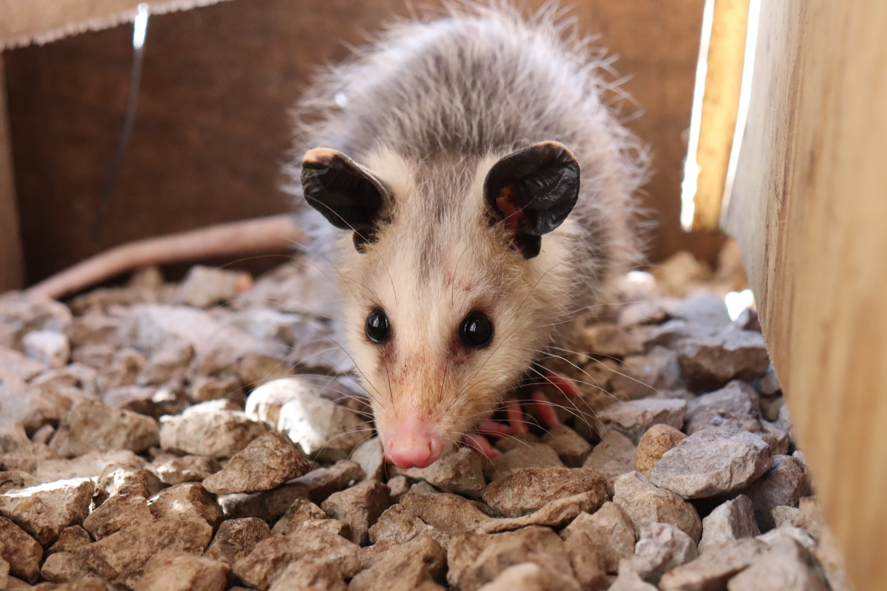
ᏂᎦᏚᏏᏁ ᏣᎳᎩ ᎠᏕᎶᏆᏍᏗ
ᎤᏤᏥᏍᏗ ᎧᏴᏐᎵ ᎠᏓᎴᏂᏍᎬ ᎦᏂᏓᏛᎢ ᎢᎦᏅᎯᏓ ᏦᎦᏚ ᎠᎴ ᏦᏍᎪᎯ ᎦᎵᏉᎩ ᎢᏏᏔᏗᏍᏗ.
From nose to the base of the tail, the possum is 13 to 37 inches long.

Slide 7
ᏂᎦᏚᏏᏁ ᏣᎳᎩ ᎠᏕᎶᏆᏍᏗ
ᎦᏂᏓᏛ ᎤᏰᎸᎭ ᎠᎴ ᎦᏅᎯᏒ ᏐᏁᎵ ᎠᎴ ᏐᏁᎳᏚ ᎢᏏᏔᏗᏍᏗ.
The tail is naked and between 9 and 19 inches long.

Slide 8
ᏂᎦᏚᏏᏁ ᏣᎳᎩ ᎠᏕᎶᏆᏍᏗ
ᏚᏩᏂᎦᏢ ᎠᎴ ᏧᏓᎴᏅᏓ ᎪᎱᏍᏗ ᏱᎦᏇᏅᎾ ᎦᏂᏓᏛ.
Branches and various things it wraps around the tail.

Slide 9
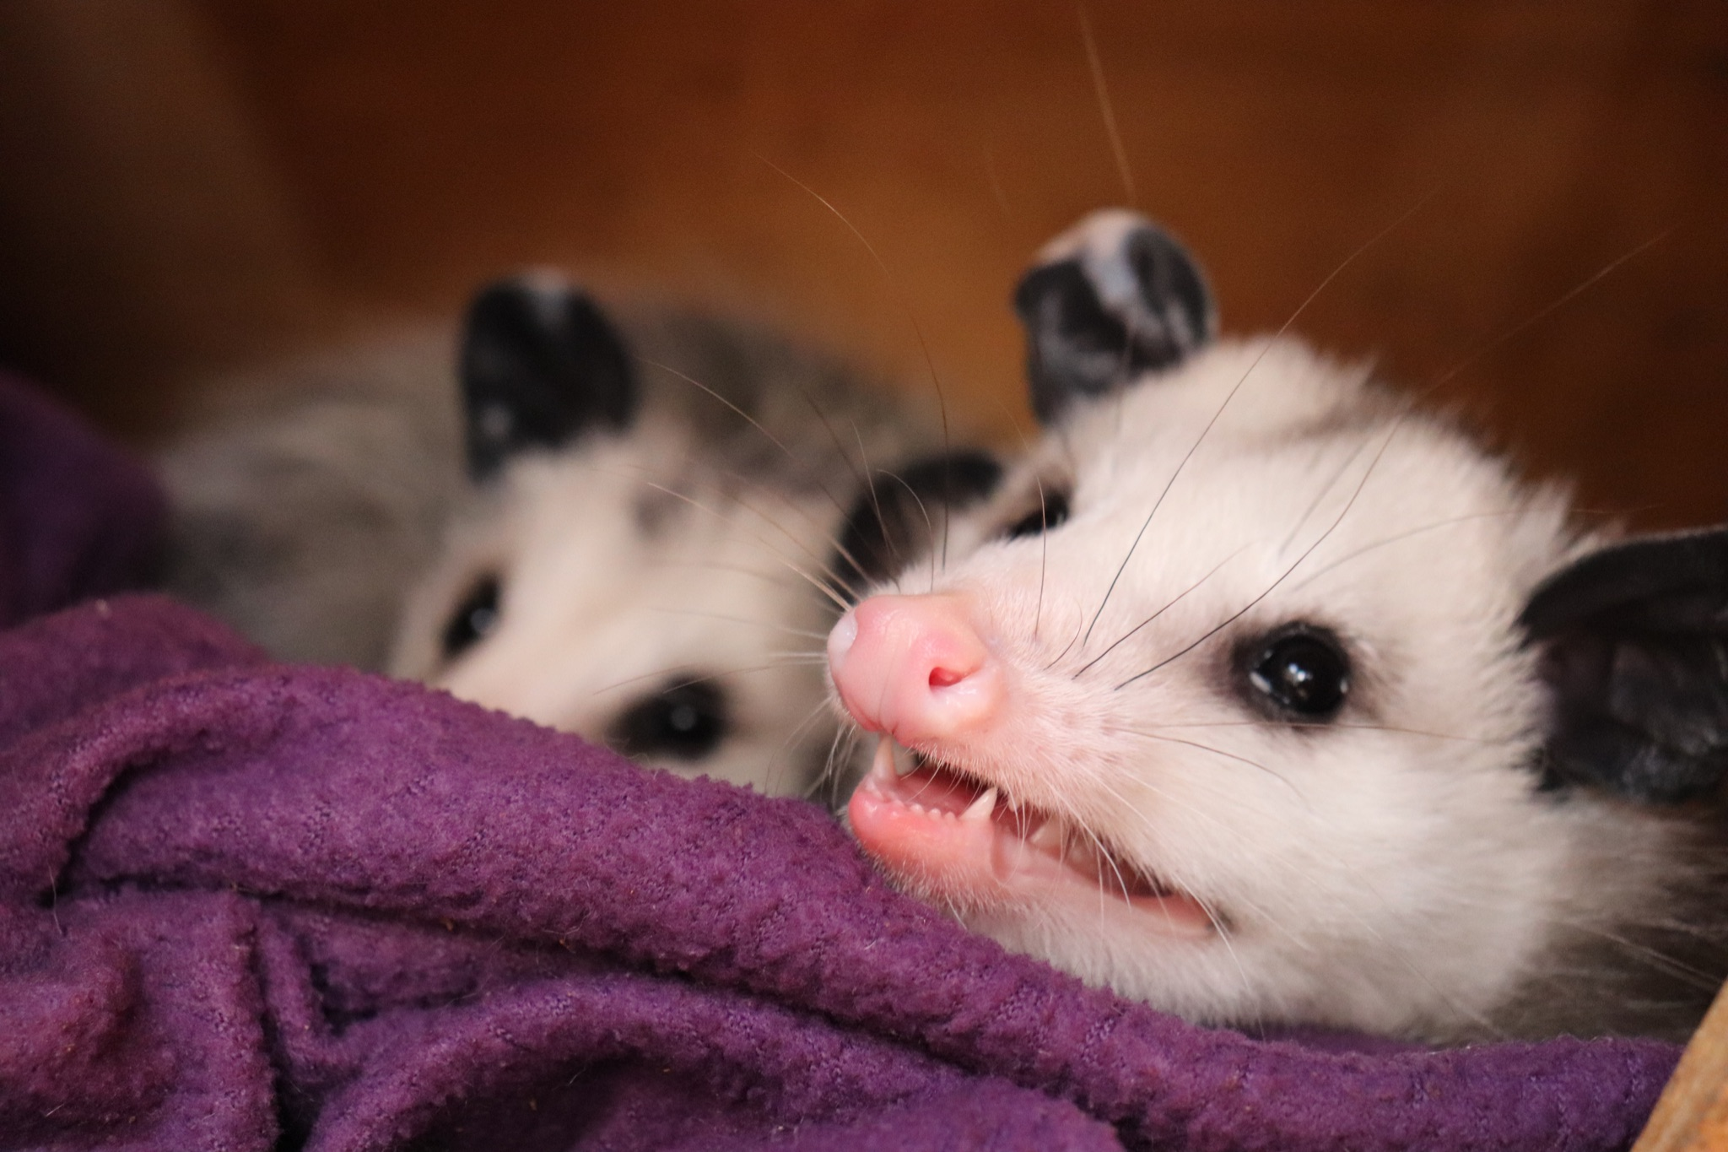
ᏂᎦᏚᏏᏁ ᏣᎳᎩ ᎠᏕᎶᏆᏍᏗ
ᎬᎿᎨ ᎤᏍᎪᎸ ᏧᎾᎵᏑᏫᏓ ᎠᎴ ᎤᏍᏗ ᏓᏂᎵᎵᎪ.
It’s gray colored and has small ears.

Slide 10
ᏂᎦᏚᏏᏁ ᏣᎳᎩ ᎠᏕᎶᏆᏍᏗ
ᎯᏍᎪᎯ ᎢᎦ ᏓᏂᎾᏙᎪ ᎠᎴ ᎬᎿᎨ ᏗᏂᎦᏙᎵ.
They have fifty teeth and black eyes.

Slide 11
ᏂᎦᏚᏏᏁ ᏣᎳᎩ ᎠᏕᎶᏆᏍᏗ
ᏏᏆ ᎤᏤᏥᏍᏗ “marsupials” ᏓᏃᏎᎰ, ᎠᏂᏓ ᎦᏃᏛᎢ ᏓᏂᏃᏙᎰ.
Possums are called “marsupials”, they carry around their young in a pouch.

Slide 12
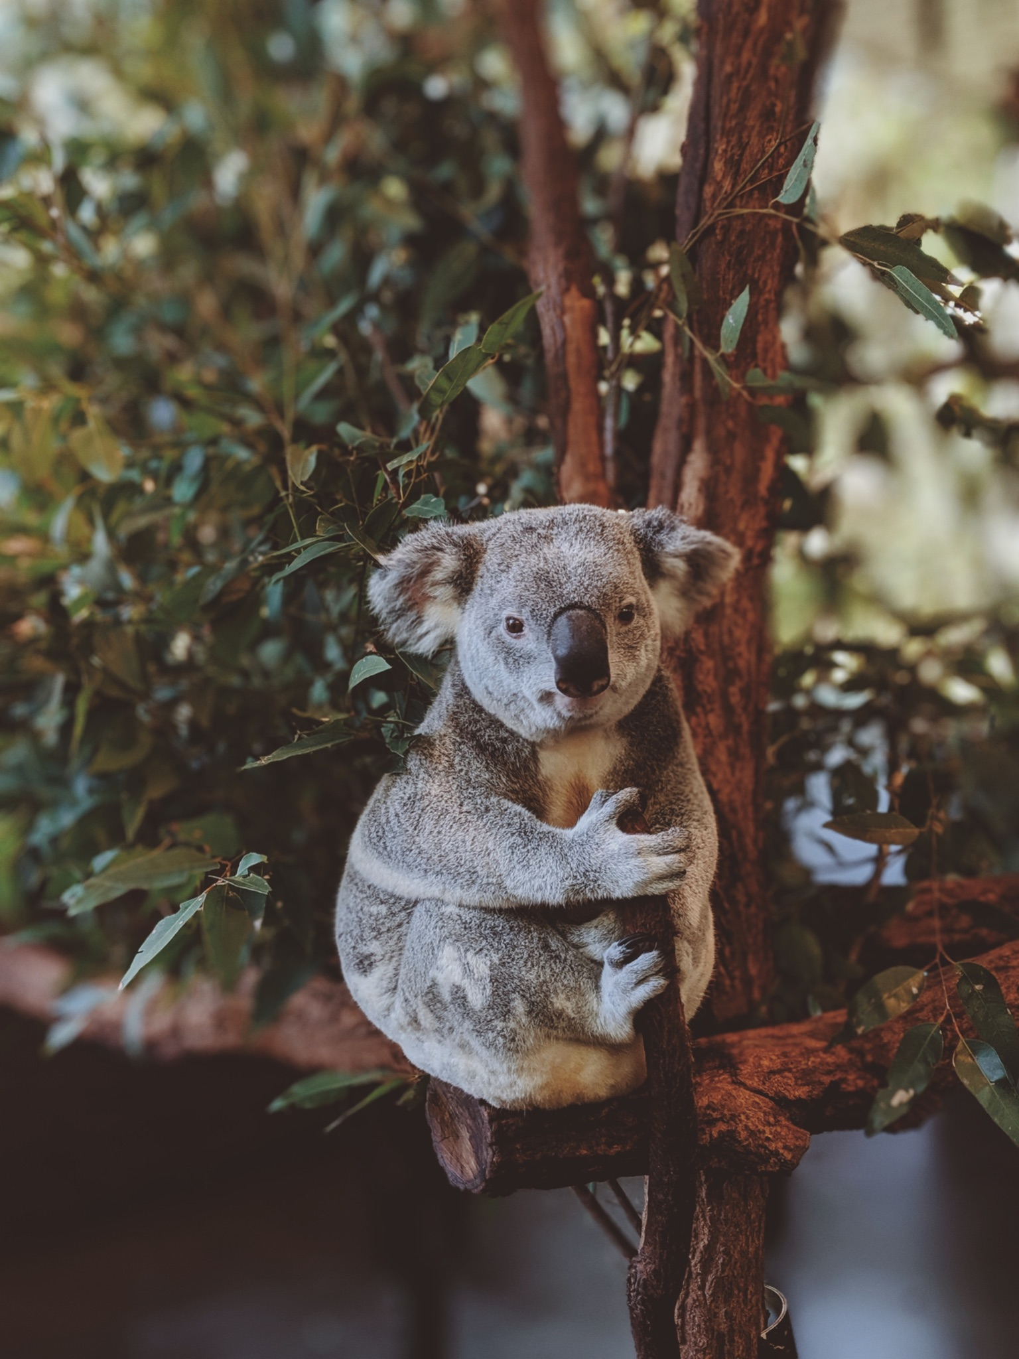
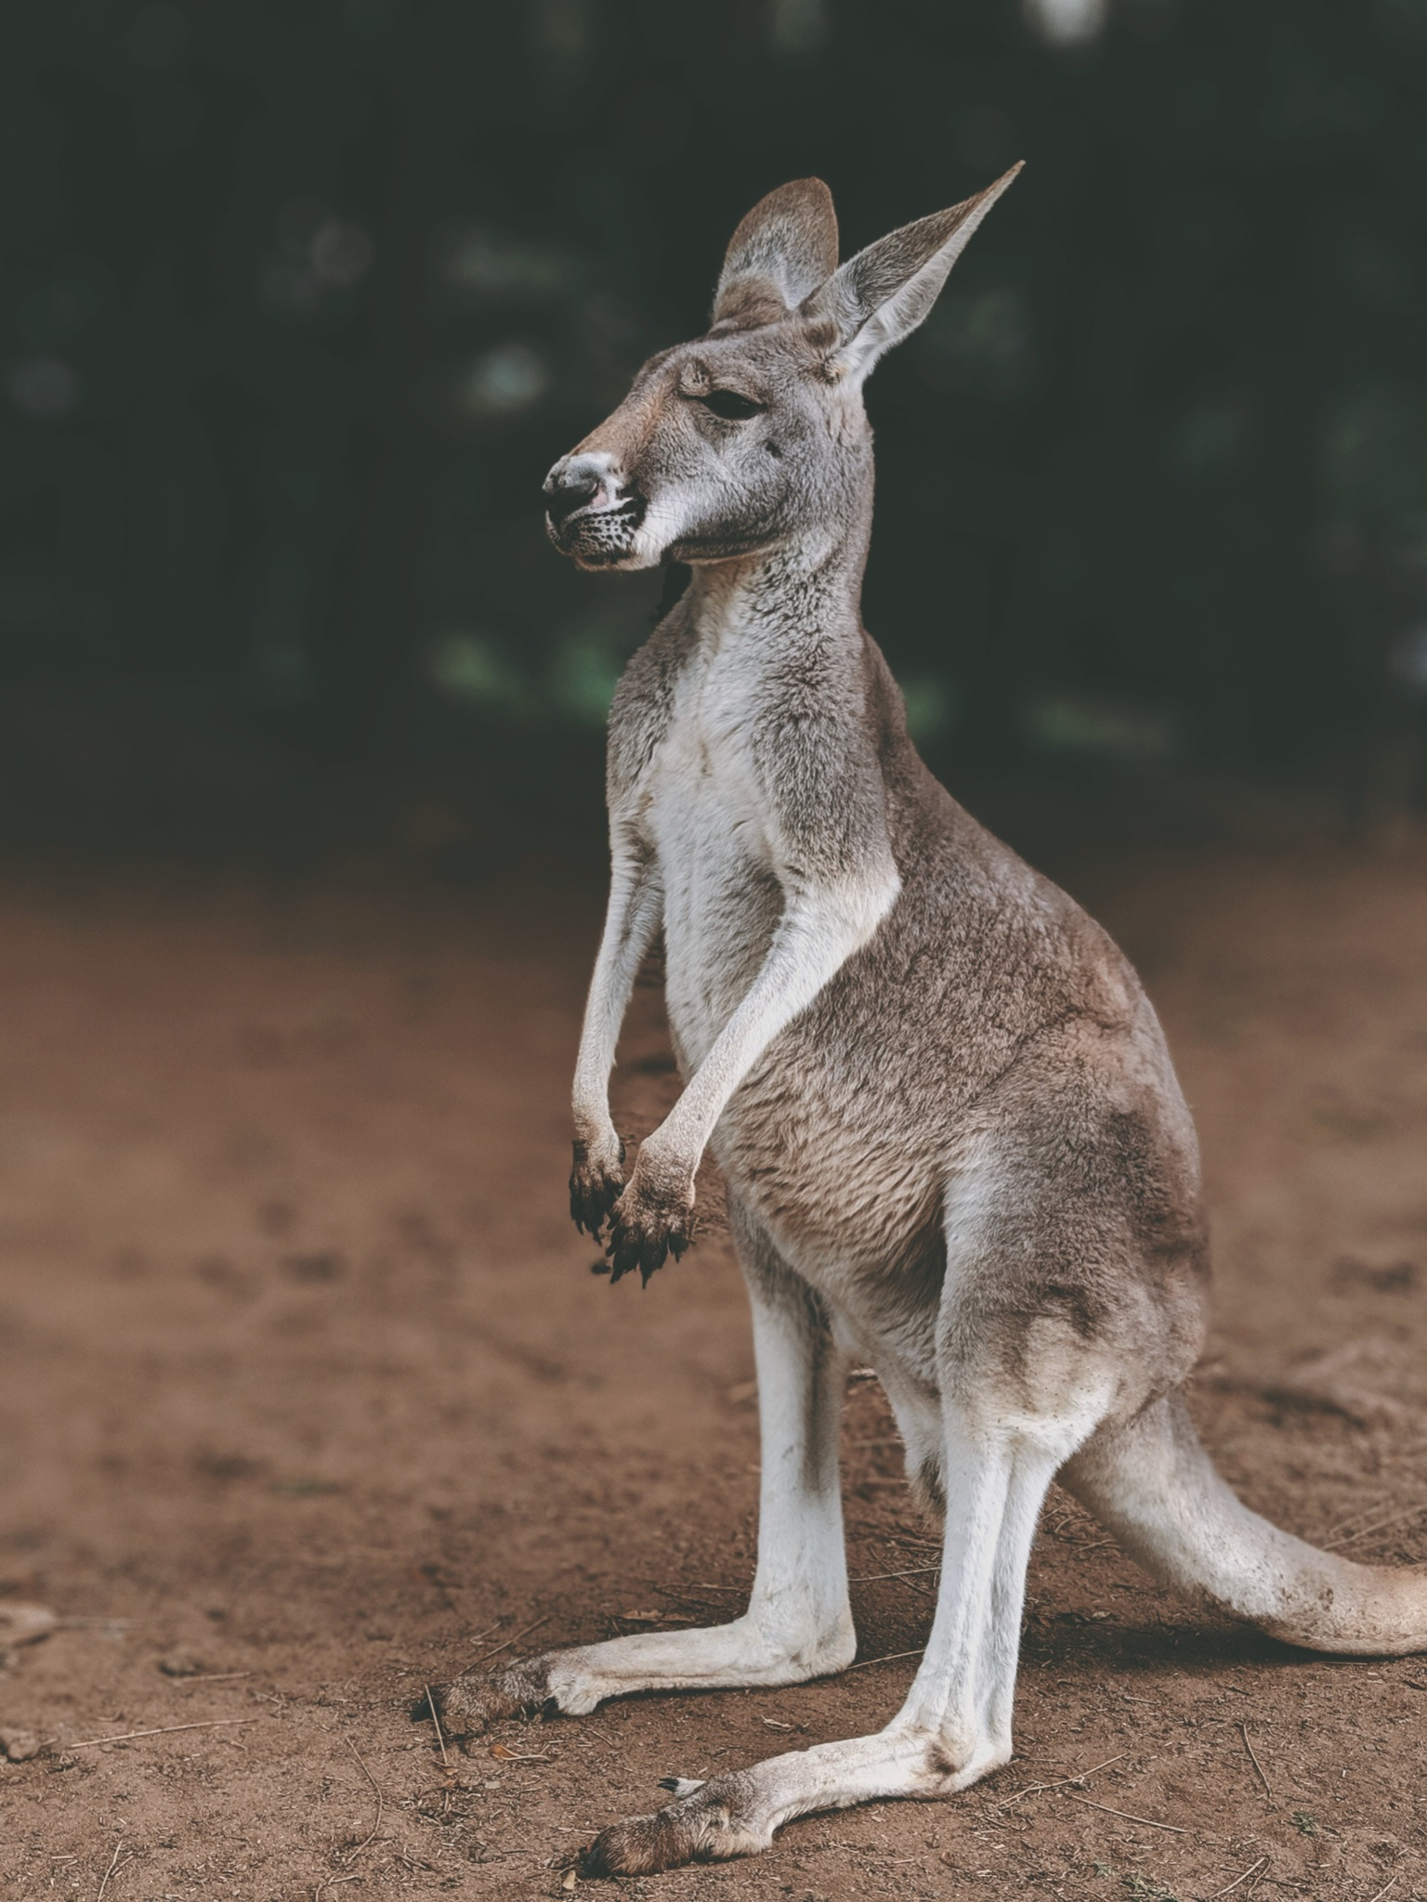
ᏂᎦᏚᏏᏁ ᏣᎳᎩ ᎠᏕᎶᏆᏍᏗ
ᏧᎾᏠᏱ ᎪᎠᎳ ᏲᎾ ᎠᎴ ᎤᏜᏩᏓ ᎤᏤᏥᏍᏗ.
Possums are similar to koalas and kangaroos.

Slide 13
ᏂᎦᏚᏏᏁ ᏣᎳᎩ ᎠᏕᎶᏆᏍᏗ
ᎤᏤᏥᏍᏗ ᎤᏅᏒ “marsupials” ᎠᏁ ᎠᎹᏰᏟ ᏧᏴᏢ.
Possums are the only marsupials in North America.

Slide 14
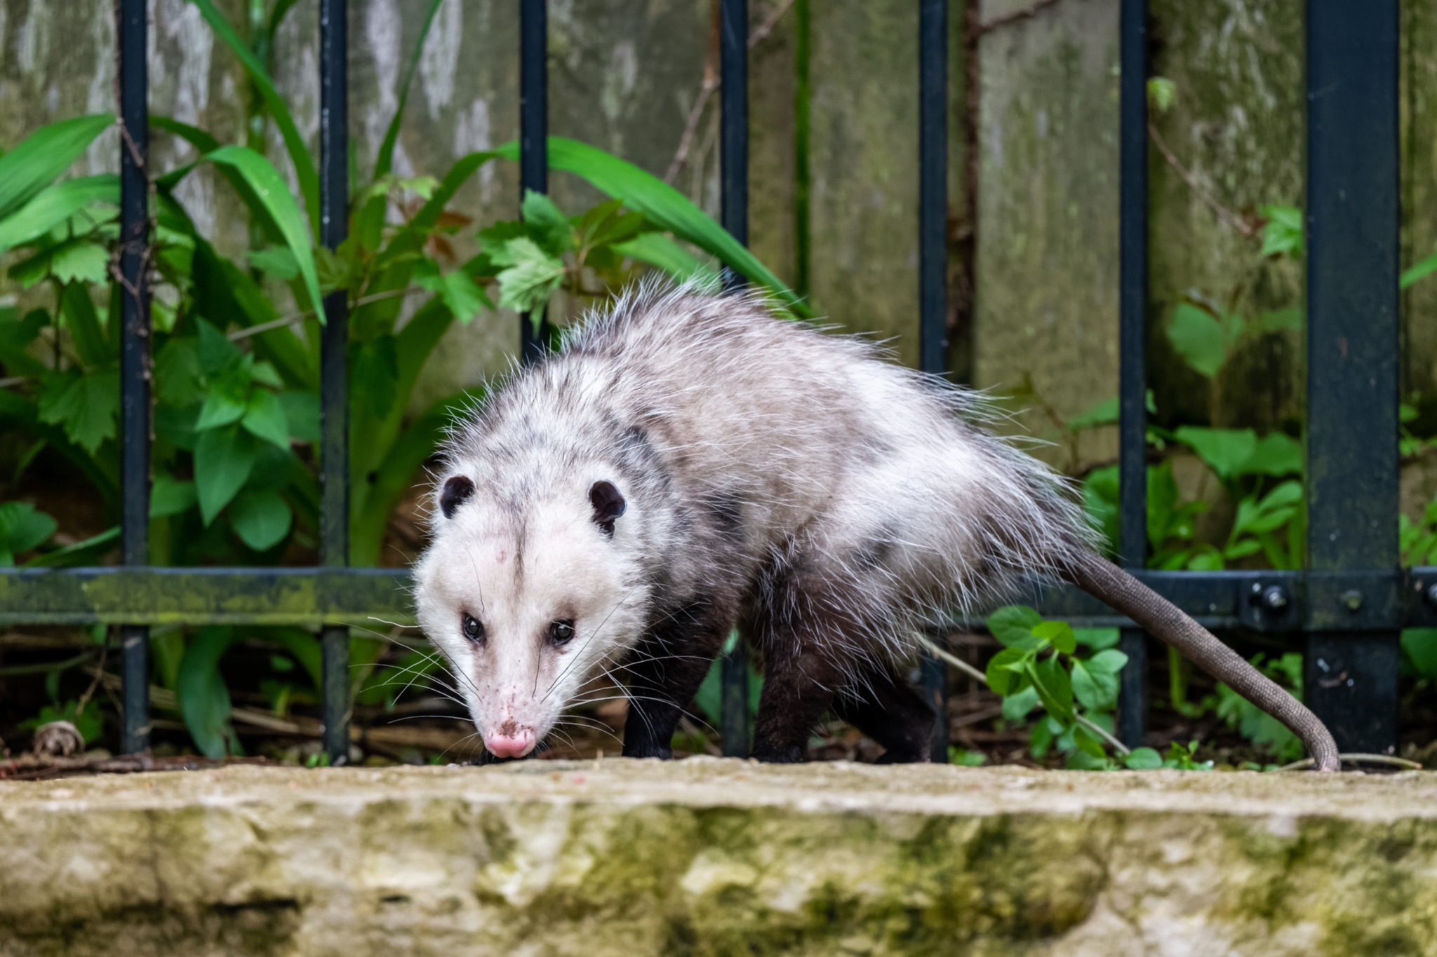
ᏂᎦᏚᏏᏁ ᏣᎳᎩ ᎠᏕᎶᏆᏍᏗ
ᎤᏤᏥᏍᏗ ᎢᎾᎨᎢ ᎠᏁᎰ ᎠᎴ ᏒᏃᏱ ᎠᎢᏄᎪᎪ.
Possums live in the woods and come out at night.

Slide 15
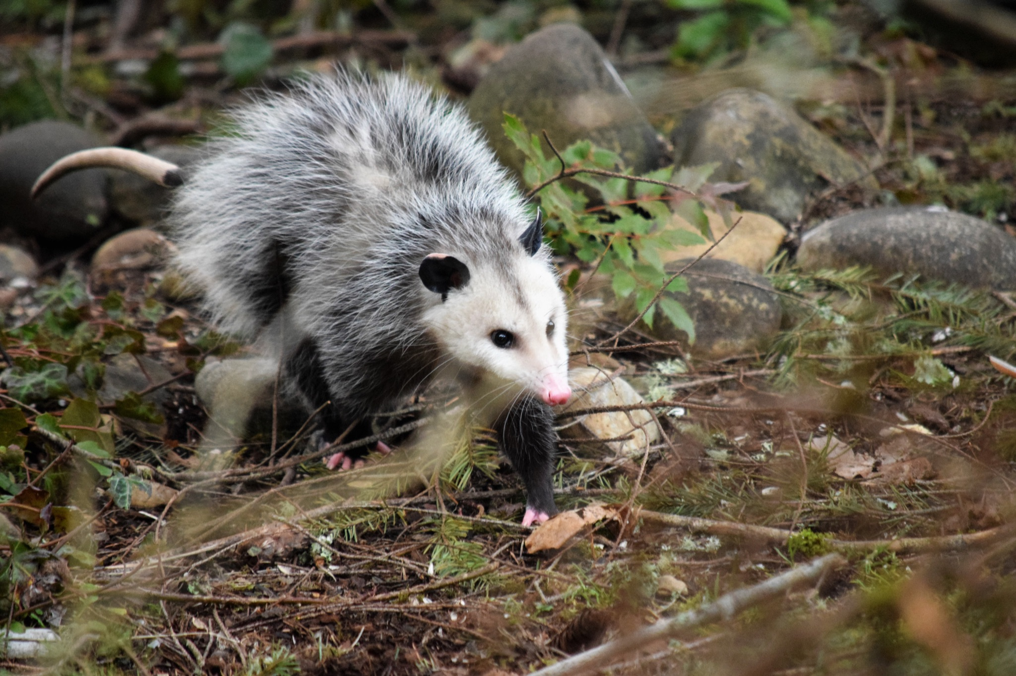
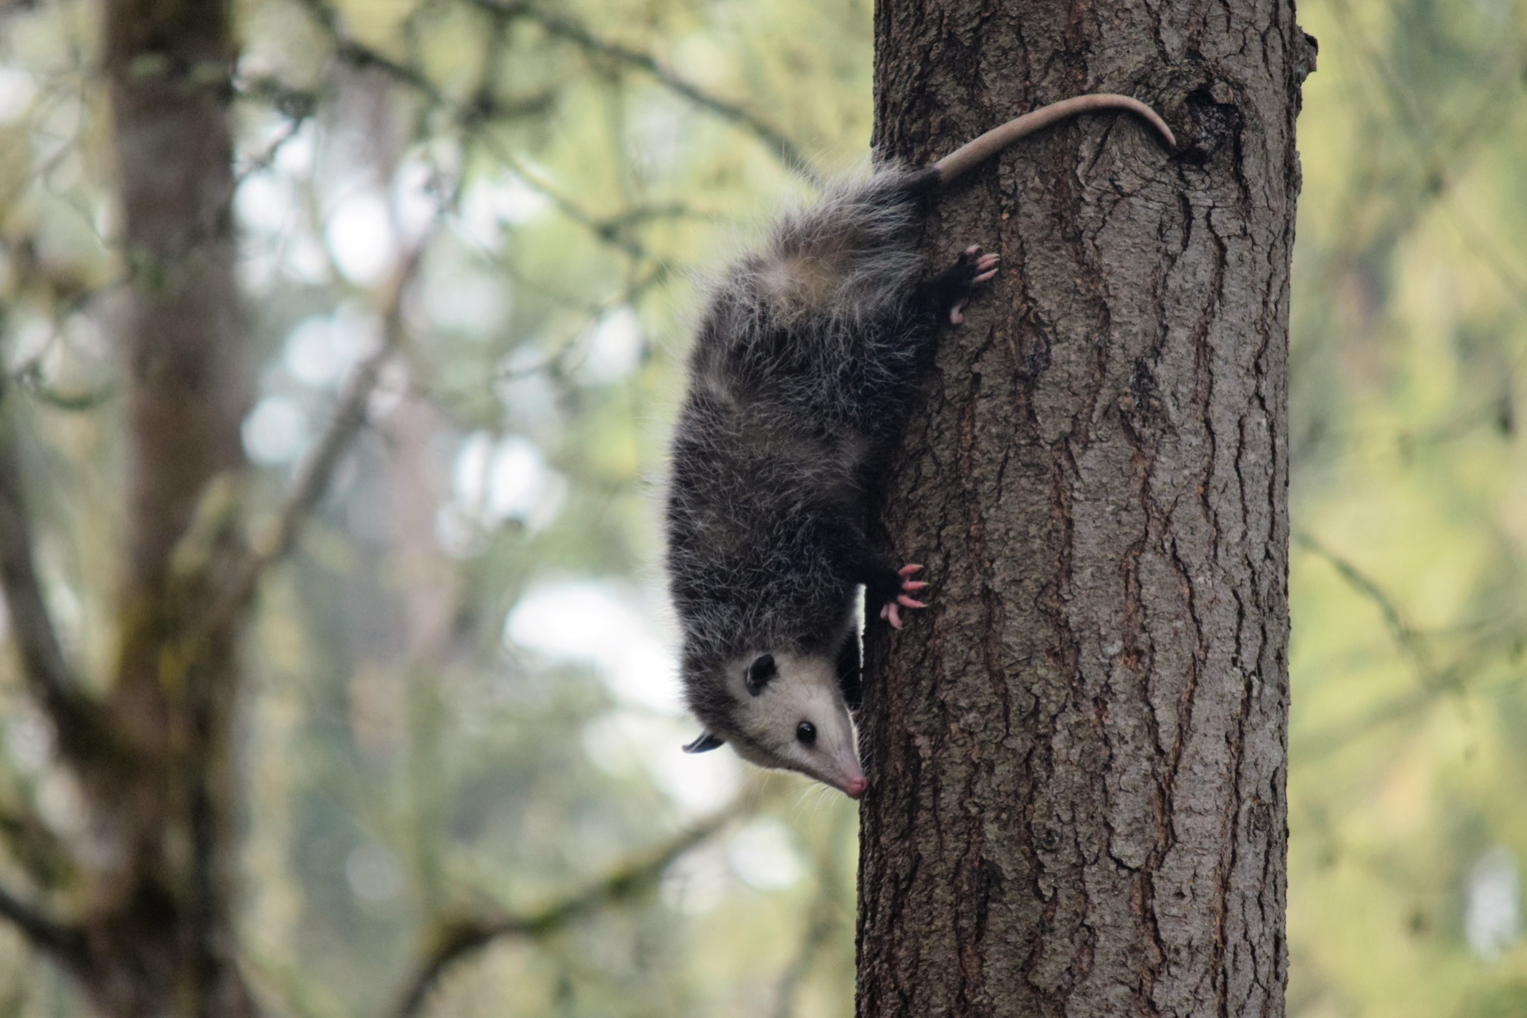
ᏂᎦᏚᏏᏁ ᏣᎳᎩ ᎠᏕᎶᏆᏍᏗ
ᏕᎵᎬᎢ ᏓᏂᎵᏙᎰ ᎠᎴᏎᏍᎩᏃ ᎦᏙ ᎥᏍᏊ ᎤᏂᎸᏈᏗ ᎤᏁᏓᏍᏗ.
The climb trees and are also comfortable on the ground.

Slide 16
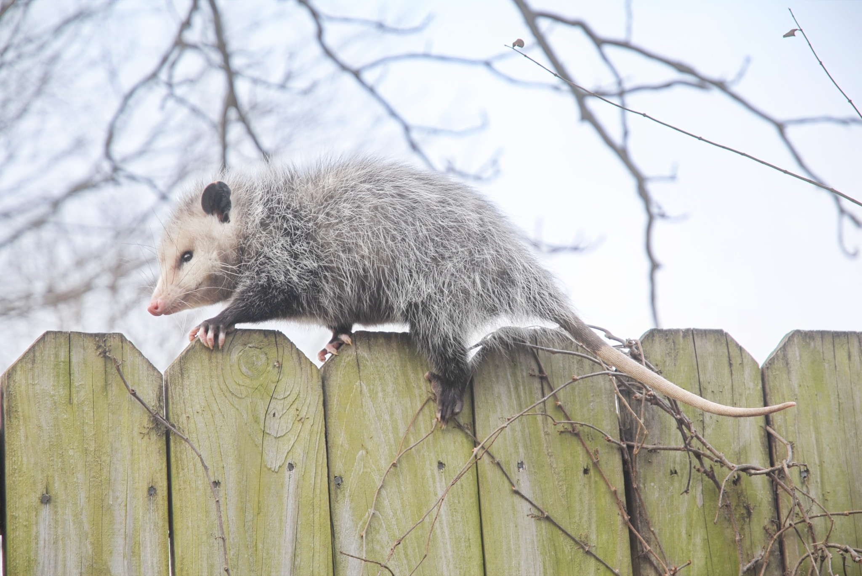
ᏂᎦᏚᏏᏁ ᏣᎳᎩ ᎠᏕᎶᏆᏍᏗ
ᎤᏍᎦᏃᎵ ᎨᏐ.
They are slow.

Slide 17
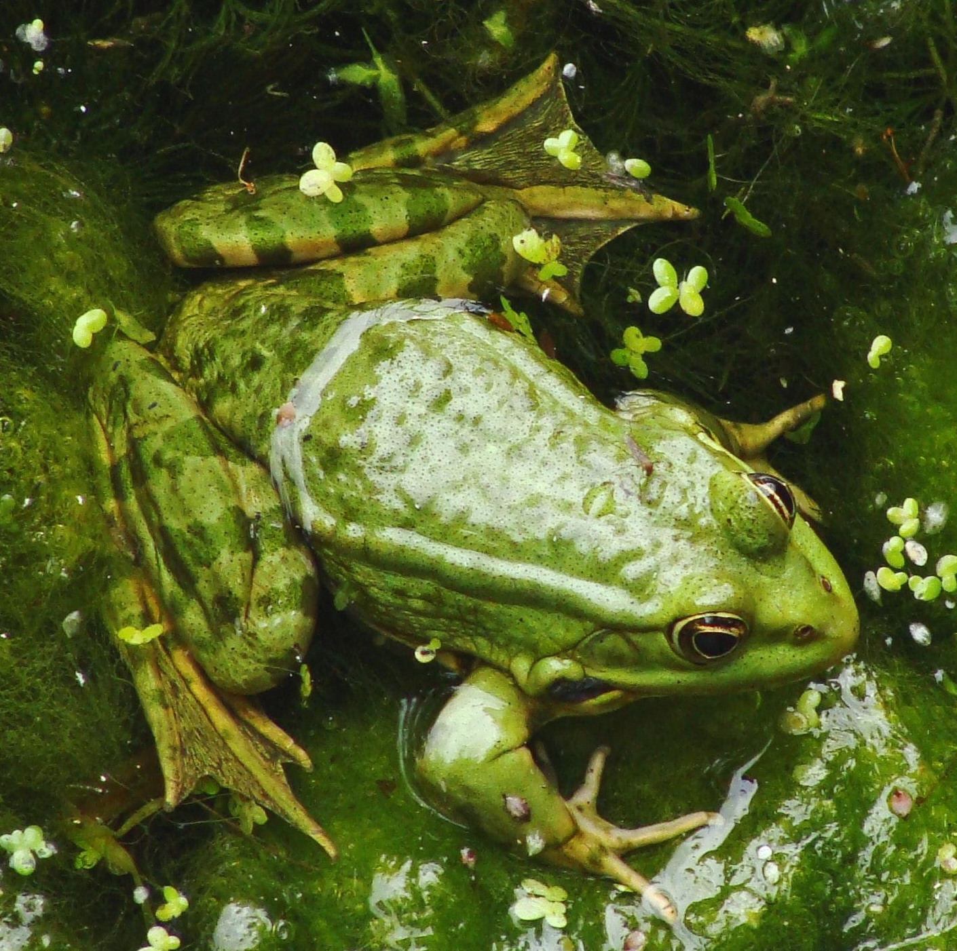
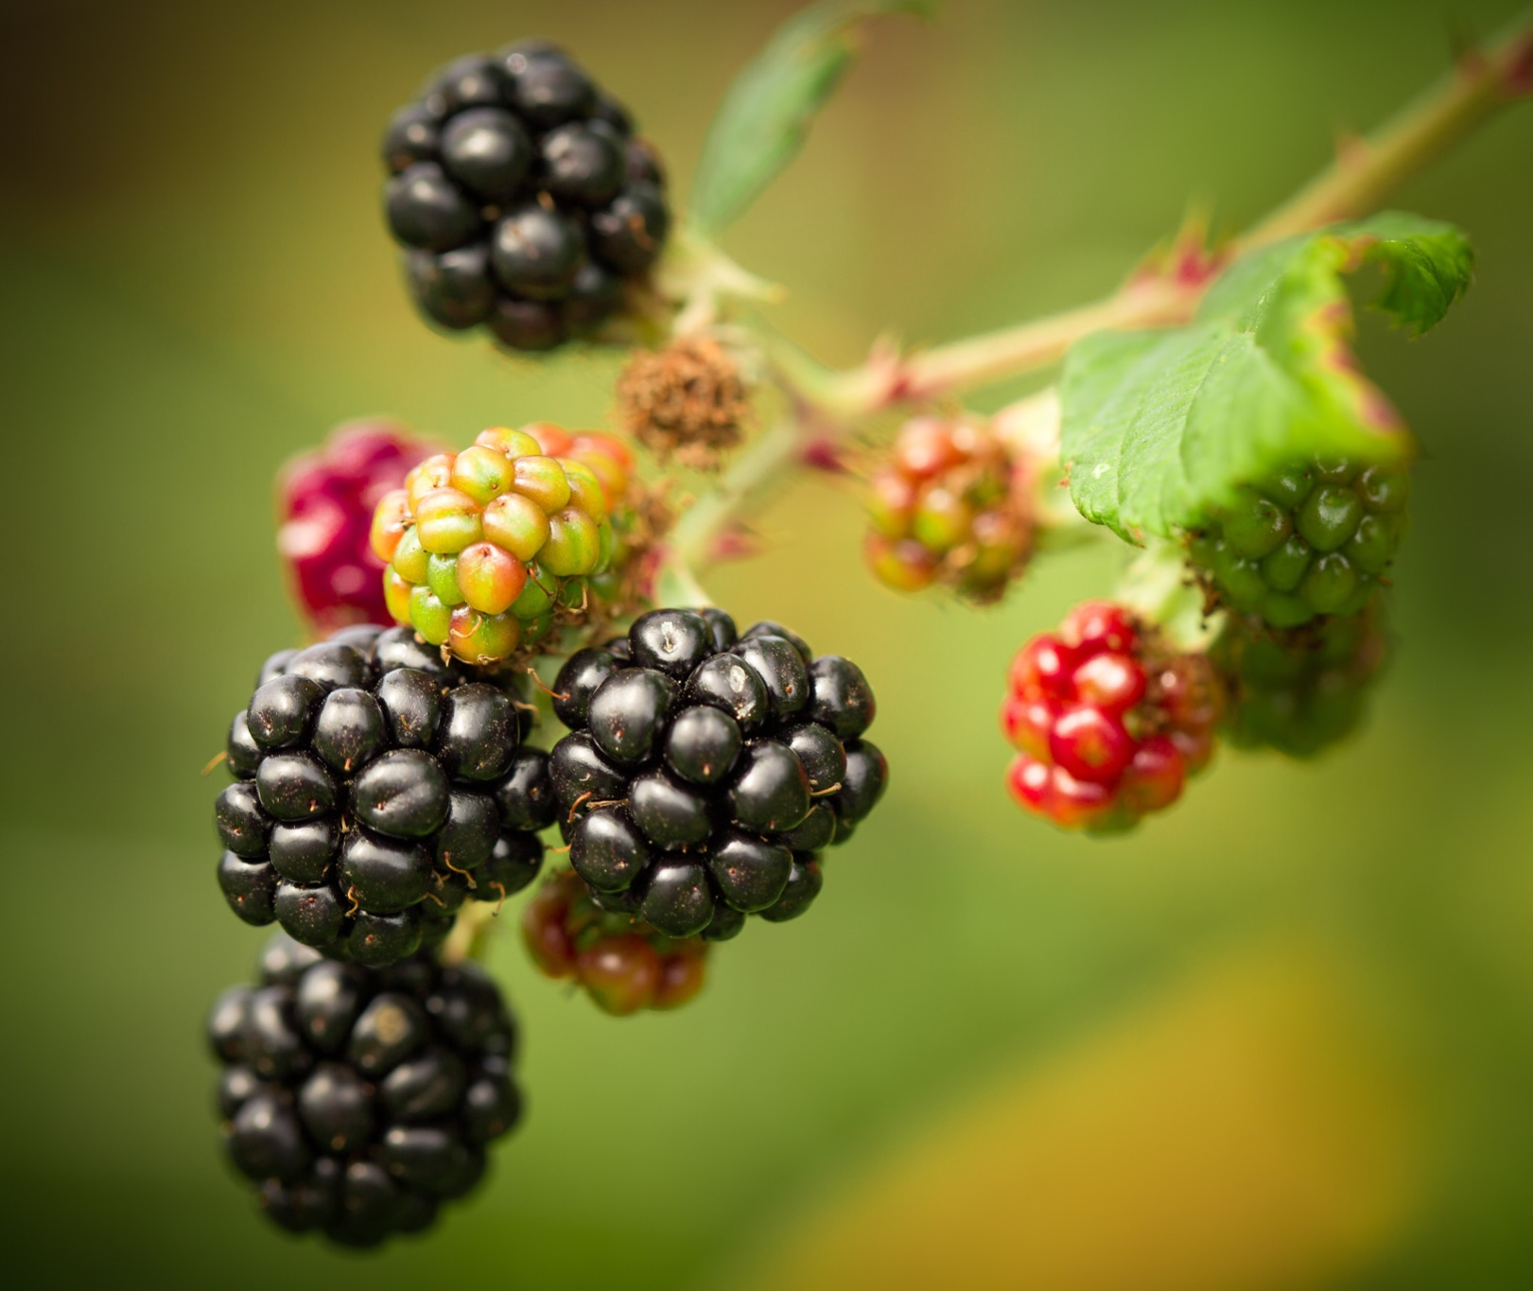
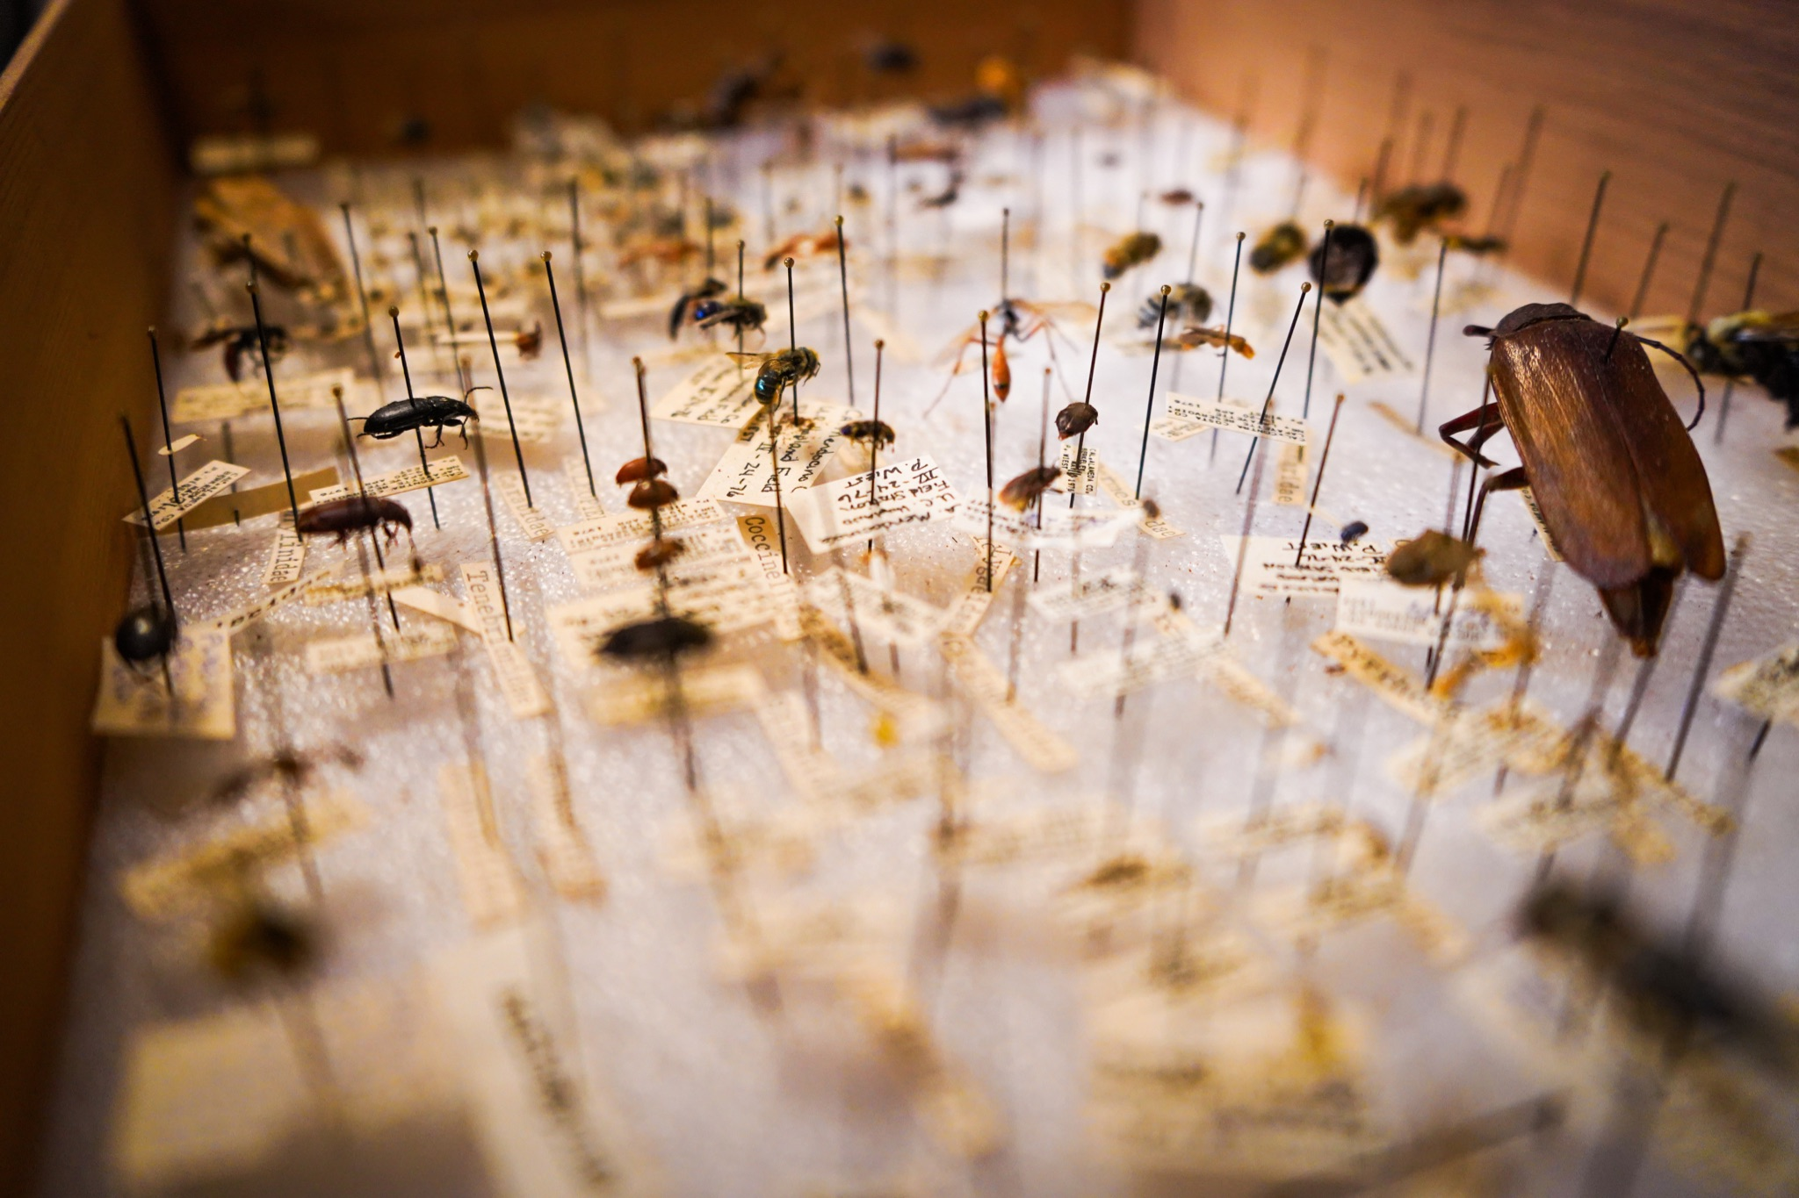
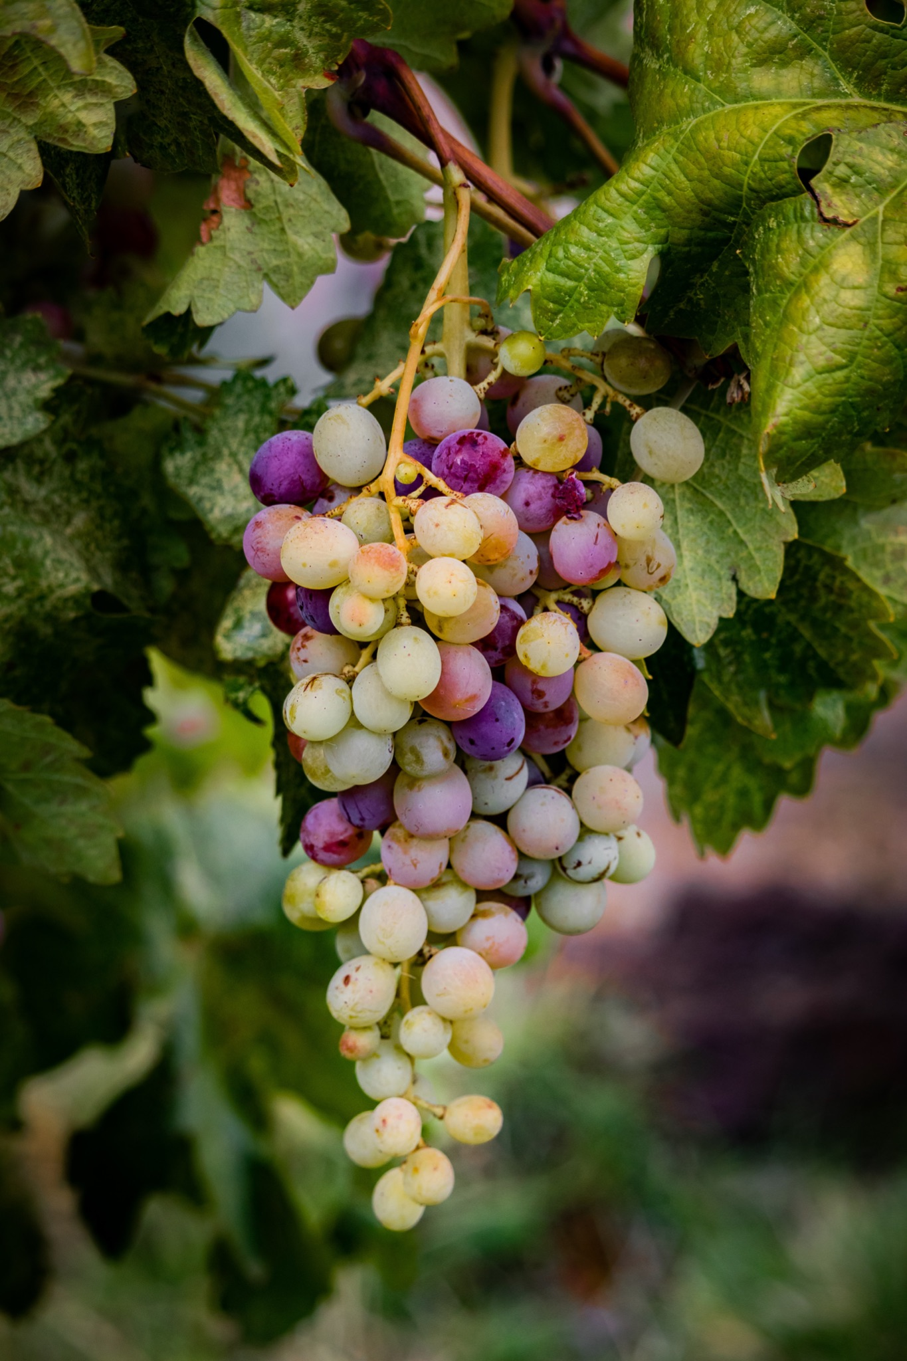
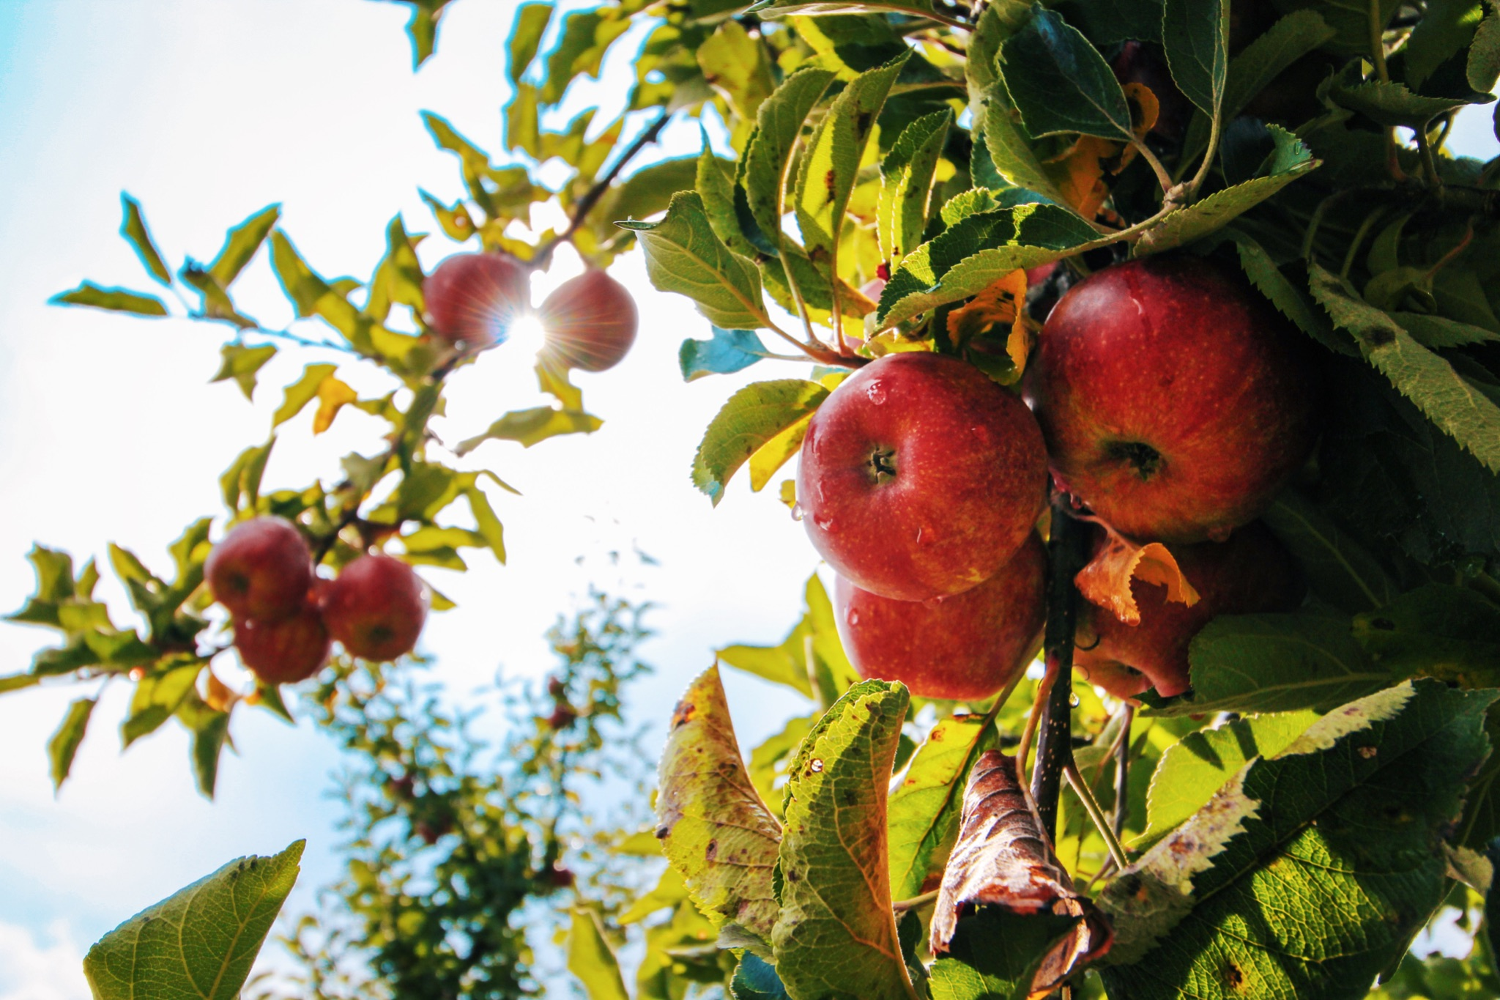
ᏂᎦᏚᏏᏁ ᏣᎳᎩ ᎠᏕᎶᏆᏍᏗ
ᎤᏂᎸᏈᏗ ᎤᏂᎩᏍᏗ ᎧᏄᎦᏟ, ᎫᏩ, ᎤᎿᏒᎩ, ᏒᎦᏔ, ᏥᏍᎪᏯ ᏧᏓᎴᎾ, ᏧᏂᏍᏗ ᏥᏍᏆ, ᏧᏪᏥ, ᏩᎶᏏ, ᏘᏲᎭᏟ ᎠᎴ ᏥᏍᏛᎾ.
They eat things like blackberries, mulberries,wild grapes, apples, bugs, small birds, eggs, frogs, lizards and crawdads.

Slide 18
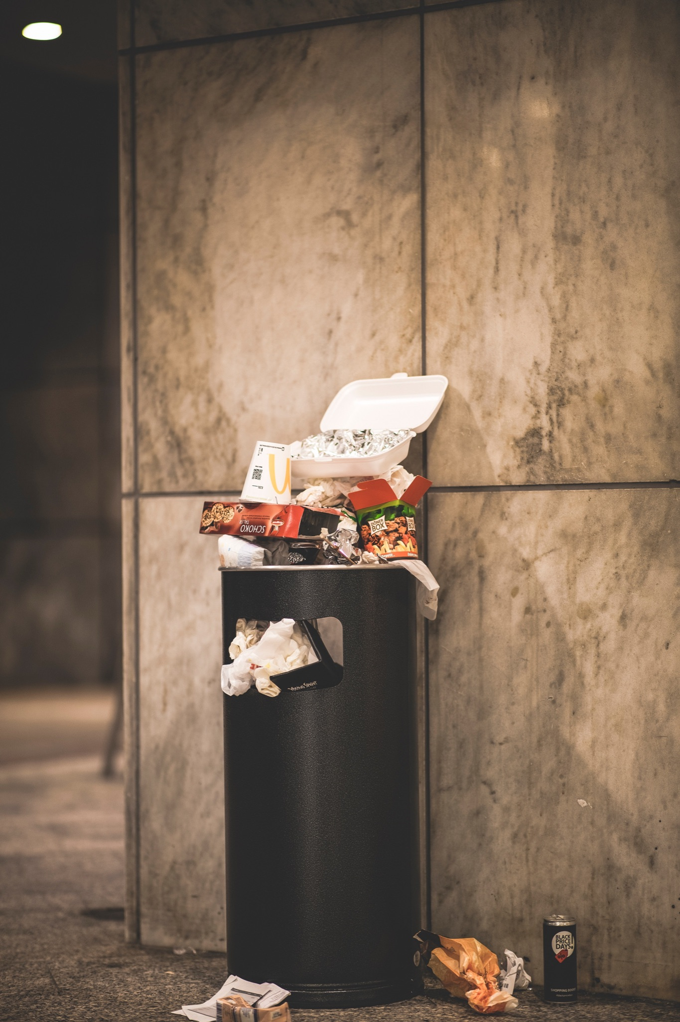
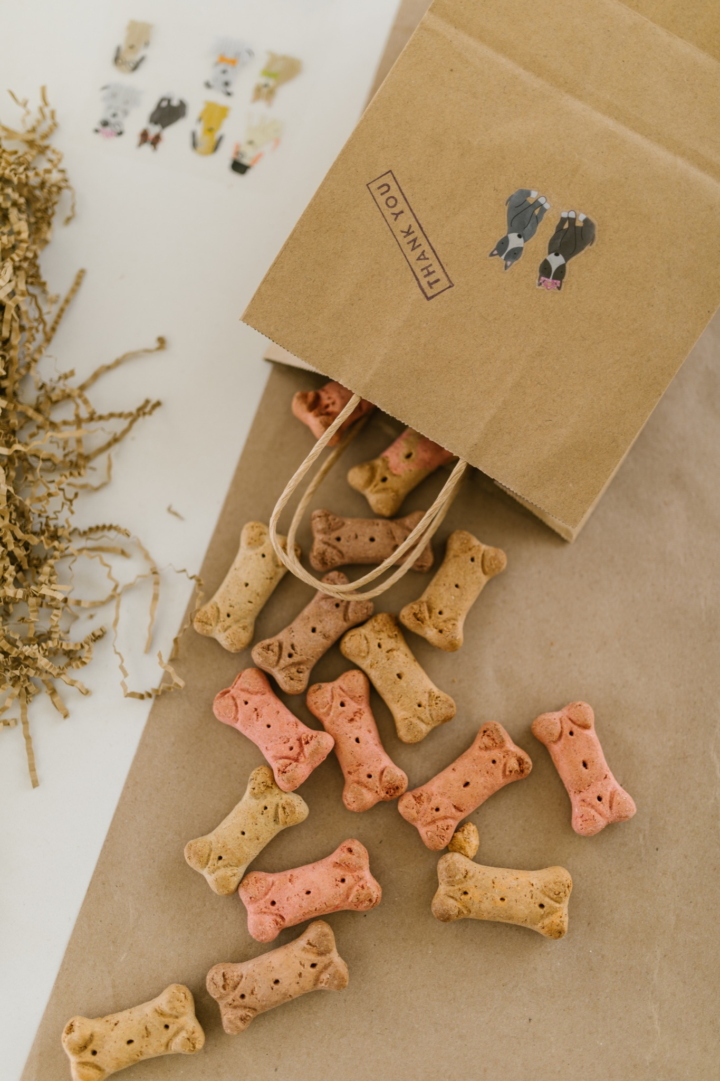
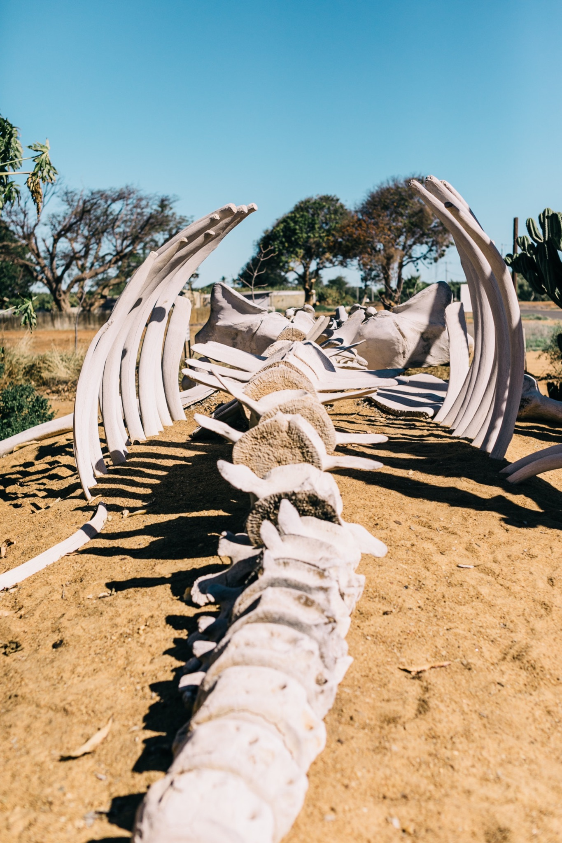
ᏂᎦᏚᏏᏁ ᏣᎳᎩ ᎠᏕᎶᏆᏍᏗ
ᎤᏤᏥᏍᏗ ᎤᏂᎸᏈᏗ ᎤᏲᏨᎯ, ᎩᏥ ᎤᏂᎩᏍᏗ ᎠᎴ ᎤᎵᏬᏨᎦᎾᏝᎥ (ᎡᎿᎢ) ᏧᎪᎳ ᏓᏂᎩᏍᎪ.
Possums also eat trash, dog food and also the bones of dead animals.

Slide 19
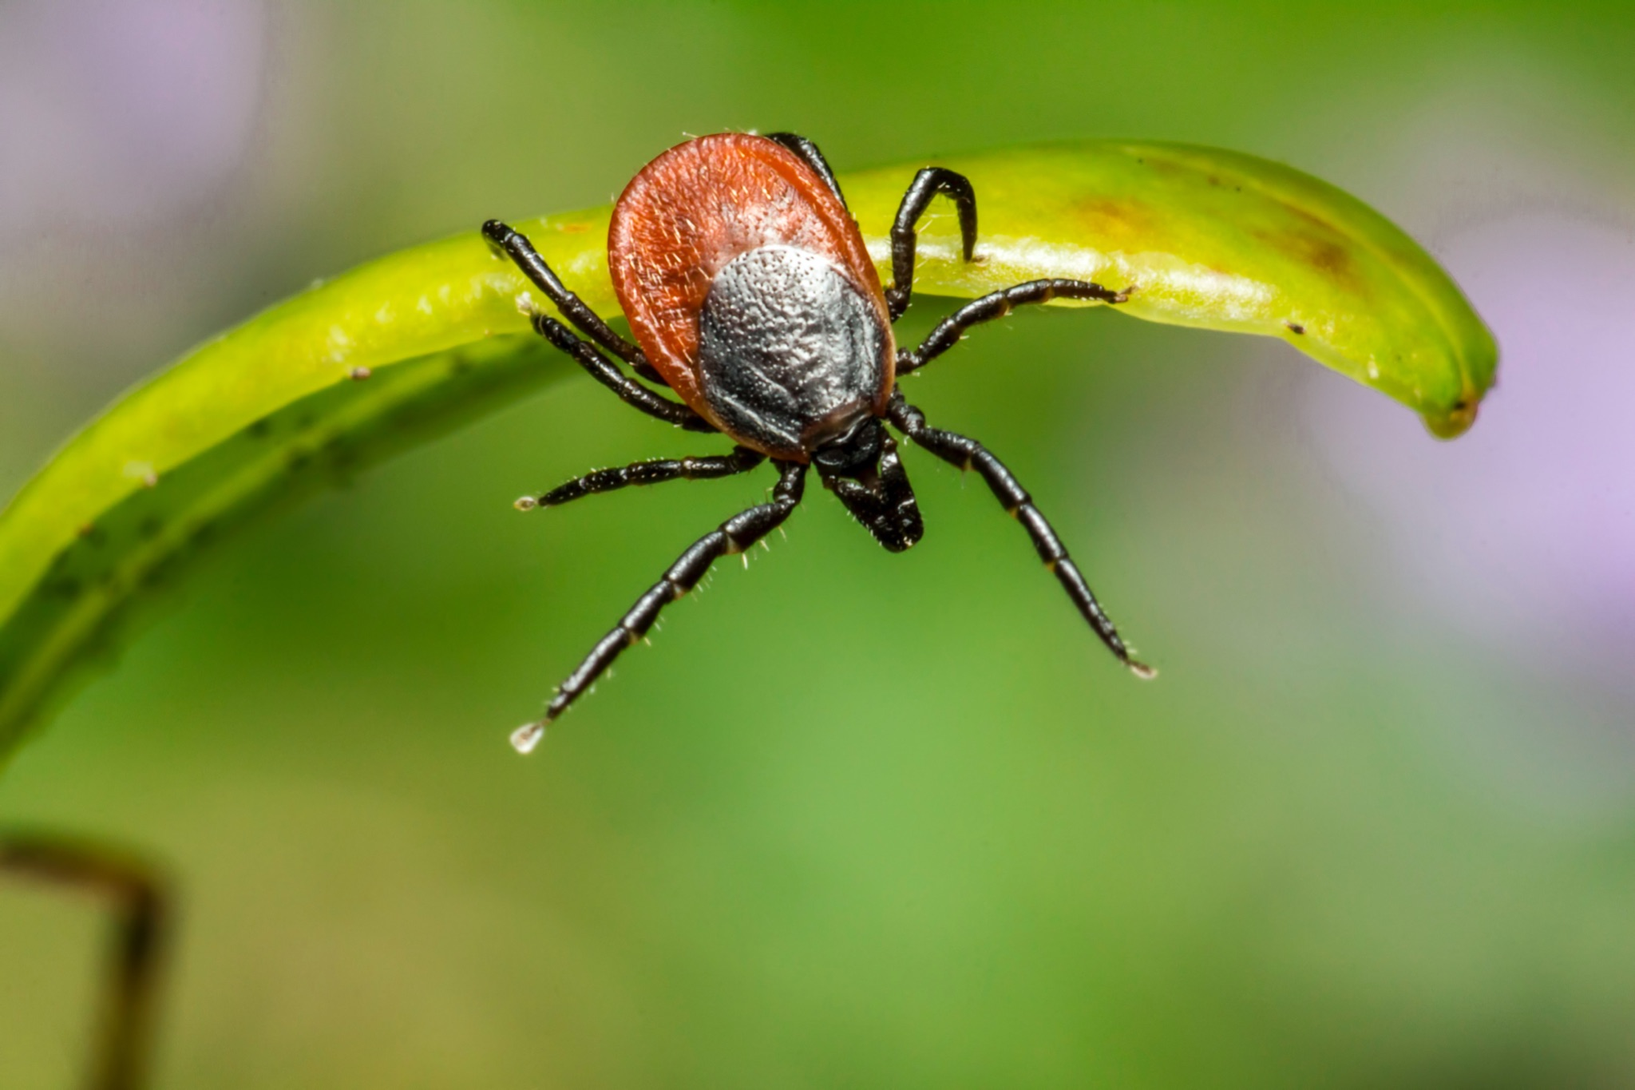
ᏂᎦᏚᏏᏁ ᏣᎳᎩ ᎠᏕᎶᏆᏍᏗ
ᏚᏂᏣᎵᏗ ᎫᎩ ᏓᏂᎩᏍᎬ.
They are well known for eating ticks

Slide 20
ᏂᎦᏚᏏᏁ ᏣᎳᎩ ᎠᏕᎶᏆᏍᏗ
ᏏᏆ ᎤᏤᏥᏍᏗ ᏔᎵ ᎠᎴ ᏅᎩ ᎢᏧᏕᏘᏴᏓ ᎠᏁᎰ.
Possums only live two to four years.

Slide 21
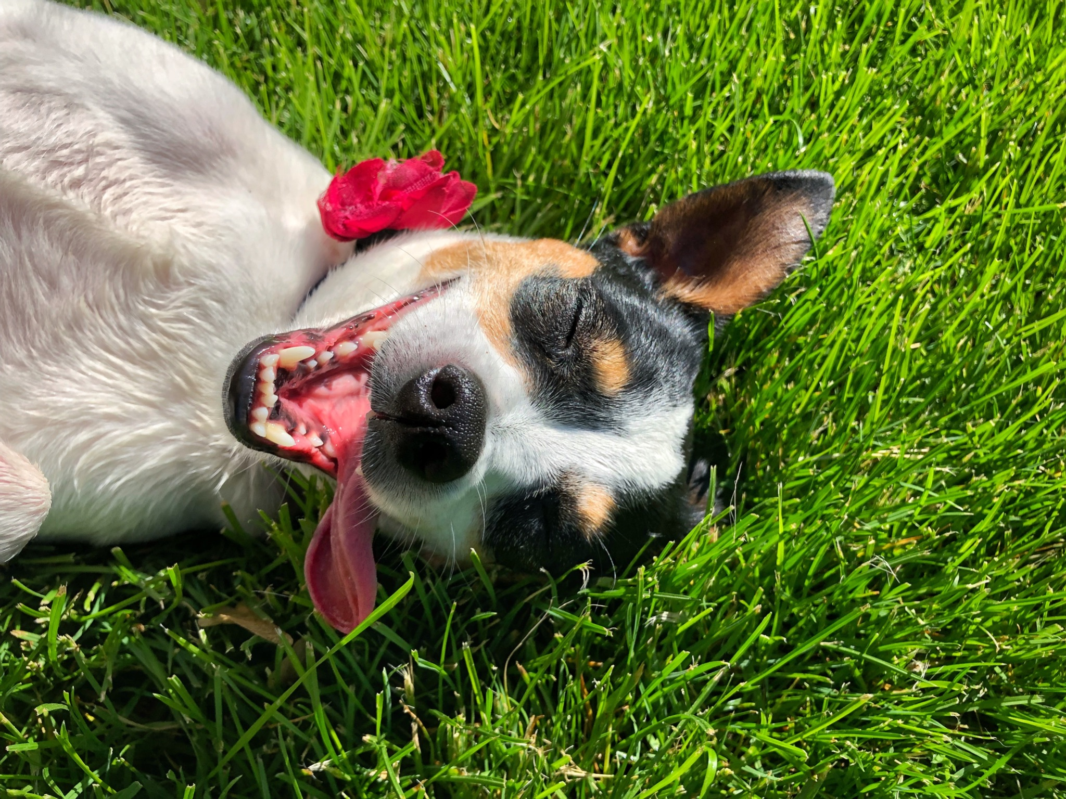
ᏂᎦᏚᏏᏁ ᏣᎳᎩ ᎠᏕᎶᏆᏍᏗ
ᎢᏳᏓᎵᎭ, ᎪᎱᏍᏗ ᏳᏍᎦᏍᏓᏁᎵ, ᎤᎵᏬᏨ ᎠᏤᎸᏍᎪ, ᏯᎾᏑᎦ, ᏳᏔᏠᎦ, ᎠᎴ ᏗᎩᏙᎵ ᏧᏍᏚᎢᏗ ᎨᏐᎢ.
Many times when the possum feels threatened, they will pretend to be dead, laying down, their mouth hanging open and their eyes open.

Slide 22
ᏂᎦᏚᏏᏁ ᏣᎳᎩ ᎠᏕᎶᏆᏍᏗ
ᎥᏍᏊ, ᎤᏂᎵᏬᏨ ᏳᎾᏤᎸᎾ, ᎤᏲ ᎠᏒᏥᎯᏍᎪ.
Also, when they play dead, they smell bad.

Slide 23
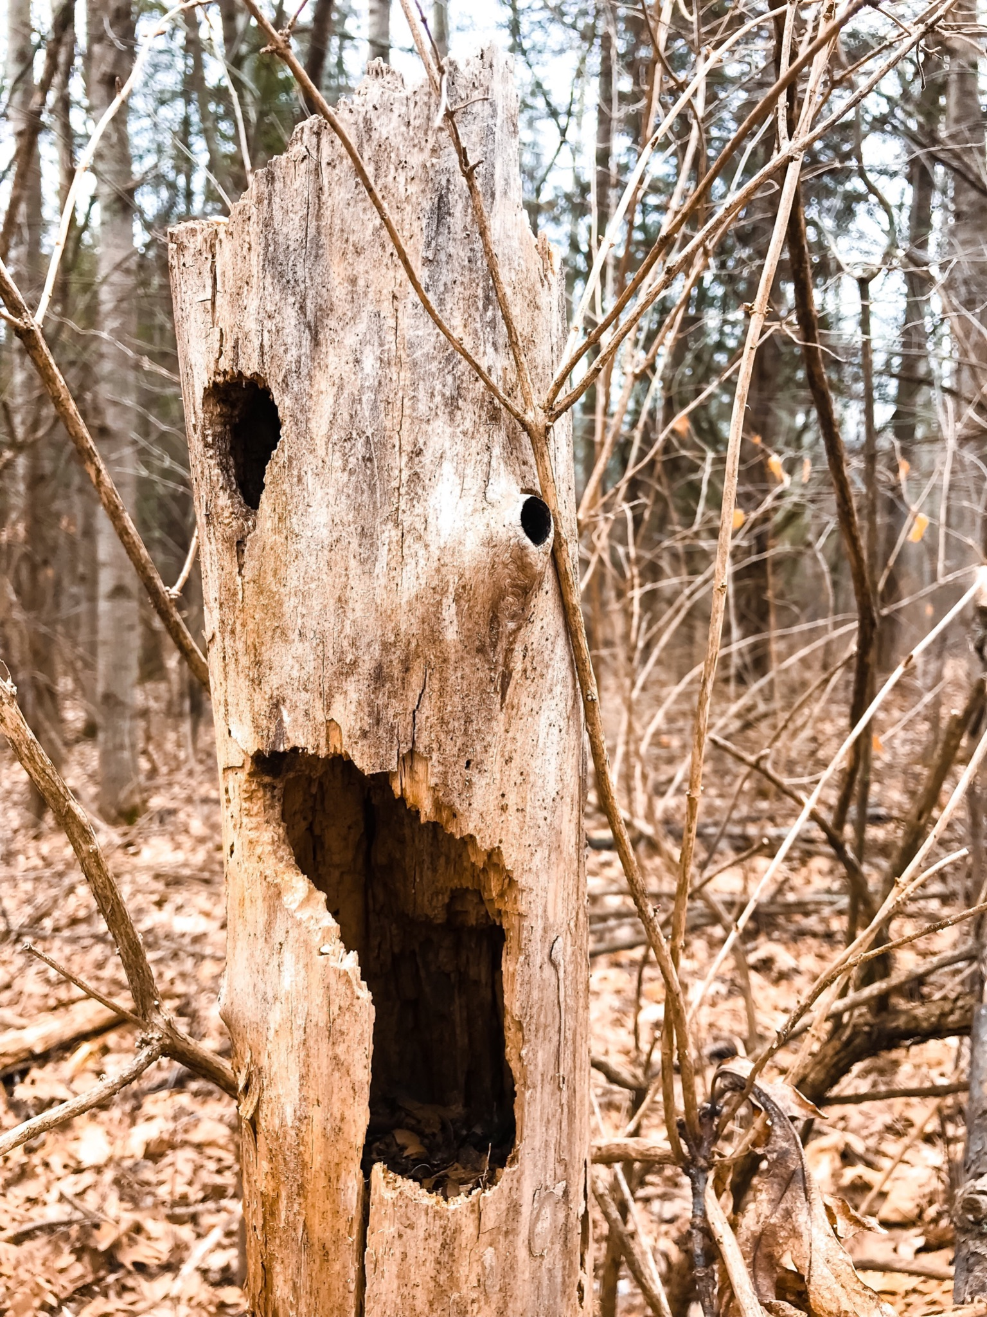
ᏂᎦᏚᏏᏁ ᏣᎳᎩ ᎠᏕᎶᏆᏍᏗ
ᏧᏌᏙᏂ ᏕᏢᎬ ᎤᎾᏣᎣ ᎠᎴ ᎭᏫᏂᏗᏢ ᏚᏂᎵᎬ ᎠᎴ ᏧᎾᏍᏕᏢ ᎠᏂᏁᎶ.
They live in hollow trees or under stumps or roots.

Slide 24
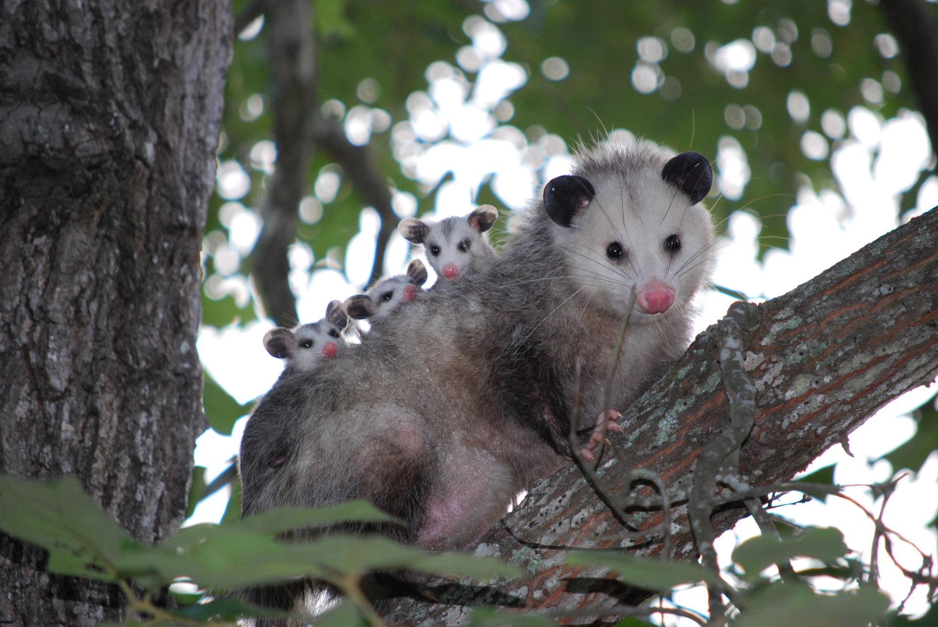
ᏂᎦᏚᏏᏁ ᏣᎳᎩ ᎠᏕᎶᏆᏍᏗ
ᏔᎵᏍᎪ ᎯᏍᎩ ᏯᏂ ᏧᏂᏍᏗ ᏯᎾᏕᎲᎦ, ᎠᏎᏃ Ꮭ ᏂᎦᏓ ᏱᏓᎾᏛᏍᎪ.
Possums can give birth to as many as 25 babies, but most do not survive to adulthood.

Slide 25
ᏂᎦᏚᏏᏁ ᏣᎳᎩ ᎠᏕᎶᏆᏍᏗ
ᏧᏂᏍᏗ ᎯᏍᎩ ᏳᎾᏙᏓᏆᏍᎩ ᎤᎾᏣᎣ ᎦᏃᏛᎢ.
The babies live about 5 weeks in the pouch.

Slide 26
ᏂᎦᏚᏏᏁ ᏣᎳᎩ ᎠᏕᎶᏆᏍᏗ
ᏔᎵ ᏯᏅᏗᏃ ᎦᏐᎯ ᎤᏂᏥ ᎤᏂᎩᎸᏗᏕᎪ.
then 2 months they ride around on their mother’s back.

Slide 27
ᏂᎦᏚᏏᏁ ᏣᎳᎩ ᎠᏕᎶᏆᏍᏗ
ᎤᏤᏥᏍᏗ ᎤᏅᏒ ᎠᏁᏙ.
Possums are solitary animals.

Slide 28
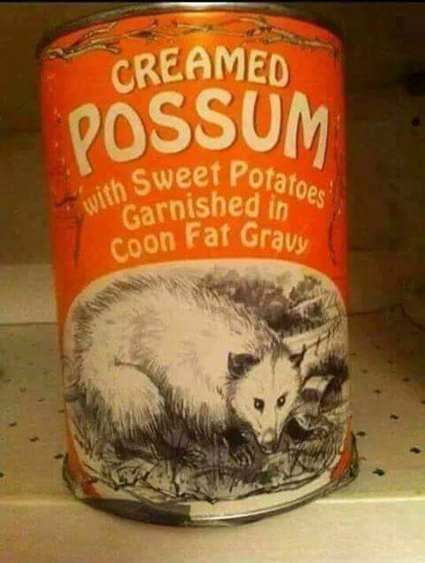
ᏂᎦᏚᏏᏁ ᏣᎳᎩ ᎠᏕᎶᏆᏍᏗ
ᎠᏂᏣᎳᎩ ᏳᏓᎭ ᎤᏤᏥᏍᏗ ᏓᏂᎩᏍᎪ, ᎠᏎᏃ ᎪᎢᎭ ᎭᏫᏯ ᎨᏐᎢ.
Cherokees would sometimes eat possum, but the meat is greasy.

Slide 29
ᏂᎦᏚᏏᏁ ᏣᎳᎩ ᎠᏕᎶᏆᏍᏗ
ᎥᏍᎩ ᏳᏍᏗ ᏄᎾ ᎠᏂᏅᎯᏓ ᎠᎴ ᎤᏤᏥᏍᏗ ᎭᏫᏯ ᎢᏧᎳ ᏓᏂᎩᏍᎪ.
It is often eaten with sweet potatoes.

