Slide 1
ᎣᏏᏲ
ᏍᎩᎦᏚᏏᏁ ᏣᎳᎩ ᎠᏕᎶᏆᏍᏗ

Slide 2
ᏍᎩᎦᏚᏏᏁ ᏣᎳᎩ ᎠᏕᎶᏆᏍᏗ
ᎢᏓᎴᎾ- Let’s begin
ᏣᎳᎩ ᎢᏗᏬᏂ- Let’s talk Cherokee

Slide 3
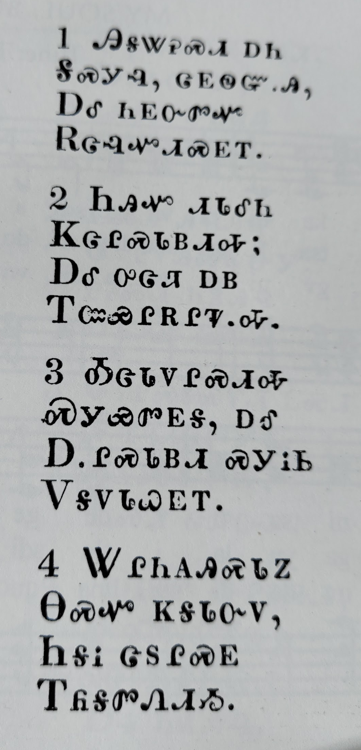
ᏔᎳᏚᏏᏁ ᏣᎳᎩ ᎠᏕᎶᏆᏍᏗ
ᎯᎦᏔᎮᏍᏗ ᎠᏂ
ᎦᏍᎩᎸ, ᏣᎬᏫᏳᎯ,
ᎠᎴ ᏂᎬᏅᏛᏉ
ᎡᏣᎸᏉᏗᏍᎬᎢ.
Know this place here
At your table, you King,
And everywhere
You will be praised.
Notes:
aksdayvhvsg

Slide 4
ᏦᎦᏚᏏᏁ ᏣᎳᎩ ᎠᏕᎶᏆᏍᏗ
2.ᏂᎯᏉ ᏗᏓᎴᏂ
ᏦᏣᎵᏍᏓᏴᏗᎭ;
ᎠᎴ ᎤᏣᏘ ᎠᏴ
ᎢᏨᏯᎵᎡᎵᏤᎭ.
It begins with only you
That we can eat this meal;
And very much
We are grateful.
Notes:
aksdayvhvsg

Slide 5
ᏂᎦᏚᏏᏁ ᏣᎳᎩ ᎠᏕᎶᏆᏍᏗ
3. ᎣᏣᏓᏙᎵᏍᏗᎭ
ᏍᎩᏯᏛᎬᎦ, ᎠᎴ
ᎠᎵᏍᏓᏴᏗ ᏍᎩᎥᏏ
ᏙᎦᏙᏓᏇᎬᎢ.
We are praying
Hear us, and
Give us food
Daily.
Notes:
aksdayvhvsg

Slide 6
ᏍᎩᎦᏚᏏᏁ ᏣᎳᎩ ᎠᏕᎶᏆᏍᏗ
4. ᏔᎵᏂᎪᎯᏍᏓᏃ
ᎾᏍᏉ ᏦᎦᏓᏅᏙ,
ᏂᎦᎥ ᏣᏚᎵᏍᎬ
ᎢᏲᎦᏛᏁᏗᏱ.
Make them strong
And then our hearts
Everything you want
For us to do.
Notes:
aksdayvhvsg

Slide 7
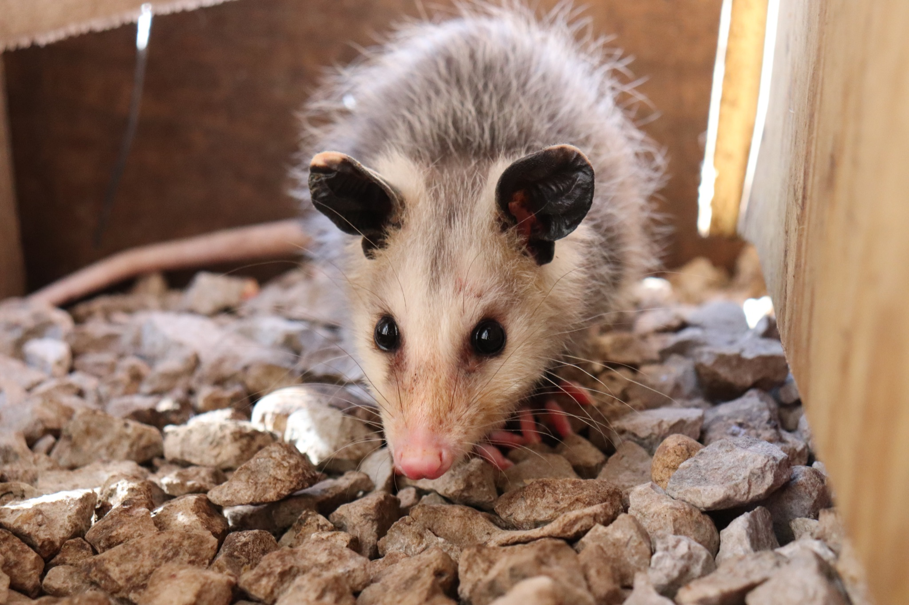
ᏍᎩᎦᏚᏏᏁ ᏣᎳᎩ ᎠᏕᎶᏆᏍᏗ
ᎤᏤᏥᏍᏗ ᎧᏴᏐᎵ ᎠᏓᎴᏂᏍᎬ ᎦᏂᏓᏛᎢ ᎢᎦᏅᎯᏓ ᏦᎦᏚ ᎠᎴ ᏦᏍᎪᎯ ᎦᎵᏉᎩ ᎢᏏᏔᏗᏍᏗ.
From nose to the base of the tail, the possum is 13 to 37 inches long.

Slide 8
ᏍᎩᎦᏚᏏᏁ ᏣᎳᎩ ᎠᏕᎶᏆᏍᏗ
ᎦᏂᏓᏛ ᎤᏰᎸᎭ ᎠᎴ ᎦᏅᎯᏒ ᏐᏁᎵ ᎠᎴ ᏐᏁᎳᏚ ᎢᏏᏔᏗᏍᏗ.
The tail is naked and between 9 and 19 inches long.

Slide 9
ᏍᎩᎦᏚᏏᏁ ᏣᎳᎩ ᎠᏕᎶᏆᏍᏗ
ᏚᏩᏂᎦᏢ ᎠᎴ ᏧᏓᎴᏅᏓ ᎪᎱᏍᏗ ᏱᎦᏇᏅᎾ ᎦᏂᏓᏛ.
Branches and various things it wraps around the tail.

Slide 10
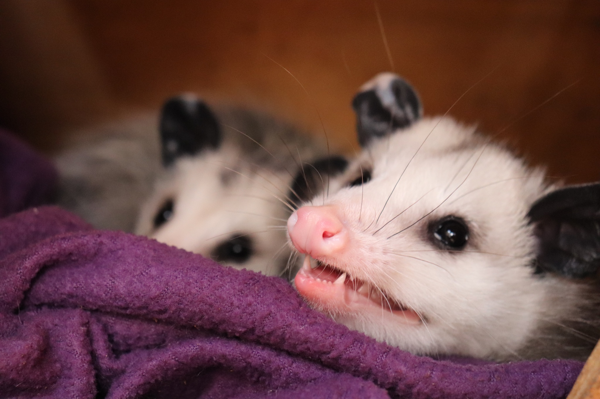
ᏍᎩᎦᏚᏏᏁ ᏣᎳᎩ ᎠᏕᎶᏆᏍᏗ
ᎬᎿᎨ ᎤᏍᎪᎸ ᏧᎾᎵᏑᏫᏓ ᎠᎴ ᎤᏍᏗ ᏓᏂᎵᎵᎪ.
It’s gray colored and has small ears.

Slide 11
ᏍᎩᎦᏚᏏᏁ ᏣᎳᎩ ᎠᏕᎶᏆᏍᏗ
ᎯᏍᎪᎯ ᎢᎦ ᏓᏂᎾᏙᎪ ᎠᎴ ᎬᎿᎨ ᏗᏂᎦᏙᎵ.
They have fifty teeth and black eyes.

Slide 12
ᏍᎩᎦᏚᏏᏁ ᏣᎳᎩ ᎠᏕᎶᏆᏍᏗ
ᏏᏆ ᎤᏤᏥᏍᏗ “marsupials” ᏓᏃᏎᎰ, ᎠᏂᏓ ᎦᏃᏛᎢ ᏓᏂᏂᏙᎰ.
Possums are called “marsupials”, they carry around their young in a pouch.

Slide 13
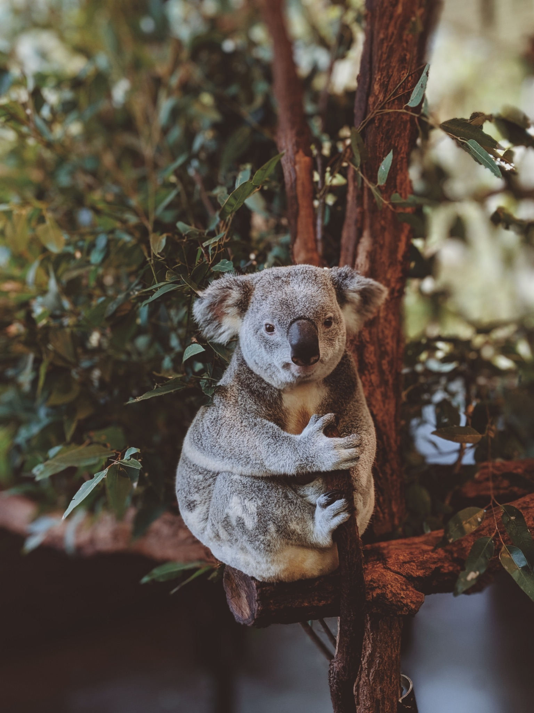
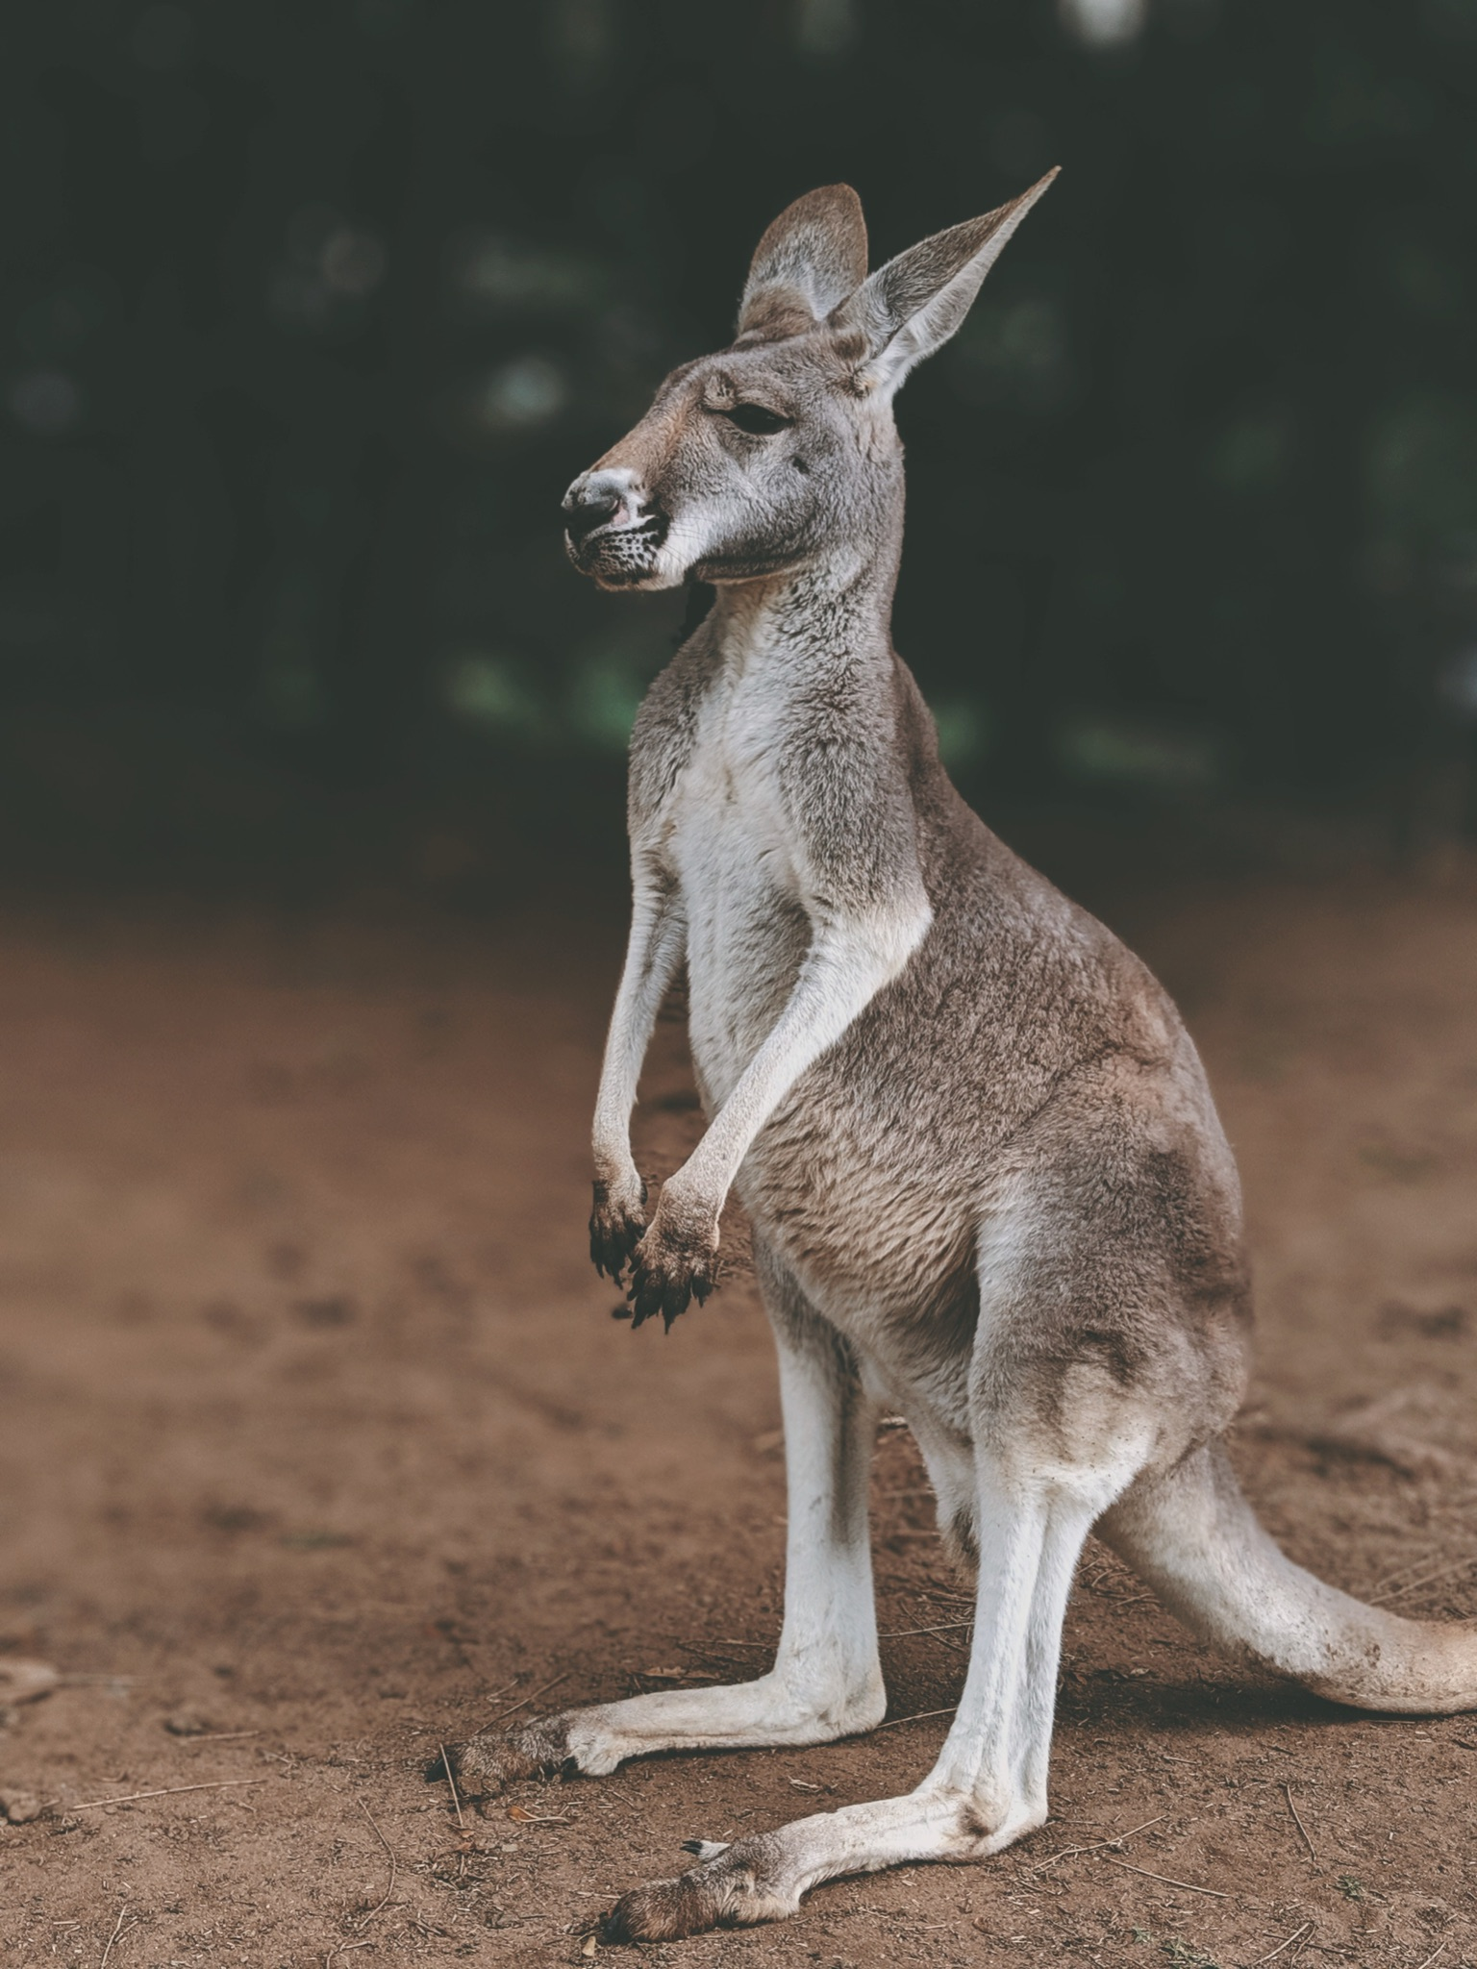
ᏍᎩᎦᏚᏏᏁ ᏣᎳᎩ ᎠᏕᎶᏆᏍᏗ
ᏧᎾᏠᏱ ᎪᎠᎳ ᏲᎾ ᎠᎴ ᎤᏜᏩᏓ ᎤᏤᏥᏍᏗ.
Possums are similar to koalas and kangaroos.

Slide 14
ᏍᎩᎦᏚᏏᏁ ᏣᎳᎩ ᎠᏕᎶᏆᏍᏗ
ᎤᏤᏥᏍᏗ ᎤᏅᏒ “marsupials” ᎠᏁ ᎠᎹᏰᏟ ᏧᏴᏢ.
Possums are the only marsupials in North America.

Slide 15
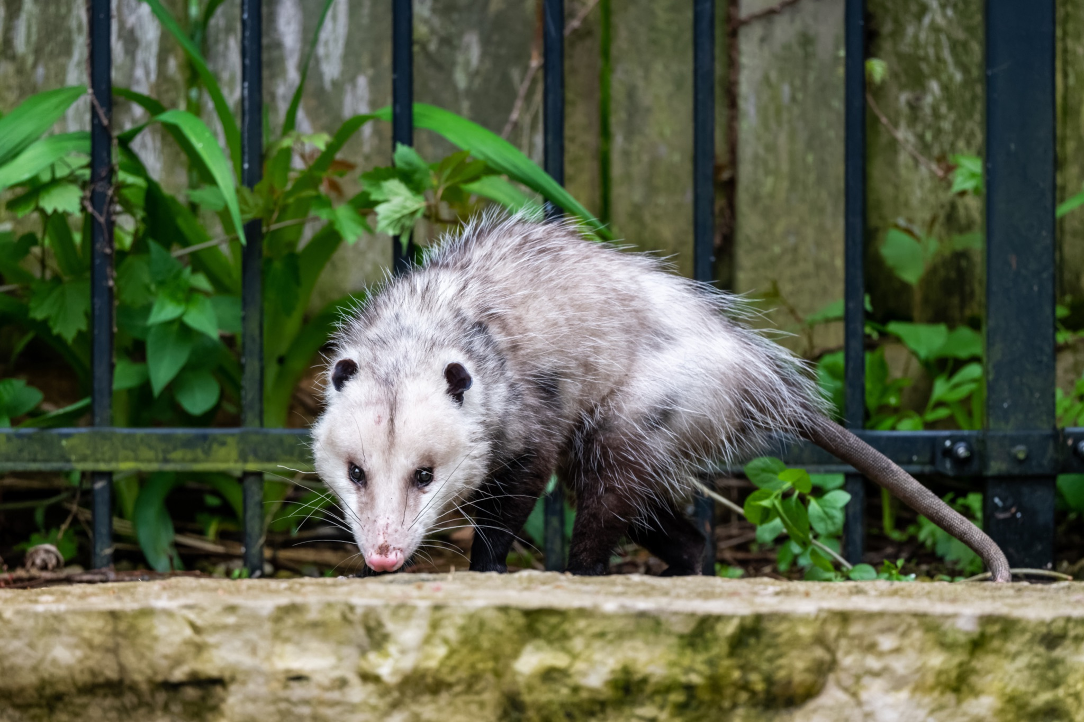
ᏍᎩᎦᏚᏏᏁ ᏣᎳᎩ ᎠᏕᎶᏆᏍᏗ
ᎤᏤᏥᏍᏗ ᎢᎾᎨᎢ ᎠᏁᎰ ᎠᎴ ᏒᏃᏱ ᎠᎢᏄᎪᎪ.
Possums live in the woods and come out at night.

Slide 16
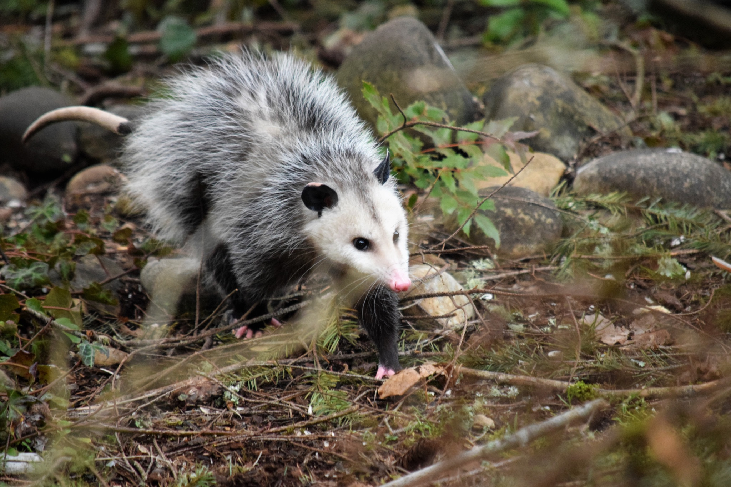
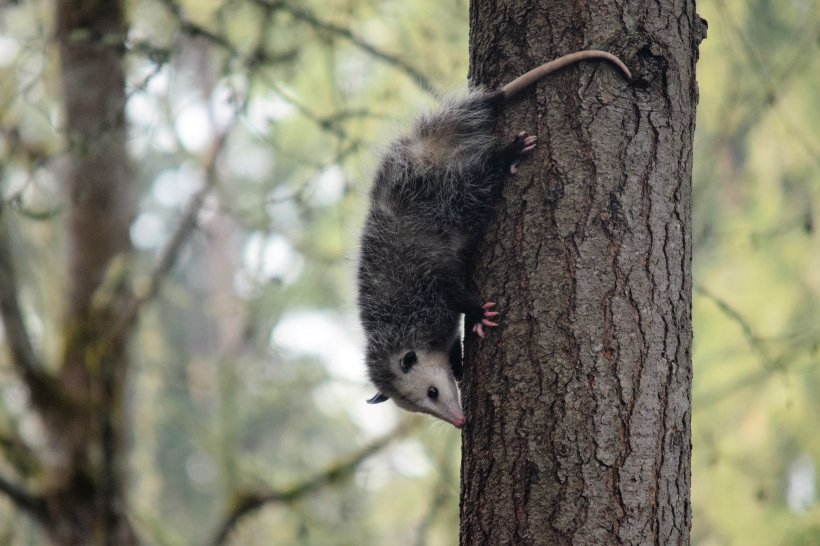
ᏍᎩᎦᏚᏏᏁ ᏣᎳᎩ ᎠᏕᎶᏆᏍᏗ
ᏕᎵᎬᎢ ᏓᏂᎵᏙᎰ ᎠᎴᏎᏍᎩᏃ ᎦᏙ ᎥᏍᏊ ᎤᏂᎸᏈᏗ ᎤᏁᏓᏍᏗ.
The climb trees and are also comfortable on the ground.

Slide 17
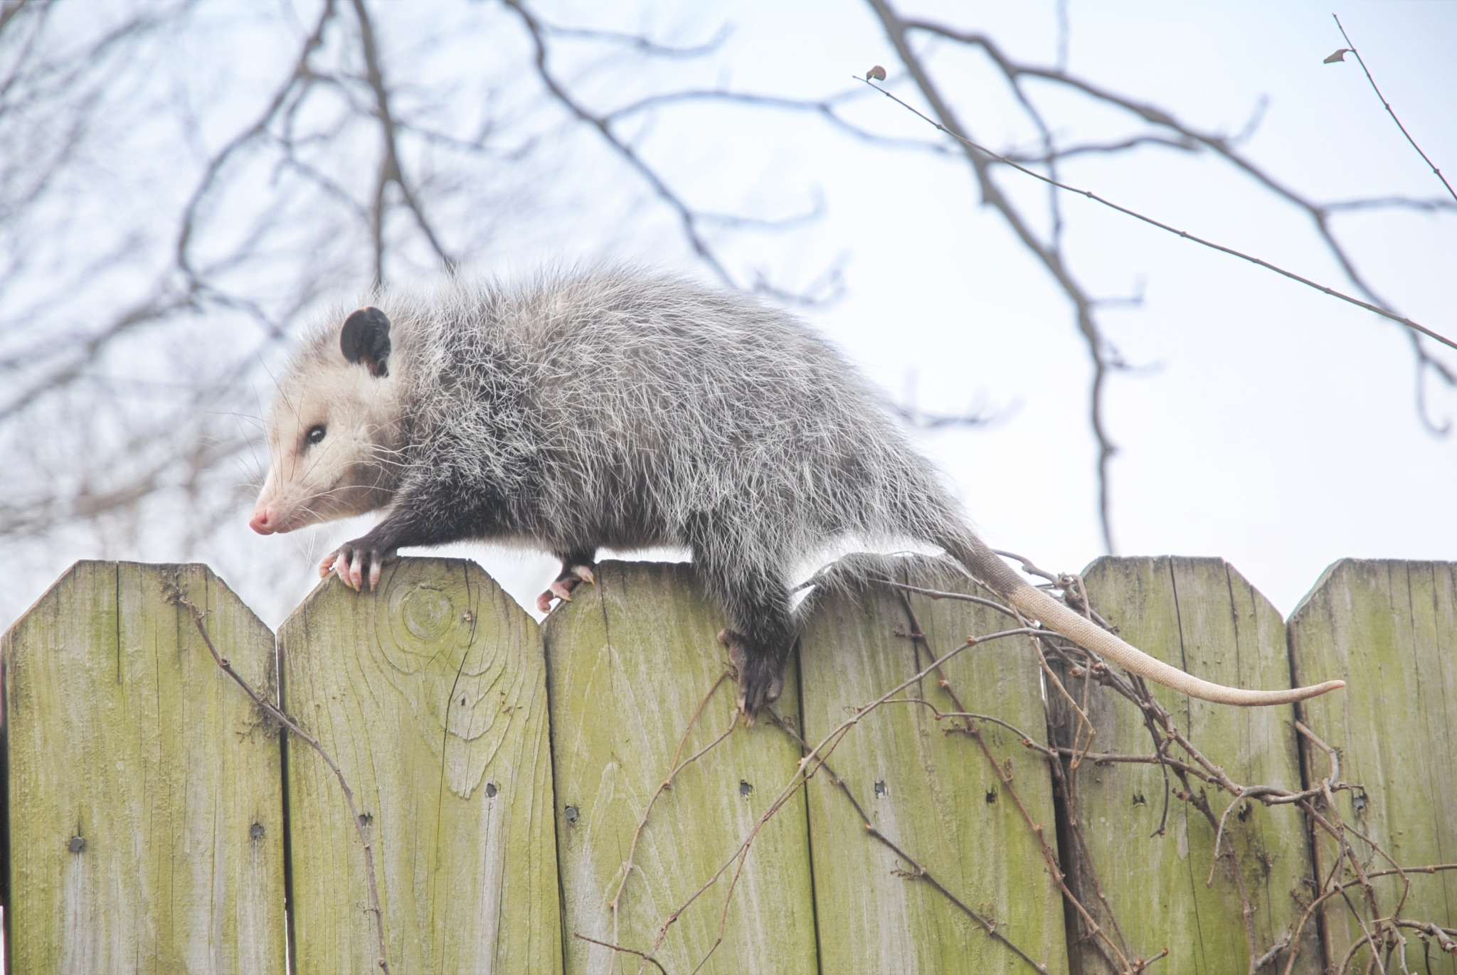
ᏍᎩᎦᏚᏏᏁ ᏣᎳᎩ ᎠᏕᎶᏆᏍᏗ
ᎤᏍᎦᏃᎵ ᎨᏐ.
They are slow.

Slide 18
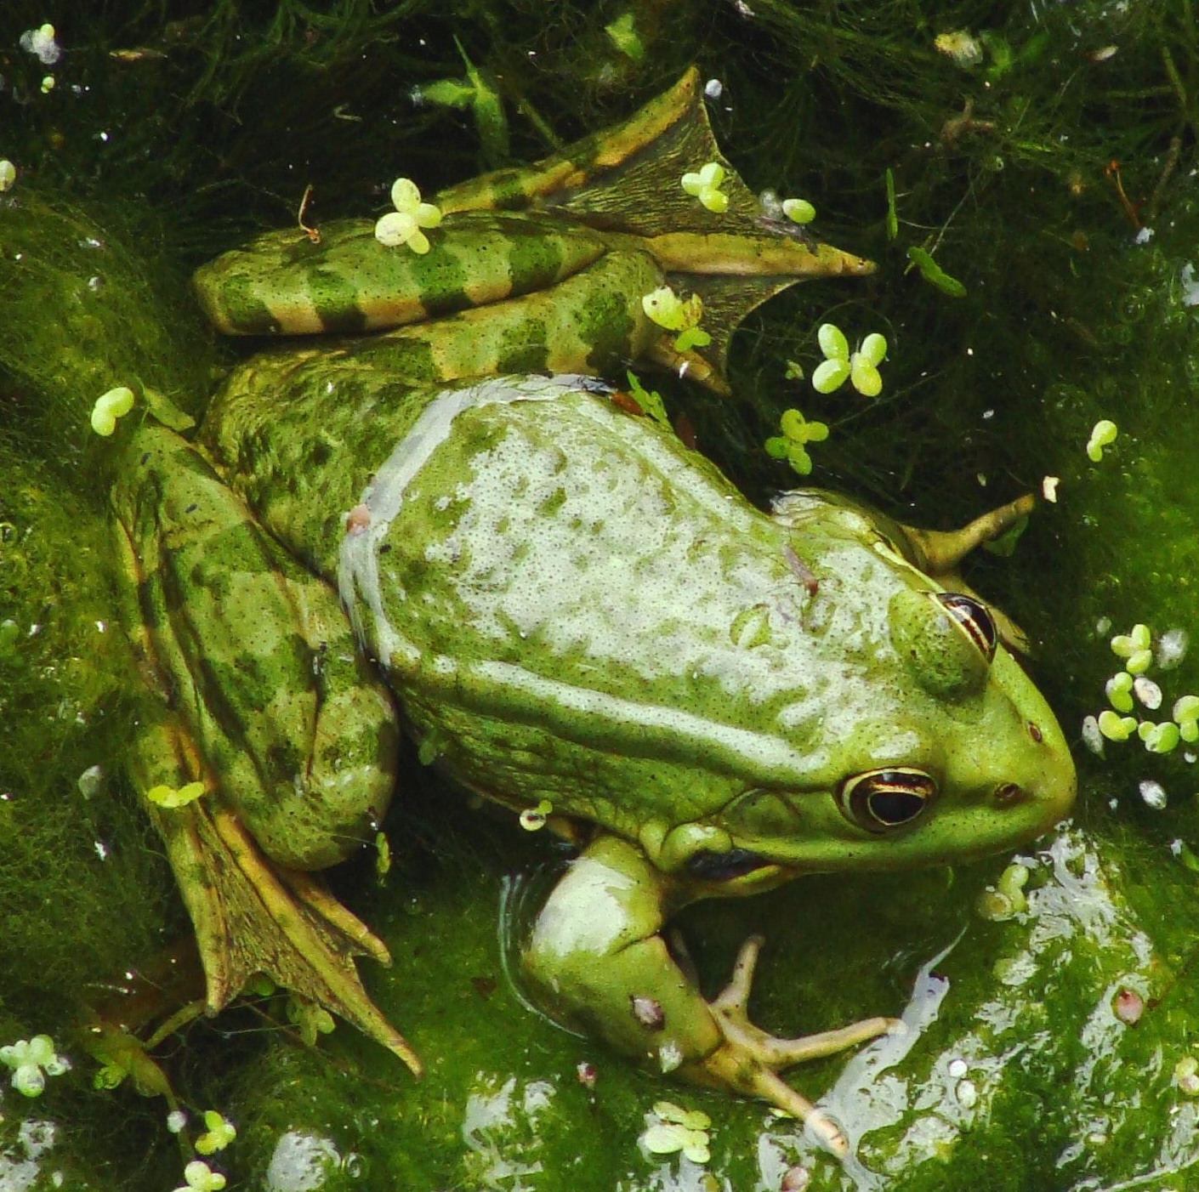
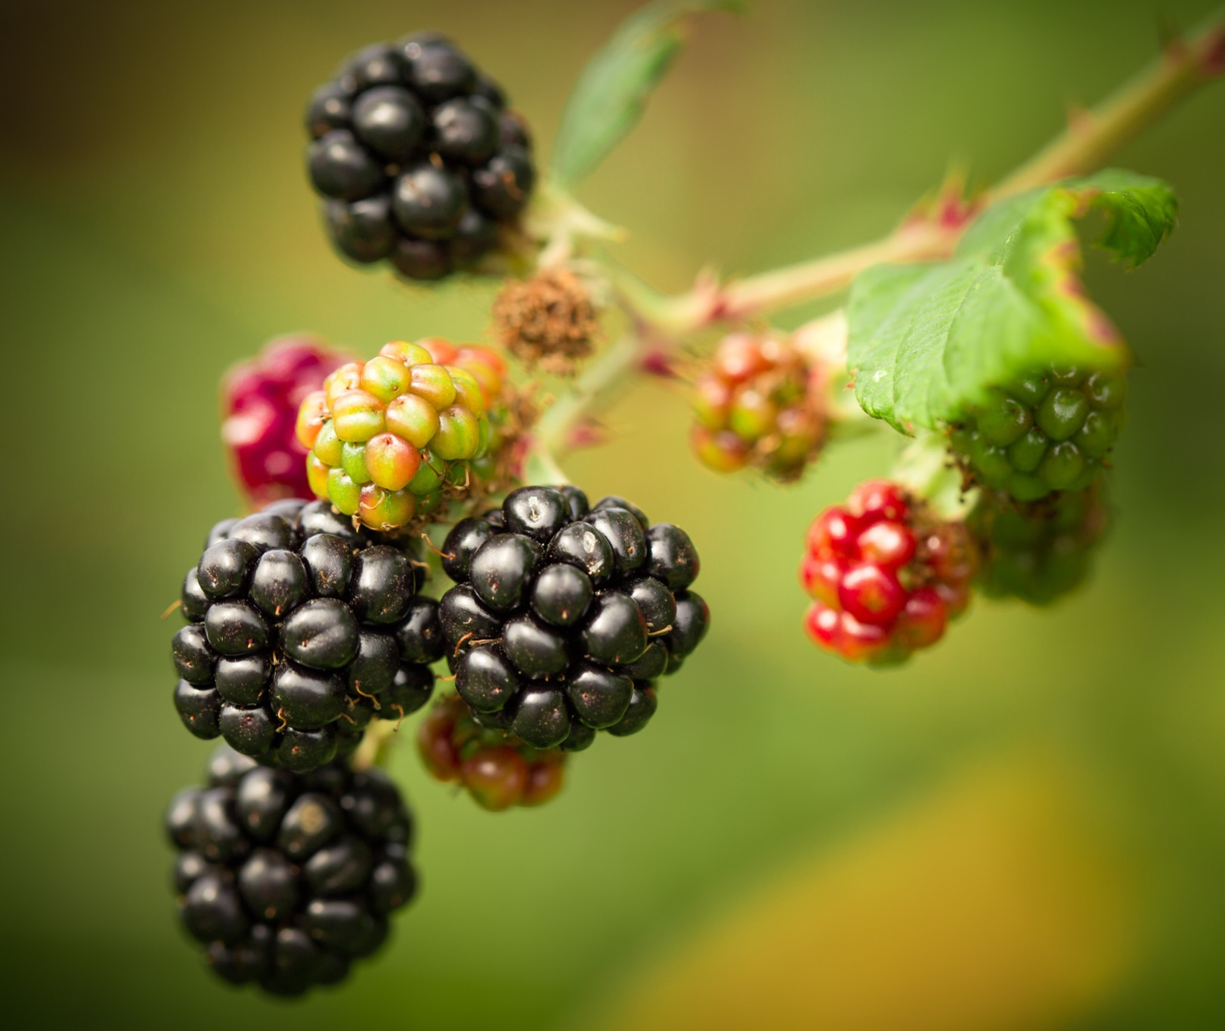
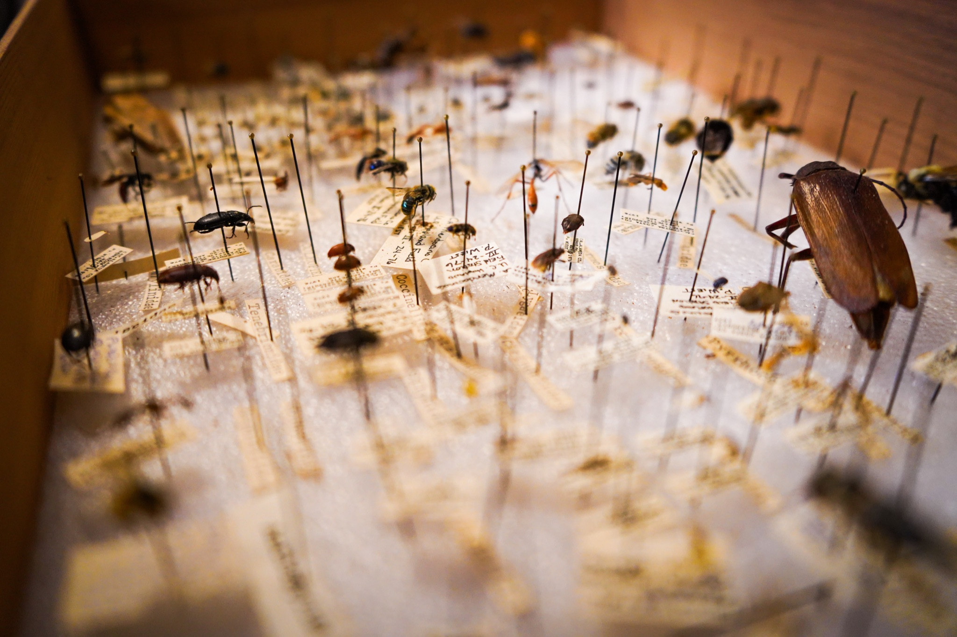
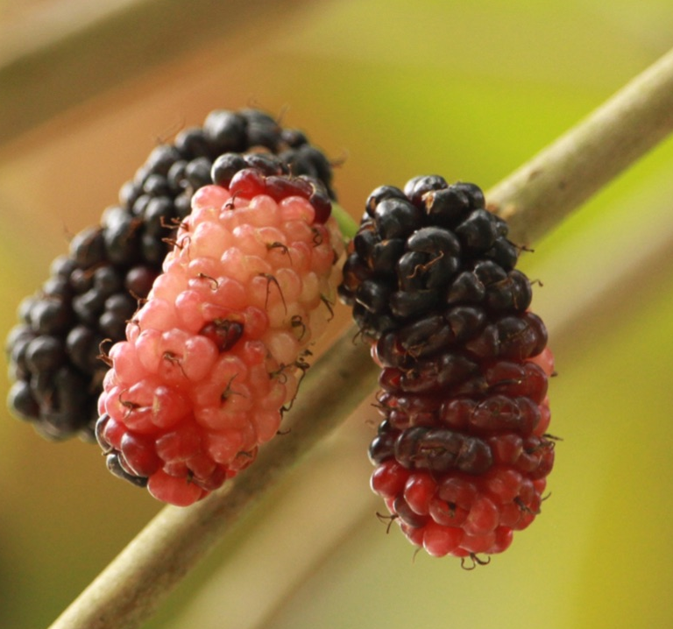
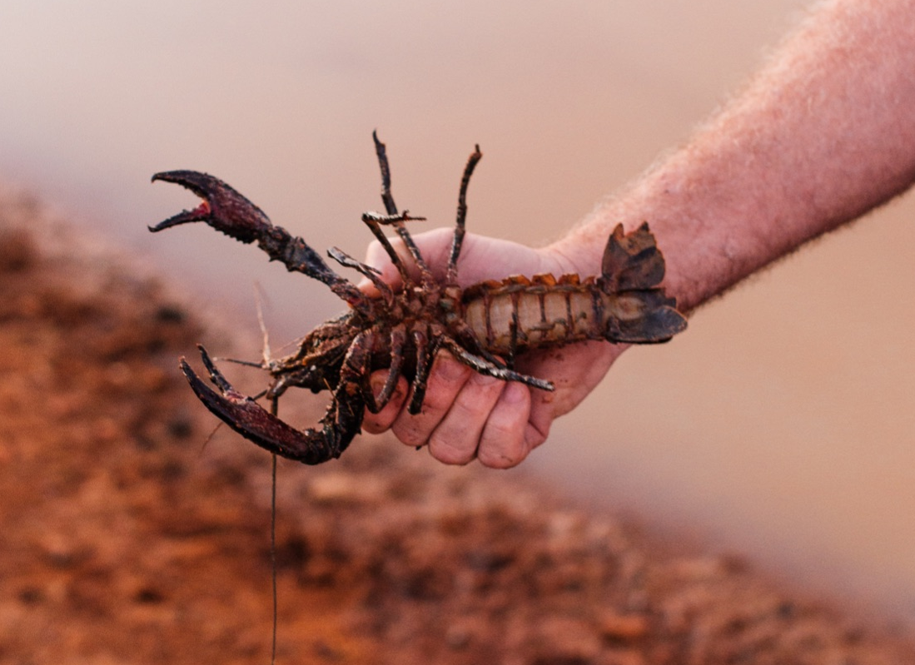
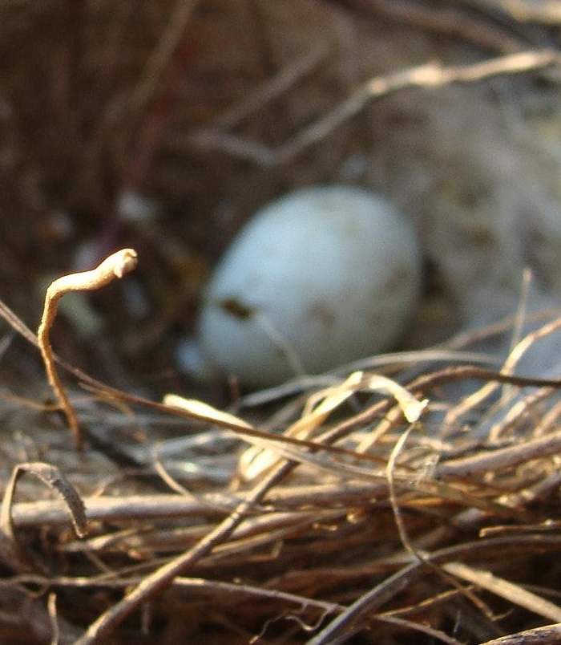
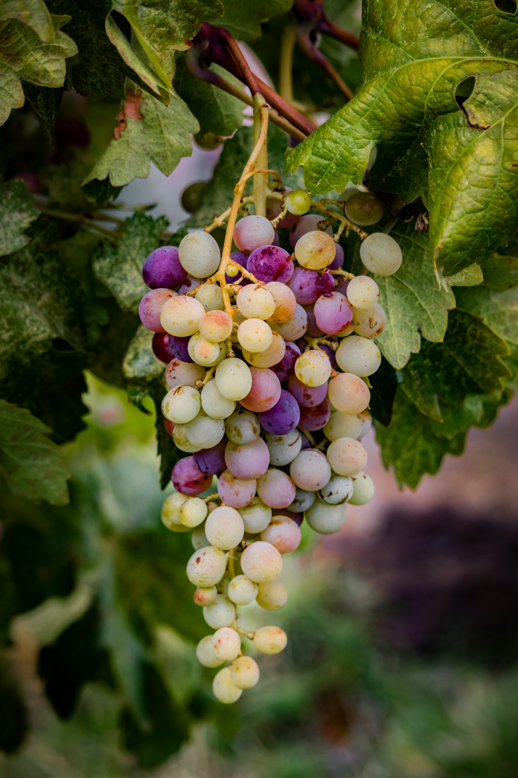
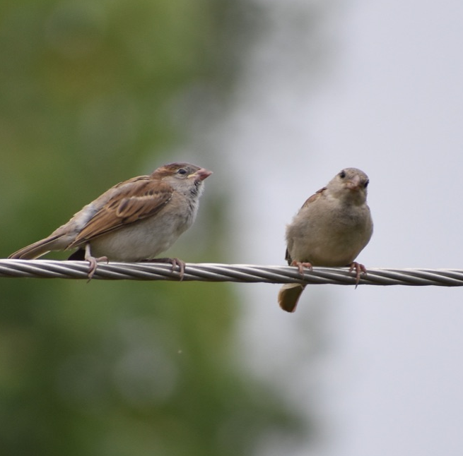
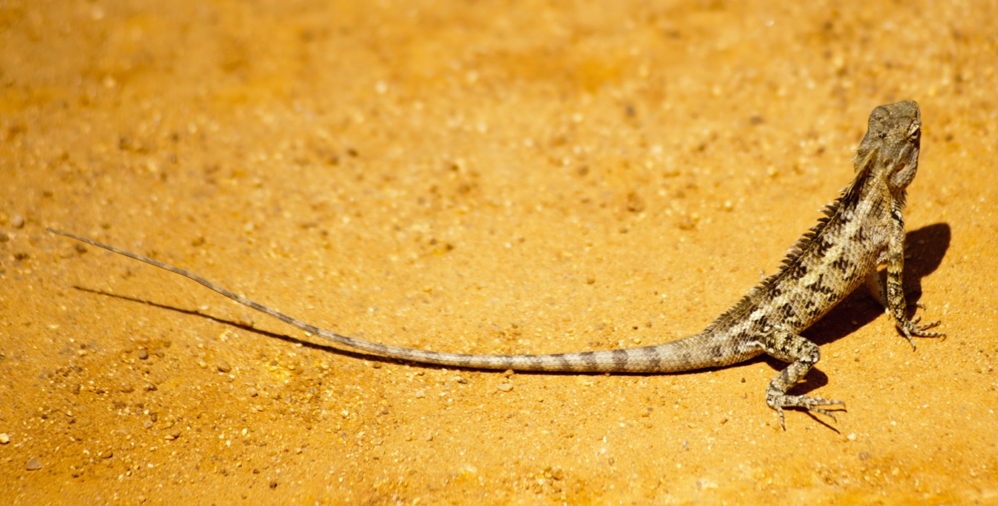
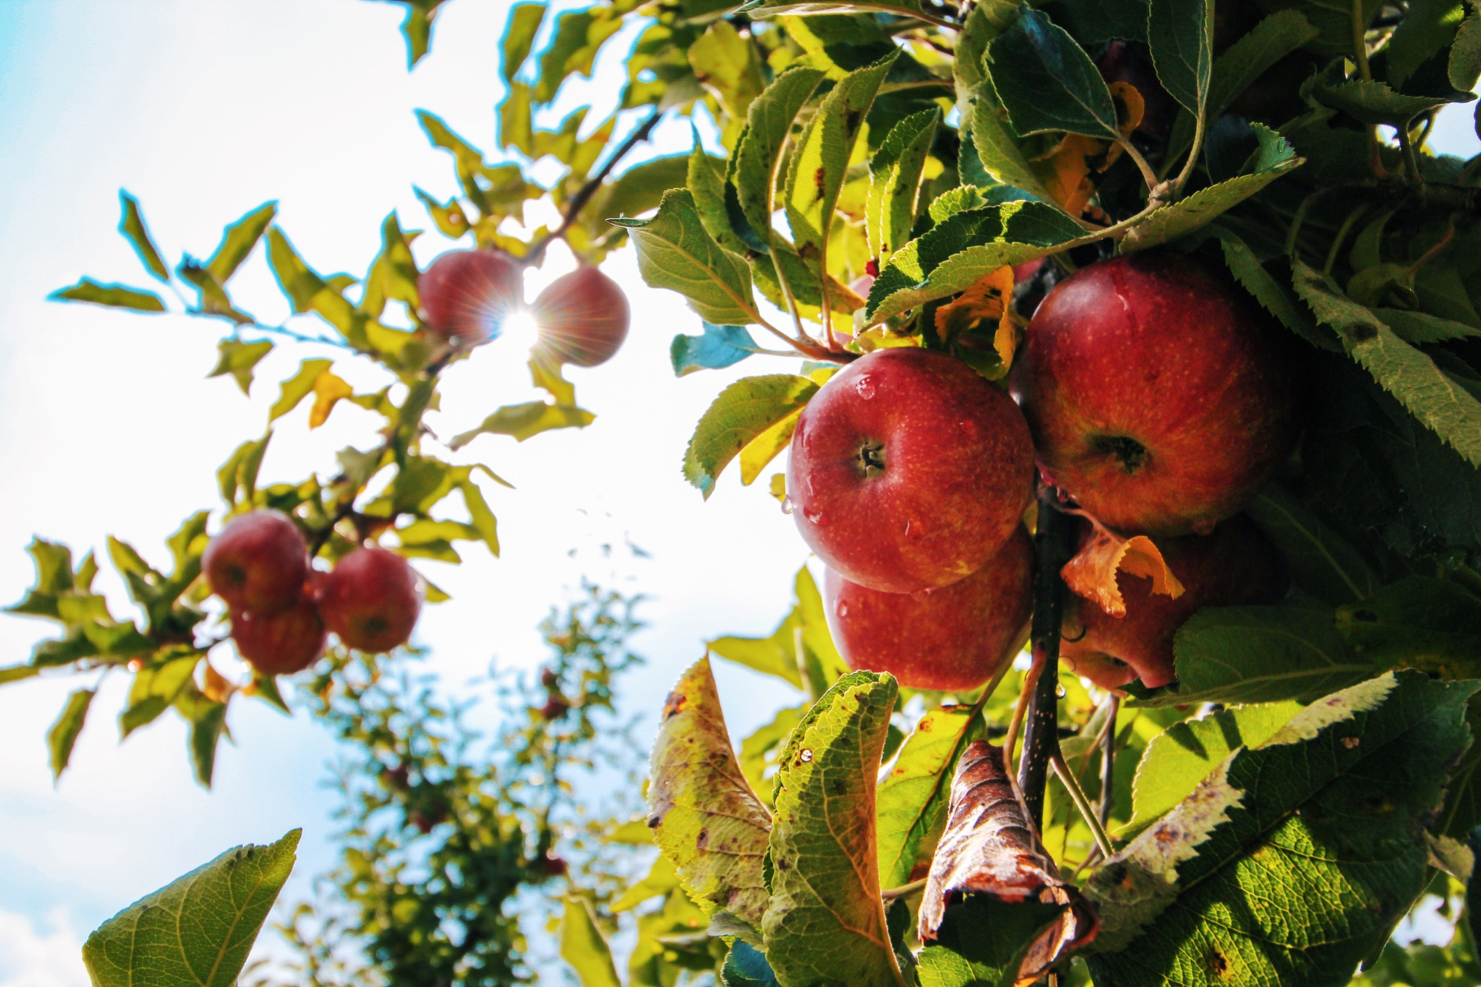
ᏍᎩᎦᏚᏏᏁ ᏣᎳᎩ ᎠᏕᎶᏆᏍᏗ
ᎤᏂᎸᏈᏗ ᎤᏂᎩᏍᏗ ᎧᏄᎦᏟ, ᎫᏩ, ᎤᎿᏒᎩ, ᏒᎦᏔ, ᏥᏍᎪᏯ ᏧᏓᎴᎾ, ᏧᏂᏍᏗ ᏥᏍᏆ, ᏧᏪᏥ, ᏩᎶᏏ, ᏘᏲᎭᏟ ᎠᎴ ᏥᏍᏛᎾ.
They eat things like blackberries, mulberries,wild grapes, apples, bugs, small birds, eggs, frogs, lizards and crawdads.

Slide 19
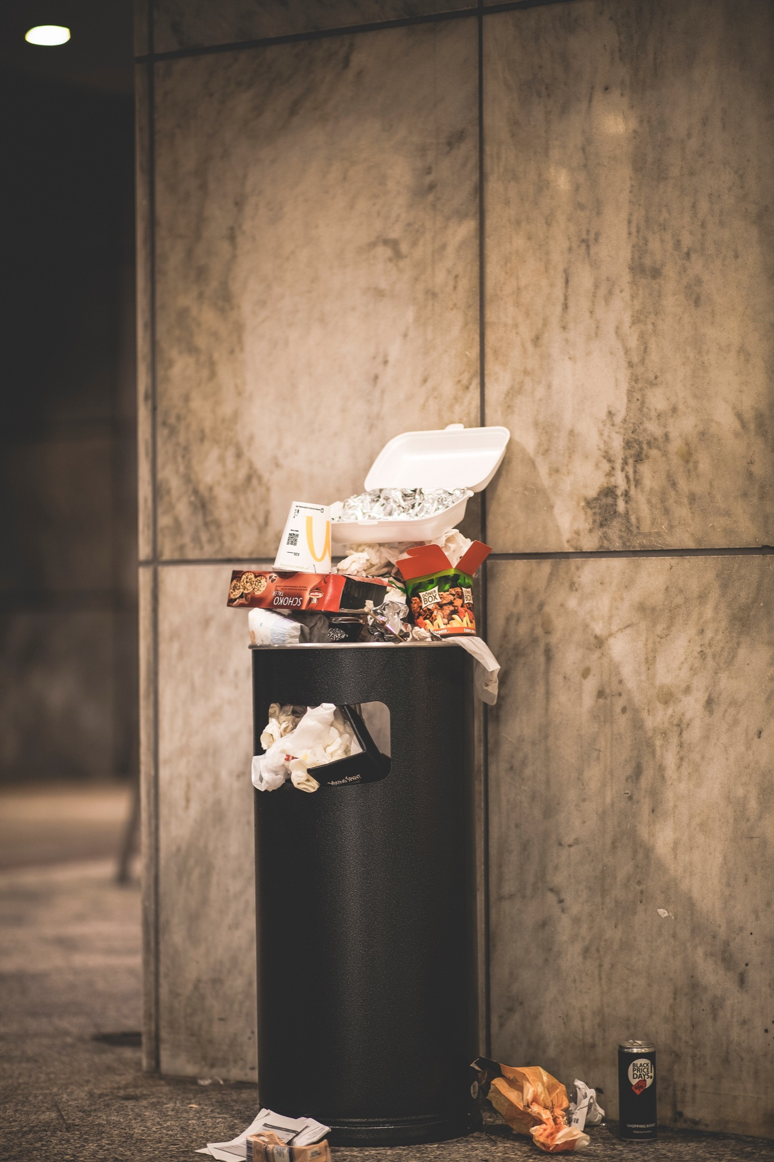
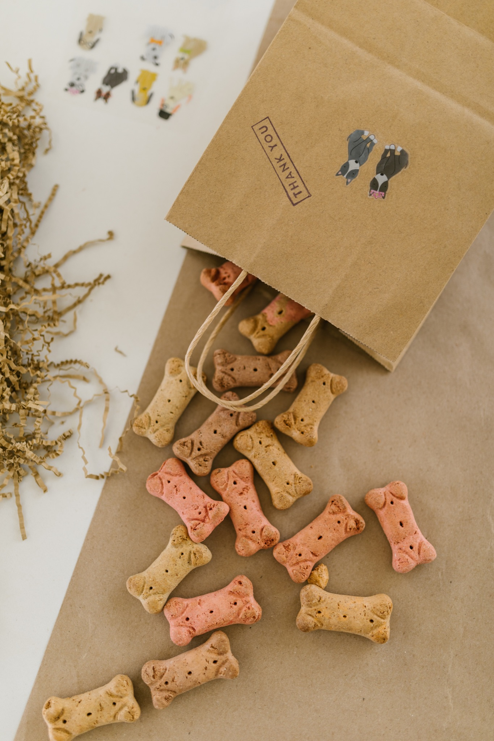
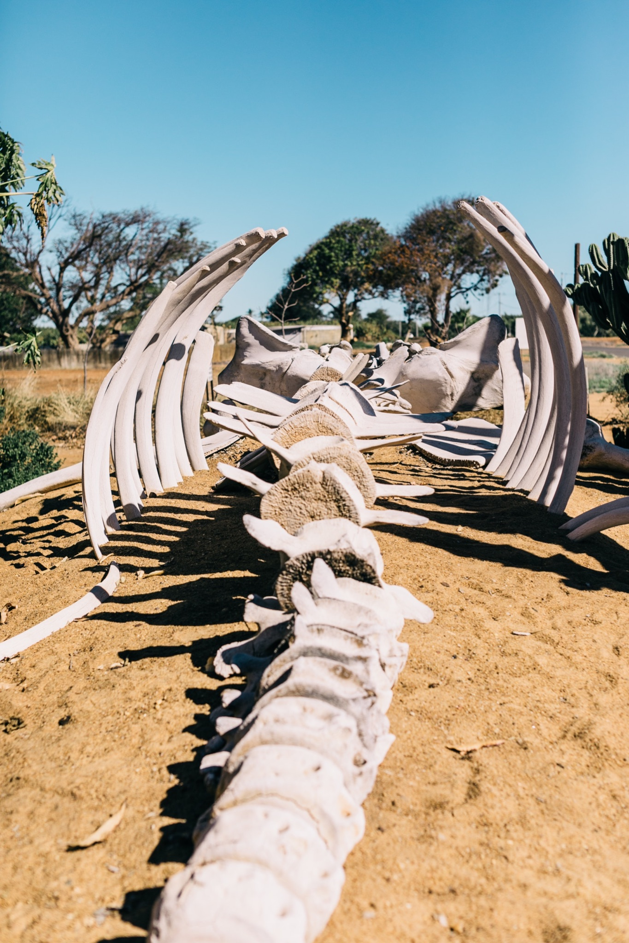
ᏍᎩᎦᏚᏏᏁ ᏣᎳᎩ ᎠᏕᎶᏆᏍᏗ
ᎤᏤᏥᏍᏗ ᎤᏂᎸᏈᏗ ᎤᏲᏨᎯ, ᎩᏟ ᎤᏂᎩᏍᏗ ᎠᎴ ᎤᎵᏬᏨ ᎦᎾᏝᎥ (ᎡᎿᎢ) ᏧᎪᎳ ᏓᏂᎩᏍᎪ.
Possums also eat trash, dog food and also the bones of dead animals.

Slide 20
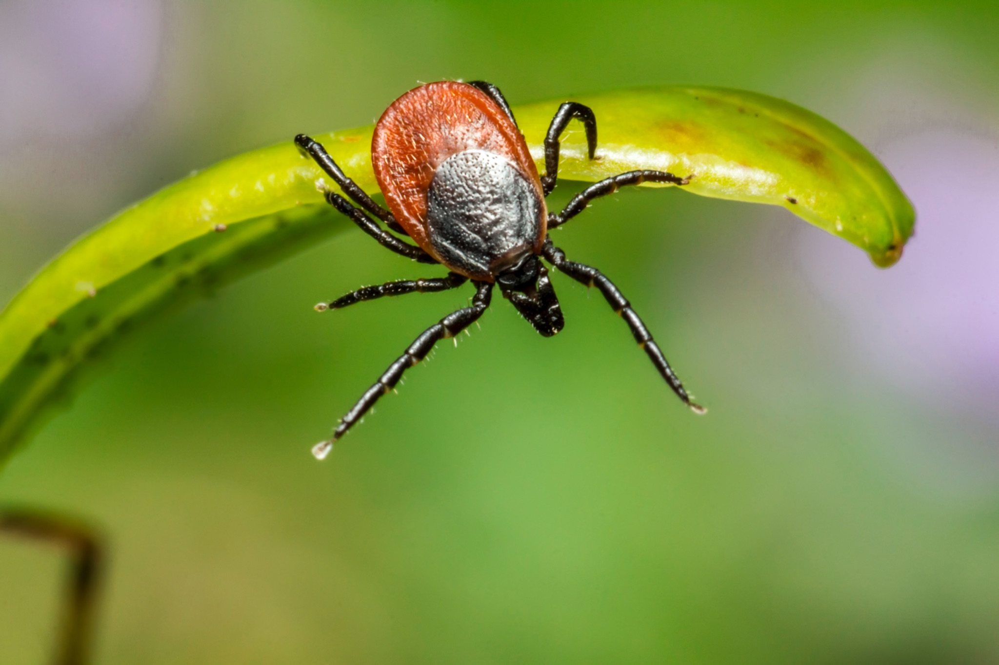
ᏍᎩᎦᏚᏏᏁ ᏣᎳᎩ ᎠᏕᎶᏆᏍᏗ
ᏚᏂᏣᎵᏗ ᎫᎩ ᏓᏂᎩᏍᎬ.
They are well known for eating ticks

Slide 21

ᏍᎩᎦᏚᏏᏁ ᏣᎳᎩ ᎠᏕᎶᏆᏍᏗ
ᏏᏆ ᎤᏤᏥᏍᏗ ᏔᎵ ᎠᎴ ᏅᎩ ᎢᏧᏕᏘᏴᏓ ᎠᏁᎰ.
Possums only live two to four years.

Slide 22
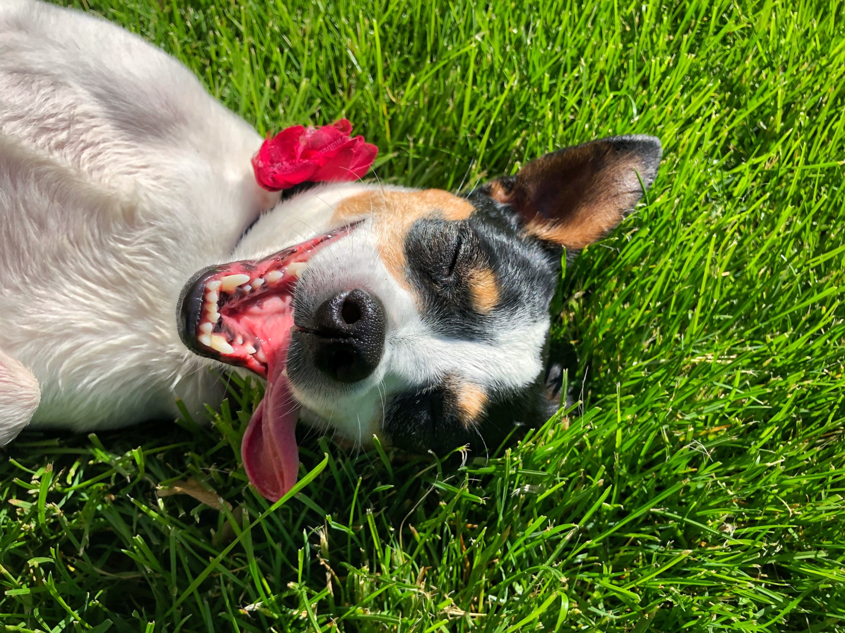
ᏍᎩᎦᏚᏏᏁ ᏣᎳᎩ ᎠᏕᎶᏆᏍᏗ
ᎢᏳᏓᎵᎭ, ᎪᎱᏍᏗ ᏳᏍᎦᏍᏓᏁᎵ, ᎤᎵᏬᏨ ᎠᏤᎸᏍᎪ, ᏯᎾᏑᎦ, ᏳᏔᏠᎦ, ᎠᎴ ᏗᎩᏙᎵ ᏧᏍᏚᎢᏗ ᎨᏐᎢ.
Many times when the possum feels threatened, they will pretend to be dead, laying down, their mouth hanging open and their eyes open.

Slide 23
ᏍᎩᎦᏚᏏᏁ ᏣᎳᎩ ᎠᏕᎶᏆᏍᏗ
ᎥᏍᏊ, ᎤᏂᎵᏬᏨ ᏳᎾᏤᎸᎾ, ᎤᏲ ᎠᏒᏥᎯᏍᎪ.
Also, when they play dead, they smell bad.

Slide 24
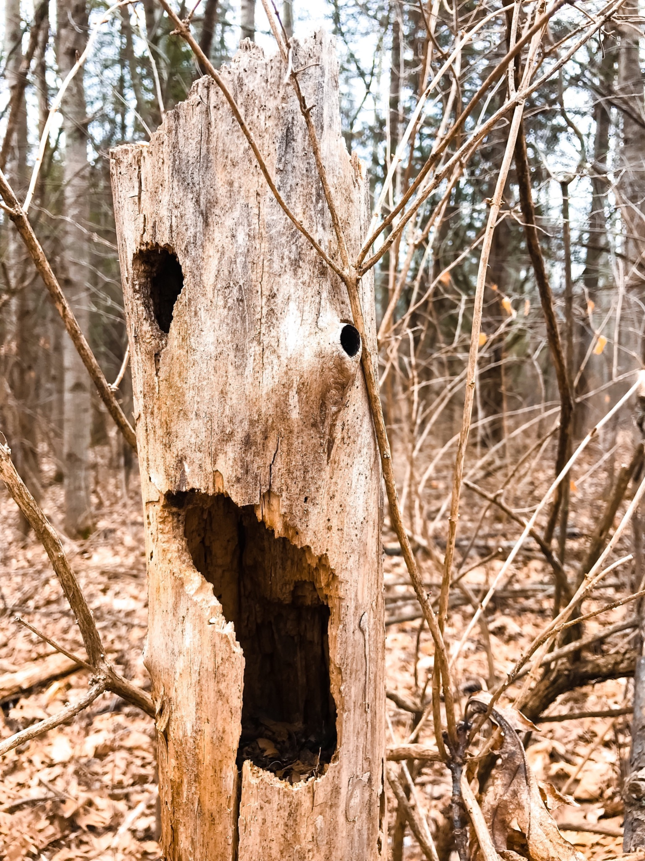
ᏍᎩᎦᏚᏏᏁ ᏣᎳᎩ ᎠᏕᎶᏆᏍᏗ
ᏧᏌᏙᏂ ᏕᏢᎬ ᎤᎾᏣᎣ ᎠᎴ ᎭᏫᏂᏗᏢ ᏚᏂᎵᎬ ᎠᎴ ᏧᎾᏍᏕᏢ ᎠᏂᏁᎶ.
They live in hollow trees or under stumps or roots.

Slide 25
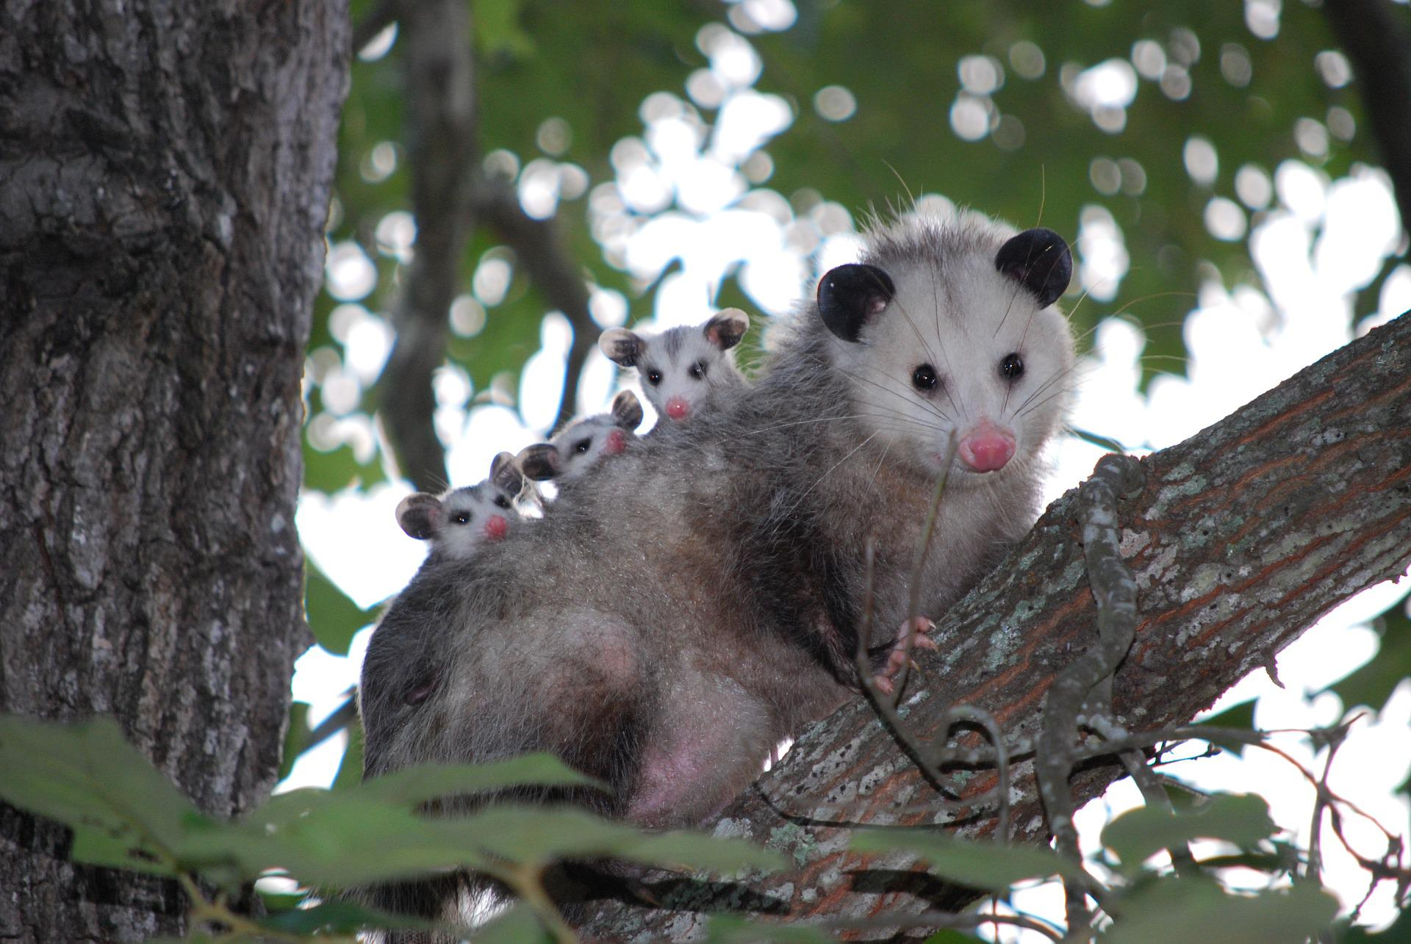
ᏍᎩᎦᏚᏏᏁ ᏣᎳᎩ ᎠᏕᎶᏆᏍᏗ
ᏔᎵᏍᎪ ᎯᏍᎩ ᏯᏂ ᏧᏂᏍᏗ ᏯᎾᏕᎲᎦ, ᎠᏎᏃ Ꮭ ᏂᎦᏓ ᏱᏓᎾᏛᏍᎪ.
Possums can give birth to as many as 25 babies, but most do not survive to adulthood.

Slide 26
ᏍᎩᎦᏚᏏᏁ ᏣᎳᎩ ᎠᏕᎶᏆᏍᏗ
ᏧᏂᏍᏗ ᎯᏍᎩ ᏳᎾᏙᏓᏆᏍᎩ ᎤᎾᏣᎣ ᎦᏃᏛᎢ.
The babies live about 5 weeks in the pouch.

Slide 27
ᏍᎩᎦᏚᏏᏁ ᏣᎳᎩ ᎠᏕᎶᏆᏍᏗ
ᏔᎵ ᏯᏅᏗᏃ ᎦᏐᎯ ᎤᏂᏥ ᎤᏂᎩᎸᏗᏕᎪ.
then 2 months they ride around on their mother’s back.

Slide 28
ᏍᎩᎦᏚᏏᏁ ᏣᎳᎩ ᎠᏕᎶᏆᏍᏗ
ᎤᏤᏥᏍᏗ ᎤᏅᏒ ᎠᏁᏙ.
Possums are solitary animals.

Slide 29
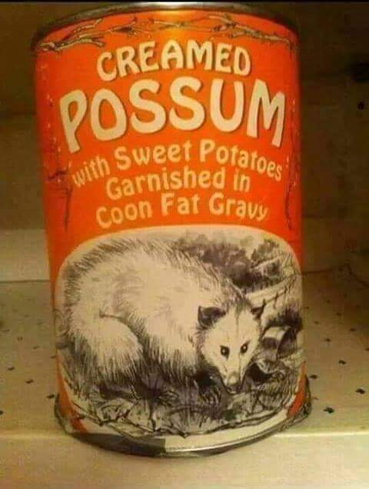
ᏍᎩᎦᏚᏏᏁ ᏣᎳᎩ ᎠᏕᎶᏆᏍᏗ
ᎠᏂᏣᎳᎩ ᏳᏓᎭ ᎤᏤᏥᏍᏗ ᏓᏂᎩᏍᎪ, ᎠᏎᏃ ᎪᎢᎭ ᎭᏫᏯ ᎨᏐᎢ.
Cherokees would sometimes eat possum, but the meat is greasy.

Slide 30
ᏍᎩᎦᏚᏏᏁ ᏣᎳᎩ ᎠᏕᎶᏆᏍᏗ
ᎥᏍᎩ ᏳᏍᏗ ᏄᎾ ᎠᏂᏅᎯᏓ ᎠᎴ ᎤᏤᏥᏍᏗ ᎭᏫᏯ ᎢᏧᎳ ᏓᏂᎩᏍᎪ.
It is often eaten with sweet potatoes.

