Slide 1
ᎣᏏᏲ
ᎦᎵᏆᏚᏏᏁ ᏣᎳᎩ ᎠᏕᎶᏆᏍᏗ

Slide 2
ᎦᎵᏆᏚᏏᏁ ᏣᎳᎩ ᎠᏕᎶᏆᏍᏗ
ᎢᏓᎴᎾ- Let’s begin
ᏣᎳᎩ ᎢᏗᏬᏂ- Let’s talk Cherokee

Slide 3
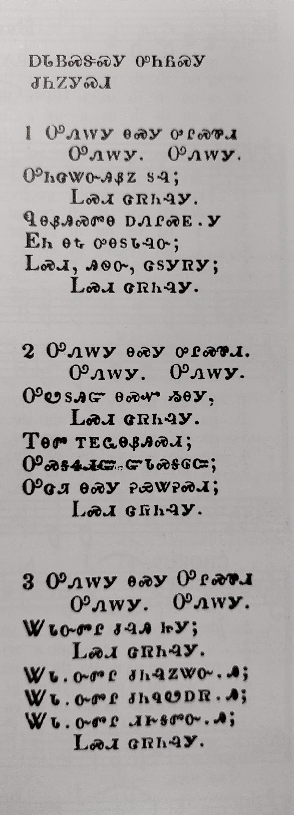
ᏔᎳᏚᏏᏁ ᏣᎳᎩ ᎠᏕᎶᏆᏍᏗ
ᎠᏓᏴᏍᏕᏍᎩ ᎤᏂᏲᏍᎩ ᏧᏂᏃᎩᏍᎩ
ᎤᏁᎳᎩ ᎾᏍᎩ ᎤᎵᏍᏈᏗ
ᎤᏁᎳᎩ. ᎤᏁᎳᎩ.
ᎤᏂᏣᏔᏅᎯᏰᏃ ᏚᎸ;
ᏞᏍᏗ ᏣᏒᏂᎸᎩ.
ᏄᎾᏰᎯᏍᏛᎾ ᎠᏁᎵᏍᎬᎩ
ᎬᏂ ᎾᎿ ᎤᎾᏚᏓᎸᏅ;
ᏞᏍᏗ, ᎯᏫᎾ, ᏣᏚᎩᏒᎩ;
ᏞᏍᏗ ᏣᏒᏂᎸᎩ.
Temperance song II
Let it be because it is almost over. Let it be, let it be.
It has killed many
Don’t touch it.
They thought it was dangerous
Clearly they are in debt
Young man, don’t drink alcohol.
Don’t touch it.
Notes:
aksdayvhvsg

Slide 4
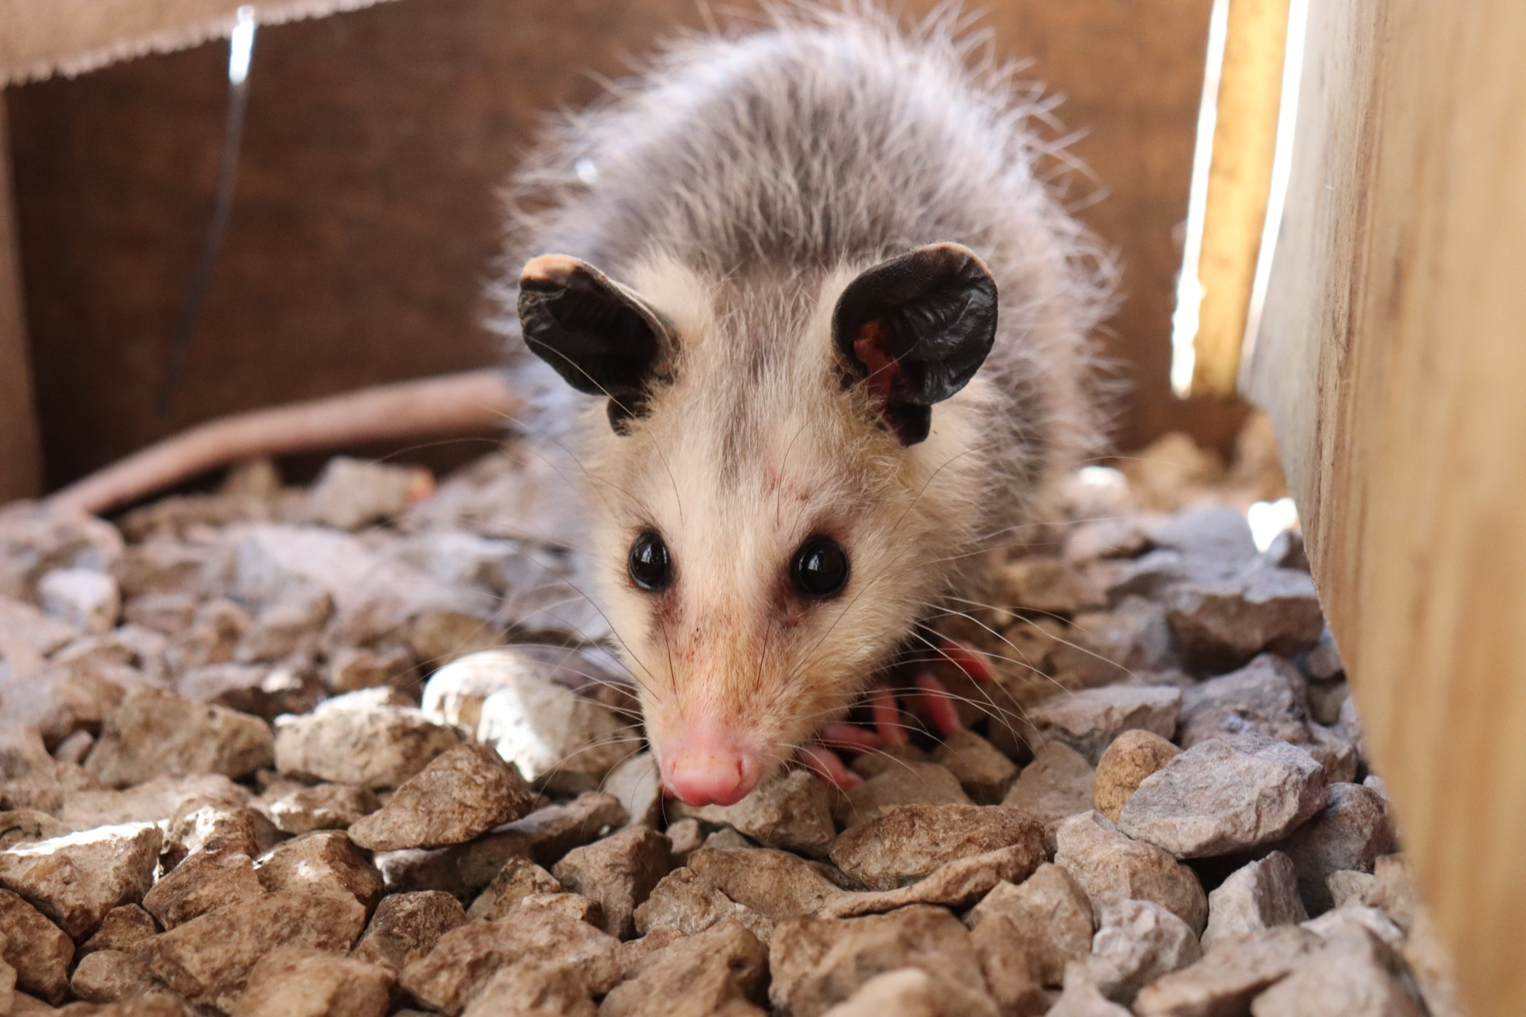
ᎦᎵᏆᏚᏏᏁ ᏣᎳᎩ ᎠᏕᎶᏆᏍᏗ
ᎤᏤᏥᏍᏗ ᎧᏴᏐᎵ ᎠᏓᎴᏂᏍᎬ ᎦᏂᏓᏛᎢ ᎢᎦᏅᎯᏓ ᏦᎦᏚ ᎠᎴ ᏦᏍᎪᎯ ᎦᎵᏉᎩ ᎢᏏᏔᏗᏍᏗ.
From nose to the base of the tail, the possum is 13 to 37 inches long.

Slide 5
ᎦᎵᏆᏚᏏᏁ ᏣᎳᎩ ᎠᏕᎶᏆᏍᏗ
ᎦᏂᏓᏛ ᎤᏰᎸᎭ ᎠᎴ ᎦᏅᎯᏒ ᏐᏁᎵ ᎠᎴ ᏐᏁᎳᏚ ᎢᏏᏔᏗᏍᏗ.
The tail is naked and between 9 and 19 inches long.

Slide 6
ᎦᎵᏆᏚᏏᏁ ᏣᎳᎩ ᎠᏕᎶᏆᏍᏗ
ᏚᏩᏂᎦᏢ ᎠᎴ ᏧᏓᎴᏅᏓ ᎪᎱᏍᏗ ᏱᎦᏇᏅᎾ ᎦᏂᏓᏛ.
Branches and various things it wraps around the tail.

Slide 7
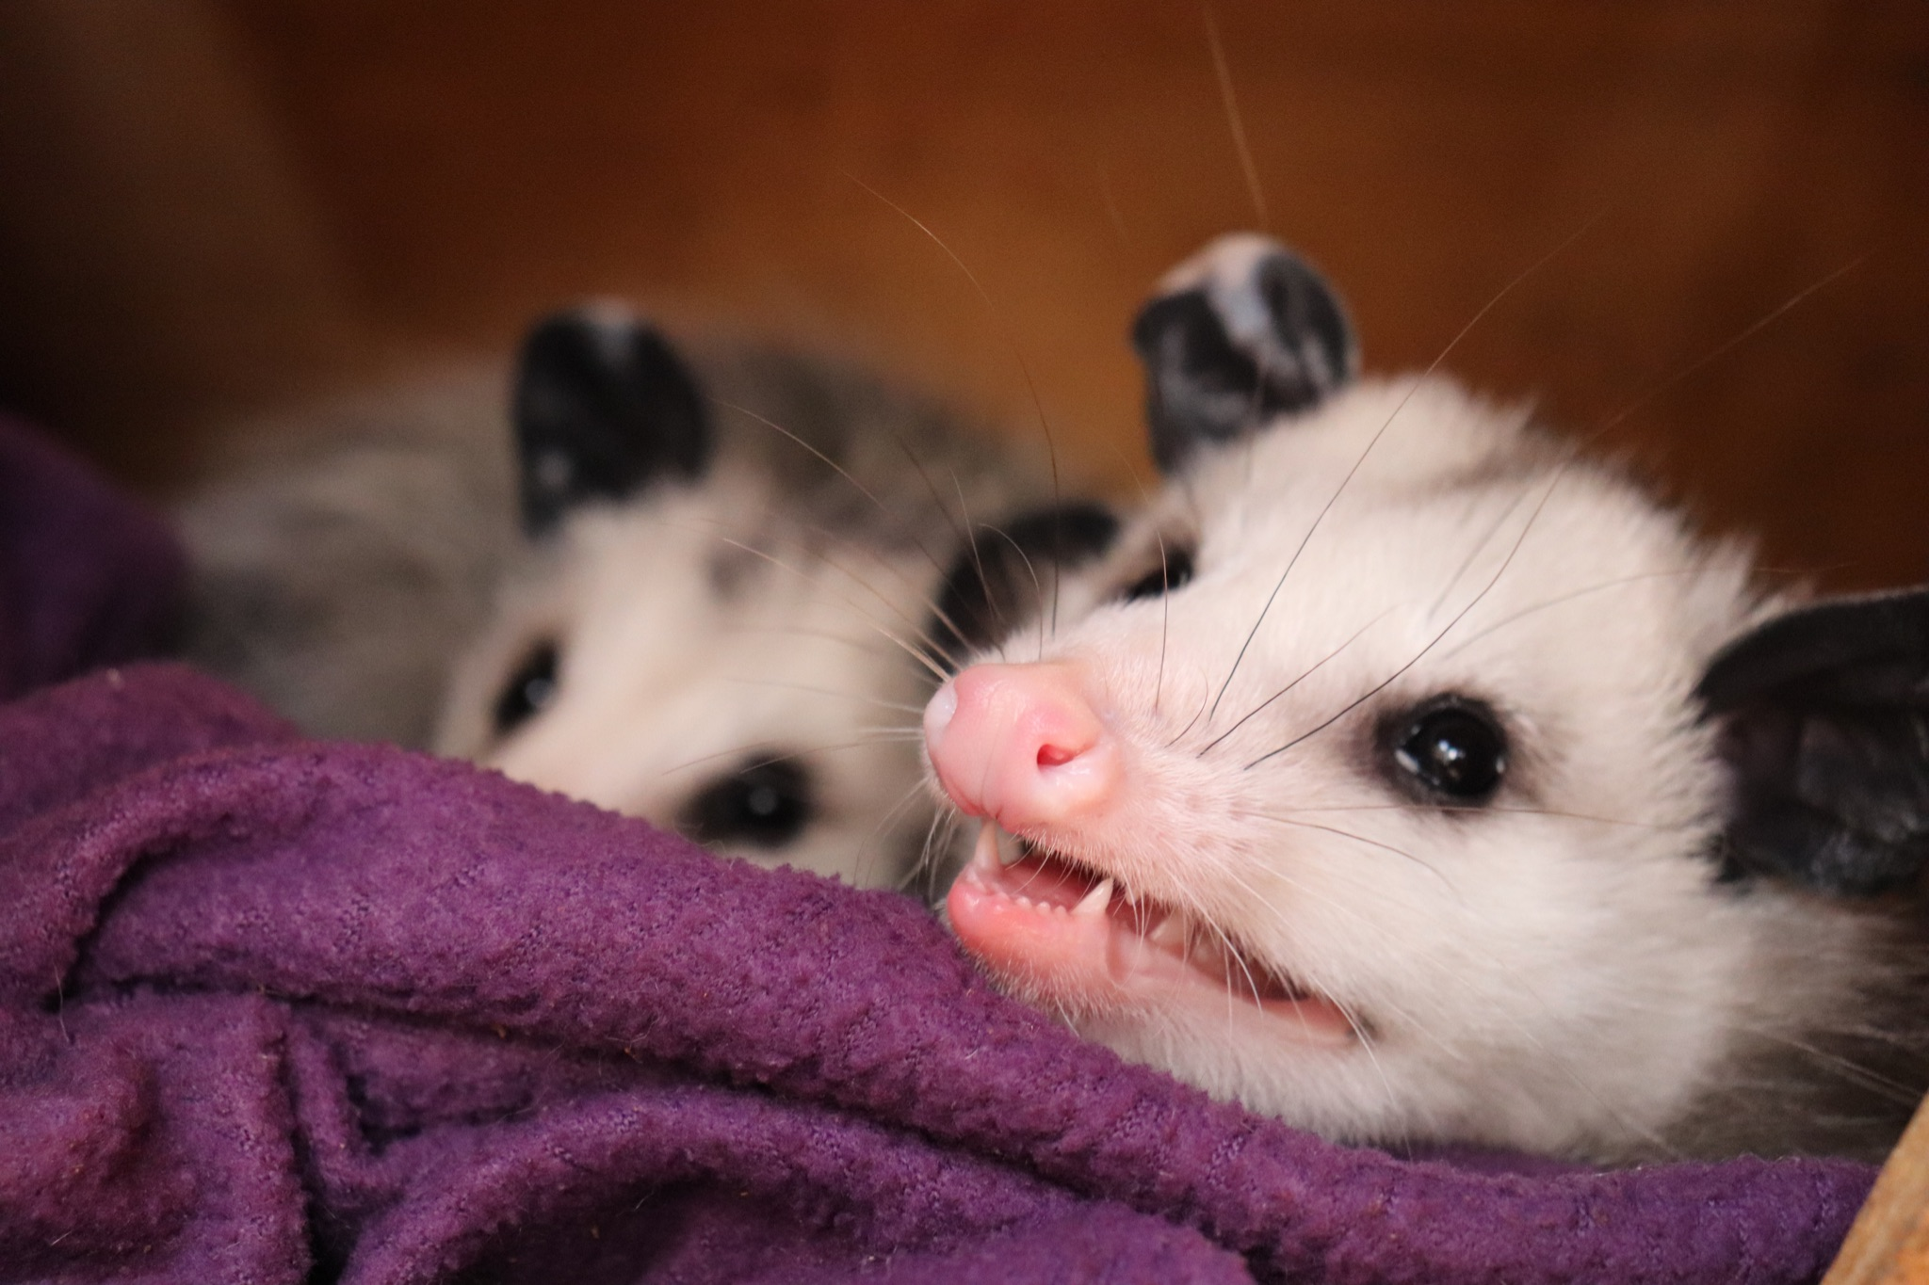
ᎦᎵᏆᏚᏏᏁ ᏣᎳᎩ ᎠᏕᎶᏆᏍᏗ
ᎬᎿᎨ ᎤᏍᎪᎸ ᏧᎾᎵᏑᏫᏓ ᎠᎴ ᎤᏍᏗ ᏓᏂᎵᎵᎪ.
It’s gray colored and has small ears.

Slide 8
ᎦᎵᏆᏚᏏᏁ ᏣᎳᎩ ᎠᏕᎶᏆᏍᏗ
ᎯᏍᎪᎯ ᎢᎦ ᏓᏂᎾᏙᎪ ᎠᎴ ᎬᎿᎨ ᏗᏂᎦᏙᎵ.
They have fifty teeth and black eyes.

Slide 9
ᎦᎵᏆᏚᏏᏁ ᏣᎳᎩ ᎠᏕᎶᏆᏍᏗ
ᏏᏆ ᎤᏤᏥᏍᏗ “marsupials” ᏓᏃᏎᎰ, ᎠᏂᏓ ᎦᏃᏛᎢ ᏓᏂᏂᏙᎰ.
Possums are called “marsupials”, they carry around their young in a pouch.

Slide 10
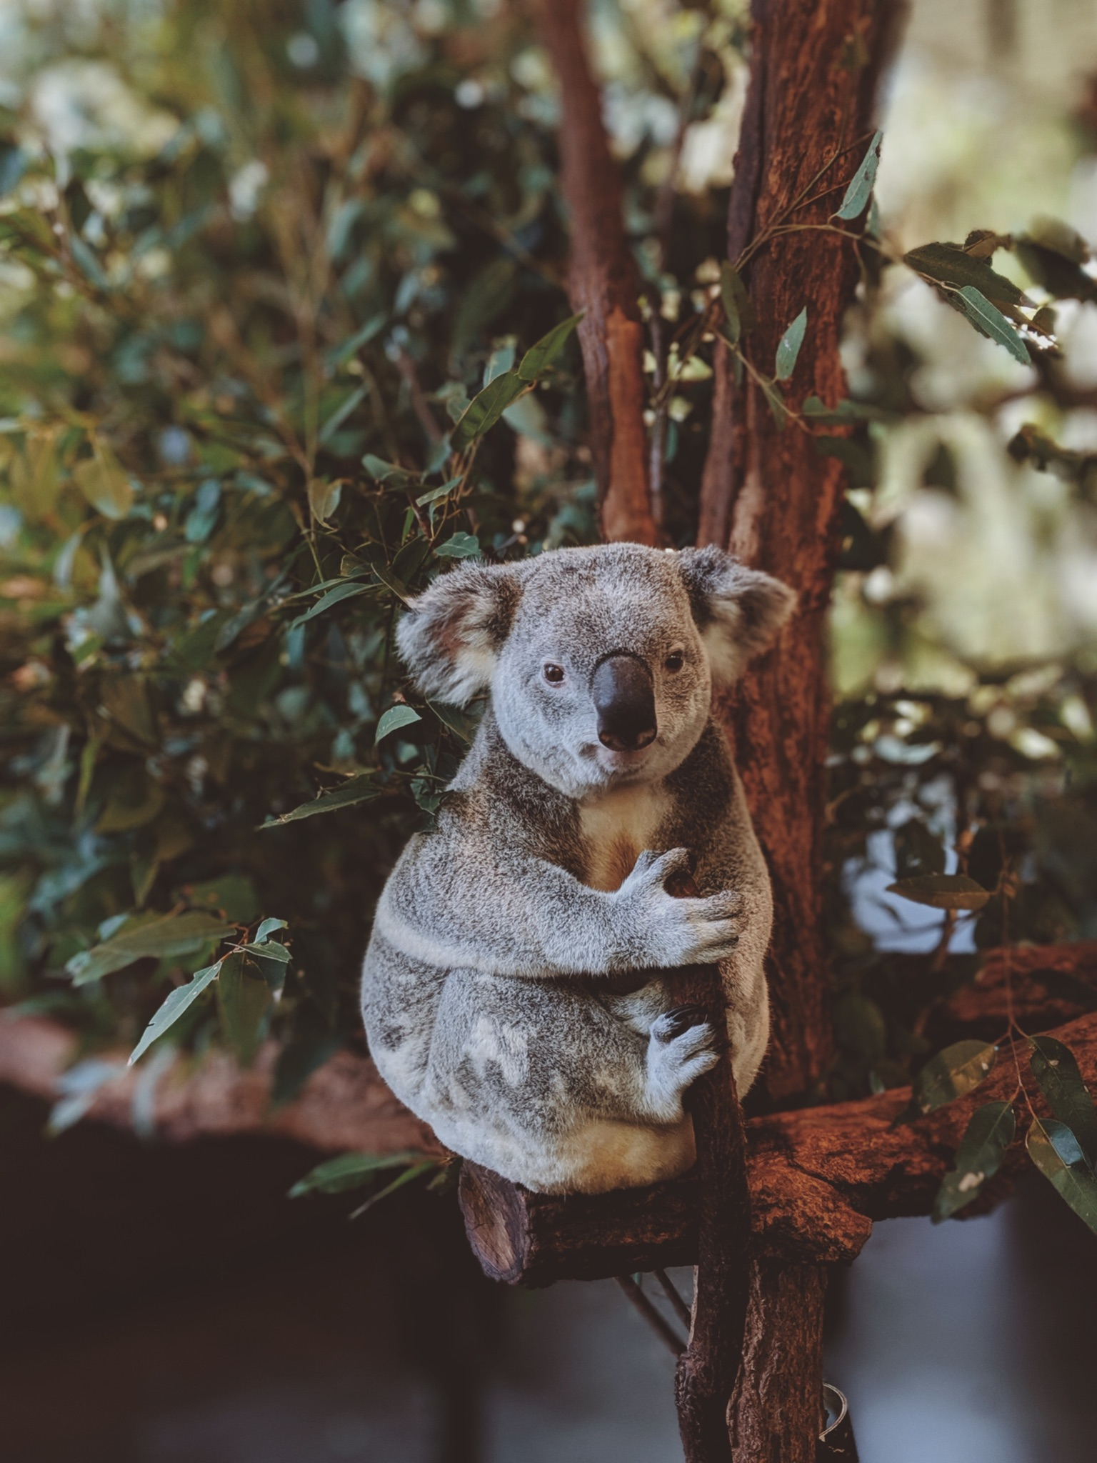
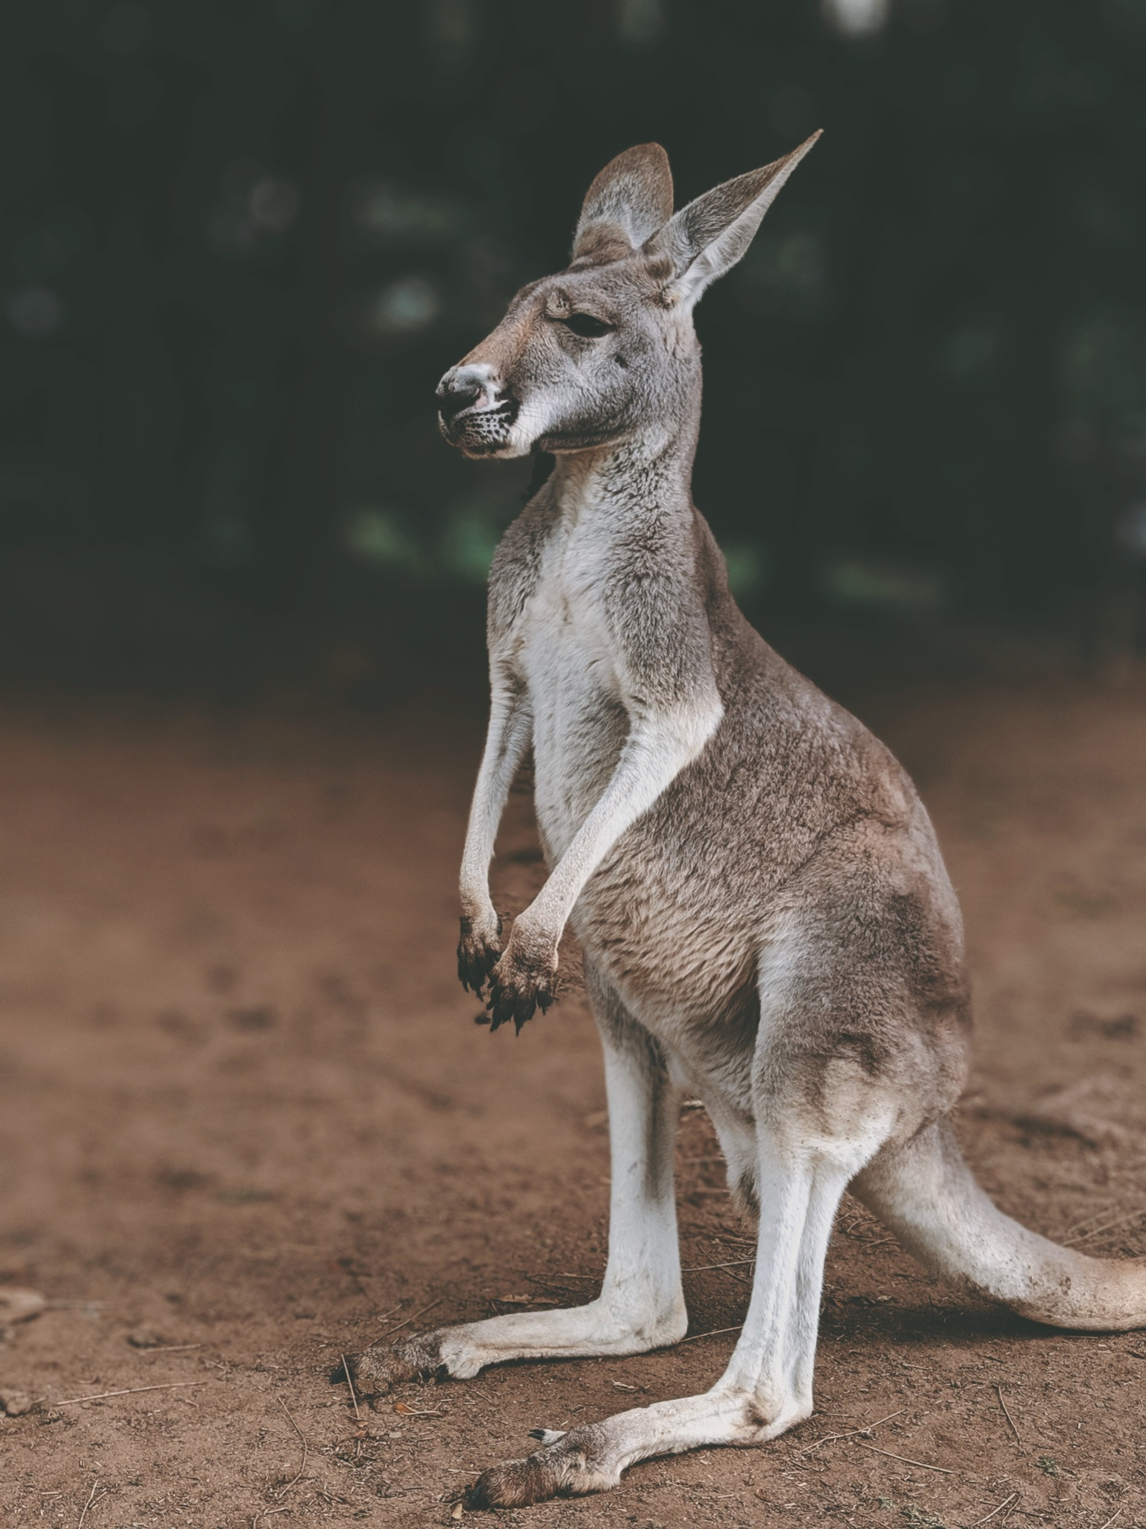
ᎦᎵᏆᏚᏏᏁ ᏣᎳᎩ ᎠᏕᎶᏆᏍᏗ
ᏧᎾᏠᏱ ᎪᎠᎳ ᏲᎾ ᎠᎴ ᎤᏜᏩᏓ ᎤᏤᏥᏍᏗ.
Possums are similar to koalas and kangaroos.

Slide 11
ᎦᎵᏆᏚᏏᏁ ᏣᎳᎩ ᎠᏕᎶᏆᏍᏗ
ᎤᏤᏥᏍᏗ ᎤᏅᏒ “marsupials” ᎠᏁ ᎠᎹᏰᏟ ᏧᏴᏢ.
Possums are the only marsupials in North America.

Slide 12
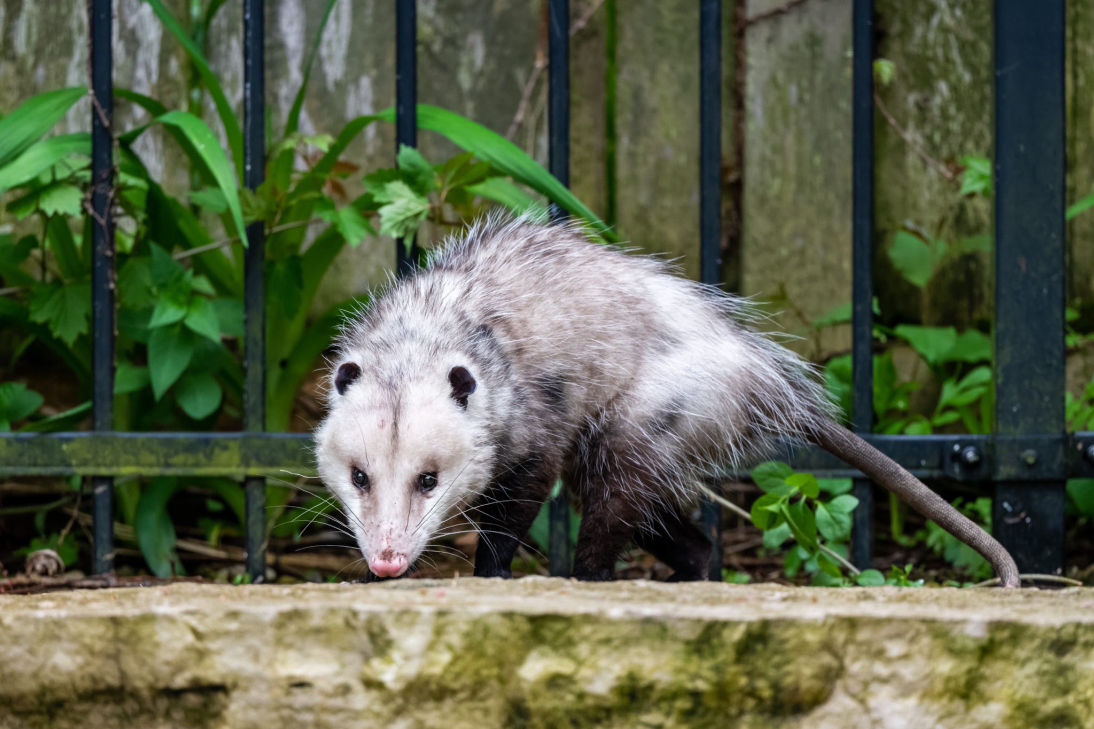
ᎦᎵᏆᏚᏏᏁ ᏣᎳᎩ ᎠᏕᎶᏆᏍᏗ
ᎤᏤᏥᏍᏗ ᎢᎾᎨᎢ ᎠᏁᎰ ᎠᎴ ᏒᏃᏱ ᎠᎢᏄᎪᎪ.
Possums live in the woods and come out at night.

Slide 13
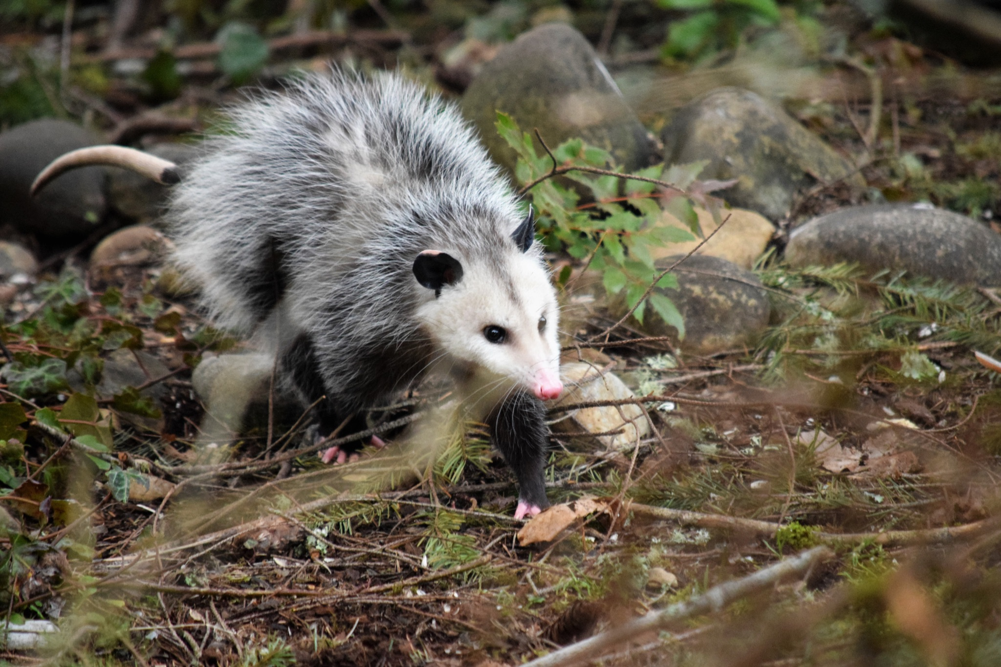
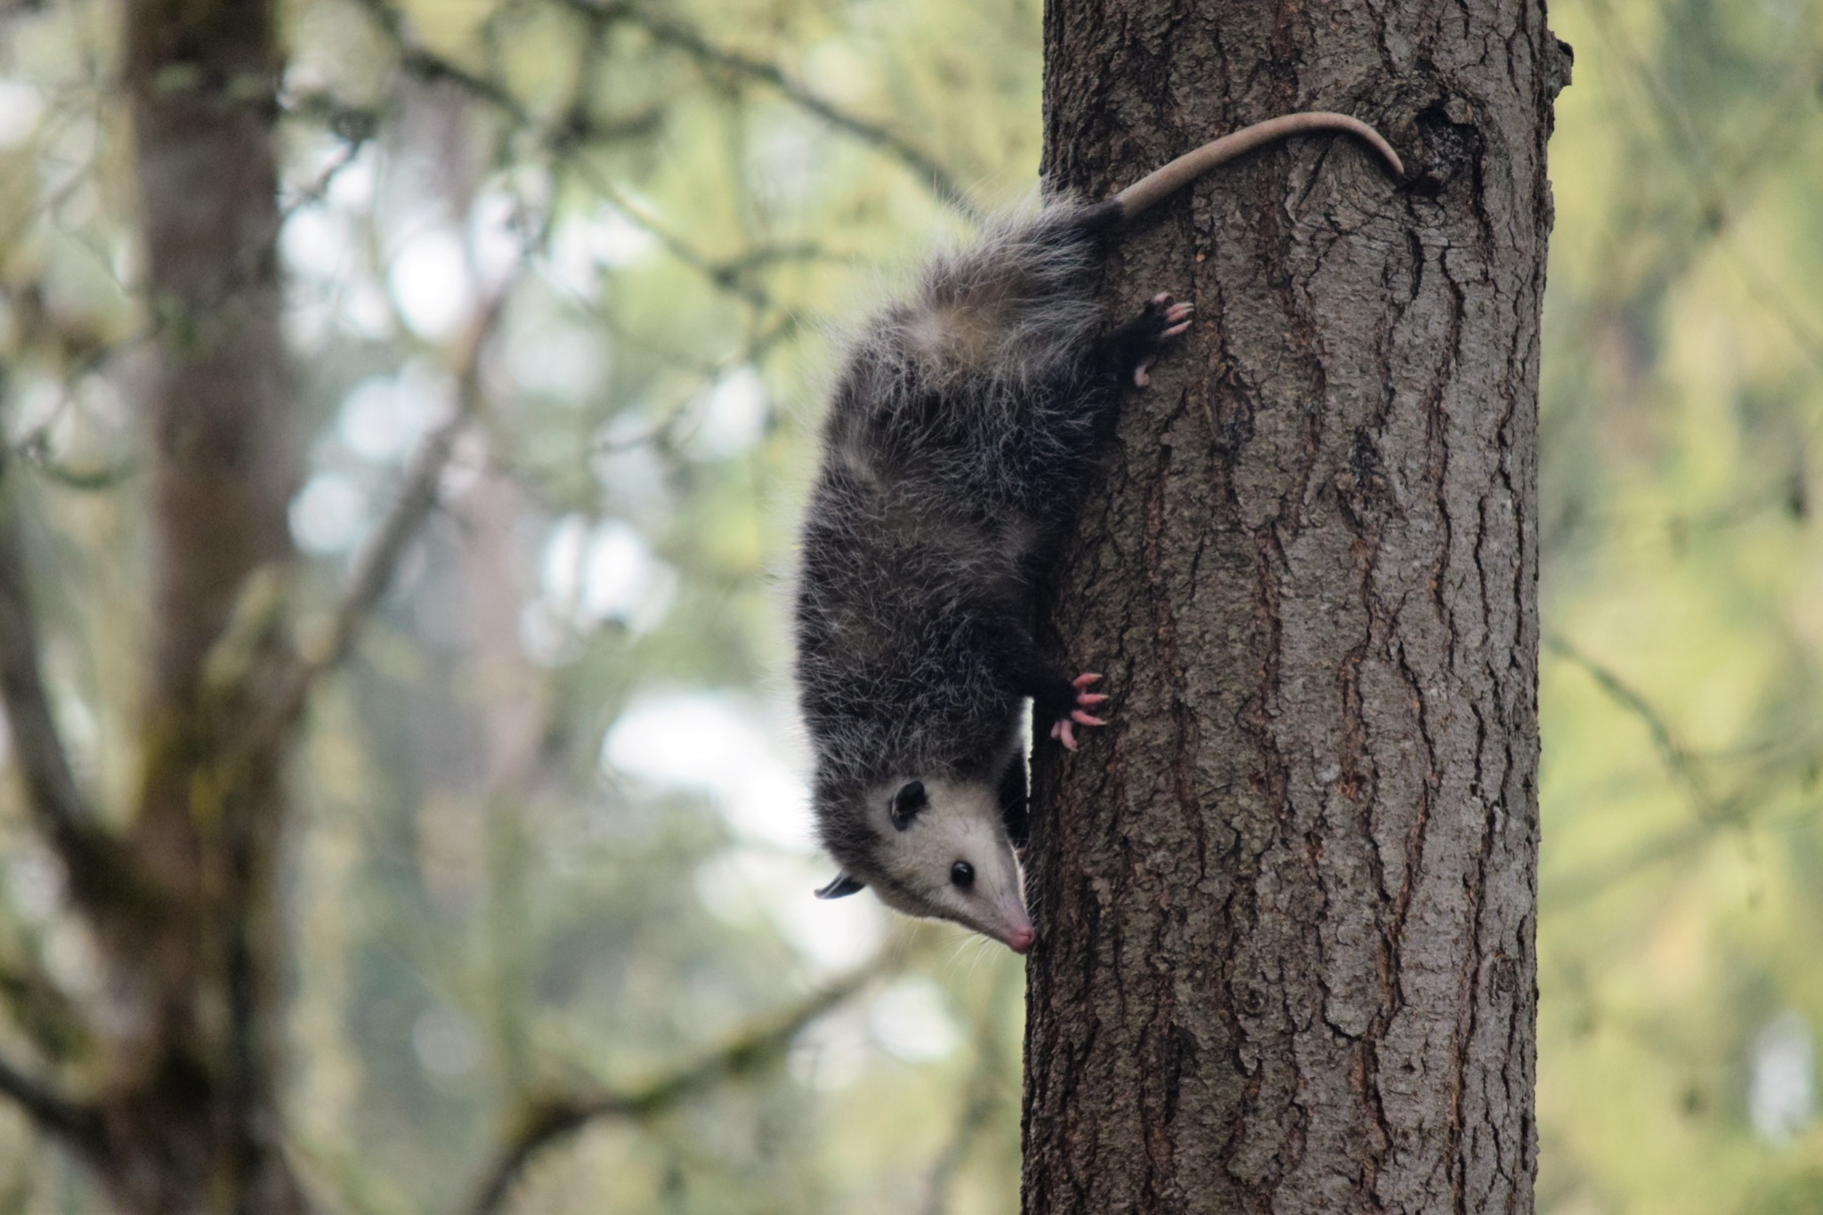
ᎦᎵᏆᏚᏏᏁ ᏣᎳᎩ ᎠᏕᎶᏆᏍᏗ
ᏕᎵᎬᎢ ᏓᏂᎵᏙᎰ ᎠᎴᏎᏍᎩᏃ ᎦᏙ ᎥᏍᏊ ᎤᏂᎸᏈᏗ ᎤᏁᏓᏍᏗ.
The climb trees and are also comfortable on the ground.

Slide 14
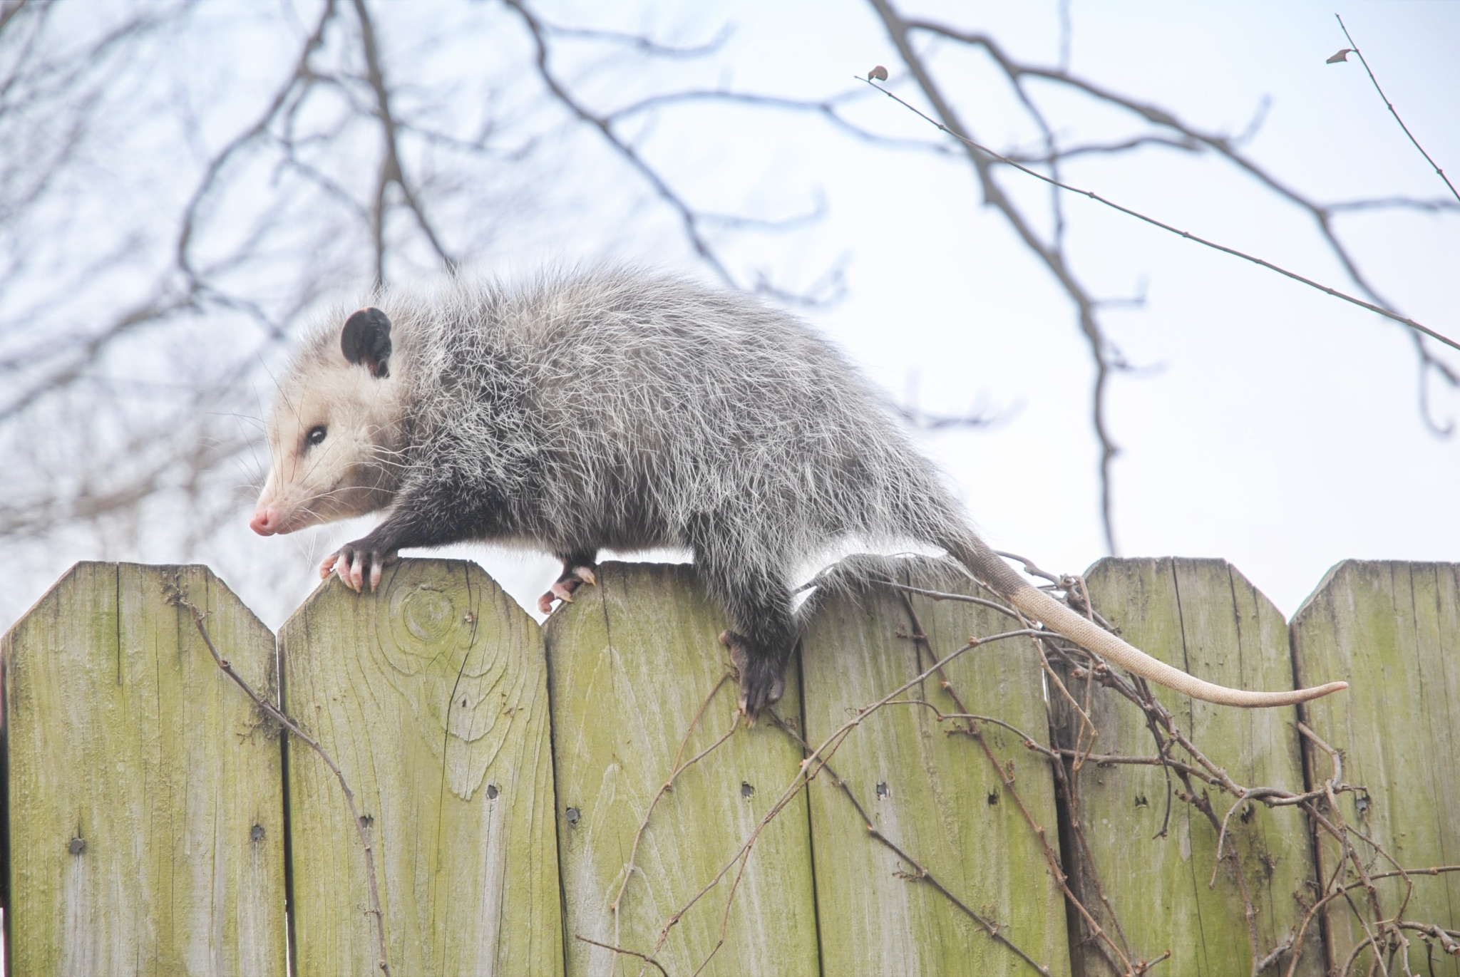
ᎦᎵᏆᏚᏏᏁ ᏣᎳᎩ ᎠᏕᎶᏆᏍᏗ
ᎤᏍᎦᏃᎵ ᎨᏐ.
They are slow.

Slide 15
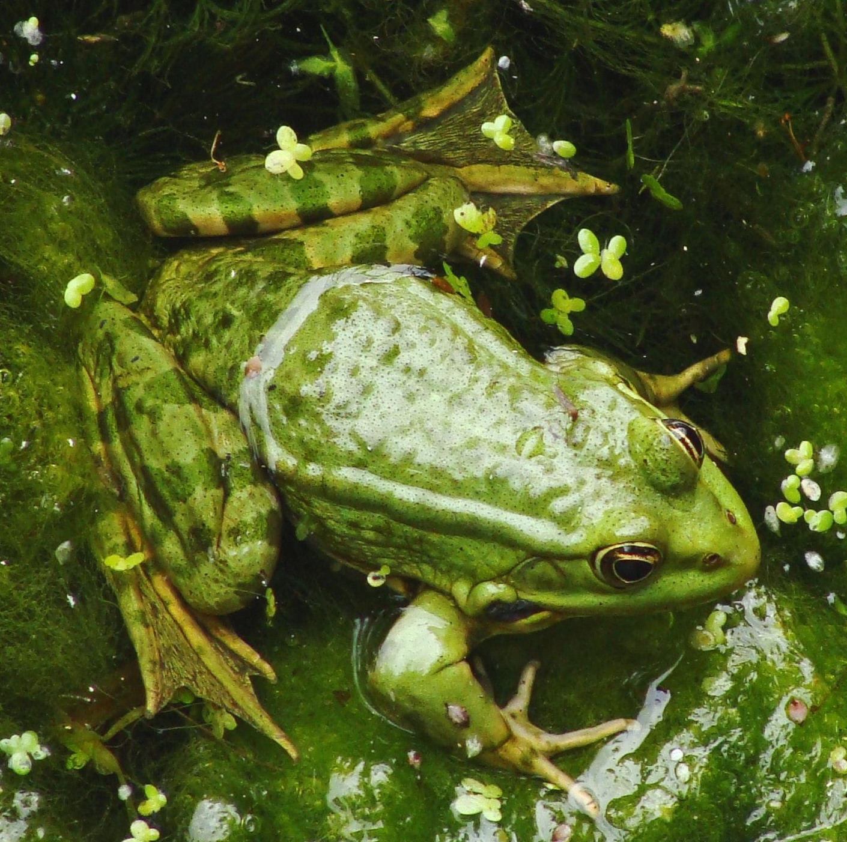
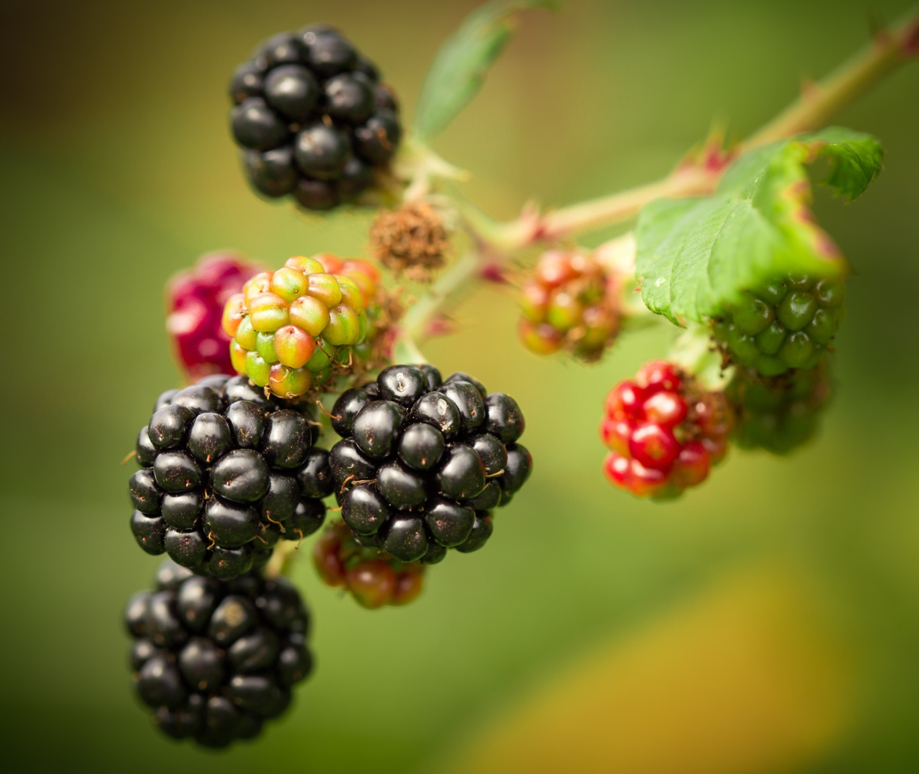
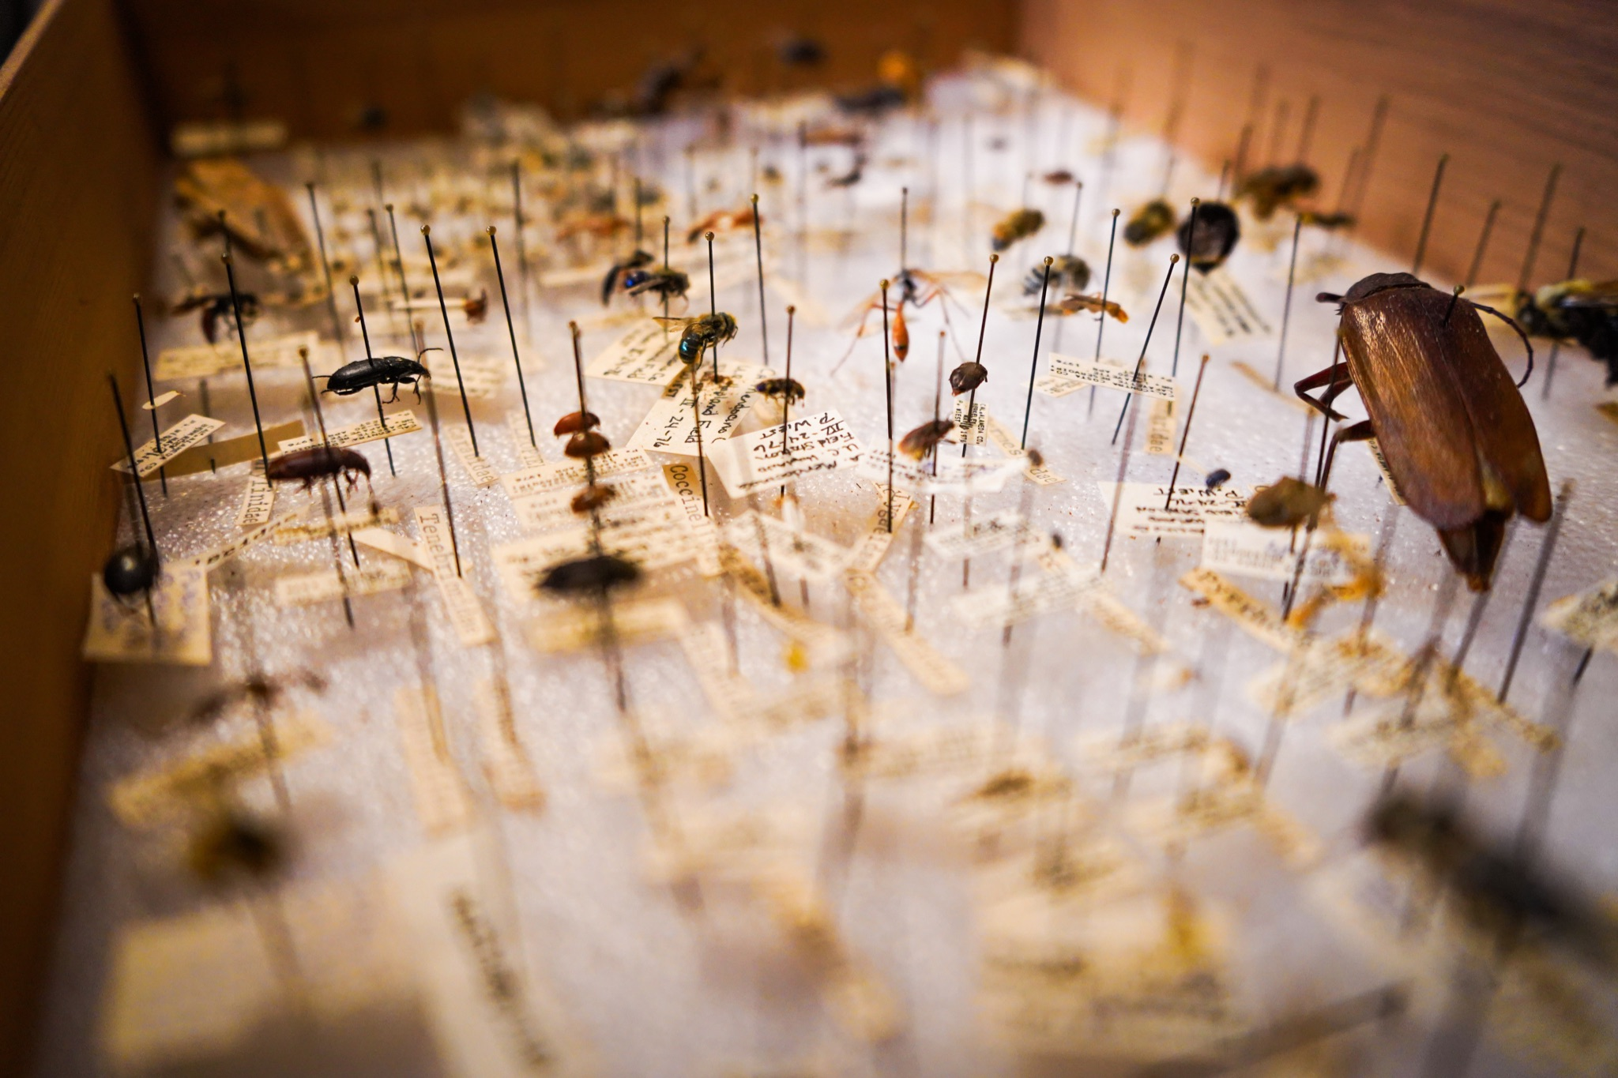
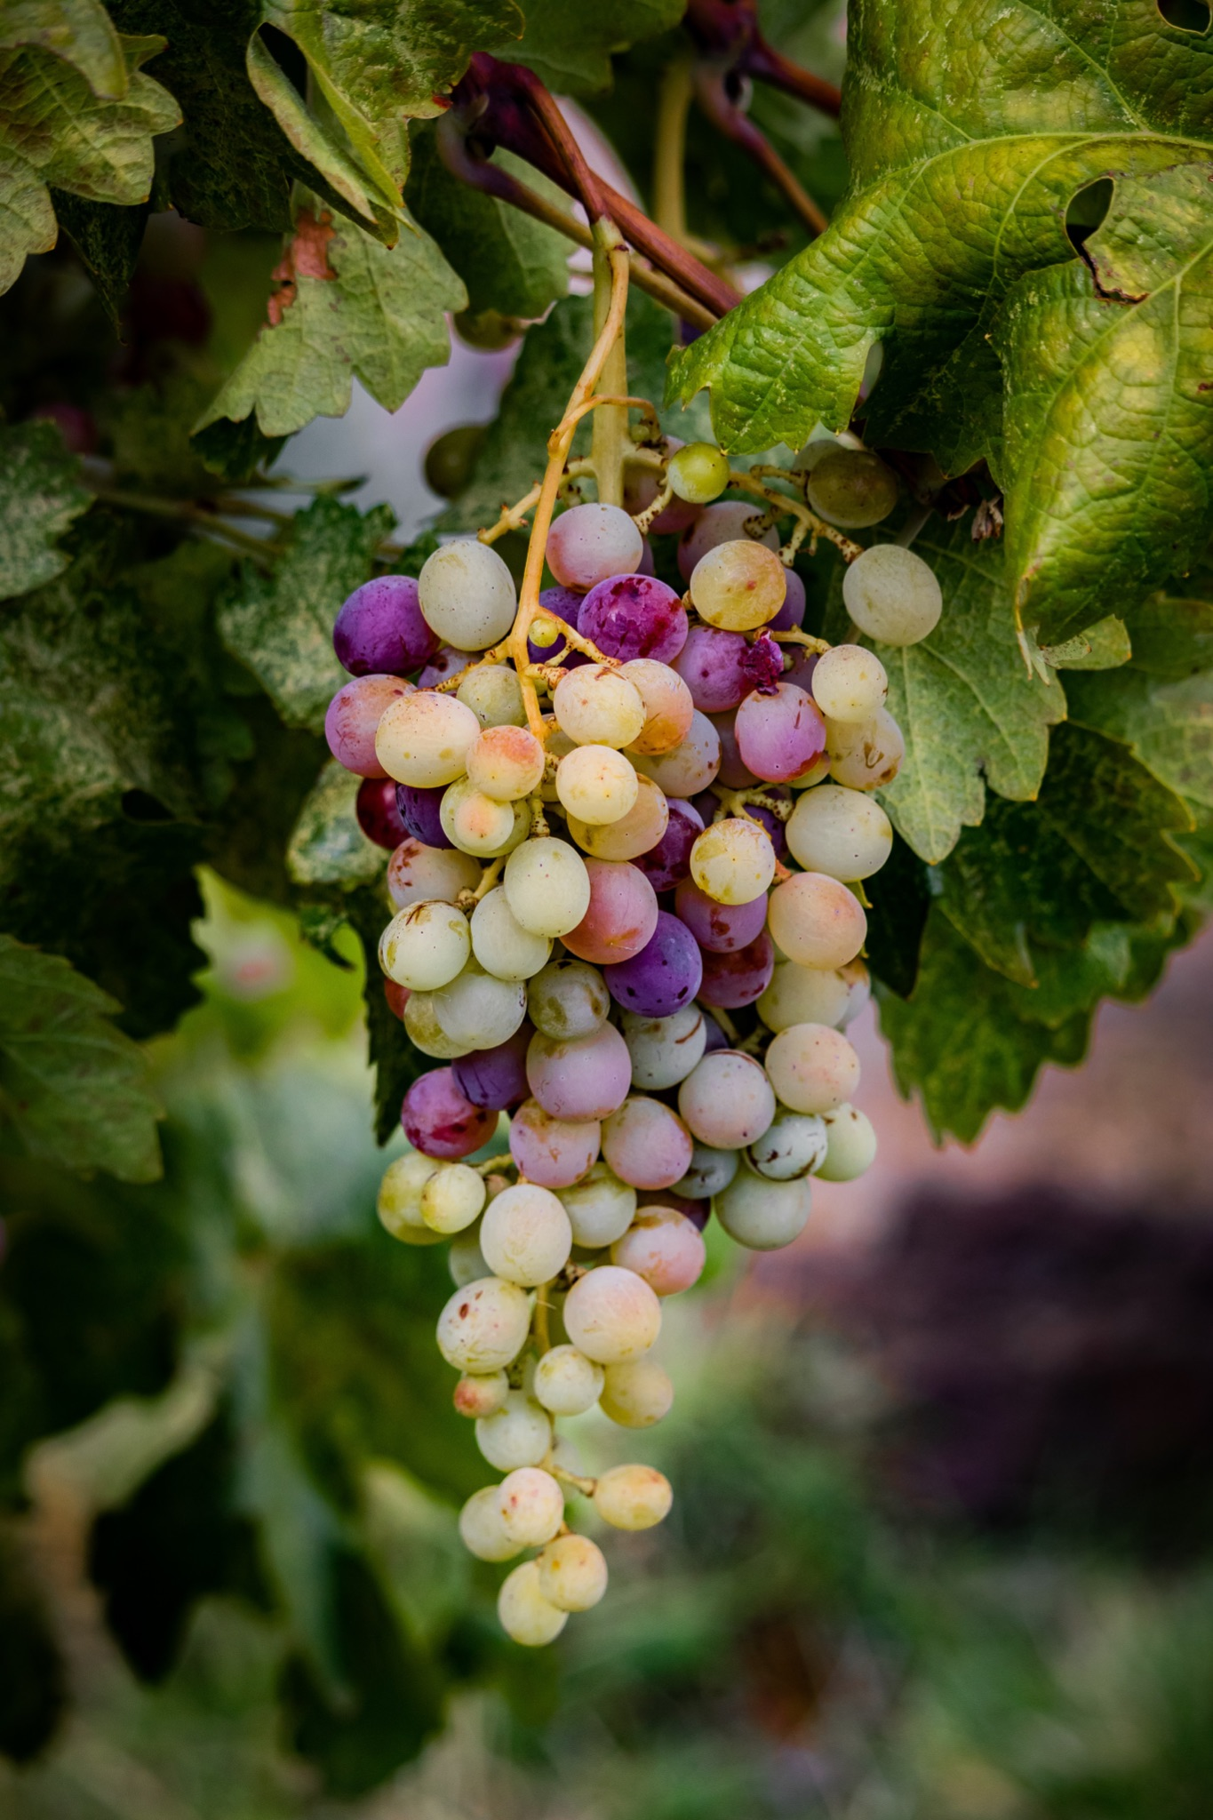
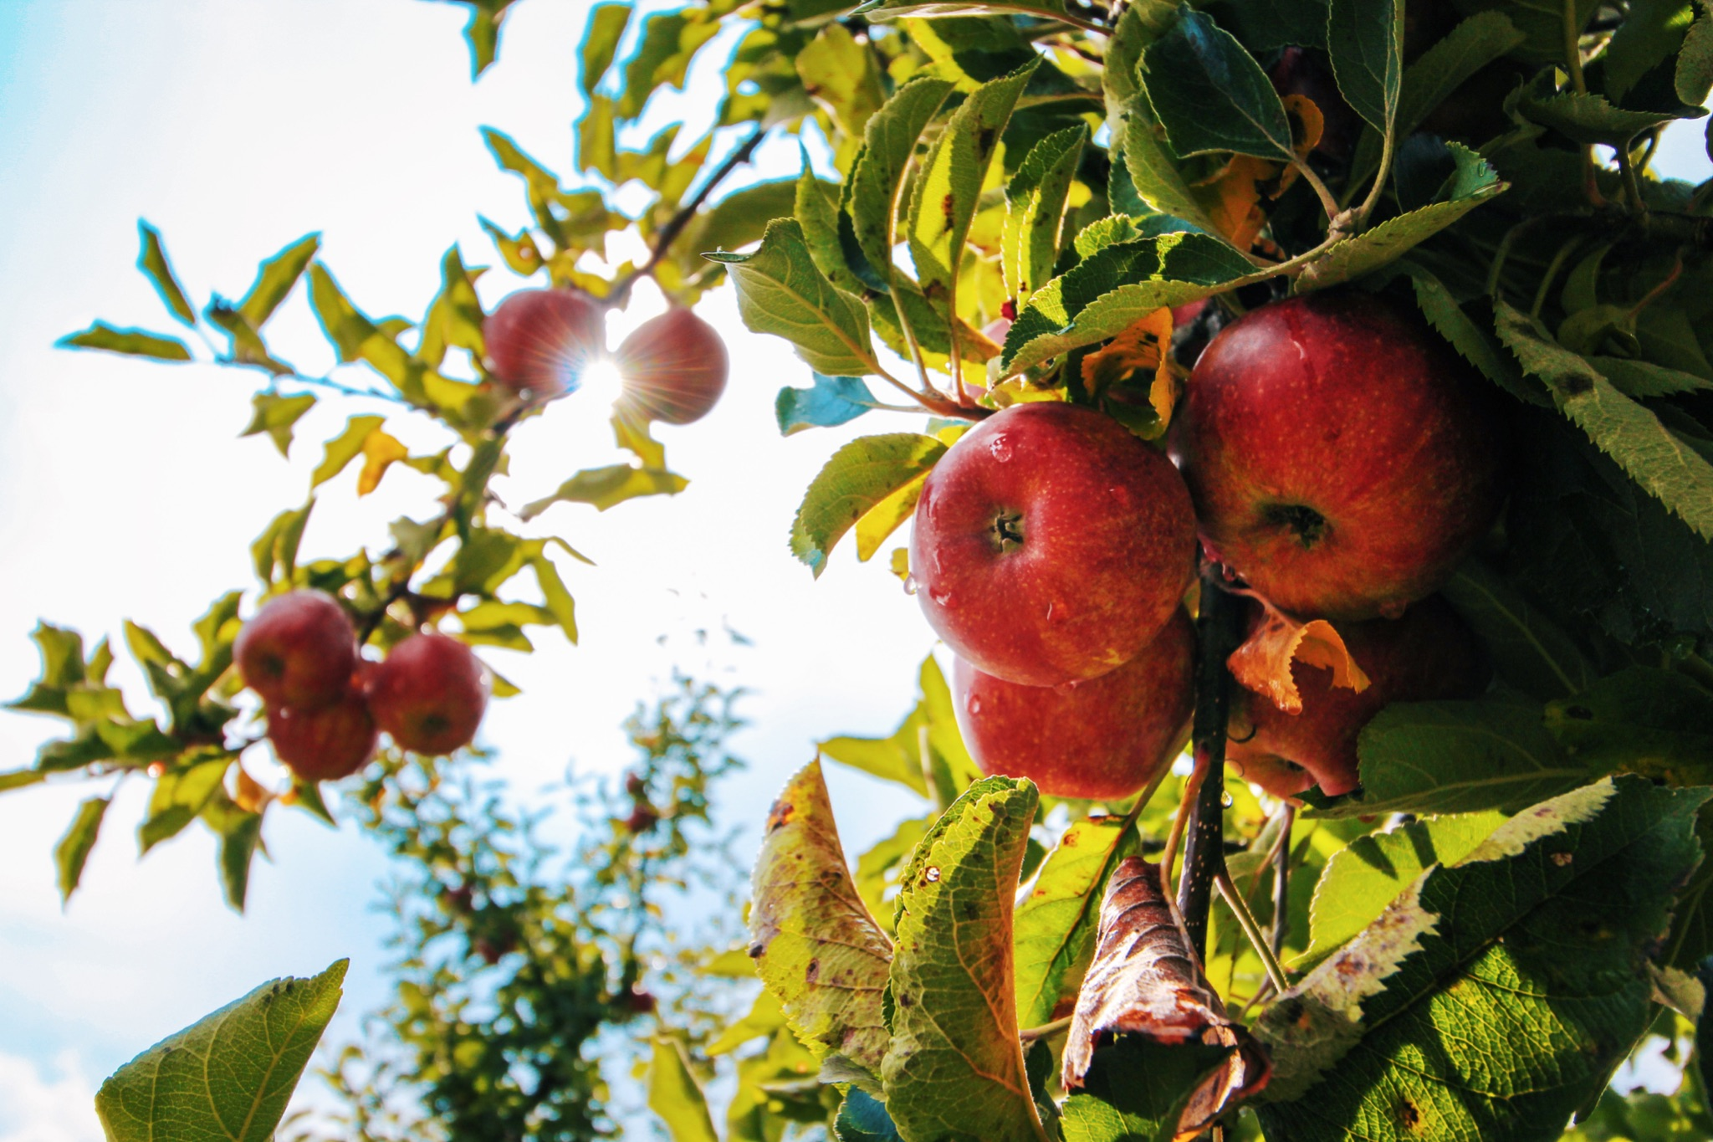
ᎦᎵᏆᏚᏏᏁ ᏣᎳᎩ ᎠᏕᎶᏆᏍᏗ
ᎤᏂᎸᏈᏗ ᎤᏂᎩᏍᏗ ᎧᏄᎦᏟ, ᎫᏩ, ᎤᎿᏒᎩ, ᏒᎦᏔ, ᏥᏍᎪᏯ ᏧᏓᎴᎾ, ᏧᏂᏍᏗ ᏥᏍᏆ, ᏧᏪᏥ, ᏩᎶᏏ, ᏘᏲᎭᏟ ᎠᎴ ᏥᏍᏛᎾ.
They eat things like blackberries, mulberries,wild grapes, apples, bugs, small birds, eggs, frogs, lizards and crawdads.

Slide 16
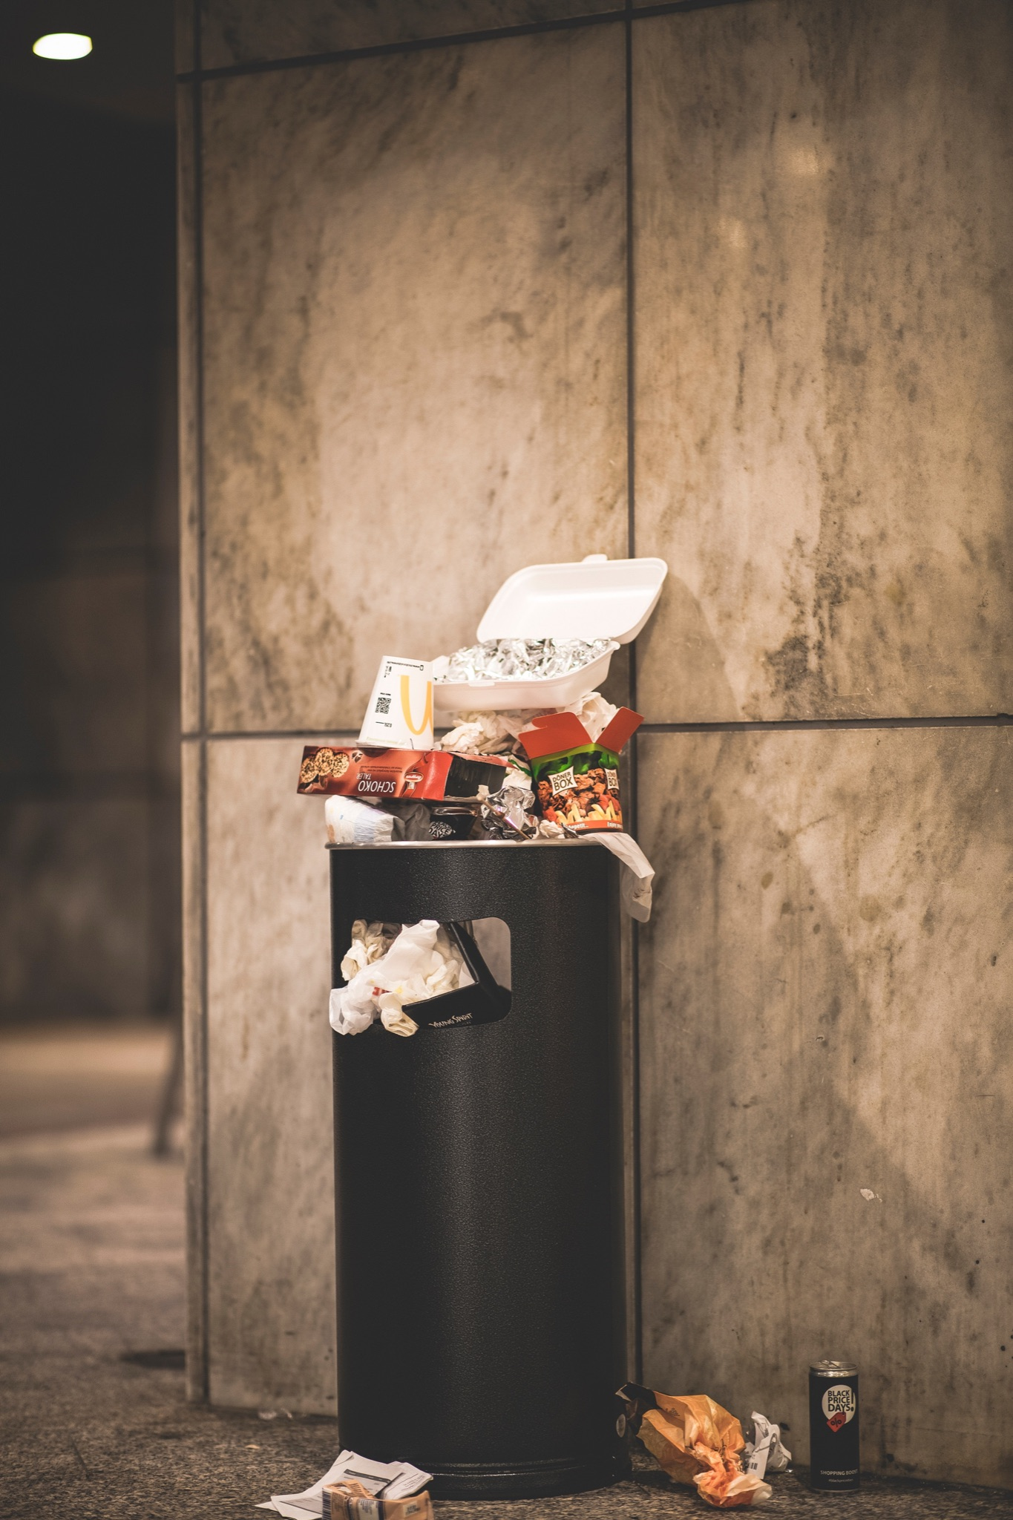
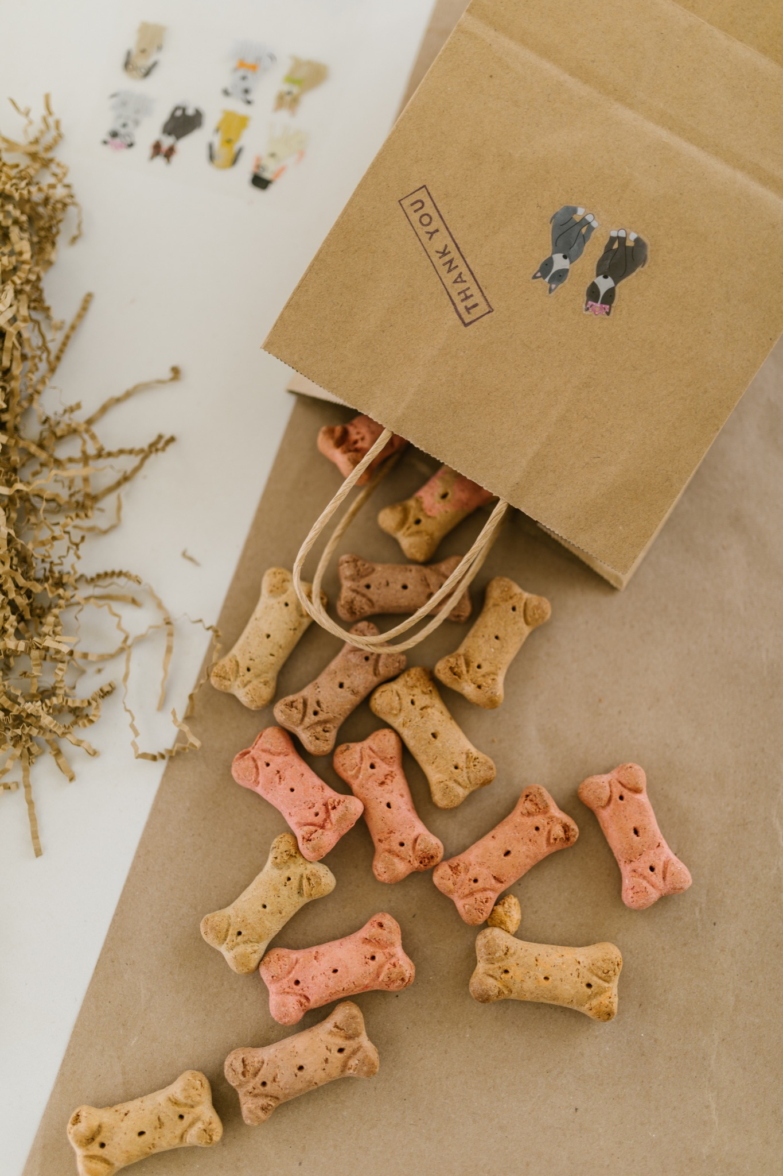
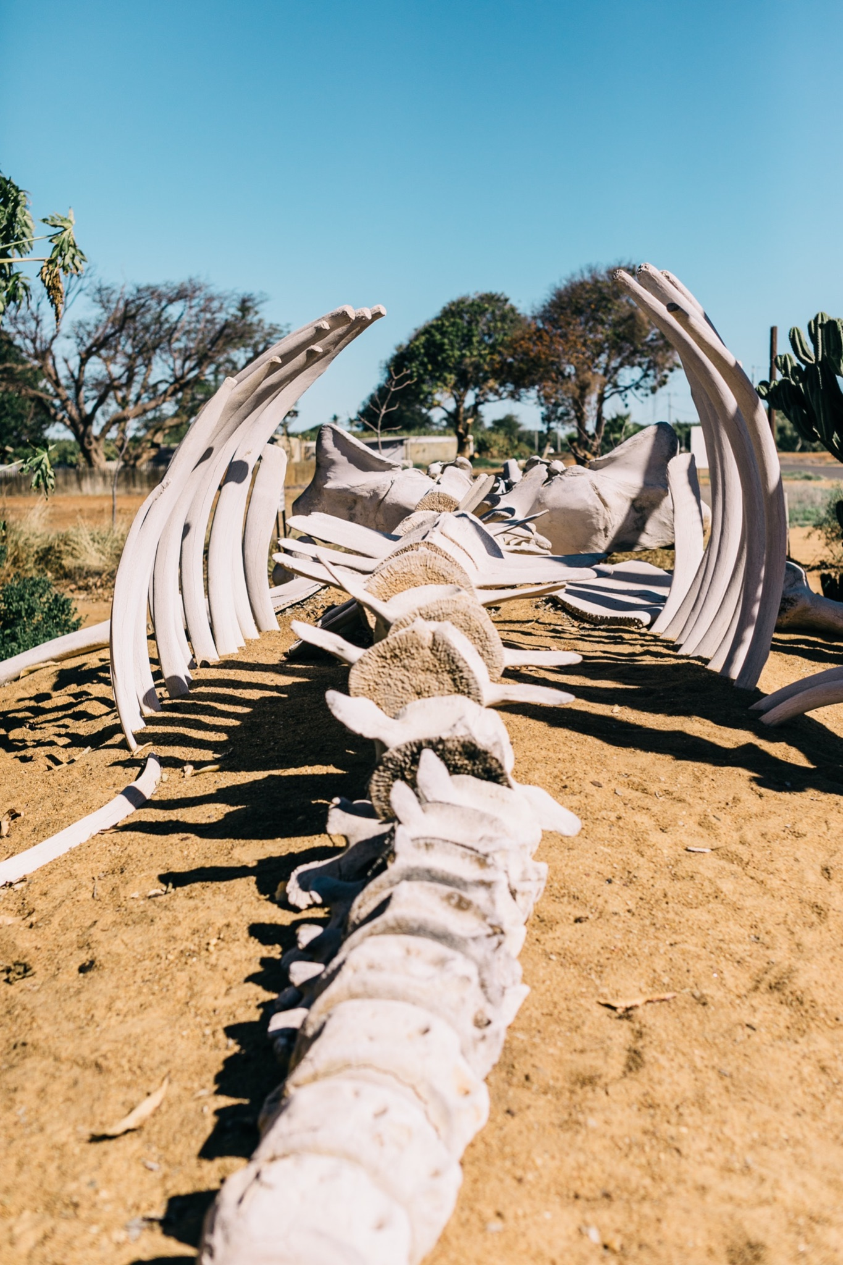
ᎦᎵᏆᏚᏏᏁ ᏣᎳᎩ ᎠᏕᎶᏆᏍᏗ
ᎤᏤᏥᏍᏗ ᎤᏂᎸᏈᏗ ᎤᏲᏨᎯ, ᎩᏟ ᎤᏂᎩᏍᏗ ᎠᎴ ᎤᎵᏬᏨ ᎦᎾᏝᎥ (ᎡᎿᎢ) ᏧᎪᎳ ᏓᏂᎩᏍᎪ.
Possums also eat trash, dog food and also the bones of dead animals.

Slide 17
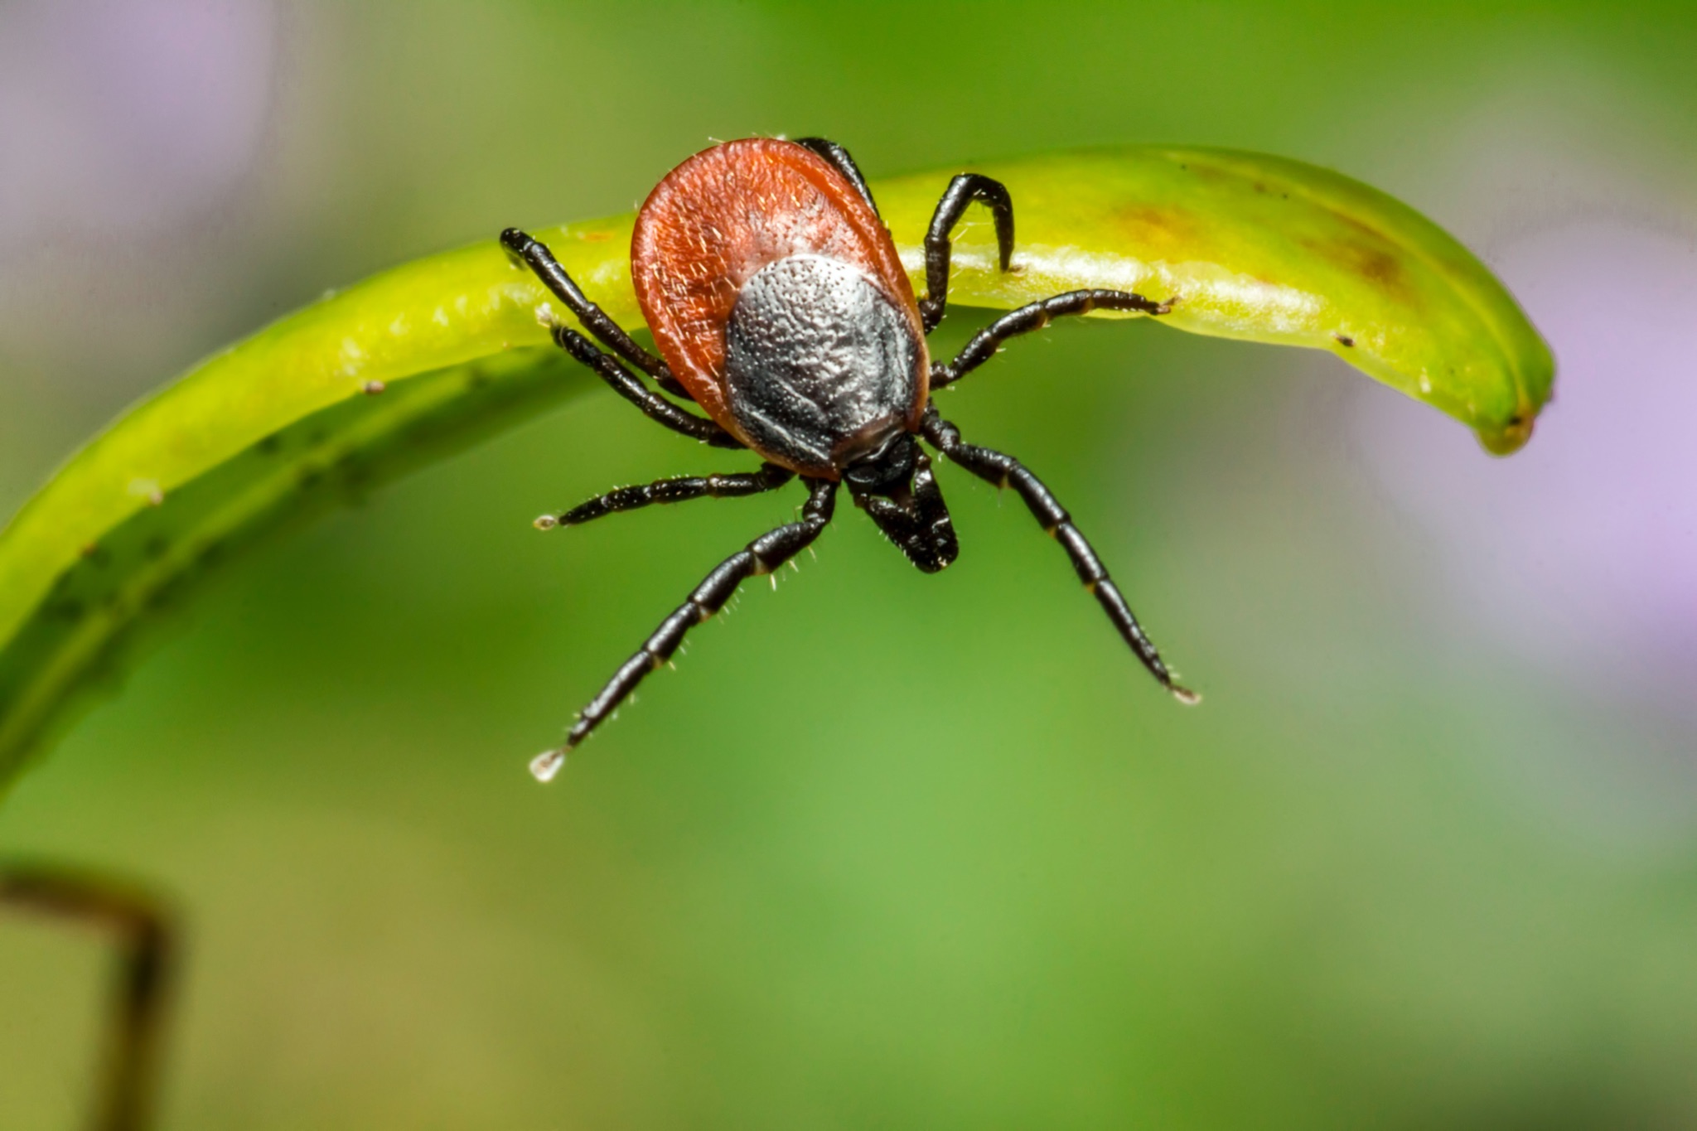
ᎦᎵᏆᏚᏏᏁ ᏣᎳᎩ ᎠᏕᎶᏆᏍᏗ
ᏚᏂᏣᎵᏗ ᎫᎩ ᏓᏂᎩᏍᎬ.
They are well known for eating ticks

Slide 18
ᎦᎵᏆᏚᏏᏁ ᏣᎳᎩ ᎠᏕᎶᏆᏍᏗ
ᏏᏆ ᎤᏤᏥᏍᏗ ᏔᎵ ᎠᎴ ᏅᎩ ᎢᏧᏕᏘᏴᏓ ᎠᏁᎰ.
Possums only live two to four years.

Slide 19
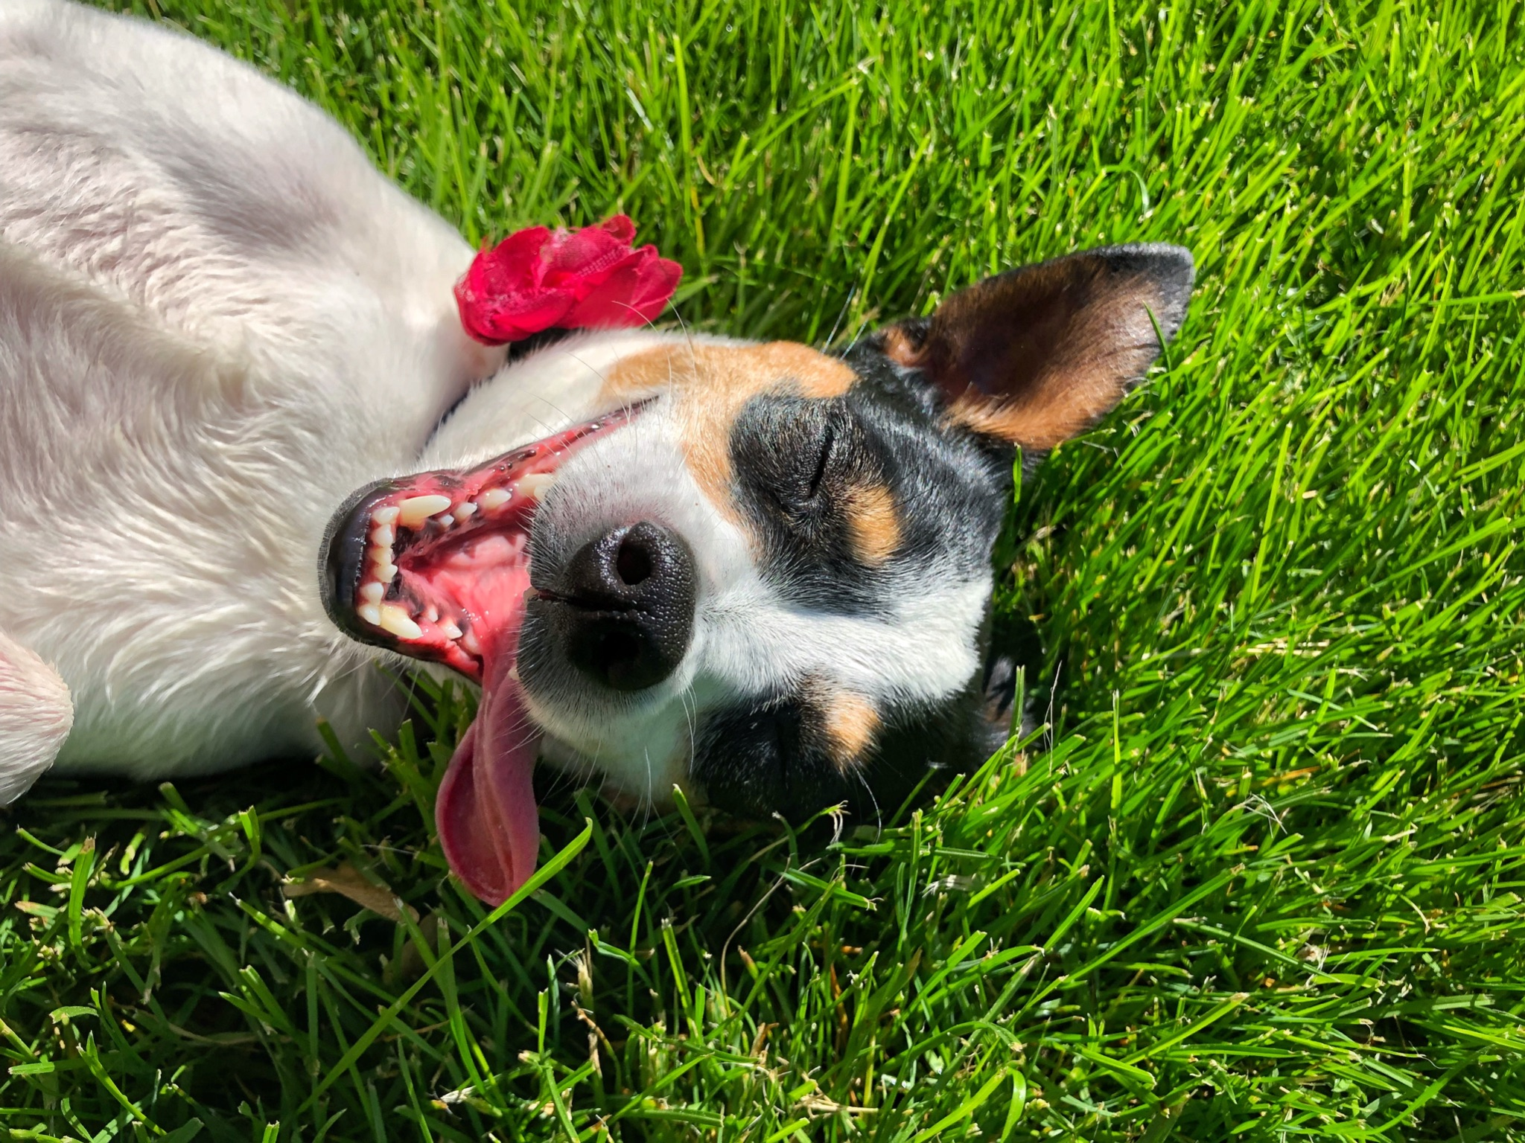
ᎦᎵᏆᏚᏏᏁ ᏣᎳᎩ ᎠᏕᎶᏆᏍᏗ
ᎢᏳᏓᎵᎭ, ᎪᎱᏍᏗ ᏳᏍᎦᏍᏓᏁᎵ, ᎤᎵᏬᏨ ᎠᏤᎸᏍᎪ, ᏯᎾᏑᎦ, ᏳᏔᏠᎦ, ᎠᎴ ᏗᎩᏙᎵ ᏧᏍᏚᎢᏗ ᎨᏐᎢ.
Many times when the possum feels threatened, they will pretend to be dead, laying down, their mouth hanging open and their eyes open.

Slide 20
ᎦᎵᏆᏚᏏᏁ ᏣᎳᎩ ᎠᏕᎶᏆᏍᏗ
ᎥᏍᏊ, ᎤᏂᎵᏬᏨ ᏳᎾᏤᎸᎾ, ᎤᏲ ᎠᏒᏥᎯᏍᎪ.
Also, when they play dead, they smell bad.

Slide 21
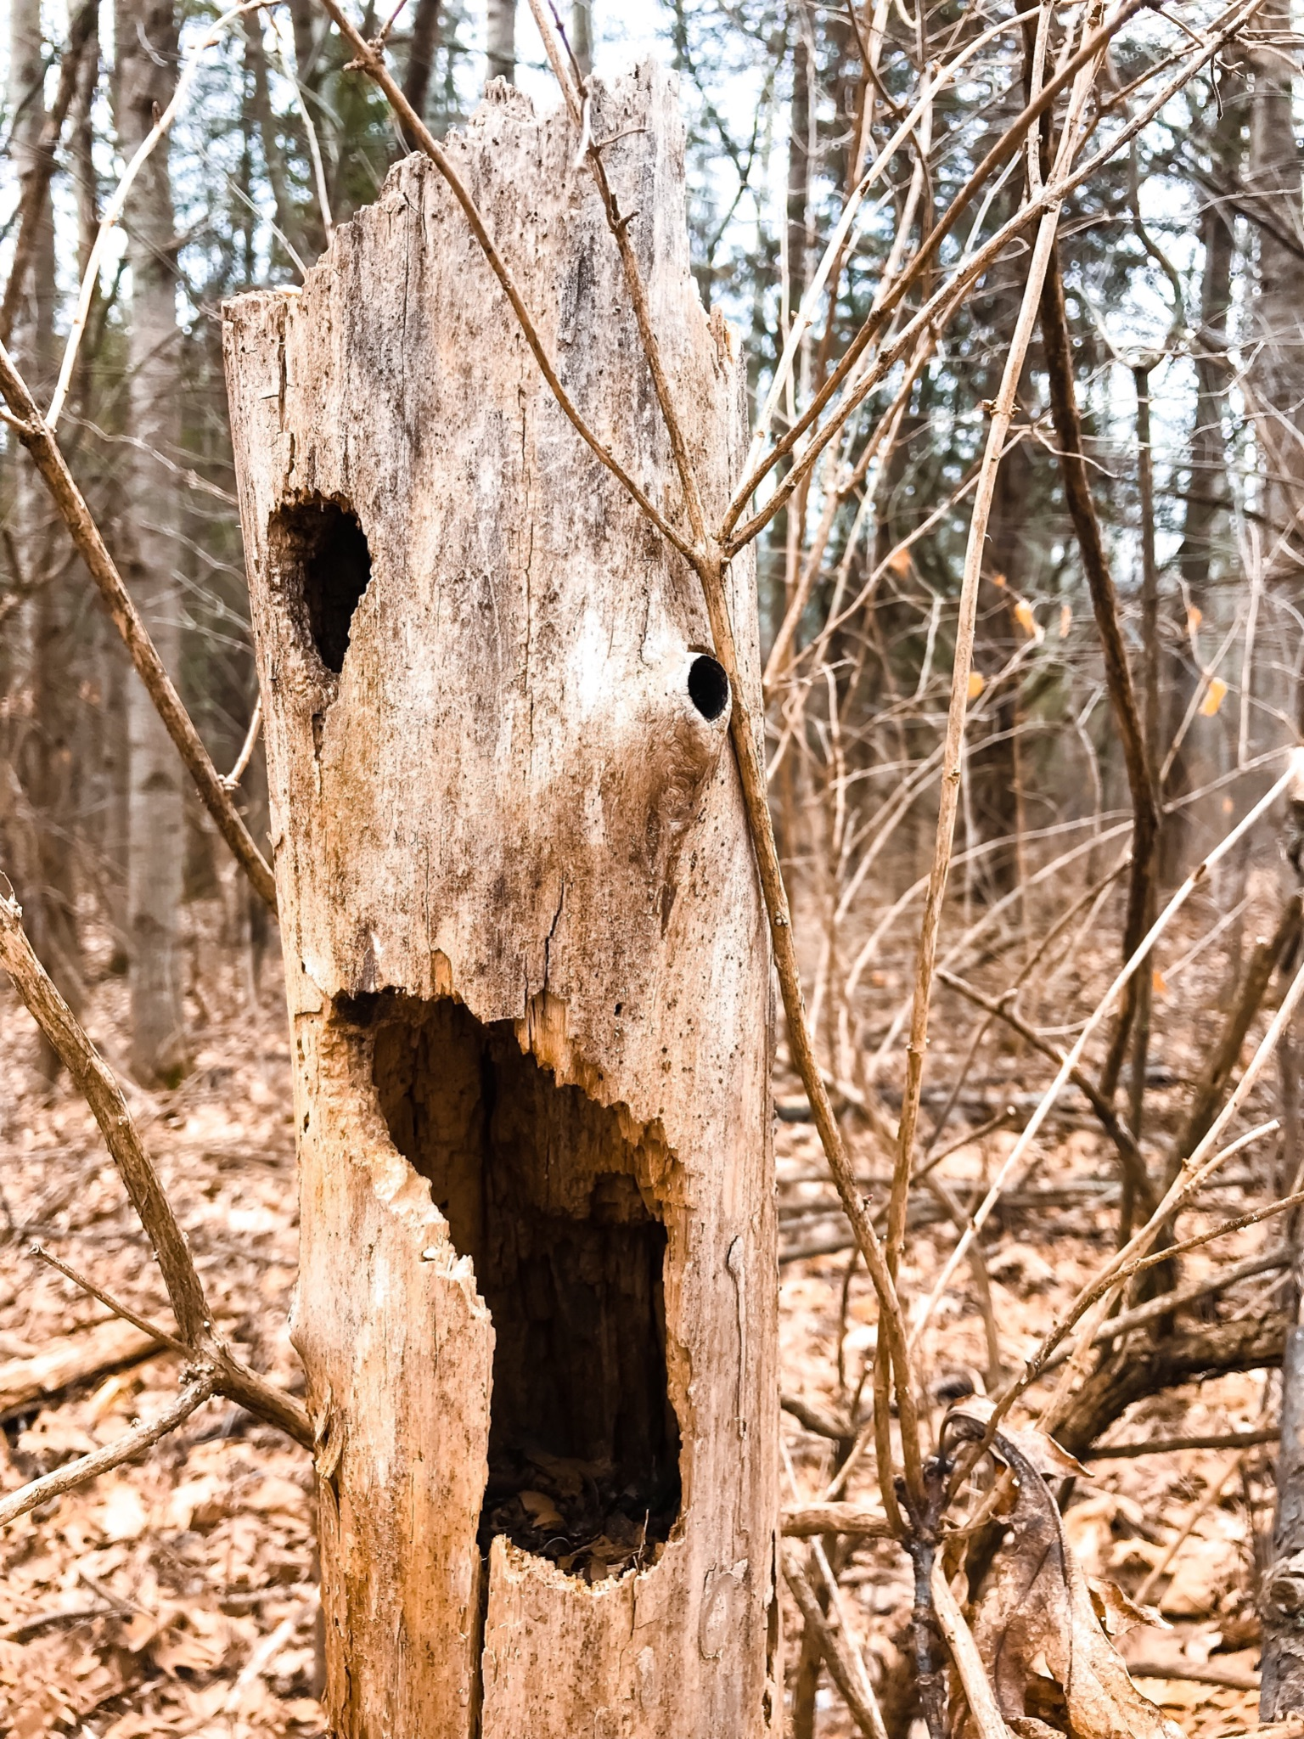
ᎦᎵᏆᏚᏏᏁ ᏣᎳᎩ ᎠᏕᎶᏆᏍᏗ
ᏧᏌᏙᏂ ᏕᏢᎬ ᎤᎾᏣᎣ ᎠᎴ ᎭᏫᏂᏗᏢ ᏚᏂᎵᎬ ᎠᎴ ᏧᎾᏍᏕᏢ ᎠᏂᏁᎶ.
They live in hollow trees or under stumps or roots.

Slide 22
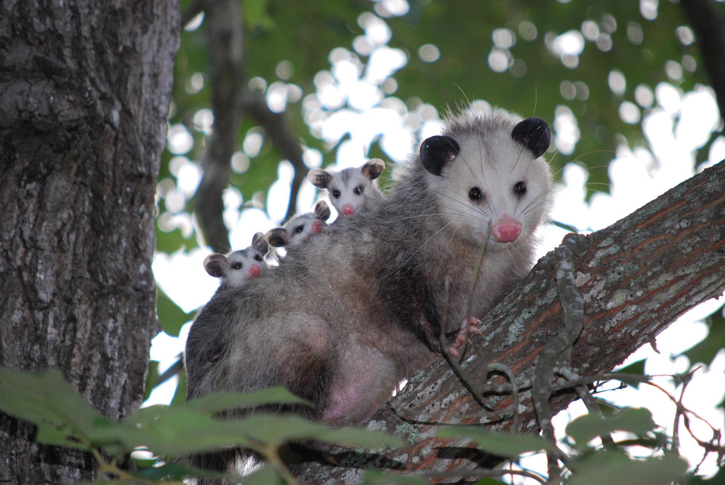
ᎦᎵᏆᏚᏏᏁ ᏣᎳᎩ ᎠᏕᎶᏆᏍᏗ
ᏔᎵᏍᎪ ᎯᏍᎩ ᏯᏂ ᏧᏂᏍᏗ ᏯᎾᏕᎲᎦ, ᎠᏎᏃ Ꮭ ᏂᎦᏓ ᏱᏓᎾᏛᏍᎪ.
Possums can give birth to as many as 25 babies, but most do not survive to adulthood.

Slide 23
ᎦᎵᏆᏚᏏᏁ ᏣᎳᎩ ᎠᏕᎶᏆᏍᏗ
ᏧᏂᏍᏗ ᎯᏍᎩ ᏳᎾᏙᏓᏆᏍᎩ ᎤᎾᏣᎣ ᎦᏃᏛᎢ.
The babies live about 5 weeks in the pouch.

Slide 24
ᎦᎵᏆᏚᏏᏁ ᏣᎳᎩ ᎠᏕᎶᏆᏍᏗ
ᏔᎵ ᏯᏅᏗᏃ ᎦᏐᎯ ᎤᏂᏥ ᎤᏂᎩᎸᏗᏕᎪ.
then 2 months they ride around on their mother’s back.

Slide 25
ᎦᎵᏆᏚᏏᏁ ᏣᎳᎩ ᎠᏕᎶᏆᏍᏗ
ᎤᏤᏥᏍᏗ ᎤᏅᏒ ᎠᏁᏙ.
Possums are solitary animals.

Slide 26
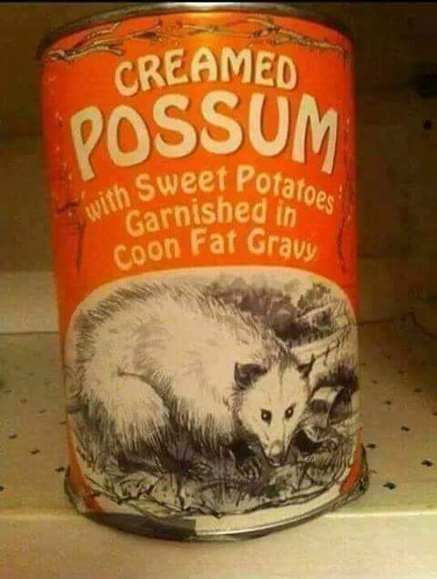
ᎦᎵᏆᏚᏏᏁ ᏣᎳᎩ ᎠᏕᎶᏆᏍᏗ
ᎠᏂᏣᎳᎩ ᏳᏓᎭ ᎤᏤᏥᏍᏗ ᏓᏂᎩᏍᎪ, ᎠᏎᏃ ᎪᎢᎭ ᎭᏫᏯ ᎨᏐᎢ.
Cherokees would sometimes eat possum, but the meat is greasy.

Slide 27
ᎦᎵᏆᏚᏏᏁ ᏣᎳᎩ ᎠᏕᎶᏆᏍᏗ
ᎥᏍᎩ ᏳᏍᏗ ᏄᎾ ᎠᏂᏅᎯᏓ ᎠᎴ ᎤᏤᏥᏍᏗ ᎭᏫᏯ ᎢᏧᎳ ᏓᏂᎩᏍᎪ.
It is often eaten with sweet potatoes.

