Slide 1
ᎣᏏᏲ
ᏁᎳᏚᏏᏁ ᏣᎳᎩ ᎠᏕᎶᏆᏍᏗ

Slide 2
ᏁᎳᏚᏏᏁ ᏣᎳᎩ ᎠᏕᎶᏆᏍᏗ
ᎢᏓᎴᎾ- Let’s begin
ᏣᎳᎩ ᎢᏗᏬᏂ- Let’s talk Cherokee

Slide 3
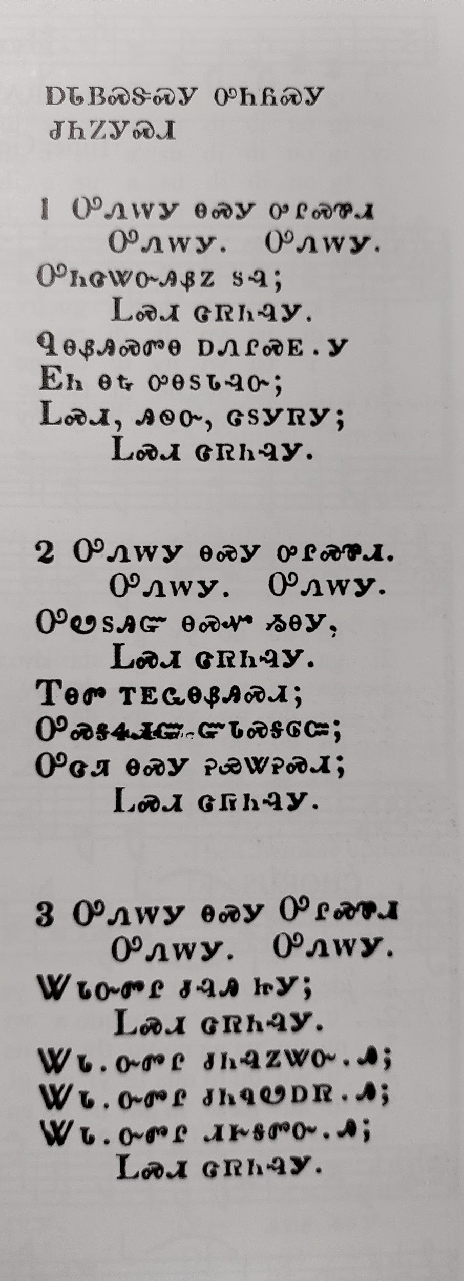
ᏔᎳᏚᏏᏁ ᏣᎳᎩ ᎠᏕᎶᏆᏍᏗ
ᎠᏓᏴᏍᏕᏍᎩ ᎤᏂᏲᏍᎩ ᏧᏂᏃᎩᏍᎩ
2. ᎤᏁᎳᎩ ᎾᏍᎩ ᎤᎵᏍᏈᏗ
ᎤᏁᎳᎩ. ᎤᏁᎳᎩ.
ᎤᏬᏚᎯᏳ ᎾᏍᏉ ᏱᎾᎩ;
ᏞᏍᏗ ᏣᏒᏂᎸᎩ.
ᎢᎾᏛ ᎢᎬᏩᎾᏰᎯᏍᏗ;
ᎤᏍᎦᏎᏗᏳ ᏳᏓᏍᎦᎶᏨ;
ᎤᏣᏘ ᎾᏍᎩ ᎮᏯᏔᎮᏍᏗ;
ᏞᏍᏗ ᏣᏒᏂᎸᎩ.
Temperance song II
Leave it alone, the cup. Leave it alone, leave it alone.
You will receive something beautiful.
Don’t touch it.
Snakes are dangerous
It’s very bad if it bites you
So be very aware.
So don’t touch it.
Notes:
aksdayvhvsg

Slide 4
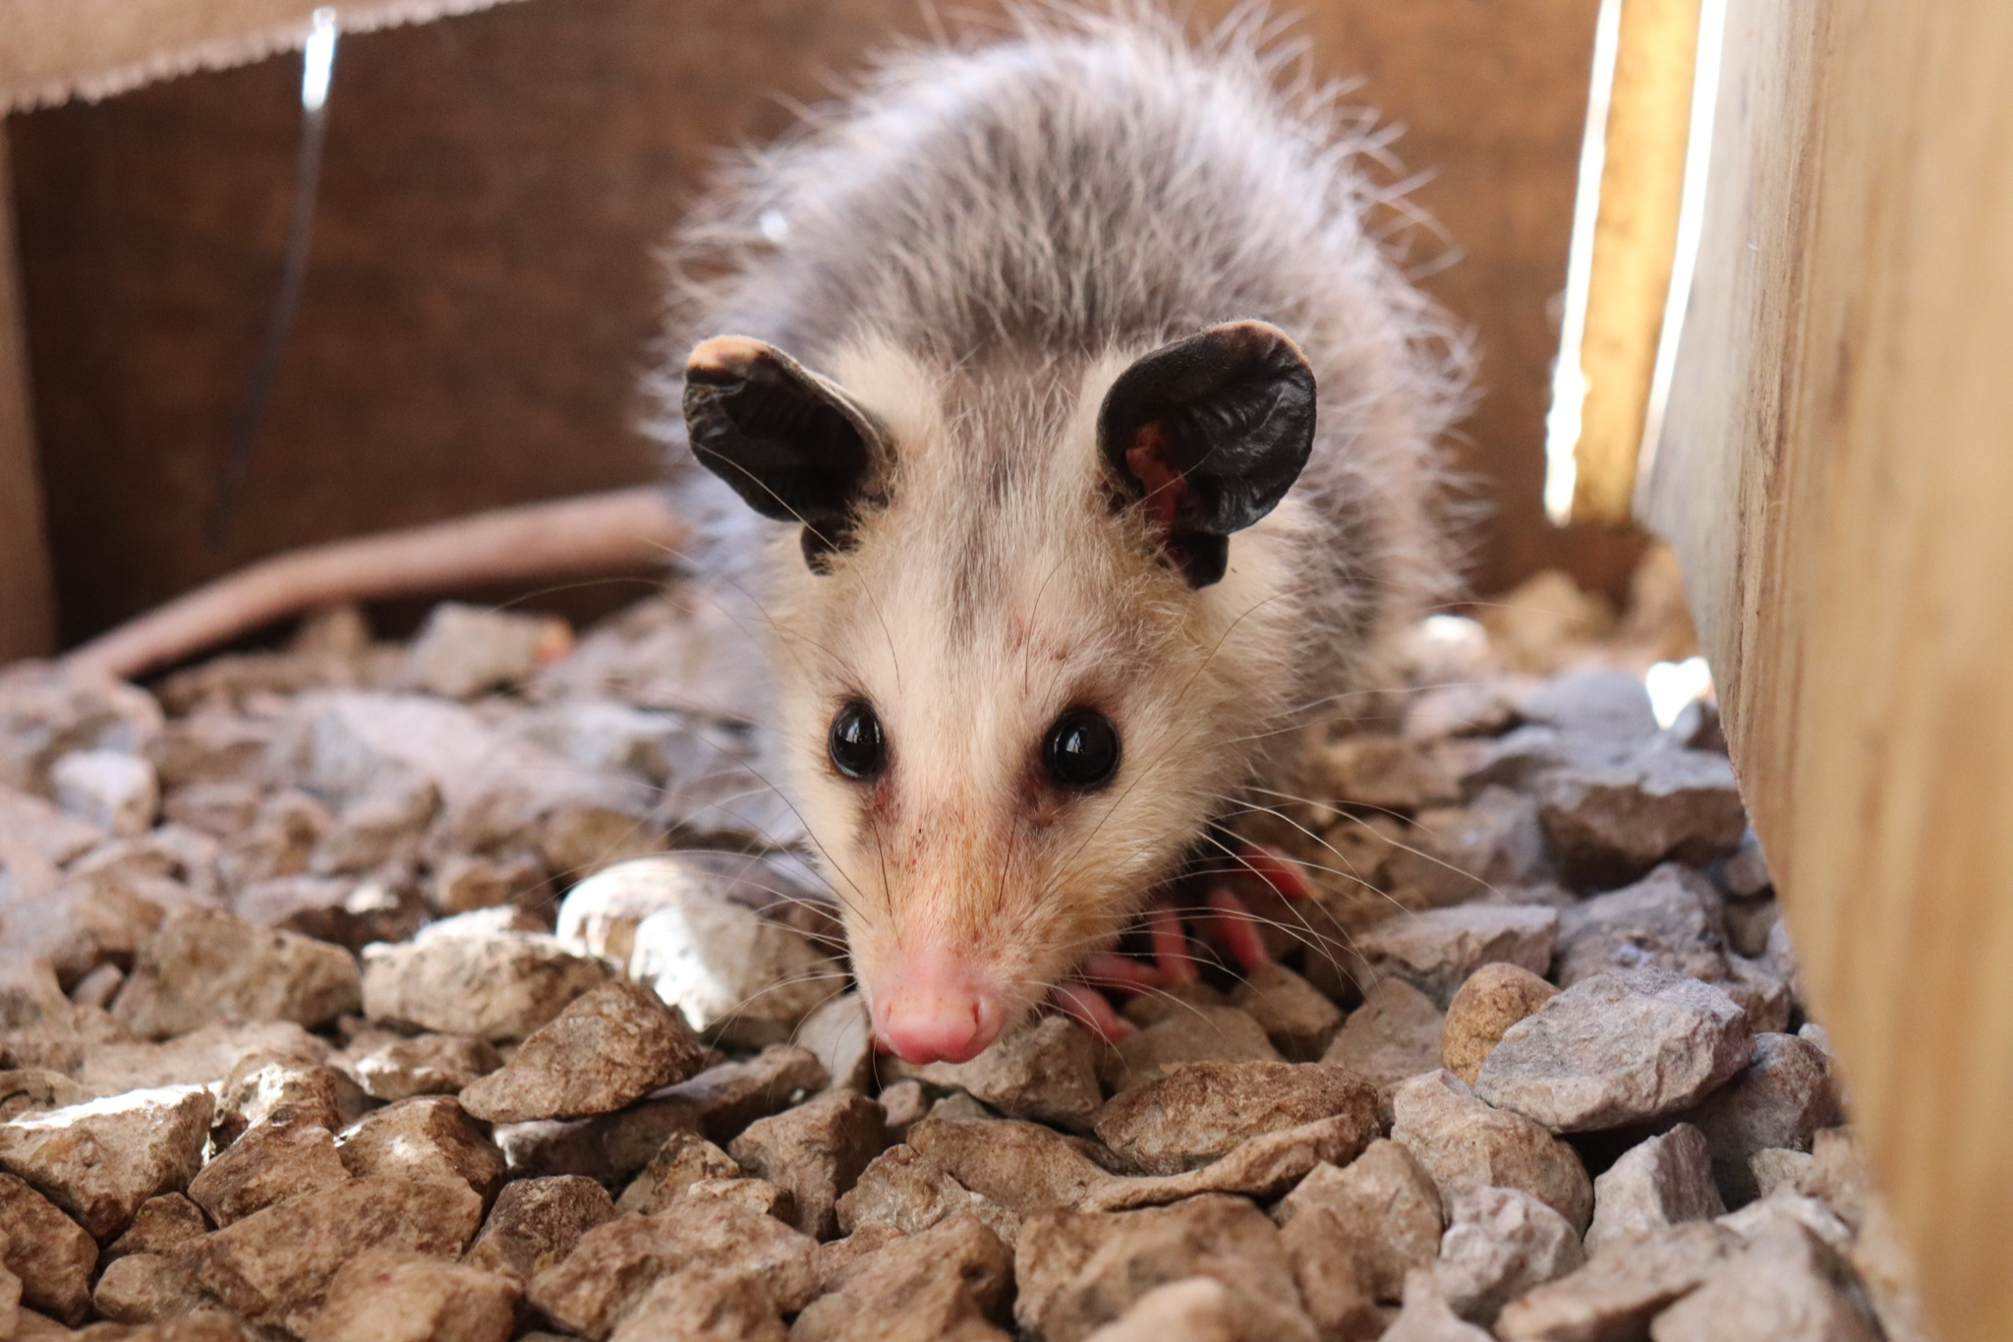
ᏁᎳᏚᏏᏁ ᏣᎳᎩ ᎠᏕᎶᏆᏍᏗ
ᎤᏤᏥᏍᏗ ᎧᏴᏐᎵ ᎠᏓᎴᏂᏍᎬ ᎦᏂᏓᏛᎢ ᎢᎦᏅᎯᏓ ᏦᎦᏚ ᎠᎴ ᏦᏍᎪᎯ ᎦᎵᏉᎩ ᎢᏏᏔᏗᏍᏗ. ᎦᏂᏓᏛ ᎤᏰᎸᎭ ᎠᎴ ᎦᏅᎯᏒ ᏐᏁᎵ ᎠᎴ ᏐᏁᎳᏚ ᎢᏏᏔᏗᏍᏗ. ᏚᏩᏂᎦᏢ ᎠᎴ ᏧᏓᎴᏅᏓ ᎪᎱᏍᏗ ᏱᎦᏇᏅᎾ ᎦᏂᏓᏛ. ᎬᎿᎨ ᎤᏍᎪᎸ ᏧᎾᎵᏑᏫᏓ ᎠᎴ ᎤᏍᏗ ᏓᏂᎵᎵᎪ. ᎯᏍᎪᎯ ᎢᎦ ᏓᏂᎾᏙᎪ ᎠᎴ ᎬᎿᎨ ᏗᏂᎦᏙᎵ. ᏏᏆ ᎤᏤᏥᏍᏗ “marsupials” ᏓᏃᏎᎰ, ᎠᏂᏓ ᎦᏃᏛᎢ ᏓᏂᏂᏙᎰ. ᏧᎾᏠᏱ ᎪᎠᎳ ᏲᎾ ᎠᎴ ᎤᏜᏩᏓ ᎤᏤᏥᏍᏗ. ᎤᏤᏥᏍᏗ ᎤᏅᏒ “marsupials” ᎠᏁ ᎠᎹᏰᏟ ᏧᏴᏢ. ᎤᏤᏥᏍᏗ ᎢᎾᎨᎢ ᎠᏁᎰ ᎠᎴ ᏒᏃᏱ ᎠᎢᏄᎪᎪ. ᏕᎵᎬᎢ ᏓᏂᎵᏙᎰ ᎠᎴᏎᏍᎩᏃ ᎦᏙ ᎥᏍᏊ ᎤᏂᎸᏈᏗ ᎤᏁᏓᏍᏗ. ᎤᏍᎦᏃᎵ ᎨᏐ. ᎤᏂᎸᏈᏗ ᎤᏂᎩᏍᏗ ᎧᏄᎦᏟ, ᎫᏩ, ᎤᎿᏒᎩ, ᏒᎦᏔ, ᏥᏍᎪᏯ ᏧᏓᎴᎾ, ᏧᏂᏍᏗ ᏥᏍᏆ, ᏧᏪᏥ, ᏩᎶᏏ, ᏘᏲᎭᏟ ᎠᎴ ᏥᏍᏛᎾ. ᎤᏤᏥᏍᏗ ᎤᏂᎸᏈᏗ ᎤᏲᏨᎯ, ᎩᏟ ᎤᏂᎩᏍᏗ ᎠᎴ ᎤᎵᏬᏨ ᎦᎾᏝᎥ (ᎡᎿᎢ) ᏧᎪᎳ ᏓᏂᎩᏍᎪ. ᏚᏂᏣᎵᏗ ᎫᎩ ᏓᏂᎩᏍᎬ. ᏏᏆ ᎤᏤᏥᏍᏗ ᏔᎵ ᎠᎴ ᏅᎩ ᎢᏧᏕᏘᏴᏓ ᎠᏁᎰ. ᎢᏳᏓᎵᎭ, ᎪᎱᏍᏗ ᏳᏍᎦᏍᏓᏁᎵ, ᎤᎵᏬᏨ ᎠᏤᎸᏍᎪ, ᏯᎾᏑᎦ, ᏳᏔᏠᎦ, ᎠᎴ ᏗᎩᏙᎵ ᏧᏍᏚᎢᏗ ᎨᏐᎢ. ᎥᏍᏊ, ᎤᏂᎵᏬᏨ ᏳᎾᏤᎸᎾ, ᎤᏲ ᎠᏒᏥᎯᏍᎪ. ᏧᏌᏙᏂ ᏕᏢᎬ ᎤᎾᏣᎣ ᎠᎴ ᎭᏫᏂᏗᏢ ᏚᏂᎵᎬ ᎠᎴ ᏧᎾᏍᏕᏢ ᎠᏂᏁᎶ. ᏔᎵᏍᎪ ᎯᏍᎩ ᏯᏂ ᏧᏂᏍᏗ ᏯᎾᏕᎲᎦ, ᎠᏎᏃ Ꮭ ᏂᎦᏓ ᏱᏓᎾᏛᏍᎪ. ᏧᏂᏍᏗ ᎯᏍᎩ ᏳᎾᏙᏓᏆᏍᎩ ᎤᎾᏣᎣ ᎦᏃᏛᎢ. ᏔᎵ ᏯᏅᏗᏃ ᎦᏐᎯ ᎤᏂᏥ ᎤᏂᎩᎸᏗᏕᎪ. ᎤᏤᏥᏍᏗ ᎤᏅᏒ ᎠᏁᏙ. ᎠᏂᏣᎳᎩ ᏳᏓᎭ ᎤᏤᏥᏍᏗ ᏓᏂᎩᏍᎪ, ᎠᏎᏃ ᎪᎢᎭ ᎭᏫᏯ ᎨᏐᎢ. ᎥᏍᎩ ᏳᏍᏗ ᏄᎾ ᎠᏂᏅᎯᏓ ᎠᎴ ᎤᏤᏥᏍᏗ ᎭᏫᏯ ᎢᏧᎳ ᏓᏂᎩᏍᎪ.

