Slide 1
ᎣᏏᏲ
ᏔᎵᏁ ᏣᎳᎩ ᎠᏕᎶᏆᏍᏗ

Slide 2
ᏔᎵᏁ ᏣᎳᎩ ᎠᏕᎶᏆᏍᏗ
ᎢᏓᎴᎾ- Let’s begin
ᏣᎳᎩ ᎢᏗᏬᏂ- Let’s talk Cherokee

Slide 3
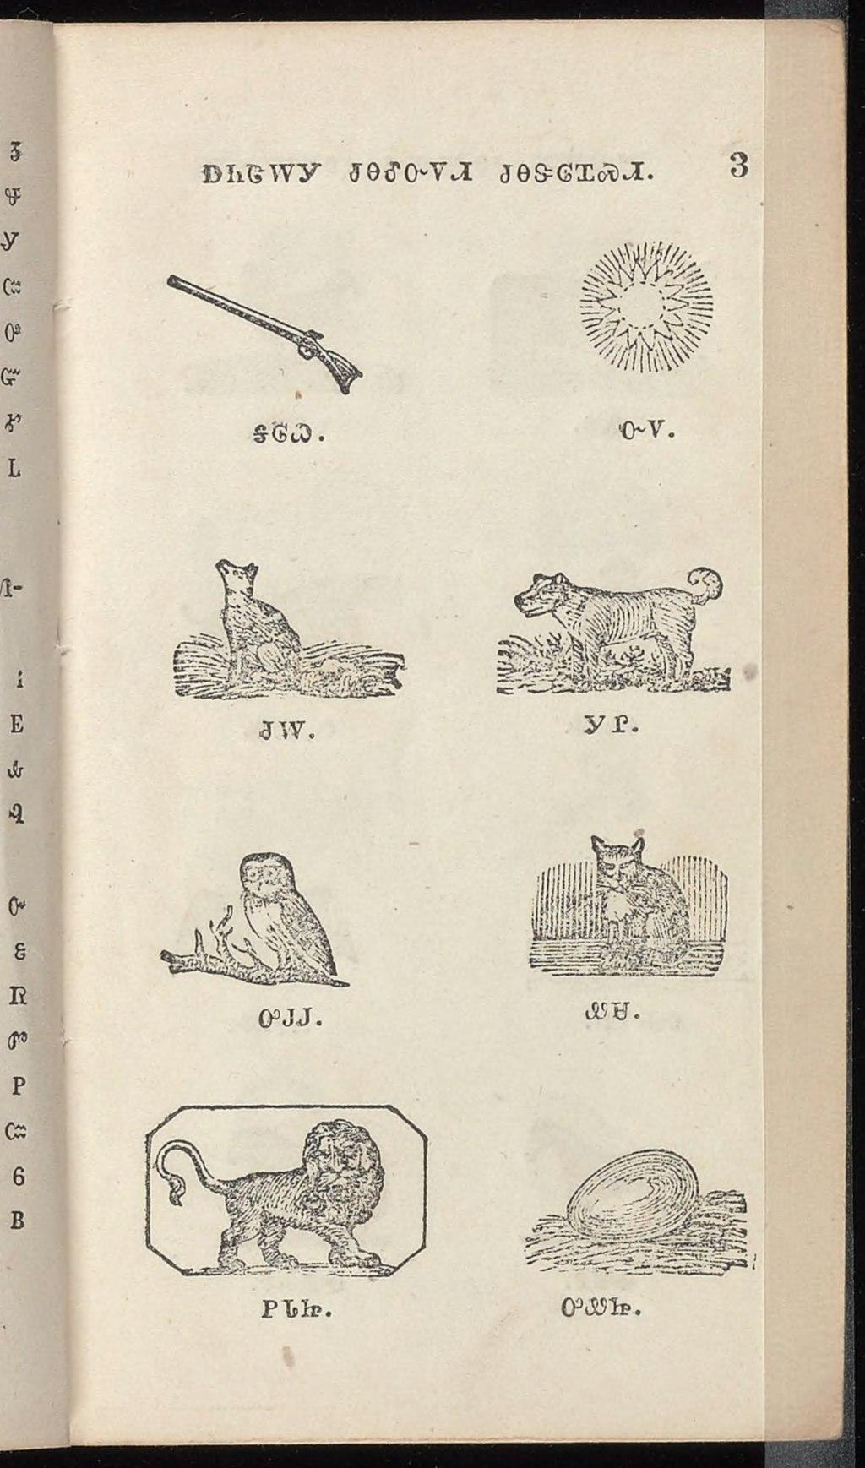
ᏔᎵᏁ ᏣᎳᎩ ᎠᏕᎶᏆᏍᏗ
ᎦᎶᏇ ᏅᏙ
ᏧᎳ ᎩᏟ
ᎤᎫᎫ ᏪᏌ
ᏢᏓᏥ ᎤᏪᏥ
Notes:
aksdayvhvsg

Slide 4
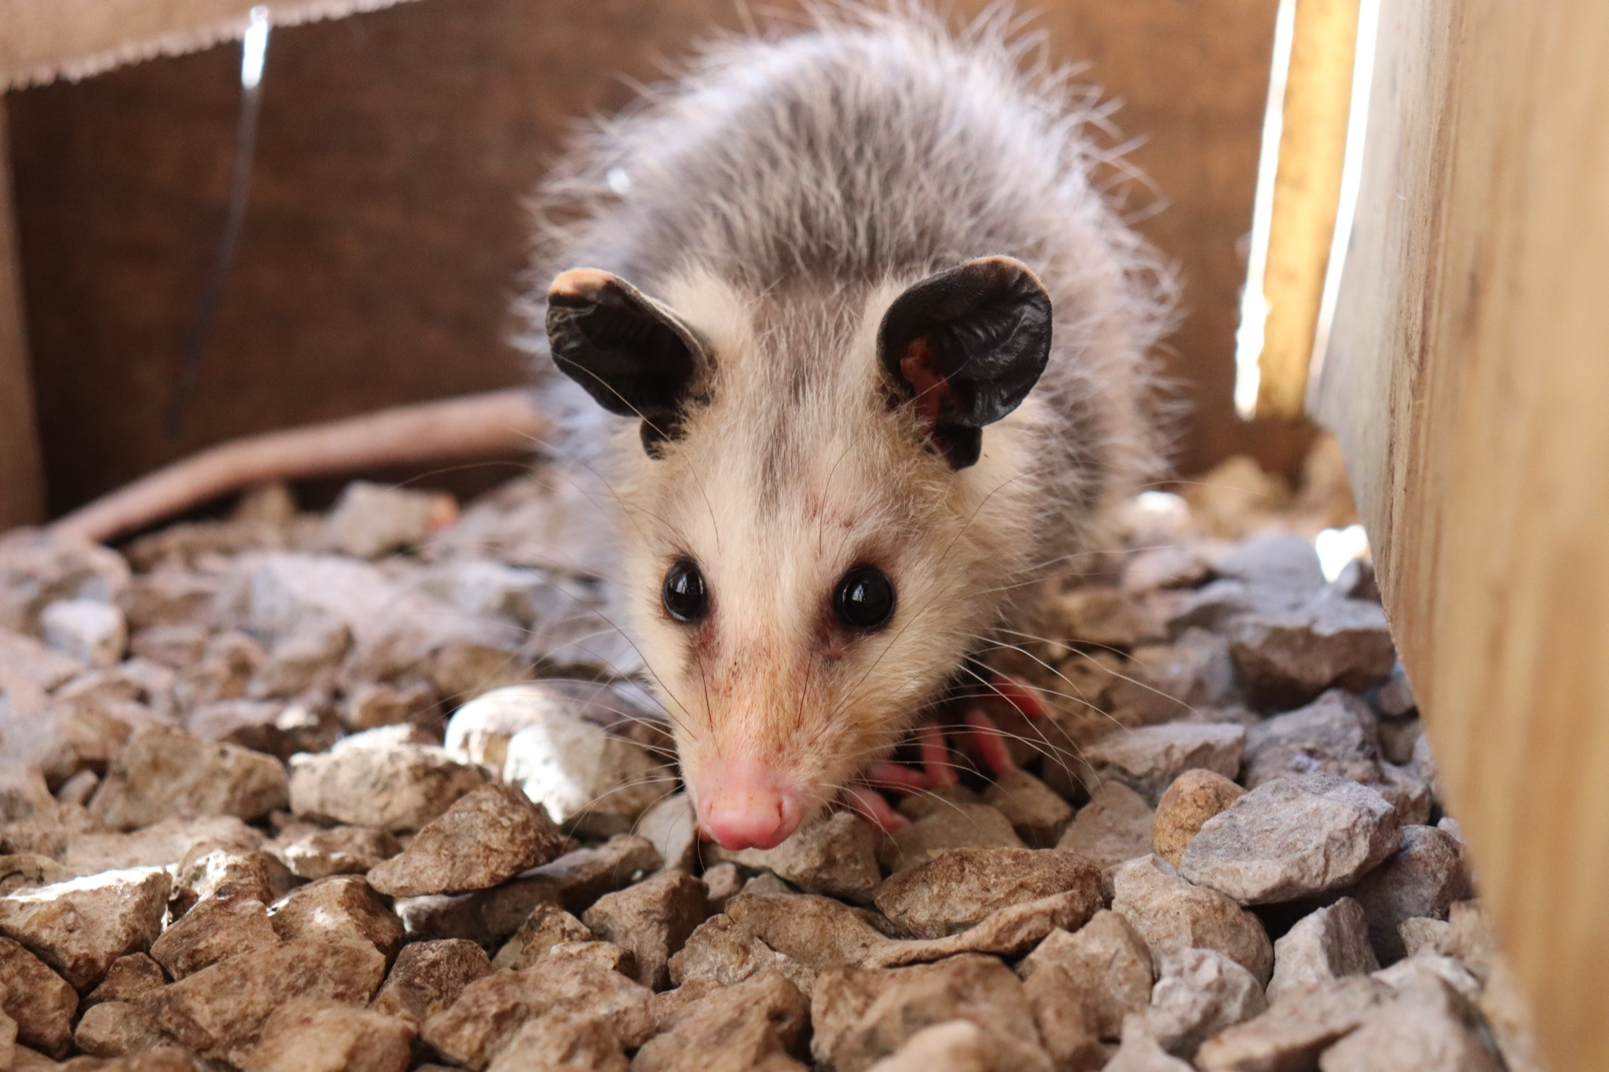
ᏔᎵᏁ ᏣᎳᎩ ᎠᏕᎶᏆᏍᏗ-
ᏏᏆ ᎤᏤᏥᏍᏗ

Slide 5
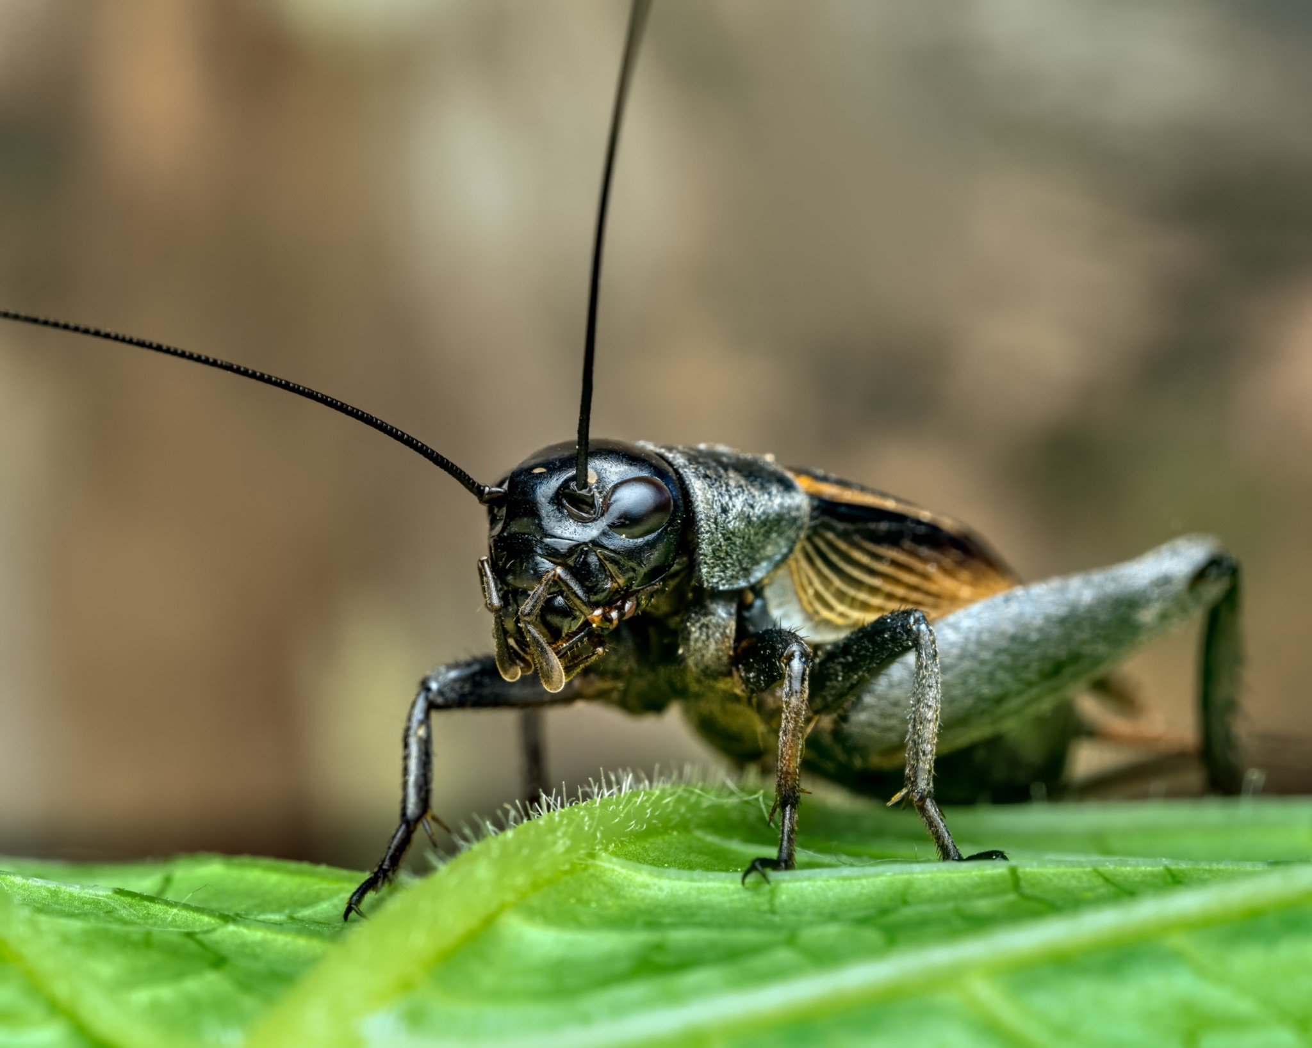
ᏔᎵᏁ ᏣᎳᎩ ᎠᏕᎶᏆᏍᏗ-
ᏔᎳᏚ

Slide 6
ᏔᎵᏁ ᏣᎳᎩ ᎠᏕᎶᏆᏍᏗ-
Atlvquisga- he’s bragging
Altawoa- he’s combing his hair
Galvhwesdi- he’s winding it up
Ayega- he’s waking up
Alsgia- he’s dancing
Dekanogia- he’s singing
Degukdiha- he’s deciding
Dadeyohvsga- he’s teaching
Atayohihv- he’s asking

Slide 7
ᏔᎵᏁ ᏣᎳᎩ ᎠᏕᎶᏆᏍᏗ
Ilvhiyu jigesv siqua ujetsd ehe.
A long time ago there was a possum.
ᎢᎸᎯᏳ ᏥᎨᏒ ᏏᏆ ᎤᏤᏥᏍᏗ ᎡᎮ.

Slide 8
ᏔᎵᏁ ᏣᎳᎩ ᎠᏕᎶᏆᏍᏗ
Doyu uwodu gese ganidadv.
His tail was really beautiful.
ᏙᏳ ᎤᏬᏚ ᎨᏎ ᎦᏂᏓᏛ.

Slide 9
ᏔᎵᏁ ᏣᎳᎩ ᎠᏕᎶᏆᏍᏗ
Ganidadv nigolv atlvquisde siqua ujetsd.
He was always bragging about his tail.
ᎦᏂᏓᏛ ᏂᎪᎸ ᎠᏢᏈᏍᏕ ᏏᏆ ᎤᏤᏥᏍᏗ.

Slide 10
ᏔᎵᏁ ᏣᎳᎩ ᎠᏕᎶᏆᏍᏗ
ulsinvsv ganidadv altawosge.
Nightly he would comb his tail.
ᎤᎵᏏᏅᏒ ᎦᏂᏓᏛ ᎠᎵᏔᏬᏍᎨ.

Slide 11
ᏔᎵᏁ ᏣᎳᎩ ᎠᏕᎶᏆᏍᏗ
Ale gigage asti galvwestisgo ganidadv.
And he would wrap it up in a red string.

Slide 12
ᏔᎵᏁ ᏣᎳᎩ ᎠᏕᎶᏆᏍᏗ
Ugitsisgv ayege alsgisidohe ganidadv alihelige dekanogisgv.
At dawn, he would wake up then he would dance and sing about his tail.
ᎤᎩᏥᏍᎬ ᎠᏰᎨ ᎠᎵᏍᎩᏏᏙᎮ ᎦᏂᏓᏛ ᎠᎵᎮᎵᎨ ᏕᎧᏃᎩᏍᎬ.

Slide 13
ᏔᎵᏁ ᏣᎳᎩ ᎠᏕᎶᏆᏍᏗ
Nigad tla yidunilvqde atlvquisgv
Everyone didn’t like his bragging.
ᏂᎦᏓ Ꮭ ᏱᏚᏂᎸᏈᏕ ᎠᏢᏈᏍᎬ.

Slide 14
ᏔᎵᏁ ᏣᎳᎩ ᎠᏕᎶᏆᏍᏗ
Adeloquasdidv duniwuktane unadehyodi
They decided to teach him a lesson
ᎠᏕᎶᏆᏍᏗᏛ ᏚᏂᏭᎧᏔᏁ ᎤᎾᏕᏲᏗ

Slide 15
ᏔᎵᏁ ᏣᎳᎩ ᎠᏕᎶᏆᏍᏗ
Taladu wunitahyotle gohusdi udvhndi
They asked cricket to do something.
ᏔᎳᏚ ᏭᏂᏔᏲᏞ ᎪᎱᏍᏗ ᎤᏛᏅᏗ.

Slide 16
ᏔᎵᏁ ᏣᎳᎩ ᎠᏕᎶᏆᏍᏗ
Usv nulsdan, taladu wuluji ujetsdi juwenvse.
That night, the cricket went to the possum’s place.
ᎤᏒ ᏄᎵᏍᏔᏅ, ᏔᎳᏚ ᏭᎷᏥ ᎤᏤᏥᏍᏗ ᏧᏪᏅᏎ.

Slide 17
ᏔᎵᏁ ᏣᎳᎩ ᎠᏕᎶᏆᏍᏗ
Nuwandese gigage asti ulvwesdv
He unwrapped the possum’s tail.
ᏄᏩᎾᏕᏎ ᎩᎦᎨ ᎠᏍᏘ ᎤᎸᏪᏍᏛ

Slide 18
ᏔᎵᏁ ᏣᎳᎩ ᎠᏕᎶᏆᏍᏗ
Taladu wugalse utsetsdi ganidadv ustigv.
The cricket cut off the hair on possum’s tail.
ᏔᎳᏚ ᏭᎦᎵᏎ ᎤᏤᏥᏍᏗ ᎦᏂᏓᏛ ᎤᏍᏘᎬ.

Slide 19
ᏔᎵᏁ ᏣᎳᎩ ᎠᏕᎶᏆᏍᏗ
Gigage asti ulvwestanv ganidadv.
He wrapped his tail in red string.
ᎩᎦᎨ ᎠᏍᏘ ᎤᎸᏪᏍᏔᏅ ᎦᏂᏓᏛ.

Slide 20
ᏔᎵᏁ ᏣᎳᎩ ᎠᏕᎶᏆᏍᏗ
uyejv utsetsdi, tla yuhnte gohusdi nulstanidolv
When the possum woke up, he didn’t know anything happened
ᎤᏰᏨ ᎤᏤᏥᏍᏗ Ꮭ ᏳᎾᏖ ᎪᎱᏍᏗ ᏄᎵᏍᏔᏂᏙᎸ.

Slide 21
ᏔᎵᏁ ᏣᎳᎩ ᎠᏕᎶᏆᏍᏗ
nuwandese gigage asti unvgowsv gesv ustigv
When he took off the red string, the hair had fallen out.
ᏄᏩᎾᏕᏎ ᎩᎦᎨ ᎠᏍᏘ ᎤᏅᎪᏩᏒ ᎨᏒ ᎤᏍᏘᎬ

Slide 22
ᏔᎵᏁ ᏣᎳᎩ ᎠᏕᎶᏆᏍᏗ
uyelvha gese ganidadv
His tail was naked.
ᎤᏰᎸᎭ ᎨᏎ ᎦᏂᏓᏛ

Slide 23
ᏔᎵᏁ ᏣᎳᎩ ᎠᏕᎶᏆᏍᏗ
Doyu udehose uyelvha ganidadv tsigesv.
He was really embarrassed that his tail was bare.
ᏙᏳ ᎤᏕᎰᏎ ᎤᏰᎸᎭ ᎦᏂᏓᏛ ᏥᎨᏒ.

Slide 24
ᏔᎵᏁ ᏣᎳᎩ ᎠᏕᎶᏆᏍᏗ
Nowu usvi yinulsdani kila ganugogo, si uyelvha ganidadv geso.
Now, he only goes out at night, and still his tail is bare.
ᏃᏭ ᎤᏒᎢ ᏱᏄᎵᏍᏓᏂ ᎩᎳ ᎦᏄᎪᎪ, Ꮟ ᎤᏰᎸᎭ ᎦᏂᏓᏛ ᎨᏐ.

