Slide 1
ᎣᏏᏲ
ᏔᎵᏍᎪᎯᏁ ᏣᎳᎩ ᎠᏕᎶᏆᏍᏗ

Slide 2
ᏔᎵᏍᎪᎯᏁ ᏣᎳᎩ ᎠᏕᎶᏆᏍᏗ
ᎢᏓᎴᎾ- Let’s begin
ᏣᎳᎩ ᎢᏗᏬᏂ- Let’s talk Cherokee

Slide 3
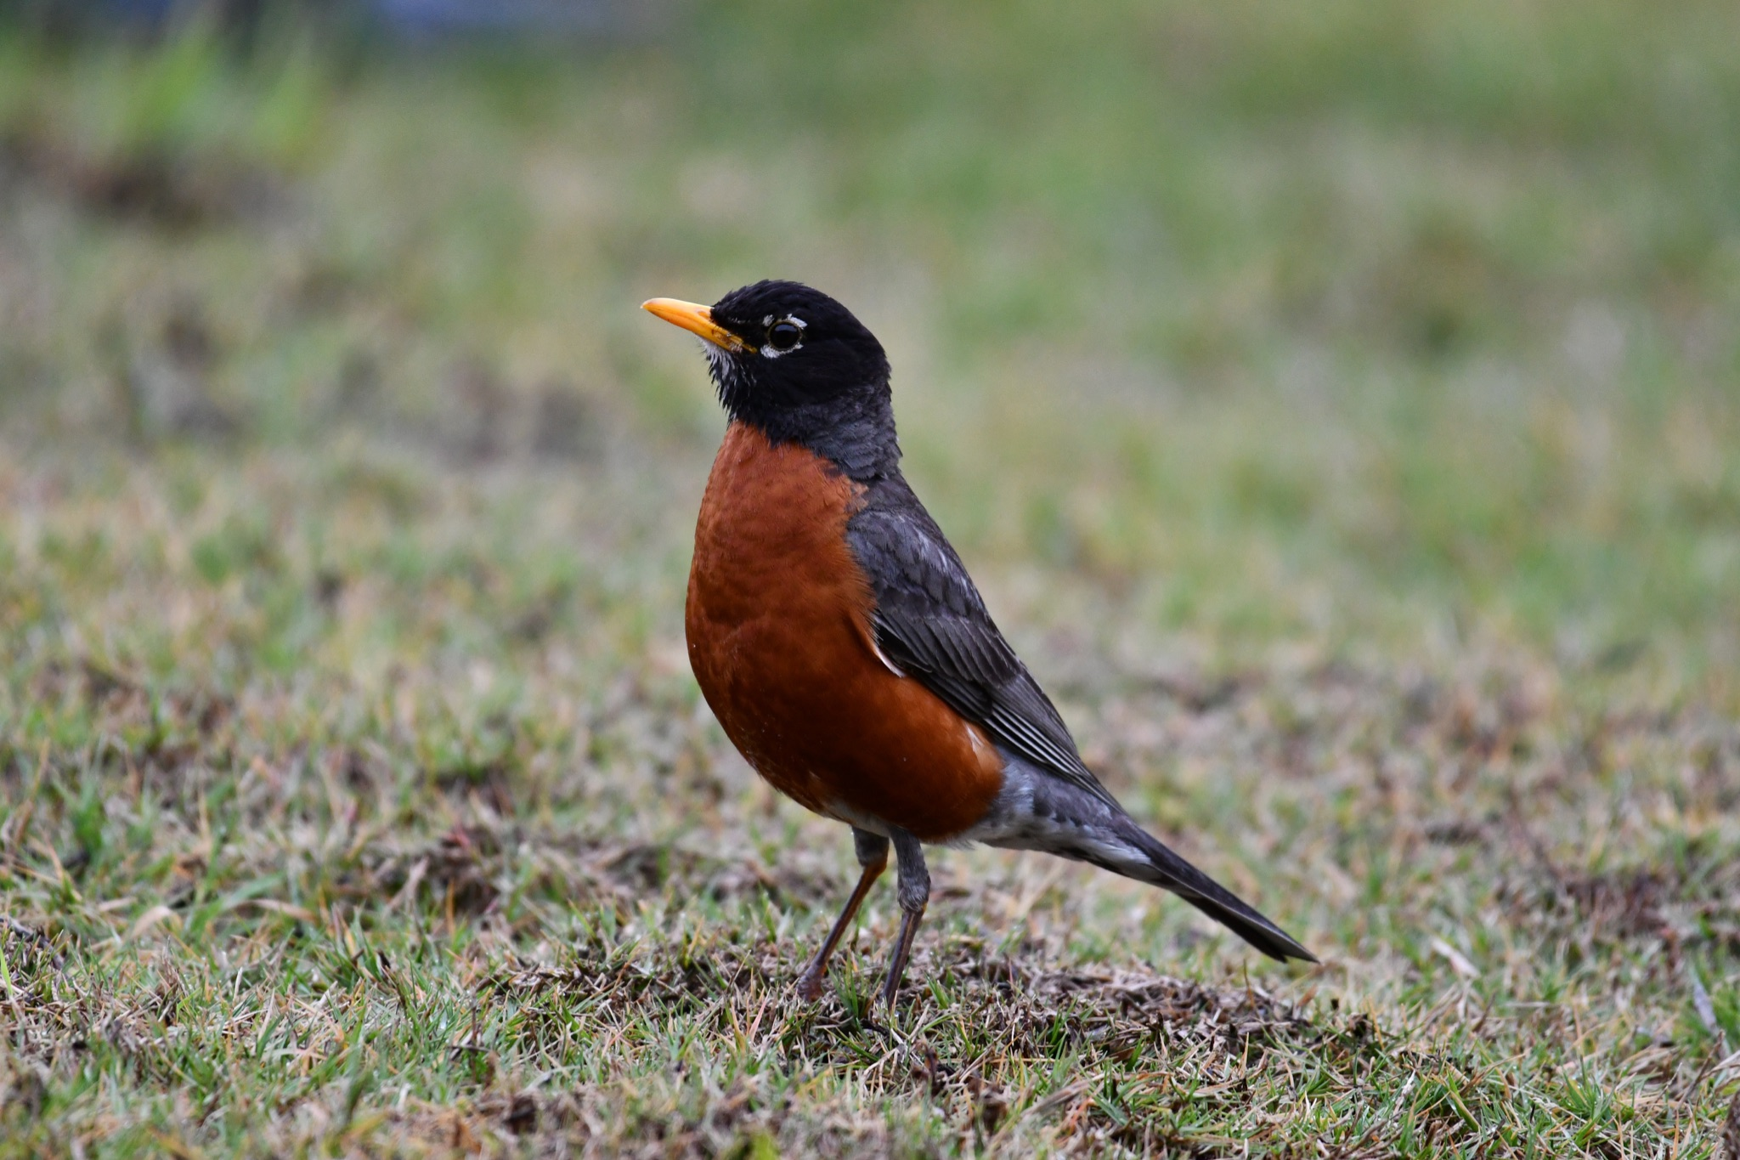
ᏔᎳᏚᏏᏁ ᏣᎳᎩ ᎠᏕᎶᏆᏍᏗ
ᎦᎪ ᏥᏍᏉᏉ ᎤᏢ?
ᎠᏯ ᎤᏛᏁ ᏥᏍᏆᏯ
ᎦᎵᏣᏗ ᎠᎴ ᎦᏟᏓ ᎠᏋᏔᏅ
ᏥᏍᏉᏉ ᏥᏢ.
Notes:
aksdayvhvsg

Slide 4
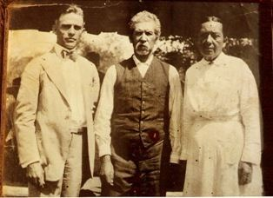
ᏔᎵᏍᎪᎯᏁ ᏣᎳᎩ ᎠᏕᎶᏆᏍᏗ
ᎯᏲᎵᎩᏍ ᎯᎠ ᎠᏍᎦᏯ ᎠᏰtᎵ ᏥᎦᏙᎦ?
Do you know the man in the center?

Slide 5
ᏔᎵᏍᎪᎯᏁ ᏣᎳᎩ ᎠᏕᎶᏆᏍᏗ
ᎯᏲᎵᎦ ᏂᎨᏒᎾ ᏱᎩ, Redbird Smith ᏚᏙᎡ.
If you don’t know him, Redbird Smith was his name.

Slide 6
ᏔᎵᏍᎪᎯᏁ ᏣᎳᎩ ᎠᏕᎶᏆᏍᏗ
ᏙᏧᏩ ᏏᏆᏂᏓ ᏚᏙᎡ, ᏣᎳᎩ ᎬᏗ.
And in Cherokee, his name was tojuwa siquanid.

Slide 7
ᏔᎵᏍᎪᎯᏁ ᏣᎳᎩ ᎠᏕᎶᏆᏍᏗ
ᏏᏛ ᎣᏣᎵᎮᎵᎦ ᎯᎢᎾ ᏧᎵᏍᎨᏓ ᎠᏍᎦᏯ.
We still are grateful to this important man.

Slide 8
ᏔᎵᏍᎪᎯᏁ ᏣᎳᎩ ᎠᏕᎶᏆᏍᏗ
ᏌᏊ ᎢᏯᎦᏴᎵ ᏣᏁᎳᏍᎪᎯᏥᏍᏊ ᎯᎩᏍᎪᎯ, ᎤᏕᏁ ᏙᏧᏩ ᏏᏆᏂᏓ.
Redbird Smith was born in 1850.

