Slide 1
ᎣᏏᏲ
ᏔᎵᏍᎪᎯᏁ ᏌᏊᎢᏁ ᏌᏊ ᏌᏊ ᏣᎳᎩ ᎠᏕᎶᏆᏍᏗ

Slide 2
ᏔᎵᏍᎪᎯᏁ ᏌᏊᎢᏁ ᏌᏊ ᏌᏊ ᏣᎳᎩ ᎠᏕᎶᏆᏍᏗ
ᎢᏓᎴᎾ- Let’s begin
ᏣᎳᎩ ᎢᏗᏬᏂ- Let’s talk Cherokee

Slide 3
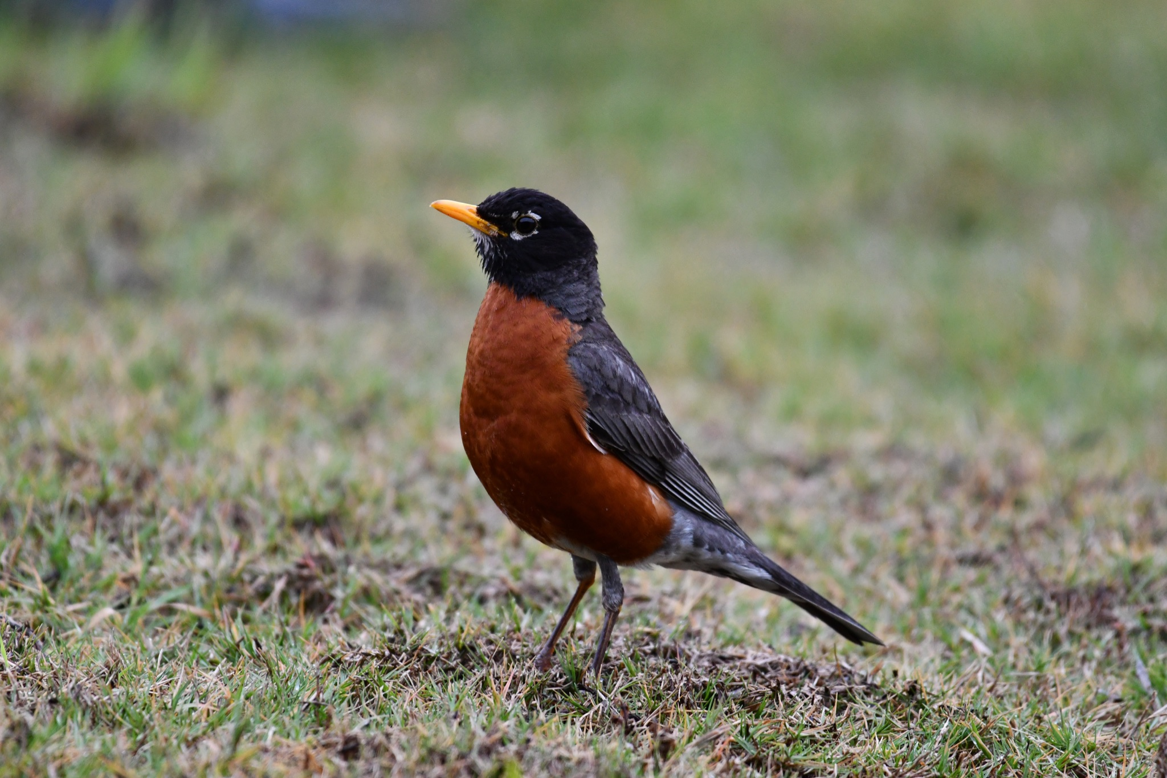
ᏔᎳᏚᏏᏁ ᏣᎳᎩ ᎠᏕᎶᏆᏍᏗ
ᎦᎪ ᏥᏍᏉᏉ ᎤᏢ?
ᎠᏯ ᎤᏛᏁ ᏥᏍᏆᏯ
ᎦᎵᏣᏗ ᎠᎴ ᎦᏟᏓ ᎠᏋᏔᏅ
ᏥᏍᏉᏉ ᏥᏢ.
Notes:
aksdayvhvsg

Slide 4
ᏔᎳᏚᏏᏁ ᏣᎳᎩ ᎠᏕᎶᏆᏍᏗ
Notes:
aksdayvhvsg

Slide 5
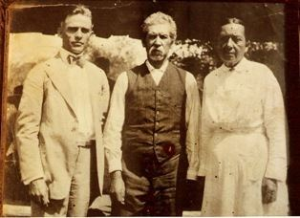
ᏔᎵᏍᎪᎯᏁ ᏌᏊᎢᏁ ᏌᏊ ᏌᏊ ᏣᎳᎩ ᎠᏕᎶᏆᏍᏗ
ᎯᏲᎵᎩᏍ ᎯᎠ ᎠᏍᎦᏯ ᎠᏰᏟ ᏥᎦᏙᎦ?
Do you know the man in the center?

Slide 6
ᏔᎵᏍᎪᎯᏁ ᏌᏊᎢᏁ ᏌᏊ ᏌᏊ ᏣᎳᎩ ᎠᏕᎶᏆᏍᏗ
ᎯᏲᎵᎦ ᏂᎨᏒᎾ ᏱᎩ, Redbird Smith ᏚᏙᎡ.
If you don’t know him, Redbird Smith was his name.

Slide 7
ᏔᎵᏍᎪᎯᏁ ᏌᏊᎢᏁ ᏌᏊ ᏌᏊ ᏣᎳᎩ ᎠᏕᎶᏆᏍᏗ
ᏙᏧᏩ ᏏᏆᏂᏓ ᏚᏙᎡ, ᏣᎳᎩ ᎬᏗ.
And in Cherokee, his name was tojuwa siquanid.

Slide 8
ᏔᎵᏍᎪᎯᏁ ᏌᏊᎢᏁ ᏌᏊ ᏌᏊ ᏣᎳᎩ ᎠᏕᎶᏆᏍᏗ
ᏏᏛ ᎣᏣᎵᎮᎵᎦ ᎯᎢᎾ ᏧᎵᏍᎨᏓ ᎠᏍᎦᏯ.
We still are grateful to this important man.

Slide 9
ᏔᎵᏍᎪᎯᏁ ᏌᏊᎢᏁ ᏌᏊ ᏌᏊ ᏣᎳᎩ ᎠᏕᎶᏆᏍᏗ
ᏌᏊ ᎢᏯᎦᏴᎵ ᏣᏁᎳᏍᎪᎯᏥᏍᏊ ᎯᎩᏍᎪᎯ, ᎤᏕᏁ ᏙᏧᏩ ᏏᏆᏂᏓ.
Redbird Smith was born in 1850.

Slide 10
ᏔᎵᏍᎪᎯᏁ ᏌᏊᎢᏁ ᏌᏊ ᏌᏊ ᏣᎳᎩ ᎠᏕᎶᏆᏍᏗ
ᎪᎯ ᏥᎩ ᎫᏰᏉᏂ ᏐᏁᎳᏚᏏᏁ ᎣᏣᎵᎮᎵᎪ ᎤᏕᏘᏱᏍᎬ, ᏝᏍᎩᏃ Ꮩ ᏲᎦᎾᏙ Ꮩ ᎤᏕᏘᏱᏍᎬ.
Today, we celebrate his birthday on July 19, but we don’t know exactly what day he was born.

Slide 11
ᏔᎵᏍᎪᎯᏁ ᏌᏊᎢᏁ ᏌᏊ ᏌᏊ ᏣᎳᎩ ᎠᏕᎶᏆᏍᏗ
ᏙᏧᏩ ᏏᏆᏂᏓ ᎤᏕᏘᏱᏍᎬ ᏱᏄᎵᏍᏓᏂ ᎠᏂᎩᏚᏩᎩ ᎠᏂᏴᏫᏯ ᎦᏘᏲ ᎠᏁᎪ.
Every year, hundreds of Kituwas go to different ceremonial grounds for his birthday.

Slide 12
ᏔᎵᏍᎪᎯᏁ ᏌᏊᎢᏁ ᏌᏊ ᏌᏊ ᏣᎳᎩ ᎠᏕᎶᏆᏍᏗ
ᎦᏙᎨ ᏙᏧᏩ ᏏᏆᏂᏓ ᎤᎵᏍᎨᏓ ᏥᎩ?
So why is Redbird Smith so important?

Slide 13
ᏔᎵᏍᎪᎯᏁ ᏌᏊᎢᏁ ᏌᏊ ᏌᏊ ᏣᎳᎩ ᎠᏕᎶᏆᏍᏗ
ᏙᏧᏩ ᎤᏙᏓ Pig Smith ᏚᏙᎡ. ᏏᏆᏂᏓ ᏣᎳᎩ ᎬᏗ ᏚᏙᎡ. ᎣᏂ Smith ᎠᏂᏲᏁᎦ ᏚᏃᎡ, ᎠᏎ ᎪᏢᏅᎥᏍᎩ ᏥᎨᏎ ᏳᏍᏗ
Redbirds father was Young Pig Smith. Young Pig was his Cherokee name and the whites called him Smith because he worked as a blacksmith.

Slide 14
ᏔᎵᏍᎪᎯᏁ ᏌᏊᎢᏁ ᏌᏊ ᏌᏊ ᏣᎳᎩ ᎠᏕᎶᏆᏍᏗ
ᏙᏧᏩ ᎤᏥ Lizzie Hildebrand ᏚᏙᎡ.
Redbird’s mother was Lizzie Hildebrand.

