Slide 1
ᎣᏏᏲ
ᏔᎵᏍᎪ ᏅᎩᏁ ᏣᎳᎩ ᎠᏕᎶᏆᏍᏗ

Slide 2
ᏔᎵᏍᎪ ᏅᎩᏁ ᏣᎳᎩ ᎠᏕᎶᏆᏍᏗ
ᎢᏓᎴᎾ- Let’s begin
ᏣᎳᎩ ᎢᏗᏬᏂ- Let’s talk Cherokee

Slide 3
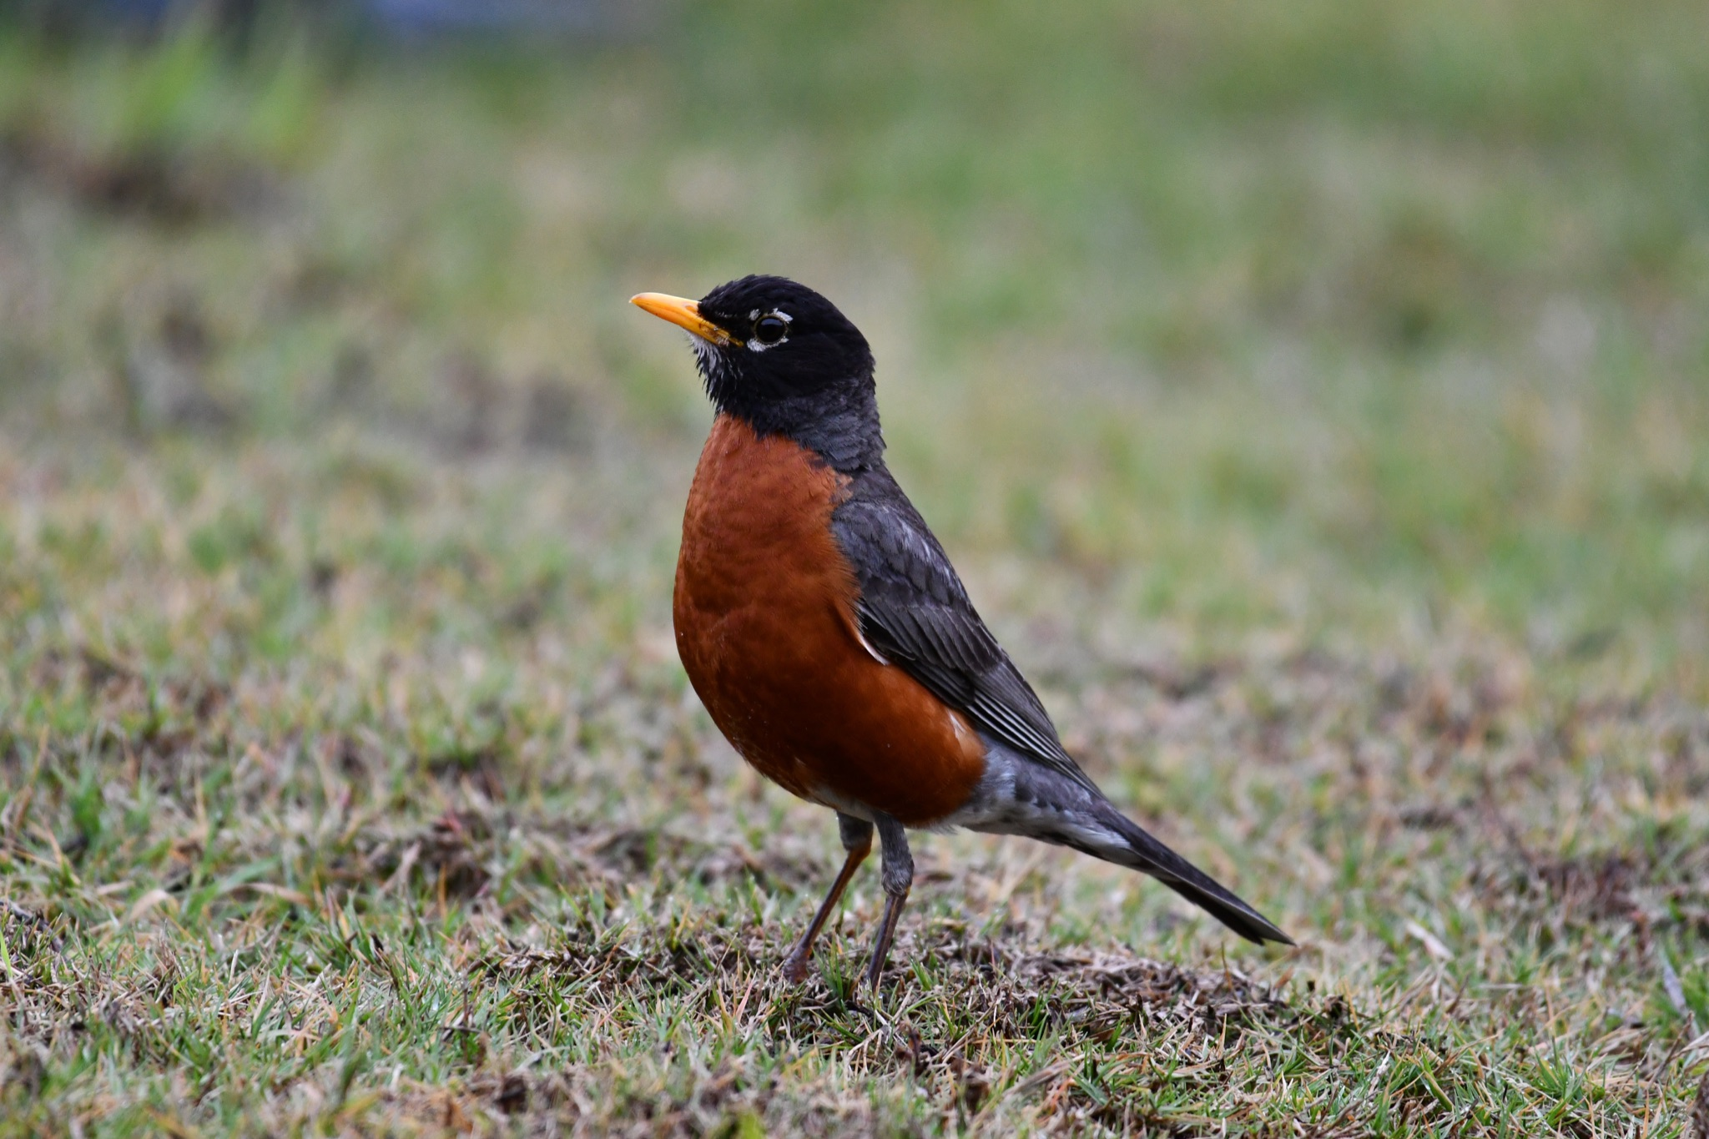
ᏔᎳᏚᏏᏁ ᏣᎳᎩ ᎠᏕᎶᏆᏍᏗ
ᎦᎪ ᏥᏍᏉᏉ ᎤᏢ?
ᎠᏯ ᎤᏛᏁ ᏥᏍᏆᏯ
ᎦᎵᏣᏗ ᎠᎴ ᎦᏟᏓ ᎠᏋᏔᏅ
ᏥᏍᏉᏉ ᏥᏢ.
Notes:
aksdayvhvsg

Slide 4
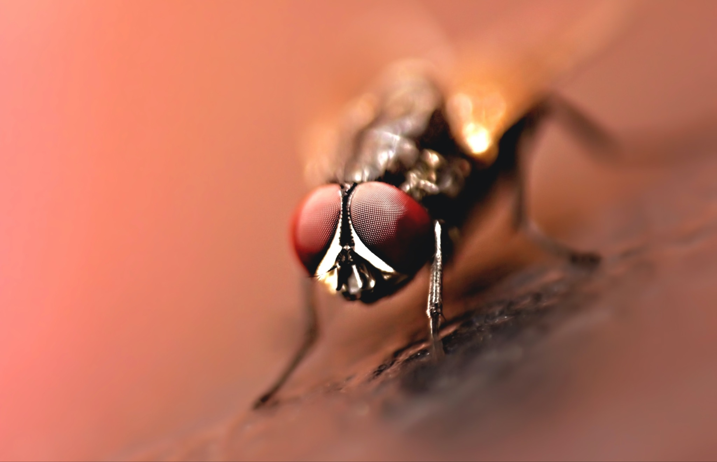
ᏔᎳᏚᏏᏁ ᏣᎳᎩ ᎠᏕᎶᏆᏍᏗ
ᎦᎪ ᎤᎪᎲ ᎤᏲᎱᏒ?
ᎠᏯ, ᎤᏛᏁ ᏛᎩ.
ᏗᏥᎦᏙᎵ ᏓᏋᏔᏅ.
ᏥᎪᎲ ᎤᏲᎱᏒ.
Notes:
aksdayvhvsg

Slide 5
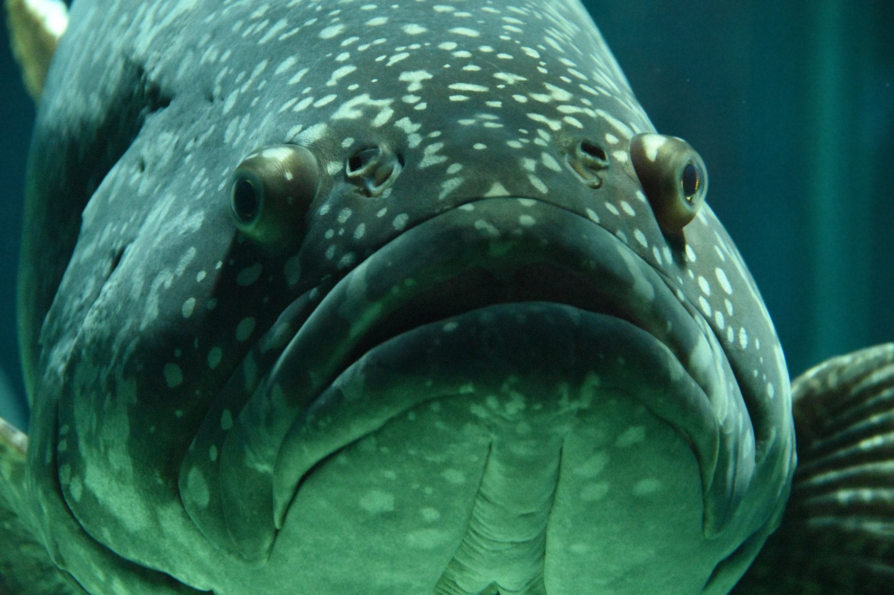
ᏔᎳᏚᏏᏁ ᏣᎳᎩ ᎠᏕᎶᏆᏍᏗ
ᎦᎪ ᎩᎦ ᎤᏂᏴᎲ?
ᎠᏯ, ᎤᏛᏁ ᎠᏣᏗ
ᎤᏍᏗ ᎤᎾᏪᏓ ᎠᏋᏔᏅ
ᎩᎦ ᎠᎩᏂᏴᎲ
Notes:
aksdayvhvsg

Slide 6
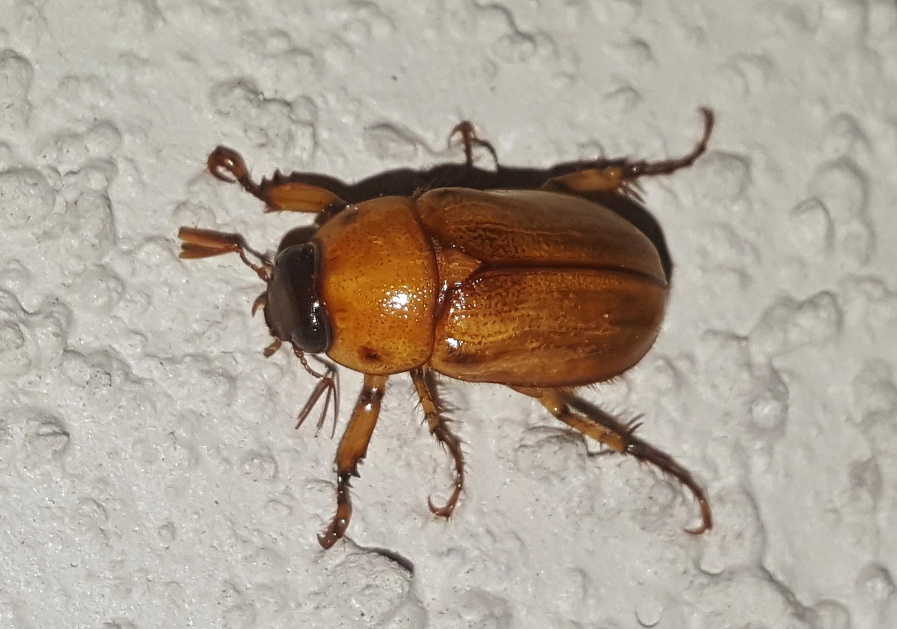
ᏔᎳᏚᏏᏁ ᏣᎳᎩ ᎠᏕᎶᏆᏍᏗ
ᎦᎪ ᎤᏢᏍᏗ ᎪᏢᏍᎨᏍᏗ
ᎠᏯ, ᎤᏛᏁ ᏙᎦ
ᎠᏍᏘ ᎠᎴ ᏴᎩ ᎠᏋᏔᏅ
ᎤᏢᏍᏗ ᎪᏢᏍᎨᏍᏗ
Notes:
aksdayvhvsg

Slide 7
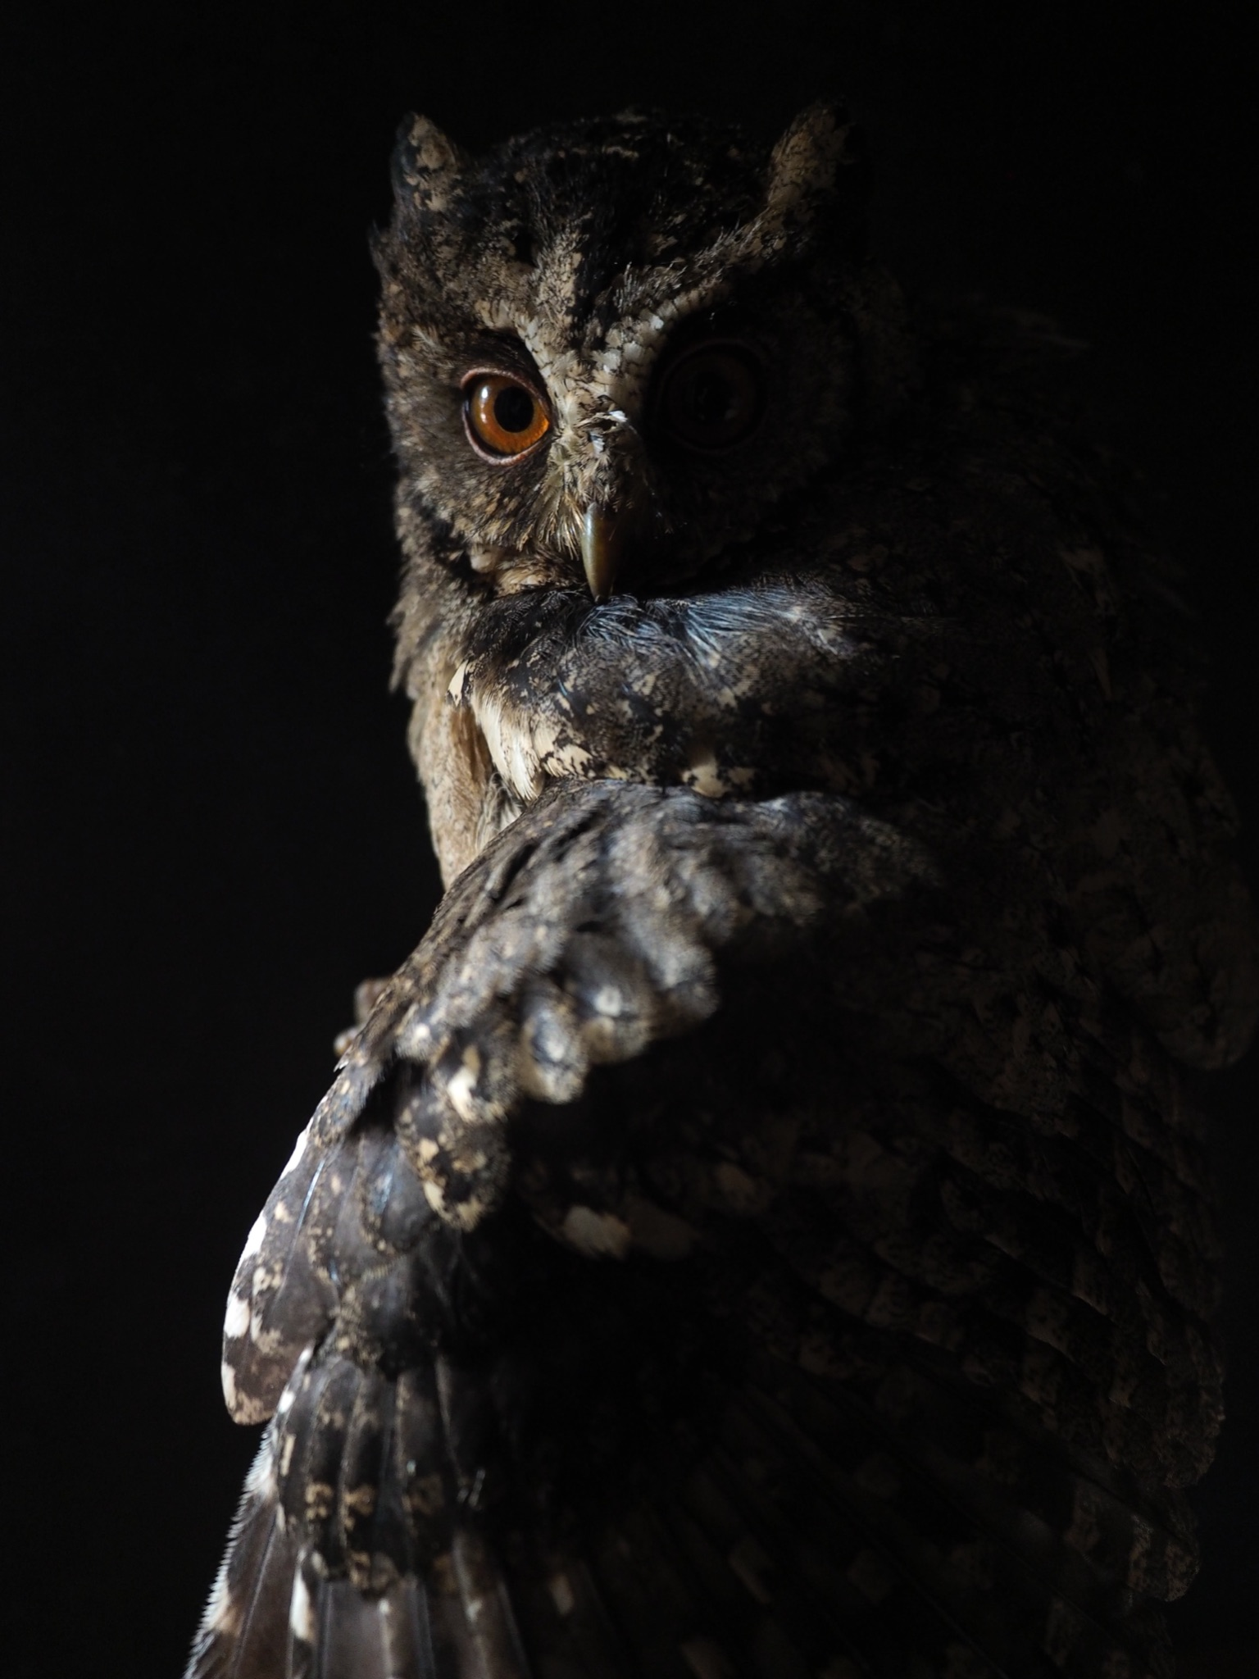
ᏔᎳᏚᏏᏁ ᏣᎳᎩ ᎠᏕᎶᏆᏍᏗ
ᎦᎪ ᎦᏂᏌᎲ ᎠᏍᎪᏍᎨᏍᏗ?
ᎠᏯ, ᎤᏛᏁ ᎤᎫᎫ.
ᎪᏕᏍᏗ ᎠᏋᏔᏅ
ᎦᏍᎪᏍᎨᏍᏗ ᎦᏂᏌᎲ.
Notes:
aksdayvhvsg

Slide 8
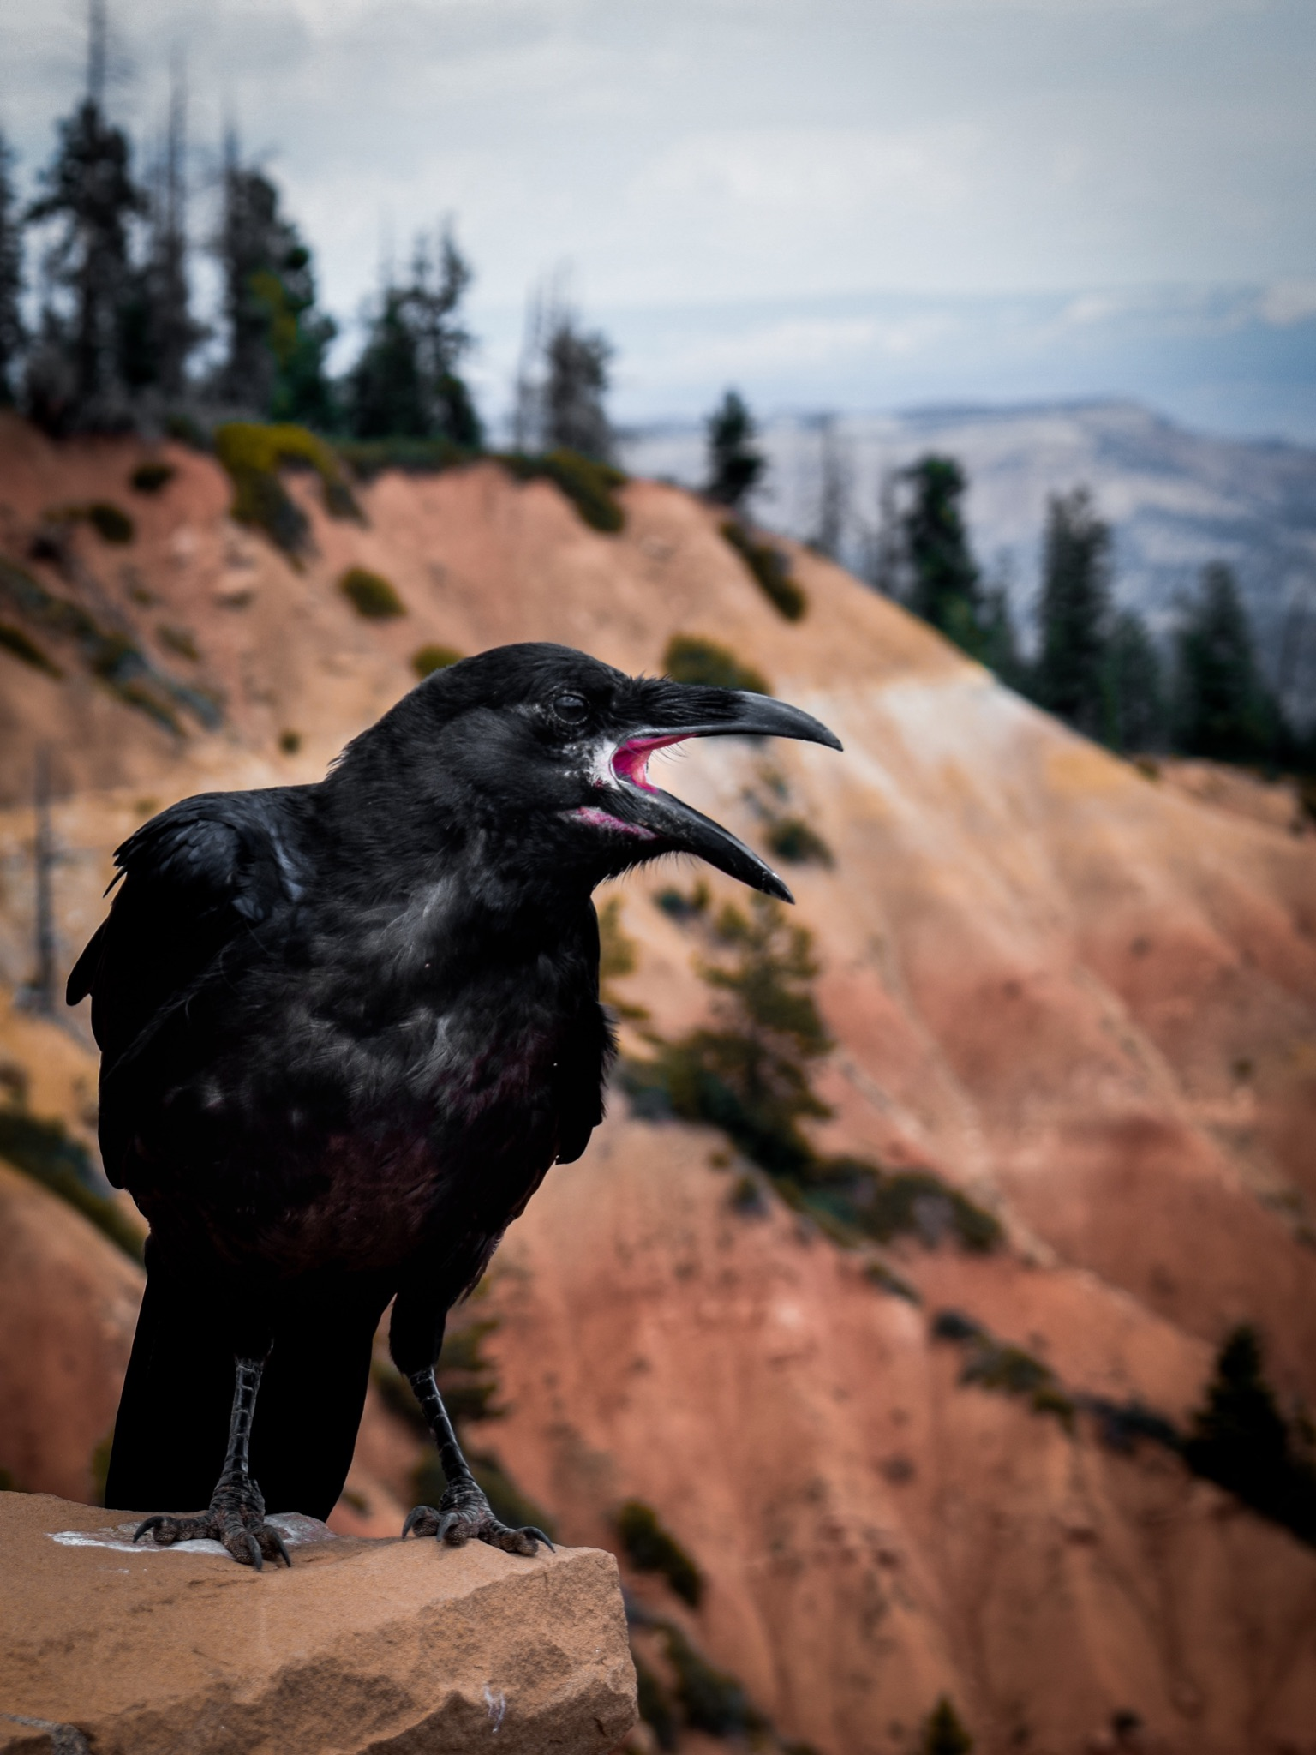
ᏔᎳᏚᏏᏁ ᏣᎳᎩ ᎠᏕᎶᏆᏍᏗ
ᎦᎪ ᎠᎵᏣᏙᎲᏍᎩ ᎨᏎᏍᏗ?
ᎠᏯ, ᎤᏛᏁ ᎪᎦ.
ᏧᎭᎨᏓ ᎪᏪᎵ ᎠᏋᏔᏅ
ᏥᎵᏣᏙᎲᏍᎩ ᎨᏎᏍᏗ.
Notes:
aksdayvhvsg

Slide 9
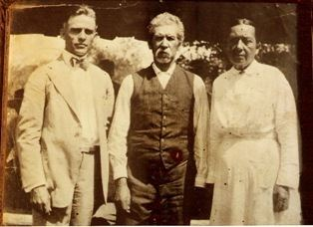
ᏔᎵᏍᎪ ᏅᎩᏁ ᏣᎳᎩ ᎠᏕᎶᏆᏍᏗ
ᎯᏲᎵᎩᏍ ᎯᎠ ᎠᏍᎦᏯ ᎠᏰᏟ ᏥᎦᏙᎦ?
Do you know the man in the center?

Slide 10
ᏔᎵᏍᎪ ᏅᎩᏁ ᏣᎳᎩ ᎠᏕᎶᏆᏍᏗ
ᎯᏲᎵᎦ ᏂᎨᏒᎾ ᏱᎩ, Redbird Smith ᏚᏙᎡ.
If you don’t know him, Redbird Smith was his name.

Slide 11
ᏔᎵᏍᎪ ᏅᎩᏁ ᏣᎳᎩ ᎠᏕᎶᏆᏍᏗ
ᏙᏧᏩ ᏏᏆᏂᏓ ᏚᏙᎡ, ᏣᎳᎩ ᎬᏗ.
And in Cherokee, his name was tojuwa siquanid.

Slide 12
ᏔᎵᏍᎪ ᏅᎩᏁ ᏣᎳᎩ ᎠᏕᎶᏆᏍᏗ
ᏏᏛ ᎣᏣᎵᎮᎵᎦ ᎯᎢᎾ ᏧᎵᏍᎨᏓ ᎠᏍᎦᏯ.
We still are grateful to this important man.

Slide 13
ᏔᎵᏍᎪ ᏅᎩᏁ ᏣᎳᎩ ᎠᏕᎶᏆᏍᏗ
ᏌᏊ ᎢᏯᎦᏴᎵ ᏣᏁᎳᏍᎪᎯᏥᏍᏊ ᎯᎩᏍᎪᎯ, ᎤᏕᏁ ᏙᏧᏩ ᏏᏆᏂᏓ.
Redbird Smith was born in 1850.

Slide 14
ᏔᎵᏍᎪ ᏅᎩᏁ ᏣᎳᎩ ᎠᏕᎶᏆᏍᏗ
ᎪᎯ ᏥᎩ ᎫᏰᏉᏂ ᏐᏁᎳᏚᏏᏁ ᎣᏣᎵᎮᎵᎪ ᎤᏕᏘᏱᏍᎬ, ᏝᏍᎩᏃ Ꮩ ᏲᎦᎾᏙ Ꮩ ᎤᏕᏘᏱᏍᎬ.
Today, we celebrate his birthday on July 19, but we don’t know exactly what day he was born.

Slide 15
ᏔᎵᏍᎪ ᏅᎩᏁ ᏣᎳᎩ ᎠᏕᎶᏆᏍᏗ
ᏙᏧᏩ ᏏᏆᏂᏓ ᎤᏕᏘᏱᏍᎬ ᏱᏄᎵᏍᏓᏂ ᎠᏂᎩᏚᏩᎩ ᎠᏂᏴᏫᏯ ᎦᏘᏲ ᎠᏁᎪ.
Every year, hundreds of Kituwas go to different ceremonial grounds for his birthday.

Slide 16
ᏔᎵᏍᎪ ᏅᎩᏁ ᏣᎳᎩ ᎠᏕᎶᏆᏍᏗ
ᎦᏙᎨ ᏙᏧᏩ ᏏᏆᏂᏓ ᎤᎵᏍᎨᏓ ᏥᎩ?
So why is Redbird Smith so important?

Slide 17
ᏔᎵᏍᎪ ᏅᎩᏁ ᏣᎳᎩ ᎠᏕᎶᏆᏍᏗ
ᏙᏧᏩ ᎤᏙᏓ Pig Smith ᏚᏙᎡ. ᏏᏆᏂᏓ ᏣᎳᎩ ᎬᏗ ᏚᏙᎡ. ᎣᏂ Smith ᎠᏂᏲᏁᎦ ᏚᏃᎡ, ᎠᏎ ᎪᏢᏅᎥᏍᎩ ᏥᎨᏎ ᏳᏍᏗ
Redbirds father was Young Pig Smith. Young Pig was his Cherokee name and the whites called him Smith because he worked as a blacksmith.

Slide 18
ᏔᎵᏍᎪ ᏅᎩᏁ ᏣᎳᎩ ᎠᏕᎶᏆᏍᏗ
ᏙᏧᏩ ᎤᏥ Lizzie Hildebrand ᏚᏙᎡ. ᎢᏧᎳ ᎠᏣᎳᎩ ᎠᎴ ᎠᏛᏥ ᎨᏎ. ᏣᎳᎩ ᎤᏪᏘ, Lizzie udoda ᏗᏍᏙᏍᎩ ᏓᎸᏫᏍᏓᏁᎲ.
Redbird’s mother was Lizzie Hildebrand. She was both Cherokee and German. Lizzie’s father worked as a miller in the old homeland.
(Robert Thomas, Origin and Development of the Redbird Smith Movement, 1953)

