Slide 1
ᎣᏏᏲ
ᏔᎵᏍᎪ ᎯᏍᎩᏁ ᏣᎳᎩ ᎠᏕᎶᏆᏍᏗ

Slide 2
ᏔᎵᏍᎪ ᎯᏍᎩᏁ ᏣᎳᎩ ᎠᏕᎶᏆᏍᏗ
ᎢᏓᎴᎾ- Let’s begin
ᏣᎳᎩ ᎢᏗᏬᏂ- Let’s talk Cherokee

Slide 3
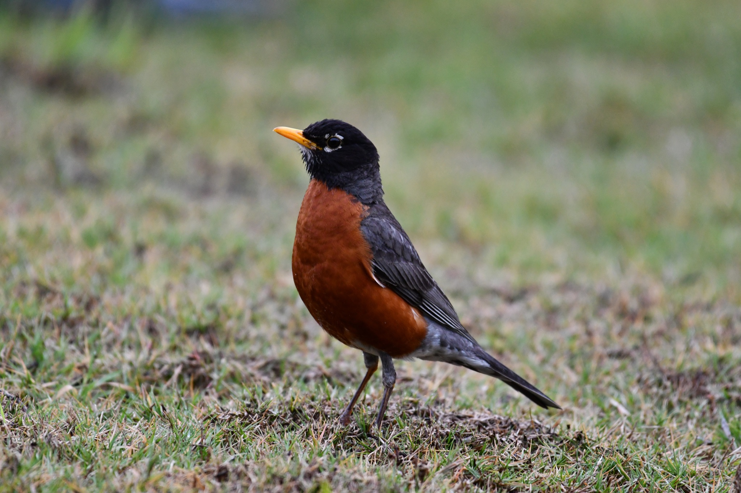
ᏔᎳᏚᏏᏁ ᏣᎳᎩ ᎠᏕᎶᏆᏍᏗ
ᎦᎪ ᏥᏍᏉᏉ ᎤᏢ?
ᎠᏯ ᎤᏛᏁ ᏥᏍᏆᏯ
ᎦᎵᏣᏗ ᎠᎴ ᎦᏟᏓ ᎠᏋᏔᏅ
ᏥᏍᏉᏉ ᏥᏢ.
Notes:
aksdayvhvsg

Slide 4
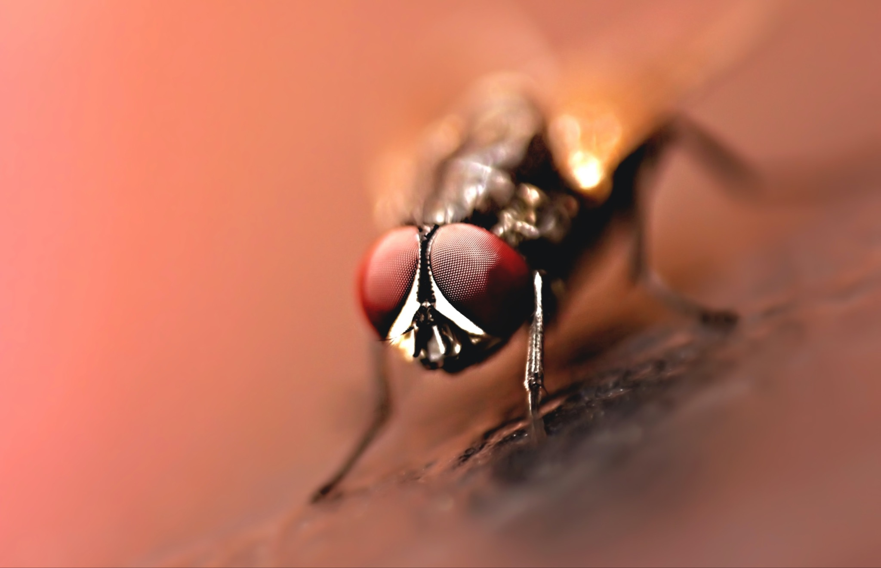
ᏔᎳᏚᏏᏁ ᏣᎳᎩ ᎠᏕᎶᏆᏍᏗ
ᎦᎪ ᎤᎪᎲ ᎤᏲᎱᏒ?
ᎠᏯ, ᎤᏛᏁ ᏛᎩ.
ᏗᏥᎦᏙᎵ ᏓᏋᏔᏅ.
ᏥᎪᎲ ᎤᏲᎱᏒ.
Notes:
aksdayvhvsg

Slide 5
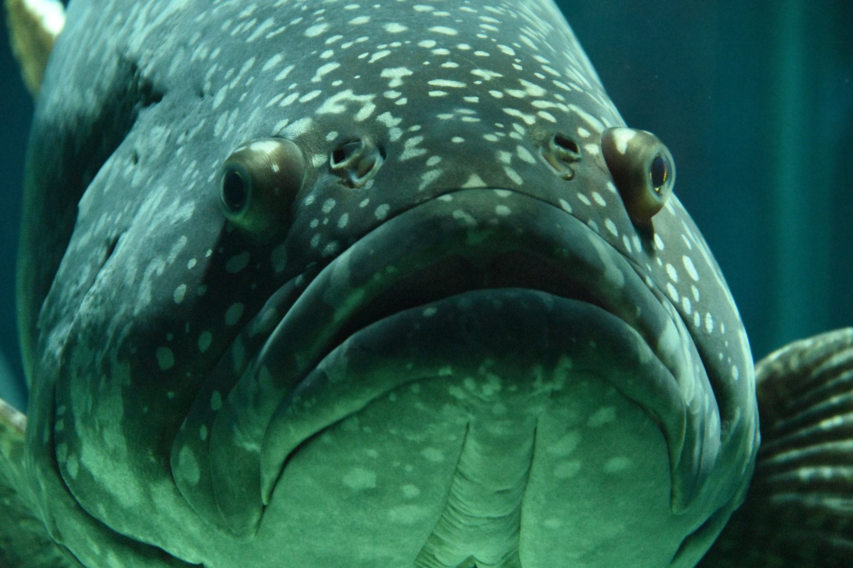
ᏔᎳᏚᏏᏁ ᏣᎳᎩ ᎠᏕᎶᏆᏍᏗ
ᎦᎪ ᎩᎦ ᎤᏂᏴᎲ?
ᎠᏯ, ᎤᏛᏁ ᎠᏣᏗ
ᎤᏍᏗ ᎤᎾᏪᏓ ᎠᏋᏔᏅ
ᎩᎦ ᎠᎩᏂᏴᎲ
Notes:
aksdayvhvsg

Slide 6
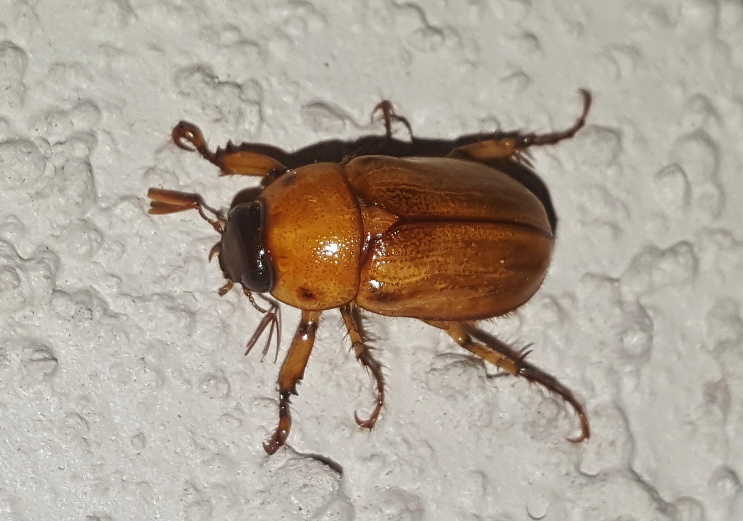
ᏔᎳᏚᏏᏁ ᏣᎳᎩ ᎠᏕᎶᏆᏍᏗ
ᎦᎪ ᎤᏢᏍᏗ ᎪᏢᏍᎨᏍᏗ
ᎠᏯ, ᎤᏛᏁ ᏙᎦ
ᎠᏍᏘ ᎠᎴ ᏴᎩ ᎠᏋᏔᏅ
ᎤᏢᏍᏗ ᎪᏢᏍᎨᏍᏗ
Notes:
aksdayvhvsg

Slide 7
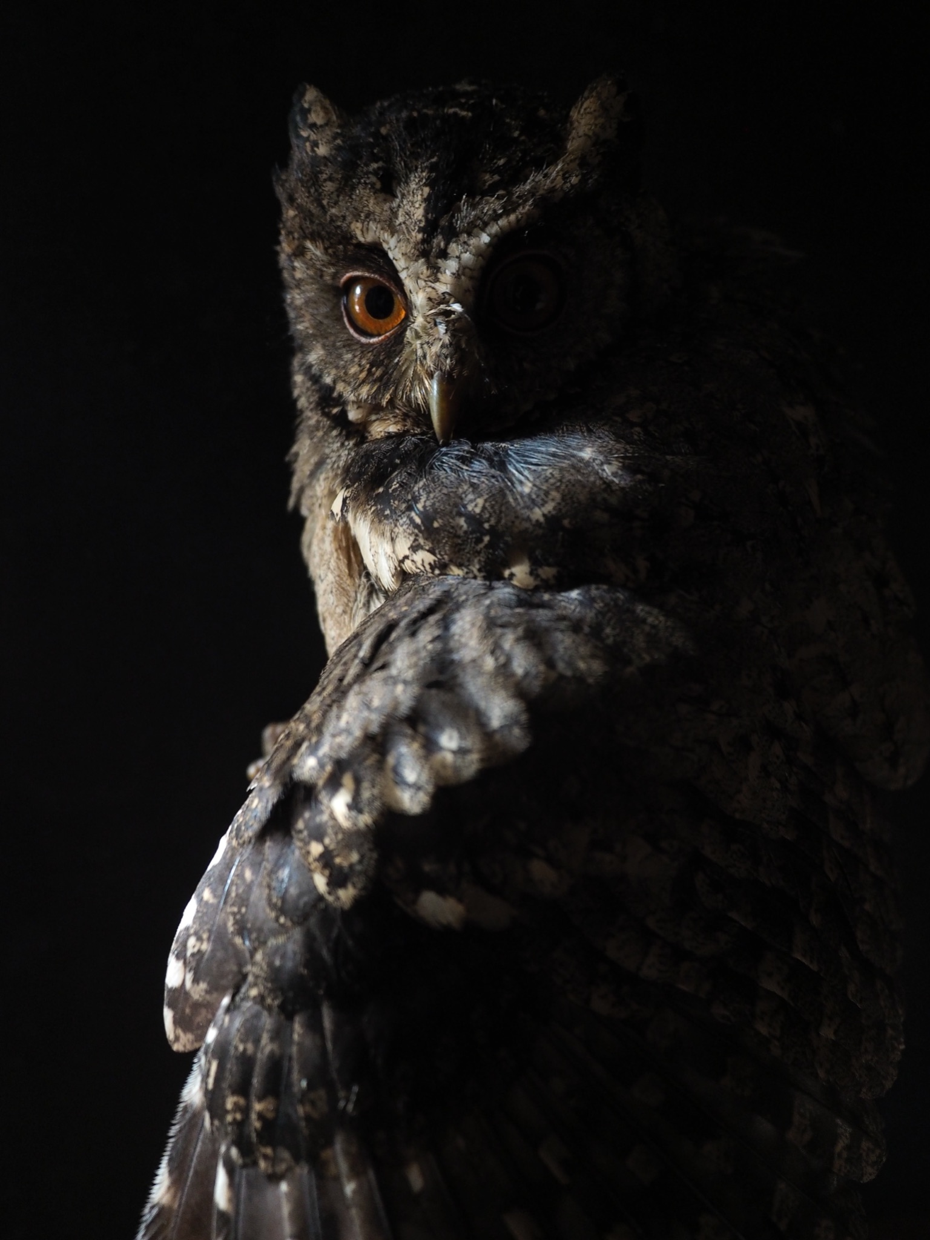
ᏔᎳᏚᏏᏁ ᏣᎳᎩ ᎠᏕᎶᏆᏍᏗ
ᎦᎪ ᎦᏂᏌᎲ ᎠᏍᎪᏍᎨᏍᏗ?
ᎠᏯ, ᎤᏛᏁ ᎤᎫᎫ.
ᎪᏕᏍᏗ ᎠᏋᏔᏅ
ᎦᏍᎪᏍᎨᏍᏗ ᎦᏂᏌᎲ.
Notes:
aksdayvhvsg

Slide 8
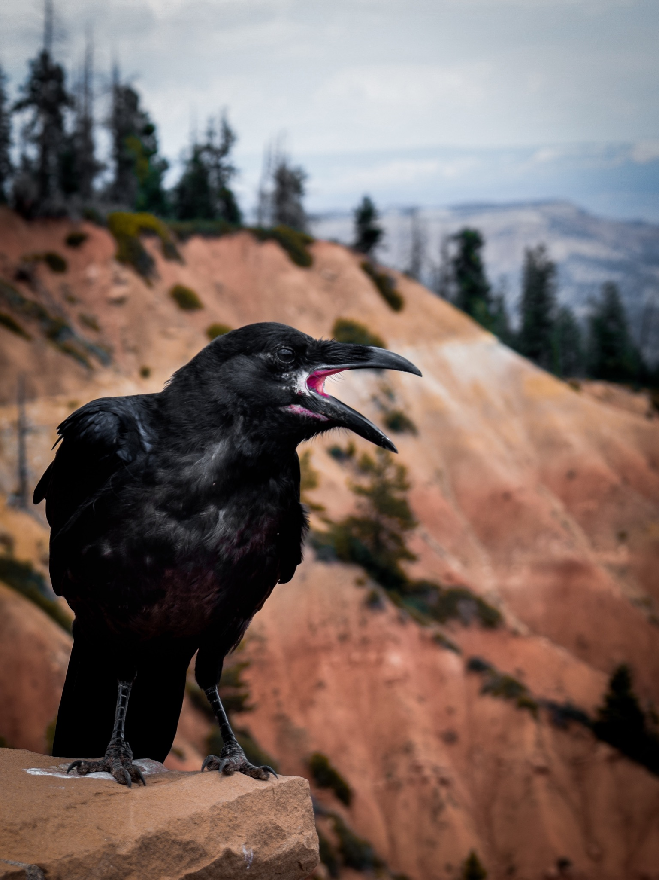
ᏔᎳᏚᏏᏁ ᏣᎳᎩ ᎠᏕᎶᏆᏍᏗ
ᎦᎪ ᎠᎵᏣᏙᎲᏍᎩ ᎨᏎᏍᏗ?
ᎠᏯ, ᎤᏛᏁ ᎪᎦ.
ᏧᎭᎨᏓ ᎪᏪᎵ ᎠᏋᏔᏅ
ᏥᎵᏣᏙᎲᏍᎩ ᎨᏎᏍᏗ.
Notes:
aksdayvhvsg

Slide 9
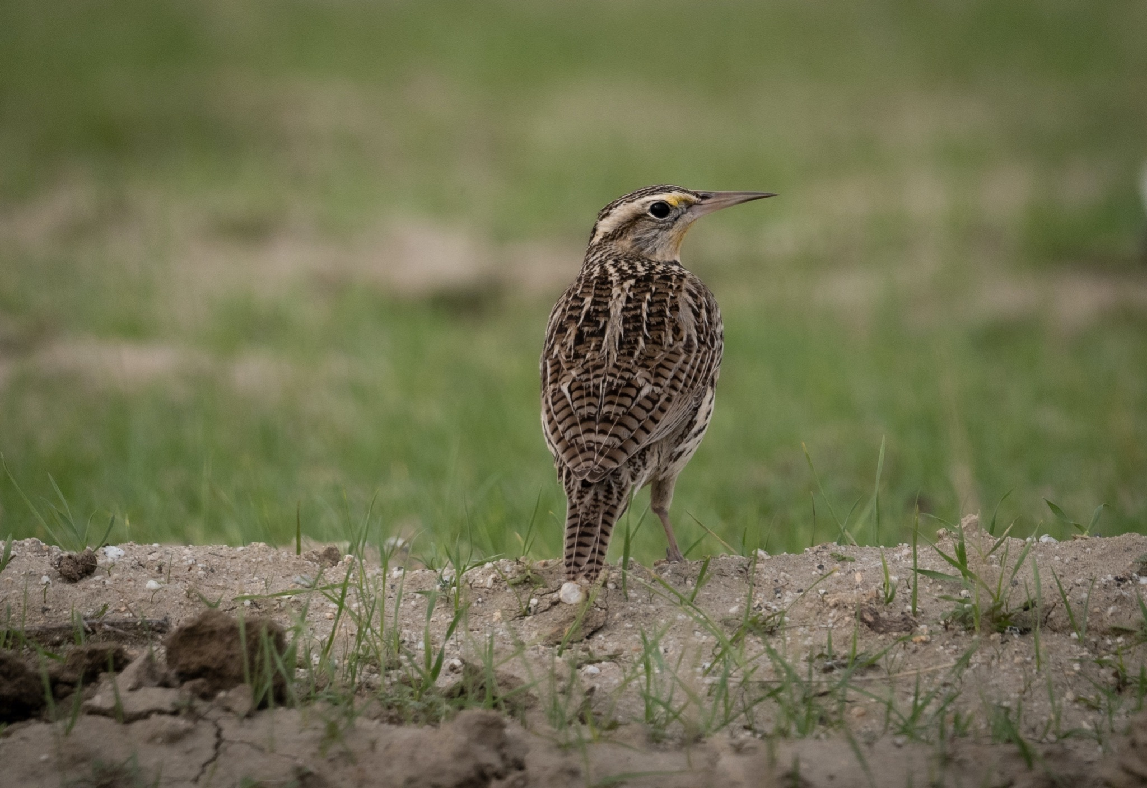
ᏔᎳᏚᏏᏁ ᏣᎳᎩ ᎠᏕᎶᏆᏍᏗ
ᎦᎪ ᏗᎪᏪᎵᏍᎩ ᎨᏎᏍᏗ?
ᎠᏯ, ᎤᏛᏁ ᏃᏈᏏ.
Ꮭ ᏳᎵᏏᎦ ᏱᎩ
ᏗᎪᏪᎵᏍᎩ ᎨᏎᏍᏗ.
Notes:
aksdayvhvsg

Slide 10
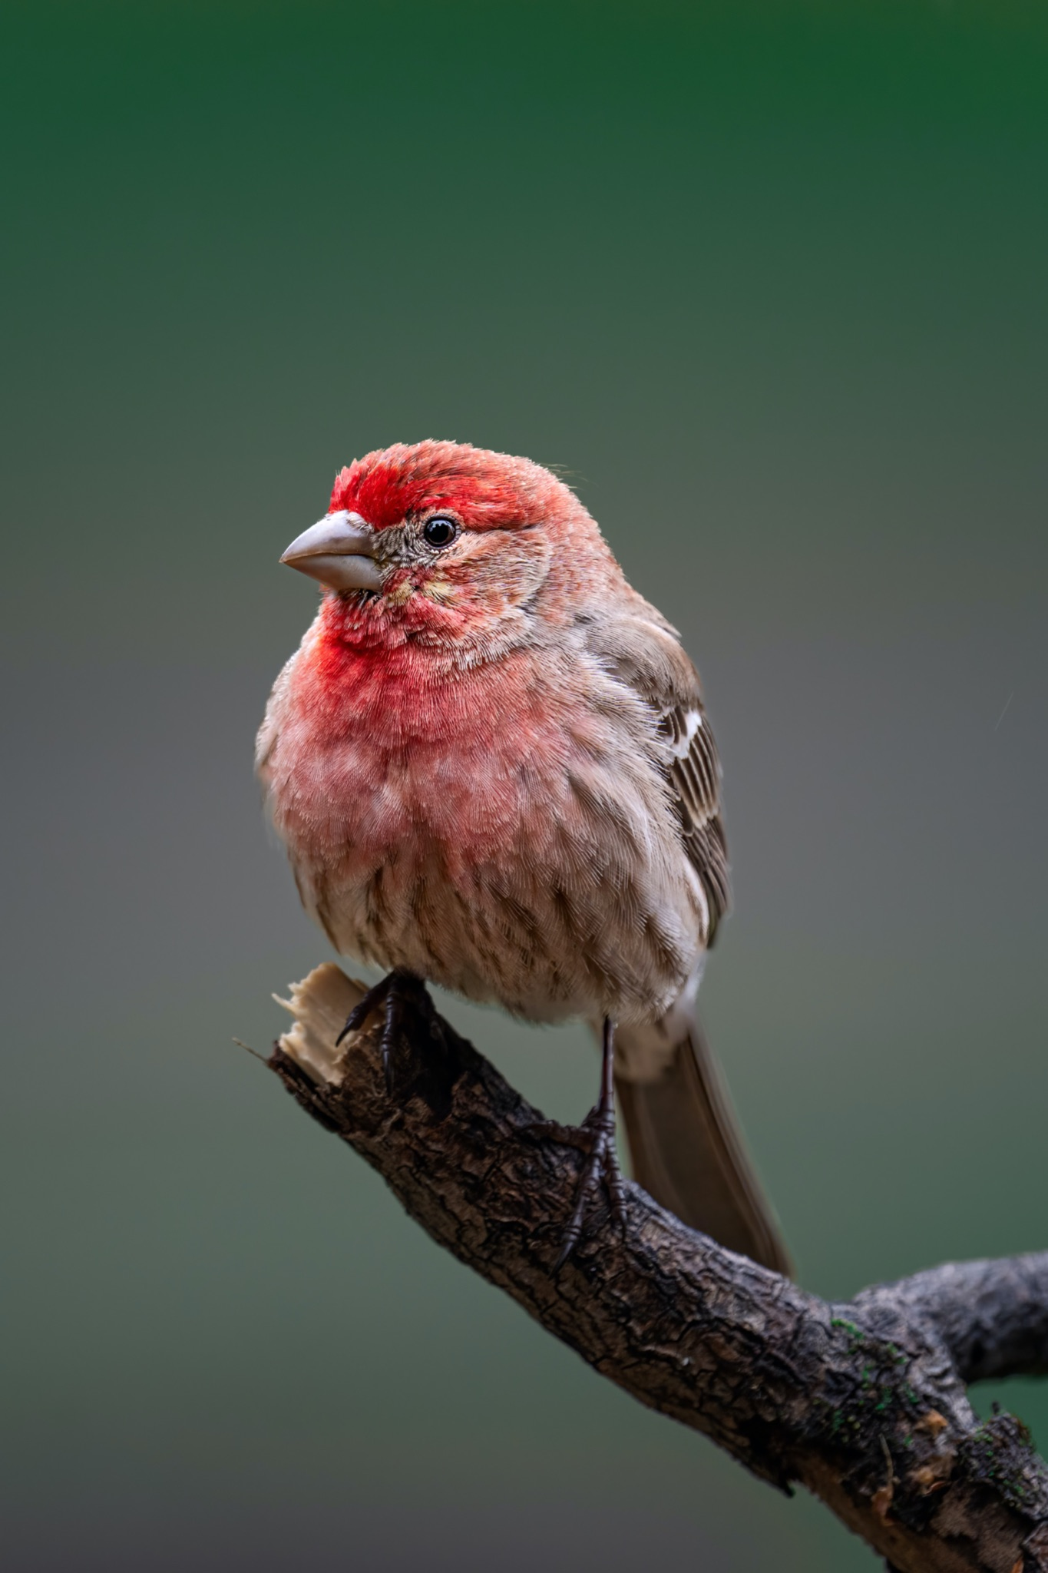
ᏔᎳᏚᏏᏁ ᏣᎳᎩ ᎠᏕᎶᏆᏍᏗ
ᎦᎪ ᎠᏨᏍᏗ ᎠᏰᏍᏗ?
ᎠᏯ, ᎤᏛᏁ ᏥᏥ.
ᎩᎳᏊ ᏫᏓᏥᎩᏍ
ᎠᏨᏍᏗ ᏥᏰᏍᏗ.
Notes:
aksdayvhvsg

Slide 11
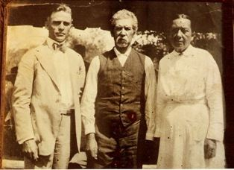
ᏔᎵᏍᎪ ᎯᏍᎩᏁ ᏣᎳᎩ ᎠᏕᎶᏆᏍᏗ
ᎯᏲᎵᎩᏍ ᎯᎠ ᎠᏍᎦᏯ ᎠᏰᏟ ᏥᎦᏙᎦ?
Do you know the man in the center?

Slide 12
ᏔᎵᏍᎪ ᎯᏍᎩᏁ ᏣᎳᎩ ᎠᏕᎶᏆᏍᏗ
ᎯᏂᏲᎵᎬᎾ ᏱᎩ, Redbird Smith ᏚᏙᎡ.
If you don’t know him, Redbird Smith was his name.

Slide 13
ᏔᎵᏍᎪ ᎯᏍᎩᏁ ᏣᎳᎩ ᎠᏕᎶᏆᏍᏗ
ᏙᏧᏩ ᏏᏆᏂᏓ ᏚᏙᎡ, ᏣᎳᎩ ᎬᏗ.
And in Cherokee, his name was tojuwa siquanid.

Slide 14
ᏔᎵᏍᎪ ᎯᏍᎩᏁ ᏣᎳᎩ ᎠᏕᎶᏆᏍᏗ
ᏏᏛ ᎣᏣᎵᎮᎵᎦ ᎯᎢᎾ ᏧᎵᏍᎨᏓ ᎠᏍᎦᏯ.
We still are grateful to this important man.

Slide 15
ᏔᎵᏍᎪ ᎯᏍᎩᏁ ᏣᎳᎩ ᎠᏕᎶᏆᏍᏗ
ᏌᏊ ᎢᏯᎦᏴᎵ ᏣᏁᎳᏍᎪᎯᏥᏍᏊ ᎯᎩᏍᎪᎯ, ᎤᏕᏁ ᏙᏧᏩ ᏏᏆᏂᏓ.
Redbird Smith was born in 1850.

Slide 16
ᏔᎵᏍᎪ ᎯᏍᎩᏁ ᏣᎳᎩ ᎠᏕᎶᏆᏍᏗ
ᎪᎯ ᏥᎩ ᎫᏰᏉᏂ ᏐᏁᎳᏚᏏᏁ ᎣᏣᎵᎮᎵᎪ ᎤᏕᏘᏱᏍᎬ, ᏝᏍᎩᏃ Ꮩ ᏲᎦᎾᏙ Ꮩ ᎤᏕᏘᏱᏍᎬ.
Today, we celebrate his birthday on July 19, but we don’t know exactly what day he was born.

Slide 17
ᏔᎵᏍᎪ ᎯᏍᎩᏁ ᏣᎳᎩ ᎠᏕᎶᏆᏍᏗ
ᏙᏧᏩ ᏏᏆᏂᏓ ᎤᏕᏘᏱᏍᎬ ᏱᏄᎵᏍᏓᏂ ᎠᏂᎩᏚᏩᎩ ᎠᏂᏴᏫᏯ ᎦᏘᏲ ᎠᏁᎪ.
Every year, hundreds of Kituwas go to different ceremonial grounds for his birthday.

Slide 18
ᏔᎵᏍᎪ ᎯᏍᎩᏁ ᏣᎳᎩ ᎠᏕᎶᏆᏍᏗ
ᎦᏙᎨ ᏙᏧᏩ ᏏᏆᏂᏓ ᎤᎵᏍᎨᏓ ᏥᎩ?
So why is Redbird Smith so important?

Slide 19
ᏔᎵᏍᎪ ᎯᏍᎩᏁ ᏣᎳᎩ ᎠᏕᎶᏆᏍᏗ
ᏙᏧᏩ ᎤᏙᏓ Pig Smith ᏚᏙᎡ. ᏏᏆᏂᏓ ᏣᎳᎩ ᎬᏗ ᏚᏙᎡ. ᎣᏂ Smith ᎠᏂᏲᏁᎦ ᏚᏃᎡ, ᎠᏎ ᎪᏢᏅᎥᏍᎩ ᏥᎨᏎ ᏳᏍᏗ
Redbirds father was Young Pig Smith. Young Pig was his Cherokee name and the whites called him Smith because he worked as a blacksmith.

Slide 20
ᏔᎵᏍᎪ ᎯᏍᎩᏁ ᏣᎳᎩ ᎠᏕᎶᏆᏍᏗ
ᏙᏧᏩ ᎤᏥ Lizzie Hildebrand ᏚᏙᎡ. ᎢᏧᎳ ᎠᏣᎳᎩ ᎠᎴ ᎠᏛᏥ ᎨᏎ. ᏣᎳᎩ ᎤᏪᏘ, ᏗᏍᏙᏍᎩ ᏓᎸᏫᏍᏓᏁᎲ Lizzie ᎤᏙᏓ.
Redbird’s mother was Lizzie Hildebrand. She was both Cherokee and German. Lizzie’s father worked as a miller in the old homeland.
(Robert Thomas, Origin and Development of the Redbird Smith Movement, 1953)

Slide 21
ᏔᎵᏍᎪ ᎯᏍᎩᏁ ᏣᎳᎩ ᎠᏕᎶᏆᏍᏗ
ᎢᏧᎳ ᏧᎦᏴᎵᎨ ᎤᏪᏘ ᏣᎳᎩ ᎾᎾᏛᏁᎲ ᏚᏃᎯᏳᏁ
Both of his parents believed in the old Cherokee ways.

Slide 22
ᏔᎵᏍᎪ ᎯᏍᎩᏁ ᏣᎳᎩ ᎠᏕᎶᏆᏍᏗ
ᏗᏓᏅᏫᏍᎩ ᎨᏎ ᎤᏙᏓ.
His dad was a medicine man

Slide 23
ᏔᎵᏍᎪ ᎯᏍᎩᏁ ᏣᎳᎩ ᎠᏕᎶᏆᏍᏗ
ᏄᏕᏅᏏ ᏙᏧᏩ, ᎠᏂᎦᏴᎵᎨ ᏗᏂᏅᏫᏍᎩ ᎤᏂᏃᏎᎴ ᏏᏆᏂᏓ ᏙᏧᏩ ᏗᏓᏘᏁᎯ ᏂᏓᎦᎵᏍᏓᏂᏒ, ᏝᏍᎩᏂ ᎯᏰᎮᏍᏗ ᏂᎦᎵᏍᏓᏅ.
Before Redbird was born, the old medicine men told Pig Smith that tojuwa would become captain, but he wasn’t going to be alive.

Slide 24
ᏔᎵᏍᎪ ᎯᏍᎩᏁ ᏣᎳᎩ ᎠᏕᎶᏆᏍᏗ
ᏄᏕᏅᏏ - before he was born
ᏄᏲᎱᏒᎾ- before he died
ᏄᎪᎲᎾ- before he saw it
ᏄᎵᏍᏛtᎷᏅᎾ- before he sat down
ᏄᏣᎲᎾ- before he got in it
ᎾᎩᏲᎱᏒᎾ, Disney World ᎠᏩᏚᎵᏗ ᎠᏇᏓᏍᏗ.
ᎠᎬᏱ ᎯᎦ ᎩᏟ ᏄᏚᎸᎾ
ᎠᎬᏱ ᏂᏚᎸᏫᏍᏓᏁᎸᎾ, ᎦᏅᏆᎶᏍᏗ ᎤᏚᎵᎮᏍᏗ.

Slide 25
ᏔᎵᏍᎪ ᎯᏍᎩᏁ ᏣᎳᎩ ᎠᏕᎶᏆᏍᏗ
ᎠᎬᏱ ᏂᏚᎸᏫᏍᏓᏁᎸᎾ, ᎦᏅᏆᎶᏍᏗ ᎤᏚᎵᎮᏍᏗ.
Before he works, he needs a hammer.
ᏂᏚᎸᏫᏍᏓᏁᎲᎾ ᏥᎩ, ᎤᏍᎩ ᏳᏍᏗ ᎠᎪᎾ ᎡᎯ
The fact that he’s not working is why he’s going without.

