Slide 1
ᎣᏏᏲ
ᏔᎵᏍᎪ ᏣᏁᎵᏁ ᏣᎳᎩ ᎠᏕᎶᏆᏍᏗ

Slide 2
ᏔᎵᏍᎪ ᏣᏁᎵᏁ ᏣᎳᎩ ᎠᏕᎶᏆᏍᏗ
ᎢᏓᎴᎾ- Let’s begin
ᏣᎳᎩ ᎢᏗᏬᏂ- Let’s talk Cherokee

Slide 3
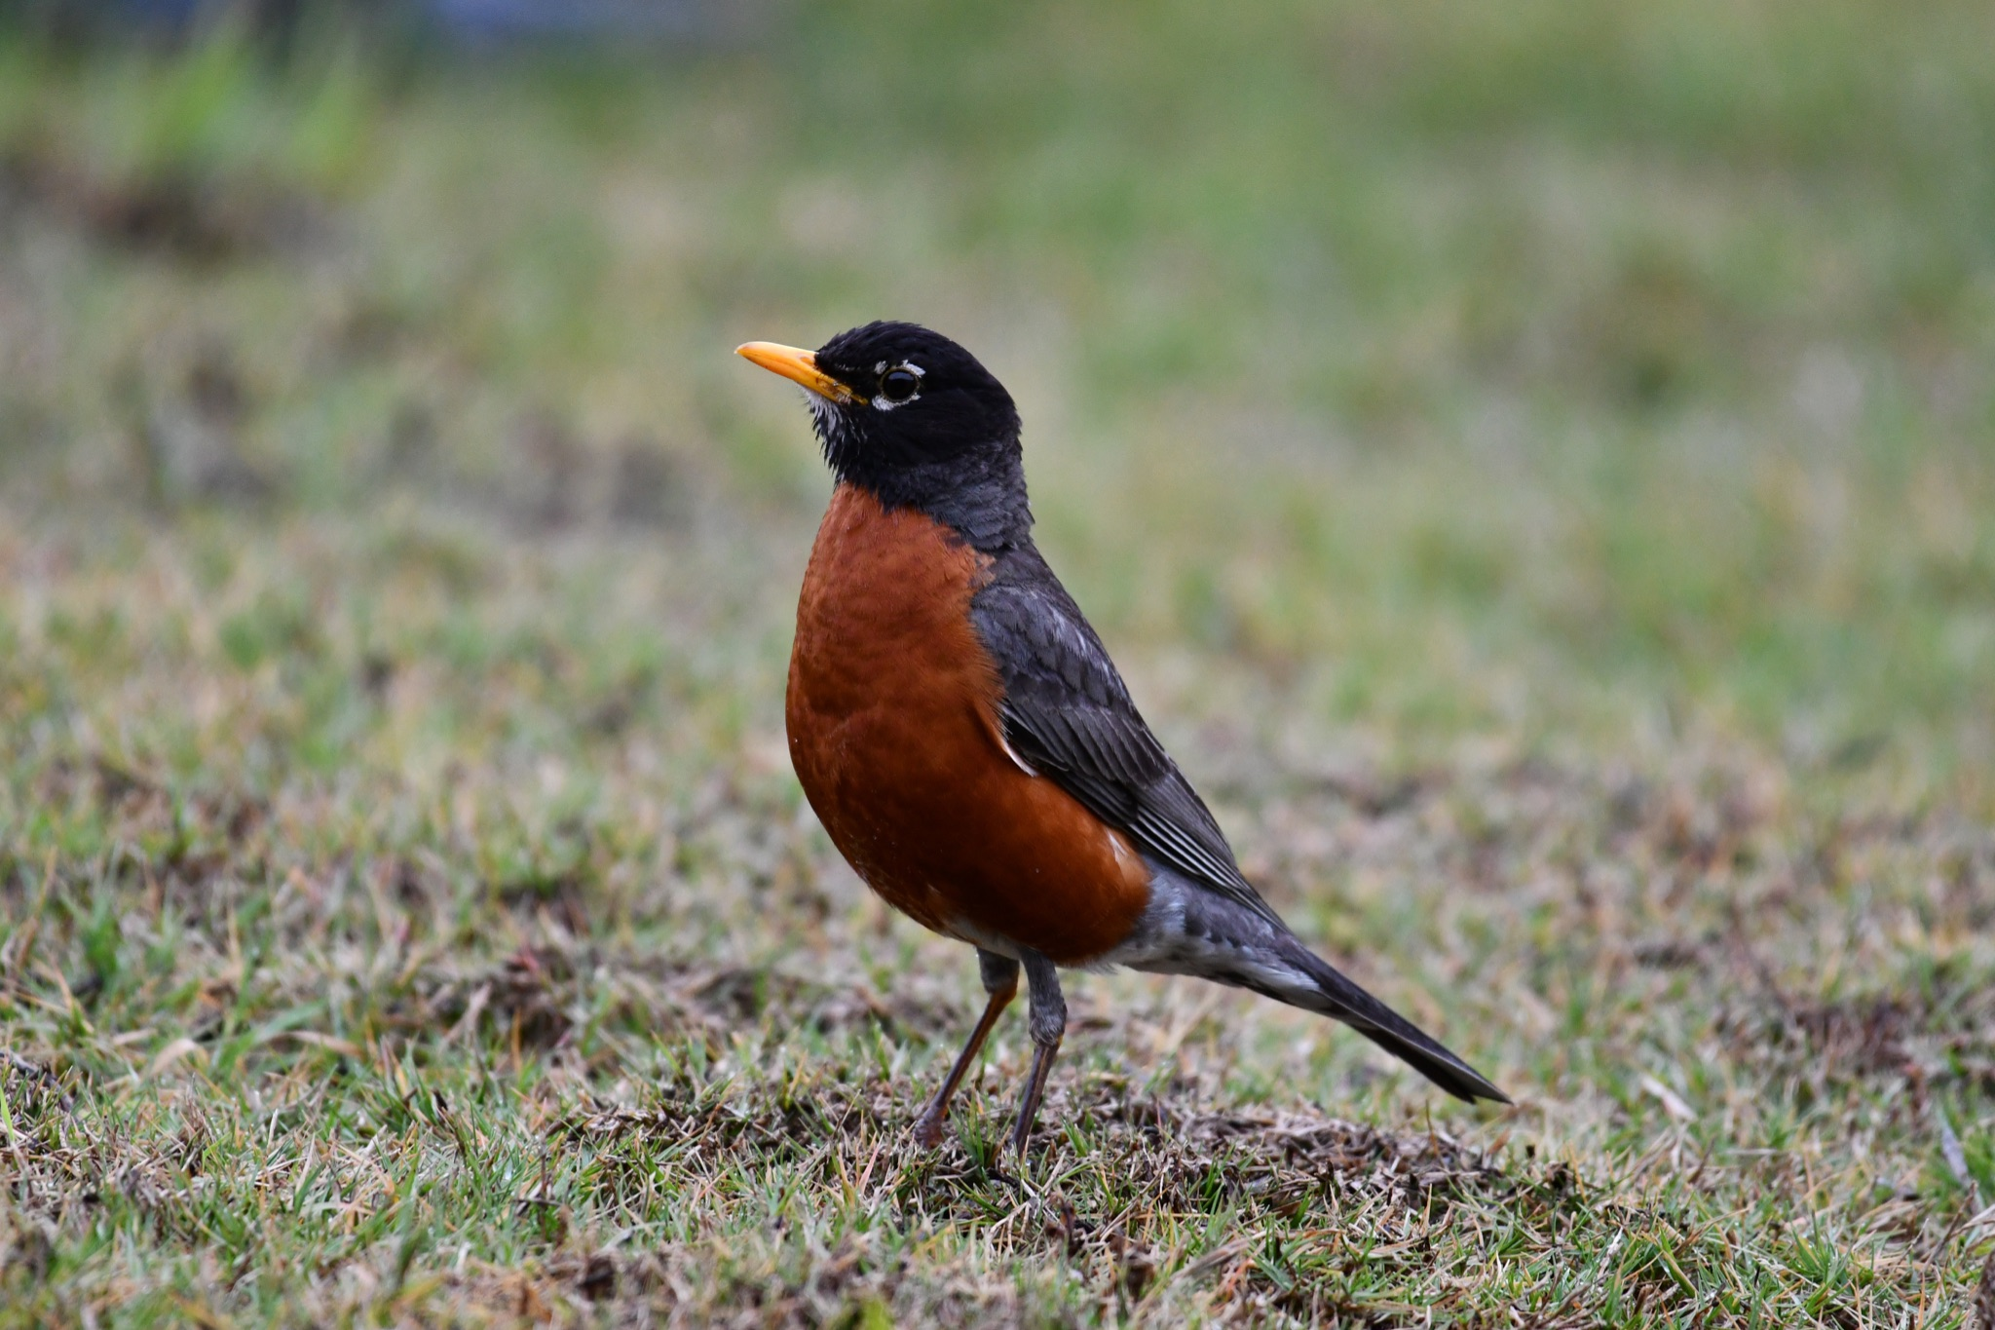
ᏔᎳᏚᏏᏁ ᏣᎳᎩ ᎠᏕᎶᏆᏍᏗ
ᎦᎪ ᏥᏍᏉᏉ ᎤᏢ?
ᎠᏯ ᎤᏛᏁ ᏥᏍᏆᏯ
ᎦᎵᏣᏗ ᎠᎴ ᎦᏟᏓ ᎠᏋᏔᏅ
ᏥᏍᏉᏉ ᏥᏢ.
Notes:
aksdayvhvsg

Slide 4
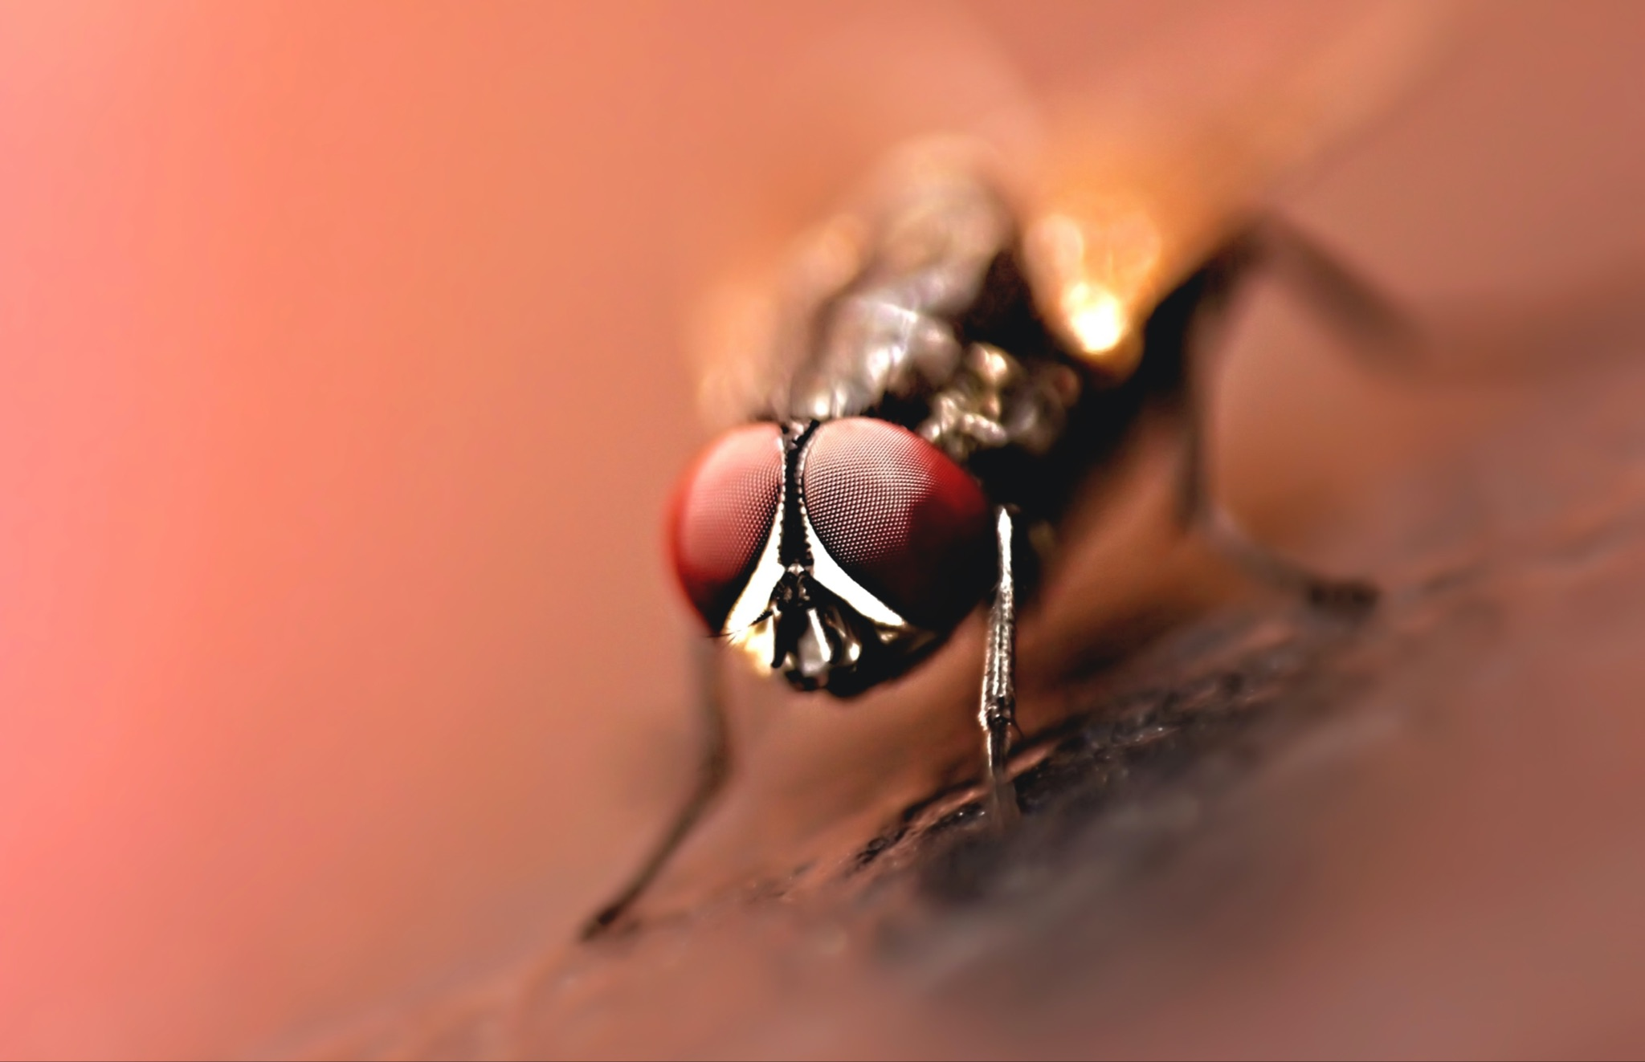
ᏔᎳᏚᏏᏁ ᏣᎳᎩ ᎠᏕᎶᏆᏍᏗ
ᎦᎪ ᎤᎪᎲ ᎤᏲᎱᏒ?
ᎠᏯ, ᎤᏛᏁ ᏛᎩ.
ᏗᏥᎦᏙᎵ ᏓᏋᏔᏅ.
ᏥᎪᎲ ᎤᏲᎱᏒ.
Notes:
aksdayvhvsg

Slide 5
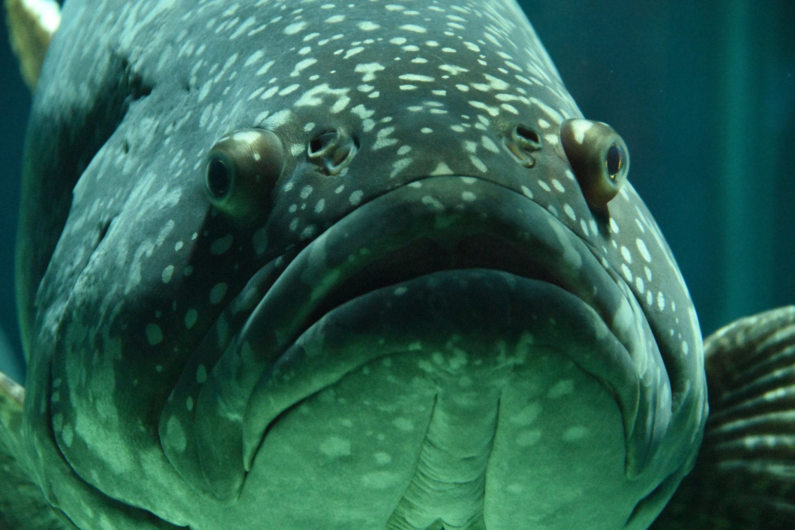
ᏔᎳᏚᏏᏁ ᏣᎳᎩ ᎠᏕᎶᏆᏍᏗ
ᎦᎪ ᎩᎦ ᎤᏂᏴᎲ?
ᎠᏯ, ᎤᏛᏁ ᎠᏣᏗ
ᎤᏍᏗ ᎤᎾᏪᏓ ᎠᏋᏔᏅ
ᎩᎦ ᎠᎩᏂᏴᎲ
Notes:
aksdayvhvsg

Slide 6
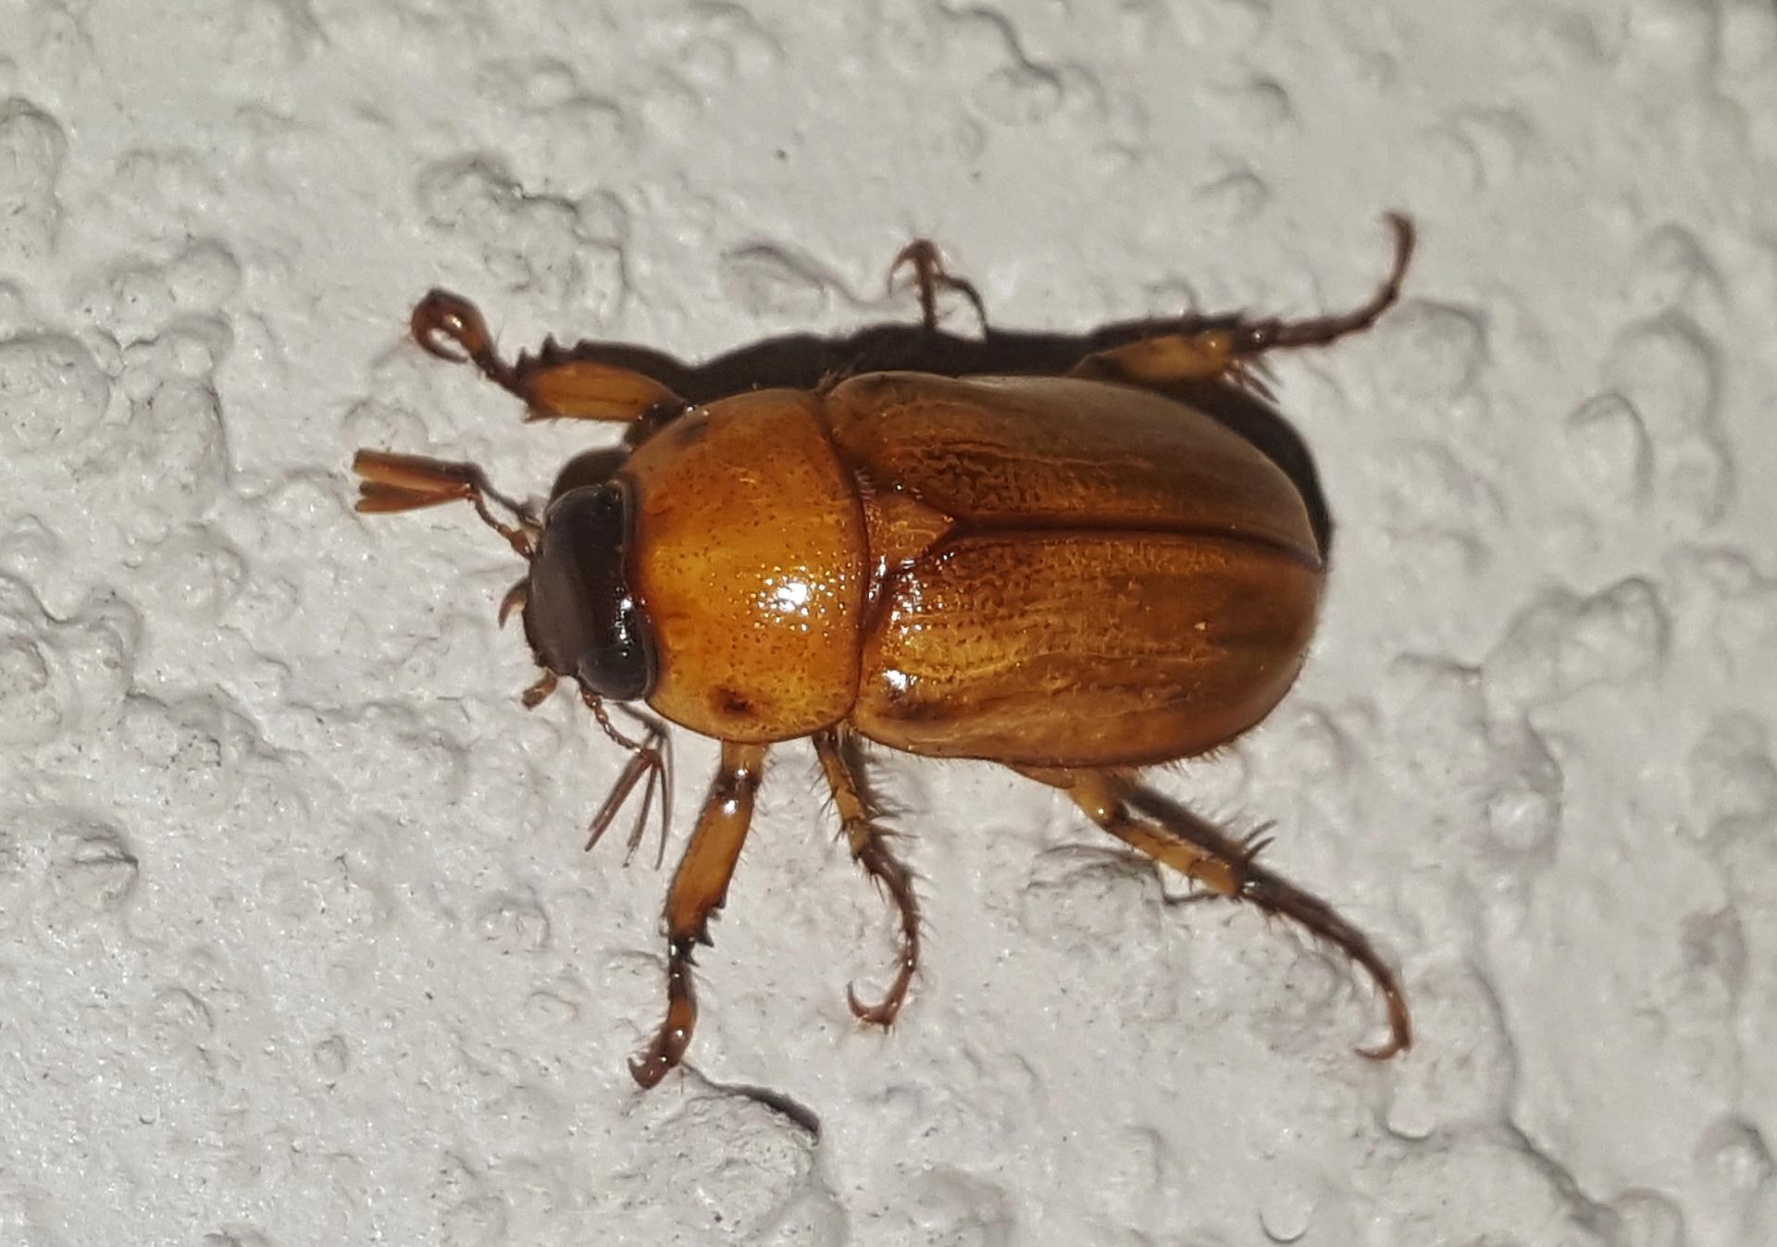
ᏔᎳᏚᏏᏁ ᏣᎳᎩ ᎠᏕᎶᏆᏍᏗ
ᎦᎪ ᎤᏢᏍᏗ ᎪᏢᏍᎨᏍᏗ
ᎠᏯ, ᎤᏛᏁ ᏙᎦ
ᎠᏍᏘ ᎠᎴ ᏴᎩ ᎠᏋᏔᏅ
ᎤᏢᏍᏗ ᎪᏢᏍᎨᏍᏗ
Notes:
aksdayvhvsg

Slide 7
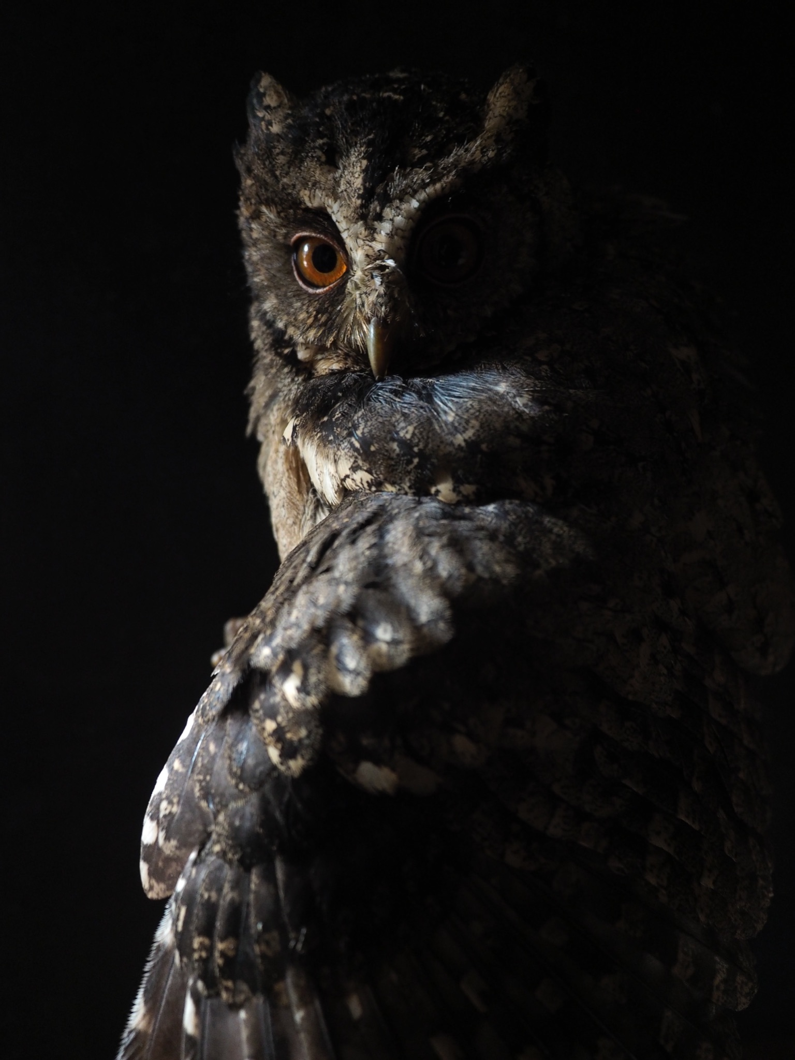
ᏔᎳᏚᏏᏁ ᏣᎳᎩ ᎠᏕᎶᏆᏍᏗ
ᎦᎪ ᎦᏂᏌᎲ ᎠᏍᎪᏍᎨᏍᏗ?
ᎠᏯ, ᎤᏛᏁ ᎤᎫᎫ.
ᎪᏕᏍᏗ ᎠᏋᏔᏅ
ᎦᏍᎪᏍᎨᏍᏗ ᎦᏂᏌᎲ.
Notes:
aksdayvhvsg

Slide 8
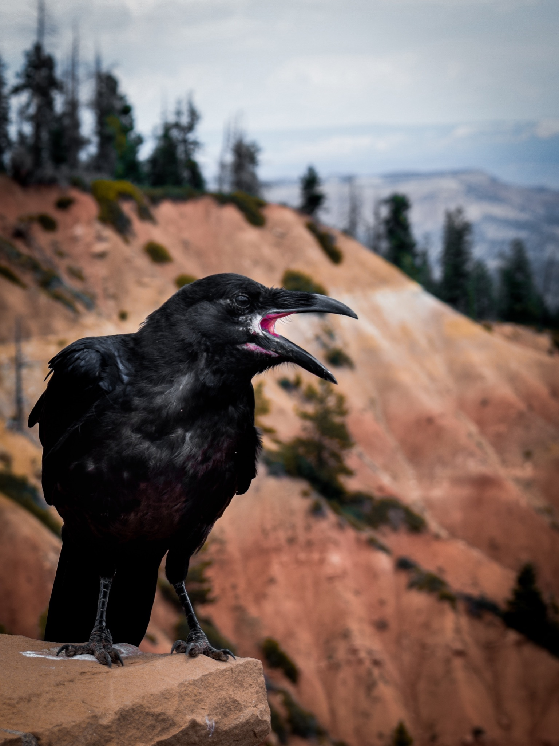
ᏔᎳᏚᏏᏁ ᏣᎳᎩ ᎠᏕᎶᏆᏍᏗ
ᎦᎪ ᎠᎵᏣᏙᎲᏍᎩ ᎨᏎᏍᏗ?
ᎠᏯ, ᎤᏛᏁ ᎪᎦ.
ᏧᎭᎨᏓ ᎪᏪᎵ ᎠᏋᏔᏅ
ᏥᎵᏣᏙᎲᏍᎩ ᎨᏎᏍᏗ.
Notes:
aksdayvhvsg

Slide 9
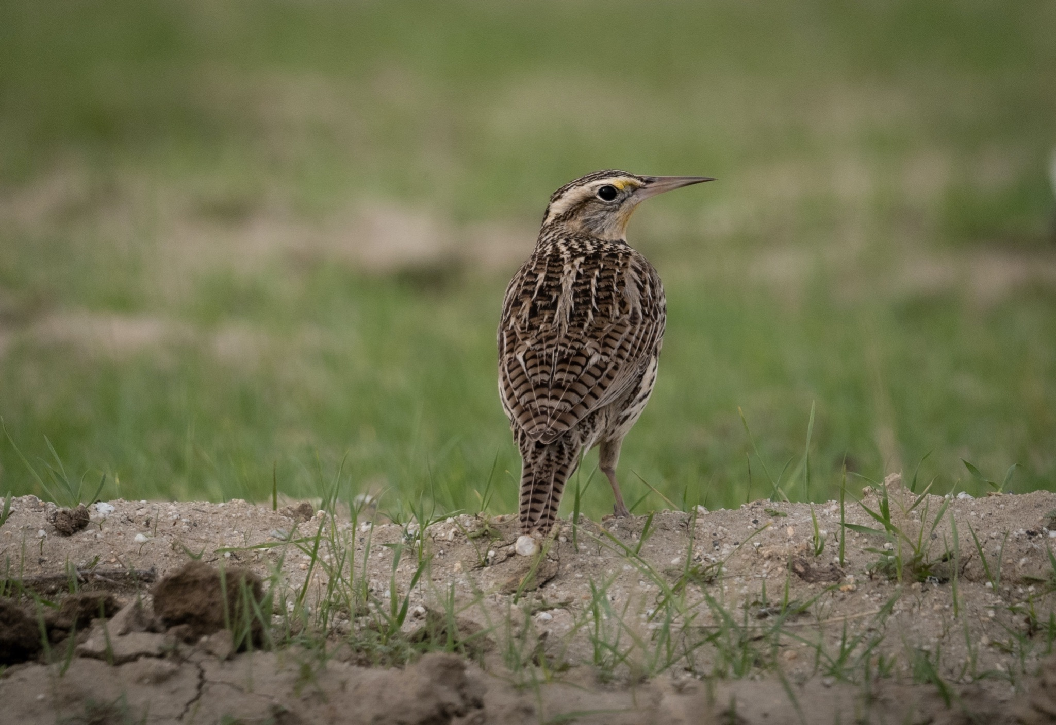
ᏔᎳᏚᏏᏁ ᏣᎳᎩ ᎠᏕᎶᏆᏍᏗ
ᎦᎪ ᏗᎪᏪᎵᏍᎩ ᎨᏎᏍᏗ?
ᎠᏯ, ᎤᏛᏁ ᏃᏈᏏ.
Ꮭ ᏳᎵᏏᎦ ᏱᎩ
ᏗᎪᏪᎵᏍᎩ ᎨᏎᏍᏗ.
Notes:
aksdayvhvsg

Slide 10
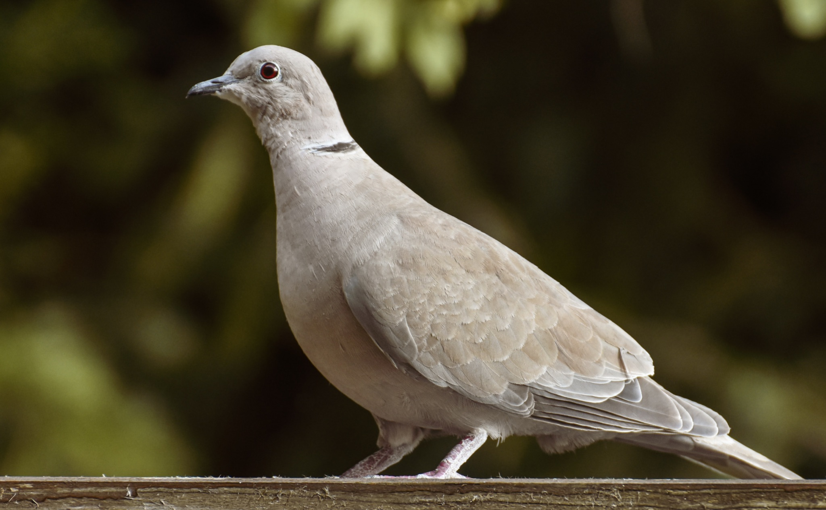
ᏔᎳᏚᏏᏁ ᏣᎳᎩ ᎠᏕᎶᏆᏍᏗ
ᎦᎪ ᎠᏍᎪᏂᏍᎩ ᎨᏎᏍᏗ?
ᎠᏯ, ᎤᏛᏁ ᎫᎴ ᏗᏍᎪᏂᎯ
ᎣᏍᏗᏁᎳ ᏥᏍᎪᏂ
ᏥᏍᎪᏂᏍᎩ ᎨᏎᏍᏗ
Notes:
aksdayvhvsg

Slide 11
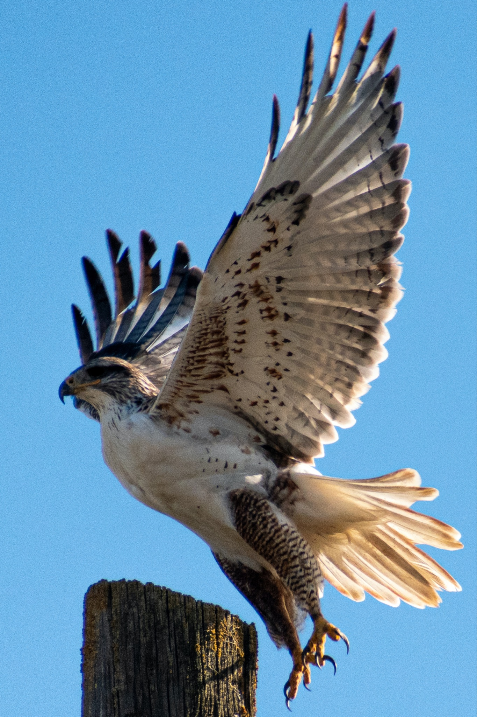
ᏔᎳᏚᏏᏁ ᏣᎳᎩ ᎠᏕᎶᏆᏍᏗ
ᎦᎪ ᎤᏲᎱᏒ ᎦᎸᏙᏗ ᎠᏠᏟᏁᎨᏍᏗ?
ᎠᏯ, ᎤᏛᏁ ᏔᏬᏗ
ᏳᎵᏨᏓᏆᏓ ᏱᎨᏍᏗ,
ᎤᏲᎱᏒ ᎦᎸᏙᏗ ᏥᏠᏟᏁᎨᏍᏗ
Notes:
aksdayvhvsg

Slide 12
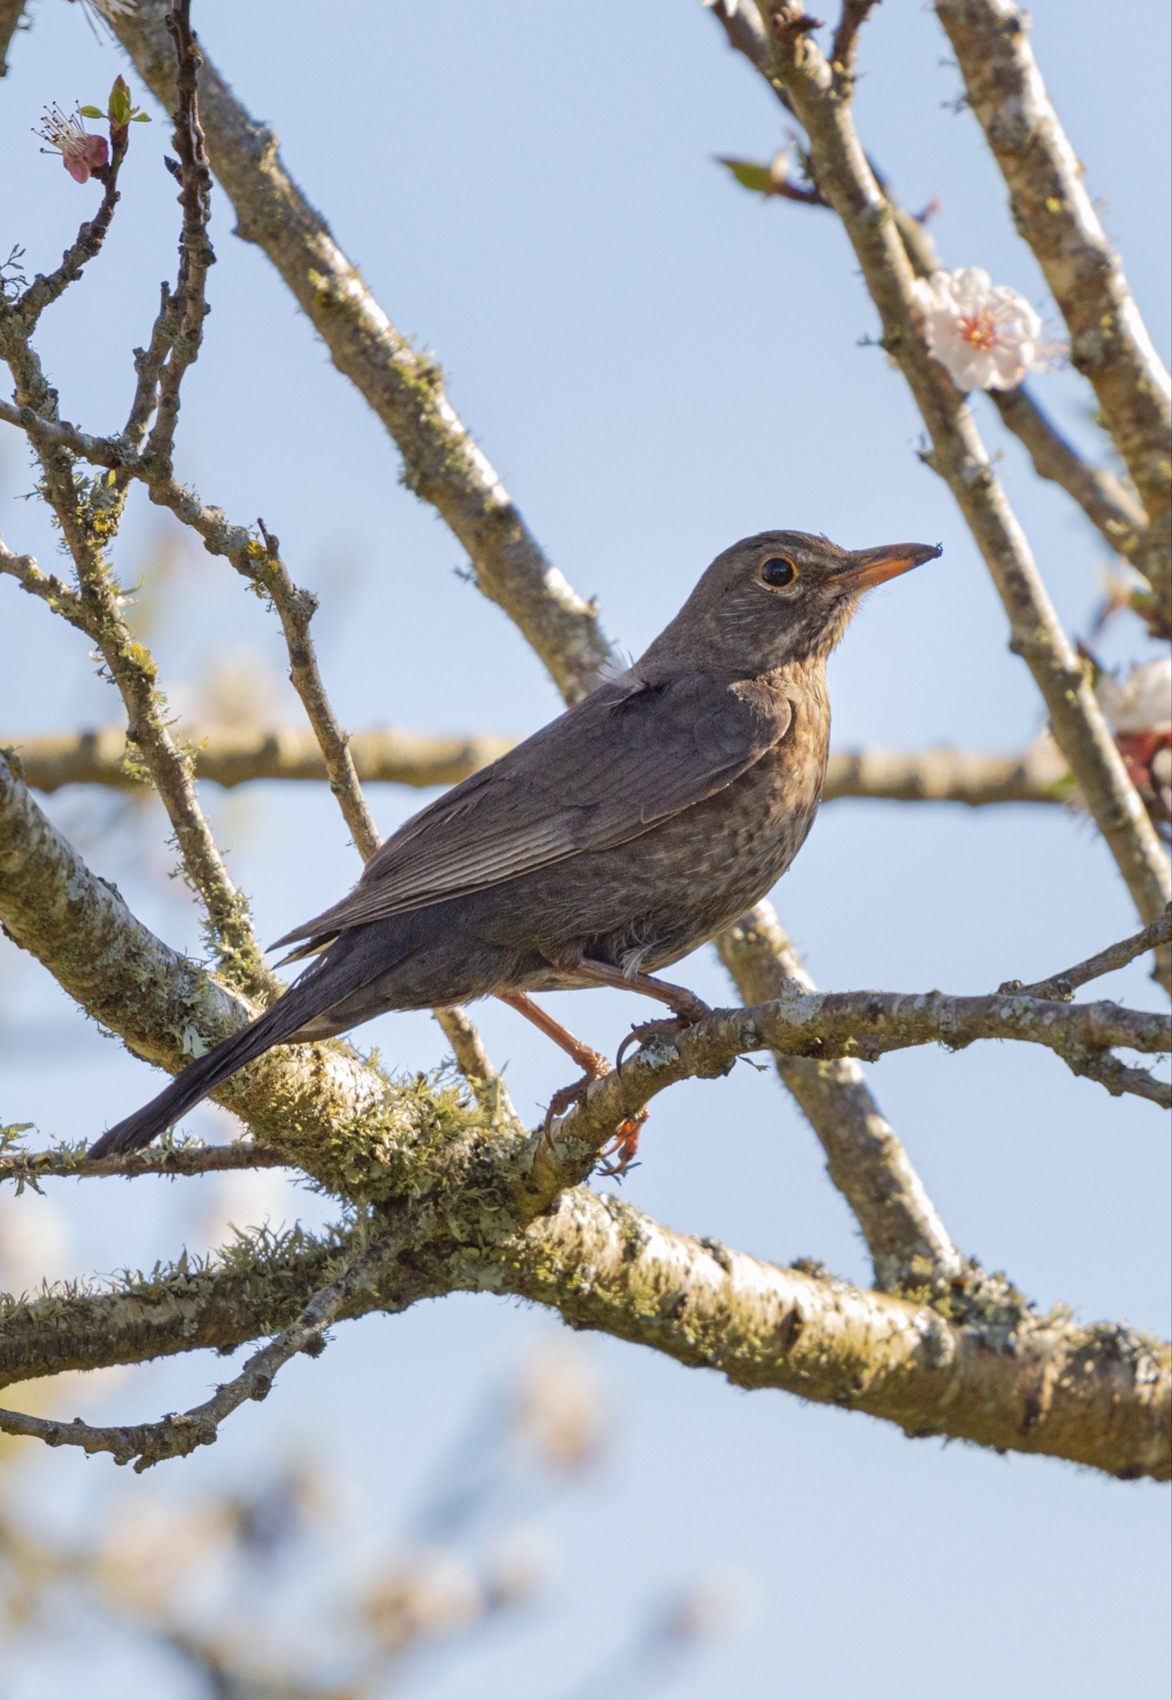
ᏔᎳᏚᏏᏁ ᏣᎳᎩ ᎠᏕᎶᏆᏍᏗ
ᎦᎪ ᏗᏂᏃᎩᏍᎩ ᎨᏎᏍᏗ?
ᎠᏯ, ᎤᏛᏁ ᎧᎶᏆ
ᎤᏩᎢᏢᎢ ᎤᎩᎸᏍᎪ
ᏕᏥᏃᎨᏍᏗ
Notes:
aksdayvhvsg

Slide 13
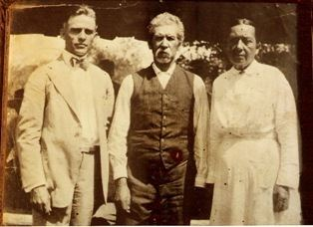
ᏔᎵᏍᎪ ᏣᏁᎵᏁ ᏣᎳᎩ ᎠᏕᎶᏆᏍᏗ
ᎯᏲᎵᎩᏍ ᎯᎠ ᎠᏍᎦᏯ ᎠᏰᏟ ᏥᎦᏙᎦ?
Do you know the man in the center?

Slide 14
ᏔᎵᏍᎪ ᏣᏁᎵᏁ ᏣᎳᎩ ᎠᏕᎶᏆᏍᏗ
ᎯᏂᏲᎵᎬᎾ ᏱᎩ, Redbird Smith ᏚᏙᎡ.
If you don’t know him, Redbird Smith was his name.

Slide 15
ᏔᎵᏍᎪ ᏣᏁᎵᏁ ᏣᎳᎩ ᎠᏕᎶᏆᏍᏗ
ᏙᏧᏩ ᏏᏆᏂᏓ ᏚᏙᎡ, ᏣᎳᎩ ᎬᏗ.
And in Cherokee, his name was tojuwa siquanid.

Slide 16
ᏔᎵᏍᎪ ᏣᏁᎵᏁ ᏣᎳᎩ ᎠᏕᎶᏆᏍᏗ
ᏏᏛ ᎣᏣᎵᎮᎵᎦ ᎯᎢᎾ ᏧᎵᏍᎨᏓ ᎠᏍᎦᏯ.
We still are grateful to this important man.

Slide 17
ᏔᎵᏍᎪ ᏣᏁᎵᏁ ᏣᎳᎩ ᎠᏕᎶᏆᏍᏗ
ᏌᏊ ᎢᏯᎦᏴᎵ ᏣᏁᎳᏍᎪᎯᏥᏍᏊ ᎯᎩᏍᎪᎯ, ᎤᏕᏁ ᏙᏧᏩ ᏏᏆᏂᏓ.
Redbird Smith was born in 1850.

Slide 18
ᏔᎵᏍᎪ ᏣᏁᎵᏁ ᏣᎳᎩ ᎠᏕᎶᏆᏍᏗ
ᎪᎯ ᏥᎩ ᎫᏰᏉᏂ ᏐᏁᎳᏚᏏᏁ ᎣᏣᎵᎮᎵᎪ ᎤᏕᏘᏱᏍᎬ, ᏝᏍᎩᏃ Ꮩ ᏲᎦᎾᏙ Ꮩ ᎤᏕᏘᏱᏍᎬ.
Today, we celebrate his birthday on July 19, but we don’t know exactly what day he was born.

Slide 19
ᏔᎵᏍᎪ ᏣᏁᎵᏁ ᏣᎳᎩ ᎠᏕᎶᏆᏍᏗ
ᏙᏧᏩ ᏏᏆᏂᏓ ᎤᏕᏘᏱᏍᎬ ᏱᏄᎵᏍᏓᏂ ᎠᏂᎩᏚᏩᎩ ᎠᏂᏴᏫᏯ ᎦᏘᏲ ᎠᏁᎪ.
Every year, hundreds of Kituwas go to different ceremonial grounds for his birthday.

Slide 20
ᏔᎵᏍᎪ ᏣᏁᎵᏁ ᏣᎳᎩ ᎠᏕᎶᏆᏍᏗ
ᎦᏙᎨ ᏙᏧᏩ ᏏᏆᏂᏓ ᎤᎵᏍᎨᏓ ᏥᎩ?
So why is Redbird Smith so important?

Slide 21
ᏔᎵᏍᎪ ᏣᏁᎵᏁ ᏣᎳᎩ ᎠᏕᎶᏆᏍᏗ
ᏙᏧᏩ ᎤᏙᏓ Pig Smith ᏚᏙᎡ. ᏏᏆᏂᏓ ᏣᎳᎩ ᎬᏗ ᏚᏙᎡ. ᎣᏂ Smith ᎠᏂᏲᏁᎦ ᏚᏃᎡ, ᎠᏎ ᎪᏢᏅᎥᏍᎩ ᏥᎨᏎ ᏳᏍᏗ
Redbirds father was Young Pig Smith. Young Pig was his Cherokee name and the whites called him Smith because he worked as a blacksmith.

Slide 22
ᏔᎵᏍᎪ ᏣᏁᎵᏁ ᏣᎳᎩ ᎠᏕᎶᏆᏍᏗ
ᏙᏧᏩ ᎤᏥ Lizzie Hildebrand ᏚᏙᎡ. ᎢᏧᎳ ᎠᏣᎳᎩ ᎠᎴ ᎠᏛᏥ ᎨᏎ. ᏣᎳᎩ ᎤᏪᏘ, ᏗᏍᏙᏍᎩ ᏓᎸᏫᏍᏓᏁᎲ Lizzie ᎤᏙᏓ.
Redbird’s mother was Lizzie Hildebrand. She was both Cherokee and German. Lizzie’s father worked as a miller in the old homeland.
(Robert Thomas, Origin and Development of the Redbird Smith Movement, 1953)

Slide 23
ᏔᎵᏍᎪ ᏣᏁᎵᏁ ᏣᎳᎩ ᎠᏕᎶᏆᏍᏗ
ᎢᏧᎳ ᏧᎦᏴᎵᎨ ᎤᏪᏘ ᏣᎳᎩ ᎾᎾᏛᏁᎲ ᏚᏃᎯᏳᏁ
Both of his parents believed in the old Cherokee ways.

Slide 24
ᏔᎵᏍᎪ ᏣᏁᎵᏁ ᏣᎳᎩ ᎠᏕᎶᏆᏍᏗ
ᏗᏓᏅᏫᏍᎩ ᎨᏎ ᎤᏙᏓ.
His dad was a medicine man

Slide 25
ᏔᎵᏍᎪ ᏣᏁᎵᏁ ᏣᎳᎩ ᎠᏕᎶᏆᏍᏗ
ᏄᏕᏅᏏ ᏙᏧᏩ, ᎠᏂᎦᏴᎵᎨ ᏗᏂᏅᏫᏍᎩ ᎤᏂᏃᏎᎴ ᏏᏆᏂᏓ ᏙᏧᏩ ᏗᏓᏘᏁᎯ ᏂᏓᎦᎵᏍᏓᏂᏒ, ᏝᏍᎩᏂ ᎯᏰᎮᏍᏗ ᏂᎦᎵᏍᏓᏅ.
Before Redbird was born, the old medicine men told Pig Smith that tojuwa would become captain, but he wasn’t going to be alive.

Slide 26
ᏔᎵᏍᎪ ᏣᏁᎵᏁ ᏣᎳᎩ ᎠᏕᎶᏆᏍᏗ
ᏏᏆᏂᏓ ᎤᏅᏒ ᎠᎫᏌ ᏌᎻ ᏙᏧᏩ ᎤᏕᏲᏗ.
Pig Smith asked Creek Sam to teach Redbird

Slide 27
ᏔᎵᏍᎪ ᏣᏁᎵᏁ ᏣᎳᎩ ᎠᏕᎶᏆᏍᏗ
ᎠᏃᏥ ᎠᏴᏫᏯ ᎨᏎ ᎠᎫᏌ ᏌᎻ.
Creek Sam was a Natchez Indian.

Slide 28
ᏔᎵᏍᎪ ᏣᏁᎵᏁ ᏣᎳᎩ ᎠᏕᎶᏆᏍᏗ
ᏄᎵᏍᏓᏅᎾ ᎠᎴ ᎤᏪᏘ ᎤᏂᏃᎮᏢᎾ ᎠᏂᏣᎳᎩ, ᎠᏂᎫᏌ ᎠᎴ ᎠᏂᏃᏥ ᏓᎧᏔᎮ ᎠᎫᏌ ᏌᎻ.
Creek Sam knew the ways and old stories of the Cherokee, Creek and Natchez.

Slide 29
ᏔᎵᏍᎪ ᏣᏁᎵᏁ ᏣᎳᎩ ᎠᏕᎶᏆᏍᏗ
ᎣᏍᏓ ᎠᏕᎶᏆᏍᎩ ᎨᎮ ᏙᏧᏩ. ᎤᏓᎿᏙ ᎠᎴ ᏙᎯ ᎦᏬᏂᏍᎩ ᎨᎭ. ᏚᏳᎪᏓ ᏃᎴ ᏥᏳᎪᏓ ᎨᎮ.
Redbird was a good learner. He was kind and soft spoken. He was honest and straight forward.

Slide 30
ᏔᎵᏍᎪ ᏣᏁᎵᏁ ᏣᎳᎩ ᎠᏕᎶᏆᏍᏗ
ᏌᏊ ᎢᏯᎦᏴᎵ ᏣᏁᎳᏍᎪᎯᏥᏍᏊᎤ ᏐᏁᎵᏍᎪ, ᏙᏧᏩ ᎠᏂᎩᏚᏩᎩ ᎠᏥᏍᏛᏂᎨᏍᏛ ᏍᎦᏚᎩ ᏗᏓᏘᏂᏙᎯ ᎨᎮ.
By 1890, Redbird was leader of the illinois district.

