Slide 1
ᎣᏏᏲ
ᏦᎢᏁ ᏣᎳᎩ ᎠᏕᎶᏆᏍᏗ

Slide 2
ᏦᎢᏁ ᏣᎳᎩ ᎠᏕᎶᏆᏍᏗ
ᎢᏓᎴᎾ- Let’s begin
ᏣᎳᎩ ᎢᏗᏬᏂ- Let’s talk Cherokee

Slide 3
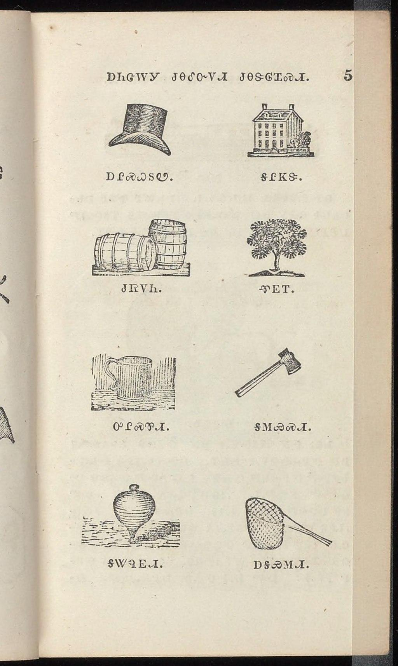
ᏦᎢᏁ ᏣᎳᎩ ᎠᏕᎶᏆᏍᏗ
ᎠᎵᏍᏇᏚᏬ ᎦᎵᏦᏕ
ᏧᏒᏙᏂ ᏡᎬᎢ
ᎤᎵᏍᏈᏗ ᎦᎷᏱᏍᏗ
ᎦᏔᏄᎬᏗ ᎠᎦᏯᎷᏗ
Notes:
aksdayvhvsg

Slide 4
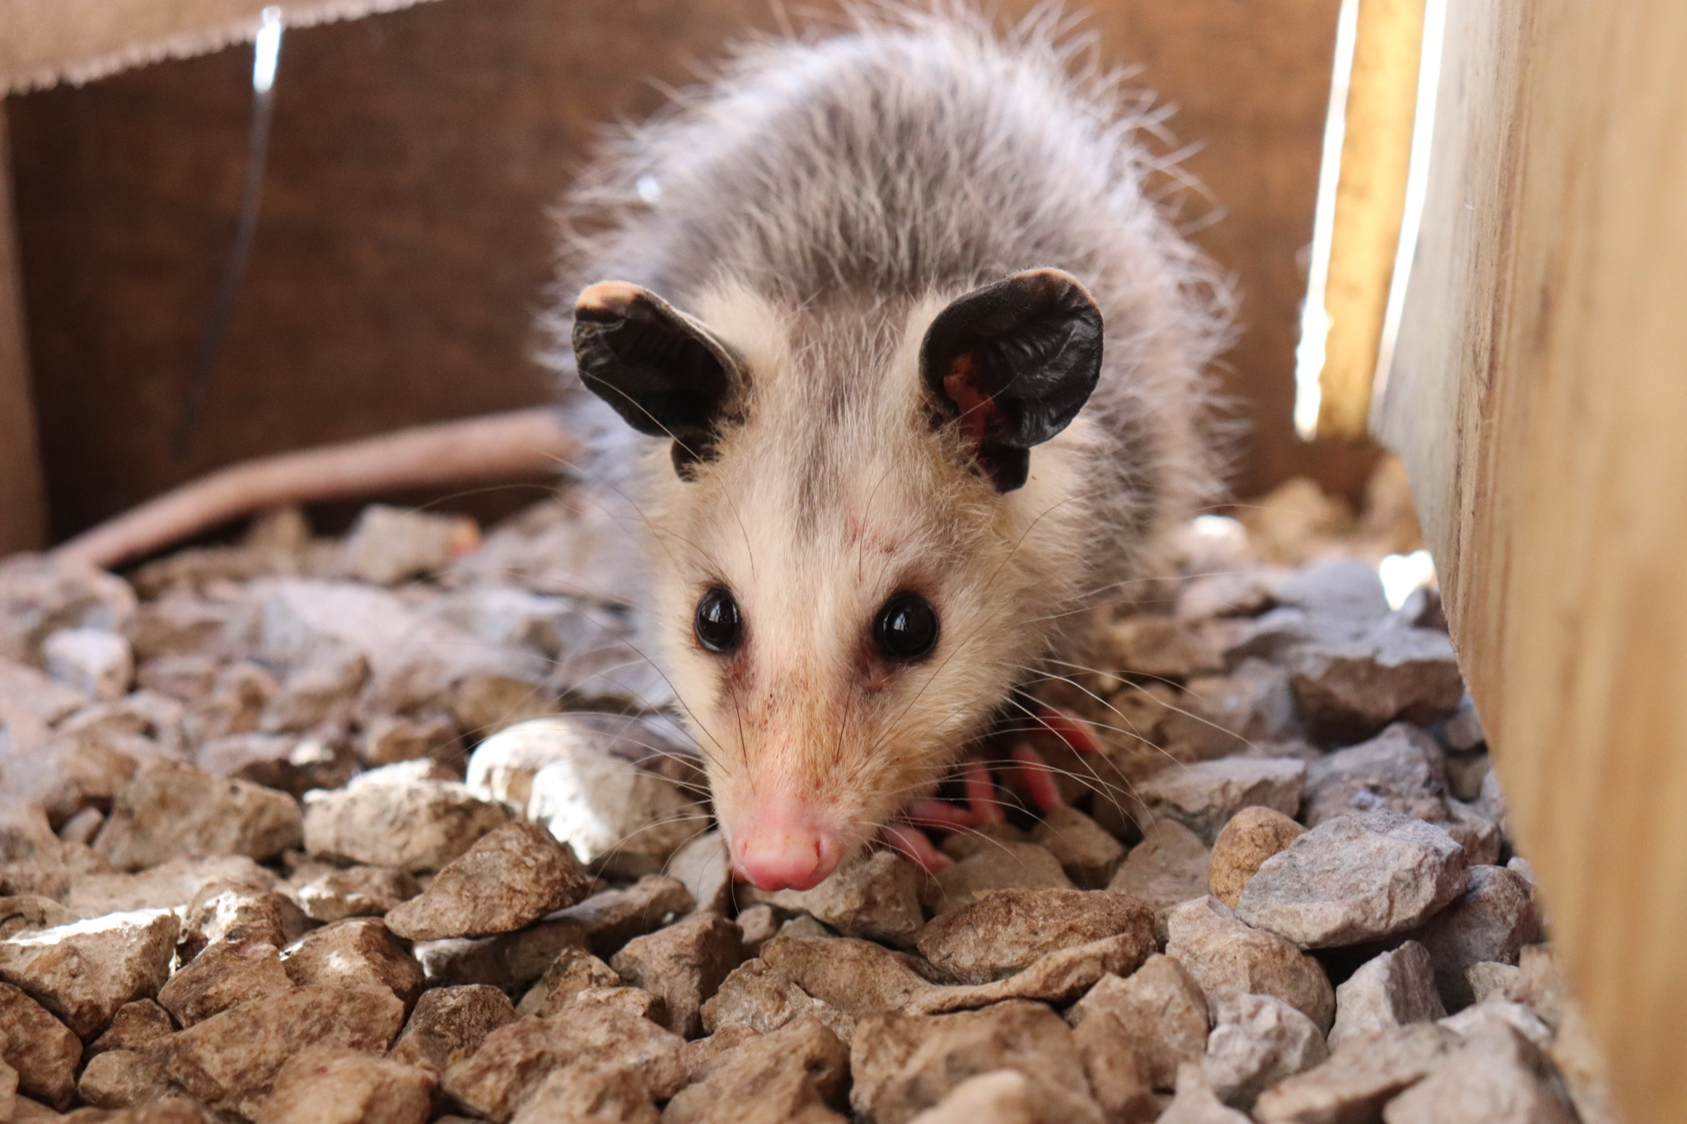
ᏦᎢᏁ ᏣᎳᎩ ᎠᏕᎶᏆᏍᏗ-
ᏏᏆ ᎤᏤᏥᏍᏗ

Slide 5
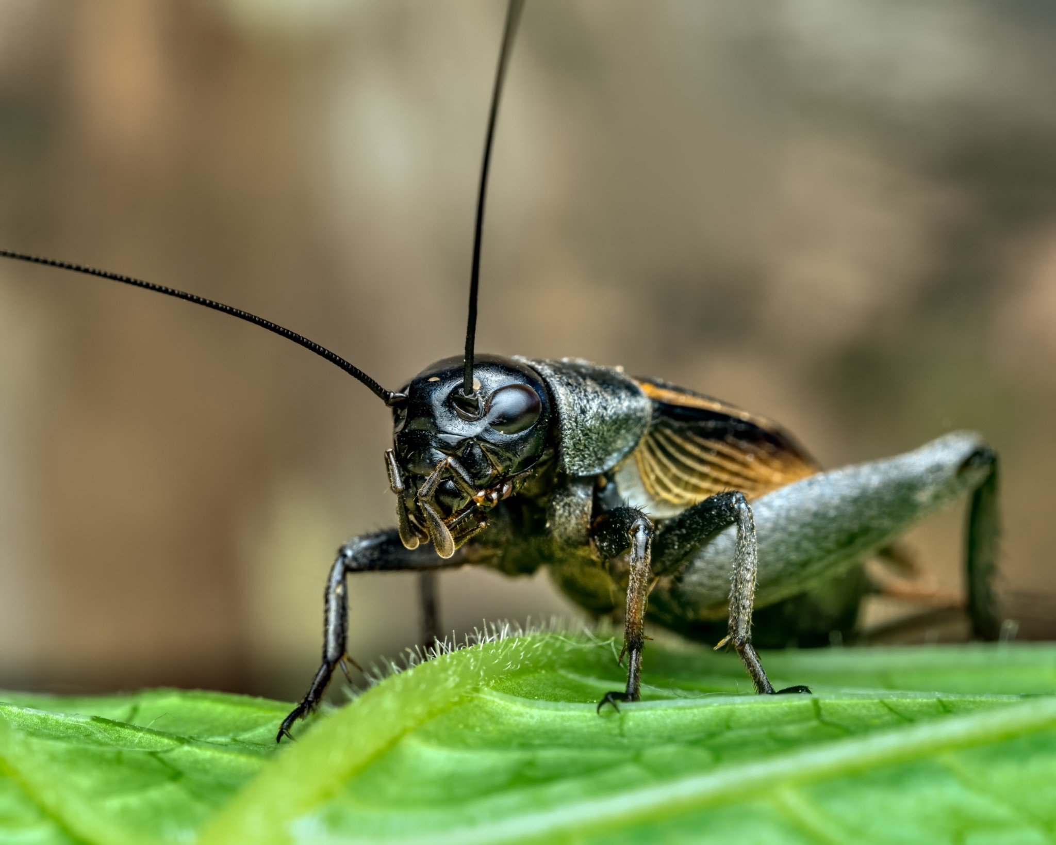
ᏦᎢᏁ ᏣᎳᎩ ᎠᏕᎶᏆᏍᏗ-
ᏔᎳᏚ

Slide 6
ᏦᎢᏁ ᏣᎳᎩ ᎠᏕᎶᏆᏍᏗ
Ilvhiyu jigesv siqua ujetsd ehe.
A long time ago there was a possum.
ᎢᎸᎯᏳ ᏥᎨᏒ ᏏᏆ ᎤᏤᏥᏍᏗ ᎡᎮ.

Slide 7
ᏦᎢᏁ ᏣᎳᎩ ᎠᏕᎶᏆᏍᏗ
Doyu uwodu gese ganidadv.
His tail was really beautiful.
ᏙᏳ ᎤᏬᏚ ᎨᏎ ᎦᏂᏓᏛ.

Slide 8
ᏦᎢᏁ ᏣᎳᎩ ᎠᏕᎶᏆᏍᏗ
Ganidadv nigolv atlvquisde siqua ujetsd.
He was always bragging about his tail.
ᎦᏂᏓᏛ ᏂᎪᎸ ᎠᏢᏈᏍᏕ ᏏᏆ ᎤᏤᏥᏍᏗ.

Slide 9
ᏦᎢᏁ ᏣᎳᎩ ᎠᏕᎶᏆᏍᏗ
Yulsinvsv ganidadv altawosge.
Nightly he would comb his tail.
ᎤᎵᏏᏅᏒ ᎦᏂᏓᏛ ᎠᎵᏔᏬᏍᎨ.

Slide 10
ᏦᎢᏁ ᏣᎳᎩ ᎠᏕᎶᏆᏍᏗ
Ale gigage asti galvwestisgo ganidadv.
And he would wrap it up in a red string.

Slide 11
ᏦᎢᏁ ᏣᎳᎩ ᎠᏕᎶᏆᏍᏗ
Ugitsisgv ayege alsgisidohe ganidadv alihelige dekanogisgv.
At dawn, he would wake up then he would dance and sing about his tail.
ᎤᎩᏥᏍᎬ ᎠᏰᎨ ᎠᎵᏍᎩᏏᏙᎮ ᎦᏂᏓᏛ ᎠᎵᎮᎵᎨ ᏕᎧᏃᎩᏍᎬ.

Slide 12
ᏦᎢᏁ ᏣᎳᎩ ᎠᏕᎶᏆᏍᏗ
Nigad tla yidunilvqde atlvquisgv
Everyone didn’t like his bragging.
ᏂᎦᏓ Ꮭ ᏱᏚᏂᎸᏈᏕ ᎠᏢᏈᏍᎬ.

Slide 13
ᏦᎢᏁ ᏣᎳᎩ ᎠᏕᎶᏆᏍᏗ
Adeloquasdidv duniwuktane unadehyodi
They decided to teach him a lesson
ᎠᏕᎶᏆᏍᏗᏛ ᏚᏂᏭᎧᏔᏁ ᎤᎾᏕᏲᏗ

Slide 14
ᏦᎢᏁ ᏣᎳᎩ ᎠᏕᎶᏆᏍᏗ
Taladu wunitahyotle gohusdi udvhndi
They asked cricket to do something.
ᏔᎳᏚ ᏭᏂᏔᏲᏞ ᎪᎱᏍᏗ ᎤᏛᏅᏗ.

Slide 15
ᏦᎢᏁ ᏣᎳᎩ ᎠᏕᎶᏆᏍᏗ
Usv nulsdan, taladu wuluje ujetsdi juwenvse.
That night, the cricket went to the possum’s place.
ᎤᏒ ᏄᎵᏍᏔᏅ, ᏔᎳᏚ ᏭᎷᏥ ᎤᏤᏥᏍᏗ ᏧᏪᏅᏎ.

Slide 16
ᏦᎢᏁ ᏣᎳᎩ ᎠᏕᎶᏆᏍᏗ
Nuwandese gigage asti ulvwesdv
He unwrapped the possum’s tail.
ᏄᏩᎾᏕᏎ ᎩᎦᎨ ᎠᏍᏘ ᎤᎸᏪᏍᏛ

Slide 17
ᏦᎢᏁ ᏣᎳᎩ ᎠᏕᎶᏆᏍᏗ
Taladu wugalse utsetsdi ganidadv ustigv.
The cricket cut off the hair on possum’s tail.
ᏔᎳᏚ ᏭᎦᎵᏎ ᎤᏤᏥᏍᏗ ᎦᏂᏓᏛ ᎤᏍᏘᎬ.

Slide 18
ᏦᎢᏁ ᏣᎳᎩ ᎠᏕᎶᏆᏍᏗ
Gigage asti ulvwestanv ganidadv.
He wrapped his tail in red string.
ᎩᎦᎨ ᎠᏍᏘ ᎤᎸᏪᏍᏔᏅ ᎦᏂᏓᏛ.

Slide 19
ᏦᎢᏁ ᏣᎳᎩ ᎠᏕᎶᏆᏍᏗ
uyejv utsetsdi, tla yuhnte gohusdi nulstanidolv
When the possum woke up, he didn’t know anything happened
ᎤᏰᏨ ᎤᏤᏥᏍᏗ Ꮭ ᏳᎾᏖ ᎪᎱᏍᏗ ᏄᎵᏍᏔᏂᏙᎸ.

Slide 20
ᏦᎢᏁ ᏣᎳᎩ ᎠᏕᎶᏆᏍᏗ
nuwandese gigage asti unvgowsv gesv ustigv
When he took off the red string, the hair had fallen out.
ᏄᏩᎾᏕᏎ ᎩᎦᎨ ᎠᏍᏘ ᎤᏅᎪᏩᏒ ᎨᏒ ᎤᏍᏘᎬ

Slide 21
ᏦᎢᏁ ᏣᎳᎩ ᎠᏕᎶᏆᏍᏗ
uyelvha gese ganidadv
His tail was naked.
ᎤᏰᎸᎭ ᎨᏎ ᎦᏂᏓᏛ

Slide 22
ᏦᎢᏁ ᏣᎳᎩ ᎠᏕᎶᏆᏍᏗ
Doyu udehose uyelvha ganidadv tsigesv.
He was really embarrassed that his tail was bare.
ᏙᏳ ᎤᏕᎰᏎ ᎤᏰᎸᎭ ᎦᏂᏓᏛ ᏥᎨᏒ.

Slide 23
ᏦᎢᏁ ᏣᎳᎩ ᎠᏕᎶᏆᏍᏗ
Nowu usvi yinulsdani kila ganugogo, si uyelvha ganidadv geso.
Now, he only goes out at night, and still his tail is bare.
ᏃᏭ ᎤᏒᎢ ᏱᏄᎵᏍᏓᏂ ᎩᎳ ᎦᏄᎪᎪ, Ꮟ ᎤᏰᎸᎭ ᎦᏂᏓᏛ ᎨᏐ.

