Slide 1
ᎣᏏᏲ
ᏦᏍᎪ ᏦᎢᏁ ᏣᎳᎩ ᎠᏕᎶᏆᏍᏗ

Slide 2
ᏦᏍᎪ ᏦᎢᏁ ᏣᎳᎩ ᎠᏕᎶᏆᏍᏗ
ᎢᏓᎴᎾ- Let’s begin
ᏣᎳᎩ ᎢᏗᏬᏂ- Let’s talk Cherokee

Slide 3
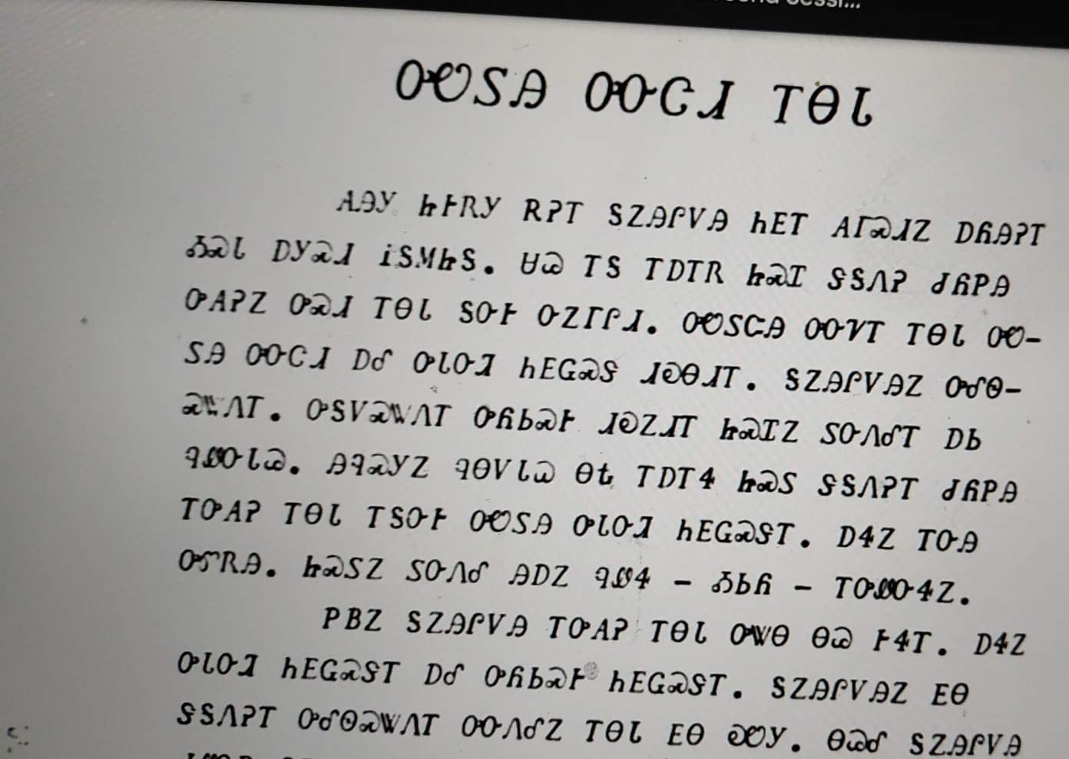
ᏔᎳᏚᏏᏁ ᏣᎳᎩ ᎠᏕᎶᏆᏍᏗ
ᏌᏊ ᎢᎦ ᎢᎠᎢᏒ ᏥᏍᏆ ᏕᎦᏁᎮ ᏧᏲᏢᎯ ᎤᎪᎮᏃ ᎤᏍᏗ ᎢᎾᏓ ᎦᏅᎨ ᏅᏃᎱᎵᏗ.
One day he was walking carrying birds that he had shot then he saw a little snake lying there next to the road.
Notes:
aksdayvhvsg

Slide 4
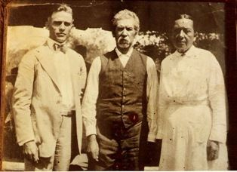
ᏦᏍᎪ ᏦᎢᏁ ᏣᎳᎩ ᎠᏕᎶᏆᏍᏗ
ᎯᏲᎵᎩᏍ ᎯᎠ ᎠᏍᎦᏯ ᎠᏰᏟ ᏥᎦᏙᎦ?
Do you know the man in the center?

Slide 5
ᏦᏍᎪ ᏦᎢᏁ ᏣᎳᎩ ᎠᏕᎶᏆᏍᏗ
ᎯᏂᏲᎵᎬᎾ ᏱᎩ, Redbird Smith ᏚᏙᎡ.
If you don’t know him, Redbird Smith was his name.

Slide 6
ᏦᏍᎪ ᏦᎢᏁ ᏣᎳᎩ ᎠᏕᎶᏆᏍᏗ
ᏙᏧᏩ ᏏᏆᏂᏓ ᏚᏙᎡ, ᏣᎳᎩ ᎬᏗ.
And in Cherokee, his name was tojuwa siquanid.

Slide 7
ᏦᏍᎪ ᏦᎢᏁ ᏣᎳᎩ ᎠᏕᎶᏆᏍᏗ
ᏏᏛ ᎣᏣᎵᎮᎵᎦ ᎯᎢᎾ ᏧᎵᏍᎨᏓ ᎠᏍᎦᏯ.
We still are grateful to this important man.

Slide 8
ᏦᏍᎪ ᏦᎢᏁ ᏣᎳᎩ ᎠᏕᎶᏆᏍᏗ
ᏌᏊ ᎢᏯᎦᏴᎵ ᏣᏁᎳᏍᎪᎯᏥᏍᏊ ᎯᎩᏍᎪᎯ, ᎤᏕᏁ ᏙᏧᏩ ᏏᏆᏂᏓ.
Redbird Smith was born in 1850.

Slide 9
ᏦᏍᎪ ᏦᎢᏁ ᏣᎳᎩ ᎠᏕᎶᏆᏍᏗ
ᎪᎯ ᏥᎩ ᎫᏰᏉᏂ ᏐᏁᎳᏚᏏᏁ ᎣᏣᎵᎮᎵᎪ ᎤᏕᏘᏱᏍᎬ, ᏝᏍᎩᏃ Ꮩ ᏲᎦᎾᏙ Ꮩ ᎤᏕᏘᏱᏍᎬ.
Today, we celebrate his birthday on July 19, but we don’t know exactly what day he was born.

Slide 10
ᏦᏍᎪ ᏦᎢᏁ ᏣᎳᎩ ᎠᏕᎶᏆᏍᏗ
ᏙᏧᏩ ᏏᏆᏂᏓ ᎤᏕᏘᏱᏍᎬ ᏱᏄᎵᏍᏓᏂ ᎠᏂᎩᏚᏩᎩ ᎠᏂᏴᏫᏯ ᎦᏘᏲ ᎠᏁᎪ.
Every year, hundreds of Kituwas go to different ceremonial grounds for his birthday.

Slide 11
ᏦᏍᎪ ᏦᎢᏁ ᏣᎳᎩ ᎠᏕᎶᏆᏍᏗ
ᎦᏙᎨ ᏙᏧᏩ ᏏᏆᏂᏓ ᎤᎵᏍᎨᏓ ᏥᎩ?
So why is Redbird Smith so important?

Slide 12
ᏦᏍᎪ ᏦᎢᏁ ᏣᎳᎩ ᎠᏕᎶᏆᏍᏗ
ᏙᏧᏩ ᎤᏙᏓ Pig Smith ᏚᏙᎡ. ᏏᏆᏂᏓ ᏣᎳᎩ ᎬᏗ ᏚᏙᎡ. ᎣᏂ Smith ᎠᏂᏲᏁᎦ ᏚᏃᎡ, ᎠᏎ ᎪᏢᏅᎥᏍᎩ ᏥᎨᏎ ᏳᏍᏗ
Redbirds father was Young Pig Smith. Young Pig was his Cherokee name and the whites called him Smith because he worked as a blacksmith.

Slide 13
ᏦᏍᎪ ᏦᎢᏁ ᏣᎳᎩ ᎠᏕᎶᏆᏍᏗ
ᏙᏧᏩ ᎤᏥ Lizzie Hildebrand ᏚᏙᎡ. ᎢᏧᎳ ᎠᏣᎳᎩ ᎠᎴ ᎠᏛᏥ ᎨᏎ. ᏣᎳᎩ ᎤᏪᏘ, ᏗᏍᏙᏍᎩ ᏓᎸᏫᏍᏓᏁᎲ Lizzie ᎤᏙᏓ.
Redbird’s mother was Lizzie Hildebrand. She was both Cherokee and German. Lizzie’s father worked as a miller in the old homeland.
(Robert Thomas, Origin and Development of the Redbird Smith Movement, 1953)

Slide 14
ᏦᏍᎪ ᏦᎢᏁ ᏣᎳᎩ ᎠᏕᎶᏆᏍᏗ
ᎢᏧᎳ ᏧᎦᏴᎵᎨ ᎤᏪᏘ ᏣᎳᎩ ᎾᎾᏛᏁᎲ ᏚᏃᎯᏳᏁ
Both of his parents believed in the old Cherokee ways.

Slide 15
ᏦᏍᎪ ᏦᎢᏁ ᏣᎳᎩ ᎠᏕᎶᏆᏍᏗ
ᏗᏓᏅᏫᏍᎩ ᎨᏎ ᎤᏙᏓ.
His dad was a medicine man

Slide 16
ᏦᏍᎪ ᏦᎢᏁ ᏣᎳᎩ ᎠᏕᎶᏆᏍᏗ
ᏄᏕᏅᏏ ᏙᏧᏩ, ᎠᏂᎦᏴᎵᎨ ᏗᏂᏅᏫᏍᎩ ᎤᏂᏃᏎᎴ ᏏᏆᏂᏓ ᏙᏧᏩ ᏗᏓᏘᏁᎯ ᏂᏓᎦᎵᏍᏓᏂᏒ, ᏝᏍᎩᏂ ᎯᏰᎮᏍᏗ ᏂᎦᎵᏍᏓᏅ.
Before Redbird was born, the old medicine men told Pig Smith that tojuwa would become captain, but he wasn’t going to be alive.

Slide 17
ᏦᏍᎪ ᏦᎢᏁ ᏣᎳᎩ ᎠᏕᎶᏆᏍᏗ
ᏏᏆᏂᏓ ᎤᏅᏒ ᎠᎫᏌ ᏌᎻ ᏙᏧᏩ ᎤᏕᏲᏗ.
Pig Smith asked Creek Sam to teach Redbird

Slide 18
ᏦᏍᎪ ᏦᎢᏁ ᏣᎳᎩ ᎠᏕᎶᏆᏍᏗ
ᎠᏃᏥ ᎠᏴᏫᏯ ᎨᏎ ᎠᎫᏌ ᏌᎻ.
Creek Sam was a Natchez Indian.

Slide 19
ᏦᏍᎪ ᏦᎢᏁ ᏣᎳᎩ ᎠᏕᎶᏆᏍᏗ
ᏄᎵᏍᏓᏅᎾ ᎠᎴ ᎤᏪᏘ ᎤᏂᏃᎮᏢᎾ ᎠᏂᏣᎳᎩ, ᎠᏂᎫᏌ ᎠᎴ ᎠᏂᏃᏥ ᏓᎧᏔᎮ ᎠᎫᏌ ᏌᎻ.
Creek Sam knew the ways and old stories of the Cherokee, Creek and Natchez.

Slide 20
ᏦᏍᎪ ᏦᎢᏁ ᏣᎳᎩ ᎠᏕᎶᏆᏍᏗ
ᎣᏍᏓ ᎠᏕᎶᏆᏍᎩ ᎨᎮ ᏙᏧᏩ. ᎤᏓᎿᏙ ᎠᎴ ᏙᎯ ᎦᏬᏂᏍᎩ ᎨᎭ. ᏚᏳᎪᏓ ᏃᎴ ᏥᏳᎪᏓ ᎨᎮ.
Redbird was a good learner. He was kind and soft spoken. He was honest and straight forward.

Slide 21
ᏦᏍᎪ ᏦᎢᏁ ᏣᎳᎩ ᎠᏕᎶᏆᏍᏗ
ᏌᏊ ᎢᏯᎦᏴᎵ ᏣᏁᎳᏍᎪᎯᏥᏍᏊᎤ ᏐᏁᎵᏍᎪ, ᏙᏧᏩ ᎠᏂᎩᏚᏩᎩ ᎠᏥᏍᏛᏂᎨᏍᏛ ᏍᎦᏚᎩ ᏗᏓᏘᏂᏙᎯ ᎨᎮ.
By 1890, Redbird was leader of the illinois district.

Slide 22
ᏦᏍᎪ ᏦᎢᏁ ᏣᎳᎩ ᎠᏕᎶᏆᏍᏗ
ᎾᎯᏳ ᏥᎨᏒ ᏣᎳᎩ ᎠᏁᎲ, ᎠᏯᏙᎯᎲ ᎨᎮ.
At that time, there were a lot of issues in cherokee country.

Slide 23
ᏦᏍᎪ ᏦᎢᏁ ᏣᎳᎩ ᎠᏕᎶᏆᏍᏗ
ᎤᏁᎫᏥᏓ ᎾᏅᏛᏁᎲ
outlawry.

Slide 24
ᏦᏍᎪ ᏦᎢᏁ ᏣᎳᎩ ᎠᏕᎶᏆᏍᏗ
ᏣᎳᎩ ᎠᏰᏟ ᎤᏗᎦᎴᏲᏨ ᎨᏒ.
Cherokee Nation was disorganized.

Slide 25
ᏦᏍᎪ ᏦᎢᏁ ᏣᎳᎩ ᎠᏕᎶᏆᏍᏗ
ᏓᎾᏟᎲ ᎤᎾᎴᏅᎲ ᎤᎾᏓᎴᎾ ᎤᎾᏓᏟᎬ
Different groups started fighting each other.

Slide 26
ᏦᏍᎪ ᏦᎢᏁ ᏣᎳᎩ ᎠᏕᎶᏆᏍᏗ
ᏍᏈᏍᏗ ᎠᏂᏲᏁᎦ ᎠᏁᎮ. Ꮭ ᎤᏁᎳᎩ ᎡᎵᏒ ᏱᎨᏎ.
Many whites were living there. They didnt have permission.

Slide 27
ᏦᏍᎪ ᏦᎢᏁ ᏣᎳᎩ ᎠᏕᎶᏆᏍᏗ
ᎠᏂᏲᏁᎦ ᏚᏙᏢᏒ ᎤᏚᎵᎮ ᎠᏯᏔᏍᏗ ᎠᏂᏣᎳᎩ ᎠᏁᎲ.
The white government wanted to divide the Cherokee lands.

Slide 28
ᏦᏍᎪ ᏦᎢᏁ ᏣᎳᎩ ᎠᏕᎶᏆᏍᏗ
ᎠᏂᏲᏁᎦ Dawes Commission ᎤᏃtᎸᏁ, ᏚᏂᏎᏍᏗ ᎠᏁᎲ ᎠᏂᏣᎳᎩ.
The whites created the Dawes Commission, who were tasked with counting all the existing Cherokees.

Slide 29
ᏦᏍᎪ ᏦᎢᏁ ᏣᎳᎩ ᎠᏕᎶᏆᏍᏗ
Dawes Commission ᎤᎾᏚᎵᎮ ᎠᏰᏟ ᏳᏂᏗᏍᏗ ᎦᏙ ᎠᏂᏣᎳᎩ
They also were to encourage the Cherokees to divide their reservation

Slide 30
ᏦᏍᎪ ᏦᎢᏁ ᏣᎳᎩ ᎠᏕᎶᏆᏍᏗ
ᎦᏙ ᎤᏂᎮ ᏂᎦᏓ ᎠᏂᏣᎳᎩ Ꮭ ᎠᏂᏏᏴᏫᎭ ᏱᎨᏎ.
The Cherokees always owned the land as a group, not as individuals

