Slide 1
ᎣᏏᏲ
ᏦᏍᎪ ᏑᏓᎵᏁ ᏣᎳᎩ ᎠᏕᎶᏆᏍᏗ

Slide 2
ᏦᏍᎪ ᏑᏓᎵᏁ ᏣᎳᎩ ᎠᏕᎶᏆᏍᏗ
ᎢᏓᎴᎾ- Let’s begin
ᏣᎳᎩ ᎢᏗᏬᏂ- Let’s talk Cherokee

Slide 3
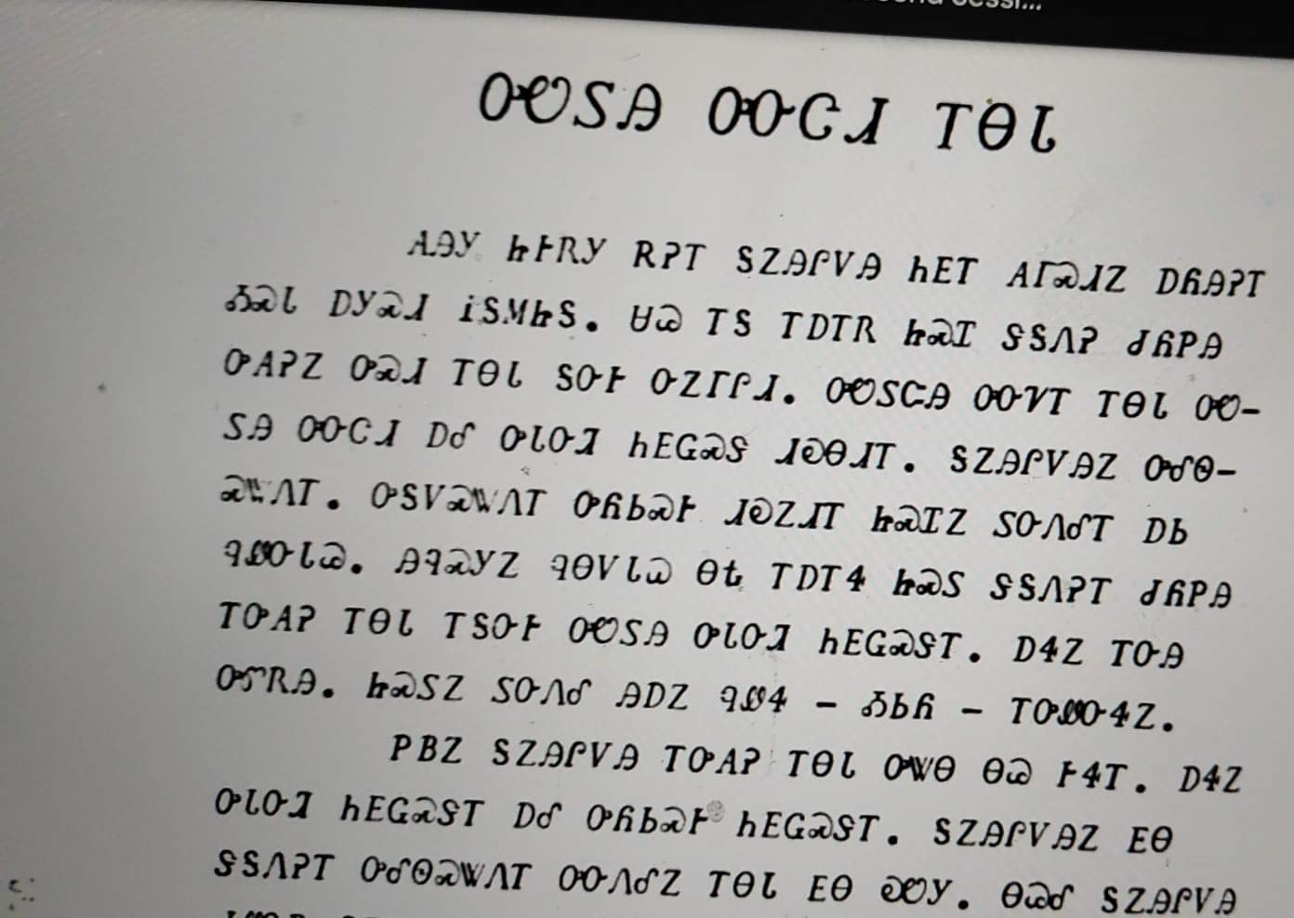
ᏦᏍᎪ ᏑᏓᎵᏁ ᏣᎳᎩ ᎠᏕᎶᏆᏍᏗ
ᎤᏬᏚᎯ ᎤᏅᏣᏗ ᎢᎾᏓ
ᎪᎯᎩ ᏥᎨᏒᎩ ᎡᎮᎢ ᎦᏃᎯᎵᏙᎯ ᏂᎬᎢ ᎪᎱᏍᏗᏃ ᎠᏲᎯᎮᎢ ᎣᏍᏓ ᎠᎩᏍᏗ ᎥᎦᎷᏥᎦ. ᏌᏊ ᎢᎦ ᎢᎠᎢᏒ ᏥᏍᏆ ᏧᏲᏢᎯ ᎤᎪᎮᏃ ᎤᏍᏗ ᎢᎾᏓ ᎦᏅᎨ ᏅᏃᎱᎵᏗ. ᎤᏬᏚᏨᎯ ᎤᏅᏤᎢ ᎢᎾᏓ ᎤᏬᏚᎯ ᎤᏅᏣᏗ ᎠᎴ ᎤᏓᏅᏘ ᏂᎬᏩᏍᏕ ᏓᎧᎾᏗᎢ.
Notes:
aksdayvhvsg

Slide 4
ᏦᏍᎪ ᏑᏓᎵᏁ ᏣᎳᎩ ᎠᏕᎶᏆᏍᏗ
ᎦᏃᎯᎵᏙᎯᏃ ᎤᎴᏫᏍᏔᏁᎢ. ᎤᎦᏙᏍᏔᏁᎢ ᎤᏲᏏᏍᎨ ᏗᎧᏃᏗᎢ ᏥᏍᏆᏃ ᏚᏅᏁᎴᎢ ᎠᏏ ᏄᏪᏅᏓᏊ.
Notes:
aksdayvhvsg

Slide 5
ᏦᏍᎪ ᏑᏓᎵᏁ ᏣᎳᎩ ᎠᏕᎶᏆᏍᏗ
ᎯᎸᏍᎩᏃ ᏄᎾᏙᏓᏇ ᎾᎿ ᎢᎠᎢᏎ ᏥᏍᏚ ᏕᎦᏁᎮᎢ ᏧᏲᏢᎯ ᎢᎤᎪᎮ ᎢᎾᏓ ᎢᎦᏅᎨ ᎤᏬᏚᎯ ᎤᏓᏅᏘ ᏂᎬᏩᏍᏕᎢ.
Several weeks later he was again walking, carrying rabbits that he had shot he again saw the pretty snake lying there that seemed friendly.
Notes:
aksdayvhvsg

Slide 6
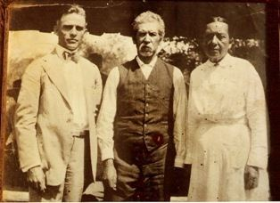
ᏦᏍᎪ ᏑᏓᎵᏁ ᏣᎳᎩ ᎠᏕᎶᏆᏍᏗ
ᎯᏲᎵᎩᏍ ᎯᎠ ᎠᏍᎦᏯ ᎠᏰᏟ ᏥᎦᏙᎦ?
Do you know the man in the center?

Slide 7
ᏦᏍᎪ ᏑᏓᎵᏁ ᏣᎳᎩ ᎠᏕᎶᏆᏍᏗ
ᎯᏂᏲᎵᎬᎾ ᏱᎩ, Redbird Smith ᏚᏙᎡ.
If you don’t know him, Redbird Smith was his name.

Slide 8
ᏦᏍᎪ ᏑᏓᎵᏁ ᏣᎳᎩ ᎠᏕᎶᏆᏍᏗ
ᏙᏧᏩ ᏏᏆᏂᏓ ᏚᏙᎡ, ᏣᎳᎩ ᎬᏗ.
And in Cherokee, his name was tojuwa siquanid.

Slide 9
ᏦᏍᎪ ᏑᏓᎵᏁ ᏣᎳᎩ ᎠᏕᎶᏆᏍᏗ
ᏏᏛ ᎣᏣᎵᎮᎵᎦ ᎯᎢᎾ ᏧᎵᏍᎨᏓ ᎠᏍᎦᏯ.
We still are grateful to this important man.

Slide 10
ᏦᏍᎪ ᏑᏓᎵᏁ ᏣᎳᎩ ᎠᏕᎶᏆᏍᏗ
ᏌᏊ ᎢᏯᎦᏴᎵ ᏣᏁᎳᏍᎪᎯᏥᏍᏊ ᎯᎩᏍᎪᎯ, ᎤᏕᏁ ᏙᏧᏩ ᏏᏆᏂᏓ.
Redbird Smith was born in 1850.

Slide 11
ᏦᏍᎪ ᏑᏓᎵᏁ ᏣᎳᎩ ᎠᏕᎶᏆᏍᏗ
ᎪᎯ ᏥᎩ ᎫᏰᏉᏂ ᏐᏁᎳᏚᏏᏁ ᎣᏣᎵᎮᎵᎪ ᎤᏕᏘᏱᏍᎬ, ᏝᏍᎩᏃ Ꮩ ᏲᎦᎾᏙ Ꮩ ᎤᏕᏘᏱᏍᎬ.
Today, we celebrate his birthday on July 19, but we don’t know exactly what day he was born.

Slide 12
ᏦᏍᎪ ᏑᏓᎵᏁ ᏣᎳᎩ ᎠᏕᎶᏆᏍᏗ
ᏙᏧᏩ ᏏᏆᏂᏓ ᎤᏕᏘᏱᏍᎬ ᏱᏄᎵᏍᏓᏂ ᎠᏂᎩᏚᏩᎩ ᎠᏂᏴᏫᏯ ᎦᏘᏲ ᎠᏁᎪ.
Every year, hundreds of Kituwas go to different ceremonial grounds for his birthday.

Slide 13
ᏦᏍᎪ ᏑᏓᎵᏁ ᏣᎳᎩ ᎠᏕᎶᏆᏍᏗ
ᎦᏙᎨ ᏙᏧᏩ ᏏᏆᏂᏓ ᎤᎵᏍᎨᏓ ᏥᎩ?
So why is Redbird Smith so important?

Slide 14
ᏦᏍᎪ ᏑᏓᎵᏁ ᏣᎳᎩ ᎠᏕᎶᏆᏍᏗ
ᏙᏧᏩ ᎤᏙᏓ Pig Smith ᏚᏙᎡ. ᏏᏆᏂᏓ ᏣᎳᎩ ᎬᏗ ᏚᏙᎡ. ᎣᏂ Smith ᎠᏂᏲᏁᎦ ᏚᏃᎡ, ᎠᏎ ᎪᏢᏅᎥᏍᎩ ᏥᎨᏎ ᏳᏍᏗ
Redbirds father was Young Pig Smith. Young Pig was his Cherokee name and the whites called him Smith because he worked as a blacksmith.

Slide 15
ᏦᏍᎪ ᏑᏓᎵᏁ ᏣᎳᎩ ᎠᏕᎶᏆᏍᏗ
ᏙᏧᏩ ᎤᏥ Lizzie Hildebrand ᏚᏙᎡ. ᎢᏧᎳ ᎠᏣᎳᎩ ᎠᎴ ᎠᏛᏥ ᎨᏎ. ᏣᎳᎩ ᎤᏪᏘ, ᏗᏍᏙᏍᎩ ᏓᎸᏫᏍᏓᏁᎲ Lizzie ᎤᏙᏓ.
Redbird’s mother was Lizzie Hildebrand. She was both Cherokee and German. Lizzie’s father worked as a miller in the old homeland.
(Robert Thomas, Origin and Development of the Redbird Smith Movement, 1953)

Slide 16
ᏦᏍᎪ ᏑᏓᎵᏁ ᏣᎳᎩ ᎠᏕᎶᏆᏍᏗ
ᎢᏧᎳ ᏧᎦᏴᎵᎨ ᎤᏪᏘ ᏣᎳᎩ ᎾᎾᏛᏁᎲ ᏚᏃᎯᏳᏁ
Both of his parents believed in the old Cherokee ways.

Slide 17
ᏦᏍᎪ ᏑᏓᎵᏁ ᏣᎳᎩ ᎠᏕᎶᏆᏍᏗ
ᏗᏓᏅᏫᏍᎩ ᎨᏎ ᎤᏙᏓ.
His dad was a medicine man

Slide 18
ᏦᏍᎪ ᏑᏓᎵᏁ ᏣᎳᎩ ᎠᏕᎶᏆᏍᏗ
ᏄᏕᏅᏏ ᏙᏧᏩ, ᎠᏂᎦᏴᎵᎨ ᏗᏂᏅᏫᏍᎩ ᎤᏂᏃᏎᎴ ᏏᏆᏂᏓ ᏙᏧᏩ ᏗᏓᏘᏁᎯ ᏂᏓᎦᎵᏍᏓᏂᏒ, ᏝᏍᎩᏂ ᎯᏰᎮᏍᏗ ᏂᎦᎵᏍᏓᏅ.
Before Redbird was born, the old medicine men told Pig Smith that tojuwa would become captain, but he wasn’t going to be alive.

Slide 19
ᏦᏍᎪ ᏑᏓᎵᏁ ᏣᎳᎩ ᎠᏕᎶᏆᏍᏗ
ᏏᏆᏂᏓ ᎤᏅᏒ ᎠᎫᏌ ᏌᎻ ᏙᏧᏩ ᎤᏕᏲᏗ.
Pig Smith asked Creek Sam to teach Redbird

Slide 20
ᏦᏍᎪ ᏑᏓᎵᏁ ᏣᎳᎩ ᎠᏕᎶᏆᏍᏗ
ᎠᏃᏥ ᎠᏴᏫᏯ ᎨᏎ ᎠᎫᏌ ᏌᎻ.
Creek Sam was a Natchez Indian.

Slide 21
ᏦᏍᎪ ᏑᏓᎵᏁ ᏣᎳᎩ ᎠᏕᎶᏆᏍᏗ
ᏄᎵᏍᏓᏅᎾ ᎠᎴ ᎤᏪᏘ ᎤᏂᏃᎮᏢᎾ ᎠᏂᏣᎳᎩ, ᎠᏂᎫᏌ ᎠᎴ ᎠᏂᏃᏥ ᏓᎧᏔᎮ ᎠᎫᏌ ᏌᎻ.
Creek Sam knew the ways and old stories of the Cherokee, Creek and Natchez.

Slide 22
ᏦᏍᎪ ᏑᏓᎵᏁ ᏣᎳᎩ ᎠᏕᎶᏆᏍᏗ
ᎣᏍᏓ ᎠᏕᎶᏆᏍᎩ ᎨᎮ ᏙᏧᏩ. ᎤᏓᎿᏙ ᎠᎴ ᏙᎯ ᎦᏬᏂᏍᎩ ᎨᎭ. ᏚᏳᎪᏓ ᏃᎴ ᏥᏳᎪᏓ ᎨᎮ.
Redbird was a good learner. He was kind and soft spoken. He was honest and straight forward.

Slide 23
ᏦᏍᎪ ᏑᏓᎵᏁ ᏣᎳᎩ ᎠᏕᎶᏆᏍᏗ
ᏌᏊ ᎢᏯᎦᏴᎵ ᏣᏁᎳᏍᎪᎯᏥᏍᏊᎤ ᏐᏁᎵᏍᎪ, ᏙᏧᏩ ᎠᏂᎩᏚᏩᎩ ᎠᏥᏍᏛᏂᎨᏍᏛ ᏍᎦᏚᎩ ᏗᏓᏘᏂᏙᎯ ᎨᎮ.
By 1890, Redbird was leader of the illinois district.

Slide 24
ᏦᏍᎪ ᏑᏓᎵᏁ ᏣᎳᎩ ᎠᏕᎶᏆᏍᏗ
ᎾᎯᏳ ᏥᎨᏒ ᏣᎳᎩ ᎠᏁᎲ, ᎠᏯᏙᎯᎲ ᎨᎮ.
At that time, there were a lot of issues in cherokee country.

Slide 25
ᏦᏍᎪ ᏑᏓᎵᏁ ᏣᎳᎩ ᎠᏕᎶᏆᏍᏗ
ᎤᏁᎫᏥᏓ ᎾᏅᏛᏁᎲ
outlawry.

Slide 26
ᏦᏍᎪ ᏑᏓᎵᏁ ᏣᎳᎩ ᎠᏕᎶᏆᏍᏗ
ᏣᎳᎩ ᎠᏰᏟ ᎤᏗᎦᎴᏲᏨ ᎨᏒ.
Cherokee Nation was disorganized.

Slide 27
ᏦᏍᎪ ᏑᏓᎵᏁ ᏣᎳᎩ ᎠᏕᎶᏆᏍᏗ
ᏓᎾᏟᎲ ᎤᎾᎴᏅᎲ ᎤᎾᏓᎴᎾ ᎤᎾᏓᏟᎬ
Different groups started fighting each other.

Slide 28
ᏦᏍᎪ ᏑᏓᎵᏁ ᏣᎳᎩ ᎠᏕᎶᏆᏍᏗ
ᏍᏈᏍᏗ ᎠᏂᏲᏁᎦ ᎠᏁᎮ. Ꮭ ᎤᏁᎳᎩ ᎡᎵᏒ ᏱᎨᏎ.
Many whites were living there. They didnt have permission.

Slide 29
ᏦᏍᎪ ᏑᏓᎵᏁ ᏣᎳᎩ ᎠᏕᎶᏆᏍᏗ
ᎠᏂᏲᏁᎦ ᏚᏙᏢᏒ ᎤᏚᎵᎮ ᎠᏯᏔᏍᏗ ᎠᏂᏣᎳᎩ ᎠᏁᎲ.
The white government wanted to divide the Cherokee lands.

Slide 30
ᏦᏍᎪ ᏑᏓᎵᏁ ᏣᎳᎩ ᎠᏕᎶᏆᏍᏗ
ᎠᏂᏲᏁᎦ Dawes Commission ᎤᏃᏢᏁ, ᏚᏂᏎᏍᏗ ᎠᏁᎲ ᎠᏂᏣᎳᎩ.
The whites created the Dawes Commission, who were tasked with counting all the existing Cherokees.

Slide 31
ᏦᏍᎪ ᏑᏓᎵᏁ ᏣᎳᎩ ᎠᏕᎶᏆᏍᏗ
Dawes Commission ᎤᎾᏚᎵᎮ ᎠᏰᏟ ᏳᏂᏗᏍᏗ ᎦᏙ ᎠᏂᏣᎳᎩ
They also were to encourage the Cherokees to divide their reservation

Slide 32
ᏦᏍᎪ ᏑᏓᎵᏁ ᏣᎳᎩ ᎠᏕᎶᏆᏍᏗ
ᎦᏙ ᎤᏂᎮ ᏂᎦᏓ ᎠᏂᏣᎳᎩ Ꮭ ᎠᏂᏏᏴᏫᎭ ᏱᎨᏎ.
The Cherokees always owned the land as a group, not as individuals

Slide 33
ᏦᏍᎪ ᏑᏓᎵᏁ ᏣᎳᎩ ᎠᏕᎶᏆᏍᏗ
ᎠᏂᏲᏁᎦ ᎤᎾᏚᎵᎮ ᏚᏂᏁᏗ ᎦᏙ ᏂᎦᏓ ᎠᏂᏣᎳᎩ ᎠᏁᎲ.
The whites wanted to give all living Cherokees land.

Slide 34
ᏦᏍᎪ ᏑᏓᎵᏁ ᏣᎳᎩ ᎠᏕᎶᏆᏍᏗ
ᏃᎴ ᏚᏂᏍᎪᎵᏙᏗ ᎠᏂᏲᏁᎦ ᎤᎾᏕᏗ ᎦᏙ.
Then they allowed the whites to live on the land.

Slide 35
ᏦᏍᎪ ᏑᏓᎵᏁ ᏣᎳᎩ ᎠᏕᎶᏆᏍᏗ
Ꮭ ᏳᎾᏚᎵᏍᎨ ᎠᏂᏣᎳᎩ ᏱᏄᎵᏍᏙᏗ
The Cherokees didn’t want this to happen.

Slide 36
ᏦᏍᎪ ᏑᏓᎵᏁ ᏣᎳᎩ ᎠᏕᎶᏆᏍᏗ
ᏂᎦᎳᏓᏅᏍᎬ, ᎠᏂᎩᏚᏩᎩ ᏗᎾᏓᏘᏁᎯ ᎠᏁᎵᏍᎨ ᏚᏳᎦᏛ ᎦᎶᎯᏍᏗ ᎤᏅᎨᏮᏍᎬ.
With all that was happening, the kituwah leaders thought they had forgotten the true path.

Slide 37
ᏦᏍᎪ ᏑᏓᎵᏁ ᏣᎳᎩ ᎠᏕᎶᏆᏍᏗ
ᎤᏁᏝᏅᎯ ᏚᏅᎨᏫᏒ ᎠᏁᎵᏍᎨ ᎠᏂᎩᏚᏩᎩ.
They thought God had forgotten them.

Slide 38
ᏦᏍᎪ ᏑᏓᎵᏁ ᏣᎳᎩ ᎠᏕᎶᏆᏍᏗ
ᎠᏂᎦᏴᎳ ᎯᎠ ᏄᏂᏪᏎᎸ ᏙᏧᏩ ᏥᏙᎲᎴᏓ ᏣᎳᎩ ᎢᏳᎾᏛᏂᏗ ᏥᎦᎶᏐᎲᏍᎩ.
The elders said this to Redbird, “Raise up the Cherokee ways that are leaving.

Slide 39
ᏦᏍᎪ ᏑᏓᎵᏁ ᏣᎳᎩ ᎠᏕᎶᏆᏍᏗ
ᎤᏛᏛᏁᏍᏊ ᏗᏓᏠᏍᏗ ᎦᎸᏉᏗ ᏭᏁᏍᏗ.
They also asked him to go and get the sacred belts.

Slide 40
ᏦᏍᎪ ᏑᏓᎵᏁ ᏣᎳᎩ ᎠᏕᎶᏆᏍᏗ
Bob Ross ᏚᎾᎡ ᏗᏓᏠᏍᏗ ᏝᏍᎩᏂ ᏧᏤᎵ ᏱᎨᏎᎢ.
Bob Ross had the belts but they didn’t belong to him.

Slide 41
ᏦᏍᎪ ᏑᏓᎵᏁ ᏣᎳᎩ ᎠᏕᎶᏆᏍᏗ
Awajeli - it is mine
Jajeli- it is yours
Ujeli- it is his/hers
Unajeli- it is theirs
Jajelis? Is it yours?
Tla awajeli yig- it isn’t mine.

