Slide 1
ᎣᏏᏲ
ᏅᎩᏁ ᏣᎳᎩ ᎠᏕᎶᏆᏍᏗ

Slide 2
ᏅᎩᏁ ᏣᎳᎩ ᎠᏕᎶᏆᏍᏗ
ᎢᏓᎴᎾ- Let’s begin
ᏣᎳᎩ ᎢᏗᏬᏂ- Let’s talk Cherokee

Slide 3
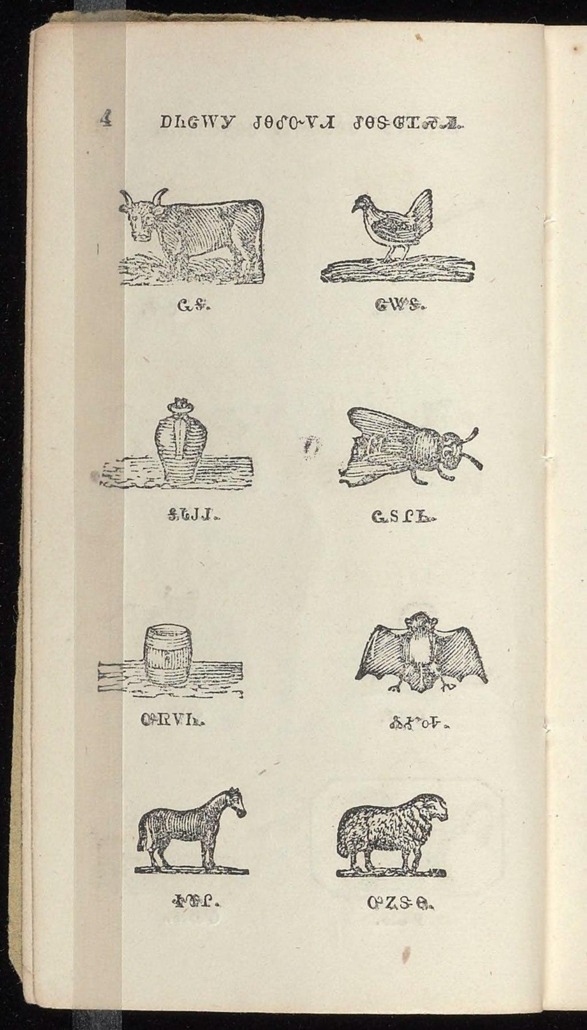
ᏅᎩᏁ ᏣᎳᎩ ᎠᏕᎶᏆᏍᏗ
ᏩᎦ ᏣᏔᎦ
ᎦᏓᎫᎫ ᏩᏚᎵᏏ
ᎤᏒᏙᏂ ᏜᎹᎭ
ᏐᏈᎵ ᎤᏃᏕᎾ
Notes:
aksdayvhvsg

Slide 4
ᏅᎩᏁ ᏣᎳᎩ ᎠᏕᎶᏆᏍᏗ
Ilvhiyu jigesv siqua ujetsd ehe.
A long time ago there was a possum.
ᎢᎸᎯᏳ ᏥᎨᏒ ᏏᏆ ᎤᏤᏥᏍᏗ ᎡᎮ.

Slide 5
ᏅᎩᏁ ᏣᎳᎩ ᎠᏕᎶᏆᏍᏗ
Doyu uwodu gese ganidadv.
His tail was really beautiful.
ᏙᏳ ᎤᏬᏚ ᎨᏎ ᎦᏂᏓᏛ.

Slide 6
ᏅᎩᏁ ᏣᎳᎩ ᎠᏕᎶᏆᏍᏗ
Ganidadv nigolv atlvquisde siqua ujetsd.
He was always bragging about his tail.
ᎦᏂᏓᏛ ᏂᎪᎸ ᎠᏢᏈᏍᏕ ᏏᏆ ᎤᏤᏥᏍᏗ.

Slide 7
ᏅᎩᏁ ᏣᎳᎩ ᎠᏕᎶᏆᏍᏗ
ulsinvsv ganidadv altawosge.
Nightly he would comb his tail.
ᎤᎵᏏᏅᏒ ᎦᏂᏓᏛ ᎠᎵᏔᏬᏍᎨ.

Slide 8
ᏅᎩᏁ ᏣᎳᎩ ᎠᏕᎶᏆᏍᏗ
Ale gigage asti galvwestisgo ganidadv.
And he would wrap it up in a red string.
ᎠᎴ ᎩᎦᎨ ᎠᏍᏘ ᎦᎸᏪᏍᏘᏍᎪ ᎦᏂᏓᏛ.

Slide 9
ᏅᎩᏁ ᏣᎳᎩ ᎠᏕᎶᏆᏍᏗ
Ugitsisgv ayege alsgisidohe ganidadv alihelige dekanogisgv.
At dawn, he would wake up then he would dance and sing about his tail.
ᎤᎩᏥᏍᎬ ᎠᏰᎨ ᎠᎵᏍᎩᏏᏙᎮ ᎦᏂᏓᏛ ᎠᎵᎮᎵᎨ ᏕᎧᏃᎩᏍᎬ.

Slide 10
ᏅᎩᏁ ᏣᎳᎩ ᎠᏕᎶᏆᏍᏗ
Nigad tla yidunilvqde atlvquisgv
Everyone didn’t like his bragging.
ᏂᎦᏓ Ꮭ ᏱᏚᏂᎸᏈᏕ ᎠᏢᏈᏍᎬ.

Slide 11
ᏅᎩᏁ ᏣᎳᎩ ᎠᏕᎶᏆᏍᏗ
Adeloquasdidv duniwuktane unadehyodi
They decided to teach him a lesson
ᎠᏕᎶᏆᏍᏗᏛ ᏚᏂᏭᎧᏔᏁ ᎤᎾᏕᏲᏗ

Slide 12
ᏅᎩᏁ ᏣᎳᎩ ᎠᏕᎶᏆᏍᏗ
Taladu wunitahyotle gohusdi udvhndi
They asked cricket to do something.
ᏔᎳᏚ ᏭᏂᏔᏲᏞ ᎪᎱᏍᏗ ᎤᏛᏅᏗ.

Slide 13
ᏅᎩᏁ ᏣᎳᎩ ᎠᏕᎶᏆᏍᏗ
Usv nulsdan, taladu wuluje ujetsdi juwenvsᎥ.
That night, the cricket went to the possum’s place.
ᎤᏒ ᏄᎵᏍᏔᏅ, ᏔᎳᏚ ᏭᎷᏤ ᎤᏤᏥᏍᏗ ᏧᏪᏅᏒ.

Slide 14
ᏅᎩᏁ ᏣᎳᎩ ᎠᏕᎶᏆᏍᏗ
Nuwandese gigage asti ulvwesdv
He unwrapped the possum’s tail.
ᏄᏩᎾᏕᏎ ᎩᎦᎨ ᎠᏍᏘ ᎤᎸᏪᏍᏛ

Slide 15
ᏅᎩᏁ ᏣᎳᎩ ᎠᏕᎶᏆᏍᏗ
Taladu wugalse utsetsdi ganidadv ustigv.
The cricket cut off the hair on possum’s tail.
ᏔᎳᏚ ᏭᎦᎵᏎ ᎤᏤᏥᏍᏗ ᎦᏂᏓᏛ ᎤᏍᏘᎬ.

Slide 16
ᏅᎩᏁ ᏣᎳᎩ ᎠᏕᎶᏆᏍᏗ
Gigage asti ulvwestanv ganidadv.
He wrapped his tail in red string.
ᎩᎦᎨ ᎠᏍᏘ ᎤᎸᏪᏍᏔᏅ ᎦᏂᏓᏛ.

Slide 17
ᏅᎩᏁ ᏣᎳᎩ ᎠᏕᎶᏆᏍᏗ
uyejv utsetsdi, tla yuhnte gohusdi nulstanidolv
When the possum woke up, he didn’t know anything happened
ᎤᏰᏨ ᎤᏤᏥᏍᏗ Ꮭ ᏳᎾᏖ ᎪᎱᏍᏗ ᏄᎵᏍᏔᏂᏙᎸ.

Slide 18
ᏅᎩᏁ ᏣᎳᎩ ᎠᏕᎶᏆᏍᏗ
nuwandese gigage asti unvgowsv gesv ustigv
When he took off the red string, the hair had fallen out.
ᏄᏩᎾᏕᏎ ᎩᎦᎨ ᎠᏍᏘ ᎤᏅᎪᏩᏒ ᎨᏒ ᎤᏍᏘᎬ

Slide 19
ᏅᎩᏁ ᏣᎳᎩ ᎠᏕᎶᏆᏍᏗ
uyelvha gese ganidadv
His tail was naked.
ᎤᏰᎸᎭ ᎨᏎ ᎦᏂᏓᏛ

Slide 20
ᏅᎩᏁ ᏣᎳᎩ ᎠᏕᎶᏆᏍᏗ
Doyu udehose uyelvha ganidadv tsigesv.
He was really embarrassed that his tail was bare.
ᏙᏳ ᎤᏕᎰᏎ ᎤᏰᎸᎭ ᎦᏂᏓᏛ ᏥᎨᏒ.

Slide 21
ᏅᎩᏁ ᏣᎳᎩ ᎠᏕᎶᏆᏍᏗ
Nowu usvi yinulsdani kila ganugogo, si uyelvha ganidadv geso.
Now, he only goes out at night, and still his tail is bare.
ᏃᏭ ᎤᏒᎢ ᏱᏄᎵᏍᏓᏂ ᎩᎳ ᎦᏄᎪᎪ, Ꮟ ᎤᏰᎸᎭ ᎦᏂᏓᏛ ᎨᏐ.

