Slide 1
ᎣᏏᏲ
ᏑᏓᎵᏁ ᏣᎳᎩ ᎠᏕᎶᏆᏍᏗ

Slide 2
ᏑᏓᎵᏁ ᏣᎳᎩ ᎠᏕᎶᏆᏍᏗ
ᎢᏓᎴᎾ- Let’s begin
ᏣᎳᎩ ᎢᏗᏬᏂ- Let’s talk Cherokee

Slide 3
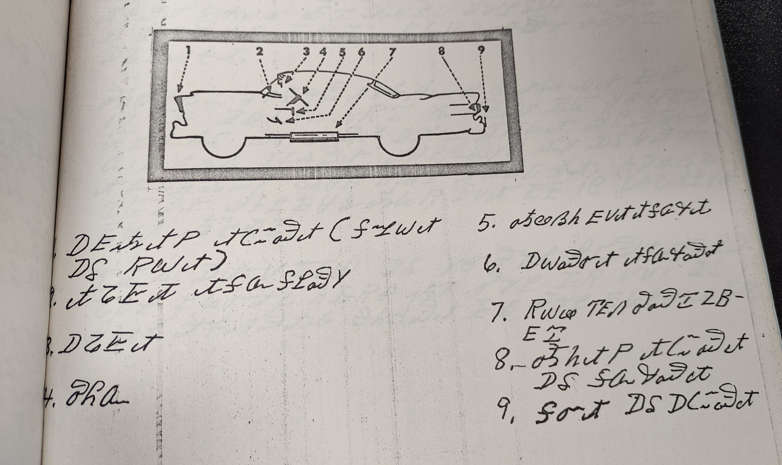
ᏑᏓᎵᏁ ᏣᎳᎩ ᎠᏕᎶᏆᏍᏗ
Notes:
aksdayvhvsg

Slide 4
ᏑᏓᎵᏁ ᏣᎳᎩ ᎠᏕᎶᏆᏍᏗ
ᎢᎸᎯᏳ ᏥᎨᏒ ᏏᏆ ᎤᏤᏥᏍᏗ ᎡᎮ. ᏙᏳ ᎤᏬᏚ ᎨᏎ ᎦᏂᏓᏛ.
ᎦᏂᏓᏛ ᏂᎪᎸ ᎠᏢᏈᏍᏕ ᏏᏆ ᎤᏤᏥᏍᏗ. ᎤᎵᏏᏅᏒ ᎦᏂᏓᏛ ᎠᎵᏔᏬᏍᎨ. ᎠᎴ ᎩᎦᎨ ᎠᏍᏘ ᎦᎸᏪᏍᏘᏍᎪ ᎦᏂᏓᏛ. ᎤᎩᏥᏍᎬ ᎠᏰᎨ ᎠᎵᏍᎩᏏᏙᎮ ᎦᏂᏓᏛ ᎠᎵᎮᎵᎨ ᏕᎧᏃᎩᏍᎬ. ᏂᎦᏓ Ꮭ ᏱᏚᏂᎸᏈᏕ ᎠᏢᏈᏍᎬ. ᎠᏕᎶᏆᏍᏗᏛ ᏚᏂᏭᎧᏔᏁ ᎤᎾᏕᏲᏗ. ᏔᎳᏚ ᏭᏂᏔᏲᏞ ᎪᎱᏍᏗ ᎤᏛᏅᏗ. ᎤᏒ ᏄᎵᏍᏔᏅ, ᏔᎳᏚ ᏭᎷᏤ ᎤᏤᏥᏍᏗ ᏧᏪᏅᏒ. ᏄᏩᎾᏕᏎ ᎩᎦᎨ ᎠᏍᏘ ᎤᎸᏪᏍᏛ. ᏔᎳᏚ ᏭᎦᎵᏎ ᎤᏤᏥᏍᏗ ᎦᏂᏓᏛ ᎤᏍᏘᎬ. ᎩᎦᎨ ᎠᏍᏘ ᎤᎸᏪᏍᏔᏅ ᎦᏂᏓᏛ. ᎤᏰᏨ ᎤᏤᏥᏍᏗ Ꮭ ᏳᎾᏖ ᎪᎱᏍᏗ ᏄᎵᏍᏔᏂᏙᎸ. ᏄᏩᎾᏕᏎ ᎩᎦᎨ ᎠᏍᏘ ᎤᏅᎪᏩᏒ ᎨᏒ ᎤᏍᏘᎬ. ᎤᏰᎸᎭ ᎨᏎ ᎦᏂᏓᏛ. ᏙᏳ ᎤᏕᎰᏎ ᎤᏰᎸᎭ ᎦᏂᏓᏛ ᏥᎨᏒ. ᏃᏭ ᎤᏒᎢ ᏱᏄᎵᏍᏓᏂ ᎩᎳ ᎦᏄᎪᎪ, Ꮟ ᎤᏰᎸᎭ ᎦᏂᏓᏛ ᎨᏐ.

