Slide 1
ᎣᏏᏲ
ᏐᏁᎵᏁ ᏣᎳᎩ ᎠᏕᎶᏆᏍᏗ

Slide 2
ᏐᏁᎵᏁ ᏣᎳᎩ ᎠᏕᎶᏆᏍᏗ
ᎢᏓᎴᎾ- Let’s begin
ᏣᎳᎩ ᎢᏗᏬᏂ- Let’s talk Cherokee

Slide 3
ᏐᏁᎵᏁ ᏣᎳᎩ ᎠᏕᎶᏆᏍᏗ
ᎤᏲ ᎢᏣᏓᏅᏗ, ᎿᏉ ᎡᏤᎾ;
ᎢᏣᎫᏴᎲᎯ ᎡᏥᎷᏥ;
ᎾᏍᎩ ᎤᏩᏒᎯᏳ ᎨᏥᏅᏬᏗ.
ᏂᎦᏛ ᎤᏲ ᎢᏣᏓᏅᏛᎢ.
Those of you who feel bad, now go;
He paid for you. Come to him. That you may come to him alone; That you may be healed by him alone. All of you who feel bad.
Notes:
aksdayvhvsg

Slide 4
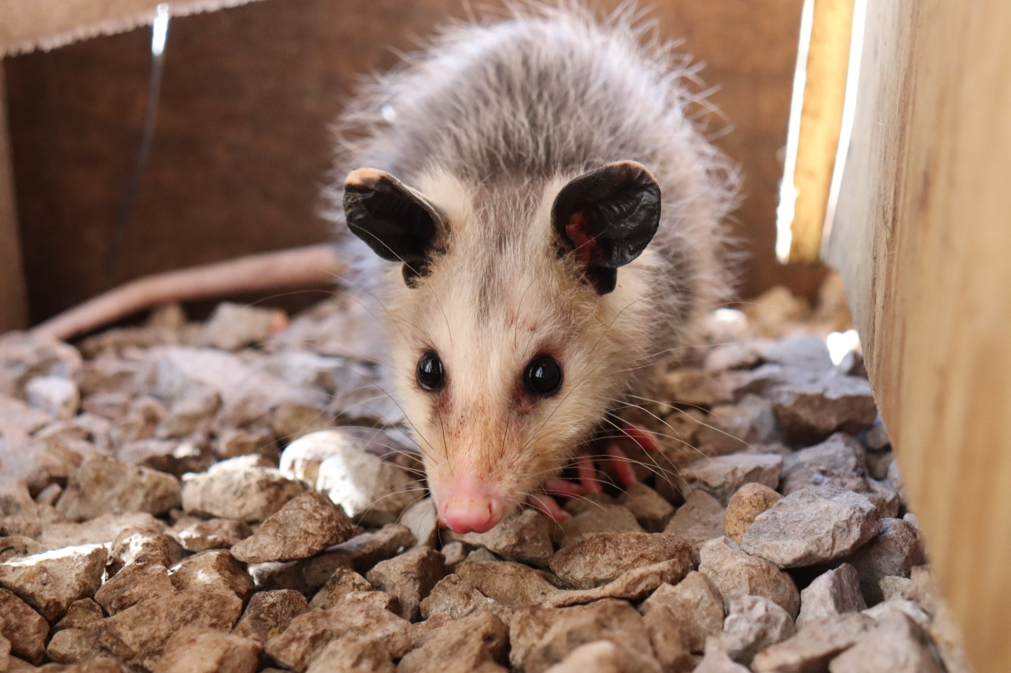
ᏐᏁᎵᏁ ᏣᎳᎩ ᎠᏕᎶᏆᏍᏗ
ᎤᏤᏥᏍᏗ ᎧᏴᏐᎵ ᎠᏓᎴᏂᏍᎬ ᎦᏂᏓᏛᎢ ᎢᎦᏅᎯᏓ ᏦᎦᏚ ᏦᏍᎪᎯ ᎦᎵᏉᎩ ᎢᏏᏔᏗᏍᏗ.
From nose to the base of the tail, the possum is 13 to 37 inches long.

Slide 5
ᏐᏁᎵᏁ ᏣᎳᎩ ᎠᏕᎶᏆᏍᏗ
ᎦᏂᏓᏛ ᎤᏰᎸᎭ ᎠᎴ ᎦᏅᎯᏒ ᏐᏁᎵ ᎠᎴ ᏐᏁᎳᏚ ᎢᏏᏔᏗᏍᏗ.
The tail is naked and between 9 and 19 inches long.

Slide 6
ᏐᏁᎵᏁ ᏣᎳᎩ ᎠᏕᎶᏆᏍᏗ
ᏚᏩᏂᎦᏢ ᎠᎴ ᏧᏓᎴᏅᏓ ᎪᎱᏍᏗ ᏱᎦᏇᏅᎾ ᎦᏂᏓᏛ.
Branches and various things it wraps around the tail.

Slide 7
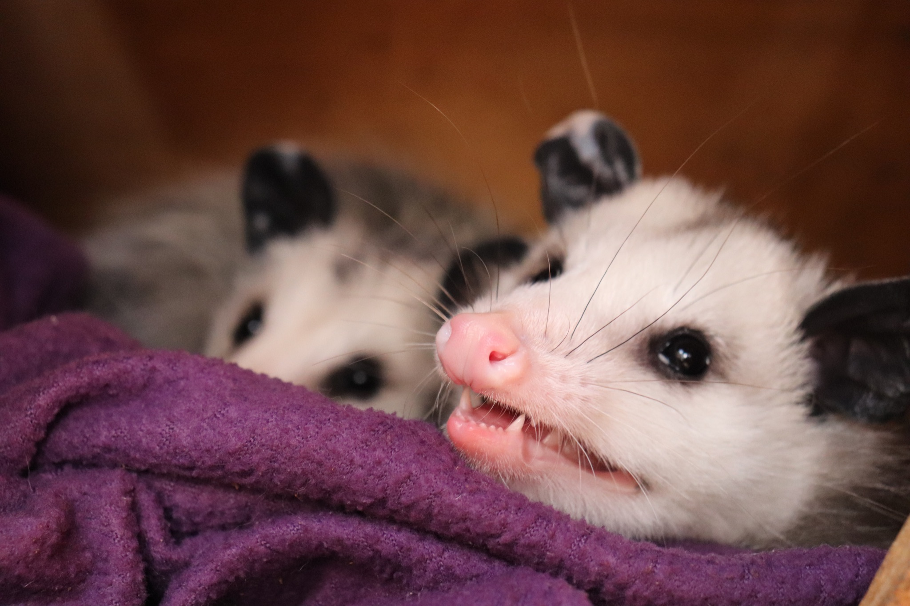
ᏐᏁᎵᏁ ᏣᎳᎩ ᎠᏕᎶᏆᏍᏗ
ᎬᎿᎨ ᎤᏍᎪᎸ ᏧᎾᎵᏑᏫᏓ ᎠᎴ ᎤᏍᏗ ᏓᏂᎵᎵᎪ.
It’s gray colored and has small ears.

Slide 8
ᏐᏁᎵᏁ ᏣᎳᎩ ᎠᏕᎶᏆᏍᏗ
ᎯᏍᎪᎯ ᎢᎦ ᏓᏂᎾᏙᎪ ᎠᎴ ᎬᎿᎨ ᏗᏂᎦᏙᎵ.
They have fifty teeth and black eyes.

Slide 9
ᏐᏁᎵᏁ ᏣᎳᎩ ᎠᏕᎶᏆᏍᏗ
ᏏᏆ ᎤᏤᏥᏍᏗ “marsupials” ᏓᏃᏎᎰ, ᎠᏂᏓ ᎦᏃᏛᎢ ᏓᏂᏃᏙᎰ.
Possums are called “marsupials”, they carry around their young in a pouch.

Slide 10
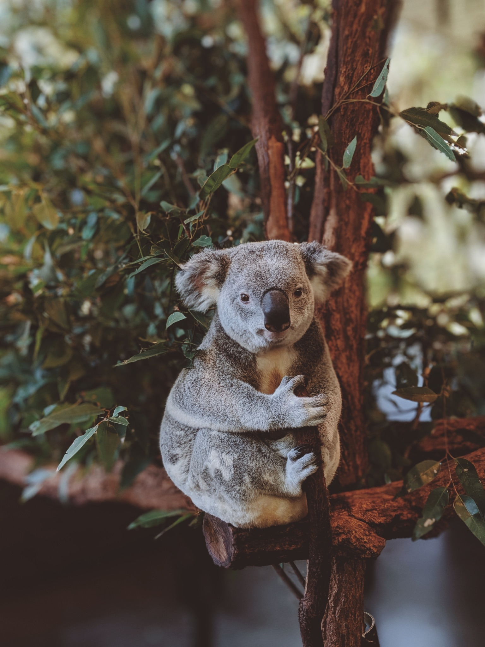
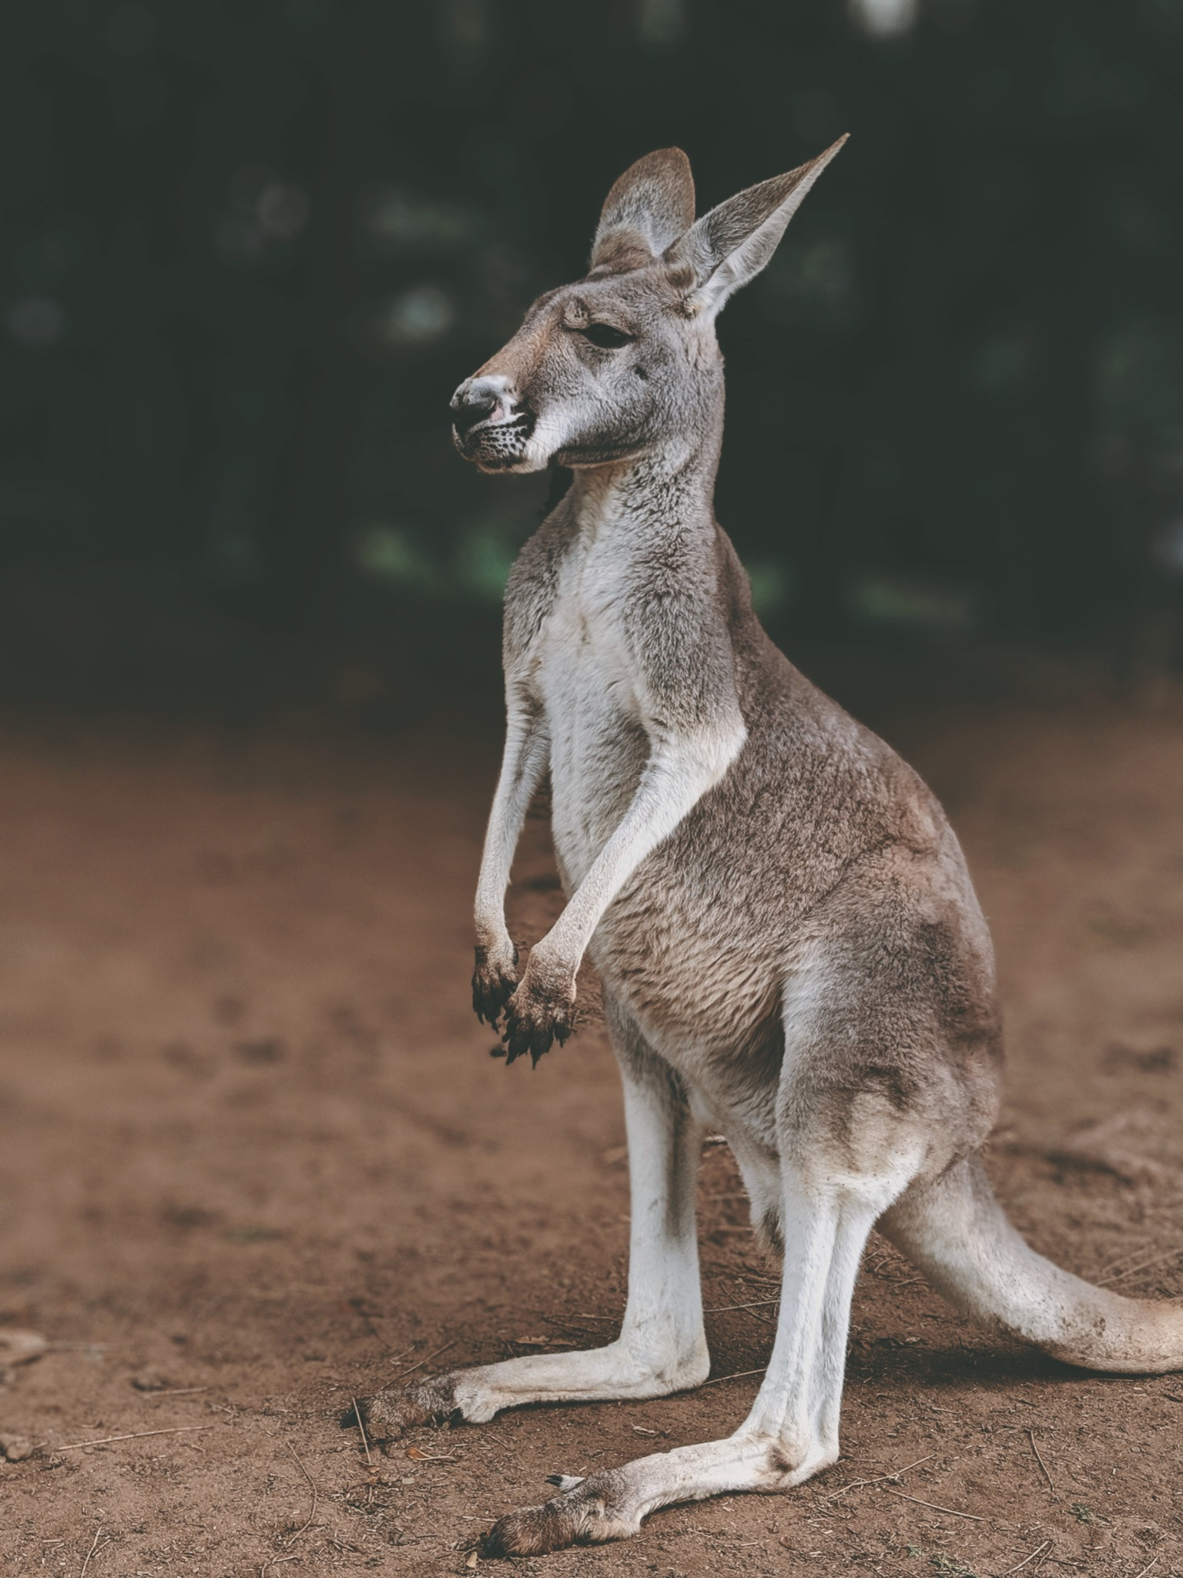
ᏐᏁᎵᏁ ᏣᎳᎩ ᎠᏕᎶᏆᏍᏗ
ᏧᎾᏠᏱ ᎪᎠᎳ ᏲᎾ ᎠᎴ ᎤᏜᏩᏓ ᎤᏤᏥᏍᏗ.
Possums are similar to koalas and kangaroos.

Slide 11
ᏐᏁᎵᏁ ᏣᎳᎩ ᎠᏕᎶᏆᏍᏗ
ᎤᏤᏥᏍᏗ ᎤᏅᏒ “marsdupials” ᎠᏁ ᎠᎹᏰᏟ ᏧᏴᏢ.
Possums are the only marsupials in North America.

Slide 12
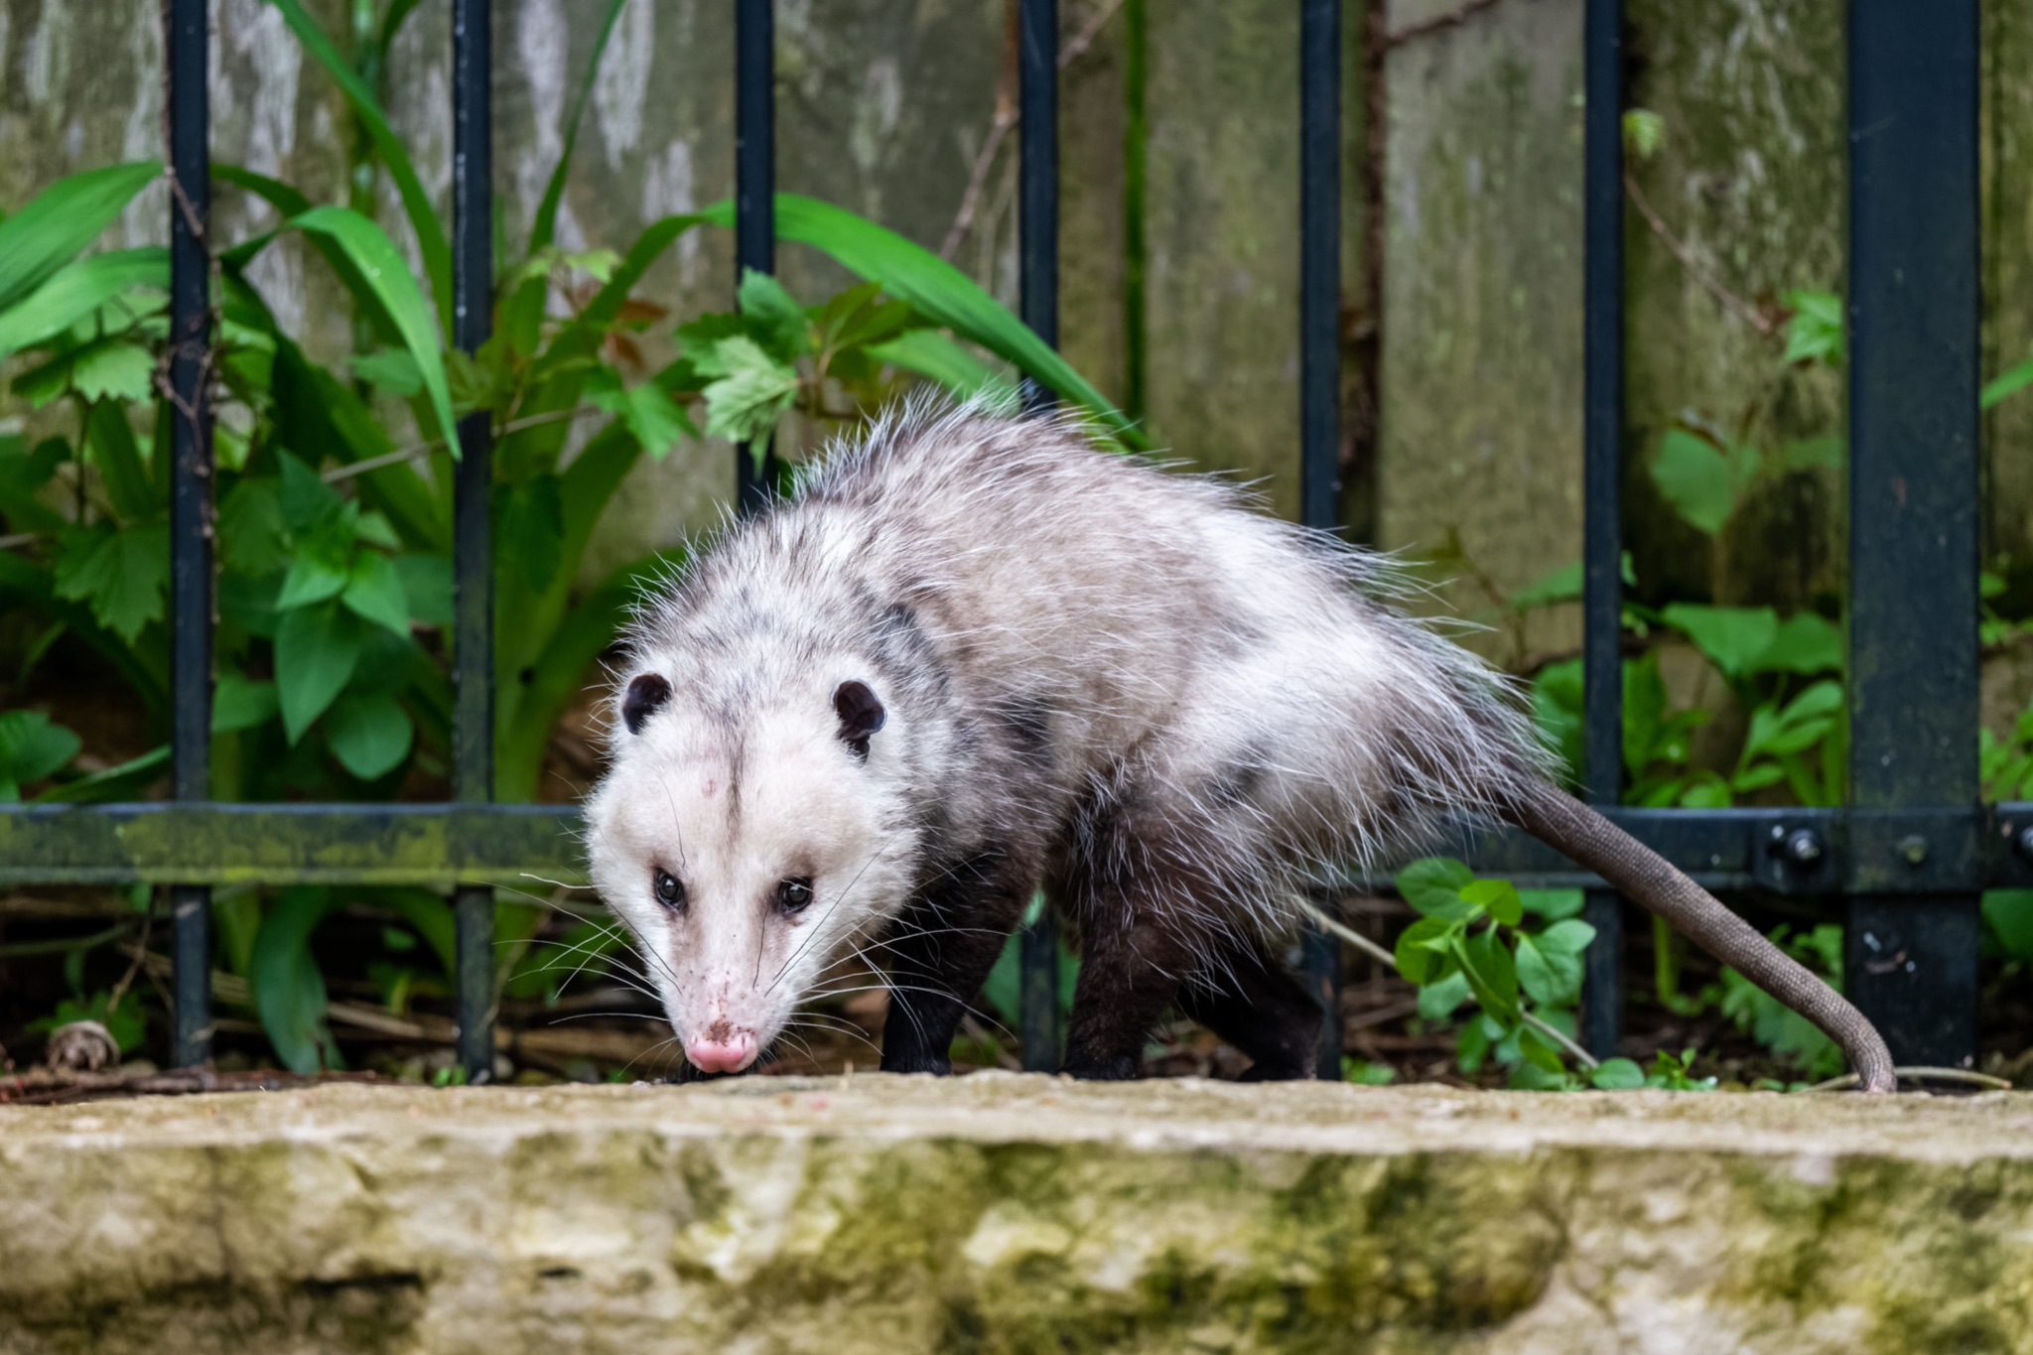
ᏐᏁᎵᏁ ᏣᎳᎩ ᎠᏕᎶᏆᏍᏗ
ᎤᏤᏥᏍᏗ ᎢᎾᎨᎢ ᎠᏁᎰ ᎠᎴ ᏒᏃᏱ ᎠᎢᏄᎪᎪ.
Possums live in the woods and come out at night.

Slide 13
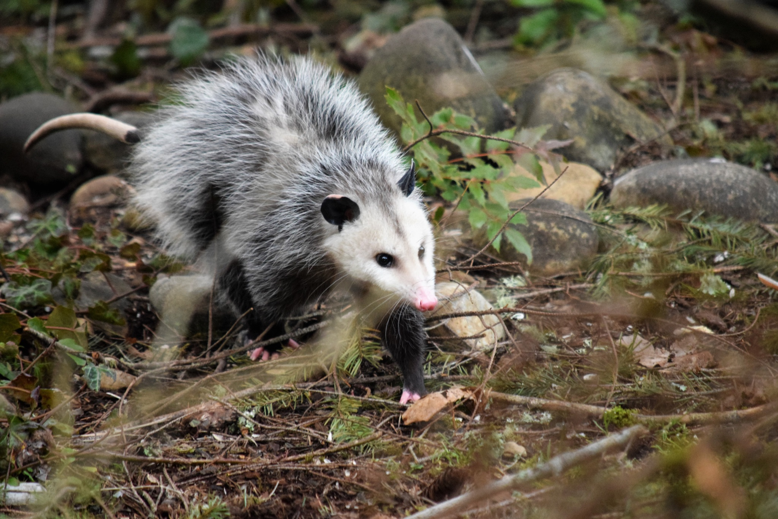
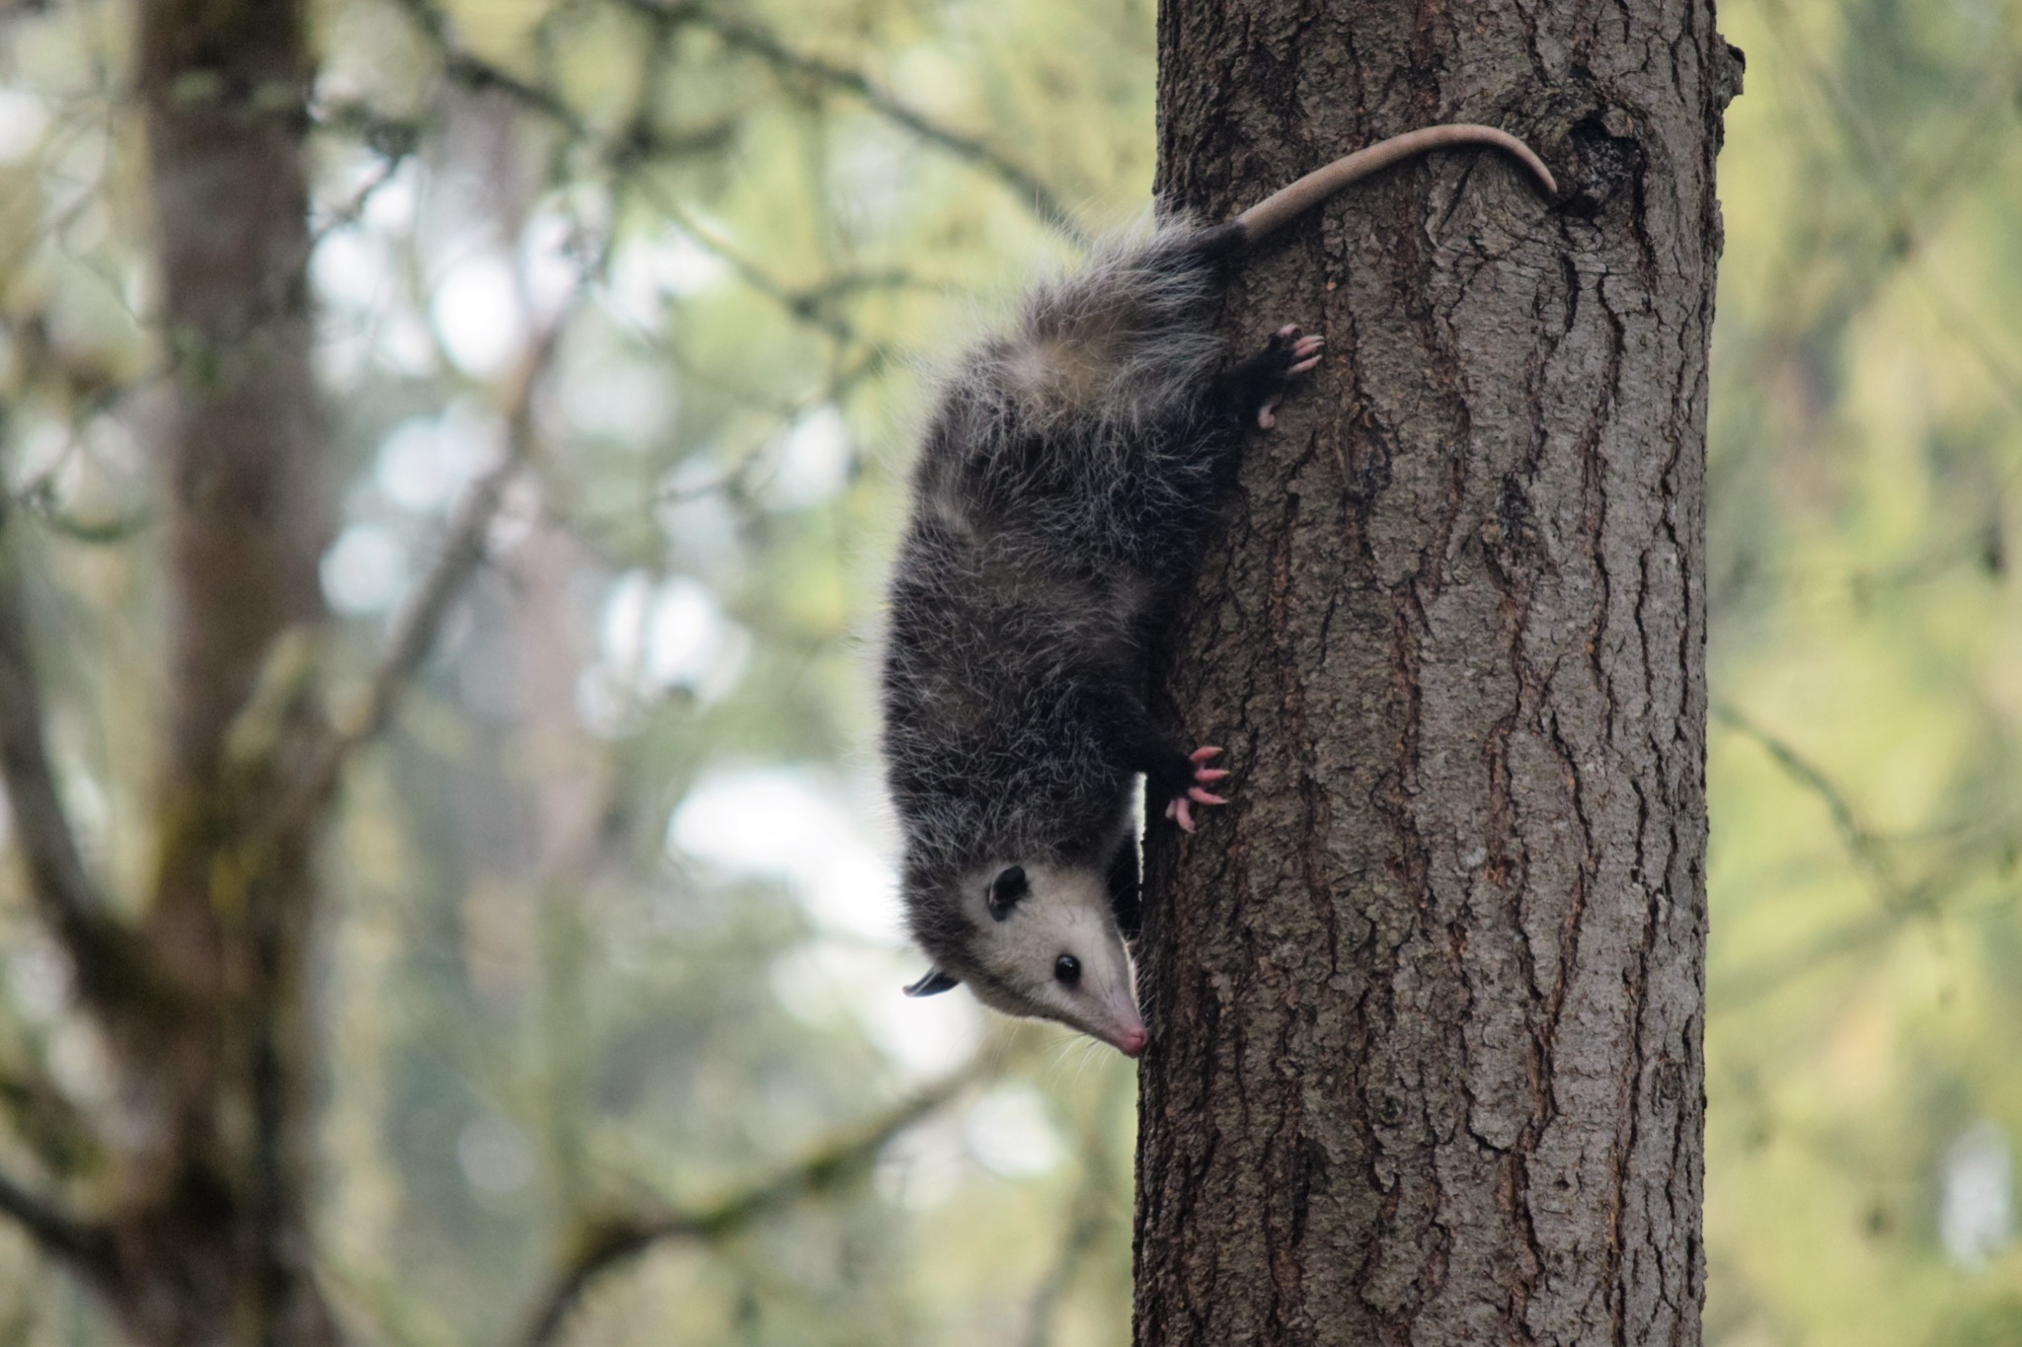
ᏐᏁᎵᏁ ᏣᎳᎩ ᎠᏕᎶᏆᏍᏗ
ᏕᎵᎬᎢ ᏓᏂᎵᏙᎰ ᎠᎴᏎᏍᎩᏃ ᎦᏙ ᎥᏍᏊ ᎤᏂᎸᏈᏗ ᎤᏁᏓᏍᏗ.
The climb trees and are also comfortable on the ground.

Slide 14
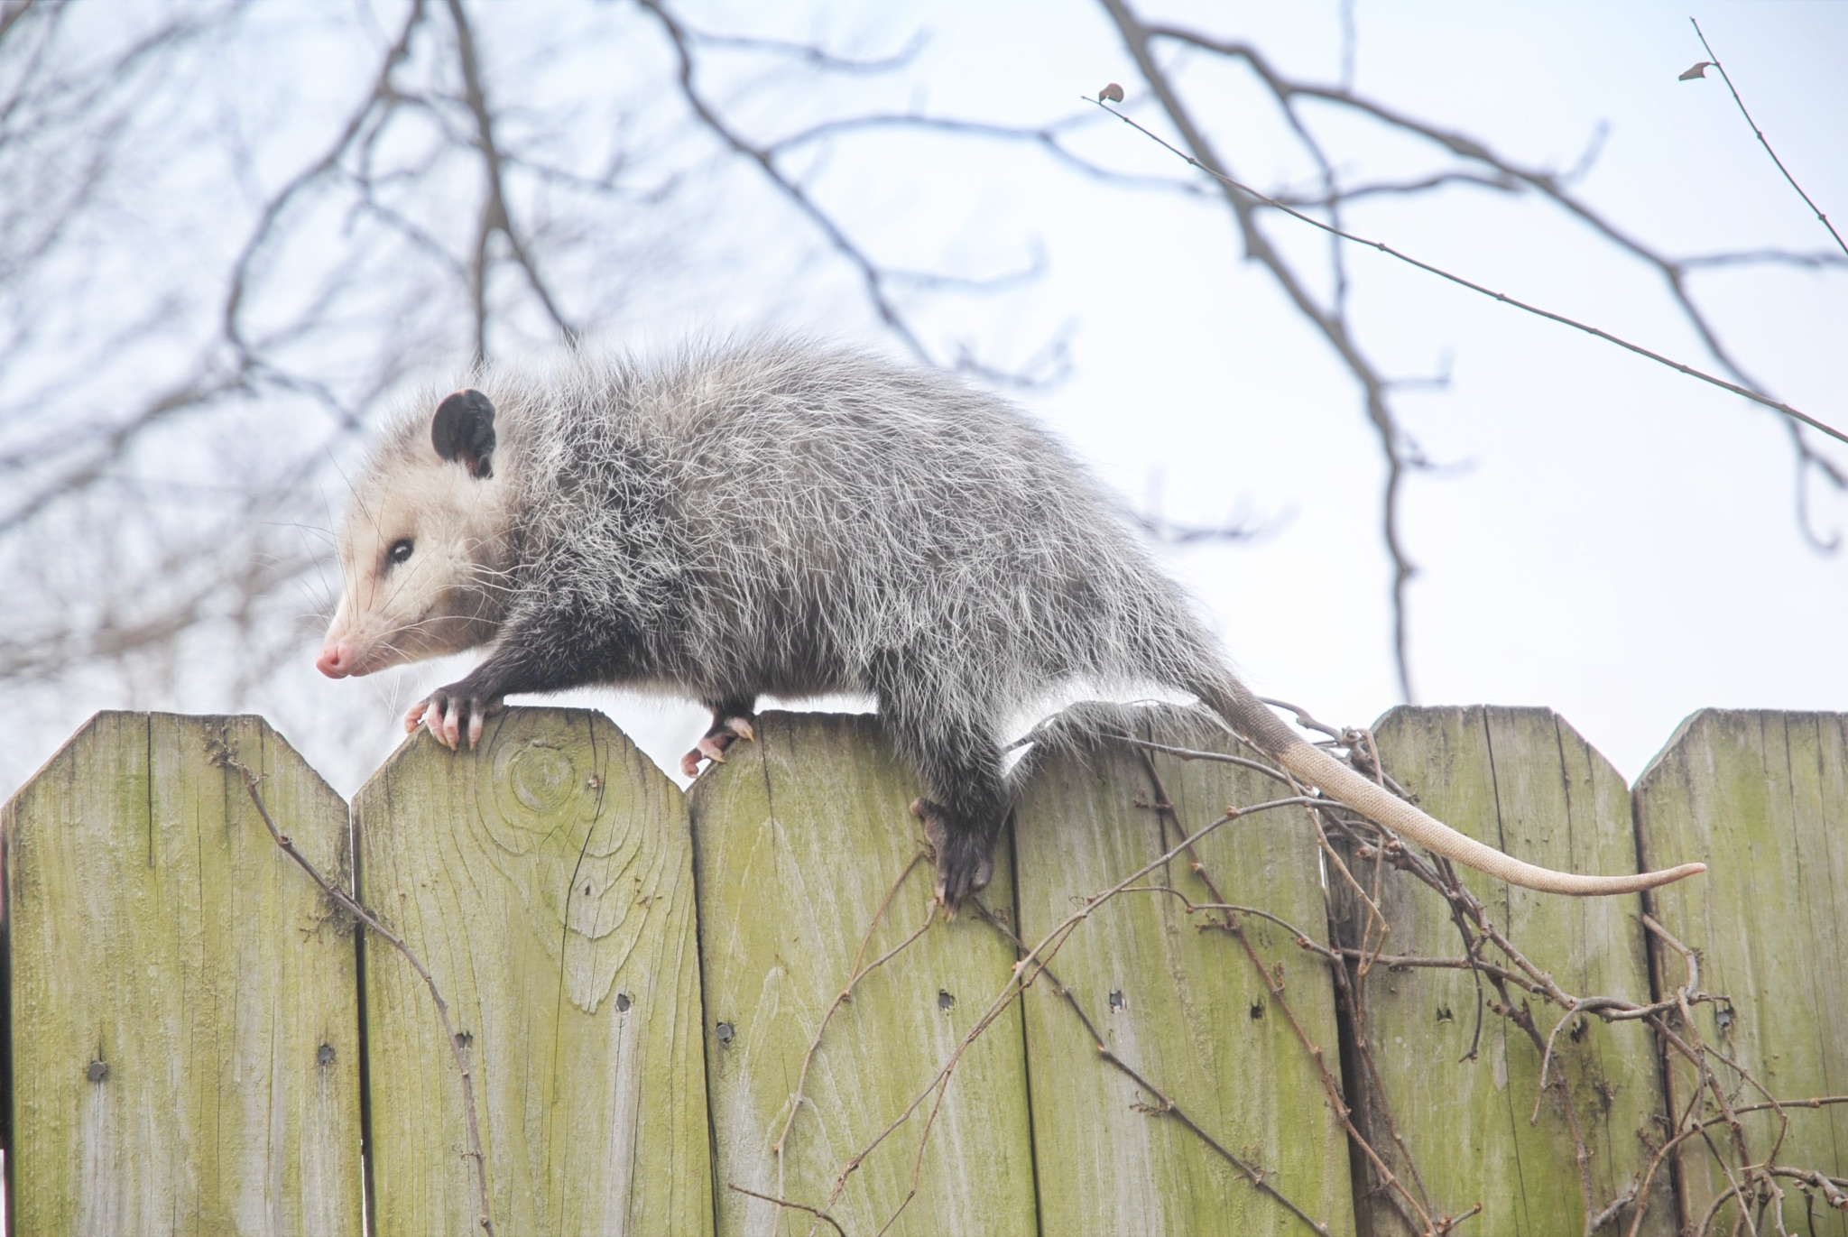
ᏐᏁᎵᏁ ᏣᎳᎩ ᎠᏕᎶᏆᏍᏗ
ᎤᏍᎦᏃᎵ ᎨᏐ.
They are slow.

Slide 15
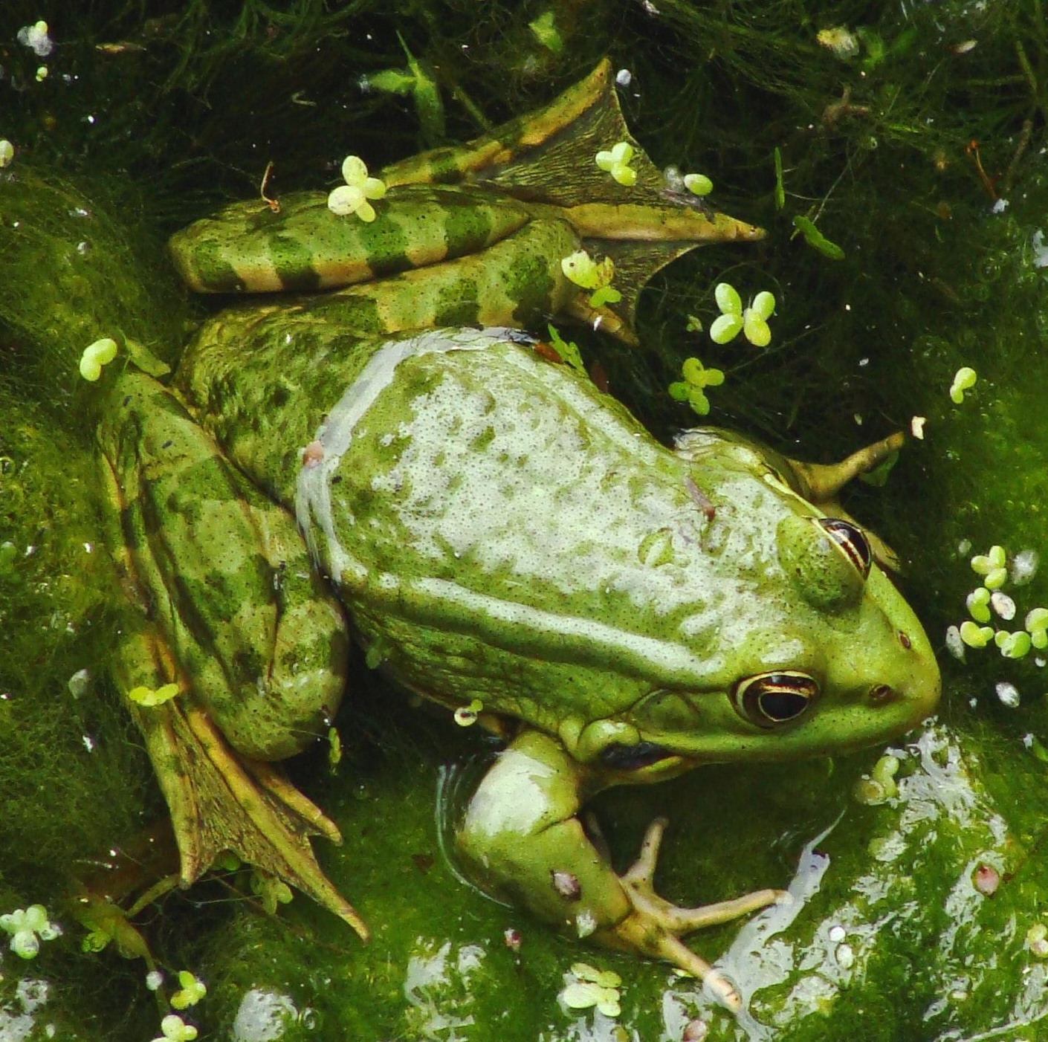
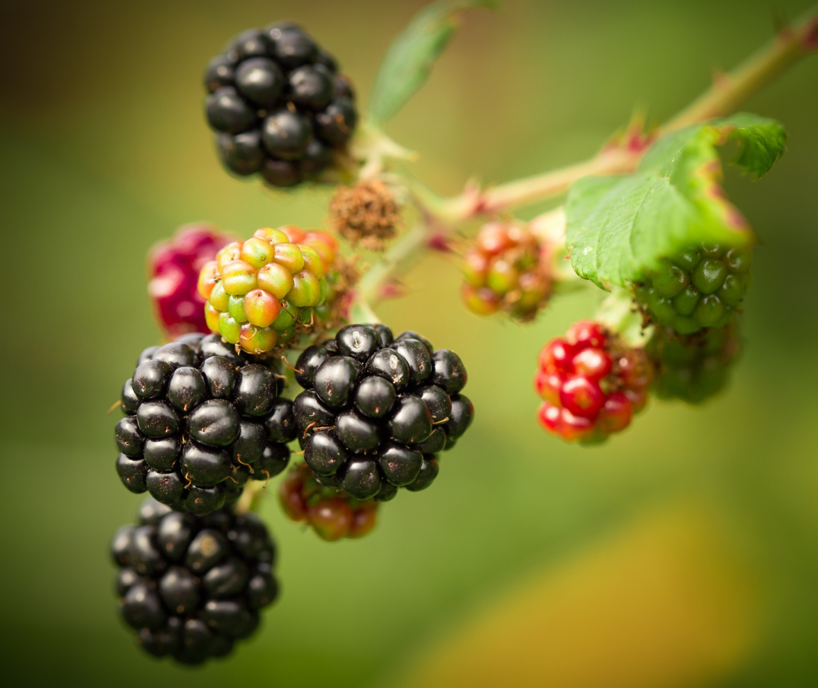
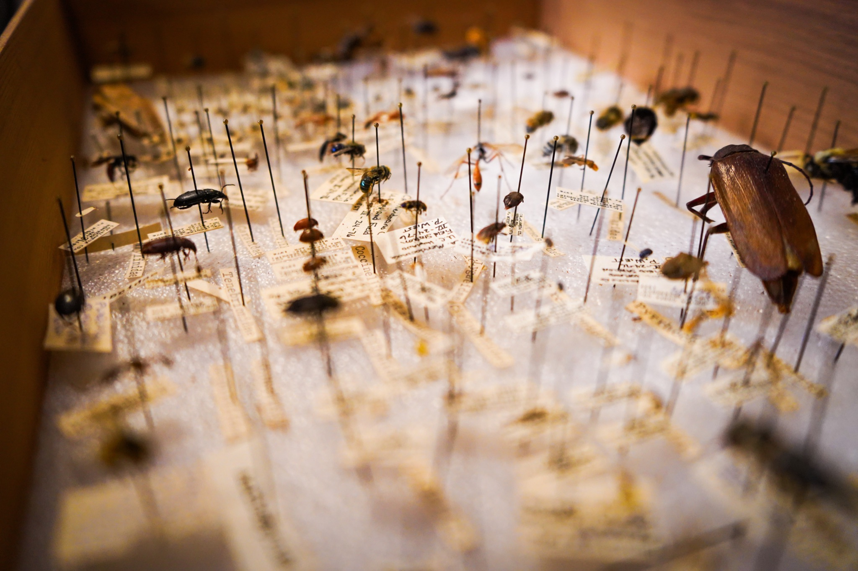
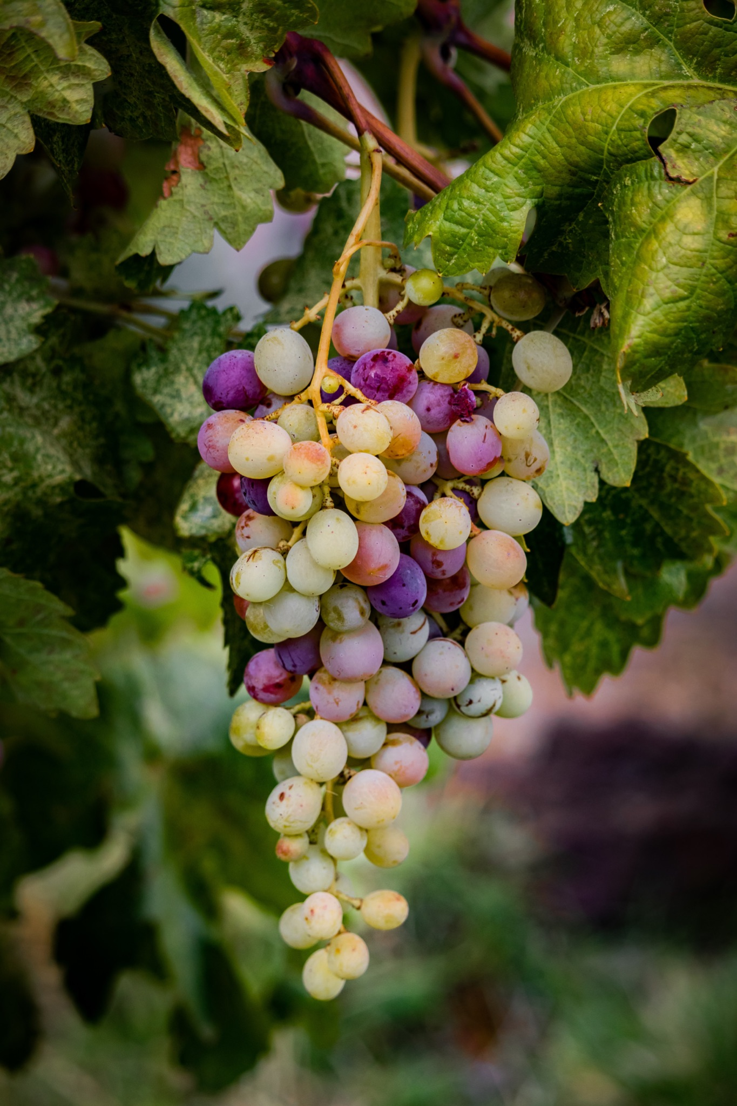
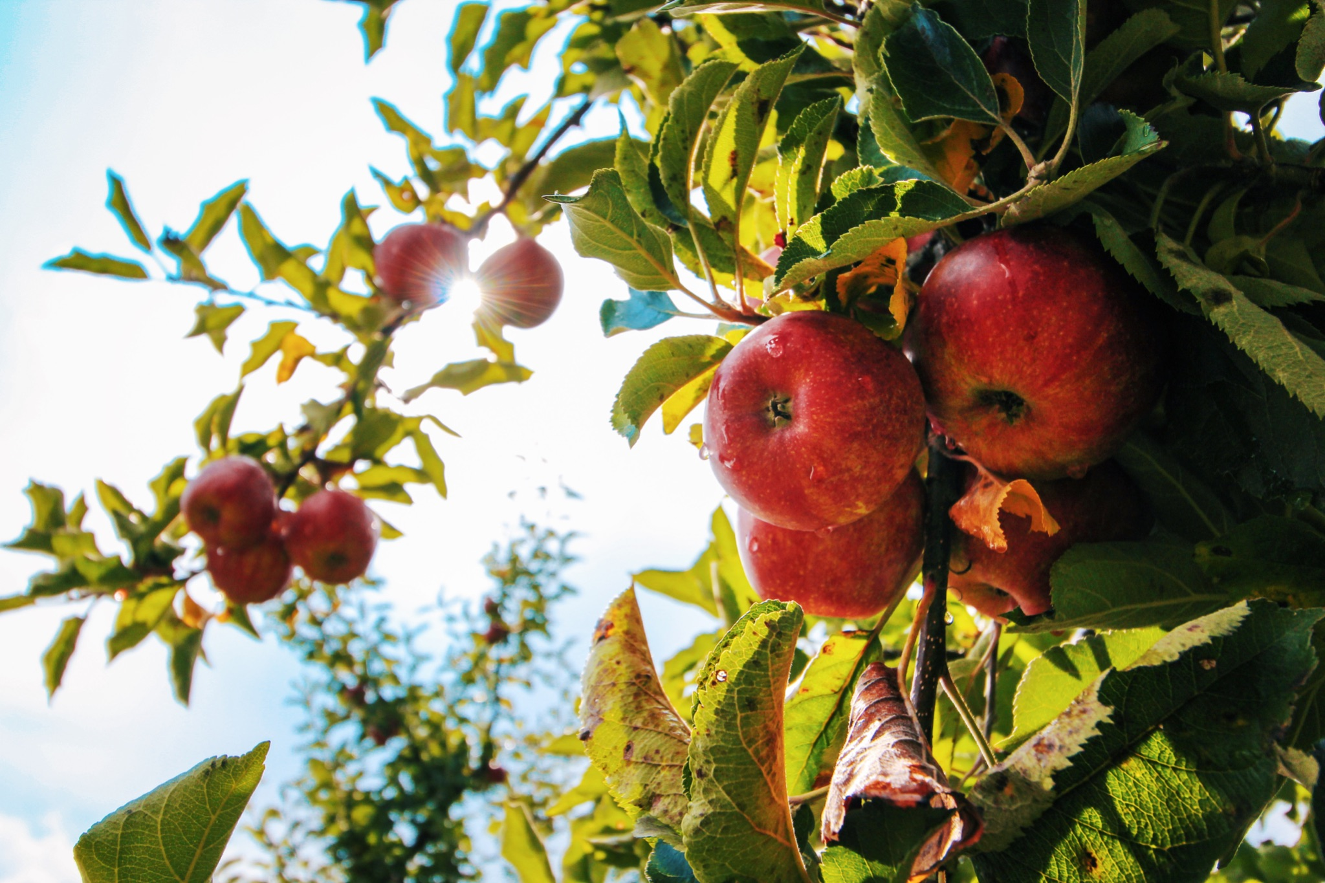
ᏐᏁᎵᏁ ᏣᎳᎩ ᎠᏕᎶᏆᏍᏗ
ᎤᏂᎸᏈᏗ ᎤᏂᎩᏍᏗ ᎧᏄᎦᏟ, ᎫᏩ, ᎤᎿᏒᎩ, ᏒᎦᏔ, ᏥᏍᎪᏯ ᏧᏓᎴᎾ, ᏧᏂᏍᏗ ᏥᏍᏆ, ᏧᏪᏥ, ᏩᎶᏏ, ᏘᏲᎭᏟ ᎠᎴ ᏥᏍᏛᎾ.
They eat things like blackberries, mulberries,wild grapes, apples, bugs, small birds, eggs, frogs, lizards and crawdads.

Slide 16
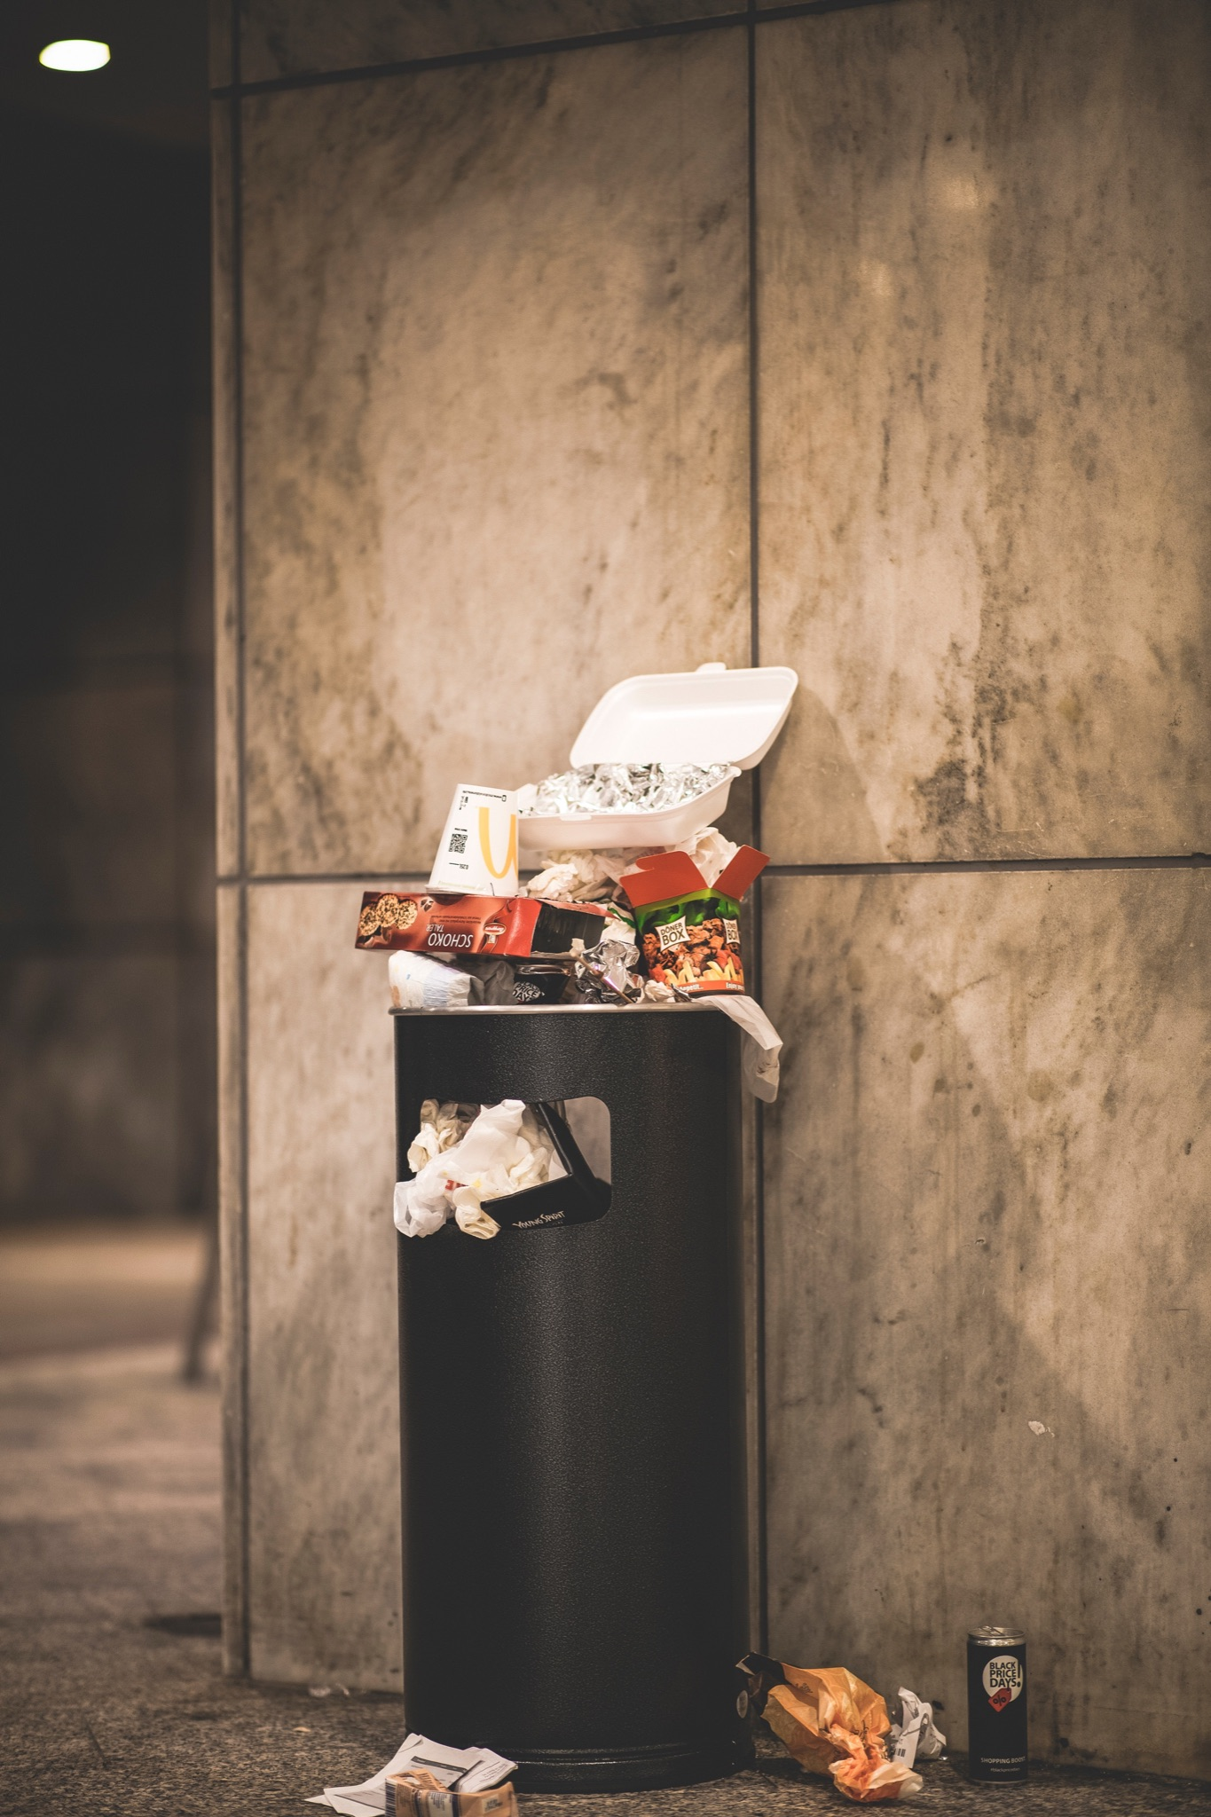
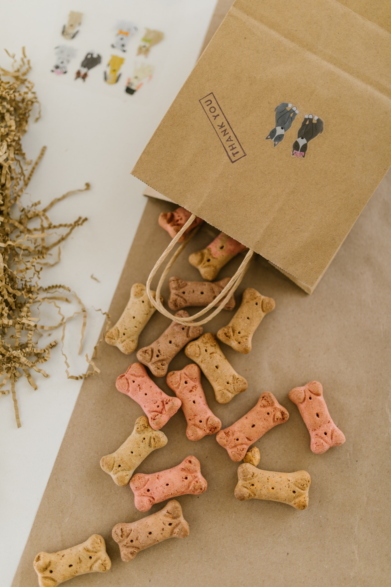
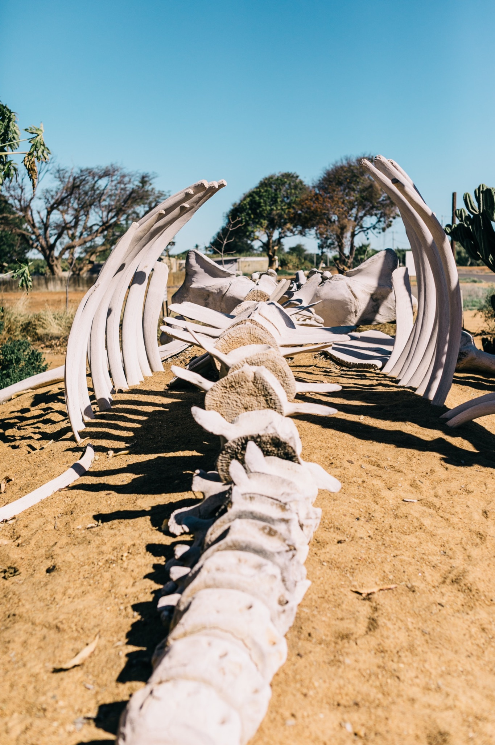
ᏐᏁᎵᏁ ᏣᎳᎩ ᎠᏕᎶᏆᏍᏗ
ᎤᏤᏥᏍᏗ ᎤᏂᎸᏈᏗ ᎤᏲᏨᎯ, ᎩᏥ ᎤᏂᎩᏍᏗ ᎠᎴ ᎤᎵᏬᏨ ᎦᎾᏝᎥ (ᎡᎿᎢ) ᏧᎪᎳ ᏓᏂᎩᏍᎪ.
Possums also eat trash, dog food and also the bones of dead animals.

Slide 17
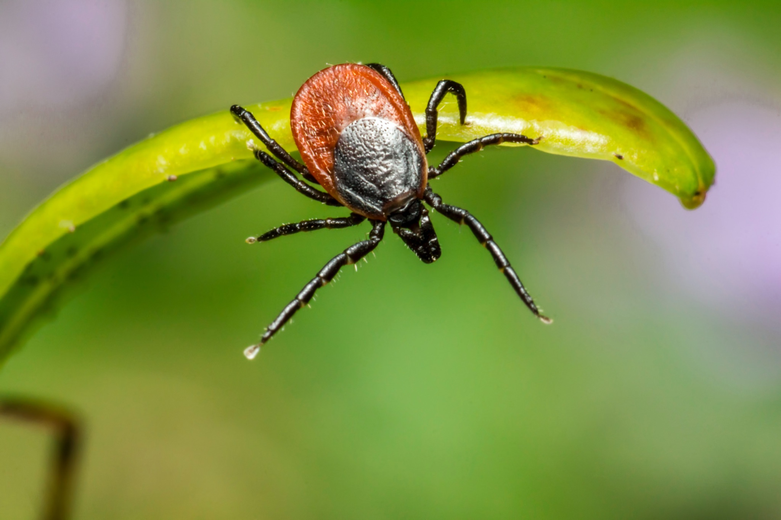
ᏐᏁᎵᏁ ᏣᎳᎩ ᎠᏕᎶᏆᏍᏗ
ᏚᏂᏣᎵᏗ ᎫᎩ ᏓᏂᎩᏍᎬ.
They are well known for eating ticks

