Slide 1
ᎣᏏᏲ
ᎠᎬᏱ ᏣᎳᎩ ᎠᏕᎶᏆᏍᏗ

Slide 2
ᎠᎬᏱ ᏣᎳᎩ ᎠᏕᎶᏆᏍᏗ
ᎢᏓᎴᎾ- Let’s begin
ᏣᎳᎩ ᎢᏗᏬᏂ- Let’s talk Cherokee

Slide 3
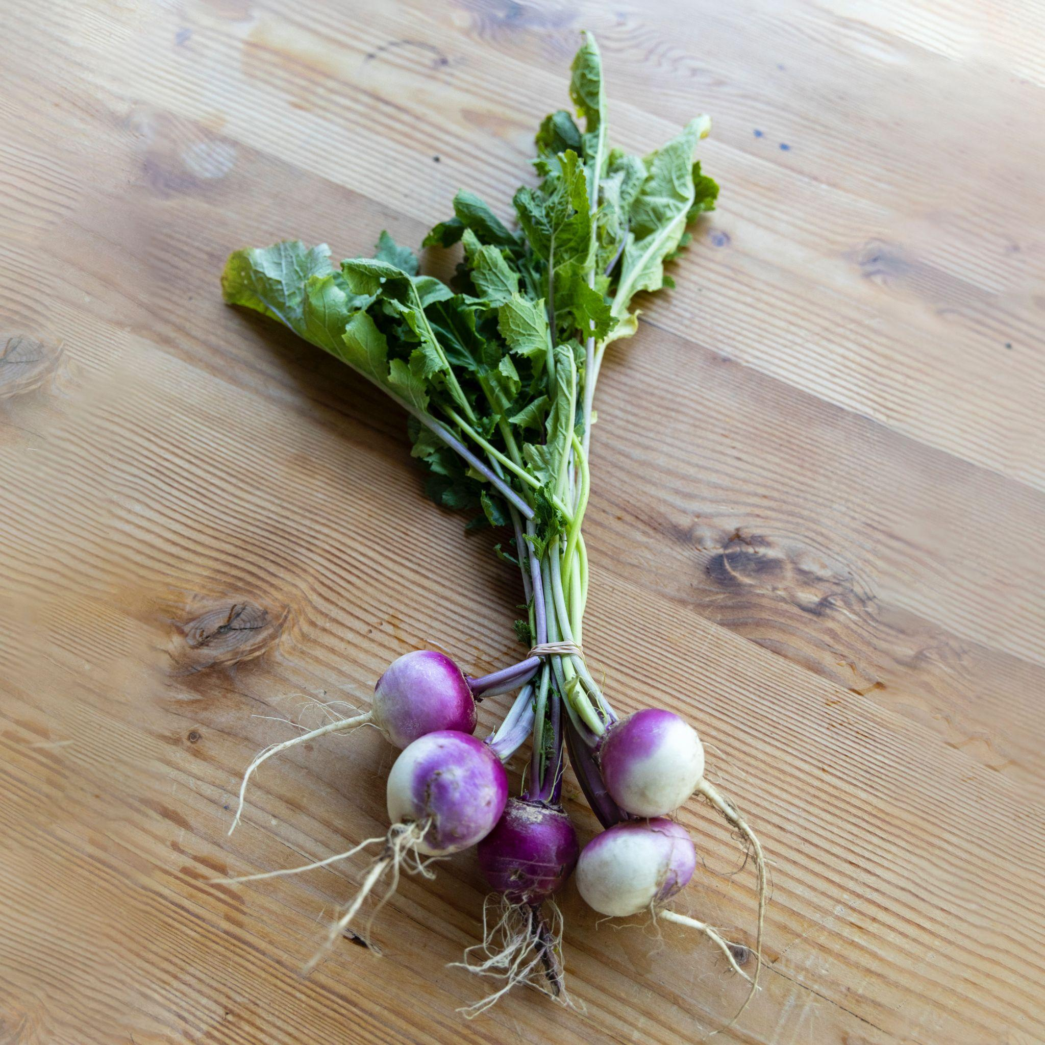
ᎠᎬᏱ ᏣᎳᎩ ᎠᏕᎶᏆᏍᏗ
ᏓᏈᏌᏂ, ᏓᏈᏌᏂ
ᎯᎾᏌᏁᎩ, ᎯᎾᏌᏁᎩ
Ꮭ ᏱᏥᏁᏏᏁᎦ, Ꮭ ᏱᏥᏂᏒᏁᎩ
ᎡᏚᏓ ᎡᎮᎾ!
ᎡᎵᏭᏍ ᏱᎦᏍᏖᎳᏭ?
“ᏚᏓ ᏚᏓ ᎡᎮᎾ!”
“ᏥᎷᎩ! ᏥᎷᎩ!”

Slide 4
ᎠᎬᏱ ᏣᎳᎩ ᎠᏕᎶᏆᏍᏗ
ᏓᏈᏌᏂ, ᏓᏈᏌᏂ
ᏍᏗᏂᏌᏁᎩ, ᏍᏗᏂᏌᏁᎩ
Ꮭ ᏲᏍᏗᏂᏒᏁᎦ, Ꮭ ᏲᏍᏗᏂᏒᏁᎦ
ᎡᎵᏏ ᎡᎮᎾ!
ᎡᎵᏭᏍ ᏱᏍᎩᏍᏕᎳ?
“ᎡᎵᏏ ᎡᎵᏏ ᎡᎮᎾ!”
“ᏥᎷᎩ! ᏥᎷᎩ!”

Slide 5
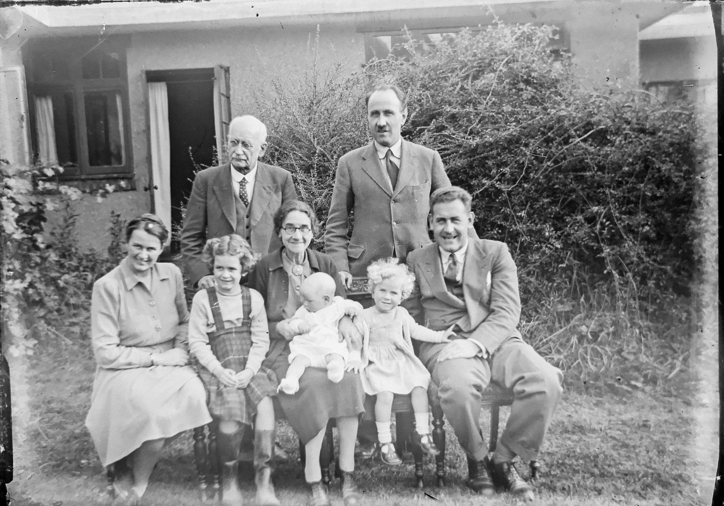
ᎠᎬᏱ ᏣᎳᎩ ᎠᏕᎶᏆᏍᏗ
ᏓᏈᏌᏂ, ᏓᏈᏌᏂ
ᎢᏥᏂᏌᏁᎩ, ᎢᏥᏂᏌᏁᎩ
Ꮭ ᏲᏥᏂᏒᏁᎦ, Ꮭ ᏲᏥᏂᏒᏁᎦ
ᎡᏥ ᎡᎮᎾ!
ᎡᎵᏭᏍ ᏱᏍᎩᏍᏕᎳ?
“ᎡᏥ ᎡᏥ ᎡᎮᎾ!”
“ᏥᎷᎩ! ᏥᎷᎩ!”
(ᎡᏙᏓ, ᎡᏠᎩ, ᎡᏗᏥ, ᎥᎩᏙ, ᏦᏍᏓᏓᎳ, ᏦᏍᏓᏓᏅᏟ)

Slide 6
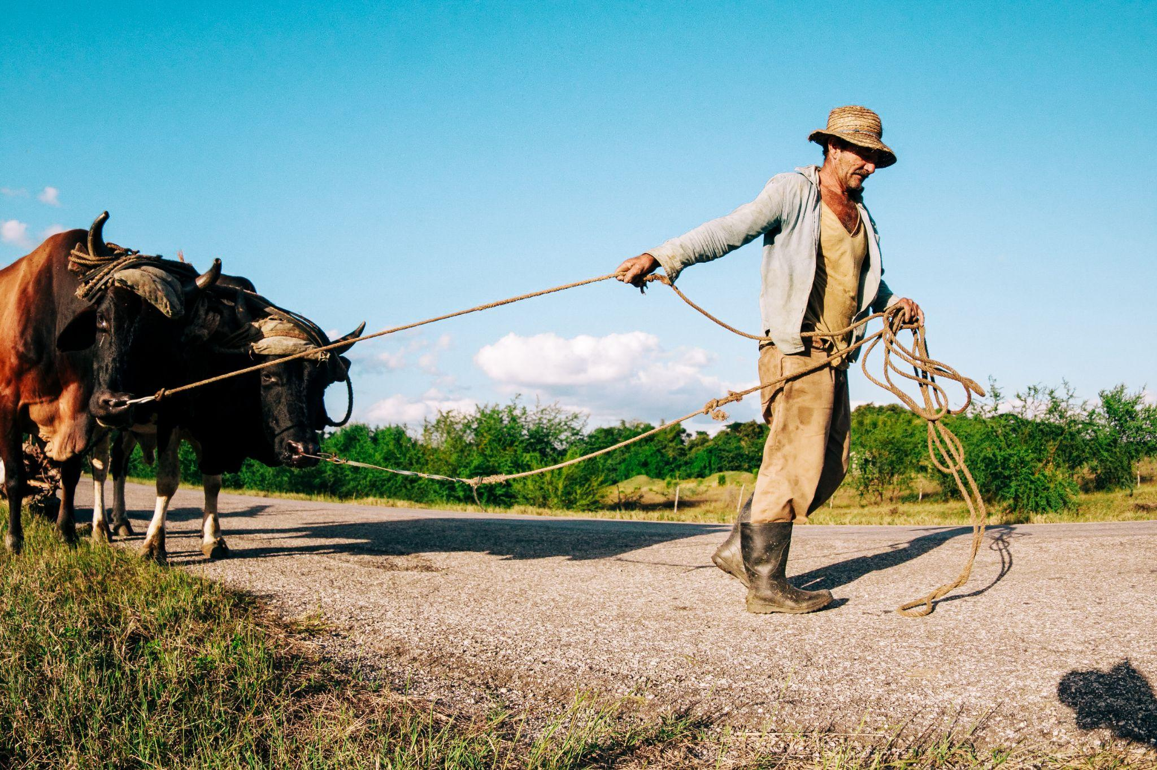
ᎠᎬᏱ ᏣᎳᎩ ᎠᏕᎶᏆᏍᏗ
ᎯᏂᏌᏁᎩ
ᏍᏗᏂᏌᏁᎩ
ᎢᏥᏂᏌᏁᎩ

Slide 7
ᎠᎬᏱ ᏣᎳᎩ ᎠᏕᎶᏆᏍᏗ
ᎾᏛᏁᎲ- Verbs
In English, verbs are generally divided into Transitive and Intransitive verbs by linguists.
In Cherokee, verbs are typically divided into set A and set B verbs by linguists.

Slide 8
ᎠᎬᏱ ᏣᎳᎩ ᎠᏕᎶᏆᏍᏗ
ᎾᏛᏁᎲ- Verbs
Set B pronoun prefixes- Let’s look at a chart of Set B prefixes for an Intransitive verb or a transitive verb where the object is “it”

Slide 9
ᎠᎬᏱ ᏣᎳᎩ ᎠᏕᎶᏆᏍᏗ
ᎾᏛᏁᎲ- Verbs
Set B pronoun prefixes- Let’s look at a chart of Set B prefixes for an Intransitive verb or a transitive verb where the object is “it”

Slide 10
ᎠᎬᏱ ᏣᎳᎩ ᎠᏕᎶᏆᏍᏗ
ᎾᏛᏁᎲ- Verbs
Single subject, single object
ᎠᎩ | I- it
Ꮳ | You- it
Ꭴ | he/she- it

Slide 11
ᎠᎬᏱ ᏣᎳᎩ ᎠᏕᎶᏆᏍᏗ
ᎾᏛᏁᎲ- Verbs
Single subject, plural object
ᏓᎩ | I- them
ᏕᏣ | You- them
Ꮪ | he/she- them

Slide 12
ᎠᎬᏱ ᏣᎳᎩ ᎠᏕᎶᏆᏍᏗ
ᎾᏛᏁᎲ- Verbs
Let’s use a verb we already know. To be hungry. (ᏲᏏ)
ᎠᎩᏲᏏ- I am hungry
ᏣᏲᏏ- you are hungry
ᎤᏲᏏ- he/she is hungry
Ex- ᏣᏲᏏᏍ? Are you hungry?

Slide 13
ᎠᎬᏱ ᏣᎳᎩ ᎠᏕᎶᏆᏍᏗ
ᎾᏛᏁᎲ- Verbs
Let’s use another one. To be angry. (ᎿᎸ)
ᎠᎩᎿᎸ- I am angry
ᏣᎿᎸ- you are angry
ᎤᎿᎸ- he/she is angry
Ex- ᎤᎿᎸᏍ Ꮎ ᎩᏟ? Is that dog angry?

Slide 14
ᎠᎬᏱ ᏣᎳᎩ ᎠᏕᎶᏆᏍᏗ
ᎾᏛᏁᎲ- Verbs
You can also use these with nouns, such as family members. Let’s take ᎡᏥ, mother.
ᎠᎩᏥ- my mother
ᏣᏥ- your mother
ᎤᏥ- his/her mother

Slide 15
ᎠᎬᏱ ᏣᎳᎩ ᎠᏕᎶᏆᏍᏗ
ᎾᏛᏁᎲ- Verbs
Let’s use a verb we already know. To have a living thing.
ᎠᎩᎧ- I have it ᏓᎩᎧ- I have them
ᏣᎧ- you have it ᏕᏣᎧ- You have them
ᎤᏪᎧ- he/she has it ᏚᏪᎧ- They have them
Ex- ᎤᏥᏯ ᎠᎩᎧ- I have a worm.
Ꮎ ᎤᏥᏯ ᏓᎩᎧ- I have the worms.

Slide 16
ᎠᎬᏱ ᏣᎳᎩ ᎠᏕᎶᏆᏍᏗ
ᎾᏛᏁᎲ- Verbs
Have is a classificatory verb, meaning that the verb is different depending on what you have. There are 5 types:
Living
Liquid
Long
Flexible
Everything else

Slide 17
ᎠᎬᏱ ᏣᎳᎩ ᎠᏕᎶᏆᏍᏗ
ᎾᏛᏁᎲ- Verbs
Living
Liquid
Long
Flexible
Everything else
ᎤᏥᏯ
ᏒᎦᏔ
ᎤᏁᎬᎭ
ᎬᏃᏌᏍᏗ
ᎤᏅᏗ

Slide 18
ᎠᎬᏱ ᏣᎳᎩ ᎠᏕᎶᏆᏍᏗ
ᎾᏛᏁᎲ- Verbs
Have alive
ᎠᎩᎧ
ᏣᎧ
ᎤᏪᎧ
Have
liquid
ᎠᎩᏁ
ᏣᏁ
ᎤᏁ
Have long
ᎠᏋᏯ
ᏨᏯ
ᎤᏮᏯ
Have flexible
ᎠᎩᎾ
ᏣᎾ
ᎤᎾ
Have other
ᎠᎩᎭ
ᏣᎭ
ᎤᎭ

Slide 19
ᎠᎬᏱ ᏣᎳᎩ ᎠᏕᎶᏆᏍᏗ
ᎾᏛᏁᎲ- Verbs
I have
ᎠᎩᎧ
ᎠᎩᏁ
ᎠᏋᏯ
ᎠᎩᎾ
ᎠᎩᎭ
I have……..
A fish (ᎠᏣᏗ)
an offspring (ᎠᏇᏥ)
A salamander (duwega)
A mean chicken (ᏥᏔᎦ ᎤᏁᎫᏥᏓ)

Slide 20
ᎠᎬᏱ ᏣᎳᎩ ᎠᏕᎶᏆᏍᏗ
ᎾᏛᏁᎲ- Verbs
I have
ᎠᎩᎧ
ᎠᎩᏁ
ᎠᏋᏯ
ᎠᎩᎾ
ᎠᎩᎭ
I have……..
Juice (ᎤᏓᏁᏅ, ᎦᏁᎲ)
Coffee (ᎧᏫ)
Gravy (ᎠᏑᏍᏗ)
Soup (ᎤᎦᎹ)

Slide 21
ᎠᎬᏱ ᏣᎳᎩ ᎠᏕᎶᏆᏍᏗ
ᎾᏛᏁᎲ- Verbs
I have
ᎠᎩᎧ
ᎠᎩᏁ
ᎠᏋᏯ
ᎠᎩᎾ
ᎠᎩᎭ
I have……..
A cigarette (ᎪᎦᏍᏗ)
A feather (ᎤᎩᏓᏟ)
A .22 rifle (ᏔᎵᏦᏁ)
A board (ᏯᏖᎾ)

Slide 22
ᎠᎬᏱ ᏣᎳᎩ ᎠᏕᎶᏆᏍᏗ
ᎾᏛᏁᎲ- Verbs
I have
ᎠᎩᎧ
ᎠᎩᏁ
ᎠᏋᏯ
ᎠᎩᎾ
ᎠᎩᎭ
I have……..
A dress (ᎠᏌᏃ)
A coat (ᎦᏌᎴᏂ)
A dead snake (ᎢᎾᏓ ᎤᎵᏬᏨ)
A dollar bill (ᎤᏃᏍᏓ)
A flower (ᎠᏥᎸᏍᎩ)

Slide 23
ᎠᎬᏱ ᏣᎳᎩ ᎠᏕᎶᏆᏍᏗ
ᎾᏛᏁᎲ- Verbs
I have
ᎠᎩᎧ
ᎠᎩᏁ
ᎠᏋᏯ
ᎠᎩᎾ
ᎠᎩᎭ
I have……..
A new car (ᎢᏤ ᏓᏆᎴᎵ)
A box (ᎧᏁᏌ)
A turtle shell (ᎤᏯᏍᎦ)
A rock (nvya)

